Slide 1
Results of the 1st
EUSO-Balloom flight
Hiroko Miyamoto
for the JEM-EUSO Collaboration, EUSO-Balloon Collaboration
Universita' degli studi di Torino/INFN
SIF 2015 September

Slide 2
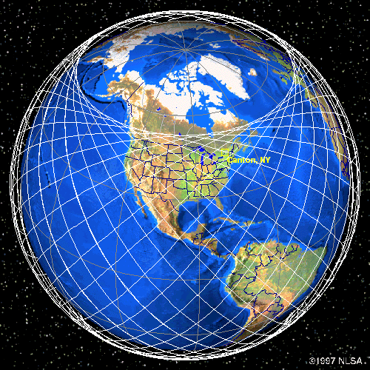
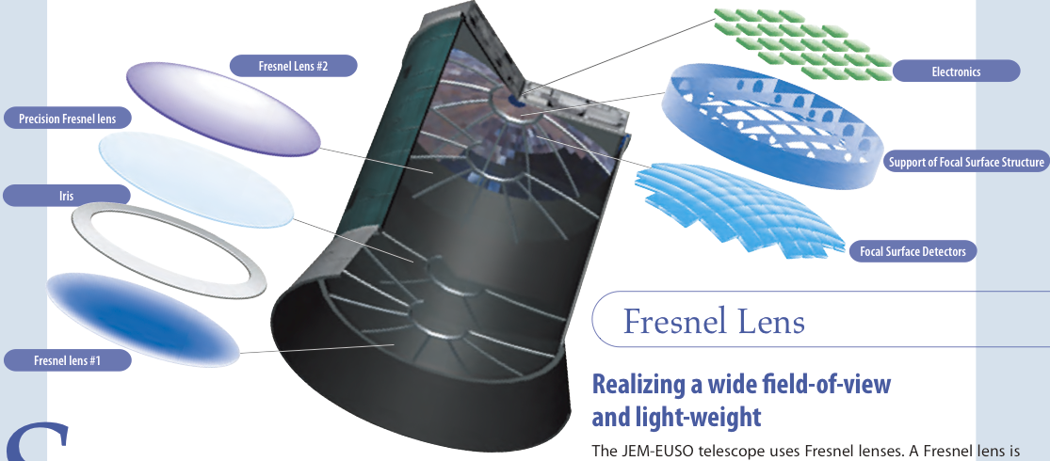
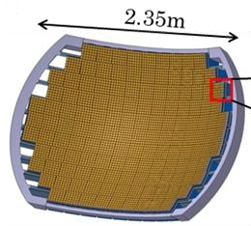
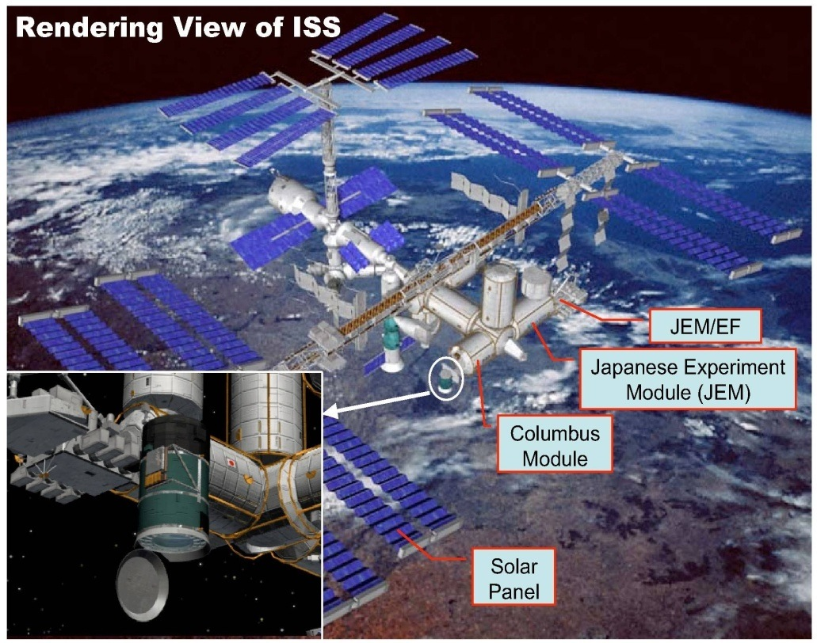

JEM-EUSO telescope
Nadir mode
Fresnel lens #2
Electronics
Precision Fresnel lens
Support of focal surface
Iris
JEM-EUSO schematic view
Focal surface detectors
Fresnel lens #1
~140 PDMs
64ch-MAPMTs
x ~5000
1PDM
~140 PDMs (0.3 M pix) on 2.3 m diameter
Focal Surface. ±30° large Field of View (FoV)
Coverage between lattitude of ±51.6°
Noth to Southof the earth by ISS orbit
Extremely High Energy Cosmic Ray (EECR) observatory onboard of International Space Station (ISS)
Observing Extensive Air Shower (EAS) produced by the EECRs
wide FoV (+-30°)
Near UV: 300 ~ 400 nm
Temporal resolution: 2.5 us
Spatial resolution: 500 m on the ground
7

Slide 3
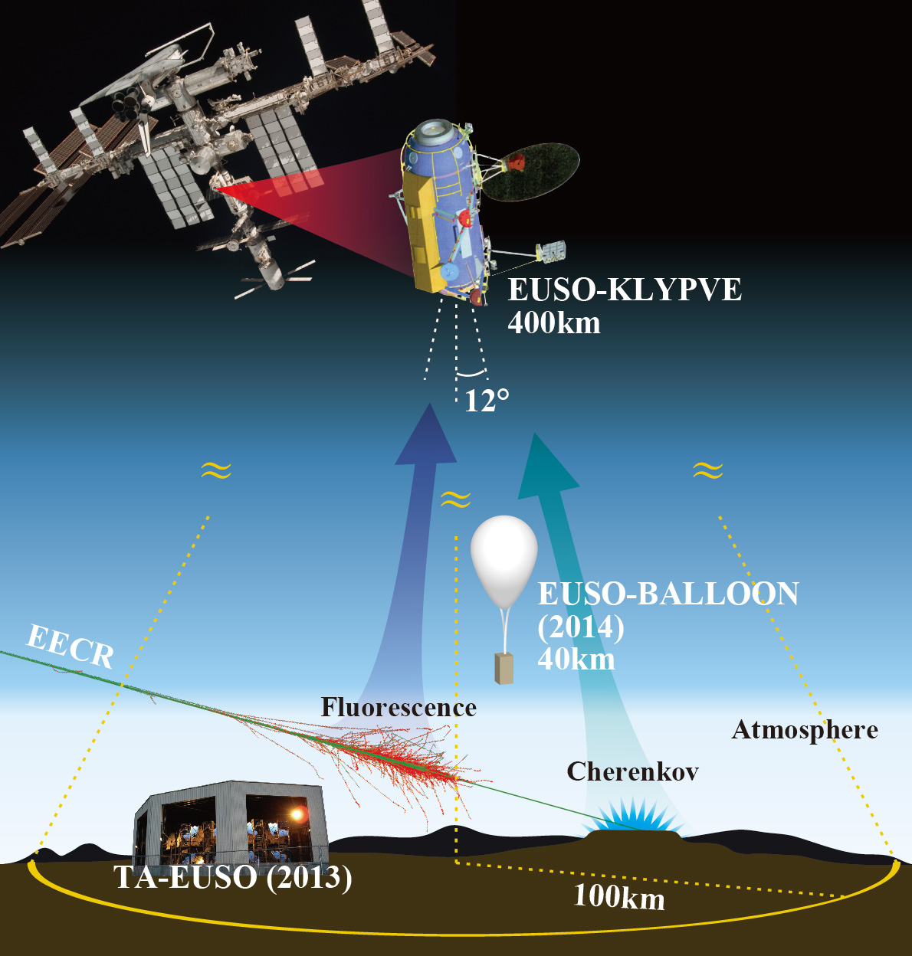
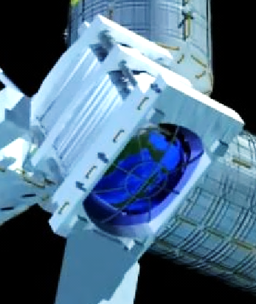
















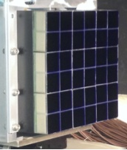
The EUSO program
1. EUSO-BALLOON:
1st balloon flight from
Timmins, Canada
(French Space Agency
CNES) 2014
2. TA-EUSO:
Ground detector at
Telescope Array site:
2015-
3. MINI-EUSO
(ASI/INFN/Roscosmos)
2017
4. EUSO-SPB
(NASA) 2017
5. JEM-EUSO
(>2020+)
MINI-EUSO
(2017)
JEM-EUSO
400km
30°
EUSO-SPB(2017)/
5
250 km
About 300 researchers from 88 institutions of 16 countries !

Slide 4
EUSO-Balloon
A balloon-borne fluorescence telescope, pathfinder of JEM-EUSO
1 PDM with electronics and mechanics as close as possible to JEM-EUSO
DAQ & BG study
Detection EAS > ~10¹⁸eV from an altitude of 40km (optinal. expected 0.2-0.3events with E>2×10¹⁸ eV during 10 hours night-flight)
Projects CNES (Le Centre national d’études spatiales) supported
by the whole JEM-EUSO collaboratio
(88 institutets from 16 countries)
Italiy supported by INFN
 | JEM-EUSO | EUSO-BALLOON
Height [km] | 420 | 40
Diameter [m] | 2.5 | 1
FoV/pixel [deg] | 0.08 | 0.25
Pixel@ground [m] | 580 | 130
FoV/PDM [deg] | 3.8 | 11-12
PDM@ground [km] | 28.2 | 8.4
Signal Ratio | 1 | 17.6
BG Ratio | 1 | 0.9-1.8
S/√N | 1 | 20-10
Eth [eV] | 3×10¹⁹ | 1.5-3×10¹⁸
# of PDM | 137 | 1
1st launch was successfully carried out on August 24-25th 2014, Timmins, Canada!!

Slide 5
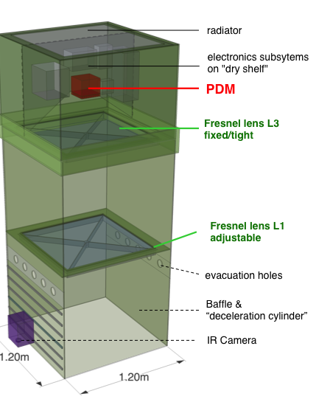
EUSO-Balloon Instrument
Instrument
• Mechanical structure (gondola)
• Optics: 2 flat Fresnel lenses (L1&L3)
• 1 Photodetector Module (PDM)
• Data acquisition system (DAQ)
• Monitoring controlled by House Keeping system (HK)
• A set of power supplies (LVPS) powered by onboard batteries (Power Pack)
• An IR camera for atmospheric monitoring

Slide 6
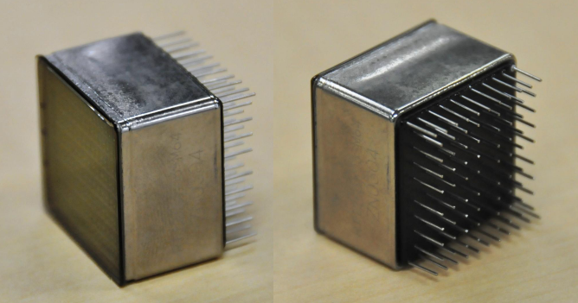
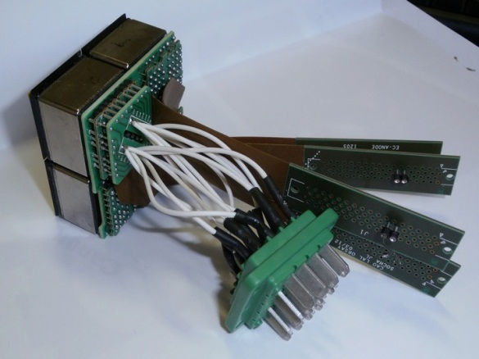
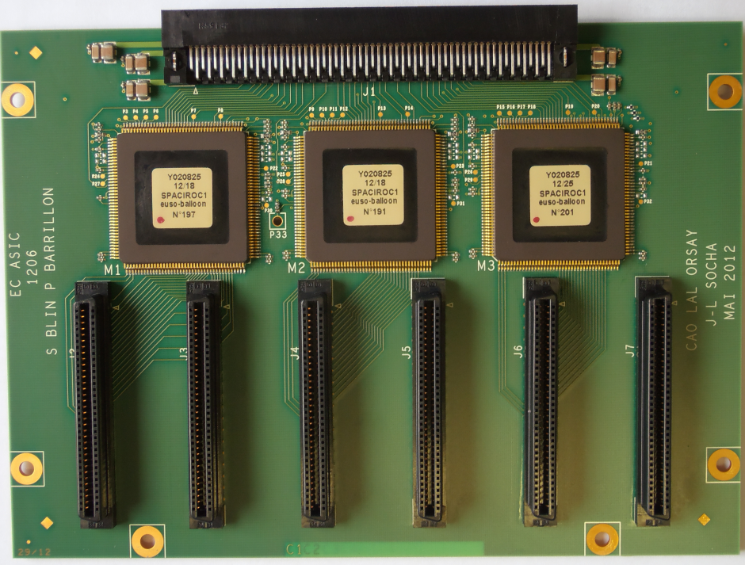
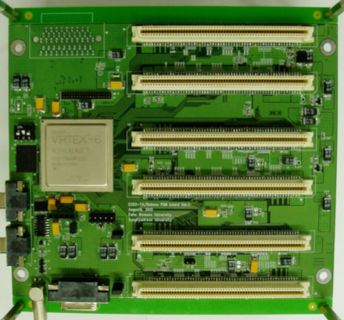
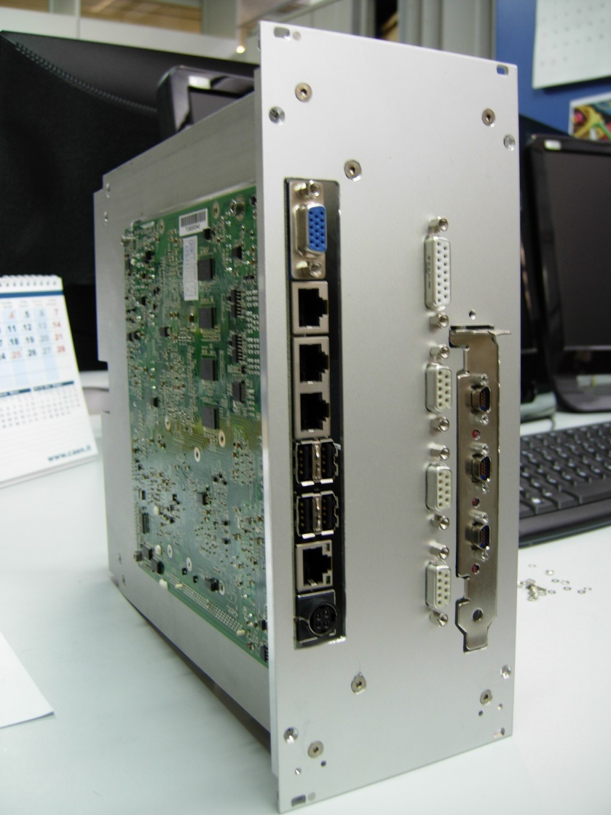
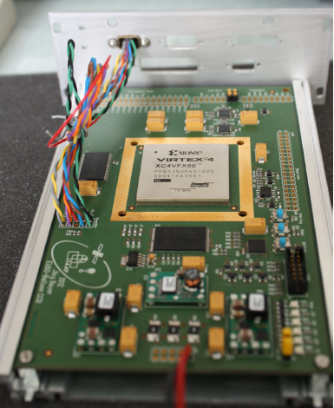
EUSO-Balloon
Data Acquisition (DAQ) Chain
Sensor (photodetector)
Front-end (FE) electronics
PMT
• Hmamatsu 64-ch MAPMT
• BG3 filter
EC-Unit
• 4 PMTs (256-ch)
readout cables
• HV board
• potting
EC-ASIC
• 6 x ASICs
• readout
• counter
PDM-Board
• Slow control
Data Processing (DP)
CPU
• Run control, config. FE electronics
• Console & GUI, remote access, etc.
• Data processing
• managing Mass Memory for data
storage
CCB
(Cluster Control Board)
• Receive data
from 9 PDMs

Slide 7
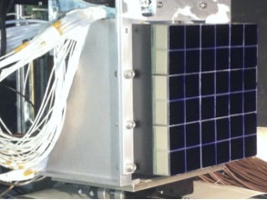
EUSO-Balloon
Data Acquisition (DAQ) Chain
Sensor (photodetector)
Front-end (FE) electronics
PDM
• 9 EC-Units (36 MAPMTs, 1024 pix)
PMT
• Hmamatsu 64-ch MAPMT
• BG3 filter
EC-Unit
• 4 PMTs (256-ch)
readout cables
• HV board
• potting
EC-ASIC
• 6 x ASICs
• readout
• counter
PDM-Board
• Slow control
Data Processing (DP)
CPU
• Run control, config. FE electronics
• Console & GUI, remote access, etc.
• Data processing
• managing Mass Memory for data
storage
CCB
(Cluster Control Board)
• Receive data
from 9 PDMs

Slide 8
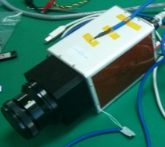
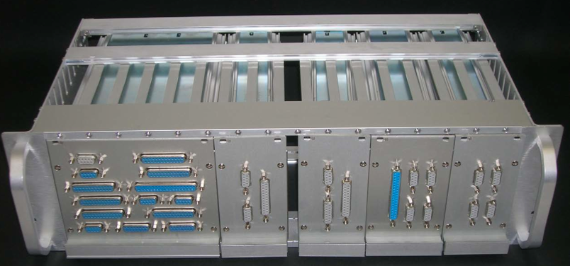
EUSO-Balloon
Data Acquisition (DAQ) Chain
IR camera
Sensor (photodetector)
Front-end (FE) electronics
PDM
• 9 EC-Units (36 MAPMTs, 1024 pix)
PMT
• Hmamatsu 64-ch MAPMT
• BG3 filter
EC-Unit
• 4 PMTs (256-ch)
readout cables
• HV board
• potting
EC-ASIC
• 6 x ASICs
• readout
• counter
PDM-Board
• Slow control
Data Processing (DP)
CPU
• Run control, config. FE electronics
• Console & GUI, remote access, etc.
• Data processing
• managing Mass Memory for data
storage
HK, LVPS
CCB
(Cluster Control Board)
• Receive data
from 9 PDMs

Slide 9
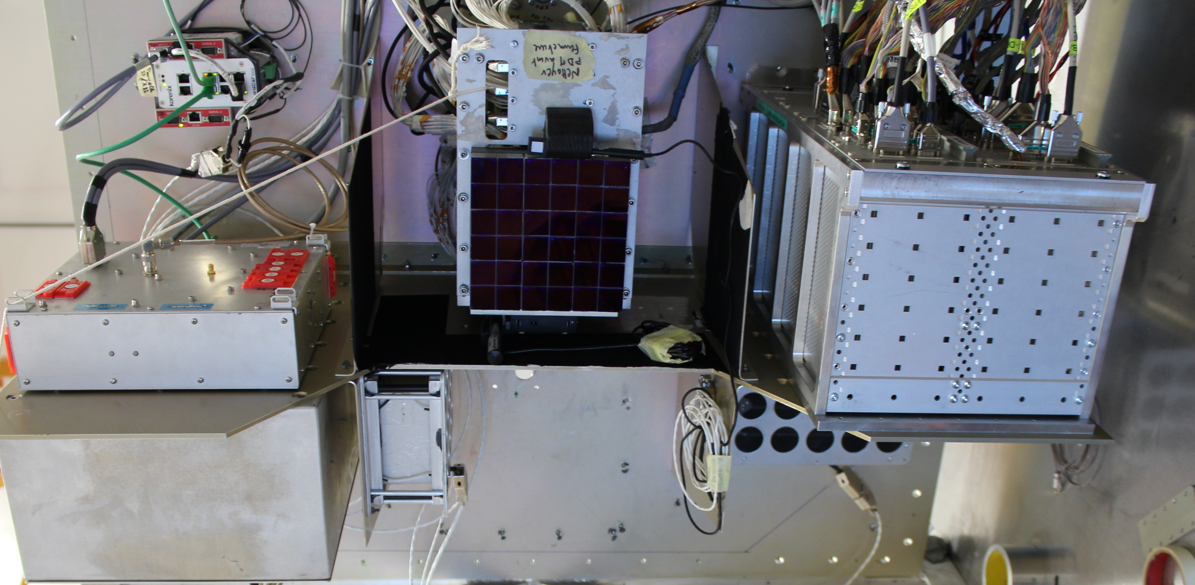
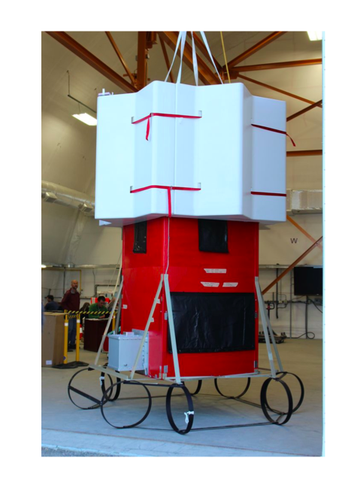
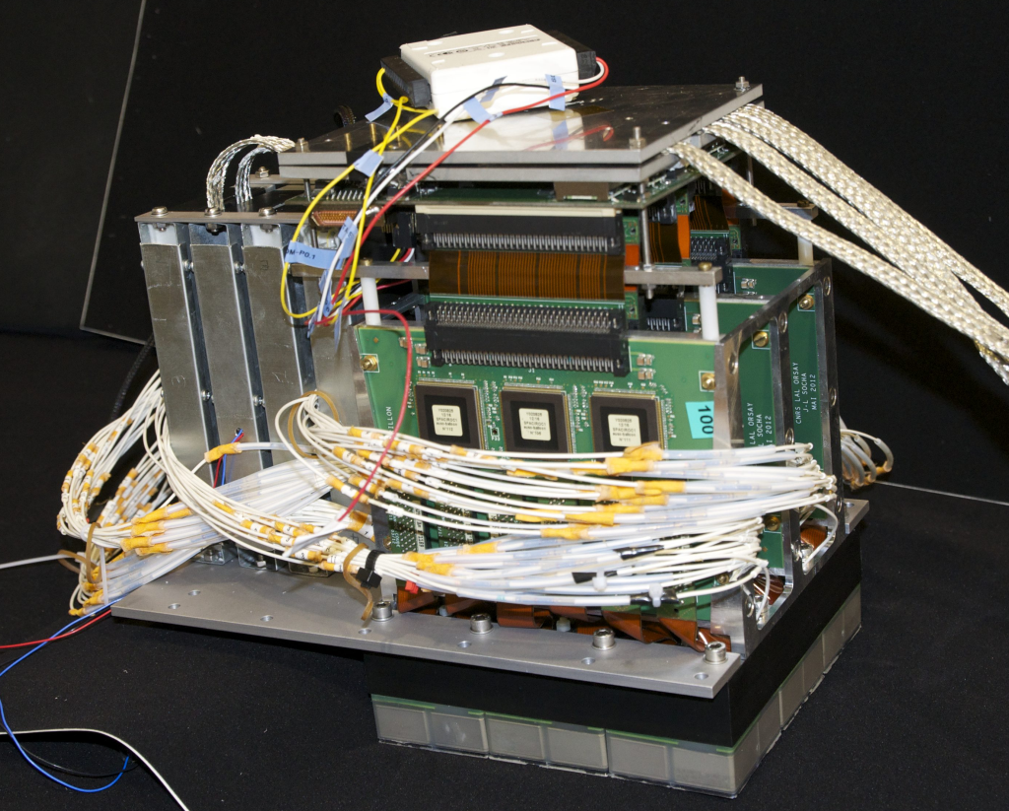
The realization

Slide 10

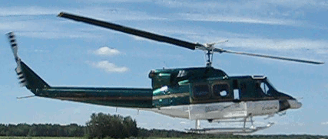
EUSO-BALLOON ‘‘in flight’’ calibration
Balloon
Testing EUSO-Balloon
Fly one aircraft equipped with
three types of calibrated pulsed UV light sources.
Point Test: Fly airplane in field of view and fire flash lamp and UV LED. Light travels directly from lamp to detector
Track Test: Fly airplane outside field of view and shoot a UV pulsed laser across field of view. Light scatters out of the beam to the detector.
(15 mJ Laser ~100 EeV Cosmic Ray)
Fly aircraft at altitudes between 3.1 km.
~38 km
EUSO
detector
11°
Field of View
scattered light
Calibrated
Flash lamp
3.1 km
Helicopter equipped with
YAG laser, UV LED and Xenon flasher
8 km

Slide 11
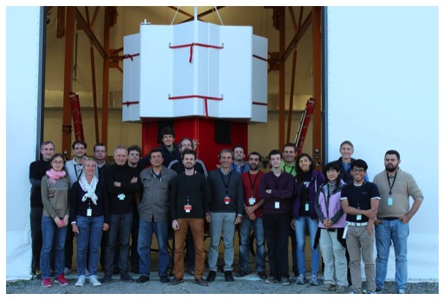
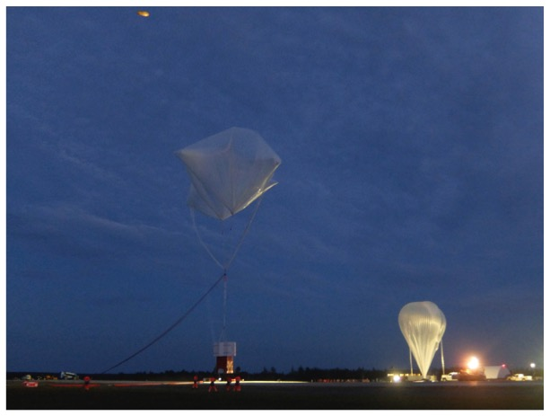
The Flight Campaign
Aug 12th : equipment arrived in Timmins (Ontario)
Aug 19th : EUSO-Ballon en configuration for the flight
Aug 24th : Ideal flight (40mn + 5h10 flight)
Aug 25th : recover of the instrument

Slide 12
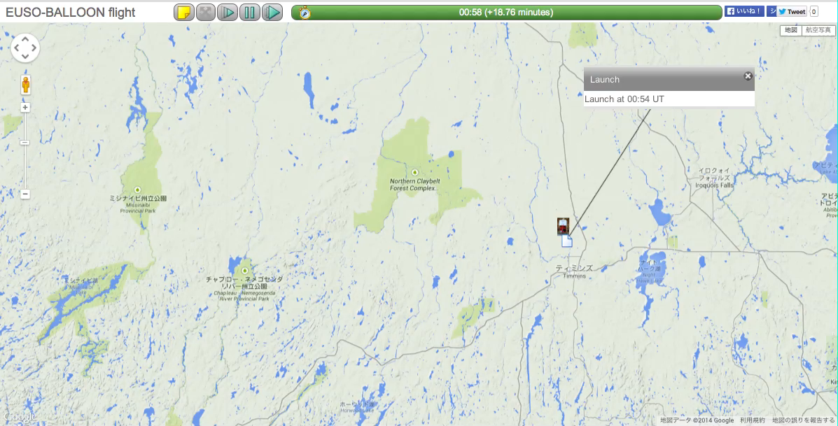
Balloon Flight Trajectory
Data acquisition with HV: started at 2:54 UTC, ended at 8:07 UTC
Total flight duration: 5h10 + 40mn

Slide 13
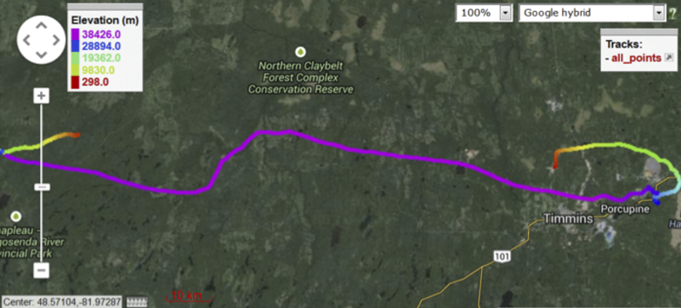
Balloon Flight Trajectory
(altitude included)
Balloon stayed at ~38km altitude during the measurement

Slide 14
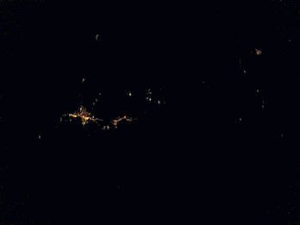
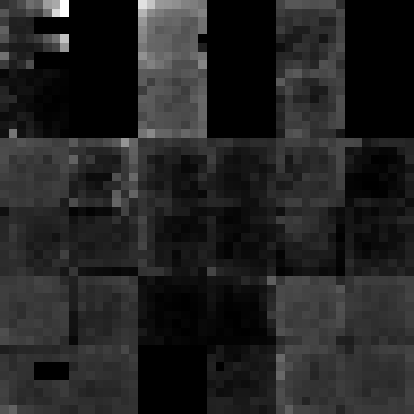
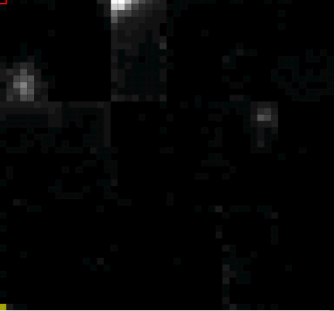
First Light
(images of Timmins city light)
GoPro image
PDM CPU_TRIGGER data
2hrs after launch (2:54~2:55 UTC) Balloon altitude 33.5km
PDM SCURVE data

Slide 15
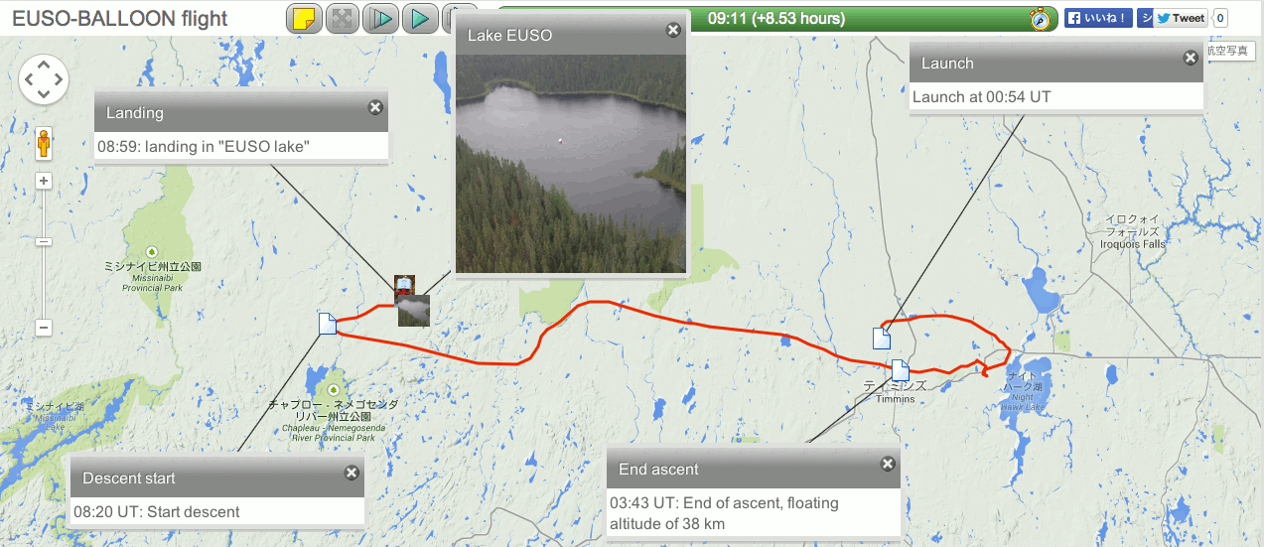
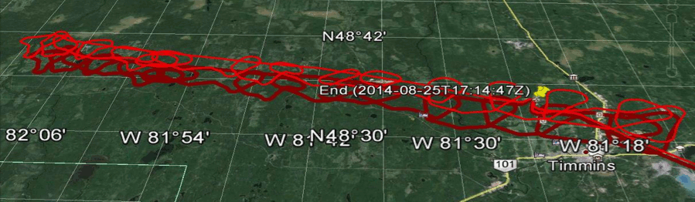
Balloon Flight Trajectory
Helicopter Trajectory

Slide 16

Laser flasher event

Slide 17

Laser flasher event

Slide 18
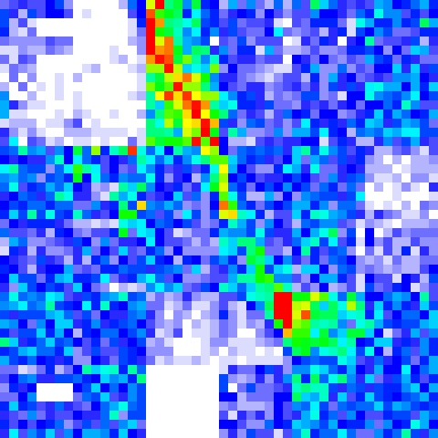
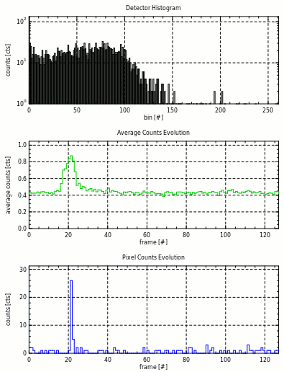
Laser track
Event profile

Slide 19
Analysis Ongoing
UV background measurement
Trigger study
Reconstruction of laser tracks

Slide 20
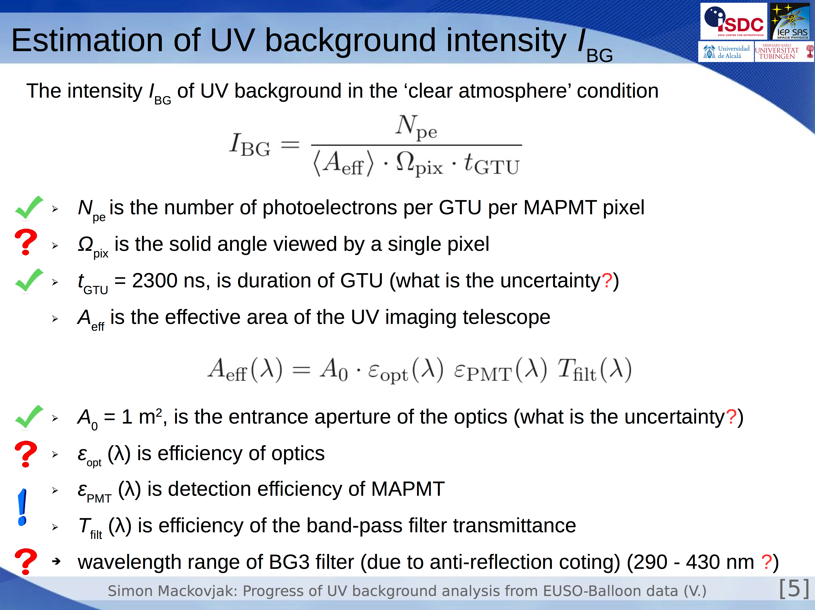
Simon Mackovjak: Progress of UV background analysis from EUSO-Balloon data

Slide 21
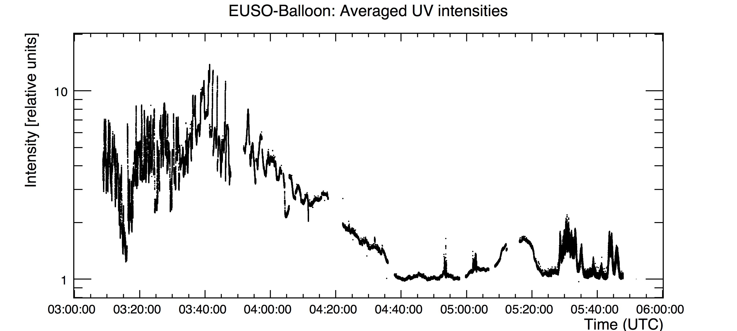
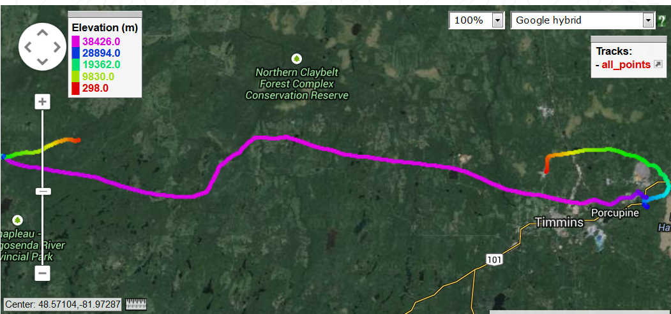
Results on UV background
10 km
S. Macovjak et al. (JEM-EUSO collaboration), ICRC #1302 (2015)

Slide 22
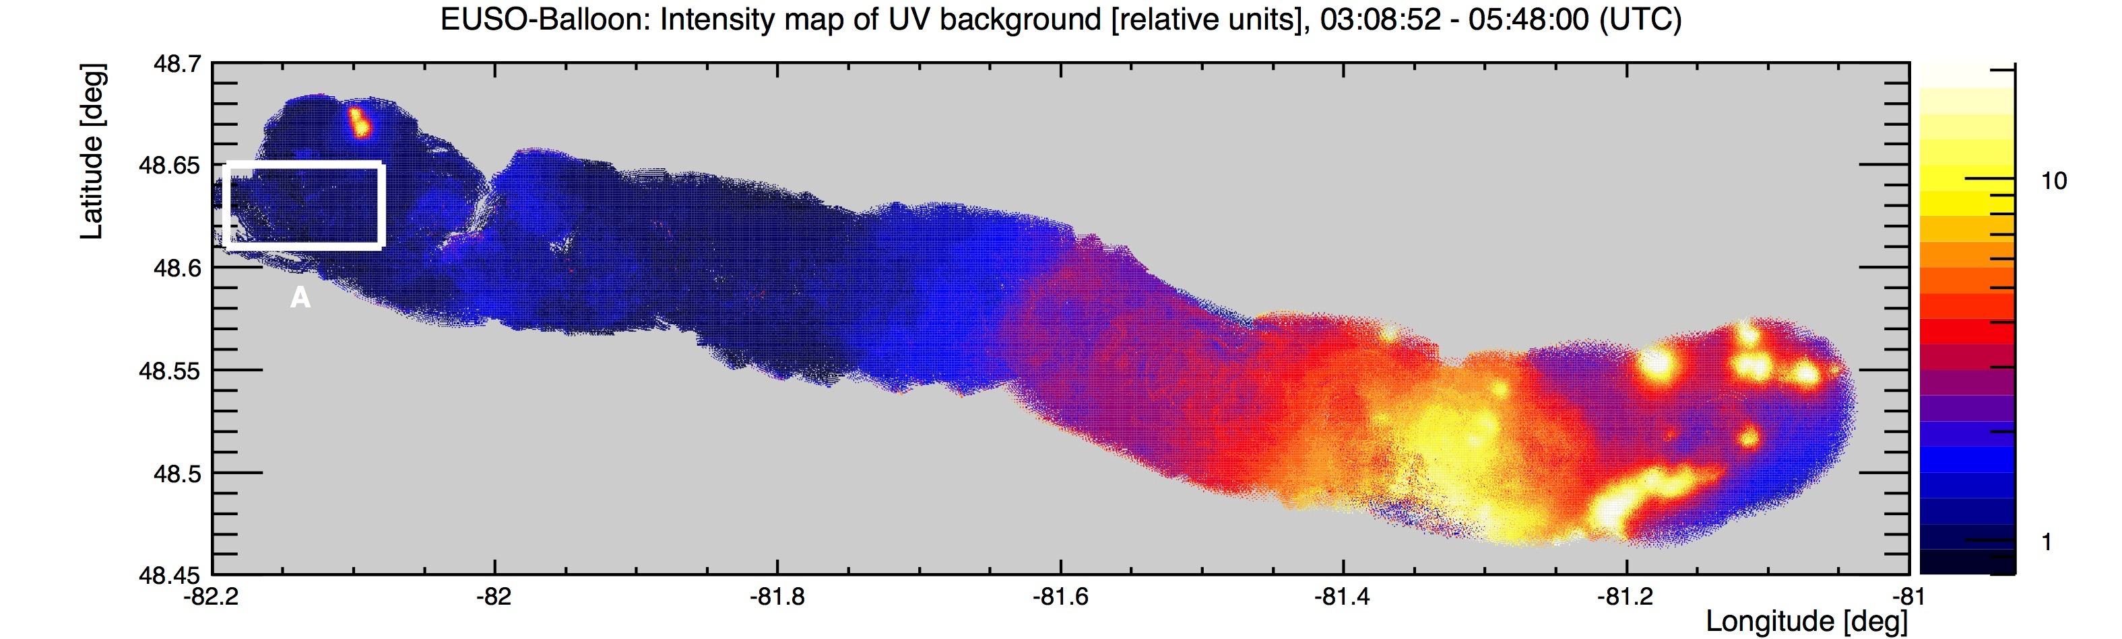
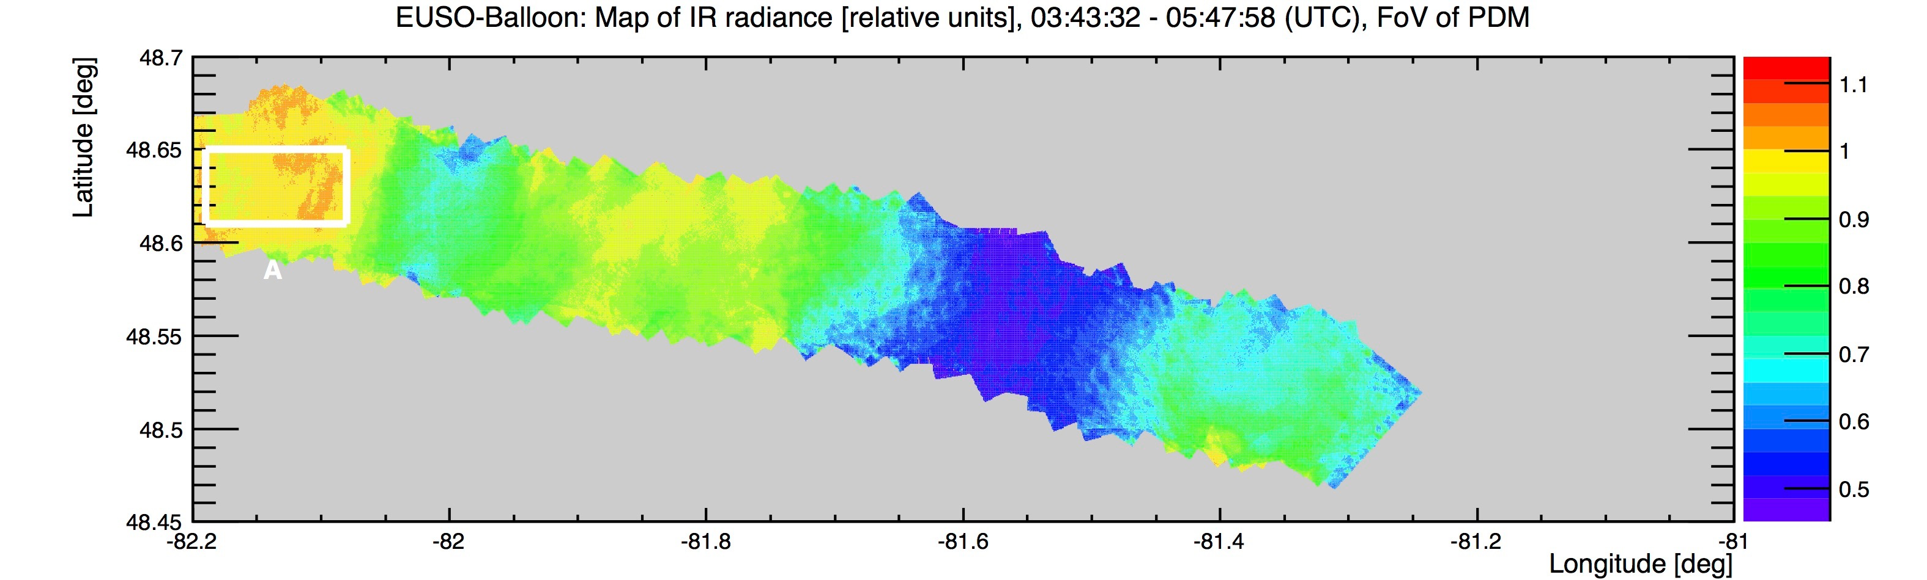
UV Background and Atmospheric Conditions
S. Macovjak et al. (JEM-EUSO collaboration), ICRC #1302 (2015)

Slide 23
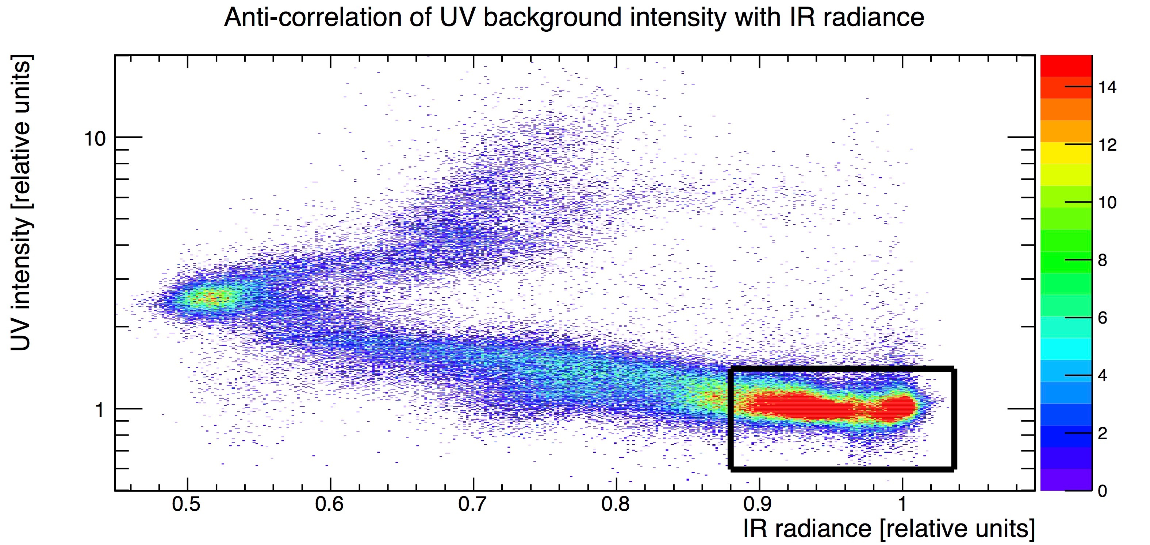
Important for JEM-EUSO:
Best conditions for measuring EAS
S. Macovjak et al. (JEM-EUSO collaboration), ICRC #1302 (2015)

Slide 24
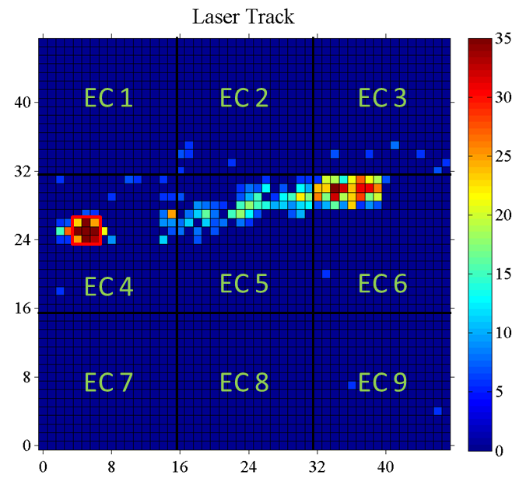
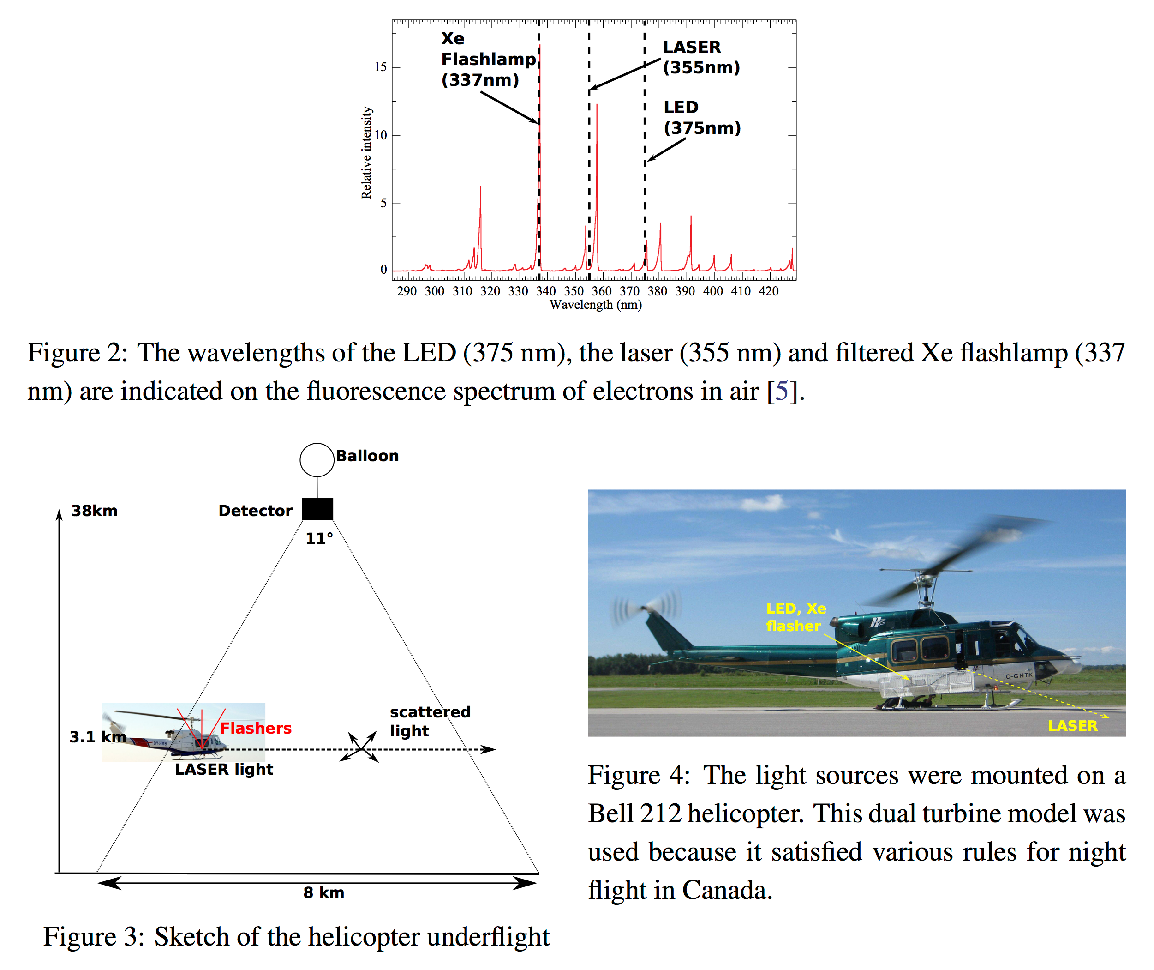
Typical LED-laser-Xe_flasher event
Image of one helicopter event obtained by integrating the counts in each pixel for the whole packet=1960 of RUN=043202 (128 GTUs). A threshold is applied to the minimum signal level to emphasize the location of the track. The UV-led and Xe-flasher signals are centered around pixel (X=5;Y=26).
G.Suino (INFN-TO) et al. (JEM-EUSO collaboration), ICRC #0925 (2015)

Slide 25
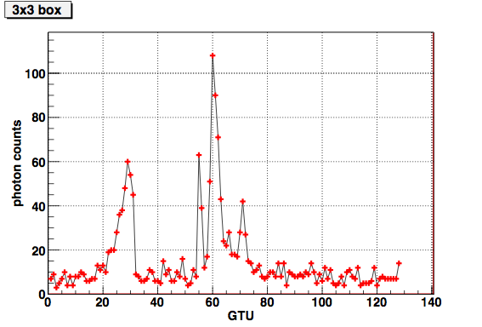
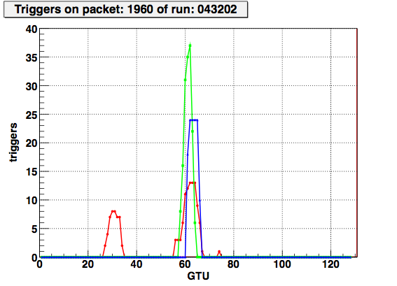
Time evolution of the signal in the underlined 3x3 pixel box
Xe flasher
LED
laser
Number of counts recored in the 3 3 pixel-box
centered around (X=5;Y=26) during the entire packet.
afterpulse Xe flasher
Triggers in this packet in the entire PDM
EC4
Sequence of trigger alerts in the different ECs where
the pixel (X=5;Y=26) is located during the entire packet.
EC5
EC6
The minimum signal required to trigger should exceed the average background level by 2.1 + 0.3 times.
G.Suino (INFN-TO) et al. (JEM-EUSO collaboration), ICRC #0925 (2015)

Slide 26
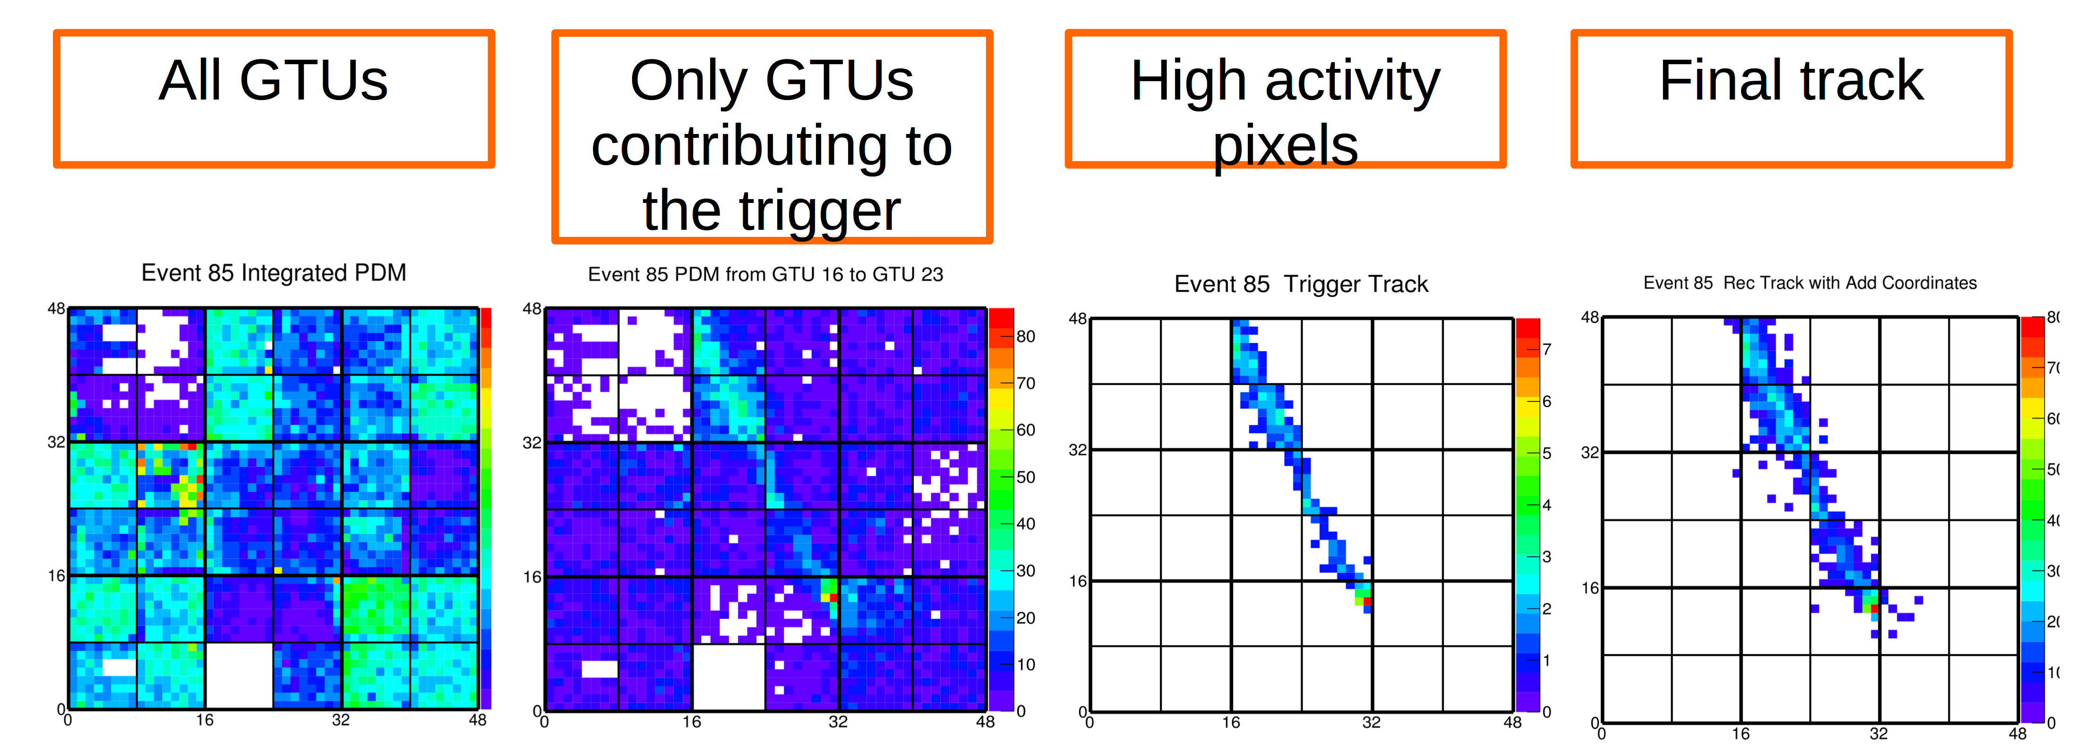
Data Analysis
OffLine
B. Panico & F. Guarino (INFN-NA) et al. (JEM-EUSO collaboration), ICRC #1155 (2015)

Slide 27
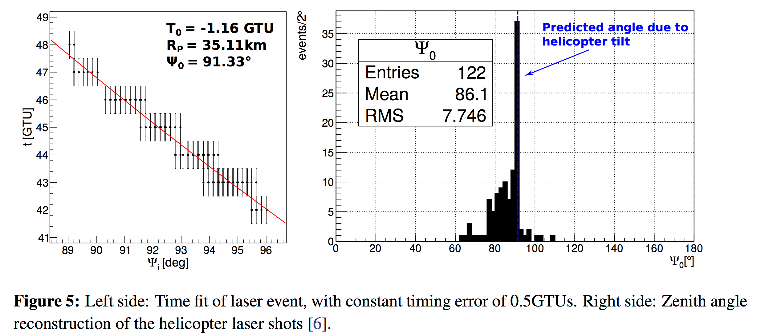
Reconstruction of laser tracks
J. Eser et al. (JEM-EUSO collaboration), ICRC #0860 (2015)

Slide 28
Summary
~2560000 packets (128 GTU/packet) acquired during the flight in 5 configs
8 GB transferred to ground during the flight while 83GB of data registerd on the disks
Telemetry data (voltages, currents and temperatures) transferred to ground during the flight
Trigger modes:
  CPU trigger .OR. GPS 1 pulse per second
  GPS 1 pulse per second .OR. 20 Hz clock
Demonstrated almost all the functions of equipment as intended including water tightness which was not expected this time
Conclustions
EUSO-Balloon 1st flight helped raising the TRL (Technical Rediness Level) of JEM-EUSO system and proved that the technique works!
The UV intensity was measured on many different conditions: grass, forest, lakes, city light, clouds with excellent spatial and temporal resolutions! Results in general agree with expectations.
It was proved that such a system can see and track EAS-like events.

Slide 29
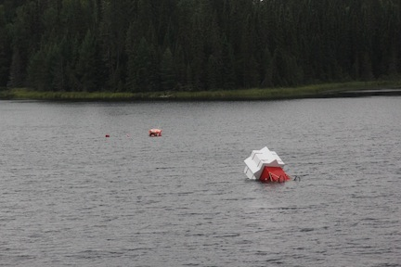
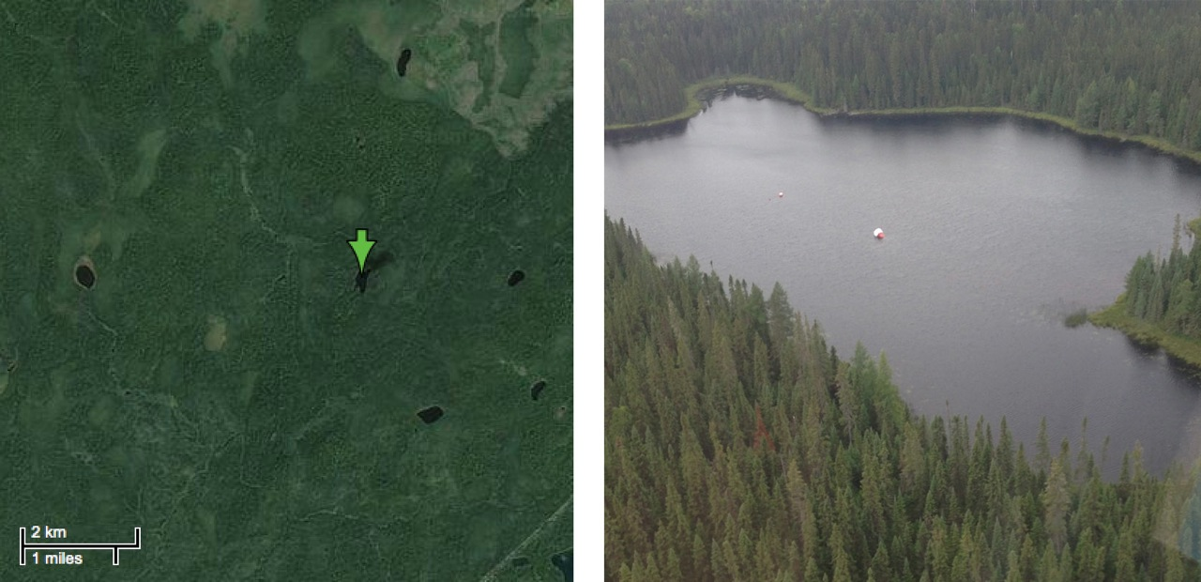
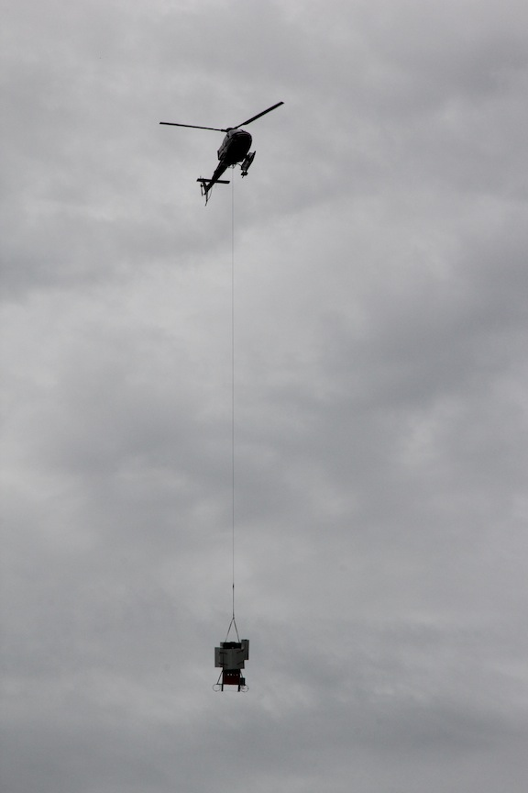
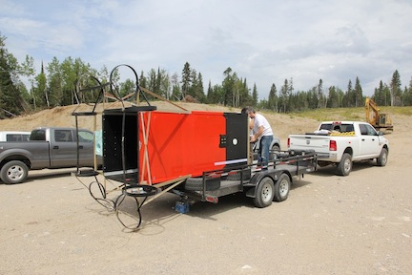
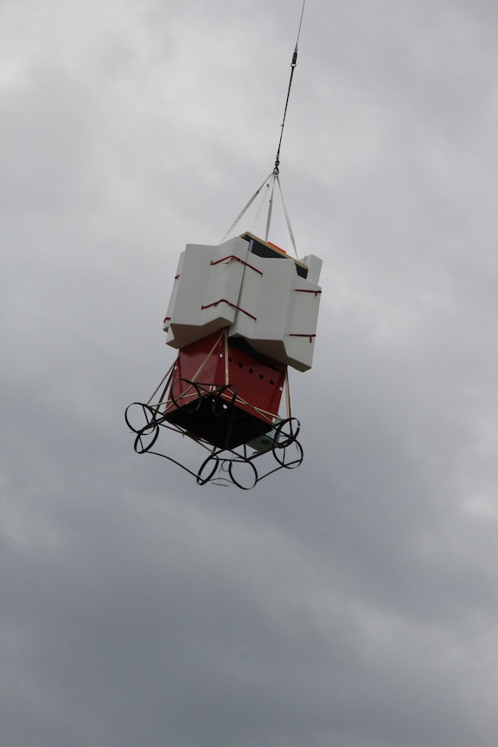
Landing and recovery

Slide 30
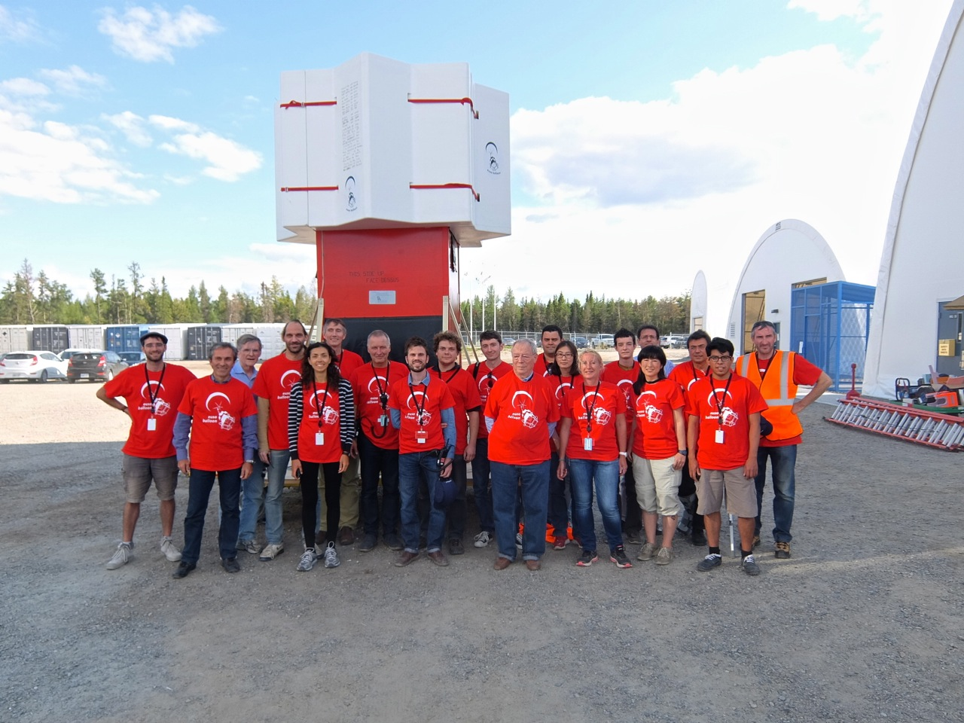
Thank you for your attention!

Slide 31

Thank you for your attention!

Slide 32
Backup slides

Slide 33

Trigger behavior on different background levels
Nominal Background | ~8.5 s
Method | Laser | Others | rate others
Box-bckg | 128 | 56 | 6.6 Hz
Pixel-bckg | 126 | 17 | 2.0 Hz
Urban-like Background | ~6.5 s
Method | Laser | Others | rate others
Box-bckg | 149 | 1941 | 299 Hz
Pixel-bckg | 148 | 59 | 9.1 Hz
The two methods provide comparable results on laser events
The Pixel-box method is more powerful in rejecting high-level background conditions
G.Suino & M. Mignone (INFN-TO)
33

Slide 34

I. Tabone (INFN-TO)
34

Slide 35

Distribution of (counts-noise)/(counts-noise)_3x3
vs size of boxes
 |  |  |  |  |  |  |  |  |  | Z9
 |  |  |  |  |  |  |  |  | Z7
 |  |  |  |  |  |  |  | Z5
 |  |  |  |  |  |  | Z3
 |  |  |  |  |  | Z1
 |  |  |  |  | Z2
 |  |  |  | Z4
 |  |  | Z6
 |  | Z8
 | Z10
Entries : 33
Results more compatibile with RMS spot size: ~3x3 box
M. Rouissat & L. Conti (INFN-RM2)

Slide 36

I. Tabone (INFN-TO)
36

Slide 37
Summary
~2560000 packets (128 GTU/packet) acquired during the flight in five configurations
83 GB of data registered on the disks
8 GB transferred to ground during the flight
Telemetry data (voltages, currents and temperatures) transferred to ground during the flight
Trigger modes:
  CPU trigger .OR. GPS 1 pulse per second
  GPS 1 pulse per second .OR. 20 Hz clock
Demonstrated almost all the functions of equipment as intended including water tightness which was not expected this time (possibility was low, prepared mainly for soil landing)

Slide 38

CNES Flight Chain
valve
Main elements
of an open
Stratospheric
balloon
20 m
~ 180 m
covering
Discharge sleeve
Remote separator
Parachute tension
Operational servitude pod (NSO)
100 m
~ 150 m
Radar refector
Beacon
Alticoder radar
responder
Scirnetific equipment
(EUSO-BALLOON main frame)
dampers
Scirnce telemetry pod

Slide 39
Other instruments onboard
Infrared Camera (IR Camera)
NIST photodiode
Geiger counter
GPS
Attitude sensor
GoPro camera
Independent of data acquisition systems
Offline synchronization (UTC time stamps)

Slide 40




Complementary and/or anecdotal data
  Light intensity (NIST)
  Cosmic ray intensity (Geiger)
  Temperature eveolution
  Infrared data

