Slide 1
Ledge-type Co/L1₀-FePt exchange-coupled composites
G. Varvaroª, A. M. Testaª, E. Agostinelliª, S. Lauretiª, V. Nappiª, D. Peddisª, G. Barucca^{b}, Th. Speliotis^{c}, G. Giannopoulos^{c}, D. Niarchos^{c}, W.F. Li^{d}, G. Hadjipanayis^{d} and D. Fioraniª
ª ISM-CNR, Area della Ricerca RM1, Via Salaria Km 29,300, P.B. 10-00015, Monterotondo Scalo, Roma, Italy
^{b} SIMAU, Università Politecnica delle Marche, via Brecce Bianche, Ancona, Italy
^{c} Institute of Materials Science, NCSR Demokritos, Athens, Greece
^{d} Department of Physics, University of Delaware, Newark, DE 19716, USA

Slide 2
INTRODUCTION
EXCHANGE COUPLED COMPOSITE (ECC) SYSTEMS: FUNDAMENTALS and APPLICATIONS
FM SOFT
ECC systems consist of ferromagnetic (FM) hard and soft phases exchange coupled through their common interface.
Varying the intrinsic and extrinsic properties of the two components and the strength of the interface coupling is possible to finely tune the magnetic properties of the composite.
FM HARD

Slide 3
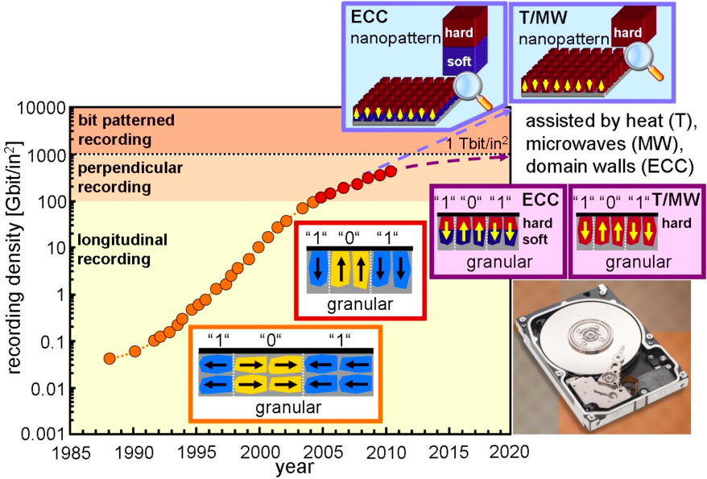
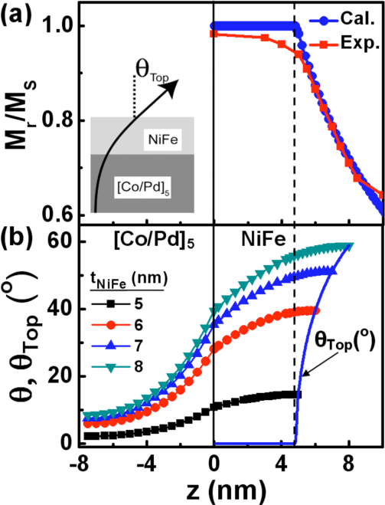
INTRODUCTION
EXCHANGE COUPLED COMPOSITE (ECC) SYSTEMS: FUNDAMENTALS and APPLICATIONS
Magnetic Recording Media
Permanent Magnets
Spin Torque Oscillators
ECC media allows improving the writability without compromising the thermal stability.
ECC media are used in current recording media based on the CoCrPt alloy and are envisaged for next generation PMR media (areal density > 1 Tbit/in²) based on hard materials (e.g. L1₀-FePtX alloys, k_{u} ~ 5 MJ/m³).
Enhancement of (BH)_{max} (up to 900 kJ/m³ for an ideal NdFeB/Fe bilayer).
Reduction of rear-earth elements by hard phase dilution.
Varying the thickness of the soft layer allows modulating the tilt angle.
→ fine tuning of magneto-dynamic properties.
L. Lewis et al., Met. Mat. Trans. A 44 S2 2013
B. Balamurugan et at., Scrip. Mat. 67 542 2012
J. Winterlik et al., Adv Mater. 24 6283 2012
O. Gutfleisch et al., Adv. Mat. 23 821 2011
D. Goll and T Bublat, Phys. Status Solidi A 210 1261 2013
T.N Nguyen et al., APL 98 172502 2011

Slide 4
INTRODUCTION
EXCHANGE COUPLED COMPOSITE (ECC) SYSTEMS: FUNDAMENTALS and APPLICATIONS
Magnetic Recording Media
Permanent Magnets
Spin Torque Oscillators
ECC media allows improving the writability without compromising the thermal stability.
ECC media are used in current recording media based on the CoCrPt alloy and are envisaged for next generation PMR media (areal density > 1 Tbit/in²) based on hard materials (e.g. L1₀-FePtX alloys, k_{u} ~ 5 MJ/m³).
Enhancement of (BH)_{max} (up to 900 kJ/m³ for an ideal NdFeB/Fe bilayer).
Reduction of rear-earth elements by hard phase dilution.
Varying the thickness of the soft layer allows modulating the tilt angle.
→ fine tuning of magneto-dynamic properties.
L. Lewis et al., Met. Mat. Trans. A 44 S2 2013
B. Balamurugan et at., Scrip. Mat. 67 542 2012
J. Winterlik et al., Adv Mater. 24 6283 2012
O. Gutfleisch et al., Adv. Mat. 23 821 2011
D. Goll and T Bublat, Phys. Status Solidi A 210 1261 2013
T.N Nguyen et al., APL 98 172502 2011

Slide 5
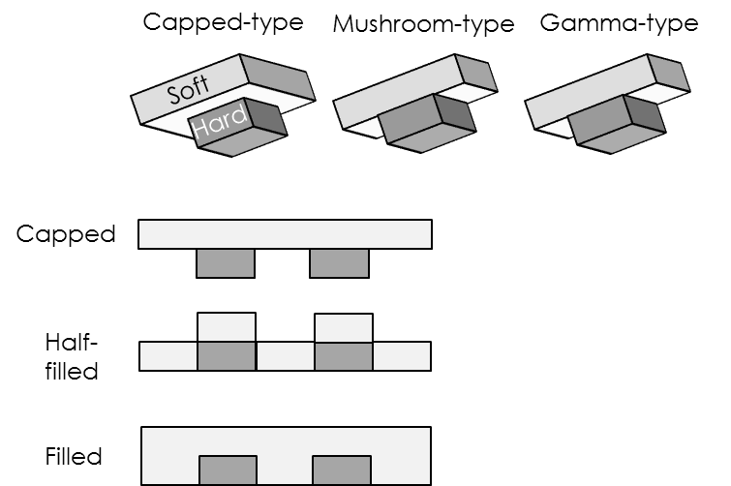
INTRODUCTION
EXCHANGE COUPLED COMPOSITE SYSTEMS for MAGNETIC RECORDING
Different ECC designs have been proposed, the difference being in the type of interface and section shape of soft and hard components.
F. Casoli et al., Ch. 5 in “Ultra-High-Density Magnetic Recording: Storage Materials and Media Designs”, G. Varvaro and F. Casoli Eds., Pan Stanford Publishing (In preparation - 2015)
G. Varvaro et al., JMMM 368 415 2014
D. Goll and T. Bublat, Phys. Status Solidi A 210 1261 2013; D. Goll and S. Macke, APL 93 152512 2008
D. Suess et al., JMMM 321 545 2009; A. Y Dobin et al., APL 89 062512 2006
Type of interface
Section shape
Exchange-Spring systems
Conventional ECC systems
Z
Sharp interface.
A non magnetic layer can be present to modulate the interface coupling.
Soft
The cross sectional shape is identical for the hard and soft phases
Hard
Soft FM
Non magnetic interlayer
Ledge-type ECC system
Single-element structures
Single-element structures
Hard FM
K_{s}
K_{h}
K
Graded systems
Nano-patterned geometries
Soft FM
K_{s}
K_{h}
Nano-patterned geometries
K
The interface is an extend region where the anisotropy gradually varies from high to low values along the thickness.
The section size of the soft phase is more extended.
Hard FM
t_{G}
z

Slide 6
INTRODUCTION
EXCHANGE COUPLED COMPOSITE SYSTEMS for MAGNETIC RECORDING
Different ECC designs have been proposed, the difference being in the type of interface and section shape of soft and hard components.
F. Casoli et al., Ch. 5 in “Ultra-High-Density Magnetic Recording: Storage Materials and Media Designs”, G. Varvaro and F. Casoli Eds., Pan Stanford Publishing (In preparation - 2015)
G. Varvaro et al., JMMM 368 415 2014
D. Goll and T. Bublat, Phys. Status Solidi A 210 1261 2013; D. Goll and S. Macke, APL 93 152512 2008
D. Suess et al., JMMM 321 545 2009; A. Y Dobin et al., APL 89 062512 2006
Type of interface
Section shape
Exchange-Spring systems
Conventional ECC systems
Z
Sharp interface.
A non magnetic layer can be present to modulate the interface coupling.
Soft
The cross sectional shape is identical for the hard and soft phases
Hard
Soft FM
Non magnetic interlayer
Ledge-type ECC system
Single-element structures
Single-element structures
Hard FM
K_{s}
K_{h}
K
Graded systems
Nano-patterned geometries
Soft FM
K_{s}
K_{h}
Nano-patterned geometries
K
The interface is an extend region where the anisotropy gradually varies from high to low values along the thickness.
The section size of the soft phase is more extended.
Hard FM
t_{G}
z

Slide 7
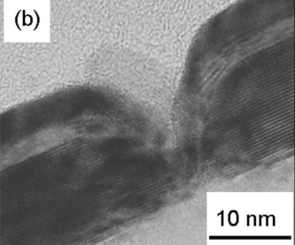
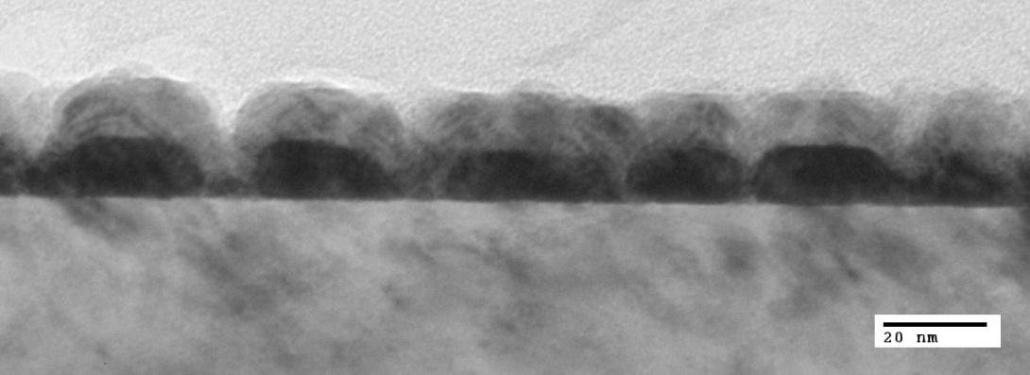
Aim
Investigation of structural, microstructural and magnetic properties of Co(soft)/L1₀-FePt(hard) ledge-type ECC systems as a function of Co thickness.
Previous works focused on FePt-based ledge type ECC systems where Fe is used as soft component
Co
L1₀-FePt
D. Goll and T. Bublat, PSS A 210 1261 2013
L.S. Huang et al., JAP 114 173903 2013
B. Ma et. al., JAP 109 083907 2011
B. Ma et al., IEEE Trans. Magn. 46 2345 2010
A. Breitling et al., PSS-RRL 3 130–132 2009
D. Goll and A. Breitling, APL 94 052502 2009
F. Casoli et al., APL 92 142506 2008
D. Goll and S. Macke, APL 93 152512 2008
MgO (100) Substrate
Co soft phase was already successfully used in different conventional ECC systems:
SmCo/Co (E.E. Fullerton et al., PRB 12193 1998; P. Chowdhury et al., JMMM 342 74 2013)
L1₀-CoPt/Co (D.C. Crew et al., JMMM 233 257 2001)
L1₀-FePt/Co (Wang et al., JAP 115 133908 2014)
Deposition | Sputtering
Structural & Microstructural Investigation | XRD - SAED
 | TEM/HRTEM
Magnetic Measurements | Vector VSM
 | SQUID
Using Co allows in principle the magnetization reversal in the two phases to be carefully investigated by using elemental specific measurement techniques.

Slide 8
Experimental
Co/L1₀-FePt ledge–type samples were prepared by sputtering (@ NCSR Demokritos, Athens - Greece)
Co
L1₀-FePt
MgO (100) Substrate

Slide 9
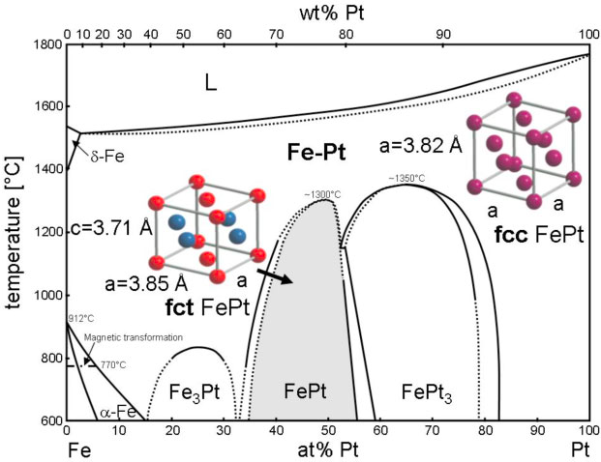
Experimental
Co/L1₀-FePt ledge–type samples were prepared by sputtering (@ NCSR Demokritos, Athens - Greece)
1
HARD FePt phase with an island-type nanostructure (Volmer-Weber growth mode) consisting of isolated (001) L1₀-FePt particles (k_{u} ~ 5 MJ/m³) with perpendicular anisotropy.
L1₀-FePt
T_{dep} = 700 °C
Nominal thickness = 3.5 nm
MgO (100) substrate
MgO (100) Substrate
T. Shima et al., APL 81 1050 2002
V. Alexandrakis et al., JAP 109 07B729 2011
SEM
easy
axis
D. Goll and T Bublat, Phys. Status Solidi A 210 1261 2013

Slide 10
Experimental
Co/L1₀-FePt ledge–type samples were prepared by sputtering (@ NCSR Demokritos, Athens - Greece)
1
HARD FePt phase with an island-type nanostructure (Volmer-Weber growth mode) consisting of isolated (001) L1₀-FePt particles (k_{u} ~ 5 MJ/m³) with perpendicular anisotropy.
L1₀-FePt
T_{dep} = 700 °C
Nominal thickness = 3.5 nm
MgO (100) substrate
MgO (100) Substrate
T. Shima et al., APL 81 1050 2002
V. Alexandrakis et al., JAP 109 07B729 2011
2
SOFT Co phase
T_{dep} = RT
Nominal thickness (th_{Co})
3, 6.5, 9.5, 20 nm

Slide 11
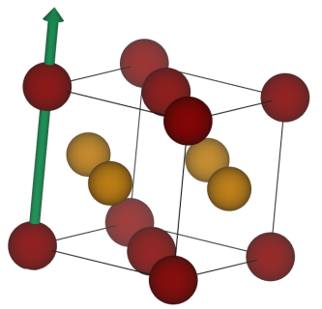
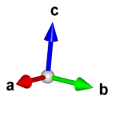
Morpho-Structural Properties
X-RAY ANALYSIS
(@ NCSR Demokritos, Athens - Greece)
A magnetically hard L1₀-FePt phase (fct) with a (001) orientation (i.e. the easy axis oriented perpendicular to film surface) was obtained.
The presence of the (003) superlattice reflection is a remarkable sign of a high chemical order degree.
th_{Co} = 20 nm
th_{Co} = 9.5 nm
[001]
easy-axis
th_{Co} = 6.5 nm
th_{Co} = 3 nm
Fe
Pt
th_{Co} = 0
Any reflection peaks related to the Co phase was observed even at the largest soft layer thickness

Slide 12
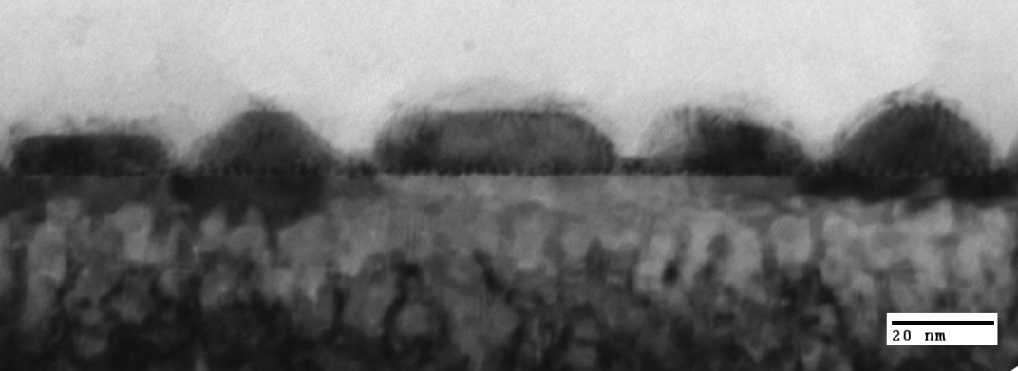
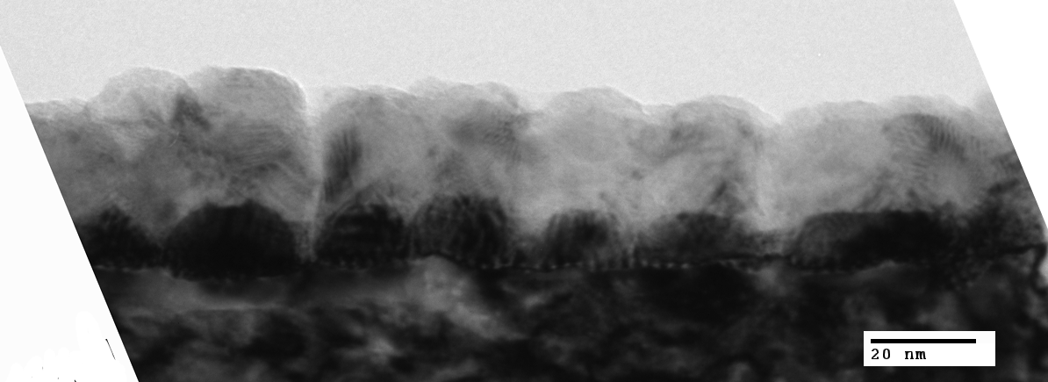
Morpho-Structural Properties
TEM ANALYSIS
(@ SIMAU, Ancona – Italy; Un. Delaware – DE, USA)
t_{Co} = 3 nm
Co
The HARD FePt phase forms with an island-type nanostructure (Volmer-Weber growth mode) consisting of isolated L1₀-FePt particles.
Island lateral size: 25 – 35 nm
Island height: ~ 10 nm
Spacing: 5 – 10 nm
L1₀-FePt
MgO (100) Substrate
20 nm
t_{Co} = 9.5 nm
Co
th_{Co} < FePt island height (~ 10 nm)
Half-filled ledge-type structure.
L1₀-FePt
MgO (100) Substrate
20 nm
t_{Co} = 20 nm
th_{Co} > FePt island height (~ 10 nm)
Filled ledge-type structure.
Co
L1₀-FePt
MgO (100) Substrate
20 nm

Slide 13
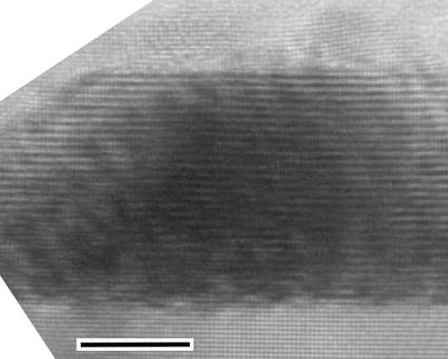
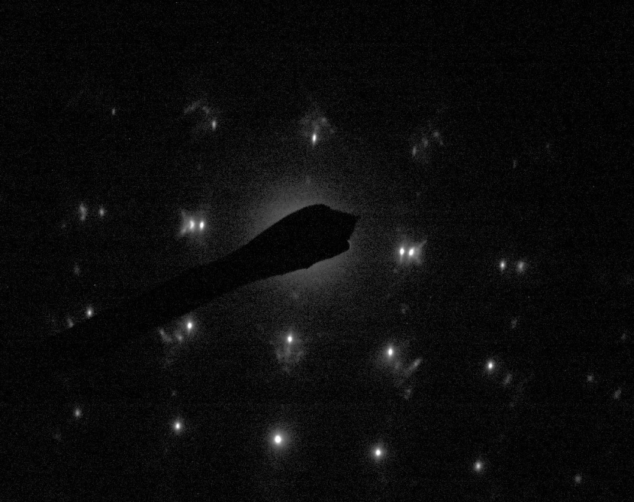
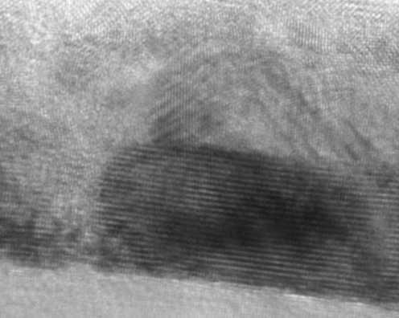
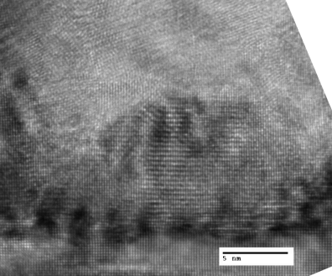
Morpho-Structural Properties
TEM ANALYSIS
HRTEM
(@ SIMAU, Ancona – Italy; Un. Delaware – DE, USA)
t_{Co} = 3 nm
Co
Co
SAED
L1₀-FePt
L1₀-FePt [001]
Co [001]
MgO (100) Substrate
L1₀-FePt
5 nm
MgO [001]
t_{Co} = 9.5 nm
Co
Co
L1₀-FePt
[001]
The formation of L1₀-FePt particles with a (001) orientation is confirmed.
The presence of a Co fcc phase with a (001) orientation was observed.
4°
MgO (100) Substrate
L1₀-FePt
20 nm
t_{Co} = 20 nm
Co
Co
<100>_{Co} // <100>_{FePt} ;
{001}_{Co} // {001}_{FePt}
{001}_{FePt} // {001}_{MgO} ;
<010>_{FePt} // <010>_{MgO}
L1₀-FePt
L1₀-FePt
MgO (100) Substrate
5 nm
[100]

Slide 14
Magnetic Properties
HYSTERESIS LOOPS (φ = 90°)
(@ ISM – CNR, Roma - Italy)
H_{c} ~ 4.5 T
z
H
φ
x
Sample plane

Slide 15
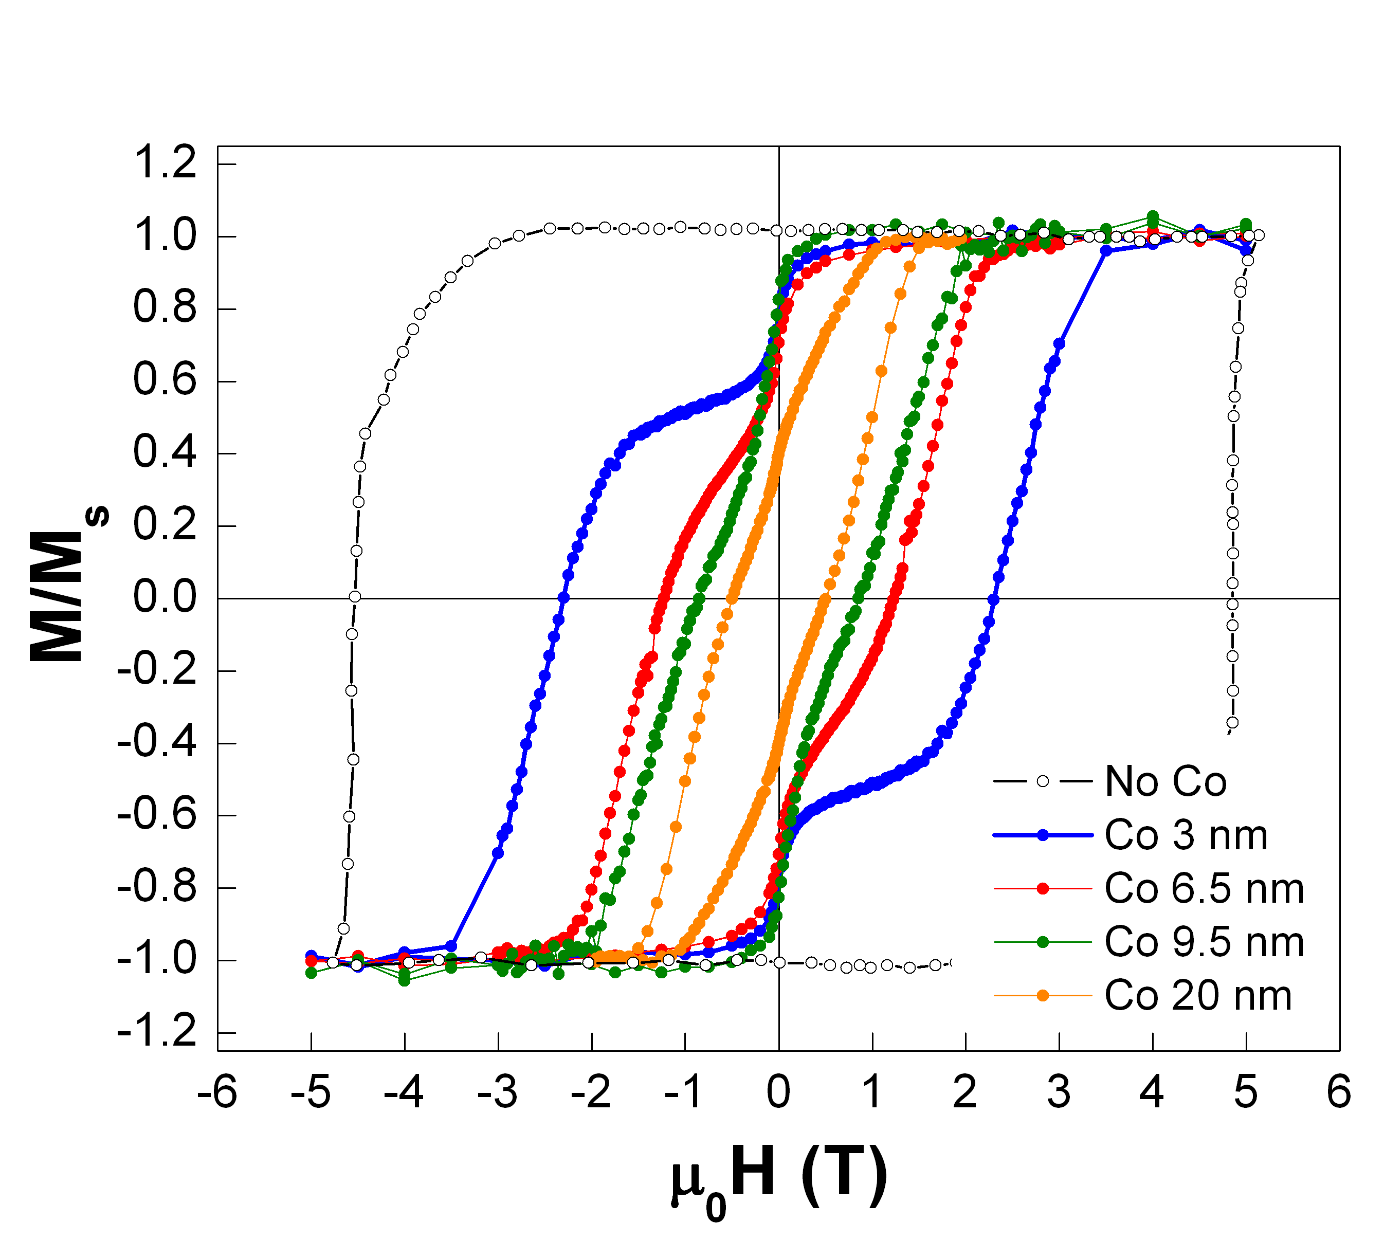
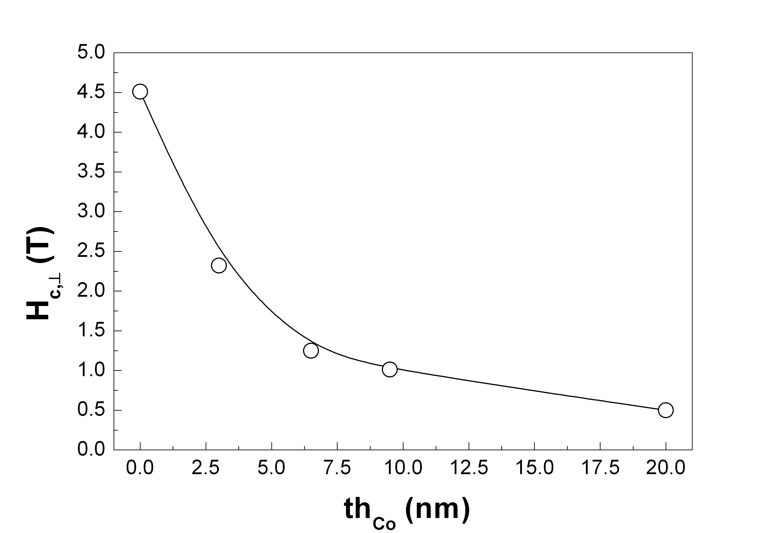
Magnetic Properties
HYSTERESIS LOOPS (φ = 90°) – Dependence of H_{c},┴ on the Co thickness (th_{Co})
(@ ISM – CNR, Roma - Italy)

Slide 16
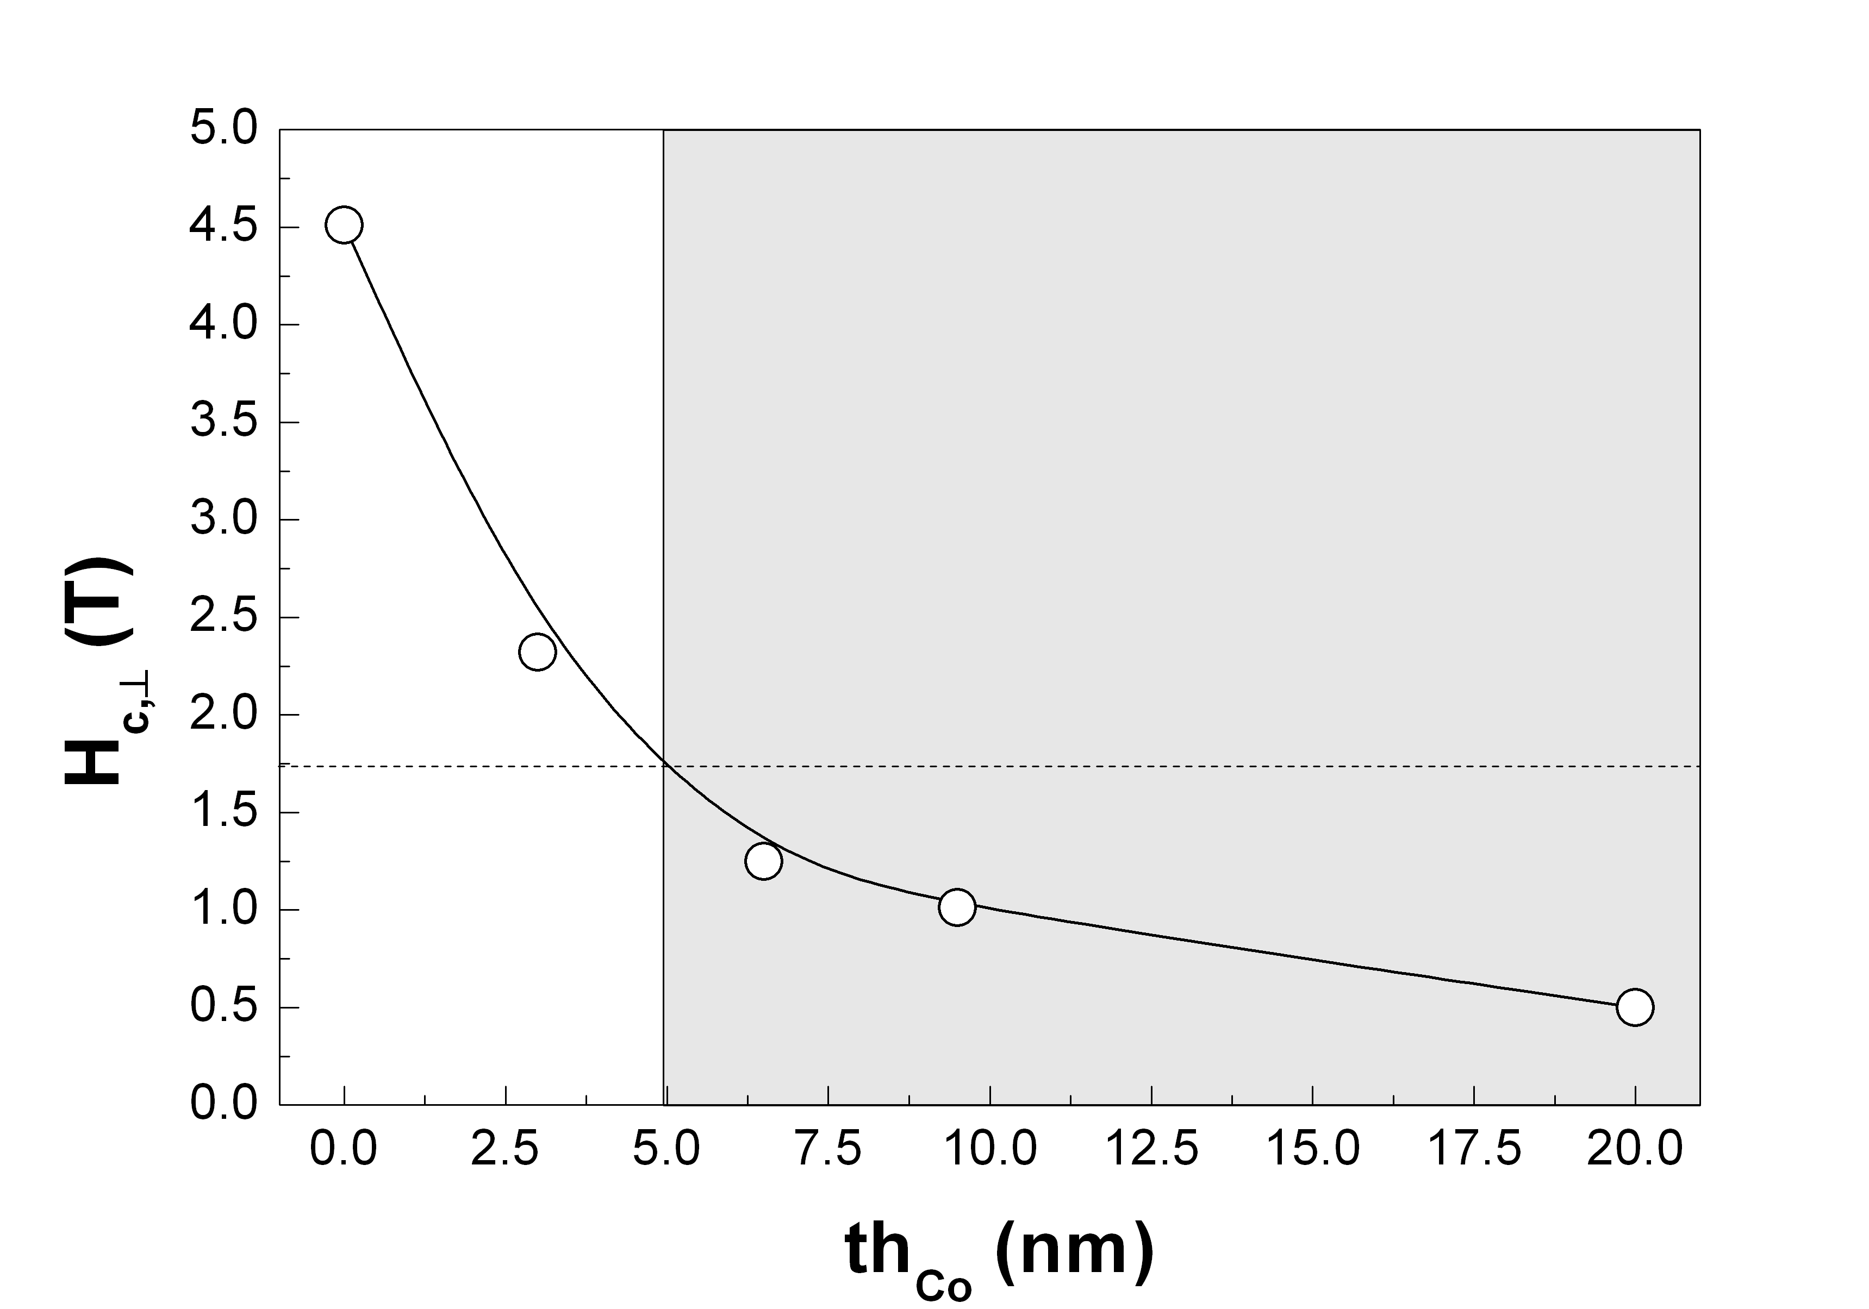
Magnetic Properties
HYSTERESIS LOOPS (φ = 90°) – Dependence of H_{c},┴ on the Co thickness (th_{Co})
(@ ISM – CNR, Roma - Italy)
Improved Writability

Slide 17
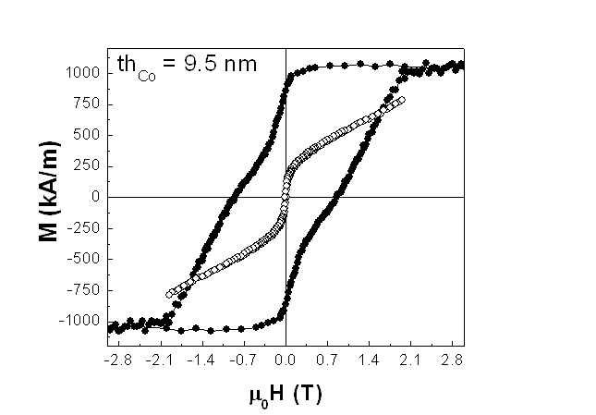
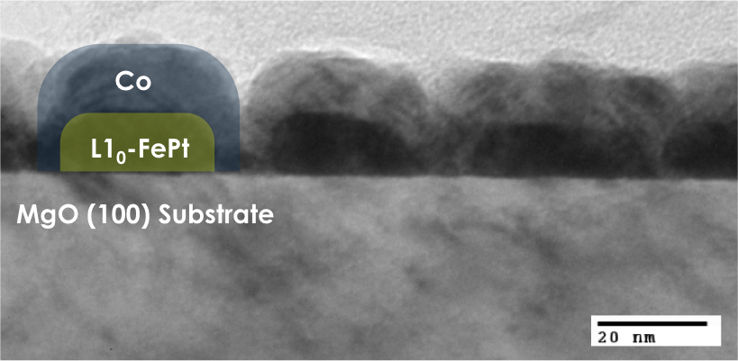
Magnetic Properties
HYSTERESIS LOOPS (φ = 90°) – Dependence of H_{c},┴ on the Co thickness (th_{Co})
(@ ISM – CNR, Roma - Italy)
Improved Writability
Half-filled ledge type structure
Perpendicular anisotropy
Significant reduction of H_{c}

Slide 18
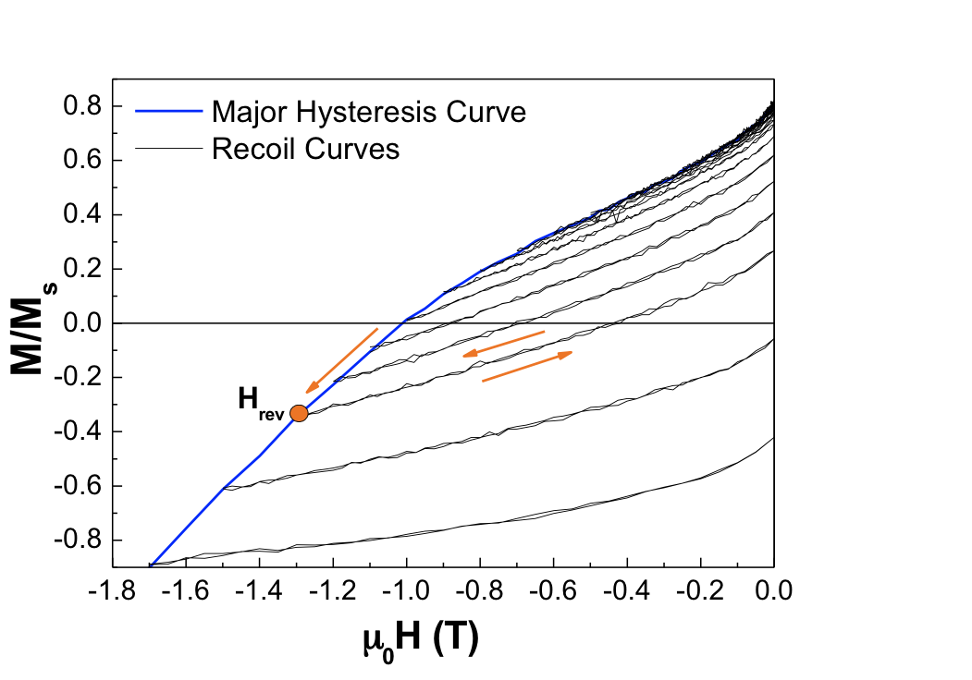
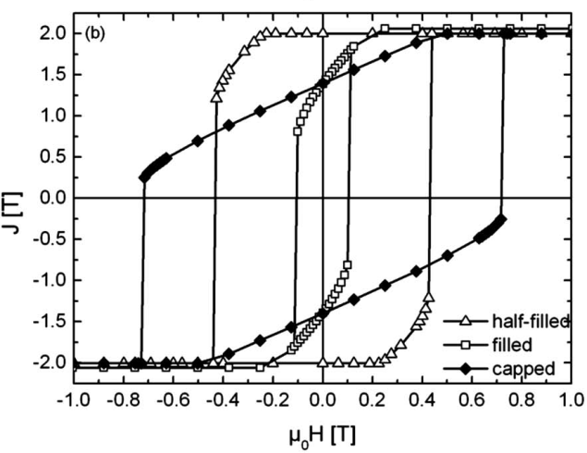
Magnetic Properties
(@ ISM – CNR, Roma - Italy)
RECOIL CURVES (φ = 90°) – REVERSAL MECHANISM
Recoil loops were measured by removing and reapplying a demagnetizing (reverse) field (H_{rev}), which is successively increased.
Reversal mechanism
Domain wall-assisted switching model
D. Suess et al., JMMM 321 545 2009
A.Yu. Dobin and H.J. Richterb, APL 89 062512 2006
Nucleation of a domain wall in the soft phase. It becomes pinned near the soft/hard interface where it compresses (reversible reversal)
Displacement of the domain wall into the hard part. Reversal of the whole system (irreversible switching).
Reversible
reversal
Irreversible
Reversal
Numerical simulation
D. Goll and S. Macke, APL 93 152512 2008

Slide 19
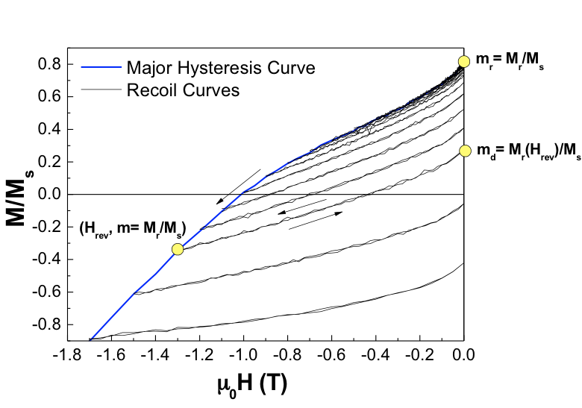
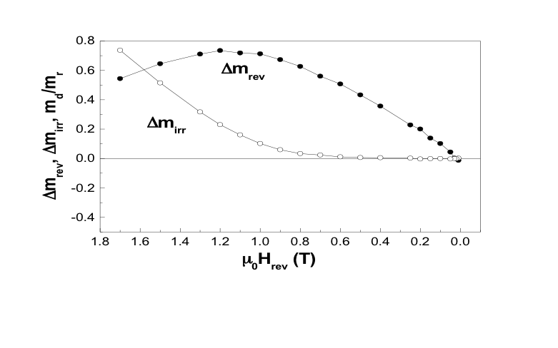
Magnetic Properties
(@ ISM – CNR, Roma - Italy)
RECOIL CURVES (φ = 90°) – REVERSAL MECHANISM
Irreversible processes appear due to the reversal of the hard phase
Reversible
reversal
Reversal mechanism
Domain wall-assisted switching model
D. Suess et al., JMMM 321 545 2009
A.Yu. Dobin and H.J. Richterb, APL 89 062512 2006
Nucleation of a domain wall in the soft phase. It becomes pinned near the soft/hard interface where it compresses (reversible reversal)
Displacement of the domain wall into the hard part. Reversal of the whole system (irreversible switching).
Reversible
reversal
Irreversible
Reversal
Numerical simulation
D. Goll and S. Macke, APL 93 152512 2008

Slide 20
Magnetic Properties
(@ ISM – CNR, Roma - Italy)
RECOIL CURVES (φ = 90°) – REVERSAL MECHANISM
Irreversible processes appear due to the reversal of the hard phase
Reversible
reversal
Reversal mechanism
Domain wall-assisted switching model
D. Suess et al., JMMM 321 545 2009
A.Yu. Dobin and H.J. Richterb, APL 89 062512 2006
Nucleation of a domain wall in the soft phase. It becomes pinned near the soft/hard interface where it compresses (reversible reversal)
Displacement of the domain wall into the hard part. Reversal of the whole system (irreversible switching).
Reversible
reversal
Irreversible
Reversal
The system behaves as an exchange-coupled composite
Numerical simulation
D. Goll and S. Macke, APL 93 152512 2008

Slide 21
Conclusions
The systems present a preferential perpendicular anisotropy up to th_{Co} = 9.5 nm
Co(fcc)/FePt(fct) ledge-type systems were prepared and investigated.
Irreversible processes appear
Reversible
reversal
4°
[001]
The crystallographic relationship among the different phases was disclosed.
Improved Writability
<100>_{Co} // <100>_{FePt} ;
{001}_{Co} // {001}_{FePt}
{001}_{FePt} // {001}_{MgO} ;
<010>_{FePt} // <010>_{MgO}
[100]
The exchange coupled composite behaviour was demonstrated.
H_{c} reduces with the increase of th_{Co}.

Slide 22
_{THANK YOU FOR THE ATTENTION}

Slide 23
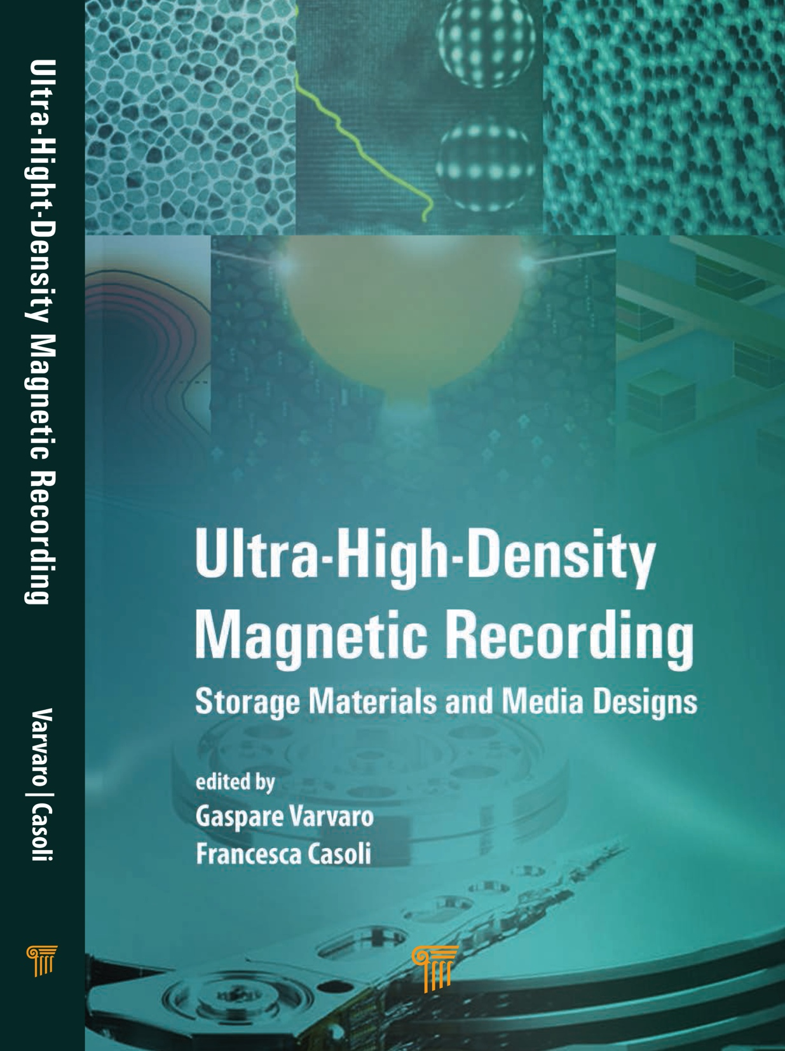
The book reports on the most recent progresses and developments in data storage from the recording medium perspective. Theoretical, experimental as well as technological aspects are presented, with special emphasis on the materials’ features for next generation perpendicular recording media. The book also reports on emerging magnetic memories, which are potential candidates for future information storage devices.
Chapter 1. Fundamentals of Magnetism
P. Allia, G. Barrera
Chapter 2. Hard Disk Drives: Fundamentals and Perspectives
G. Bertero, G. Guo, S. Dahandeh, A. Krishman
Chapter 3. Conventional Perpendicular Magnetic Recording Media
H.-S. Jung
Chapter 4. Energy Assisted Magnetic Recording
E. Gage, K.-Z. Gao, J.-G. Zhu
Chapter 5. L1₀-FePt Granular Films for Heat Assisted Magnetic Recording Media
K. Hono, Y.K. Takahashi
Chapter 6. Exchange-Coupled Composite Media
F. Casoli, L. Nasi, F. Albertini, P. Lupo
Chapter 7. Bit Patterned Magnetic Recording
D. Makarov, P. Krone, M. Albrecht
Chapter 8. Magnetic Characterization of Perpendicular Recording Media
G. Varvaro, A.M. Testa, E. Agostinelli, D. Peddis, S. Laureti
Chapter 9. New Trends in Magnetic Memories
R. Bertacco, M. Cantoni
Notes:
Upcoming relaese

Slide 24
_{Additional Information}

Slide 25
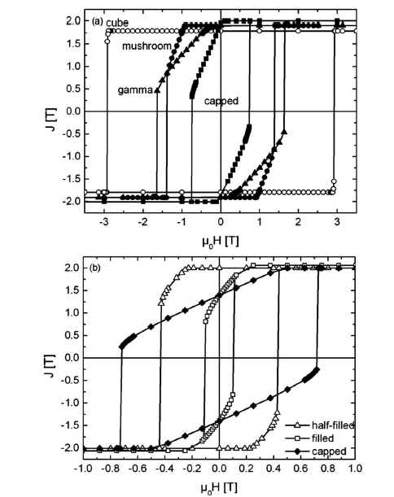
Exchange Coupled Composite Media
Ledge-Type Systems
Single-element structures
TYPE
Single elements
Cube | 1.57
Mushroom | 1.71
Gamma | 1.45
Capped | 1.18
Nanopatterns
Half-filled | 1.23
Filled | 1
Capped | 1
Nano-patterned geometries
Nano-patterned geometries
GAIN FACTOR (ξ)
ξ =1 Single S-W Hard Phase
ξ >1 Exchange Coupled System
D. Goll and S. Macke, APL 93 152512 2008

Slide 26
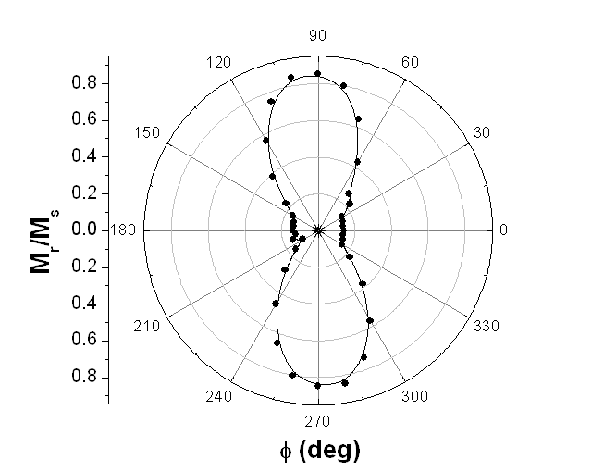
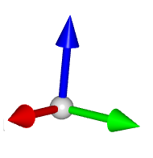
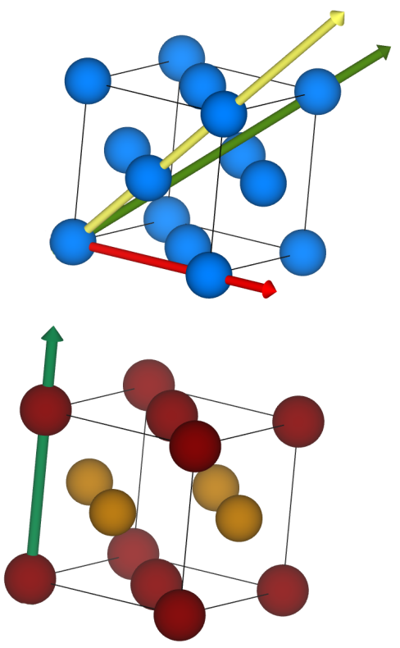
Magnetic Properties
ANGULAR REMANENCE CURVE (M_{r}/M_{s} vs. φ)
(@ ISM – CNR, Roma - Italy)
(100) plane
th_{Co} = 9.5 nm
[001]
φ
[010]
[100]
medium-axis – [110]
easy-axis – [111]
Co
FCC (001)
easy-axis
hard-axis – [100]
L1₀-FePt
FCT (001)
The symmetry is essentially two folds
→ The system behaves as a uniaxial perpendicular media
Lobes of weaker intensity appear around 0° and 180°

Slide 27
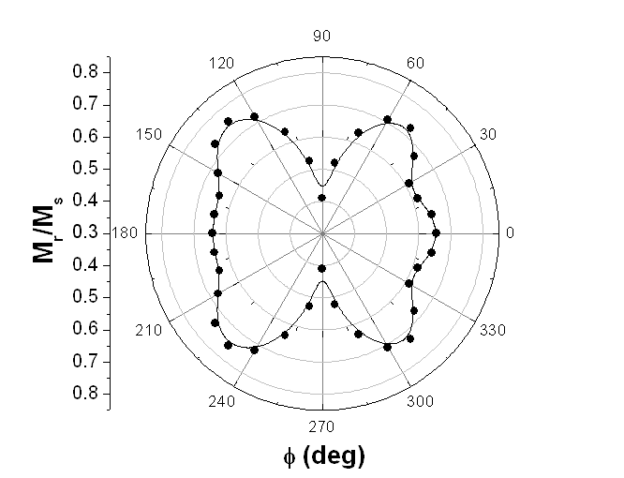
Magnetic Properties
ANGULAR REMANENCE CURVE (M_{r}/M_{s} vs. φ)
(@ ISM – CNR, Roma - Italy)
th_{Co} = 9.5 nm
th_{Co} = 20 nm
[001]
(100) plane
φ
[010]
[100]
medium-axis – [110]
easy-axis – [111]
Co
FCC (001)
The symmetry is essentially two folds → The system behaves as a uniaxial perpendicular media.
Six-folds symmetry
→ Multi-axial system
easy-axis
hard-axis – [100]
Lobes of weaker intensity appear around 0°and 180°
Magneto crystalline anisotropy
L1₀-FePt (FCT): Uniaxial
Co (FCC): Cubic (k₁ and K₂ are both negative)*
Shape anisotropy
Interface exchange coupling
Angular Remanence Curve depends on
L1₀-FePt
FCT (001)
*J.E. Fisher and J. Goddard, J. Phys. Soc. Jap. 25 143 1968
M. Getzlaff , “Magnetic Anisotropy Effects” in Fundamental of Magnetism, M. Getzlaff Ed., Springer, 2007

Slide 28
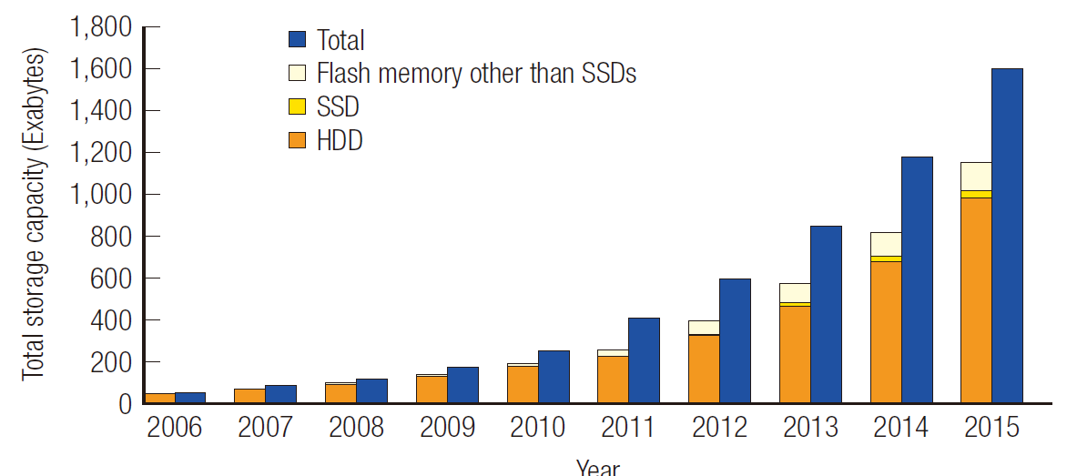
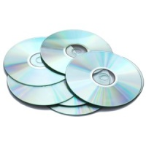
Trend in digital data storage capacity
Volume of data has been increasing by 40% annually
Storage devises have been continuously improved in terms of capacity, performance, reliability and cost
Solid State Drives (SSDs)
Hard Disk Drives (HDDs)
PROS Write/Read speed, Reliability
PROS Cost, Capacity, Availability
CONS Capacity, Life-time, Cost
CONS Reliability, Write/Read speed
Optical Disk Drives (ODDs)
Flash memory other that SSDs
PROS Reliability, Life-time, Cost, Transportability
PROS Transportability, Reliability
CONS Capacity, Life-time
CONS Reusability, Writing-time, Capacity

Slide 29
Hard Disk Drives
Leading technology for massive digital data storage
Current HDDs
Recording Density: ~ 700 Gb/in²
HDD sold in 2014: ~ 557 million
Cost/Gb: 0.03 $
"All that data stored in the cloud isn't on droplets of airborne water. It's stored on hard disk drives."

Slide 30
Hard Disk Drives
Areal Density Evolution
▲2011 DEMO
[Co/Pd]_{n} BPM – 1T/in²
TERAMAGSTOR EU-Project
High-K_{u} materials,
EAMR, ECC, BPMR, STMR, TDMR
Current HDDs
Perpendicular technology
Recording Density: ~ 700 Gb/in²
HDD sold in 2014: ~ 557 million
Cost/Gb: 0.03 $
?
Disk Medium
Spindle Motor
Head
Longitudinal Recording
Perpendicular Recording
Voice Coil
Motor
Encoder
&
Decoder

Slide 31
Hard Disk Drives
Recording Medium
Magnetic Medium
Hard Ferromagnet
→ It can be permanently magnetized permitting information to be retained over time.
Substrate

Slide 32
Hard Disk Drives
Recording Medium
PFPE
Reduces friction and wear during the head-disk contact
Dip-coating
IBD, PE-CVD, Sputtering
Lubricant
Diamond Like Carbon – DLC – & CNx
Provides chemical and mechanical protection
Overcoat
Recording layer
Intermediate Layer
Ni-(X,Y)/Ru or Ru-(X,Y)/Ru (X, Y = Cr, Mn, W)
Exchange-decouples the SUL and the magnetic layer
Favours the epitaxial growth of the magnetic layer
Soft Underlayer (SUL)
Sputtering
Co(Fe)TaZr-based
Helps in conducting the flux form the writing pole of the head and the connector pole
AlTi, CtTi, NiTa
Improve the adhesion of SUL
Improve corrosion robustness of the substrate
Adhesion layer
Substrate
AlMg (Server & Desktop), Glass (Laptop)
Performs the role of support (hard, stiff, inert, smooth)

Slide 33
Hard Disk Drives
Recording Medium – Recording Layer
PFPE
Reduces friction and wear during the head-disk contact
Dip-coating
IBD, PE-CVD, Sputtering
Lubricant
Diamond Like Carbon – DLC – & CNx
Provides chemical and mechanical protection
Overcoat
Recording layer
Intermediate Layer
Ni-(X,Y)/Ru or Ru-(X,Y)/Ru (X, Y = Cr, Mn, W)
Exchange-decouples the SUL and the magnetic layer
Favours the epitaxial growth of the magnetic layer
Soft Underlayer (SUL)
Sputtering
Co(Fe)TaZr-based
Helps in conducting the flux form the writing pole of the head and the connector pole
AlTi, CtTi, NiTa
Improve the adhesion of SUL
Improve corrosion robustness of the substrate
Adhesion layer
Substrate
AlMg (Server & Desktop), Glass (Laptop)
Performs the role of support (hard, stiff, inert, smooth)

Slide 34
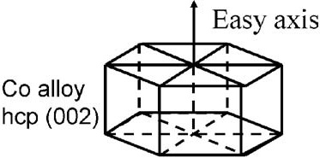
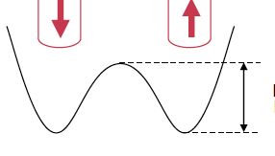
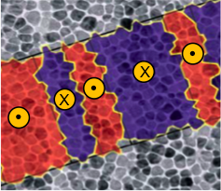
Hard Disk Drives
Recording Medium – Magnetic Layer (1st Generation – 2005 –)
CoCrPt@SiO₂
K_{u} = 0.2 – 0.5 10⁶ J/m³
SiO₂ : promotes grain isolation
Stoner-Wolfarth like system
Single domain grains
Weakly exchange coupled grains
Uniaxial perpendicular anisotropy K_{u}
ΔE₀
Granular Microstructure (d ~ 10 nm)
Smooth surface (Ra roughness ~1 nm)
Bit Pattern
Boundary: SiO₂
(non-magnetic)
R/W
Head
Core: Co-rich
(magnetic)
d
NANOSLIDER
~5 nm
~0.3 mm
CoCrPt@SiO₂
Hard Disk Surface
Ground
20 – 40 m/s
easy-axis

Slide 35
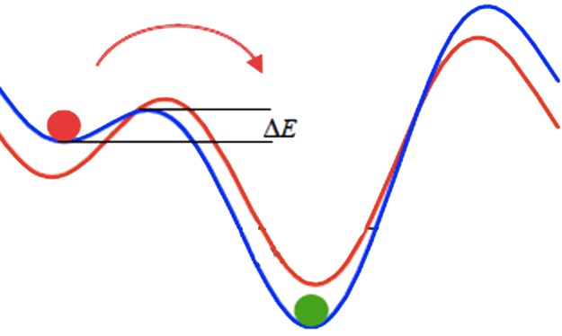
Hard Disk Drives
Recording Medium – Magnetic Layer (1st Generation – 2005 –)
CoCrPt@SiO₂
K_{u} = 0.2 – 0.5 10⁶ J/m³
SiO₂ : promotes grain isolation
Stoner-Wolfarth like system
Single domain grains
Weakly exchange coupled grains
Uniaxial perpendicular anisotropy K_{u}
H₂ > H₁
H₁
H₂
Granular Microstructure (d ~ 10 nm)
Smooth surface (Ra roughness ~1 nm)
Bit Pattern
Boundary: SiO₂
(non-magnetic)
R/W
Head
Core: Co-rich
(magnetic)
d
NANOSLIDER
~5 nm
~0.3 mm
CoCrPt@SiO₂
Hard Disk Surface
Ground
20 – 40 m/s
easy-axis

Slide 36
Hard Disk Drives
Evolution of Perpendicular Magnetic Recording Media
1st (2005)
Generation
7st (2013)
Single
CoCr(Pt,Ta,B) Layer
ML (K₂)
ML (K₃)
ML (K₄)
BL
ML (K₂)
ML (K₃)
ML (K₁)
ML (K₂)
ML (K₁)
ML (K₁)
K₁ > K₂
K₁ > K₂ > K₃
K₁ > K₂ > K₃ > K₄
EXCHANGE COUPLED COMPOSITE MEDIA
Multilayer structures consisting of CoCrPt-Oxide magnetic layers (ML) with different anisotropy (K) separated by a non magnetic breack layer (BL, e.g. Pt)
Improved writability
Reduction of magnetic layer thickness

Slide 37
Hard Disk Drives
Evolution of Perpendicular Magnetic Recording Media
R/W
Head
1st (2005)
Generation
7st (2013)
NANOSLIDER
Single
CoCr(Pt,Ta,B) Layer
1.5 nm
ML (K₂)
Ra Rough. 3.5 Å
ML (K₃)
Overcoat (< 2 nm)
Lubricant (~ 1 nm)
ML (K₄)
Recording layer (15 nm)
BL
ML (K₂)
ML (K₃)
Intermediate Layer (15 nm)
ML (K₁)
ML (K₂)
ML (K₁)
SAF – SUL (50 nm)
ML (K₁)
K₁ > K₂
K₁ > K₂ > K₃
K₁ > K₂ > K₃ > K₄
EXCHANGE COUPLED COMPOSITE MEDIA
Multilayer structures consisting of CoCrPt-Oxide magnetic layers (ML) with different anisotropy (K) separated by a non magnetic breack layer (BL, e.g. Pt)
Improved writability
Reduction of magnetic layer thickness
Adhesion layer (5 nm)
Substrate

Slide 38
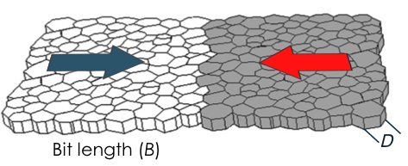
Hard Disk Drives
Towards 1 Tbit/in² and Beyond – Recording Trilemma
Longitudinal Magnetic Recording (LMR) Media
The areal density has been increased by continuously reducing the in-plane size of the grain in order to maintain an adequate SNR.
Number of grains per bit
Higher areal density require smaller grains (D)

Slide 39
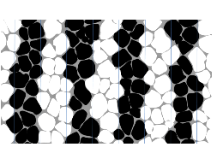
Hard Disk Drives
Towards 1 Tbit/in² and Beyond – Recording Trilemma
Perpendicular Magnetic Recording (PMR) Media
The in-plane size of the grain has been kept almost constant and higher areal densities have been obtained reducing the number of grains per bit (up to 15 – 20) without compromising the SNR.

Slide 40
Hard Disk Drives
Towards 1 Tbit/in² and Beyond – Recording Trilemma
Perpendicular Magnetic Recording (PMR) Media
The in-plane size of the grain has been kept almost constant and higher areal densities have been obtained reducing the number of grains per bit (up to 15 – 20) without compromising the SNR.
To go in the Tbit regime the grain size must be reduced to maintain an adequate SNR.

Slide 41
Hard Disk Drives
Towards 1 Tbit/in² and Beyond – Recording Trilemma
Number of grains per bit
Higher areal density require smaller grains (D)
D
SNR

Slide 42
Hard Disk Drives
Towards 1 Tbit/in² and Beyond – Recording Trilemma
Number of grains per bit
Higher areal density require smaller grains (D)
D
SNR
THERMAL
STABILITY
ΔE₀
Uniaxial Anisotropy Constant
Grain Volume
Stoner-Wolfarth system
10 Years
STABILITY FACTOR

Slide 43
Hard Disk Drives
Towards 1 Tbit/in² and Beyond – Recording Trilemma
Number of grains per bit
Higher areal density require smaller grains (D)
D
SNR
THERMAL
STABILITY
ΔE₀
Recording Medium Material | K_{u} (10⁶ J/m³)
SmCo₅ | 10 – 20
L1₀ FePt | 7 – 10
L1₀ CoPt | ~ 5
Co/Pt(Pd) | ~1
CoCrPt | 0.2 – 0.5
Uniaxial Anisotropy Constant
Grain Volume
Thermally stable at D = 3 nm
Stoner-Wolfarth system
10 Years
STABILITY FACTOR

Slide 44
Hard Disk Drives
Towards 1 Tbit/in² and Beyond – Recording Trilemma
Number of grains per bit
Higher areal density require smaller grains (D)
D
SNR
Switching Field
THERMAL
STABILITY
WRITABILITY
ΔE₀
Writing Field
Recording Medium Material | K_{u} (10⁶ J/m³) | Write Head Material | B_{s} (T)
SmCo₅ | 10 – 20 | Co₃₅Fe₆₅ | 2.4
L1₀ FePt | 7 – 10 → μ₀H_{sw} ~ 5-6 T | CoNiFe | 2.0
L1₀ CoPt | ~ 5 | Ni₄₅Fe₅₅ | 1.5
Co/Pt(Pd) | ~1
CoCrPt | 0.2 – 0.5
Uniaxial Anisotropy Constant
Grain Volume
Stoner-Wolfarth system
10 Years
STABILITY FACTOR

