Slide 1

Re-entrant antiferromagnetism in the exchange-coupled IrMn/NiFe system
L. Del Bianco, E. Bonfiglioli, F. Chinni, M. Tamisari, F. Spizzo
Dipartimento di Fisica e Scienze della Terra,
Università di Ferrara, Italy
lucia.delbianco@unife.it

Slide 2
Objective
Description of the dynamic magnetic behavior of the antiferromagnet in exchange-coupled FM/ AFM NiFe/IrMn bilayers
From the continuous NiFe/IrMn film to dot arrays: spatial confinement and exchange coupling mechanism
Re-entrant antiferromagnetism
We exploit the exchange coupling with a soft FM as a tool to gain an insight into the magnetic properties of the AFM
We study the magnetic properties of the AFM phase to gain an insight into the exchange coupling mechanism
(exchange bias effect)

Slide 3
NiFe/IrMn film
Si / Cu[5 nm] / Py[5 nm] / IrMn[6 nm] / Cu [5 nm]
Py: Ni₈₀Fe₂₀ IrMn: Ir₂₅Mn₇₅
Reference film: Si / Cu[5 nm] / Py[5 nm] / Cu [5 nm]
Deposition by dc-magnetron sputtering
Ar atmosphere, deposition rate ≅ 0.2 nm/s
H_{dep} = 400 Oe

Slide 4
Hysteresis loops
(5-400 K temperature range)
Change of magnetic regime at T ~ 100 K

Slide 5
step 1: FC@ H_{cool} =500 Oe
Magnetization reversal study -
SQUID measurement procedure
5 K
400 K
step 2: M vs T @ H_{inv}

Slide 6
Py
Measurement on reference Py film in H = 50 Oe
Pronounced magnetization decrease in the bilayer is ascribed to the reduction of the exchange magnetic anisotropy in the Py layer

Slide 7

Py
AFM film consists of non-interacting nanograins
⇓
Distribution of effective anisotropy energy barriers ΔE
We obtain information on the anisotropy energy barrier distribution of the AFM as it is felt by the FM component
F. Spizzo et al., J. Phys.: Condens. Matter 25, 386001 (2013)

Slide 8
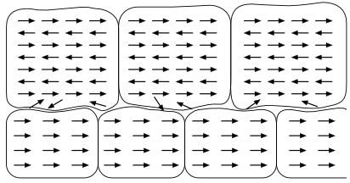
IrMn
spin-glass-like
behavior
Py
bulk AFM nanograins
V = 25 kT_{B}/K_{IrMn}
⇒ size ~ 10 nm
K_{IrMn} = 1.8 × 10⁶ erg/cm³
Notes:
grani: magnetically uncorrelated

Slide 9
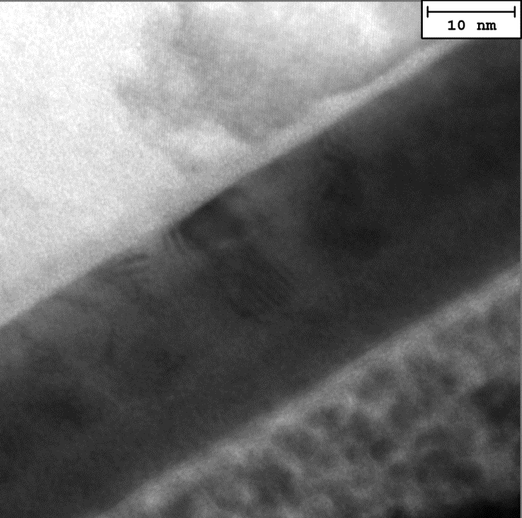
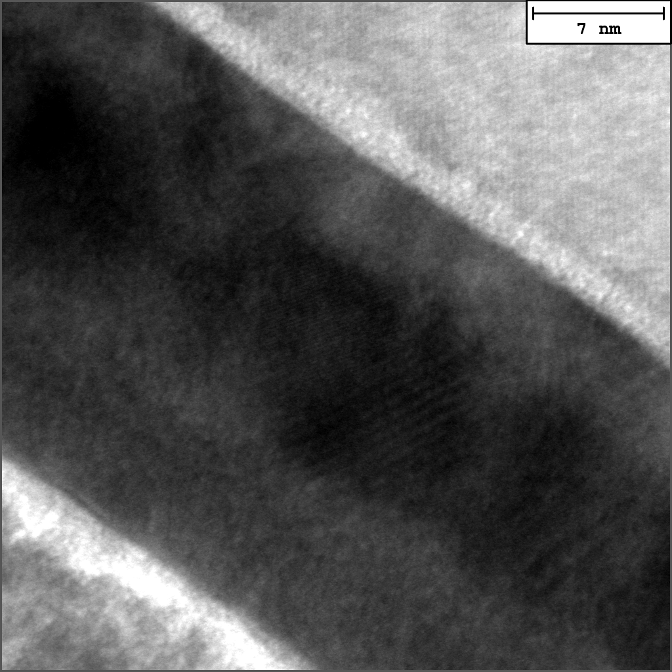

10 nm
Si
Si
Cu
Cu
IrMn
NiFe
(a)
(b)
(a)
Existence of a disordered AFM region at the interface with the NiFe phase
TEM results confirm our prediction on the structure of the AFM phase

Slide 10
No chance to observe EB effect at the temperature above which the AFM bulk nanograins enter the superparamagnetic regime
T
T > 100 K
Only the interfacial AFM spins tightly anchored to the spin lattice of the bulk AFM nanograins contribute to H_{ex}
H_{ex} decreses and finally the EB effect disappears
T ~ 100 K
The frozen collective state breaks up.
Polarizing action of bulk AFM spins on the interfacial ones prevents the development of a paramagnetic state.
Re-entrant antiferromagnetism
T< 100 K
AFM interfacial spins are frozen and subjected to a high effective anisotropy.
H_{ex} is maximized

Slide 11
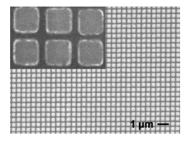
From the continuous film to dot arrays
Si / Cu[5 nm] / IrMn[10 nm] / Py [5 nm]
Electron beam lithography and lift-off
dc-magnetron sputtering
(H_{dep} = 400 Oe)
FM
AFM
spatial confinement
FM
AFM

Slide 12
MOKE - FC hysteresis loops
(H_{cool} = 500 Oe;
10-300 K temperature range)
A = 1000 nm
B = 500 nm
C = 300 nm
(Oe)
(Oe)

Slide 13
At low temperature
(Oe)
The correlation length among the AFM interfacial spins increases with reducing T

Slide 14

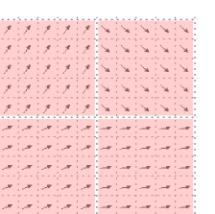
Dependence of H_{ex} on the
AFM correlation length λ
Object Oriented MicroMagnetic Framework
Dot size = 1200 nm
OOMMF cell size = 10 nm
K_{AFM} = 2 × 10⁷ erg/cm³ cells:
FM/AFM exchange interaction = 10⁻⁷ erg/cm
Different cell size:
10, 20, 100, 200, 300 nm
FM
AFM
λ
F. Spizzo et al., Phys. Rev. B 91 (2015) 064410

Slide 15
Object Oriented MicroMagnetic Framework
Dependence of H_{ex} on the
AFM correlation length λ
Dot size = 1200 nm
All the AFM cells with
high K (100% pinning centers)
Different cell size:
10, 20, 100, 200, 300 nm
(Oe)
H_{ex} increases as
D/λ →1

Slide 16
(Oe)
At low temperature
Correlated AFM spins exert a stronger pinning action as
D/λ →1
Spin correlation effect

Slide 17
Conclusions
Re-entrant antiferromagnetism ⇒ Passage from the glassy to the AFM state
Re-entrant magnetic regime: the magnetism of AFM interfacial spins is sustained by stable nanograins.
Exchange coupling mechanism
Low temperature: collective freezing of the disordered AFM spins ⇒ high H_{ex}.
High temperature: FM/AFM coupling governed by a fraction of interfacial AFM spins.
Spatial confinement ⇒ spin correlation effect
MIUR FIRB2010 - NANOREST
A. Gerardino, A. Notargiacomo
IFN-CNR, I-00156 Roma, Italy
G. Barucca
Univ. Politecnica delle Marche,
I-60131 Ancona, Italy
Thanks for attention

