Slide 1
Antimatter freefall: The $AE\overline{g}IS$ experiment at CERN
AEGIS
Zeudi Mazzotta*
On behalf of the AEgIS collaboration
from
Università degli studi di Milano
Istituto Nazionale di Fisica Nucleare
Notes:
1. Buongiorno a tutti! Mi chiamo Zeudi e sono una dottoranda in Fisica dell’università degli studi di Milano. Lavoro nell’esperimento AEgIS, il cui apparato sperimentale è situato all’Antiproton Decelerator del CERN. Sono qui, oggi, per parlarvi del nostro lavoro.

Slide 2
OUTLINE
The AEgIS experiment
The role of Positronium in the AEgIS experiment
Current status: latest results
Notes:
2. L’avventura nella scoperta dell’esperimento AEgIS comprende anche uno sguardo al ruolo che il Positronio ha nell’esperimento e sarà conclusa con un resoconto degli ultimi risultati sperimentali ottenuti.

Slide 3
The physics of the AEgIS experiment
Notes:
3. Cominciamo quindi col dare un’occhiata alla fisica dell’esperimento AEgIS.

Slide 4
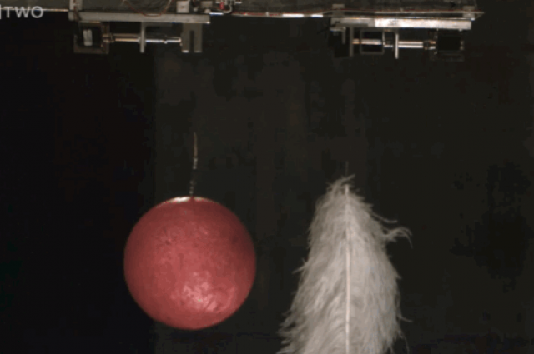
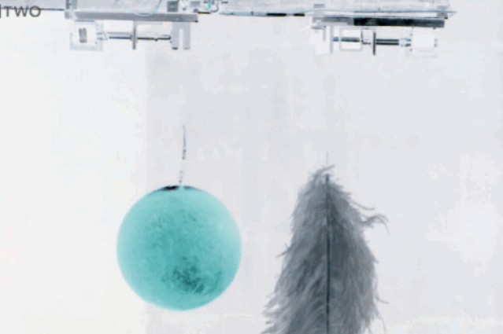
The weak equivalence principle (WEP)
CPT symmetric situation
All matter bodies at the same space-time point in a given matter gravitational field will undergo the same acceleration
All antimatter bodies at the same space-time point in a given antimatter gravitational field will undergo the same acceleration
Notes:
4. Il principio di equivalenza debole afferma che, in un dato campo gravitazionale di materia, tutti i corpi costituiti da materia nello stesso punto dello spazio tempo subiranno la medesima accelerazione. Il teorema di simmetria CPT prevede che dovremmo osservare il medesimo comportamento anche nel caso di corpi di antimateria in un campo gravitazionale di antimateria.

Slide 5
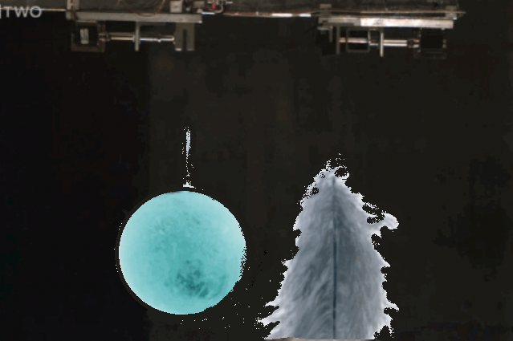
The weak equivalence principle (WEP)
All matter bodies at the same space-time point in a given matter gravitational field will undergo the same acceleration
Will antimatter bodies at the same space-time point in a given matter gravitational field undergo the same acceleration?
All antimatter bodies at the same space-time point in a given antimatter gravitational field will undergo the same acceleration
Notes:
5. Ma, cosa accade quando abbiamo dell’antimateria in un dato campo gravitazionale di materia?

Slide 6
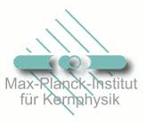
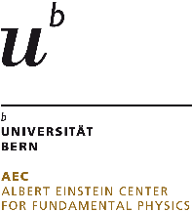
AEgIS collaboration
CERN
Czech Technical
University
ETH Zurich
Stefan Meyer Institute
University of
Genova
University of
Milano
University of
Padova
University of
Pavia
Institute of Nuclear
Research of the
Russian Academy
of Science
Max-Planck Institute
Heidelbert
Politecnico di
Milano
University College
London
University of
Bergen
University of
Bern
University of
Brescia
Heidelberg
University
University of
Oslo
University of
Paris Sud
University of
Trento
University of Lyon 1
INFN sections of:
Genova, Milano,
Padova, Pavia,
Trento
Notes:
6. Dare una risposta sperimentale a questo quesito è il principale obiettivo dell’esperimento AEgIS, che è una collaborazione tra 21 diversi istituti in tutta Europa, di cui molti italiani. Ora, quello che in AEgIS ci si propone di fare è

Slide 7
The main goal of AEgIS
Neutral antimatter:
Antihydrogen
$e^{+}$
$$p^{−}$$
Measurement of the gravitational acceleration $\overline{g}$
of the antimatter into the Earth gravitational field
$$\overline{H}$$
?
$$\overline{g}$$
Notes:
7. Misurare l’accelerazione gravitazionale dell’antimateria nel campo gravitazionale terrestre. In particolare, la configurazione più semplice che minimizzi la presenza di altre forze (che è il problema più presente nel caso di antiparticelle cariche) è lo studio della caduta libera di antimateria neutra, tramite la produzione di atomi di Antidrogeno. Ma… come può essere prodotto l’Antidrogeno?

Slide 8
Antihydrogen production
Charge exchange with Positronium
AEgIS strategy
PROMISING TECHNIQUE
Control of the antihydrogen quantum state
Cold antihydrogen atoms (v_{antihydrogen} ~ v_{antiproton})
Advantages in the cross section (see later)
Antiprotons and positrons Recombinations
Other strategies
The second seems to be the dominant process (highly exicited antihydrogen)
Antihydrogen atoms warmer than trapped antiprotons (Hbar production when v_{antiproton} ~ v_{positron})
Cross section
and
Notes:
8. In AEgIS si è pianificato di produrre Antidrogeno attraverso la reazione di scambio di carica tra antiprotoni e atomi di Positronio. Grazie a questa reazione, possiamo controllare lo stato quantico dell’Antidrogeno e la sua temperatura. Ma il più importante vantaggio di questa reazione è la sezione d’urto, che risulta essere molto alta. Infatti, se diamo un’occhiata al tipico modo di produrre antidrogeno, che vuol dire ricombinare antiprotoni e positroni, una grossa problematica è che gli atomi di antidrogeno così generati sono troppo caldi e anche la sezione d’urto è di molto inferiore rispetto alla nostra strategia. Pertanto, come si evince immediatamente, il Positronio diventa per noi un mezzo fondamentale per produrre atomi di Antidrogeno freddi. Vediamo un attimo cos’è

Slide 9
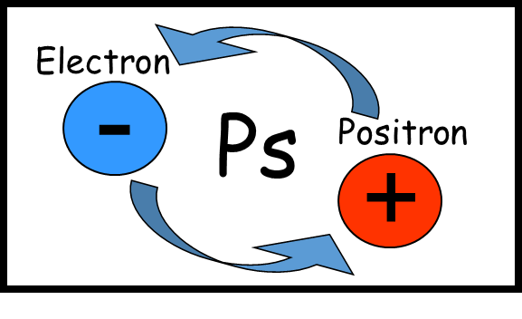
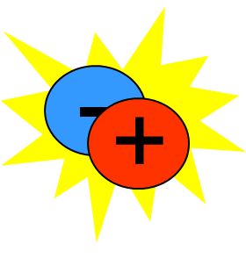
Positronium atom
Purely leptonic atom
Ps n-level energy
$$E_{Ps_{n}}=\frac{E_{H_{n}}}{2}$$
γ
para-Ps
Singlet state
Mean lifetime 0,125ns
2γ annihilation
γ
orto-Ps
Triplet state
Mean lifetime 142ns
3γ annihilation
γ
γ
γ
γ Energies = 511keV
γ Energies < 511keV
Notes:
9. Il Positronio è un atomo puramente leptonico, essendo uno stato confinato tra un elettrone e un positrone. Esso esiste in due stati differenti: lo stato di singoletto, chiamato para-Ps e lo stato di tripletto chiamato orto-Ps. Il para-Ps ha una vita media molto breve e, quando muore annichila in due raggi gamma; l’orto positronio vive un po’ più a lungo e quando muore annichila in tre raggi gamma di energia più bassa.

Slide 10
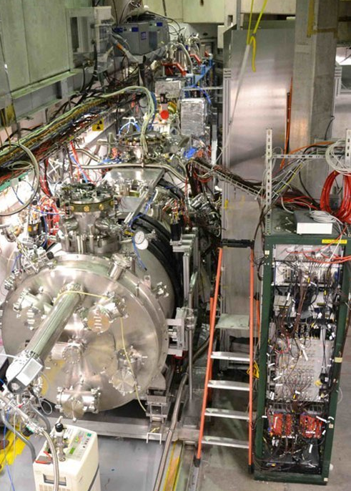
AEgIS in short
Antiprotons from CERN AD
(Antiproton Decelerator)
e+
p⁻
p⁻
e+ beam
Notes:
10. So, what do we do in AEgIS? I remind you that we need Positronium atoms and antiprotons to produce Antihydrogen… Therefore the trip starts from two parallel lines. Along this line we manipulate positrons for the
Positronium production, along the other one we manipulate Antiprotons coming from the CERN Antiproton Decelerator. On the right I give you a parallel with the real apparatus..

Slide 11
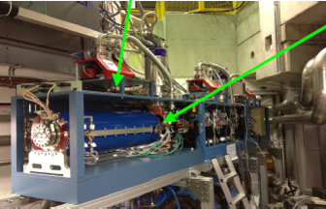
AEgIS in short
antiprotons cooling and trapping
e+ accumulator
p⁻
e+
e+ pulse dumping and acceleration
4,5 Tesla magnet
Notes:
11. In the positrons line we have a positrons accumulator, whose task is to dump and accelerate positrons coming from a Na radioactive source. Here we are in a 4,5 Tesla magnet where we trap and cool them.

Slide 12
AEgIS in short
Trapped&cooled antiprotons
1 Tesla magnet
e+ pulse implantation and Positronium formation
Notes:
12. The next step is the two line moving into a 1Tesla magnet, where cold antiprotons are stored and, off axis, positrons
arrive onto a target converting them into Positronium atoms (later we will see how!).

Slide 13
AEgIS in short
PRODUCTION TRAP
Ps and p- overlap region:
Charge exchange reaction takes place!
$$\overline{H}$$
1 Tesla magnet
Notes:
13. The Positronium cloud grows up until we have the overlap with the antiprotons cloud. Here we have the Antihydrogen formation! For this reason we call this trap the "production trap".

Slide 14
AEgIS in short
Antihydrogen accelerated beam
$$\overline{H}$$
1 Tesla magnet
$$\overline{H}$$
Notes:
14. Then Antihydrogen atoms are guided from an electric field gradient toward a Moirè deflectometer.

Slide 15
AEgIS in short
$$\overline{g}$$
$$\overline{H}$$
$\overline{g}=\frac{2∆x}{t^{2}}$
1% precision
$$\overline{g}$$
1m of Moirè deflectometer
$$\overline{H}$$
Tens of microns of deflection
Moirè deflectometer
Use of emulsions
Notes:
15. in which we measure their vertical deflection, due to some gravitational acceleration, and their time of flight. In
this way we can obtain gbar.

Slide 16
Role of Positronium in AEgIS
Notes:
16. So, let's see more in detail the role of Positronium in the experiment. First of all we must understand how we
produce it!

Slide 17
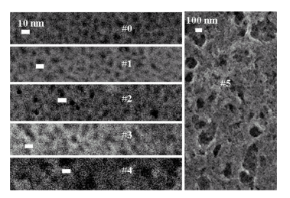
The Positronium production
e+/Ps converter
Positronium is created in the material bulk
Nanochanneled Si
Frontal view
Porous Silicon target
e+
Positron pulse:
4,2kV
20000K
A bunched positron beam is sent toward a porous «target» able to convert positrons into Positronium.
Pores diameter
~10nm
4.2 kV
A fraction of the Ps exiting the target is thermalized into the target pores
cooled Positronium cloud
Notes:
17. A buncher, providing a parabolic potential, has the task to further accelerate and compress in time the positron dump coming from the accumulator. The bunched positron beam is then implanted inside a porous silicon target. In this way, some positrons capture an electron from the material and generate Positronium at around 20000K. Atoms exit the target through the pores
and, bouncing on their walls, cool down. As a result, we have outside the target a Ps cloud with a thermalized percentage.
This percentage depends on how deep was the implantation of positrons, and therefore on their implantation energy.

Slide 18
The role of Positronium in AEgIS
Ps is needed to generate Antihydrogen in the
Charge exchange reaction
The cross section of this reaction increases with the Ps principal quantum number:
$$σ\sim a_{0}^{2}n^{4}$$
Required Ps excitation to Rydberg levels (n=15…24) !!!
Not too high, for ionization issues induced by the strong magnetic field inside the $\overline{H}$ production trap
(motional Stark field E)
Notes:
18. The Ps atom plays a fundamental role, in the AEgIS experiment, not only because, as we have already seen, it generates Antihydrogen with antiprotons; but mainly because it is the actual responsible of the large cross section of the reaction. In fact the cross section depends on the fourth power of the Ps principal quantum number. For this reason we can drastically increase it by exciting the atom to Rydberg levels! Reaching too high Rydberg levels is dangerous because of the presence of high fields inside the production trap, which can induce ionization. This is the reason why we planned not to exceed the 24th level.

Slide 19
Positronium laser excitation and detection
Notes:
19. Let me now describe how We bring Positronium atoms on Rydberg levels.

Slide 20
AEgIS Ps Rydberg laser excitation strategy
Continuum
Final Rydberg excitation efficiency for a TWO STEP STRATEGY
(simple 3-level model of Ps in field free environment)
1->3->n = 30%
0,75eV
~1680nm
High n
n=3
6,05eV
205nm
n=1
PHYSICAL REVIEW A 78, 052512 2008: Efficient positronium laser excitation for antihydrogen production in a magnetic field, F. Castelli, I. Boscolo, S. Cialdi, and M. G. Giammarchi, D. Comparat
NIMB 269 (2011) 1527–1533: Efficient two-step Positronium laser excitation to Rydberg levels, S. Cialdi, I. Boscolo, F. Castelli, F. Villa; G. Ferrari, M.G. Giammarchi
Notes:
21. This means that we send simultaneously two laser pulses: an UV laser pulse to excite it towards the third level and an
IR laser pulse to excite it to Rydberg levels. The final efficiency that one can reach with a two-step strategy is, for our strategy 30% for our strategy.

Slide 21
Current status for Positronium and antiprotons
Achievements towards the gravity measurement
Catching and cooling of large number of antiprotons
Transfer of the antiproton plasma in the production trap
Production, transfer and storage of a high number of positrons
Studies of Ps formation and laser excitation to Rydberg levels¹
Notes:
22. Few experimental results about this topic have been achieved in my last moths at CERN. First we detected n=3 excitation via n=3 level photoionization. Then we detected Rydberg excitation via the strategy I’ve just explained. The evidences of n=3 and Rydberg excitation have been found performing resonance measurements tuning, respectively, n=3 and Rydberg excitation wavelengths.

Slide 22
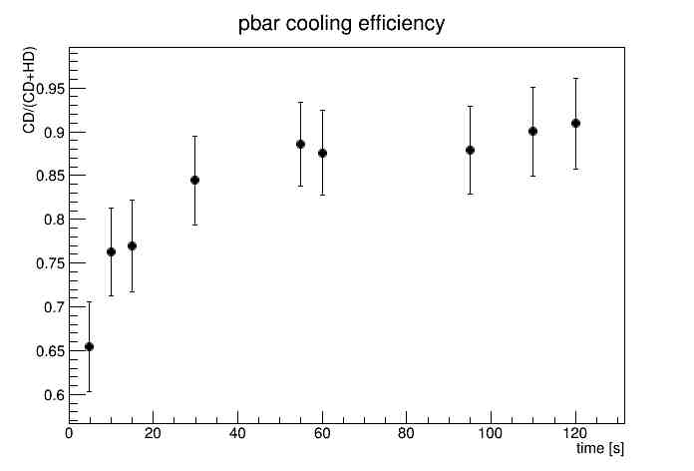
Antiprotons
Catching and cooling of large number of antiprotons
$1.3\%$ catching efficiency obtained at 9 kV, corresponding to around $4⋅{10}^{5}$ pbars
Antiprotons stored with a lifetime $τ=13min$
Transfer of the antiproton plasma in the production trap
90% cooling efficiency
temperature of 10-20K
Notes:
42. We performed Ps excitation towards Rydberg levels with a double purpose: have a further demonstration that we are able to excite Positronium on the n=3 level, and try to understand whether our strategy to bring Positronium to Rydberg levels passing through the third level works well.

Slide 23
Positrons
Catching and cooling of large number of positrons
$>95\%$ transfer and cooling efficiency when more than $10^7e^{+}/sho$t are manipulated
$2,2×{10}^{8}e^{+}$ stacked in 1hour
PRELIMINARY
Notes:
42. We performed Ps excitation towards Rydberg levels with a double purpose: have a further demonstration that we are able to excite Positronium on the n=3 level, and try to understand whether our strategy to bring Positronium to Rydberg levels passing through the third level works well.

Slide 24
Positronium
n=3 excitation evidence
Rydberg n=15-16-17 excitation evidence
Experimental value
λ0 = $205,0487±0,005$
FWHM =1,15THz
15% photoionization efficiency
Theoretical value
λ0 = 205,0474
(Ruggero Caravita, Fabrizio Castelli, Fabio Villa)
preliminary
preliminary
Notes:
42. We performed Ps excitation towards Rydberg levels with a double purpose: have a further demonstration that we are able to excite Positronium on the n=3 level, and try to understand whether our strategy to bring Positronium to Rydberg levels passing through the third level works well.

Slide 25
Conclusions & next goals
CURRENT STATUS
Antiprotons
$1.3\%$ catching efficiency obtained at 9 kV, corresponding to around $4⋅{10}^{5}$ pbars
Antiprotons stored with a lifetime $τ=13min$
90% cooling efficiency
temperature of 10-20K
Positrons
$>95\%$ transfer and cooling efficiency when more than $10^7e^{+}/sho$t are manipulated
$2,2×{10}^{8}e^{+}$ stacked in 1hour
Positronium
n=3 excitation evidence (via photoionization)
n=15-16-17 excitation evidence
NEXT STEPS
Main magnet (1T)
Off-axis recapture of positrons: for Ps production inside the 1T magnet
Ps excitation in the 1T magnet
Antihydrogen production in the production trap
External Ps Experimental Chamber
Deeper study on Rydberg excitation efficiencies
Resonance studies for chosing the best Ps converter for the 1T magnet

Slide 26
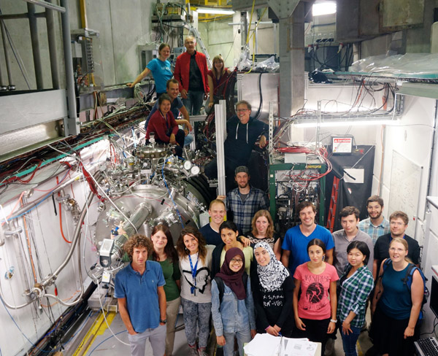
Thank you for your attention
AEGIS
AEGIS
AEGIS
AEGIS
Notes:
48. Thank you very much!

Slide 27
1.The lasers
How we produce the two wavelength for n=3 and Rydberg excitation
Notes:
26. For exemple, when we excite Positronium on the n=3 level, the excitation itself is not able to induce significant
changes in the lifetime spectra. The strategy we used has been to photoionize selectively only excited Positronium.

Slide 28
266nm
EKSPLA Nd:YAG
+ 2nd + 4th harmonics
532nm
UV
λ
OPG
Sum
Crystal
OPA
894nm
205nm
205nm
Notes:
23. The wavelength to excite Ps to the n=3 level is produced in this way. Our pump laser is a q-switched Nd:Yag laser, providing, with a rate of 10Hz, laser pulses lasting 5ns of 1064nm of wavelength. To produce a 205nm light, we start from the second and fourth harmonic of the pump laser. An OPG generates via a parametric down conversion a 894nm pulse from the second harmonic, and then an OPA increases the resulting pulse amplitude. At this point, the Nd:Yag fourth harmonic and the 894nm radiation are sent inside a sum crystal, generating the 205nm radiation.

Slide 29
266nm
EKSPLA Nd:YAG
+ 2nd + 4th harmonics
532nm
1064nm
IR
UV
λ
OPG
λ
OPG
Sum
Crystal
OPA
OPA
894nm
1680nm
205nm
205nm+1680nm
Notes:
24, The wavelength for the Rydberg excitation is generated inside another line, just like the 894nm one, but the starting wavelength now is the pump wavelength: 1064nm.

