Slide 1
Recent achievements and future perspectives in stratospheric research
Francesco Cairo, Federico Fierli, Chiara Cagnazzo. Marcel Snels
Consiglio Nazionale delle Ricerche
Dipartimento Scienze del Sistema Terra e Tecnologie per l'Ambiente
Istituto di Scienze dell'Atmosfera e del Clima
Italy

Slide 2
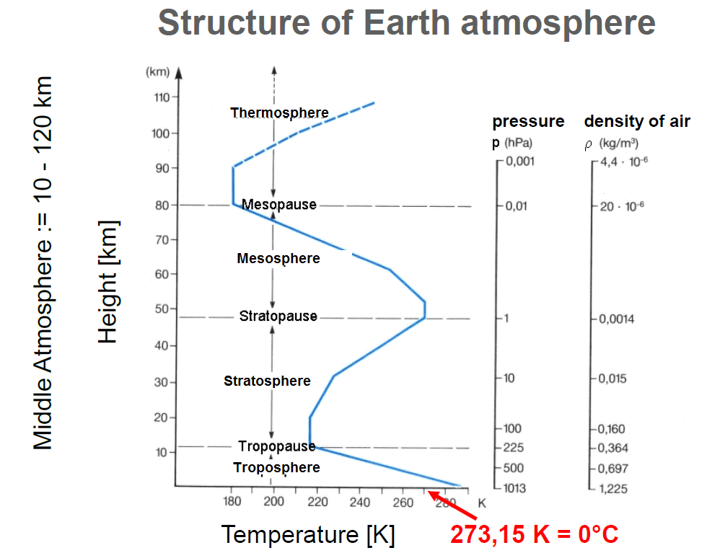

Slide 3
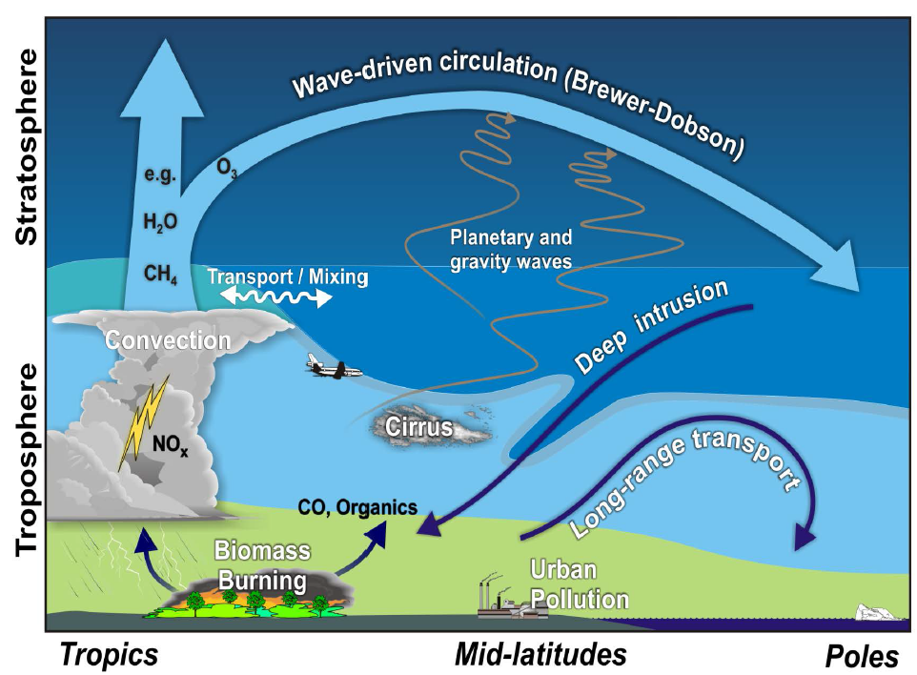

Slide 4
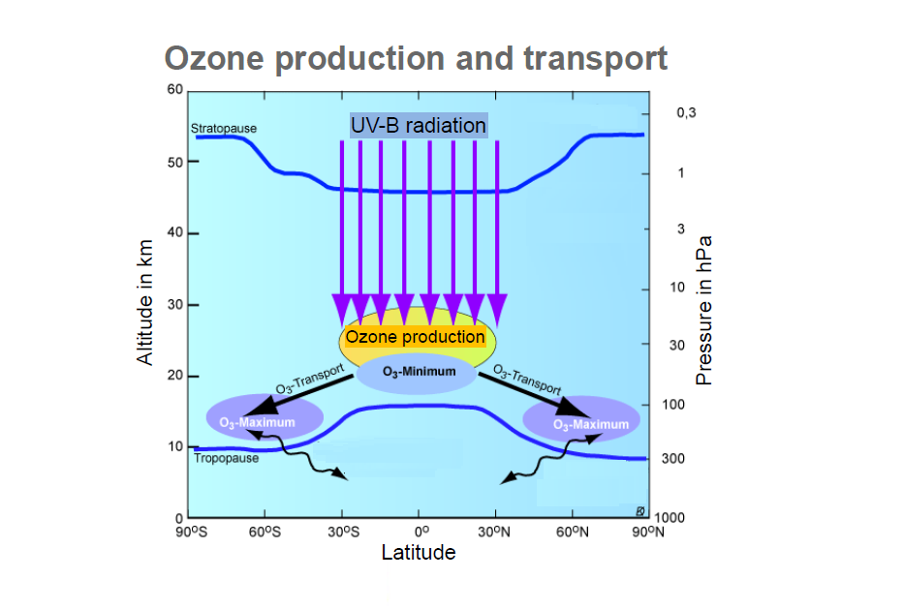

Slide 5
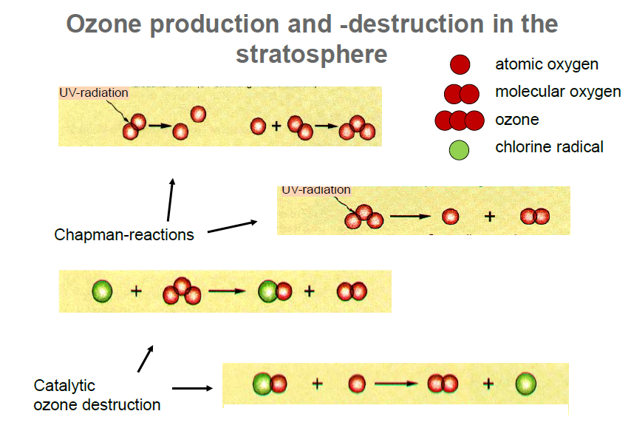
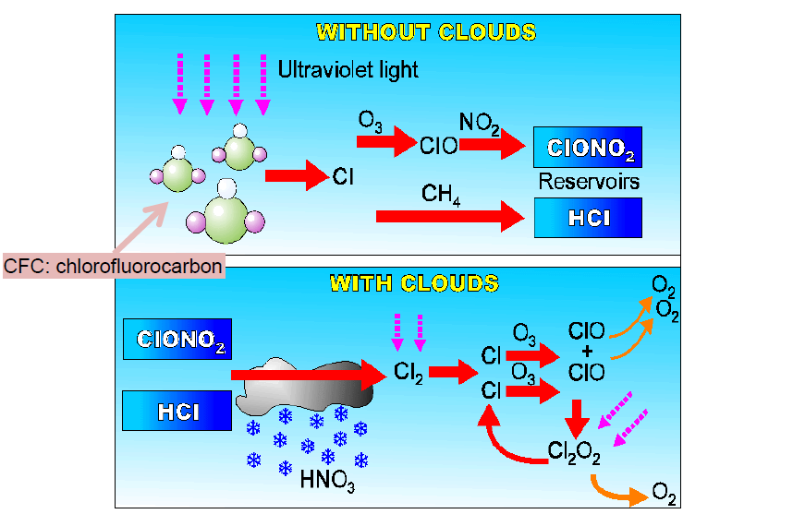
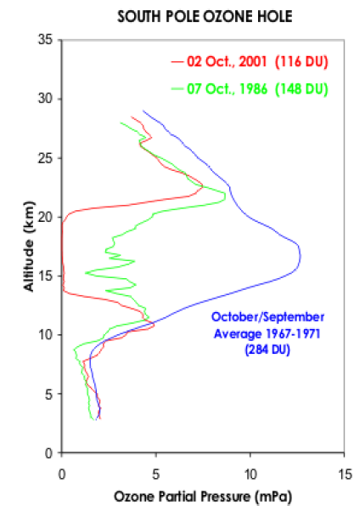
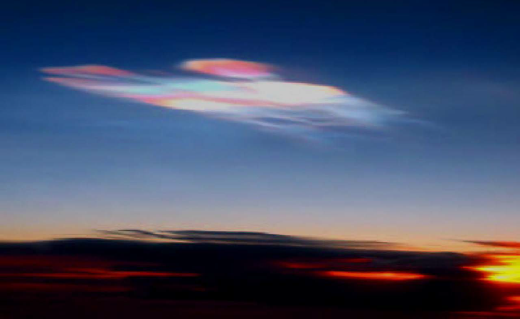

Slide 8
Climate-Chemistry Interactions How will stratospheric ozone and other constituents evolve? How will changes in stratospheric composition affect climate? What are the links between changes in stratospheric ozone, UV radiation and tropospheric chemistry?

Slide 9
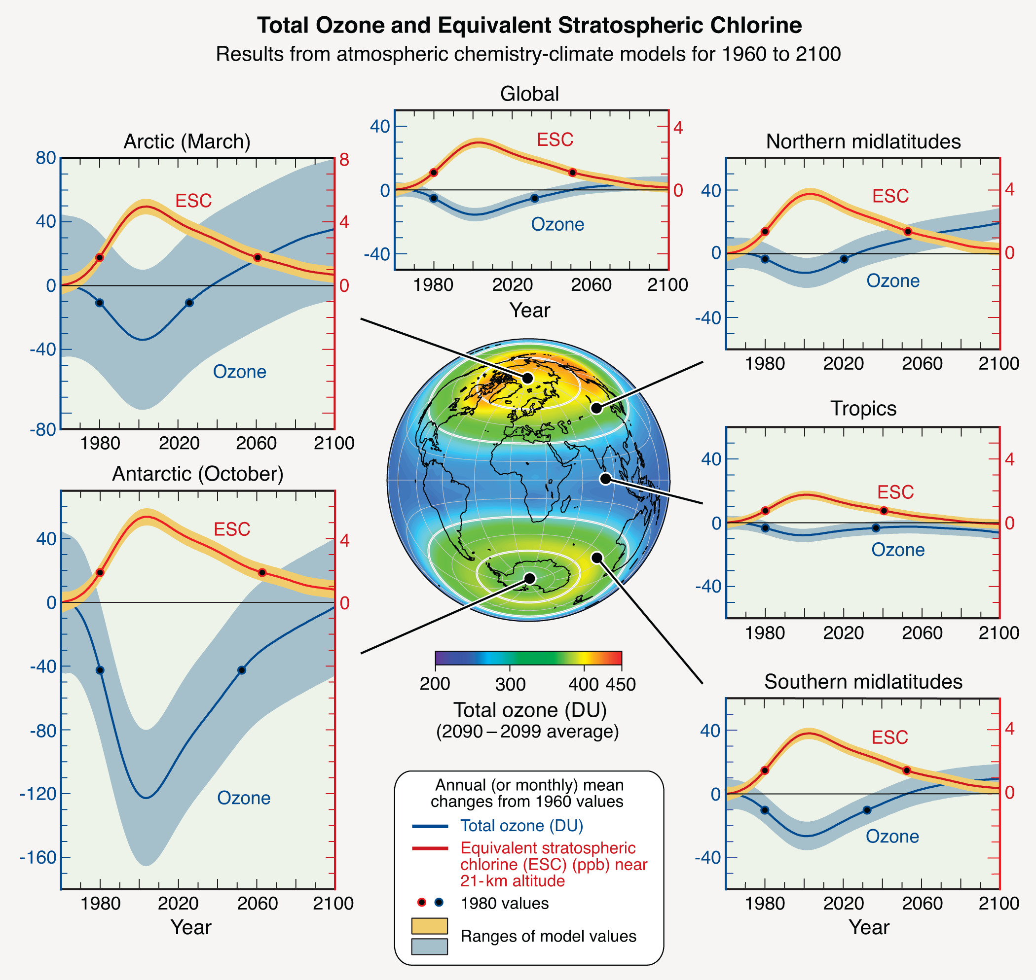
WMO/UNEP Scientific Assessment of Ozone Depletion: 2010 (WMO, 2011)

Slide 10
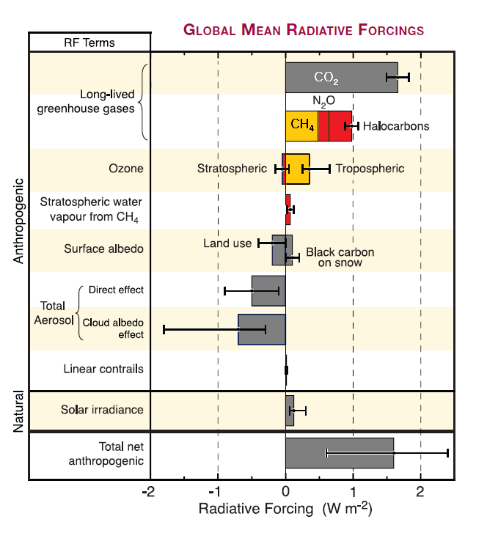
Adapted from IPCC Fourth Assessment Report (2007)

Slide 11
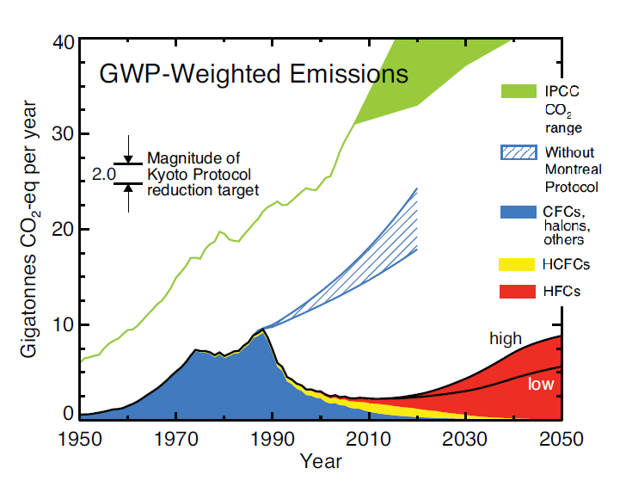
Adapted from Velders et al. (PNAS, 2007) and WMO (2011)

Slide 12
Detection, Attribution and Prediction of Stratospheric Change What are the past changes and variations in the stratosphere? How well can we explain past changes in terms of natural and anthropogenic effects? How do we expect the stratosphere to evolve in the future, and what confidence do we have in those predictions?

Slide 13
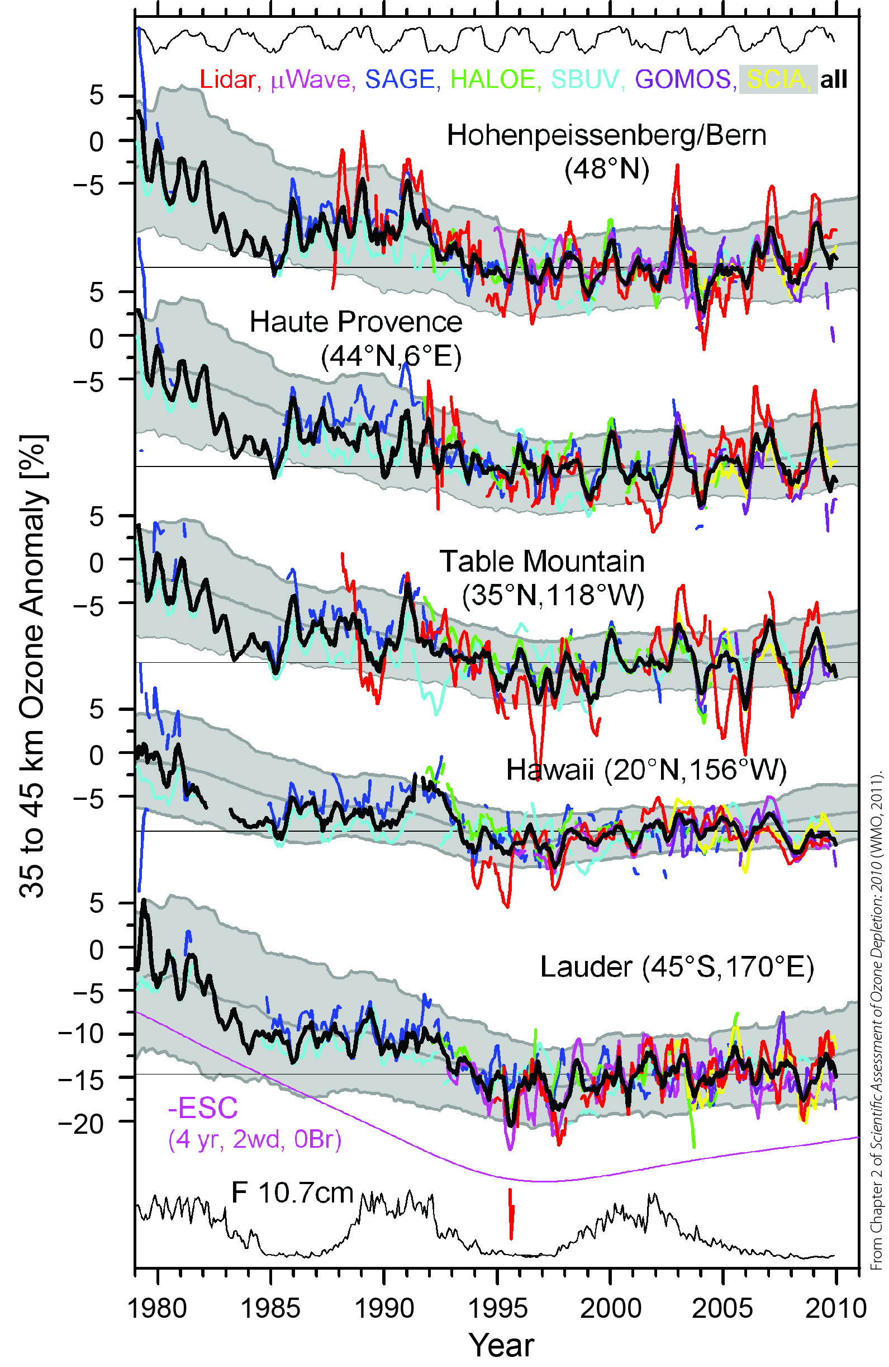
Updated from Steinbrecht et al. (2009), from WMO (2011).

Slide 14
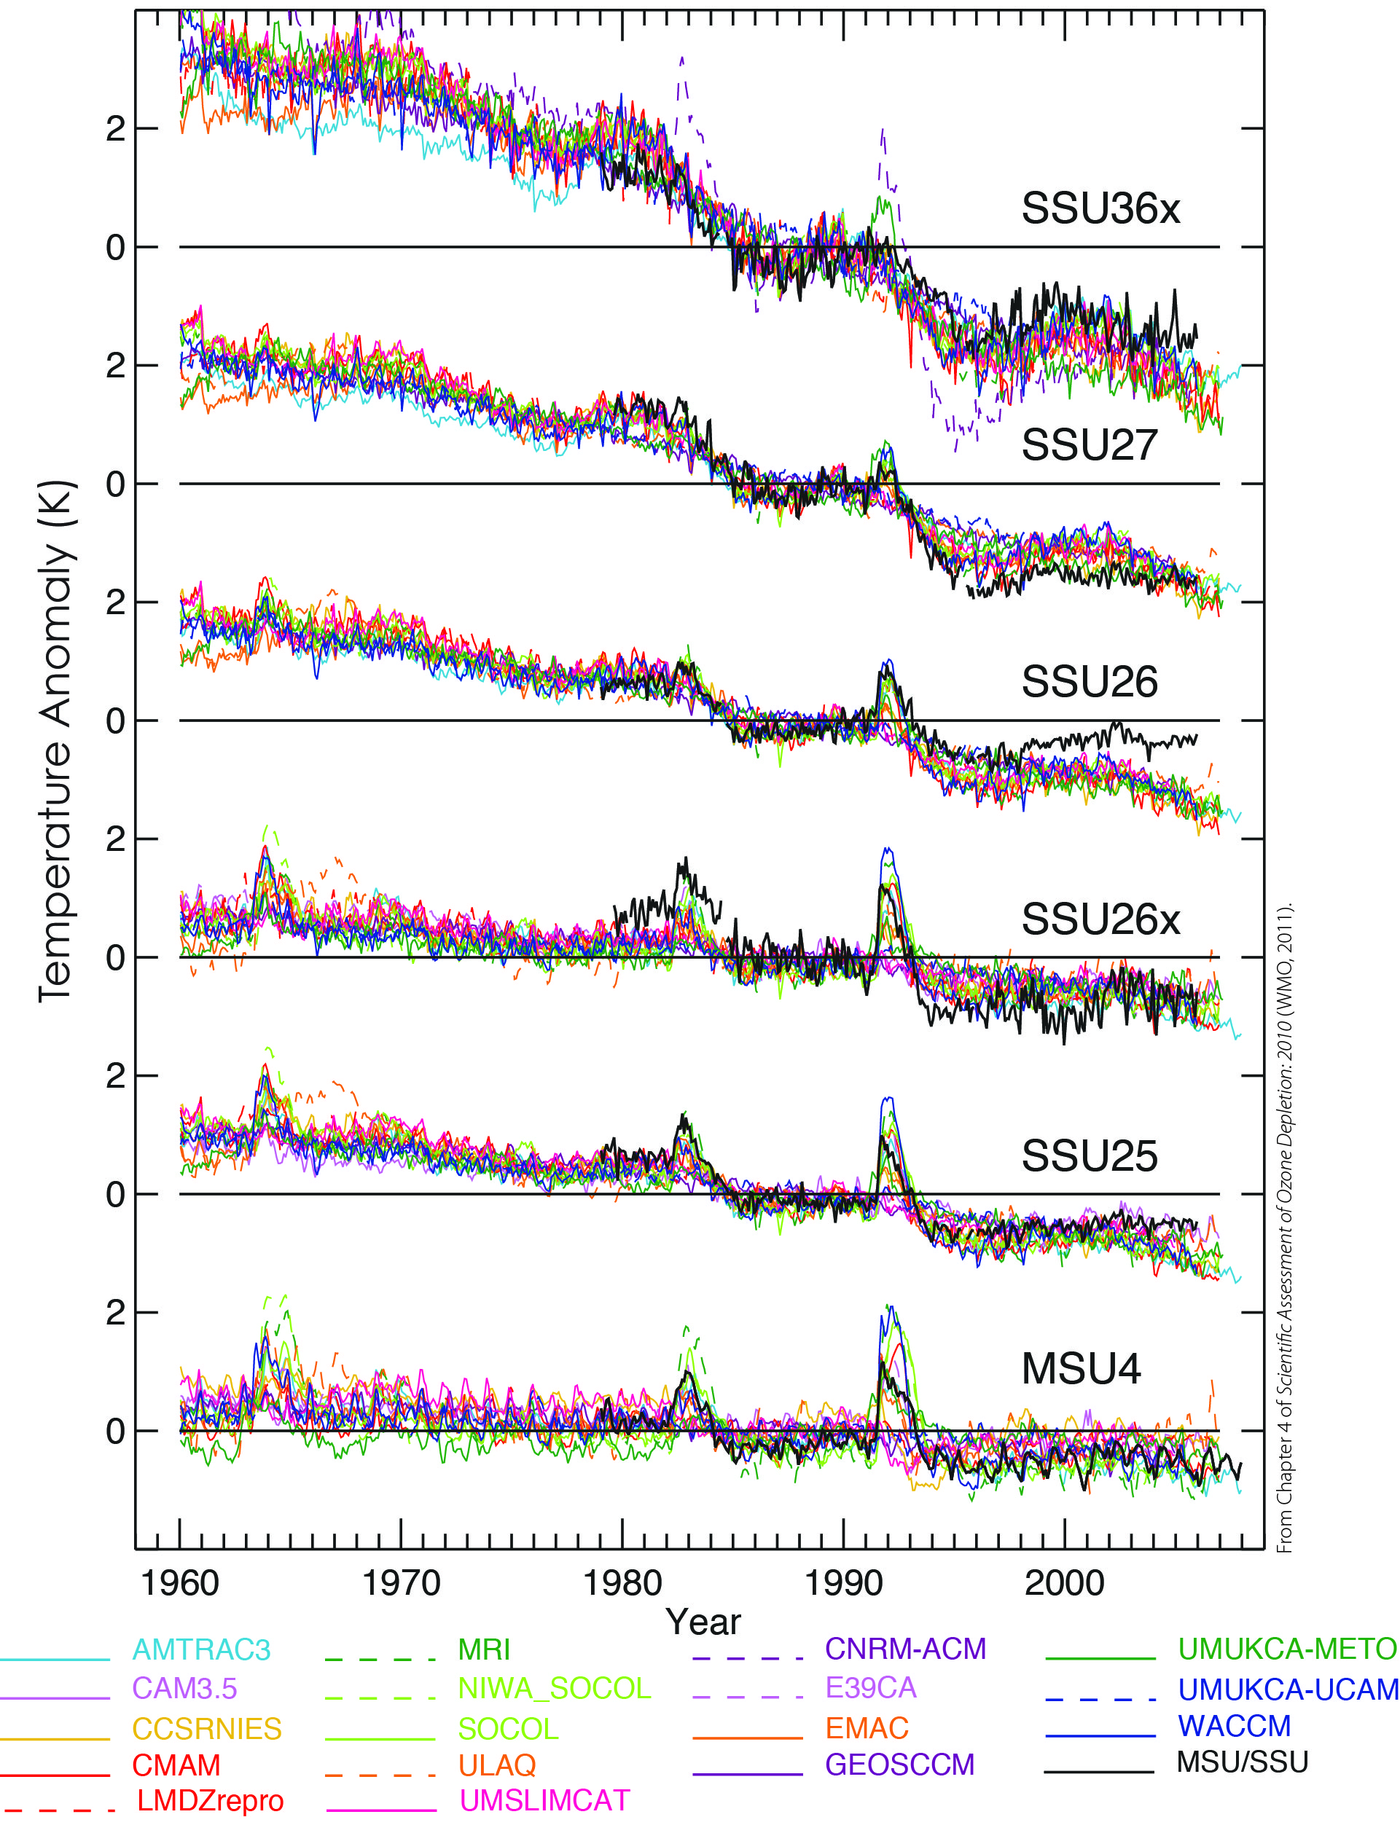
From WMO (2011).

Slide 15
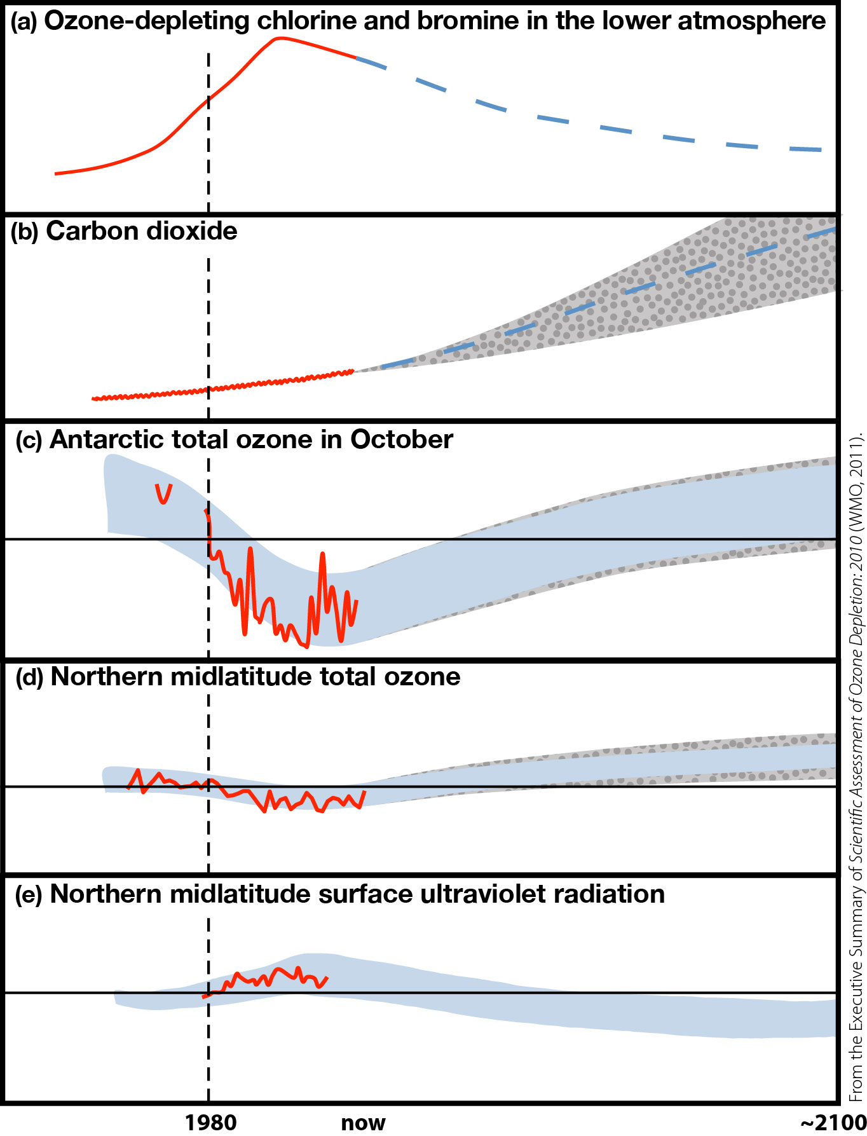
WMO (2011).

Slide 16
Stratosphere-Troposphere Dynamical Coupling What is the role of dynamical and radiative coupling of the stratosphere to the underlying troposphere? By what mechanisms do the stratosphere and troposphere act as a coupled system? What will be the role of the stratosphere as climate changes?

Slide 17
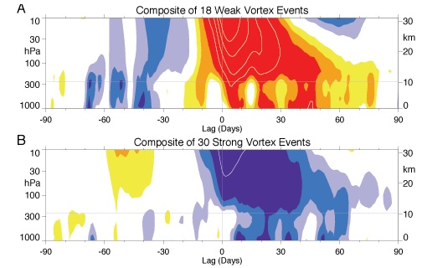
Baldwin and Dunkerton, 2001

Slide 18
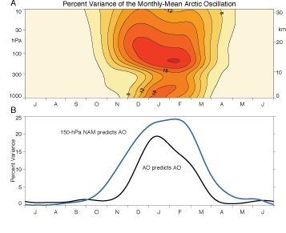
Baldwin et al., 2003

Slide 20
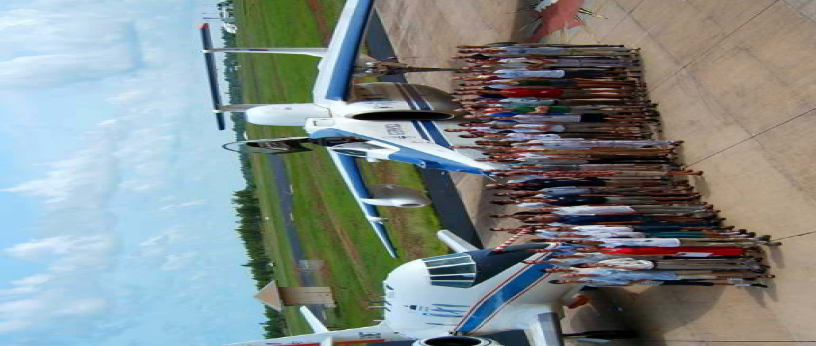
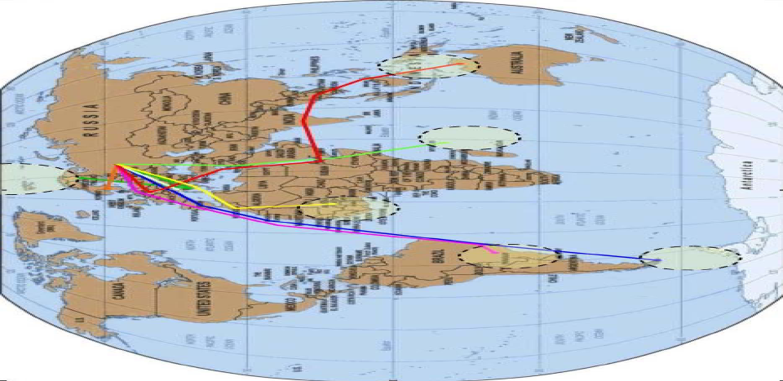
More than 200 flight of M-55 “Geophysica” aircraft ( 1993- 2010)
More than 800 flight hours
8 scientific campaigns, 20 peer-reviewed publication per project
3 test campaigns, 6 ENVISAT validation campaigns

Slide 21
Tropical UTLS:
Deep convection. Effects of lightning on O3 and NOx budgets, This and subvisible cirrus microphysics
Polar UTLS:
Microphysics, chemistry and dynamics in the polar vortex

Slide 22
Issues for understanding UTLS processes
Compare simulations to observations
Observations
Process
e.g. Deep Convection; Asian Monsoon; Polar Vortex; Barriers permeability, Transport
Understanding and
Improved parametrization
Reference simulations
Simulations
Simulations with new parameterisations
addressed with high resolution measurements of key species and dynamical variables, accessible via stratospheric aircraft

Slide 23
Climate Change
Temperature
Circulation
Atmospheric Composition
Clouds
Geoengineering?
Stratospheric Ozone

Slide 24
Transport
Subtropical and polar mixing barriers, meridional circulation
Radiation
Solar uv-vis actinic fluxes
Heating rates
Chemistry & Microphysics
Photochemical Mechanisms,
Ox, HOx, NOx, ClO, BrOx reactions,
Aerosol and cloud microphysics
Dynamics
Stratosphere-troposphere exchange, waves
courtesy H. Boenisch

Slide 25
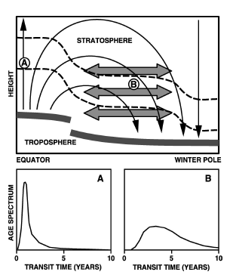
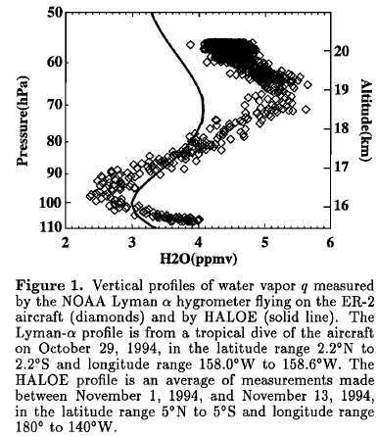
Global Processes
Age of Air: measurement of conserved tracers with known tropospheric trends (CO2, SF6)
Tape Recorder: profiles of species with seasonal signatures (H2O, CO2)
Waugh et al., 2002
Mote et al., 1996
Determination of Tropical Ascent Rate:
Measurement of Tropical -Midlatitude age gradients
Tropical-Extratropical Mixing :
Measurements of latitudinal gradiants of long-lived species; vertical profiles of species with known seasonal signatures

Slide 26
Processes Affecting Composition
Fractional release of Cly: (CFC12, CFC11) measures how much of the source gas is photolyzed or oxidized since the entry in stratosphere
Chemistry: Profiles and tracer-tracer correlations of radical precursors (N2O, O3, NOy, Clyb Bry )and radicals (O(3P), O(1D), HOx, NOx, ClO, BrO, Cly, Bry, NOy) and their seasonal evolution,
Comparison with climatologies

Slide 27
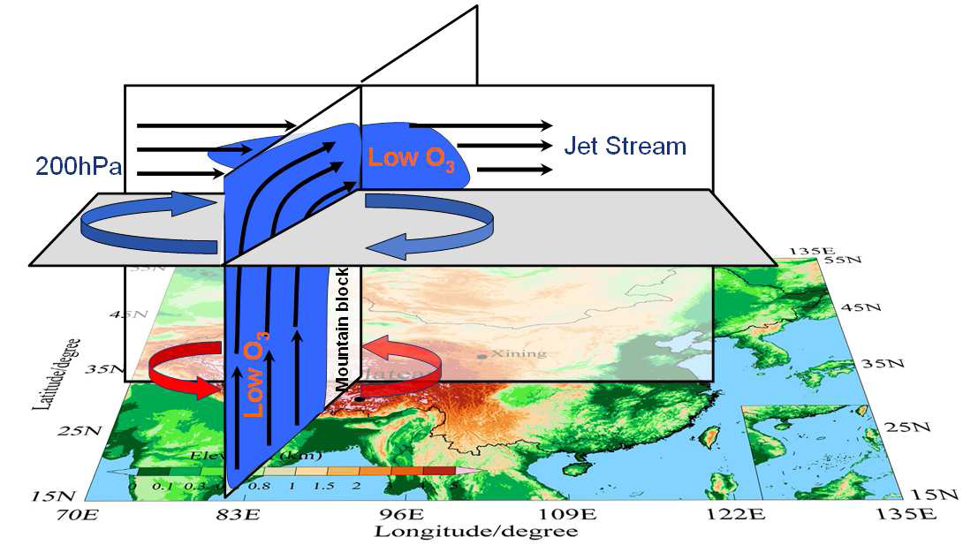
Synoptic Processes
Asian Monsoon influence on the stratosphere
Randel et al., Science, 2010: „...the monsoon circulation provides an effective pathway for pollution from Asia, India, and Indonesia to enter the global stratosphere...“

Slide 28
StratoClim
Stratospheric and upper tropospheric processes for better climate predictions
An improved representation of key processes in the Upper Troposphere and Stratosphere (UTS) will be achieved by an integrated approach bridging observations from dedicated field activities, process modelling on all scales, and global modelling with a suite of chemistry climate models (CCMs) and Earth system models (ESMs).
Main focus is:
improve the understanding of the microphysical, chemical and dynamical processes that determine the composition of the UTS, such as the formation, loss and redistribution of aerosol, ozone and water vapour, and how these processes will be affected by climate change;
(b) implement these processes and fully include the interactive feedback from UTS ozone and aerosol on surface climate in CCMs and ESMs. Through StratoClim new measurements will be obtained in key regions:
(1) in a tropical campaign with a high altitude research aircraft carrying an innovative and comprehensive payload,
(2) by a new tropical station for unprecedented ground and sonde measurements, and
(3) through newly developed satellite data products.
The improved climate models will be used to make more robust and accurate predictions of surface climate and stratospheric ozone.

Slide 29
http://www.stratoclim.org/
http://www.sparc-climate.org/
Thank you

