Slide 1
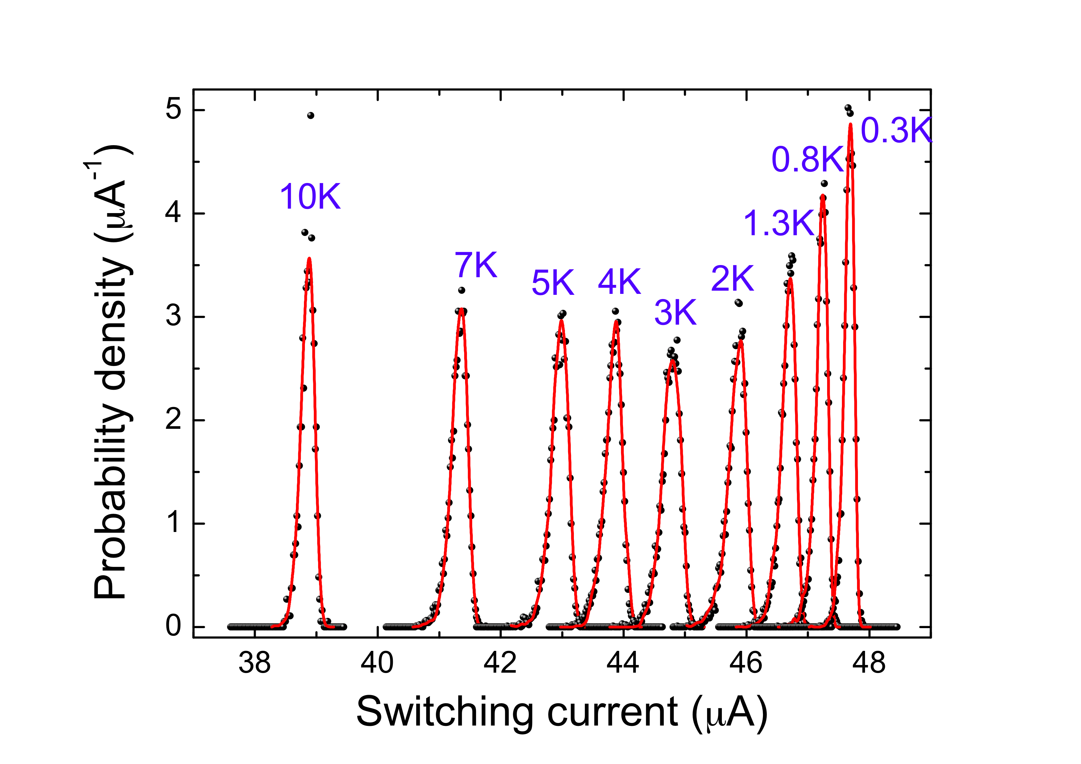
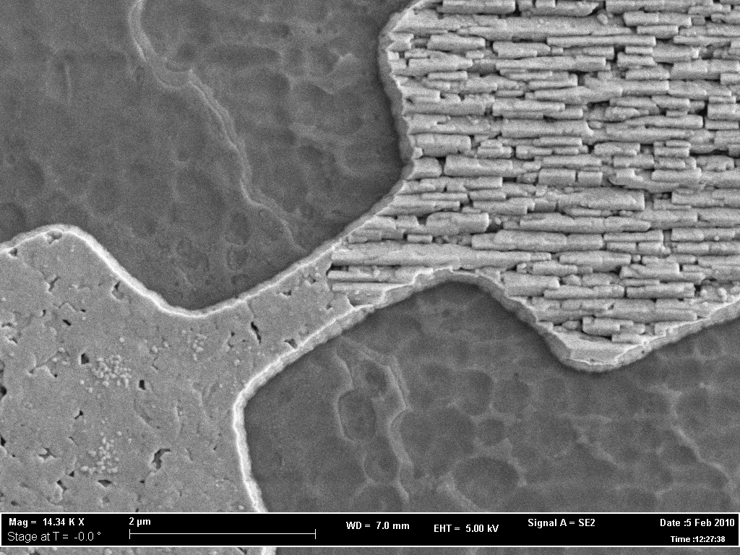
Dissipation modes of nanoscale ordered domains in YBCO Josephson junctions
D. Massarotti^{1,2}, P. Lucignano², L. Galletti^{1,2}, G. Rotoli³, D. Stornaiuolo^{1,2},
F. Lombardi⁴, L. Longobardi³, A. Tagliacozzo^{1,2}, and F. Tafuri^{2,3}
Università di Napoli "Federico II", Dipartimento di Fisica, Napoli, Italy
CNR-SPIN UOS Napoli
3) Seconda Università di Napoli, Dipartimento di Ingegneria Industriale e dell'Informazione, Aversa (Ce), Italy
4) Department of Microtechnology and Nanoscience, MC2, Chalmers University of Technology, Göteborg, Sweden

Slide 2
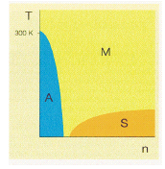
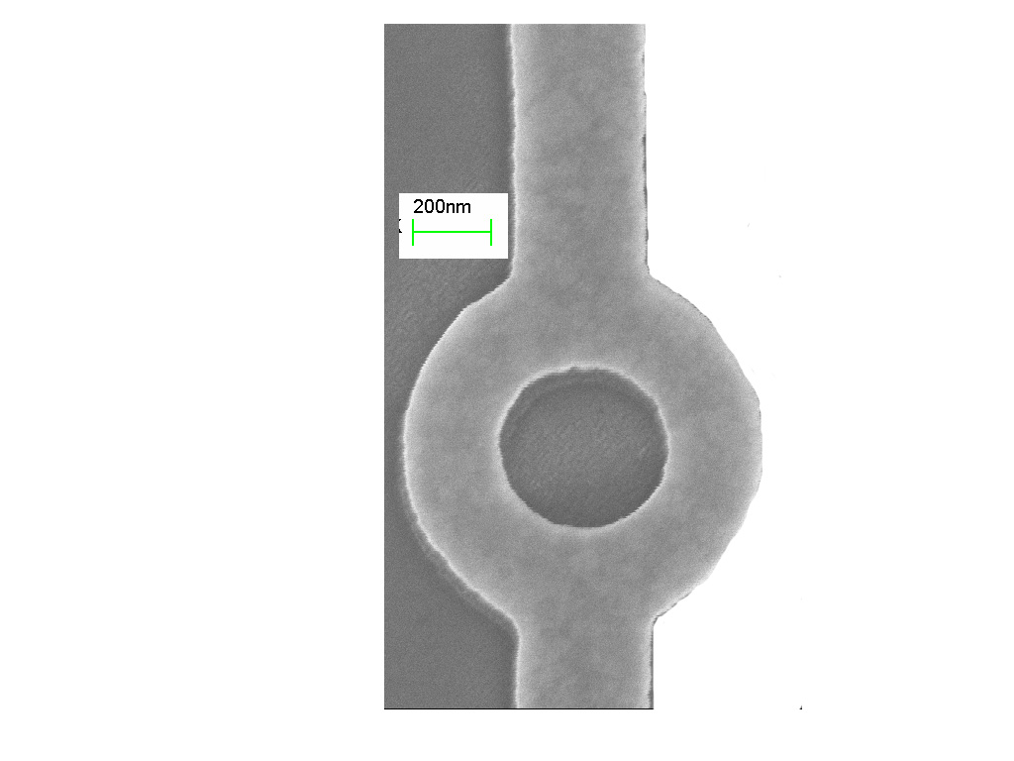
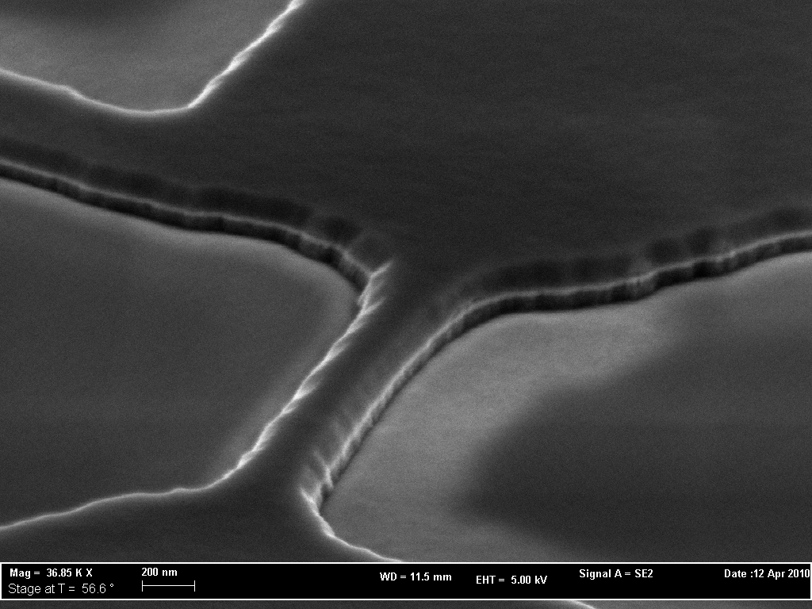
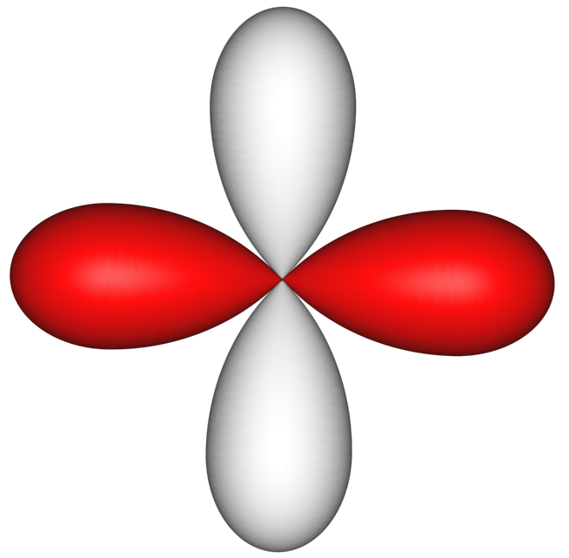

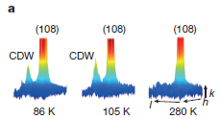
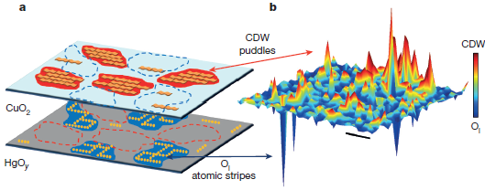
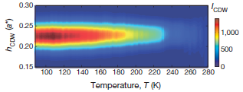
High Tc superconductors
Intrinsic scaling size
λ_{L}
ξ

Slide 3

Phase dynamics vs interface orientation
B
C

Slide 4

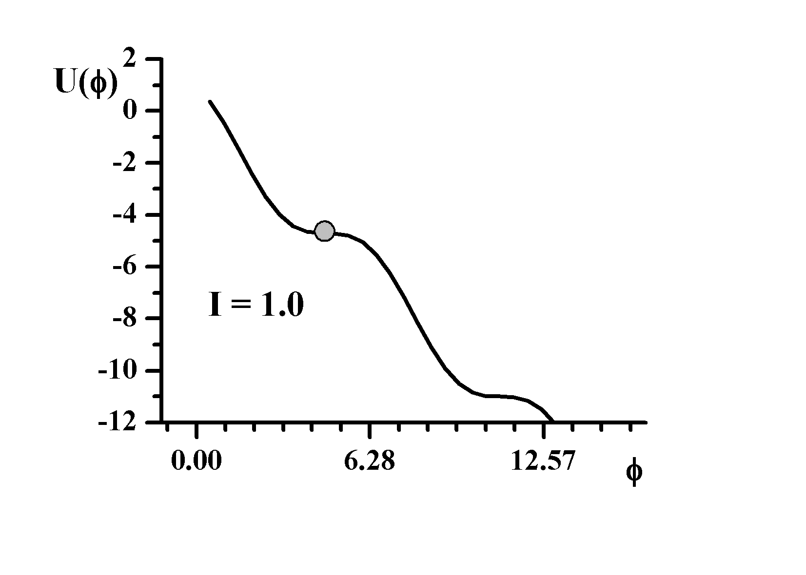
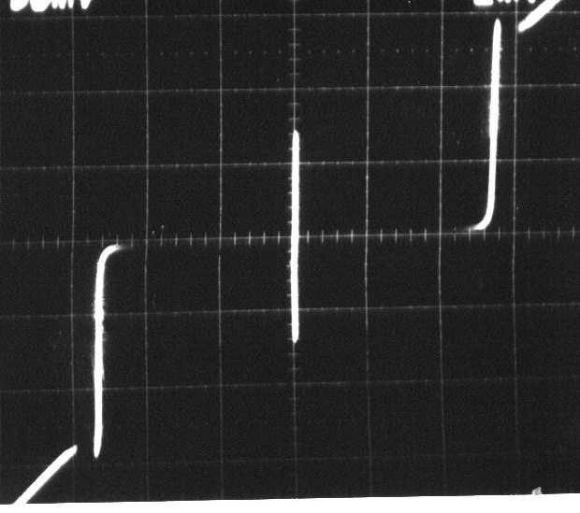
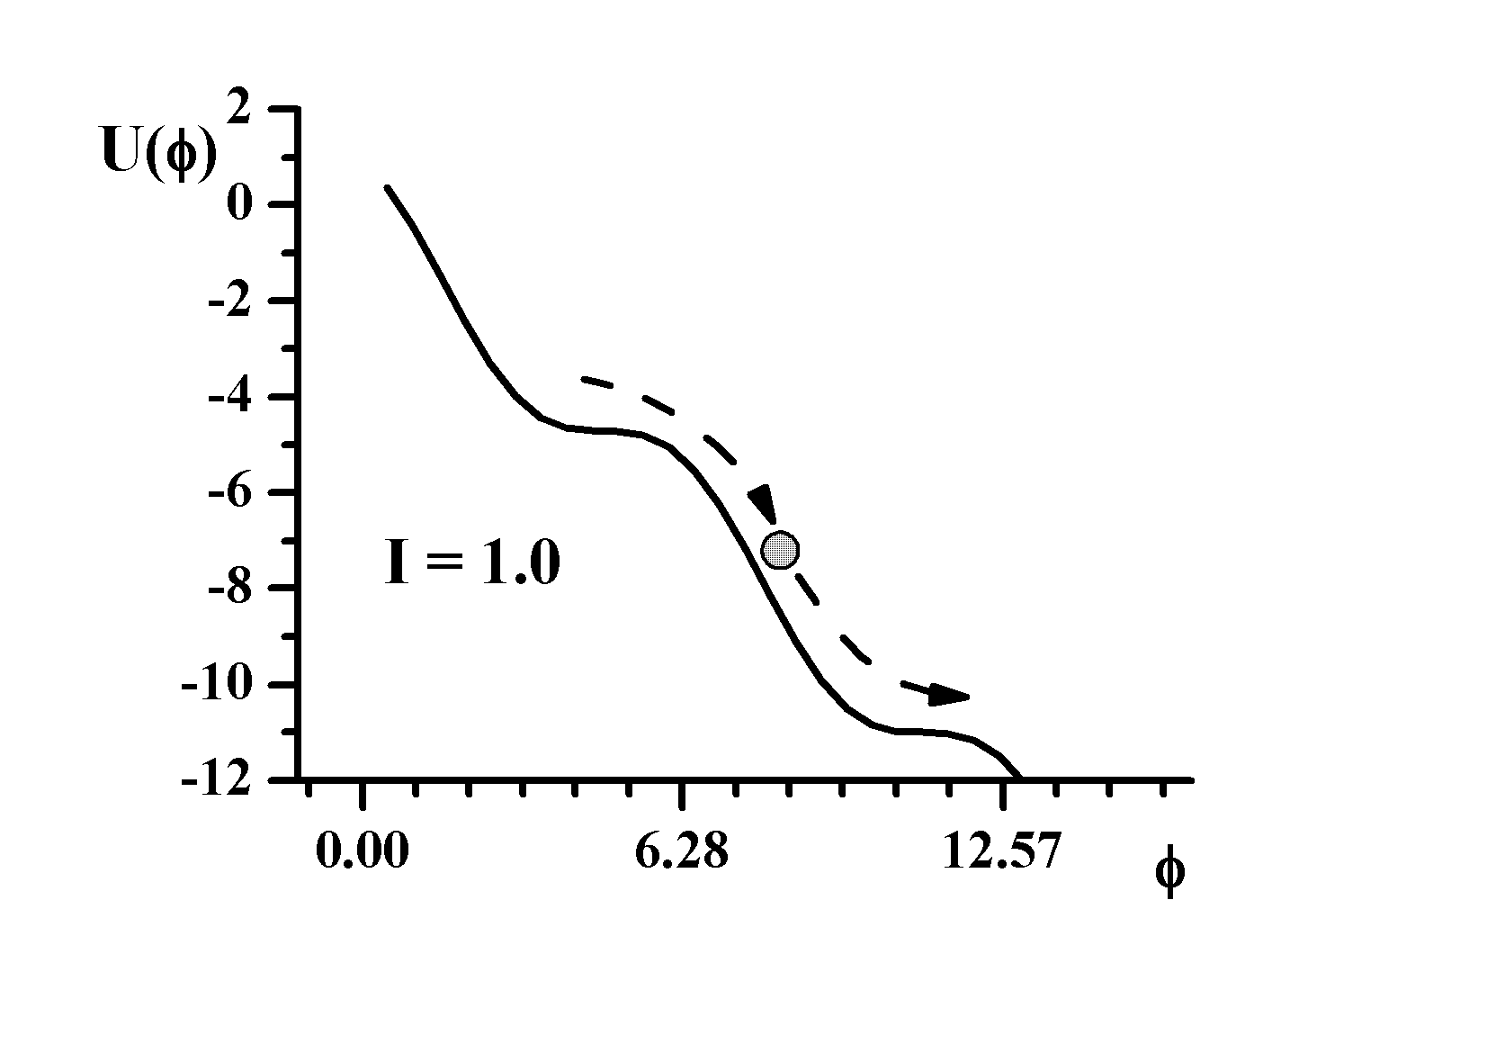
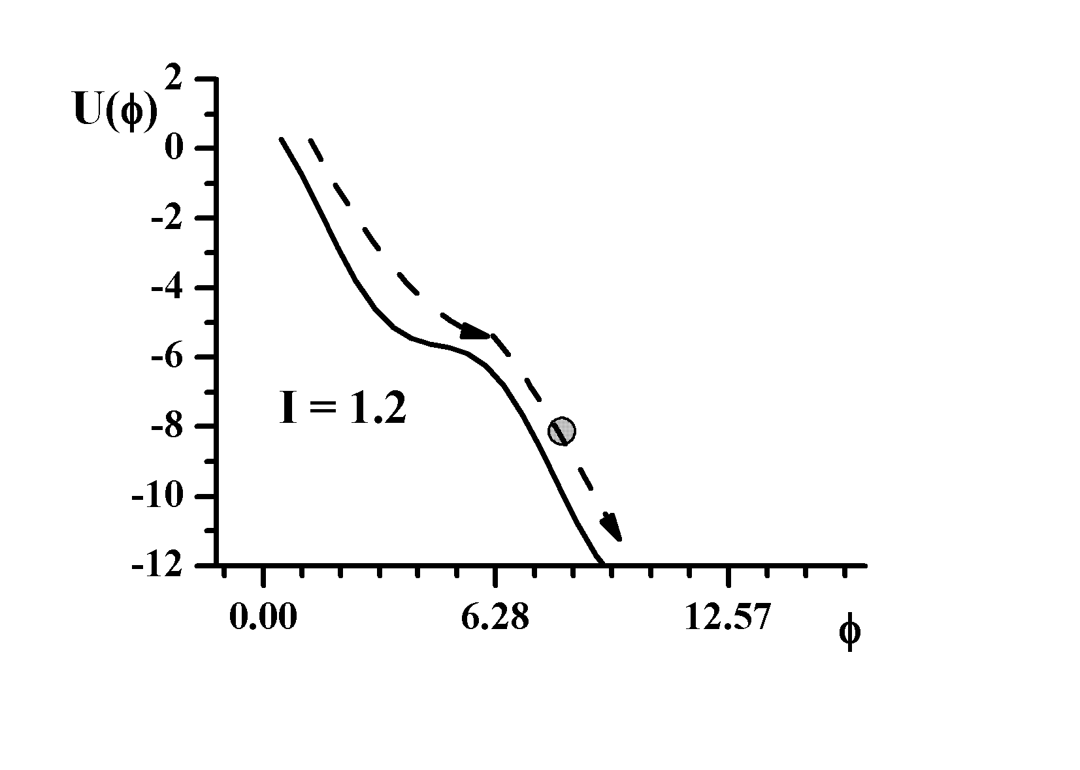
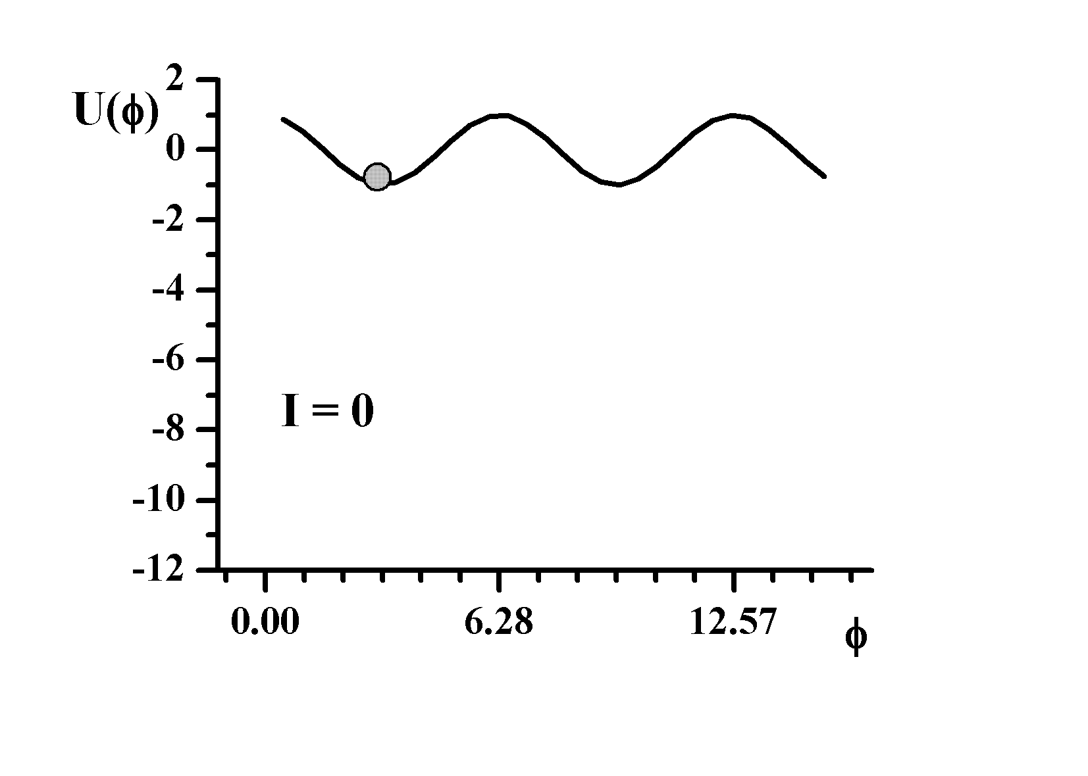
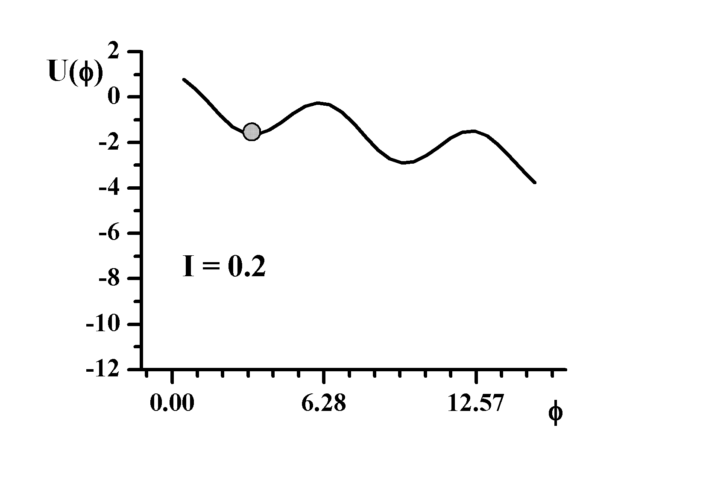
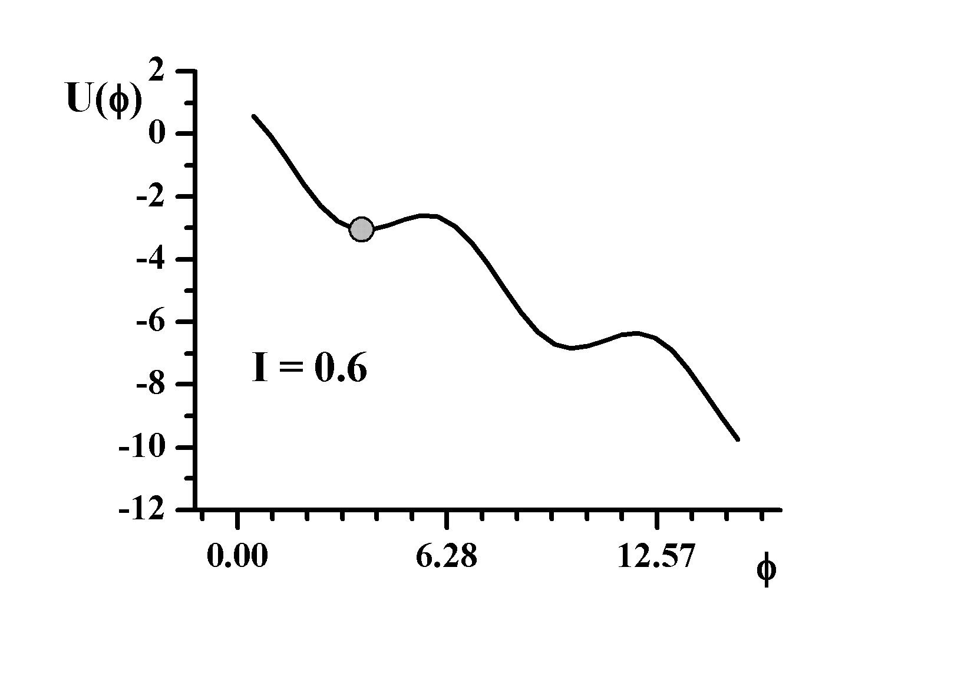
Phase dynamics of current biased JJ
RCSJ Model
Josephson inductance
I
shunting
admittance
junction capacitance
barrier
height
plasma
frequency
V
quality factor
Underdamped JJ

Slide 5
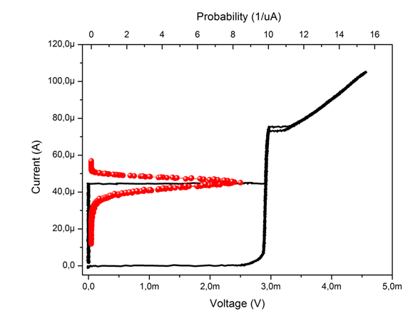
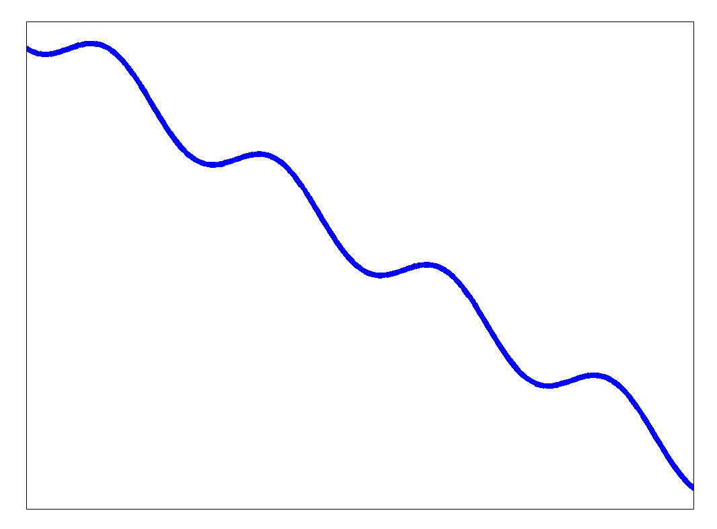
In a ‘nano-world’, reduction of I_{c}
unavoidably leads to a reduction of Q → increase in dissipation
Probability
Escape rates
Current
Thermal Escape
Voltage
Retrapping
(Phase diffusion)
MQT
Running state
Retrapping rate
Moderately damped JJ

Slide 6
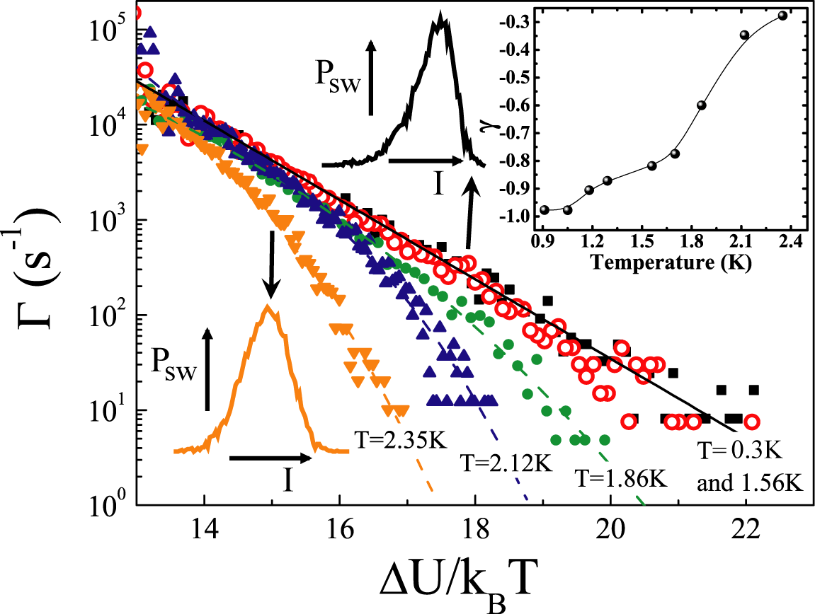
Moderately damped JJs
Thermal
Escape
Probability
Current
Retrapping
(Phase diffusion)
MQT
Voltage
2.35K
U
Running state
2.12K
1.86K
φ
R=65 Ω
C=300 fF
Q=2.7
T*
T_{cross}
L. Longobardi, D. Massarotti et al. Appl. Phys. Lett. 99, 062510 (2011)
L. Longobardi, D. Massarotti et al. Phys. Rev. B 84, 184504 (2011)

Slide 7
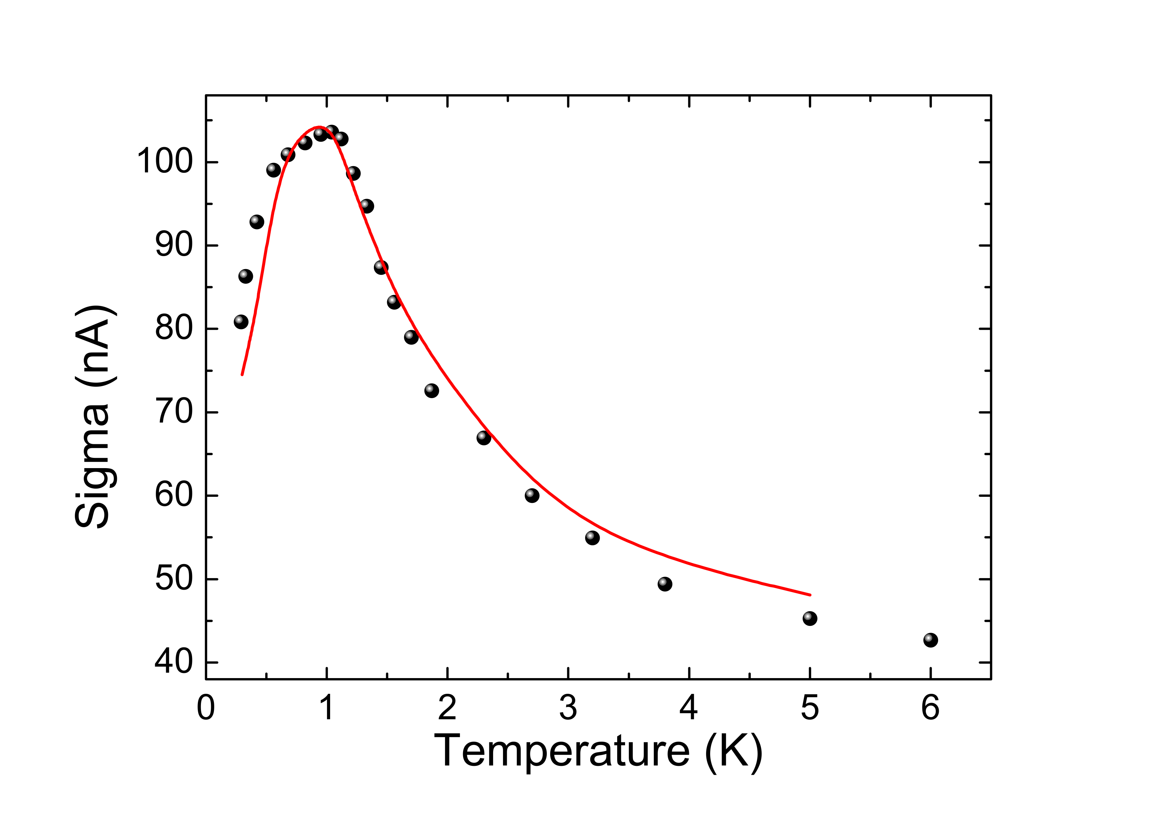
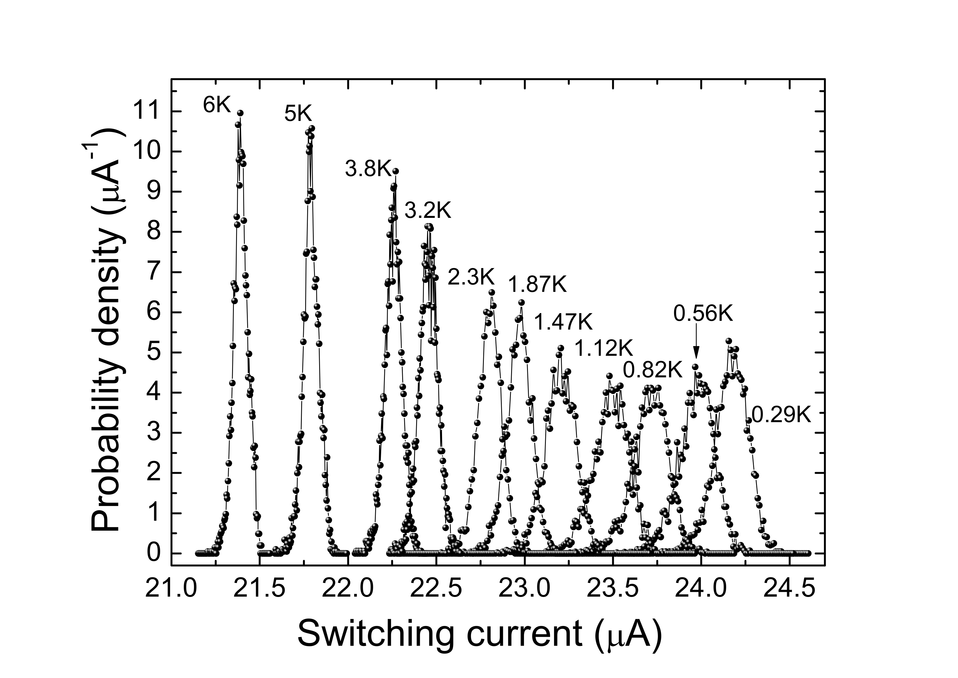
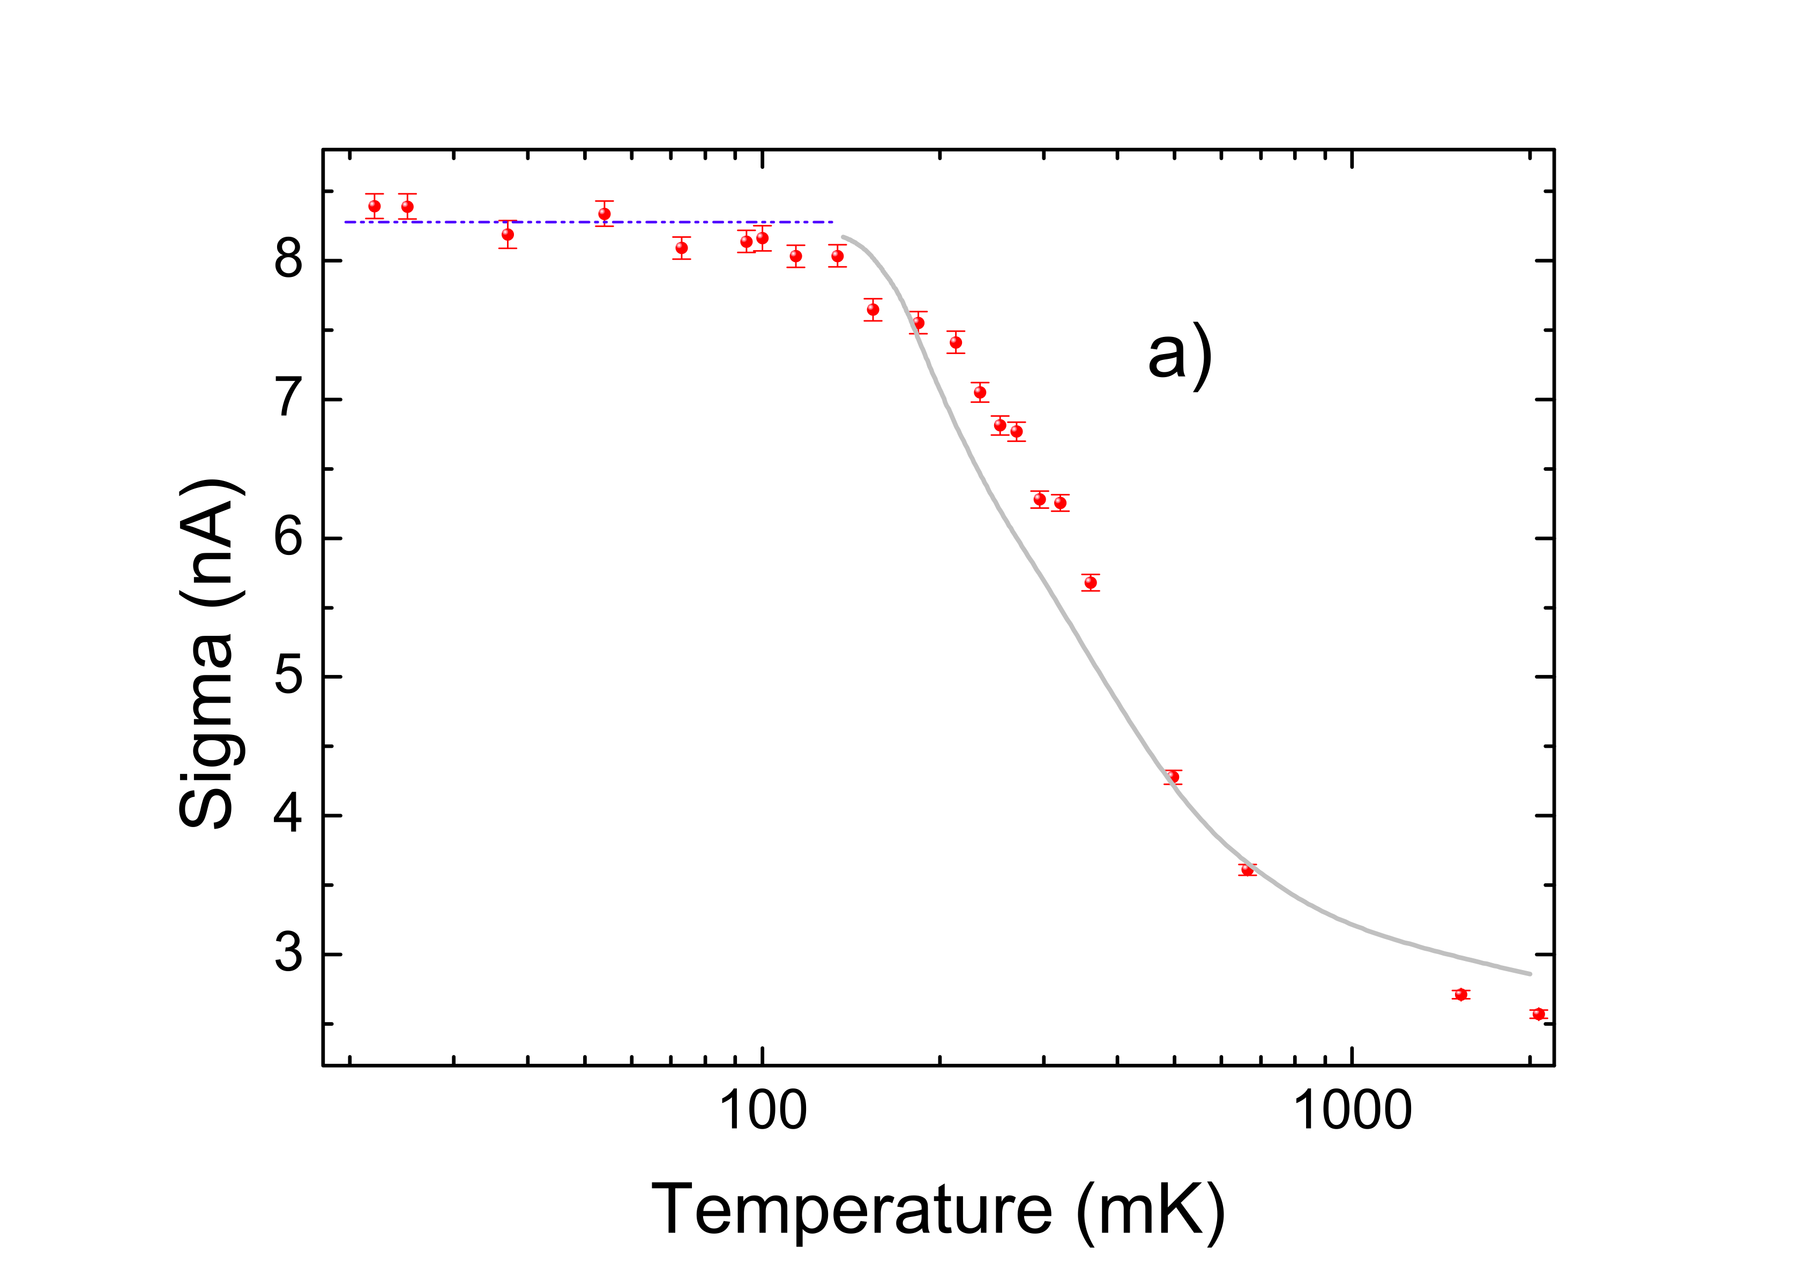
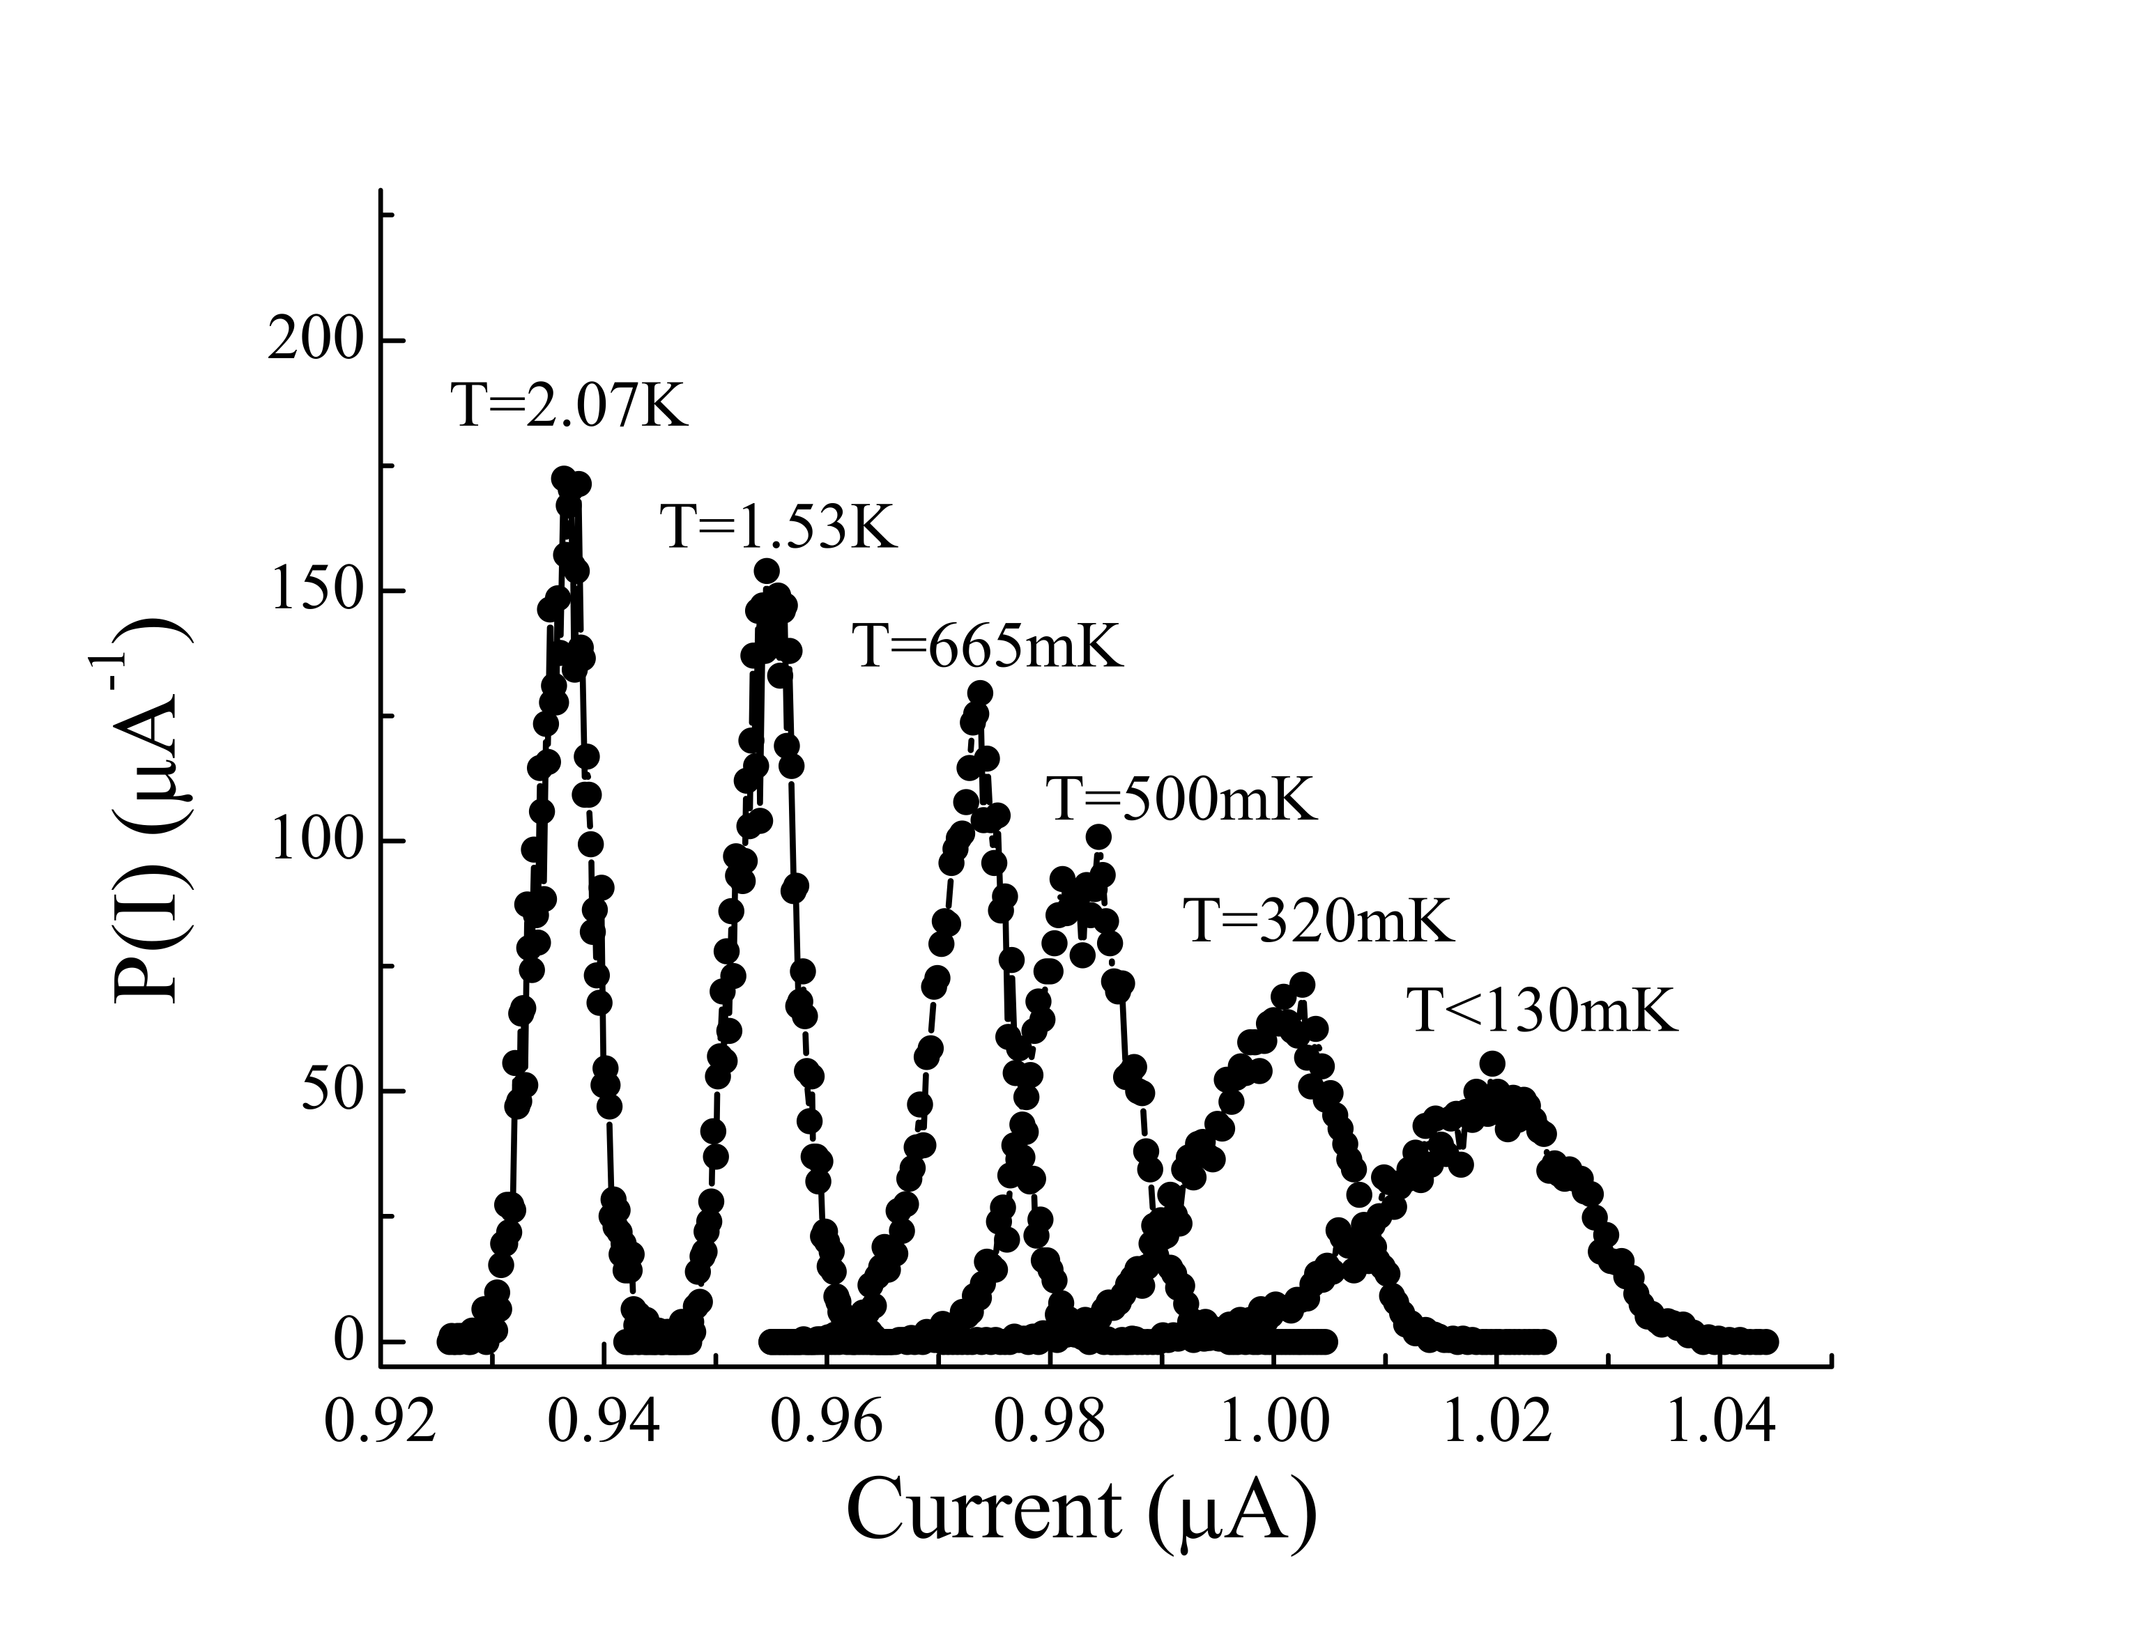
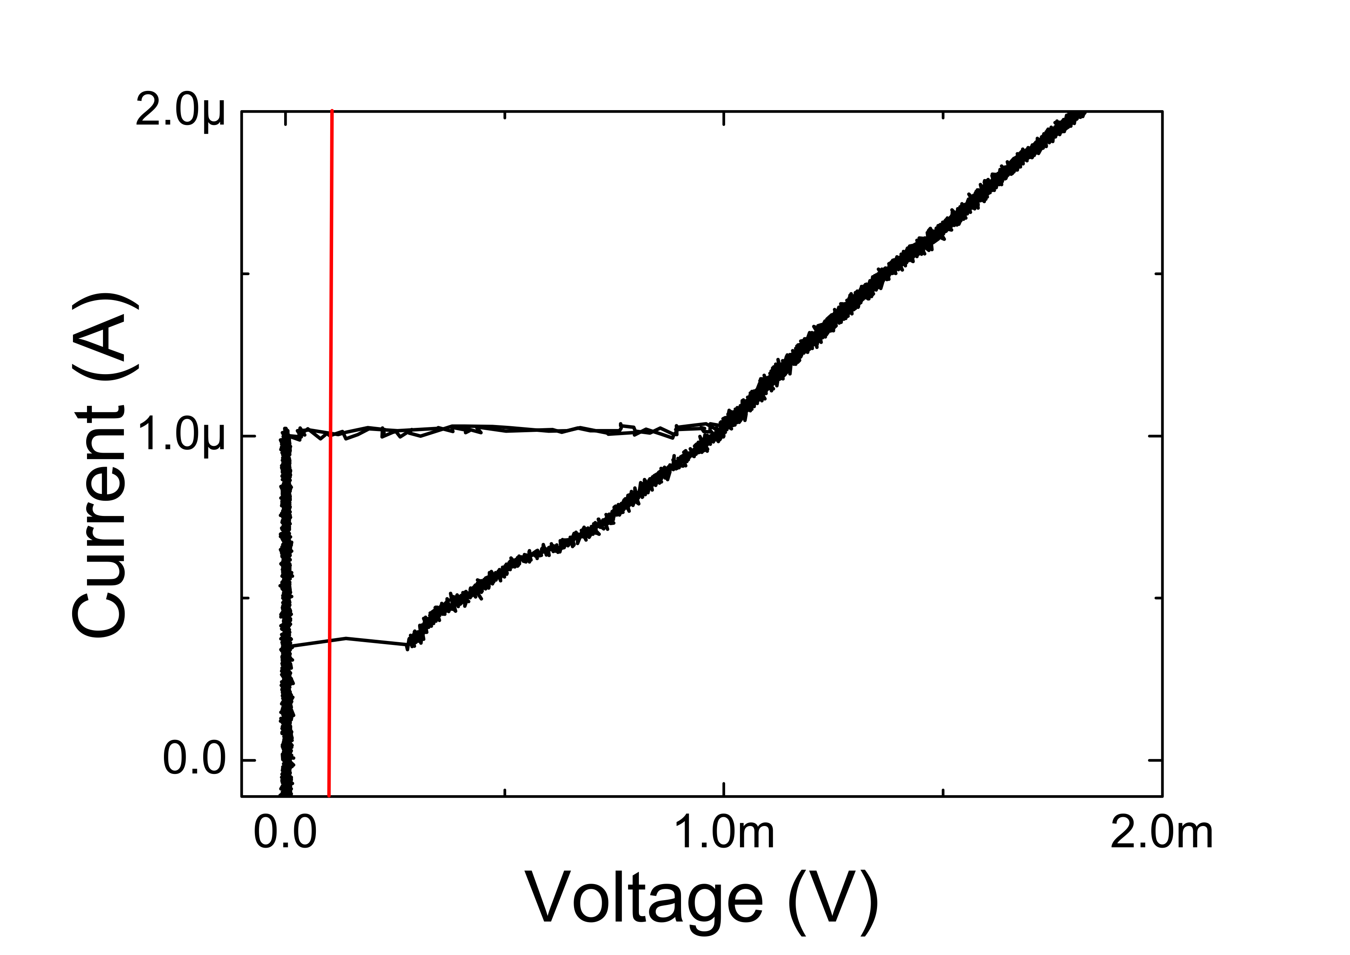
Phase dynamics of low Jc YBCO JJs
Monte Carlo
Simulations
Q=1.2
R =85 Ω
C =65 fF
Q = 1.3

Slide 8
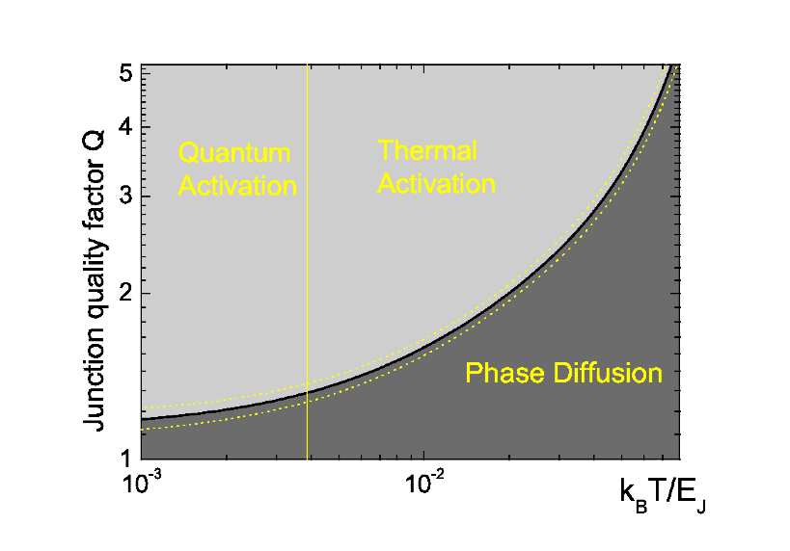
Phase dynamics of low Jc YBCO JJs
L. Longobardi, D. Massarotti et al. Phys. Rev. Lett. 109, 050601 (2012).
D. Stornaiuolo, G. Rotoli, D. Massarotti et al. Phys. Rev. B 87, 134517 (2013)
Running State
Diffusive regime
Running State
Diffusive regime
Mannik et al. PRB 71 (2005)
Kivioja et al. PRL 94 (2005)
Krasnov et al. PRL 95 (2005)
Longobardi et al. PRB 84 (2011)
Yu et al. PRL 107 (2011)
L. Longobardi et al. PRL (2012)
– Nb/AlOx/Nb
– Al/AlOx/Al
– BSCCO IJJ
– NbN/MgO/NbN
– Nb/AlOx/Nb
– GB YBCO

Slide 9
GB configurations
Sample | I_{c0} (μA) | W (μm) | J_{c} (A/cm²) | E_{J} (meV)
JCT C | 50 | 0.2 | 10⁵ | 100
High Jc grain boundary junction
(103)
YBCO
Moderately damped grain boundary junction
(001)
YBCO

Slide 10
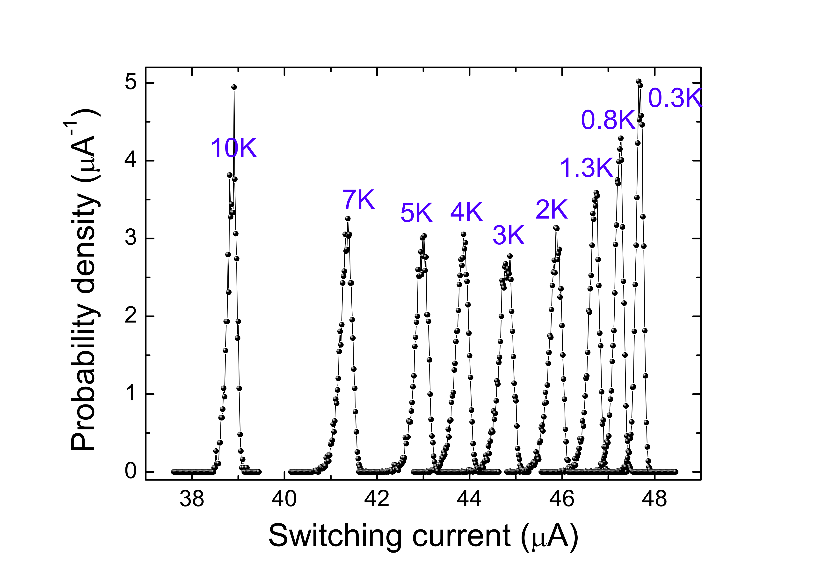
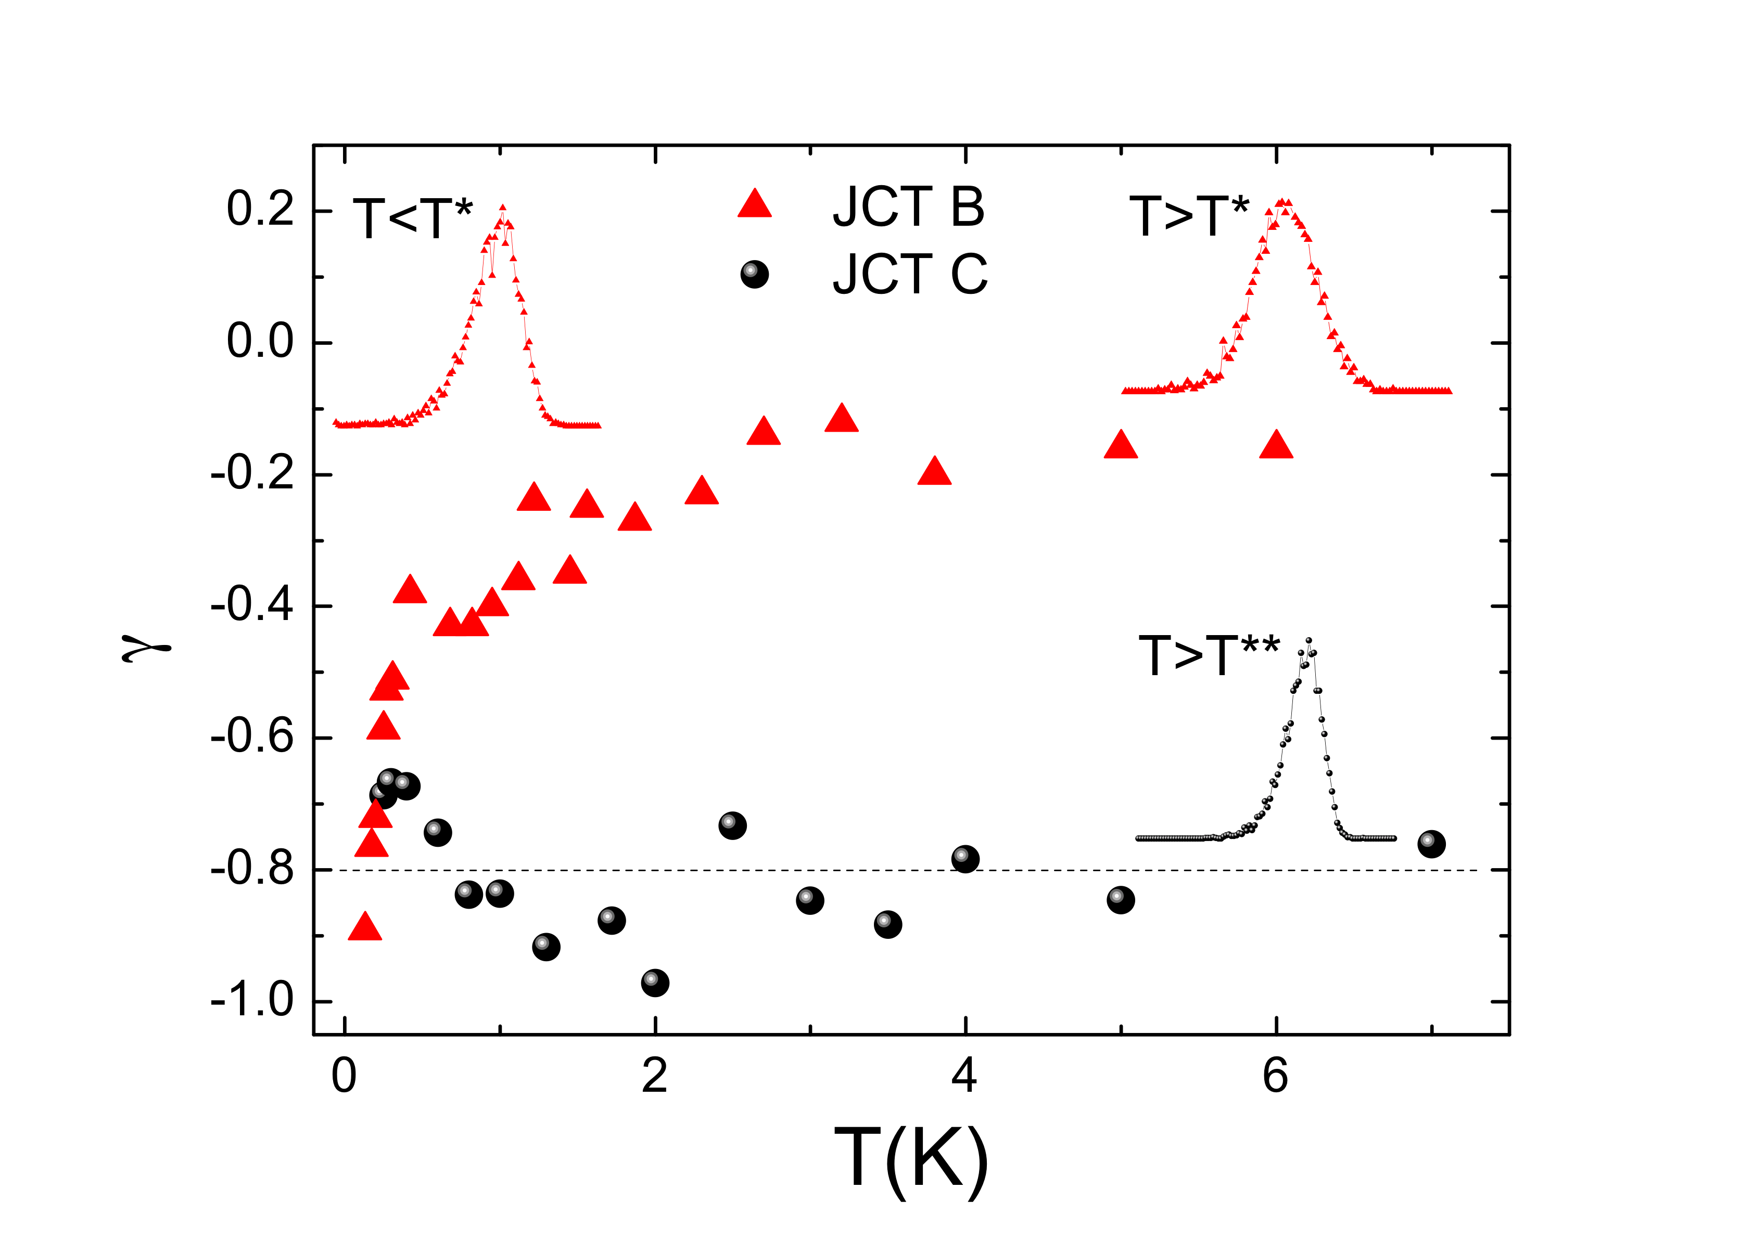
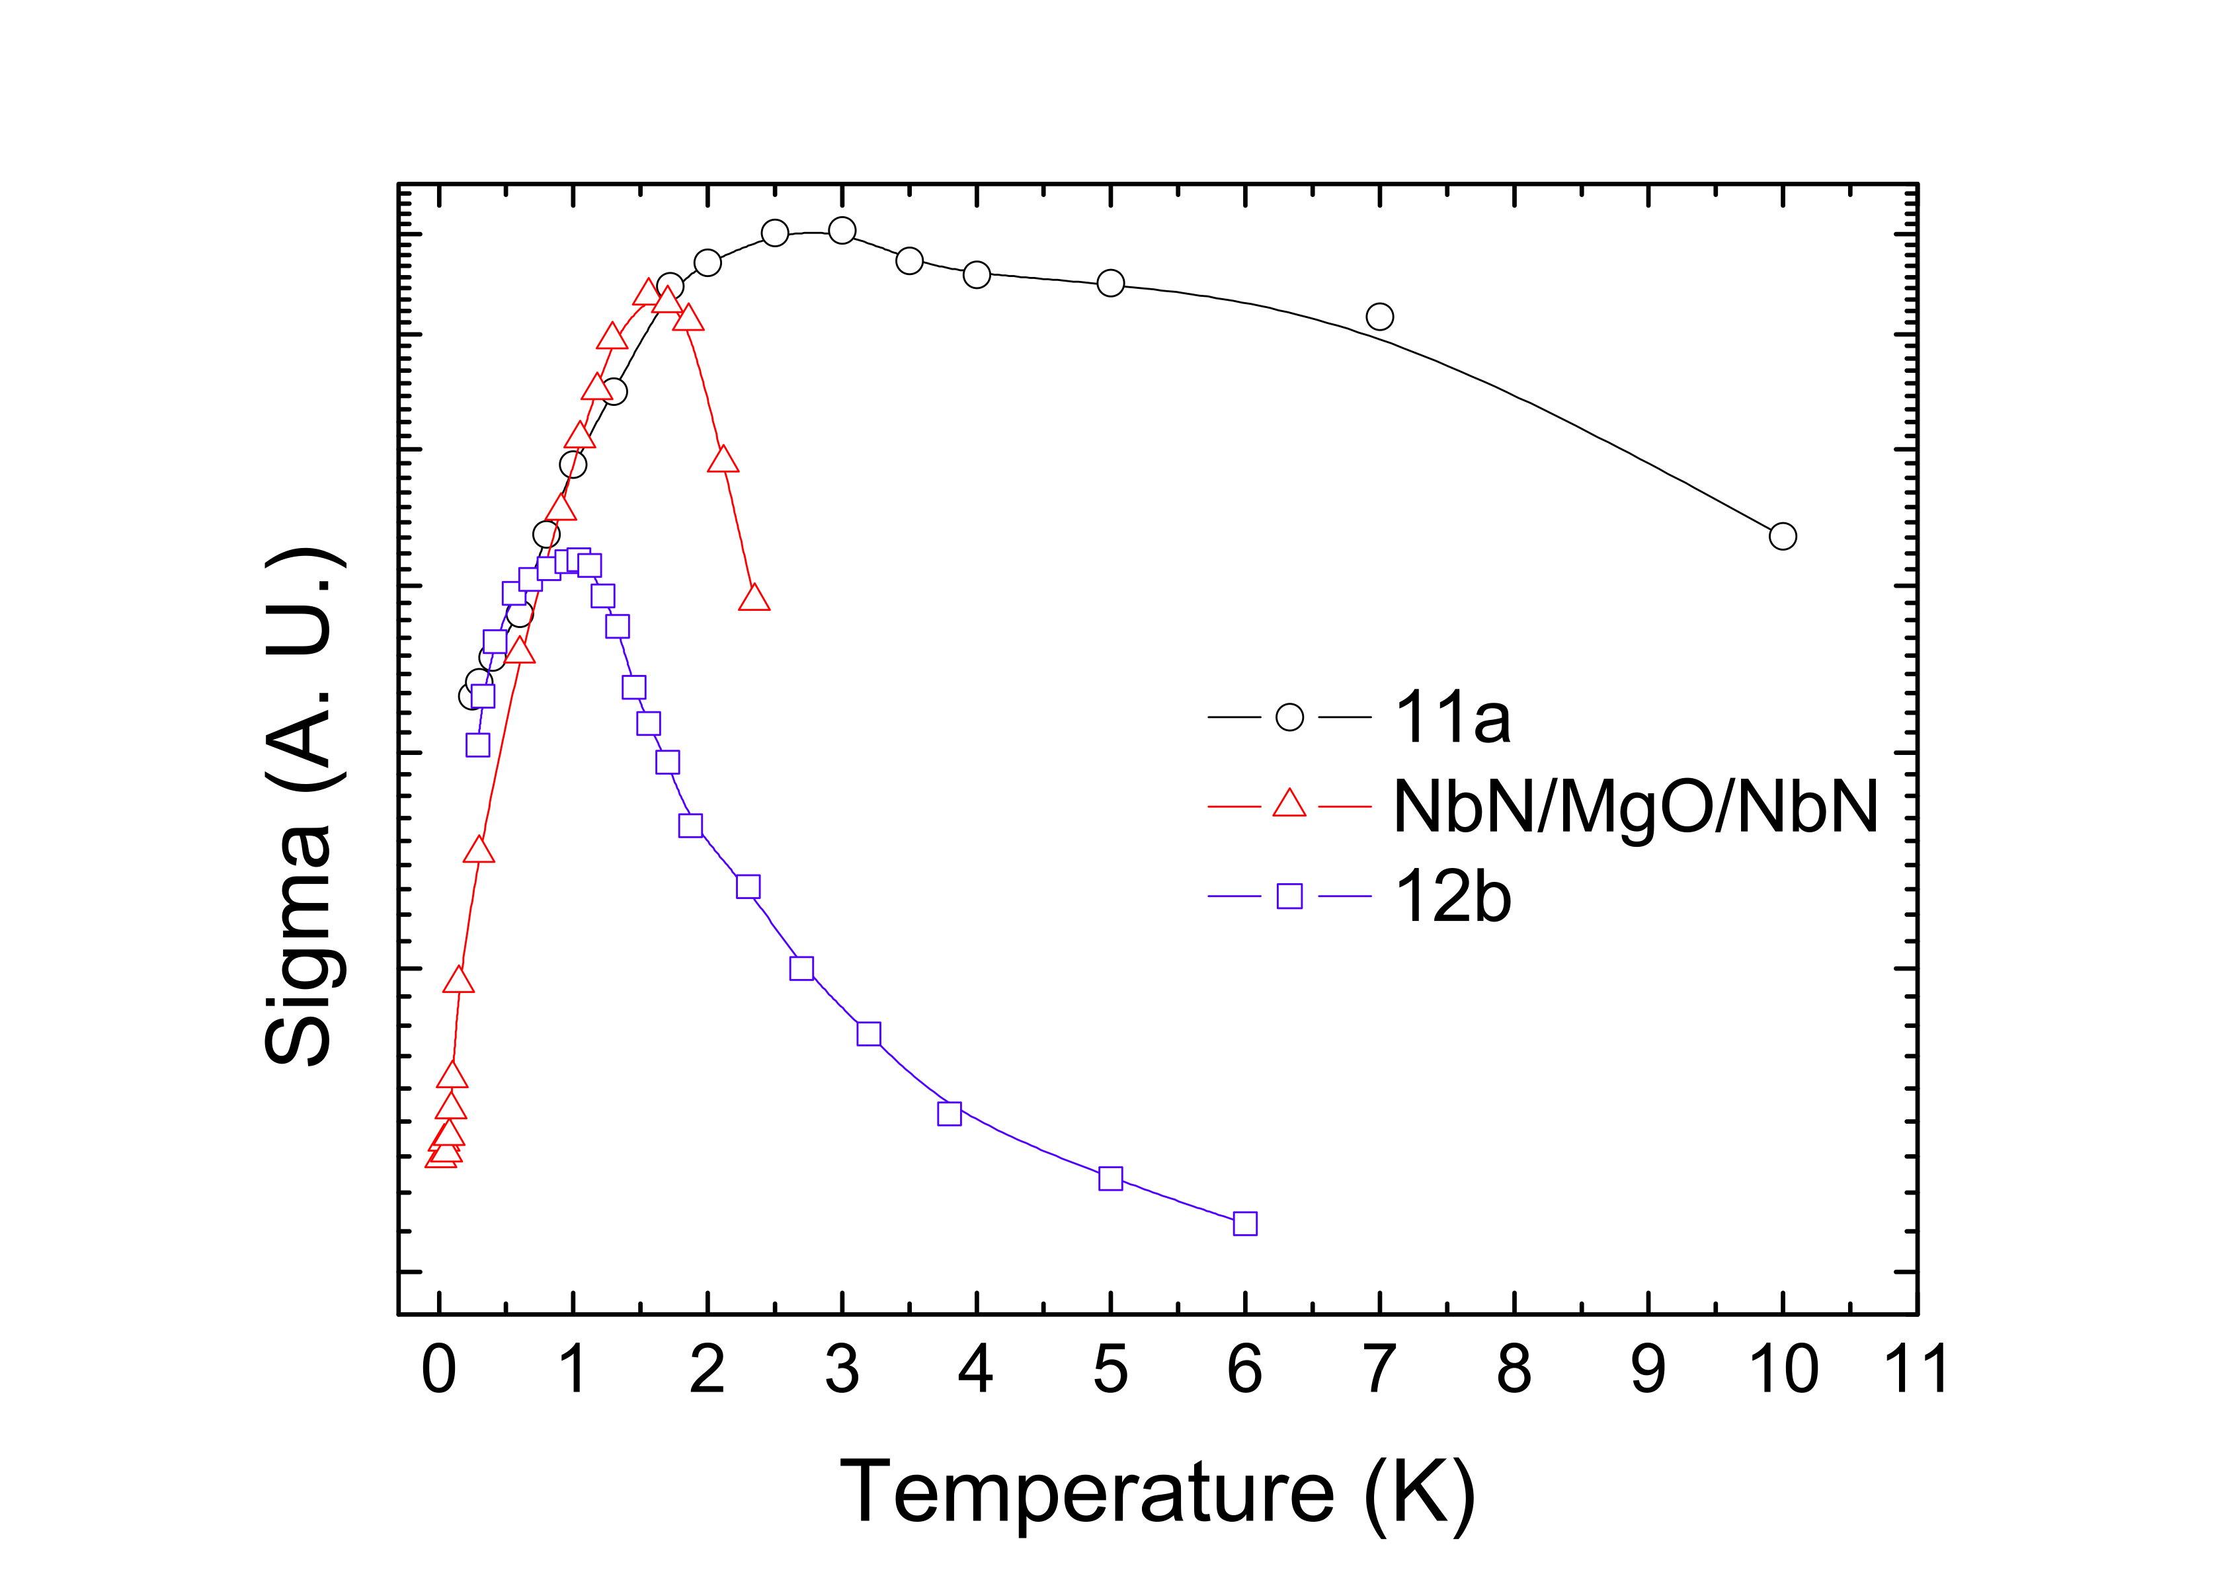
Switching dynamics in high Jc JJs
JCT C
High Jc YBCO JJ
Moderately damped
YBCO JJ
High Jc YBCO JJ
High Jc YBCO JJ:
T*=3K
I_{c}=50 μA
The slope of σ above T* is much smaller when compared to those of moderately damped JJs
No symmetrization of the switching histograms
High Jc YBCO JJ
NbN/MgO/NbN JJ
Moderately damped
YBCO JJ

Slide 11

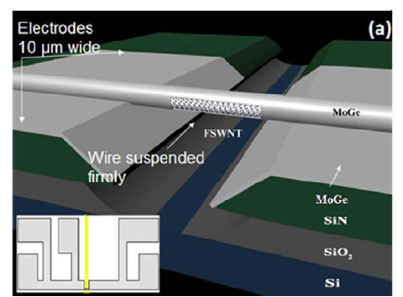
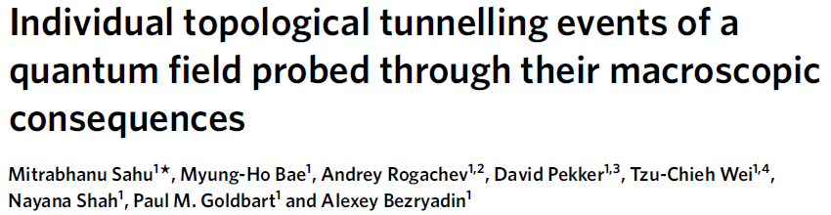
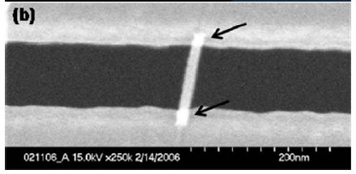
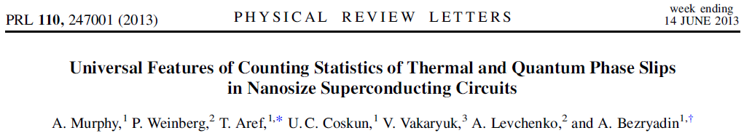
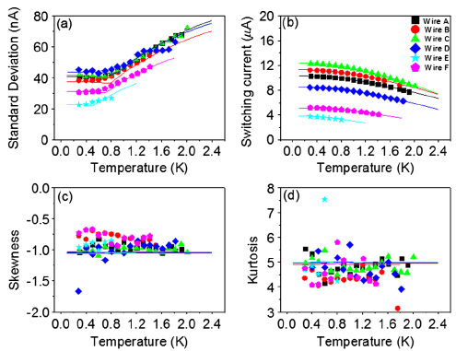
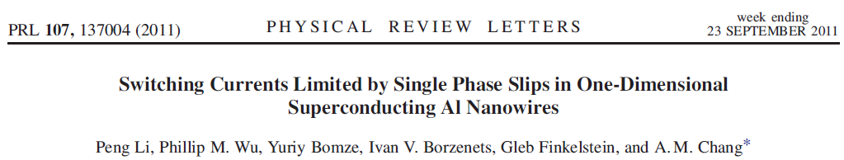
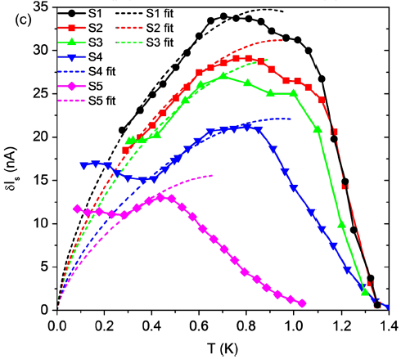
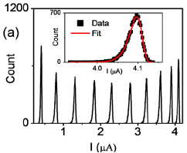
Switching dynamics in nanowires

Slide 12
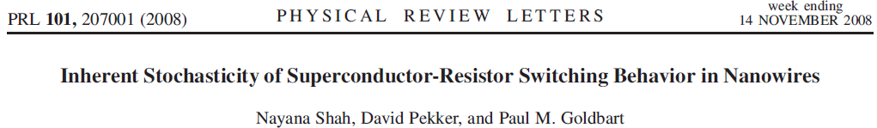

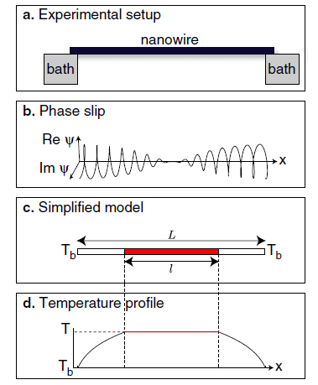


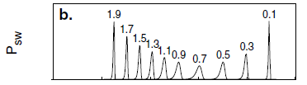
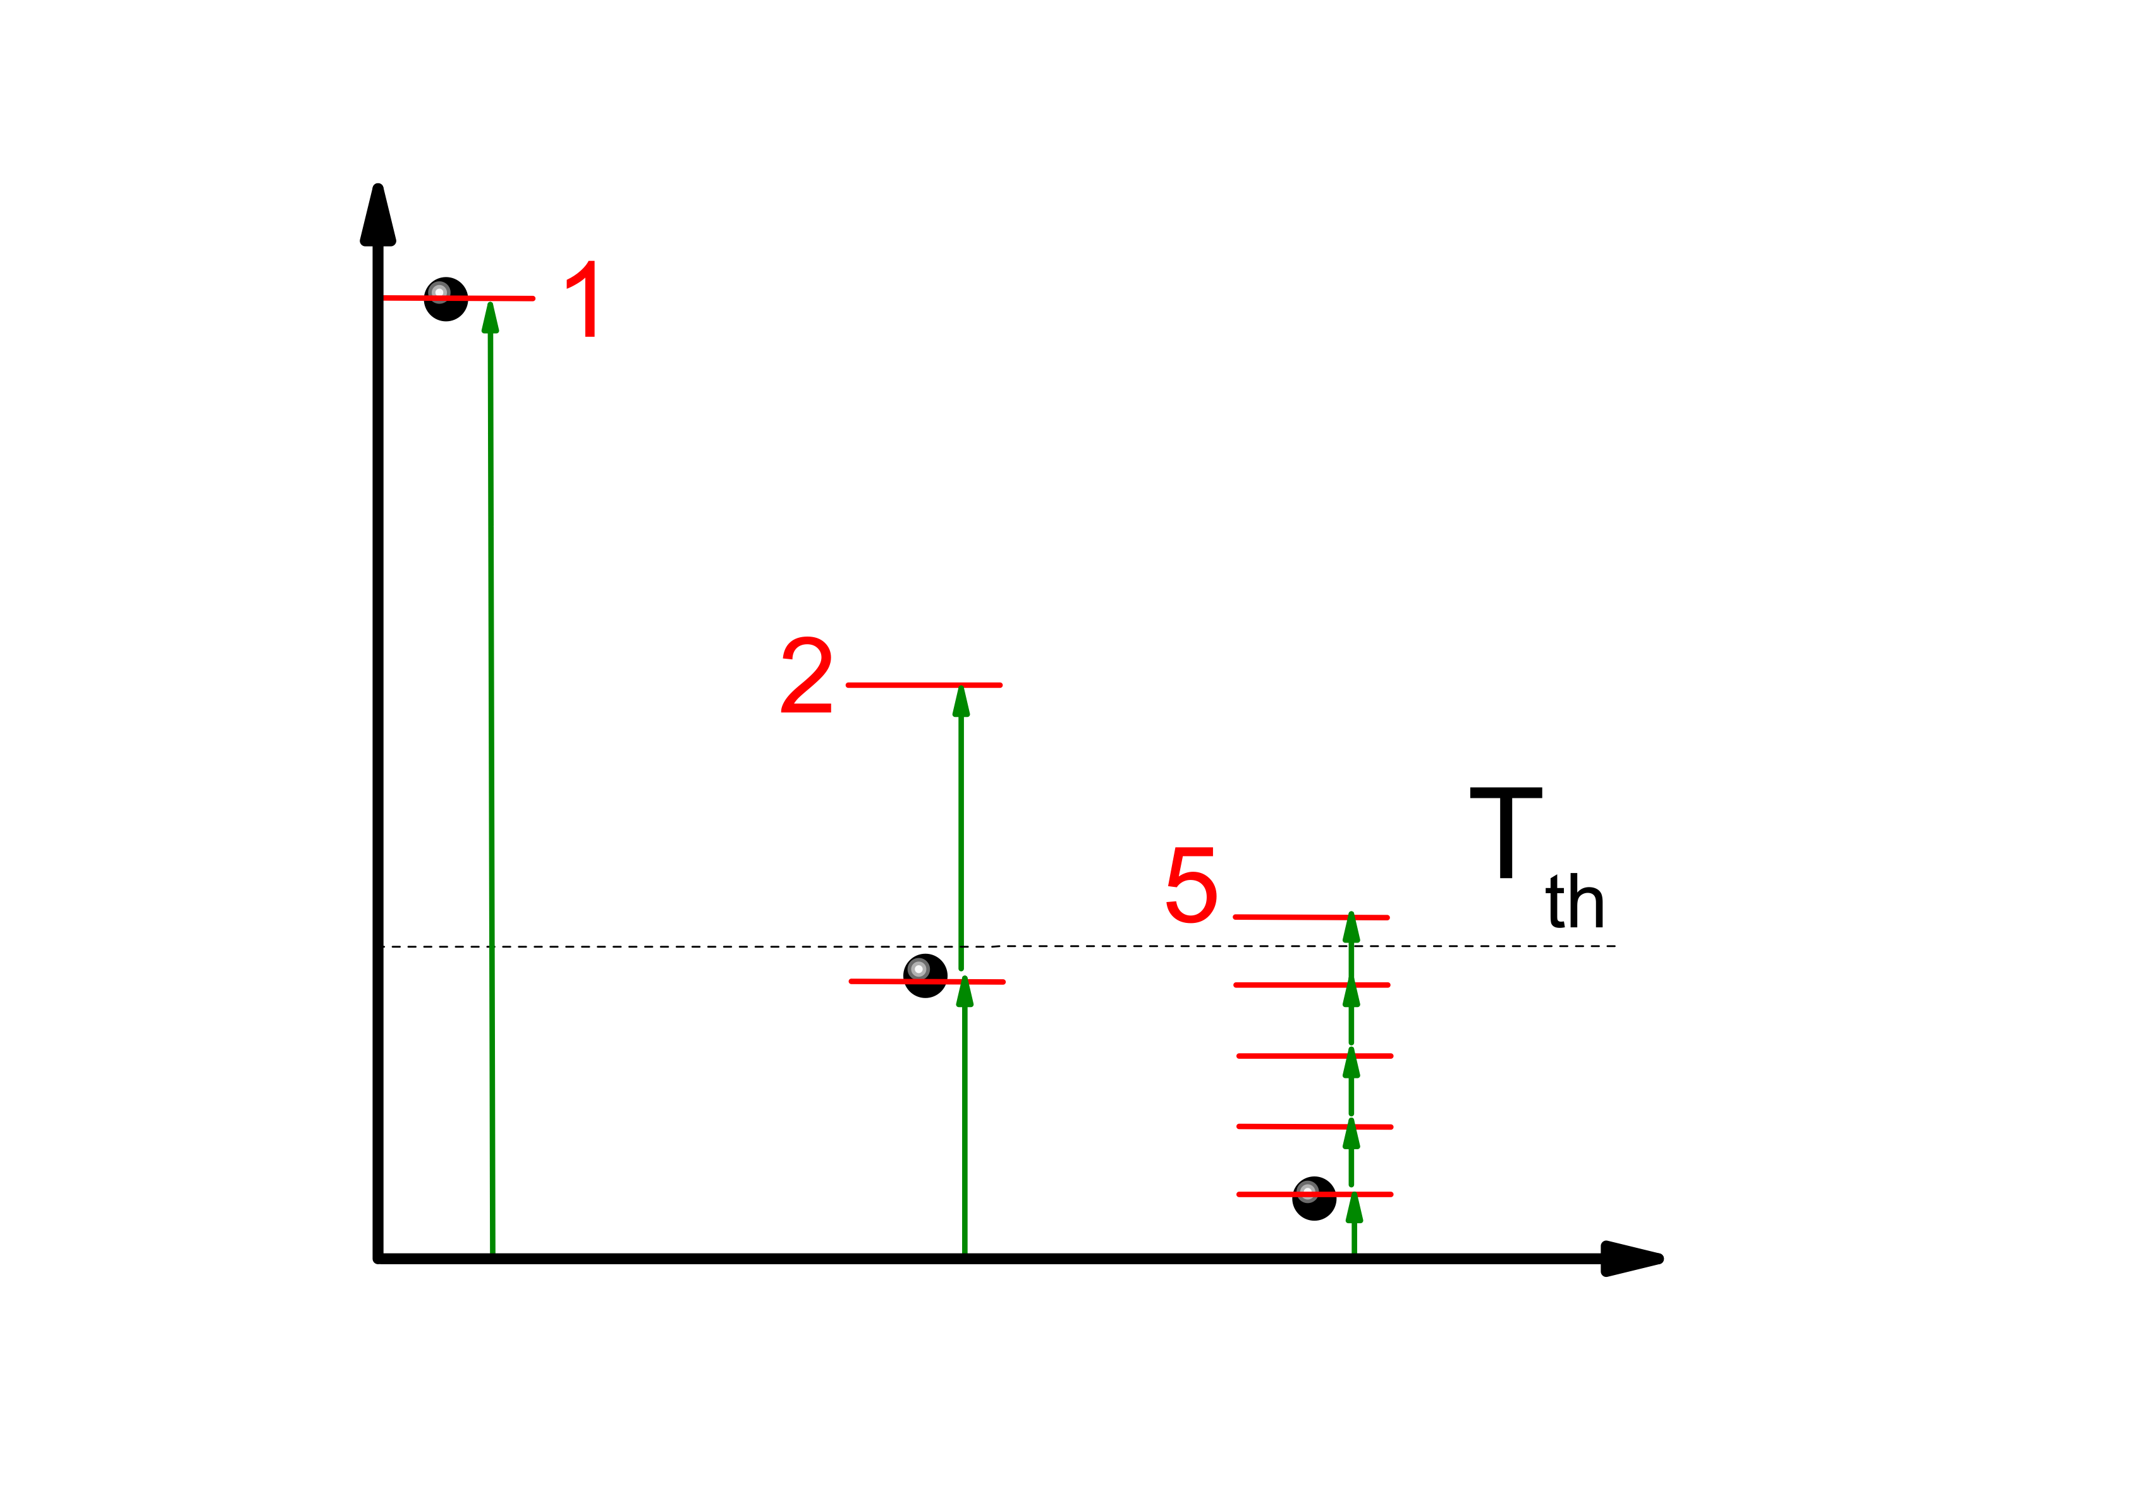
Numerical simulations
δT(K)
Tb(K)

Slide 13
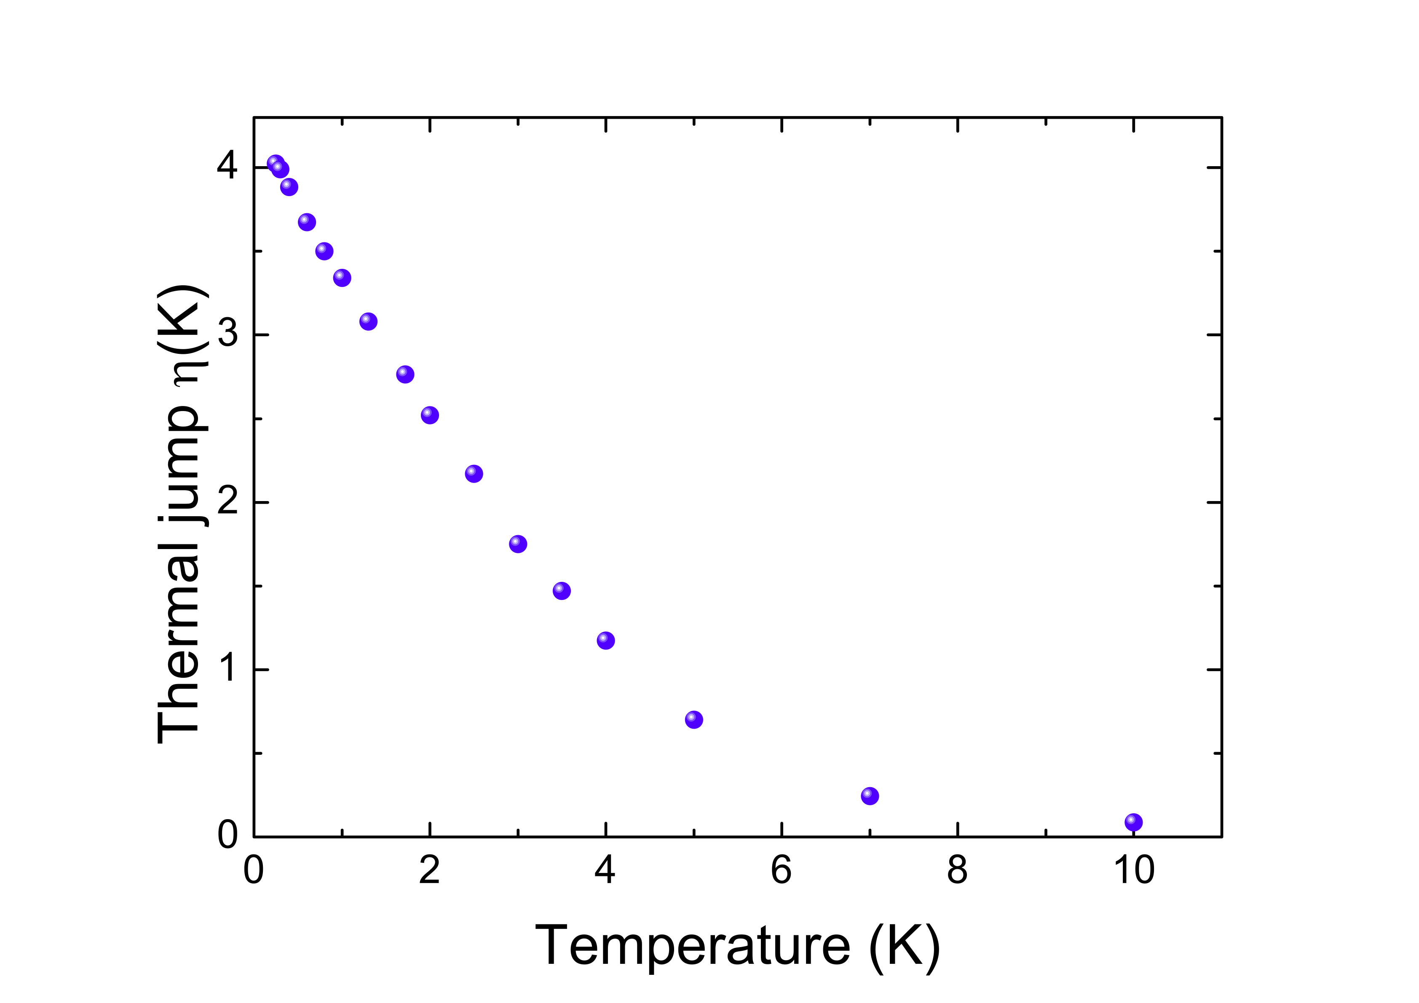
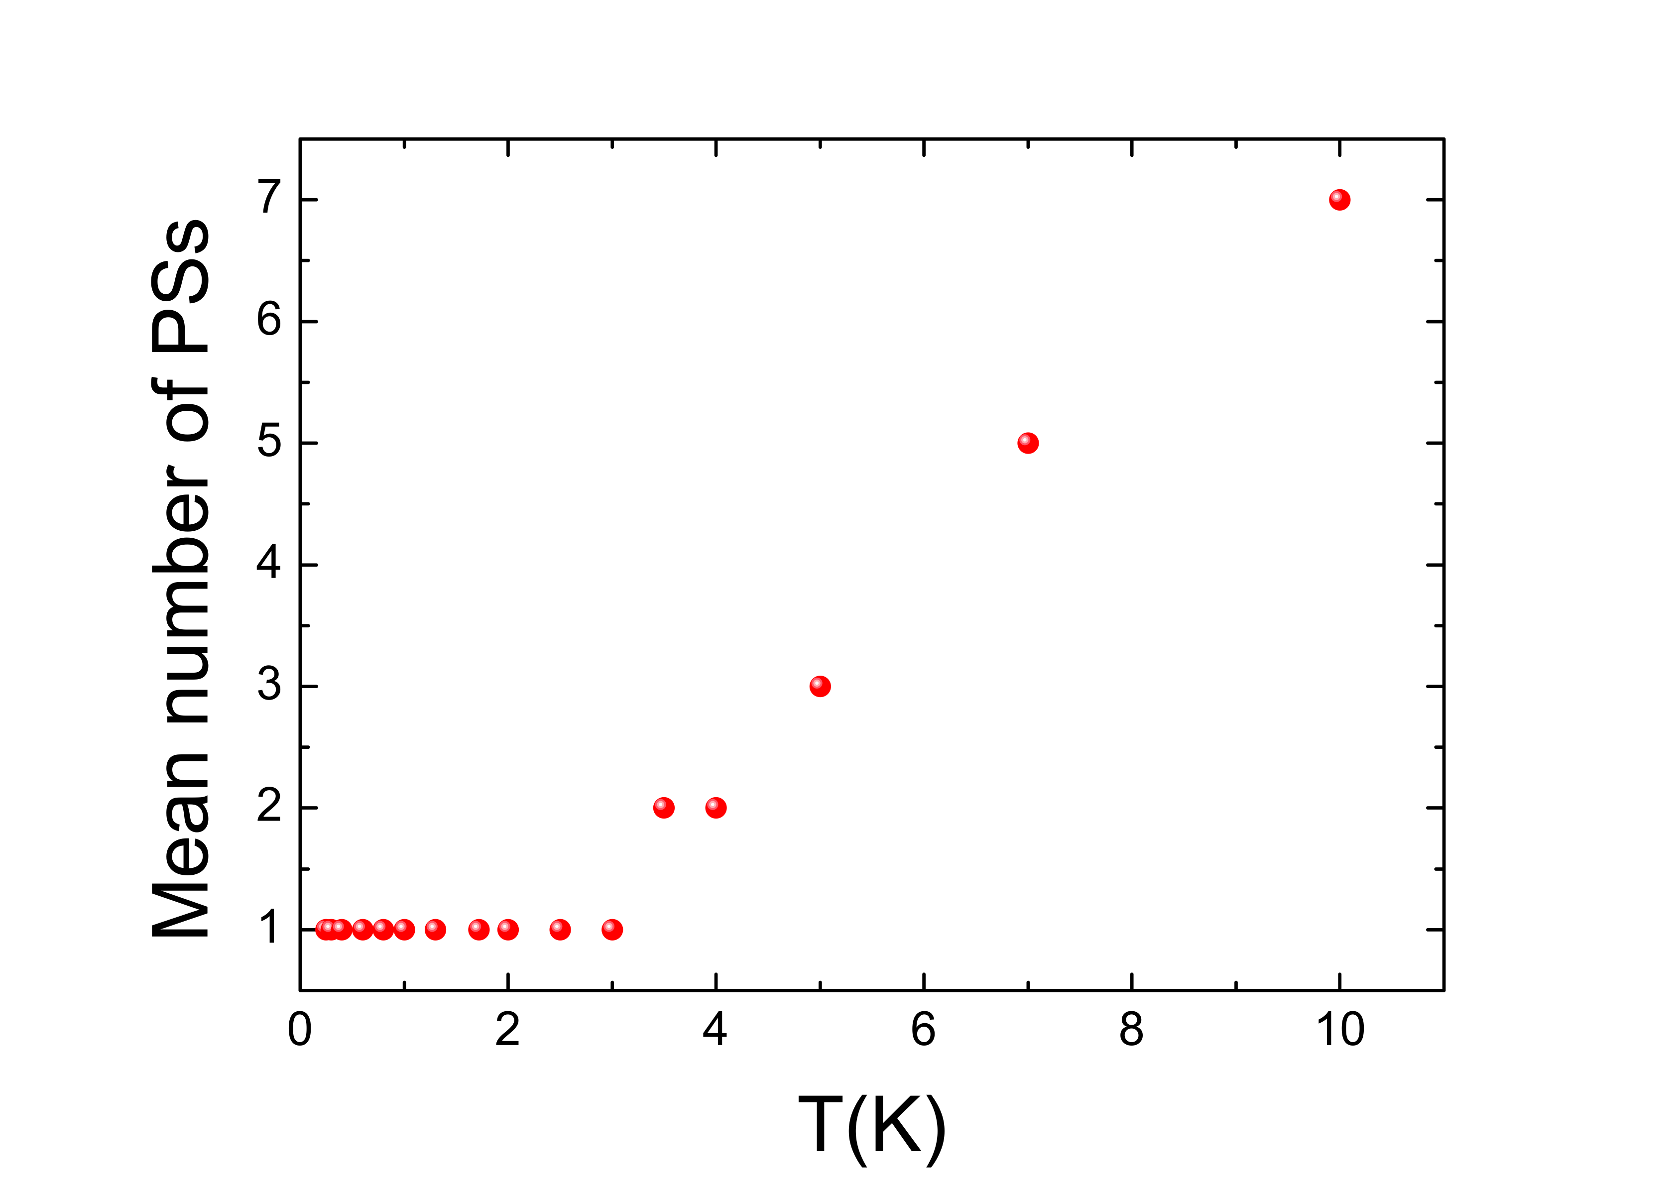
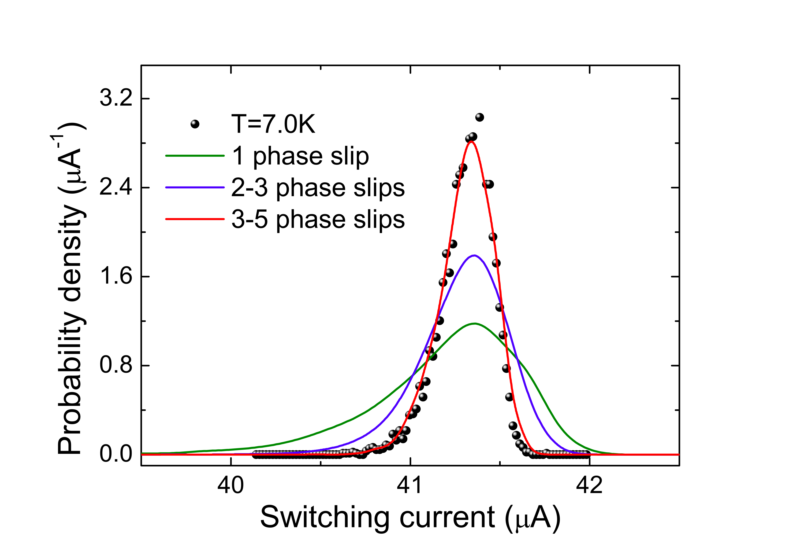
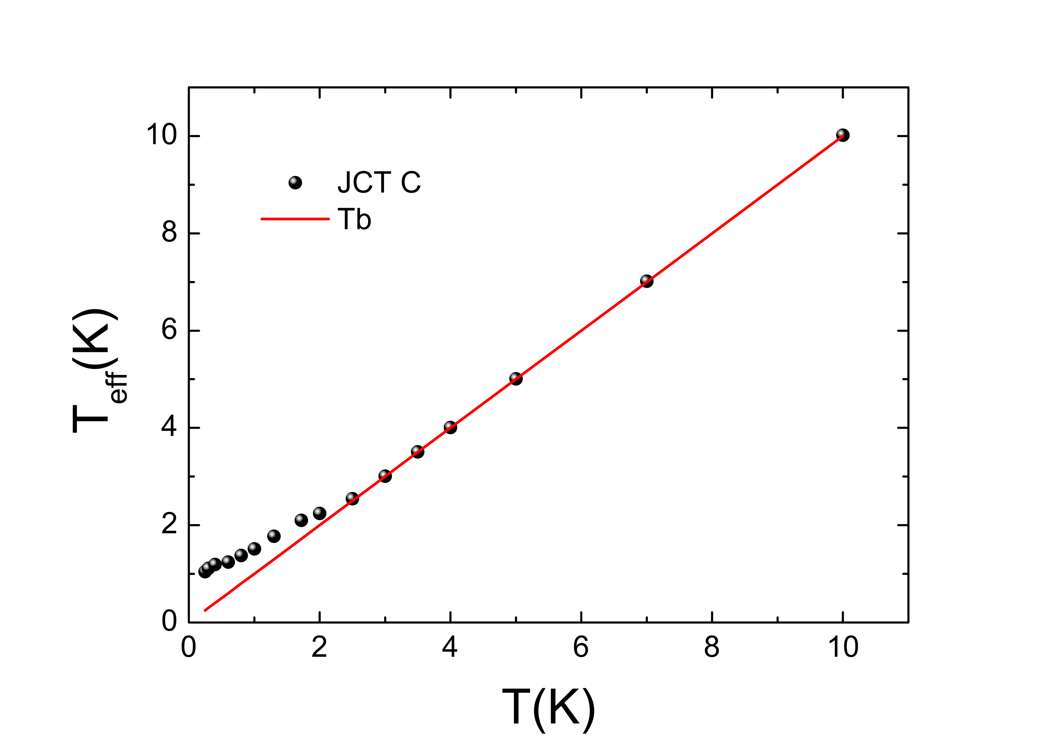
Numerical simulations
D. Massarotti et al. Phys. Rev. B 92, 054501 (2015)
1 heating event
2-3 heating events
4-6 heating events
Distinctive switching phenomena
Local heating processes drive the transition to the resistive state
Non-equilibrium effects in high Jc JJs

Slide 14
Conclusions
High Jc grain boundary junction
Phase dynamics of YBCO JJs: fingerprints of different sources of dissipation
High Jc JJs: switching dynamics regulated by local heating processes
Breakdown of the Josephson phase dynamics in YBCO nano-channels
δT(K)
Tb(K)

Slide 16
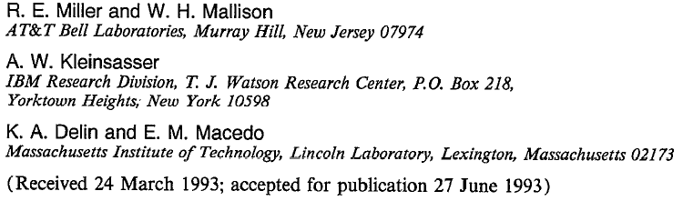
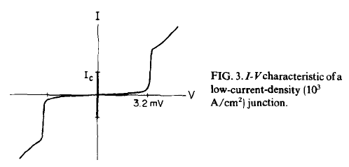
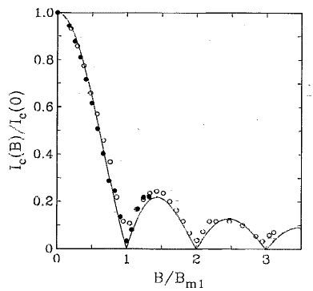
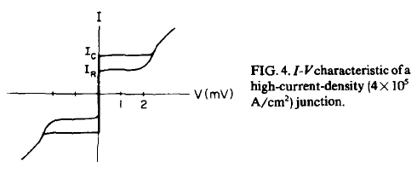
Switching dynamics in high Jc JJs

Slide 17
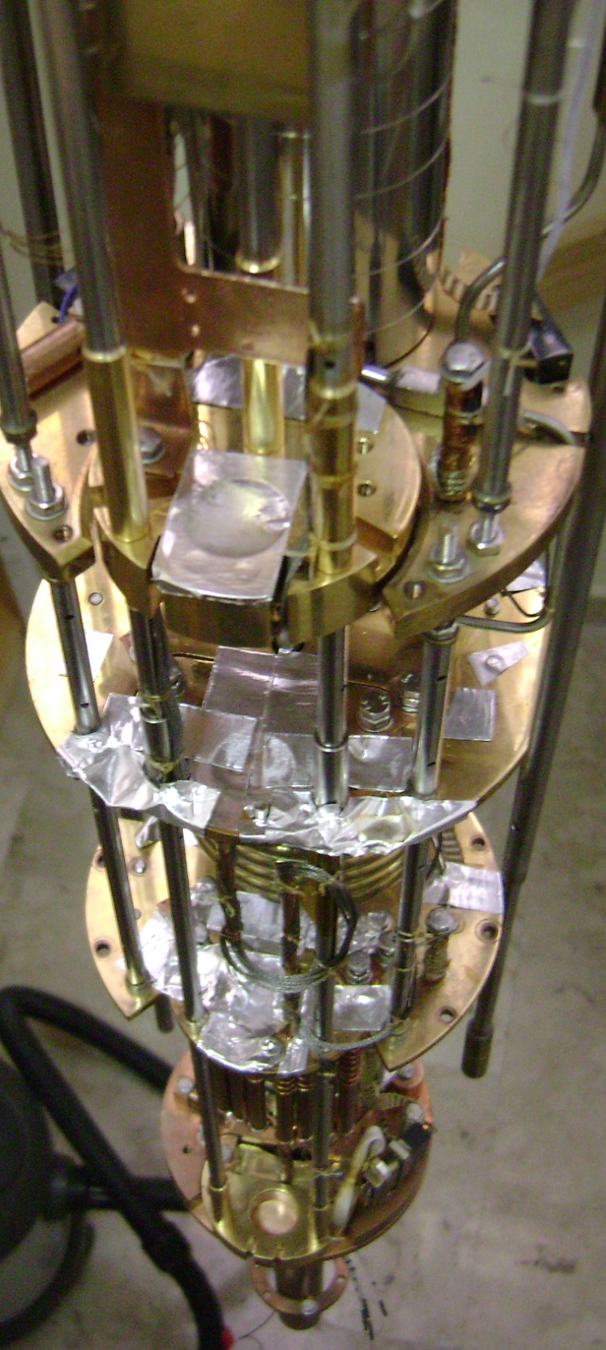
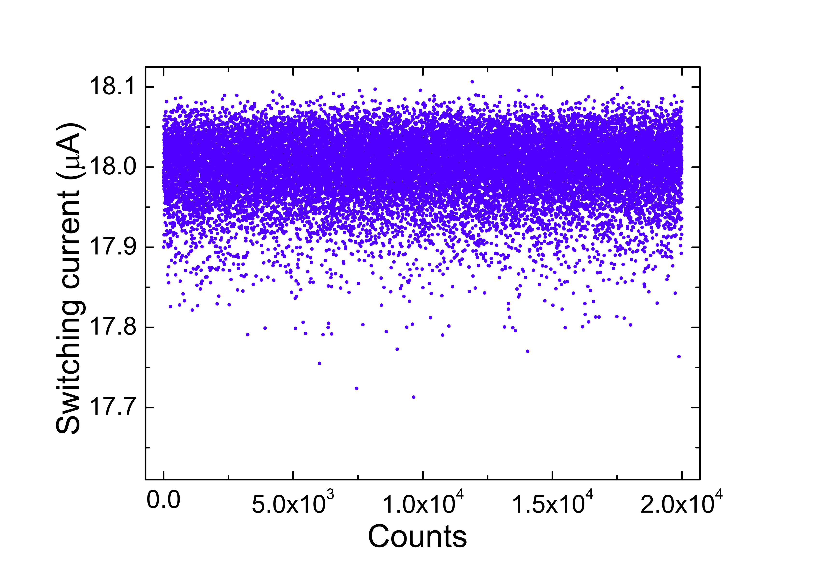

Switching distribution measurements
Measurement setup
T=1.5 K: RC filters
GPIB -> PC
T=50 mK: Cu powder filters
T=20 mK: sample stage

Slide 18





Slide 19

IV characteristics
A. Barone and G.Paternò, “Physics and Applications of the Josephson effect”, Wiley, 1982
Notes:
Necessità di collegare con capcità

Slide 20


HTS ‘Nano’-junctions
Self-assembling+nanopattering Embedded self-assembling

Slide 21


Realization of YBCO GB biepitaxial JJs
or
(LSAT)
F.Lombardi et al. Phys. Rev. Lett. 89 207001 (2002)

Slide 22






SFS JJs

