Slide 1

Geophysical methods
for environmental purposes
Giorgio Cassiani
with (in Random Order):
Markus Wehrer,, Rita Deiana, Klaus Haaken, Jacopo Boaga, Claudio Paniconi, Giulio Vignoli, Matteo Rossi, Maria Teresa Perri, Michela Giustiniani, Damiano Pasetto, Mario Putti, Marco Marani, Alberto Bellin, Bruno Majone, Nicoletta Fusi, Sebastiano Piccolroaz, Franco Palmieri, Andy Binley, Andreas Kemna, Enzo Rizzo, Giuseppe Fadda, Simona Consoli, Daniela Vanella, Adrian Flores Orozco, Gabriele Manoli, Peter Dietrich, Ulrike Werban, Gian Piero Deidda, Nadia Ursino, Andrea D’Alpaos, Matteo Camporese, Oscar Cainelli, Alberto Villa, Paolo Frattini, Giovanni Crosta, Bruno Della Vedova, Paolo Salandin, Isabella Gervasio, Enrico Dezzan, and others that I may have forgotten….
Dipartimento di Geoscienze – Università di Padova

Slide 2
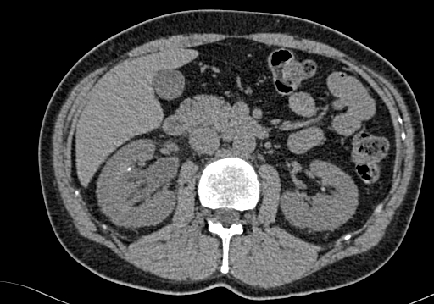
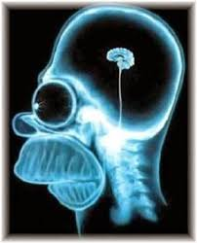
Geophysical Imaging

Slide 3

Geophysical measurements
instrument
G = measured (geo)physical quantity
P= (geo)physical parameter spatially distributed
in the subsoil, influencing response G
domain of investigation
G = G(P, F = forcing conditions)

Slide 4
MEASUREMENT
Physics
physical
parameter
P(x,y,z)
signal G(x,y)
PROCESSING
INVERSION
distribution
of P(x,y,z)
(estimated)
information
for end users
(site conceptual model)
ANALYSIS

Slide 5
GEOPHYSICAL
METHODS
APPLICATIONS
?
Hydrocarbon exploration
Mineral exploration
Engineering studies
Hydrogeological studies
Contaminant identification
Geological investigations
Forensic studies
Archaelogical studies
...
Geo-electrics
Seismics
GPR
EM methods
Gravimetry
Magnetism
...

Slide 6
GEOPHYSICAL
METHODS
APPLICATIONS
The choice should be made according to the following criteria:
the goal of the application must be compatible with the measured physical quantity
the method must have sufficient spatial (and temporal) resolution and sufficient penetration
cost
logistics
environmental impact

Slide 7
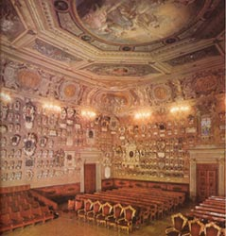
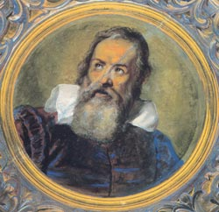
What is the role
of applied geophysics ?
SITE CHARACTERIZATION
SITE
CONCEPTUAL
MODEL
DESIGN OF SITE CHARACTERIZATION
Notes:
Sources:
Morris and Therivel, Chapters 2, 3, 5, 6
DoE: App. 1, App 4, App. 9, App.10

Slide 8
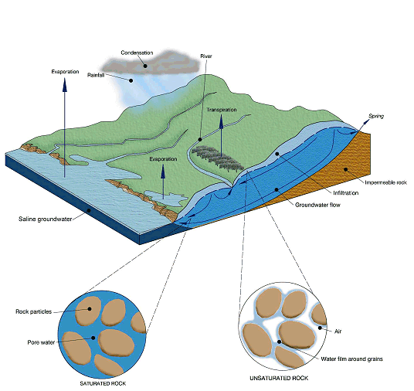
Hydrology
Floods
Mountain slope stability
Soil/groundwater contamination
Water in the shallow subsurface
carries energy
modifies the state of stress
carries contaminants
Environmental fluid-dynamics
(hydrology)
Shallow geophysics
(hydro-geophysics)

Slide 9
Applicable methods and measured physical quantities
METHOD
PHYSICAL PROPERTY
Seismics
elastic properties and density
Electro-magnetic methods
electrical conductivity /resistivity
DC resistivity methods
electrical conductivity /resistivity
Gamma ray spectrometry
natural gamma radiation
Ground Penetrating Radar
dielectric constant (electrical conductivity)‏
Magnetics
magnetic susceptibility / permanent magnetization
Gravimetry
density
(Spectral) Induced Polarization
complex electrical conductivity
Self Potential
DC sources
Nuclear Magnetic Resonance
free water content and decay time

Slide 10
What geophysical methods can help define
Notes:
10

Slide 11





What geophysical methods can help define
structure / texture
water table
aquifer
confining layer
impermeable
bedrock
large scale
small scale
Notes:
11

Slide 12
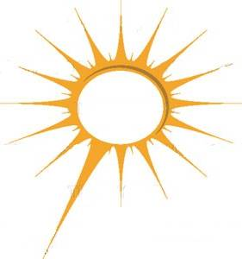

What geophysical methods can help define
structure / texture
fluid-dynamics: e.g. time-lapse evolution of moisture content
evapo-transpiration
spring
water table
aquifer
confining layer
impermeable
bedrock
water table
large scale
small scale
Notes:
12

Slide 13
What geophysical methods can help define
structure / texture
fluid-dynamics: e.g. time-lapse evolution of moisture content
contamination
evapo-transpiration
spring
water table
aquifer
confining layer
impermeable
bedrock
water table
large scale
small scale
Notes:
13

Slide 14
Applicable methods and subsurface characteristics
METHOD
STRUCTURE
DYNAMICS
CONTAMINATION
Seismics
++
Electro-magnetic methods
+
++
+
DC resistivity methods
++
++
+
Gamma ray spectrometry
++
Ground Penetrating Radar
++
++
+
Magnetics
+
Gravimetry
+
++
(Spectral) Induced Polarization
+
+
++
Self Potential
++
+
Nuclear Magnetic Resonance
+
++

Slide 15
GOAL
Integrate measurements and physical models that explain the space-time evolution of state variables such as moisture content, solute concentration and temperature that affect the space-time changes of geophysical response.
Physical
model
(e.g hydrologic)
Geophysical
measurements
structure
(geometry,
geology)
physical
parameters
(e.g. hydraulic
conductivity)
dynamics
(fluids,
temperature)

Slide 16
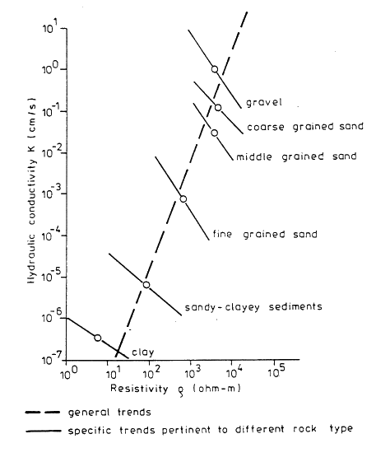
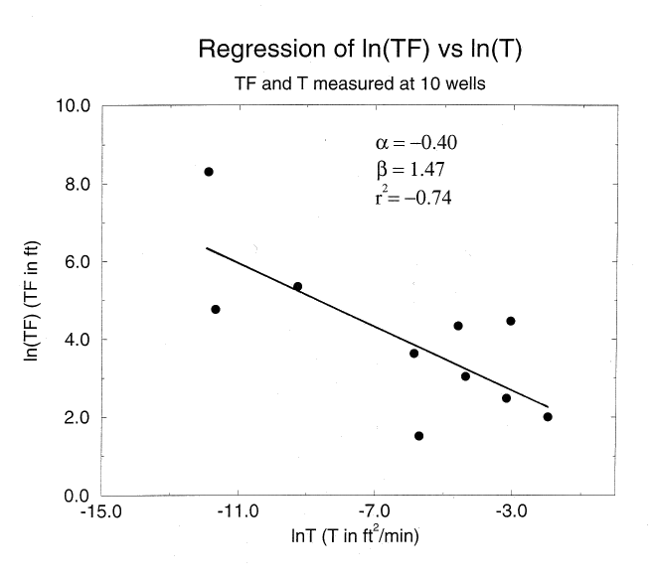
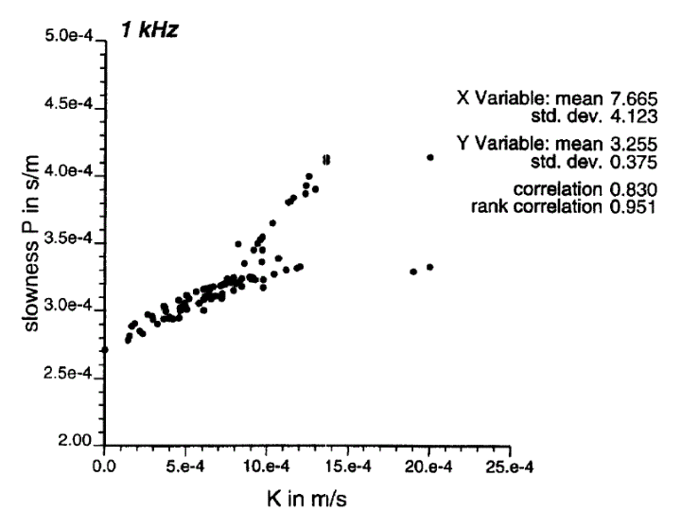
“Vintage” approach:
direct link between physical properties of models and geophysical quantities
Mazac et al., 1985
Cassiani and Medina, GW, 1995
Cassiani et al., JH, 1998

Slide 17
measured
or
simulated
geophysical
quantity
(saturation,
concentration)‏
Time – lapse geophysics
measured
or
simulated
geophysical
data
static aspects (geology)‏
dynamic aspects (hydrology)‏
Acquisition geometry
(resolution-sensitivity issues)‏
cross-hole
surface-to-hole
surface-to-surface
Applicable methods
Ground-Penetrating Radar (GPR)‏
Electrical Resistivity Tomography (ERT)‏
… etc
Hydrology – Geophysics
constitutive relationships
dielectric properties (GPR)‏
DC resistivity (ERT)‏
complex resistivity (SIP)‏

Slide 18
SUMMARY
Hydro-geophysics: a problem-driven discipline
A Glimpse to a number of applications
Conclusions and outlook

Slide 19
A glimpse to applications
Vadose zone
Critical zone
Aquifers
Hyporheic zone
Hillslope
Conclusions
Catchment
Contamination
Acknowledgments

Slide 21
SUMMARY
Hydro-geophysics: a problem-driven discipline
A Glimpse to a number of applications
Vadose zone characterization
Conclusions and outlook

Slide 22
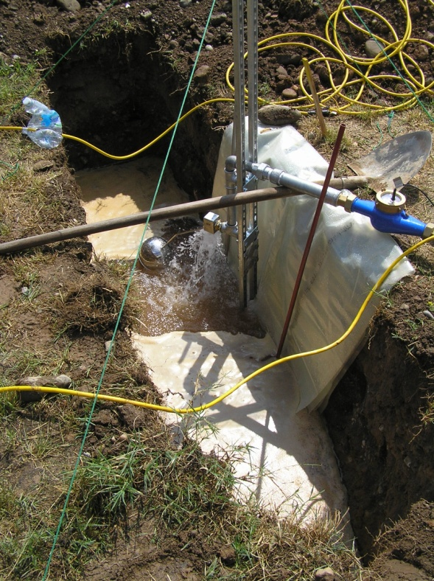
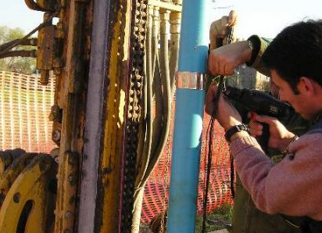
Characterisation of the vadose zone
of the Po river plain sediments:
the Gorgonzola (Milan) test site
Borehole A
ERT & GPR
7.95 m
trench
Borehole D
(cored)
Water injection experiment in trench
22 m³ of water in 10 hours
6.65 m
7.20 m
Borehole C
ERT & GPR
Borehole B
ERT &GPR
Deiana et al., VZJ, 2008

Slide 23






Gorgonzola: injection experiment
3 hr 11 hr 22 hr 45 hr 117 hr 141 hr
0
0
0
0
0
0
-2
-2
-2
-2
-2
-2
0.07
-4
-4
-4
-4
-4
-4
0.06
-6
-6
-6
-6
-6
-6
0.05
ERT
-8
-8
-8
-8
-8
-8
0.04
m
m
-10
m
m
m
m
0.03
-10
-10
-10
-10
-10
0.02
-12
-12
-12
-12
-12
-12
0.01
-14
-14
-14
-14
-14
-14
0
-16
-16
-16
-16
-16
-16
-0.01
depth (m b.g.l.)
-18
-18
Δθ
-18
-18
-18
-18
-20
0
2
m
4
6
-20
0
2
m
4
6
-20
0
2
m
4
6
-20
0
2
4
6
-20
0
2
4
6
-20
0
2
4
6
end of
injection
m
m
m
0.00
0.00
0.00
0.00
0.00
0.00
-4.00
-4.00
-4.00
-4.00
-4.00
-4.00
ZOP
GPR
-8.00
-8.00
-8.00
-8.00
-8.00
-8.00
-12.00
-12.00
-12.00
-12.00
-12.00
-12.00
-16.00
-16.00
-16.00
-16.00
-16.00
-16.00
depth (m b.g.l.)
-20.00
0.00
0.02
0.04
0.06
-20.00
0.00
0.02
0.04
0.06
-20.00
0.00
0.02
0.04
0.06
-20.00
0.00
0.02
0.04
0.06
-20.00
0.00
0.02
0.04
0.06
-20.00
0.00
0.02
0.04
0.06
Δθ (-)
Δθ (-)
Δθ (-)
Δθ (-)
Δθ (-)
Δθ (-)
Deiana et al., VZJ, 2008

Slide 24
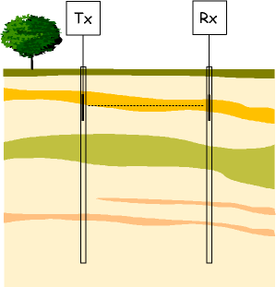
Injection phase
1 hr 2 hr 3 hr 5.5 hr 7 hr 8 hr 9 hr 10 hr 11 hr
depth (m b.g.l.)
Δθ
Δθ
Δθ
Δθ
Δθ
Δθ
Δθ
Δθ
Δθ
zop GPR
Deiana et al., VZJ, 2008

Slide 25
MASS BALANCE
known
injected
mass
Fresnel volume
MODEL
FIELD DATA
r_{max}
r_{max}
L
mass in given
control volume
mass in given
control volume

Slide 26
Model calibration on the centre of mass
anisotropic models
-2
-4
ZOP
MOG
ERT
K_{H} = 36 m/d, α = K_{H}/K_{V} = 10
-6
K_{H} = 36 m/d, α = K_{H}/K_{V} = 5
depth of centre of mass (m b.g.l.)
-8
-10
K_{H} = 288 m/d
K_{H} = 36 m/d
α = K_{H}/K_{V} = 3
K_{H} = 72 m/d
K_{H} = 144 m/d
-12
K_{H} = 36 m/d, α = K_{H}/K_{V} = 2
-14
0
20
40
60
80
time after start of injection (hr)
Deiana et al., VZJ, 2008

Slide 27
Injection phase
1 hr 2 hr 3 hr 5.5 hr 7 hr 8 hr 9 hr 10 hr 11 hr
0
-4
-8
depth (m b.g.l.)
-12
-16
-20
0.00
0.02
0.04
0.06
0.00
0.02
0.04
0.06
0.00
0.02
0.04
0.06
0.00
0.02
0.04
0.06
0.00
0.02
0.04
0.06
0.00
0.02
0.04
0.06
0.00
0.02
0.04
0.06
0.00
0.02
0.04
0.06
0.00
0.02
0.04
0.06
Δθ
Δθ
Δθ
Δθ
Δθ
Δθ
Δθ
Δθ
Δθ
measured using zop GPR
simulation results: isotropic model with K_{s} = 5 m/d
Fresnel zone
simulation results: anisotropic model with K_{sH} = 288 m/d, α = K_{sH}/K_{sV} = 3
Deiana et al., VZJ, 2008

Slide 29
SUMMARY
Hydro-geophysics: a problem-driven discipline
A Glimpse to a number of applications
Aquifer characterization
Conclusions and outlook

Slide 30
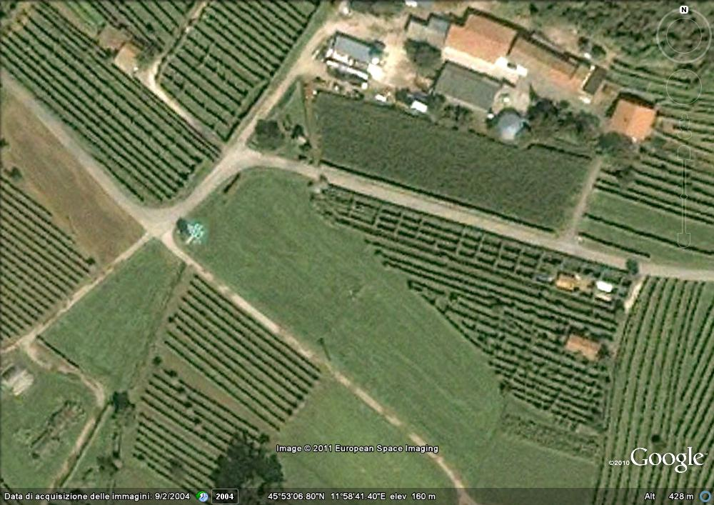
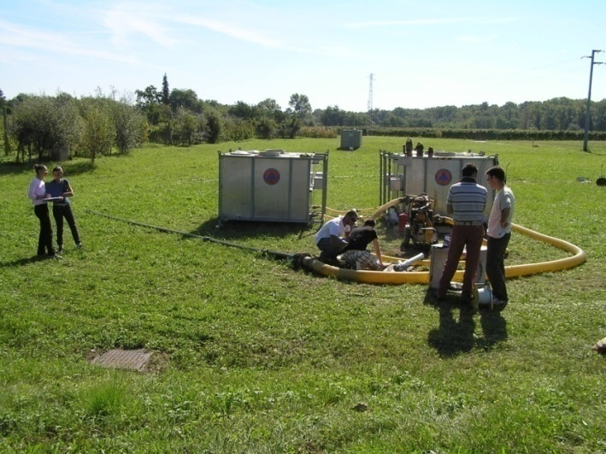
EXPERIMENTAL TEST AREA – Valdobbiadene – NE Italy
saline tracer test to identify
travel times and hydraulic conductivity structure
saline tracer injection well
flow direction
20 m
ERT equipped wells
15 m
15 m
15 m
35 m
pumping well (200 l/s)
Perri et al., JAG, 2012

Slide 31
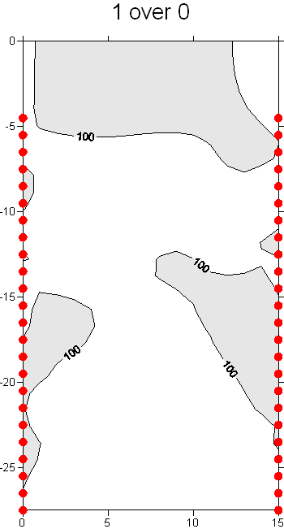

EXPERIMENTAL TEST AREA – Valdobbiadene – NE Italy
Time 1 (hh:mm): 00:34 after injection
3
2
resistivity ratio w.r.t. background
water table
Experimental Test Area
2
20 m
15 m
15 m
3
15 m
35 m
monitoring line

Slide 32
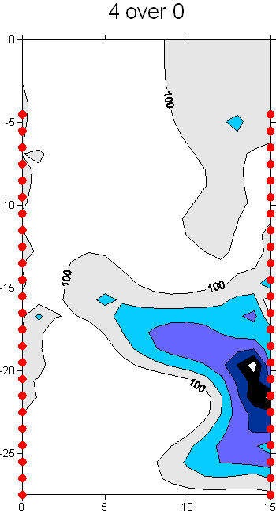
EXPERIMENTAL TEST AREA – Valdobbiadene – NE Italy
Time 4 (hh:mm): 03:27 after injection
3
2
resistivity ratio w.r.t. background
water table
2
20 m
15 m
15 m
3
15 m
35 m
monitoring line

Slide 33
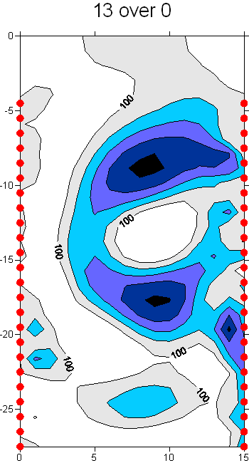
EXPERIMENTAL TEST AREA – Valdobbiadene – NE Italy
Time 13 (hh:mm): 11:30 after injection
3
2
resistivity ratio w.r.t. background
water table
2
20 m
15 m
15 m
3
15 m
35 m
monitoring line

Slide 34
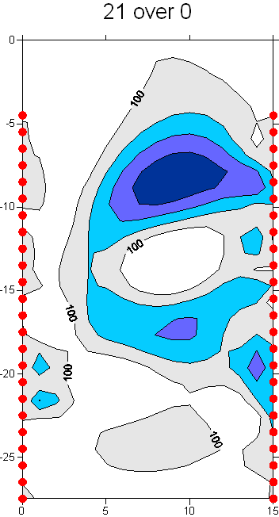
EXPERIMENTAL TEST AREA – Valdobbiadene – NE Italy
Time 21 (hh:mm): 21:43 after injection
3
2
resistivity ratio w.r.t. background
water table
2
20 m
15 m
15 m
3
15 m
35 m
monitoring line

Slide 35
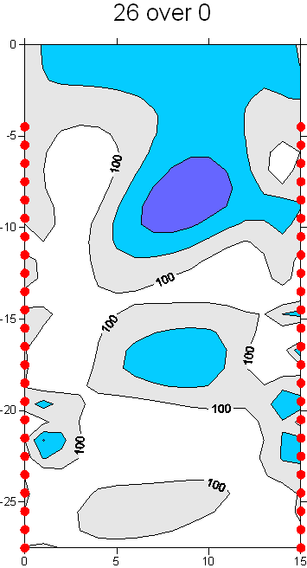
EXPERIMENTAL TEST AREA – Valdobbiadene – NE Italy
Time 26 (hh:mm): 54:27 after injection
3
2
resistivity ratio w.r.t. background
water table
2
20 m
15 m
15 m
3
15 m
35 m
monitoring line

Slide 36
INFORMATION CONTENT IN
TRACER TEST EXPERIMENTS MONITORED WITH ERT
Great care must be taken when interpreting ERT results:
Resolution depends dramatically on the acquisition configuration
(surface vs cross-hole)
Cross-borehole
ERT results
Surface
ERT results
Perri et al., JAG, 2012

Slide 38
SUMMARY
Hydro-geophysics: a problem-driven discipline
A Glimpse to a number of applications
Hillslope characterization
Conclusions and outlook

Slide 39
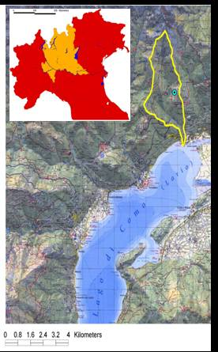
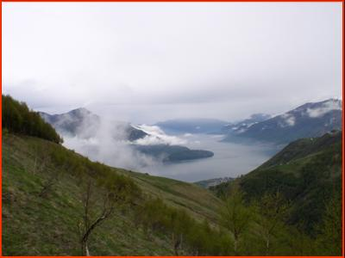
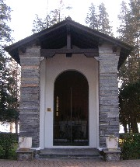
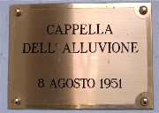
Montemezzo project
Can we identify the
prevailing flow path?
precipitation
surface runoff
St. Vincenzo
Creek basin
fast subsurface flow in soil cover
deep subsurface flow in fractured rock (old water)
Cassiani et al., NSG, 2009

Slide 40
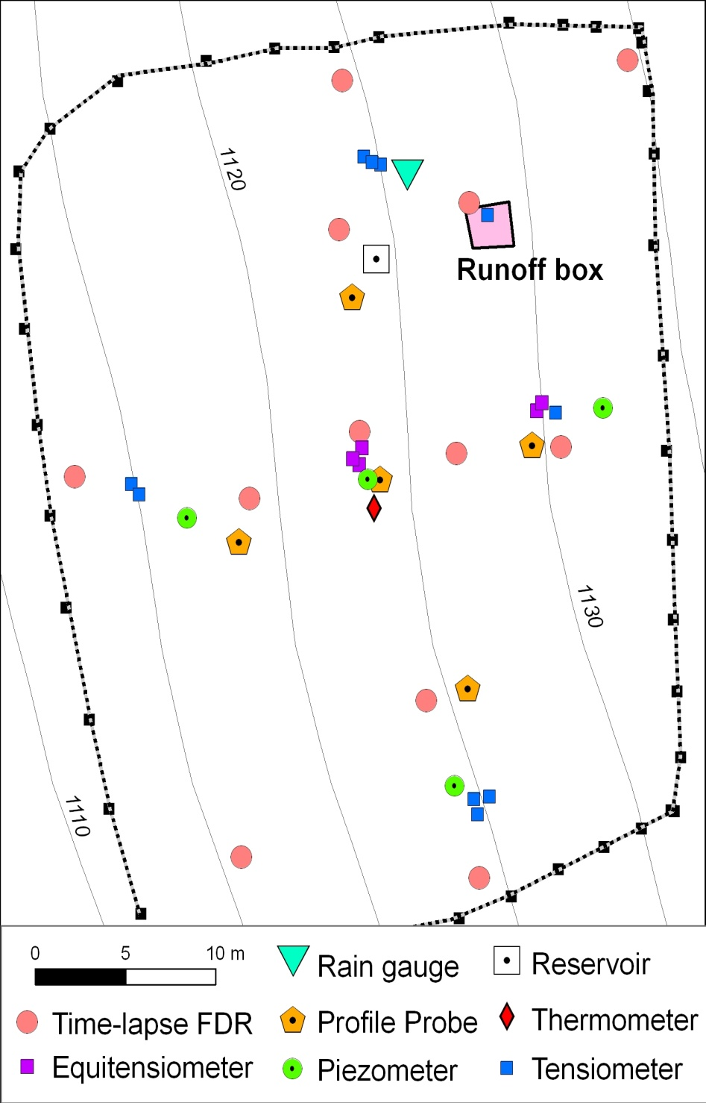
Controlled irrigation tests
We conducted two irrigation tests on a controlled runoff box, equipped with TDR, tensiometers and boreholes having electrodes installed for 3D cross-hole ERT.
2D ERT line
downhill
TDR6
C
TDR1
F
E
TDR2
B
A
1 m
TDR3
TDR5
TS60
TS30
D
RUNOFF BOX
TS60
TDR4
2 m
Cassiani et al., NSG, 2009

Slide 41
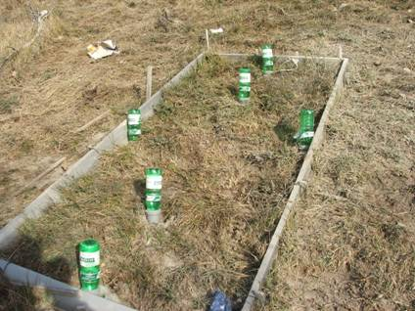
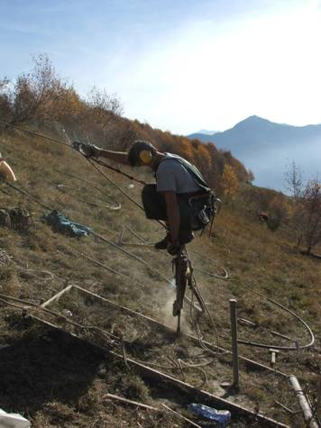
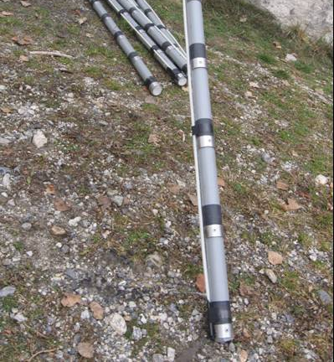
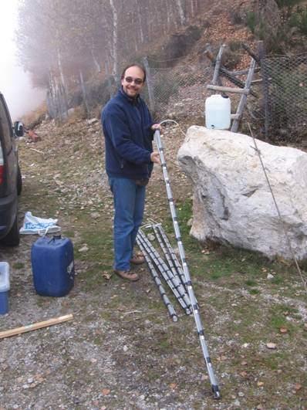
Installation of boreholes
B
A
C
D
E
F
RUNOFF BOX
30-40°
Six boreholes, 2 m deep.
12 electrodes in each borehole.
Cassiani et al., NSG, 2009

Slide 42
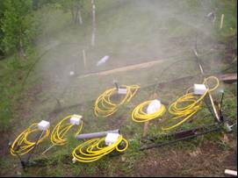
3D ERT – Resistivity ratio inversion w.r.t. background
dark blue = 30% of background
light blue = 70% of background
C
B
2 m
E
D
surface
2 m
B
C
D
E
soil-bedrock interface
After 0.8 h
After 2.4 h
THE INFILTRATION TAKES PLACE VERY QUICKLY, APPARENTLY THROUGH
PREFERENTIAL PATHWAYS
RUNOFF BOX

Slide 43
After 18 h
Runoff Box
2D ERT
Resistivity ratio
inversion w.r.t. background
END OF IRRIGATION
B
E
After 19 h
0
-1
-2
-3
0
5
10
15
20
25
30
35
After 21 h
0
-1
-2
-3
0
5
10
15
20
25
30
35
After 26 h
0
-1
-2
0
-3
2D ERT
0
5
10
15
20
25
30
35
B
0
C
-1
D
-2
-3
0
5
10
15
20
25
30
35
E
Distance along slope [ m ]
% of background
resistivity

Slide 44
THE DEEP SUBSURFACE FLOW
IS THE PREVAILING MECHANISM !
Cassiani et al., NSG, 2009

Slide 46
SUMMARY
Hydro-geophysics: a problem-driven discipline
A Glimpse to a number of applications
Catchment characterization
Conclusions and outlook

Slide 47
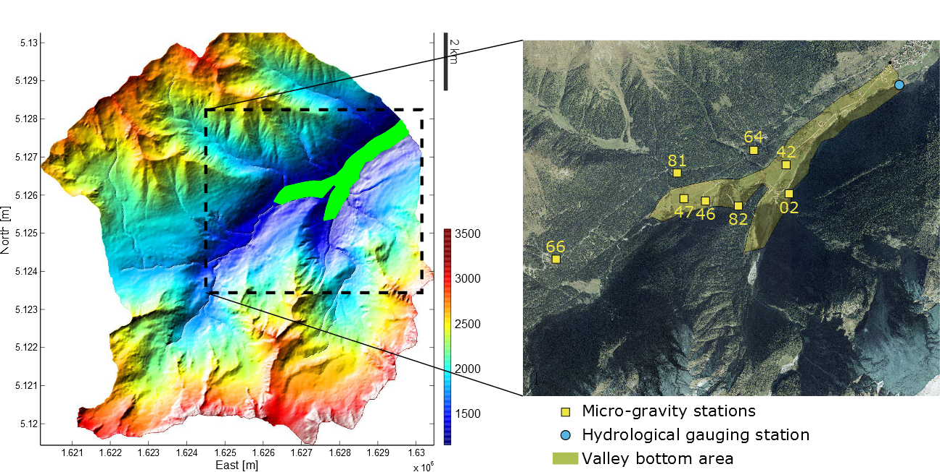
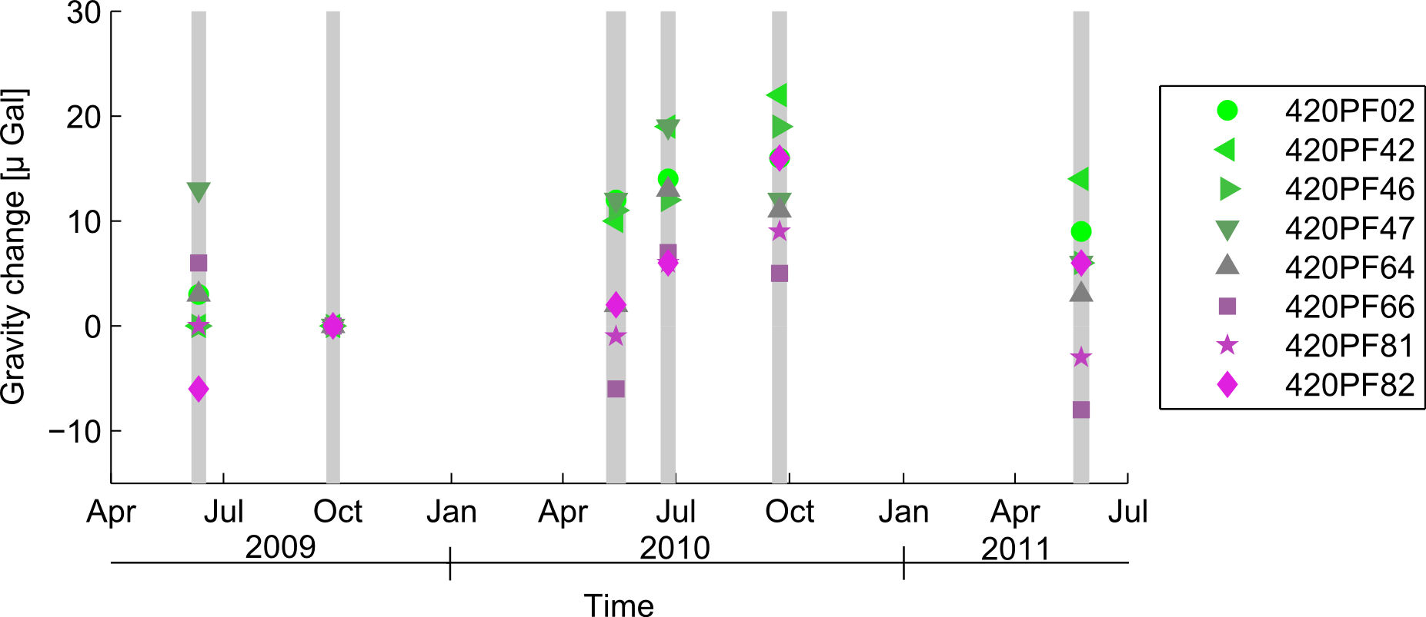

Val di Sole - Trentino
Micro-gravity time-lapse monitoring
Fieldwork and data acquisition:
6 field campaigns between June 2009 and May 2011;
extensive point gravity measurements on a network of 53 stations;
the Vermigliana catchment has been monitored through 8 stations;
streamflow data are available at the Vermiglio stream gauging station.
Piccolroaz et al., WRR, 2014
Notes:
the best candidate for reference

Slide 48
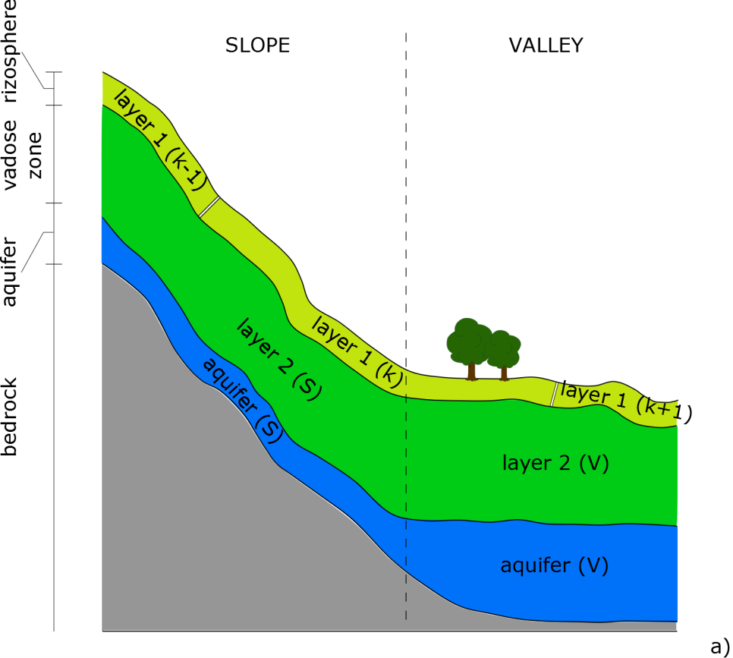
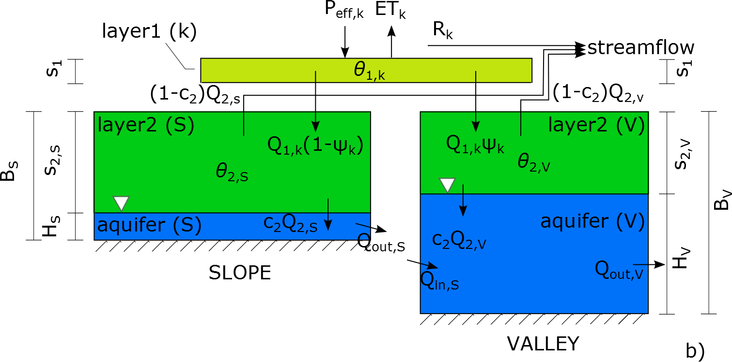
Hydrological model: a modified version of GEOTRANSF (Majone et al., 2012, WATER RESOUR RES), a semi-distributed model characterized by:
subdividing the catchment into slope and valley bottom areas (governed by inherently different processes);
explicitly coupling vadose-zone and groundwater dynamics.
Piccolroaz et al., WRR, 2014
Notes:
Which includes a simple degree-day snow melting and snow accumulation model

Slide 49
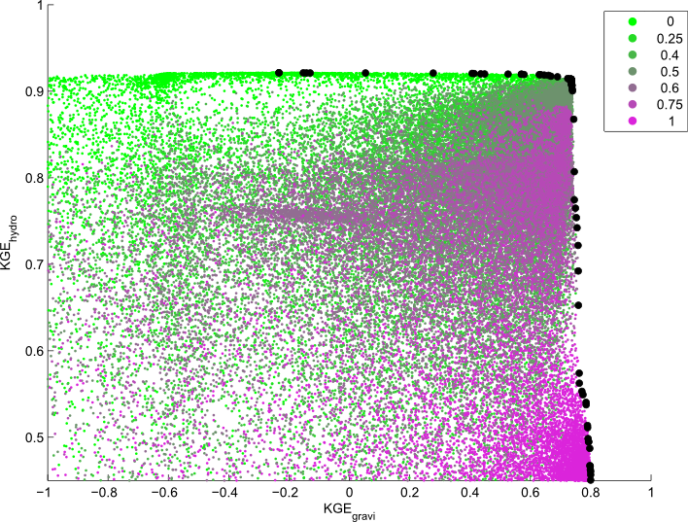
Pareto front
α
very sharp shape
Matching also the micro-gravity data requires that the model also describes
the saturated zone and its dynamics
Change of the system’s conceptualization
Piccolroaz et al., WRR, 2014
Notes:
\In this case the Pareto front has a very
sharp structure. The calibration based only on
Microgravity changes provides a bad simulation of
the catchment runoff. However,a minor relaxation of
the performance of the microgravity simulations
implies a significant improvement in the catchment
runoff simulation. The balanced optimum solution is
seen to provide a proper balance between the two objectives.
Within the the 10% from the maximum likelihood value

Slide 50
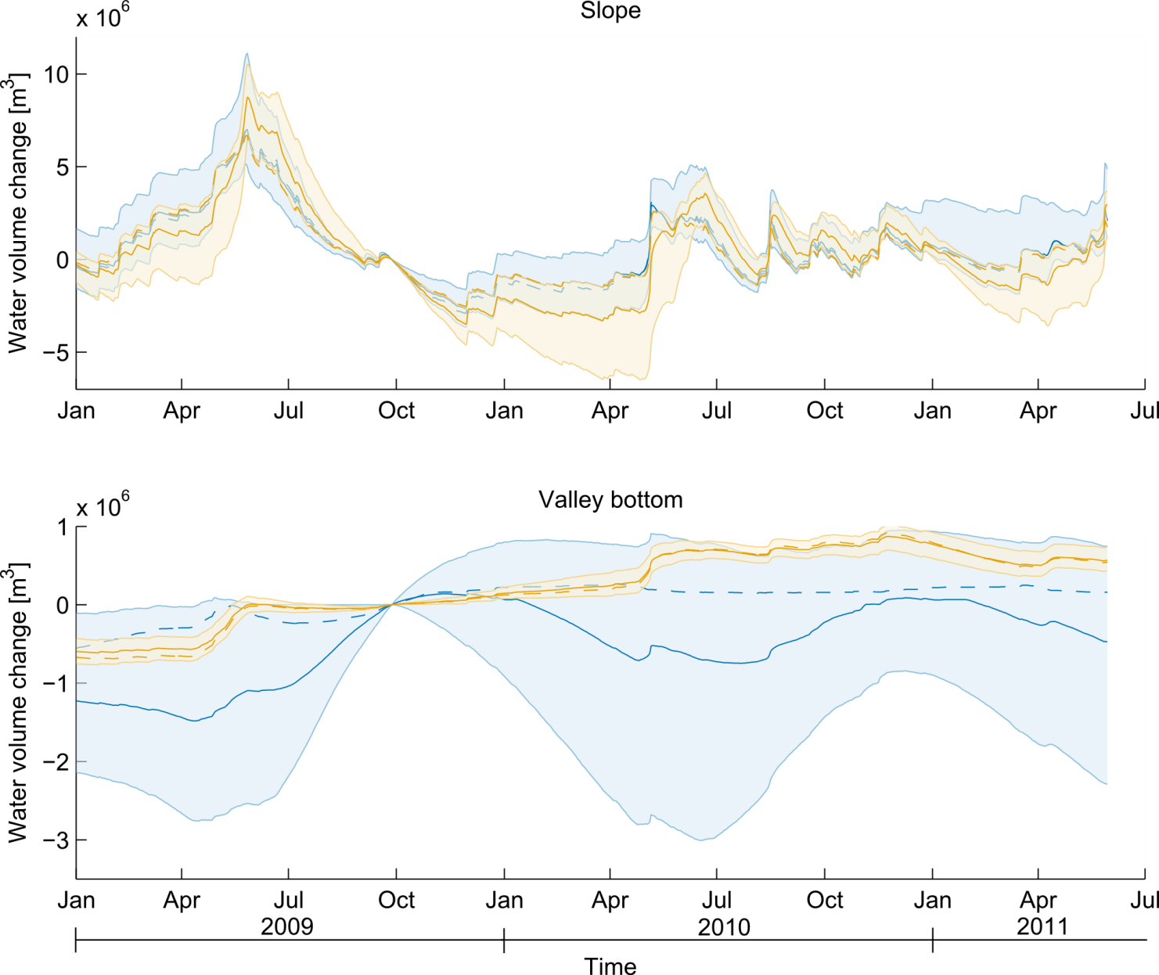
median
α=0 (95% uncert. bounds)
Water volume change
best sim.
α=0.5 (95% uncert. bounds)
d-factor
2.8E6 m³ = 2.8E6 m³
d-factor
2.2 m³ >> 0.2E6 m³
Piccolroaz et al., WRR, 2014

Slide 52
SUMMARY
Hydro-geophysics: a problem-driven discipline
A Glimpse to a number of applications
Contamination characterization
Conclusions and outlook

Slide 53
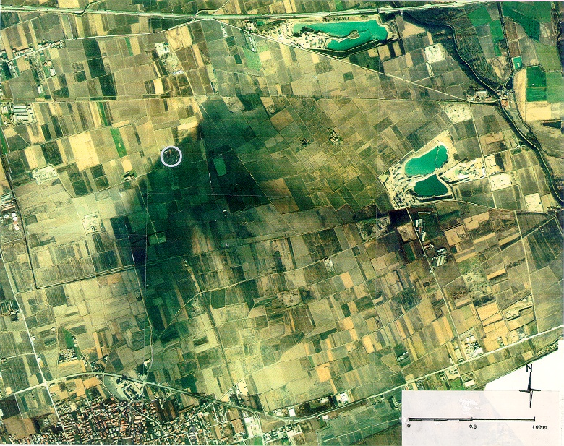

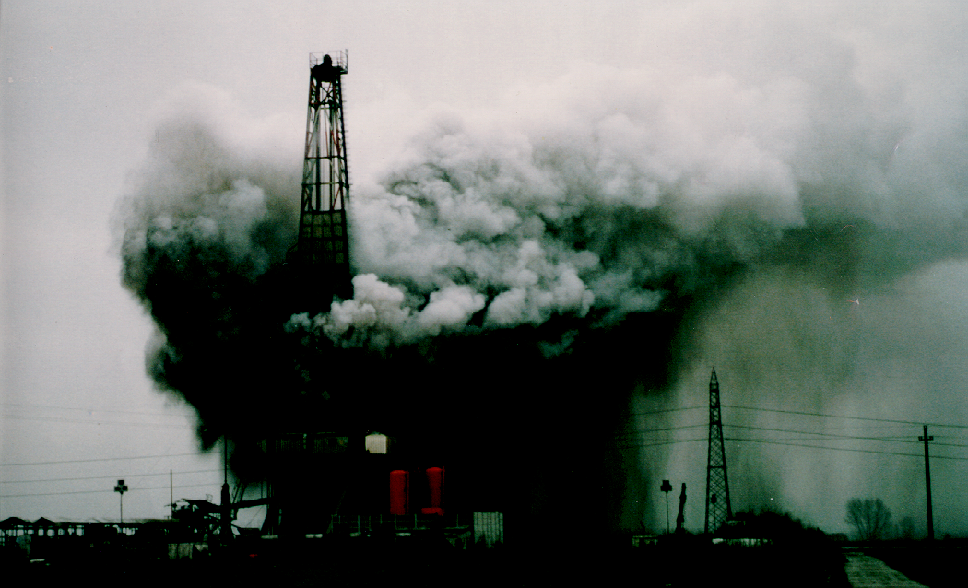
TR24
0 0.5 1 km
Blow out of TR24 oil well
Trecate, Novara
February 28 1994
Cassiani et al., ESPR, 2014

Slide 54
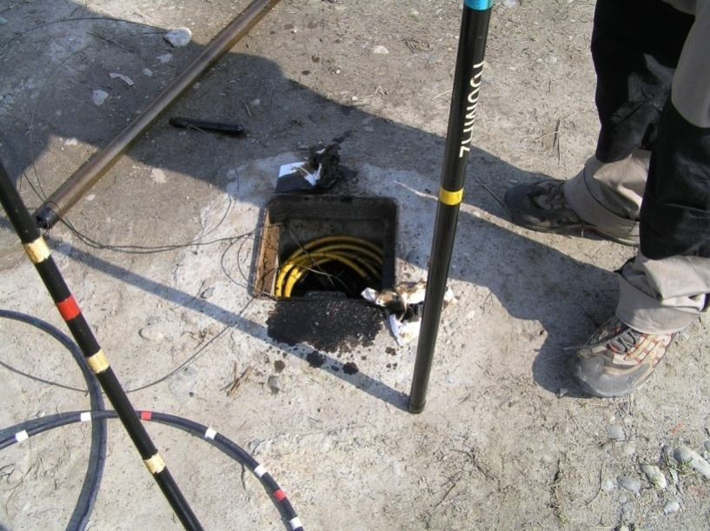
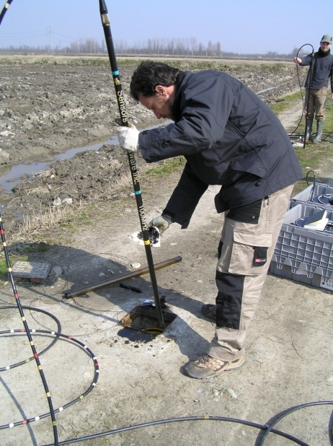

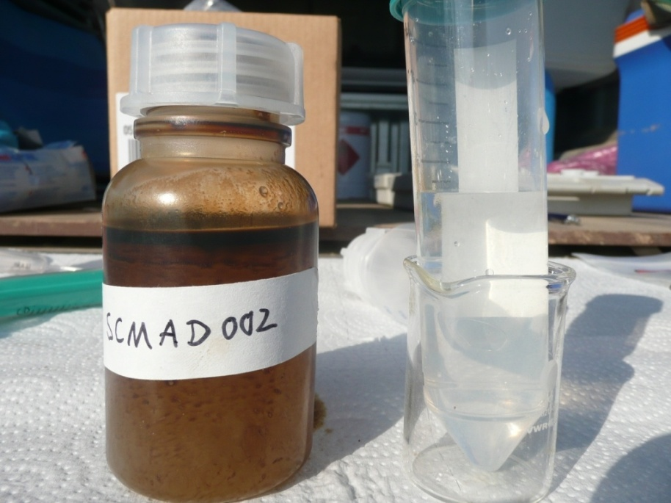
Contamination
The sample in the plastic bottle left is not filtered, it has a thin floating oilphase and the brown aqueous phase below is an emulsion.
The sample in the tube on the right (which is the same sample but filtered at 0.45 µm), is tranparent
Cassiani et al., ESPR, 2014

Slide 55
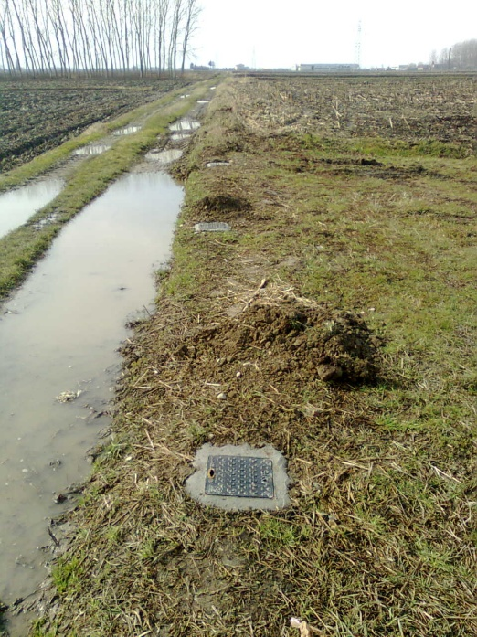
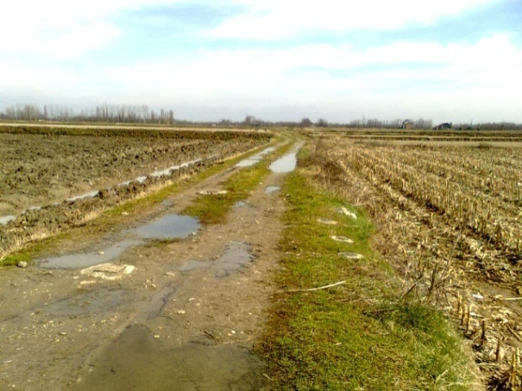
TRECATE
B’
B
2009 SoilCAM boreholes
2011 SoilCAM boreholes
A
A’

Slide 56
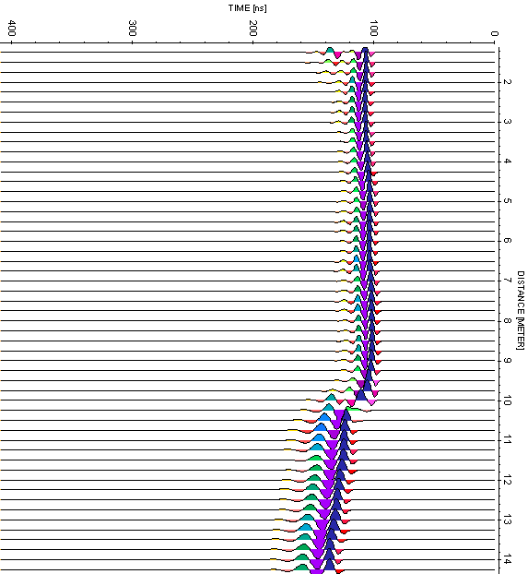
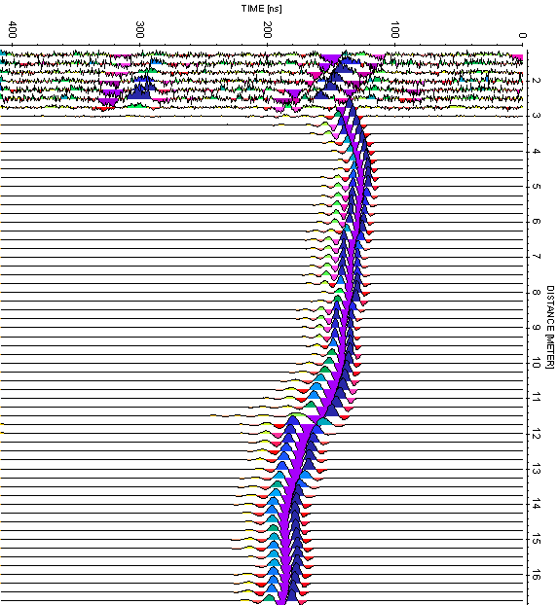
2011 Soilcam boreholes
(uncontaminated)
2009 Soilcam boreholes
(contaminated)
ZOP GPR
water table
water table
MARCH 2011
Cassiani et al., ESPR, 2014

Slide 57
uncontaminated
contaminated
Yearly water table
oscillation range

Slide 58
Yearly water table
oscillation range
ZOP GPR
vs
multilevel samplers

Slide 59
Yearly water table
oscillation range
Yearly water table
oscillation range
ZOP GPR
vs
multilevel samplers

Slide 60
B’
Trecate site: reconsider
surface measurements
A
A’
SoilCAM holes
uncontaminated line B
contaminated line A
B
B’
A
A’
Depth
(m)‏
Depth
(m)‏
Distance (m)‏
ρ (Ωm)‏
Distance (m)‏
contaminated (smear) zone
B
50
500
5000
B’
A
A’
Depth
(m)‏
Depth
(m)‏
Distance (m)‏
Distance (m)‏
Cassiani et al., ESPR, 2014

Slide 62
General conclusions
Near surface geophysics is strongly affected by both static and dynamic soil/subsoil characteristics.
This fact, if properly recognized, is potentially full of information on the soil/subsoil structure and behaviour.
The information is maximized if geophysical data are collected in time-lapse mode.
Constitutive laws linking hydrology and geophysics are essential together with a full understanding of the acquisition and inversion characteristics of the adopted methods
Integration with physical-mathematical models is essential to capture the meaning of space-time changes.

Slide 64
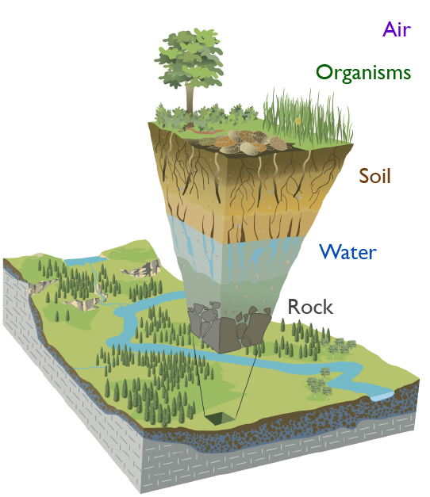
The Earth’s Critical Zone
OUTLOOK
The Earth’s Critical Zone (CZ) is the thin outer veneer of our planet from the top of the tree canopy to the bottom of our drinking water aquifers.
The CZ supports almost all human activity.
Particular attention shall be devoted to the soil-plant-atmosphere (SPA) interactions,
National Research Council (2001)

Slide 65
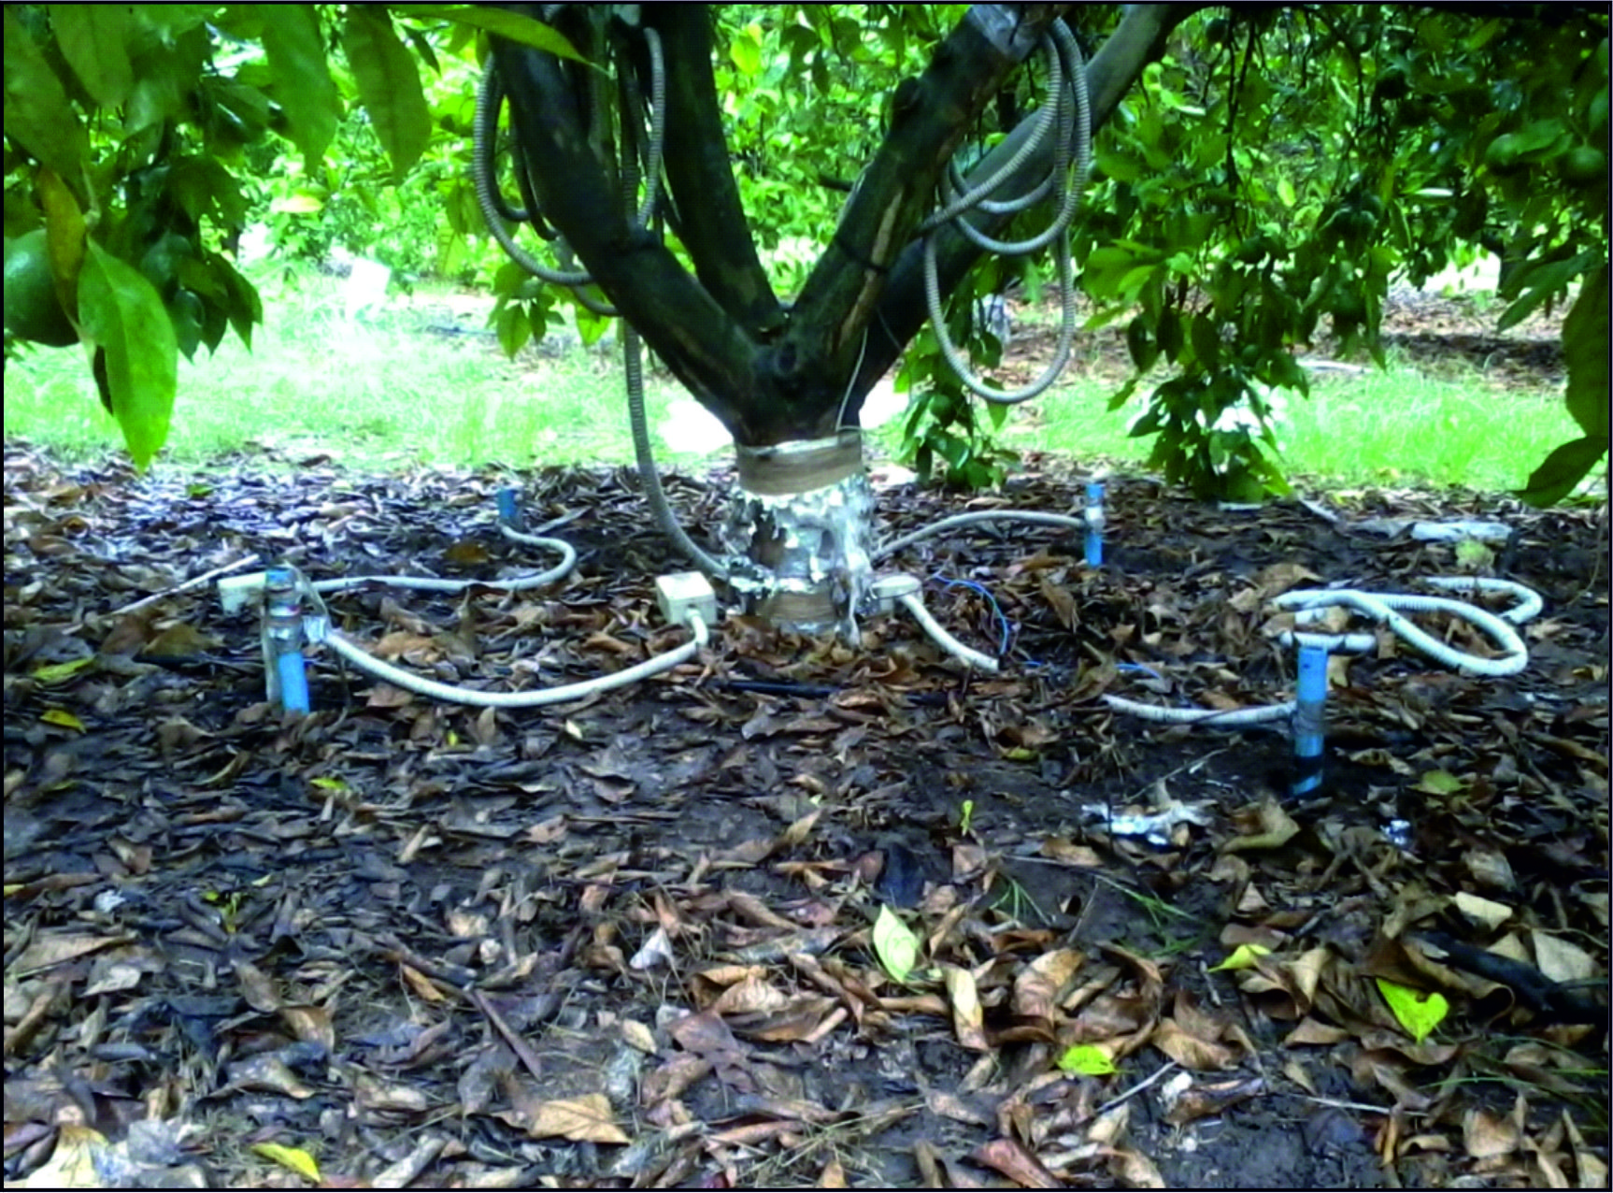
Borehole electrodes
Sap flow probes
Surface electrodes

Slide 66
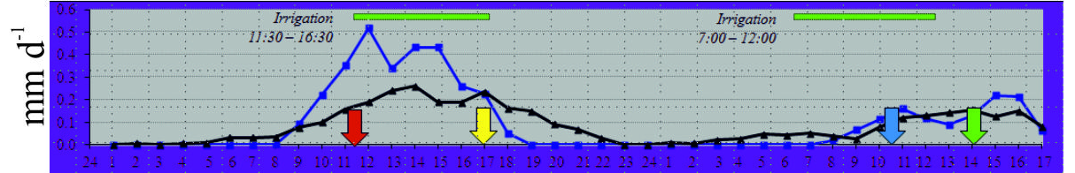
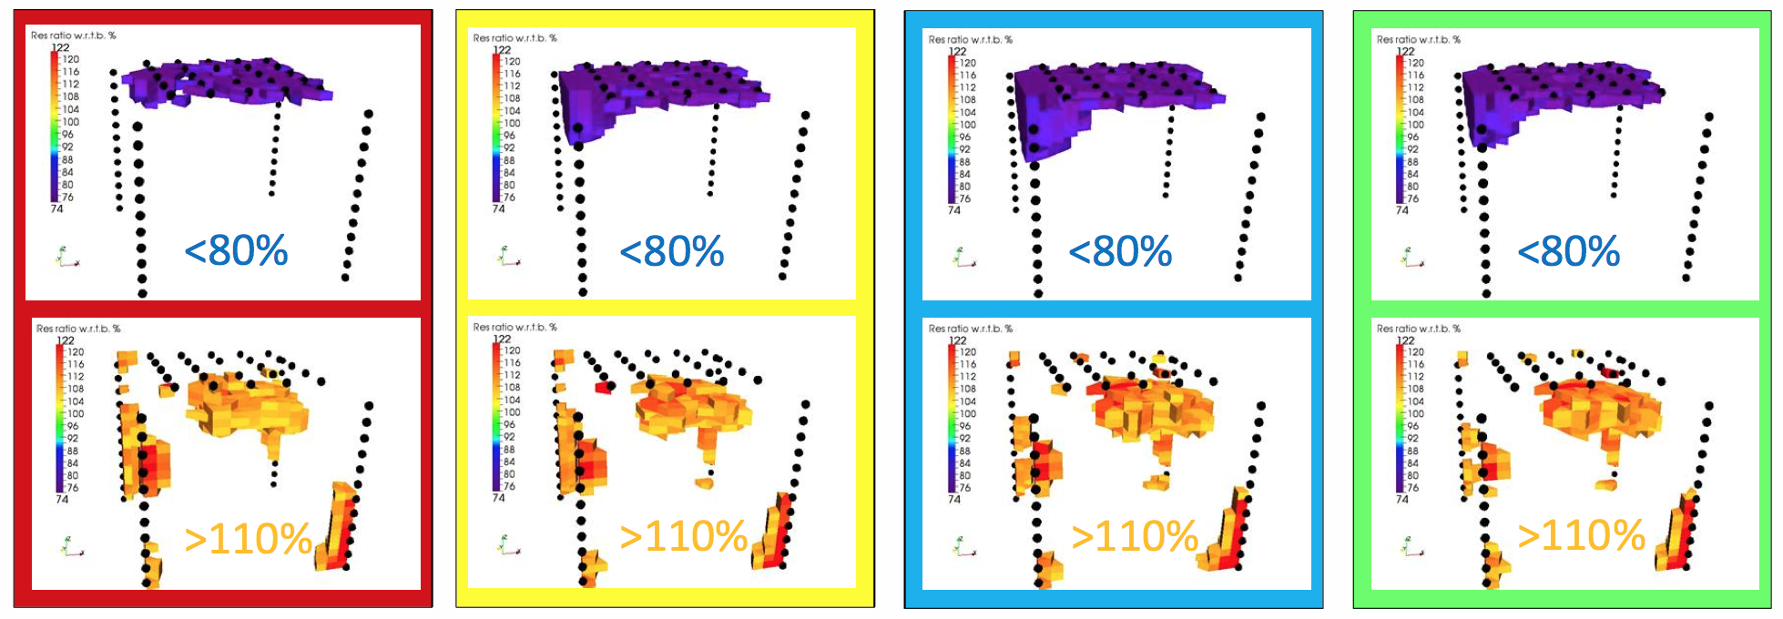
Time-lapse monitoring during irrigation
(4 liters/min per dripper, 4 drippers per tree – spaced 1 m)
October 2-3, 2013
eddy covariance
sap flow
hours

Slide 67
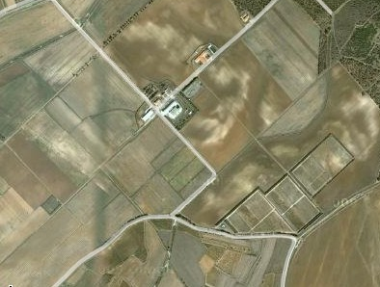

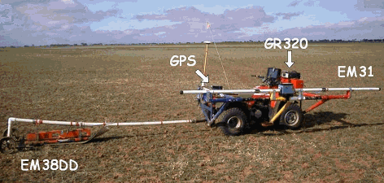

AGRIS San Michele experimental farm - Ussana - Sardinia
FP7 EU
collaborative project
field 21
field 11

Slide 68
Digital soil mapping using frequency-domain EM
Wheat crop was planted in Jan 2010 on part of an otherwise bare soil field
This area is considerably drier than the bare soil

Slide 69


TIME LAPSE MICRO-ERT in the Venice Lagoon
Are marsh plants able to induced a permanent aerated layer when flooded ?
Marani et al. 2006, WRR

Slide 70
TIME LAPSE MICRO-ERT in the Venice Lagoon
July 2012 experiment: resistivity ratio with respect to background
at 3 time steps during marsh flooding
Dryer zone at roots depth
Boaga et al. 2014

Slide 72
The hyporheic zone
OUTLOOK
USGS

Slide 73



Vermigliana creek (hyporheic and riparian zones)
Upper Val di Sole (TN)
Presena glacier
Nivo-glacial regime

Slide 74






Left bank
Creek
Resistivity
ratio
%
Right bank
ERT and DTS systems placed using directional drilling below the river bed.
14 May 2014
20 June 2014
16 July 2014
meters
09 Sept. 2014
01 Aug. 2014
15 July 2014
26 June 2014
05 June 2014
T
(°C)
Vermigliana

Slide 76







Acknowledgements for funding
EU FP7 iSOIL
EU FP7 CLIMB
EU FP7 ModelPROBE
EU FP7 GLOBAQUA
MIUR PRIN 2007
MIUR PRIN 2011
EXCELLENCE PROJECT CARIPARO FOUNDATION
Università degli Studi di Padova

