Slide 1
101° Congresso Nazionale della Società Italiana di Fisica
Roma 21-25 Settembre 2015
Sezione 4: Geofisica e fisica dell'ambiente
Processi atmosferici su terreno complesso:
problemi aperti per la fisica dell’atmosfera e sfide operative per la meteorologia.
Dino Zardi
Gruppo di fisica dell’atmosfera,
DICAM, Università di Trento

Slide 2
Terreno complesso
=
terreno non riducibile a terreno piano + «piccole» disomogeneità

Slide 3
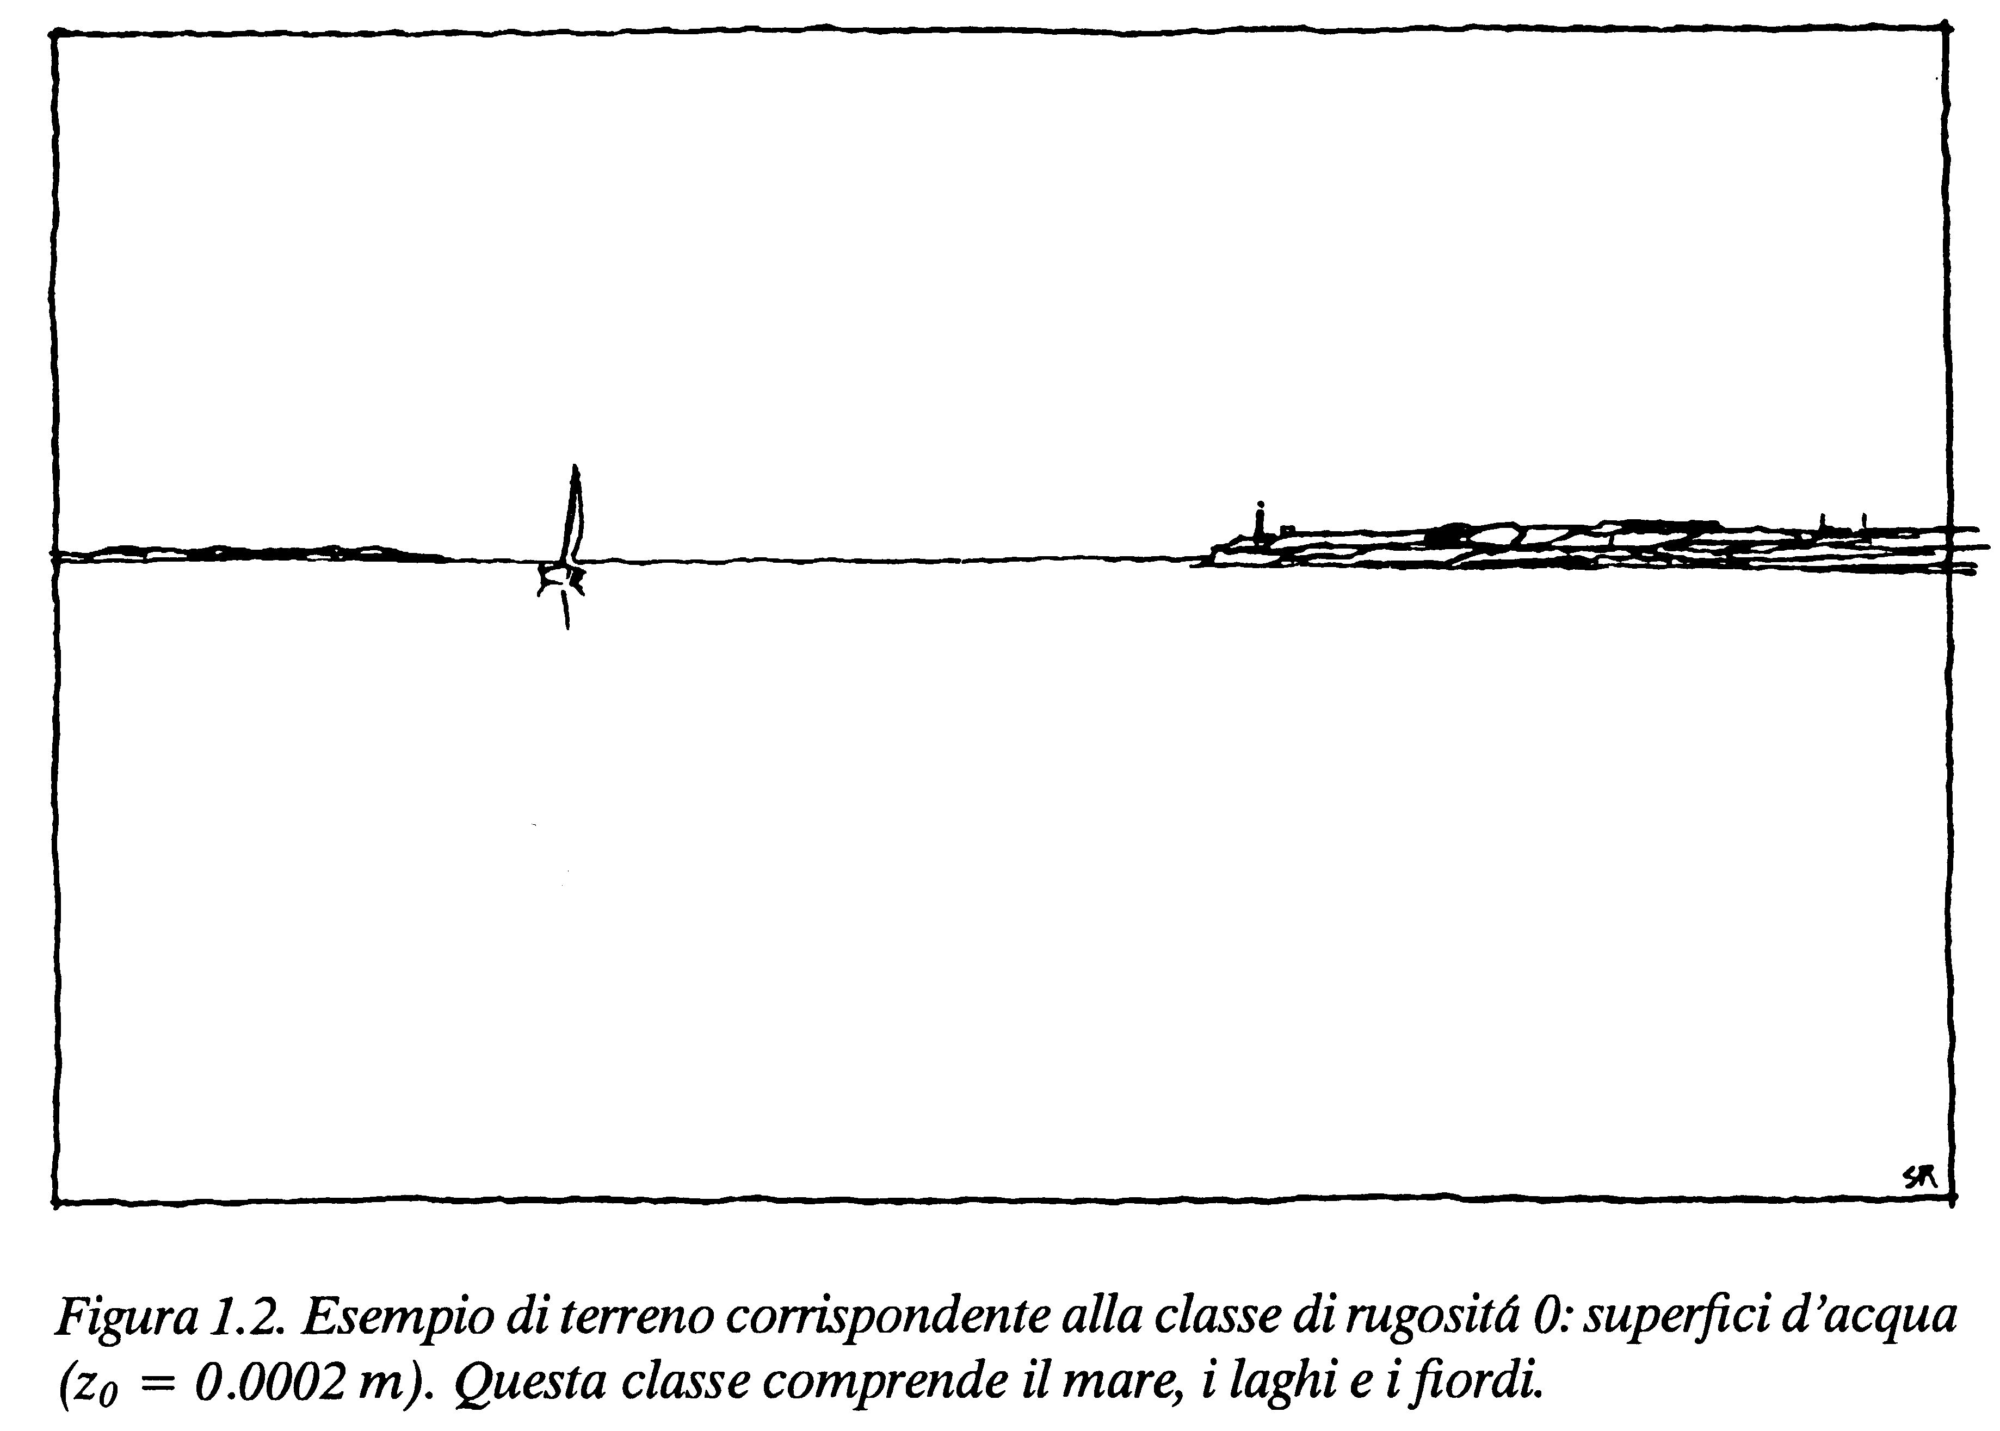
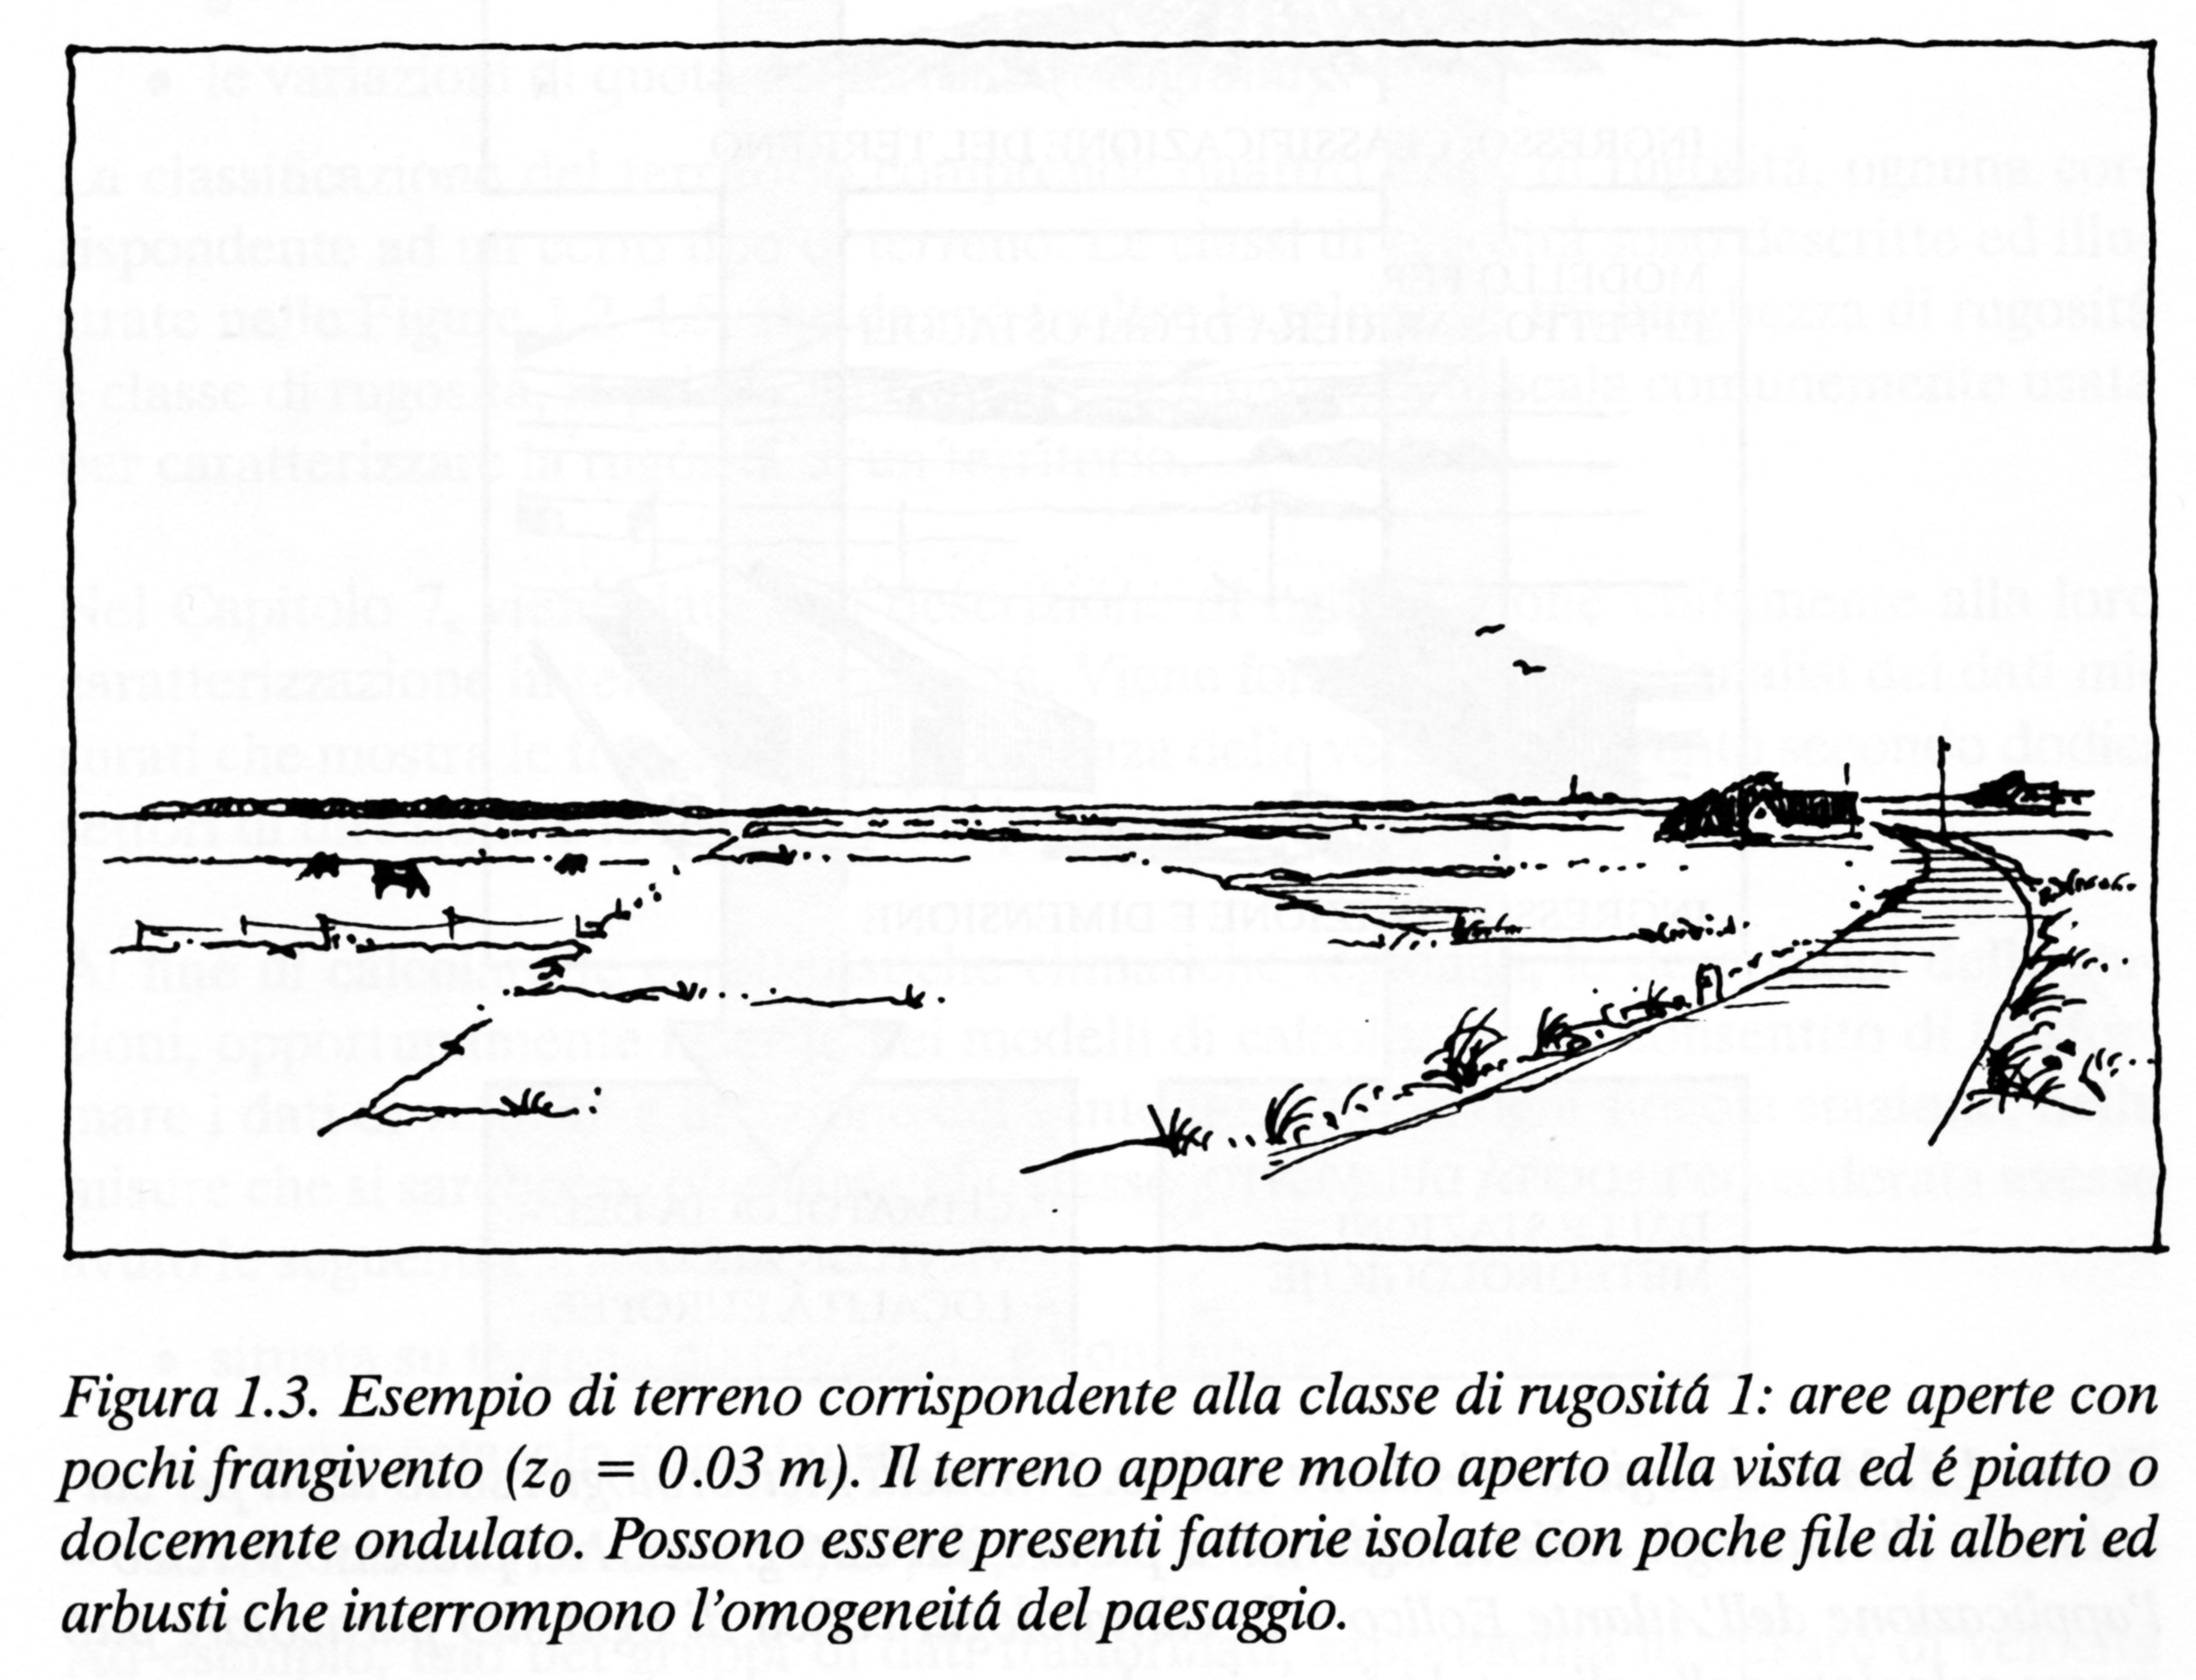
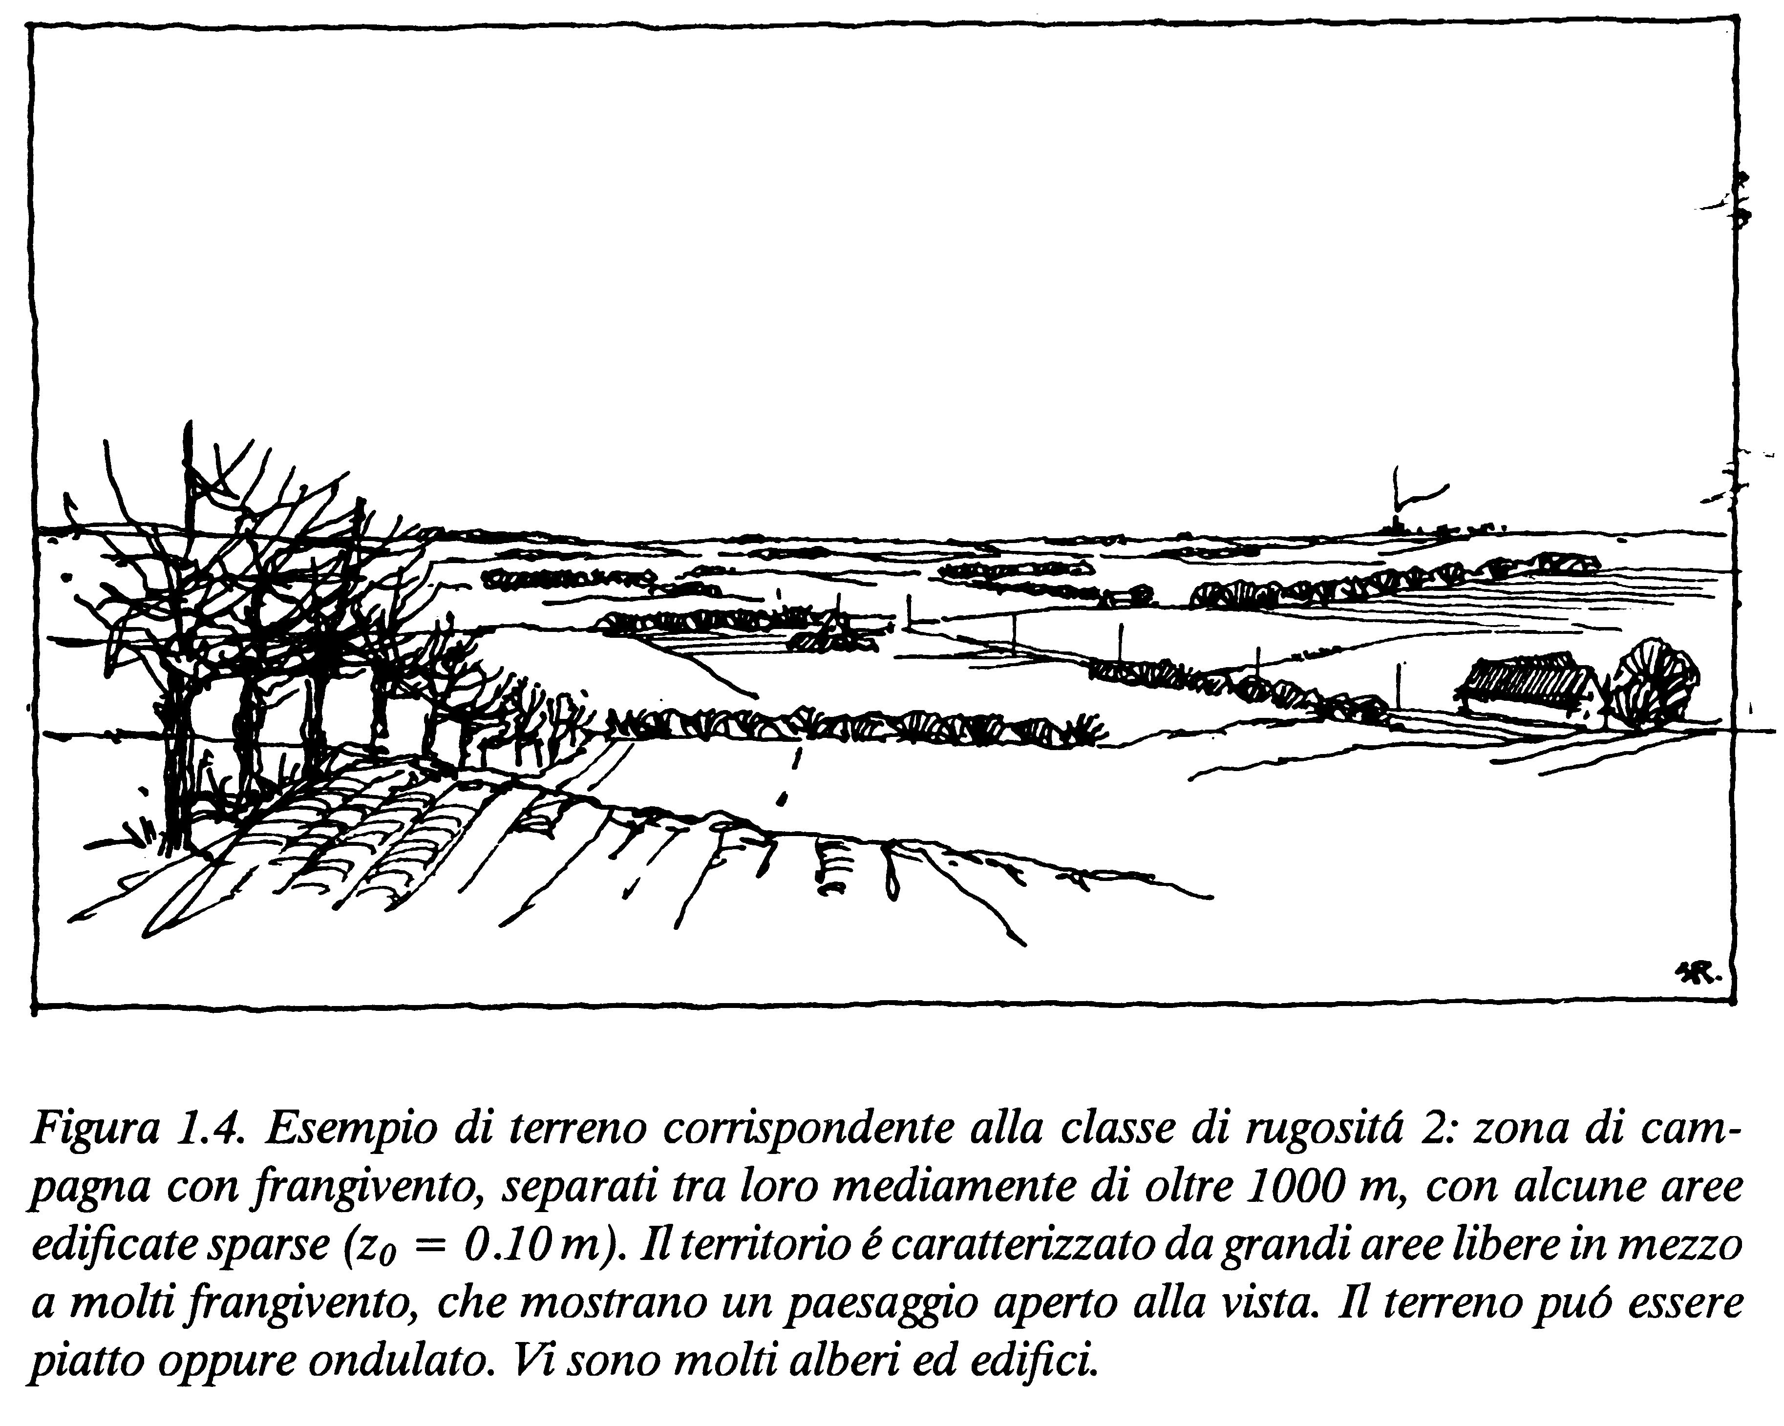
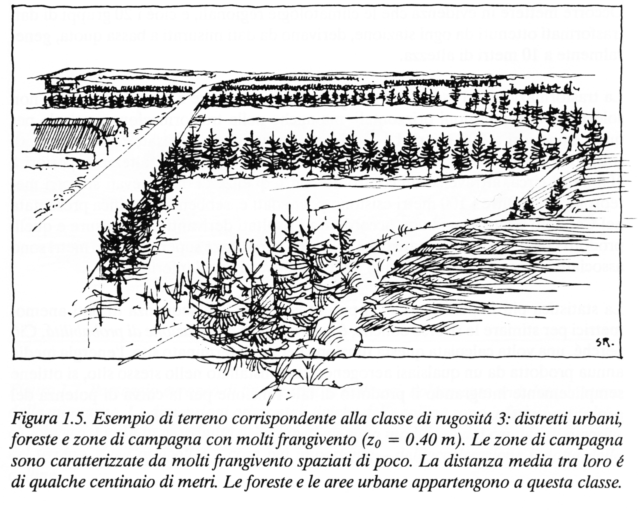
Terreno piano disomogeneo
(Atlante Europeo del vento, 1990)

Slide 4
Terreno complesso

Slide 6
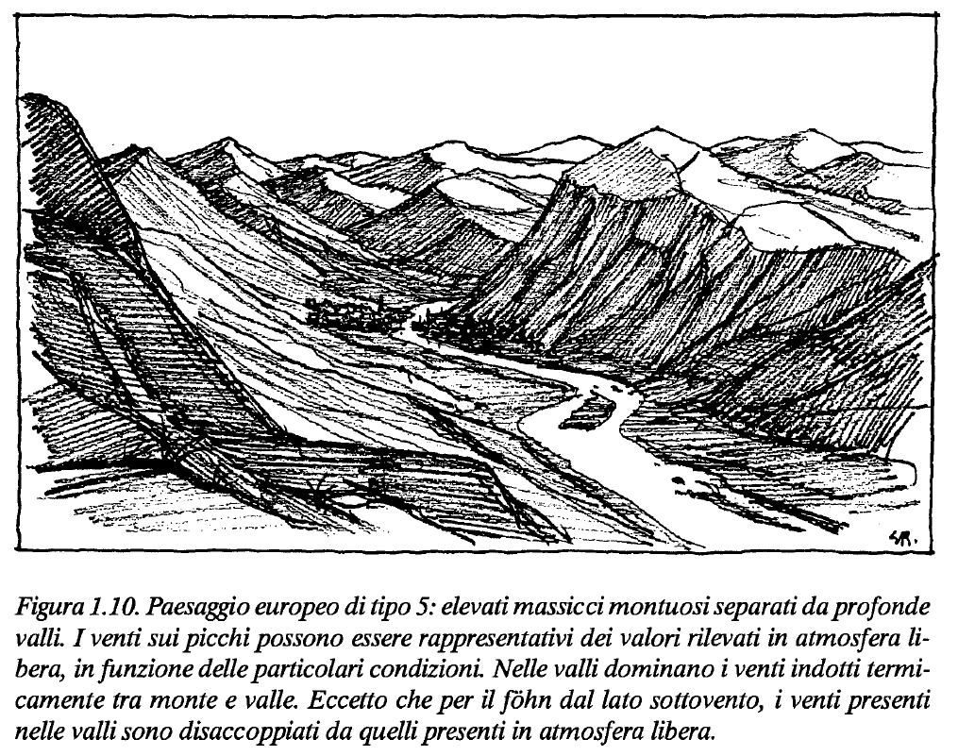

Slide 7
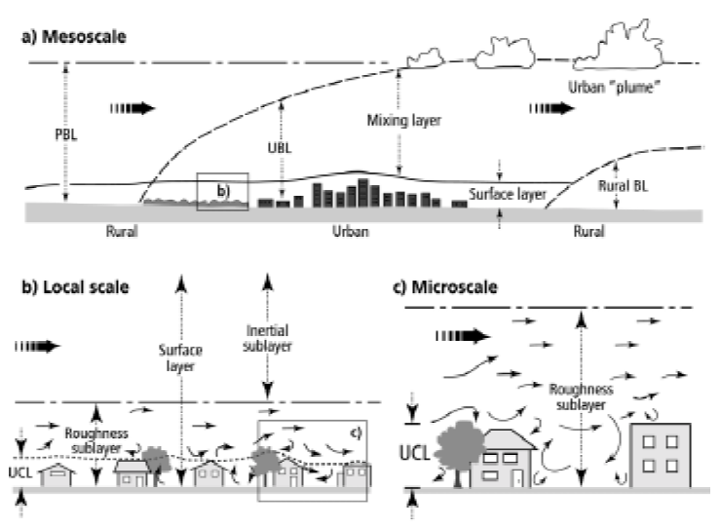
Mesoscala
Scala locale
Microscala

Slide 8
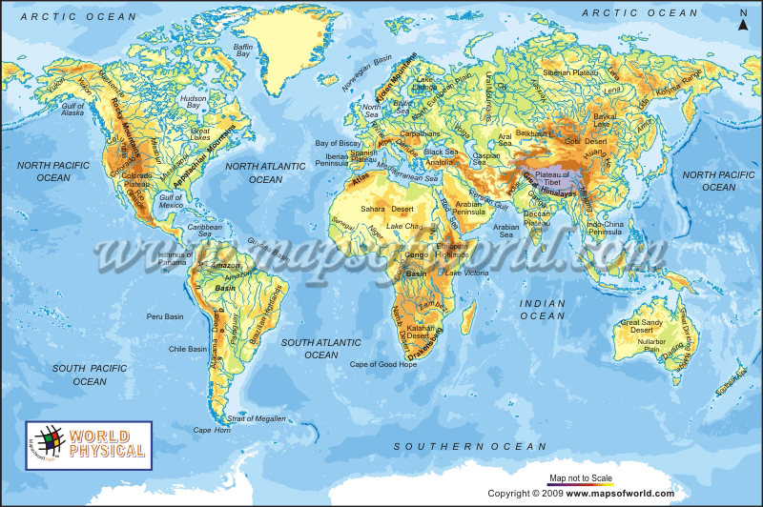
Mountains in the world

Slide 9
Mountains in numbers
Mountains account for about 25% of the earth surface
Provide 32% of the global runoff (“water towers”)
26% of world population lives in mountainous regions

Slide 10
Dynamically driven effects
Key factors
    Wind speed
    Topography shape (in particular height and length)
    Stability (= gravity + stratification)
    Coriolis (large scale)

Slide 11
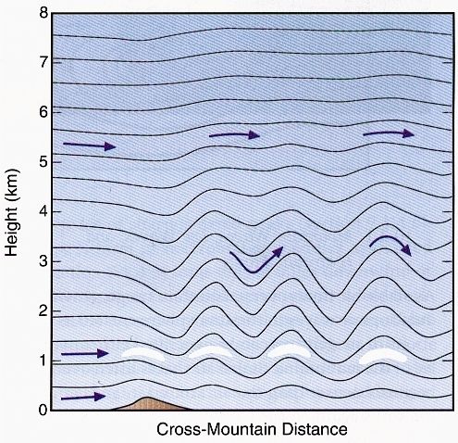
Trapped mountain waves
Trapped lee waves reach their highest amplitudes in a confined layer on the lee side of the mountains. Regularly spaced low-altitude lenticular clouds are the best indicators of trapped lee waves (Whiteman 2000, adapted from Carney et al. 1996).

Slide 12
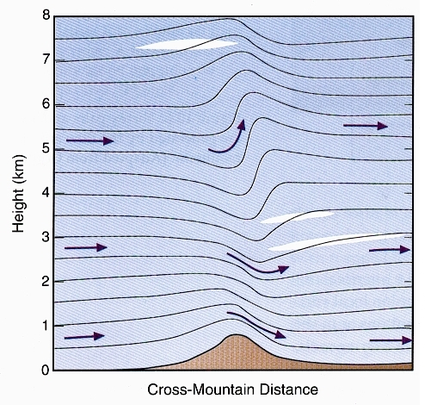
Vertically propagating mountain waves
Vertically propagating mountain waves have their highest amplitudes well above the mountains. High lenticular clouds are often indicators of these waves (Whiteman 2000, adapted from Carney et al. 1996).

Slide 13
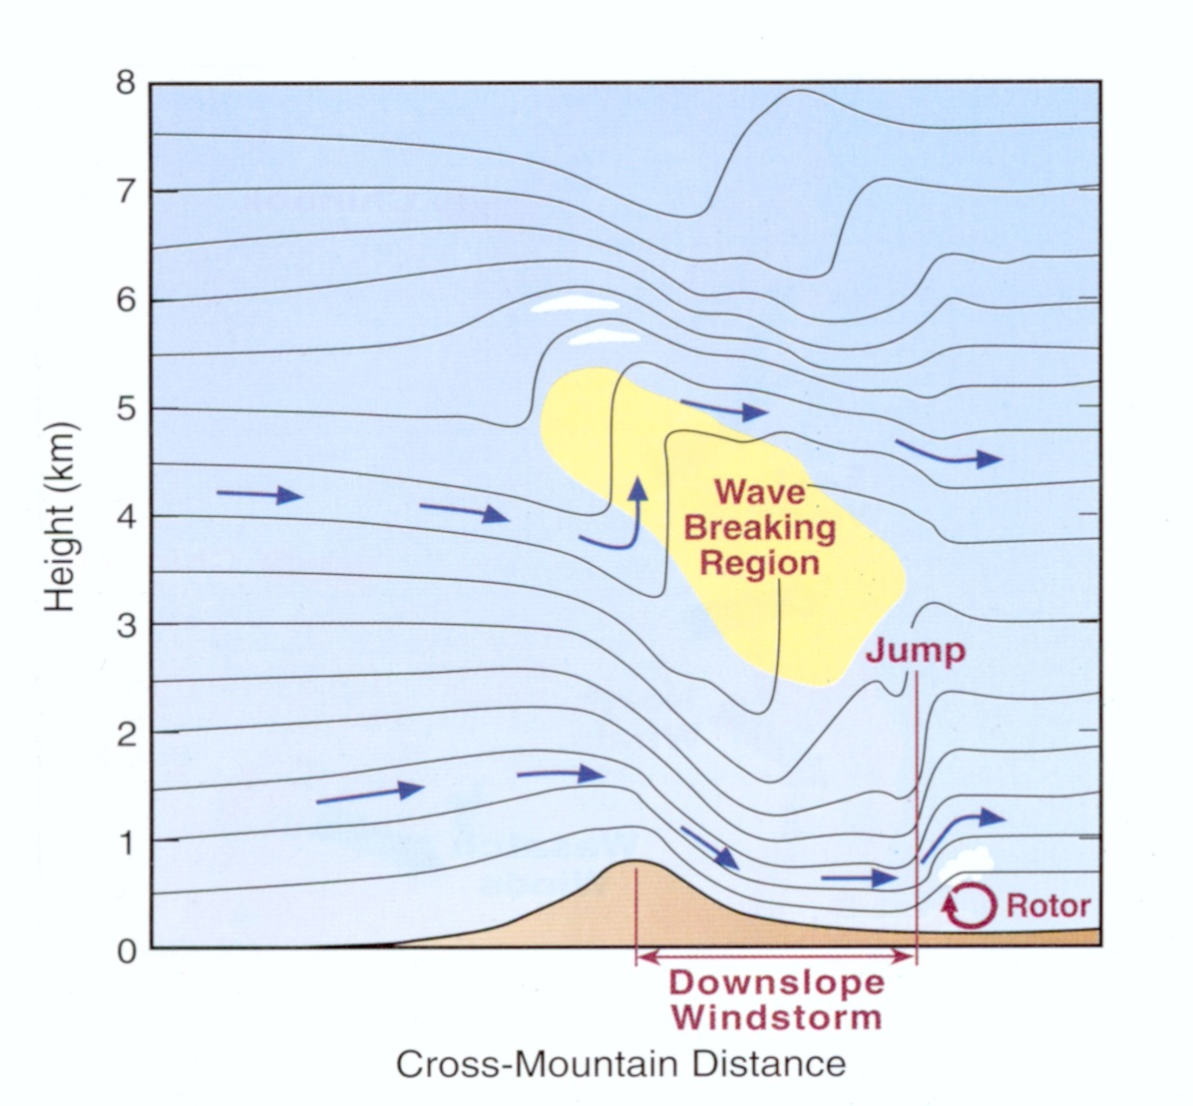
Downslope windstorms
Hydraulic flow produces a distinctive flow pattern in the lee of a mountain barrier that is characterised by a region of wave-breaking aloft and a sudden jump in the streamline pattern (hydraulic jump) downwind of the barrier. A turbulent rotor cloud may form behind the hydraulic jump. Downslope windstorms may occur during hydraulic flow (Whiteman 2000, adapted from Carney et al. 1996).

Slide 14
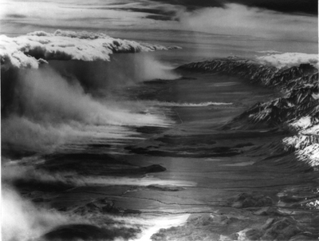
Rotors
A rotor cloud photographed by P-38 fighter pilot Robert Symons looking south along the eastern slope of the Sierra Nevada. Flow is from right to left. Dust is being swept up off the floor of the Owens Valley and lifted vertically into the rotor cloud on the left of the picture. Higher lee wave clouds are seen above and to the right of the rotor cloud, and a chinook wall cloud is visible over the crest of the Sierra Nevada at the right of the photo (Whiteman 2000, U. S. Air Force photo provided by R. A. Houze).

Slide 15
Thermally driven effects
Key factors
Topography
Heat fluxes (radiation → sensible heat flux)
Stability (= gravity + stratification)
Notes:
prova

Slide 16
Daily-periodic thermally driven winds
Slope winds
Valley winds
Basins/plateaus
Mountain-plain circulations
Notes:
prova

Slide 17
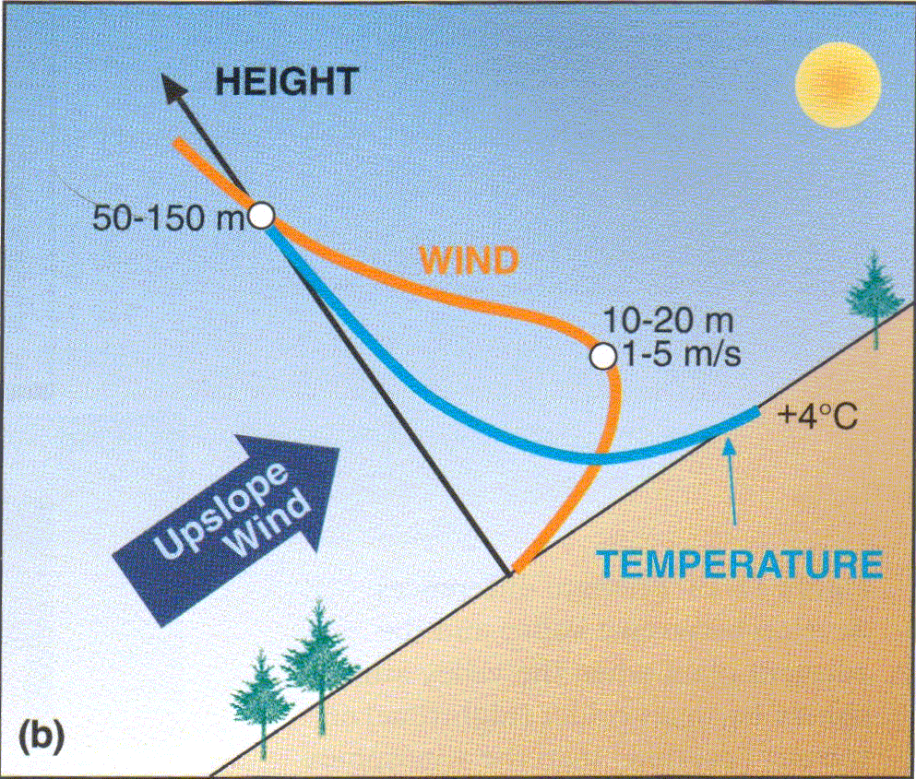
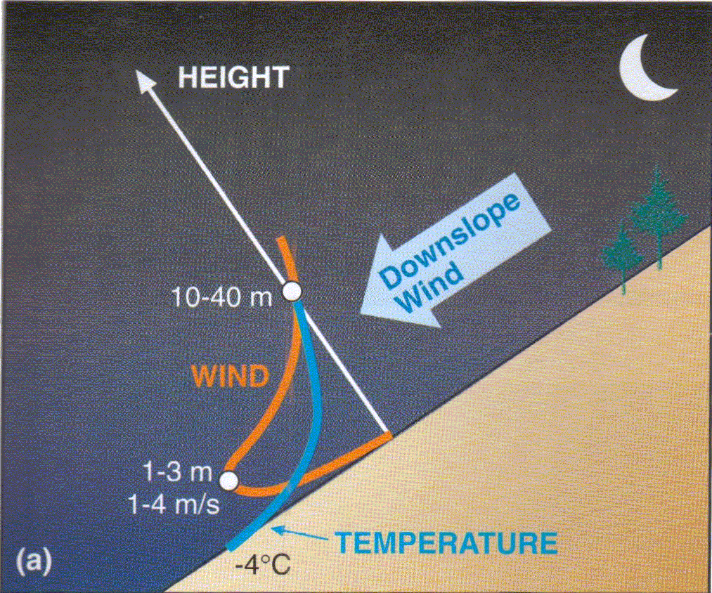
Slope winds
⎧ Up-slope winds
⎪
⎨
⎪
⎩ Down-slope winds
(Whiteman, 2000)

Slide 18
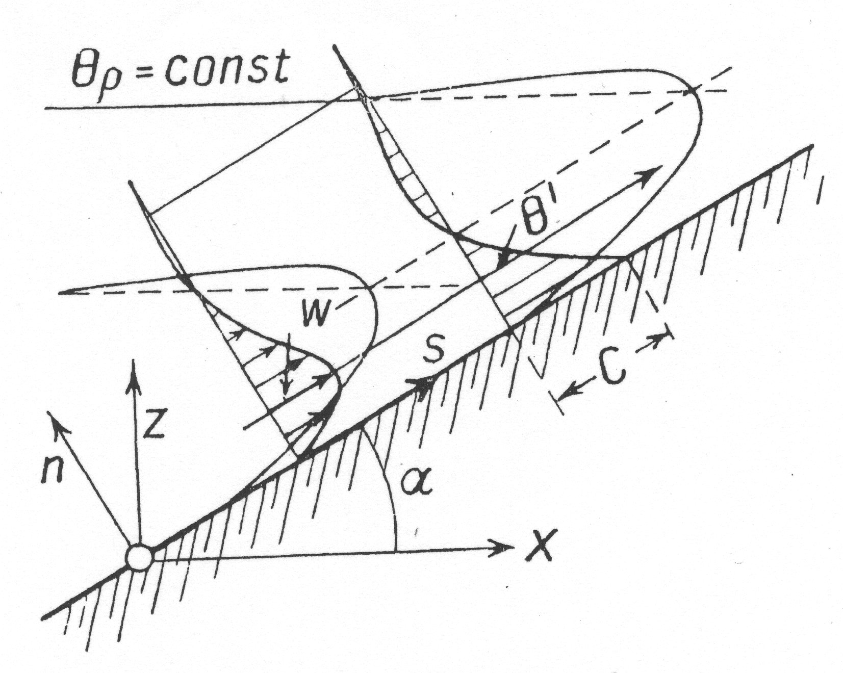
Prandtl (1942)
U

Slide 19
Prandtl’s (1942) assumptions
Infinite slope
s-invariance (uniform validity -∞ < s < +∞)
Parallel flow
Steady state
No Coriolis
Boussinesq
Laminar flow
Unperturbed state: θ₀ = θ₀₀ + γ z
Boundary conditions: u_{n=0} = 0 u_{n→∞} = 0
θ_{n=0} = C θ_{n→∞} = 0

Slide 20
Extensions of Prandtl (1942)
Turbulent flow: Defant (1949), Grisogono and Oerlemans (2002)
Coriolis: Gutman and Malbakhov (1964), Stiperski et al. (2007), Shapiro & Fedorovich (2008)
Weakly curved topography: Zammett & Fowler (2007)
Weakly nonlinear effects: Grisogono et al. (2014)
Time variations: Defant (1949), Gutman & Malbakhov (1964), Zardi & Serafin (2015).

Slide 21
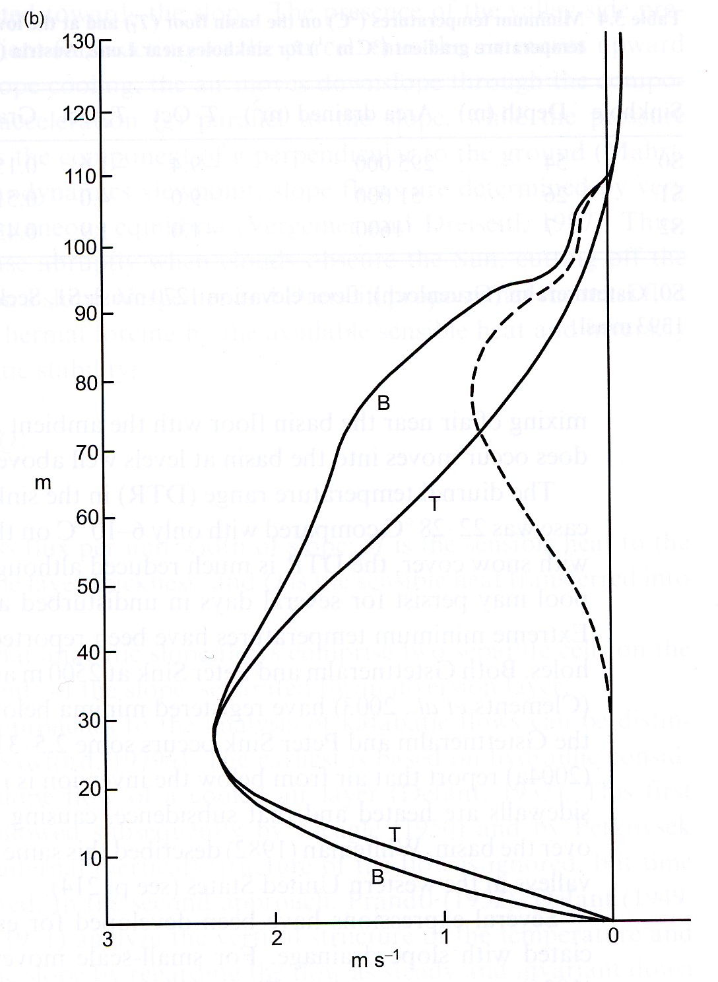
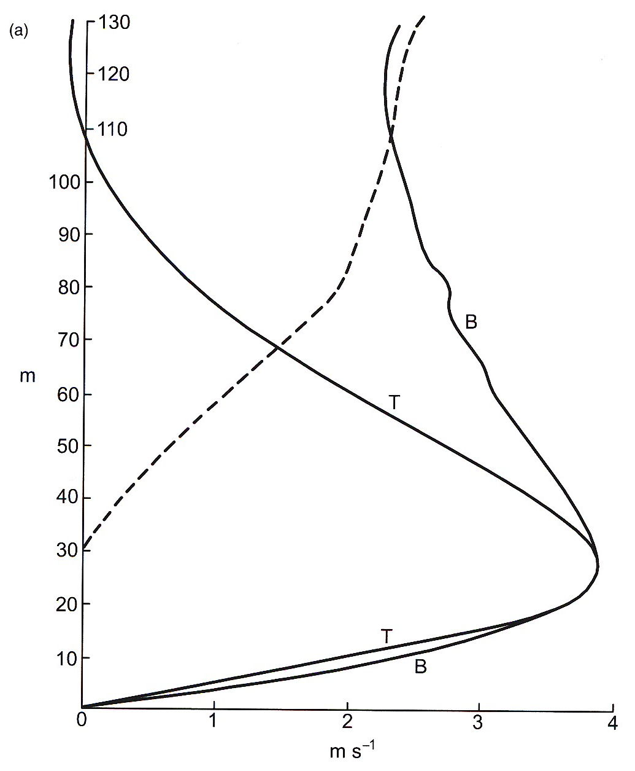
Daytime
Nightime
Observations (B)
Theory (T)
Theoretical (T) slope wind profiles and balloon (B) observations on the Nordkette near Innsbruck (From F. Defant 1949, as published by Barry 2008)

Slide 22
Some weaknesses
Constant lapse rate γ ⇒ negative potential temperature below z₀ = - θ₀₀/γ
Perfect gas: β = 1/T . Not a constant!
The conduction heat flux is proportional to ∇T not ∇θ
Boussinesq : acceptable over scales smaller than the intrinsic scale of density variation.
Laminar flow: to what extent stable?
Parallel flow: to what extent parallel? Entrainment?

Slide 23
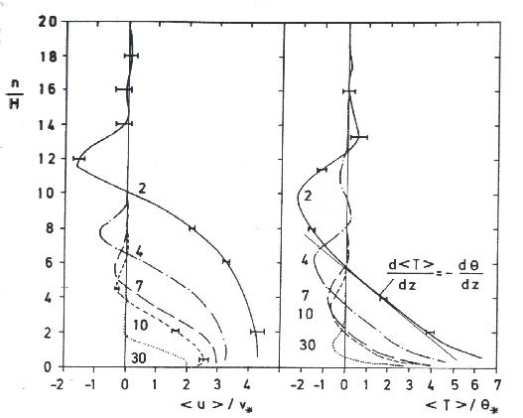
LES (Schumann 1990)

Slide 24
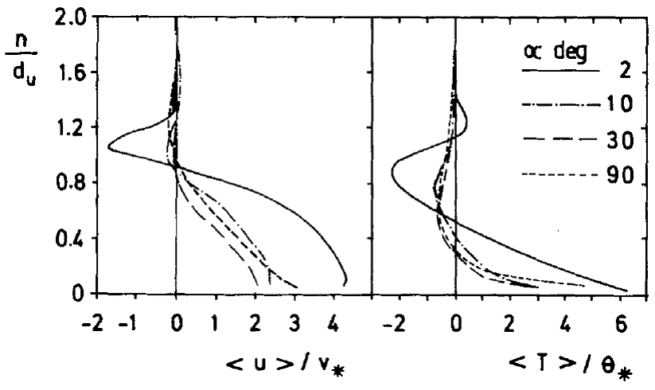

Slide 25
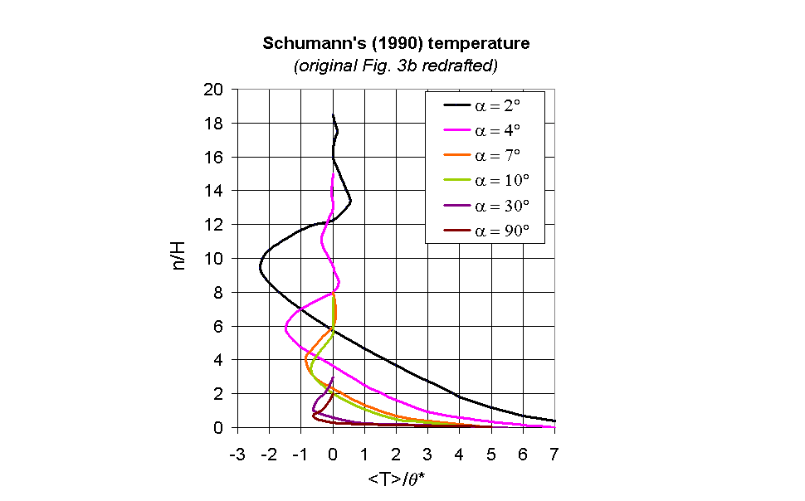

Slide 26
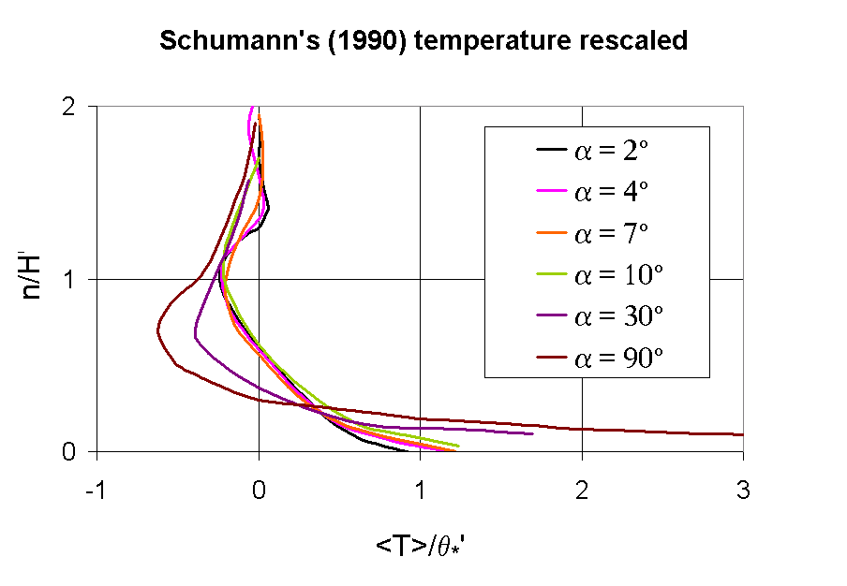

Slide 27
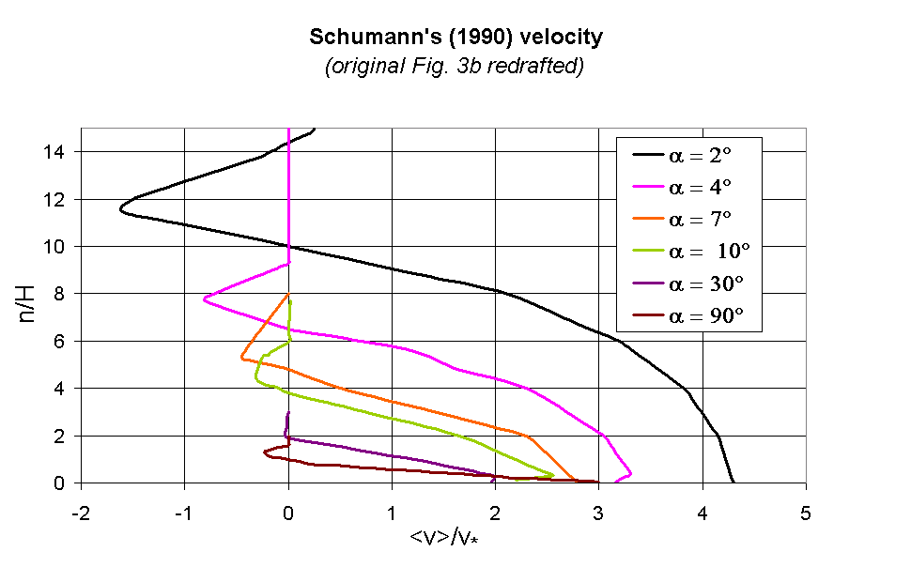

Slide 28
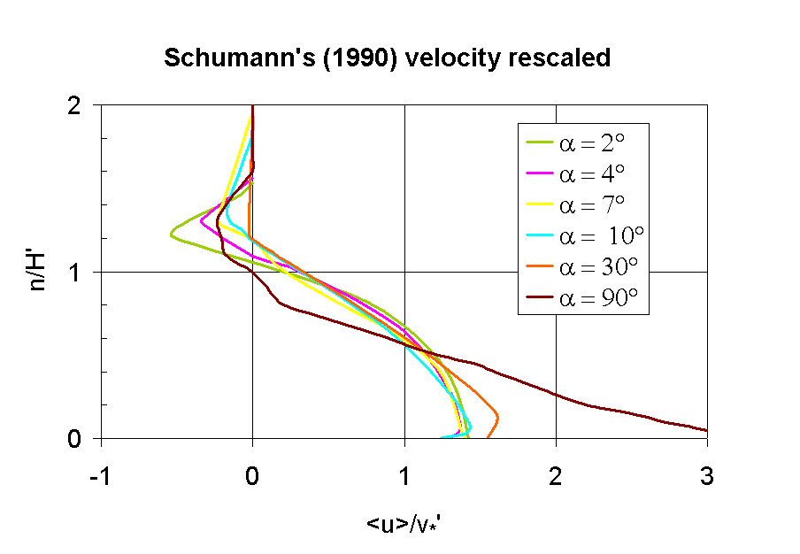

Slide 29
Problemi aperti

Slide 30
Instability
Laminar → Turbulent
Parallel → Vertical
Hocut, Liberzon and Fernando JFM 2015
And other features like waves, rolls, entrainment,…

Slide 31
Instability
C_{c}
α

Slide 32
Linee di sviluppo
futuro della ricerca

Slide 33
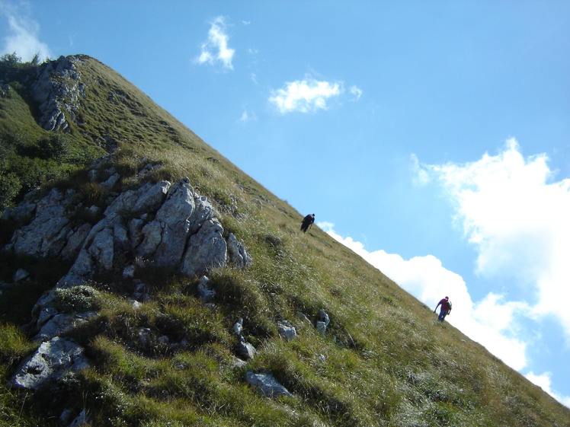
1. High-resoluition field measurement on an «ideal» slope

Slide 34
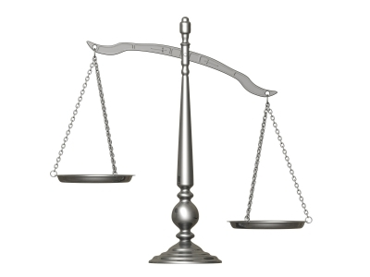
2. High-resolution LES simulations
Schumann (1990)
Skyllingstad (2003)
Axelsen & Van Dop (2008)
Axelsen & Van Dop 2009)

Slide 35
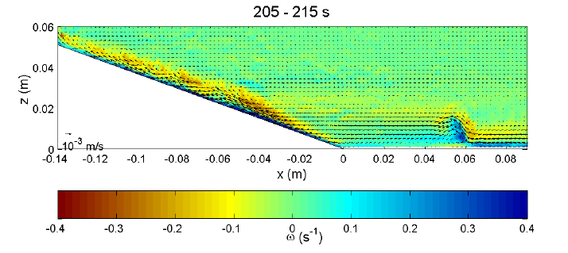
3. A combination of theoretical analysis, laboratory measurements, and high-resolution DNS simulations to investigate instabilty and transition.
Giorgilli, Moroni & Cenedese (2012)

Slide 36
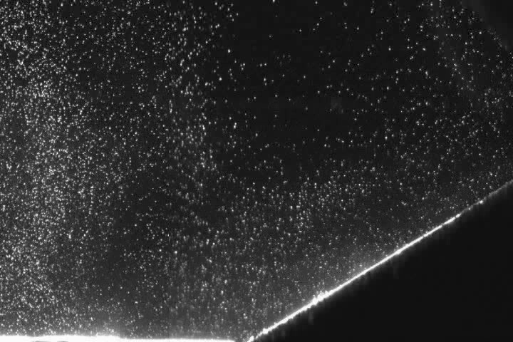
Slope flows – laboratory experiments
Cenedese, Giorgilli & Moroni (2015)

Slide 37
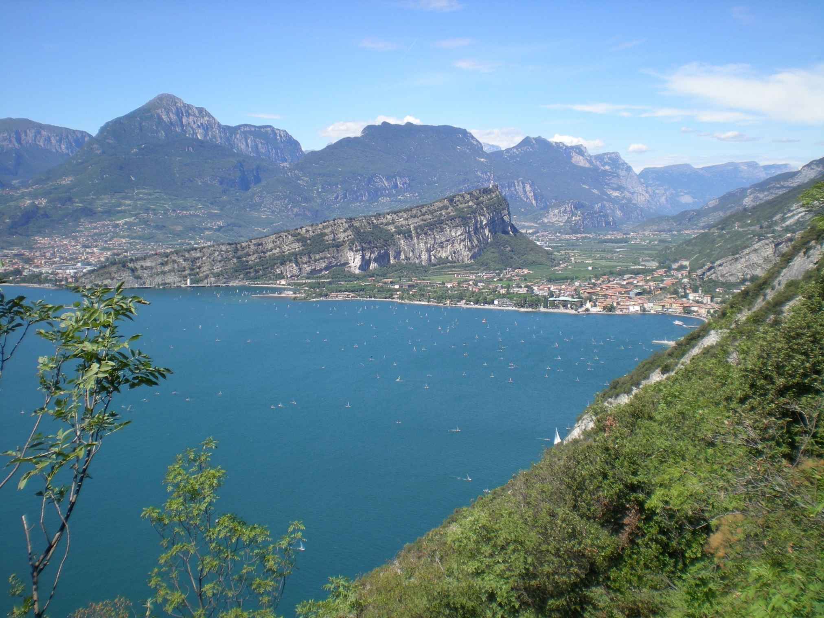
Grazie per l’attenzione!
E…

Slide 38

www.festivalmeteorologia.it

Slide 39
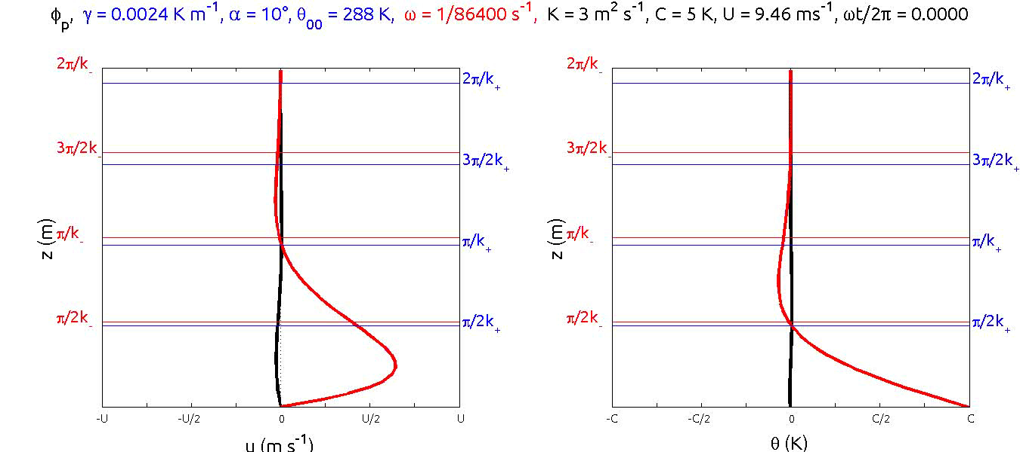
Supercritical case: N sinα > ω
Zardi & Serafin QJ 2015

