Slide 1


SWIFT Science and Future
Gianpiero Tagliaferri
INAF – OABr
SIF, 25 September 2015, Rome

Slide 2
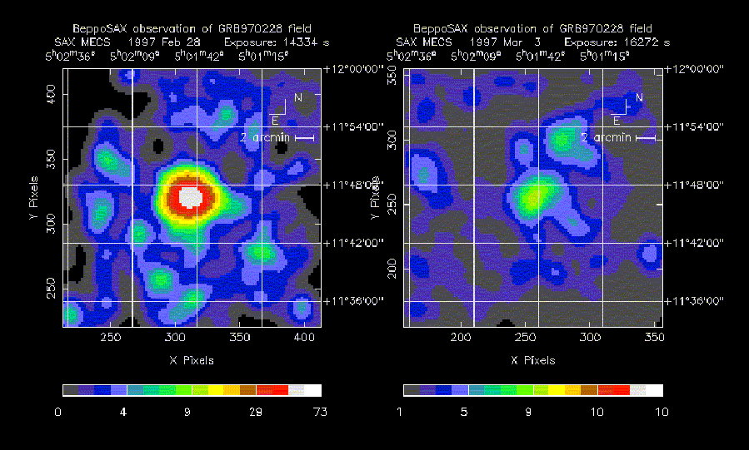
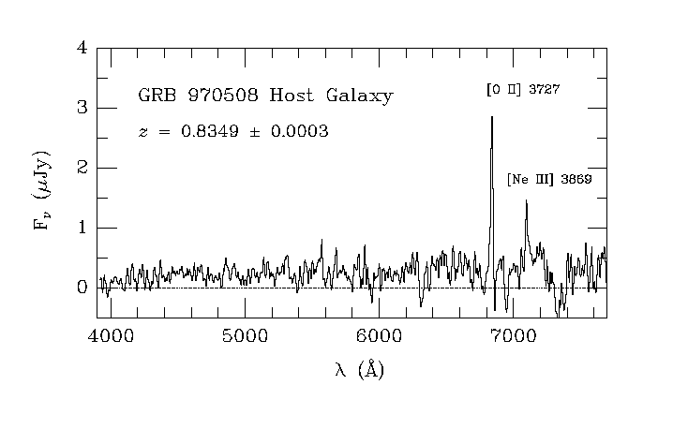
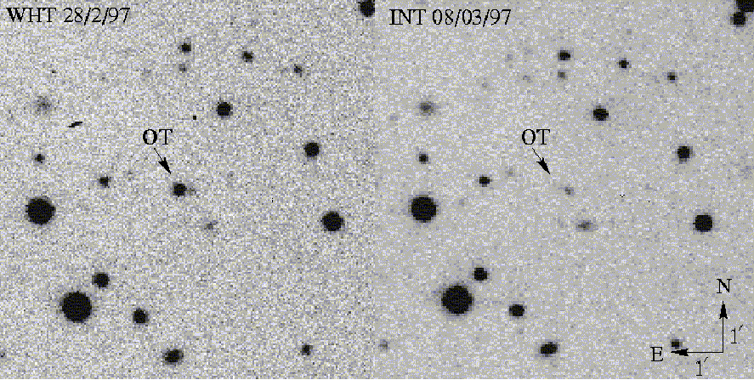
GRB970228: 1st X-ray and Optical afterglow
Fast follow up with the BeppoSAX-NFIs (8hr) led to the discovery of a bright unknown X-ray source.
A second pointing 3 days after showed that source had faded.
(Costa, et al., 1997)
GRBs have:
X-ray afterglows > 90%
Optical afterglows ~ 60-70%
Radio afterglows ~ 35% - 40%
(Van Paradijs, et al., 1997)

Slide 3
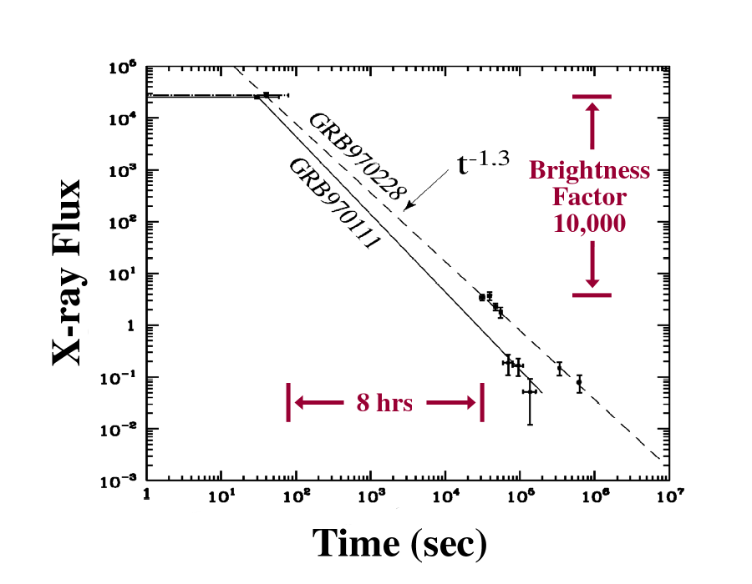
The Gap
X-RAY OBSERVATION MANDATORY! ==>Almost all GRBs have a X-ray afterglow
Fast observations ==>X-ray afterglow rapidly fading

Slide 4
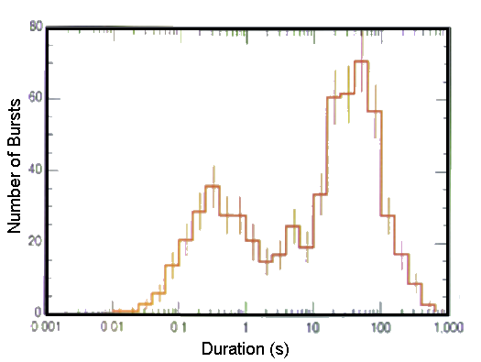
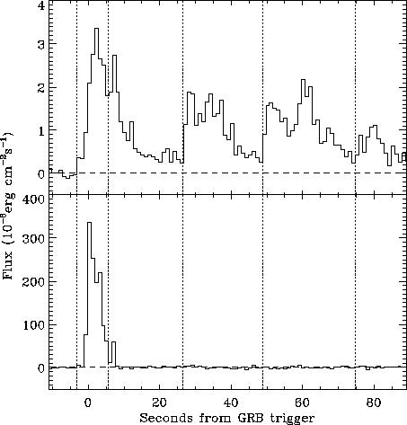
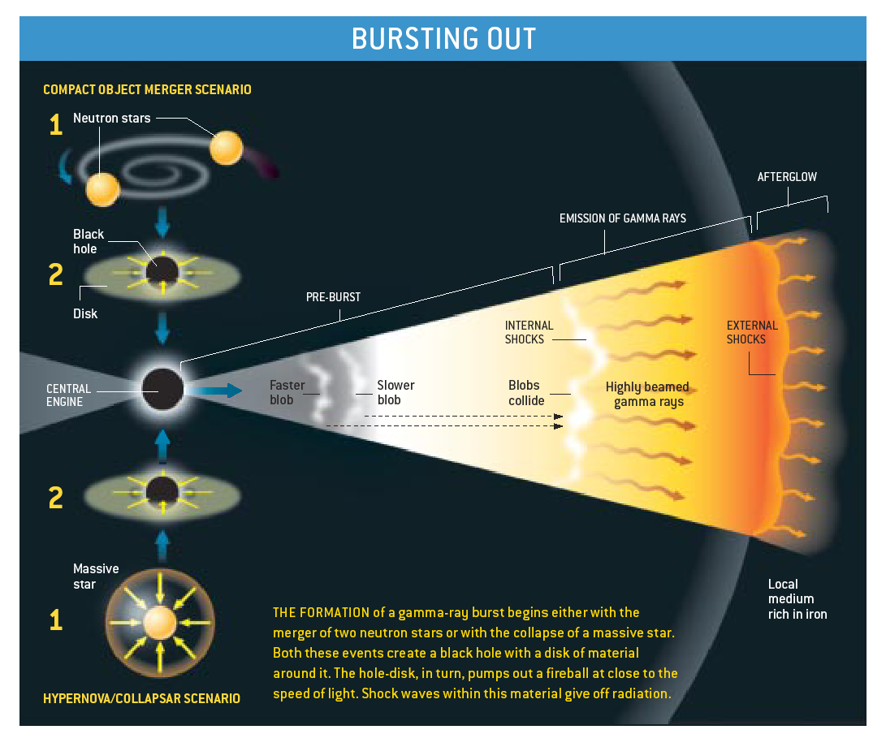
Swift Science
What causes GRBs?
What is the origin of subclasses of GRBs?
What physcis can be learned about BH formation and jets?
Swift
BeppoSAX
Mission Capabilities:
Arcsec positions and counterparts for 100’s of GRBs
Identify host galaxies and measure offsets
Sensitive to short and X-ray bursts
5X more sensitive than BATSE
Multiwavelength observations on all timescales
X-ray and UV/optical spectroscopy
Rapid GRB notifications via GCN
Fireball Model
Other models do exist: fireshell, canon-ball, etc.

Slide 5
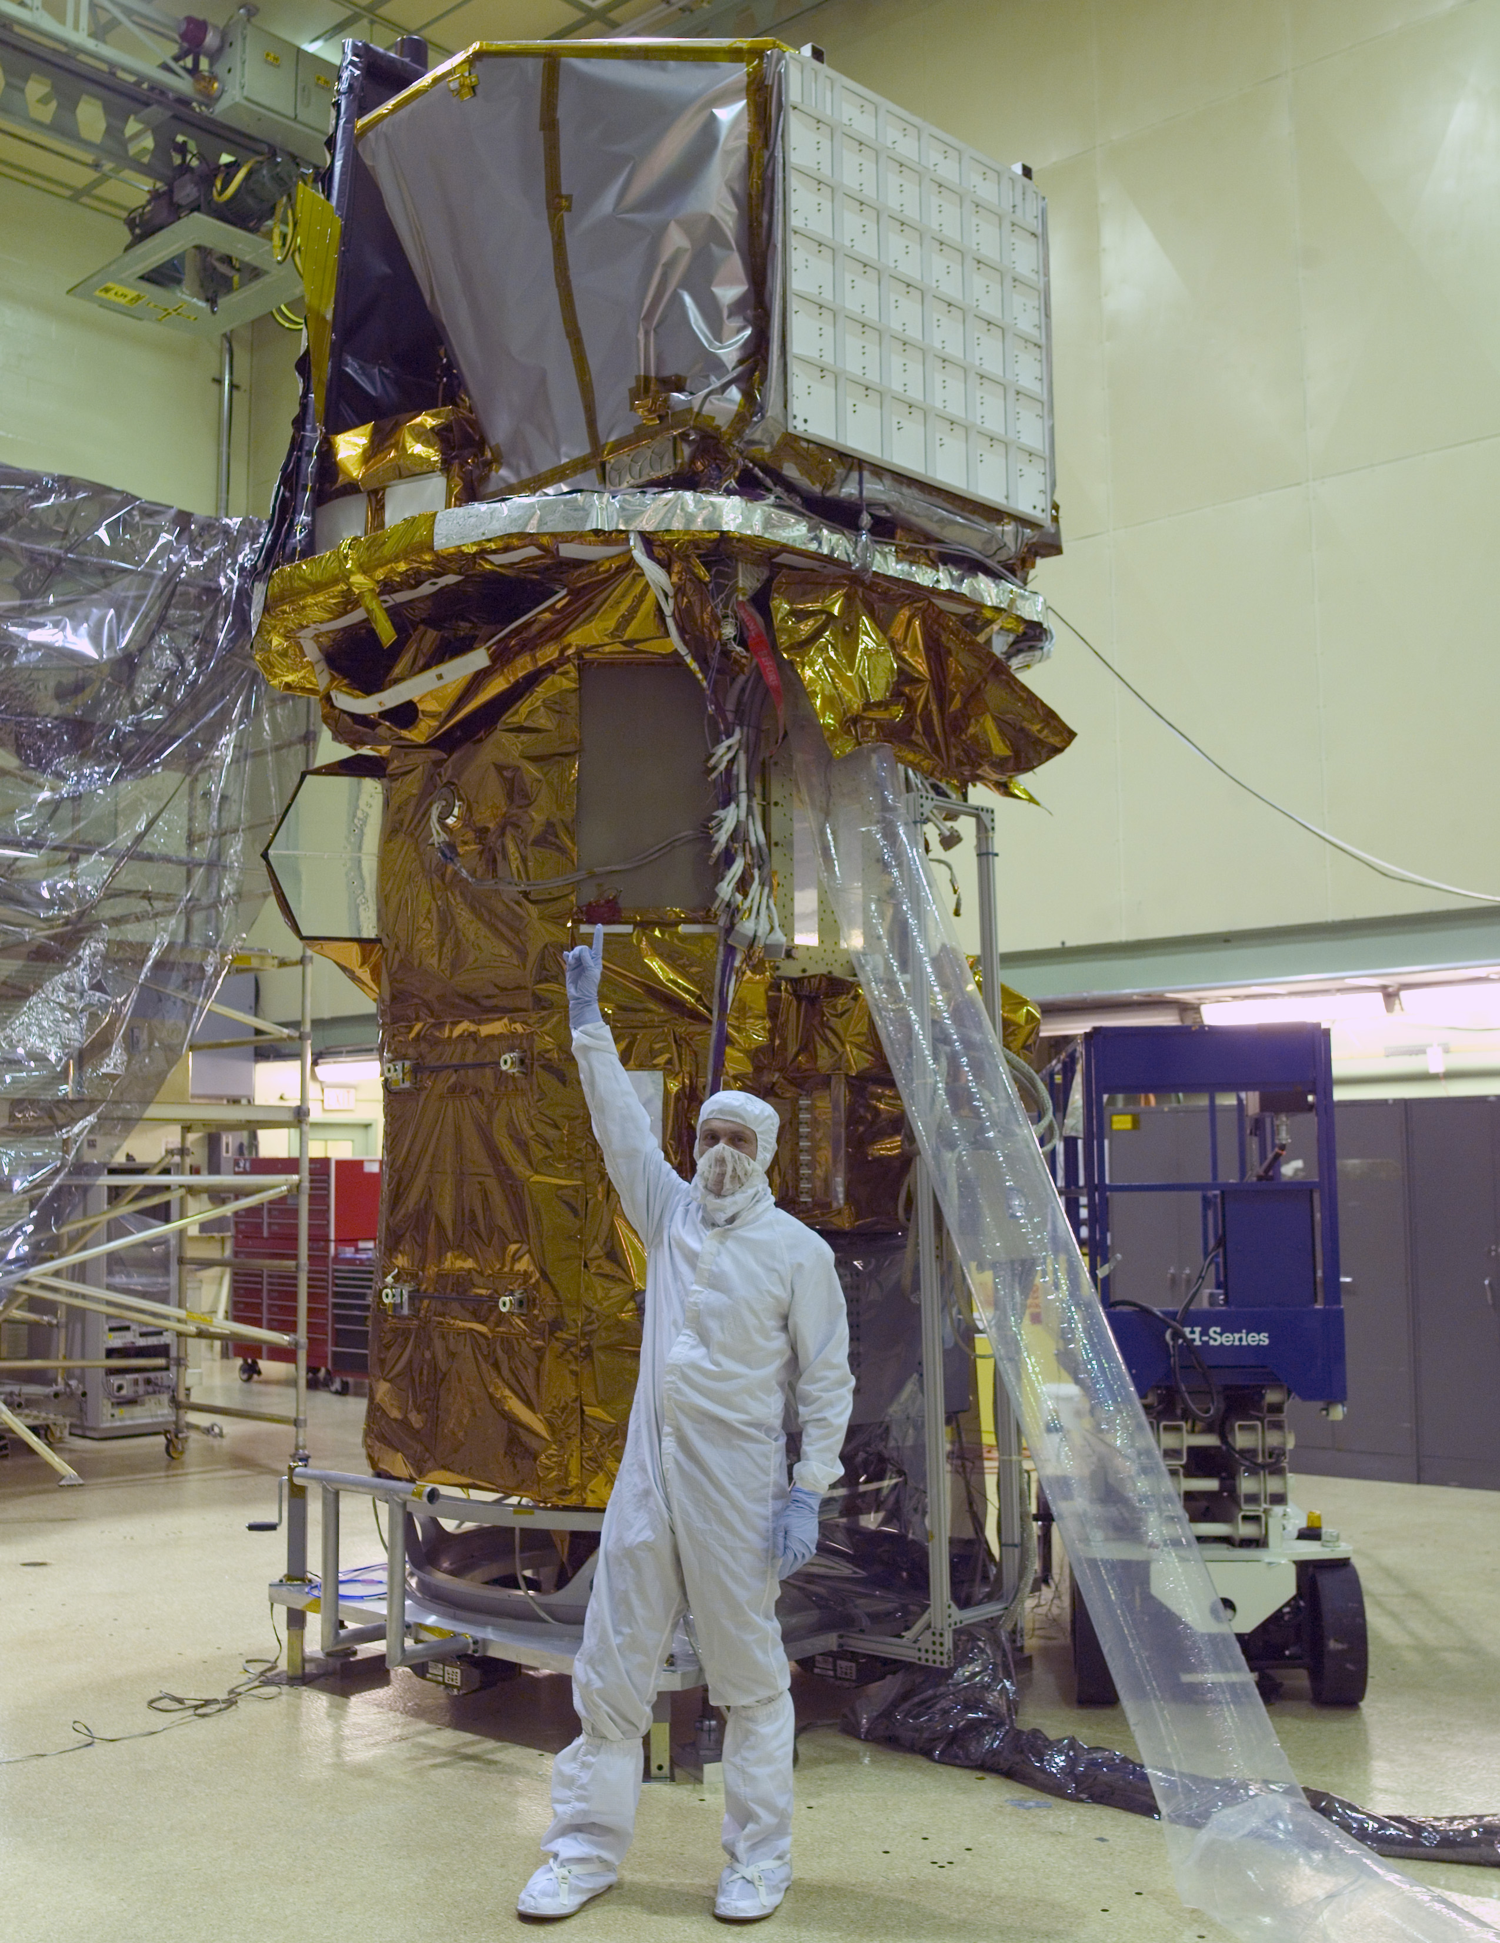
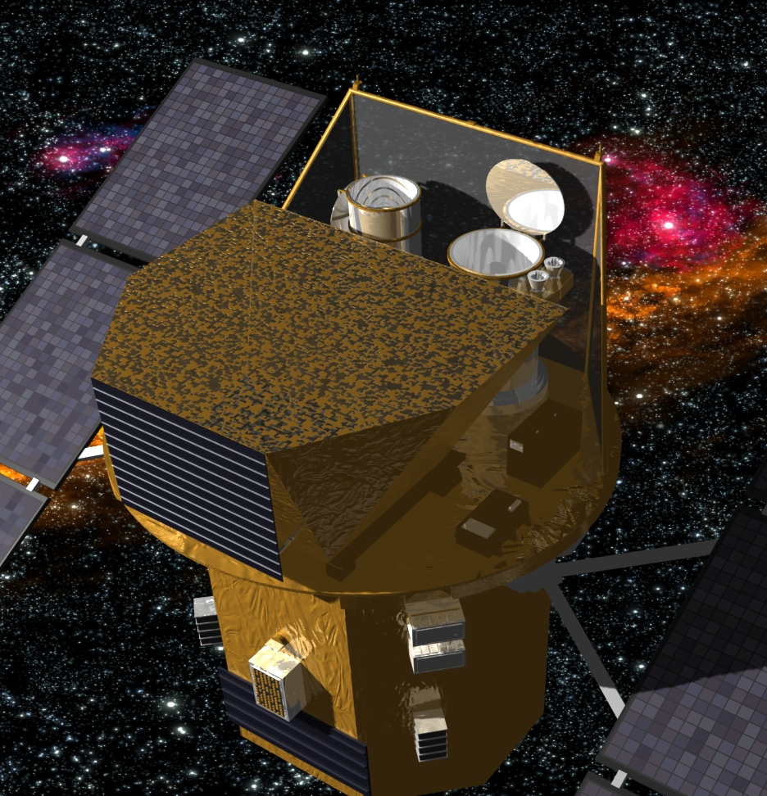




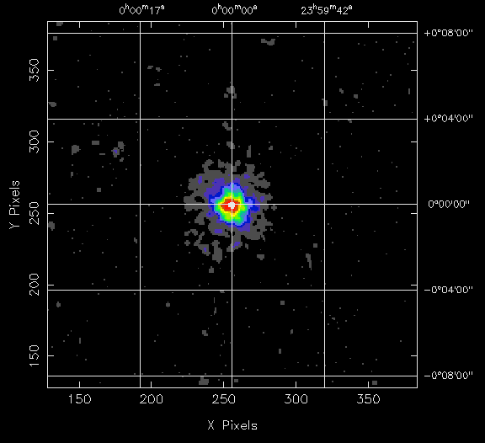
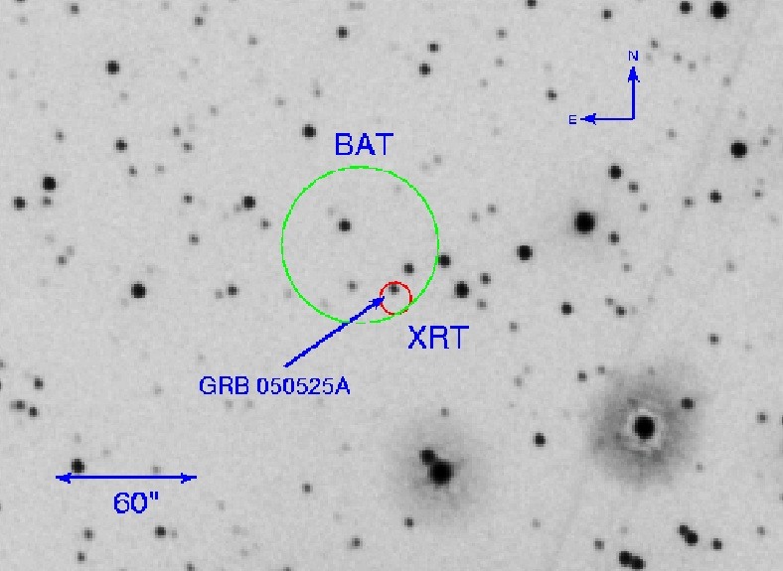
Swift – Time Domain Observatory
UVOT
XRT
Proposed in 1998
Selected for phase-A study in 1999
Finally selected on Oct 14, 1999
Launched on November 24, 2004 !!
BAT
Instruments
  BAT (2 sr): 15-300 keV 32,000 CZT detectors
  XRT: 0.3-10 keV arcsec imaging
  UVOT: 170-600 nm grism spectra
2 gamma-ray bursts / week
3 rapid targets per day
BAT Position - 2 arcmin
XRT Position - 5 arcsec
UVOT Position - < 1 arcsec
T<10 sec
T<90 sec
.
T<2 min

Slide 6
Swift: Italian Contribution & Responsibility
Mirror Module of the XRT Telescope
Malindi Ground Station
XRT Analysis software & Italian Swift archive
BA&XBS responsibility
XRT calibration & operation support

Slide 7
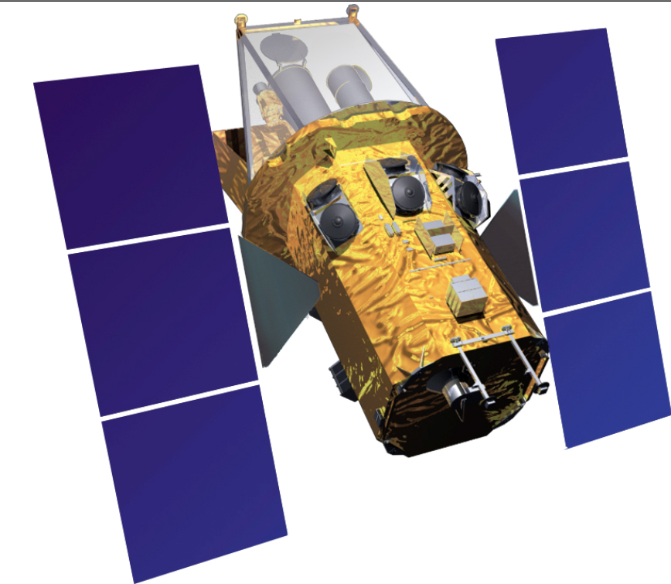
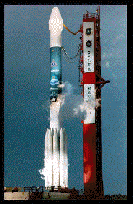
The Swift communication network
Payload
BAT
XRT
UVOT
TDRSS
Spacecraft
Spectrum Astro
Rapid Autonomous Slews
Mission
Operations Center
(MOC)
Malindi
PSU
ASI
Science Center
GSFC
GCN & Web
Delta 2320
600 km X 22º inclination
HEASARC
UK
Italian Archives
User Community
Launcher

Slide 8
Swift – Time Domain Observatory
Gamma Ray Bursts
  >980 GRB (10% short), most with arcsec positions
  Hard X-ray prompt detection
  Multiwavelength rapid (100 s) follow-up
Non-GRBs
  >300 transients detected by BAT
  >5800 Target of Opportunities
  Multiwavelength rapid (1 hr) response
  Joint observations with NuSTAR, Fermi, PTF,
  ASASSN, Kepler, WISE, LCOGT, Pan-STARRS
  Surveys with all instruments
Instruments
  BAT (2 sr): 15-300 keV, 2 arcmin, 5000 cm²
  XRT: 0.3-10 keV, 2 arcsec, 120 cm²
  UVOT: 170-600 nm, <1 arcsec, 30 cm mirror
UVOT
XRT
BAT

Slide 9
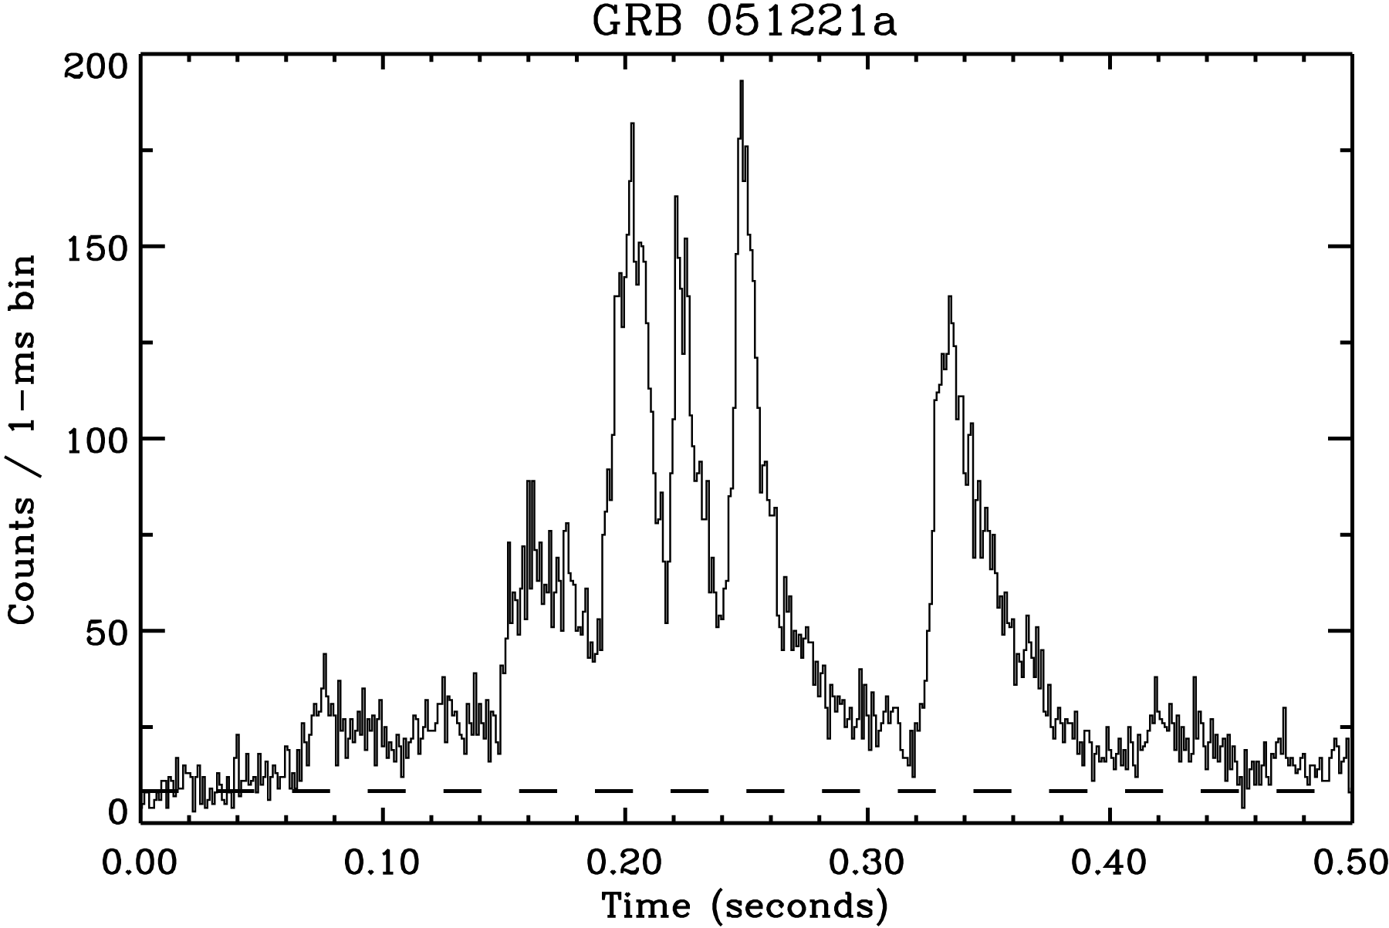
GRB Variability
Swift Short GRB
GRB 061121 = brightest long GRB
GRB 061210 = brightest short GRB

Slide 10
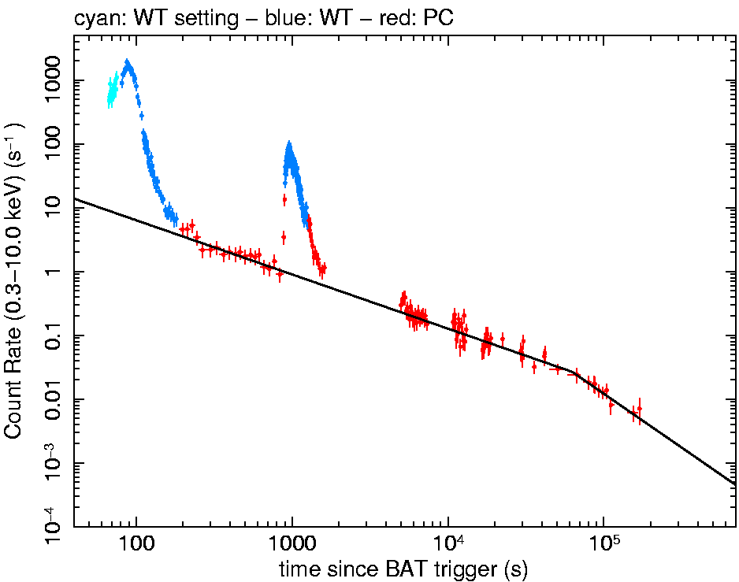
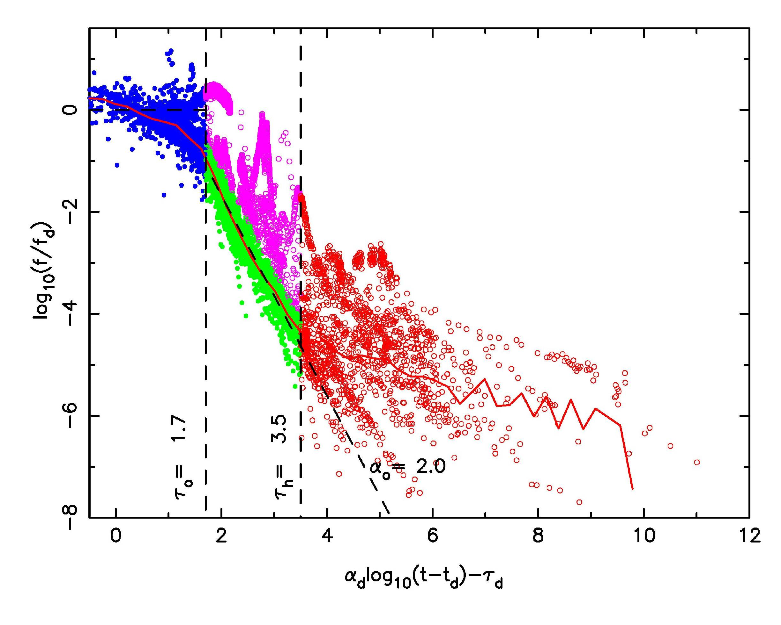
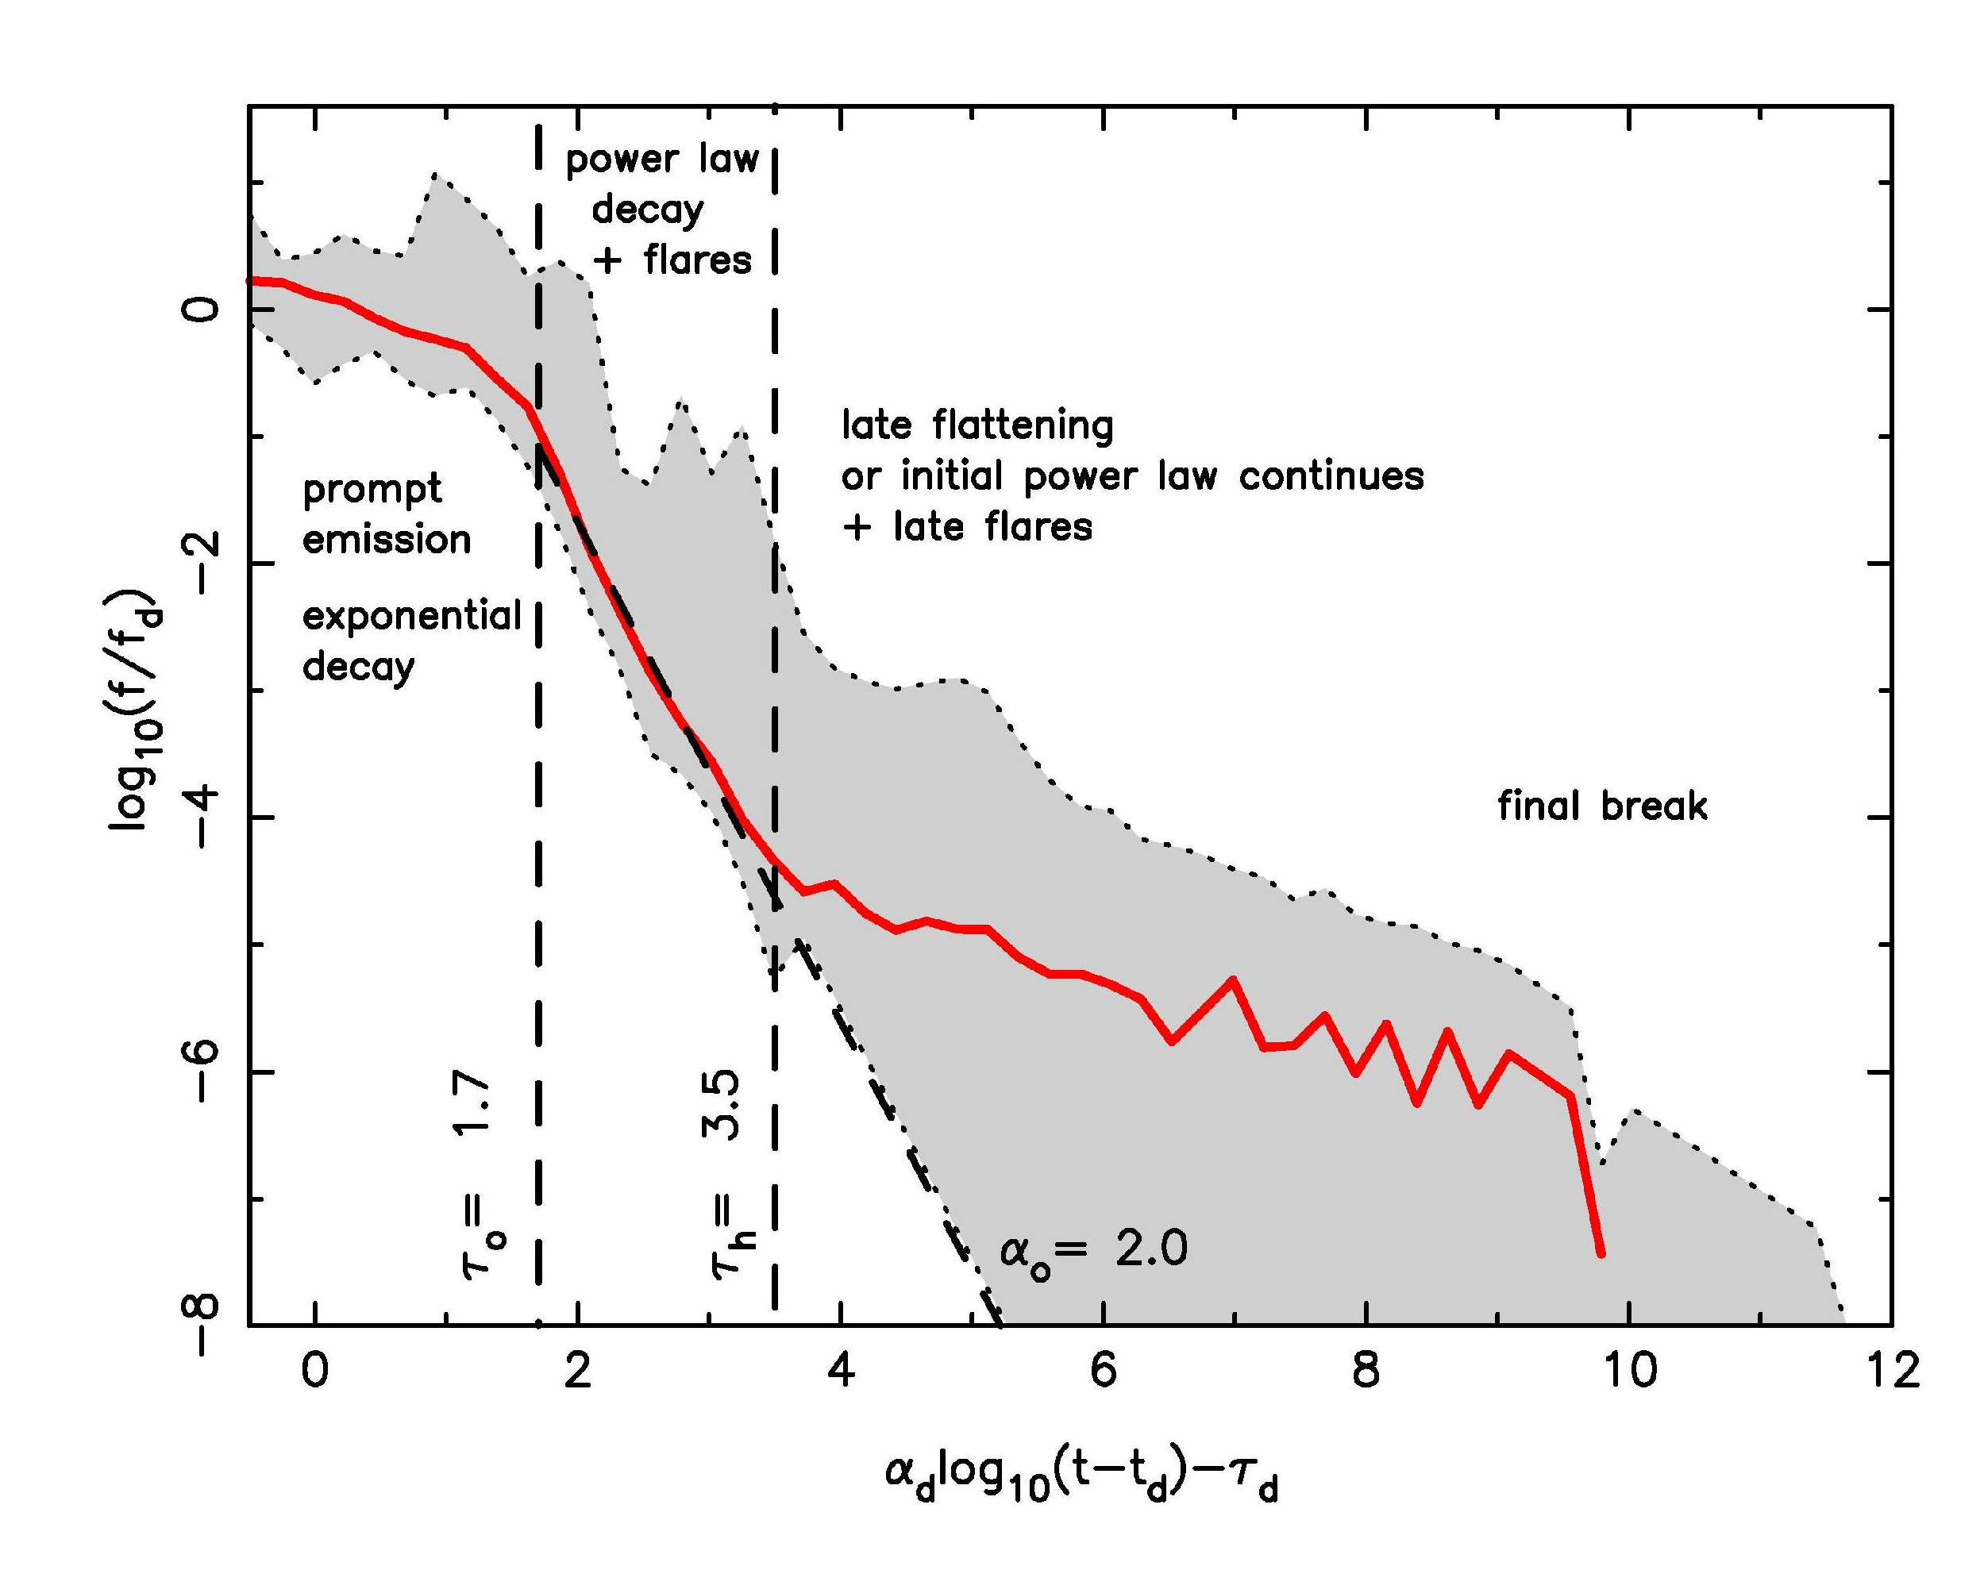
Composite X-ray Swift GRB light curves
• Prompt (<T_{p})
• PL Decay
О Flares
О Emission “Hump”
.
Nousek et al. 2005, ApJ 642, 389
O’Brien et al. 2006, ApJ 647, 1213
Chincarini et al. 2007, ApJ 671, 1903

Slide 11
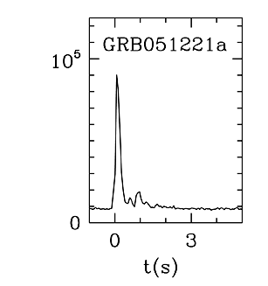
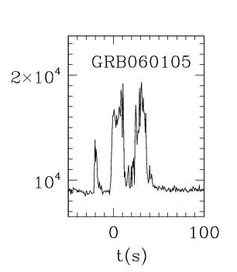
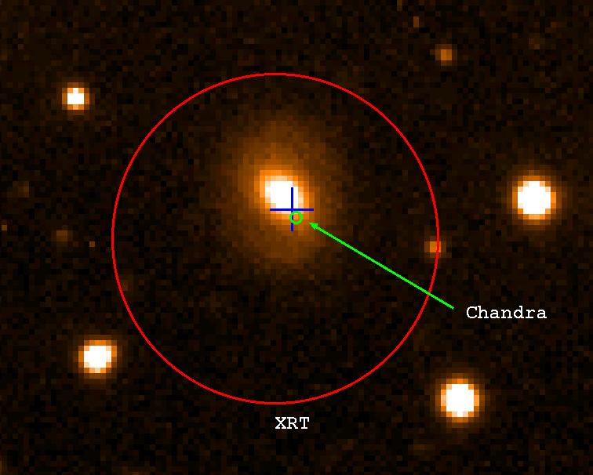
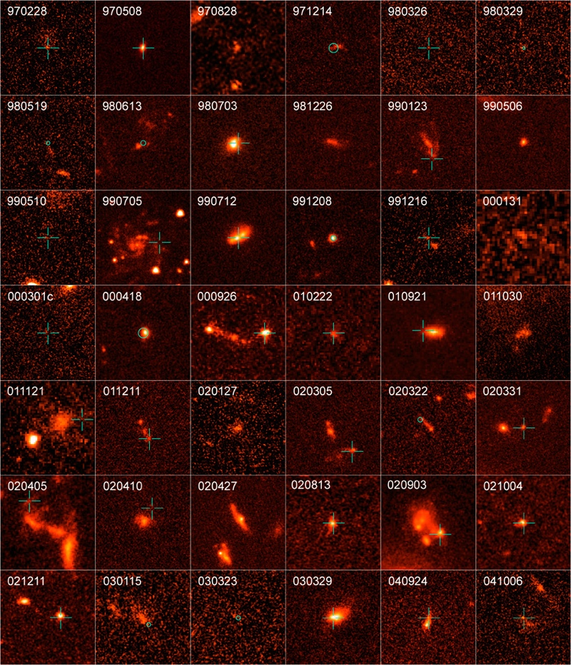
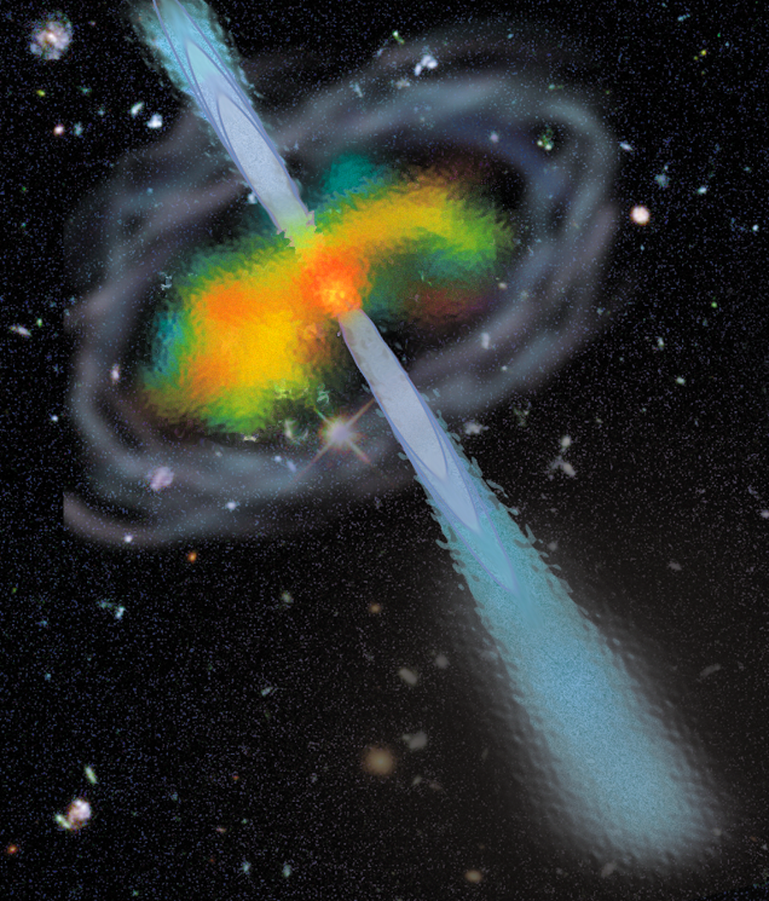
Short GRB
Short vs Long GRBs
Long GRB
Cnts/s
GRB 050724 - Swift
elliptical host
GRB 020903 - SAX
SF dwarf host
Cnts/s
Chandra
GRB
XRT
In non-SF
and SF galaxies
No SNe detected
Possible merger model
In SF
galaxies
Accompanied by SNe
Collapsar model well supported
BH

Slide 12
Short GRB Summary
Similar to LGRBs:
  - extragalactic
  - occur in distant galaxies
  - collimated jet outflows
  - produced by gravitational
  collapse, probably to BHs
Dissimilar to LGRBs
- not accompanied by SN
  (but maybe kilonova)
- not concentrated in SR regions
- lower redshift
- weaker afterglows

Slide 13
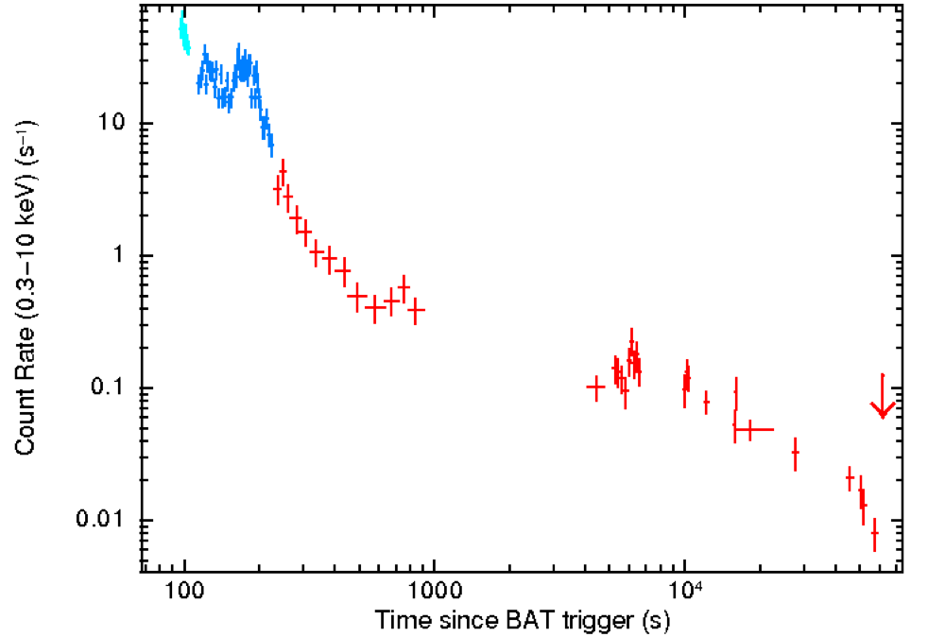
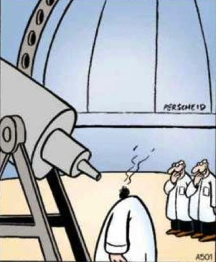
Long GRBs Seen to High z
X-ray Lightcurve
GRB 150711A
z Look-Back GRB Optical
Time (Gyr) Brightness
9.4 13.1 090429B K = 19
8.2 13.0 090423 K = 20
~8 13.0 120923A
7.5 13.0 100905A H ~ 19
6.7 12.8 080813 K = 19
6.3 12.8 050904 J = 18
6.2 12.8 120521C
5.6 12.6 060927 I = 16
5.3 12.6 050814 K = 18
5.11 12.5 060522 R = 21
1 Crab
HST image

Slide 14
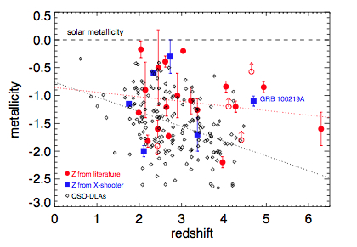
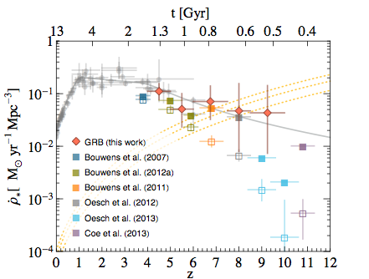
Tools to study the high-z Universe
Star formation rate
Metallicity
Thöne et al. 2012
Savaglio 2006
GRBs: the most brilliant sources at high-z

Slide 15
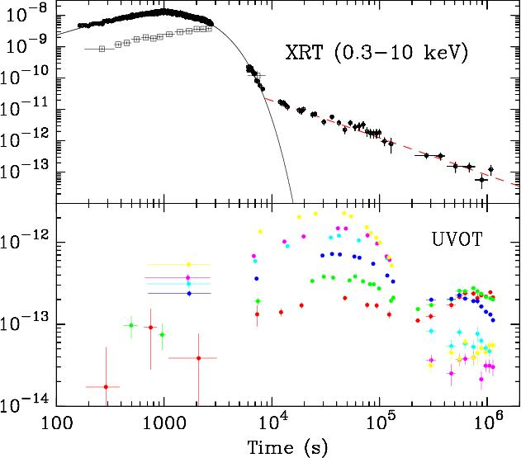
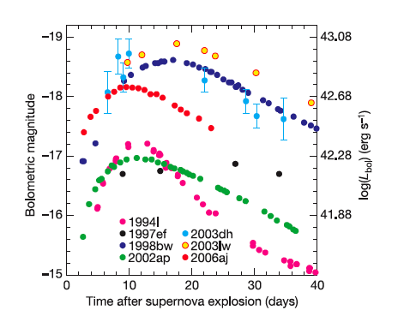
GRB 060218: GRB + Hypernova
GRB SNe
Super-long GRB - ~35 minutes
BAT, XRT, UVOT during GRB
z = 0.033 (450 M yrs)
SN 2006aj SN Ib/c
E_{iso} = few x 10⁴⁹ erg - underluminous
SNe Ic
Campana et al., Mazzali et al., Pian et al., Soderberg et al.

Slide 16
Swift unique Time Domain Astronomy sampling and wavelength coverage
Conceived as a mission for rapid follow-up of GRBs, Swift has also proven to be highly flexible and responsive to allow observations of nearly every type of astronomical object
Up to 75 targets per day, >1000 observing programs per year
Autonomous response => observations in seconds to minutes of GRBs, SGRs, flare stars, supergiant fast X-ray transients and other hard X-ray transients
ToOs response (on average 3 every day) in as little as ten minutes, or samplings over periods of time ranging from minutes to hours, days or months

Slide 17
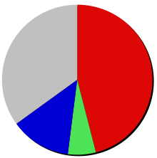
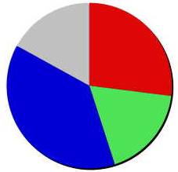
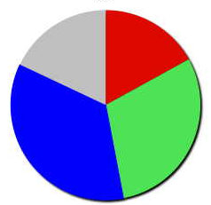
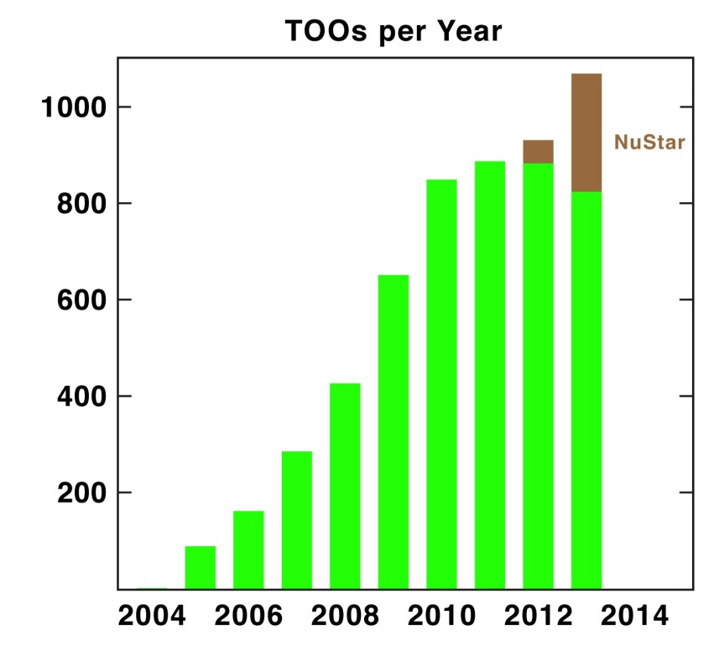
Evolving Observing Time
2005
2009
2012
35%
17%
27%
18%
17%
46%
30%
38%
18%
35%
13%
6%
TOO Approved Requests per Year
GRBs
TOOs
GI obs & Fill-ins
SAA & Calibration
2 per day

Slide 18
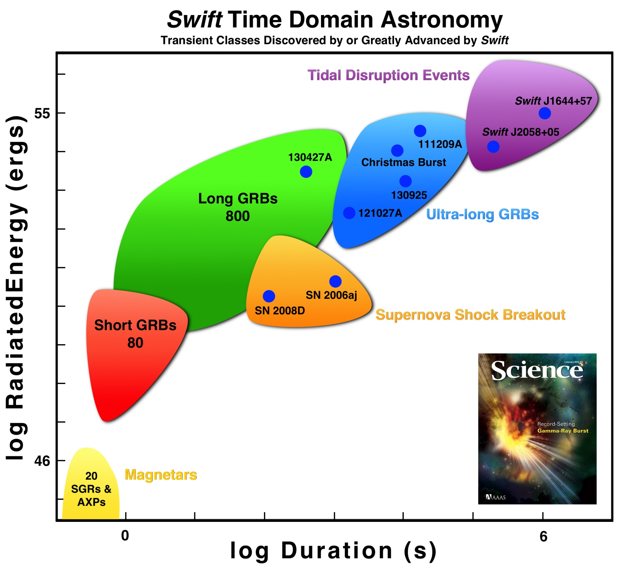
965
95

Slide 19
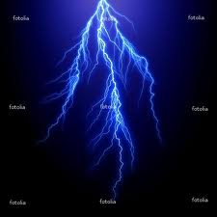

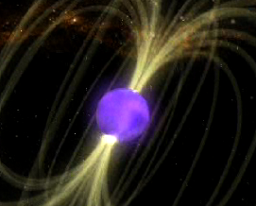
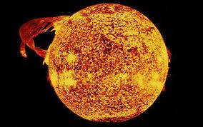
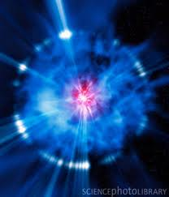
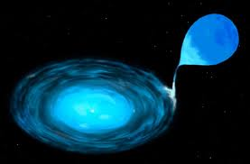
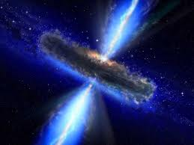
Time
Object
Duration
  TGF msec
  GRB msec - mins
  SGR msec - sec
  TDE day - yrs
  solar flare mins
  supernova/nova mins - yrs
  accreting BH / NS secs - days variable
  AGN hrs - days variable

Slide 20
Energy
Object
Source - γ-ray E
  TGF E field - 10¹⁰ erg
  GRB gravity - 10⁵¹ erg
  SGR B field - 10⁴⁴ erg
  TDE gravity - 10⁵² erg
  solar flare B field - 10³² erg
  supernova/nova nuclear - 10⁴⁹ erg
  accreting BH / NS gravity - 10³⁶ erg/s
  AGN gravity - 10⁴³ erg/s

Slide 21
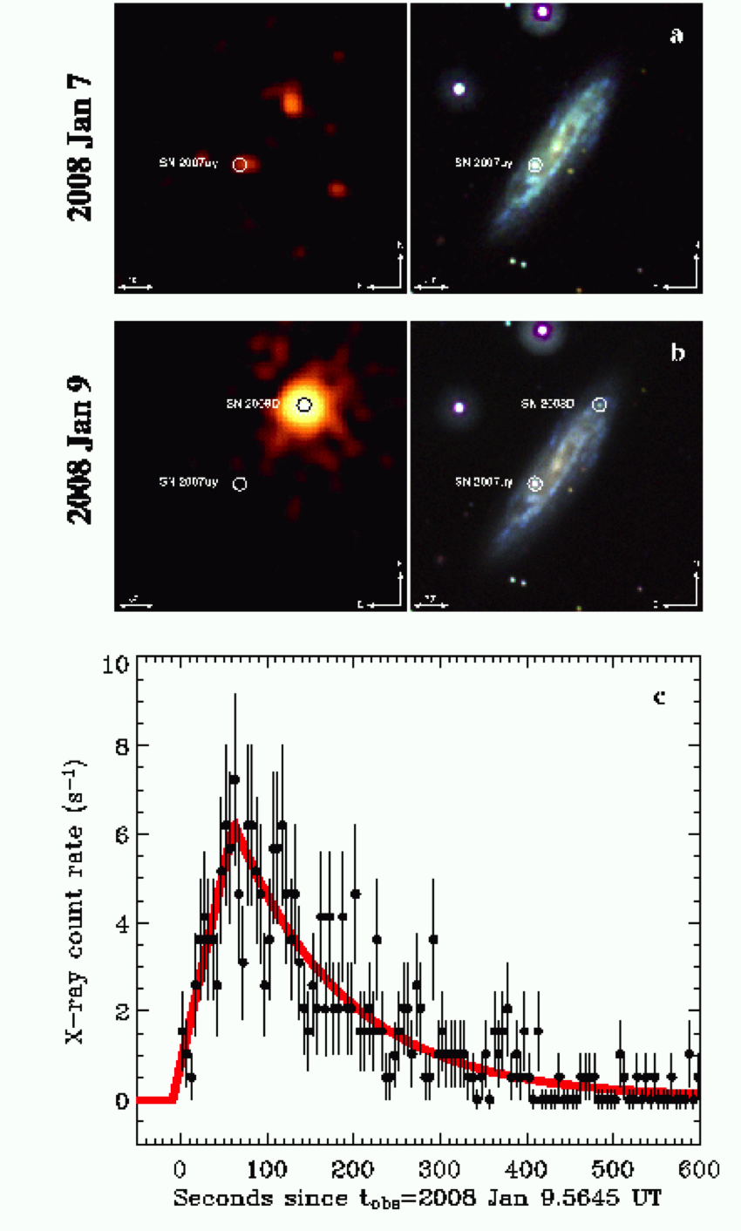
SN 2008D Shock Breakout
9 Jan 2008
Soderberg+ 08
XRT narrow-field monitoring of SN 2007y
Luminous X-ray outburst from SN 2008D
Shock breakout. May occur for all SNe
Power source:
Gravity + E&M

Slide 22
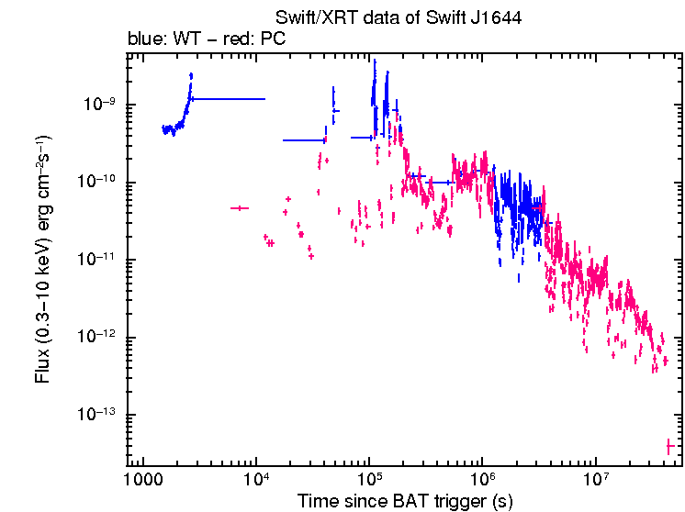
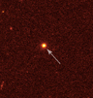
Swift Transient - Sw J1644+57
Highly erratic γ-ray and X-ray light curve, March 28, 2011
Like a GRB, but lasting 2 days instead of 20 second
Tidal disruption event beamed at us
E ~ 10⁵¹ ergs M_{BH} = 10⁶ – 10⁷ M_{solar}
Swift Light Curve
HST Image
t^{-4/3}
2 days
Center of galaxy at z=0.35
Bloom+, Burrows+, Levan+ ... 11

Slide 23

The onset of a jet from a TDF

Slide 24
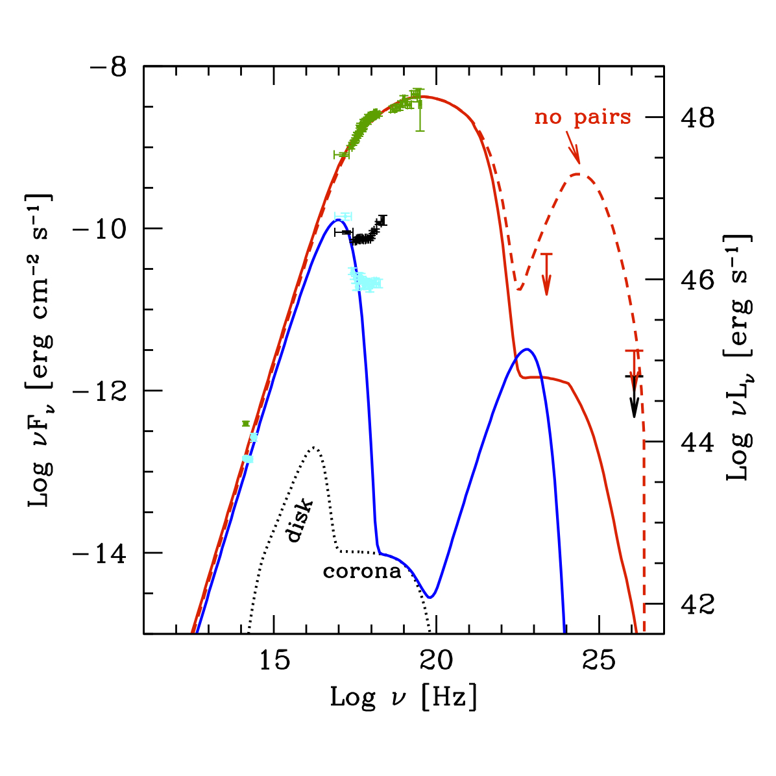
A blazar model dominated by synchrotron emission
10⁶-10⁷ M
Optical/NIR => particle starved, magnetically dominated jet
γ-TeV => γ-γ pair production => Γ≤20
Burrows et al. Nature 2011, 476, 421

Slide 25
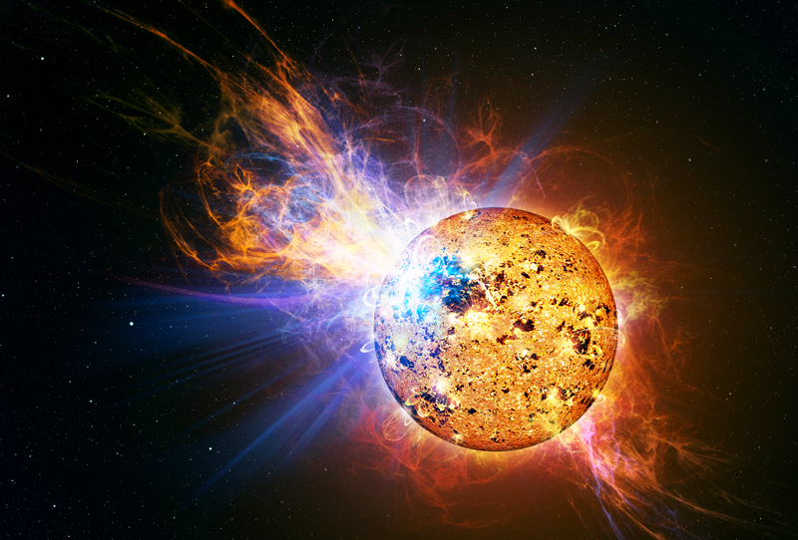
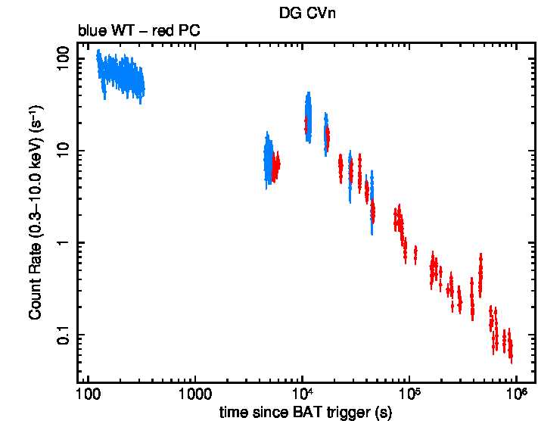
DG CVn Large Stellar Flare
DG CVn - April 23, 2014
Large X-ray "super-flare"
Brighter than star luminosity
10,000x largest solar flare
Young star at 18 pc
previous events: EV Lac, II Peg
Power source:
B field reconnection
Drake, Osten, Page, Oates +

Slide 26
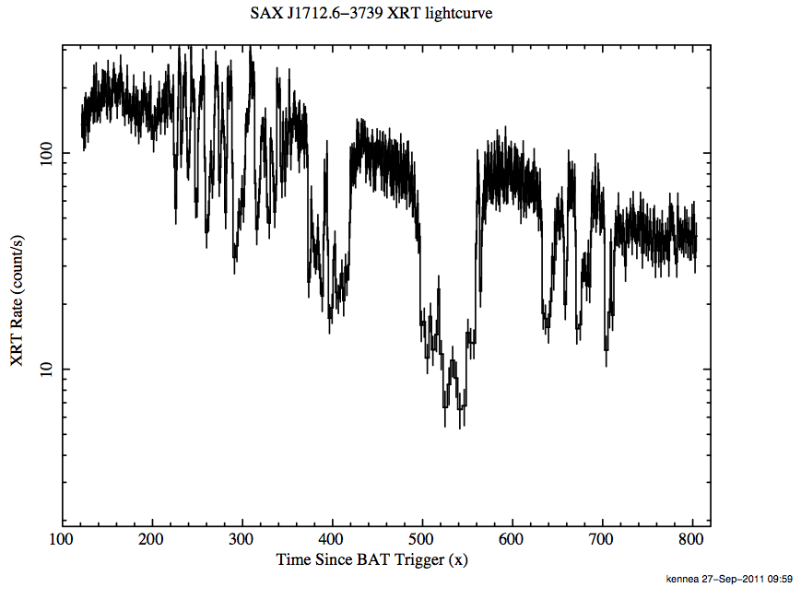
LMXB Superburst
SAX J1712.6-3739 27-Sept-2011
4U 1850-08 10-Mar-2014
SAX J1712.6-3739
Large thermonuclear burn
Carbon burning of XRB ashes
Factor 1000 longer and less
frequent than XRBs
Discovered by RXTE
BAT fluence trigger
XRT Rate (counts / s)
Time Since BAT Trigger (s)
Power source:
Nuclear burning
in't Zand, Strohmayer,

Slide 27
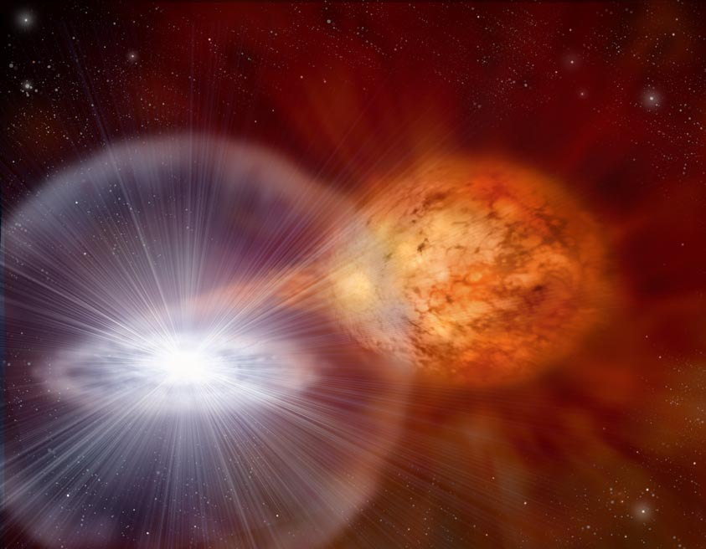
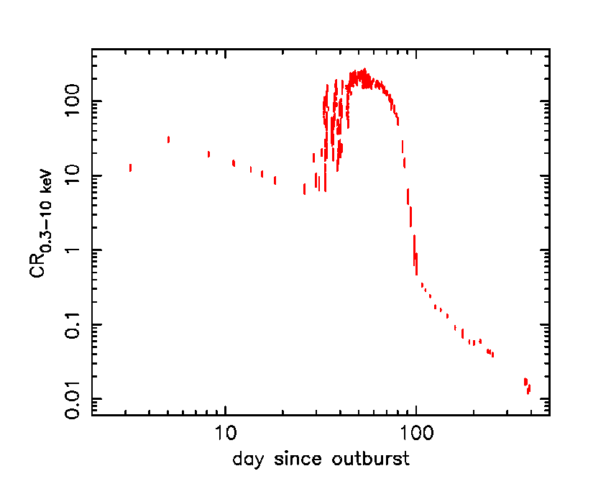
Nova Outbursts
Thermonuclear detonation of accumulated accretion on white dwarf
- >30 novae observed
- keV emission from shocked ejecta
- Super-Soft emission from WD surface
- Extensive observations of RS Oph 2006
(~400 ksec)
- Earth mass ejected at ~4000 km/s into wind of companion Red Giant
1.6 kpc
RS Oph
Power source:
Nuclear burning
Osborne+ '11
Notes:
27

Slide 28
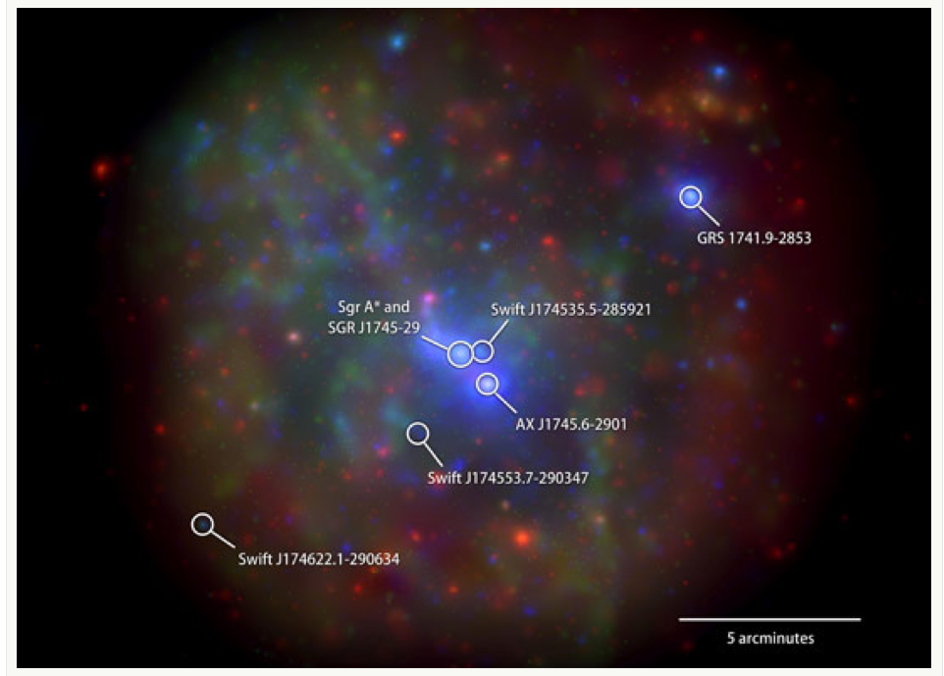
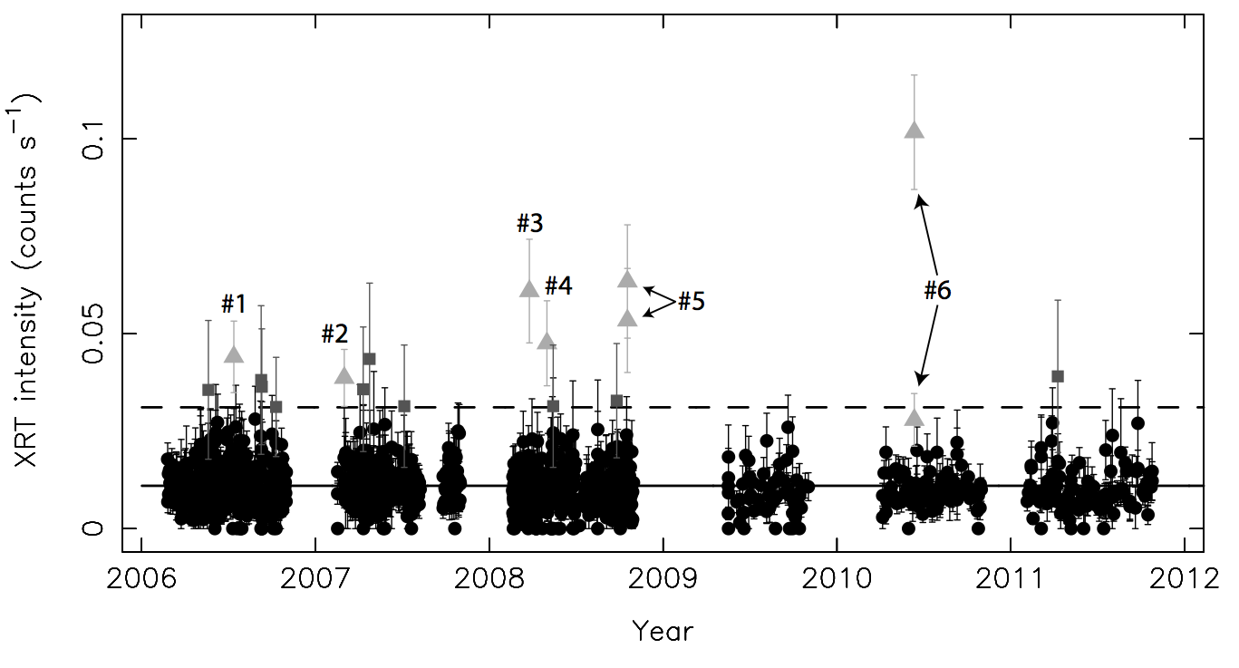
Sgr A* Flares
Daily XRT monitoring of GC
6 flares seen from Sgr A*
+ 10 weak candidate flares
Sgr A* is not dormant
L_{X} ~ 10³³ erg/s
~ 1 billionth Eddington
Degenaar+ 13
Power source:
Gravity

Slide 29

Synergies with Other Missions
3C 454.3
Fermi & AGILE: Follow-up of GRBs, blazars,
unidentified sources, ....
NuSTAR: all NuSTAR observations have a Swift pointing
INTEGRAL: Follow-up of transients, GRBs,
MAXI: Collaboration, follow-up of transients
XMM and Chandra: synergy in TOO programs
HST: Deep follow-up observations of GRBs
TeV observatories: Joint observations of blazars, triggers for GRB searches
extended-LIGO/Super-VIRGO: MoU agreement to search for counterpart of GW events!
IceCube: Agreement, follow up of transients, triggers for GRB searches
EVLA & LOFAR: Collaboration, triggers for GRB searches
UVOT
LAT
XRT
radio

Slide 30

3C 454.3
Swift XRT +UVOT + BAT
Fermi adattive bin 1GeV light-curve
factor 10⁴ !
credits P. Giommi

Slide 31


PKS2155-304
Aharonian et al 2007
credits P. Giommi

Slide 34












The Future: we will still need a mission like Swift

Slide 35
Conclusions
The sky is rich in transients of many types, with GRB being the most powerful and explosive sources
Swift is exploring the transient sky with unprecedented sensitivity and coverage
Every year bring new discovery in time domain science
Explosion mechanisms range from gravitational collapse to nuclear burning to B field reconnection
Swift will hopefully last another 10 years and has exciting science to perform partnering with new ground observations and increasing capabilities

