Slide 1
Luigi Piro (IAPS/INAF)

Slide 2
The Science Theme motivating the Athena mission

Slide 3
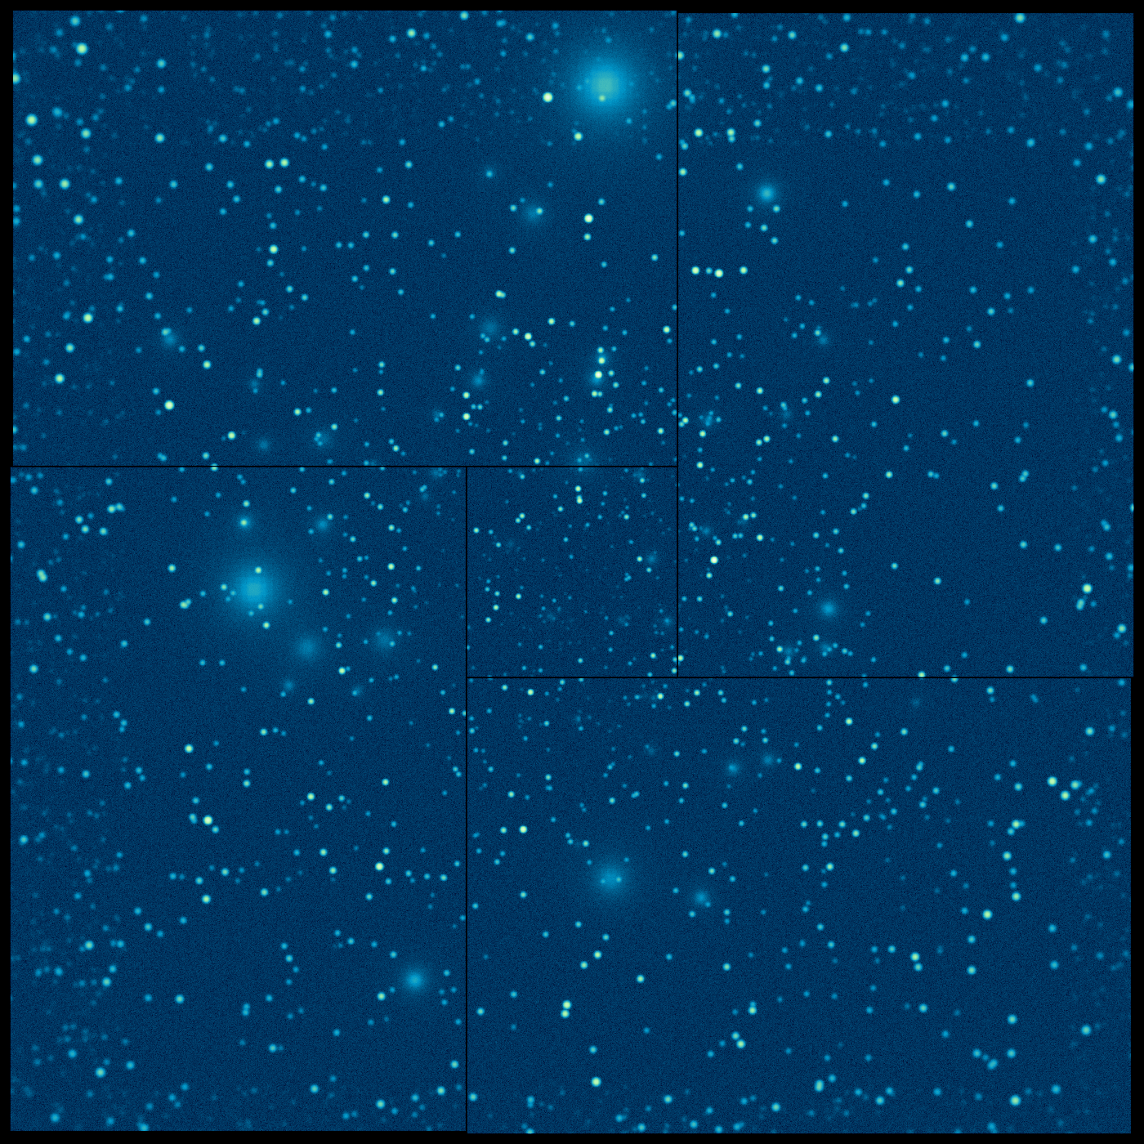
Key questions for observational astrophysics in 2028
1. How does ordinary matter assemble into the large scale structures we see today?
Extended X-ray sources
Oppenheimer et al. 2009
Athena Deep Field
Pointecouteau, Reiprich et al., 2013 arXiv1306.2319

Slide 4
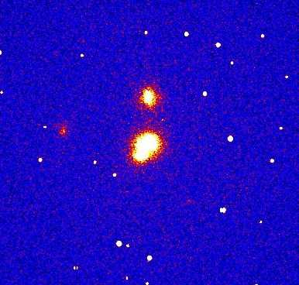
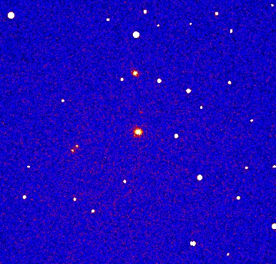
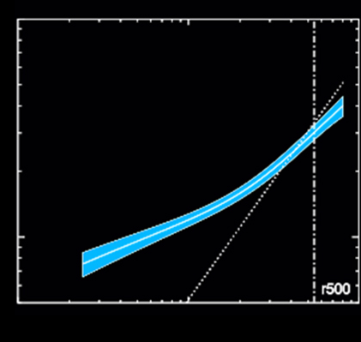
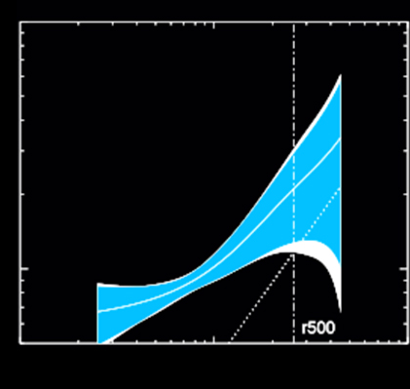
The formation and evolution of clusters and groups of galaxies
How and when was the energy contained in the hot intra-cluster medium generated?
Pointecouteau, Reiprich et al., 2013 arXiv1306.2319
z=2
z=1
1000
1000
Entropy profile
Entropy profile
Pure gravitation
Pure gravitation
Entropy
With AGN and supernova heating
With AGN and supernova heating
100
100
Athena Simulation
10
10
100
100
1000
1000
Radius (kpc)
Radius (kpc)
How does ordinary matter assemble into the large-scale structures that we see today?

Slide 5
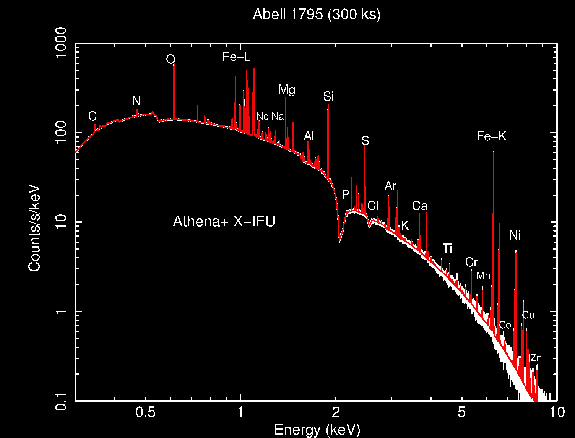
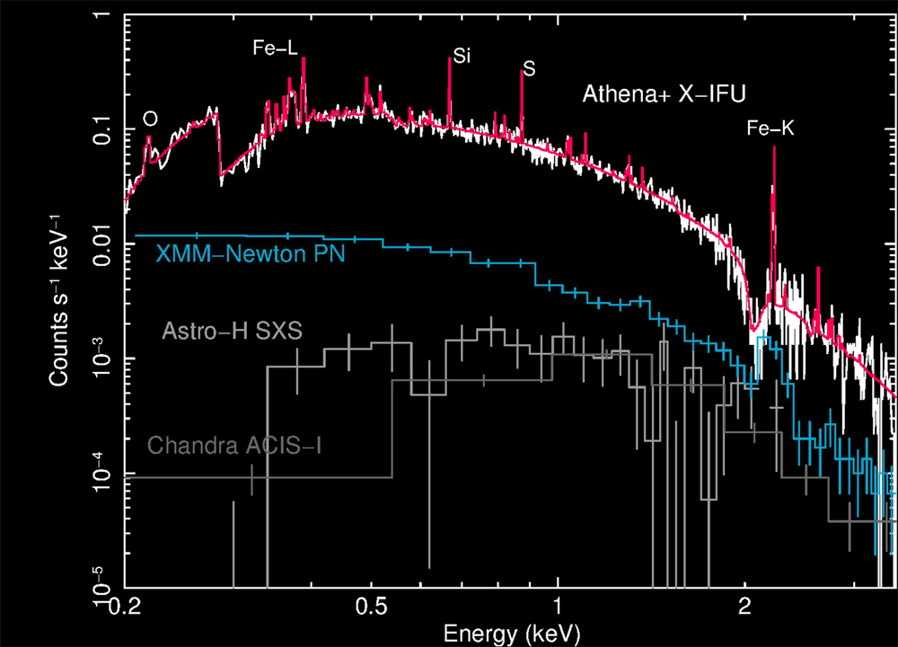
The chemical evolution of hot baryons
When and how were the largest baryon reservoirs in galaxy clusters chemically enriched?
z=2 cluster
Ettori, Pratt, et al., 2013 arXiv1306.2322
How does ordinary matter assemble into the large-scale structures that we see today?

Slide 6
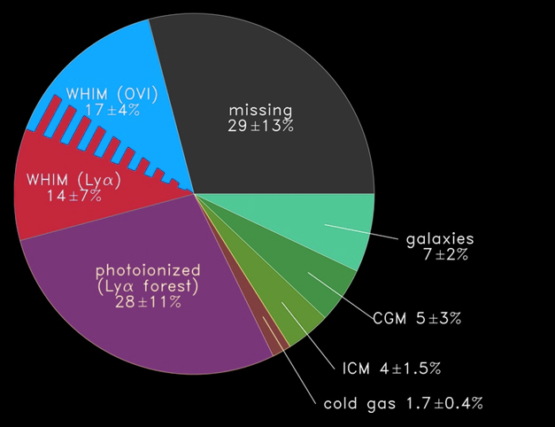
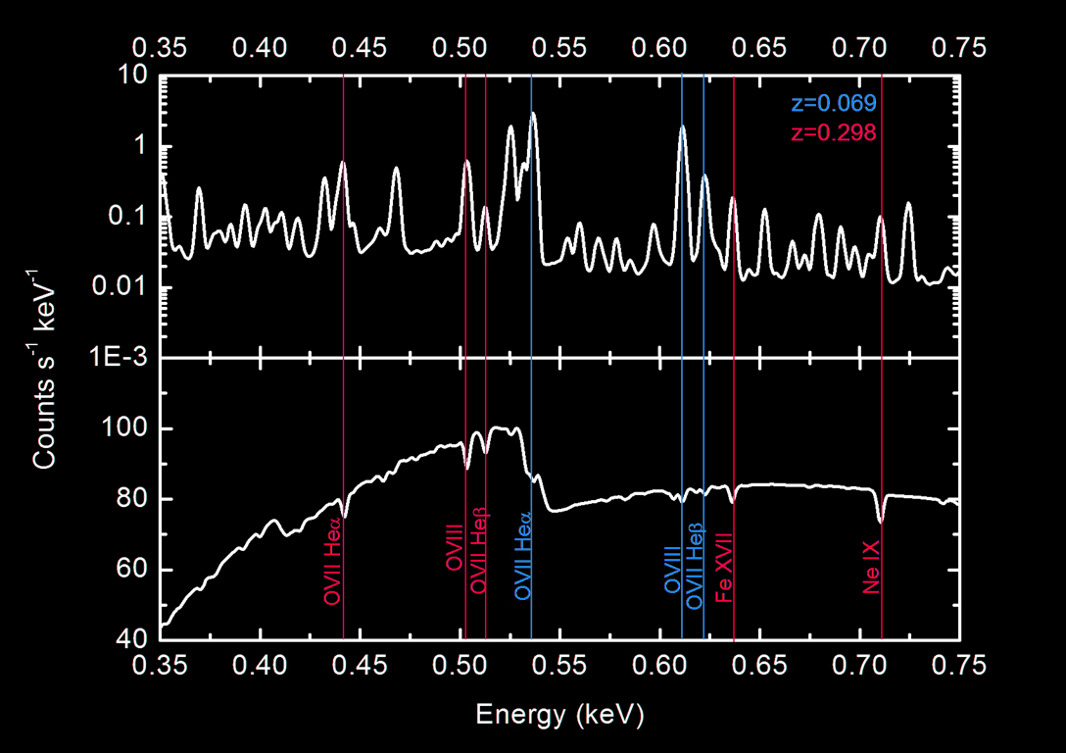
The Warm-Hot intergalactic medium (WHIM)
Where are the missing baryons in the local Universe? What is the underlying mechanism determining the distribution of the hot phase of the cosmic web?
Kaastra, Finoguenov et al., 2013 arXiv1306.2324
How does ordinary matter assemble into the large-scale structures that we see today?

Slide 7
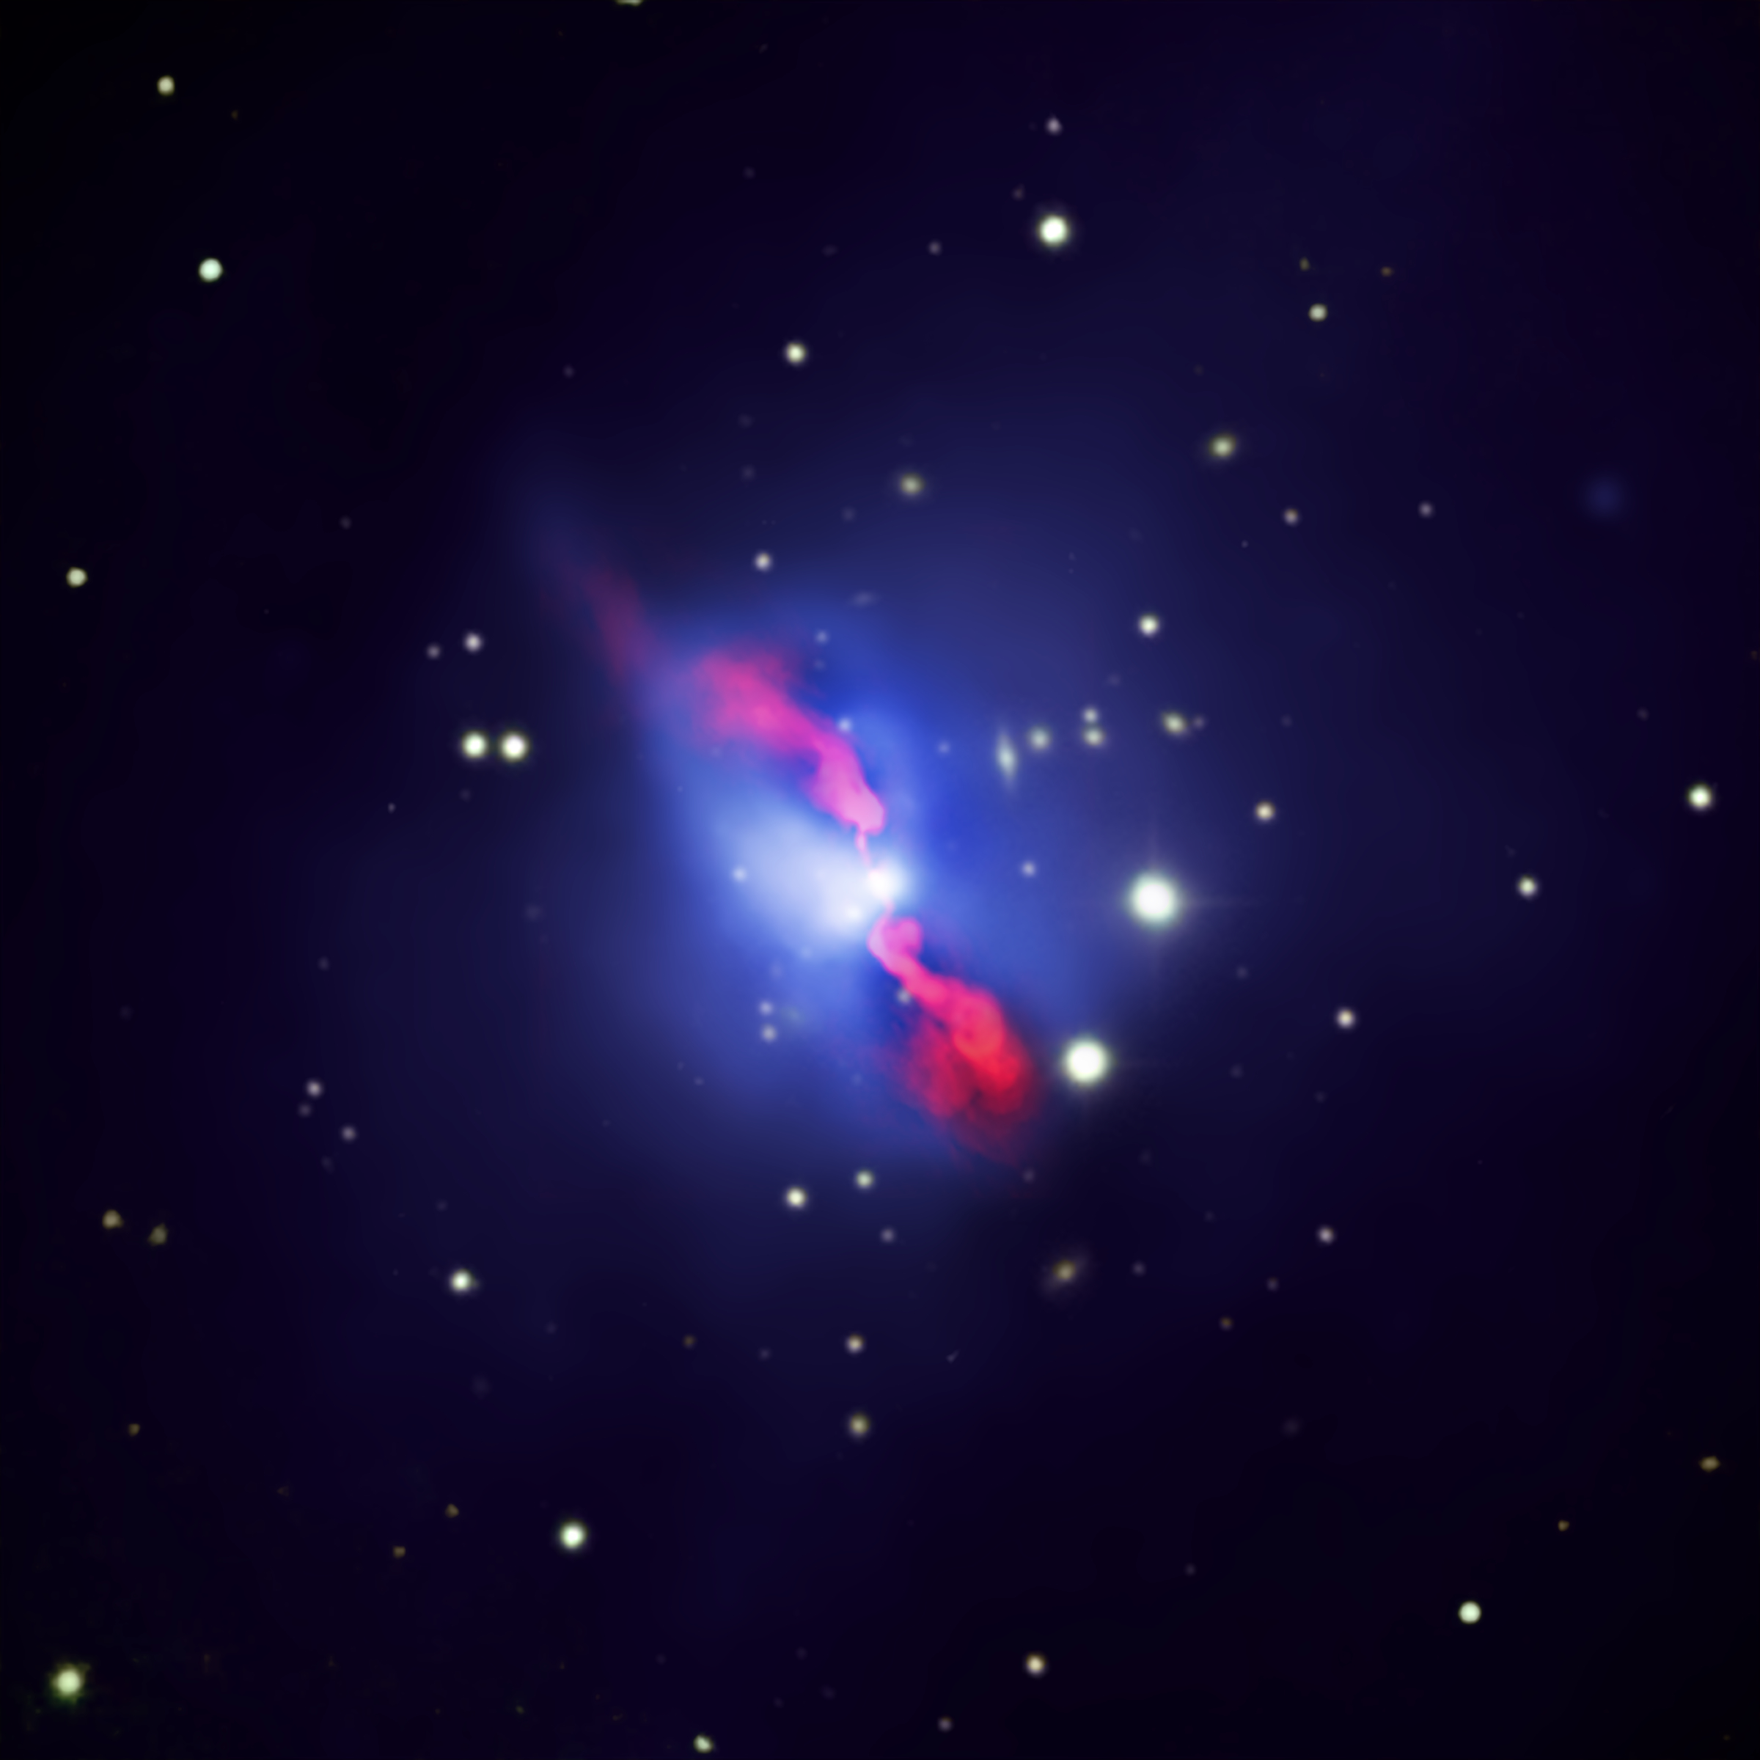
Key questions for observational astrophysics in 2028
1. How does ordinary matter assemble into the large scale structures we see today?
2. How do black holes grow and shape the Universe?
Extended X-ray sources
X-ray point sources
Athena Deep Field

Slide 8
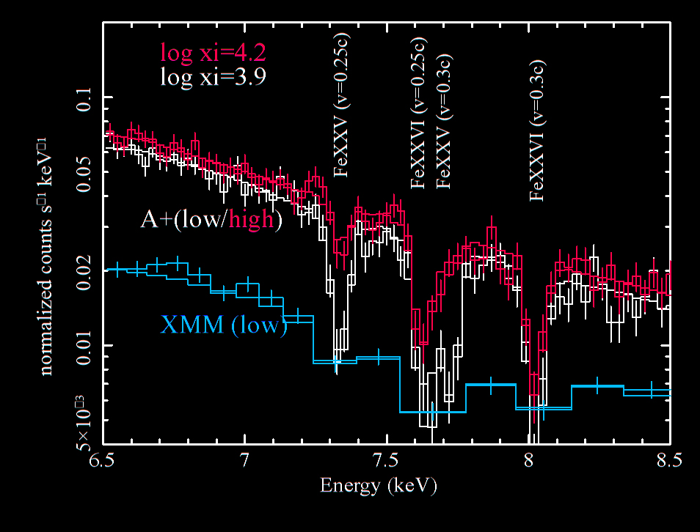
Cosmic feedback: the origin of black hole winds
How do black holes launch winds and outflows? How much energy do they carry out to larger scales?
Cappi, Done et al., 2013 arXiv1306.2330
Dovciak, Matt et al., 2013 arXiv1306.2331
How do black holes grow and shape the Universe?

Slide 9
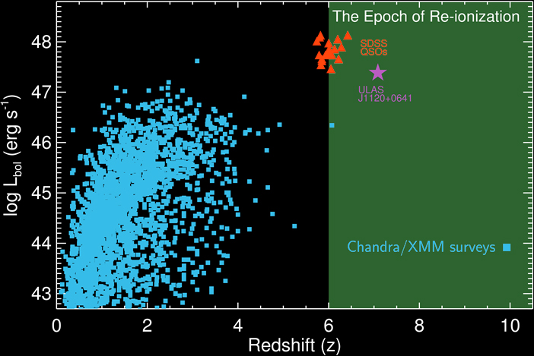
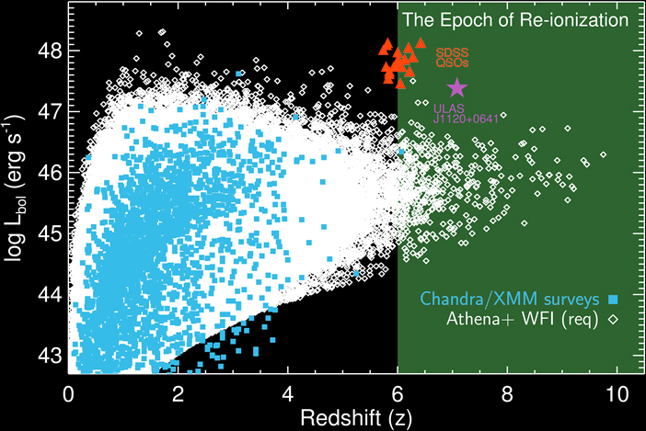
Black hole growth in the early Universe
What was the growth history of black holes in the epoch of reionization?
Aird, Comastri et al. 2013 arXiv1306.2325
How do black holes grow and shape the Universe?

Slide 10
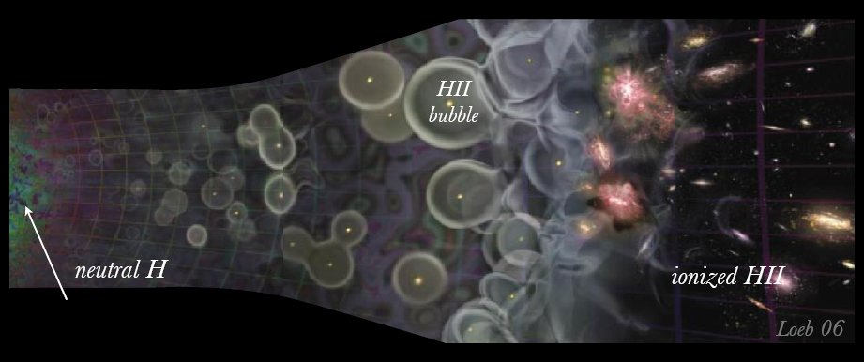
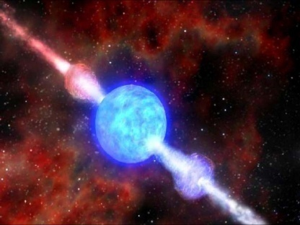
The first stars, the first BH, the first metals
z=1089
Pop III collapsars?
Pop II GRBs
z=12
z=5
z=0
Dark Ages
Reionization
GRB
Quasar
Galaxy
Notes:
Z= 20 circa 300Myrs
I primi

Slide 12
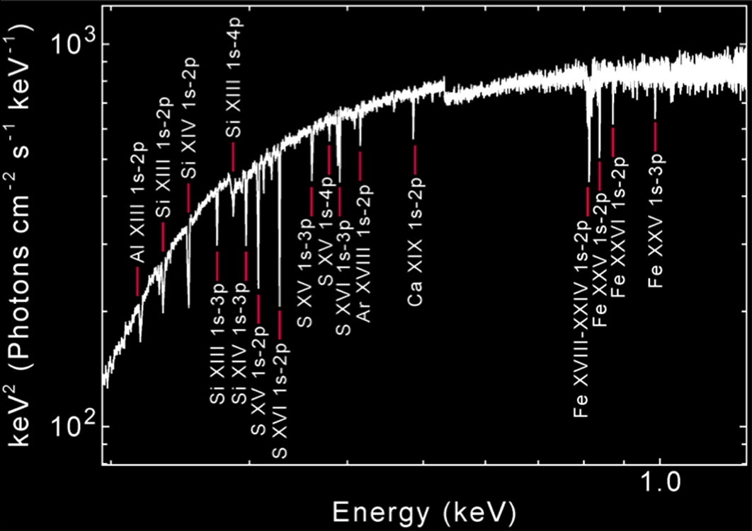
The first stars and black holes
When did the first generation of stars explode to form the first seed black holes and disseminate the first metals in the Universe?
Gamma Ray Burst at z=7
Jonker, O'Brien et al., 2013 arXiv1306.2336
How do black holes grow and shape the Universe?

Slide 13
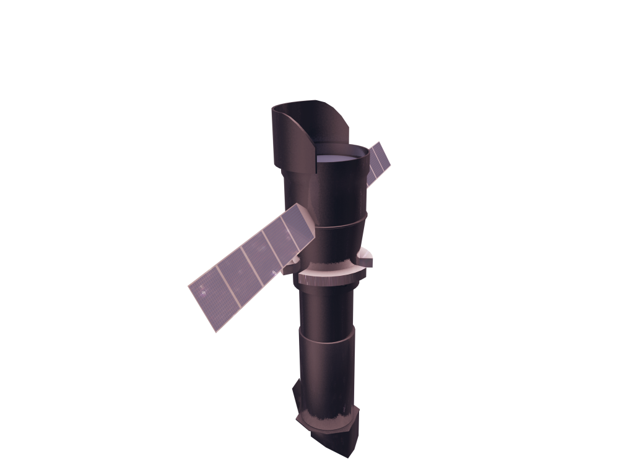
The Athena Observatory
Willingale et al, 2013 arXiv1308.6785
L2 orbit Ariane V
Mass < 5100 kg Power 2500 W 5 year mission
Silicon Pore Optics:
2 m² at 1 keV 5 arcsec HEW Focal length: 12 m Sensitivity: 3 10⁻¹⁷ erg cm⁻² s⁻¹
X-ray Integral Field Unit:
ΔE: 2.5 eV Field of View: 5 arcmin Operating temp: 50 mk
Wide Field Imager:
ΔE: 125 eV Field of View: 40 arcmin High countrate capability
Barret et al., 2013 arXiv:1308.6784
Rau et al. 2013 arXiv1307.1709

Slide 14
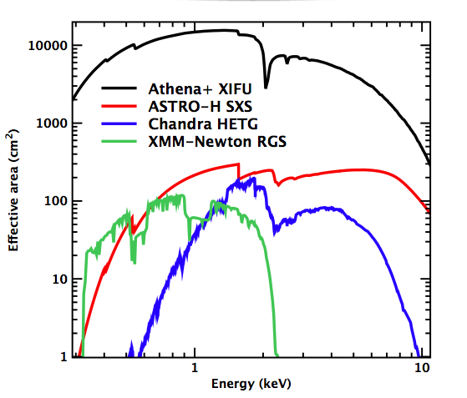
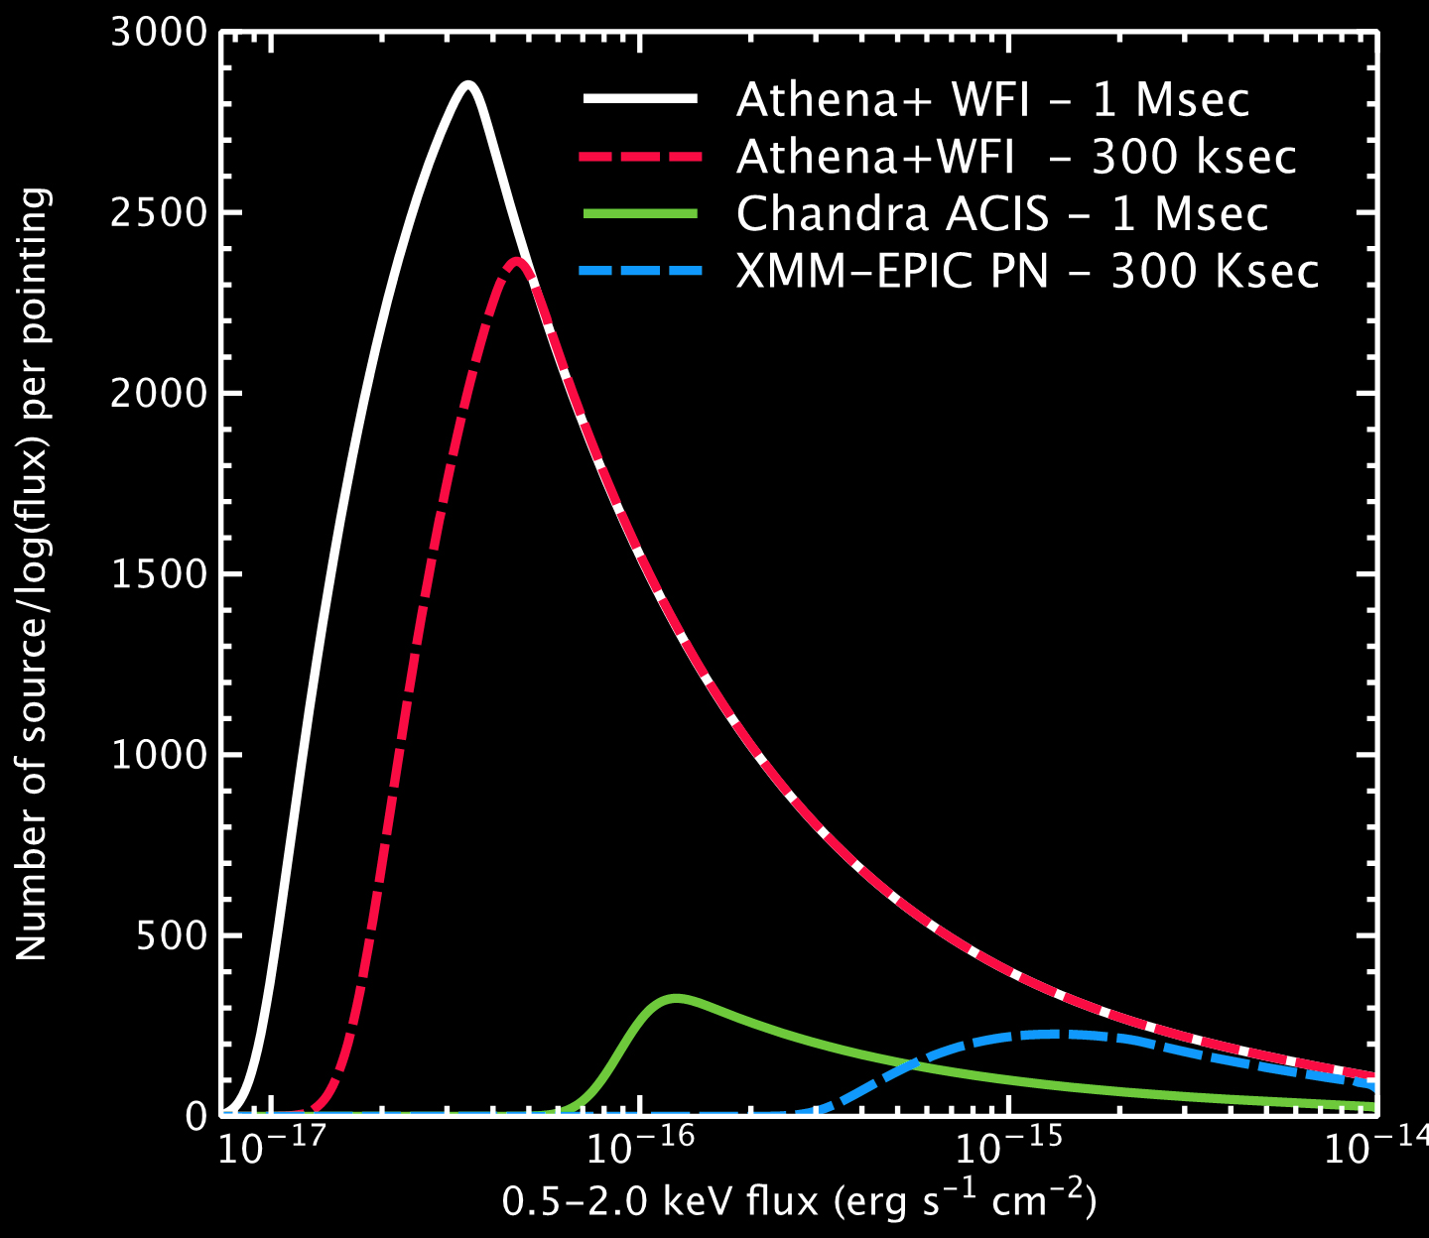
The first Deep Universe X-ray Observatory
Athena has vastly improved capabilities compared to current or planned facilities, and will impact on virtually all areas of astrophysics
Line Sensitivity
100 x ASTRO-H
Survey Speed
1000 x
XMM-Newton
X-ray spectroscopy at the peak of the activity of the Universe
Deep survey capability into the dark ages and epoch of reionization

Slide 15
Athena science in context
Athena is a crucial part of the suite of large observatories needed to reach the science objectives of astronomy in the coming decades

Slide 16
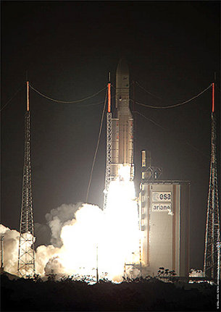
Athena milestones
Oct 2013: Senior Survey Committee and SPC recommend “The Hot and Energetic Universe” them for L2 mission in 2028
Jan 2014: Call for mission proposals
Apr. 2014: Athena proposal
2015: Phase A started
2015-2018: Technology development phase
2019-20: Start implementation phase
2028 LAUNCH!

Slide 17
Study Team & Community Organization
http://www.cosmos.esa.int/web/athena
http://www.cosmos.esa.int/web/athena

