Slide 1
Cosmological Axion Search:
A Brief and Partial Introduction
SIF ROMA SETTEMBRE 2015
Giovanni Carugno
Dipartimento Fisica & INFN Padova

Slide 2
Outline
Short theoretical introduction
Axion Interaction Channels
Where and How to Search Cosmological Axions
Extraterrestrial Evidence ?
Conclusions

Slide 3
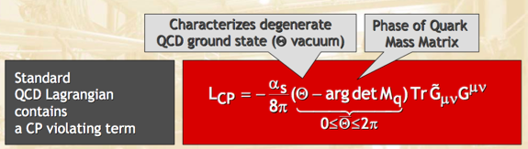

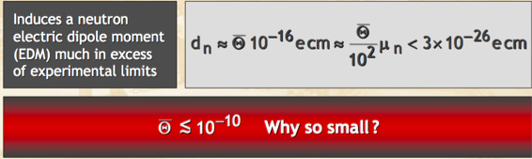
The strong CP problem
The QCD lagrangian contains a term that foresees CP violation
The parameter θ is unprescribed by the theory, it is expected to be θ ~ 1. QCD interaction actually depends on θ through its difference with the phase of the quark mass matrix:
VERY FINE TUNING! -> STRONG CP PROBLEM

Slide 4
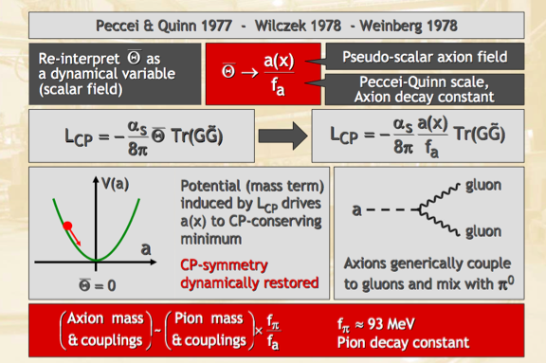
Dynamical Solution

Slide 5

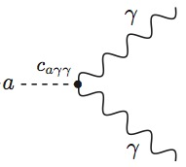
The “standard” axion
The axion is a light pseudoscalar boson, its properties can be derived using current algebra techniques
The axion is the light cousin of the π⁰ :
m_{p} = 135 MeV – pion mass
f_{p} = 93 MeV – pion decay constant
The axion, like the pion, couples to two photons
Originally it was thought that f_{a} @ electroweak scale v_{weak}(250 GeV)
RULED OUT BY ACCELERATOR EXPERIMENTS
m_{a} ≈ 100 keV

Slide 6
The “invisible” axion
No upper bound on axion decay constant: f_{a} >> v_{weak}
New axion models with addition of scalar fields or Higgs doublets carrying the U_{PQ}(1) charge
The strength of the axion interaction depends on the assignment of the U_{PQ}(1) charge to quarks and leptons.
There are two (main) models:
Kim-Shifman-Vainstein-Zakharov (KSVZ)
(Kim 1979; Shifman, Vainstein, and Zhakharov 1980)
Dine-Fischler-Srednicki- Zhitnitskii (DFSZ)
(Zhitnitskii 1980; Dine, Fischler, and Srednicki, 1981a, 1981b)

Slide 7
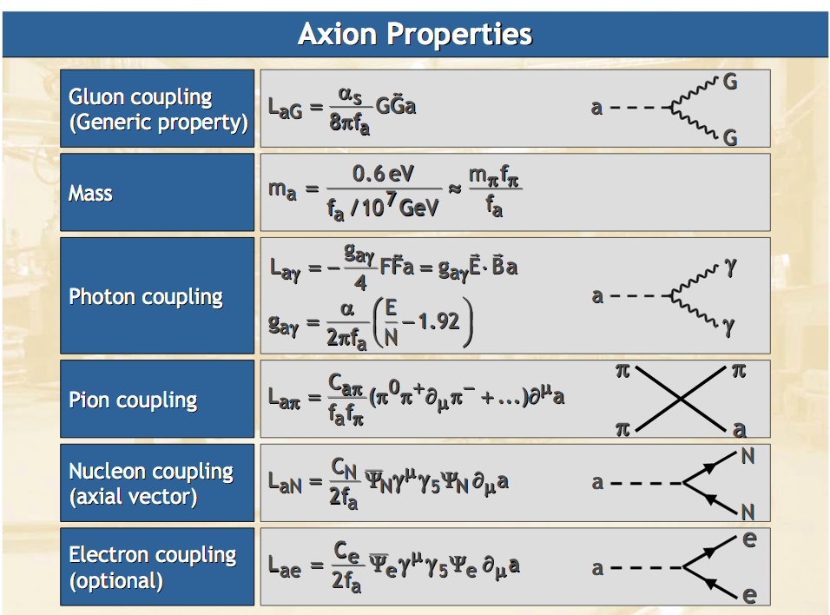

Slide 8
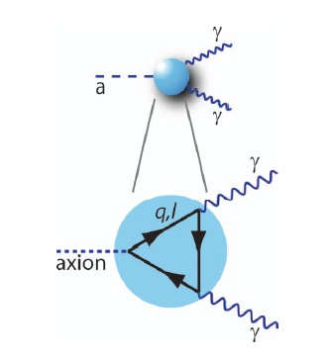

Axion Photon Interaction
Axion interactions are now model dependent
Axion photon photon
g_{γ} = 0.36 (DFSZ)
g_{γ} = - 0.97 (KSVZ)
If the axion mass is lighter than 2 m_{e}, we can calculate its lifetime
Where t_{U} ≈ 4 10¹⁷ s is the age of the Universe
For g_{γ}≈1 an axion of mass 24 eV has the lifetime corresponding to t_{U}.

Slide 9



Axion Electron Interaction
The interaction of the axion with the a spin ½ particle
In the non relativistic approximation:
Cold Dark Matter Cosmological Axions
The interaction term has the form of a spin - magnetic field interaction with playing the role of an effective magnetic field

Slide 10
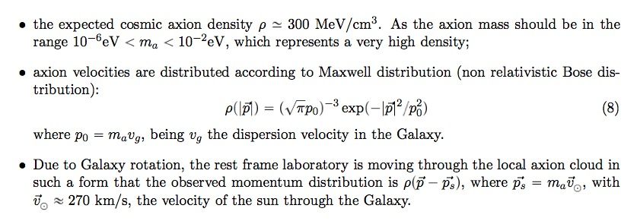


Galactic Axions
With the following hypothesis:

Slide 11
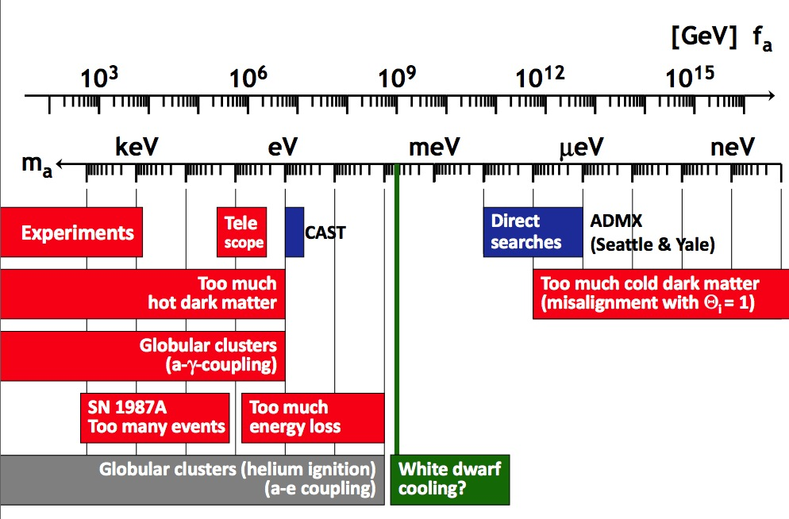
Does the axion exist?
While the standard Peccei Quinn Weinberg Wilczeck (PQWW) axion was soon ruled out ( Electro Weak Scale F = 250 GeV ), the other axion (DFSZ, KSVZ) continues to evade all current experimental limits
A reduced window of possibilities is actually left for discovery
Excluded
Searches
Hint
From G. Raffelt talk in Vistas in Axion Physics, INT, Seattle, 23–26 April 2012

Slide 12
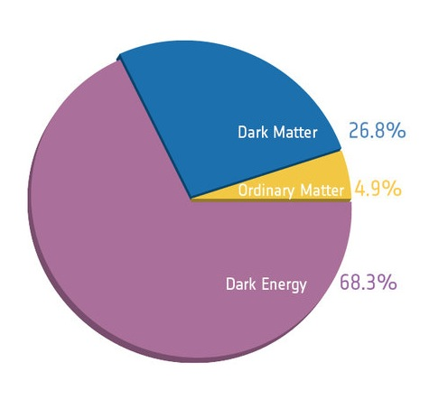
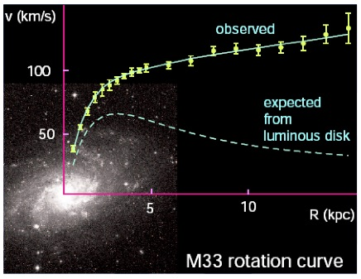
Axions in the outer space
As we have seen a light axion (m_{a} < eV) has lifetime that can be longer than the age of the Universe. This kind of axion is indeed important for cosmology.
Are they a main component of Dark Matter?
Composition of the Universe after Planck precise measurement of CMB
Typical rotational curve of galaxys
http://www.esa.int/For_Media/Photos/Highlights/Planck
P. Salucci
Axions are weakly interacting, stable on cosmological times, non relativistic

Slide 13
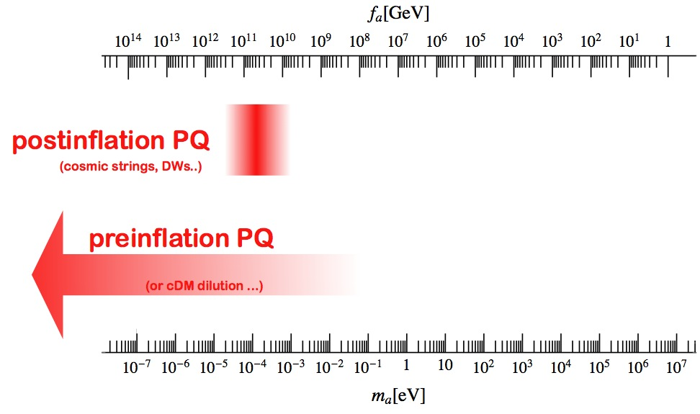
Cosmological axion
In the early universe axions are produced by processes involving quarks and gluons -> hot dark matter (BAD)
In addition, axions produced by the “vacuum realignment mechanism”: relaxation of the axion field after breakdown of the PQ simmetry -> Cold dark matter (GOOD)
The expected cosmic mass density of axions depends on whether inflation happens after or before PQ breakdown
Allowed regions of mass/coupling constant
From J. Redondo talk at Dark Matter: a light move DESY 2013

Slide 14
Axions in the galactic halo
In order to explain galaxy rotation curves, an halo of dark matter is hypothesize
Accepted value for local dark matter density
Cold dark matter component is thermalized and has a Maxwellian velocity distribution
There might be a non-thermalized component with sharper velocity distribution

Slide 15
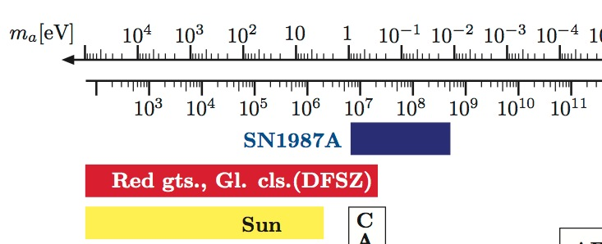
Axion and stars
Axions have very small masses and therefore can be emitted without important threshold effects from stars, in analogy to neutrinos
The method to constrain axion models is basically the overall energy loss rate
We may use the axion couplings to γ, p, n, and e to study the core evolution of a star. Simple bounds are obtained by comparing the energy loss rates by axion and by neutrino emission
F_{a}[GeV]

Slide 16
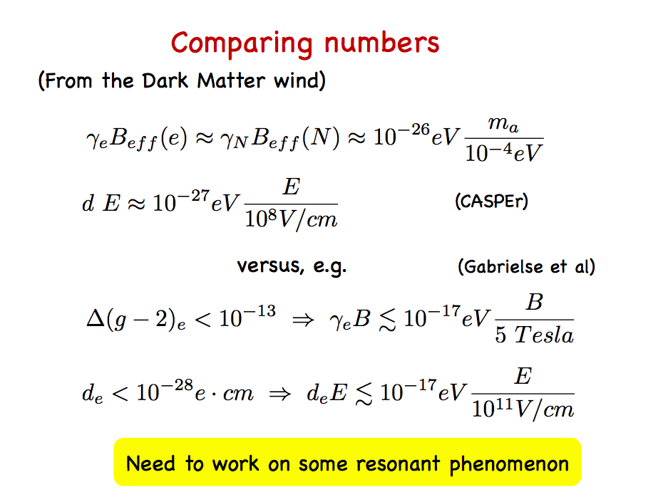
From BARBIERI TALK JAN 2015

Slide 17
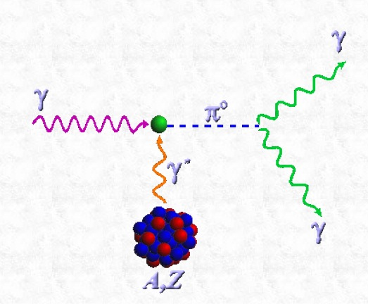
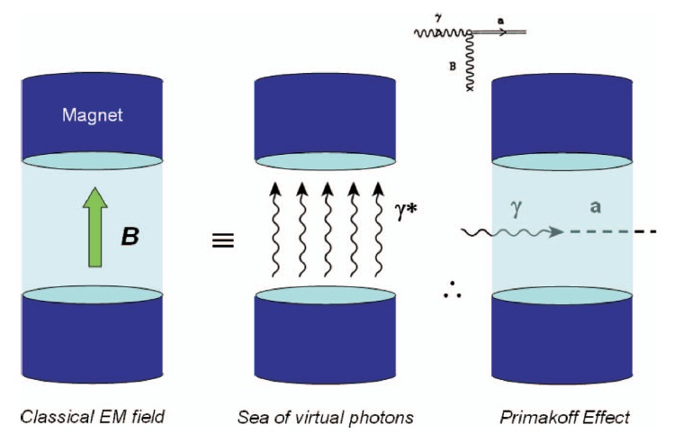
Can we detect Cosmological Axions?
Searching for “invisible axion” extremely challenging
Most promising approach to date: use axion-photon-photon vertex
Primakoff effect:
scattering from an electromagnetic field (virtual photon)
In the presence of an external field (magnetic or electric) the axion and the photon mix and give rise to oscillation/conversion
G. Carosi et al, Contemp. Phys. 49, 281 (2008)
Higher magnetic field are easily obtainable than electric fields

Slide 18
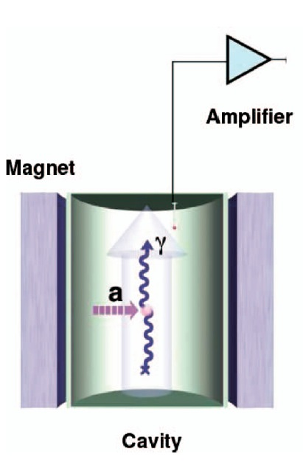
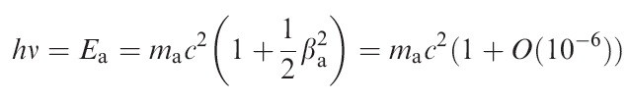
Haloscopes – Galactic axions
Search for cold dark matter constituent
Original proposal by P. Sikivie (1983)
DM particles converted into photons inside a magnetic field (Primakoff)
The mass of the DM particle determines the frequency of the photons to be detected. For axions we are in the microwave range.
β_{a}~10⁻³ axion velocity
Use a microwave cavity to enhance signal. Cavity must be tuned to axion mass. Being this unknown, tuning is necessary: very time consuming experiment!
μeV <-> GHz

Slide 19
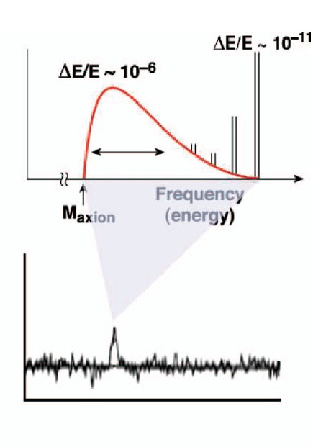
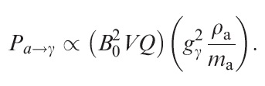
Haloscopes – Galactic axions
Search for cold dark matter constituent having galactic density ρ_{a}
Original proposal by P. Sikivie (1983)
DM particles converted into photons inside a magnetic field (Primakoff)
Expected signal a nearly monochromatic line. Broadened by the thermal distribution of DM in the Milky Way
Possible very sharp component due to non-thermalised axion falling in and out of the Milky Way
Power proportional to the number density and the square of the axion-photon coupling

Slide 20
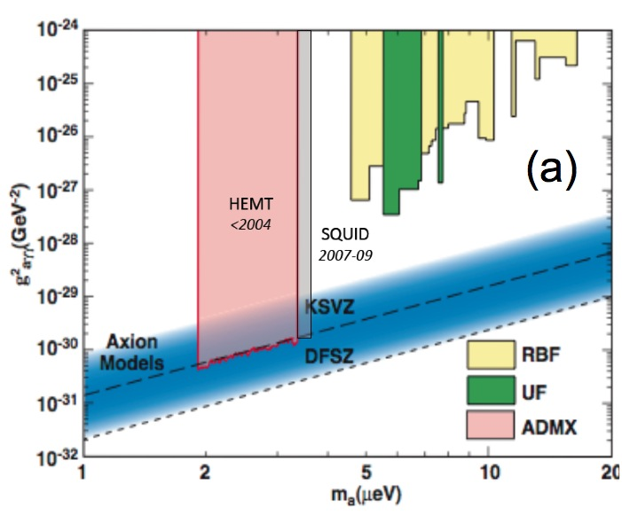
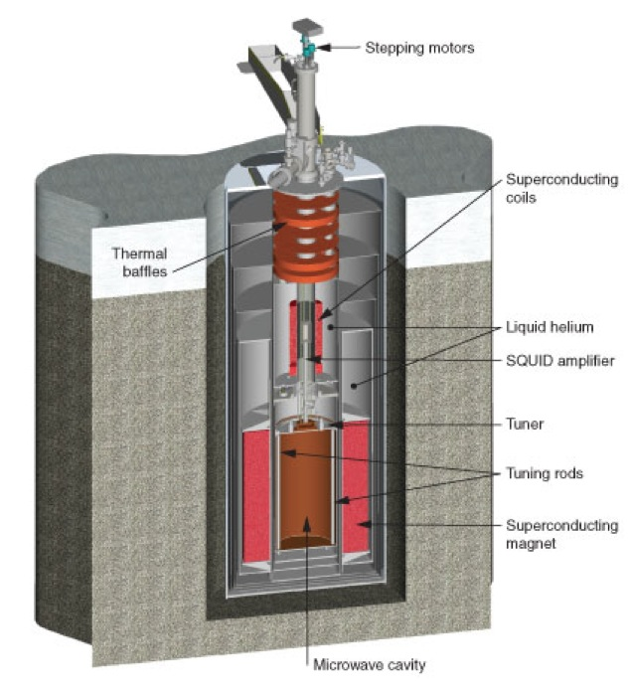
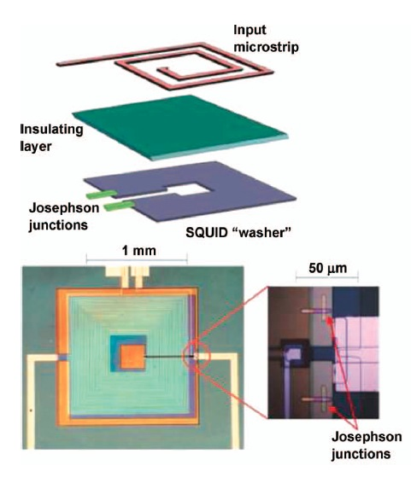
Haloscope detectors
Pilot experiments in Brookhaven (1988) and University of Florida (1990)
Second generation experiments:
  ADMX @ Lawrence Livermore employing low noise amplifier detectors
  CARRACK @ Kyoto employing Rydberg atom detectors
ADMX – Axion Dark Matter eXperiment
High Q microwave cavity inside an 8.5 T magnet
Almost Quantum Limited SQUID detector
Reached sensitivity for probing DM axion:
If all galactic DM is all made of axion
If we assume KSVZ model right
If the axion has the right mass, i.e. resonant with the cavity

Slide 21
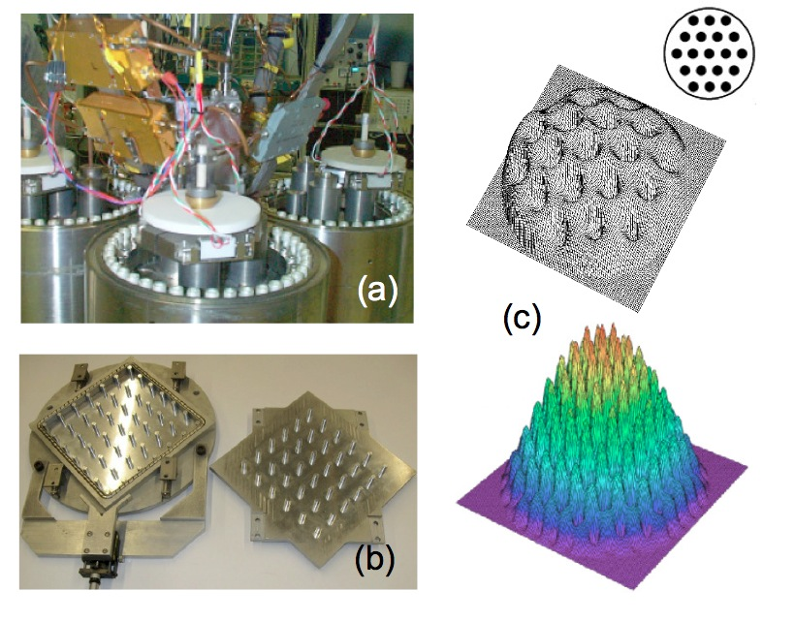
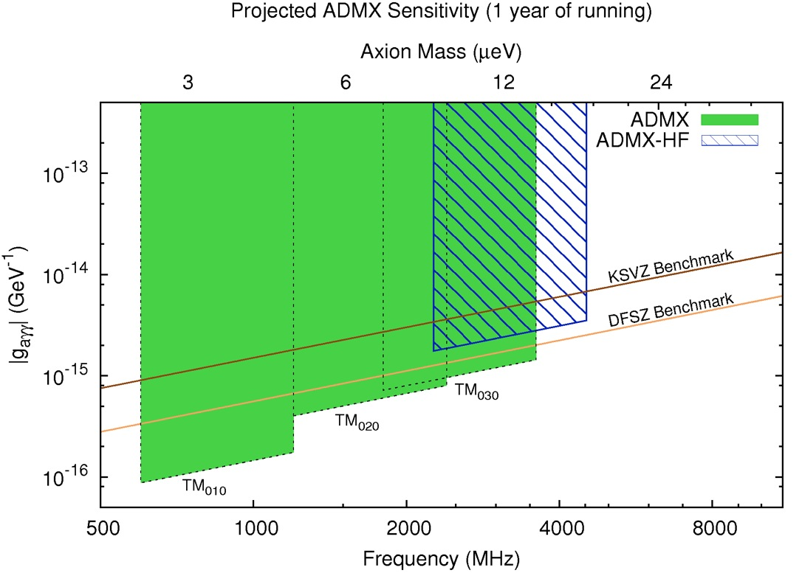
ADMX recent progress and prospects
The experiment goes to a second stage with a collaboration between University of Washington and Yale
New scheme to employ SQUID at higher frequency
New type of amplifier at frequencies above a few Ghz
Use higher order modes in the resonant cavity
Optimize cavity material to obtain higher Qs – hybrid superconducting cavities
http://www.phys.washington.edu/groups/admx/future.html
Photonic band gap cavity in the multi-GHz range

Slide 22

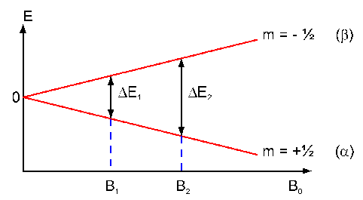
QUAX detector (Haloscope)
The idea for the axion detection is to exploit the axion - electron coupling
Due to the motion of the solar system in the Galaxy, the axion DM cloud acts as an effective rf magnetic field on electron spin (causing the spin flip)
An external polarizing magnetic field H₀ set their Larmor frequency
The equivalent magnetic (rf) field excites transition in a magnetized sample
which behaves as a rf receiver tuned at the Larmor frequency
The interaction with axion field produces a variation of magnetization which is in principle measurable
MS – Magnetized Sample (YIG)
Axion
MS
Detectable signal
Wind
Idea to exploit Electron Spin Resonance (ESR) in not new and comes from several works:
L.M. Krauss, J. Moody, F. Wilczeck, D.E. Morris, ”Spin coupled axion detections”, HUTP-85/A006 (1985)
L.M. Krauss, ”Axions .. the search continues”, Yale Preprint YTP 85-31 (1985)
R. Barbieri, M. Cerdonio, G. Fiorentini, S. Vitale, Phys. Lett. B 226, 357 (1989)
A.I. Kakhizde, I. V. Kolokolov, Sov. Phys. JETP 72 598 (1991)

Slide 23
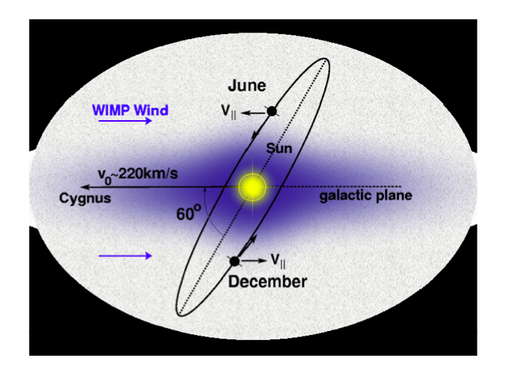
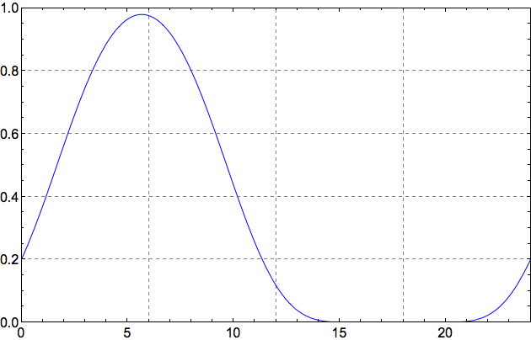
QUAX Directional Pattern
Due to Earth rotation, the direction of
the static magnetic field H₀
and (linearly polarized) pump field H₁
changes with respect to the
direction of the axion wind (Vega)
QUAX @Legnaro (PD)
H₀ along local vertical
H₁ in the local horizontal
plane and oriented N-S
A strong modulation occurs!
It is not due to seasonal or Earth rotation doppler effect (few %) but to direction changes (up to 100%)
QUAX Pattern
Time [h]

Slide 24
Experimental parameters
Axion mass
Equivalent RF magnetic field
Working frequency
Detector bandwidth
Electron Larmor Frequency
Measurement at the quantum limit
Magnetizing field
Working temperature

Slide 25
Detection issues
The working frequency lies in a region at the interface of two different regimes for best detection sensitivity
Frequency
Below 40 GHz
Above 40 GHz
FIELD DETECTION
(Linear detection)
ENERGY DETECTION
(Square detection)
- EPR Magnetometry
- MASER Amplifier
- QUANTUM COUNTER
(ZEEMAN Transitions)
In either case to reach quantum limit sensitivity 1 mole of a magnetized sample at cryogenic temperature is necessary

Slide 26
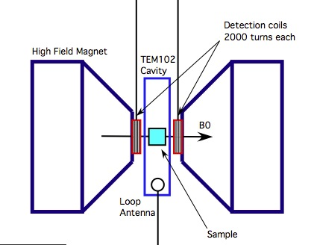
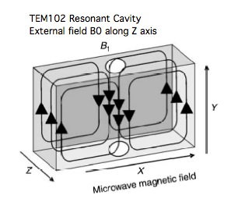
Electron Spin Resonance = Field Detection
Electron Spin Resonance (ESR or EPR) inside a magnetic media (rf receiver) is tuned by an external magnetizing field H₀; the rf field H₁ (orthogonal to H₀) in the GHz range excites the spin flip transitions at Larmor resonance ν_{L} . M undergo precession!
H₀
M
H₁
1 T -> ν_{L} =28 GHz
We studied the Electron Spin Resonance in 3 experimental situations for the magnetized sample:
  free space (radiation damping problem)
  rf cavity with hybridization of cavity-kittel modes (thermal photons problem)
  waveguide in cutoff ν_{c} > ν_{L} (under investigation)
Notes:
Electron paramagnetic resonance (EPR) or electron spin resonance (ESR) spectroscopy is a technique for studying materials. The basic concept of epr are the same of NMR.
We considered magnetized sample by a static magnetic field B_0 along the z direction and a stationary rf field applied in the plane perpendicular to z.
We test 3 different experimental configuration for the sample : in free space, in a rf cavity and in a waveguide.
The configuration in free space and rf cavity are ruled out by radiation damping and thermal noise respectively

Slide 27
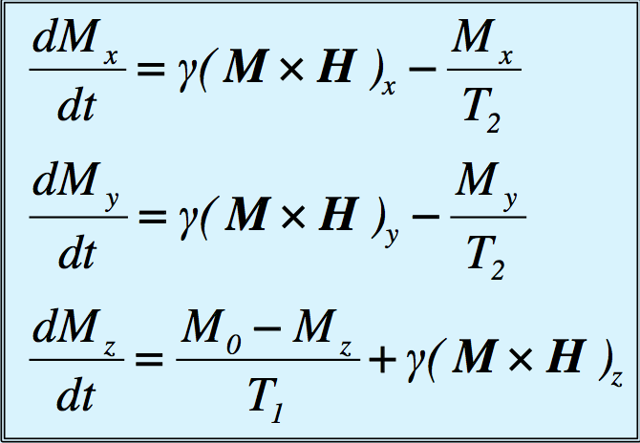
The Bloch equations
The evolution of the magnetization M (due to spin transitions) under the influence of external fields is described by a set of coupled non-linear equations (H=Magnetizing field H₀ + driving rf field H₁)
Spin-lattice relaxation time T₁:
establish energetic equilibrium of M_{z}.
Spin-spin relaxation time T₂ < T₁:
H₁ forces M_{x} M_{y} to rotate and T₂ sets
equilibrium
At low temperature T < 1 K
T₁ ~ 10⁻⁶ to 10 s
T₂ ~ 10⁻⁶ to 0.1 s
depends on spin density
e.g. Magnetization of a paramagnet
N₀ – spin density
μ_{B} – Bohr magneton
T – sample temperature

Slide 28
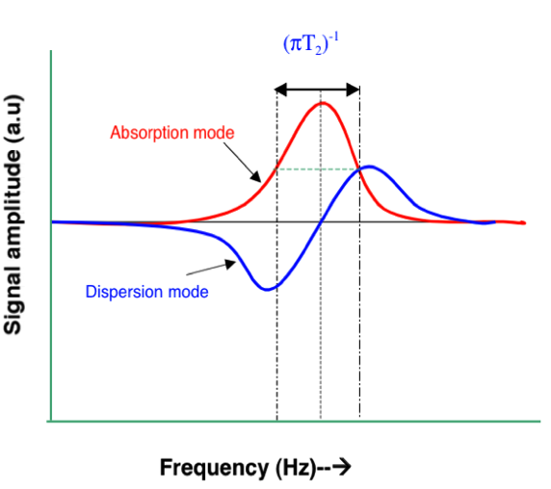
LOngitudinal Detection (LOD) of axion field (1)
Magnetize the sample along the z-axis orthogonal to the axion direction
H₀ amplitude matches the searched value of the axion mass
Then the equivalent axion field h_{a} is in the transverse direction
Drive the sample with a pump field H_{p} near the Larmor frequency
H₀
h_{a}
H_{p}
Total driving radio-frequency field

Slide 29
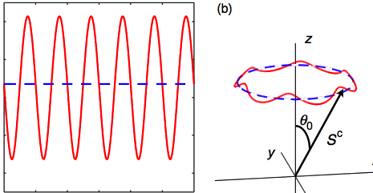
Longitudinal detection of axion field (2)
H₁ is a linear superposition of two rf fields (pump and axion or any rf field) with slightly
different frequencies ω_{p} and ω_{a} with amplitudes H_{p} >> h_{a} and T₁T₂γ²(H_{p}+h_{a})²<<1
IF ω_{p} - ω_{a} <<ω_{L} and (ω_{p} + ω_{a} )/2 ≈ω_{L} we can calculate M_{z} from quasi-stationary solutions
Then M_{z} oscillates at very low frequency!
Assuming ω_{D} < min(1/T₁,1/T*₂)
the amplitude of oscillations is
M_{z}
Time

Slide 30
Longitudinal detection of axion field (3)
We can define a sort of gain G_{r} for the low frequency component Δm_{z} with respect to the high frequency field h_{a}
If we put some relevant numbers (already published for YIG)
T₁ ≈ 10⁻⁶ s
T₂ ≈ 10⁻⁶ s
M₀ = 0.2 T
We obtain G_{r} > 100
for a pump field H_{p} ~ 0.1 μT
Can we get enough gain G_{r} to be able to reach a measurable low frequency Δm_{z} from amplitude axion field h_{a} ~ 10⁻²² T?
find the right material (YIG)
power dissipated in the cryogenic system
noise sources in the system

Slide 31
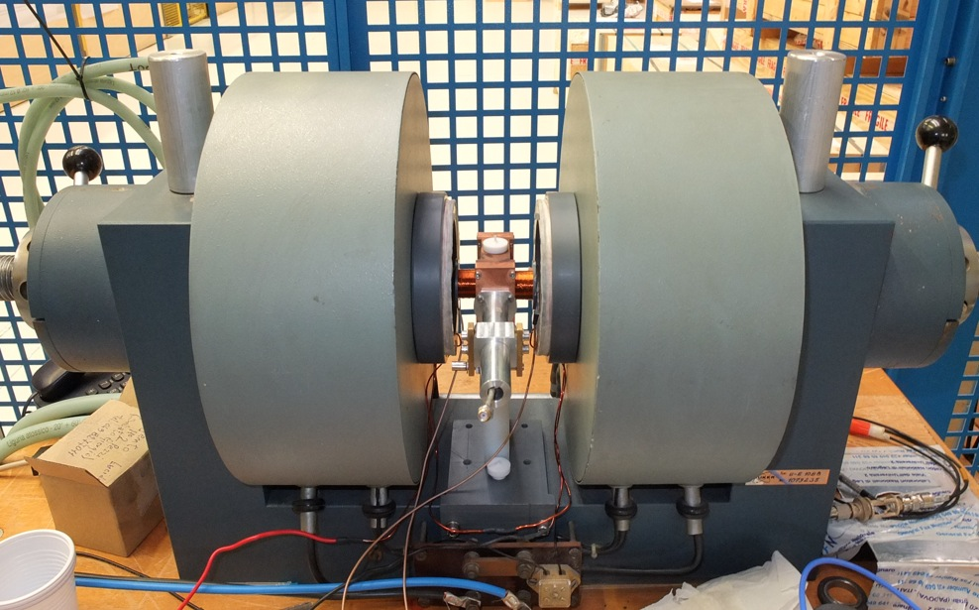
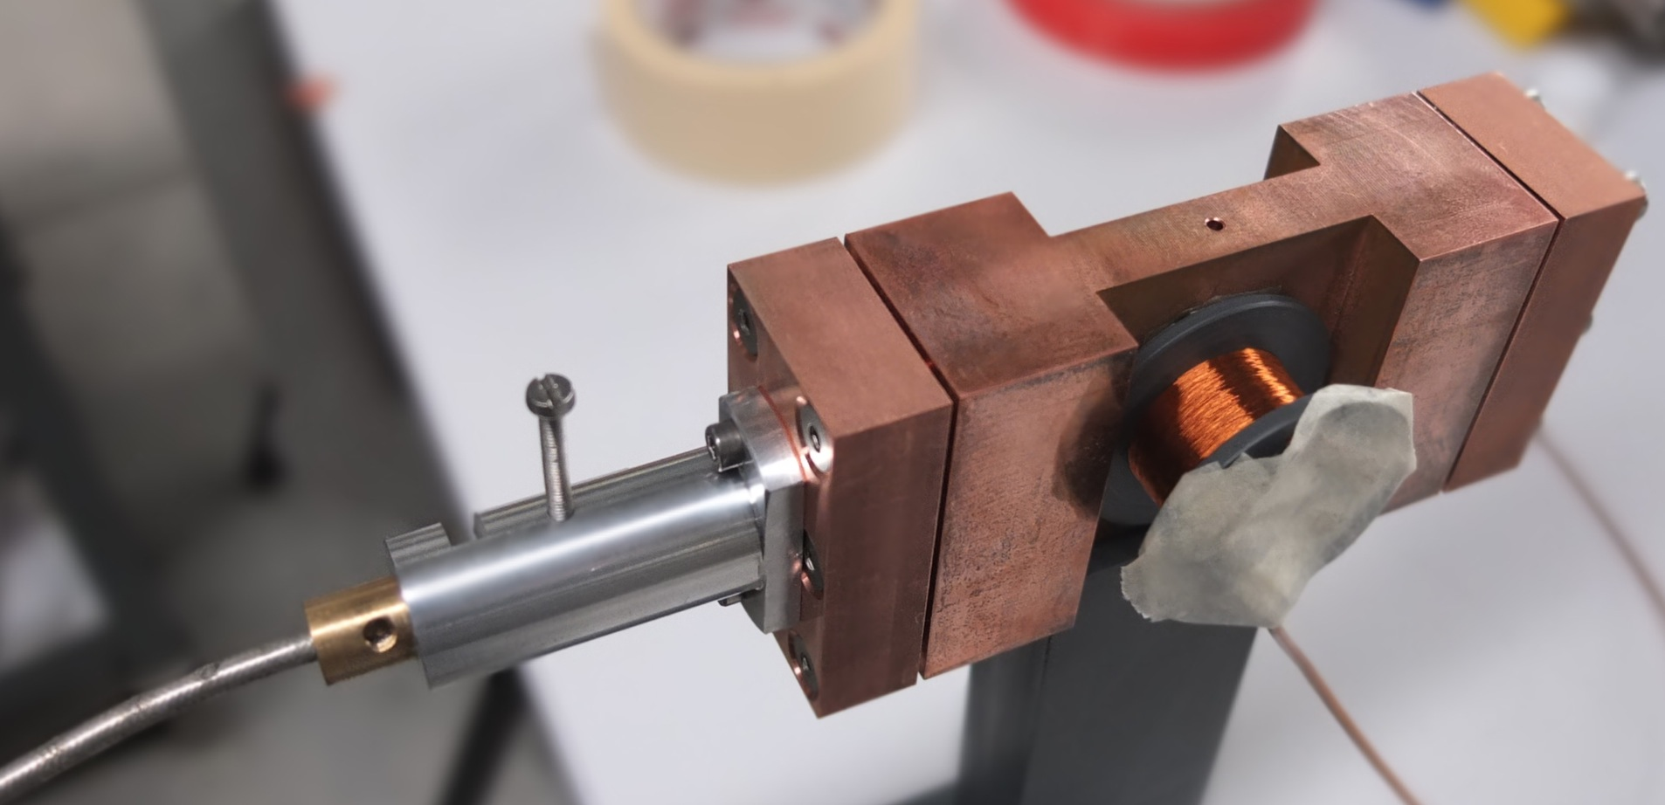
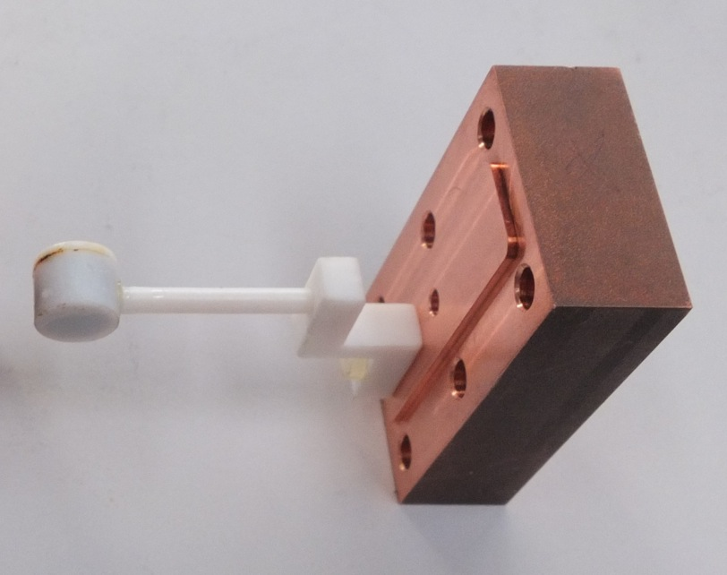
Calibration/Detection scheme
5 GHz
cavity
Magnetic field source
Paramagnetic sample
DPPH box
DPPH box

Slide 32
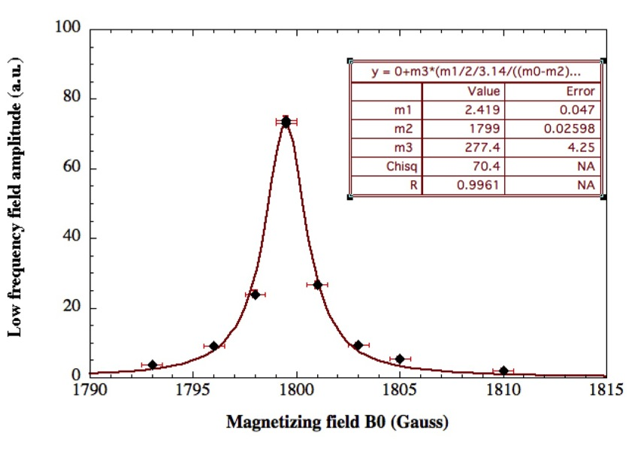
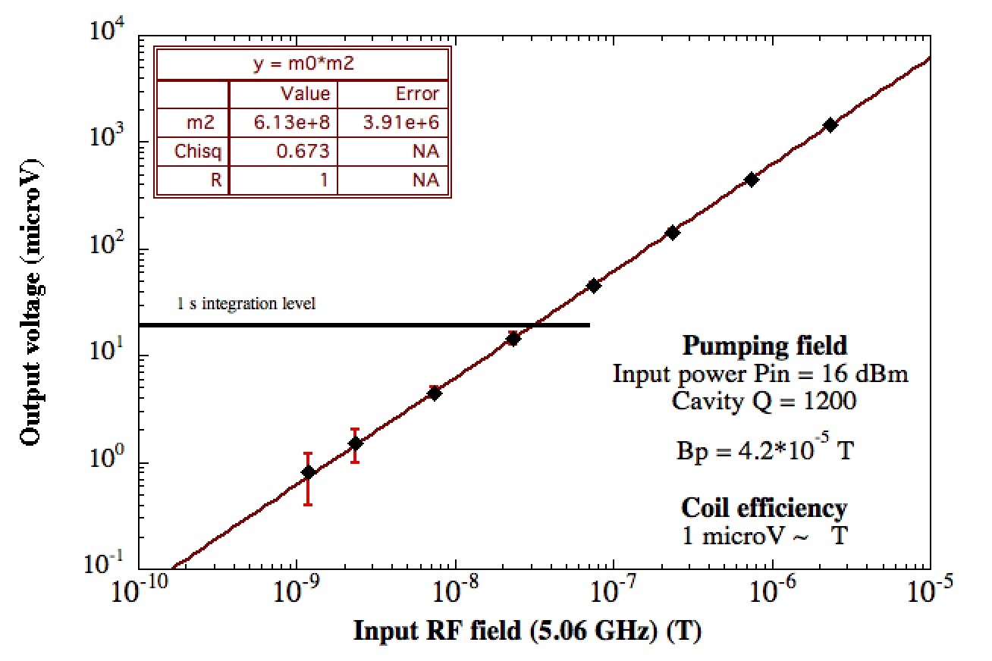
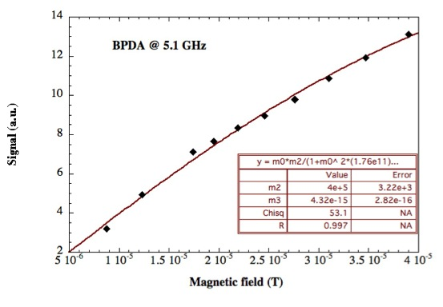
Paramagnetic sample @ 5.0 GHz
Linewidth measurement (T₂)
Linearity measurements
Saturation measurements (T₁)
We have check the formula for the gain:
Correct within a factor about 2

Slide 33
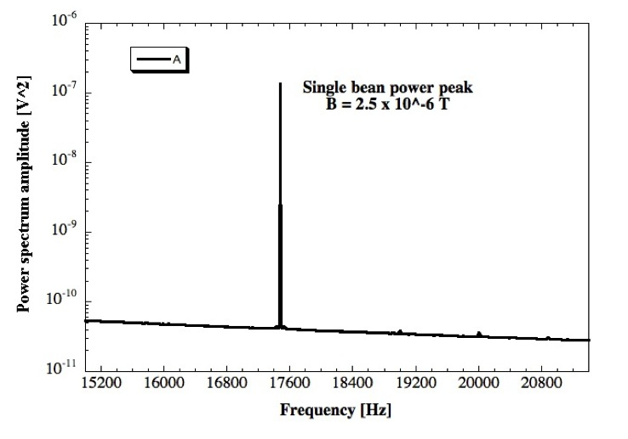
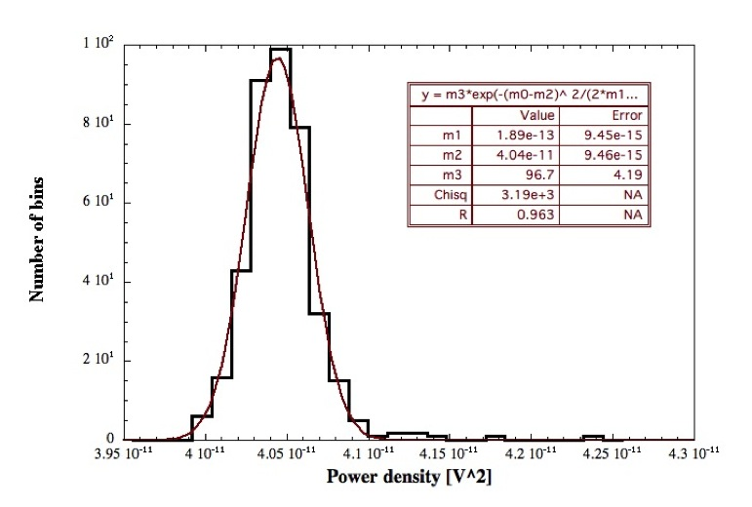
End – to – End calibration with BDPA @ 5 GHz at 300 K
By using a calibration signal we have evaluated the sensitivity for an axion like signal (Stochastic signal with Q ~ 10^6) by performing a power spectral analysis
Power spectrum of downconverted signal
Histogram of values
The sensitivity is about 4 x 10⁻¹³ V² that corresponds to 5 x 10⁻⁸ T for a signal spread over a 5 kHz band (1 hr averaging time)

Slide 34
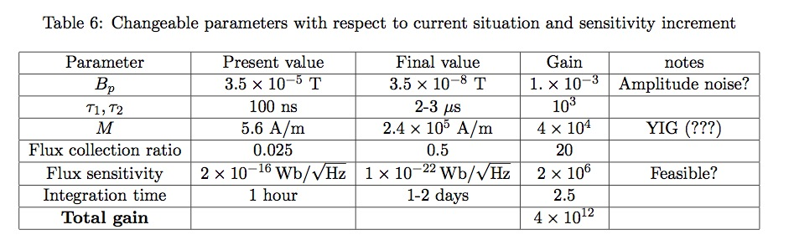
Possible Improvements

Slide 35
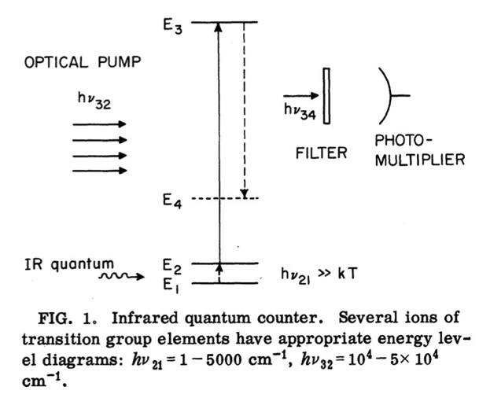
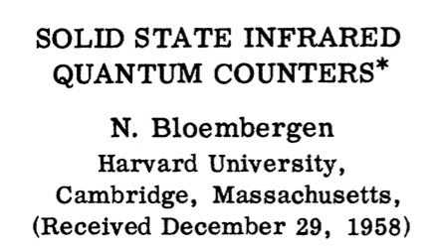
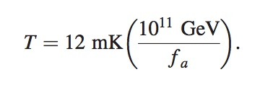
Quantum Counter = Energy Detection
Detection of IR photons with high quantum efficiency in the absence of photomultipliers
Extend the same idea into the microwave regime where a Zeeman transition is tuned to the axion mass with an external field.
All the atoms must be in the
Zeeman lower level.
(Sikivie, 2014)

Slide 36
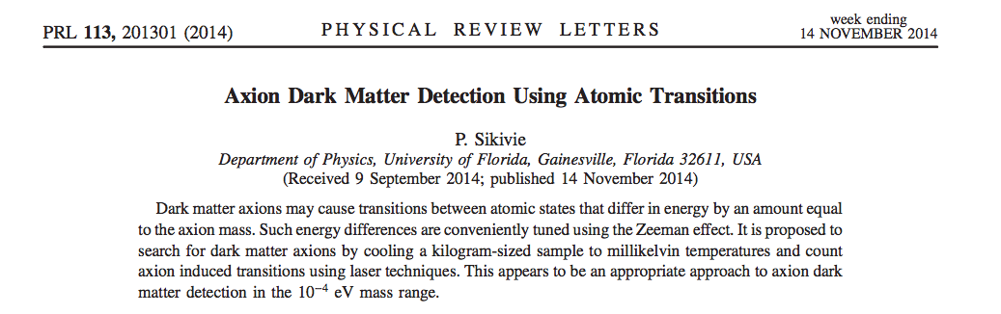


ZEEMAN TRANSITION RATE With 1 Mole of Polarized Electrons

Slide 37
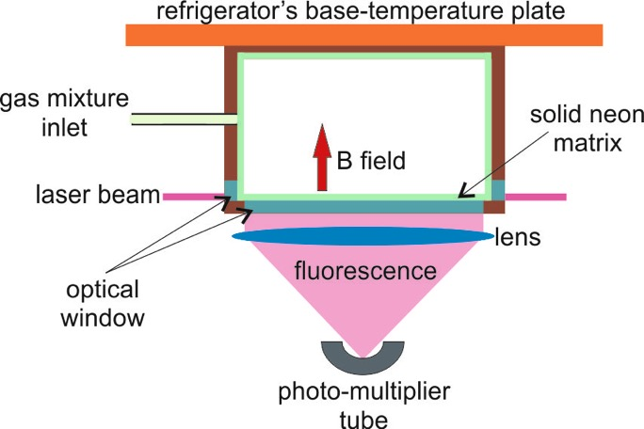
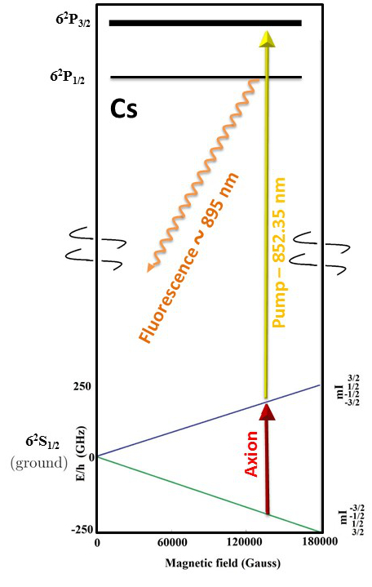
Detection with O₂ molecules or Cs atoms?
Together with people in Pisa, Napoli and Firenze we are studying the possibility of using Oxygen molecules or atomic Cesium cooled to 280 mK (Buffer gas cooling) as magnetized target.
Work in the higher axion mass range
Number of available atoms can be an issue
Find an appropriate detection technique with high efficiency (REMPI – resonance enhanced multiphoton ionization - interrogation scheme?)
(Courtesy of P. Maddaloni)

Slide 38
Conclusions
A partial review of various Axion Matter Interaction has been presented
The Axion, invented to solve a specific problem of QCD, became a perfect Dark Matter candidate:
  It can be searched for in dedicated experiments (Haloscopes)
  Helioscopes and terrestrial experiment don’t seems to be able to reach the parameter space for an axion DM candidate
Axion like particles came also into the scene. They might be as well good DM candidates
Several efforts in different physics fields can help to find or rebut the existence of this exotic particle

Slide 40
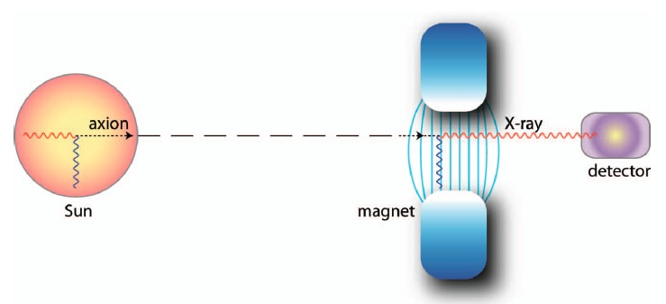
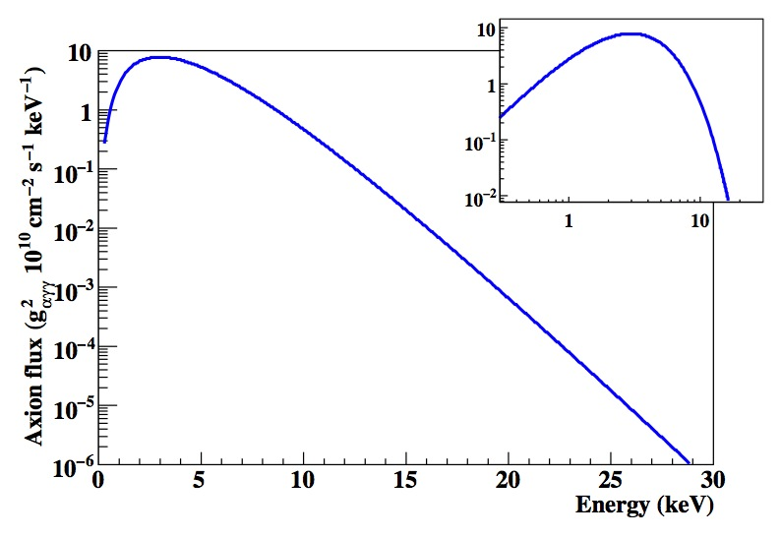

Detection of axion from the Sun
Originally proposed by P. Sikivie (1983)
Axion produced in the Sun by the Primakoff process: blackbody photons in the EM fields associated with stellar plasma
Thermal axion spectrum with mean energy 4.2 keV (X rays)
Axion production rate depends on Solar model and production model
Axion flux on Earth
G. Carosi et al, Contemp. Phys. 49, 281 (2008)
Conversion probability in detecting magnetic field
The factor F(q) reflects the coherence between axion and produced x rays. Can be changed with buffer gas.

Slide 41
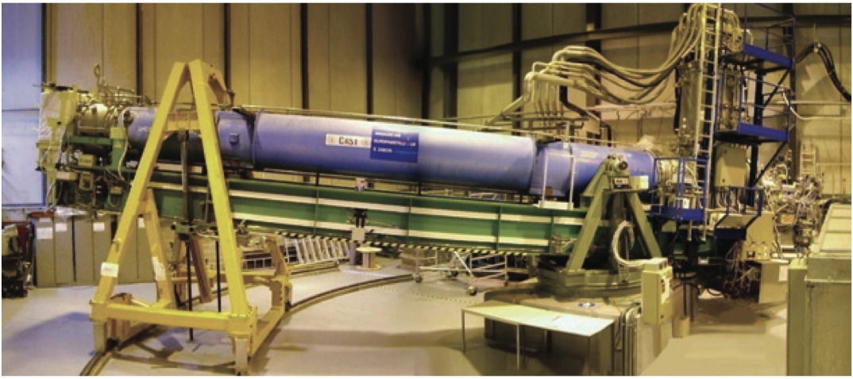

Detection of axion from the Sun - apparata
First experiment performed in Brookhaven in 1992 by the BFR collaboration
  2.2 T fixed magnet Proportional Chamber as detector
Second generation experiment in Tokyo - SUNICO
  4 T magnet on a rotating platform
The CAST experiment (CERN Axion Solar Telescope)
10 m - 9 T - LHC prototype magnet pointing to the sun
Most sensitive experiment looking for axion-like particles
It relies on Astrophysical assumption
From A. Lindner Talk, Lisbon 2014

Slide 42


Prospects: the IAXO experiment
The International AXion Observatory proposal is a dramatic push up of CAST performances:
  Larger magnet aperture
  Toroid magnet similar to ATLAS
  X-Ray optics similar to satellite experiments
IAXO could probe QCD Axion
From G. Irastorza Talk @ Dark Matter: a light move, DESY 2013
IAXO
However: DM Axion expected @ lower masses

Slide 43

Propagation of the photon in the cosmo
Large scale magnetic B fields exist in astrophysics
Even if fields are very low (μG, nG), they extend over a very large length L.
The product BL can then be large: ALPs oscillation with the photon can then be studied
SN1987A: ALPs emission due to Primakoff production in core
ALPs partially converted into γ rays in galactic magnetic field (GMF)
No γ rays burst observed in coincidence with SN1987A neutrinos

Slide 44

Propagation of the photon in the cosmo
Magnetically induced oscillations between photons and Axion-like particles can modify the photon flux from distant sources, featuring:
  Frequency dependent dimming
  Modified polarization
  Avoiding absorption by propagation in the form of axion
This modification can be crucial in the behavior of Very High Energy (VHE, energy > 100 GeV) γ rays from extragalactic sources
Typical sources: Active Galactic Nuclei (AGN) measured with Imaging Air Cherenkov Detector (IACT)
M. Meyer | EPS HEP Stockholm | July 18, 2013 |

Slide 45


VHE photons from distant sources
Gamma rays can interact with cosmic photon background (EBL) and produce e-p pairs
Optical depth τ is not zero and the flux follows an exponential law
At present there are tension between models and data for energies > 1 TeV
M. Meyer | EPS HEP Stockholm | July 18, 2013 |

Slide 46


Comparison
Lab Experiments
Helioscopes
Haloscopes
Axion Like Particle
Wide band experiment
Optical photons
Model independent
Low axion flux
Low sensitivity to alps coupling
ALPS & QCD Axion
Wide band experiment
X rays photons
Model dependent
Medium axion flux
Good sensitivity to alps coupling
ALPS & QCD Axion
Resonance experiment
Microwave photons
Strong model dependency
High axion flux
Reaches KSVZ axion
model

Slide 47

Global perspectives
http://lanl.arxiv.org/pdf/1405.3685v1.pdf

Slide 48

From BARBIERI TALK JAN 2015
AXION ELECTRON/NUCLEUS SPIN COUPLING: DETECTION FEASIBILITY

Slide 49

From BARBIERI TALK JAN 2015

Slide 50

Peccei Quinn simmetry
Peccei and Quinn (1977) proposed to solve the strong CP problem by postulating the existence of a global U_{PQ}(1) quasisimmetry (it is spontaneously broken).
The axion (Weinberg 1978, Wilczeck 1978) is the pseudo Goldstone boson associated with the spontaneous breakdown of the PQ simmetry.
With the PQ quasisimmetry the fine tuning problem can be solved
a(x) – axion field
f_{a} – axion decay constant
f_{a} is the quantity that determines all the low energy phenomena of the axion

Slide 51

Axion Photon interactions 1
Axion interactions are model dependent
Axion photon photon
g_{γ} = 0.36 (DFSZ)
g_{γ} = - 0.97 (KSVZ)
Axion electron electron
(DFSZ)
g_{e} = 0,001g_{e} DFSZ (KSVZ)
All couplings are extremely weak!

Slide 52


