Slide 1


Slide 2
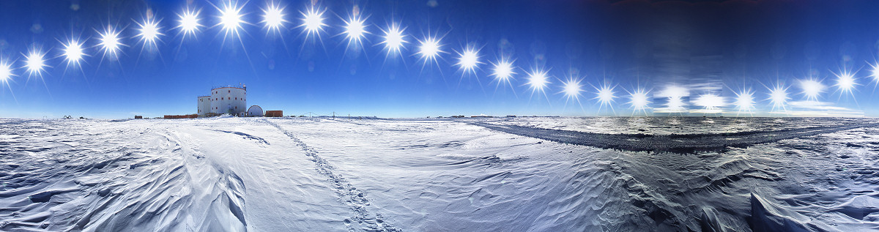


Atmosphere monitoring in the mm/sub-mm spectral band with the CASPER spectrometer at
Concordia Station (Antarctica)
Marco De Petris
“Sapienza” University , Rome, Italy
Department of Physics
in collaboration with G. Amico ¹, A. Baù ², D. Buzi ¹, S. De Gregori ¹, M. Gervasi ², L. Lamagna ¹, S. Masieri ³, E. Massera ¹, J.R. Pardo ⁵, A. Passerini ², B. Petkov ³, G. Pisano ⁴, C. Tomasi ³, C. Tucker ⁴ and M. Zannoni ²
      (1) Department of Physics – University La Sapienza – Rome (Italy)
      (2) Department of Physics - Milan Bicocca University - Milan (Italy)
      (3) Institute of Atmospheric Sciences and Climate – CNR - Bologna (Italy)
      (4) School of Physics and Astronomy - Cardiff University - Cardiff (UK)
      (5) Centro de Astrobiologia (CSIC/INTA) - Madrid (Spain)

Slide 3
Outline
Concordia Station @ Dome C (Antarctica) is an excellent site for sub&mm sky observations.
Atmospheric performance monitoring will support future installations, (see the incoming QUBIC experiment [Buzi et al. SIF Communication]).
Two requirements:
  Low opacity (i.e. low pwv content)
  High stability (i.e. low pwv fluctuations)
Two strategies:
  A semi-empirical approach to perform analysis of atmospheric transmission and emission at Dome C with radiosoundings data
  A spectrometer to explore the 90÷450 GHz (3÷15 cm⁻¹) spectral region: CASPER

Slide 4
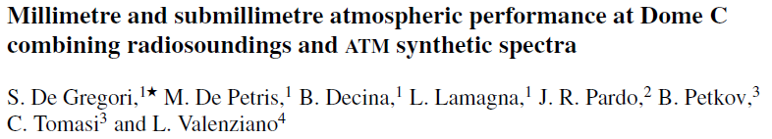
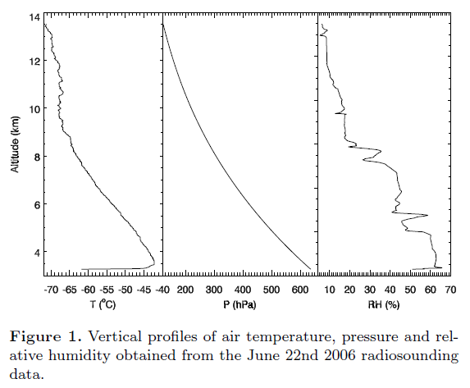

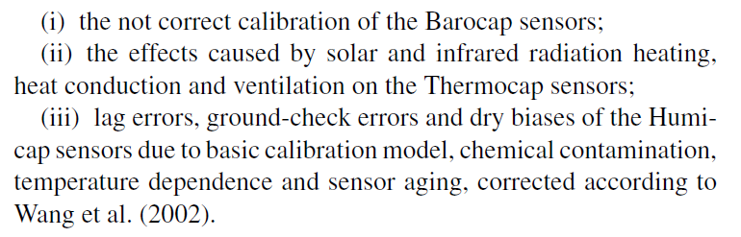
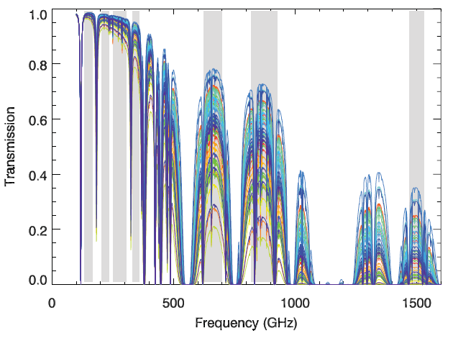
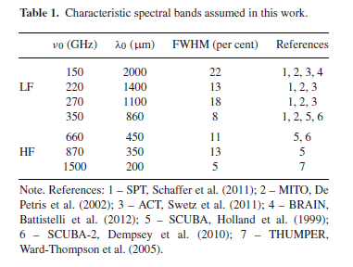
Semi-empirical approach: data + code
Old data: 469 radiosounding measurements taken routinely at Dome C at 12:00 UTC from May 2005 to Jan 2007
Data Correction (Tomasi et al. 2006)
ATM
Atmospheric Transmission at Microwaves
Opacity
100 GHz – 2 THz
Routine Meteorological Observations (RMO)
Research Project (http://www.climantartide.it)
Daily transmission spectra
Selected 7 observational bands
T = e^{-τ}

Slide 5
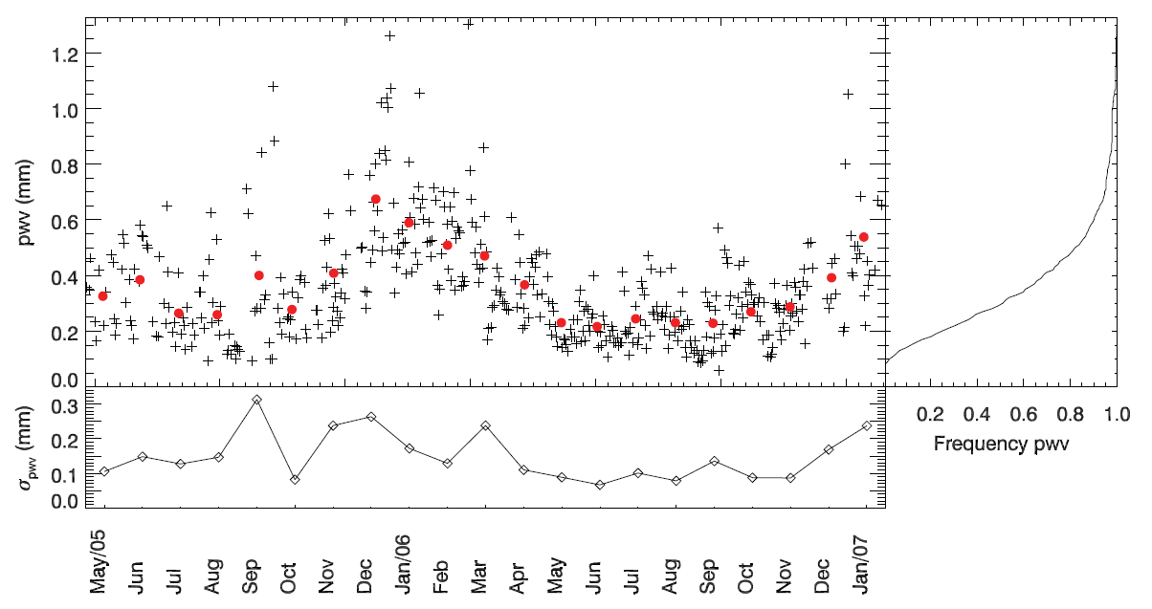
pwv values
Monthly averages of pwv
Daily values standard deviation
Daily values of pwv estimated from the 12:00 UTC radiosounding measurements performed at Dome C over the period from 2005 May to 2007 January.
PWV seasonal variation with values lower than 0.3 mm and a mean dispersion of about 150 μm (on daily data)

Slide 6
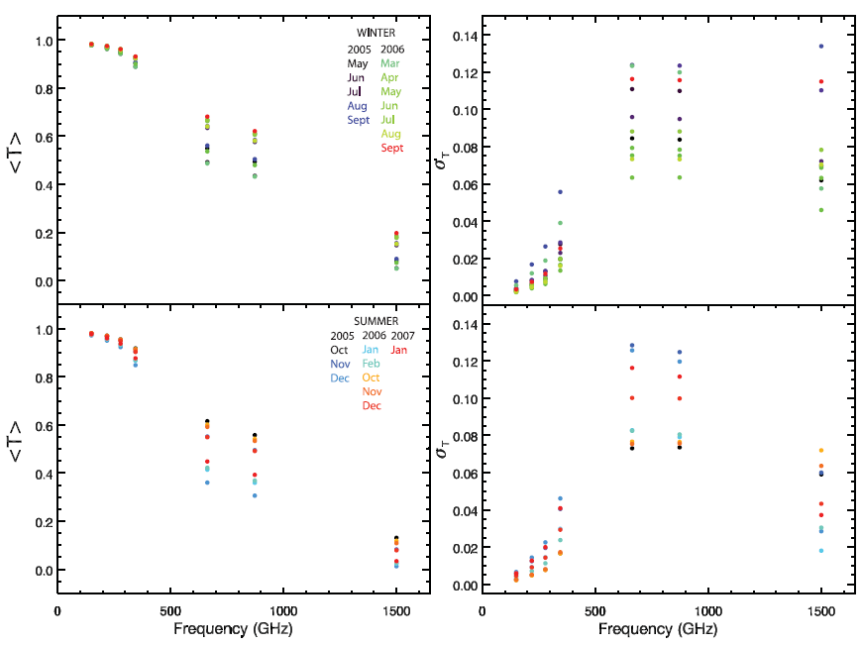
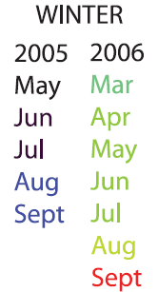
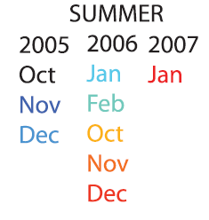
In-band Transmission fluctuations
Monthly average values of transmission
Monthly transmission fluctuations

Slide 7
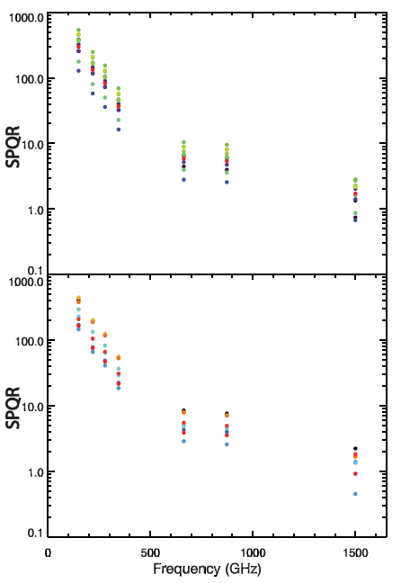

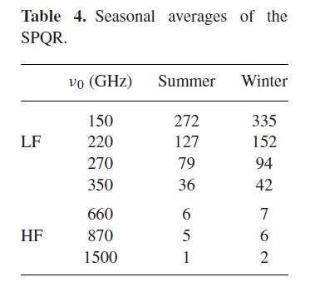
Site quality
To quantify the real capability of the observational site we need to study the atmospheric performance, mainly stability and high transmission.
A new specific quality indicator:
the Site Photometric Quality Ratio
for each band
monthly averaged transmission
monthly transmission fluctuations
It is difficult to identify a desired SPQR threshold but this proxy could represent a useful tool to compare band performance or …sites

Slide 8
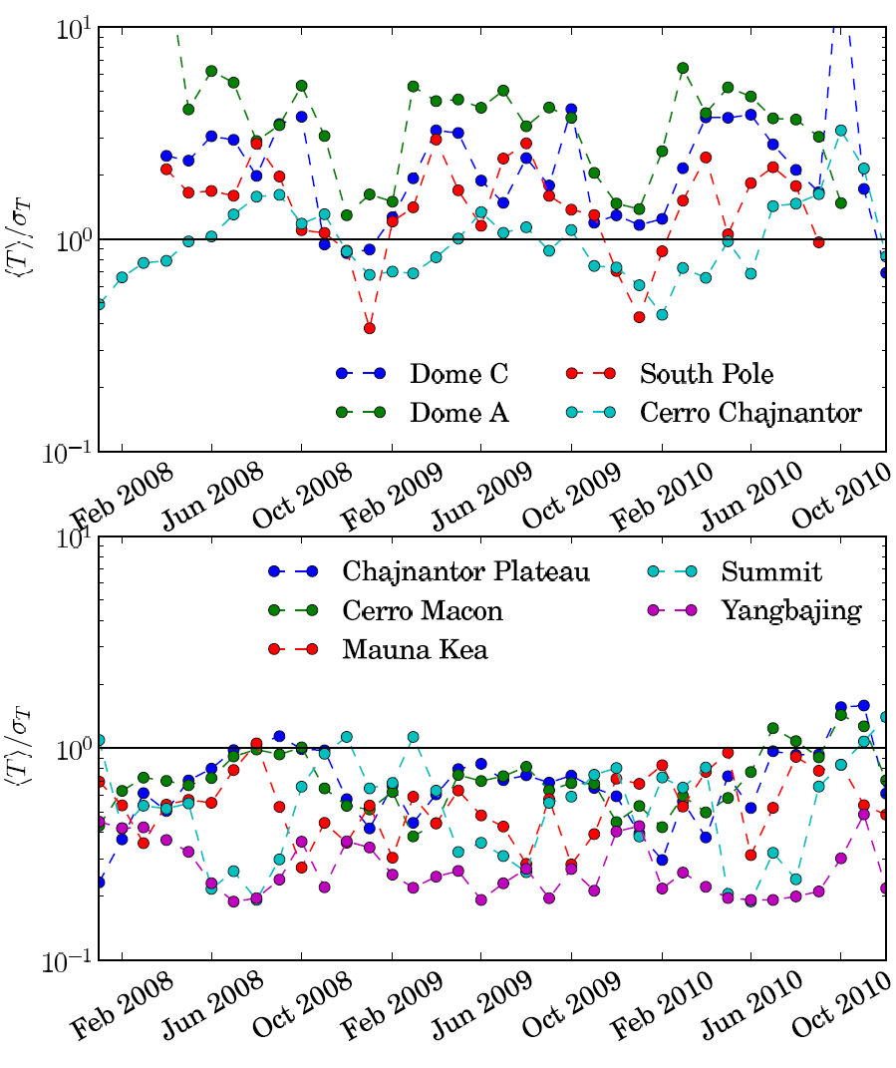
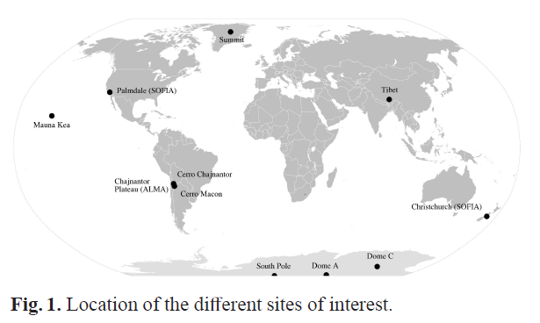
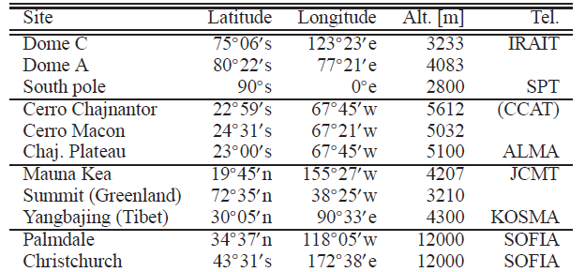
Comparisons of atmo performance @200µm
Fixed the band, SPQR has been used as indicator to quantify and compare the best sub/mm worldwide observational sites.
The comparison of 7 sites at 200 µm in 2008-2010 period (Tremblin+12)
Antarctic sites (+CC) SPQR>1
@ 200 μm
Arctic + Temperate sites SPQR<1
Tremblin et al. A&A (2012)

Slide 9
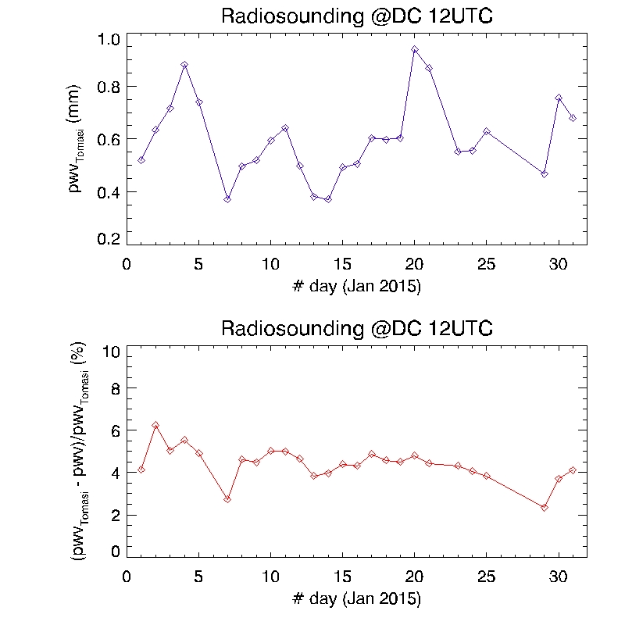
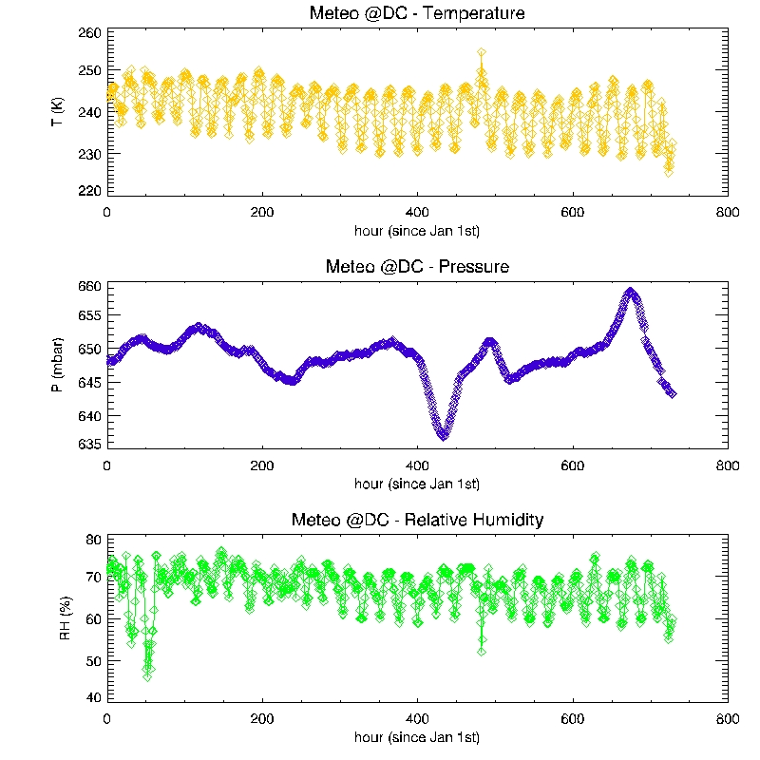
pwv fluctuations DC Jan 2015
<pwv> = 0.60 ± 0.15 mm
credits B. Petkov
www.climantartide.it
Daily values of pwv estimated by the 12:00 UTC radiosounding measurements performed at Dome C over the period from January 1st to 31st 2015 and corrected with Tomasi et al. procedure.

Slide 10
Atmospheric wide spectral coverage
Radiosounding data: 1/day – a code to infer atmo in the sub-mm/mm range
Direct and frequent measurements of atmospheric transmission in a wide spectral range can provide a perfect knowledge of atmospheric influence on astronomical observations.
If the opacity measurements are done in a narrow (a few MHz) spectral coverage, it is impossible to distinguish between clear sky opacity, hydrometeors contributions and systematic errors.
A wide frequency coverage (several hundreds of GHz) is necessary to make
sure we are in clear sky conditions and no instrumental offset is affecting our measurement and our analysis. In this way it is also possible to determine the dry and the wet continuum terms [Pardo, Serabyn, & Cernicharo 2001]

Slide 11
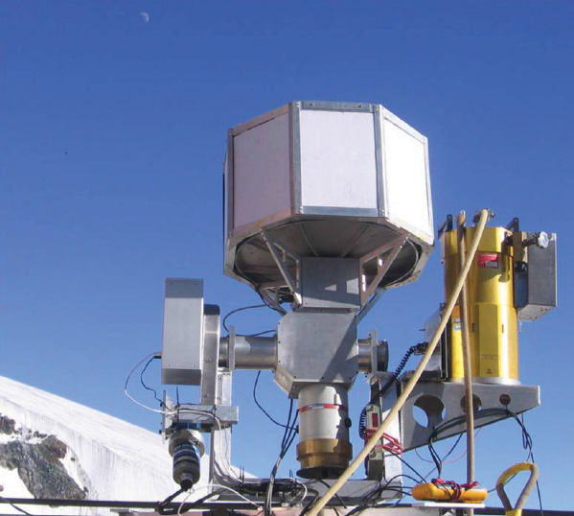
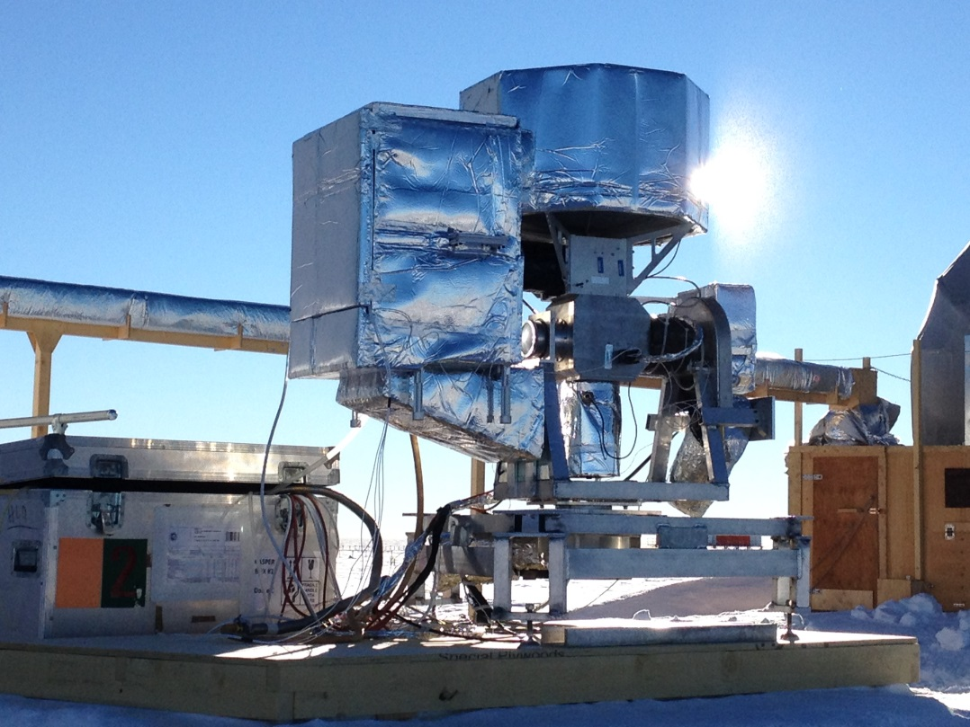

A mm/submm spectrometer: CASPER
A large spectral sampling can be achieved at the price of a bit complex instrument.
The possibility to monitor the atmosphere towards different positions in the sky, also avoids bias due to a spatial model assuming the multi layers approximation.
CASPER, a dedicated spectrometer that already operated at Testa Grigia station (3500m asl, Alps, Italy) [Decina , MDP et al. +10; MDP et al., +13] , has been adapted to work at severe ambient conditions and installed at Concordia Station in Antarctica in December 2014 to observe during January 2015.
-2C
-43C
Testa Grigia station
Alps 3500 m a.s.l.
Concordia station
Antarctica 3200 m a.s.l.

Slide 12
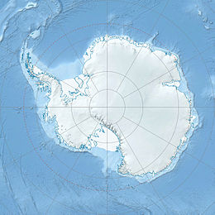
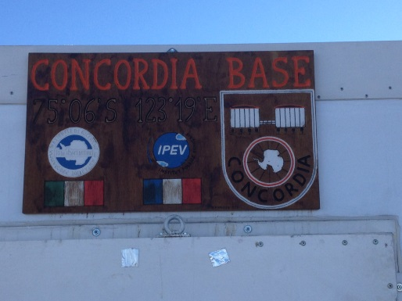
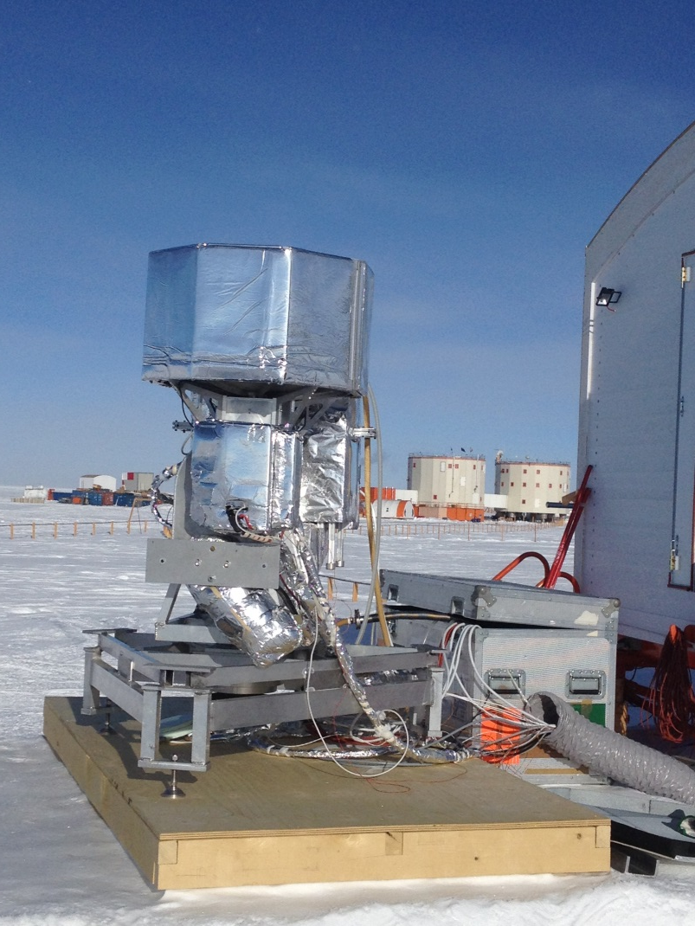
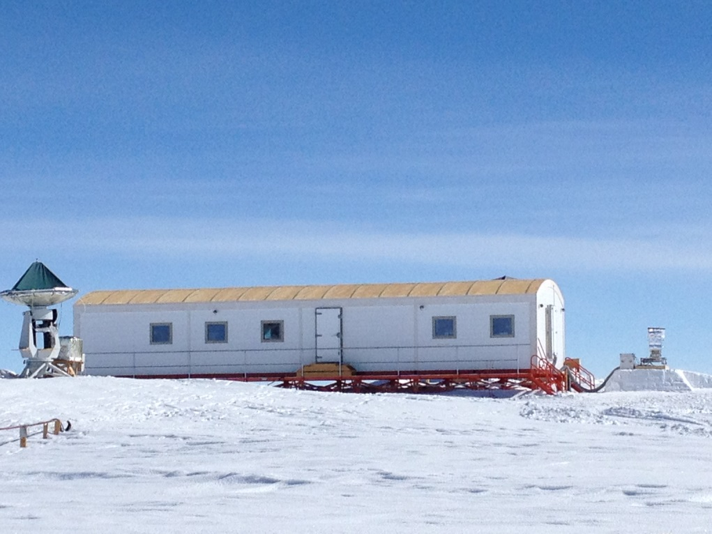
A mm/submm spectrometer: CASPER
Dec 2014 - Jan 2015
First installation in Antarctica at Italian-French base, Concordia Station
(75° 05′ 59.25″ S - 123° 19′ 55.33″ E, 3220 m a.s.l.) ,close to the Astronomy Laboratory
Dome C

Slide 13
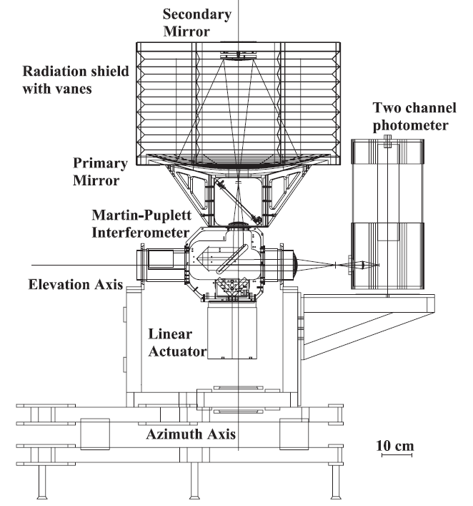
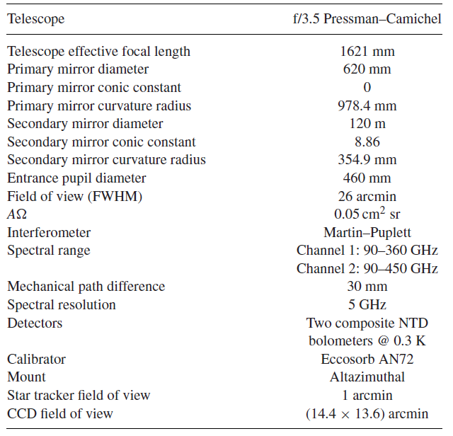
CASPER – the instrument
62-cm reflective telescope + Martin-Puplett Interferometer + 0.3K detectors + altaz mount

Slide 14
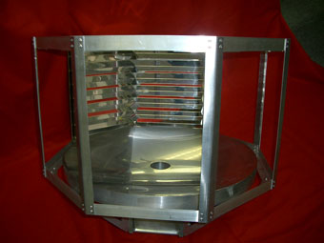
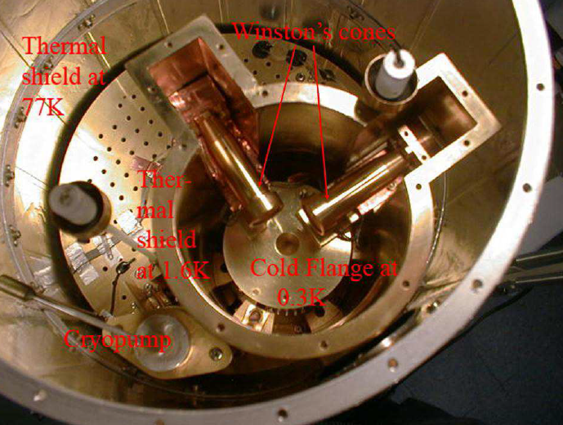
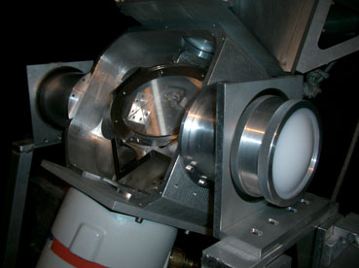
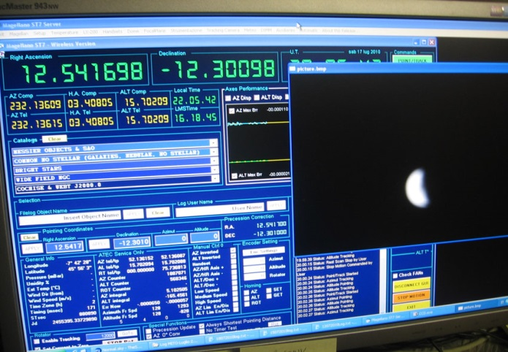
CASPER – the instrument
62-cm reflective telescope
f/3.5 Pressman-Camichel config. / telescope shield with vanes / subreflector support in styrodur
Wet cryostat with 300 mK detectors
liquid nitrogen and helium tanks and a He3 fridge
to cool down to 290 mK two Ge-bolometers
Martin-Puplett Interferometer
3 different kinds of phase modulations
Altazimuthal mount
with a CCD camera as star-tracker

Slide 15
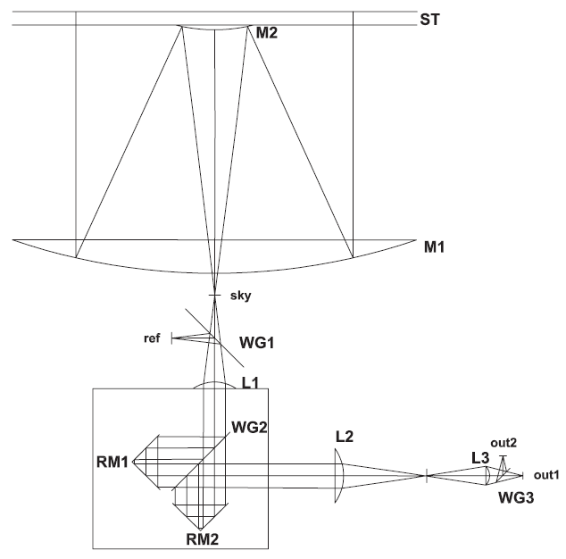
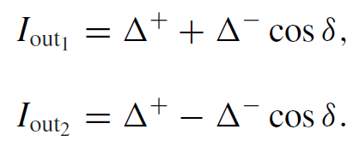







CASPER – the optics
f/3.5 Pressman-Camichel telescope 62-cm in dia + MPI : abs calibration procedure 1/2
interferograms
where
specific brightness of ..

Slide 16
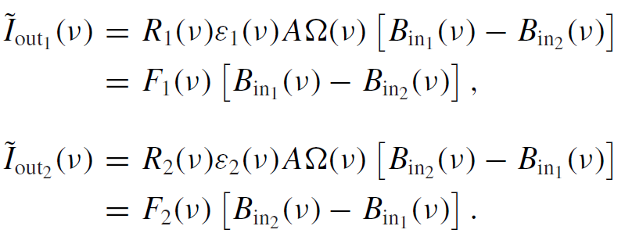
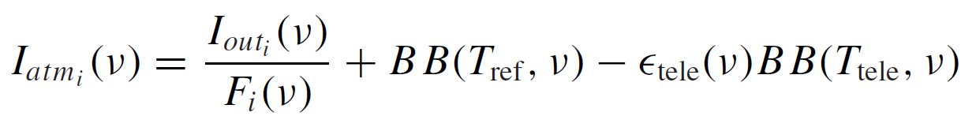
CASPER – the optics
f/3.5 Pressman-Camichel telescope 62-cm in dia + MPI : abs calibration procedure 2/2
spectra
(baseline removed)
calibration functions
estimated by filling in₁ with a well-modeled source (77K BB)
2 identical inputs = Null interferogram
To put a constraint on the minimum detectable contribution on the PWV content:
discriminate spectra with ΔPWV = 0.01 mm at least for PWV<1 mm

Slide 17
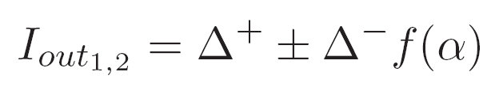

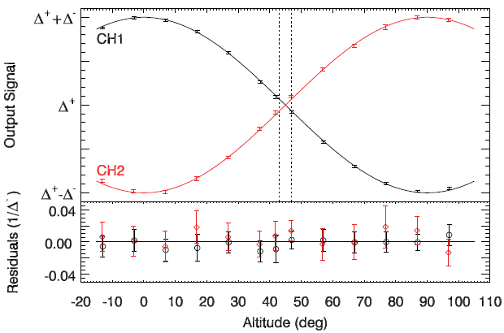
CASPER – the optics
MPI efficiency versus telescope altitude
Fixed detector ⇨ dependence of ZPD output signals with altitude angle, α
SNR < 3
ALT
Blind region around alt= 45 deg
AZ

Slide 18
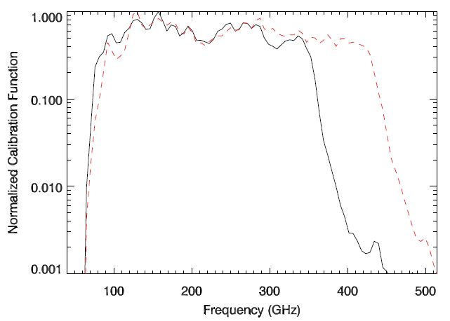
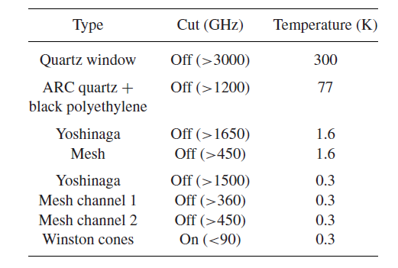

CASPER – cold detectors & bands
Channel 1 : 90 – 360 GHz
Channel 2 : 90 – 450 GHz
(to explore high-frequency atmospheric emission, more sensitive to PWV fluctuations)
2 Ge-bolometers with NEP ∼ 10⁻¹⁵ W Hz^{1/2} cooled down to 290 mK by a wet cryostat
(Infrared Labs, HDL-8)

Slide 19
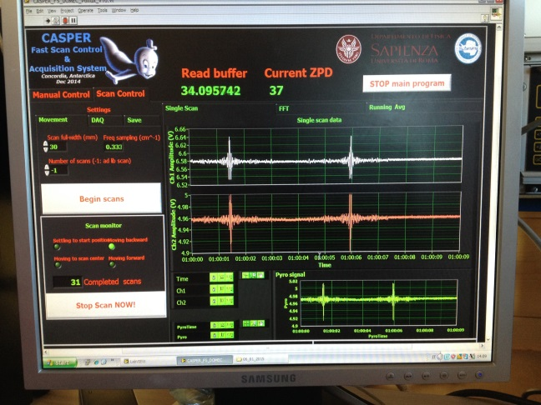
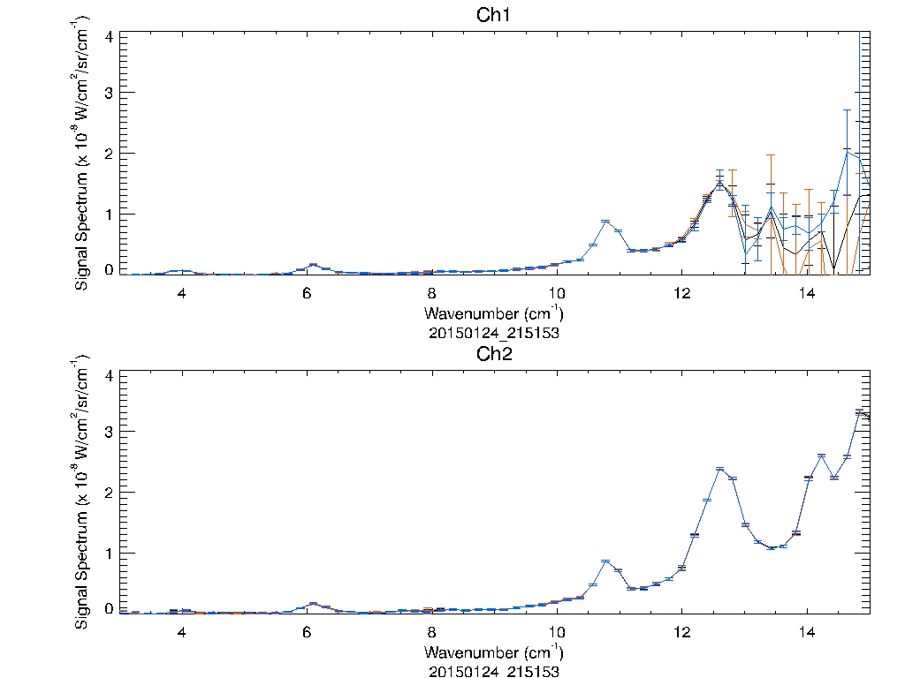
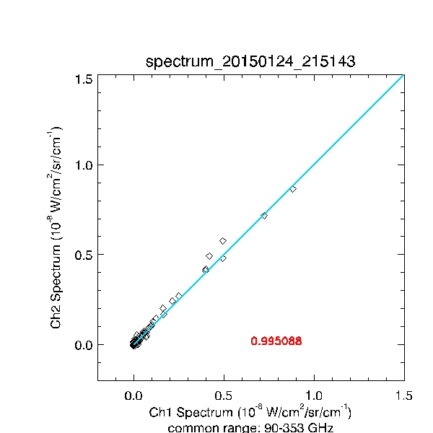
CASPER – 2 bands spectra
Atmospheric spectra and correlation between common range signals (Jan 24th 2015 DC)
Channel 1 : 90 – 360 GHz
Channel 2 : 90 – 450 GHz
O₂
H₂O
H₂O
H₂O
O₂
C=0.9950

Slide 20
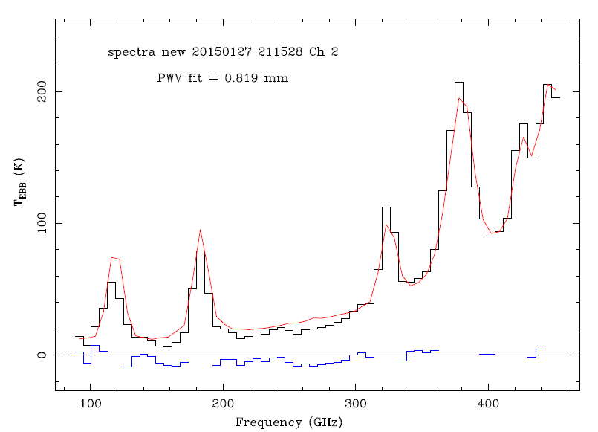
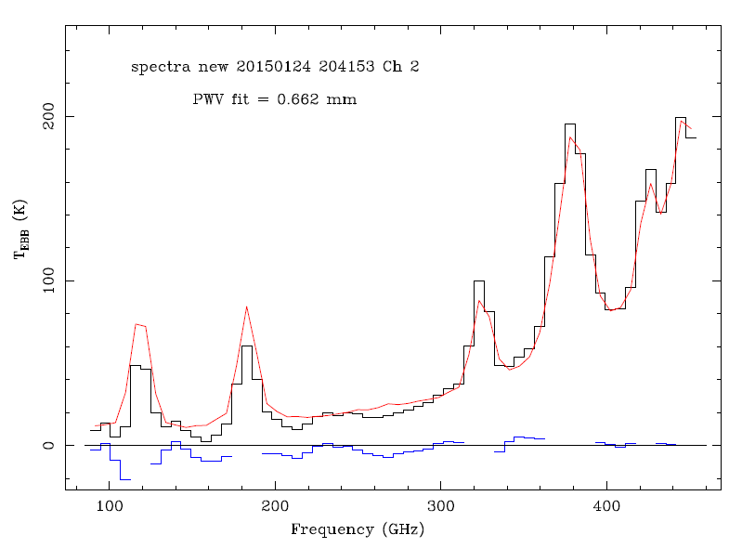


CASPER – pwv
Fit with ATM code to infer pwv content for two spectra, as an example
input 1 = SKY ; input 2 = BB_ref
T_BB_ref = 240.670 K
T_amb = 233.450 K
P_amb = 650.700 mbar
UR = 61.0000 %
Elevation: 90 deg
Procedure: Fast Scan
Clear sky: YES
fits J.R. Pardo
input 1 = SKY ; input 2 = BB_ref
T_BB_ref = 243.150 K
T_amb = 233.350 K
P_amb = 647.700 mbar
UR = 64.0000 %
Elevation: 90 deg
Procedure: Fast Scan
Clear sky: YES

Slide 21
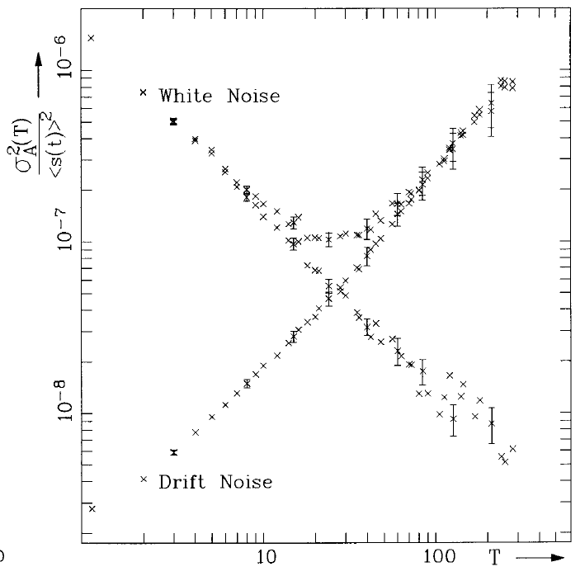
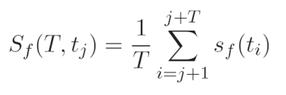
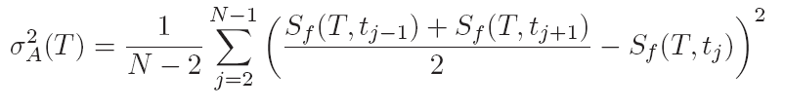
CASPER – spectra acquisition timescale
GOAL: maximise the number of recorded independent spectra with high S/N.
The maximum number of spectra, that can be averaged, is constrained by the timescale resulting on a tradeoff between thermal noise and atmospheric fluctuation regime.
Appropriate statistical approach: Allan Variance
White noise appears with a slope of −1
Drift noise with a slope of ~ +1
The combination of both results:
The typical Allan plot has a minimum at some well defined time.
Schieder and C. Kramer (2001) A&A

Slide 22
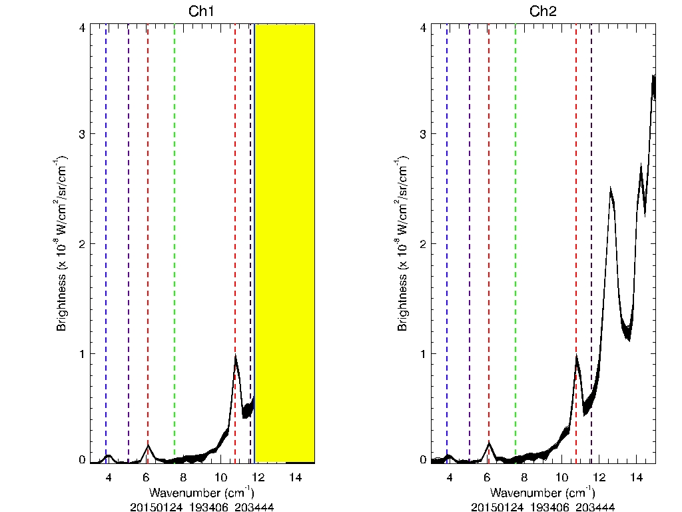
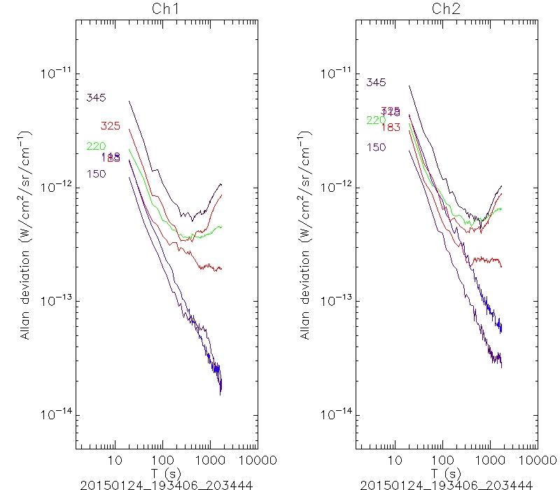
CASPER – atmosphere stability
Allan Variance estimated at 6 fiducial frequencies: in-band & out-band
thermal noise
atm. fluct.
thermal noise
atm. fluct.
180 atmospheric zenithal spectra recorded at DC
(Jan 24th, 2015)
Maximum timescale ~200-300 s
to average multiple spectra
or
to achieve constant emission
O₂
118 GHz
H₂O
183 GHz
H₂O
325 GHz

Slide 23
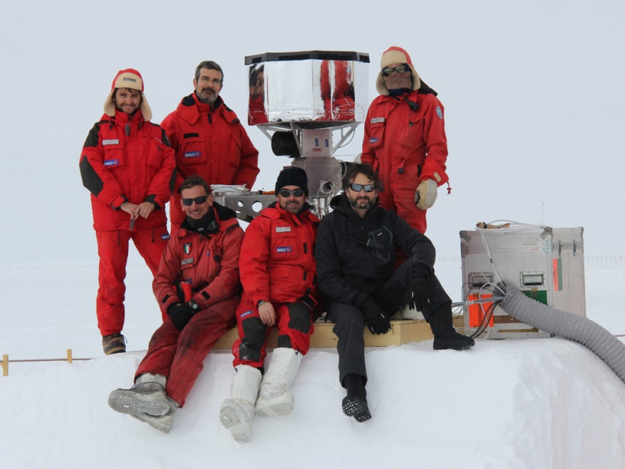
Conclusions
Installation and first observations (mm-spectra) with CASPER (wet cryostat version) at Dome C
Preliminary results: pwv from zenith observations and atmosphere stability
On-going analysis:
  Complete the zenith obs and skydips to compare the opacities at mm/sub-mm bands and the pwv values with other in-situ observational approches;
  Observations with polarization modulation.

Slide 24


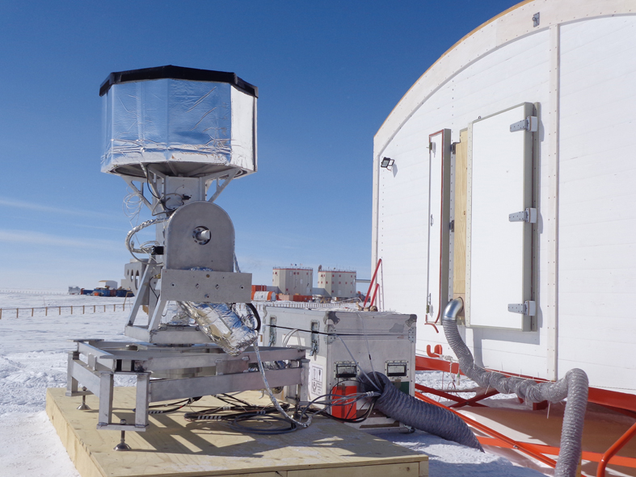
Acknoledgements
PNRA and IPEV for logistic support
W. Jones and SPIDER team for providing us LHe4 from McMurdo
COCHISE team for instrumental support on-site
On-site meteo data and information were obtained from IPEV/PNRA Project “Routine Meteorological Observation at Station Concordia -www.climantartide.it.
Thank you for your attention!

