Slide 1

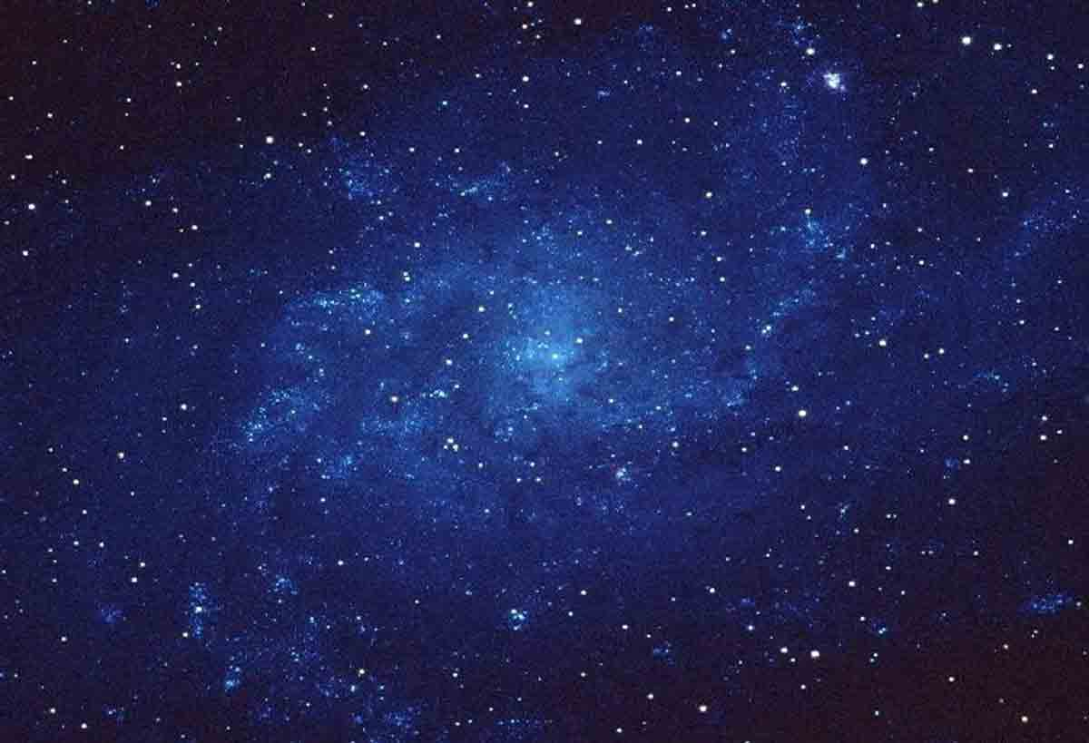


Study of the ¹⁰B(p,α)⁷Be Reaction through the Indirect Trojan Horse Method
NELLY PUGLIA
LNS-INFN

Slide 2
Outline
Light Elements in the Universe and their Astrophysical Relevance
Importance of the ¹⁰B(p,α)⁷Be reaction in astrophysics
Study of the reaction via the Trojan Horse Method (THM)
The experimental procedure
Results

Slide 3
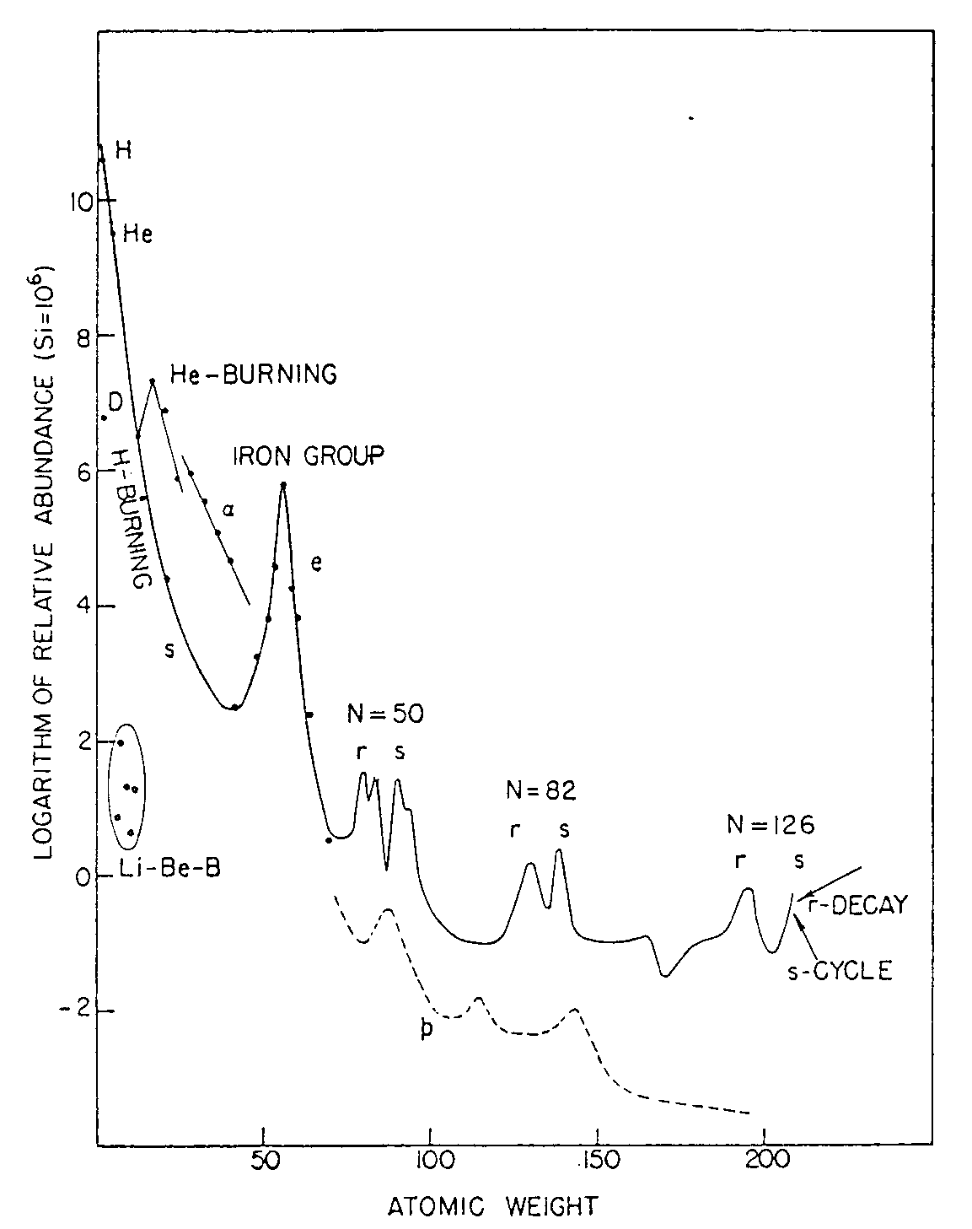
Light Elements in the Universe
H,D, He, Li, Be B
Main production site: Spallation processes on ISM; BBN (mainly for lithium and “probably” beryllium). Neutrino nucleosynthesis in Supernovae (only ⁷Li and ¹¹B)
(Anders e Grevesse (1996) )
DEPLETION OF THE LIGHT ELEMENTS
Solar System abundances
Chemical evolution of the Galaxy;
Primordial Nucleosyntesis & Spallation processes on ISM;
Stellar evolution
Li Be B
These elements, though being so rare, play a relevant role for solving several
astrophysical problems

Slide 4
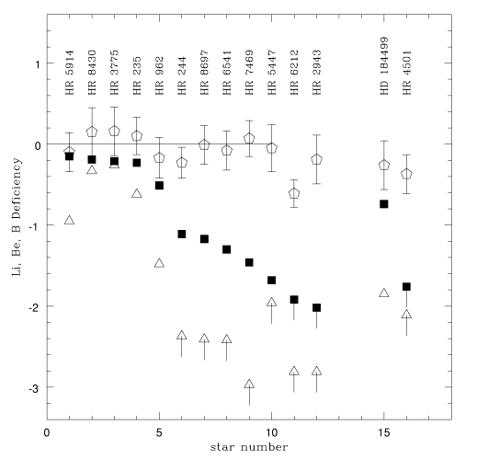
Li Be B Observational Status
The trend of the abundances of Li, Be and B is shown as a function of Be-deficiency for low-metallicity young star (5800<T _{eff} (K)<6500, M* ∼1Mo).
Li Be B as indicators of the processes occurring inside stars (Boesgaard, 1998)
Li
Be
B
Li,Be,B Deficiency
Theoretical Models
Mass loss (Schramm, 1990)
Microscopic diffusion (Richer & Michaud 1993)
Slow mixing (Pinsonneault, 1990; Zahn, 1992)
Be-deficiency
Depletion of Li and Be
Constant rate of Boron

Slide 5
Depletion of Light Elements
Main Destruction Sites: Stellar interior
Burning (p,α) channel as the main contribution to their destruction
Li 2·10⁶ K
Be 3.5·10⁶ K
B 5.3·10⁶ K
Nuclear reactions
⁶Li(p,α)³He
⁷Li(p,α)⁴He
⁹Be(p,α)⁶Li
¹⁰B(p,α)⁷Be
¹¹B(p,α)⁸Be
(Tumino A. et al.,PRC 67, 2003)
(Lattuada M. et al.: Ap. J. 562, 2001)
(Wen et al. 2008)
Already been studied
via THM
(Lamia L. et al. 2012)

Slide 6
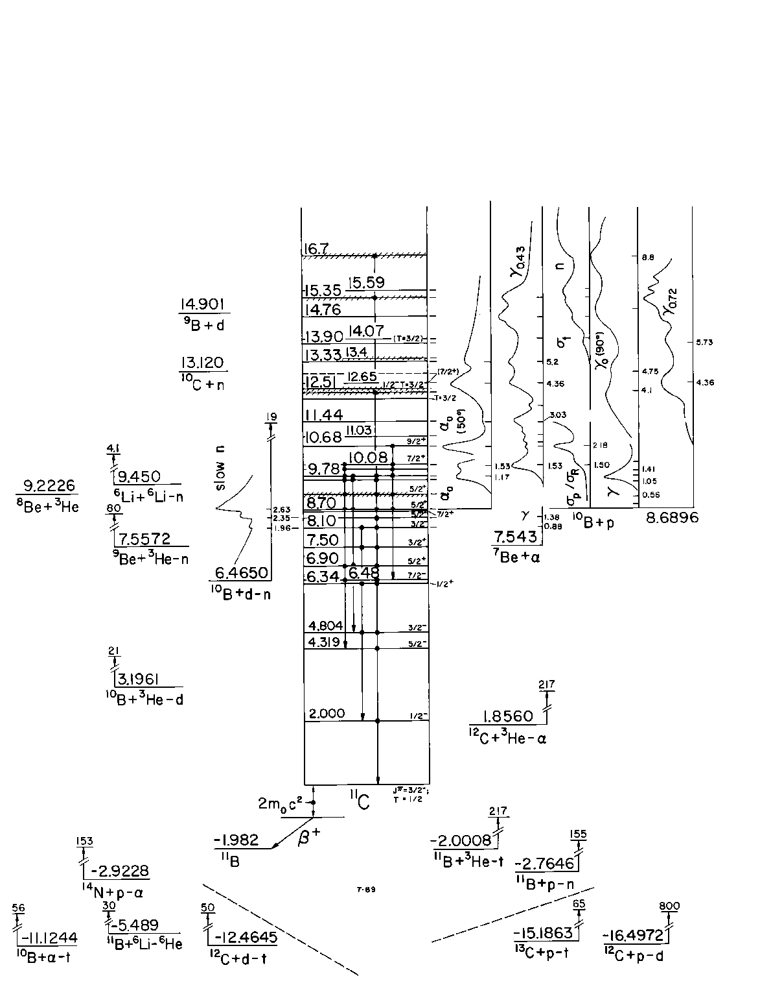
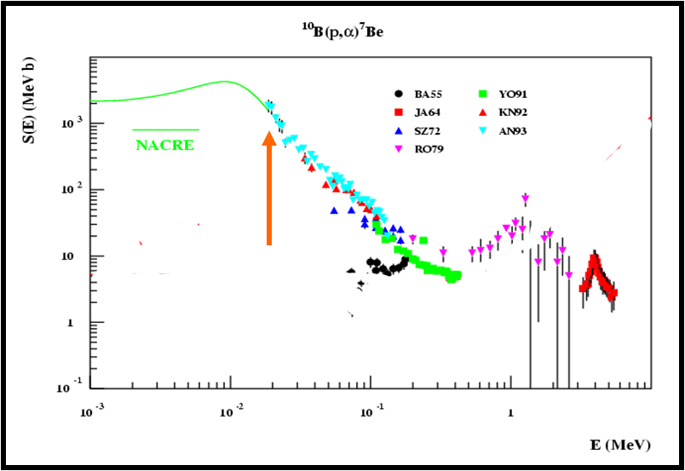
¹⁰B(p,α)⁷Be
✓ By considering the typical temperatures of some 10⁶ K at which burning (p,α) reactions typically occur for boron isotopes in stellar environments, the Gamow peak is at about
Presence of a resonance ∼ 10 keV
E₀=1.22(Z²_{x}Z²_{y}μT₆²)^{1/3} keV ≈ 10 keV
E_{10B-p}=10keV
→E*_{11C}=8.7MeV
E_{Gamow peak}
Aim → study the energy region corresponding to the Gamow peak
EXTRAPOLATION

Slide 7
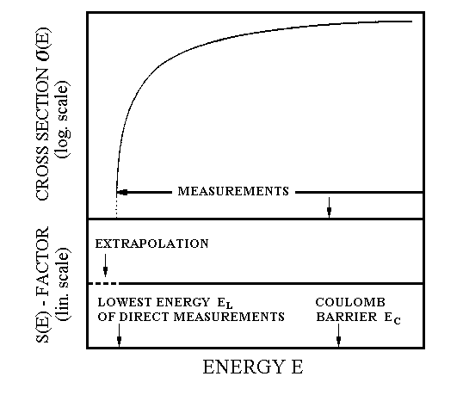
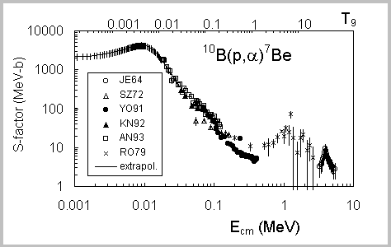

Nuclear reaction at astrophysical energies
Main problem: presence of the Coulomb barrier between the interacting nuclei
10⁻⁹:10⁻¹² barn!!!
The Coulomb barrier E_{coul}, usually of the order of MeV, is much higher than energy E_{kin} ~ keV
exponential decrease of
the cross section
V
E_{C} (MeV)
Astrophysical energies
INDIRECT METHODS
NACRE
Extrapolation from the higher energies by using the
ASTROPHYSICAL FACTOR
S(E) = σ(E) E exp(2πη)
THM
extrapolation
EXTRAPOLATION

Slide 8


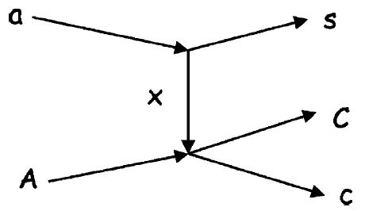
The Trojan Horse Method
The THM allows to study the astrophysically relevant two-body reaction x(A,C)c at Gamow energies, from quasi-free contribution of an appropriate three-body reaction a(A,Cs)c, induced at energies higher than the Coulomb barrier.
QF Break-up
a= x ⊕ s clusters
only x interact with A
s is considered to be spectator to the virtual reaction A + x → c + C
Impulse Approximation
The reaction x(A,C)c is at energy E_{cm}=E_{cC}- Q_{2body}
virtual reaction
A + x → c + C
off-energy-shell cross section for the virtual reaction at the E_{cm} energy
C
s impulse distribution inside the nucleus a
Kinematic factor
Notes:
a)The momentum transfer is sufficiently high or equivalently the associated wavelenght sufficiently small. Conseguently the interaction can be considered confined.b) the incident center of mass energy is higher than the binding energy of the cluster x-s

Slide 9
Indirect study of the ¹⁰B(p,α)⁷Be reaction through ²H(¹⁰B,α⁷Be)n by means of the THM
Study of the ¹⁰B(p,α)⁷Be reaction (Q= 1.14 MeV) through ²H(¹⁰B,α⁷Be)n 3-body reaction (Q=-1.08MeV, Ecoul=1.23 MeV);
n
The deuteron is used like Trojan Horse nucleus.
Deuteron nucleus has a simpler cluster structure d=p +n with binding energy
B_{p-n} =2.2MeV
The momentum distribution of intercluster motion inside the deuteron is known and has maximum at p_{s}=0 MeV/c. [Zadro et al.(1989)]
Coulomb barrier ¹⁰B-²H = 1.80 MeV
²H
⁷Be
p
¹⁰B
α

Slide 10
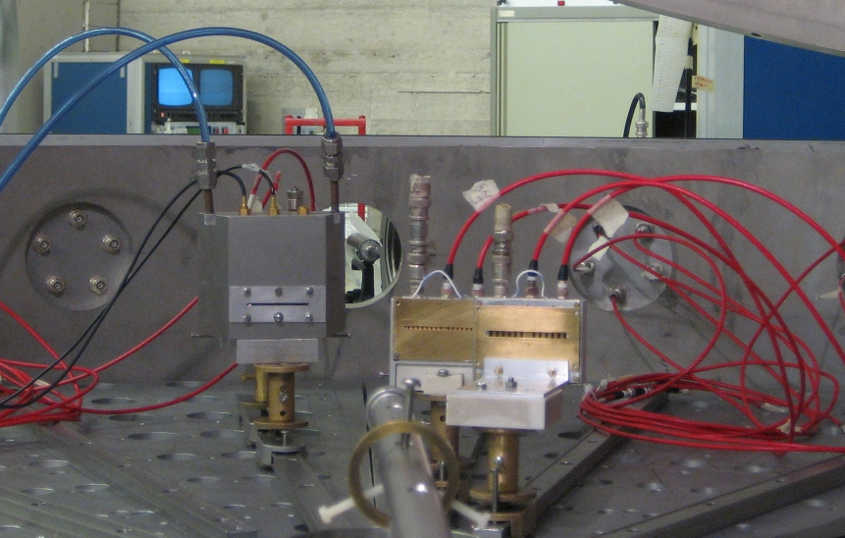
Experimental Setup
2 Experiments: 1° LNS-Catania
2° l’Istituto de Fisica Nuclear di Saõ Paulo del Brasile
1° Experiment
The experiment was performed at LNS-INFN (Catania, Italy)
⁷Be. d=57cm θ=6.9 ±2.5
PSD2
E_{beam}(¹⁰B)=24.4 MeV I_{beam}(¹⁰B)=1 nA
ΔE
CD₂
¹⁰B⁺⁺
Target thickness CD₂ ∼200 µg/cm²;
⁷Be
α. d=35cm θ=8.2 ± 4
α
PSD1
Displacement of the detectors around the whole QF-angular range.
10B beam
@24.4MeV
α. d=33cm
θ=17.9 ± 4.3
PSD3

Slide 11
Experimental Setup II
2° Experiment
The experiment was performed at l’Istituto de Fisica Nuclear di Saõ Paulo del Brasile
E_{beam}(¹⁰B)=27MeV & I_{beam}(¹⁰B)=1 nA
Target thickness CD₂ ∼200 µg/cm²;
PSD2
ΔE
CD₂
¹⁰B⁺⁺
14°
Displacement of the detectors around the whole QF-angular range.
16°
PSD1

Slide 12
Three-body ²H(¹⁰B,α⁷Be)n channel identification
✓ After calibration, Be isotopes were selected by using standard DE-E technique.
Experimental Q-value reaction with the assumption of mass 1 for the 3rd undetected particle: agreement between theoretical and experimental one (Q_{THM}=-1.07 MeV, Q_{THEORETICAL}=-1.079 MeV)
Kinematical locus
²H(¹⁰B,α⁷Be)n
@ 7 MeV

Slide 13
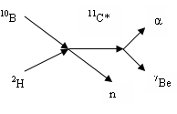
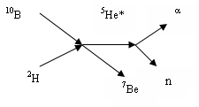
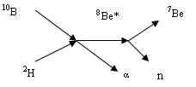
Reaction Mechanism
Sequential mechanisms coming from excited states of
¹¹C, ⁵He, ⁸Be
Study of relative energies
E_{αn} vs E_{αBe}, E_{Ben} vs E_{αBe}
¹¹C levels@
1→8.104 MeV
2→8.42 MeV
3→8.654 MeV
4→8.699 MeV

Slide 14
Selection of the QF-mechanism: Experimental Momentum Distribution
Presence of Quasi-Free mechanism
experimental neutron momentum distribution.
N
Comparison between the experimental data (black points) and the theoretical Hulthén wave function (black line) and a DWBA calculation (red dashed line)

Slide 15
Two-body cross section
By using the PWIA it is possible to extract the nuclear part of the 2-body cross section for the ¹⁰B(p, α ) ⁷Be reaction
In order to compare the THM data with the direct ones an l=0 penetrability function was introduced.
d³σ
dσ^{N}
dΩ_{α} dΩ_{7Be}dE_{cm}
∝
dΩ
KF · |Φ(Ps)|²
kr
P_{l}(k_{10b-p} R)=
F_{l}²(k_{10b-p}R)+ G_{l}²(k_{10b-p}R)

Slide 16
Astrophysical factor S(E): Results
Spitaleri, C.; Lamia, L.; Puglia, S. M. R.; et al. PHYSICAL REVIEW C Volume: 90
Already pubblisched
S(10keV)_{THM}= 2942± 588 (MeV b)
S(10keV)_{EXTR} = 2870± 500 (MeV b) Angulo et al. (1993)
BLU LINE: the THM S(E)-factor at infinite resolution togheter with its upper and lower limit in comparison with direct data (black point)

Slide 17
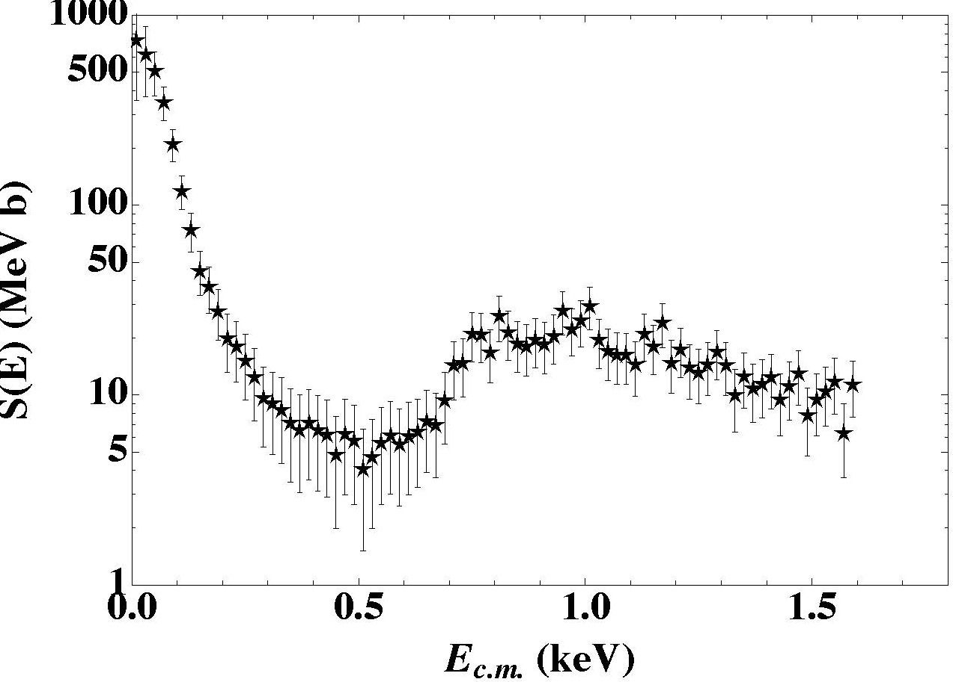
PRELIMINARY RESULT
Experiment at l’Istituto de Fisica Nuclear Saõ Paulo (Brasile)
Preliminary result
EXTRAPOLATION
We want to study energy region between 0.1-1.5 MeV !!!

Slide 18
Remarks and Conclusions:
¹⁰B(p,α)⁷Be Reaction
The indirect study of the ¹⁰B(p,α)⁷Be reaction was performe by means of the Trojan Horse Method
Strong quasi-free contribution in the three-body channel around E_{s}=0 has been identified: needed for THM
The Resonance at E_{cm}=10 keV(Gamow energy) corresponding to the ¹¹C*(8.70 MeV) level has been reproduced
Measurement of cross-section at the Gamow Energy
S(E)-factor in agreement with direct data BUT it is a FIRST
measurements below 20 keV where is present the Gamow Peak
New preliminary results in the energy region between 0.1-1.5 MeV in order to make a new normalization procedure

Slide 19


C. Spitaleri, L. Lamia, S.M.R. Puglia, S. Romano, M. La Cognata, V. Crucilla`, R.G. Pizzone, G.G. Rapisarda, M.L. Sergi, and A. Tumino
INFN, Laboratori Nazionali del Sud, Catania, Italy
Dipartimento di Fisica e Astronomia, Universit ́a di Catania, Catania, Italy
Thanks
M. Gimenez Del Santo, N. Carlin, M. G. Munhoz, F.A.Souza, and A.Szanto de Toledo
Departamento de Fisica Nuclear, Universitade de Sao Paulo, Sao Paulo, Brasil
^{B. Irgaziev}
GIK Institute of Engineering Sciences and Technology, Topi, Districti Swabi, N.W. P.Pakistan
A. Mukhamedzhanov and G. Tabacaru
Cyclotron Institute, Texas A&M University, College Station, TX 77843, USA
V. Burjan, V. Kroha, Z. Hons, and J. Mrazek
Nuclear Physics Institute of ASCR, Rez, Czech Republic
Chengbo Li, Qungang Wen, and Shu-Hua Zhou
China Institute of Atomic Energy, Beijing, China
Y. Wakabayashi and H. Yamaguchi
Center for Nuclear Study, University of Tokyo, RIKEN Campus,Wako, Japan
^{E. Somorjai}
^{Atomki, Debrecen, Hungary}

Slide 21
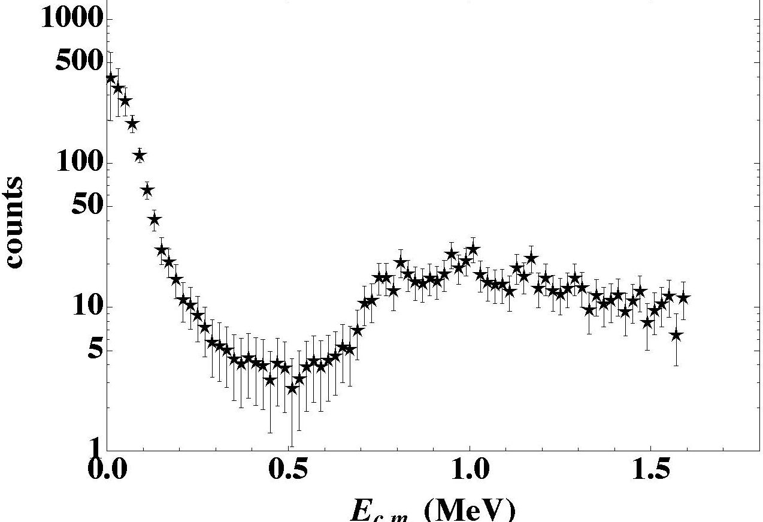
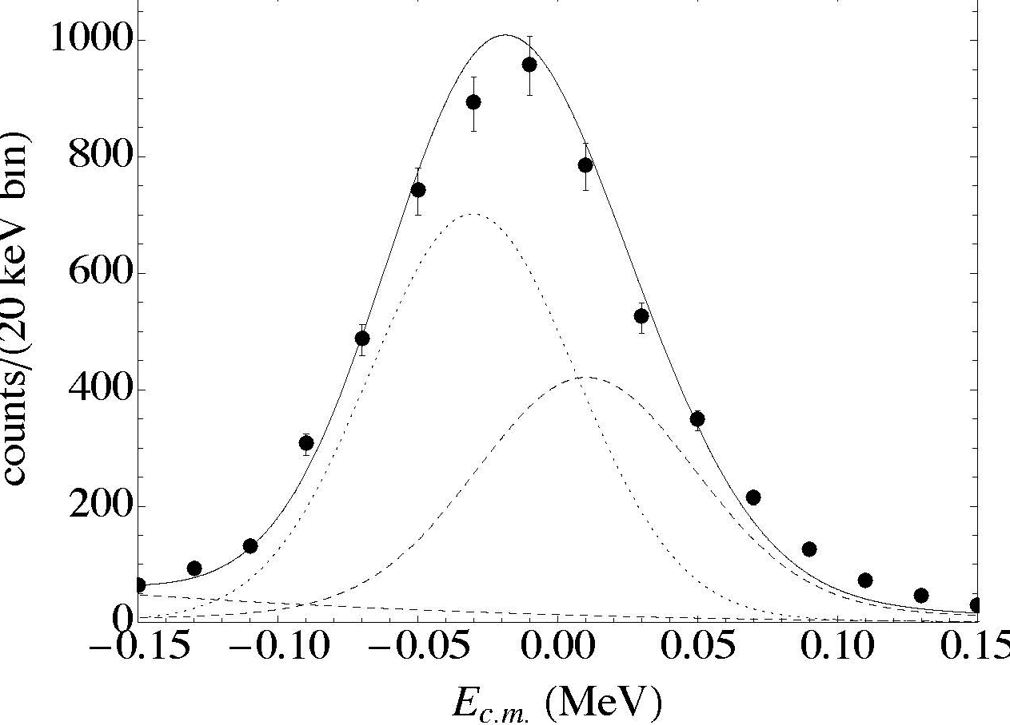
Study of 10 keV resonance
¹¹C levels E (MeV) | J^{π} | E_{cm} (keV) | Г_{cm} (keV) | Г_{tot}(experimental) (keV)
2)→8.420 | 5/2⁻ | -287 | 8 •10⁻³ | 31± 3
3)→8.655 | 7/2⁺ | -35 | < 5 | 34± 2
4)→8.699 | 5/2⁺ | 10 | 16±1 | 40± 2

Slide 22
Direct S(E)-factor
Resonance parameters used in R-matrix calculation present in literature
Direct S(E)-factor .
The lines represent the R-matrix calculation with the resonance parameters from the litterature, for bare (dashed line) and screened (full line).
Data are in the Nacre compilation
Angulo et al.1999
Wiesher et al. 1983
Kelley et al. 2012

Slide 23
Study of 10 keV resonance
¹¹C levels E (MeV) | J^{π} | E_{cm} (keV) | Г_{cm} (keV) | Г_{tot}(experimental) (keV)
2)→8.420 | 5/2⁻ | -287 | 8 •10⁻³ | 31± 3
3)→8.655 | 7/2⁺ | -35 | < 5 | 34± 2
4)→8.699 | 5/2⁺ | 10 | 16±1 | 40± 2
^{F (E)}_{unres.} ^{= bw(E)}₍₂₎ ^{+ bw(E)}₍₃₎ ^{+ p(E)}

Slide 24
COMPARISON WITH DIRECT DATA
BLU LINE: the THM S(E)-factor at infinite resolution togheter with its upper and lower limit in comparison with direct data (black point)

Slide 25
Errors bars
Value of the S(E) at infinite resolution and at THM energy resolution 34 keV.
Addition source of error are the effect of the change of the interaction radius r₀ on the penetration factor 2% and the normalizzation error 11%

Slide 26
ELECTRON SCREENING
Blu line: The bare nucleus THM S(E) factor at infinite resolution togheter with the upper and lower values (dashed blue line)
Red Line: the low energy data fitted leaving U_{e} as the only free parameter leading to U_{e}=310± 200 eV

Slide 27
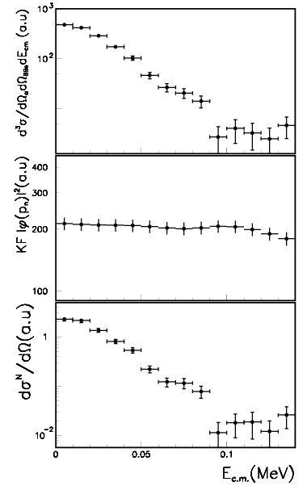
Excitation function
By using the PWIA it is possible to extract the nuclear part of the 2-body cross section for the ¹⁰B(p, α ) ⁷Be reaction
d³σ
dσ^{N}
KF · |Φ(P_{s})|² ·
∝
dΩ
dΩ_{α} dΩ_{7Be}dE_{cm}
d³σ
dσ^{N}
dΩ_{α} dΩ_{7Be}dE_{cm}
∝
dΩ
KF · |Φ(Ps)|²

Slide 28
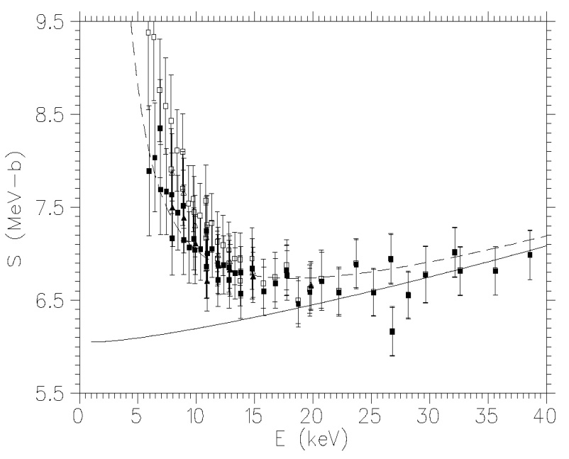
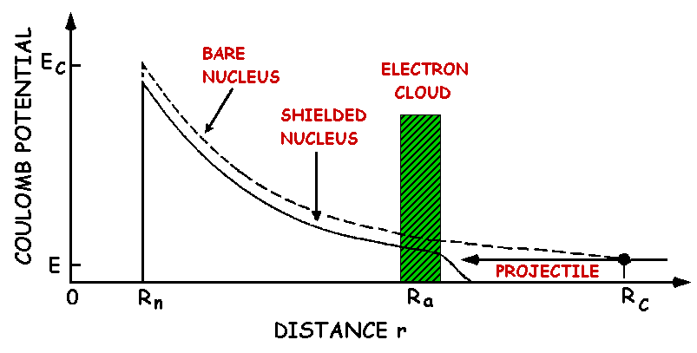
Electron screening
At astrophysical energies the presence of electron clouds must be taken into account in laboratory experiments
³He(d,p)⁴He
Enhancement in the astrophysical S_{b}(E)-factor
Directly measured
Electron screening potential
Obtained by extrapolation
To extract from direct (shielded) measurements the bare astrophysical S_{b}(E) -factor, necessary for astrophysics EXTRAPOLATION were performed at higher energy

Slide 29
PWIA
x
s
The projectile a does not interact with both the constituents of the cluster structure (b and s) at the same time
The interaction of the incident particle with the cluster b in the target is the same as if the cluster were alone
b
d
a
c
KF
cross section for the virtual reaction at the energy
E_{cm} = E_{c-d} – Q_{2-body}
Kinematic factor
it is a function of the masses, momenta and angles of the outgoing particles
s momentum distribution inside the nucleus x

Slide 30
FROM
THREE-BODY CROSS SECTION
x
s
b
d
a
c
TO
INDIRECT TWO-BODY CROSS SECTION
b
d
Measured
a
c
Calculated

Slide 31
THM: ENERGY PRESCRIPTION
1- In the quasi-free kinematical condition,
the incoming “Trojan horse “ particle
x is accelerated at energies E_{x} above
the Coulomb barrier energy (B_{xa})_{Coul.Bar}
E_{x} > (B_{xa})_{Coul.Bar}
x
s
2- The nucleus x can be brought into nuclear
field of nucleus a and
the cluster b induces the reaction
a + b → c + d
b
d
a
c
E_{cm} = E_{ab} < B_{ab}

Slide 32
Under proper kinematical condition
E_{C-D} = Q_{2B}
x
s
b
d
a
c
E_{cm} = 0
E_{cm} = E_{C-D} - Q_{2B}
Q_{2b} is the two-body Q-value of the a + b→ c + d reaction
E_{C-D} is the relative energy between the outgoing particles C and D
Overcoming
the problem of the Coulomb barrier in the cross section measurements in reactions between charged particles to astrophysical energies
No Coulomb effects
No electron screening

Slide 33
Nuclear reaction at astrophysical energies
Maxwell-Boltzmann
distribution
∝ exp(-E/kT)
tunnelling through
Coulomb barrier
∝ exp(- )
Main problem: presence of the Coulomb barrier between the interacting nuclei
relative probability
Gamow peak
ΔE₀
The Coulomb barrier E_{coul}, usually of the order of MeV, is much higher than energy E_{kin} ~ keV
exponential decrease of
the cross section
kT
E₀
energy
10⁻⁹:10⁻¹² barn!!!
INDIRECT METHODS
Extrapolation from the higher energies by using the
ASTROPHYSICAL FACTOR
S(E) = σ(E) E exp(2Πη)
THM

