Slide 1



First Results from the Run-1
of the
Extreme Energy Events
experiment
M. Abbrescia for the
Extreme Energy Events collaboration

Slide 2
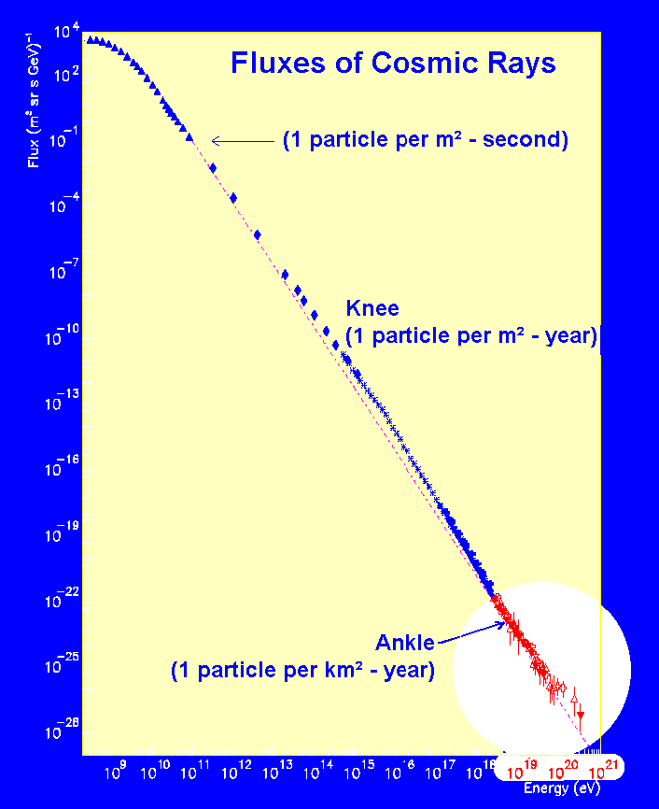
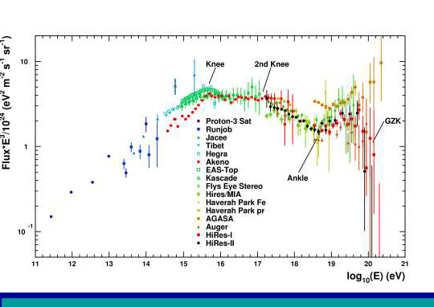
The project
Conceived in 2004 by its scientific leader, prof. A. Zichichi
Aims at covering the most interesting, and still unexplored, region of the cosmic ray spectrum:
  E > 10¹⁸ eV
  Extragalactic sources
  GZK cutoff
  (Greisen, Zatspein and Kuz’min)

Slide 3
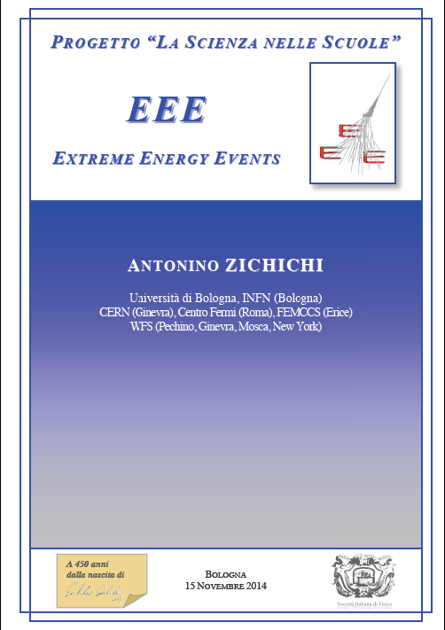
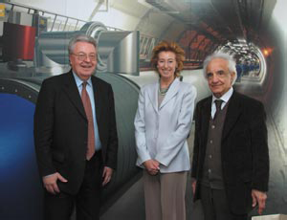
All details in…
A. ZICHICHI, Progetto "La Scienza nelle Scuole”
EEE – Extreme Energy Events
Società Italiana di Fisica (SIF), Bologna
1st Ed. 2004; 2nd Ed. 2005
3rd Ed. 2012, 4th Ed. 2014
An experiment in collaboration among:
  Centro Fermi
  INFN
  CERN
  MIUR
  SIF
Launch event on 3 May 2004 at CERN
R. Aymar – CERN DG
L. Moratti – Minister of Science & Education
A. Zichichi – Centro Fermi President

Slide 4
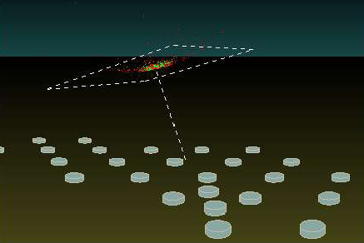
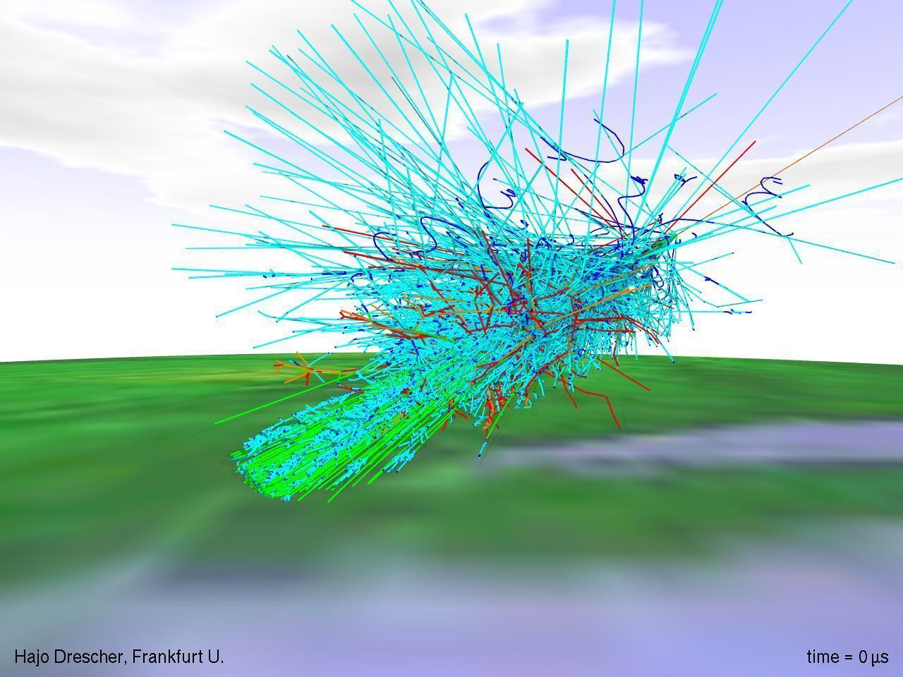
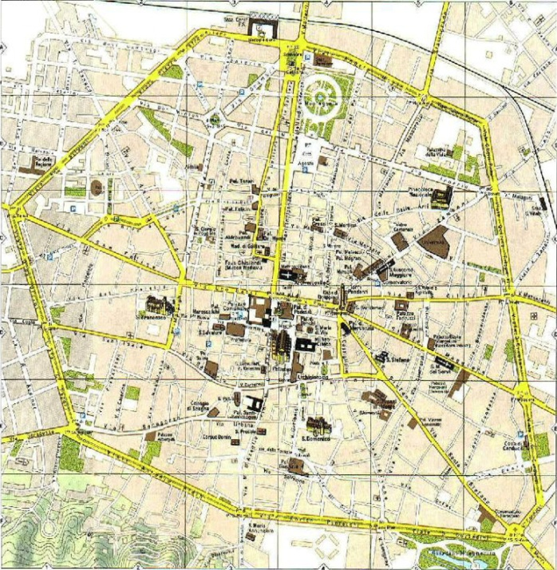
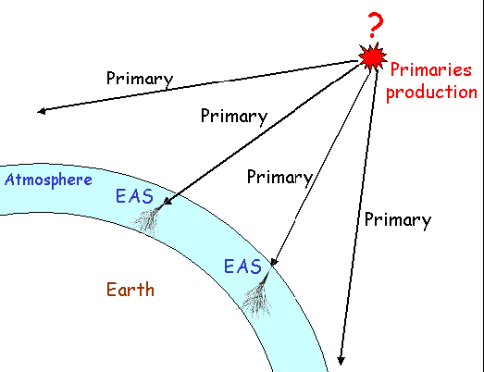
The EAS array
Essentially, sampling tecniques are used
Detect muons arriving at the surface
Many, low cost, easy to operate stations
Simulation of the shower induced by a 10¹⁷eV proton
At ground level 1 million muons arrive, over an area with radius at least 2 km.
Long distance correlations

Slide 5
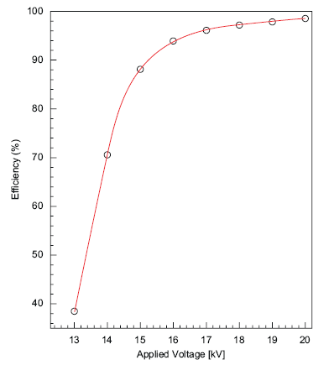
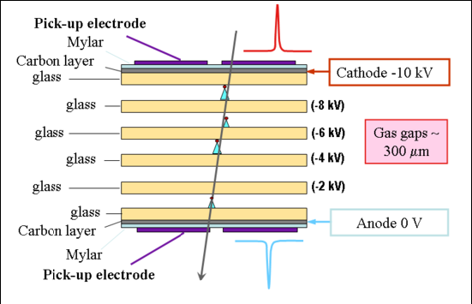
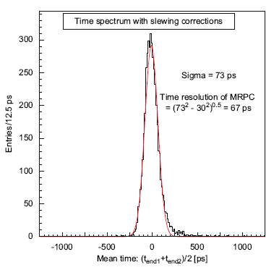
The detector used
Efficiency
(in dedicated beam tests)
Time resolution
(in dedicated beam tests)
It is a larger (~2 m²) and cheaper version of the Multigap RPC developed for the ALICE TOF
Operated with a mixture of C₂H₂F₄/SF₆ 98/2
at a continuous flow in the order of 3 l/h

Slide 6
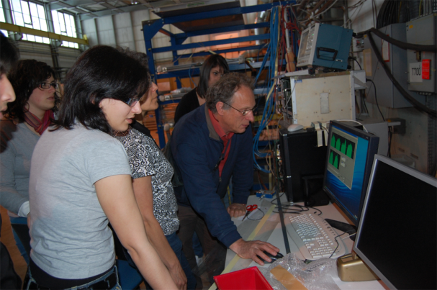
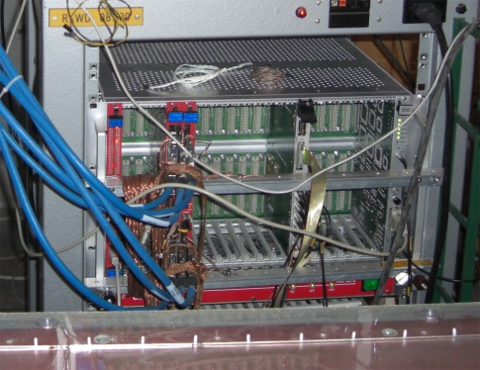
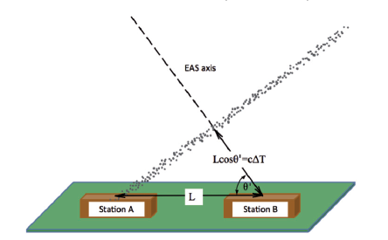
The EEE experiment structure
Each station consists of a telescope made out of 3 MRPC
  Exceptional tracking and timing performance
Data are readout by VME electronics and sent to a PC for analysis
Coincidences among distant telescopes are searched for, to spot high energy showers

Slide 7
Okay, this is about
the experiment, but…
why is EEE so innovative?

Slide 8
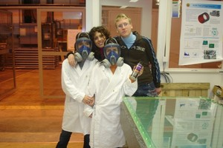
EEE is so innovative…
  because the experiment does not take place in scientific labs but…
in italian high schools
  because main actors of the experiment are not scientists but…
high schools students and teachers
  With the help of experts from the scientific world, students and teachers, they:
  Build their detectors at CERN
  Build the stations at their schools
  Take care of the data taking and relative analysis

Slide 9
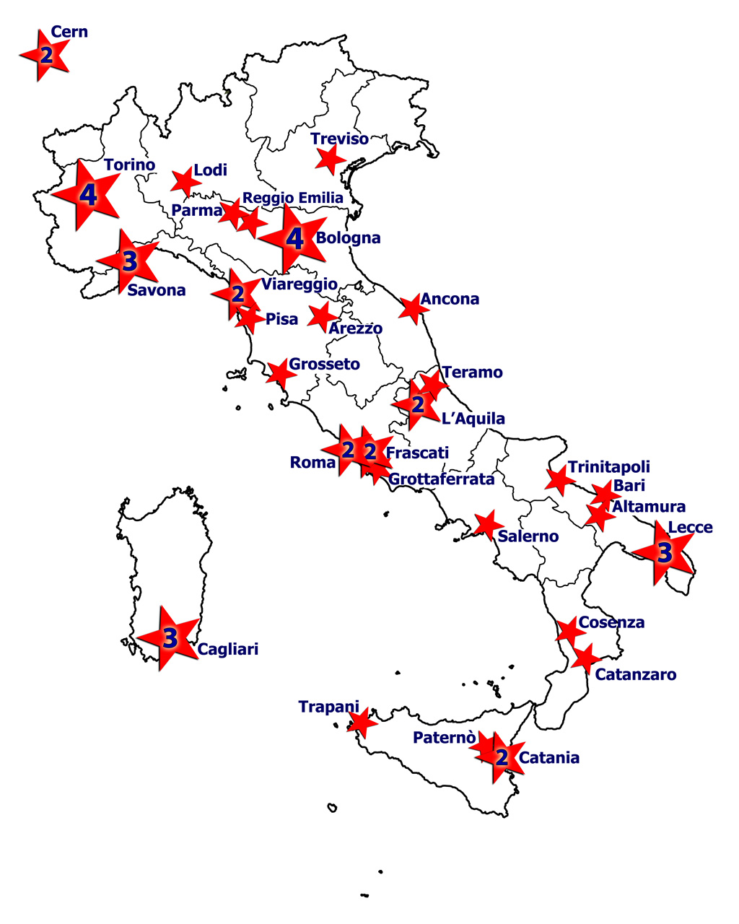
The schools involved
At present, 47 High Schools
are involved:
42 + 5 new High Schools in 2015
They are mostly distributed in
clusters in the whole Italian territory
+ 2 telescopes at CERN
+ 3 in INFN Units
Total: 52 telescopes
3 new High Schools in 2016 → 50 !!!

Slide 10
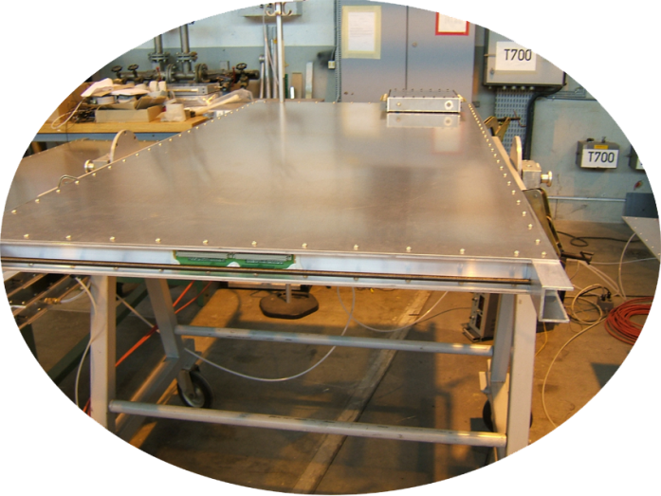
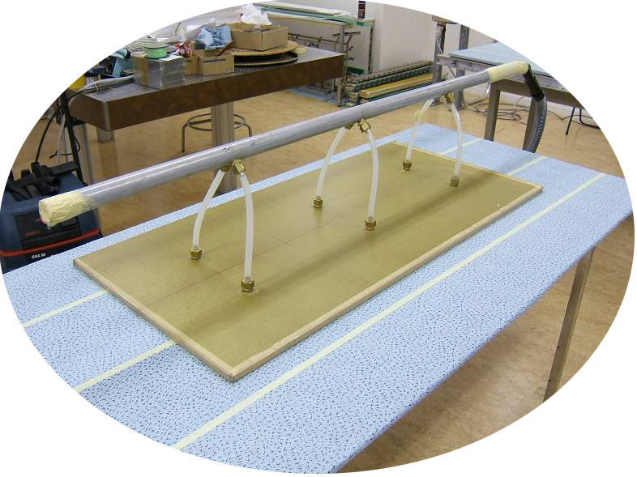
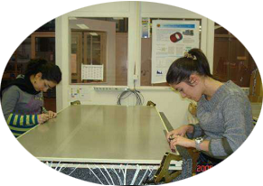
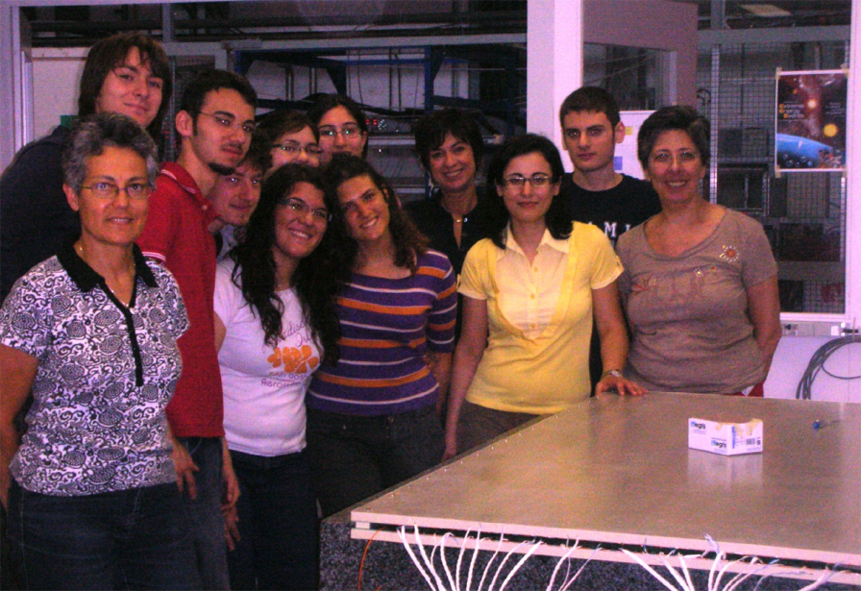
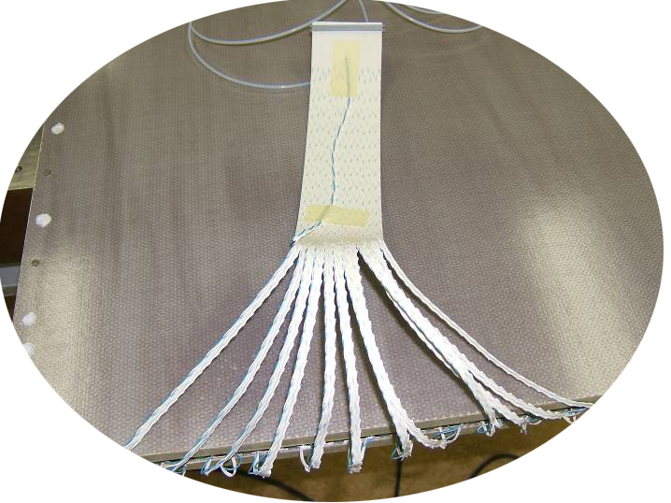
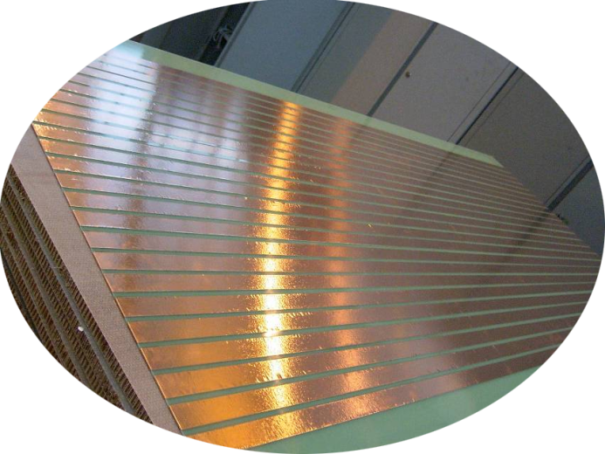
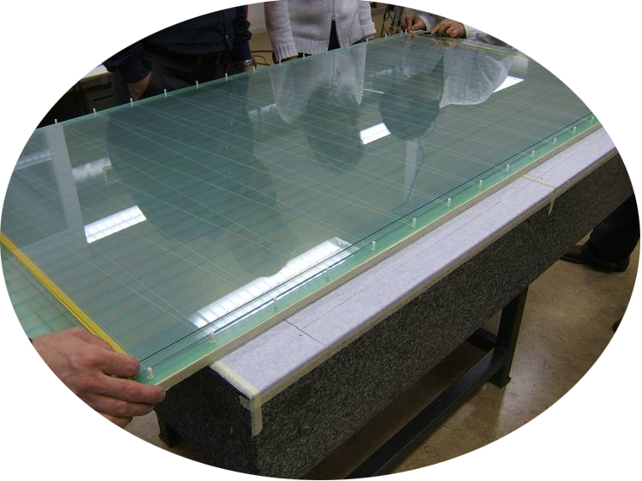
Phase 1: construction
Device to lift the
glass plates
Completly assembled MRPC under test
Copper read-out strip panel
Flat cable connected and soldered to the strips
Nylon fishing line used
as plane spacers

Slide 11
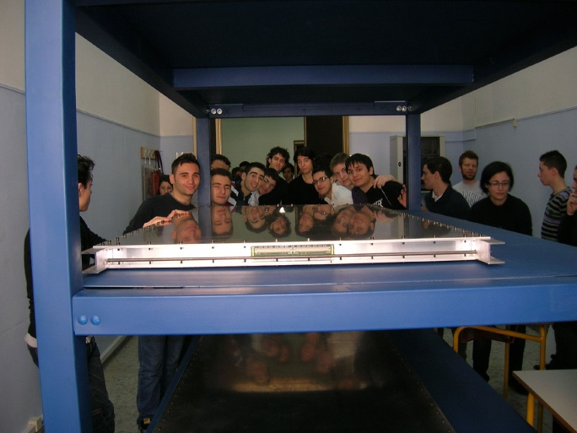
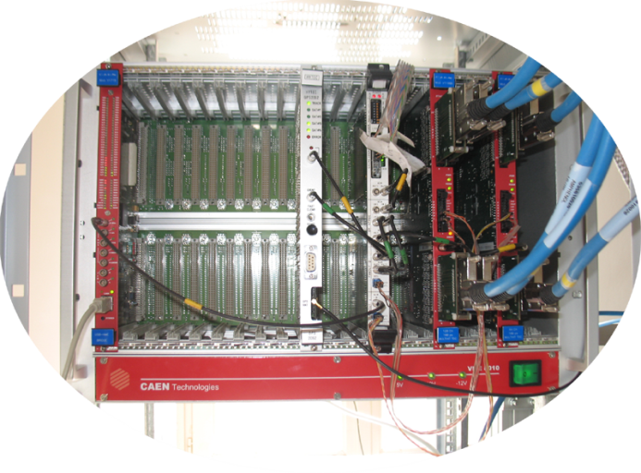
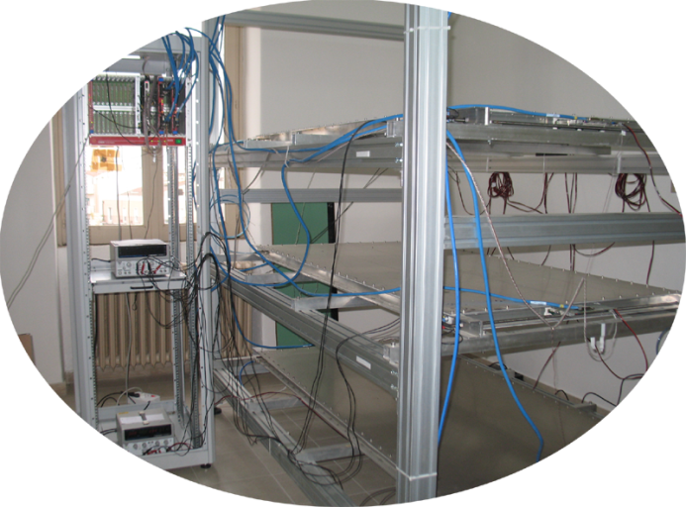
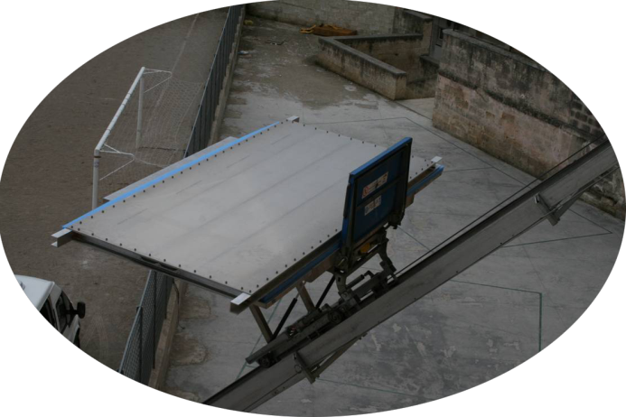
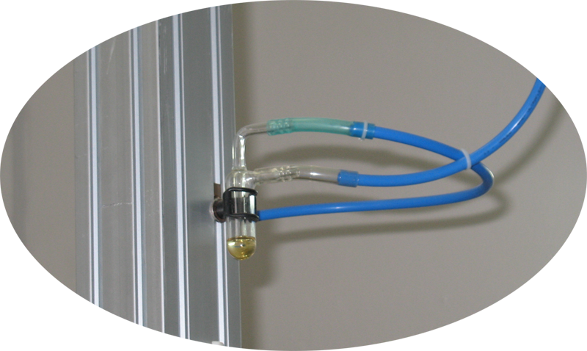
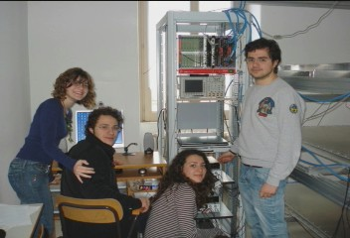
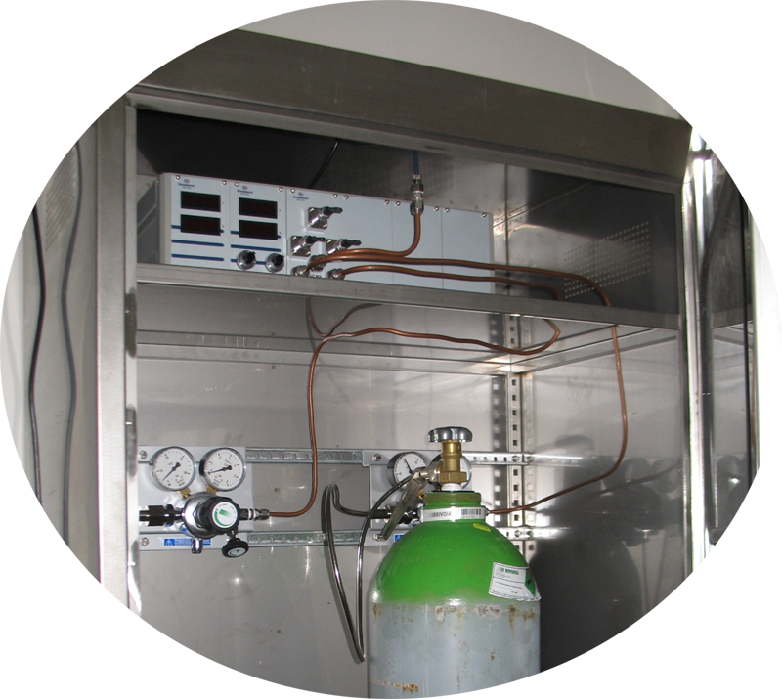
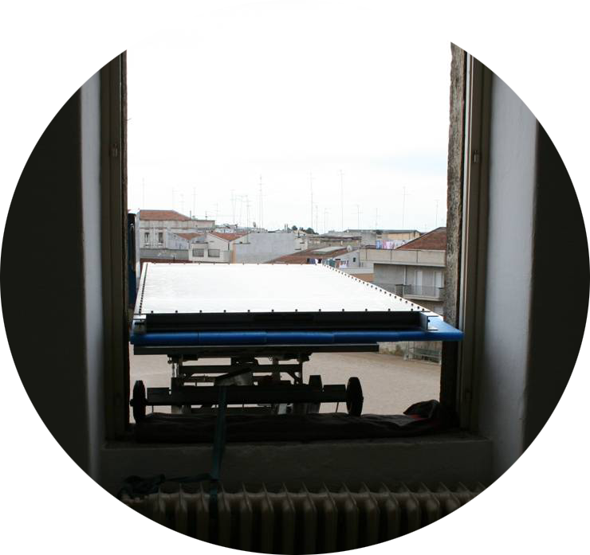
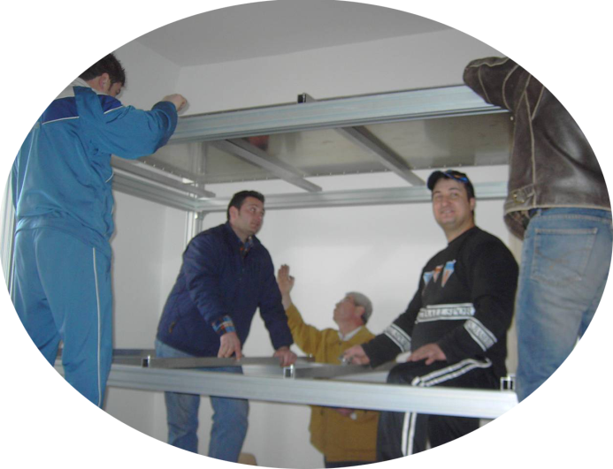
Phase 2: assembling
Electronic readout system
Assembled telescope
Gas system
Chamber arrival

Slide 12
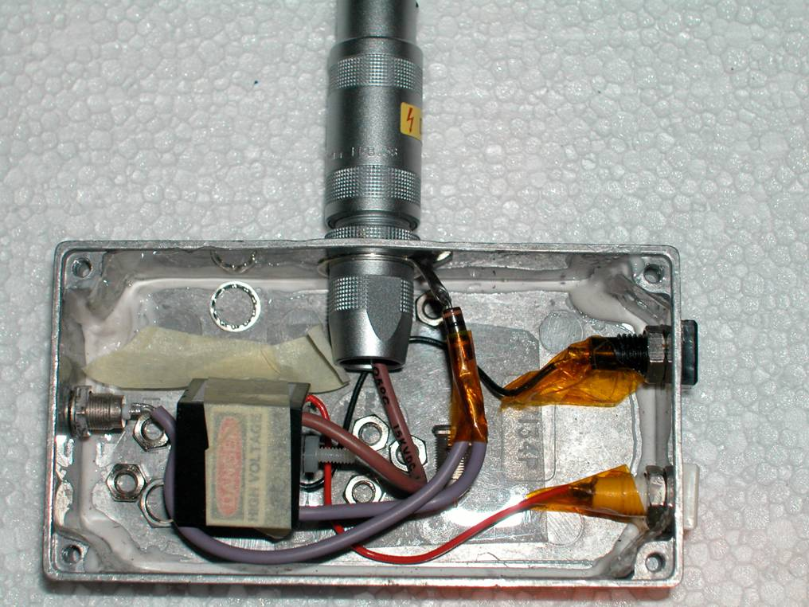
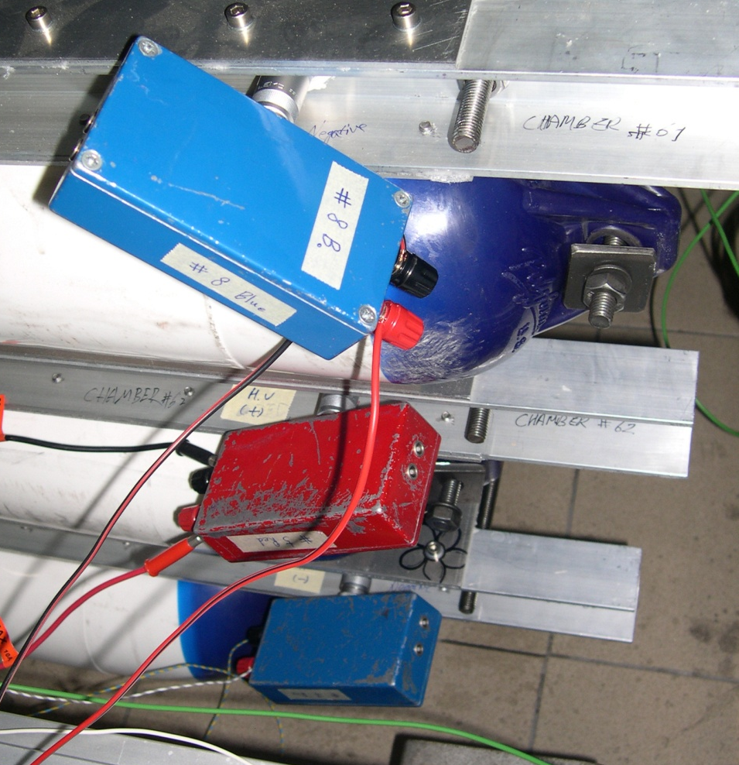
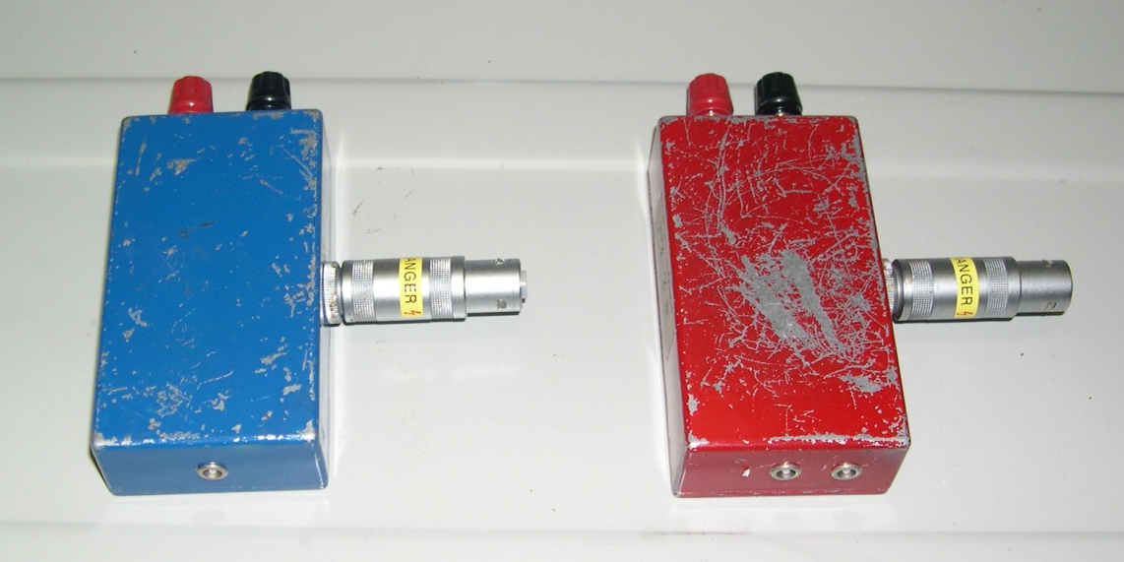
Something peculiar: the HV system
The EEE Project MRPCs work at voltages around 20 kV
DC/DC converters packed in small boxes and directly connected to the electrodes of the detector
EMCO Q series converters providing an output voltage up to ±10 kV when powered with 0-5 V
-HV
+HV

Slide 13
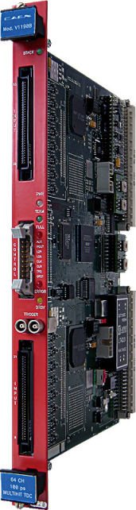
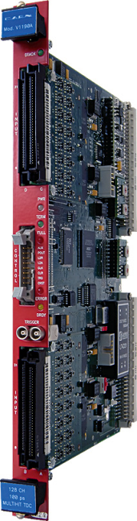

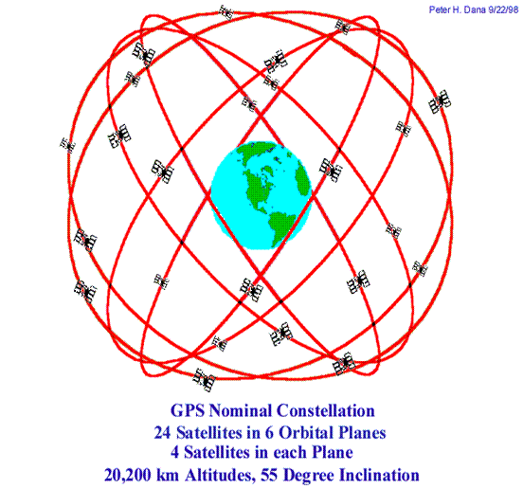
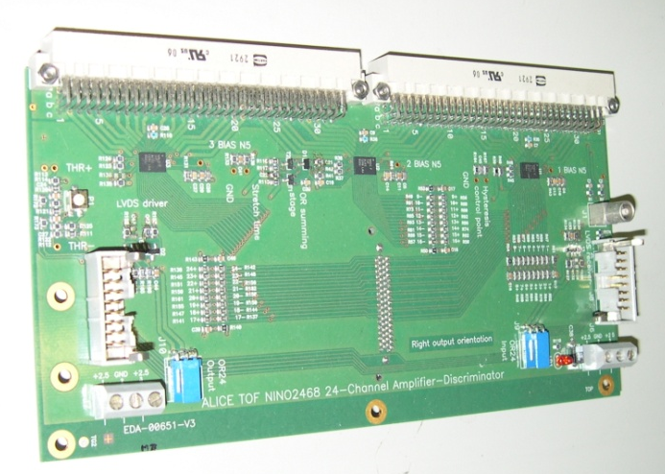
Electronics and GPS
144 channels TDC
Trigger unit
GPS Unit
VME crate CAEN Mod.8010
USB connection to PC
VME Bridge CAEN Mod. V1718
Acquisition and control software based on Labview
FE cards (24 channels) – with NINO ASIC
Tot. # of readout channels = 144
Hytec or Spectracom GPS to synchronize stations at different location
Time stamps

Slide 14
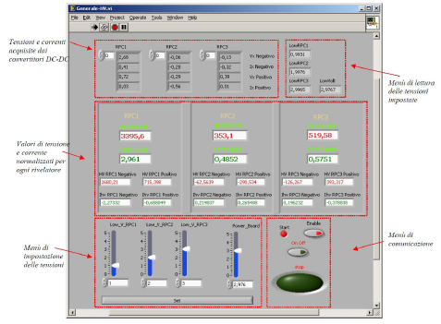
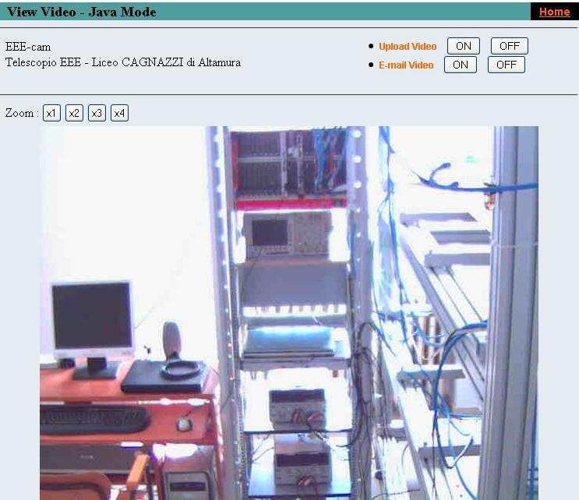
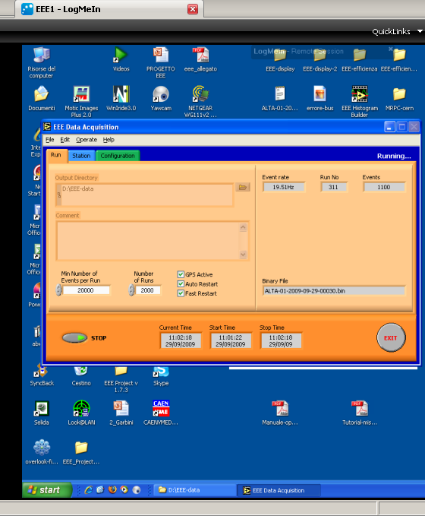
Monitor and control
Stations are sometimes located several km apart from the closest INFN section: remote control is essential
HV-LV system
DAQ & online analysis
Gas system
Data transfer
All remotely
controlled

Slide 15
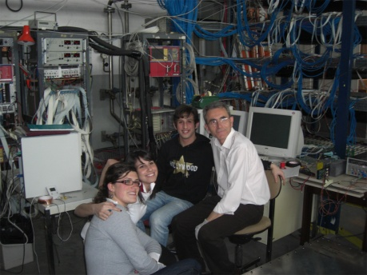
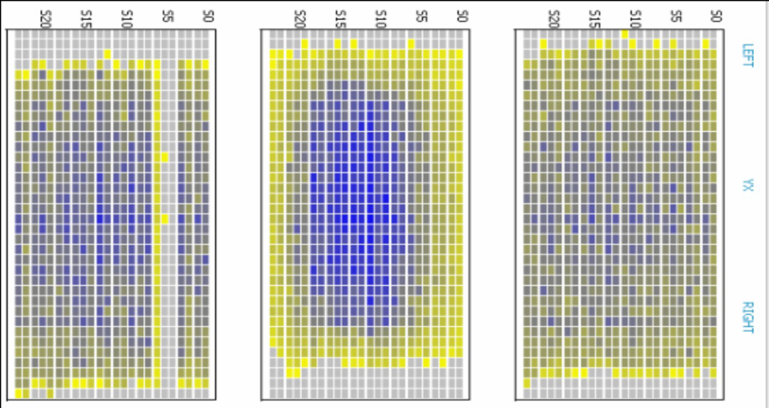
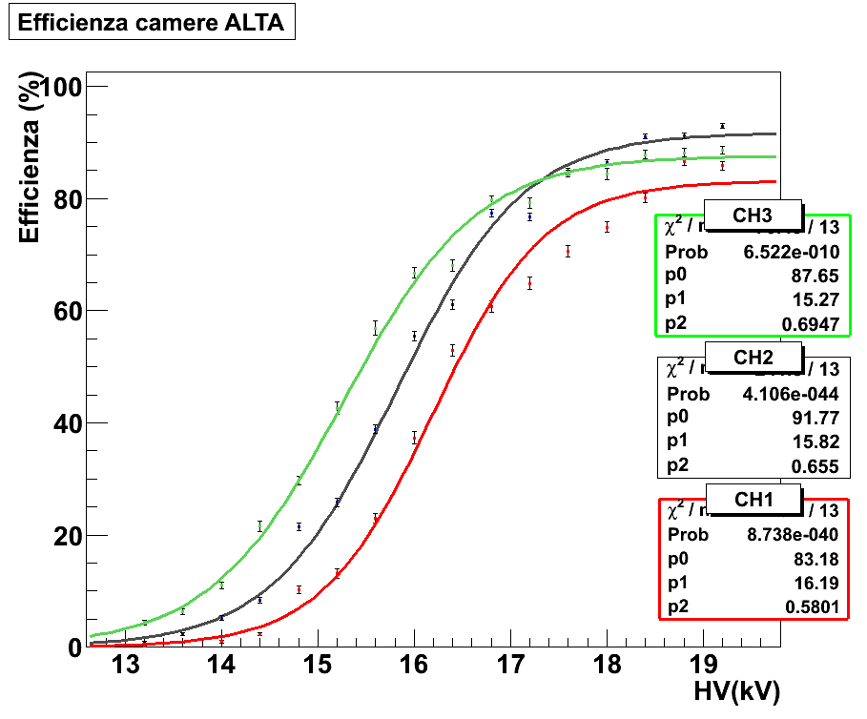
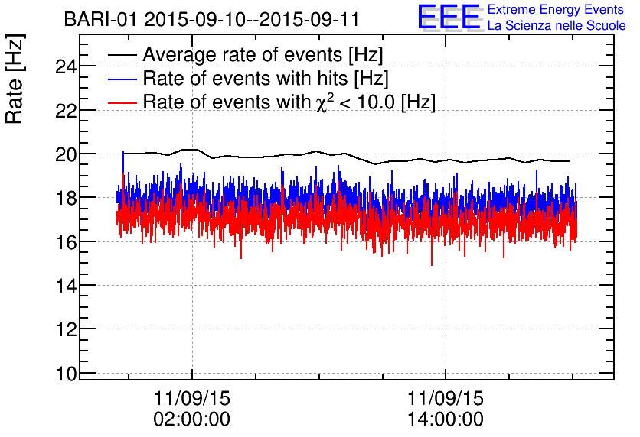
Some results at sites
Much more and more details in:
E. Bossini “Test and characterization of Multigap Resistive Plate Chambers for the EEE Project”
(tomorrow morning)
Top
Mid
Bot
Hit distribution on chambers
Trigger rate
Chamber efficiency
Not corrected for T and p

Slide 16
The Pilot Run and the Run-1(&2)
in 2014: a Pilot-run involving the simultaneous and, for the first time, completely automatic acquisition, reconstruction and data storage of EEE events from half (23) of the EEE telescopes at the
INFN-CNAF computer centre of Bologna has been performed
Nearly 1 billion events i.e. muon tracks collected in nearly three weeks (27 October-14 November 2014)
in 2015: for Run-1, two thirds (35) of the EEE telescopes took part in the data taking:
More than 5 billion events i.e. muon tracks collected in about
three months (2 February-30 April)
In 2015-2016: for Run-2 the acquisition will start at the end of October to last until mid May, without interruption.
More than 10 billion events expected to be collected

Slide 17
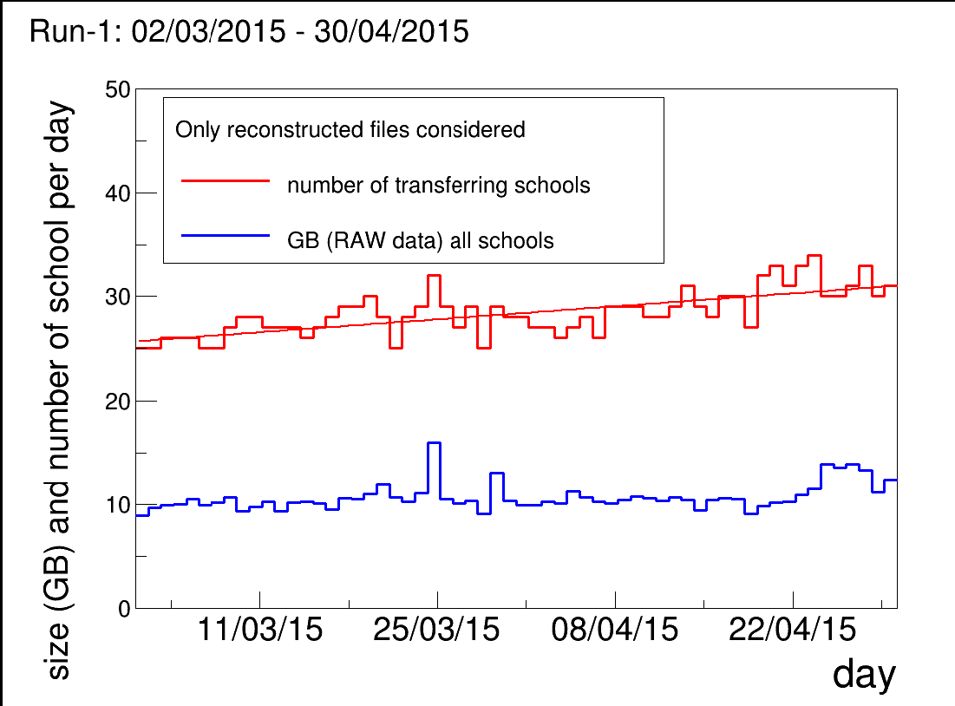
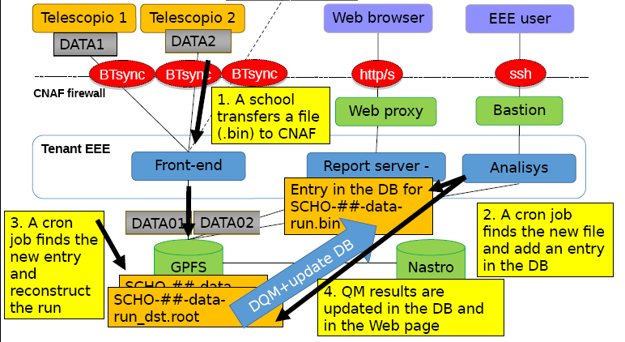
EEE@CNAF
5-10 TB per year are expected
Full statistics from Pilot run to Run-1:
∼2.4 TB (raw: ∼2 TB, reco: ∼0.4 TB)
(+3 TB from past years)
A complex software architecture has been set-up to reconstruct the data and provide quasi-online (few hours) histograms on the web for monitoring purposes

Slide 18
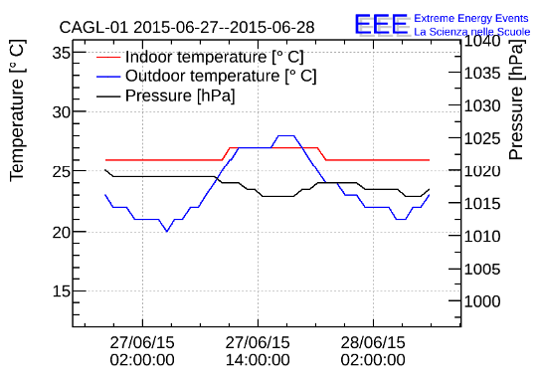
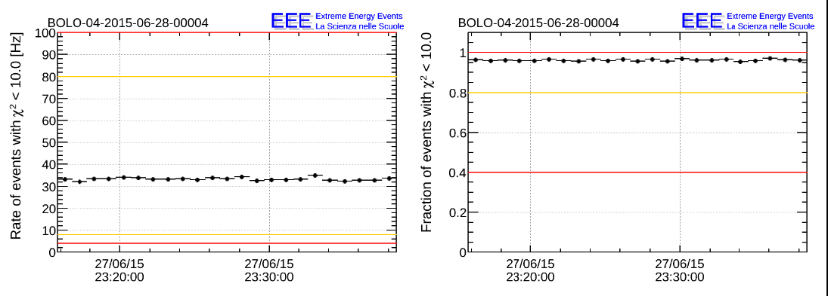

Quasi online monitoring
www.centrofermi.it/monitor
Fraction of reconstructed tracks
Trigger rate
Two e-logs!
Link to the day by day DQM
Link to the run by run DQM

Slide 19
Okay, all this is really nice,
but…
does it produce physics?

Slide 20

  YES … so much!
  20 Papers
  30 Conferences
  Map of the 37
  schools active in 2010 in the experiment
  First “physics” paper publ. by EEE
  First detection of coincidences among the L’Aquila telescopes

Slide 21
Just this year…
Frontier detectors for Frontier Physics (13th Pisa Meeting on advance detectors)
M. P. Panetta: “The EEE Project: an extended network of muon telescopes for the study of cosmic rays”
F. Noferini: “The computing and data infrastructure to interconnect EEE stations”
(with proceedings published on Nucl. Instr. & Meth. A )
International School of Subnuclear Physics – Erice 2015
L. Cifarelli: “The EEE Project of the Enrico Fermi Centre “
34th International Cosmics Rays Conference ICRC 2015 (The Hague)
I.Gnesi: “Results from the observations of Forbush decreases by the Extreme Energy Events experiment“
F. Pilo: “First results from Run-1 of the Extreme Energy Experiment “
(with proceedings published on Proceedings of Science)
Cosmic Ray Internation Seminars 2015
De Gruttola: “First results from coordinated data taking by the Extreme Energy Events experiment“
(with proceedings published on Nuclear and Particle Physics Proceedings)
Topics in Astroparticle and Underground Physics 2015
L. Perasso: “EEE – Extreme Energy Events: an astroparticle experiment in italian high schools”
Congresso SIF 2015
M. Abbrescia: “Run-1 of the Extreme Energy Events experiment”
E. Bossini: “Test and characterization of Multigap Resistive Plate Chambers for the EEE Project.”
M. P. Panetta: “Distribuzioni angolari di muoni cosmici osservati dai Telescopi del Progetto EEE.”
And, in addition three papers ready and more in preparation:
EEE collaboration: “Looking at the sub-TeV sky by cosmic muons detected in the EEE MRPC telescopes, in print on EPJ-Plus
EEE collaboration: “A study on upward going particles with the Extreme Energy Events telescopes”, to be submitted on JINST

Slide 22

Coincidences…
Coincidence is God’s way to remain anonymous (A. Einstein)

Slide 23




First coincidences detected
  At L’Aquila, closest stations of the experiment
  Angular correlations between “coincidences”
  Time difference
  between events
  revealed at the
  two stations
  No cuts
  Angular cut
  (requiring quasi parallelism) improves S/N

Slide 24


Coincidences up to 2012…
Number of coincidences per day, as measured by different telescope pairs of the EEE network, vs. the relative distance between the two telescopes
Included in the plot:
CERN-Geneva (15 m), L’Aquila (180 m), Cagliari (520 m) and Frascati (650 m)
Results consistent with Corsika and Cosmos Monte Carlo simulations
Few months to observe coincidences for distances > 1 km
Corsika Monte Carlo simulations

Slide 25



… and during Run-1
Coincidences well reconstructed for several distances between telescopes:15 m, 100 m,, 200 m, 500 m, 1200 m
Increasing the distance between telescopes the energy of the primary observed increases as well
More data taking needed to observe a peak above the background of accidental coincidences
FWHM ≈ 200-250 ns

Slide 26



… and during Run-1
For the first time coincidences were observed between two telescopes installed in High Schools at a distance > 1 km (significance S/√(S+B) = 5.1)
In addition to the increased statistics this was allowed by the time delay correction (up to few µs) between pairs of telescopes because of the propagation of the wave front of the shower, made possible thanks to the EEE telescopes directionality

Slide 27


Toward higher energies
The lateral distribution of photons (open circles), electron (open squares) and muons (open triangles) above 10 MeV and muons (stars) above 1 GeV simulated with Corsika MC
Below the distance indicated by the red arrows the muon density is expected to be > 1/m²
Multi-track events detected in pairs of EEE telescopes could allow to select very high energy showers
Bologna cluster
Three-telescopes coincidences
Higher energy showers
Less background due to accidentals
Lower rates (more data-taking needed)

Slide 28
Just coincidences?
Cosmic Rays (Forbush)Decreases
Local anisotropies
Upward going events

Slide 29


2011 Valentine’s Day Solar Flare
Flare recorded by the Solar Dynamics Observatory (SDO)
on the night between
14th and 15th
February 2011.
It is a solar flare, of category X2, followed by an important Coronary Mass Emission (CME)
This kind of flares are constantly monitored since they can have relevant consequences on Eartth

Slide 30


The Valentine’s Day solar flare as observed by the EEE Altamura telescope
First school ever to observe a Forbush decrease
Observed in the muon channel (rather rare)
First in the world to publish!
Data quality comparable to the one of professional observatories
(as presented to ICRC 2011)
Notes:
Qui i dati ottenuti ad Altamura vengono confrontati con quelli di Catania (sempre telescopio EEE, ma sito presso il dipartimento di fisica)
e quelli di OULU dove c’è un Neutro Monitor.

Slide 31



The March 2012 Forbush decrease observed by
the Oulu (Finland) and Rome detectors
of the Neutron Monitor Network
5 EEE telescopes:
Altamura, Bologna (3), Catania
Notes:
Qui i dati ottenuti ad Altamura vengono confrontati con quelli di Catania (sempre telescopio EEE, ma sito presso il dipartimento di fisica)
e quelli di OULU dove c’è un Neutro Monitor.

Slide 32


Two more recent decreases
Immediately after the EEE Pilot run of 2014, a GCRD event was observed by 6 EEE telescopes: Altamura, Frascati, Grosseto, Savona (2), Viareggio
Muon rates averaged over 6 EEE telescopes and Neutron rates from the Oulu station, Finland, during the GCRD associated to X class solar flare
on 7 November 2014
A GCRD occured on June 23th, 2015, and observed by 5 EEE stations, even though the array was under maintenance and upgrade.
Among the 5 active telescopes we chose for the preliminary analysis CATA-02, in comparison with the OULU data.
Notes:
Qui i dati ottenuti ad Altamura vengono confrontati con quelli di Catania (sempre telescopio EEE, ma sito presso il dipartimento di fisica)
e quelli di OULU dove c’è un Neutro Monitor.

Slide 33


Local anisotropies
Much more and more details in:
M. P. Panetta “Distribuzioni angolari di muoni cosmici osservati dai telescopi del progetto EEE” (last Monday afternoon)
We assume that the direction of secondary muons mirrors, within a few degrees, that of the primary particle
Aitoff map of the sky coverage of a typical EEE telescope
Skymap in equatorial coordinates from a set of about 100 M events from 4 schools in Catania, Cagliari, Savona and Trinitapoli
possibility to explore the sky in the low energy region, where the influence of local phenomena could produce non uniformity over space and time
The result is compatible with isotropic distributions at the 0.005-0.01 level
(from the statistics associated to the number of events analyzed
- in print on EPJ-PLus
Notes:
Qui i dati ottenuti ad Altamura vengono confrontati con quelli di Catania (sempre telescopio EEE, ma sito presso il dipartimento di fisica)
e quelli di OULU dove c’è un Neutro Monitor.

Slide 34


Upward-going events
About 1 event over 2000 observed to go in an upward direction
Some of them identified as
electrons coming from muon decays (in the floor or in the bottom chamber), looking at their Time Difference with respect to the Previous (TDP) events
Tagged downward µ + upgoing electron
Event display
(in the two projections)
Notes:
Qui i dati ottenuti ad Altamura vengono confrontati con quelli di Catania (sempre telescopio EEE, ma sito presso il dipartimento di fisica)
e quelli di OULU dove c’è un Neutro Monitor.

Slide 35

What’s next
We are at the beginning of a new long period
of data taking:
  at least double the statistics
  improve our reconstruction&analysis software
  include multi-track telescope analysis
  search for three telescopes coincidences
Extend coincidence measurements to larger (>2 km) distances
  coincidences of clusters of telescopes between different cities
  extend the study to telescopes located in different cities to look for exotic (“unexpected”) high energy events
Increase the number of EEE telescopes
  from 50 to 100 High Schools (original project!)
Search for upgoing events
  in single telescopes and in two-telescopes coincidences
Test the pointing capabilities of telescopes
  Cosmic rays anisotropies
  Moon (and Sun) shadow
Search for the unexpected!!!

Slide 36
Conclusions
The EEE experiment is an innovative approach to:
  scientific research
  scientific communication
Its stations, located in high schools, acquire data almost continuosly
  incredible enthusiasm by students and teachers
EEE produces -a lot of- physics!
  detectors performance similar to LHC ones
  very interesting observations of cosmics phenomena (coincidences, GCRD, upward events)
but… above all:

Slide 37

The project
… it was a lot of fun!
Conceived in 2005 by its scientific leader, prof. A. Zichichi

