Slide 1



Crystal channeling to extract a high-energy hadron beam from an accelerator, the CRYSBEAM project
L. Bandiera
INFN, Section of Ferrara - Italy
G. Cavoto
INFN, Section of Roma Sapienza - Italy
Rome, September 24, 2015
1

Slide 2
Outlook
Motivation: Efficient crystal extraction of a multi-TeV hadron beam for fixed target experiments;
The Challenge: from crystal assisted beam collimation to extraction. The CRYBEAM PROJECT;
Crystal Channeling for Extraction at the LHC;
Conclusions.
CRYSBEAM is funded by a ERC Consolidator Grant GA 615089 (FP7 IDEAS action) for the period May 2014- May 2019. Principal investigator: G. Cavoto (INFN-RM1).
Website : http://crysbeam.roma1.infn.it/

Slide 3
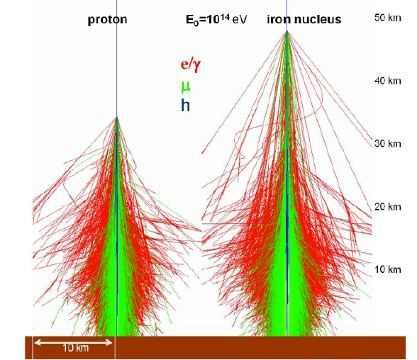
MOTIVATION
Future perspective for a multi-TeV extracted beamline

Slide 4
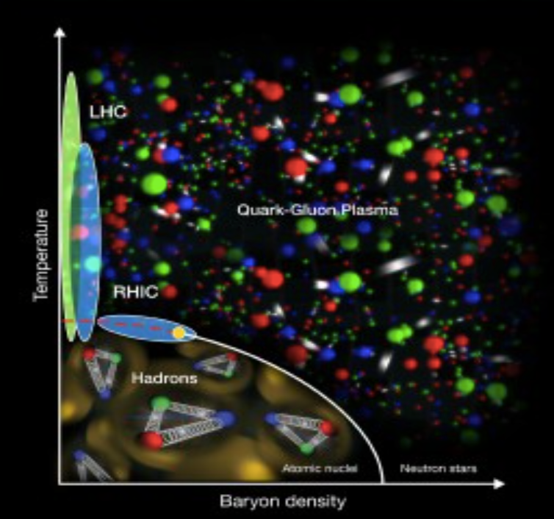
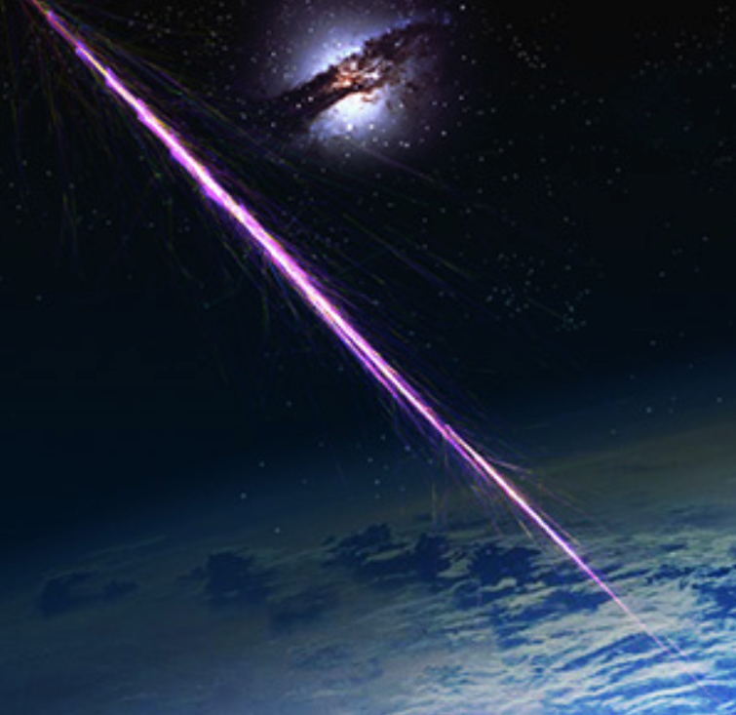
Physics with a multi-TeV beam
QCD at unprecedented laboratory energies and momentum transfers
Quark-gluon plasma excitation in the target rest frame
What is the nature of the cosmic rays?
Which the nature of dark matter ?
Study the interaction of hadrons with different targets
... and more with secondary beams
Phase diagram of hadronic matter
Cosmic ray shower
”Physics opportunities of a fixed-target experiment using LHC beams”
S. J. Brodsky, F. Fleuret, C. Hadjidakis, and J. P. Lansberg, Phys. Rep. 522 (2013) 239-255.

Slide 5
CRYSTAL-ASSISTED BEAM MANIPULATION
The Physical Challenge:
from the LHC Collimation to the Extraction.

Slide 6
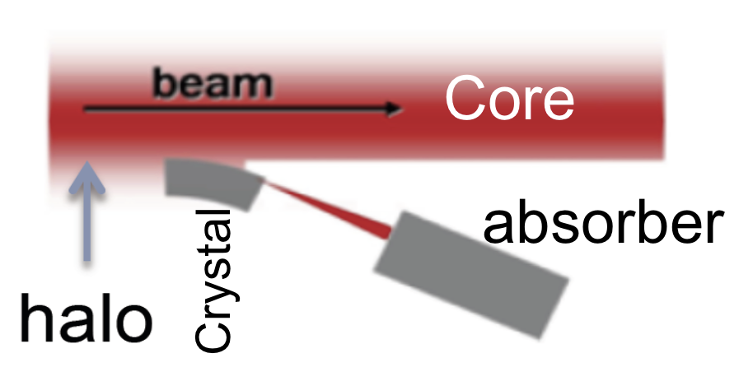
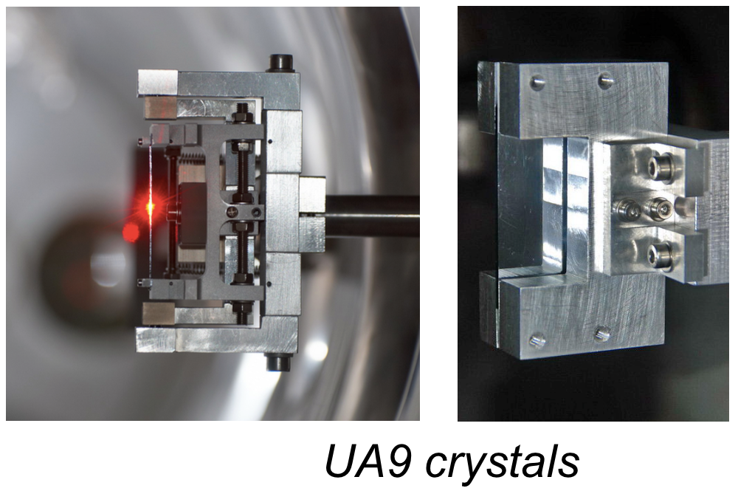
The crystal collimation: UA9 collaboration
Aside from the CRYSBEAM project the UA9 collaboration is aiming to the usage of crystal device for the collimation of the LHC.
In the crystal-collimation scheme the beam halo is deflected by a bent crystal towards a secondary collimator instead of being randomly scattered by amorphous target out of the beam line.
Two crystalline primary collimators have been installed into the LHC and successfully tested at the injection energy in August 2015.

Slide 7
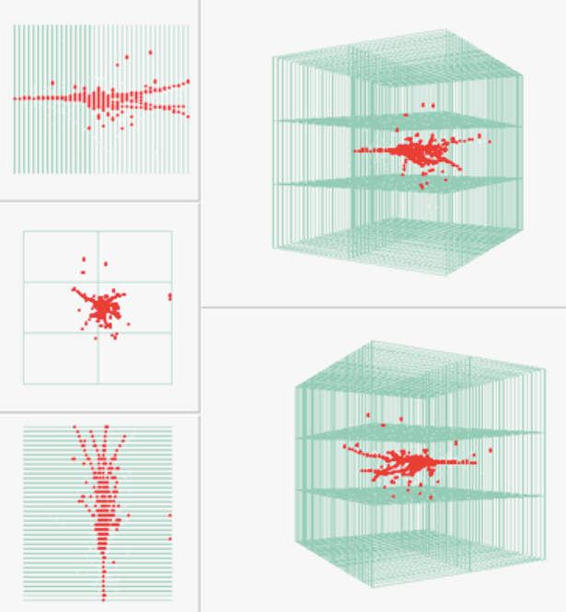
The CRYSBEAM project
Parasitic extraction of LHC beam with a bent crystal in channeling orientation.
  Low background
  Continuous extraction
  Extraction of beam halo
  10⁸ particles per second
Instrumented (“smart”) absorber to measure the hadronic shower structure
CALICE Digital HCAL

Slide 8
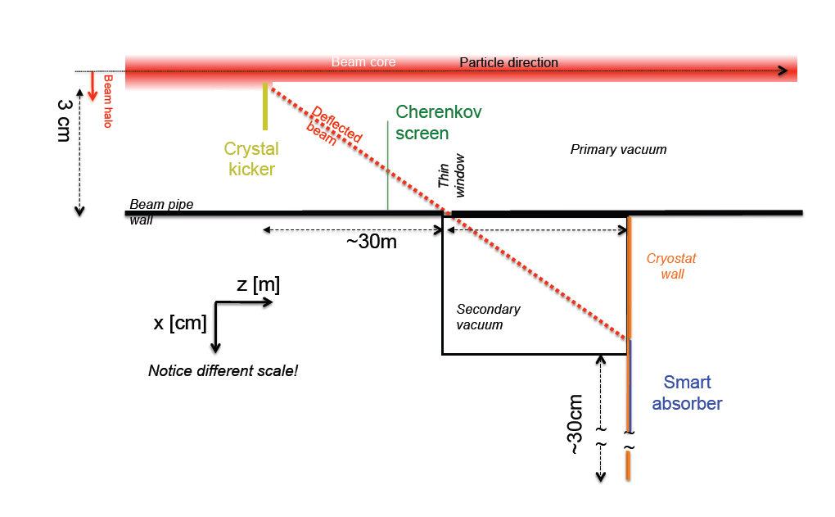
CRYSBEAM conceptual layout
Crystal kick about 1 mrad technically feasible.
Detection and timing of deflected/extracted beam at the vacuum/air interface with a detector based on Cherenkov light emission (see F. Iacoangeli talk tomorrow).
Instrumented beam dump in air.

Slide 9
CRYSTAL CHANNELING FOR EXTRACTION at lhc
Channeling in a bent crystal;
Crystal characteristic for efficient LHC beam extraction.

Slide 10
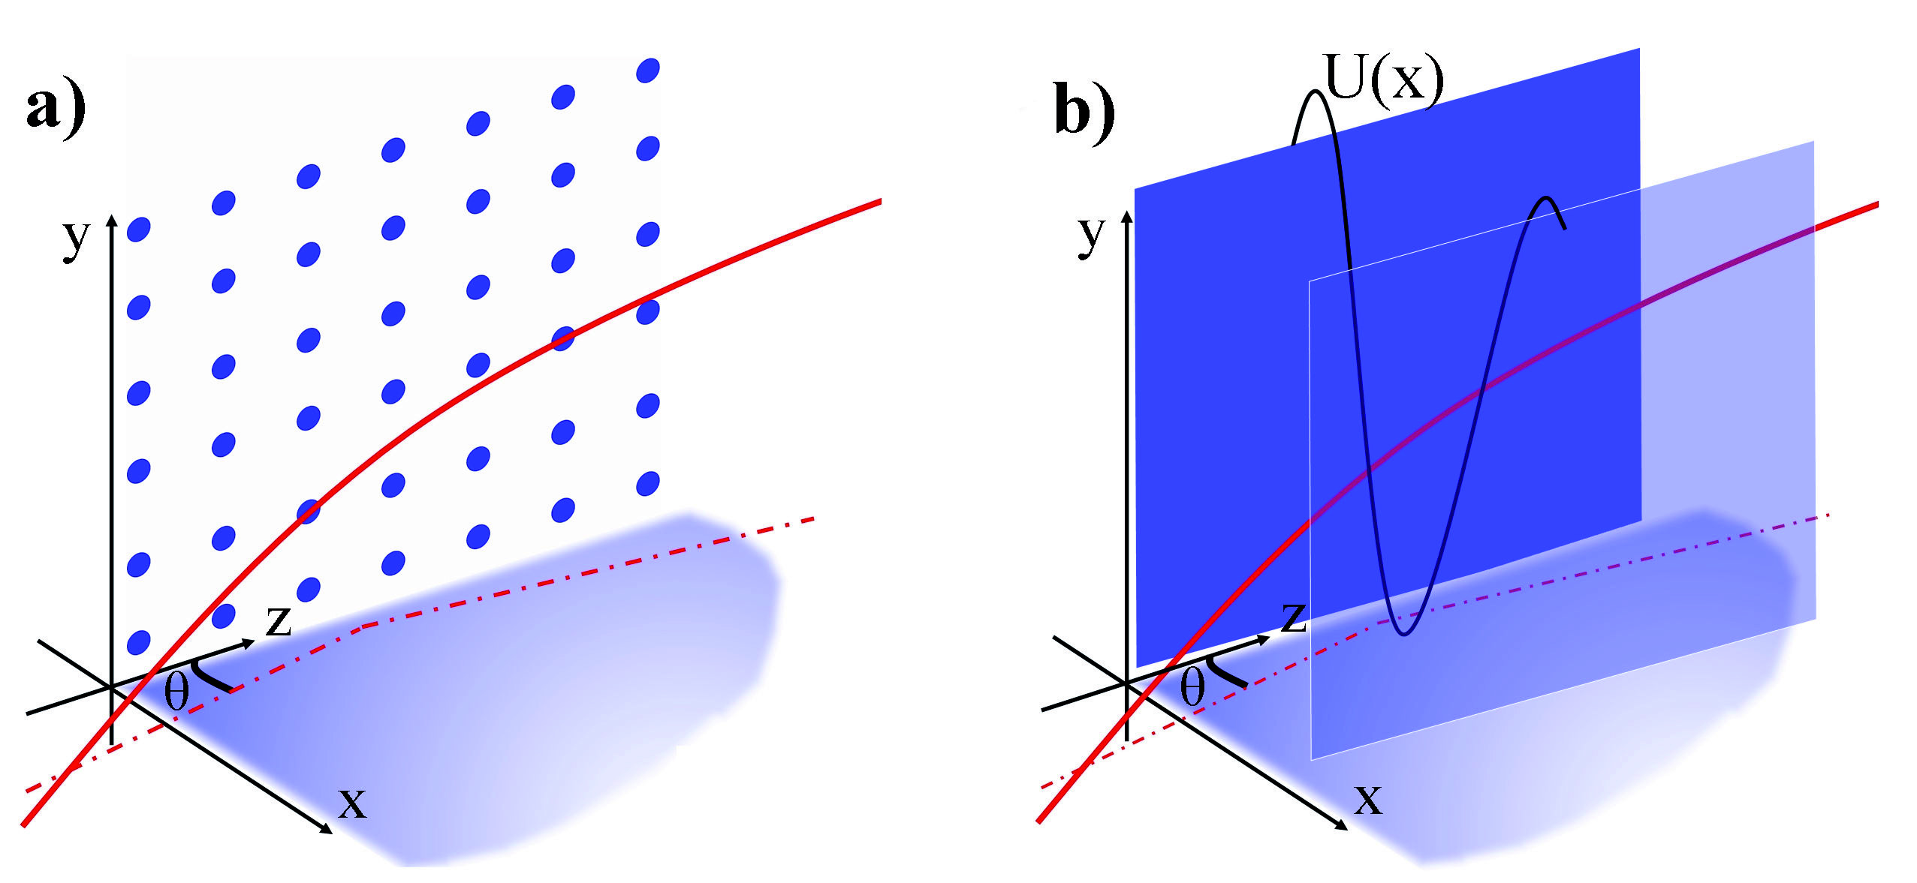
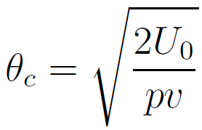
Channeling
Amorphous or non-crystalline solid
Crystalline solid
(Si, C, Ge, W…)
e
+
e⁻
planar channeling
Channeling occurs as the trajectory of particles forms an angle lower than the critical angle:
max of U(x)
momentum
velocity
U₀ = 22.7 eV for (110) Si planes
θ_{C} ≈ 7 μrad at E ~ 1 TeV
J. Lindhard, K. Dan. Vidensk. Selsk. Mat. Fys. Medd. 34 (1965) 14.
Notes:
Classical mechanics is applicable thanks to the large number of energetic levels in the planar potential well (>10-100 MeV for electrons)
Channeling is the confinement of charged particles traveling through a crystal in the planar/axial potential well
Channeling may occur as the trajectory of particles forms an angle lower than the critical angle with crystal planes(axes)

Slide 11
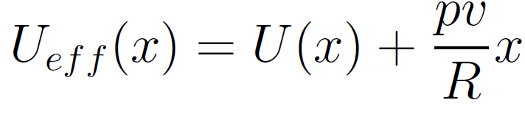

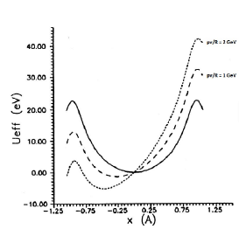
Channeling in a bent crystal
If crystal is bent, in the comoving reference frame a centrifugal force appears and the particle moves in an effective potential:
11
With a short bent crystal (~mm÷cm), it is possible to deflect ultra-high-energy particles
with angles (100 µrad – 1mrad) achievable by a
100-1000 Tesla magnet having a similar size
Tsyganov (1976)

Slide 12
The Critical Radius for Channeling
Requirement for extraction from LHC, deflection angle Φ ≥ 1 mrad.
The ideal length of the crystal, L, can be determined by L = Φ*R, where R is the bending angle of the crystal.
Channeling efficiency plotted vs R/Rc
Critical radius of bending
High efficiency zone
Si (110):
Rc = 12m at pv = 7 TeV
Ge (110):
Rc = 7m at pv = 7 TeV
R/Rc ≥ 10
Crystal length has to be: 12 cm for Si and 7 cm for Ge to obtain a deflection of 1 mrad.
Much longer than for LHC collimation (~ mm).
E. Bagli et al., Eur. Phys. J. C (2014) 74:2740
Si bent crystal (L = 2mm)
(1 1 0) plane
400 GeV/c protons at H8-SPS

Slide 13
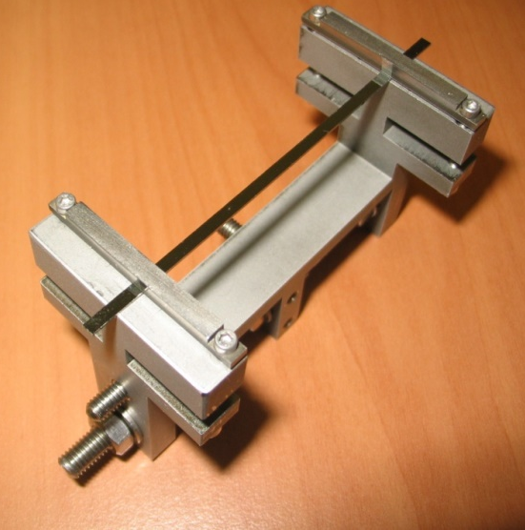
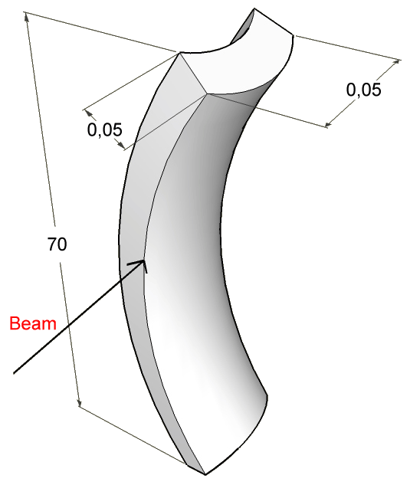


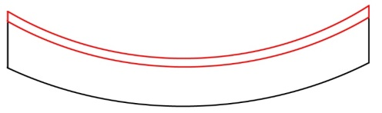
New Technology for crystal bending: assistance from a tensile layer
Usual mechanical bending
Assistance from a tensile layer
A primary curvature is imparted by mechanical external forces, which result in a secondary (anticlastic) curvature
Silicon sample
Beam
Deposition at high T
Cooling at room T
Possibility to deposit a wide class of materials
  Thin films (silicon oxide, silicon nitride, metals, thickness up to ~400 nm).
  Thick films (aluminium based alloys, carbon fiber, thickness from a few micron to a few mm).
Holder needed for a fine adjustment of crystal deformation
JAP 107(2010) 113534
Notes:
Thin/thick films deposited on silicon substrate may induce a deformation of the substrate:
Film and silicon substrates have different thermal expansion coefficients.
Film deposition is performed at high temperature.
The deformation is induced while cooling to room temperature

Slide 14
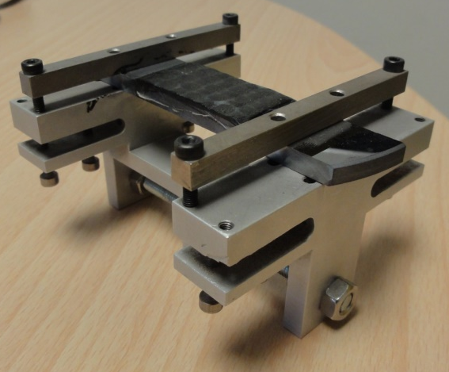
New Technology for crystal bending: assistance from a tensile layer
Usual mechanical bending
Assistance from a tensile layer
A primary curvature is imparted by mechanical external forces, which result in a secondary (anticlastic) curvature
Beam
Possibility to deposit a wide class of materials
  Thin films (silicon oxide, silicon nitride, metals, thickness up to ~400 nm).
  Thick films (aluminium based alloys, carbon fiber, thickness from a few micron to a few mm).
Holder needed for a fine adjustment of crystal deformation
JAP 107(2010) 113534
Notes:
Thin/thick films deposited on silicon substrate may induce a deformation of the substrate:
Film and silicon substrates have different thermal expansion coefficients.
Film deposition is performed at high temperature.
The deformation is induced while cooling to room temperature

Slide 15
Conclusions
The CRYSBEAM (and INFN) propose to demonstrate multi-TeV crystal extraction is feasible;
The experience in crystal-assisted collimation for high-energy hadron accelerator establishes the starting point of the project;
Strict requirements for bent crystals suitable for LHC extraction→ A technological challenge:
  crystal bending assisted by the deposition of a tensile layer;
  Innovative crystal holder design.

Slide 16
BACKUP SLIDES

Slide 17

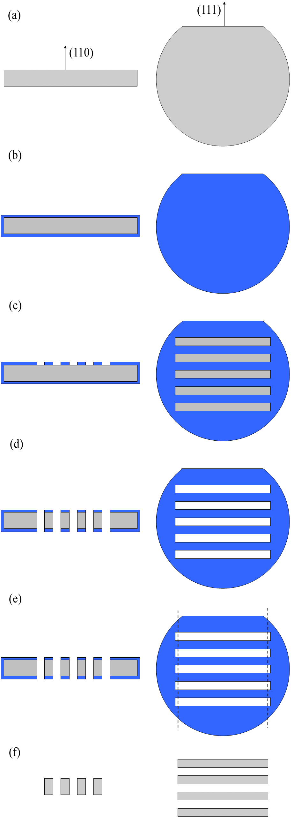
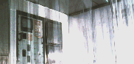
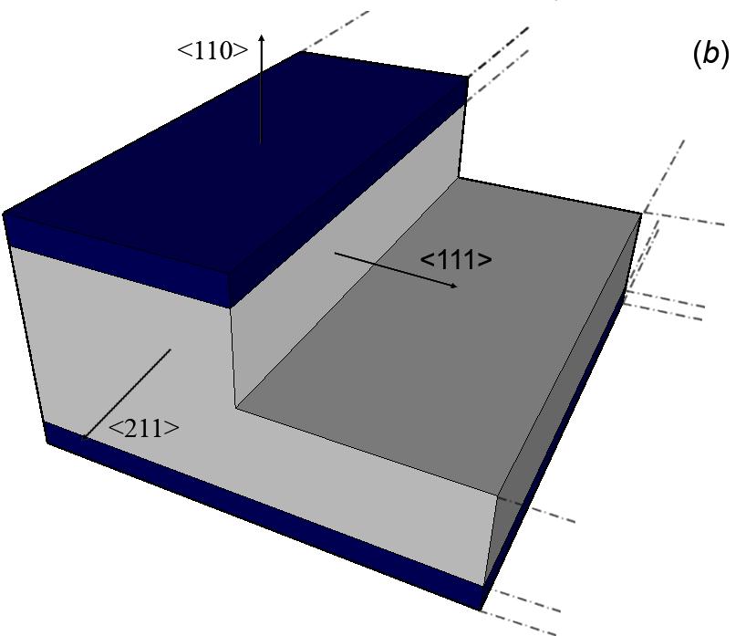
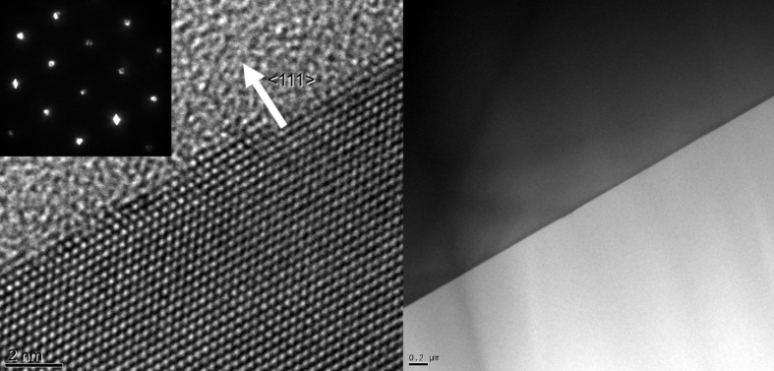
Silicon Crystal Fabrication
LPCVD deposition of silicon nitride thin layer
Anisotropic etching:
Etching rate on different silicon planes for KOH 20% at 40 °C
Silicon nitride patterning
Crystalline surfaces
S. Baricordi et al., Journal of Physics D: Applied Physics 41 (24), 245501
S. Baricordi et al., Applied Physics Letters 91 (6), 061908

Slide 18

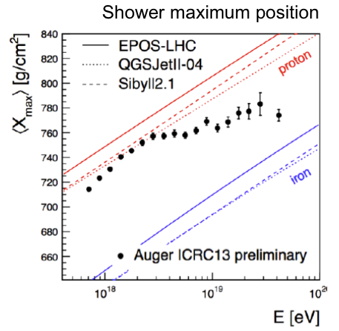
Ultra High Energy Cosmic Rays
Extensive shower at ground level.
Accelerator based experiments to unravel this (LHC-f, NA61, …)
Cosmic ray experiment observation depends on detailed MonteCarlo code to disentangle primary ray
  Data interpretation depends on MC used to described the shower
Measuring cross section at various energies (100 GeV-10 TeV) on atmosphere-like target can help in those MC calibration
Pierre Auger Observatory

