Slide 1

Experiments and ab initio simulations
The case of Amyloid-metal complexes
(or the role of metals in the Alzheimer disease)
Silvia Morante
Department of Physics & INFN
University of Rome “Tor Vergata”

Slide 2


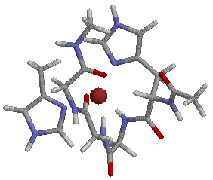

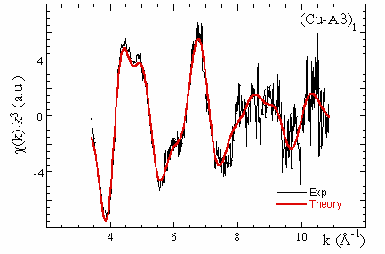
XAS - EXAFS
Data analysis
metal
Data refinement
Structural information
Structural model
Ab initio calculations

Slide 3
Outline
Biological challenge
understanding the molecular basis of
Protein Conformational Diseases (PCD’s)
among which the Alzheimer disease
  misfolding and aggregation
  the Aβ-peptide
  metal ions and brain
Scientific instruments
focused experiments + numerical approaches
  XAS spectroscopy
  classical and ab initio molecular dynamics
  Results
  unveiling the (relevant) role of metal ions

Slide 4
Protein Conformational Diseases (PCD’s)
Disease | Misfolded Protein
Alzheimer’s Disease | Aβ-peptide
Transmissible Spongiform Encephalopathies (TSE) | Prion protein
Parkinson’s disease | α-synuclein
Type II diabetes | Amylin
Thyroid carcinoma | Procalcitonin
Atrial amyloidosis | Atrial natriuretic factor
Amyotrophic lateral sclerosis | Superoxide dismutase
Huntington disease | Glutamine
Primary systemic amyloidosis | Ig light chains
Secondary systemic amyloidosis | Serum amyloid A
Senile systemic amyloidosis | Transthyretin (wild tipe)
Familial amyloidotic polyneuropathy I | Transthyretin (mutant)
Familial amyloidotic polyneuropathy II | Apolipoprotein A1
Familial Mediterranean fever | Serum amyloid A
Hemodialysis-related amyloidosis | b2-microglobulin
Finnish hereditary systemic amyloidosis | Gelsolin (mutant)
Lysozyme systemic amyloidosis | Lisozime
Insulin-related amyloidosis | Insulin
Fibrinogen systemic amyloidosis | Fibrinogen α chain

Slide 5
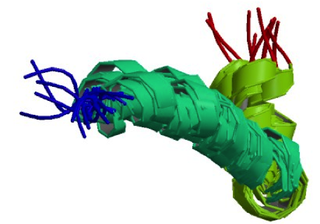
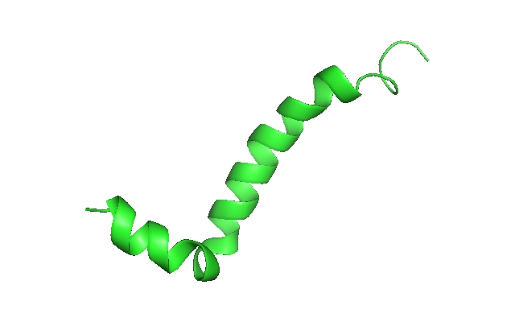
The Aβ-peptide aggregation
Crescenzi et al. (2002) Eur. J. Biochem. 269, 5642–5648
NMR
α
PDB-ID; 1IYT
β
Cross-beta fibril
Oligomer
Proto-filament
Amyloid-like aggregates are now widely studied also in non-medical contexts
food science, pharmacology, nanomaterials …

Slide 6
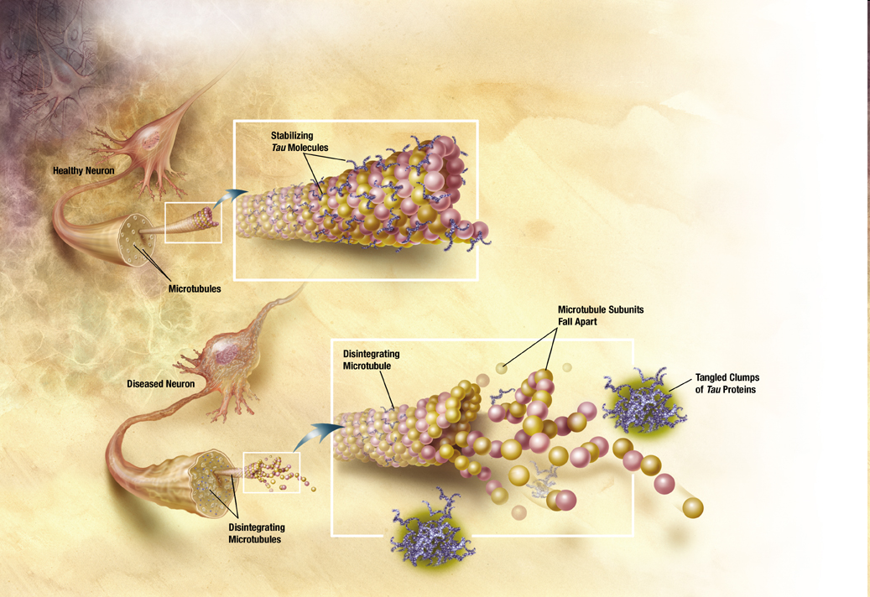
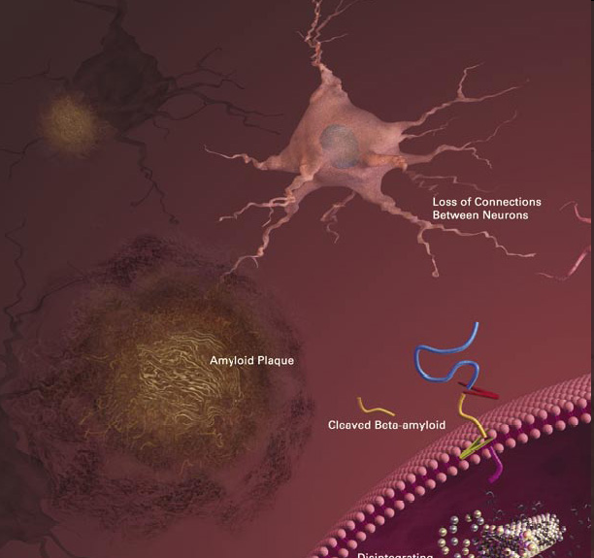
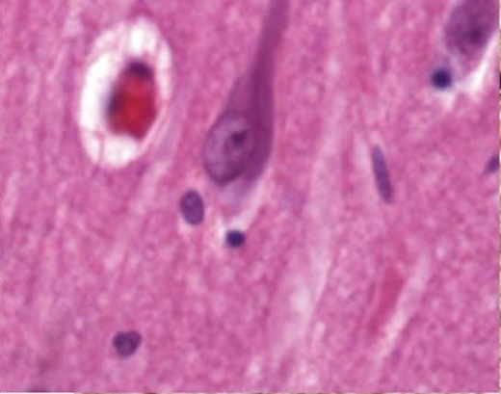
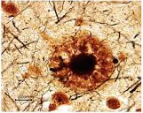
Protein aggregation
Neurofibrillary Tangles
Intracellular elicoidal fibers mainly composed by tau protein
A.Serrano-Pozo et al. Cold Spring Harb Perspect Med 2011;1:a006189
Amyloid Plaques
Extracellular deposits of
Aβ peptides

Slide 7
Metal ions are essential cell components
They can easily and quickly form complexes with enzymes and other biological molecules
They are involved in a wide range of biological processes
≈ ¼ ÷ ⅓ of all proteins are estimated to require metals to function
Metalloproteins have many different functions in cells
storage and transport
enzymatic activity
signalling and transduction
…
…
but metals high reactivity can easily become
Highly toxic for the CELL

Slide 8

Metals should cross the blood-brain barrier
Central Nervous System
Metals are essential for neurochemical activity
Fe, Cu and Zn are fairly abundant in grey matter
during neuro-transmission processes, high concentrations
of Zn (~300 μM) and Cu (~30 μM) are normally released
Fe, Cu and Zn are continuously trafficked whithin the cell
and also into and out of it
Metals deficiency may cause dysfunctionality and metal excess may lead to toxicity
Failure of metal trafficking (dyshomeostasis) is known to occur both in AD and in Parkinson diseases
In presence of dyshomeostasis, metal ions may
interfere with normal nervous cells activities
disrupt brain electrochemical balance
•••
promote protein misfolding and aggregation?

Slide 9

The amyloid β-peptide
N
APP
α-secretase
extracellular domain
harmless peptide
γ-secretase
p3
cell membrane
transmembrane
domain
cytoplasmatic
domain
C
APP: transmembrane 770 a.a.’s protein
687
699
711
713
723
…KMDAEFRHDSGYEVHHQKLVFFAEDVGSNKGAIIGLMVGGVVIATVIVITLVMLKKKQY…
α cut
γ cuts

Slide 10
The amyloid β-peptide
N
APP
β-secretase
extracellular domain
harmful peptide
γ-secretase
Aβ
cell membrane
transmembrane
domain
cytoplasmatic
domain
C
APP: transmembrane 770 a.a.’s protein
672
699
711
723
713
…KMDAEFRHDSGYEVHHQKLVFFAEDVGSNKGAIIGLMVGGVVIATVIVITLVMLKKKQY…
β cut
γ cuts

Slide 11
The amyloid β-peptide
N
APP
Aβ
β-secretase
extracellular domain
harmful peptide
γ-secretase
cell membrane
transmembrane
domain
cytoplasmatic
domain
C
DAEFRHDSGYEVHHQKLVFFAEDVGSNKGAIIGLMVGGVV
APP: transmembrane 770 a.a.’s protein
672
711
Aβ₁₋₄₀

Slide 12
The amyloid β-peptide
N
APP
Aβ
β-secretase
extracellular domain
harmful peptide
γ-secretase
cell membrane
transmembrane
domain
cytoplasmatic
domain
C
DAEFRHDSGYEVHHQKLVFFAEDVGSNKGAIIGLMVGGVVIA
APP: transmembrane 770 a.a.’s protein
672
713
Aβ₁₋₄₂

Slide 13
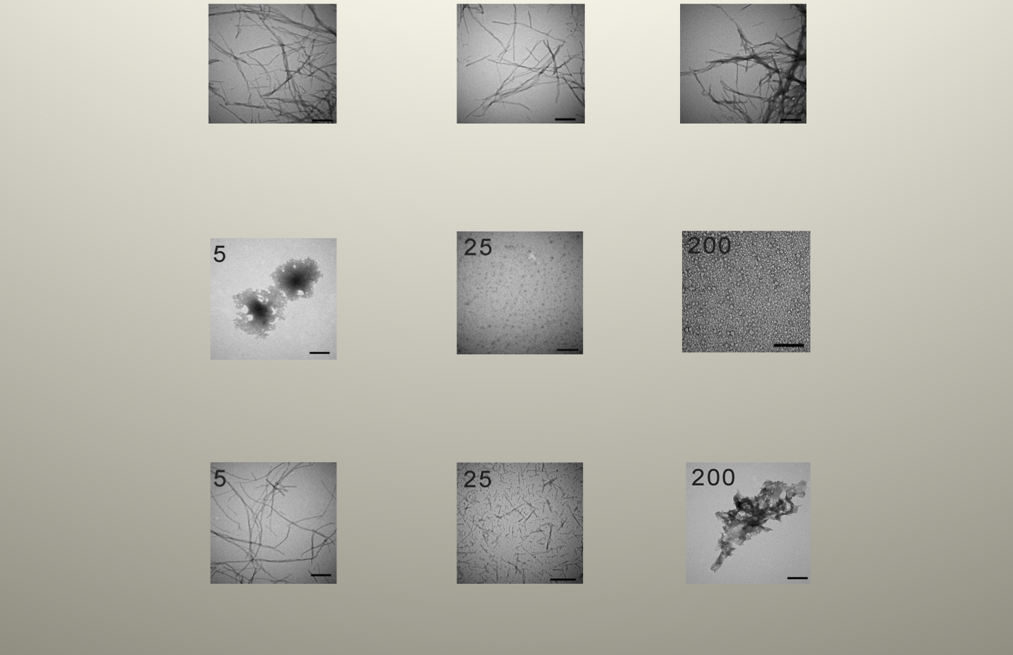
Metals affect Aβ-peptide aggregation
Aβ
(25 μM)
Aβ+Zn²⁺
Aβ+Cu²⁺
Chen et al. J. Biol. Chem. 2011, 286:9646-9656.

Slide 14
Normal aging and increased brain metal level
Maynard et al. (2002) JBC, 277: 44670
The triggering event is possibly metal dyshomeostasis

Slide 15
World Health Organization
The number of people aged 60 and over has doubled since 1980
The number of people aged 80 years or older will have almost quadrupled to 395 millions between 2000 and 2050
The risk of dementia (like Alzheimer disease) rises sharply with age with an estimated 25-30% of people aged 85 or older having some degree of cognitive decline.
Horizon 2020: improve healthy ageing

Slide 16
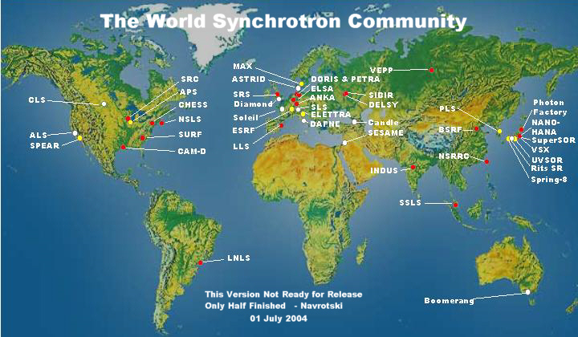
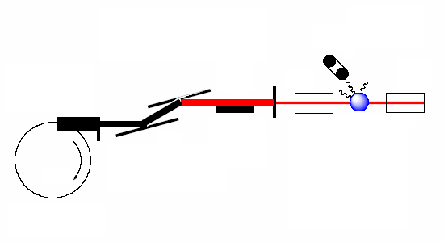
X-ray Absorption Spectroscopy - XAS
Photons are produced by synchrotrons
Synchrotron
X-ray source
I_{F} measurement
Solid State Detector
Monochromatic beam
White beam
Sample
X-ray mirror
Ionization chambers
I₀ / I measurement
Incident energy selection
monochromator

Slide 17
X-ray Absorption Spectroscopy - XAS
it may be used to study samples in any aggregation state (not necessarily crystallized, frozen or transparent)
proteins can be studied in physiological and/or
in controlled solution condition
There are no selection rules for absorption
a XAS spectrum can always be measured
Spectra registered in a relatively short time (few min’s to few msec’s)
limited radiation damage
High chemical selectivity and sensitivity
local atomic environment around any selected absorber
even in very diluted samples

Slide 18
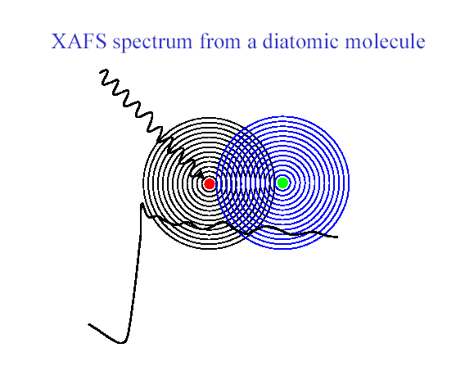
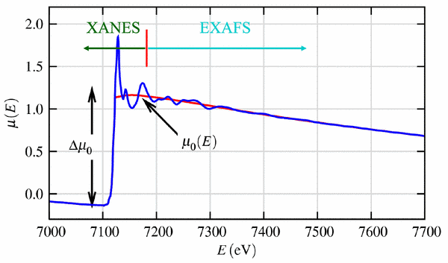
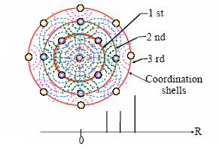
XAS of a multi atomic system
Absorption coefficient, μ, behaviour as a function of emitted photon energy
● red dot: the absorber
● green dot: the scatterer
Single Scattering approximation

Slide 19
Numerical simulation
Car Parrinello Molecular Dynamics based on Density Functional Theory and Classical MD CPMD DFT
Density Functional Theory
The energy is a functional of the electronic density,
that is at its minimum when n(r) is the ground-state electronic density.
The latter is determined by solving the Kohn-Sham equations
Hartree potential
Exchange-correlation potential

Slide 20

CP simulations
Quantum-ESPRESSO package
The simulation strategy
www.quantum-espresso.org
“prepare” the initial state of the system
    type of atoms: number of electrons and bands → pseudopotentials
    atomic coordinates
    dimension of system cell
    cut-offs → plane wave expansion
    FFT grid spacing
electronic minimization (Steepest Descent, SD) with fixed ions → ground state
ionic positions minimization (SD or damped dynamics ) → to relax the system
start the Car-Parrinello dynamics
NOTE: in order to reach the desired temperature
ions are coupled to Nosè-Hoover thermostat
QM key feature: bonds not imposed (like in MD)
but derived from Schroedinger equation solution

Slide 21

MD simulations
The simulation strategy
“prepare” the initial state of the system
    atomic coordinates
    atomic velocities
    force field choice
    dimension of system box
    water
    …
system equilibration: potential energy minimization (T=0 K)
system heating: rise temperature to the desired value
start MD: solve the Newton’s equation of motion

Slide 22
1. Zn-ion-induced aggregation pattern
XAS allows to identify
the “minimal” Zn²⁺ and Cu²⁺-binding site sequence in Aβ₁₋₄₀
1 40
DAEFRHDSGYEVHHQKLVFFAEDVGSNKGAIIGLMVGGVV
We measure XAS spectra of the following samples
Cu²⁺/Zn²⁺- Aβ₁₋₁₆
minimal fragment containing His₆, His₁₃, and His₁₄, suggested to be involved in metal binding
Cu²⁺/Zn²⁺- Aβ₁₇₋₄₀
complementary to the previous sequence: no His is present
besides the three His’s, it contains a long hydrophobic region believed to be relevant in the aggregation process
Cu²⁺/Zn²⁺- Aβ₁₋₂₈
V. Minicozzi … S.M. et al., J Biol Chem (2008) 283: 10784 F. Stellato … S.M. et al., Eur Biophys J (2006) 35: 340

Slide 23
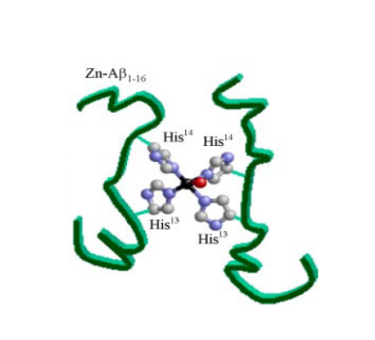
1° Zn-ion-induced aggregation pattern
Synopsis of XAS results: comparing spectra
Cu²⁺/Zn²⁺- Aβ₁₇₋₄₀ = Cu²⁺/Zn²⁺- buffer → neither Cu²⁺ nor Zn²⁺ are able to bind Aβ₁₇₋₄₀
Cu²⁺- Aβ₁₋₁₆ = Cu²⁺- Aβ₁₋₂₈ = Cu²⁺- Aβ₁₋₄₀ → Cu²⁺ always binds to the first 16 a.a. fragment
Zn²⁺- Aβ₁₋₁₆ = Zn²⁺- Aβ₁₋₂₈ = Zn²⁺- Aβ₁₋₄₀
Zn²⁺ always binds, with the same (very crowded) binding structure, to the first 16 a.a.’s
Zn²⁺-Aβ₁₋₁₆
Zn²⁺-Aβ₁₋₁₆
4 histidines
1 water

Slide 24
1° Zn-ions-induced aggregation pattern
Models and ab-initio calculations
Question:
which structure stabilizes this (very crowded), 4 His’s - Zn²⁺ coordination?
XAS: structure information only within 5-6 Å from the absorber
ab-initio simulations: structural information up to a longer distance
Model building
XAS → 4 His’s coordination → two Aβ₁₋₁₆ –peptides (denoted A and B)
with a single Zn atom bridging N_{δ}(His₁₄(A)) and N_{δ}(His₁₄(B))
minim + Monte Carlo Random Walk (MCRW) (“bad” contact discarded) → only configurations that fulfill structural constraints of point 1. are retained
Aβ₁₋₁₆ truncated to Aβ₁₁₋₁₆ and put in a cell with periodic conditions filled with TIP3P water molecules
Four trial binding geometries are chosen for ab initio computations

Slide 25
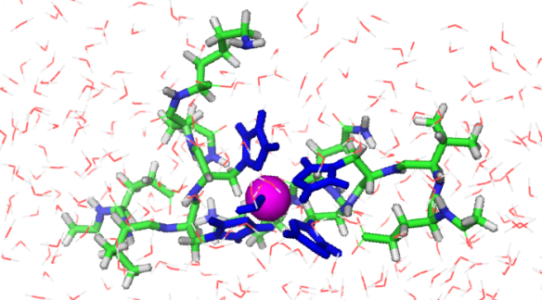
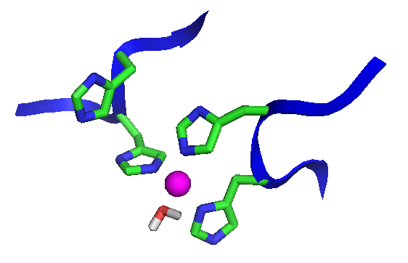
1° Zn-ion-induced aggregation pattern
S1
Besides the two His₁₄, also the two His₁₃ happen to be within 3 Å from Zn
Name | Starting configuration
S1 | Zn: 4N_{His} + 1O_{W}
S1
Name | Final configuration
S1 | Zn: 3N_{His} + 1O_{W}

Slide 26
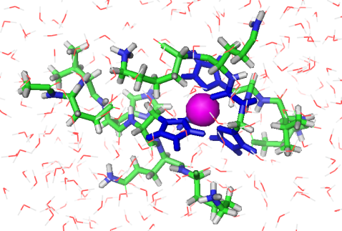
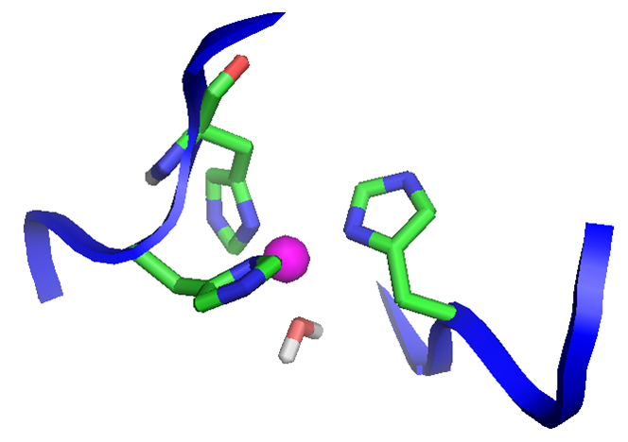
1° Zn-ion-induced aggregation pattern
Name | Starting configuration
S2 | Zn: 3N_{His} +1O_{His} + 1O_{W}
Only three His, but one bond also through His oxygen
S2
S2
Name | Final configuration
S2 | Zn: 3N_{His} + 1O_{W}

Slide 27
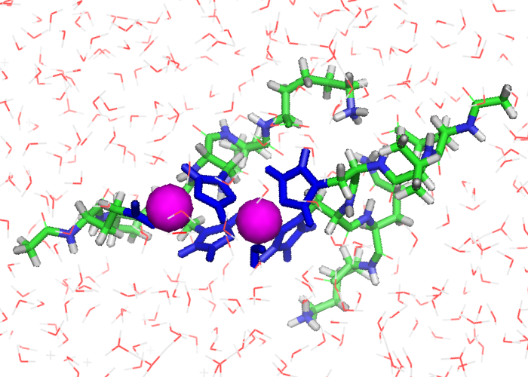
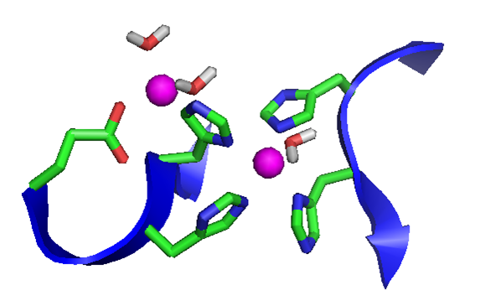
1° Zn-ion-induced aggregation pattern
S3
Zn_{b}
Name | Starting configuration
S3 | Zn_{a}: 4N_{His} + 1O_{W} Zn_{b}: 1N_{His} + 2O_{Glu}
modified S1: the Hε of a His₁₄ is substituted by a second Zn
S3
S3
Zn_{a}
S3
Name | Final configuration
S3 | Zn_{a}: 4N_{His} + 1O_{W} Zn_{b}: 1N_{His} + 1O_{Glu}+ 2O_{W}

Slide 28
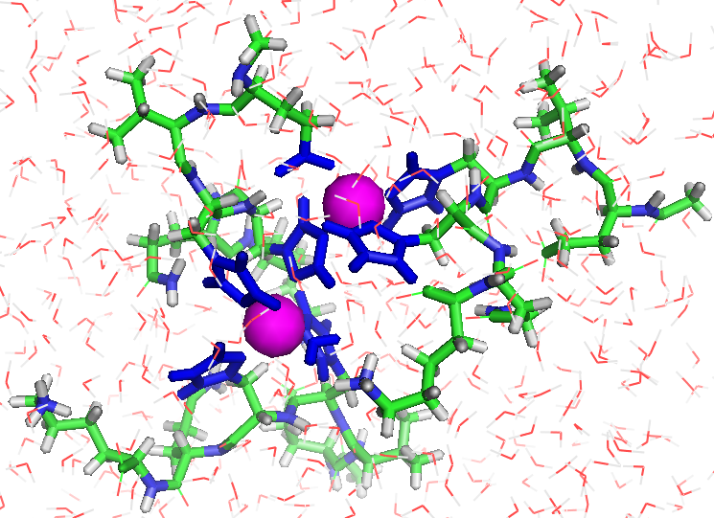
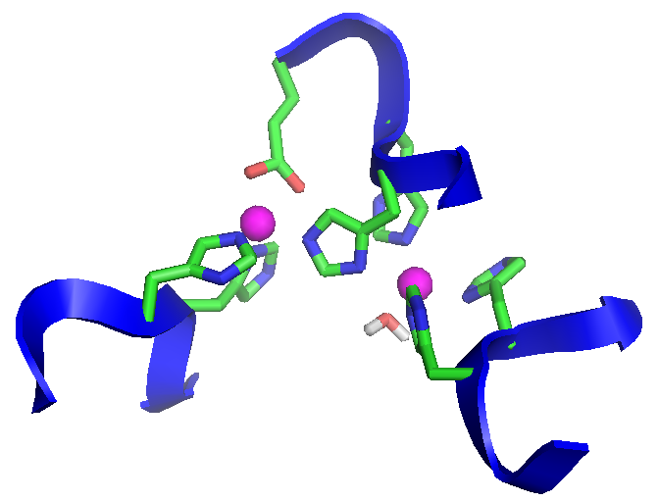
1° Zn-ion-induced aggregation pattern
S4
Zn_{A}
modified S3: a third peptide is bound to the second Zn
Name | Starting configuration
S4 | Zn_{a}: 4N_{His} + 1O_{W} Zn_{b}: 3N_{His} + 1O_{Glu}
Zn_{B}
S4
Name | Final configuration
S4 | Zn_{a}: 4N_{His} + 1O_{W} Zn_{b}: 3N_{His} + 1O_{Glu}

Slide 29
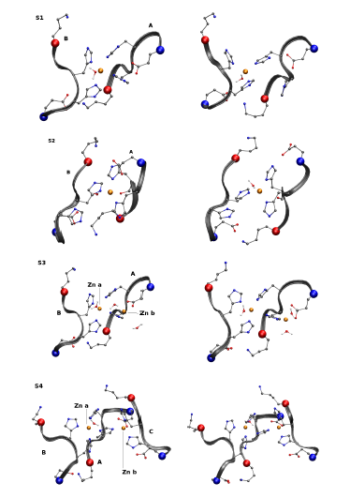

1° Zn-ion-induced aggregation pattern
Zn site structures in the four models
P. Giannozzi, K. Jansen, G. La Penna, V.Minicazzi, S. M., G.C. Rossi, F. Stellato. Metallomics (2012)
Our favorite model

Slide 30
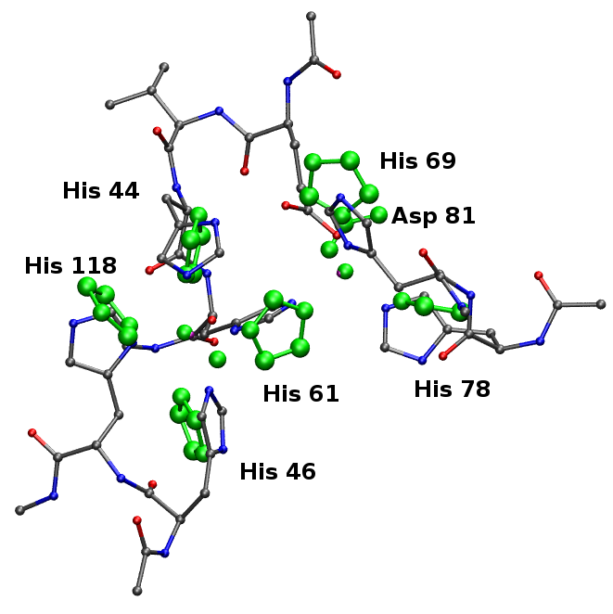
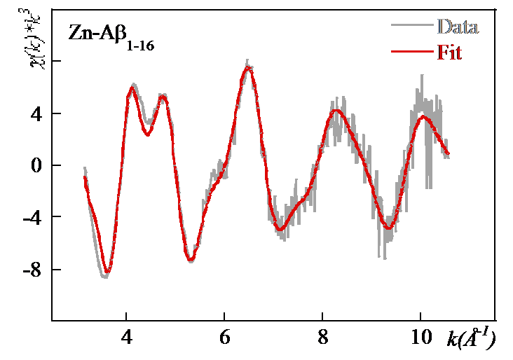
1° Zn-ion-induced aggregation pattern
XAS spectrum fitted using the S4 model structure
Comparison between the atomic structure of bovine SOD enzyme (PDB 1SXA), in green, and the last S4 configuration
His “crowding” in SOD enzymes is helped by the presence of two metal ions bridged by the His imidazole (in the unusual form of an imidazolate anion)

Slide 31
1° Zn-ion-induced aggregation pattern
Conclusions
Zn promotes oligopeptides formation
Aβ
Zn-Aβ
XAS cannot discriminate among different structural models, but
empirical and first-principle simulations → stable Zn-His-Zn structure (≈ SOD)

Slide 32
General conclusions
XAS - EXAFS
Data analysis
metal
Data refinement
Structural information
Structural model
Ab initio calculations

Slide 33
2° - Cu²⁺-Zn²⁺ cross-modulation in Aβ binding
XAS measurements: Aβ + Zn and/or Cu → they compete for the binding
  De Santis, … S.M. et al. J. Phys. Chem. B (2015) submitted
It would be of the utmost importance to know what happens to the whole peptide structure as a result of metal binding competition …
… we are planning to investigate this problem via MD and CPMD simulations
3° - Beta-sheet-breakers BSB’s: targeting Aβ fibrils
MD of Aβ + BSB’s that inhibit or delay Aβ conformational transition →
we devised a new, more efficient, BSB
It would be of great interest to study how BSB’s affect metal-Aβ interaction …
… we are planning XAS of Aβ + BSB’s in the presence of Cu and/or Zn

Slide 34
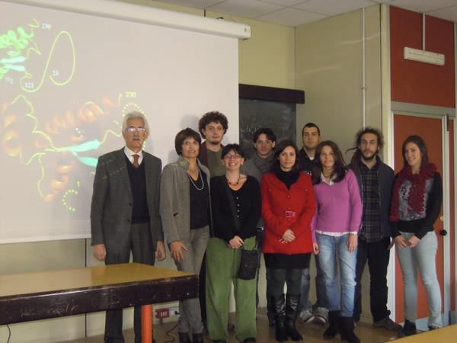

Acknowledgements
The Biophysics
Group in Tor Vergata
biophys.roma2.infn.it
Silvia Morante
Giancarlo Rossi
Velia Minicozzi
Francesco Stellato
Marco Pascucci
Emiliano De Santis
Collaborators
Giovanni La Penna (CNR)
Olivier Proux (ESRF)
Glenn Millhauser (UCSC)
Sunil Saxena (Uni Pittsburgh)
Ann Spevacek (UCSC)

