Slide 1
Competizione tra i modi di decadimento ed influenza dell’isospin nei sistemi prodotti nelle collisioni 78,86Kr+40,48Ca a 10AMeV
B. Gnoffo INFN – Catania
ISODEC – NEWCHIM Collaboration

Slide 2
OUTLINE
The Physics Case
The Experimental Method
Experimental Results
• IMF behavior
• Global features
Conclusions and Outlook
B. Gnoffo 101° Congresso SIF Roma 21-25 Set 2015

Slide 3
The Physics Case
Neutron richness of a compound nucleus is expected to play a crucial role in the competition between various de-excitation channels
-> Information about level density, fission barrier, viscosity
The Level density parameter is related to the effective mass of nucleons in the nuclear medium that is sensitive to the n/p of nuclei
The fission barriers depend clearly on the symmetry energy that is weakly constrained by existing data
The viscosity reflects a coupling between collective modes and intrinsic DoF -> related to the Fermi energy level and to ratio n/p
Novel information can be obtained by the study of the fission cross section across long isotopic chains of compound nuclei, extending from the neutron-rich to neutron-poor side
B. Gnoffo 101° Congresso SIF Roma 21-25 Set 2015

Slide 4
The Experimental Method
^{78,86}Kr + ^{40,48}Ca -> ^{118,134}Ba
E/A=10 MeV/A E* ≈ 250 MeV
CHIMERA at INFN-LNS
S. Pirrone et al., EPJ 17 (2011) 16010
G. Politi et al., EPJ 21 (2012) 02003
S. Pirrone et al., AIP Conf. Proc. 1524 (2013) 7
G. Politi et al., JPS Conf. Proc. Vol. 6 (2015) 030082
S. Pirrone et al., Journal of Physics: Conf. Series 515 (2014) 012018
M. La Commara et al., EPJ 11 (2012);
^{78,82}Kr + ⁴⁰Ca -> ^{118,122}Ba E/A=5.5 MeV/A E* ≈ 100 MeV
INDRA at GANIL
G. Ademard et al. PRC 83 (2011) 054619
Composite systems with higher E and T -> effects on decay
Larger domain of N/Z (max with stable beam)
B. Gnoffo 101° Congresso SIF Roma 21-25 Set 2015

Slide 5
The Experimental Method
CHIMERA detector at INFN-LNS
4π device
1192 Telescopes
Si (300μm) - CsI(Tl)
Forward part 1°<θ<30°
688 modules
9 Rings 100cm<d<350 cm
Backward part 30°<θ<176°
504 modules
Sphere R=40 cm
Precise measurement of E, TOF, Velocity, θ, φ
Different identification methods: PSD Si, E-ToF, DE/E, PSD CsI
A. Pagano et al., NPA681 (2001) 331, G. Politi et al., IEEE NSS Conf. Rec. (2005) N28-5
B. Gnoffo 101° Congresso SIF Roma 21-25 Set 2015

Slide 6
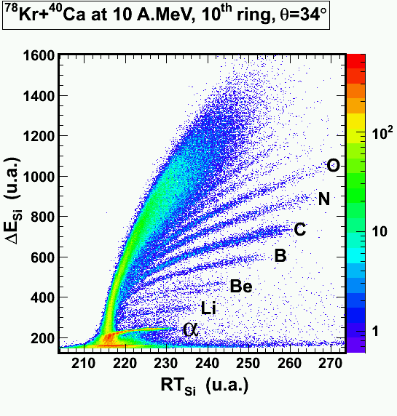
The Experimental Method
CHIMERA detector at INFN-LNS
4π device
1192 Telescopes
Si (300μm) - CsI(Tl)
Forward part 1°<θ<30°
688 modules
9 Rings 100cm<d<350 cm
Backward part 30°<θ<176°
504 modules
Sphere R=40 cm
Precise measurement of E, TOF, Velocity, θ, φ
Different identification methods: PSD Si, E-ToF, DE/E, PSD CsI
A. Pagano et al., NPA681 (2001) 331, G. Politi et al., IEEE NSS Conf. Rec. (2005) N28-5
B. Gnoffo 101° Congresso SIF Roma 21-25 Set 2015

Slide 7
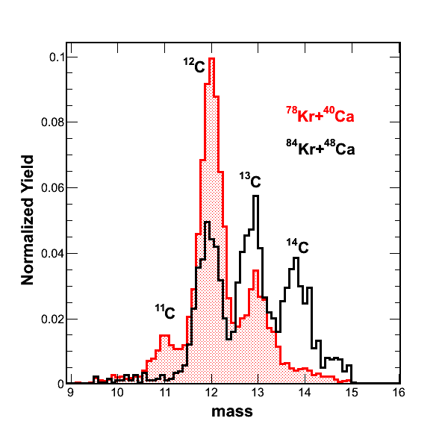
Experimental Results
Analisys of IMF characteristics
Relative abundance of isotopes with 2 < Z < 9 is very different for
the two systems
B. Gnoffo 101° Congresso SIF Roma 21-25 Set 2015

Slide 8
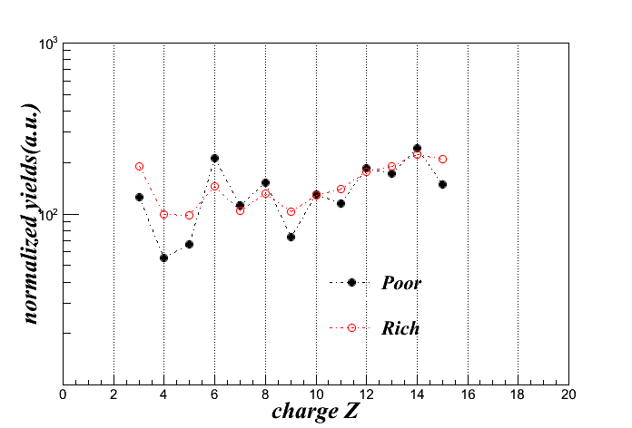
Experimental Results - IMF characteristics
Charge Yields for IMF in the range θ_{lab} = 10°- 16°
The IMF yields exhibits an odd-even staggering, more pronounced for the n-poor system
I. Lombardo et al., PRC 84 (2011) 024613 G. Casini et al., PRC 86 (2012) 011602
B. Gnoffo 101° Congresso SIF Roma 21-25 Set 2015

Slide 9
Experimental Results - IMF characteristics
Preliminary comparison with Di Nuclear System (DNS) code
S.A. Kalandarov et al., PRC 82 (2010) 044603
Simulation performed for the TOTAL cross section normalized at Z=5
DNS seems to reproduce slightly better the n-poor system
Yield (a.u.)
Yield (a.u.)
charge Z
charge Z
B. Gnoffo 101° Congresso SIF Roma 21-25 Set 2015

Slide 10
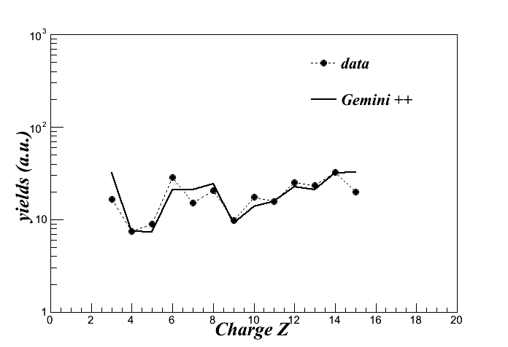
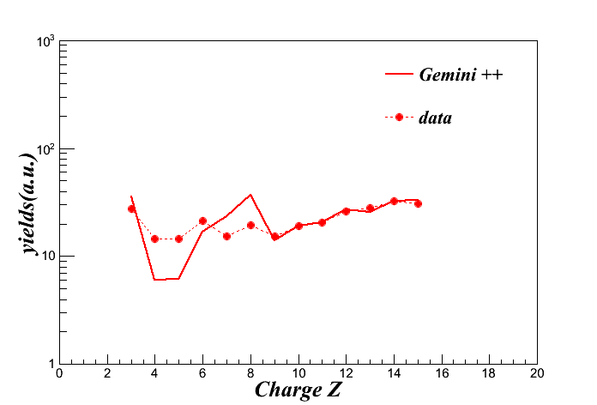
Experimental Results - IMF characteristics
Preliminary comparison with Gemini ++ code
Simulation performed for the TOTAL cross section normalized at Z=14
Gemini++ seems to reproduce slightly better the n-poor system
B. Gnoffo 101° Congresso SIF Roma 21-25 Set 2015

Slide 11
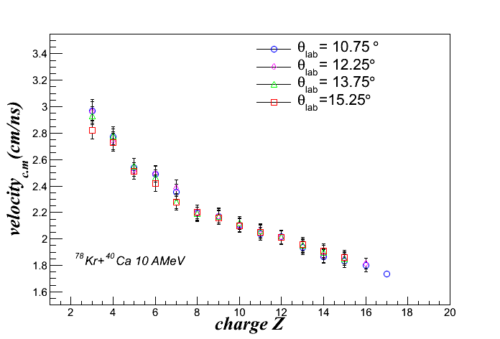
Experimental Results - IMF characteristics
Average velocity for Z= 3-17 in the center of mass frame for different Z and at different θ_{lab}
Energy and velocity spectra in CM frame slightly change with
detection angle -> high degree of relaxation of kinetic energy
B. Gnoffo 101° Congresso SIF Roma 21-25 Set 2015

Slide 12
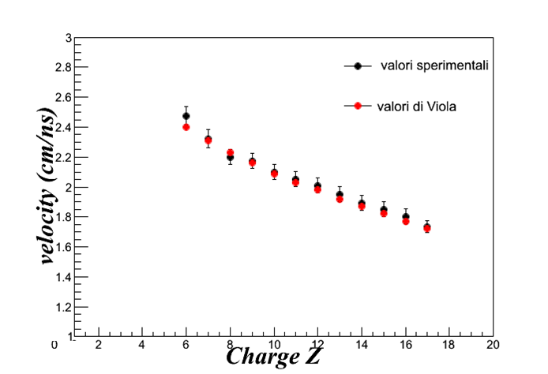
Experimental Results - IMF characteristics
Average velocity for Z= 3-17 in the center of mass frame for different Z compared with Viola – Hinde systematics NPA472 (1987) 318
Signature of a binary process dominated by the Coulomb interaction
Experimental
average values
Viola values
B. Gnoffo 101° Congresso SIF Roma 21-25 Set 2015

Slide 13
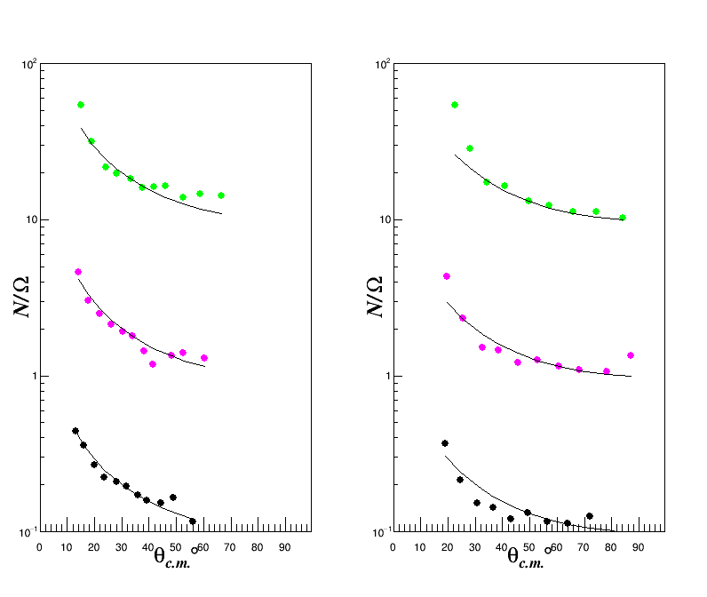
Experimental Results - FF characteristics
Angular distributions in the center of mass frame for fission fragments
1/sinθ behaviour -> high degree of relaxation, long lived system
Similar results for the n-rich system
⁷⁸Kr + ⁴⁰Ca
Z=31-32
dσ/dΩ (a.u.)
Z=18
dσ/dΩ (a.u.)
Z=29-30
Z=15
Z=27-28
Z=12
B. Gnoffo 101° Congresso SIF Roma 21-25 Set 2015

Slide 14
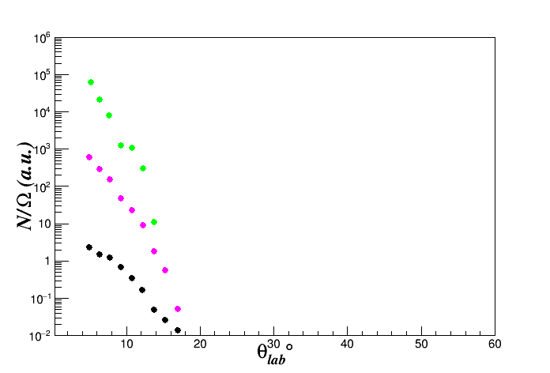
Experimental Results - ER characteristics
Angular distributions in the lab frame for groups of Z
Very strongly forward peaked as expected for evaporation residues
⁷⁸Kr + ⁴⁰Ca
dσ/dΩ (a.u.)
Z=45-46
Z=43-44
Z=41-42
B. Gnoffo 101° Congresso SIF Roma 21-25 Set 2015

Slide 15
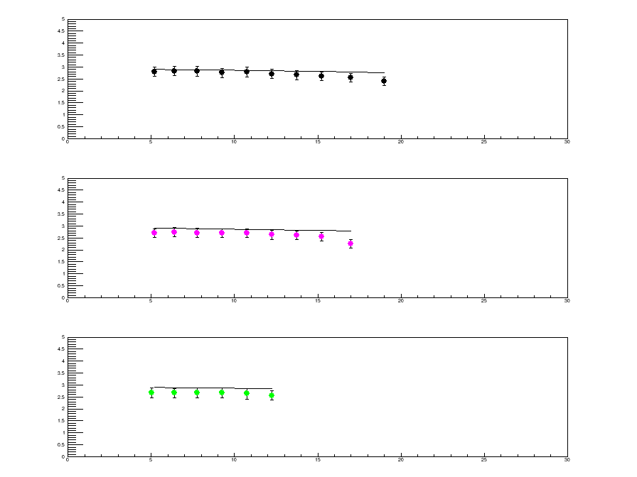
Experimental Results - ER characteristics
Average V_{ER} for evaporation residues vs θ_{lab} compared to V_{CN} cosθ_{lab}
Z=41-42
Vel (cm/ns)
Z=43-44
Z=45-46
B. Gnoffo 101° Congresso SIF Roma 21-25 Set 2015

Slide 16
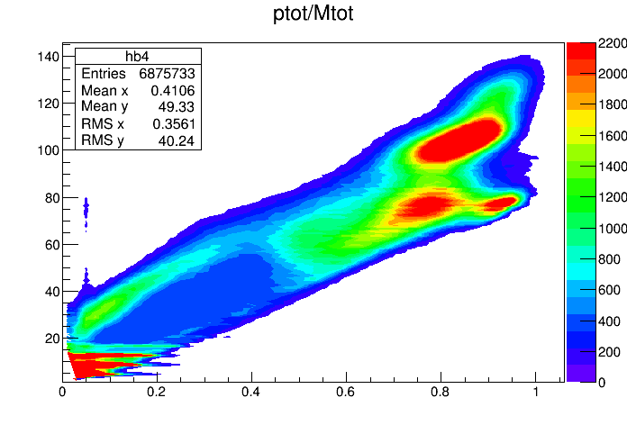
Experimental Results - Global Features
M_{tot} - P_{tot} plot for complete events selection:
Multiplicity ≥ 2 0.8 M_{CN} ≤ M_{tot} ≤ 1.1 M_{CN} 0.6 ≤p_{tot}/p_{beam} ≤1
M_{tot}
⁷⁸Kr + ⁴⁰Ca
P_{tot}/P_{beam}
B. Gnoffo 101° Congresso SIF Roma 21-25 Set 2015

Slide 17
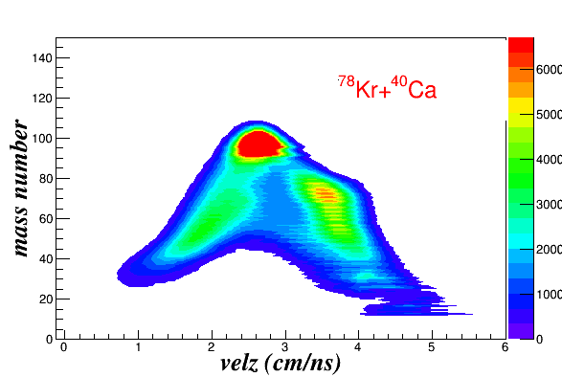
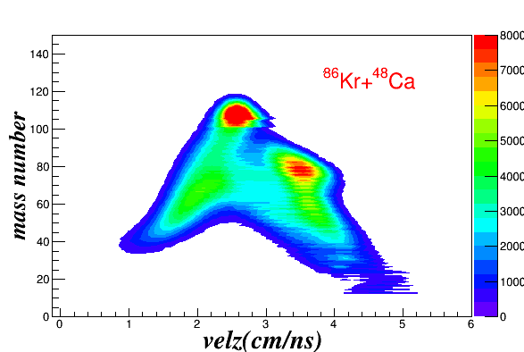
Experimental Results - Global Features
Mass - V_{par} for reaction products with complete events selection
-> Important information on the interplay between mechanism
-> Very preliminary analysis seems to show an higher ER/FF ratio for n-poor system compared to the n-rich one
ER
ER
FF-QF
FF-QF
V_{CN}
V_{CN}
V_{P}
V_{P}
B. Gnoffo 101° Congresso SIF Roma 21-25 Set 2015

Slide 18
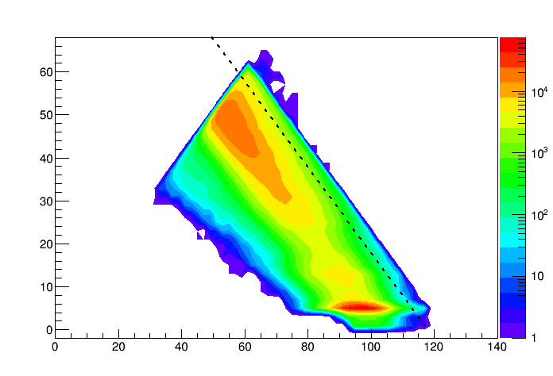
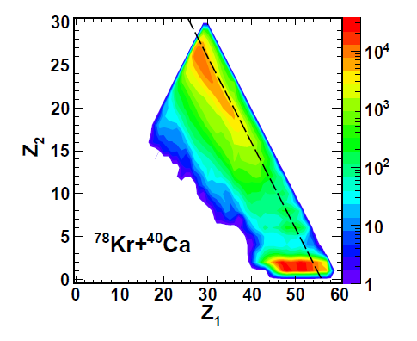
Experimental Results - Comparison with lower energy
Preliminary comparison in the reaction ⁷⁸Kr +⁴⁰Ca at two different energies
Present work
⁷⁸Kr +⁴⁰Ca
10 AMeV
⁷⁸Kr +⁴⁰Ca
5.5 AMeV
FF
FF
QF
QF
M₂
ER
ER
M₁
B. Gnoffo 101° Congresso SIF Roma 21-25 Set 2015

Slide 19
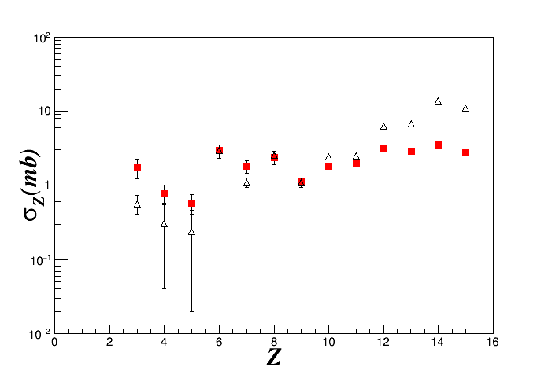
Experimental Results - Comparison with lower energy
Very Preliminary comparison of IMF production cross section in the reaction ⁷⁸Kr +⁴⁰Ca at two different energies
⁷⁸Kr + ⁴⁰Ca 5.5 AMeV
G. Ademard et al., PRC 83 (2011) 054619
⁷⁸Kr + ⁴⁰Ca 10 AMeV
Present work
B. Gnoffo 101° Congresso SIF Roma 21-25 Set 2015

Slide 20
Conclusion and Outlook
Results of the reactions ^{78,86}Kr + ^{40,48}Ca at 10 AMeV
The kinematical characteristics and the angular distributions seem to indicate for both reactions a high degree of relaxation of the system
The results put in evidence the influence of the neutron enrichment of the entrance channel on:
Different isotopic composition and relative richness of products
Odd - even effect in IMF charge distributions -> stronger for n-poor
Sizeable differences for the different reaction channels:
FF, QF and ER -> there is a higher ER/FF ratio for n-poor system compared to the n-rich one
B. Gnoffo 101° Congresso SIF Roma 21-25 Set 2015

Slide 21
Conclusion and Outlook
Data analysis is in progress:
Cross sections calculations for different mechanisms to confirm this first qualitative observation
Study of the Coincidence between LCP-FF, LCP-ER ,LCP-IMF
More precise comparisons with theoretical predictions to provide indications on the isospin influence on the reaction mechanism
LOI presented in May 2014 at the
“Second SPES International Workshop at INFN-LNL“
⁹²Kr + ^{40,48}Ca 10 AMev ^{132,140}Ba* E* ~ 320 MeV
CN with N/Z =1.5 greater then with stable beams.
-> study of the evolution, with isospin asymmetry, of the dynamics
-> interplay between nuclear structure and reaction mechanism in the emission process
B. Gnoffo 101° Congresso SIF Roma 21-25 Set 2015

Slide 22
NEWCHIM – ISODEC collaboration
S.Pirrone¹, G.Politi^{1,2}, M.LaCommara^{3,4}, J.P.Wieleczko⁵, B.Gnoffo¹, E.DeFilippo¹, P.Russotto^{2,6}, M.Trimarchi^{7,8}, M.Vigilante^{3,4}, G.Ademard⁵, F.Amorini⁶, L.Auditore^{7,8}, C.Beck⁹, I.Berceanu¹⁰, E.Bonnet⁵, B.Borderie¹¹, G.Cardella¹, A.Chbihi⁵, M.Colonna⁶, A.D’Onofrio^{4,12}, J.D.Frankland⁵, E.Geraci^{2,1}, E.Henry¹³, E.LaGuidara^{1,14}, G.Lanzalone^{15,6}, P.Lautesse¹⁶, D.Lebhertz⁵, N.LeNeindre ¹⁷, I.Lombardo⁴, D.Loria^{7,8}, K.Mazurek⁵, S.Norella^{7,8}, A.Pagano¹, E.V.Pagano^{2,6}, M.Papa¹, E.Piasecki¹⁸, F.Porto^{2,6}, L.Quattrocchi^{7,8}, M.Quinlann¹³, F.Rizzo^{2,6}, E.Rosato^{3,4}, W.U.Schroeder¹³, G.Spadaccini^{3,4}, A.Trifirò^{7,8}, J.Toke¹³, G.Verde¹
1) INFN - Catania, Italy
2) Dipartimento di Fisica e Astronomia, Università di Catania, Italy
3) Dipartimento di Scienze Fisiche, Università Federico II Napoli, Italy
4) INFN - Napoli, Italy
5) GANIL - Caen, France
6) INFN LNS - Catania, Italy
7) Dipartimento di Fisica, Università di Messina, Italy
8) INFN Gruppo Collegato di Messina, Italy
9) IN2P3 - IPHC Strasbourg, France
10) IPNE, Bucharest, Romania
11) IN2P3 - IPN Orsay, France
12) Dipartimento di Scienze Ambientali - Seconda Università di Napoli, Caserta, Italy
13) University of Rochester, USA
14) Centro Siciliano Fisica Nucleare e Struttura della Materia, Catania, Italy
15) Università Kore, Enna, Italy
16) IN2P3 - IPN Lyon, France
17) IN2P3 - LPC Caen, France
18) University of Warsaw, Poland
B. Gnoffo 101° Congresso SIF Roma 21-25 Set 2015

