Slide 1
Silvia Giomi
Istituto Nazionale di Ricerca Metrologica (INRiM)
TES as NIR Photon Number Resolving Detector (PNRD)
S.Giomi - CI Congresso Nazionale SIF, 21-25/09/2015, Roma

Slide 2
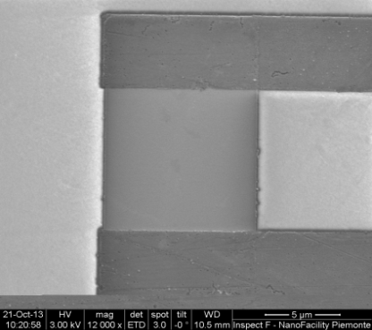
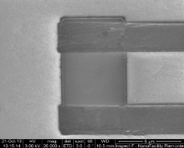
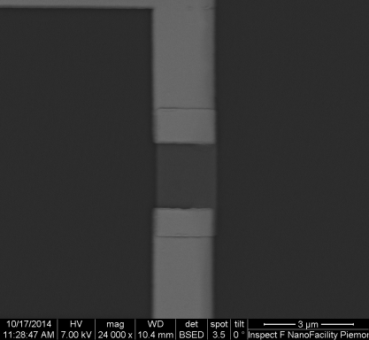
What is a Transition-Edge Sensor (TES)?
TES is a device made by a superconducting film operated in the temperature region between the normal and the superconducting state
Active area
10 µm x 10 µm
Active area
5 µm x 5 µm
Active area
2 µm x 2 µm
Active area
1 µm x 1 µm
1/15
S.Giomi - CI Congresso Nazionale SIF, 21-25/09/2015, Roma

Slide 3
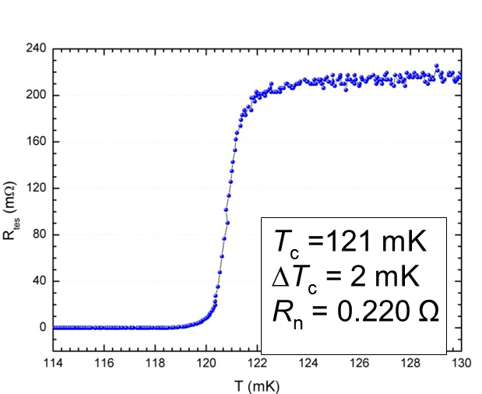
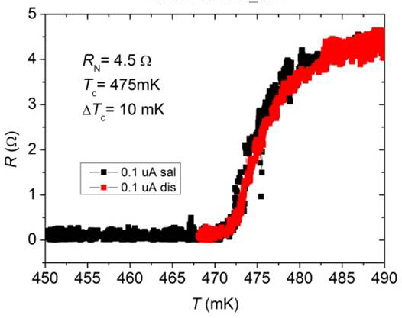
How does TES work?
TES is a device made by a superconducting film operated in the temperature region between the normal and the superconducting state
Ti/Au 10 µm x 10 µm
Ti TES 1 µm x 1 µm
R_{N}
(mΩ)
R_{N} /2
R_{tes}
T (mK)
T_{c}
T_{c} : Critical Temperature
R_{N}: Normal Resistance
2/15
S.Giomi - CI Congresso Nazionale SIF, 21-25/09/2015, Roma

Slide 4
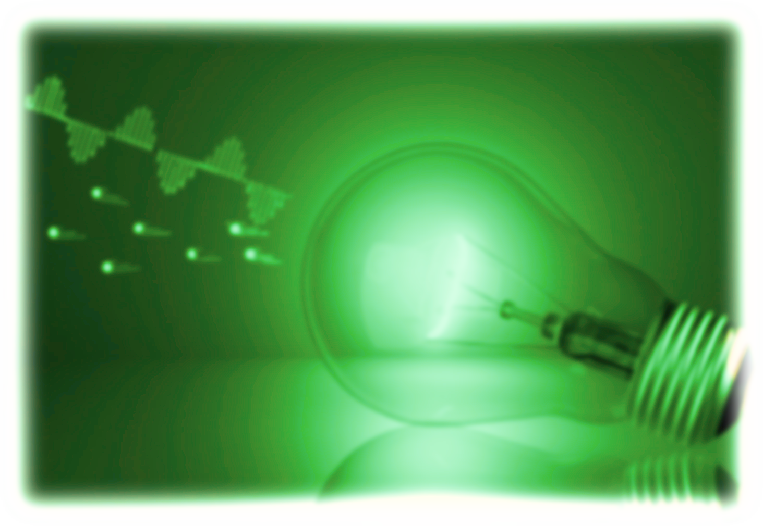
How does TES work?
V_{out}
I_{bias}
R_{p}
R_{out}
(mΩ)
Voltage bias
L_{in}
L_{out}
R_{sh}
I_{tes}
R_{tes}
R_{tes}
T (mK)
DC-SQUID sensor
3/15
S.Giomi - CI Congresso Nazionale SIF, 21-25/09/2015, Roma

Slide 5
How does TES work?
(mΩ)
R_{tes}
T (mK)
V_{out}
I_{tes}
I_{bias}
R_{p}
R_{out}
(µA)
L_{in}
L_{out}
R_{sh}
I_{tes}
R_{tes}
I_{bias}
(µA)
4/15
S.Giomi - CI Congresso Nazionale SIF, 21-25/09/2015, Roma

Slide 6
How does TES work?
(mΩ)
Working Point
I_{tes}
R_{tes}
(µA)
T (mK)
Working Point
I_{bias}
(µA)
5/15
S.Giomi - CI Congresso Nazionale SIF, 21-25/09/2015, Roma

Slide 7
How does TES work?
(mΩ)
R_{tes}
t (µs)
T (mK)
I_{tes} (µA)
6/15
S.Giomi - CI Congresso Nazionale SIF, 21-25/09/2015, Roma

Slide 8
How well TESs count photons?
Effective Response Time
Working at higher T_{c}
shorter Response Time
Energy Resolution
Smaller size TESs
higher Energy Resolution
7/15
S.Giomi - CI Congresso Nazionale SIF, 21-25/09/2015, Roma

Slide 9
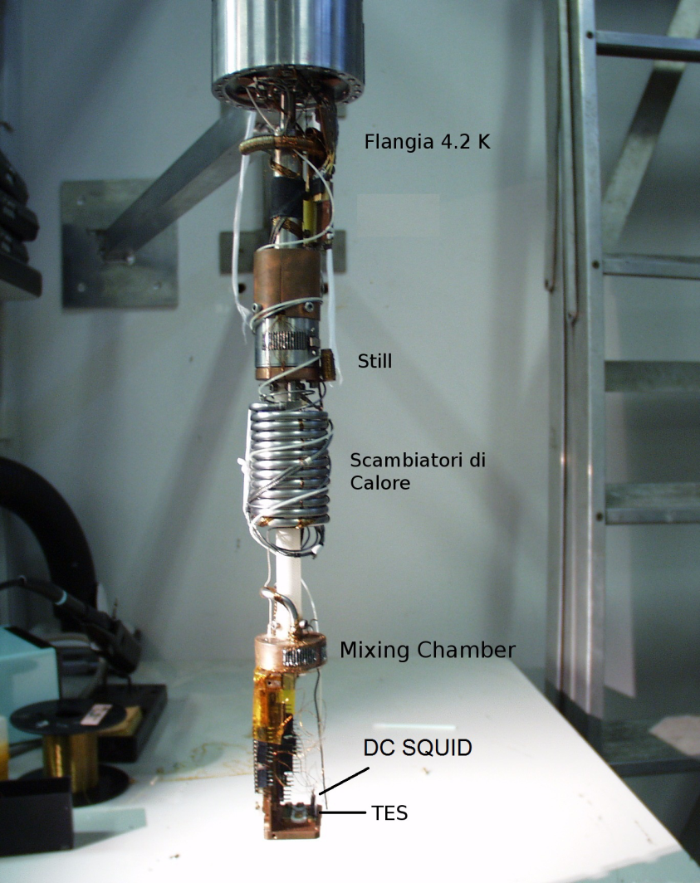
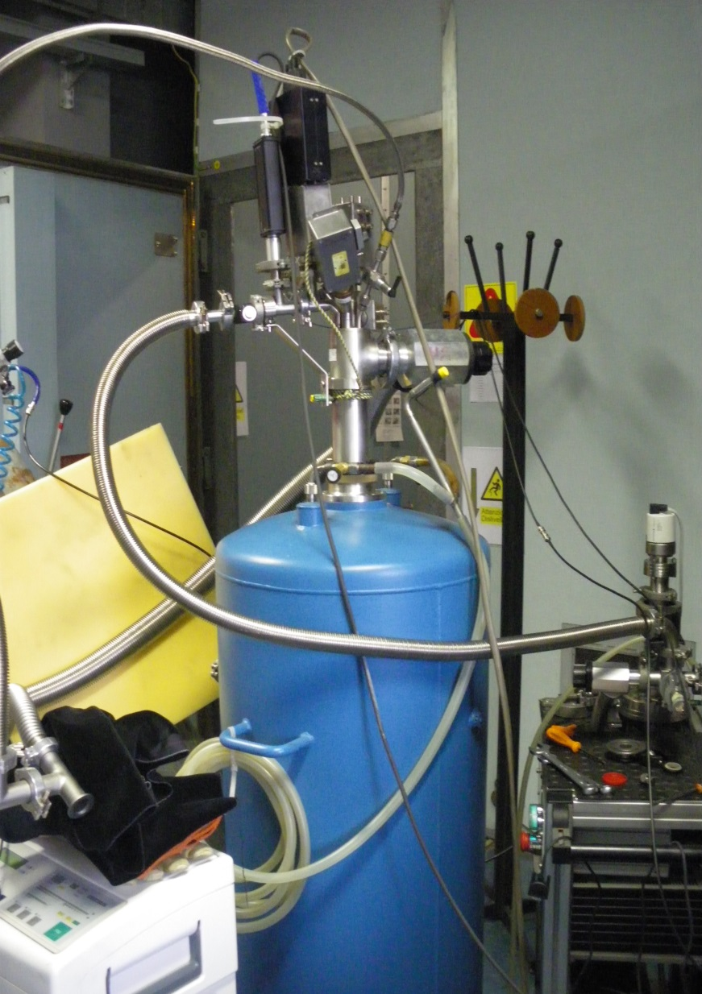
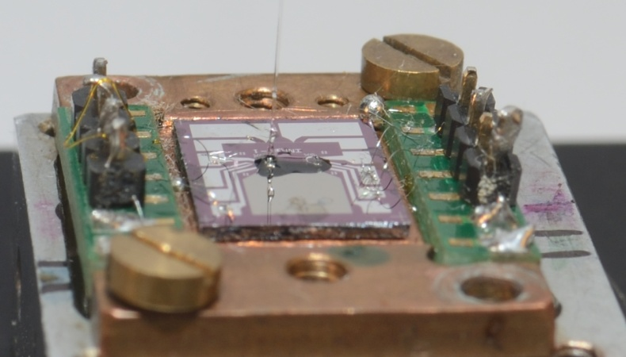
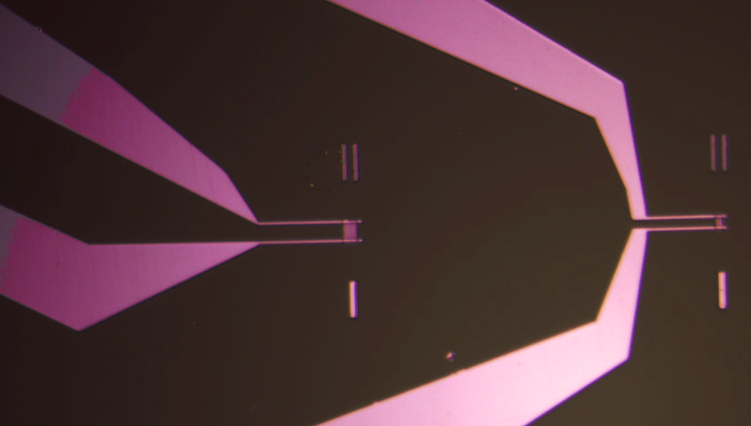
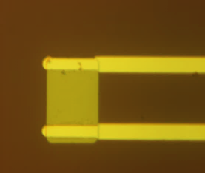
Experimental set-up
Active area
20 µm x 20 µm
Active area
10 µm x 10 µm
Optical Fiber
8/15
S.Giomi - CI Congresso Nazionale SIF, 21-25/09/2015, Roma

Slide 10
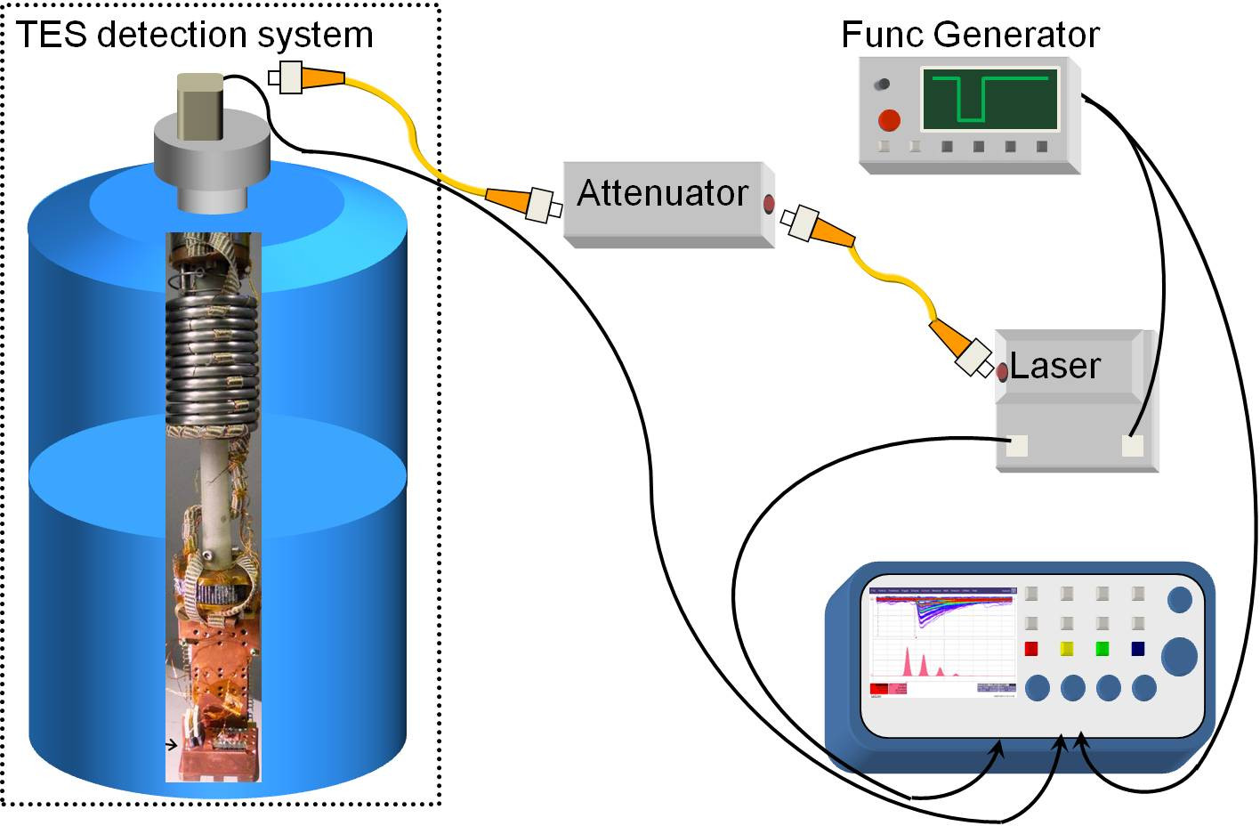
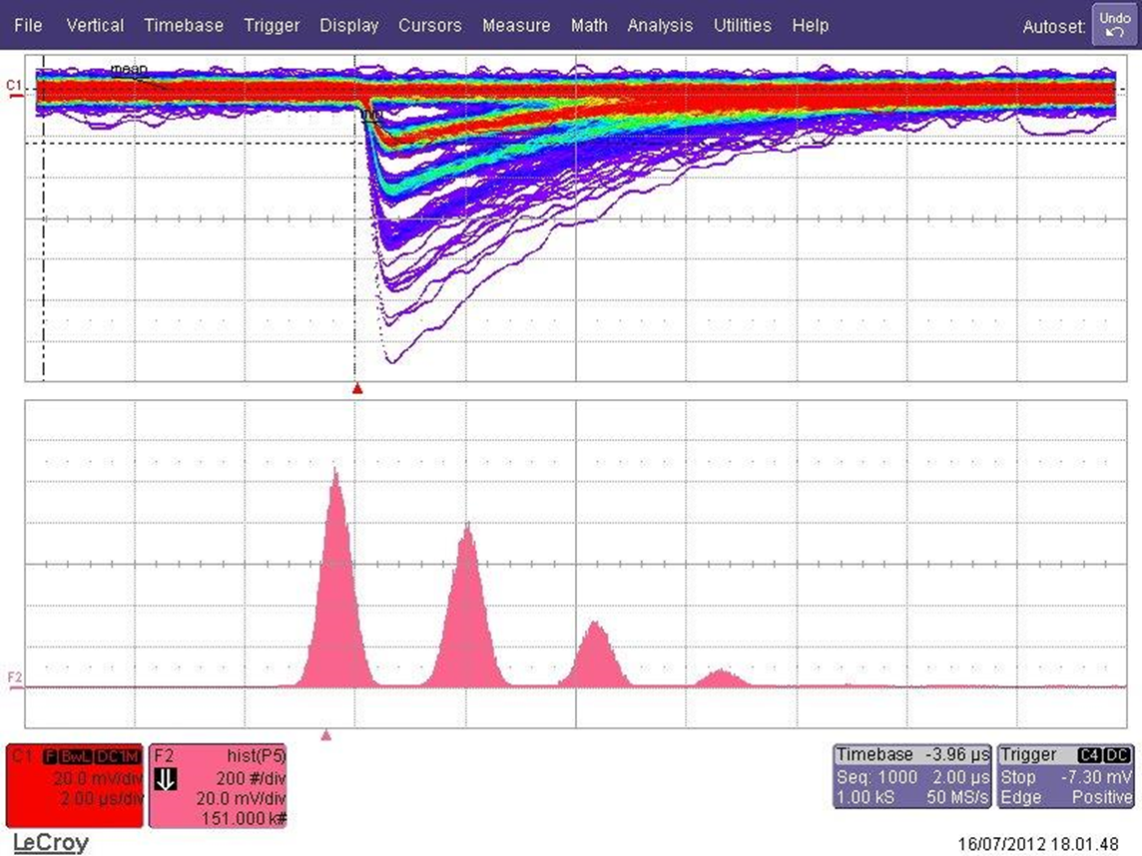
Experimental set-up
0 photons
1 photon
2 photons
3 photons
9/15
S.Giomi - CI Congresso Nazionale SIF, 21-25/09/2015, Roma

Slide 11
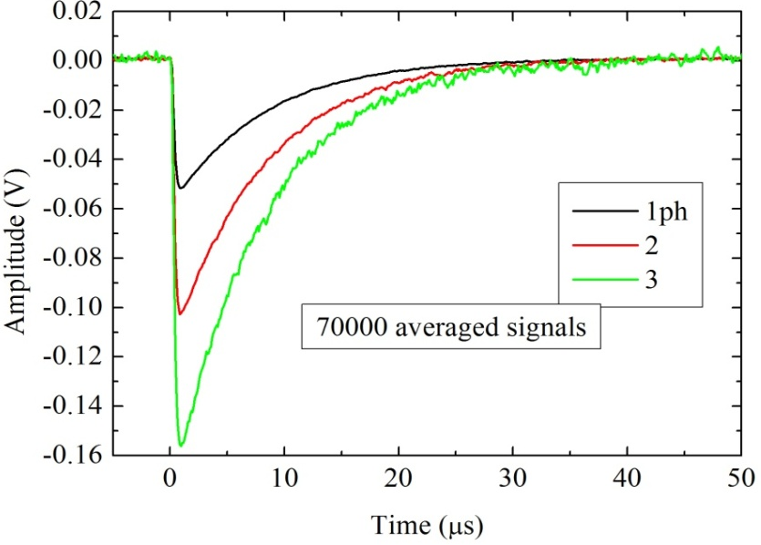
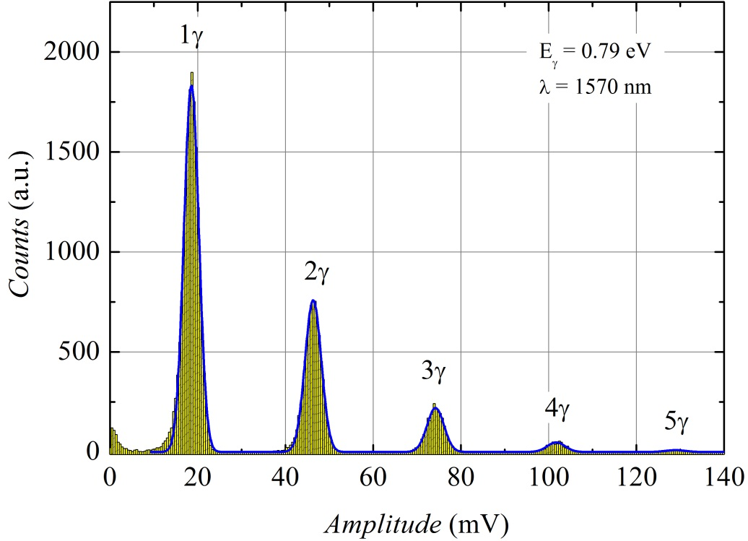
How well TESs count photons?
Ti/Au TES 10 µm x 10 µm
T_{c}~ 106 mK
τ_{eff} = 4 µs
ΔE_{FWHM}= 0.113 eV
@1570 nm
L.Lolli et al arXiv:1306.5385v1 [physics.ins-det], June 2013
10/15
S.Giomi - CI Congresso Nazionale SIF, 21-25/09/2015, Roma

Slide 12
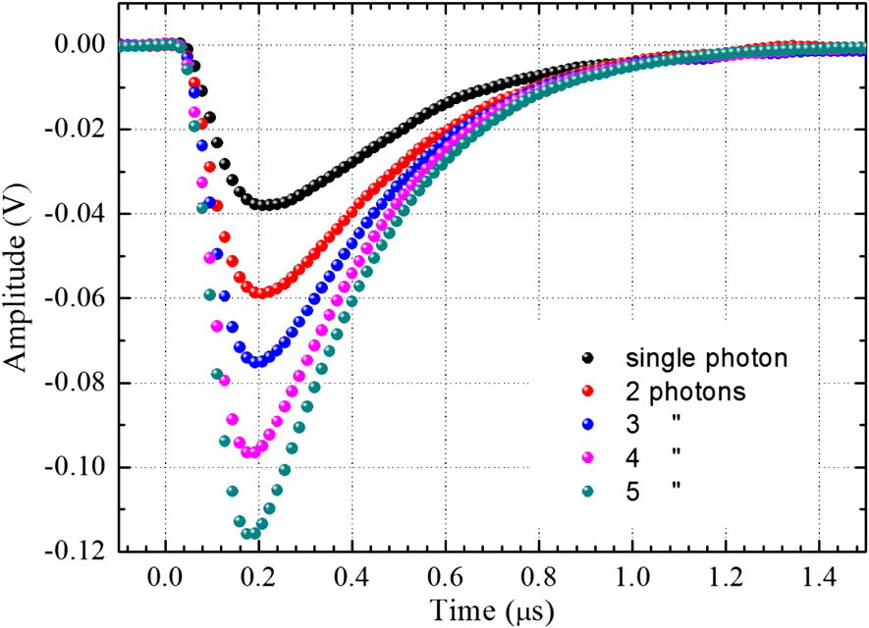
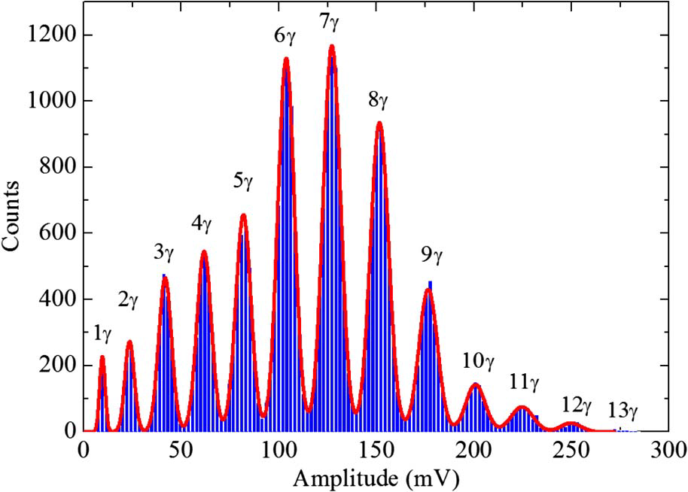
How well TESs count photons?
Ti/Au TES 10 µm x 10 µm
T_{c}~ 300 mK
τ_{eff} = 186 ns
ΔE_{FWHM}= 0.263 eV @1535 nm
L.Lolli et al IEEE Trans.Appl.Supercond., vol.23, n.3, June 2013
11/15
S.Giomi - CI Congresso Nazionale SIF, 21-25/09/2015, Roma

Slide 13
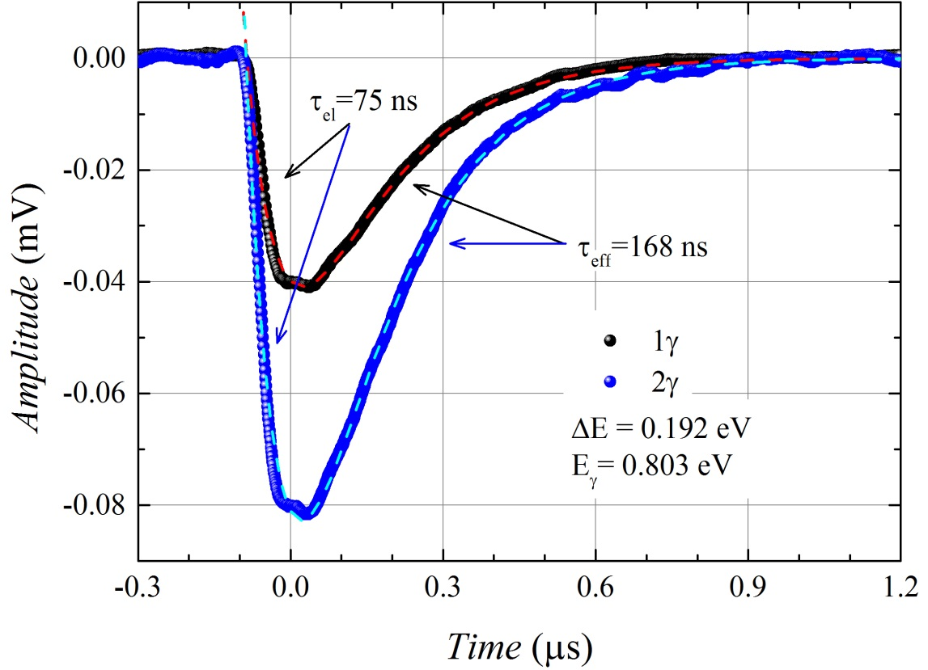
How well TESs count photons?
Ti TES 2 µm x 2 µm
T_{c}~ 470 mK
τ_{eff} = 168 ns
ΔE_{FWHM}= 0.19 eV @1545 nm
C.Portesi et al IEEE Trans.Appl.Supercond., vol.25, n.3, June 2015
12/15
S.Giomi - CI Congresso Nazionale SIF, 21-25/09/2015, Roma

Slide 14
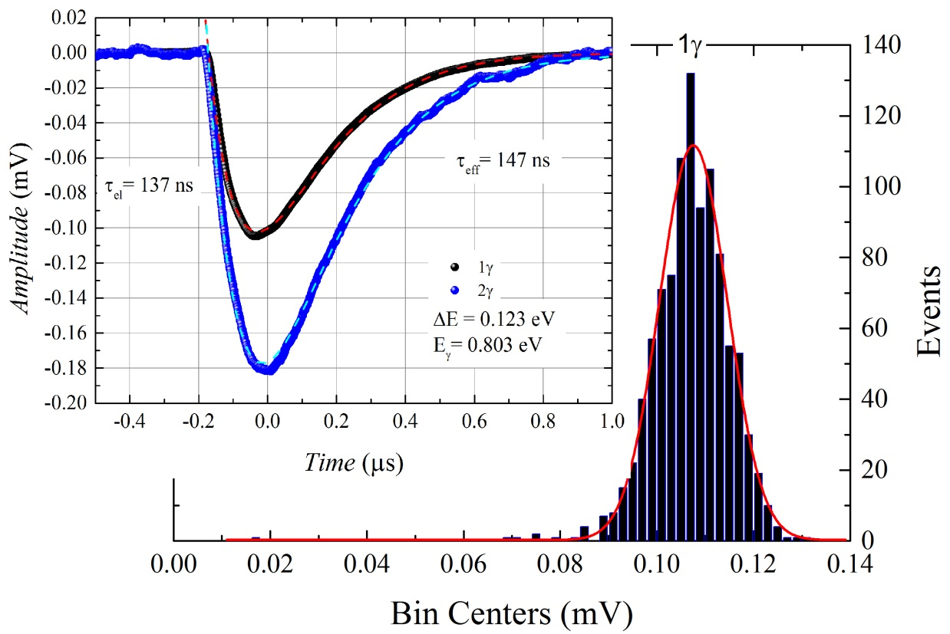
How well TESs count photons?
Ti TES 1 µm x 1 µm
T_{c}~ 470 mK
τ_{eff} = 147 ns
ΔE_{FWHM}= 0.12 eV @1545 nm
C.Portesi et al IEEE Trans.Appl.Supercond., vol.25, n.3, June 2015
13/15
S.Giomi - CI Congresso Nazionale SIF, 21-25/09/2015, Roma

Slide 15
Future with photons
14/15
S.Giomi - CI Congresso Nazionale SIF, 21-25/09/2015, Roma

Slide 16
Which applications are TESs useful for?
Validation of innovative absolute calibration technique
A. Avella et al, Optics Express (2011) 19, 23249-23257
Characterization of single photon source in Quantum Optics Group
L. LOLLI et al, Int. J. Quantum Inform. (2011) 09, 405
Quantum metrology
Quantum optics
Quantum imaging
Quantum mechanics
Quantum information
Characterization of single photon source NV centers in nano-diamond from PTB
W. Schmunk et al, METROLOGIA (2012) 49, 56-160
@INRiM
Material analysis
Astronomy
Validation of first experimental tomography of
the positive operator-valued measure (POVM)
G. Brida et al, New J. Phys. (2013) 14 085001
15/15
S.Giomi - CI Congresso Nazionale SIF, 21-25/09/2015, Roma

Slide 17
Thanks for your attention
S.Giomi - CI Congresso Nazionale SIF, 21-25/09/2015, Roma

