Slide 1
MediaChrom: a new class of versatile polarity-sensitive dyes for imaging applications
Luca Ronda
Department of Neurosciences
University of Parma
Notes:
Abstract: A small library of six polarity-sensitive fluorescent dyes, nicknamed MediaChrom, was prepared. This class of dyes is characterized by a pyrimidoindolone core fitted out with a conjugated push-pull system, and a carboxy-linker for a conceivable coupling with biomolecules. The optimized eight-step synthetic strategy involves a highly chemo- and regio-selective gold catalyzed cycloisomerization reaction. The photophysical properties of MediaChrom dyes have been in-depth evaluated. In particular, the MediaChrom bearing a diethylamino as electron-donating group and a trifluoromethyl as electron-withdrawing group displays the most interesting and advantageous spectroscopic features (e.g. absorption and emission in the visible range and a good quantum yield). Promising results in terms of sensitivity have been obtained in vitro on this dye as membrane/lipophilic probe and as peptide fluorescent label.

Slide 2
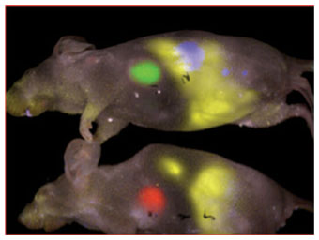
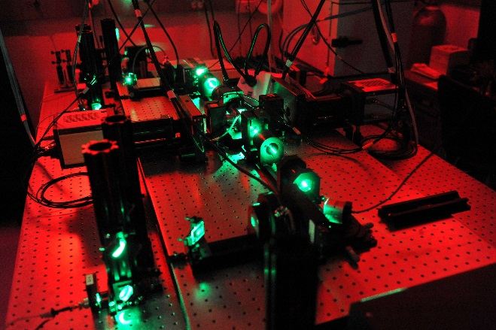
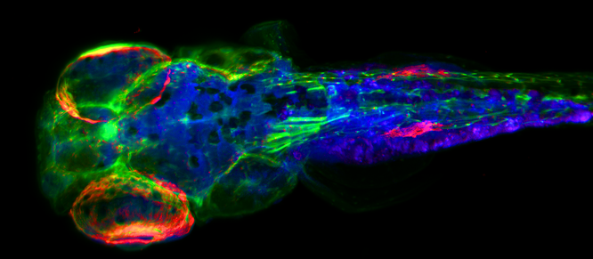
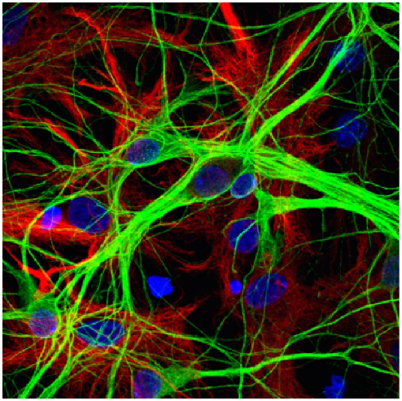
Still need for a new fluorophore?
Modern biophysical and biomedical research asks for a continuous development of new fluorescent dyes
improved performances
sensitive monitoring

Slide 3
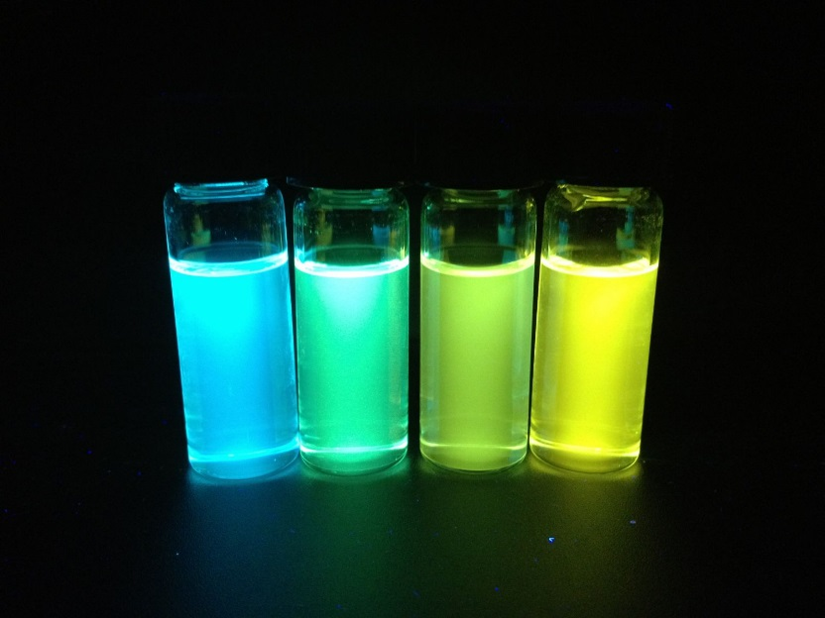
Solvatochromic dyes
Ideal probes to monitor:
solvent polarity
Nature Protocols 7, 24–35 (2012)
RSC Adv., 2014, 4, 14335-1434
local properties in cellular districts
biomolecular interactions
- peptide-nucleic acid
- protein-protein
- peptide-lipid, etc.
Notes:
Interaction of human serum albumin with liposomes of saturated and unsaturated lipids with different phase transition temperatures: a spectroscopic investigation by membrane probe PRODAN: grafico a dx
Two main classes of polarity-sensitive dyes are available, single-band and two-band solvatochromic dyes.^{[6,7]} The former are the most used, because the latter suffer from poor photostability. ^{[8]} Single-band solvatochromic dyes are usually characterized by a rigid aromatic backbone bearing conjugated electron acceptor and electron donor groups at the opposite sides. In these molecules, the dipole moment increases by electronic excitation due to an intramolecular charge transfer from the electron donating (ED) to the electron withdrawing (EW) group. If their excited states are stabilized by dipole-dipole or H-bonding interactions with the surrounding medium, these dyes exhibit a bathochromic effect of their emission spectrum in response to an increase in solvent polarity (positive solvatochromism
In order to exhibit NLO behavior an organic molecule must possess a highly polarizable electron cloud. Such molecules typically have a p-conjugated framework, end-capped by electron-withdrawing (EW) and electron-donating (ED) groups in order to enhance the polarizability and hyperpolarizability. A general structure of donor±acceptor p organic molecules, usually referred to as push-pull derivatives, is for instance 1. The degree of the ground-state polarization depends on the relative contribution of the two limit forms, 1a (neutral and aromatic) and 1b (dipolar and quinoid).

Slide 4
MediaChrom
Pyrimidoindolone core endowed with a conjugated push-pull system
δ +
δ -
linking point for the conjugation with biomolecules
rigid aromatic backbone bearing conjugated electron acceptor and electron donor groups at the opposite sides
dipole moment increases by electronic excitation due to an intramolecular charge transfer from the electron donating (ED) to the electron withdrawing (EW) group
excited states are stabilized by dipole-dipole or H-bonding interactions with the surrounding medium -> bathochromic effect of their emission spectrum in response to an increase in solvent polarity
Notes:
Usually characterized by a rigid aromatic backbone bearing conjugated electron acceptor and electron donor groups at the opposite sides. In these molecules, the dipole moment increases by electronic excitation due to an intramolecular charge transfer from the electron donating (ED) to the electron withdrawing (EW) group. If their excited states are stabilized by dipole-dipole or H-bonding interactions with the surrounding medium, these dyes exhibit a bathochromic effect of their emission spectrum in response to an increase in solvent polarity (positive solvatochromism

Slide 5
Effect of substituents on spectroscopic properties: absorption
Dye | R¹ | R² | λ_{absorption} (nm) | ε (mM⁻¹ cm⁻¹)
15a | Et₂N- | -SO₂-Me | 401 | 8.5
15b | Et₂N- | -NO₂ | 456 | 7.6
15c | Et₂N- | -CF₃ | 393 | 13.8
15d | Et₂N- | -CN | 409 | 15.4
15e | morpholine | -SO₂-Me | 369 | 17.1
15f | morpholine | -CF₃ | 377 | 17.5
Prodan | - | - | 360 | 18.4
Absorb light in the ∼370-460 nm range with good absorption

Slide 6
Effect of substituents on spectroscopic properties: fluorescence
Solvent | λ_{emission} (nm)
 | 15a | 15b | 15c | 15d | 15e | 15f
Hexane | 525 | 594 | 490 | 525 | 512 | 482
n-Octanol | 585 | - | 525 | 585 | 568 | 514
Ethanol | 595 | - | 540 | 595 | 582 | 528
DMF | 605 | - | 565 | 615 | 597 | 553
λ_{abs} = 393 nm
λ_{abs} = 369 nm
(poor solubility)

Slide 7
MediaChrom 15c
hexane
OctOH
EtOH
DMF
UV LED illumination (∼400 nm)

Slide 8
MediaChrom 15c photochemical characterization
Absorbance
Fluorescence

Slide 9
Lippert plot
excited state
ground state
$$\overline{υ_{a}}−\overline{υ_{f}}= \frac{2}{hc}\left(\frac{ε−1}{2ε+1}−\frac{n^{2}−1}{2n^{2}+1}\right)\frac{{\left(μ^{∗}−μ\right)}^{2}}{a^{3}}+const$$
Lippert-Mataga equation
Stokes shift
orientational
polarizability (Δf)
cavity radius
MediaChrom | μ*-μ (Debye)
15a | 13.0
15b | -
15c | 13.3
15d | 13.4
15e | 13.0
15f | 13.4
Regardless the substituents, the charge transfer is comparable
the differences in the Stokes shift suggests an effect of substituents on the non-emitting energy loss in the excited state
Notes:
To describe quantitatively the effects of the physical properties of the solvent on the fluorescent emission spectra of the dye, Lippert-Mataga equation was used.^{[39]} This correlation is based on the assumption that the solvent is a continuum in which the fluorophore is contained, and solvent-specific interactions are not considered. It can be approximated that the energy difference between the ground and the excited states is a property of the refractive index (n) and the dielectric constant (ε) of the solvents. In Figure 4 the orientational polarizability (Δf) is plotted against Stokes shift (in cm⁻¹) for MediaChrom 15c and compared to Prodan under the same experimental conditions.
For both fluorophores, a clear dependence of the Stokes shift on orientational polarizability of the solvent was observed. As Lippert-Mataga equation usually well describes fluorophores behavior in aprotic solvents, only data for both dyes in aprotic solvents were used to fit and determine the change in dipole moment upon excitation (μ*-μ).
MediaChrom 15c and Prodan Stokes shifts showed a well-defined dependence to orientational polarizability, considering all solvents. In particular, data obtained in aprotic solvents showed a good correlation, with a (μ*-μ) of 13.3 ± 0.6 and 8.1 ± 0.4 Debye, respectively. For all other MediaChrom dyes, which showed similar solvatochromic shifts, the dipole moment changes fall in the 13.0-13.4 Debye range (see table S2 in SI). This finding demonstrates that, regardless the substituent pattern, the charge transfer process is similar. Moreover, the differences in the Stokes shift suggests an effect of substituents on the non-emitting energy loss in the excited state.

Slide 10
MediaChrom 15c in DPPC vesicles
temperature increase
MediaChrom 15c
Prodan
20 °C
37 °C
20 °C
37 °C
Notes:
. Fluorescence spectra of 1.6 μg/mL MediaChrom 15c (A) and Prodan (B) in DPPC vesicles at different temperatures: 20°C (black lines) and 37°C (red lines).

Slide 11
MediaChrom deprotection for labeling applications
H
Solvent | MediaChrom 15c (benzyl ester) | MediaChrom 15’c (carboxyl free)
hexane | 490 nm | 487 nm
n-octanol | 525 nm | 520 nm
ethanol | 540 nm | 537 nm
DMF | 565 nm | 563 nm

Slide 12
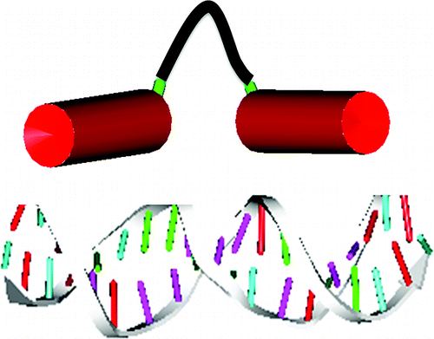
MediaChrom 15c labeling: in vitro experiment
Interaction model: Cro-DNA
+DNA
-DNA
MediaChrom 15c
+DNA
Mazumder et al. ACS Chem. Biol., 2012, 7 (6), pp 1084–1094
+DNA
-DNA
peptide mimics of Cro protein from bacteriophage λ that binds to the DNA (operator site O_{R}3)
Solid phase peptide synthesis of Cro peptide labeled a the N-terminus with MediaChrom 15c

Slide 13
Photostability
Photodegradation test at 380 nm
- Mediachrom 15c
- Prodan
MediaChrom 15c decays significantly slower than Prodan, showing a halved emission after 2800 seconds, while the latter after 1750 seconds
Notes:
Photodegradation test for MediaChrom 15c (red line) and Prodan (black line).

Slide 14
CONCLUSIONS
We designed a new class of polarity-sensitive dyes, named MediaChrom, that absorb and emit light in the near UV-visible range with good extinction coefficient and quantum yield
MediaChrom proved to be highly sensitive to the environment polarity, and can be easily conjugated to proteins and peptides for directing them to defined biological targets
MediaChrom 15c can be considered a photostable versatile dye to be used as a lipophilic probe or conjugated to biomolecules

Slide 15
FUTURE DEVELOPMENT
Preparation of MediaChrom derivatives endowed with activated esters for easy batch proteins and peptides conjugation
Cellular studies (preliminary results showed no cellular toxicity and some selectivity towards cellular organelles membranes)

Slide 16
ACKNOWLEDGEMENTS
DISFARM - University of Milan
Monica dell’Acqua
Giorgio Abbiati
Sara Pellegrino
Francesca Clerici
Elisabetta Rossi
Maria Luisa Gelmi
University of Parma
Riccardo Piano
Andrea Mozzarelli
Stefano Bettati
Fondazione Cariplo
“Development of an innovative user-friendly colorimetric biosensor based on aptamer-functionalized nanomaterials for the detection of Staphylococcus aureus from different biological sources”

