Slide 1

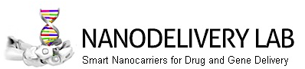

Exploitation of nanoparticle-biomolecular corona for targeted delivery of nanomedicine
Daniela Pozzi
Dipartimento di Medicina Molecolare
101° Congresso della Società Italiana di Fisica – Roma, 21-25 settembre 2015

Slide 2
Table of Contents
Targeting strategies for nanocarriers: active and passive targeting
Targeting by Protein Corona
Rethinking targeting strategies: from synthetic to biological identity
The proof of concept
101° Congresso della Società Italiana di Fisica – Roma, 21-25 settembre 2015

Slide 3
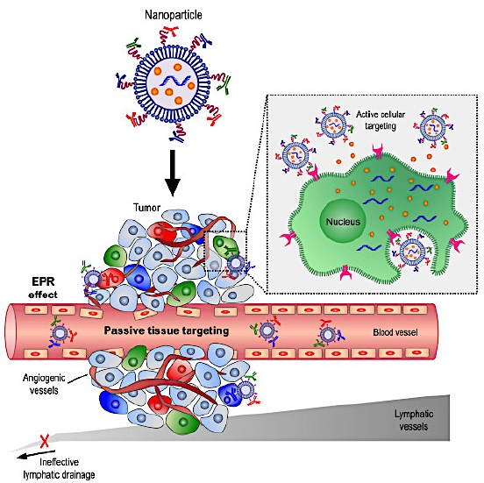
Targeting strategies for nanocarriers in cancer therapy
Cancer therapy
Active targeting
Passive targeting
Abnormal tissue growth
Involves attaching
to the nanocarrier a ligand (e.g. antibody, protein) recognized by receptor of target cells
Angiogenesis
Leaky vasculature
(200-2000 nm gaps beteen endothelial cells)
Enhanced Permeation and Retention
Effect
Does it work in vivo?
101° Congresso della Società Italiana di Fisica – Roma, 21-25 settembre 2015

Slide 4
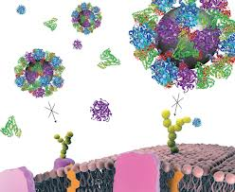
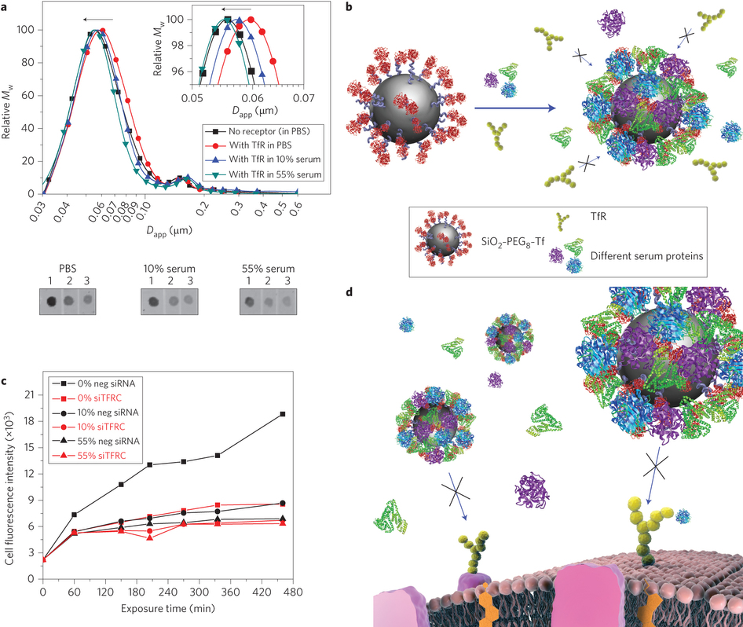
Nanocarriers in a physiological environment: the biological impact of the “Protein Corona”
Exposure to biofluid
Functionalized
Nanoparticle
Protein Corona
formation
Nanoparticle loses its targeting ability
Adapted from A. Salvati et al.,
Nature Nanotechnology 8, 137–143 (2013)
It is this nanoparticle–biomolecule interface
that is ‘read’ and acted upon by the cellular machinery
101° Congresso della Società Italiana di Fisica – Roma, 21-25 settembre 2015

Slide 5

Hypothesis. If the corona composition can be properly manipulated to contain proteins that are specifically recognized by receptors on target cells
then the PROTEIN CORONA can be exploited as the liposome targeting moiety!
Problem
Opportunity
101° Congresso della Società Italiana di Fisica – Roma, 21-25 settembre 2015

Slide 6
1. Synthetic Identity of Nanocarriers
Nanocarrier’s identity card
101° Congresso della Società Italiana di Fisica – Roma, 21-25 settembre 2015

Slide 7
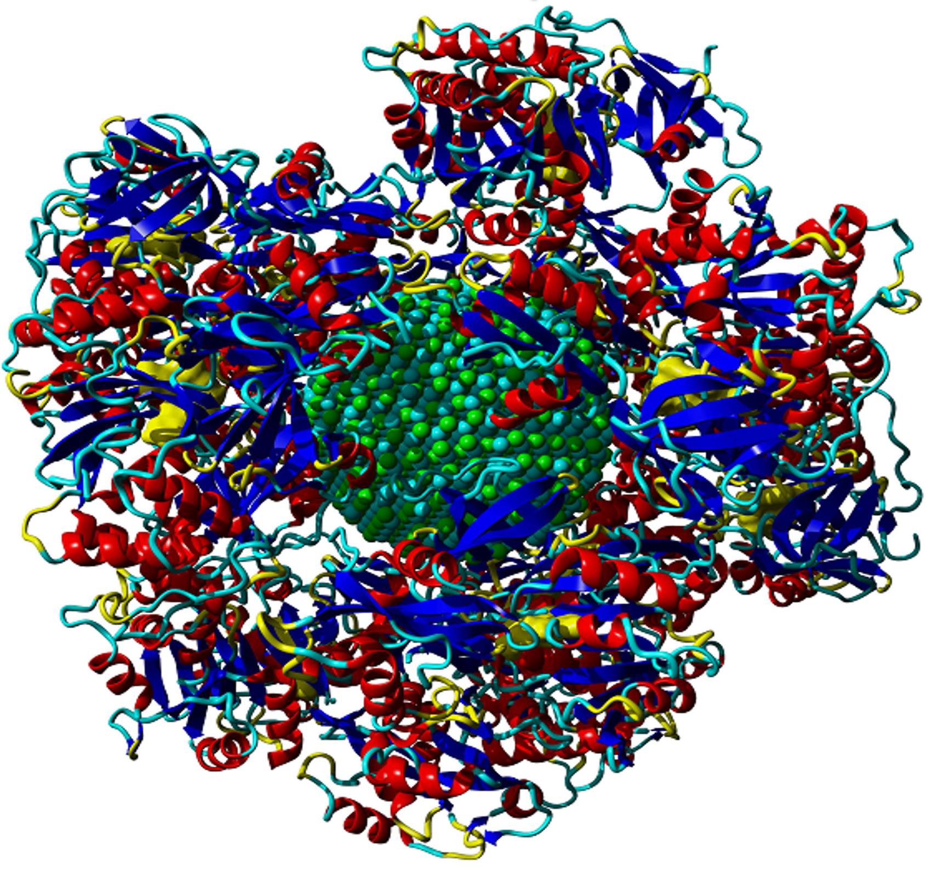
2. Nanocarriers in a physiological environment: The Biological Identity
The nanoparticle-protein corona
101° Congresso della Società Italiana di Fisica – Roma, 21-25 settembre 2015

Slide 8
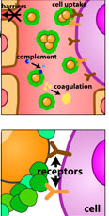

3. Physiological Response
Lipoplex
1-hour incubation
+
Lipoplex
Human plasma
101° Congresso della Società Italiana di Fisica – Roma, 21-25 settembre 2015

Slide 9
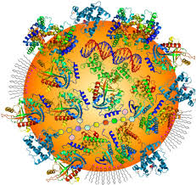
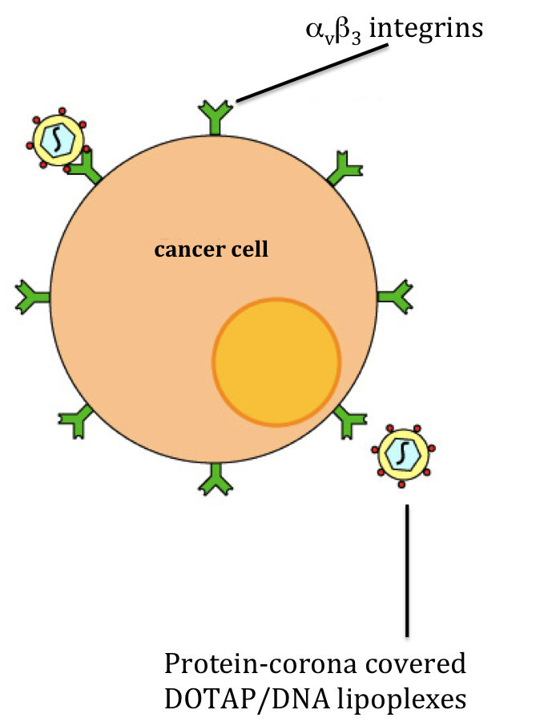
Quantitative determination of the protein corona
by mass spectrometry
Coupling corona proteins and cell receptors
101° Congresso della Società Italiana di Fisica – Roma, 21-25 settembre 2015

Slide 10
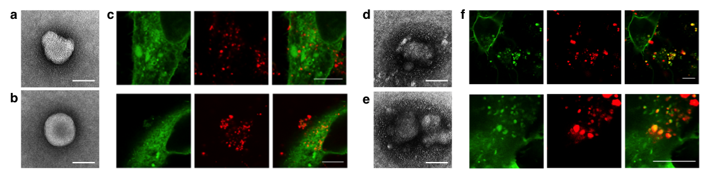
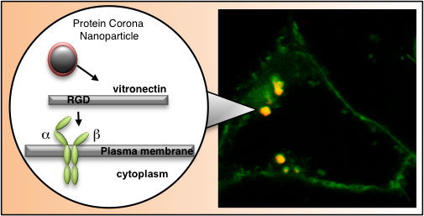
HEK 293 cells expressing
GFP-conjugated integrins
(GFP–α_{v} integrin coexpressed with untagged β₃ integrin)
The protein corona switches from aspecific internalization
to a receptor-mediated mechanism
101° Congresso della Società Italiana di Fisica – Roma, 21-25 settembre 2015

Slide 11
Future perspectives
Targeting prediction by bioinformatics
In vivo validation
Using the nanoparticle-protein corona for cancer biomarker discovery

Slide 12






Thank you for your attention and thanks to
Nanodelivery Lab Staff @ Sapienza
Giulio Caracciolo
Sara Palchetti
Valentina Colapicchioni
Luca Digiacomo
Department of Chemistry @ Sapienza
Aldo Laganà
IIT @ Nest
Francesco Cardarelli
101° Congresso della Società Italiana di Fisica – Roma, 21-25 settembre 2015

