Slide 1
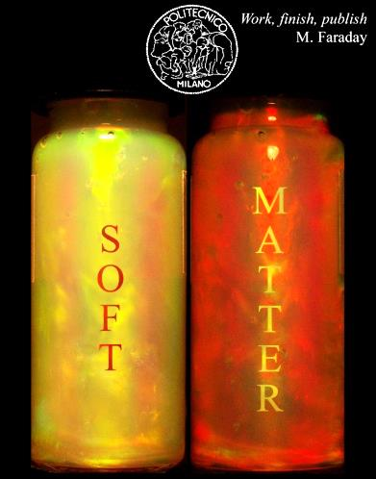
Roma, September 25, 2015
Roberto Piazza
SOFT MATTER
As a powerful testing ground for statistical physics

Slide 2
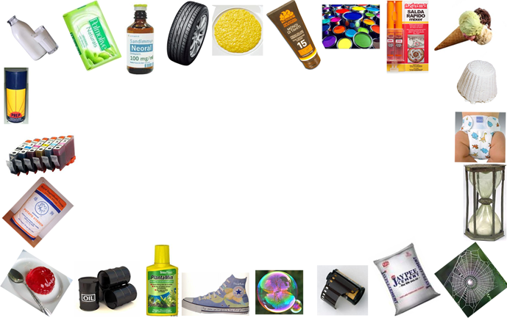
INTRODUCTION: Why bothering with soft matter?
BUT WHICH
NEW PHYSICAL INSIGHTS DO WE GAIN BY DEALING WITH SOFT MATTER?
SURELY, APPLICATIONS ARE GREAT!
ENVIRONMENTAL
Geology
Environmental safety
Waste disposal
CULTURAL
Restoration
HIGH TECH
New drugs
Biotechnologies
Photonics
Nanotechnology
PRIMARY
Agricolture
Mining & Oil
Chemistry
Building
Energy
CONSUMER MARKET
Food
Detergency
Cosmetics
Textiles
A THOUSAND BILLION $ MARKET!

Slide 3
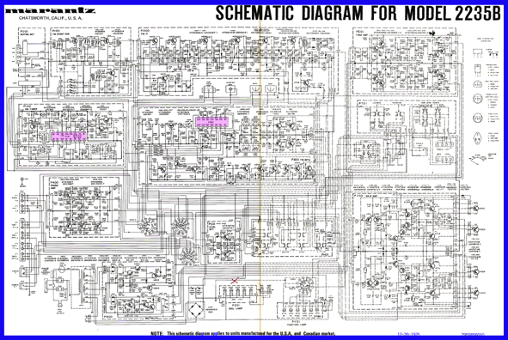
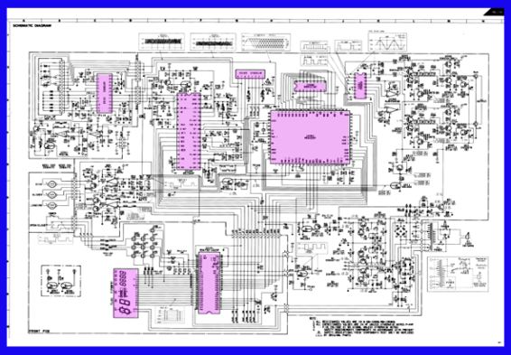
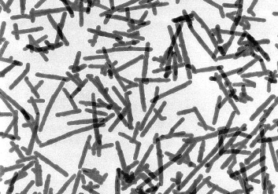
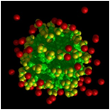

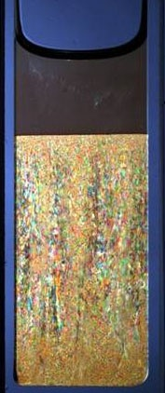
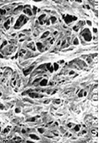
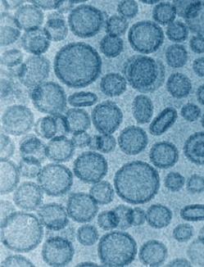
What is shared by all this stuff?
Marantz amplifier (’70s)
Hi-Fi amplifier (today)
A clue from the development of integrated electronics
A novel strategy in material science: building by mesoscopic blocks
FLEXIBILITY
SELF
ASSEMBLY
ANISOTROPY
VALENCY
SPHERES
FIBERS
PATCHYBALLS
POLYMERS
SURFACTANTS
THE “RAVE PARTY”
OF SOFT MATTER
COLLOIDAL CRYSTALS
LIQUID CRYSTALS
MOLECULAR-LIKE CRYSTALS
NETWORKS
MICELLES
VESICLES

Slide 4
But for statistical physics there is much more:
Colloids as model systems
The small components can be “traced out”, mapping the suspension onto a single-component system of particles interacting via effective forces
Actually, a complex multi-component mixture. However, since ρ_{p} << ρ_{s} …
PAIR INTERACTIONS (works just because $ρ_{p}≪ ρ_{s}$)
T-dependent
In fact,
a FREE energy!
Direct
interactions
Solvent-mediated
forces
“Volume” term (crucial in inhomogeneous systems)
TUNABLE POTENTIAL
(playing with solvent or additives)

Slide 5
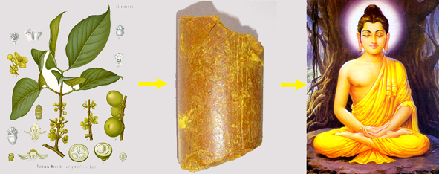
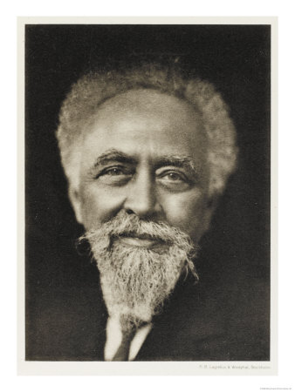
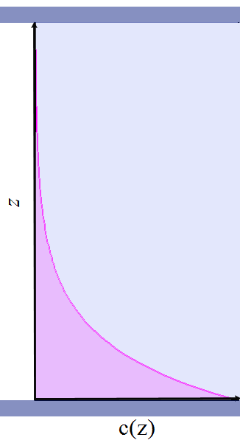
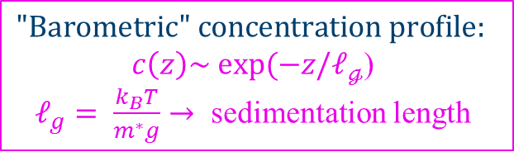
Back to the daybreak of statistical mechanics:
Perrin’s legacy
Gamboge:
the perfect yellow
BUDDHIST ATOMISM
4th century BCE: BASIC MODEL (4 kinds of atoms, corresponding to the standard elements)
7th century CE: FIELD THEORY (atoms point-like and made of pure energy)
1908: ATOMS DO EXIST!
From the equilibrium sedimentation profiles of a dilute emulsion of gamboge droplets:
a) Confirmation of Einstein/Smoluchowski theory of Brownian motion
b) Confirmation of equipartition of energy
c) Determination of Avogadro’s number
d) Estimate of the electron charge
Jean-Baptiste Perrin
Lille 1870 – New York 1942
Nobel Laureate
In Physics (1926)
“for his work on the discontinuous structure of matter, and especially
for his discovery of sedimentation equilibrium”
$$\text{"}\text{Barometric}\text{"} concentration profile:$$
$c\left(z\right)\sim exp⁡(−z/ℓ_{ℊ}$)
$ℓ_{g}= \frac{k_{B}T}{m^{∗}g}→$ sedimentation length

Slide 6

Novel milestones and riddles: a summary of this talk
PART A: Along Perrin's route (3 case studies)
A1) Order without attraction: crystallization of hard spheres
A2) Attraction without order: the weird world of short-range potentials
A3) Hyperstressed solids: foams and droplets beyond close packing
EXPLOTING, IN THE FOOTSTEPS OF PERRIN…
THE UNBEARABLE
HEAVINESS OF COLLOIDS
PART B: Driven and active matter (2 sketches)
B1) Thermal forces: moving matter with thermal gradients
B2) Frantic bacterial swarms: eddies, swirls, and pit-stops

Slide 7
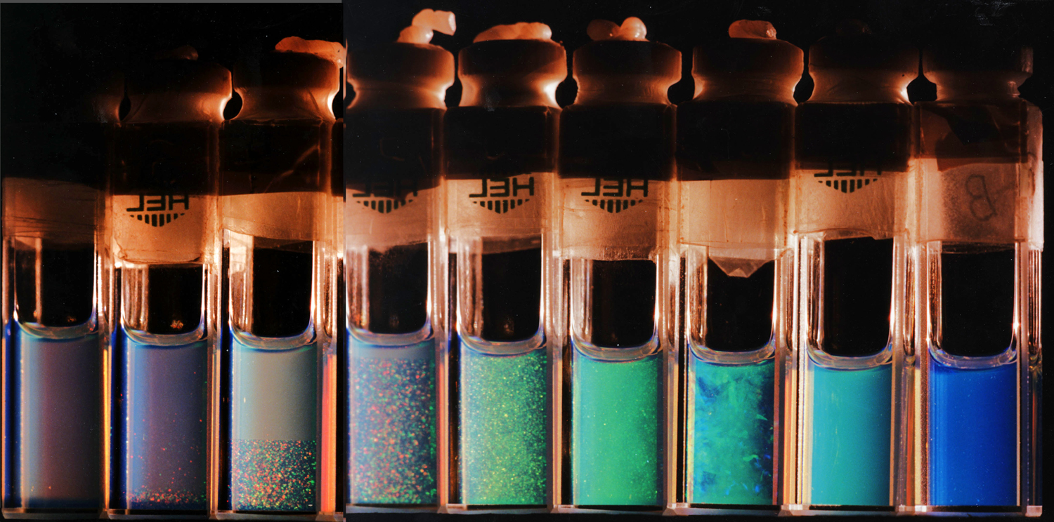

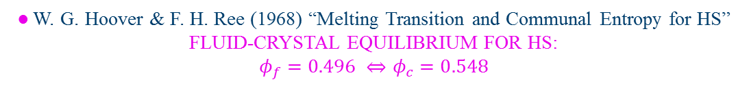



A1) Entropy brings order :
Crystallization of Hard Spheres
● J. G. Kirkwood (1939) “Molecular Distribution in Liquids”
…one would conclude therefore that a limiting density exists above which a liquid type of distribution and a liquid structure cannot exist. Above this density, only structures with crystalline long range order would then be possible.
● B. J. Alder & T. E. Wainwright (1957) “Phase Transition for a Hard Sphere System”
… for an infinite system a horizontal line must appear, characteristic of a first order phase transition which is strongly indicated by the present results.
● W. G. Hoover & F. H. Ree (1968) “Melting Transition and Communal Entropy for HS” FLUID-CRYSTAL EQUILIBRIUM FOR HS:
$$φ_{f}=0.496 ⇔φ_{c}=0.548$$
BUT DO HARD SPHERES REALLY EXIST?
● P. N. Pusey & W. van Megen (1986) “Phase behavior of concentrated suspensions of nearly hard colloidal spheres”
$$φ<0.49$$
FLUID
$$0.49<φ<0.55$$
FLUID + CRYSTAL
$$0.55<φ<0.58$$
CRYSTAL
$$φ>0.58$$
GLASS?

Slide 8
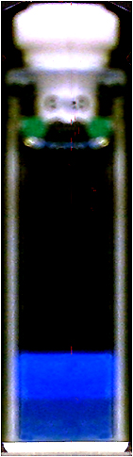

Beyond Perrin:
Sedimentation of concentrated colloids
R.P., Rep. Prog. Phys. 2014
When the net flux vanishes
If we are able to measure the
local particle concentration Φ(z)
GRAVITY
OSMOTIC PRESSURE
Top of the cell (∞)
Supernatant
(solvent)
z
Colloidal
fluid
Density mismatch with the solvent
Local volume fraction
Colloidal
crystal
From Π(z) and Φ(z) → Π(Φ)
The full equation of state in a single shot!
A suspension of particles (expected to behave as hard spheres) at sedimentation equilibrium after ≈ 6 months

Slide 9


Sedimentation equilibrium and the equation of state of Hard Spheres
S. Buzzaccaro & R.P., PRL 2007
Using Optically anisotropic (internally crystalline) spherical particles…
Profile from Depolarized Light Scattering
Equation of state from profile integration
Ideal gas
Colloidal fluid
Mean field e.o.s. for HS colloidal crystal
Z(Φ) =3/(1 – Φ/0.74)
Colloidal
crystal
Carnahan-Starling e.o.s. (NO fit parameter)

Slide 10
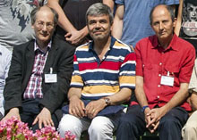
A2) The weird world of short-ranged potentials
ENTROPY FULLY AT WORK: DEPLETION FORCES
U(r)
MOLECULAR
SYSTEMS
SHORT-RANGED
ATTRACTION
⬧
Adding much smaller particles to a colloidal suspension generates effective attractive forces →
r
T
CP
LIQUID
SOLID
GAS
FLUID
CP
SOLID
TP
?
r
The liquid-gas transition becomes metastable with respect to freezing
IN OTHER WORDS, NO MORE “LIQUID”!
The entropy of the small spheres can be maximized by separating out the large ones
(muchos pocos hacen un mucho)
The large particles subtract free volume to the small ones (which dominate entropy)
BUT WHAT HAPPENS WITHIN THE L-G COEXISTENCE REGION?

Slide 11
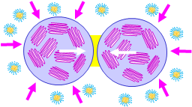
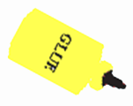
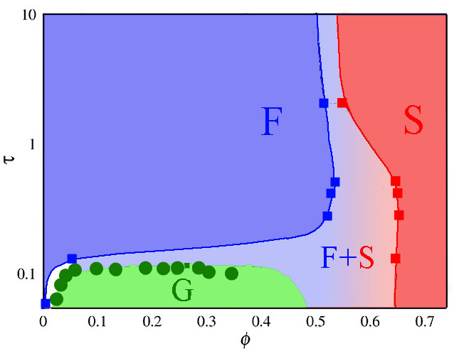
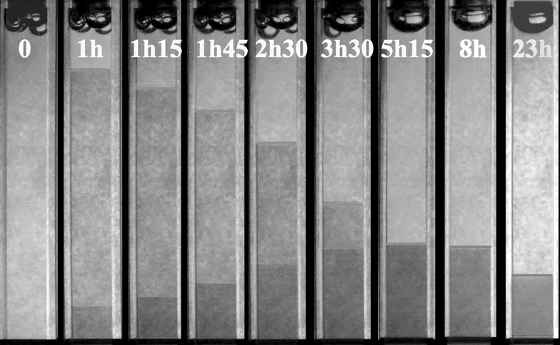
Sticky Hard Spheres:
Equation of state & Phase Diagram
S. Buzzaccaro & R.P., PRL 2007
σ
Depletion by surfactant micelles
A very short-range
attractive potential
size ratio
σ/R =0.03
U(r)
R
r
Akin to Sticky Hard Spheres
(a single “stickiness”parameter τ)
Close to OCP!
PHASE DIAGRAM
E.O.S. fitted as Sticky HS
SUPERFAST SETTLING
GELATION
DRIVEN BY
PHASE SEPARATION

Slide 12
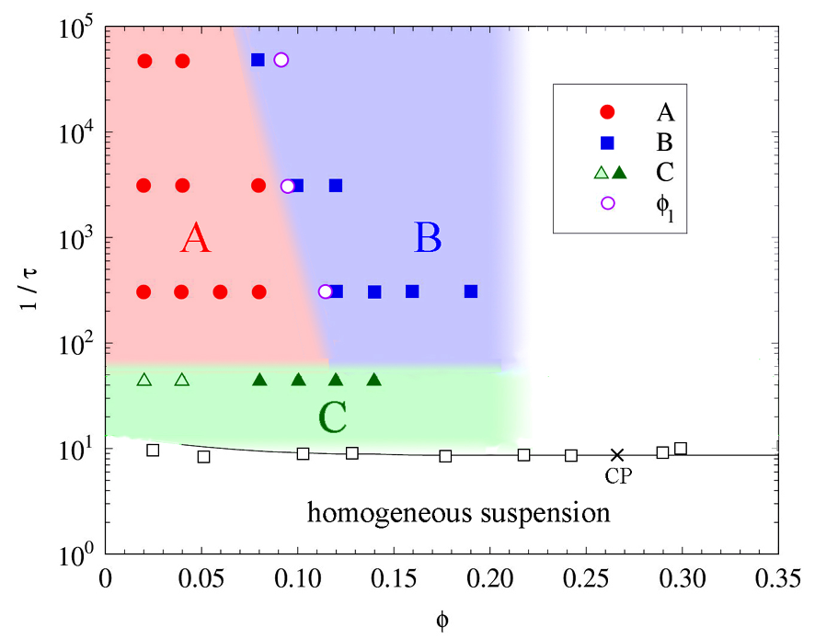
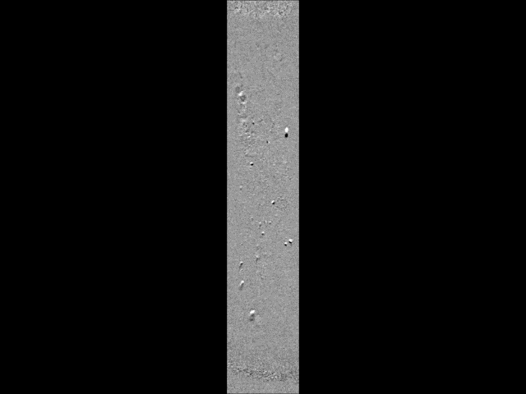
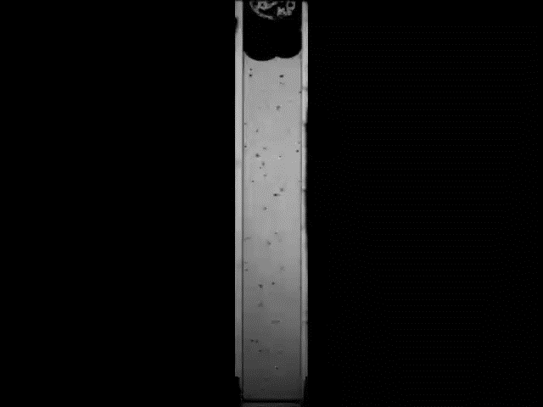
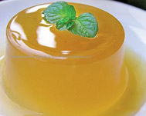
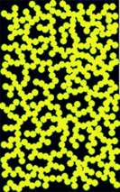
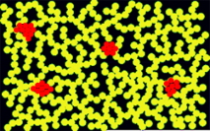
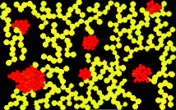

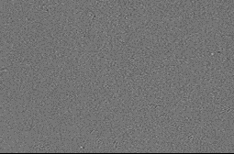
A single or several kinds of gel?
E.Secchi, S. Buzzaccaro, and R. P, Soft Matter 2014
Kinetics of settling
A
“collapsing” gels
B
“creeping”
gels
Late stage
Zero Poisson ratio! The gel compresses as a foam (or cork)
Early compression stage gravity-independent (similar to the syneresis of a polymer gel)
C: “nucleating” gels
Crystallites form within the gel, and grow until the stress they exert breaks the structure
Dendritic growth
Space-filling cellular pattern
What about patchy particles and "empty" liquids?

Slide 13

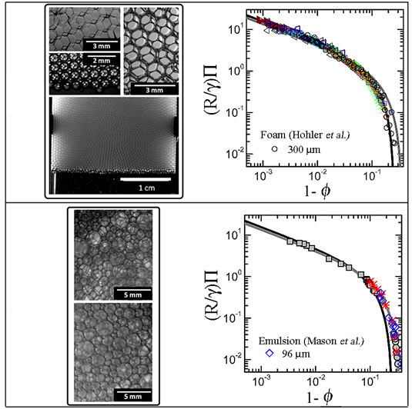
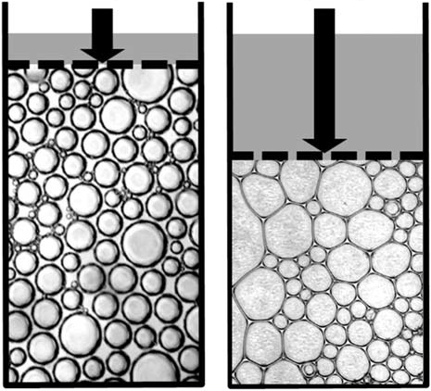
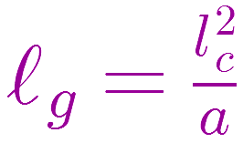
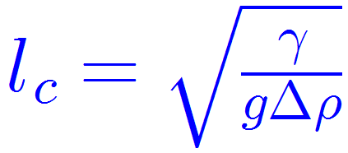
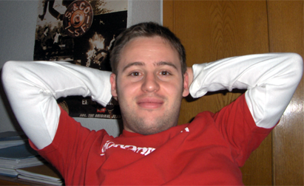
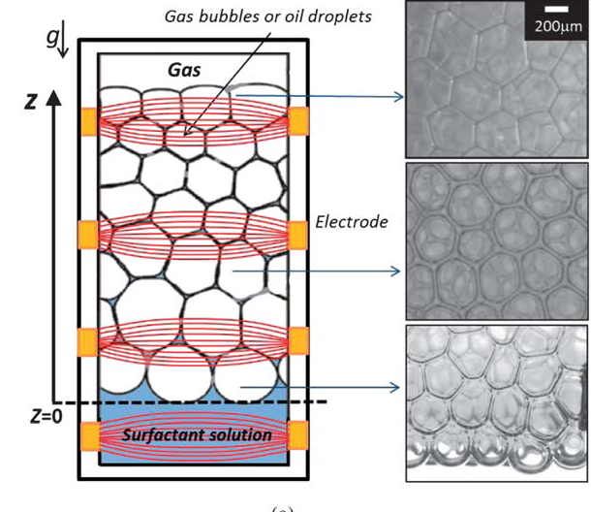

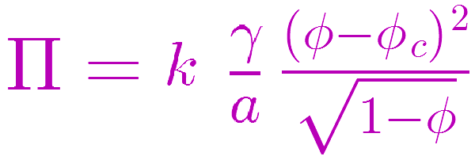
A3) An equation of state for cellular structures
A. Maestro et al., Soft Matter 2014
Osmotic membrane
ordered
Again, an integration of the concentration profile induced by gravity (acting as a “generalized membrane”) allows to reconstruct the elastic modulus Π(ϕ)
(Princen 1986)
Equivalent of the sedimentation length:
disordered
Armando Maestro
Capillary length
Wiebke Drenckhan
ordered: φ_{c} = 0.74
disordered: φ_{c} ≈ 0.64
A wide class of ordered and disordered
foam & emulsion systems
droplet size
So far, NO theoretical justification!

Slide 14
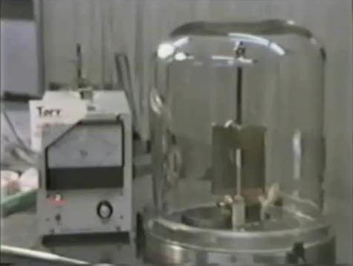
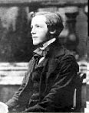






B1) Thermophoresis in a nutshell
R. P. & A. Parola, JPCM 2008
● In a temperature gradient, colloidal particles drift: WHY?
“Those who cannot remember the past are condemned to repeat it” (G. Santayana)
C
O
L
D
?
● “Thermal creep” in gases
HO
T
Most particles/polymers/surfactant aggregates/proteins migrate to the cold plate…but not all of them!
COLD
HOT
~λ
Natural convection vs. thermal creep
In rarefied gases
(Yoshio Sone, Phys. Fluids A ,1991)
● Stationary thermophoretic velocity acquired by a particle in a thermal gradient:
Momentum transfer
● The Ludwig-Soret effect in fluid mixtures and solutions
${\vec{v}}_{T}=− D_{T}\vec{ ∇}T$
Thermophoretic mobility
${(D}_{T}>0⟹ to the cold$)
“I propose to investigate if the final EQUILIBRIUM state is the same when the temperature is varying from one point to another in the liquid…This question was, to my knowledge, never treated before and a priori the answer cannot be given”
● Stationary state
(∇T along z)
$$\frac{dc}{dz}=cS_{T}\frac{dT}{dz}$$
Soret coefficient: $S_{T}=$ $\frac{1}{c}\frac{dc}{dT}=\frac{D_{T}}{D}$
STATIONARY STATE
(heat flows!)
● An intrinsic length scale:
MASS
heat
heat
$$ℓ_{T}={\left(S_{T}∇T\right)}^{−1}=\frac{v_{T}}{D}$$
$like{ ℓ}_{g}$!

Slide 15
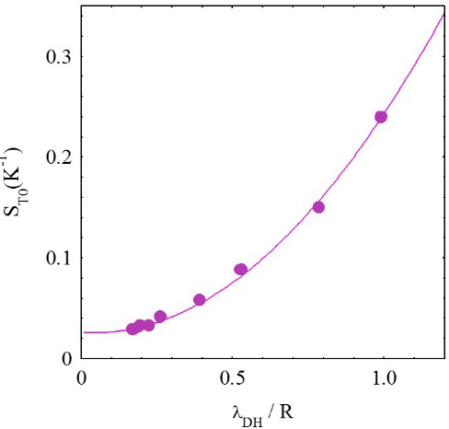
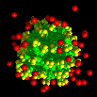
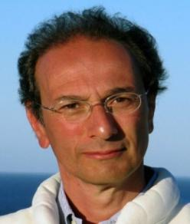
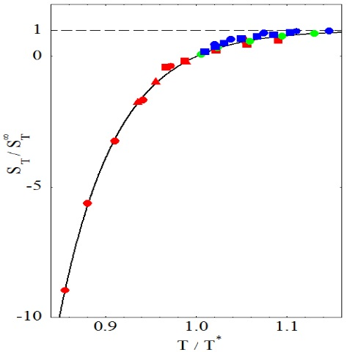
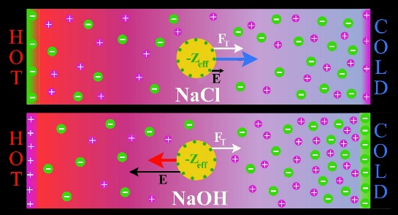

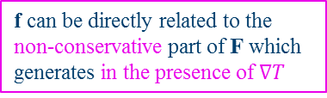

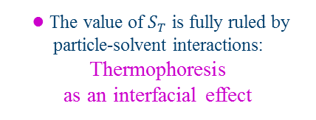


Some results and several open questions
● The value of $S_{T}$ is fully ruled by particle-solvent interactions:
Thermophoresis
as an interfacial effect
Charged surfactant micelles:
● Interfacial transport is common in soft matter (e.g.: electrophoresis). However, here:
i) There is no real external field
$$S_{T0}∝λ_{DH}^{2}$$
ii) There is no real equilibrium (just a stationary state)
● A. Parola starting point: Can we introduce a “fictitious” external force f leading to an equilibrium particle distribution that coincides with the steady-state profile induced by the thermal gradient?
E. Ruckenstein
KEY IDEA
The particle acts on the solvent as an external field F originating from direct particle-solvent interactions
● For aqueous systems of many kinds
(colloids, emulsions, proteins, DNA)
the T-dependence is universal:
● Using the NS eqq. for the fluid + Fokker-Planck eq. for the particle
f can be directly related to the non-conservative part of F which generates in the presence of $∇T$
Sign reversal with temperature!
● to the cold when it is hot
● to the hot when it is cold
(a kind of «macromolecular tourist»)
$$S_{T}=−β{f\left(∇T\right)}^{−1}$$
∇T
$$\frac{{S_{T}^{∞}−S}_{T}}{S_{T}^{∞}}=\exp\left[A\left(1−\frac{T}{T^{∗}}\right)\right]$$
● A simplified physical picture:
z
A kind of
“Munchausen bootstrap”
● In the presence of strongly
T-sensitive electrolytes:
a Seebeck-like effect!
But do we really need hydrodynamics?
Can we make a fully microscopic model in the spirit of the Langevin’s approach?

Slide 16


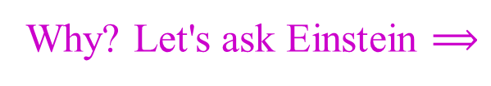

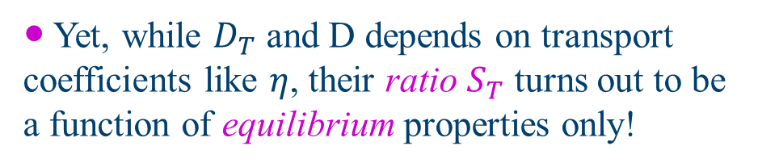


Non equilibrium stationary states
● Non-equilibrium → no partition function → no minimum free-energy criterium (even local)
$$n\left(z\right)=n_{0}e^{−z/ℓ_{g}}$$
$$n\left(z\right)=n_{0}e^{−z/ℓ_{T}}$$
● To obtain the stationary state, require using dynamic equations (Langevin, NS…)
$$\vec{J_{q}}≠0$$
$$\vec{g}$$
● Yet, while $D_{T}$ and D depends on transport coefficients like $η$, their ratio $S_{T}$ turns out to be a function of equilibrium properties only!
Why? Let's ask Einstein $⟹$
Physical equivalence justifies the use of an effective "thermal force"
Are stationary states, where matter attains a steady distribution, special nonequilibrium states?
Is there a simpler description for these special states, "borrowed" from equilibrium StatMec?

Slide 17
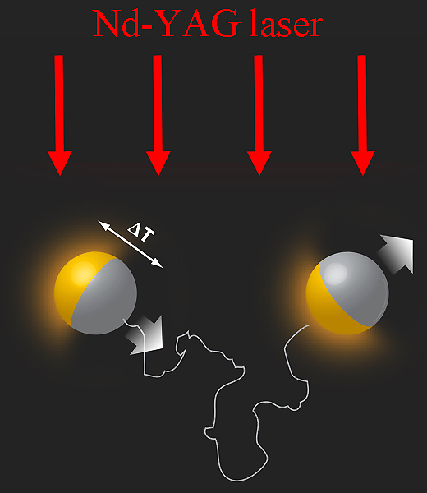
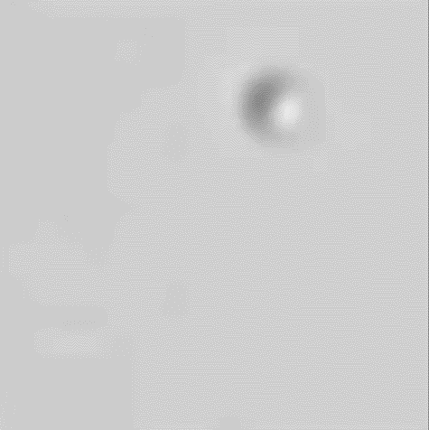
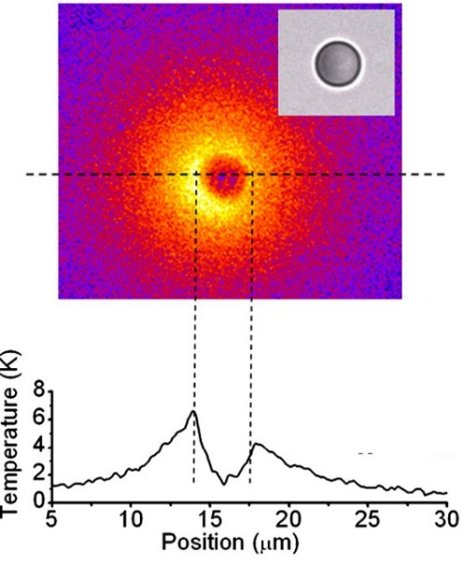

Self-thermophoresis
(Jiang et al., PRL 2010)
Gold-capped
1-3 μm silica spheres

Slide 18













A mob of thermally excited particles
Single Particle
(R. Golestanian, PRL 2012)
Propulsion velocity
Effective diffusion constant
$$v_{0}=\frac{εID_{T}}{6κ}$$
$εI$= absorbed intensity
$$D_{eff}=D_{0}+\frac{v_{0}^{2}}{6D_{r}}$$
$κ$= thermal conductivity
Persistence set by $rotational diffusion{ D}_{r}$
Collective Behaviour
● By introducing the Peclét number, $Pe=\frac{v_{0}R}{D},$and solving coupled equations for the density & temperature profiles
$$∇^{2}Ψ=−κ^{2}e^{∓Ψ}{ }$$
$$κ=4πℓρ_{0}$$
$$\left\{\begin{aligned}−f\text{or} S_{T}>0 \\ + for S_{T}<0\end{aligned}\right.$$
Where: $\left\{\begin{aligned}Ψ=\frac{\left|S_{T}\left[T\left(r\right)−T_{0}\right]\right|}{1+2/9Pe^{2}} \\ ℓ=\frac{εIR^{2}{|S}_{T}|}{2κ (1+2/9Pe^{2})}\end{aligned}\right.$
(rescaled T)
● Holds even for $v_{0}=0 (Pe=0)$,
namely, for uniformly absorbing particles too!
(intrinsic length)
$S_{T}>0 ⟹$"thermo-repulsive"
$S_{T}<0 ⟹$"thermo-attractive"
$$ΔT$$
Attraction or repulsion stems from asymmetric temperature profiles
$$ΔT$$

Slide 19










A "thermal Manning condensation" and a colloidal supernova
${● S}_{T}>0$($\text{thermo}\text{phobic} particles$): A Poisson-Boltzmann equation
$ℓ→$equivalent to Bjerrum-Landau length $ℓ_{B}$
$κ^{−1}→$equivalent to Debye screening length $λ_{DH}$
2D: cylinder
$$\frac{ρ_{mid}}{ρ_{edg}}≃{\left(\frac{2L}{Nℓ}\right)}^{2}$$
$$ρ_{edg}$$
$$L$$
Full analogy with strongly charged particles
(almost 1-component plasma, since $κ≪1)$
$$ρ_{mid}$$
like Manning condensation in DNA!
${● S}_{T}>0$($\text{thermo}\text{philic} particles$):
A SUPERNOVA CATASTROPHE!
Like the collapse of a Type I supernova into a white dwarf! (but dissipative)
$${ρ_{mid}}/{ρ_{edg}}$$
?
$$4πℓhN/L^{2}$$

Slide 20


Exploiting thermal forces at full power
A FLUID DRIVEN BY LIGHT
A NANO-GARBAGE COLLECTOR
Opto-thermal pumping
(F. Weiner & D. Braun, J. Appl.Phys 2008)
Opto-thermal conveyor belt
(F. Weinert & D. Braun, Nano Letters 2009)
Nonequilibrium thermal forces: an intriguing charming world!

Slide 21






B2) Intermittent bacterial turbulence
BACTERIAL TURBULENCE
● MOTIVATION: Many species of bacteria live in confined environments, where they attain very high cell densities. Living at close quarters with their conspecifics substantially alters the motility of bacteria: complex flow patterns emerge, characterized by the presence of continuously morphing eddies and jets, and suggestive of the turbulent flow of simple fluids at high Reynolds numbers.
● MAIN QUERIES: Just a qualitative analogy? What is the counterpart of the energy cascade in classical turbulence? Can any features typifying the onset of turbulence by spotted?
● KEY STRATEGY: Studying the forced flow of concentrated bacteria suspensions in a microfluidic geometry, by means of a novel optical correlation technique, Ghost Particle Velocimetry, allowing to reconstruct the full velocity filed even for dense suspensions where bacteria cannot be individually resolved.
Non-flowing bacteria
Velocity autocorrelation
● SYSTEM: Bacillus subtilis (4x1 µm) at very high concentration ($≈2×{10}^{10}$ cells ml⁻¹)
1 µm
$$g_{L}\left(r\right)→$$
Longitudinal
correlations
$$g_{T}\left(r\right)→$$
Transversal
correlations

Slide 22






Flowing bacteria
Flow in a μ-fluidic channel at low flow rate $(190{μm}/{s ⟹}$ shear rate $S=2.2 s^{−1})$
Time-lapse frames
(fluctuations on a fixed section)
STRONG, INHOMOGENEOUS
VELOCITY FLUCTUATIONS
velocity profiles
Comparison with $"$k$illed"$ bacteria
Parabolic
Plugged
Fluctuations decrease and vanish with S
The strongest spatial intermittency occurs for the lowest flow rate ~100 µm s⁻¹, approximately twice the characteristic velocity of bacterial turbulence in the absence of flow (~40 µm s⁻¹).
NO concentration fluctuations!

Slide 23




Is it true intermittency?
Q: Do bacteria really “switch on and off” or are they simply advected by the flow?
A: Follow the motion in time of a given volume element (Lagrangian description)
Statistical description of turbulence
(standard Reynolds’ decomposition of the NS equation)
● Write: $U\left(x,y,t\right)=V\left(x,y,t\right)+u(x,y,t)$
with ${\left\langle u\left(x,y,t\right)\right\rangle }_{t}=0$ (fluctuating component)
● Define the (2D) intensity of turbulence as:
$$I\left(t\right)=\sqrt{u_{x}^{2}\left[x\left(t\right),y\left(t\right),t\right]+u_{y}^{2}\left[x\left(t\right),y\left(t\right),t\right]}$$
(at channel mid-depth: $u_{z}≪u_{x},u_{y}$)
● Reynolds’ stress tensor: $τ_{ij}=−ρ{\left\langle u_{i}u_{j}\right\rangle }_{t}$
True intermittency!

Slide 24




Open questions
● Bacterial “turbulent” motion is known to lower the viscosity of the suspension
● In a statistical description of turbulence, reduction of the effective viscosity requires a “promoting” Reynolds stress, namely, that $τ_{ij} \text{and} η∂V_{i}/∂x_{j}$ have opposite sign.
● Correlations between $u_{x}$ and $u_{y}$
do exist, and have the correct sign
● Quantitatively, however, they are far too small to justify the large reduction in viscosity.
● The main question: what is the “machinery” of bacterial turbulence?
High Re turbulence: the energy “cascade”
Energy is supplied at the largest spatial scale and dissipated at the viscous scale
Bacterial turbulence:
Energy is supplied at the scale of bacteria, goes up to the scale of the largest eddies,
and must be eventually dissipated again at the viscous scale…
…what is the origin of this “energy yo-yo” ?
E. Secchi et al.
submitted to Science...
then to Nature Physics…
then to Nature Comm…
then…

Slide 25

Summing up, I just hope I made you wonder whether…
…soft matter may also be matter for physicists!
Thank you and arrivederci
from the whole
Soft Matter Lab!

