Slide 1
Algebraic reconstruction algorithms applied to proton computed tomography data
M. Bruzzi^{1,2}, M. Brianzi², M. Carpinelli^{3,9}, G.A.P. Cirrone⁴, C. Civinini², G. Cuttone⁴, D. Lo Presti^{5,8},G. Maccioni³, S. Pallotta^{2,6,7}, N. Randazzo⁸, M. Scaringella², F. Romano⁴, V. Sipala^{3,9}, C. Stancampiano^{5,8}, C. Talamonti^{2,6,7}, E. Vanzi¹⁰
^{Prima – RDH Collaboration}
¹Physics and Astronomy Department, University of Florence, Florence, Italy
²INFN - Florence Division, Florence, Italy
³INFN Cagliari Division, Cagliari, Italy
⁴INFN - Laboratori Nazionali del Sud, Catania, Italy
⁵Physics and Astronomy Department, University of Catania, Catania, Italy
⁶Department of Biomedical, Experimental and Clinical Sciences, University of Florence, Florence, Italy
⁷SOD Fisica Medica, Azienda Ospedaliero-Universitaria Careggi, Firenze, Italy
⁸INFN - Catania Division, Catania, Italy
⁹Chemistry and Pharmacy Department, University of Sassari, Sassari, Italy
¹⁰ Fisica Sanitaria, Azienda Ospedaliero-Universitaria Senese, Siena, Italy
Società Italiana di Fisica – Congresso Nazionale 2015
Roma 22/09/2015

Slide 2
Introduction
Proton Computed Tomography (pCT): apparatus and principle of operation
Algebraic Reconstruction Technique (ART)
Proton Most Likely Path (MLP)
    ART results from 62 MeV beam test (INFN-LNS Catana line)
Two pCT systems:
  5x5cm²
  5x20cm²
    Under construction

Slide 3
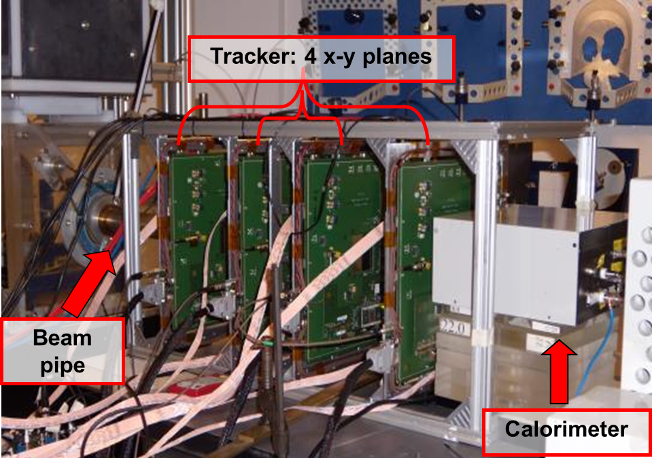
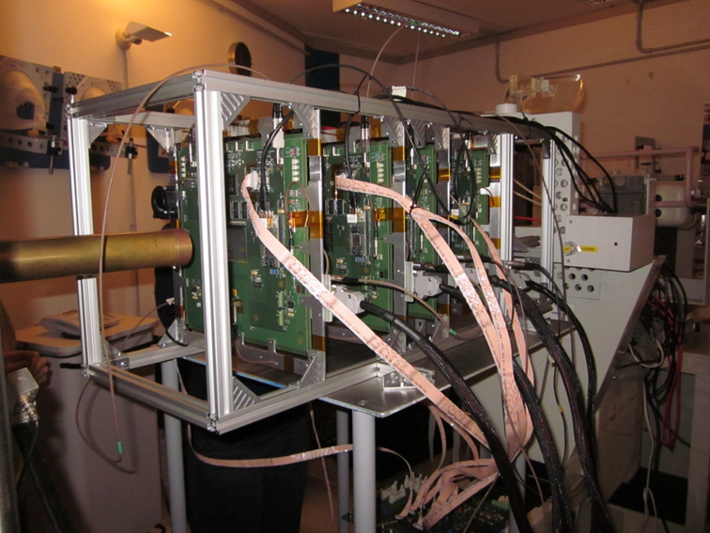
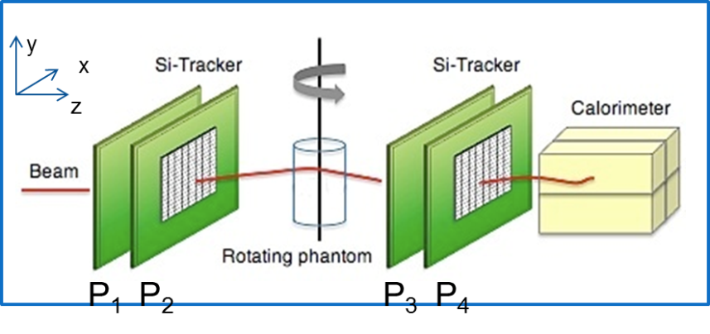
PRIMA collaboration: small area pCT apparatus
CATANA beam line:
62 MeV protons
used to treat ocular tumors
Four x-y silicon microstrip based
tracking planes
Yag:Ce calorimeter
Proton entry and exit positions and directions
Proton residual energy

Slide 4
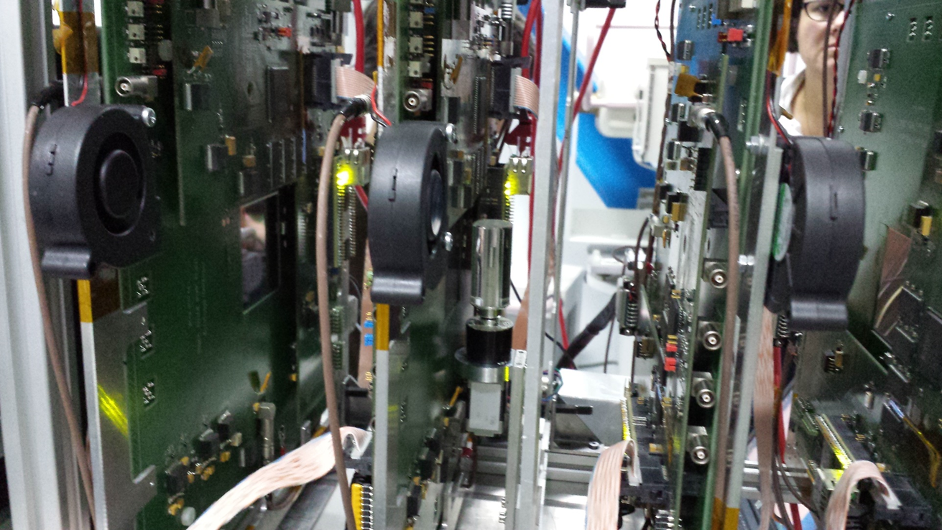
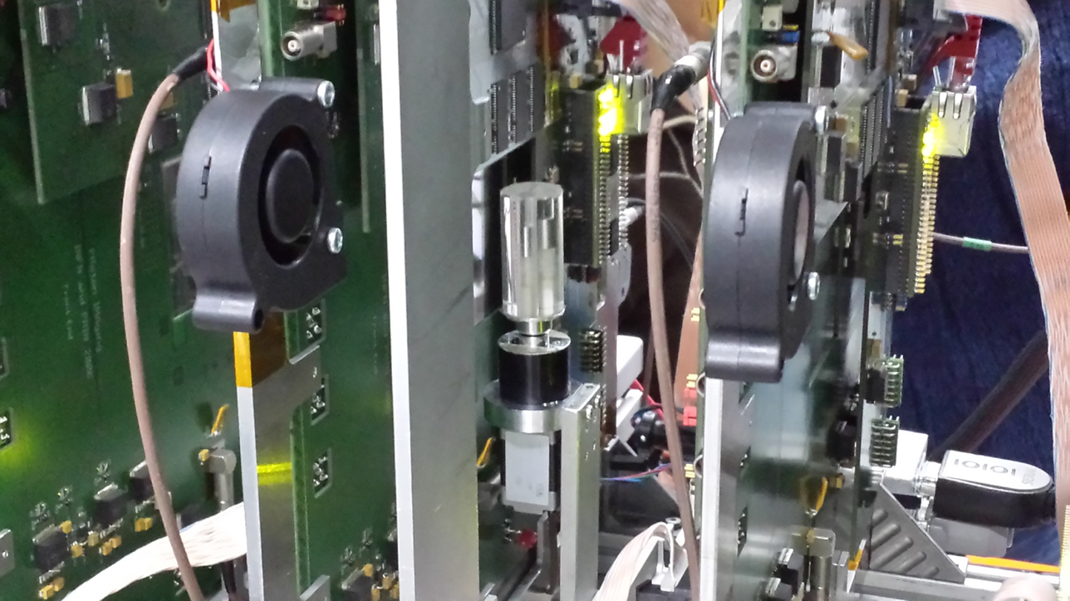
Tomografic set-up

Slide 5
Algebraic Reconstruction Techniques
Iterative algorithm to reconstruct tomographic images (proton stopping power maps) from ‘projections’ (for pCT set of single proton events)
Starting point (S(x,y,E) stopping power):
Introducing the mass stopping power S/ρ:
E₀ = a fixed energy (200 MeV or ... 60 MeV in our case)

Slide 6
Algebraic Reconstruction Techniques
Dividing by S/ρ at energy E:
The left hand side doesn’t depend too much on the material composition (~2-4*10⁻³) and could be replaced by the one measured for liquid water (NIST pstar tables - http://physics.nist.gov/PhysRefData/Star/Text/PSTAR.html):

Slide 7
Algebraic Reconstruction Techniques
Integrating along the proton path:
E_{in} is given by the accelerator, E_{out} by the calorimeter and the ‘path’ by the tracker (Most Likely Path)
Subdividing the object into a set of pixels, for the i^{th} proton:
Where w_{ij} is the path length of proton i inside the pixel j
Wang, Med.Phys. 37(8), 2010: 4138

Slide 8
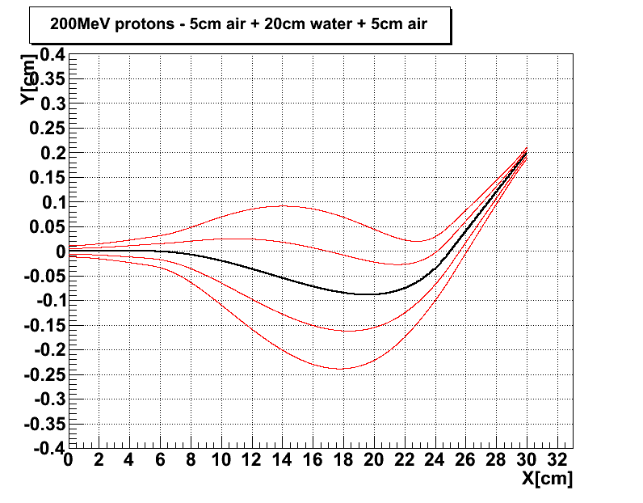
Pixel 1
Pixel j
Phantom: 20 cm of water
p out 90 MeV
Computational challenge: find the simplest (fastest) way to build the w_{ij} matrix (could have billions of elements, most of them equal to zero)
p in
200
MeV
w_{ij}
Pixel N

Slide 9
Algebraic Reconstruction Techniques
The problem is then to solve, for S_{j}, the following set of equations:
N = number of pixels; M number of protons
In our case:
  N = (250x250)=62500 pixels
  M ~ 36(angles)*10⁶ events

Slide 10
Algebraic Reconstruction Techniques
The system could be solved using an iterative formula:
S^{k+1}= S^{k} + λ_{k} {(p_{i} - <w^{i},S^{k}>) w^{i}} / ǁw^{i}ǁ²
Gordon, R; Bender, R; Herman, GT J. Theor. Biol. (1970) 29 (3): 471–81.
S^{k} image vector at iteration k (stopping power)
w^{i} i^{th} track length in each pixel (vector) → Tracker
p_{i} stopping power integral (number) → Calorimeter
λ_{k} relaxing factor (constant value or →0 as ~k⁻¹)
S⁰ initial image: {0} or approx (i.e., from FBP reconstruction).

Slide 11
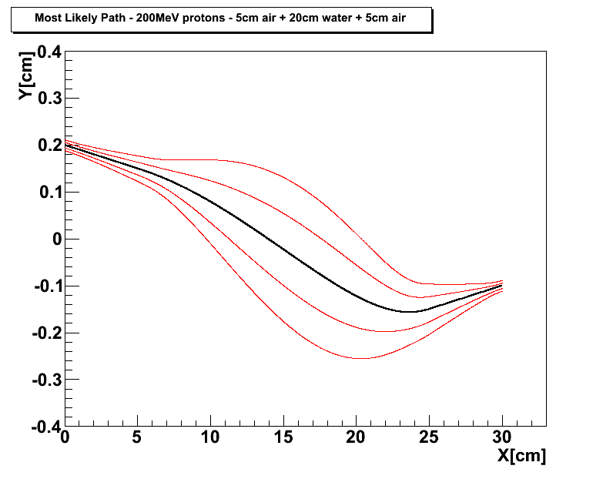
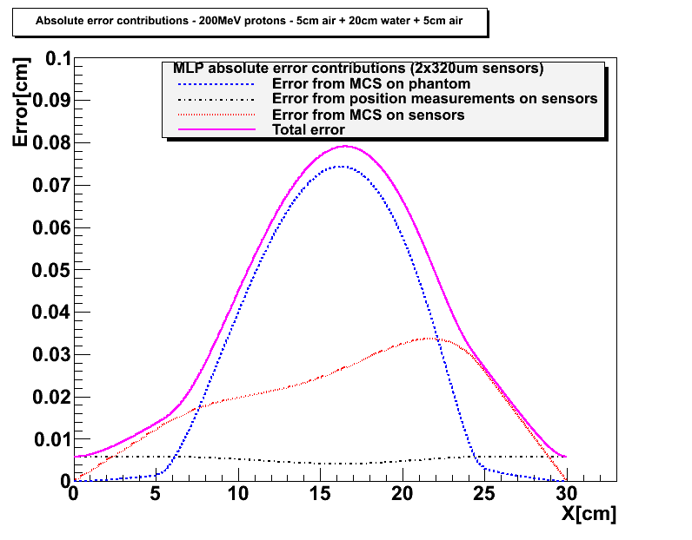
Most Likely Path in a pCT geometry
Starting from D.C. Williams Phys. Med. Biol. 49 (2004) and R.W. Shulte at al. Med. Phys. 35 (11) (2008)
5 cm of air have been inserted in front and behind the 20cm H₂O phantom
MLP example with 200MeV
kinetic energy protons in
20cm of water:
Entry: Y(0) = 0.2cm
Y’(0) = -10mrad
Exit: Y(20) = -0.1cm
Y’(20) = +10mrad
Silicon microstrip detectors:
320μm thick
200μm strip pitch
MLP error envelope plus contributions from detector position measurement error (~ pitch/√12) and MCS inside the silicon sensors →
The sensor thickness contribution affects only the MLP error at the edge of the phantom
σ ~ 150-250μm
200MeV in
90MeV out

Slide 12
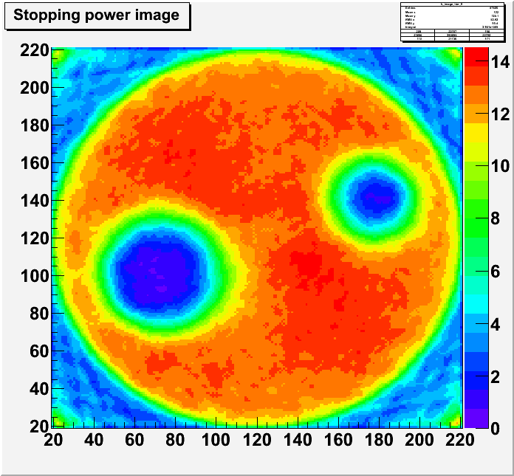
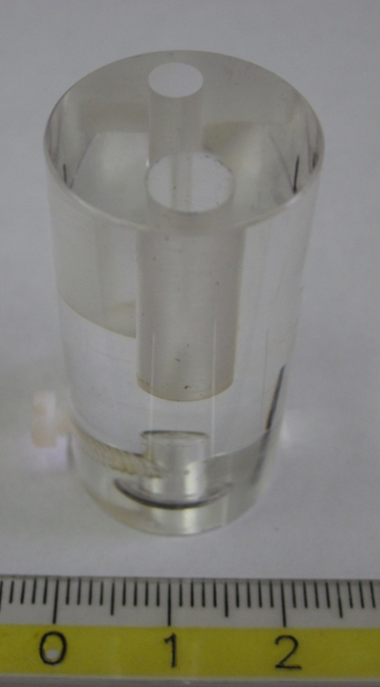
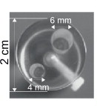
ART images from 62 MeV data
PMMA
phantom
x100μm
cm
ART reconstruction:
14 iteration starting from {0}
~ 10⁶ events per angle
(36 angles)
4mm vertical slice selected
(2D only)
~4’ per iteration CPU time
1 cm
x100μm

Slide 13
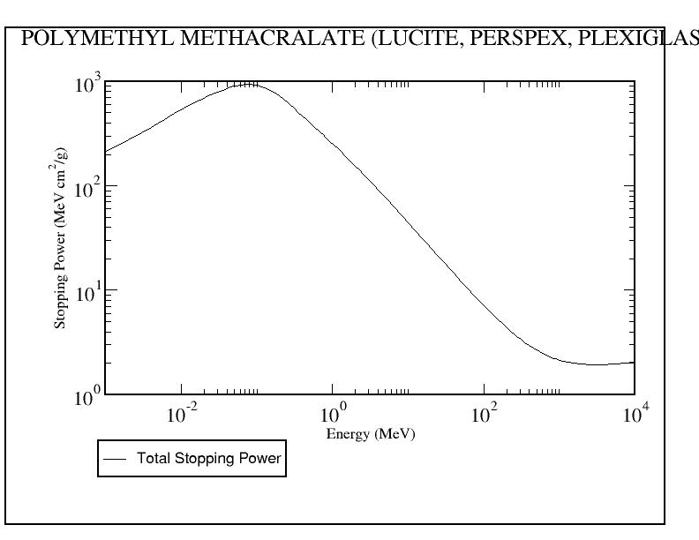
PMMA mass stopping power
(from NIST database)
S/ρ(E₀=60MeV)=
10.5 MeVcm²/g
ρ_{PMMA}~1.19 gcm⁻³
60 MeV
S(E₀=60MeV)=
12.49 MeV/cm
Compatible with the ART reconstructed value

Slide 14
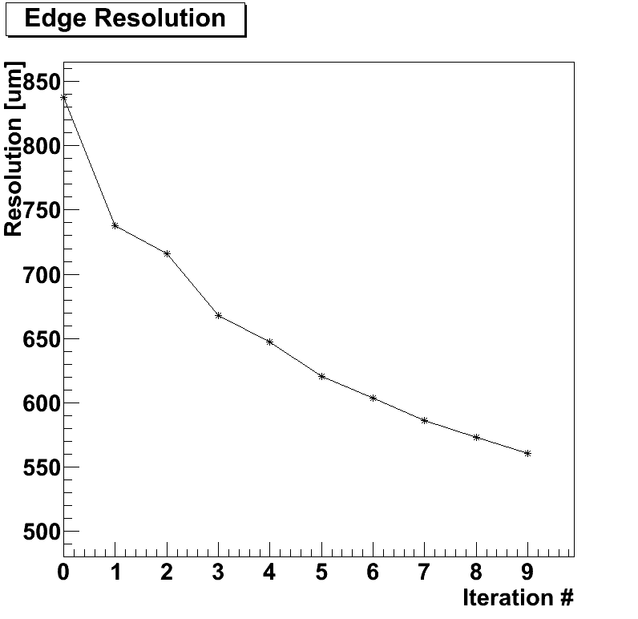
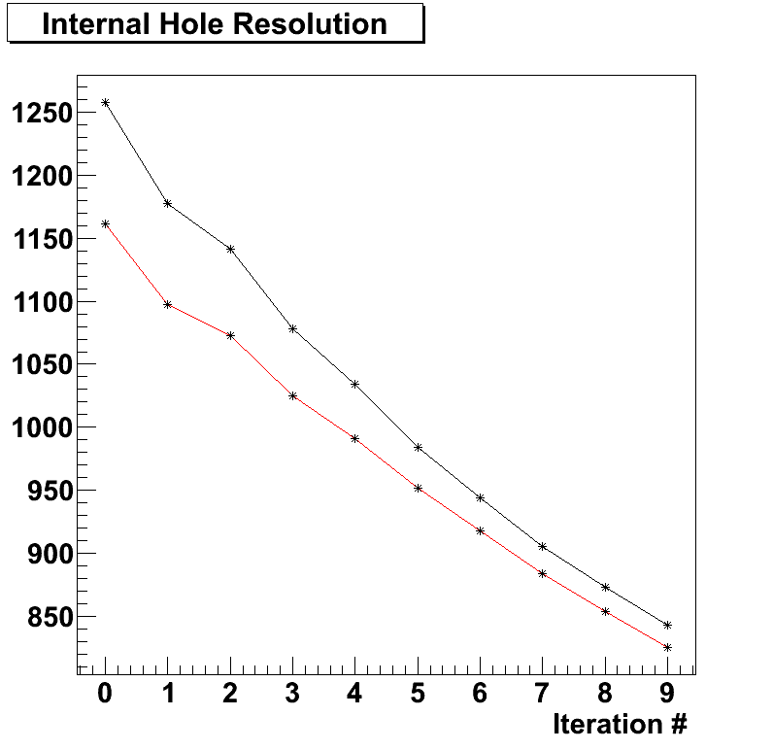
ART images from 62 MeV data
Resolution [μm]
Small hole
Large hole
Starting image = {0}, still room to improve

Slide 15
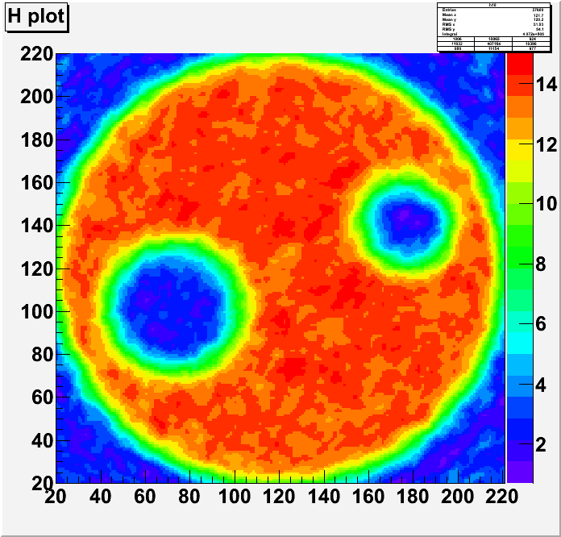
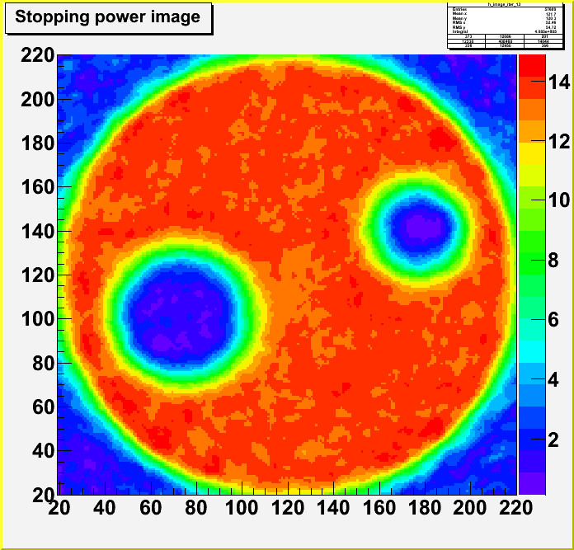
FBP used as seed for ART
x100μm
x100μm
x100μm
x100μm
FBP initial image →
ART after 14 iterations starting
from FBP seed
Vanzi E. et al., Nucl. Instr. and Meth. A 730 (2013) 184-190

Slide 16
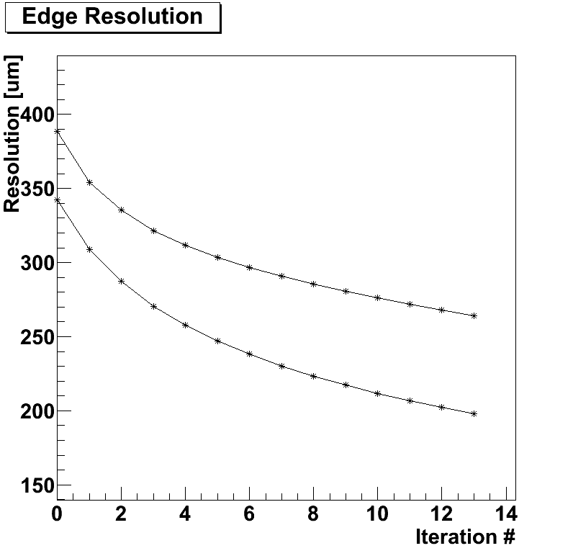
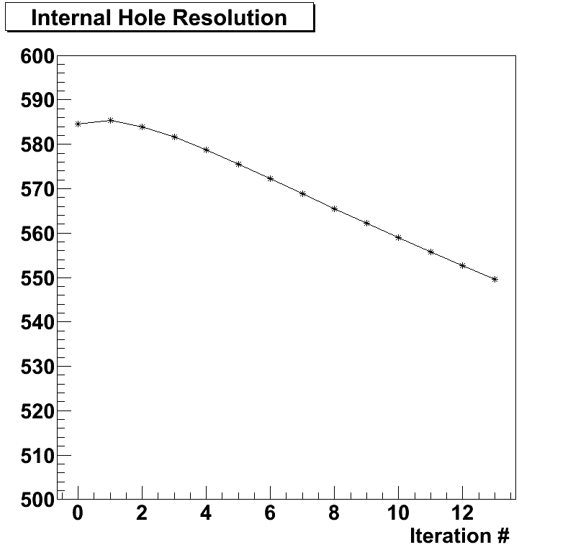
ART Resolutions
Resolution [μm]
Two different edge
Positions
Inner holes:
resolution affected by
multiple scattering
External edges

Slide 17
Conclusions
The Prima/RDH pCT ‘proof-of-principle’ apparatus has been tested at 62 MeV (INFN-LNS, Catania) and 175 MeV (Svedberg Laboratory, Uppsala)
FBP and Algebraic algorithms have been used to reconstruct tomographic images taken at 62 MeV
The use of ART improves the spatial resolutions obtained with FBP
ART is able to handle arbitrary proton paths (most suitable for pCT analysis) but should be carefully implemented to keep the reconstruction time at a reasonable level
A larger field of view pCT apparatus is under construction

Slide 18

pCT upgrade (5x20cm²)
A system similar to the one already tested
  Microstrip tracker
  YAG:Ce calorimeter
But with a 50 x 200 mm² field of view
On-line data aquisition
1 MHz capability
Rectangular aspect ratio to perform tomographies in slices
Phantom
Beam pipe
Tracker planes
Silicon sensors
Calorimeter

Slide 19
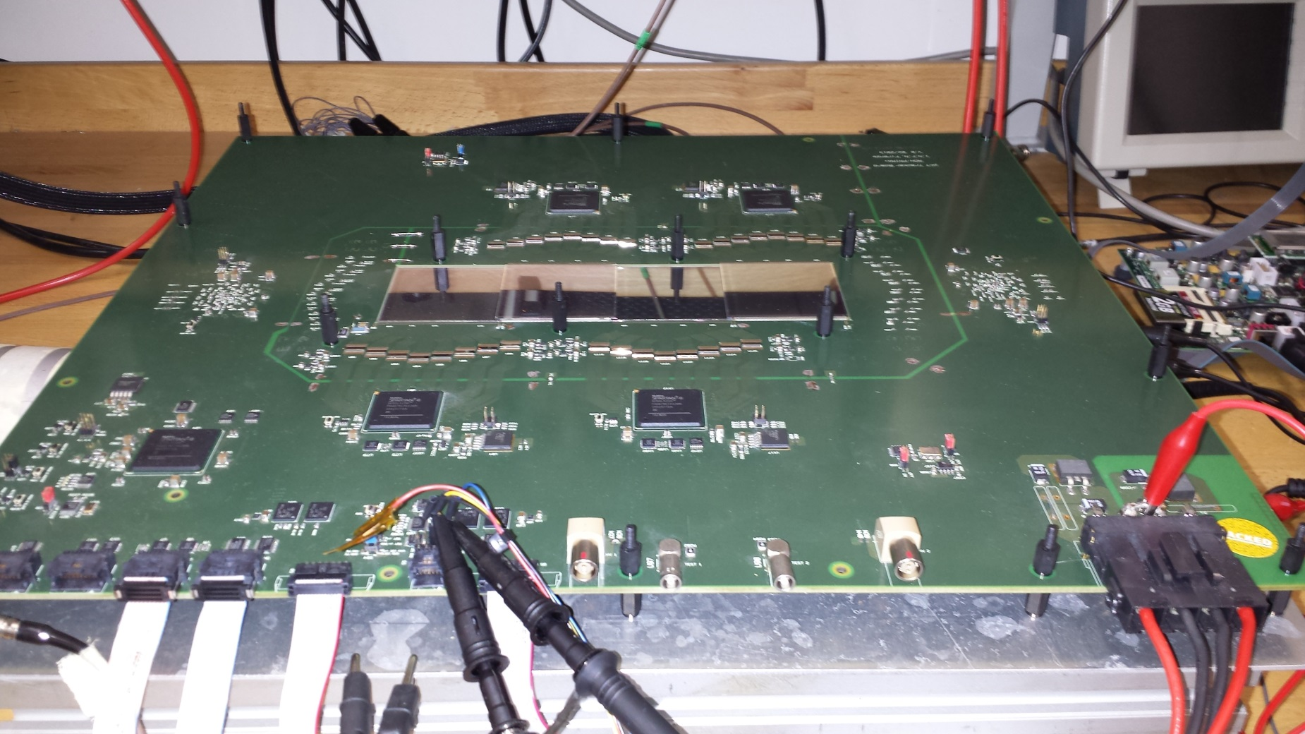
Fully assembled Tracker plane
Chip front-end
Silicon μstrip
Master FPGA
Virtex6
Slave FPGAs

Slide 20
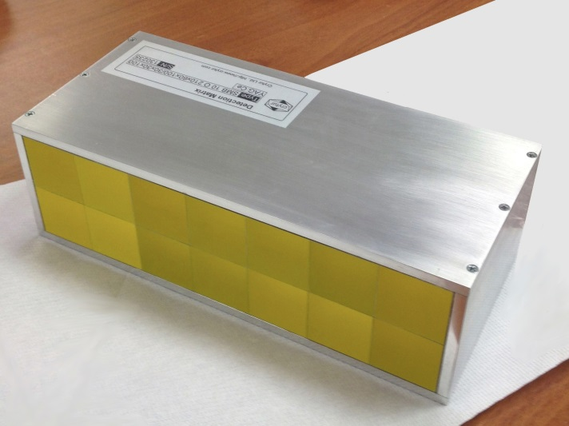
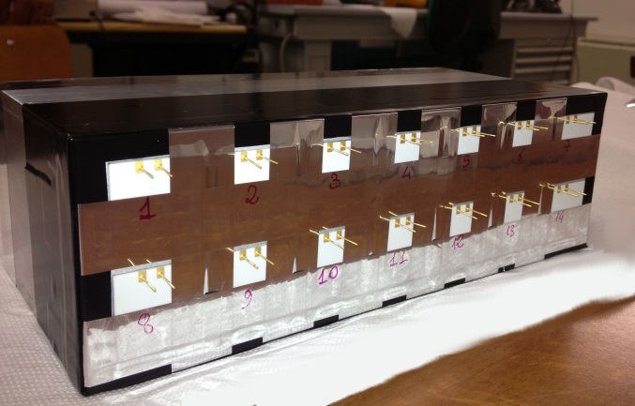
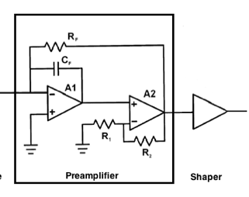
YAG:Ce calorimeter
Data Acquisition System
2x7 YAG:Ce Crystals Array
Size: 3x3x10cm³
FlexRIO
NI PXIe-7962R
CHASSIS NI PXIe-1071
Ad.Mod.
NI-5751
14 Analog Channels
Parallel read-out
Sampling: 5MS/s
24 Samples x event
RT Controller
NI PXI-8102
7Dig I/O GEN
Dig. Trigger
Disable Trigger
Silicon Photodiodes 1.8x1.8cm²
Tracker
x14
Fast Charge Amplifier + Shaper

