Slide 1
Electronic structure of adsorbed organic precursor toward graphene nanoribbons
101° congresso della Società Italiana di Fisica
Avvisati Giulia
Della Pia A., Ourdjini O., Massimi L., Mariani C., Betti M.G.
Notes:
Good morning to you all, I am here to talk to you about the electronic structure of adsorbed organic precursor toward graphene nanoribbons formation, whose evolution has been monitored with valence-band photoemission spectroscopy.

Slide 2
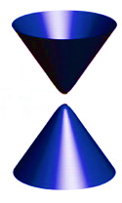
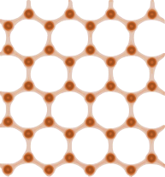
Graphene nanoribbons
Berger C. et al., Science 312, 1191-1196 (2006)
Geim A.K. et al., Nature Mat. 6, 183-191 (2007)
Raza H. et al., Phys.Rev.B 77, 245434 (2008)
Why quantum confinement?
to tunable band-gap
semiconductor
from semimetallic
$$k_{T}=\frac{nπ}{W}$$
$$∆E=∆E(W)∝\frac{1}{W}$$
W
Ambipolar transport
High mobility
Notes:
First of all I want to clarify why we are interested in studying graphene nanoribbons, which are quasi-one-dimensional carbon allotrope. In this configuration in the usually semimetallic graphene band structure, thanks to quantum confinement, a width-dependent band gap opening is achieved, but mantaining the excellent transport properties of graphene. This means that, thanks to quantum confinement an excellent semiconductor with tunable band-gap, inversely proportional to the ribbon’s width, which could be exploited for the fabrication of electronic devices.

Slide 3
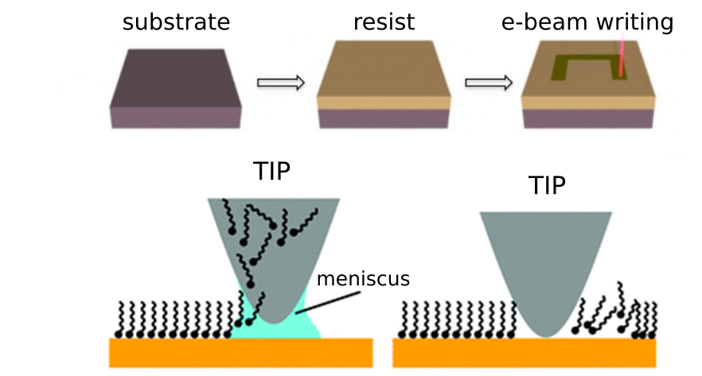
Graphene nanoribbons: lithography
How to obtain quantum confinement?
Han M. et al., Phys.Rev.Lett. 98, 206805 (2007)
Giesbers A.J.M. et al., Sol.Stat.Comm. 147, 366-369 (2008)
Tapaszto L. et al., Nature Nanotech. 3, 397-401 (2008)
Top-down lithographic approaches
Cheap
GNR with different
shapes and width
Too wide (>10 nm)
GNR
Rough edges
Notes:
But how to achieve quantum confinement? As often happens in nanoscience a first attempt has been made by using top-down lithographic techniques, such as electron beam litography and scanning probe lithography. In this way it is possible to cheaply fabricate GNR with different shapes, width and oriented along various crystallographic direction. However, the GNRs obtained in this way are generally to wide, which means that exhibit no technologically interesting band-gap value, and with rough edges on the nanometric scale. This could result in the appearence of electronic states inside the band gap, thus vanishing the effort.

Slide 4
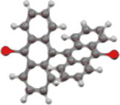
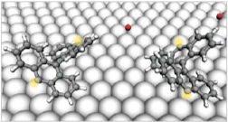
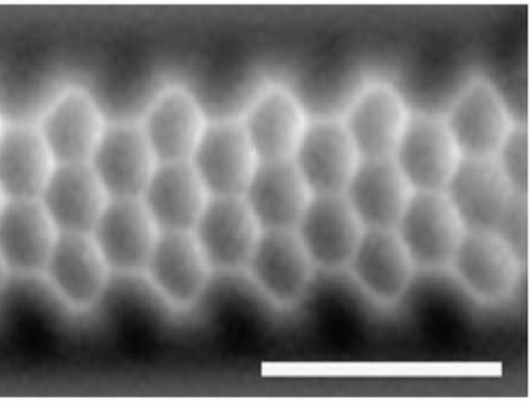
Graphene nanoribbons: molecular precursor
Bottom-up approach
Key ingredients:
Molecular precursor
Catalytic substrate
Atomic precision!
1 nm
Cai J. et al., Nature 466, 470-473 (2010)
van der Lit J. et al., Nature Comm. 4, 2023 (2013)
Notes:
In 2010 a new route has been established and GNR where grown by using a bottom-up approach. A suitable precursor monomer is chosen, in this and in our case the DBBA molecule which is essentially composed by two bromo-terminated anthracene units, and deposited on a substrate. During deposition it undergoes dehalogenation and, during an annealing at 470K, the radical diffuse on the surface and connect to each other, forming a linear polymer. A final annealing at 670K allow the breaking of the inner CH bonds and the formation of the fully aromatic GNR and, with this bottom-up approach, atomic precision is finally achieved. We see that the key ingredients in this process are the molecular precursor, which has been chosen because of the fact that C-Br bonds are weaker than C-C bonds and so can be selectively broken without compromising the quality of the final results. And the substrate which have to catalyze the reactions but without forming chemical bonds, for this aim gold surfaces seem an appropriate choiche.

Slide 5
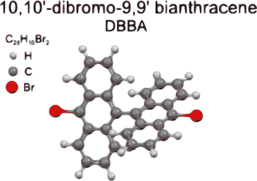
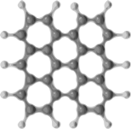
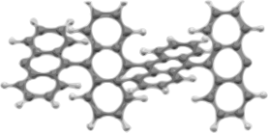
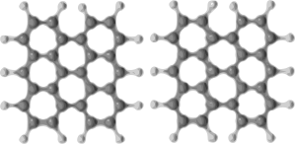
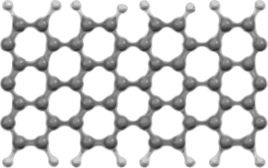
Our choice: DBBA/Au(110)
Massimi L. et al., J.Phys.Chem. C 119, 2427-2437 (2015)
RT deposition
HT (470K) deposition
300K, intact molecule
0.1 SL, bisanthene
400K, polyanthryl
Temperature
0.5 SL, bisanthene
chains
Coverage
700K, GNR
1.0 SL, GNR
Notes:
In particular the 110 surface of gold, anisotropic and easily reconstructed, allows to not only catalyze the process but also to control the GNR growth alignment. For this particular monomer-substrate combination to different procedure leading to graphene nanoribbons formation have been identified. The first one starts with the deposition of the molecular precursor on the substrate kept at room temperature and, as for the previously described procedure, the different steps of the process, polymer and GNR, are identified by the annealing temperature. The second procedure requires to deposit the molecules on the substrate kept at 470 K, in this way the monomers undergoes debromination and dehalogenation simultaneously and already during deposition so the different steps are identified by the quantity of deposited molecule: at very low coverage we find isolated monomers but, if we deposit more, we increase the probability that two monomers are found near and, at the completion of the first single layer, they cohalesce and form GNR.

Slide 6
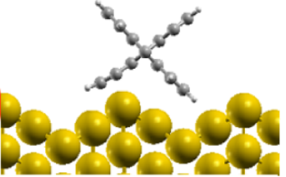
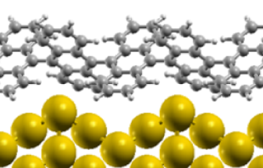
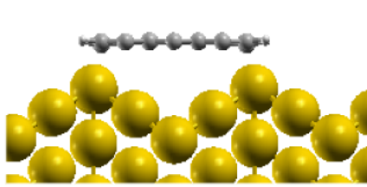
Electronic properties: from DBBA to GNR
Chemical species involved in the process of GNR formation:
DBBA molecule
polyanthryl
nanoribbon
Massimi L. et al., J.Phys.Chem. C 119, 2427-2437 (2015)
Della Pia A. et al., to be published
Notes:
So the chemical species involved in the process are essentially dbba molecule, polyanthryl and bisanthene. Let’s start with characterizing the precursor monomer, that completely determines the subsequent phases.

Slide 7
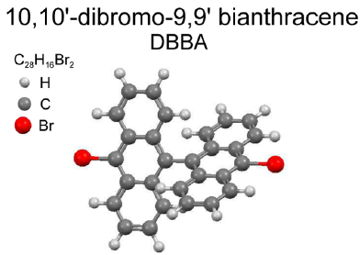
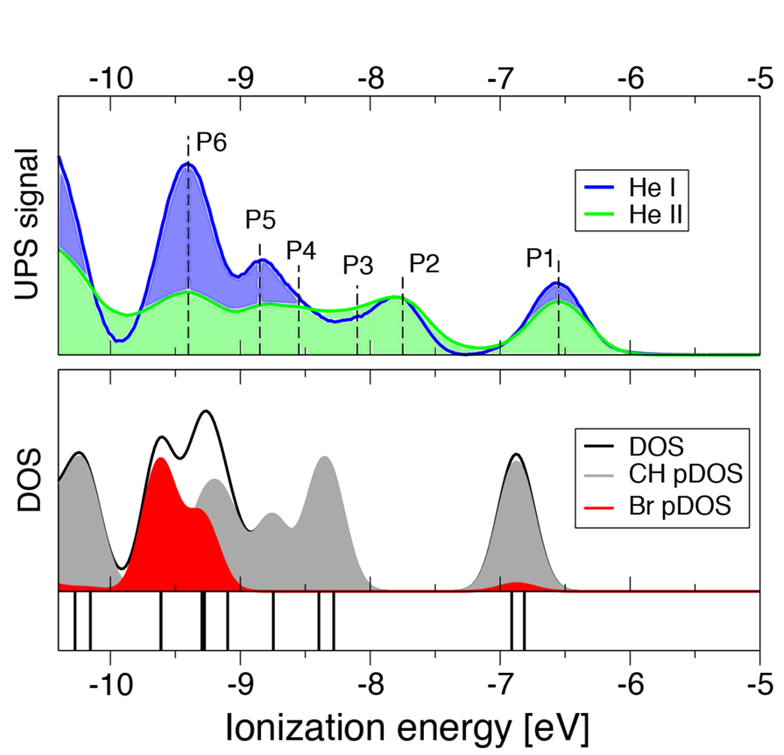
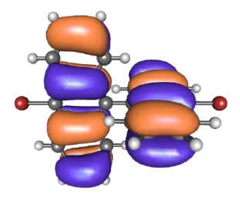
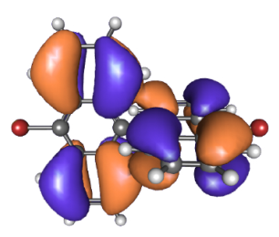
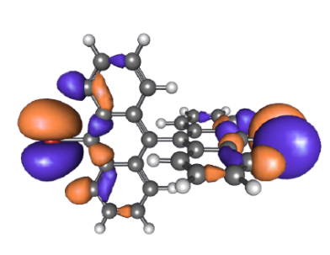
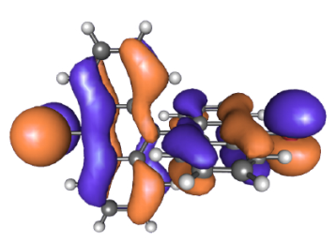
Our molecular precursor: DBBA
Della Pia A. et al., to be published
Notes:
By depositing a thick molecular film we were able to identify six non dispersive electronic states. A subsequent step was to identify the atomic contribution to each orbital: for this aim the theoretically calculated density of states has been projected on each atomic species and highlights a significant bromine contribution for peaks 5 and 6 and none to peak 2. In order to compare these results we exploited the cross-section effects by repeating the measurements with two different photon energies, normalized the two spectra with respect to peak to, thus neglecting the cross-section effects of the carbon atom. The result is that we effectively see a signal enhancement in the blu spectrum with respect to the green one, in agreement with what expected for a molecular orbital mostly localized on the bromine atom.

Slide 8
Electronic properties: from DBBA to GNR
Chemical species involved in the process of GNR formation:
DBBA molecule
polyanthryl
nanoribbon
Massimi L. et al., J.Phys.Chem. C 119, 2427-2437 (2015)
Della Pia A. et al., to be published
Notes:
We now want to see how the electronic structure of the sample evolves in the process, for the different chemical species.

Slide 9
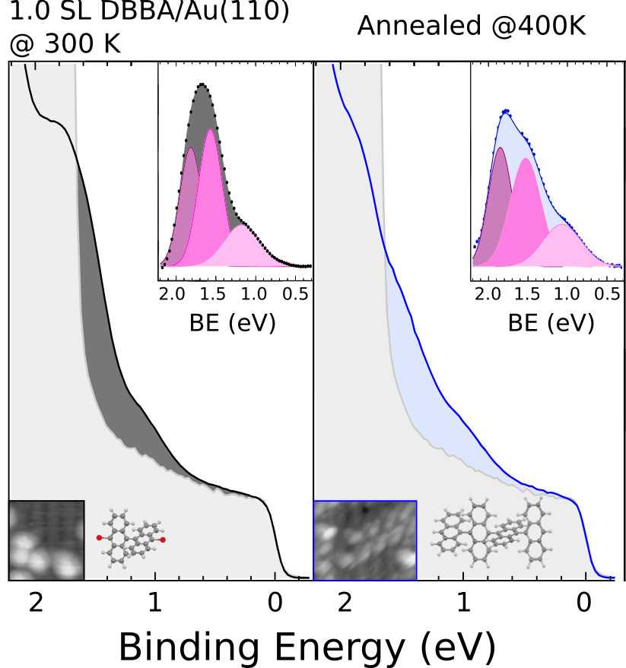
Della Pia A. et al., to be published
Evolution of the VB spectrum
Sample | C-Au peak BE (± 0.05 eV)
DBBA | 1.15
Polyanthryl | 1.05
Notes:
We see that the spectra are characterized by three main features, the first one at 1.85 eV below the fermi level is common to all the three spectra and is attributable to the gold surface state. The second one, at 1.55 eV be is the HOMO level for the intact molecule and is again present in all the three spectra, thus indicating that part of the molecules remain intact and do not contribute to graphene nanoribbons formation. The third feature represent the electronic states of those molecule that undergoes dehalogenation and whose dangling bonds are filled by the golden atoms, and the fact that it shifts toward lower binding energy effectively indicate an evolution of the sample’s geometry from a non-flat adsorption configuration, in which one dehalogenated anthracene units is found to be very near the gold surface to a flat geometry, in which the presence of an onset located at around 0.7 eV below the fermi level is in perfect agreement with what theoretically expected for GNR formed on this surface.

Slide 10
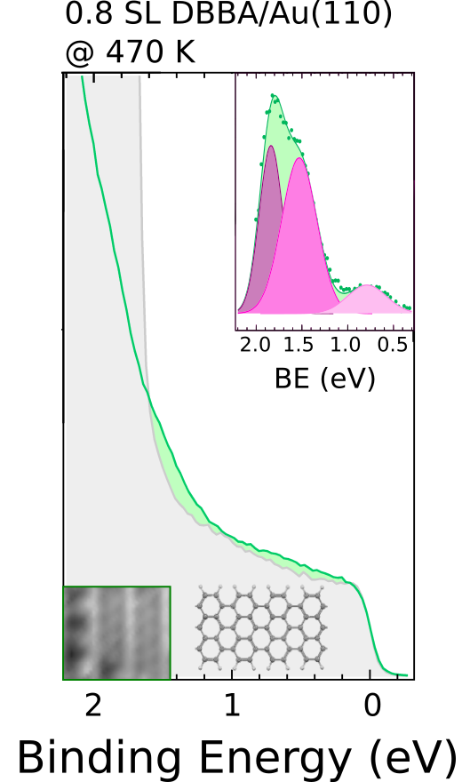
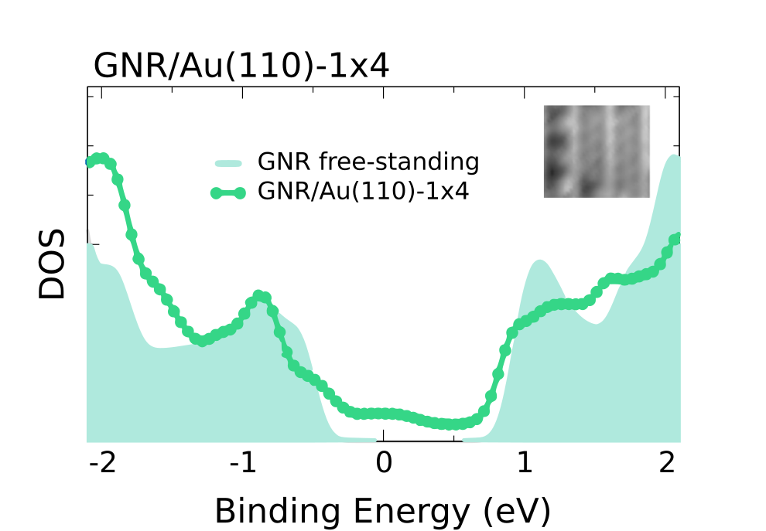
Della Pia A. et al., to be published
Evolution of the VB spectrum
Notes:
We see that the spectra are characterized by three main features, the first one at 1.85 eV below the fermi level is common to all the three spectra and is attributable to the gold surface state. The second one, at 1.55 eV be is the HOMO level for the intact molecule and is again present in all the three spectra, thus indicating that part of the molecules remain intact and do not contribute to graphene nanoribbons formation. The third feature represent the electronic states of those molecule that undergoes dehalogenation and whose dangling bonds are filled by the golden atoms, and the fact that it shifts toward lower binding energy effectively indicate an evolution of the sample’s geometry from a non-flat adsorption configuration, in which one dehalogenated anthracene units is found to be very near the gold surface to a flat geometry, in which the presence of an onset located at around 0.7 eV below the fermi level is in perfect agreement with what theoretically expected for GNR formed on this surface.

Slide 11
Conclusions
Identification and attribution of the molecular electronic states;
Study of the DBBA/Au(110) interaction;
Sample | C-Au peak BE (± 0.05 eV)
DBBA | 1.15
Polyanthryl | 1.05
Determination of the valence
band evolution
 | Free-standing state BE (± 0.05 eV) | Interaction state BE (± 0.05 eV)
GNR | 1.50 | 0.80

Slide 12
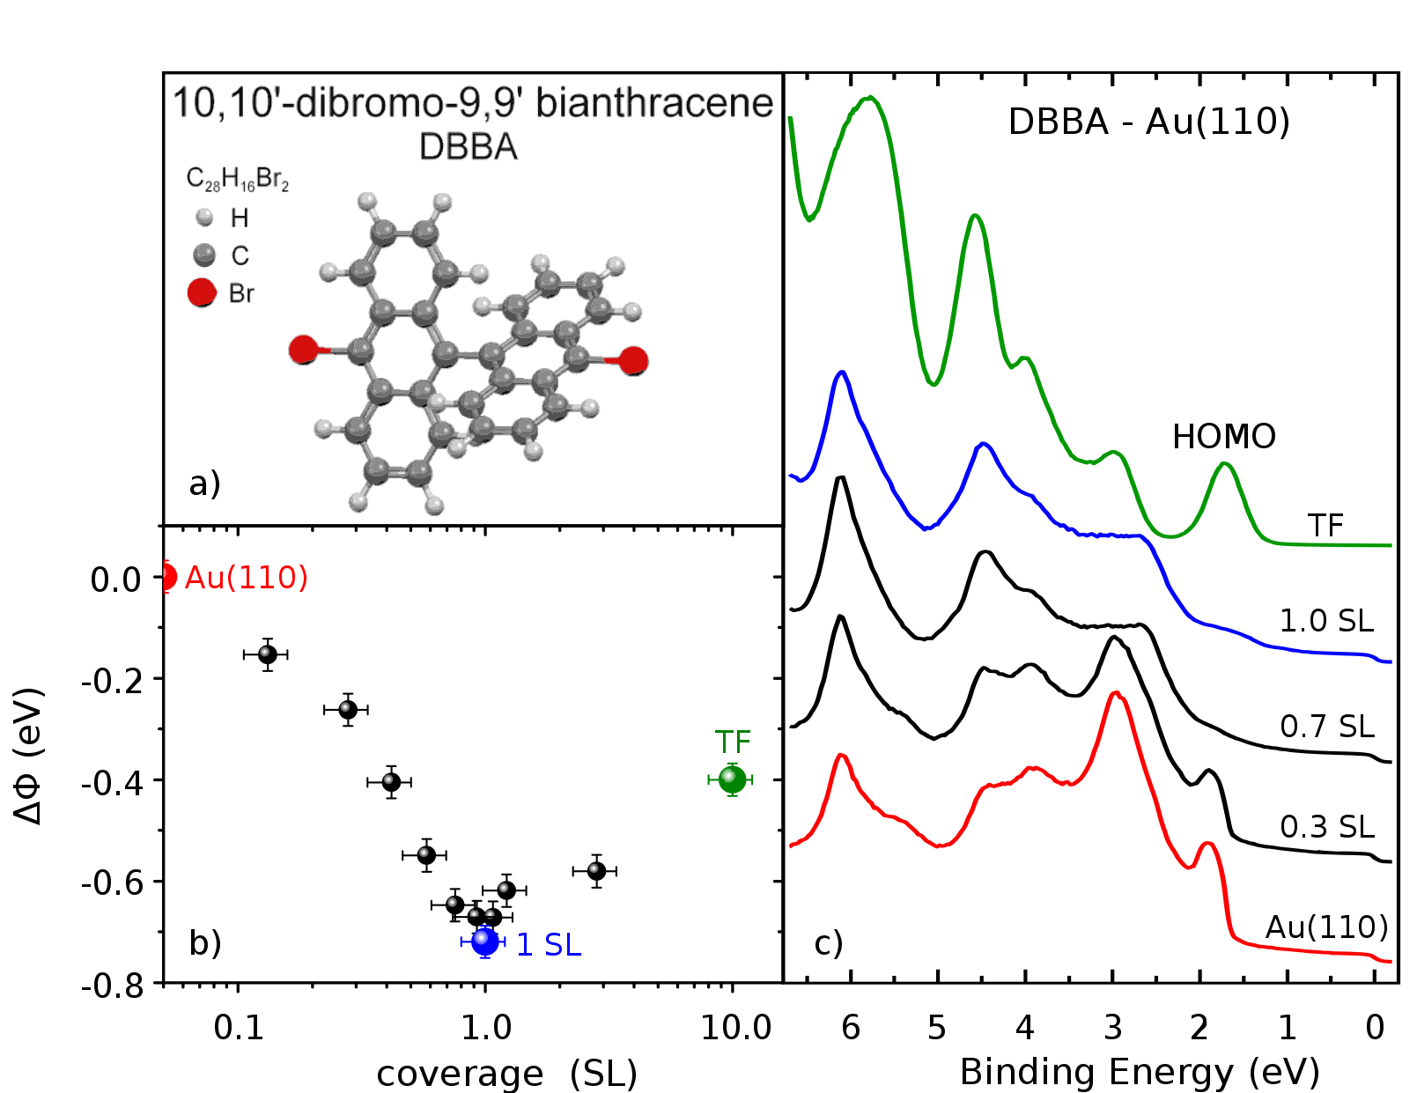
Electronic state evolution

Slide 13
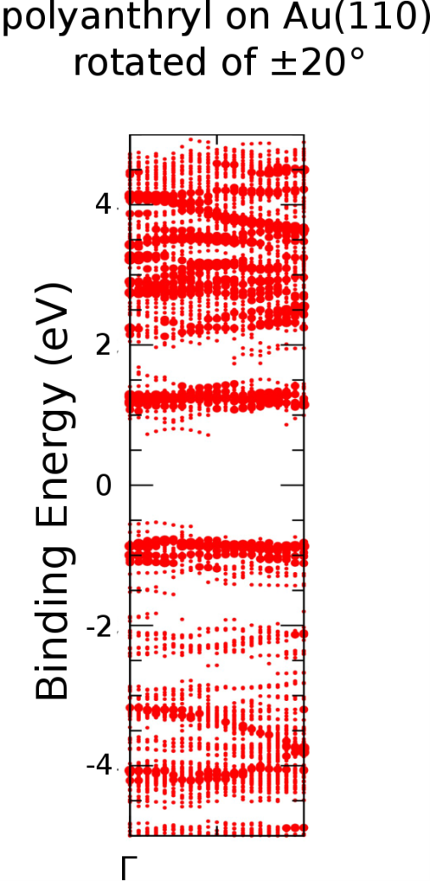
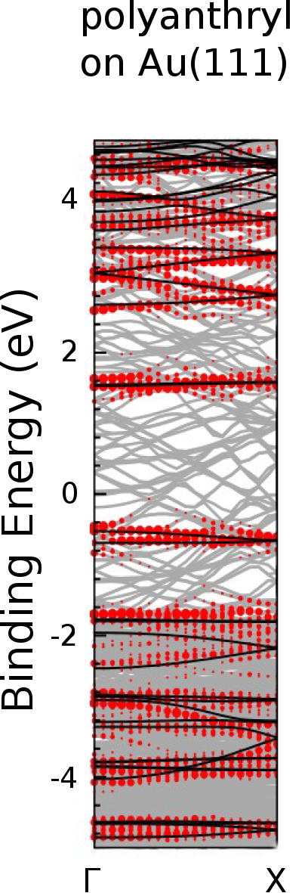
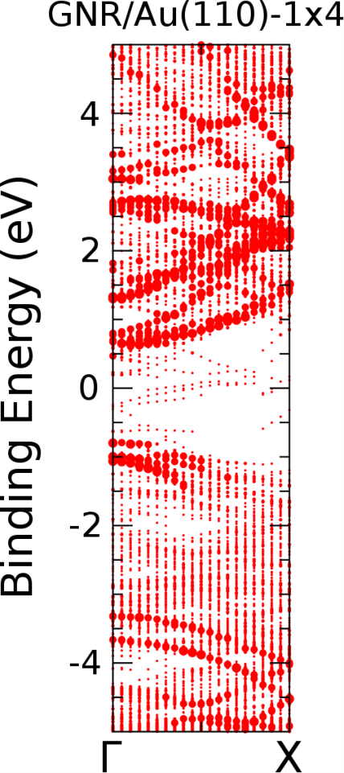
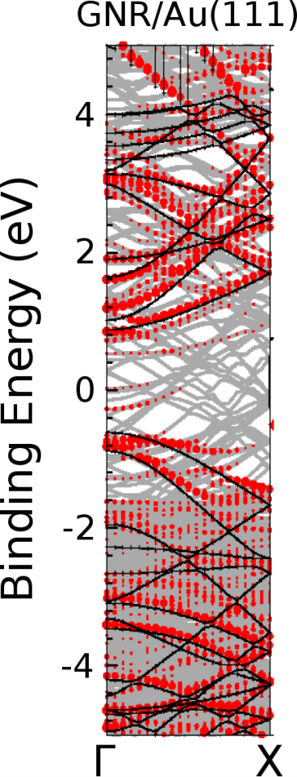
Au(110) vs Au(111)
Chemical species
Chemical species
DBBA
DBBA
Polyanthryl
Polyanthryl
Bisanthene
Nanoribbons
Nanoribbons
Batra A. et al., SI Chem. Sci. 5, 4419-4423 (2014)
Massimi L. et al., J.Phys.Chem. C 119, 2427-2437 (2015)
Della Pia A., to be published
Batra A. et al., Chem. Sci. 5, 4419-4423 (2014)
Ruffieux P. et al., ACSnano 6, 6930-6935 (2012)
Bronner C. et al., J.Chem.Phys. 140, 024701 (2014)

