Slide 1

HoW Fast an Earthquake Early Warning can Be Issued
Gaetano Festa, Aldo Zollo, Simona Colombelli,
Matteo Picozzi, Alessandro Caruso
Dipartimento di Fisica; Università di Napoli Federico II

Slide 2
Summary
Earthquake Early Warning
Concepts
Methods
Southern Italy application
Next generation of ew systems

Slide 3
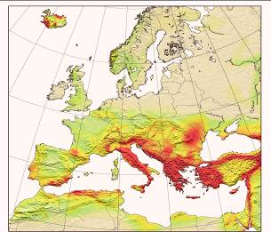
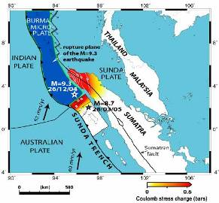
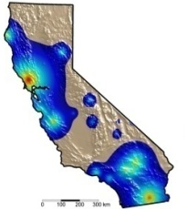
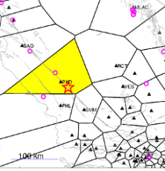
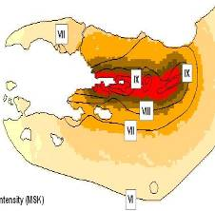
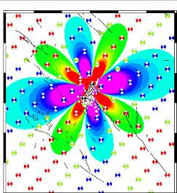
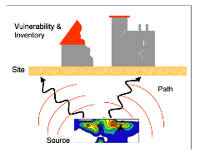
Time scales of seismic hazard
From REAKT
REAL-TIME SEISMOLOGY
Earthquake
Long-term
Hazard
Mapping
Long-Term
Forecasting
Short-Term
Forecasting
& Prediction
Early
Warning
ShakeMaps
&Rapid Loss Assessment
Aftershock
Hazard
decades
years
days
0
seconds
minutes
days/
months
Notes:
3

Slide 4
Fundamentals of EW
TARGET

EPIC
Light speed:
around 3x10⁵ km/sec
S-wave velocity:
around 3.5 km/sec
Based on the difference between the propagation velocity of the seismic waves and radio signals or cable
The information about earthquake ground shaking can reach a target “potentially at risk” from a few to tens of seconds before the arrival of the largest amplitude seismic waves.
Notes:
-

Slide 5
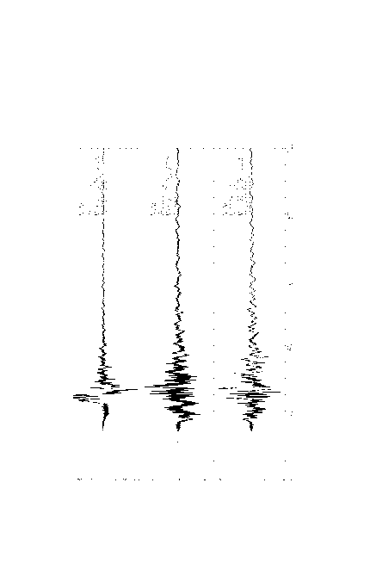
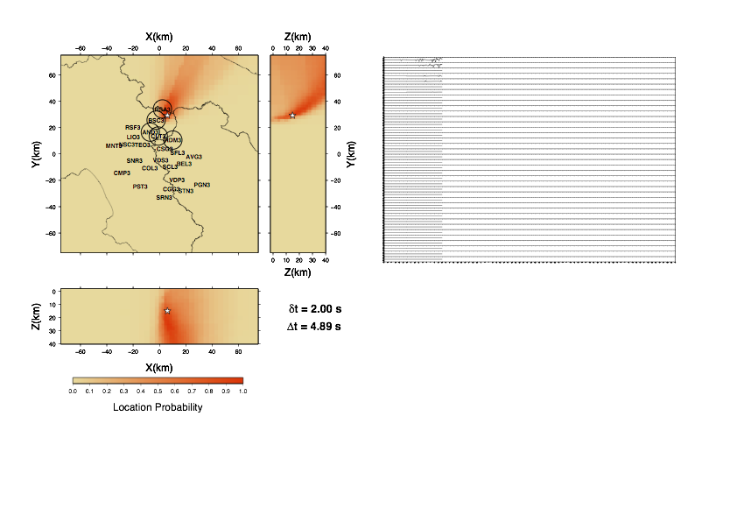
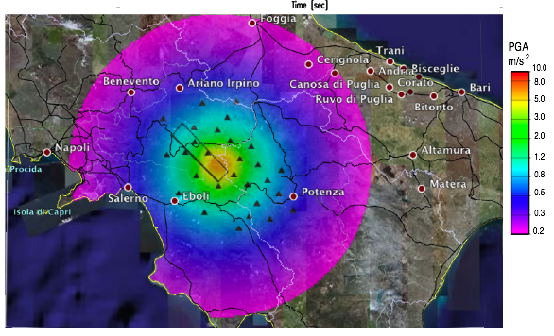
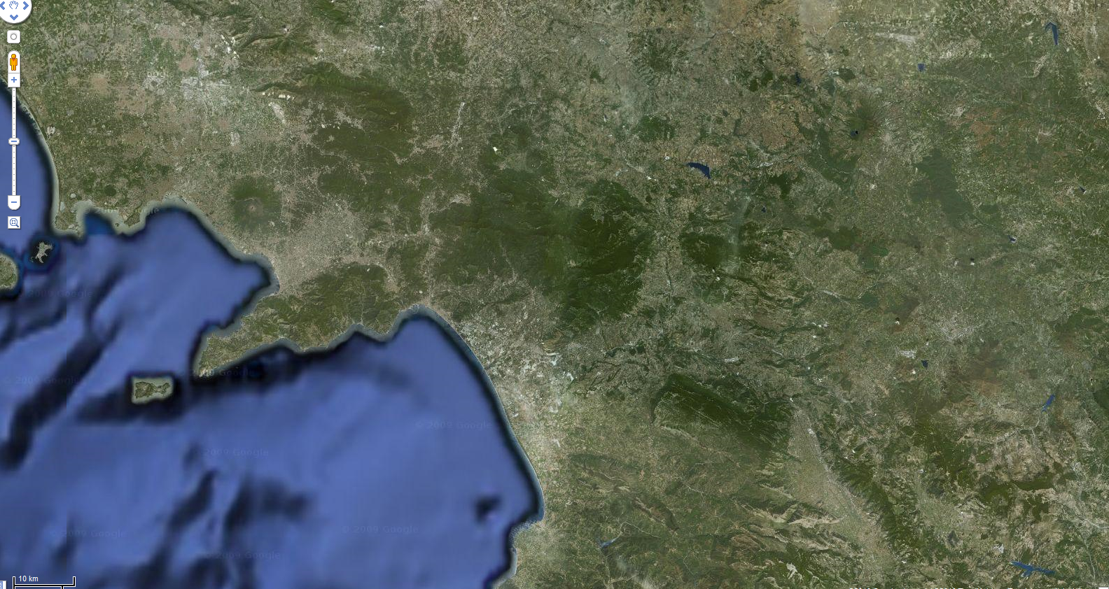
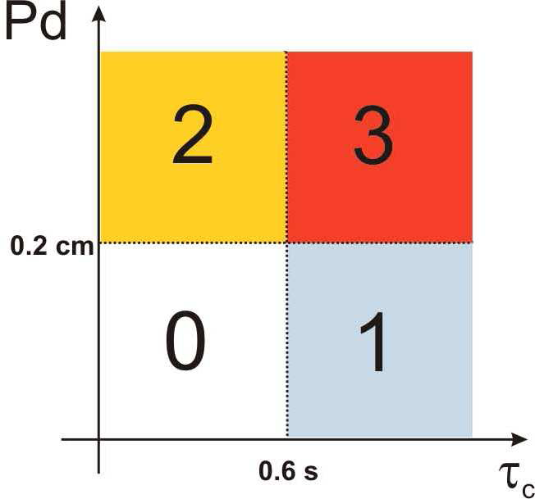
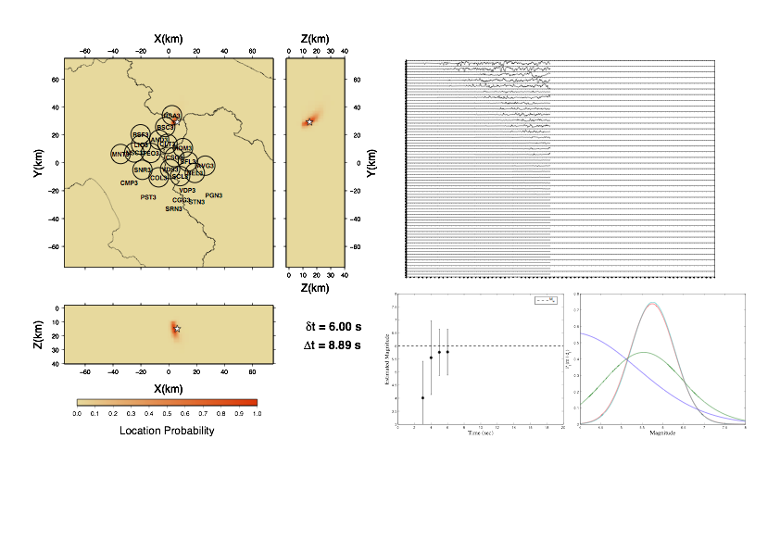
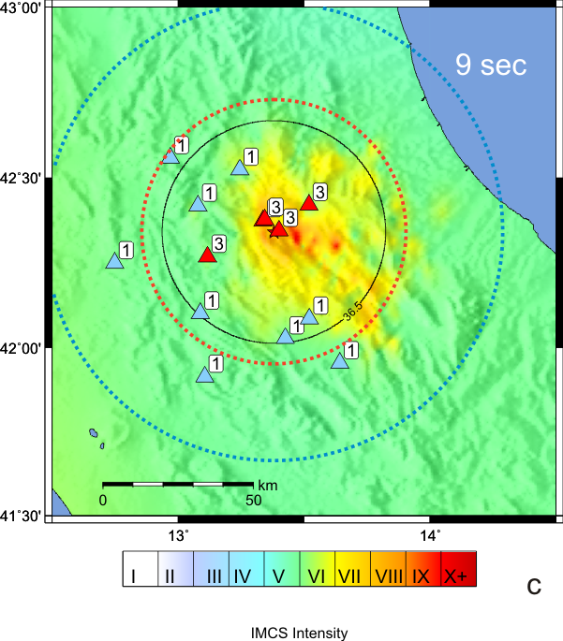
Early Warning Time-Line – PRESTo ^{PLUS}
SECS AVAILABLE TO TARGET
 |  |  |  | 17 | 15 | 13 | 11 | 9 | 7 | 5 | 3 | 1
P-Waves at
1st Station
Probabilistic
Location
Regional Scale
Peak Ground Motion
85 km
P
NAPLES
C
TARGET
Origin Time
On-Site
Alerts
Bayesian
Magnitude
PDZ - Probable
Damaged Zone
S-Waves
At Target
0 | 2 | 4 | 6 | 8 | 10 | 12 | 14 | 16 | 18 | 20 | 22 | 24
SECS FROM ORIGIN TIME

Slide 6
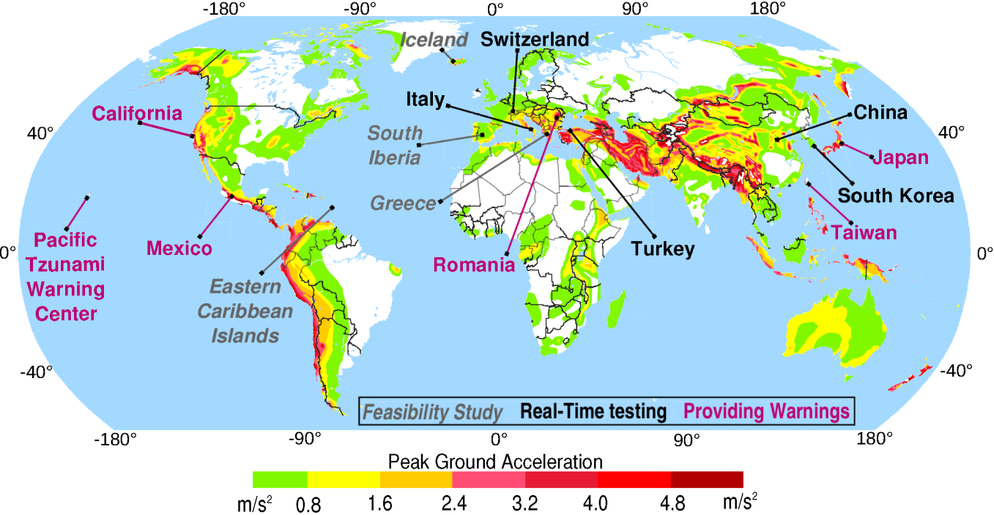
Worldwide EWS

Slide 7

Regional vs Onsite EW
Regional
S/Surface Waves (3,3.5 km/s)
Warning (Light/connection Speed)
✹
(S-target)- (first-P network )
Lead-time
target
Epicentral Area
(P-target)- (S target )
P Waves (5-6 km/s)
S/Surface Waves (3,3.5 km/s)
Onsite
Event detection
Telemetry
Early Warning
~ 10- 30 s
Postevent
~ 10 min
T0
TP
TStarget
Time

Slide 8
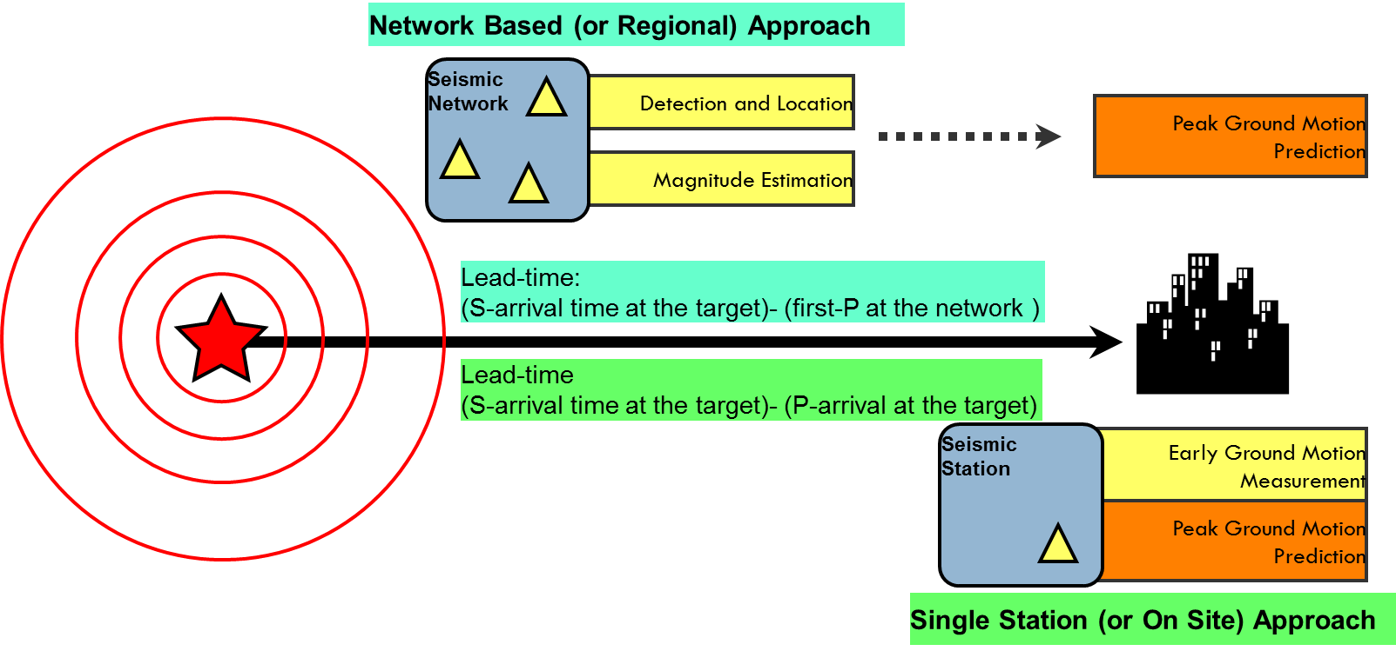
P-wave based Early Warning
Objective:
estimating fast and reliably the earthquake’s damage potential

Slide 9
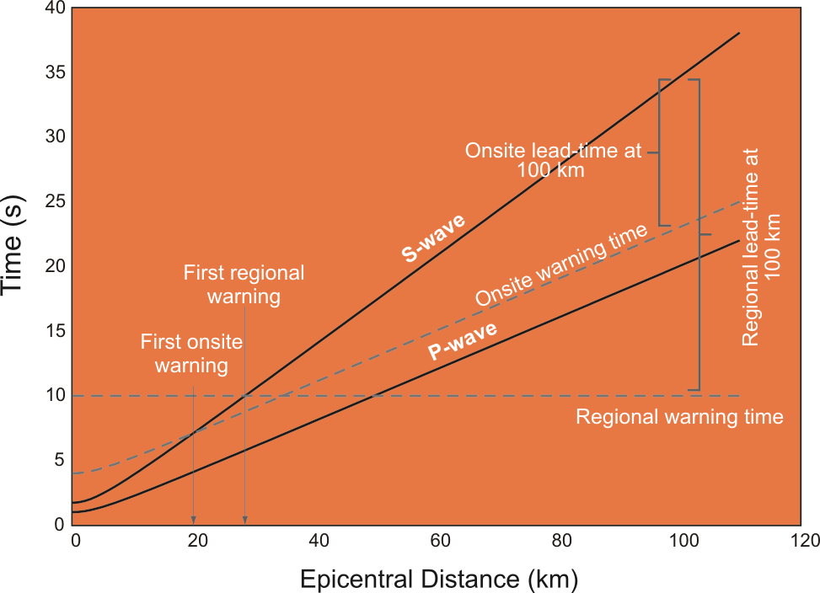
Lead-times for P-wave based EWS
The expected lead-time of Regional system increases with distance and is larger than for On-site systems for d>50 km.
On-site systems can provide fast warning to targets close to the epicenter.

Slide 10
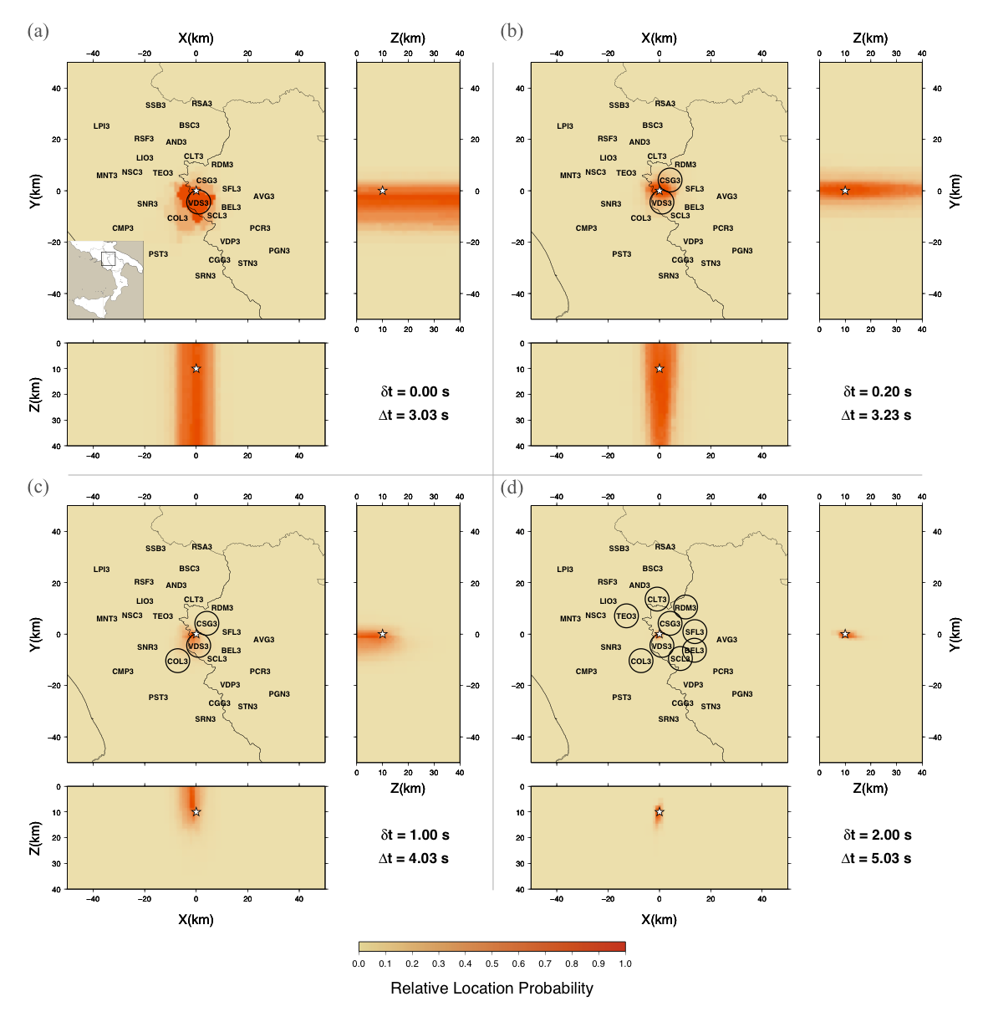
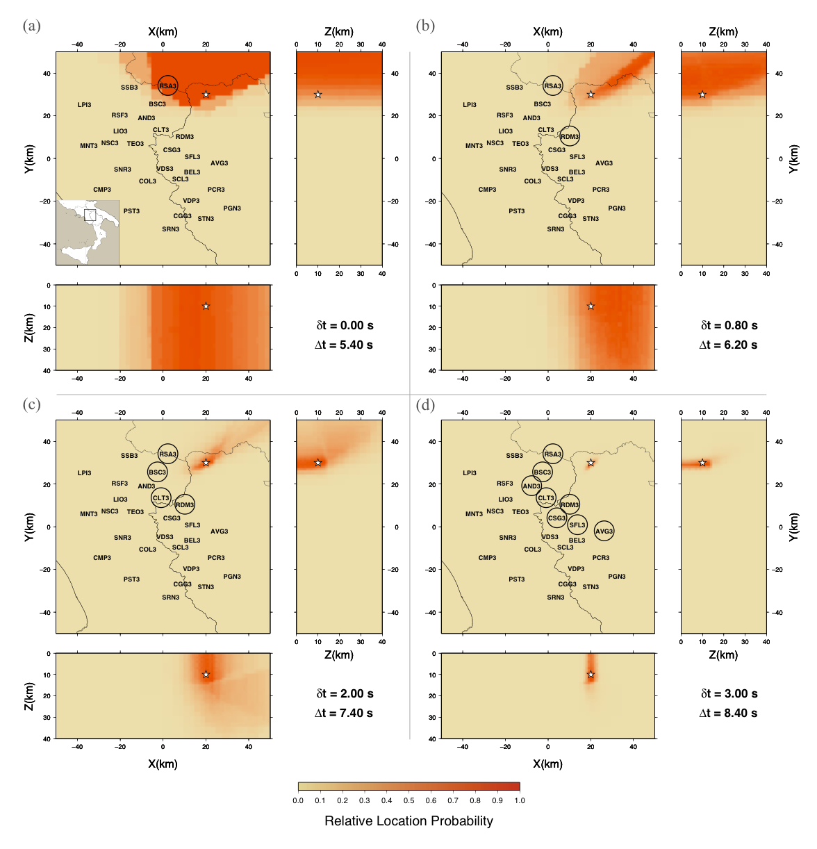
Real Time Earthquake Location (RTLOC)
In a dense network accurate location can be obtained within 3-4 s from OT
Events in the network outskirts require a longer time for the location to converge (6-10s)
Satriano et al., BSSA,2008

Slide 11
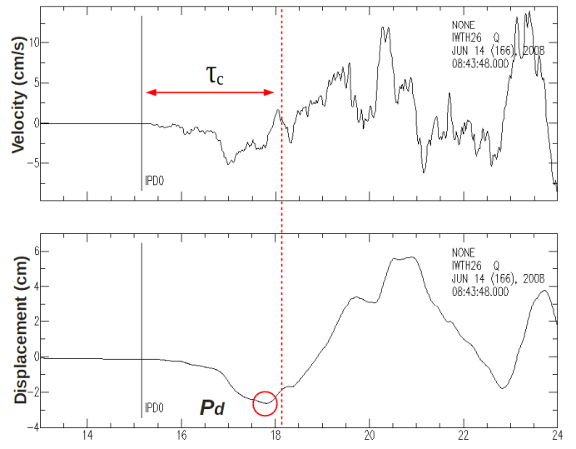
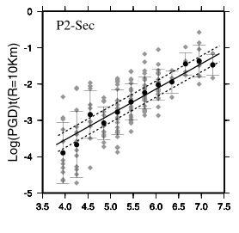
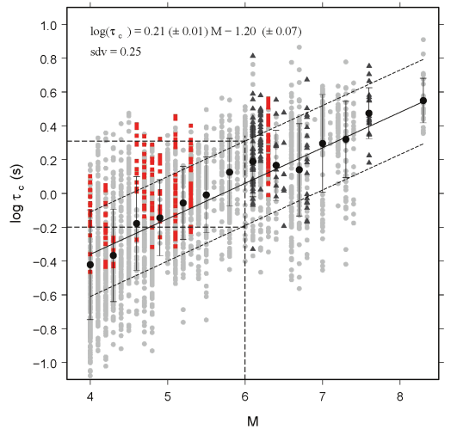
Magnitude: an empirical approach
P_{d} = peak displacement
τ_{c} = average period
Data from European SM data-base
Data from Japan,Taiwan, and Italy
log P_{d} = A + B * M + C log R
log τ_{c} = A' + B' * M

Slide 12
Real Time Magnitude
Basic Concepts
Use of information carried out by early P- and S-waves recorded at a dense, high dynamics network deployed in the source area of earthquakes
Determine empirical regression laws between real-time measured ground motion parameters (dominant period, peak displacement) and magnitude
At each time step after first P, evaluate the magnitude using an evolutionary approach and combining P and S information at all recording stations
Notes:
The real time magnitude: basic concepts
- Information from few seconds of initial P- and S-wave signals
- Empirical regression laws relating the measured parameter and magnitude
- Probabilistic and Evolutionary combining the available P- and S- information

Slide 13
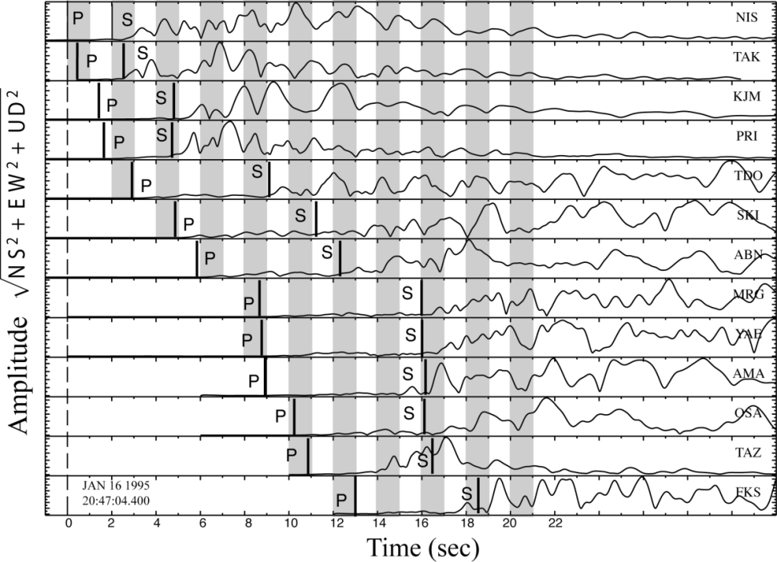
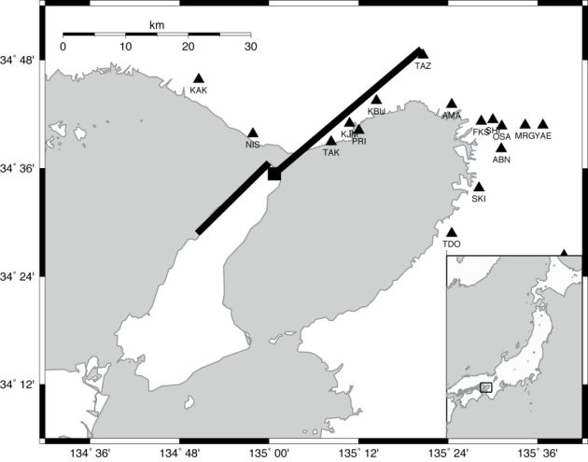
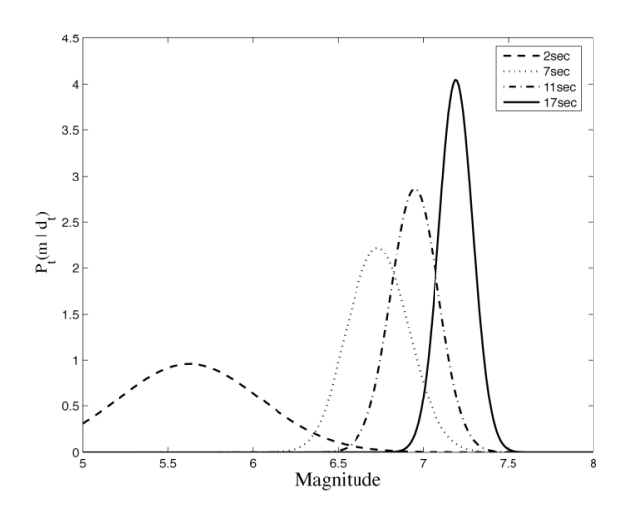

Offline application: The 1995 Kobe Eqk
P(m|d) vs Time
Magnitude vs Time
Probability to exceed M 6.5 and M 7.0 thresholds as a function of time
M 6.5
M 7.0
Lancieri & Zollo, JGR, 2008
Notes:
We show the time evolution of the PDF and related magnitude as a function of time, with uncertainty. The initial magnitude from the closest station largely underestimate the earthquake size, while the arrival of P- and S data from distant stations 6-7 seconds after the first arrival contribute to improve the accuracy on the magnitude estimation. The available PDF allows to compute the probability to exceed a given magnitude threshold as a function of time. We observe that after about 6 sec the probability for the event to exceed M 6.5 become stable with time, thus providing with a usefull information for alert notification.

Slide 14
Prediction of peak ground motion at the target site
Use of existing Ground Motion Prediction Equations (GMPE) for PGV,PGA, …
At each time step, the instantaneous attenuation curve can be built given the estimated values of M.
The map of predicted PGX is obtained by calculating the expected value of ground motion parameter, given the estimated Magnitude and Distance (from eqk location)
Log( Peak Motion amplitude)
M2
M1
Increasing Magnitude
D1
D2
Log( Epicentral distance)

Slide 15
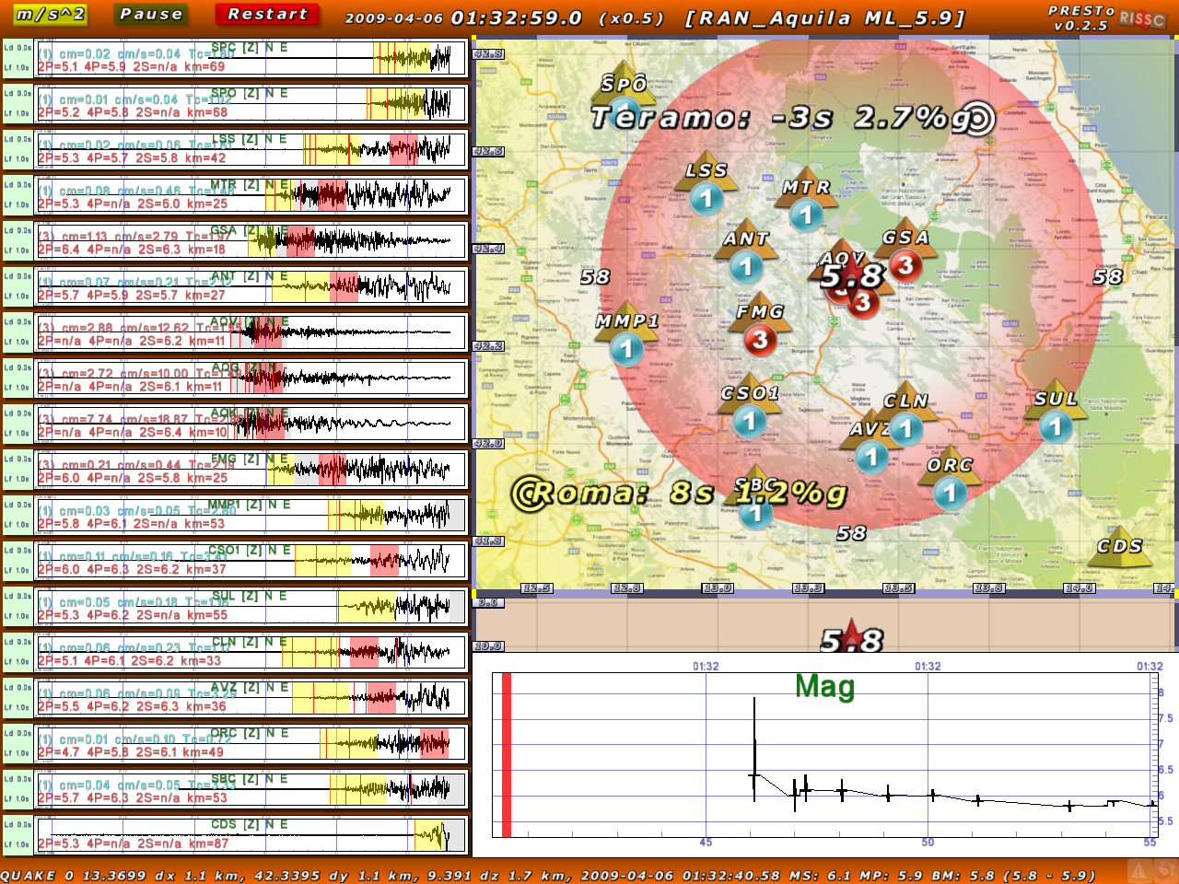
PRESTo ^{PLUS} Playback of L’Aquila 2009, ML 5.9 Eqk
S-Waves
Vulnerable Site
Epicenter
Station
Alert Level
Depth
Magnitude
T₀
Accelerograms
P- and S-waves Windows
Notes:
Off-line application and testing of PRESTo+ for the 2009, Mw 6.2, L’Aquila earthquake in Central Italy

Slide 16
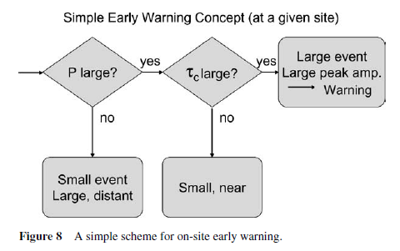
Issuing an EW alert: Can we by-pass the Magnitude estimation?
Observed correlation between PD and PGV (Wu & Kanamori, 2005)
For moderate to strong eqks PGV is related to seismic intensity
Using PD and Tau for setting up an alert decision table
From Kanamori, 2005

Slide 17
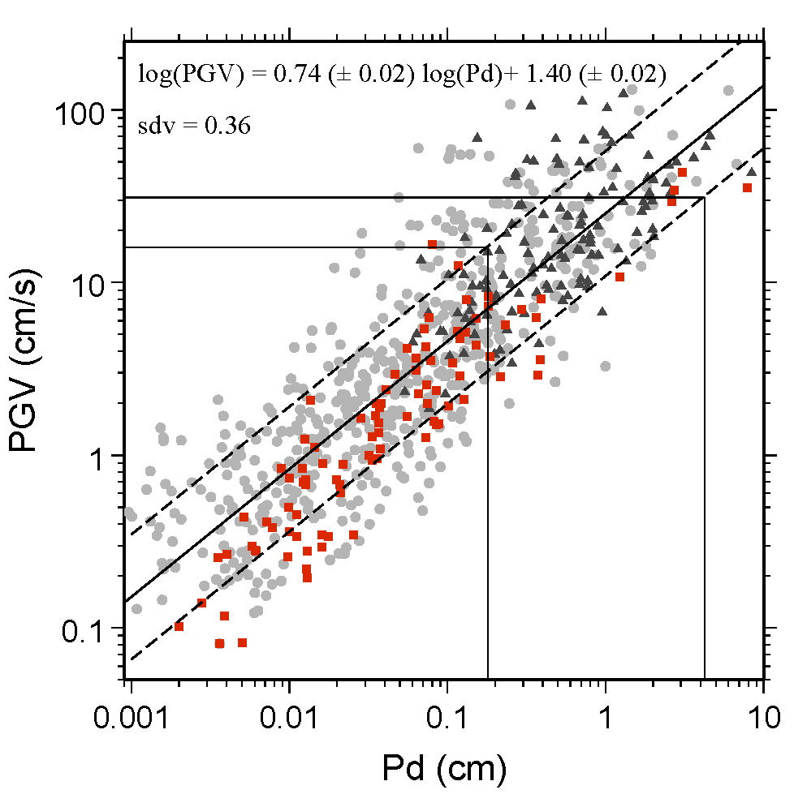
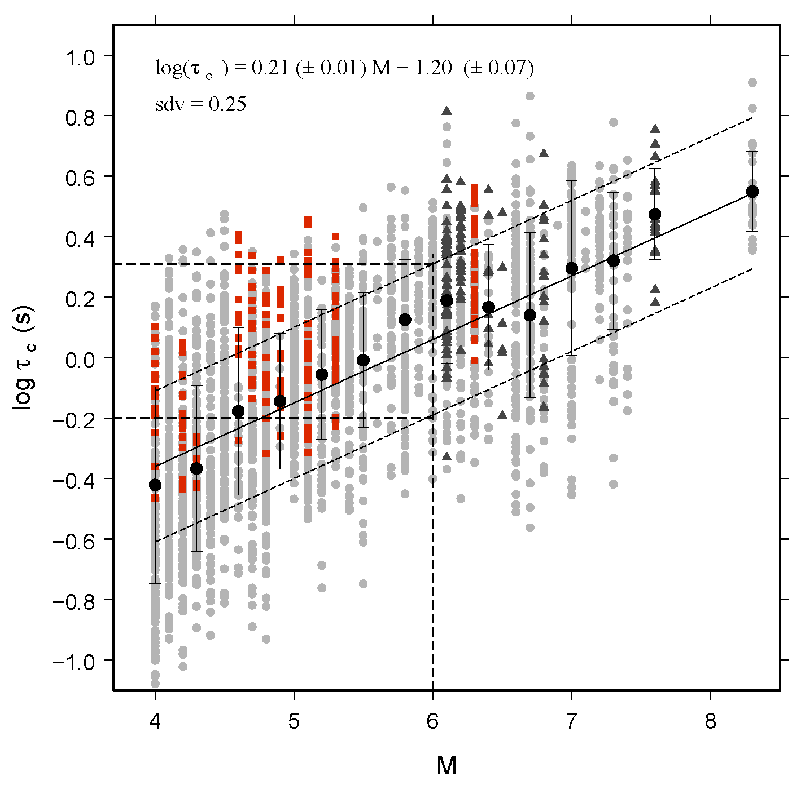
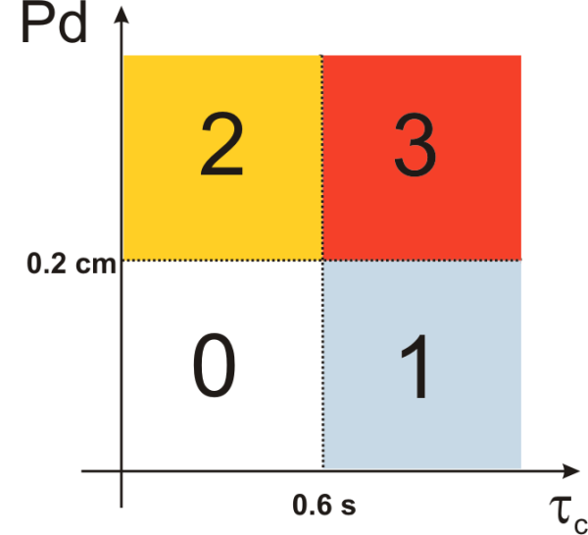
A Threshold-Based Early Warning
Zollo et al., GJInt,2010
Initial P-peak displacement (Pd) correlates with whole-record Peak Ground Velocity.
Pd>0.2 cm → PGV > 16 cm/sec → I_{MM}> VII : DAMAGING EQK!
Initial P-period parameter (τ_{c}) correlates with final magnitude. τ_{c} > 0.6 sec → M> 6
Japan
Taiwan
Central Italy
Alert levels and threshold values for P_{d} and τ_{c}
Alert levels
Damages nearby & far away from the station | Damages only nearby the station | Damages only far away from the station | No damages
3 | 2 | 1 | 0

Slide 18
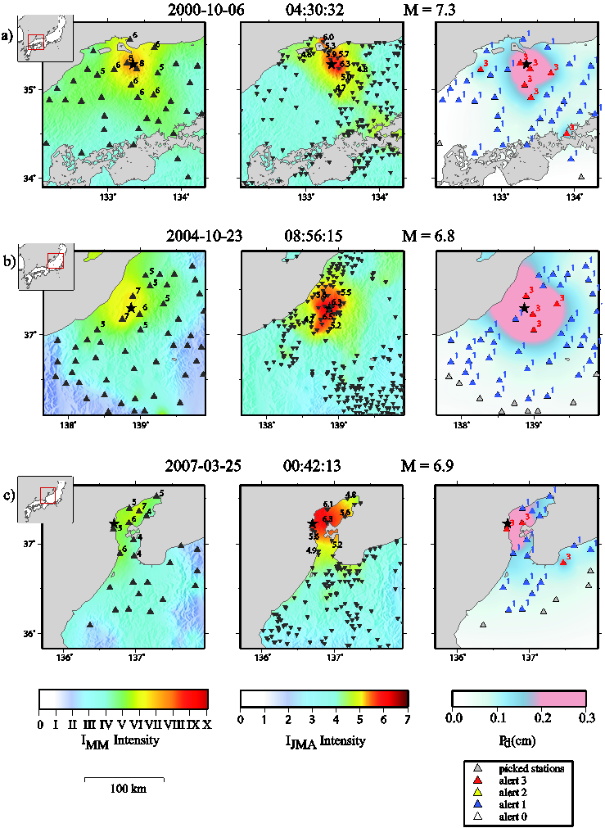
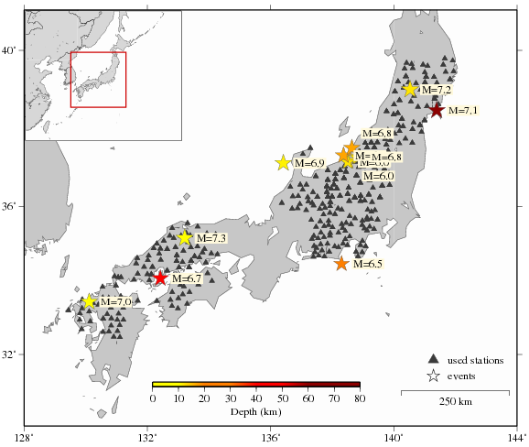
Test of the Threshold Method on Japanese Eqks
PGV → I_{MM}
I_{JMA}
PDZ
Qualitative comparison of the
Threshold Early Warning method
with I_{MM} maps of
three M_{w}>6 earthquakes in Japan occurred during the last decade
Colombelli et al., 2011, Test of a threshold-based Earthquake Early Warning method using Japanese data, Bull.Seism.Soc.Am.

Slide 19
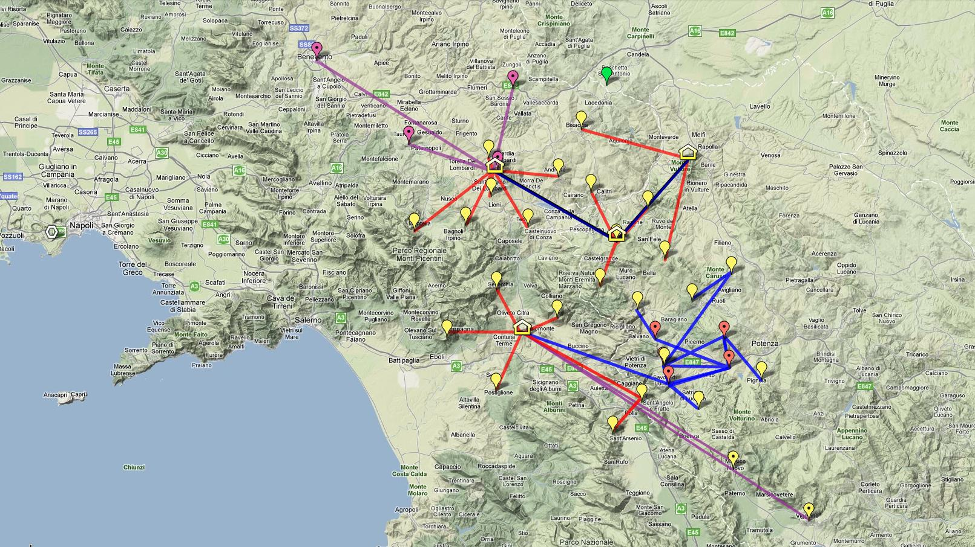
Southern Italy –ISNet & INFO

Slide 20
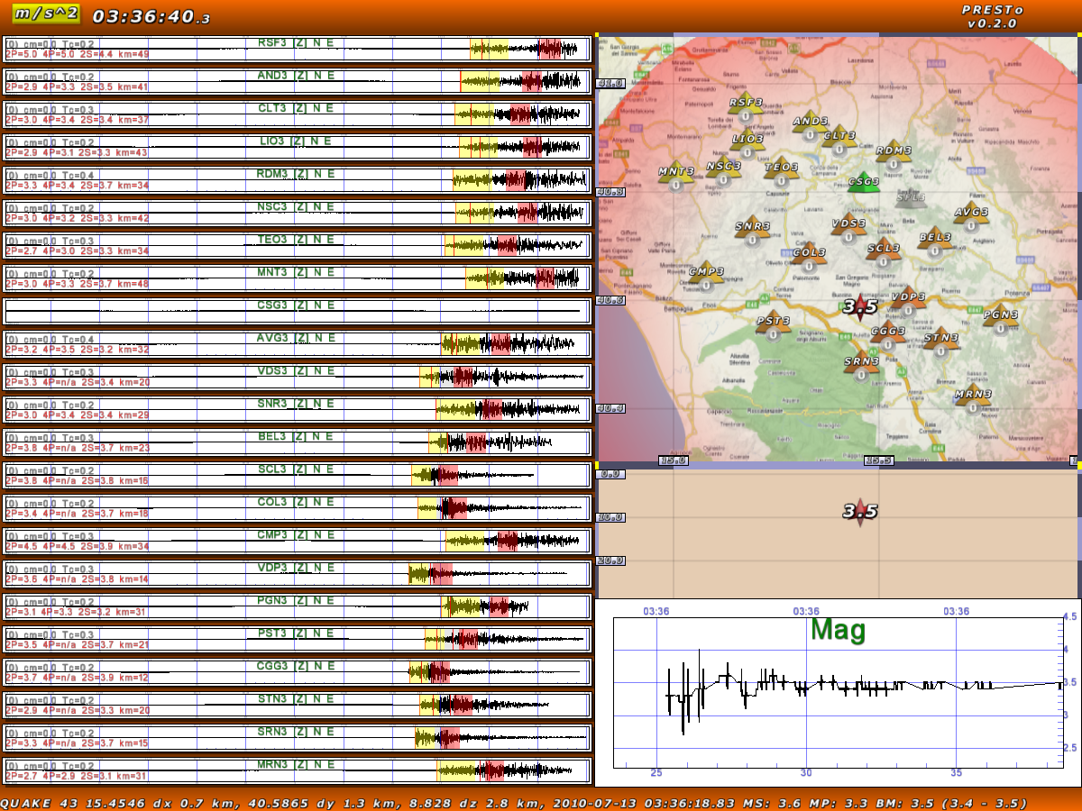

Slide 21
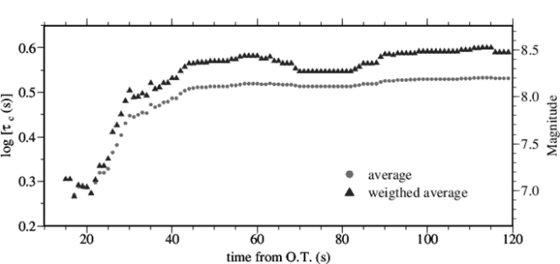
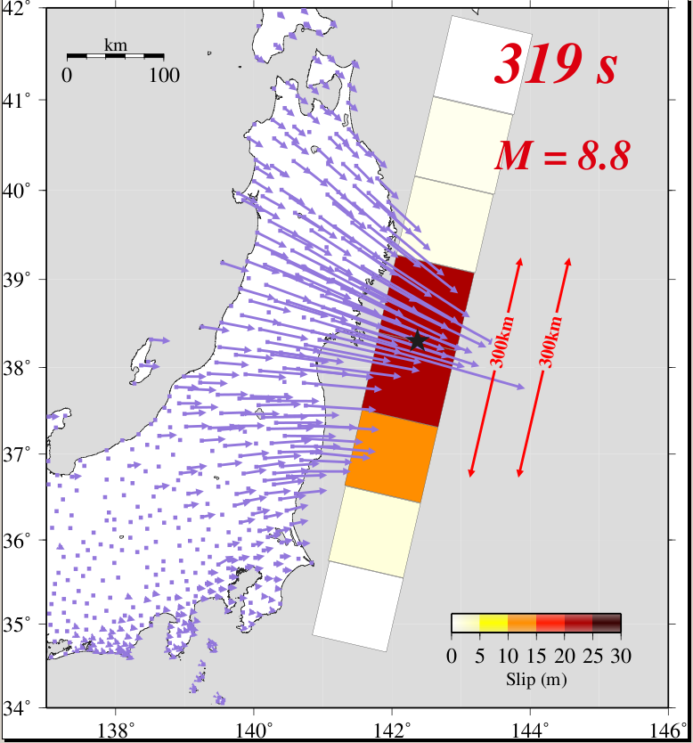

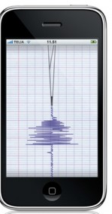
Toward next EWS generation
Early Warning for
Mega-Earthquakes
Different initial Pd slope
NEW
EWS
Real time GPS application
Low-cost sensors

Slide 22
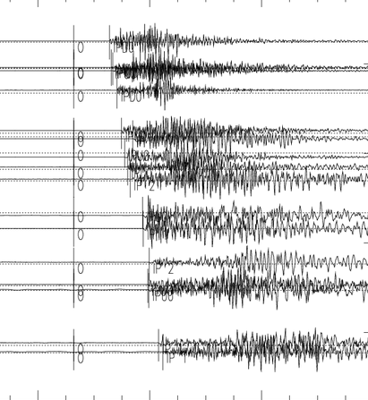

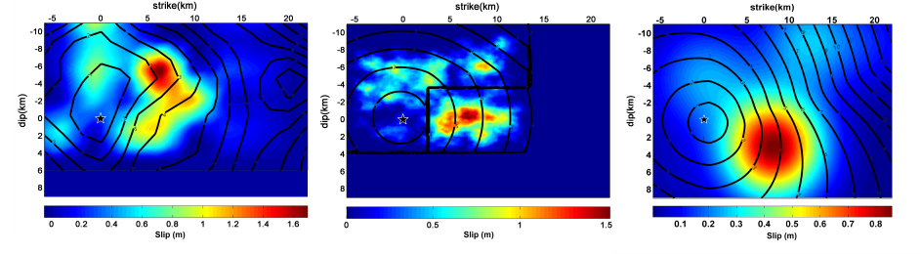

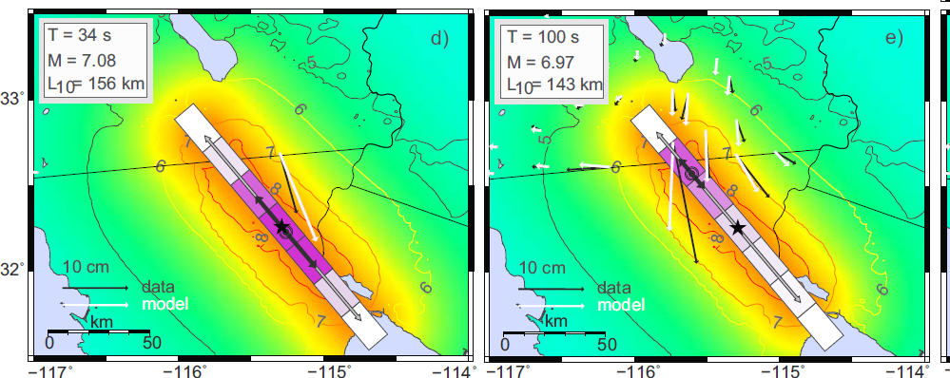
Future challenges
Past
Future
Robustness
Future
Actual
Blind
zone
Time
Real time continuous
data processing
Bayesian
combination
HPC
Evolutionary
Ground shaking
A-priori

