Slide 1
Visions for Science Education Education Policy work at the Royal Society and the Institute of Physics, UK Professor Dame Julia Higgins FRS FREng Italian Physical Society, 101st National Congress, Rome, 21-25 September, 2015.

Slide 6
Success depends on teachers. They should receive the recognition, reward and support they deserve.
Just 3% and 5%, respectively, of England’s primary school teachers hold specialist mathematics or science degrees.
More than 20% of mathematics and chemistry teachers and a third of physics teachers have no degree level qualification in the subject.

Slide 10
The problems
- Loss of entitlement: In about 1000 schools; no culture of physics
- Representation (gender): 20% girls from age 16; physics is 19th most popular subject amongst girls
- Representation (socio-economic): the 1000 schools (above) tend to be in more deprived areas
- Under-equipped workforce: non-specialist teachers; 500 schools have no specialist physics teacher
- Recruitment and shortage of specialist teachers: 20 years of decline; break even this year; short of ~4000 specialists
- Training Subject knowledge; 1 year PGCE; professionalization
- Retention: ~ 50% of teachers leave in first 5 years; slightly lower for physics
- Curriculum and assessment: Structures; content; image of physics;

Slide 11
Solving the problems
Programmes of activity
Teacher recruitment and retention
Teacher support networks
Improving Gender Balance
School support and resources
Policy and curriculum
Higher Education
Notes:
40,000 members. Mainly professional physicists. Governed by a council of members.
Most of them will have had a good experience of physics at school. So, genuinely, the members would like to help others get a similarly good experience.
Also, there is a sense that they want to preserve physics.
In both cases, they – and we – genuinely value physics, physics education and good physics teachers. For its own sake.
However, there are and have been concerns.
Declining A-level numbers
And, no doubt related, a shortage good, specialist physics teachers.
So, happily, the IOP has invested in addressing these issues over the years and built up a large and active education department. And a large network of over 80 field workers
Should say it includes a number of ex teachers (over a hundred years of teaching experience – just among the office staff)

Slide 12
Recruitment - projects
MITRE
Marketing events (30 visits) in physics and engineering departments
15% increase in applications
School experience programme (taster placements in schools)
Scholarships
Working closely with government
556 applications
216 interviews (over 7 sessions)
107 awarded and accepted
Degree profile up (1sts and 2(i)s: 47% to 64%)
Student Teacher Affiliation
2000 affiliates each year
Learning to Teach Physics
Mentoring, visits and masterclasses (improve early career retention)

Slide 13
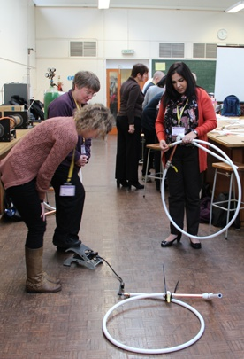
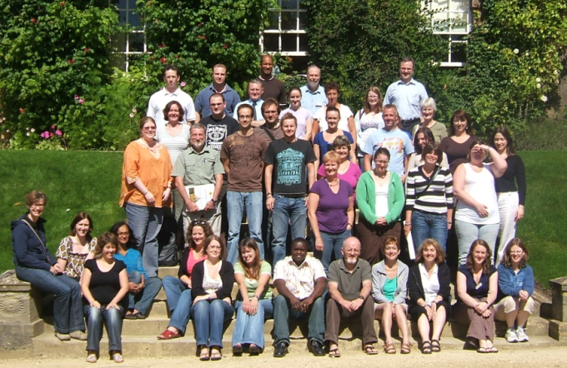
Teacher support networks
Teacher Network
In school workshops. E.g. 53 Physics Network Coordinators across UK and Ireland
~ 3000 teacher-days of professional development last year
Stimulating Physics Network
Intensive support in schools
35 Teaching and Learning Coaches
7000 teacher days of professional development
Improved post-16 uptake in partner schools
Improved GCSE results
Improved gender balance
Work with 50% of UK schools over three year cycle

Slide 14
Improving Gender Balance
We are running 4 related pilot projects in 20 schools
With new approaches to addressing the issue:
Strand A: Working with girls aged 11-16 to build confidence and resilience (8 schools)
Strand B: Working with teachers of physics to enhance the experience of girls in the physics classroom (8 schools)
Strand C: Working with senior leaders, governors, pupils and teachers across all subjects on gender equity and whole school culture (4 schools)
Strand D: A combination of strands A to C (4 schools)
Chance of taking physics in a maintained mixed school is about half what it should be
It is a subtle; but it is a whole school issue

Slide 15
European networks
GIREP
IOP has good, long-standing, links with GIREP
We took part in workshop on teacher support at the 2015 conference
The workshop discussed a possible network of networks across Europe
HOPE
IOP attended the 2015 conference in Zagreb
The focus was on teacher recruitment and teacher education
We are expecting a final report from HOPE in 2016 with data and descriptions of good practice across Europe

Slide 16
Thank you

