Slide 1
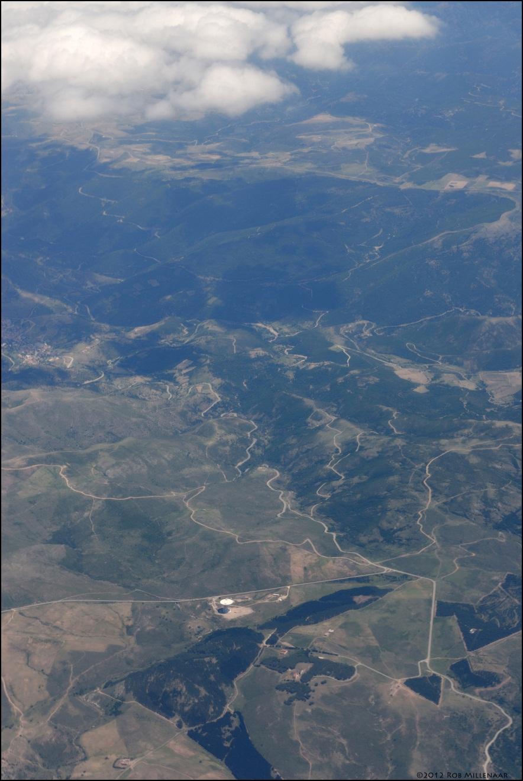





The Sardinia Radio Telescope
Isabella Prandoni
Project Scientist
&
Nichi D’Amico
Project Director
http://www.srt.inaf.it
Notes:
2:53

Slide 2
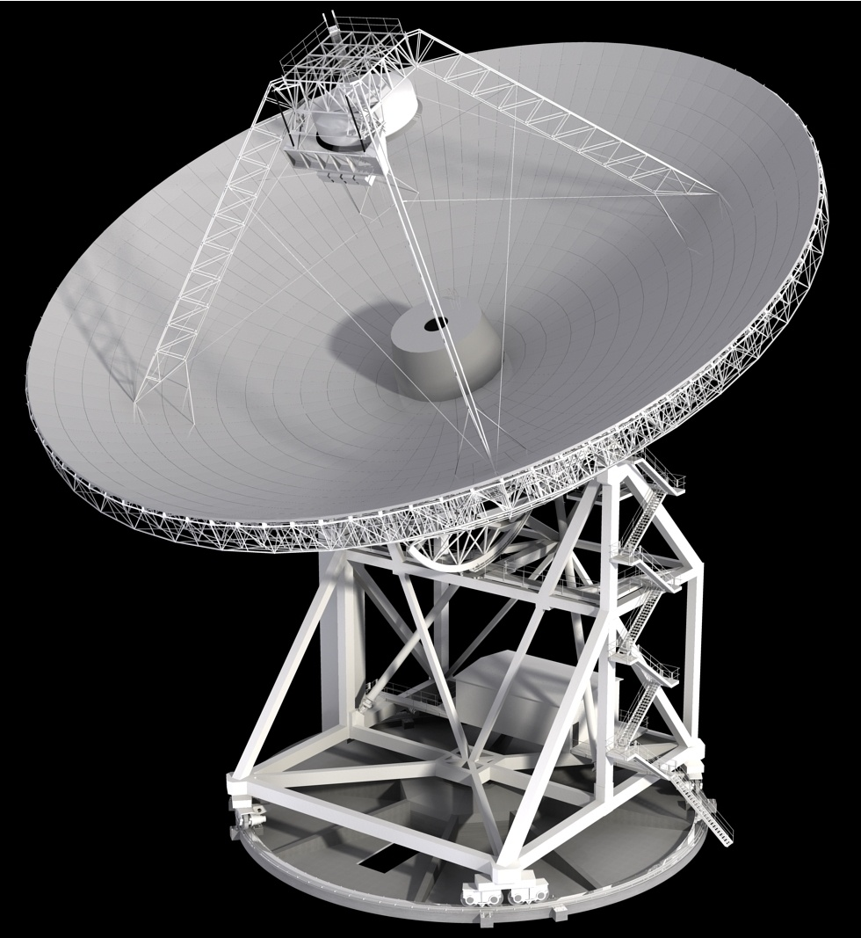
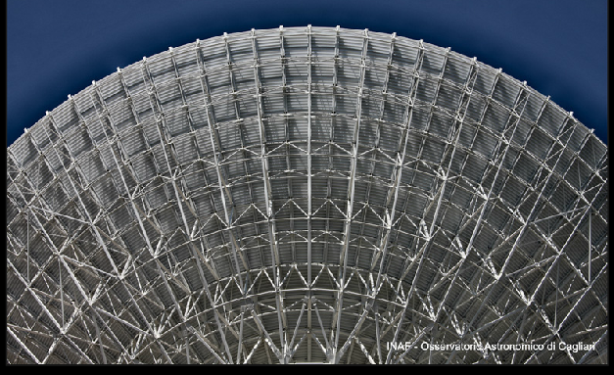
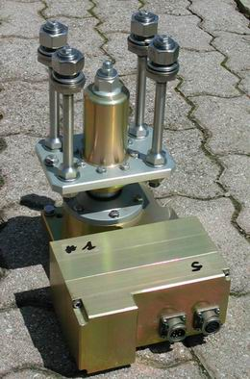
SRT
Main Characteristics
Fully steerable, 64m diameter, paraboloidal radio telescope.
3,000 t, 70m height
Alt- Azimuth mounting
Quasi-Gregorian Optical design with shaped surfaces
Multiple focal positions
(P, G, 4 BWG)
Can host up to 20 receivers
with frequency agility
Wide frequency range: from 300MHz to 100GHz (λ ~ 3 mm)
Surface Accuracy: rms << λ/10 << 300 μm
Active surface: efficiency ranges
from ~63% at ∼10GHz
to ~35% at ∼100GHz
1008 panels, 1116 electro-mechanical actuators with remote control
Notes:
SRT e’ un paraboloide di 64 m, con montatura alt-azimutale, orientabile in tutte le direzioni
Ruze Formula: 150 um RMS per 3 mm (100 GHz)
300 um RMS per 6 mm (50 GHz)

Slide 3
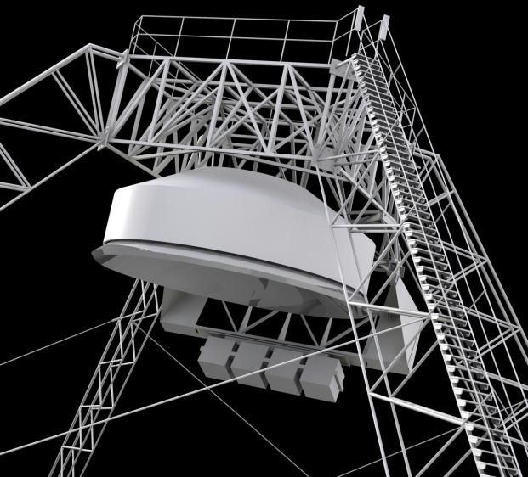
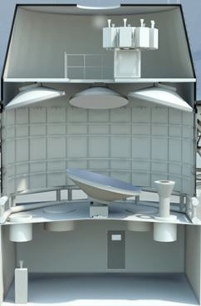
MULTIPLE FOCAL POSITIONS
Primary, Gregorian, 2 Beam Wave Guide:
Primary Focus
F/D ratio=0.33
300MHz < f < 20GHz
8 receivers
→ 20 Receivers
[Frequency agility]
Gregorian Focus
F/D ratio=2.35
7.5GHz < f < 100GHz
8 receivers
4 BWG Foci
F/D ratio=1.37 & 2.81
1.4GHz < f < 35GHz
2+2 receivers
Notes:
Presento i risultati dell’attivita’ del GdL “Scienza con SRT”

Slide 4
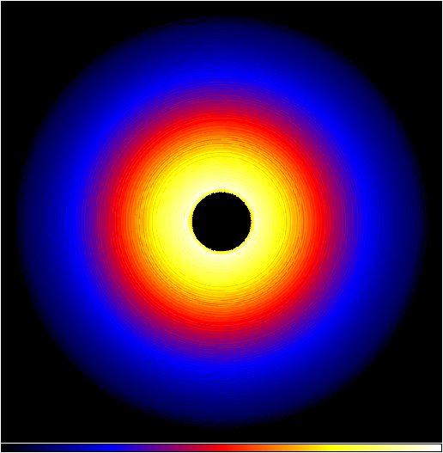
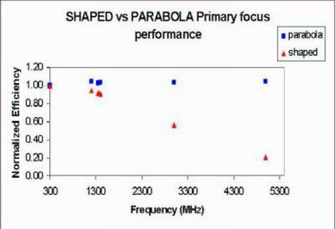
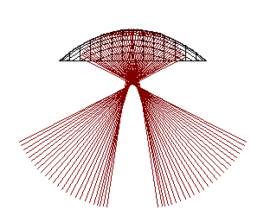
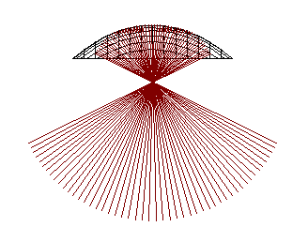
ACTIVE SURFACE – I
Shaping: better illumination of secondary foci
- Null field in region blocked by sub-reflector
Redistribution of the field over unblocked region
Under-illumination of the external edge
➔ Better efficiency over reduced FoV, No spillover, No multiple reflections [high efficiency spectroscopy]
Parabolic/Elliptical:
max eff. & FOV @ primary
focus (low freq.)
Secondary → Elliptical
Primary → parabolic
Secondary → shaped
Primary → shaped
Notes:
caratteristiche innovative
specchi quasi parabolici o ellittici (curve non classiche) → migliore illuminazione dei fuochi gregoriano e BWG
a) campo nullo in regione centrale dello specchio primario, bloccata dallo specchio secondario
b) Campo redistribuito sulla parte accessibile dello specchio, con aumento dell’efficienza di illuminazione
c) sotto-illuminazione del bordo del riflettore
No spillover, no riflessioni multiple (spettroscopia ad alta efficienza

Slide 5
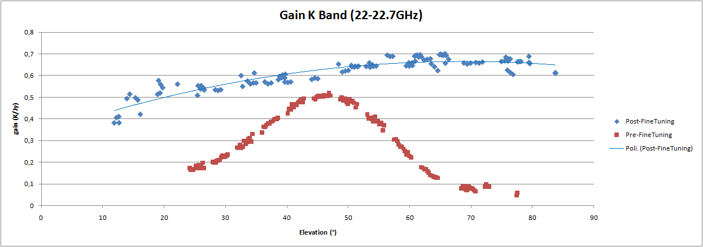
ACTIVE SURFACE – II
Passive Surface: Surface Accuracy: RMS = 306 μm @ 45° Elevation
Active Surface: Correct deformations of backup structure to increase efficiency
- phase 1: gravity deformations only (repeatable effect) ➔ Optimize Performance @ 20 ÷ 50 GHz
Photogrammetry: Finite Element Analysis (FEA) for correction of antenna geometry at any elevation:
Gain vs El K band Beam Deformations
Bolli et al. 2015
phase 2: wind pressure, temperature gradients corrections (non repeatable effects)
➔ Optimize Performance up to 100 GHz → RMS ~150 μm → Efficiency @ 100 GHz ~67%
Metrology: pressure/temperature sensors to measure and correct deformations in real time
(Microwave Holography)
Notes:
Gravity: fotogrammetric measurements

Slide 6
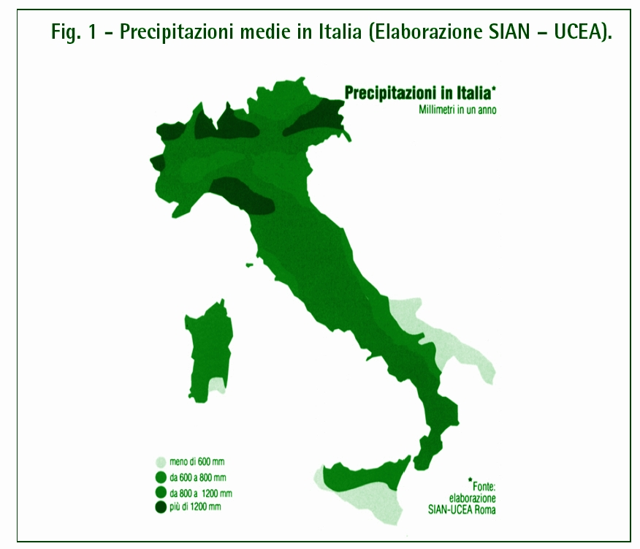
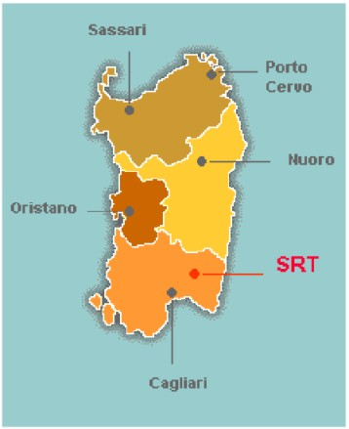
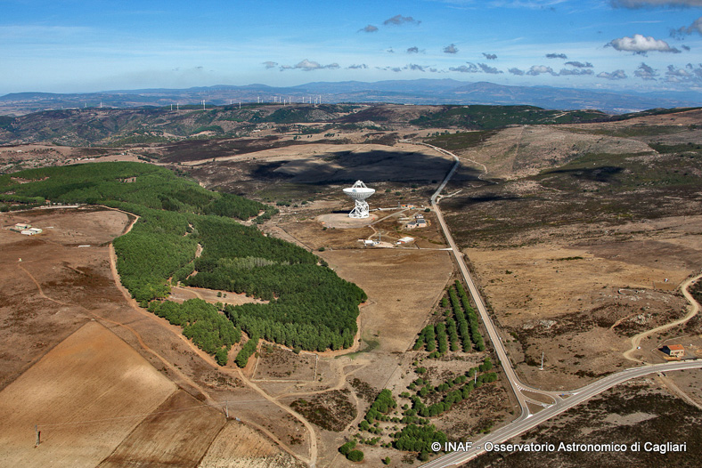
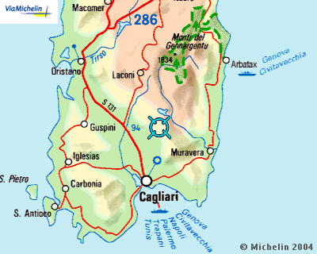
TELESCOPE SITE
Pranu Sanguni, San Basilio,
35 km North of Cagliari
Optimize UV coverage
Natural wind screen
Low RFI
Rain < 600 mm/yr
Altitude | 585 m
Longitude | –09⁰ 14^{m} 40^{s}
Latitude | +39⁰ 29^{m} 50^{s}

Slide 7
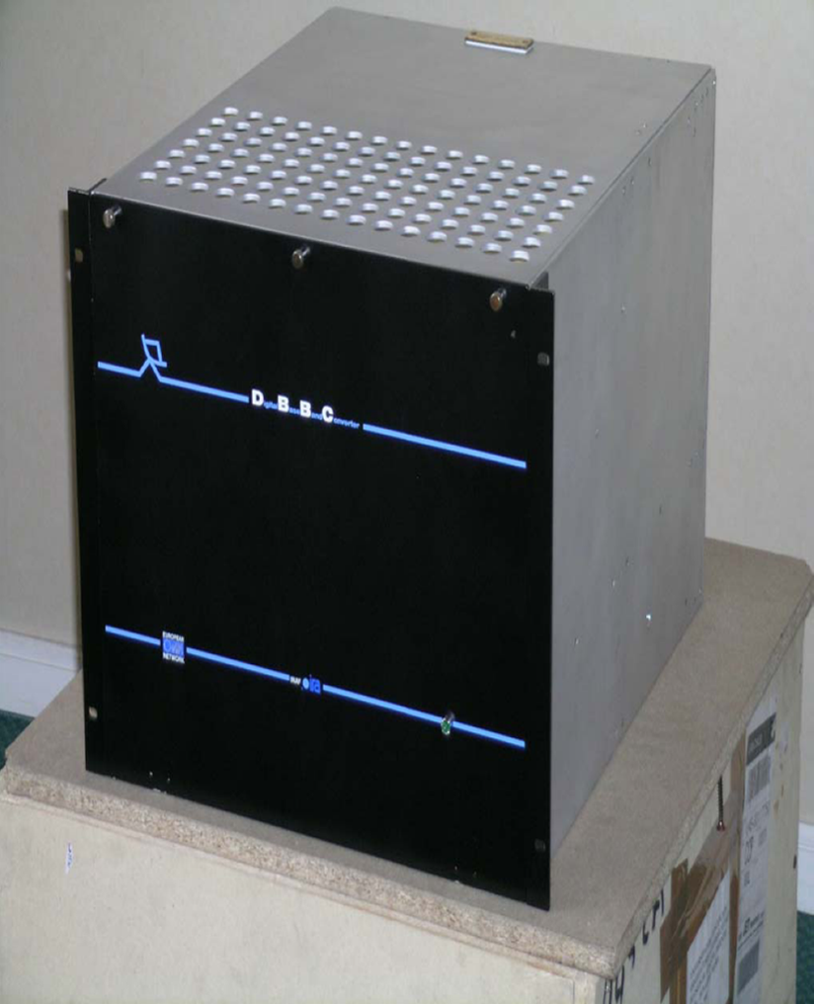
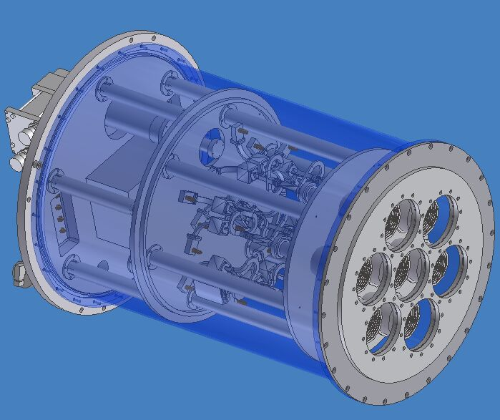
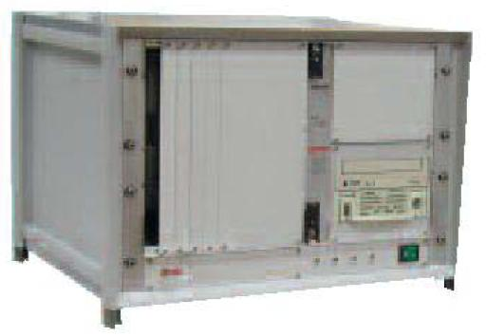
FIRST GENERATION INSTRUMENTATION
RECEIVERS
310-420 MHz
1.3-1.8 GHz
5.7-7.7 GHz Mono-feed
18-26 GHz Multi-feed
7 elements
BACK-ENDs
DFB: Digital Spectrometer (pulsar)
(ATNF Pulsar Digital Filterbank)
1 GHz BW, up to 16384 channels
ROACH: 2x512 MHz/1x1024 MHz
Dual Band
DBBC (1 GHz, 4 IFs) + MARK 5 C (VLBI) + SW Correlator
TP: analog back-end Total Power
7x2 outputs, 2 GHz BW
XARCOS: Digital Spectrometer
8 outputs, 60 MHz BW, 4096 channels

Slide 8
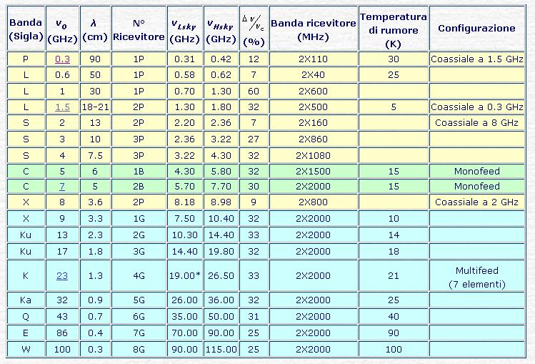
SRT – Future Development
2° Generation Instrumentation
Pulsar
RAS
Geo/ASI
MIUR
→VLBI
Coaxial S/X/Ka →Geo/ASI
Surveys
MIUR/RAS RADIONET
19-feeds
19 feeds
Notes:
Presento i risultati dell’attivita’ del GdL “Scienza con SRT”

Slide 9
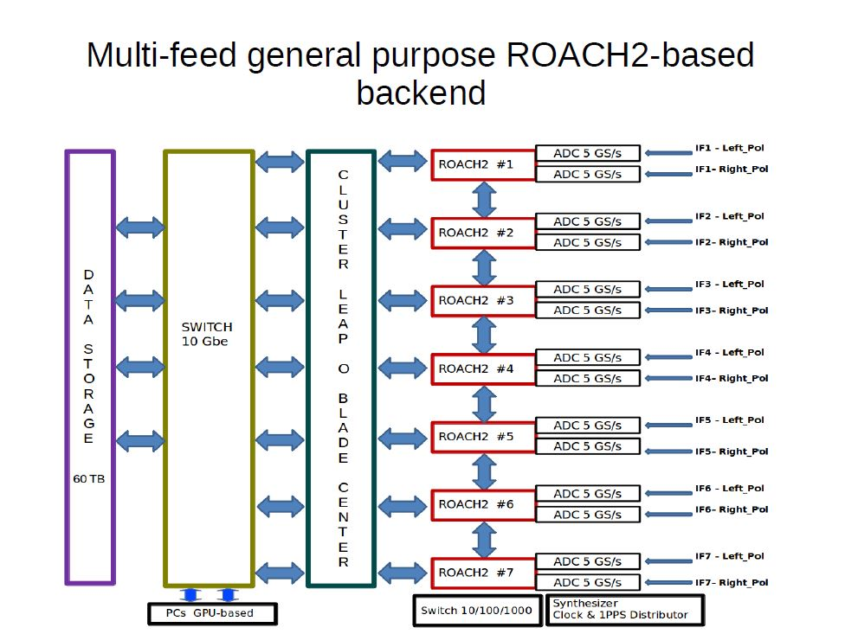

Slide 10

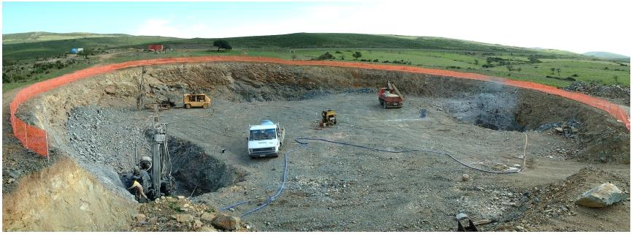
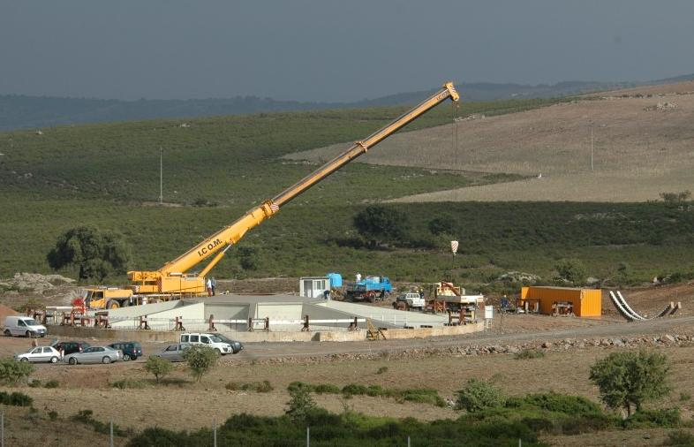
TIMELINE AND MILESTONES
2003: Signed the contract with MT-Mechatronics (MAN) The construction of the SRT parts begins in Egypt
2003: Signed by INAF the contracts with the local companies Porru and CAP for the basement construction
2006: Local farm ICOM appointed by MT-Mechatronics

Slide 11
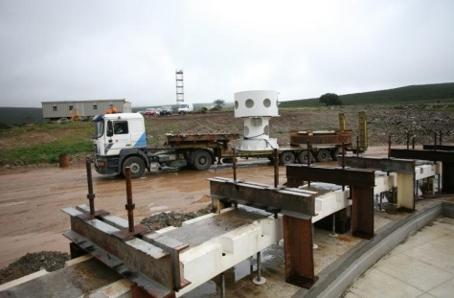
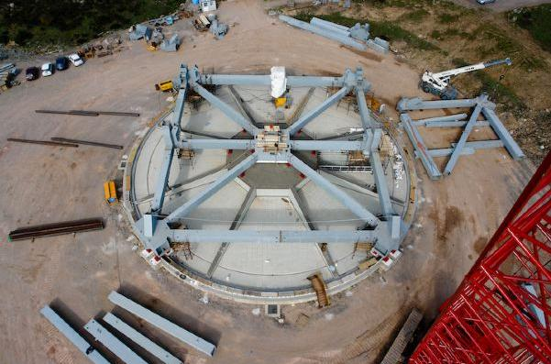

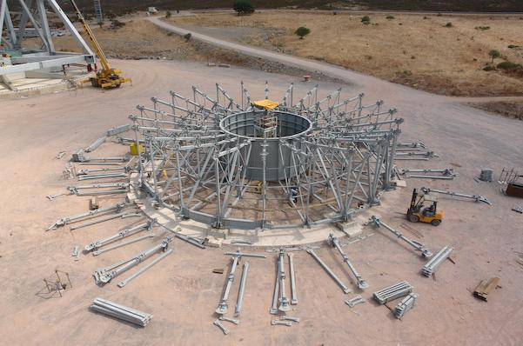
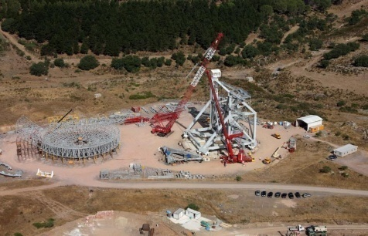
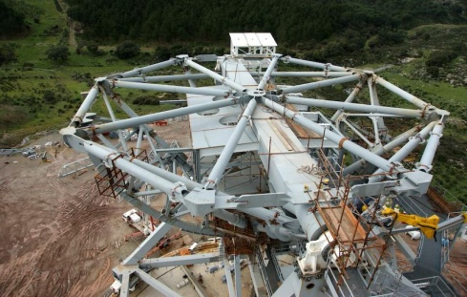
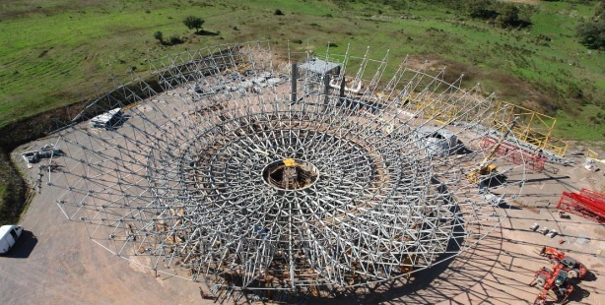
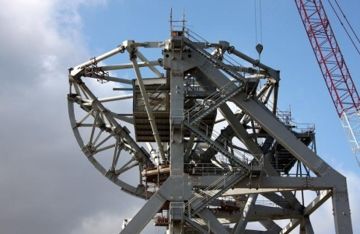
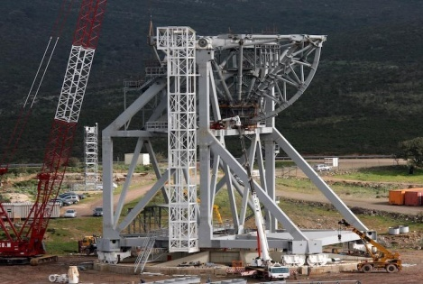
April 22, 2007 – 2010: Telescope Construction

Slide 12
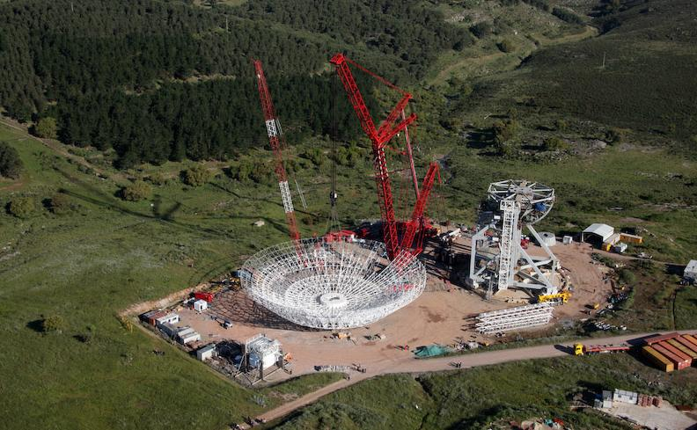
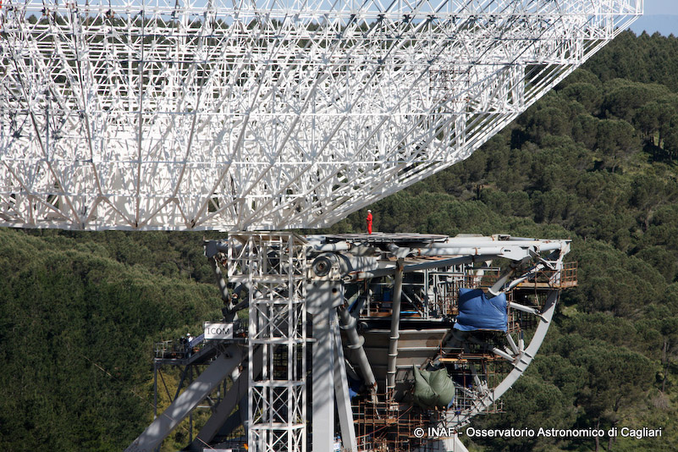
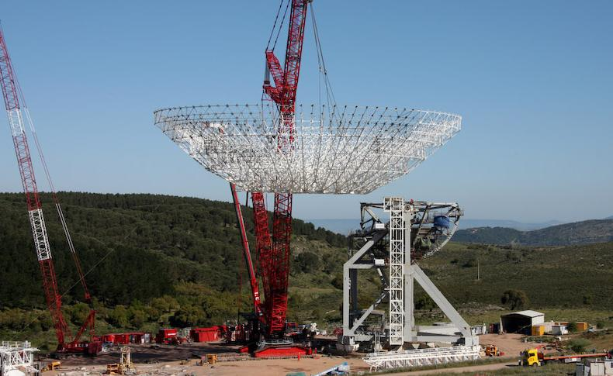
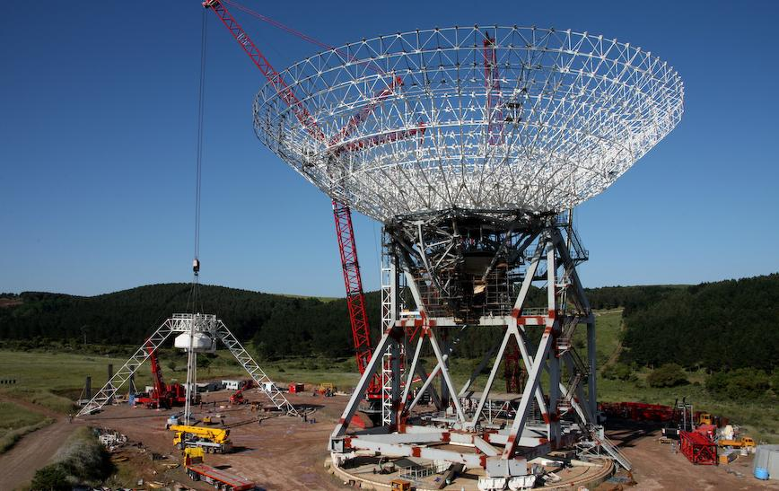
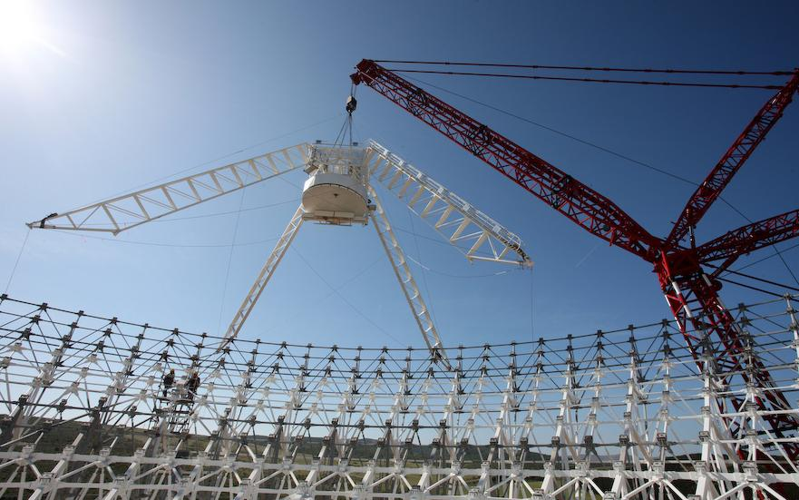
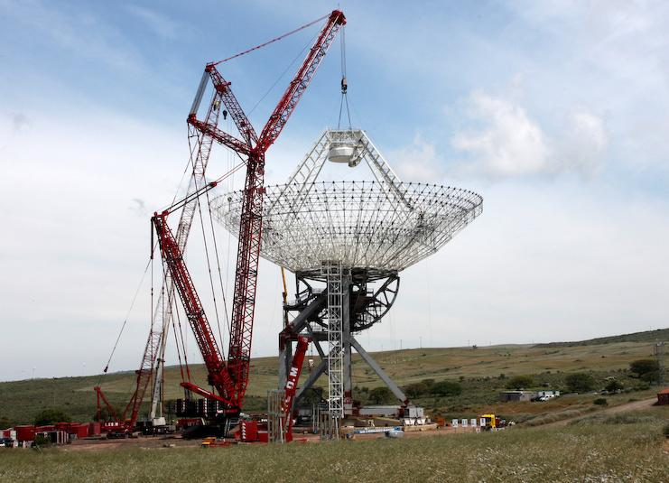
May 22 2010: The big event!
A single big lift, 64m, 500t ... the first ever!
May 30 2010:

Slide 13
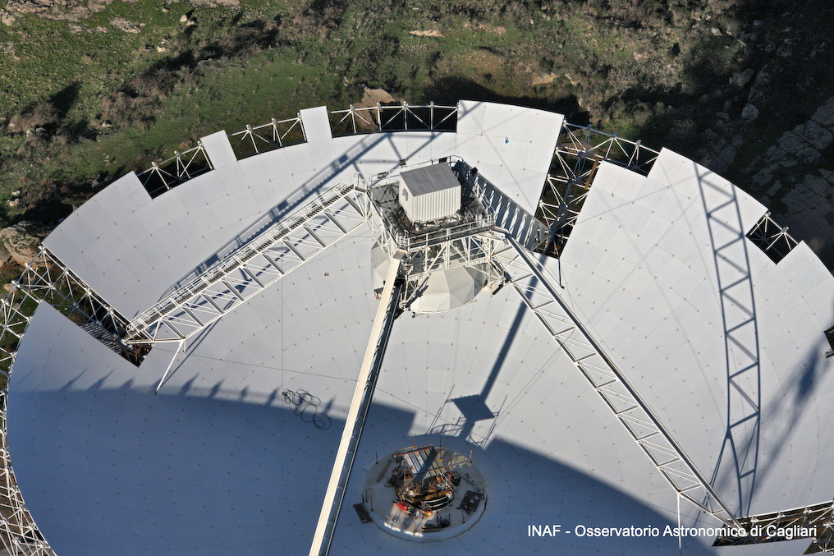
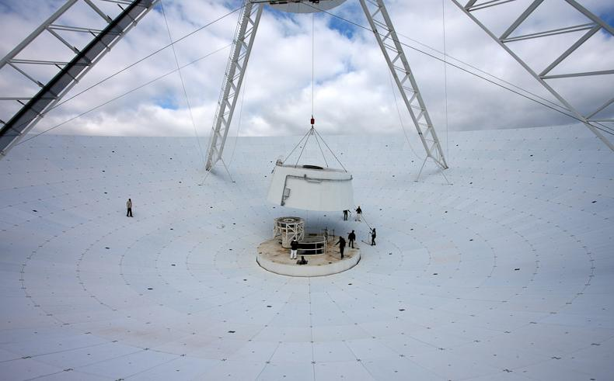
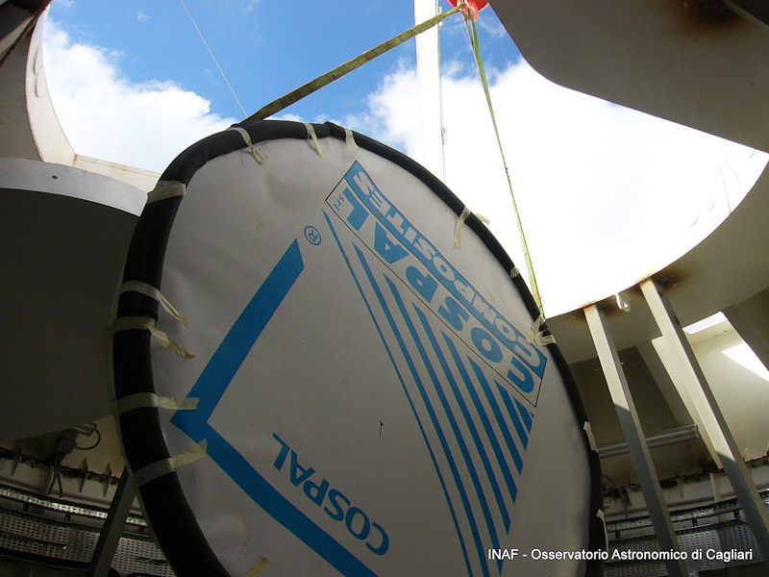
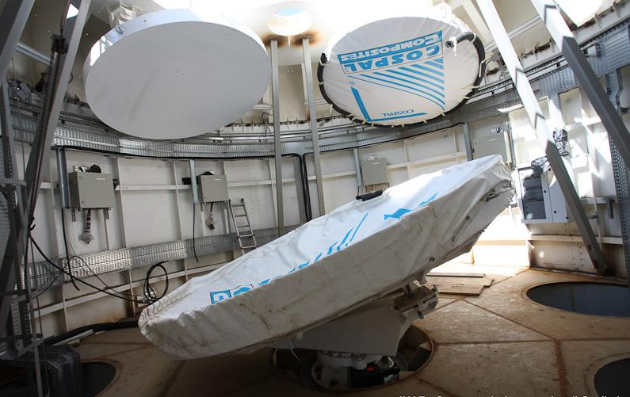
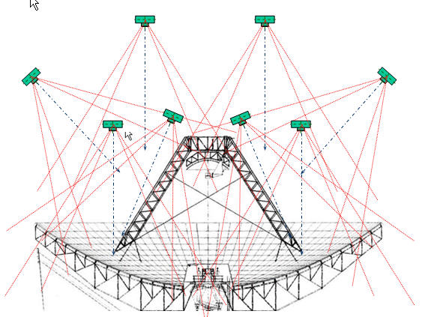
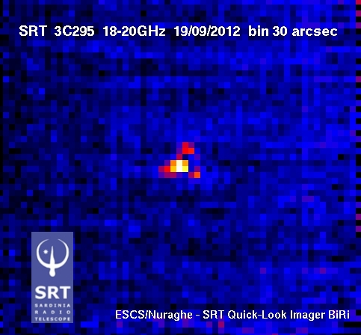
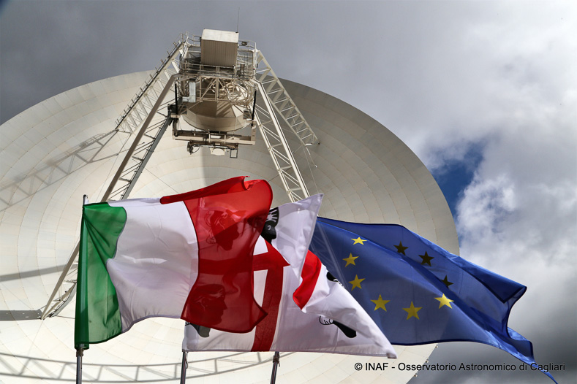
2010 – 2012: Surface Panels, Mirrors, Panel Alignment Alignment
2012 - 2013: Technical Commissioning (see Bolli et al. 2015)
Aug. 2012: Final acceptance of Instrument
Sept. 21, 2012: First Light!
Sept. 30, 2013: Opening Ceremony
2014 - 2015: Fine-tuning & Astronomical Validation
Notes:
Fine Tuning: Integration and optimization of all sub-systems (sub-reflector, active surface, etc.)

Slide 14
Astronomical Validation (AV) toward a radio observatory!
Last phase before first astronomical observations (shared risk, early science) [2014 -2015]
Goal 1: Tests on predefined sources to characterize the SRT astronomical performance in all standard observing modes; identification of technical problems and/or limitations
Goal 2: Transforming the SRT into a real Observatory (HW/SW development, observing/analysis tools, cook-book, etc.);
Goal 3: maximization of science exploitation since first light (science-driven HW modifications; prioritization of AV activities)

Slide 15
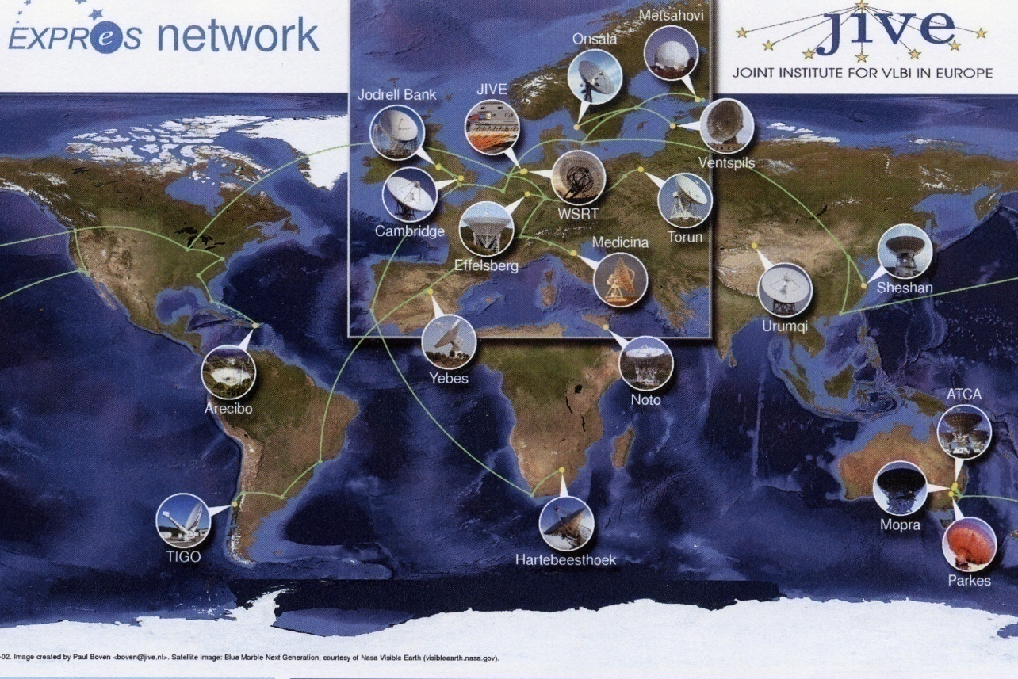
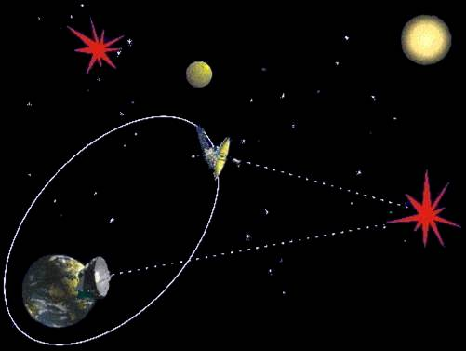
DBBC2 + Mark5C
SRT as part of VLBI Networks
EVN (14 Istituti):
Large collecting area→ Sensitivity Increment (especially for Space VLBI)
Geographical position → improve UV coverage → improve image fidelity
Active surface → high efficiency at high frequency→ mm-VLBI
SRT, Noto, Medicina → Italian VLBI
optical fiber link → eVLBI
RadioAstron
Frequency band [GHz]‏
0,327
1,665
4,83
18 - 25
Orbital Period: 7-10 gg
Apogee : 310.000-390.00 km
Perigee : 300-7.000 km
Ang. Res. At 350.000 km baseline [microas]
540
106
37
7 - 10

Slide 16
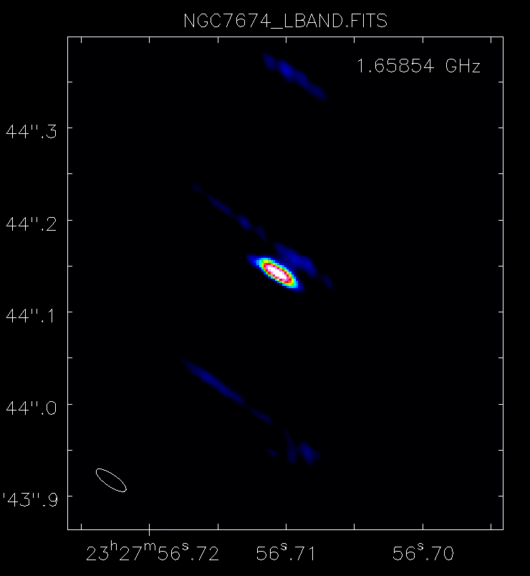
DBBC2 + Mark5C
SRT &VLBI – Milestones
2013, Oct. 10 → First Italian VLBI test:
Medicina-Noto-SRT + SW correlator
First fringes Med-SRT K-band 27-01-2014!
Feb/Mar 2014 → First EVN tests
5 tests performed, 3 successful (2 L-band + 1 K-band)
    29 May 2014 → 1st EVN experiment
L-band - PI Perez-Torres 6h
    4/5 June 14: 1st RadioAstron Experiment
L-band 13.5h - PI Sovolainen
    Feb/Mar 2015: 1st full participation to EVN
Shared-risk mode;
11/17 successful experiments

Slide 17
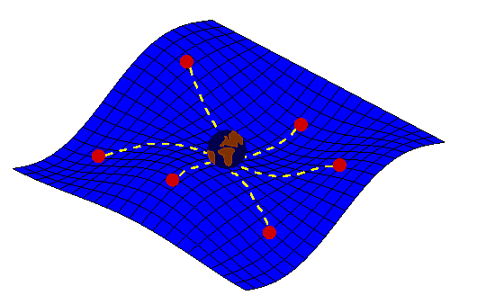

L/P Dual Band
+ ROACH1
PULSAR STUDIES WITH SRT
Dual band 20+90 cm receiver ➔ unique capability to remove interstellar medium effects
LEAP: Large European Array for Pulsars
(Westerbork, JB, Effelsberg, Nancay, SRT)
Phased Array: ‘Coherent’ combination of the 5 major European telescopes ➔ most sensitive telescope at L-band for timing (~200m, ie ~ Arecibo-illuminated dish, but able to track sources, and observe larger region of sky)
Ultra-precision Pulsar Timing: Searching for signature of space-time perturbations in pulsar timing residuals
Leader experiment for detecting GW from cosmological background or from local SMBH in merging systems
Courtesy A. Possenti
Notes:
Ricevitore dual band consente una rimozione estremamente accurata degli effetti mezzo interstellare → timing ultra preciso di pulsar e detezione perturbazioni spazio tempo da analisi dei residui. Pertantp SRT avra’ un ruolo fondamentale nell’ambito del LEAP, che prevede la combinazione coerente del segnale dei maggiori 5 radiotelescopi europei per fare timing di pulsar. Le pulsar utilizzate a questo scopo forniranno le braccia di un immenso rilevatore di onde gravitazionali che non avra’ rivali fino all’avvento di SKA. Qusto e’ quindi considerato l’esperimento leader per la detezione di onde gravitazionali.

Slide 18
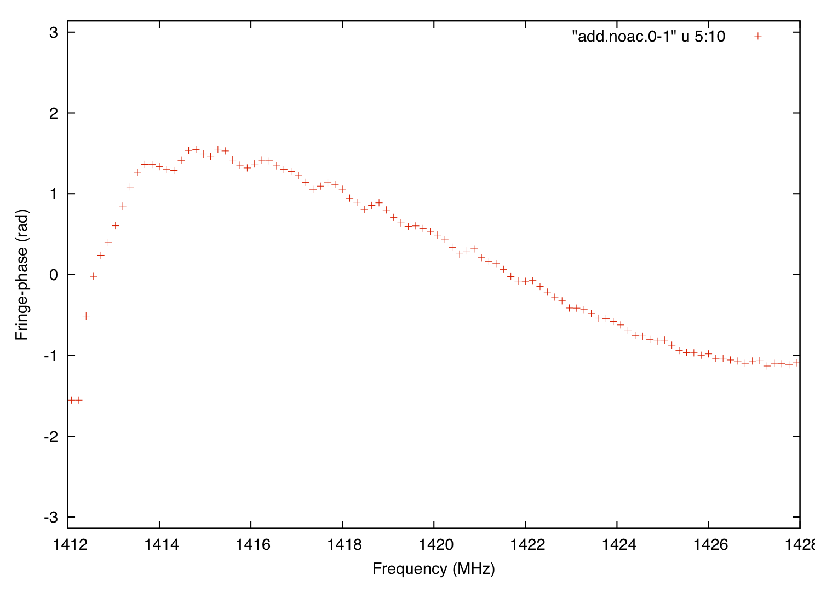
L/P Dual Band
+ ROACH1
SRT & LEAP – AV Milestones
ROACH1
15 min, 1.436 GHz
BW=16 MHz
S/N=37
2013, July 27th → First LEAP session including SRT
5 telescopes - ROACH installed – only 1 band (16 MHz)
Only brightest pulsars
Goal: 128 MHz → LEAP; 500 MHz → EPTA
Feb. 2014: 8-node cluster available
31/03/14: First LEAP session with 8 bands (128 MHz)!
→ SRT participate to all monthly 25^{h} LEAP sessions (nearly all msec pulsars detected)
May 9, 2014: Correlation between SRT and Westerbork
Sept. 2014: data acquisition completely automatized (SEADAS+NURAGHE)
Work in progress: 5 Telescope LEAP coherent addition
J1022+1001
Fringe SRT-Wb
Main Issue: Strong RFIs in L-band → Site + nearby radar (RFI up to 1460 in 1 pol)
Pulsar Group OAC: Perrodin, Concu, Melis, etc.
Notes:
ToO Magnetar -> profilo integrato contenete 3.3 ore (non consecutive) di dati della magnetar in banda C.
backend total-power e frequenza non adatti a osservazioni pulsar (segnale impulsivo disperso e a spettro ripido), ma la peculiare natura di questo oggetto (spettro circa piatto, periodo di rotazione lungo) ha reso possibile osservare questo oggetto a SRT.
Quella di SRT e' la prima (e tutt'ora unica, credo) osservazione in banda C di questa sorgente.
LEAP -> purtroppo per motivi vari (e indipendenti da SRT) non abbiamo ancora potuto correlare i dati di tutti e 5 i telescopi. L'immagine B1937+21_ROACH e' quindi relativa a una osservazione con il solo SRT (e una sola delle 16 sottobande da 16 MHz della ROACH; per usarle tutte abbiamo bisogno del cluster per il quale abbiamo bisogno di piu' potenza in sito). Si tratta di B1937+21, la prima MSP scoperta (e la seconda piu' rapidamente rotante nella Galassia). Osservazione su 16 MHz di banda per 15 min in banda L (23 Sept 13). Risultato molto buono e in linea con quello che si vede agli altri telescopi LEAP.
DFB -> B1937+21 osservata col DFB. Da confromtare con quella di LEAP: qui abbiamo una banda molto maggiore (500 MHz vs 16 MHz, quindi ovviamente raggiungiamo un alto SNR molto piu' rapidamente), ma la risoluzione temporale e, soprattutto, in frequenza sono piu' limitate (dedispersione incoerente in un canale di frequenza da ~1 MHz con DFB vs dedispersione coerente con la ROACH). A causa di cio' il profilo integrato e' molto piu' largo e non mostra tutte le features fini che invece con baseband recording e dedispersione coerente la ROACH permette di mettere in evidenza.

Slide 19
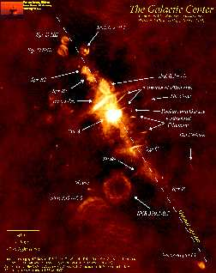
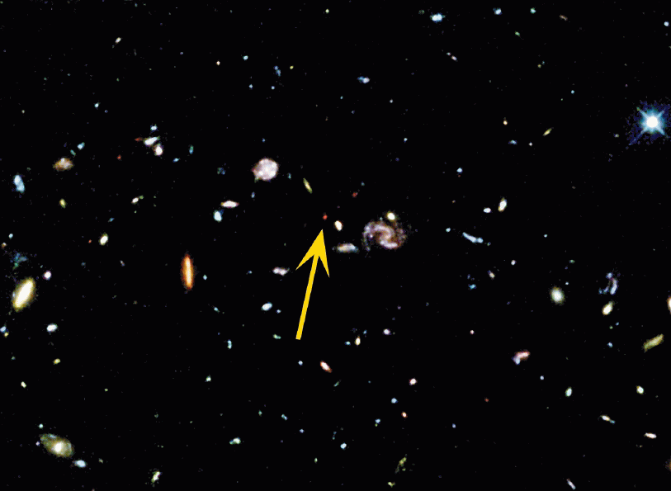

18-26 GHz
Multi-feed
K BAND SURVEYS
Centro Galattico
- Pulsars:
- Searching Recycled/msec pulsars in Galactic Center
→ chance to reveal binary systems
msec pulsar/BH → gravitational tests
- Continuum Surveys:
- free-free emission in Galactic Plane
→ Ultra-Compact HII Regions
- Deep Fields [SRT confusion limit: 50-70 μJy (rms)]
→ adding information @ ≥ 10 GHz → AGN/ SF thermal emission
- Line Surveys:
- Searching maser H₂O in Local Group
→ Distance & 3D motions → Dark Matter & Cosmology
- Unbiased Mapping NH_{3in} galactic Plane
→ Astrochemistry in SF Regions
0.5 deg
2 deg
Courtesy A. Possenti
Z = 6
Lagoon Nebula
Courtesy J. Brand

Slide 20

18-26 GHz
Multi-feed
SPECTROSCOPY @ SRT &
Line Surveys @ K-band
Example: NH₃ Unbiased Mapping in star forming regions
NH₃(1,1) and (2,2) at ∼23.7 GHz
+ hyperfine transitions [τ]
➔ Temp. of molecular clouds
Taurus (D=140 pc)
¹³CO(1-0) and protostars
In sinergy with JCMT, Herschel/Spitzer, APEX, ALMA
Localization pre-stellar cores
Study physical and chemical properties of various components: gas, dust, stars
2.4 pc
∼ 1ºx 1º in 34 hours
Courtesy P. Caselli & J. Brand

Slide 21
18-26 GHz
Multi-feed
Pilot Survey with K-band Multi-feed @ Medicina
Pre-commissioning + AV @ Medicina in 2010-11
(Multi-feed + TP + ESCS OTF mode)
Pilot survey North Polar Cap (~900 deg² @ Decl. +72.3°)
~70 RS with S>100 mJy
Precursor: Implementation of derotator
Righini et al. 2012
Ricci et al. 2013
Notes:
HSA= High Sensitive Array (link to VLBA, GBT, E-VLA)
RadioAstron: lancio schedulato per Maggio 2011

Slide 22
SRT – Imaging Performance
HDR + Image Fidelity: C-band obs. of SNR 3C157/IC 443
VLA 330 MHz
64”x74” res. ~1 hour
VLA+Arecibo 1.4 GHz 40” res. + 3.9’ res.
~6.3 hours
SRT 6.9 GHz - ROACH2
2.7’ res. ~13 hours
Lee et al. 2008
Hewitt et al. 2006
SDI SW: Baseline subtraction + RFI flagging + Calibration
Credits SDI Team: A.Pellizzoni, E.Egron, N.Iacolina, S.Righini, A.Trois, V.Vacca
AV: June 2014

Slide 23
SRT – Imaging Performance
HDR + Image Fidelity: C-band obs. of W3(OH) – Reduction with SCUBE
DR~9000
2x2 deg2
2.6’ res.
~8h
Credits: M. Murgia, F. Govoni, S.Poppi, V.Vacca, P.Castangia, A.Tarchi, F. Loi
Notes:
NB: No beam deconvolution performed. Only RFI flagging and de-striping

Slide 24
SRT – Spectroscopy with XARCOS
W3OH
6.7 GHz Methanol maser emission
with XARCOS [2048 channels]
Four simultaneous sub-bands with increasing spectral resolution
P. Castangia, A. Tarchi, & AV Team
BW = 62.5 MHz
30.5 kHz (1.4 km/s)
BW = 7.8125 MHz
3.8 kHz (170 m/s)
BW 1.953 MHz
0.95 kHz (40 m/s)
BW 0.488 MHz
0.24 kHz (10 m/s)
I. Prandoni - INAF - ORA, Bologna
24

Slide 25

SRT – Spectroscopy with XARCOS
L483 Molecular Cloud
NH3(1-1) line spectrum
with XARCOS – Preliminary!
P. Castangia, A. Tarchi & AV Team
BW = 62.5 MHz
30.5 kHz (1.4 km/s)
S. Poppi, A. Tarchi & the AV Team
BW = 7.8125 MHz
3.8 kHz (170 m/s)
BW 1.953 MHz
0.95 kHz (40 m/s)
BW 0.488 MHz
0.24 kHz (10 m/s)
I. Prandoni - INAF - ORA, Bologna
25

Slide 26
SRT - Current Status
VALIDATED (Prandoni et al. 2015; Prandoni et al. in prep.)
VLBI Operations: ready from technical point of view (EVN+RadioAstron) L, C, K
LEAP Operations: L-band/Roach
Single Dish: Continuum TP Observations: C-band; K-band-single
Pulsar folding mode
CLOSE TO COMPLETION:
Single Dish:
Continuum TP observations: K-band-multifeed
Spectroscopy with XARCOS
Pulsar search mode: DFB/ROACH
FUTURE PROSPECTS:
spectropolarimetry with DFB/ROACH
eVLBI → as soon as optic fibre available
mm-VLBI → 86 GHz + 43 GHz (under design); metrology
ToO → limited time available as DDT since May 2013

Slide 27

SRT - ToO OBSERVATIONS
7.3 GHz
BW=680 MHz,
S/N=20.7
3.3 hours
- 2013 Nov. 9th → Magnetar observed in L Band with ROACH
TP not suited BUT produced
First SRT publication!
ATEL#5053 – 14 May 2013
Credits: M. Burgay + Pulsar Group OAC
Notes:
ToO Magnetar -> profilo integrato contenete 3.3 ore (non consecutive) di dati della magnetar in banda C.
backend total-power e frequenza non adatti a osservazioni pulsar (segnale impulsivo disperso e a spettro ripido), ma la peculiare natura di questo oggetto (spettro circa piatto, periodo di rotazione lungo) ha reso possibile osservare questo oggetto a SRT.
Quella di SRT e' la prima (e tutt'ora unica, credo) osservazione in banda C di questa sorgente.
LEAP -> purtroppo per motivi vari (e indipendenti da SRT) non abbiamo ancora potuto correlare i dati di tutti e 5 i telescopi. L'immagine B1937+21_ROACH e' quindi relativa a una osservazione con il solo SRT (e una sola delle 16 sottobande da 16 MHz della ROACH; per usarle tutte abbiamo bisogno del cluster per il quale abbiamo bisogno di piu' potenza in sito). Si tratta di B1937+21, la prima MSP scoperta (e la seconda piu' rapidamente rotante nella Galassia). Osservazione su 16 MHz di banda per 15 min in banda L (23 Sept 13). Risultato molto buono e in linea con quello che si vede agli altri telescopi LEAP.
DFB -> B1937+21 osservata col DFB. Da confromtare con quella di LEAP: qui abbiamo una banda molto maggiore (500 MHz vs 16 MHz, quindi ovviamente raggiungiamo un alto SNR molto piu' rapidamente), ma la risoluzione temporale e, soprattutto, in frequenza sono piu' limitate (dedispersione incoerente in un canale di frequenza da ~1 MHz con DFB vs dedispersione coerente con la ROACH). A causa di cio' il profilo integrato e' molto piu' largo e non mostra tutte le features fini che invece con baseband recording e dedispersione coerente la ROACH permette di mettere in evidenza.

Slide 28

SRT – Operations
SRT Operation → Team on Site of 18 FTE coordinated by 5 senior staff
At present, 12 Staff appointed, some with temporary positions
WP-1 Mechanics | WP 8 Backends & VLBI
WP-2 Servo systems | WP 9 LAN | WP 11 Observations | WP 13 Outreach | WP 14 Logistics
WP-3 Metrology and optics | WP 10 Control Room | WP 12 Documentation |  | WP 15 Safety
WP-4 Receivers
WP-5 Time and Frequency
WP-6 RFI
WP-7 Site monitoring , GPS

Slide 29
SUMMARY
SRT station not fully staffed yet.. BUT we are gradually moving into regular operations:
VLBI/LEAP Operational (best effort)
Single-Dish Operations & 1st Generation Instrumentation largely validated
→ A Call for proposals (shared risk) is expected later this year
NB: Period of stop planned for the second half of next year:
→ refurbishment of the active surface actuator boxes
→ implementation of optical fibre
→ moving instrumentation and control room to final destination buildings

Slide 30


WP04 (Meteorology)
WP05 (RFI)
SITE MONITORING
Monitoring campaigns
RFI & atmospheric trasparency
Transparency at high frequency monitored with GPS and radiometers
30% of winter time τ_{100 GHz}<0.15
Dynamic Scheduling
RFI Monitoring
Notes:
Cumulative opacity distribution in winter: 30% of time tau<0.15

Slide 31
The SRT: INTERNATIONAL CONTEXT
Single-Dish Operations: Competitors
60/100m class radio telescopes: SRT, JB (70m), Eff (100m), GBT(100m), Parkes (64m)
- Dishes with active surface: SRT, Effelsberg, GBT
+ Yebes (40m), Noto (32m), IRAM (30m), Onsala (25m), Metshaovi (14m)
Highest Priority:
Include SRT in International Networks: EVN, LEAP
SD Operations: Pulsars (dual-band RX)
K-band Surveys (multi-feed+active surface)
State-of-the-art RX, Back-end (multi-feeds, etc.)
Ad hoc observing strategies/pipelines (large surveys, imaging SW, etc)
Coordinated use of Italian antennas (exploit synergies)
High frequency science (Dynamic scheduling, metrology, multi-feeds, etc.)
Networks: Cooperation
- EVN, eVLBI, Space-VLBI, mm-VLBI, Italian VLBI, AVN,…
- PTAs/LEAP
Ad hoc RX, Back-ends (eg 43/86 GHz; ROACH, etc.)
SW Correlation for Italian VLBI, AVN (DIFX)
National Expertise/Scientific Interests
Notes:
Nel far cio’ non si puo’ prescindere dal contesto generale in cui SRT si trovera’ adoperare. Contesto nazionale: SRT sara’ la 3a antenna in Italia, con caratteristiche diverse dalle precedenti e quindi andra’ potenziato un uso sinergico delle 3 antenne. Inoltre non si puo’ prescindere dagli interessi/expertise della comunita’ radio Italiana. Allargando l’orizzonte, bisogna tener presente in che direzioni si muove la RA internazionale: verso SKA a bassa freq. Verso ALMA ad alta freq.. Quindi bisogna muoversi in questo ambito individuando quale contributo SRT puo’ dare in questo contesto. Infine e’ necessario valorizzare SRT rispetto agli altri telescopi della stessa classe, nonche’ favorire un utilizzo sinergico degli stessi.

Slide 32

ASI & SRT
ASI Equipment: Transmitter + Dedicated Receivers (X/Ka/K)
Radar Techniques
tracking of space probes, Space Science, etc.
ASI will support:
Astronomy Missions
b. Planetary System Exploration Missions (incl. Radio Science)
c. Space Situational Awareness (SSA) Programme

Slide 33
IRA – January 2014
I. Prandoni, IRA – INAF, ITALY
WP04 (Meteorology)
WP05 (RFI)
SITE MONITORING
Monitoring campaigns
RFI & atmospheric trasparency
Transparency at high frequency monitored with GPS and radiometers
30% of winter time τ_{100 GHz}<0.15
Dynamic Scheduling
RFI Monitoring
Notes:
Cumulative opacity distribution in winter: 30% of time tau<0.15

Slide 34
DBBC2 + Mark5C
SRT as part of VLBI Networks
EVN → Medicina & Noto + SRT from 2015
Space-VLBI (RadioAstron) → Medicina & Noto, SRT test experiments ongoing
eVLBI: Optic fibre connection to Medicina & Noto + SRT in 1-1.5 years
mm-VLBI (7/3 mm) → high-ν capability Noto + SRT 43 GHz funded; 86 GHz IRAM
Italian VLBI → Medicina, Noto, SRT + SW correlator (DIFX) – tests ongoing
RadioAstron
Frequency band [GHz]‏
0,327
1,665
4,83
18 - 25
Orbital Period: 7-10 gg
Apogee : 310.000-390.00 km
Perigee : 300-7.000 km
Ang. Res. At 350.000 km baseline [microas]
540
106
37
7 - 10

Slide 35






IRA – January 2014
I. Prandoni, IRA – INAF, ITALY
20/90 cm
Dual Band
PULSAR STUDIES WITH SRT
SRT: Dual band 20+90 cm receiver ➔ unique capability to remove interstellar medium effects
LEAP: Large European Array for Pulsars
(Westerbork, JB, Effelsberg, Nancay, SRT)
Phased Array: ‘Coherent’ combination of the 5 major European telescopes ➔ most sensitive telescope at L-band for timing (Arecibo-like, but able to track sources, and observe larger region of sky)
Ultra-precision Pulsar Timing: Searching for signature of space-time perturbations in pulsar timing residuals
Leader experiment for detecting Cosmological Background of Gravitational Waves and/or GW from local SMBH in merging systems
Courtesy A. Possenti
Notes:
Ricevitore dual band consente una rimozione estremamente accurata degli effetti mezzo interstellare → timing ultra preciso di pulsar e detezione perturbazioni spazio tempo da analisi dei residui. Pertantp SRT avra’ un ruolo fondamentale nell’ambito del LEAP, che prevede la combinazione coerente del segnale dei maggiori 5 radiotelescopi europei per fare timing di pulsar. Le pulsar utilizzate a questo scopo forniranno le braccia di un immenso rilevatore di onde gravitazionali che non avra’ rivali fino all’avvento di SKA. Qusto e’ quindi considerato l’esperimento leader per la detezione di onde gravitazionali.

Slide 36
IRA – January 2014
I. Prandoni, IRA – INAF, ITALY
SPECTROSCOPY with XARCOS – STATUS OF AV
July 2013 - XARCOS installed, cabled and tested - July 2013 (Melis et al. 2013)
November 2013 – Attempt to use XARCOS to observe ISON Comet prior to perihelion passage
Intense preparatory work to use XARCOS ACS component
Results:
- ACS component ok, but problems with Scheduler
[Ad hoc python script to bypass Scheduler]
ephemeris computed externally
- Got useful information for debugging
- FITS to CLASS Converter
ISON – data reduction ongoing
L483 molecular cloud
NH3(1-1) line spectrum
Credits ISON: M. Buttu, S.Casu, A.Melis, C.Migoni, A.Orlati, S.Poppi, I. Porceddu
Further Activity planned for April 2014
Courtesy S. Poppi, A. Tarchi
Notes:
Slide Update XArcos On the second half of July, the XARCOS spectropolarimeter has been installed, cabled, and tested on the SRT. A few preliminary uncalibrated spectra were acquired on strong spectral line sources at C and K band (central feed only) [Melis et al. OAC Int Rep n. 29; 13/09/2013] ___________________________________________________________________________ On November 2013, a ToO project (PIs: I. Porceddu, S. Casu) was conducted to detect 23-GHz ammonia lines in the comet ISON prior to its perihelion passage. An intense preparatory work was necessary in order to make the XArcos spectropolarimeter available within the Nuraghe control system and to allow for tracking both the fast changing sky position and the frequency/velocity Doppler shift. Thus, the XArcos ACS component was implemented in Nuraghe and a Python script developed in order to account for the aforementioned requests. The observations have allowed us to test the component and the Python script. Indeed, for the former, some work has still to be performed in order to make it more stable. Nicely, during the run a preliminary 23-GHz spectrum of the L483 molecular cloud was successfully obtained, produced by using an 'ad hoc' Python data-reduction script, that shows the detection of the NH3(1-1) ammonia line (Fig. 1). [Poppi, Buttu, Migoni, Orlati, Melis et al. Report in prep.] ___________________________________________________________________________ Subsequently, in order to be able to reduce the data obtained with XArcos within the standard spectral-line data reduction IRAM software CLASS, we have developed a converter from the raw data FITS format of the XArcos measurements provided by the telescope and a FITS format readable within CLASS. The converter has allowed us to reduce with CLASS the data for L483 confirming the ammonia spectrum (Fig 2) and opening up the possibility to reduce the data of the observations of the ISON Comet. [Trois, Tarchi, et al. Report in prep.] The data reduction on the ISON data is presently ongoing.

Slide 37
IRA – January 2014
I. Prandoni, IRA – INAF, ITALY
SRT & VLBI
DBBC + Mark5c
EVN (14 Institutes) → Italy participates with Medicina & Noto + SRT in the near future
Space-VLBI (RadioAstron) → Medicina & Noto already involved
eVLBI: Optic fibre connection to Medicina & Noto + SRT in 1-1.5 years
mm-VLBI (7/3 mm): high frequency SRT & Noto capabilities (plan to incl. phased ALMA)
Italian VLBI: Mc, Nt, SRT + SW correlator
Space-VLBI
Frequency band [GHz]‏
0,327
1,665
4,83
18 - 25
Orbital Period: 7-10 gg
Apogeo : 310.000-390.00 km
Perigeo : 300-7.000 km
Ang. Res. At 350.000 km baseline [microas]
540
106
37
7 - 10

Slide 38

IRA – January 2014
I. Prandoni, IRA – INAF, ITALY
DBBC + Mark5c
SRT & HSA
High Sensitivity Array (HSA):
Including SRT in network High Sensitivity VLBI Array:
VLBA, VLA, GBT (100m), Arecibo (300m), Effelsberg (100m) + SRT (64m)
Dec. -20◦
Dec. +10◦
Dec. +30◦
Increment in sensitivity and UV coverage
Incl. SRT (full tracks):
22 GHz : 10 %
5 GHz : 10 % → 16 % (no Arecibo)
1.6 GHz : 8 % → 15 % “
Dec. +60◦

Slide 39
Team AV
IRA – January 2014
I. Prandoni, IRA – INAF, ITALY
PS: Isabella Prandoni
Co-PS:
Matteo Murgia,
Andrea Tarchi,
Sandro Orfei,
Gianni Comoretto
+ 34 people
covering various
technical/astronomical
expertises (8 IRA/Med;
24 OACa; 2 Arcetri)
→ Pulsar; Galactic & Extra-galactic, etc.
→ Continuum, Line, Mapping, VLBI, etc.
→ SW, Receivers, Backends, etc.
[interface with commisioning team]

Slide 40
IRA – January 2014
I. Prandoni, IRA – INAF, ITALY
HIGH DYNAMIC RANGE IMAGING – STATUS OF AV
Advanced Test
06 Dec 2013 – First observations with TP (C Band) to test/debug beam deconvolution procedures (based on Imaging SW SCUBE). Before Fine
Tuning
Results are encouraging:
Beam reconstruction and shapelet modeling works fine
➔ DR~600 Goal: DR~1000
Need deep beam pattern measurements at fine El. steps
3C147: Dirty Image
3C147: Beam Model
Credits:
M. Murgia, F. Govoni, S.Poppi, V.Vacca, P.Castangia, A.Tarchi
Calibrated & cleaned Image; Restoring beam FWHM=2.8’
Notes:
Slide Update XArcos On the second half of July, the XARCOS spectropolarimeter has been installed, cabled, and tested on the SRT. A few preliminary uncalibrated spectra were acquired on strong spectral line sources at C and K band (central feed only) [Melis et al. OAC Int Rep n. 29; 13/09/2013] ___________________________________________________________________________ On November 2013, a ToO project (PIs: I. Porceddu, S. Casu) was conducted to detect 23-GHz ammonia lines in the comet ISON prior to its perihelion passage. An intense preparatory work was necessary in order to make the XArcos spectropolarimeter available within the Nuraghe control system and to allow for tracking both the fast changing sky position and the frequency/velocity Doppler shift. Thus, the XArcos ACS component was implemented in Nuraghe and a Python script developed in order to account for the aforementioned requests. The observations have allowed us to test the component and the Python script. Indeed, for the former, some work has still to be performed in order to make it more stable. Nicely, during the run a preliminary 23-GHz spectrum of the L483 molecular cloud was successfully obtained, produced by using an 'ad hoc' Python data-reduction script, that shows the detection of the NH3(1-1) ammonia line (Fig. 1). [Poppi, Buttu, Migoni, Orlati, Melis et al. Report in prep.] ___________________________________________________________________________ Subsequently, in order to be able to reduce the data obtained with XArcos within the standard spectral-line data reduction IRAM software CLASS, we have developed a converter from the raw data FITS format of the XArcos measurements provided by the telescope and a FITS format readable within CLASS. The converter has allowed us to reduce with CLASS the data for L483 confirming the ammonia spectrum (Fig 2) and opening up the possibility to reduce the data of the observations of the ISON Comet. [Trois, Tarchi, et al. Report in prep.] The data reduction on the ISON data is presently ongoing.

