Slide 1
Whole Body PET-CT Effective Dose calculations using Physico®: an automatic dosimetric software.
Fabio Tanzi¹, Andrea Ribolzi², Raffaele Novario³ , Carla Bianchi¹.
1) Struttura Complessa Fisica Sanitaria, Ospedale Di Circolo e Fondazione Macchi – Varese.
2) EMME ESSE M.S. SRL Via Giuba 11, 20132 Milano - ITALY e-mail: info@emme-esse.com.
3) Dipartimento di Biotecnologie e Scienze della vita, Università dell'Insubria, Varese .
Roma, 24 settembre 2015

Slide 2
Physico®: a software suite for Medical Physics and Radiation Protection.
Physico is the result of a cooperation between The Medical Physics Dept. and Emme-Esse SRL.
Our Medical Physics Dept. Is involved in all the types of activities related to:
Medical Physics (patient RP, radiological Machines QC, etc.)
Radiation Protection (Dosimetry LAB, personnel and environmental dosimetry, etc)

Slide 3
Physico®: architecture (1).
Physico® is intended to provide the framework in which is supported:
Direct integration between RIS, PACS, Record & Verify, and Treatment Planning Systems, NM - NBP Software.
DataBase containing all the info retrieved from:
Medical Imaging
RT planning
NM Sources QC and administration
Environmental Active and passive Dosimetry
Personnel Dosimetry (active and passive).

Slide 4
Physico®: architecture (2).
Physico® gives the users the full real-time control of:
Radioactive Sources DataBase
Radiological Machines Database (QC, Service Reports, etc.)
Radiometric Instrumentation DataBase, with cal. Certificates and alerts.

Slide 5
Physico®: architecture (3).
Physico® gives the users the full, real-time control of:
For Medical Physicist (D. lgs. 187/2000)
Patient Dosimetry
L.D.R. (Diagnostic Reference Levels) calculations and reporting
Radiological Machines and LINAC QC Dbase and Reporting
For Radiation Protection Qualified Expert (D. lgs. 241/2000)
Radioactive Sources charge – discharge Registers
Personnel External Dosimetry
Environmental dosimetry
Personnel Internal Dosimetry
Personnel Radiation protection documentation (Scheda Dosimetrica Personale, Libretto Personale di Radioprotezione)

Slide 6
Physico®: Features.
Architecture: LINUX (Debian® or Ubuntu® 14)
DataBase: Postgre with NVIDIA® CUDA® computation !
WEB based Interface: you can use it by using a WEB Browser: no client installation !
Different user – levels:
Administrator
Medical Physicist/Qualified Expert
Technician

Slide 7
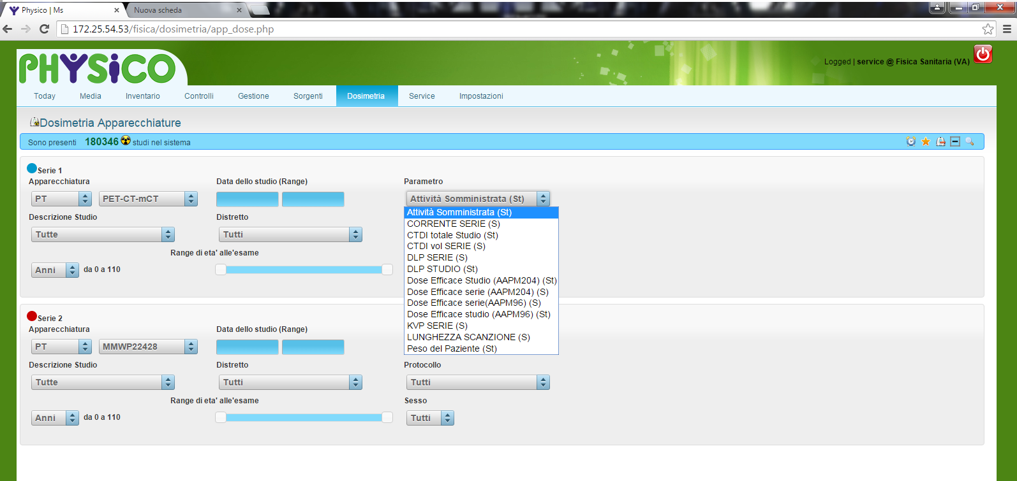
Patient Dosimetry Module:

Slide 8
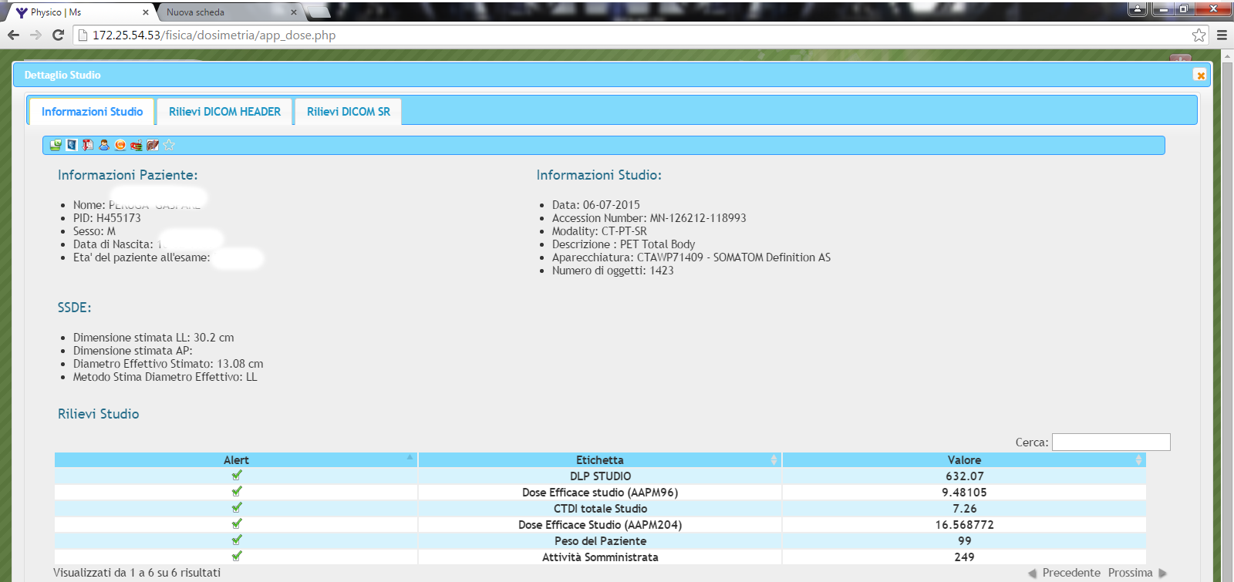
Patient Dosimetry Module:

Slide 9
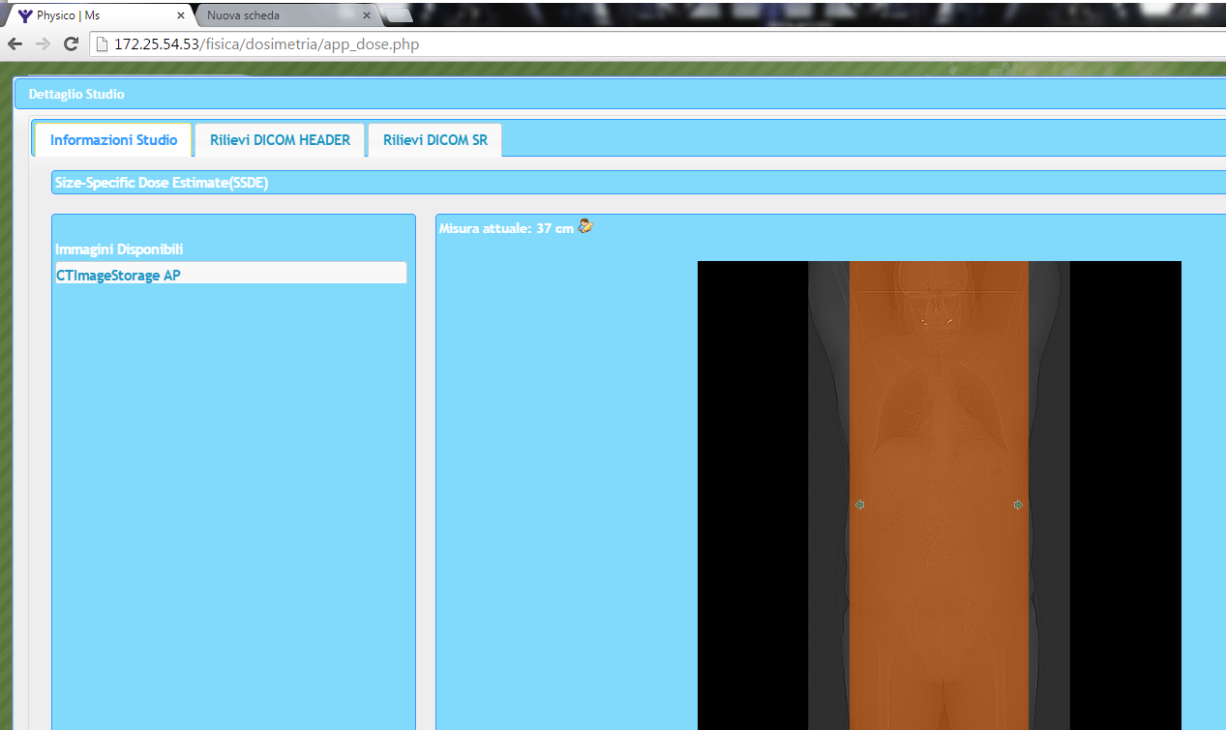
Patient Dosimetry Module:

Slide 10
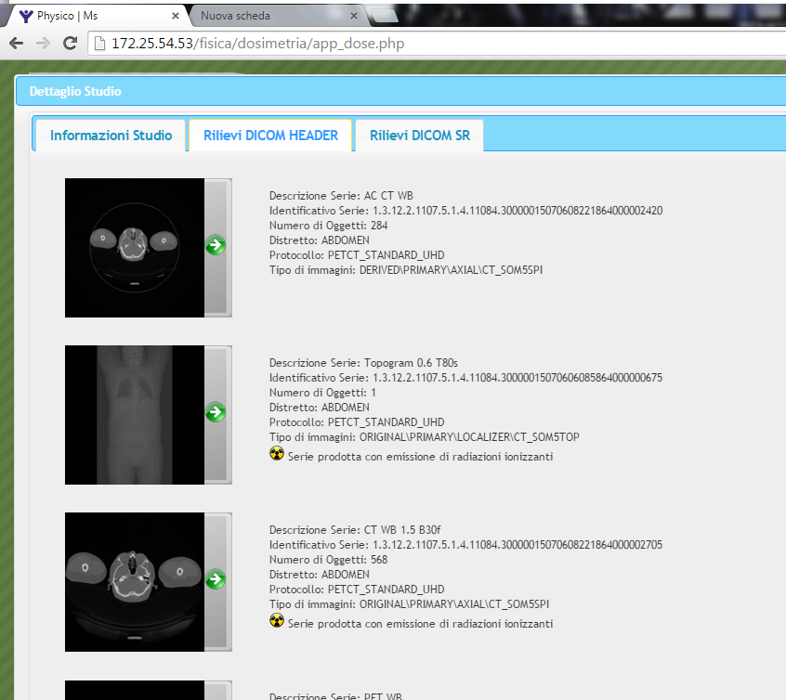
Patient Dosimetry Module:

Slide 11
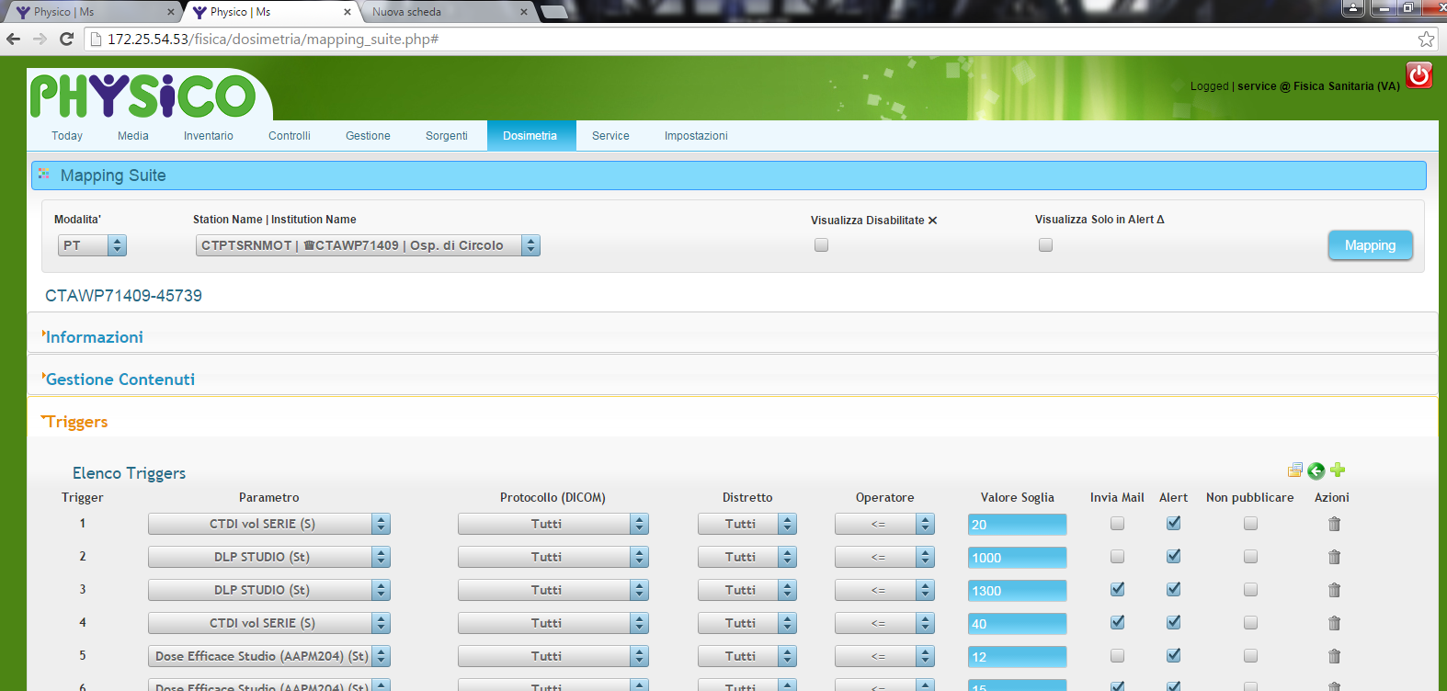
Patient Dosimetry Module:

Slide 12
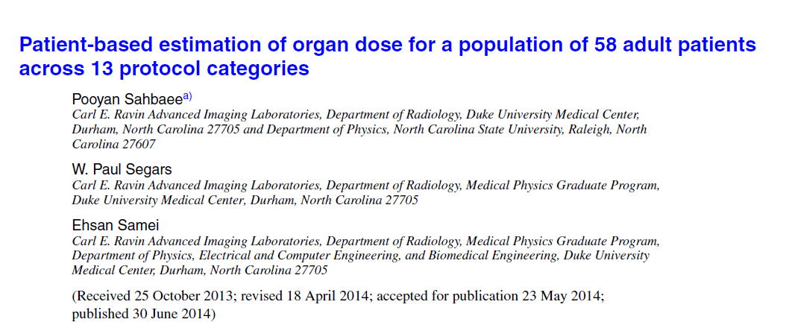
Patient Dosimetry Module CT Organ Doses:

Slide 13
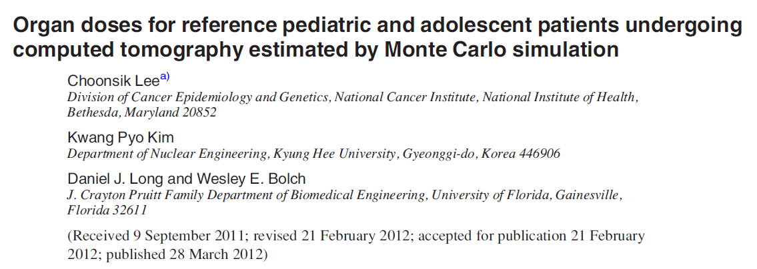
Patient Dosimetry Module: pediatric CT Organ Doses

Slide 14
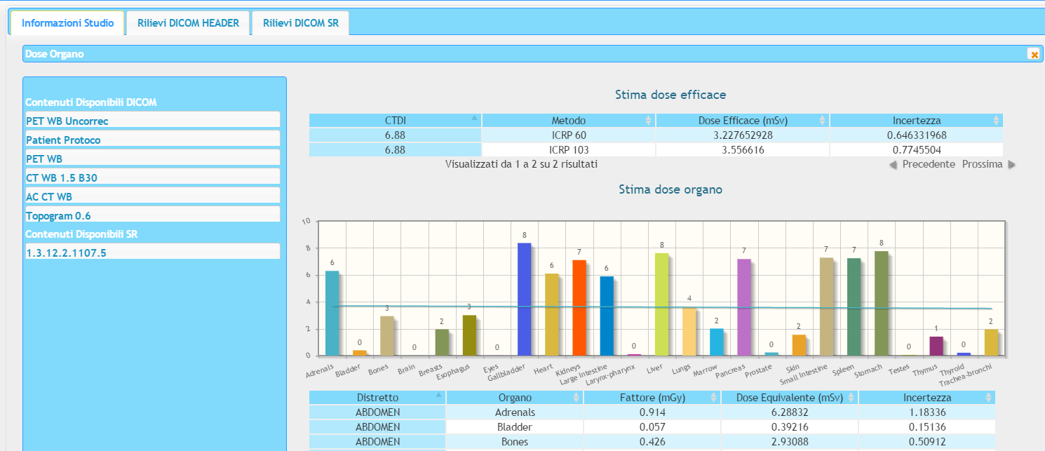
Patient Dosimetry Module:

Slide 15
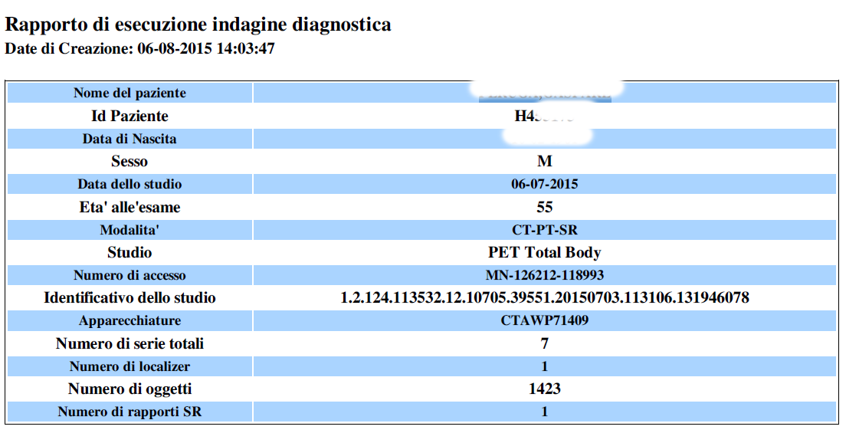
Patient Dosimetry Module:

Slide 16
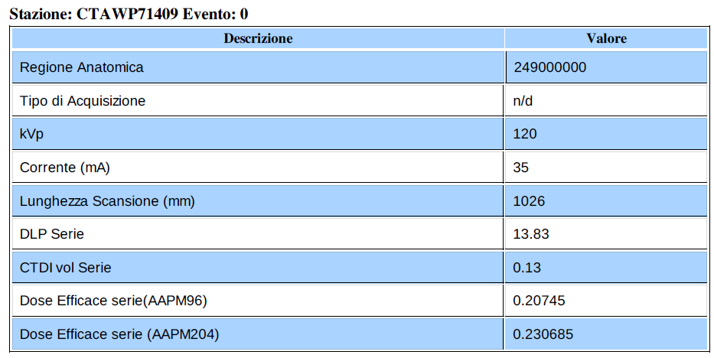
Patient Dosimetry Module:

Slide 17
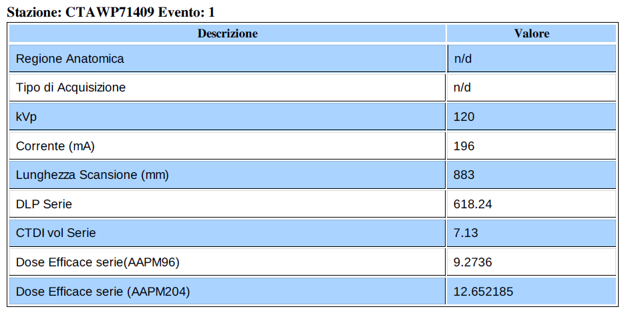
Patient Dosimetry Module:

Slide 18
Patient Dosimetry Module:

Slide 19
Patient Dosimetry Module:

Slide 20
Some Results in PET-CT
Attività (Mbq) | CTDI totale Studio | DLP Totale Studio | Dose Efficace Impegnata | Dose Efficace studio (AAPM96) | Dose Efficace studio (ICRP 103) | Incertezza Dose Efficace Studio(ICRP103) | Dose Efficace Impegnata | Dose Efficace studio (ICRP 60) | Incertezza Dose Efficace Studio(ICRP60) | Peso del Paziente (Kg)
164 | 5,26 | 458,65 | 3,185905 |  | 8,117040594 | 1,685511527 | 3,185905 | 7,32513296 | 1,45699987 | 70
113 | 4,75 | 414,43 | 2,19516625 |  | 7,330027152 | 1,522087405 | 2,19516625 | 6,614901437 | 1,315731822 | 46
202 | 5,3 | 461,8 | 3,79586866 |  | 8,096384406 | 1,671075191 | 3,79586866 | 7,187723207 | 1,403855445 | 74
136 | 4,96 | 434,56 | 2,64197 |  | 7,654091511 | 1,589379691 | 2,64197 | 6,907349711 | 1,373901018 | 55
155 | 5,19 | 452,34 | 3,01106875 |  | 8,009019141 | 1,663080765 | 3,01106875 | 7,227650202 | 1,437610138 | 61
197 |  |  | 3,82697125 |  |  |  | 3,82697125 |  |  | 80
300 | 26,05 | 617,71 | 5,6374287 | 1,297191 |  |  | 5,6374287 |  |  | 83
 | 5,7 | 566,36 |  |  | 8,707432286 | 1,797194073 |  | 7,730192883 | 1,509806799
149 | 4,21 | 367,16 | 2,89451125 |  | 6,496718802 | 1,3490501 | 2,89451125 | 5,862891589 | 1,166153889 | 50
 | 4,5 | 392,35 |  |  | 6,874288647 | 1,418837426 |  | 6,102783855 | 1,191952736
182 | 5,34 | 465,02 | 3,42004008 |  | 8,157489194 | 1,683687079 | 3,42004008 | 7,241970175 | 1,41445058 | 72
148 | 7,37 | 641,54 | 2,875085 |  | 11,37311581 | 2,361638774 | 2,875085 | 10,26354181 | 2,041461796 | 60
295 | 26,23 | 621,78 | 5,73074375 | 1,305738 |  |  | 5,73074375 |  |  | 50
148 | 4,5 | 392,4 | 2,78113149 |  | 6,874288647 | 1,418837426 | 2,78113149 | 6,102783855 | 1,191952736 | 60
258 | 7,37 | 733,13 | 4,84818868 |  | 11,25855718 | 2,323740407 | 4,84818868 | 9,99500378 | 1,952153704 | 106
235 |  |  | 4,41598582 | 0 |  |  | 4,41598582 |  |  | 95
289 | 26,23 | 621,9 | 5,61418625 | 1,30599 |  |  | 5,61418625 |  |  | 63
141 | 4,97 | 555,28 | 2,73910125 |  | 7,669523147 | 1,592584085 | 2,73910125 | 6,921275819 | 1,37667098 | 57
306 | 26,23 | 618,17 | 5,75017727 | 1,298157 |  |  | 5,75017727 |  |  | 99
128 | 5,36 | 469,32 | 2,48656 |  | 8,271356955 | 1,717555472 | 2,48656 | 7,464394043 | 1,484699488 | 55
180 |  |  | 3,496725 | 0 |  |  | 3,496725 |  |  | 72

Slide 21
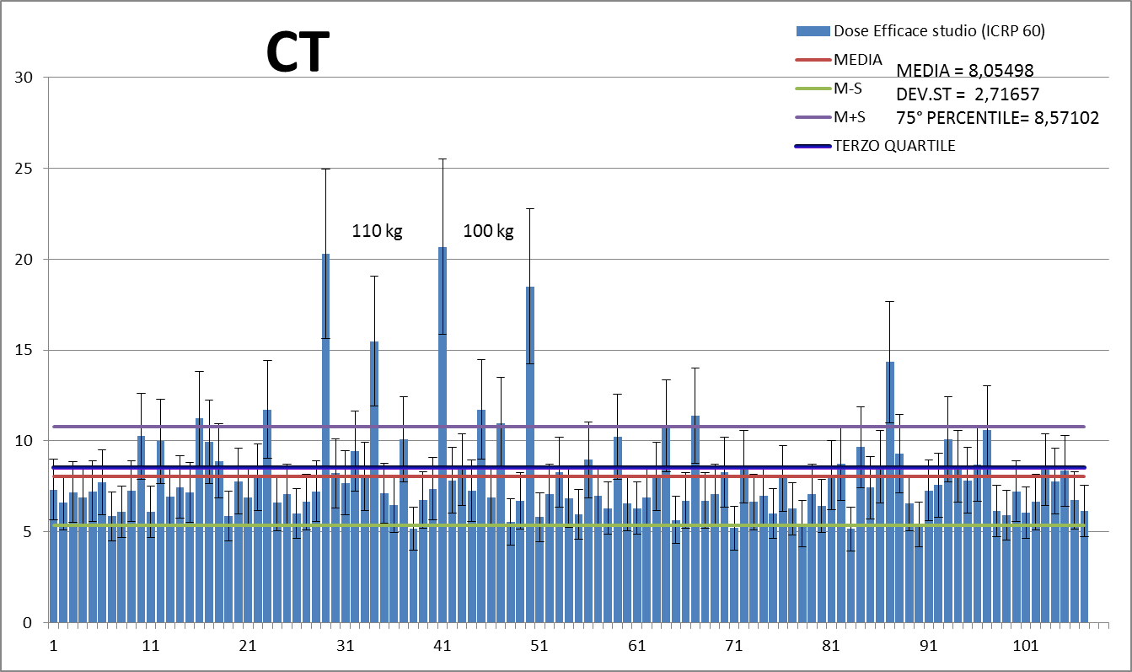
Patient Dosimetry Module example: results on 110 Pet-CT studies

Slide 22
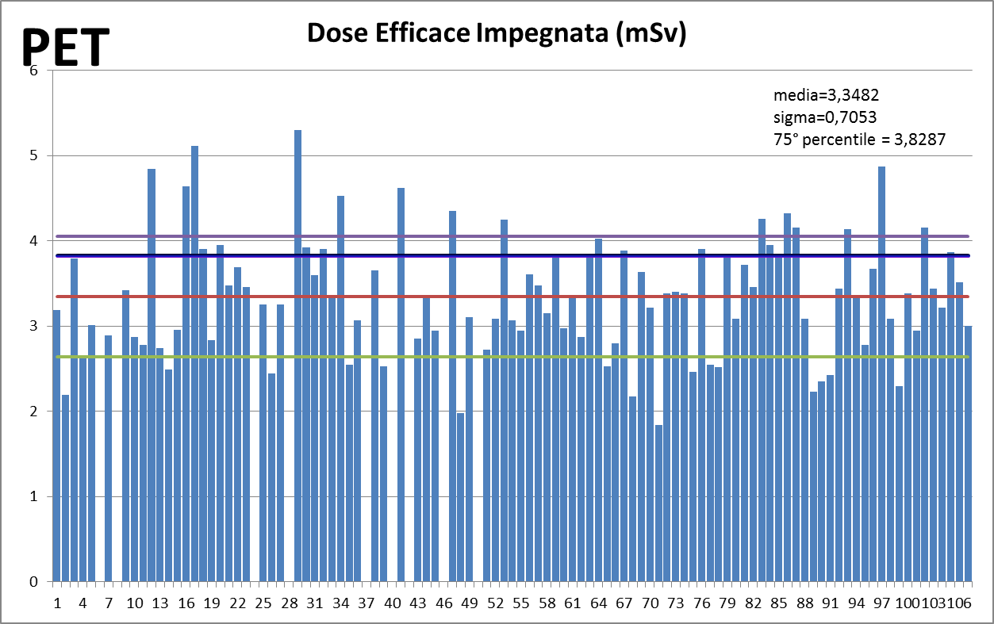
Patient Dosimetry Module example: results on 110 Pet-CT studies

Slide 23
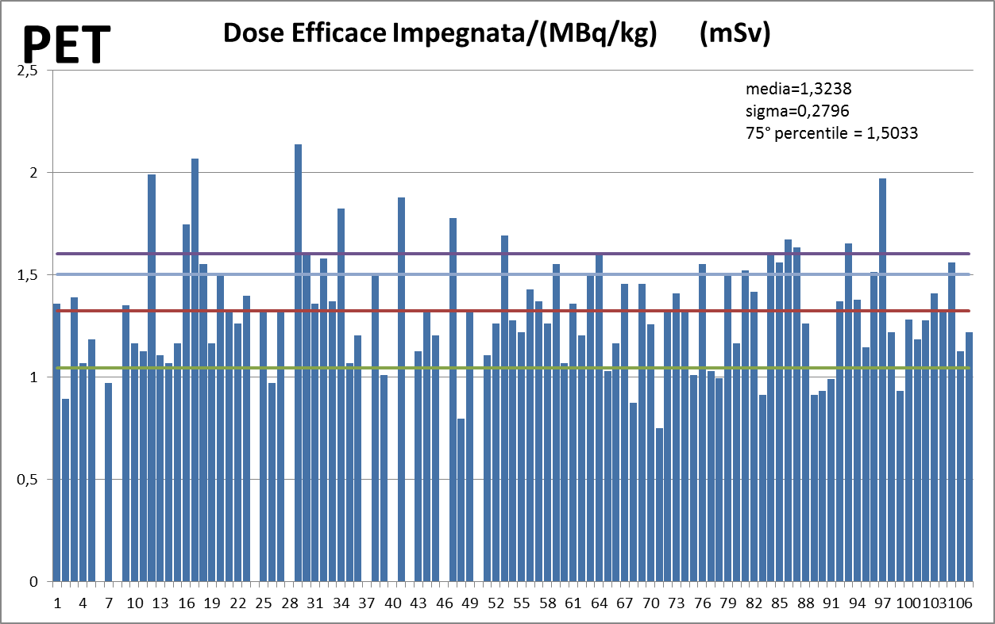
Patient Dosimetry Module example: results on 110 Pet-CT studies

Slide 24
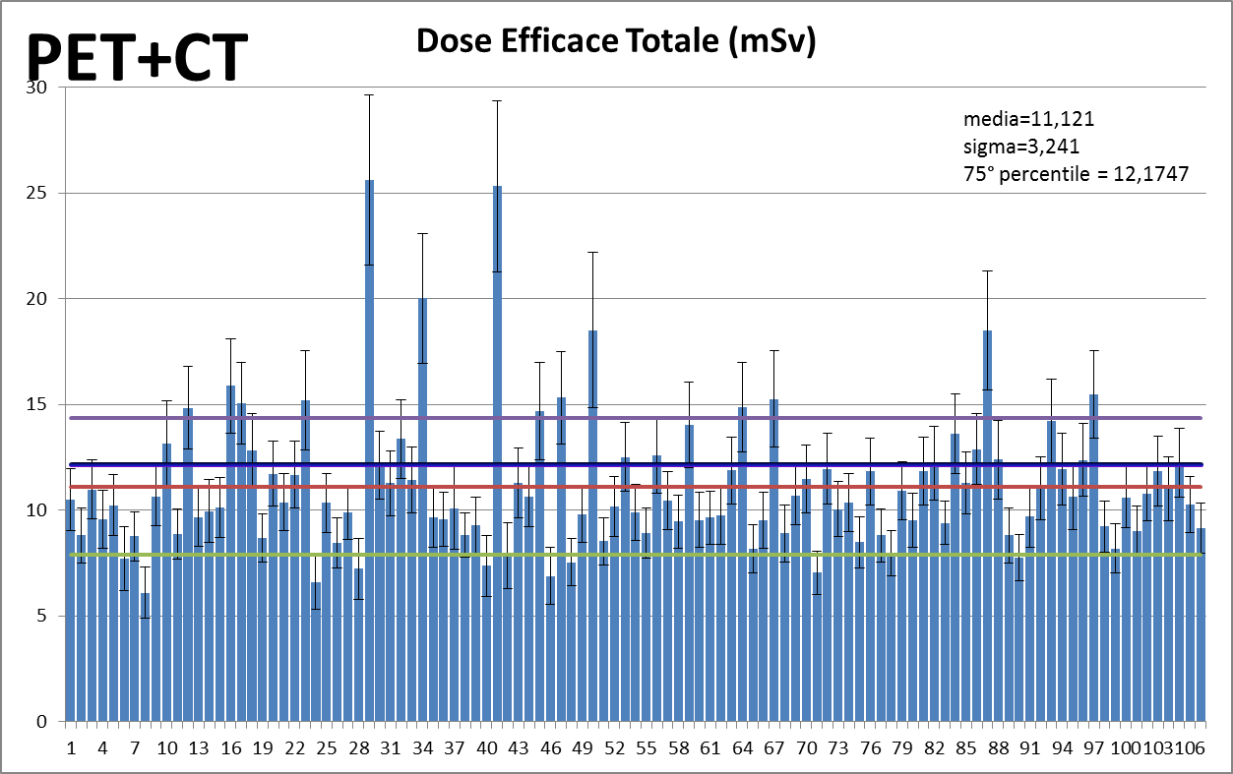
Patient Dosimetry Module example: results on 110 Pet-CT studies

Slide 25
Conclusions:
Using this software it’s possible to analyze very large amount of dosimetric patient’s data coming directly from both DICOM Headers and DISCOM SR.
We processed data from 110 patients undergoing PET-CT WB examinations.
Results seems to validate the Lee Method (EFFECTIVE and Organ Doses) (in comparison with ImpaCT ® CTDosimetry® Excel® Worksheet)
The tool is very fast and allows (also) to calculate TC DRLs for our MN site.

Slide 26
Thanks for you attention !!

