Slide 1
Alberto Traverso Politecnico di Torino & INFN Torino on behalf of the M5L Collaboration (alberto.traverso@polito.it)
M5L: servizio di analisi
on demand di CT polmonari
Congresso Nazionale SIF – Roma – 2015/09/24

Slide 2
Outline
Background: cancer facts and figures
Lung Cancer in Medical Imaging: status of art and challenges
The M5L Project: lung CAD on-demand service
The M5L Project: clinical validation and future developments
Conclusions and References

Slide 3
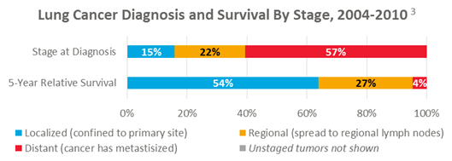
Cancer facts and figures (2015)
Is there a valid method for the diagnosis of lung cancer in the asyntomatic phase?

Slide 4
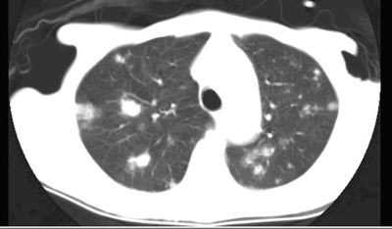
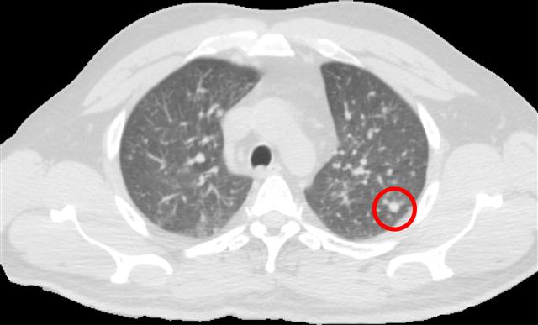
Lung Cancer in medical imaging
In order to support radiologists, we definitely need to develop algorithms (Computer Aided Detection) for the automatic detection of pulmonary nodules
Low dose means noisy / poor contrast images
Usually high number of slices to be analyzed
Pulmonary nodules: small structures inside the parenchyma or attached to pleura
Usually CT scans are reviewed by at least 2 radiologists (sometimes 3 for doubt cases)
Sensitivivity of radiologist decreases as number of images increase

Slide 5
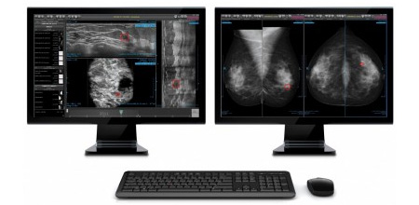
Computer Aided Detection – status of art
Challenges
Usually stand-alone work-stations with high license costs
How to make CAD results available without requiring SW installation to users?
Computational power needed for CAD algortirhms increases as algorithm complexity increseas
Required power is often unpredictable (e. g. massive screening campaigns)
How to make CAD results available without requiring HW installation to users?
How to guarantee flexibility of computing resources?

Slide 6
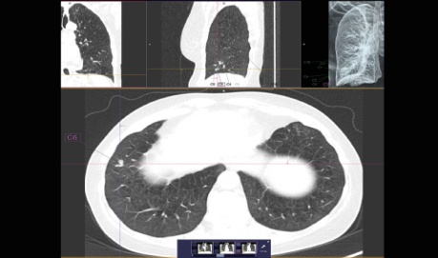
M5L project – general overview
Provide a CAD service for the analysis of pulmonary nodules in chest CT without requiring the installation of SW or HW to the users

Slide 7
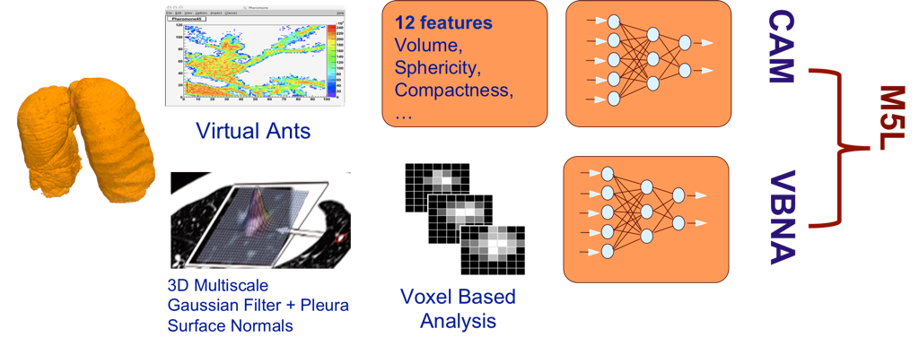
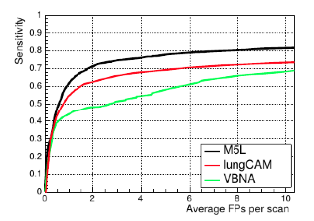
M5l: the algorithms
Validation performed over the biggest public etherogeneus data-set available (Lung Image Data-base consortium) – 1018 CT scans
Sensitvity up to 80% at 6 FPs per scan

Slide 8
M5L : the web front-end
Provide a web-based service to allow:
The submission of CT scans for CAD computations
The on-line annotation of the exam by the radioligsts before/after CAD
The on-line access to CAD results
100% free and open-source, developed with the tool DRUPAL
Available through every browser from PCs, tablets and mobiles without requiring the any SW installation
Two roles: a submitter (e.g., a techinician) and a reviewer (a radiologist)
The system allows to use the CAD both as ‘second reader’ and ‘concurrent reader’ mode

Slide 9
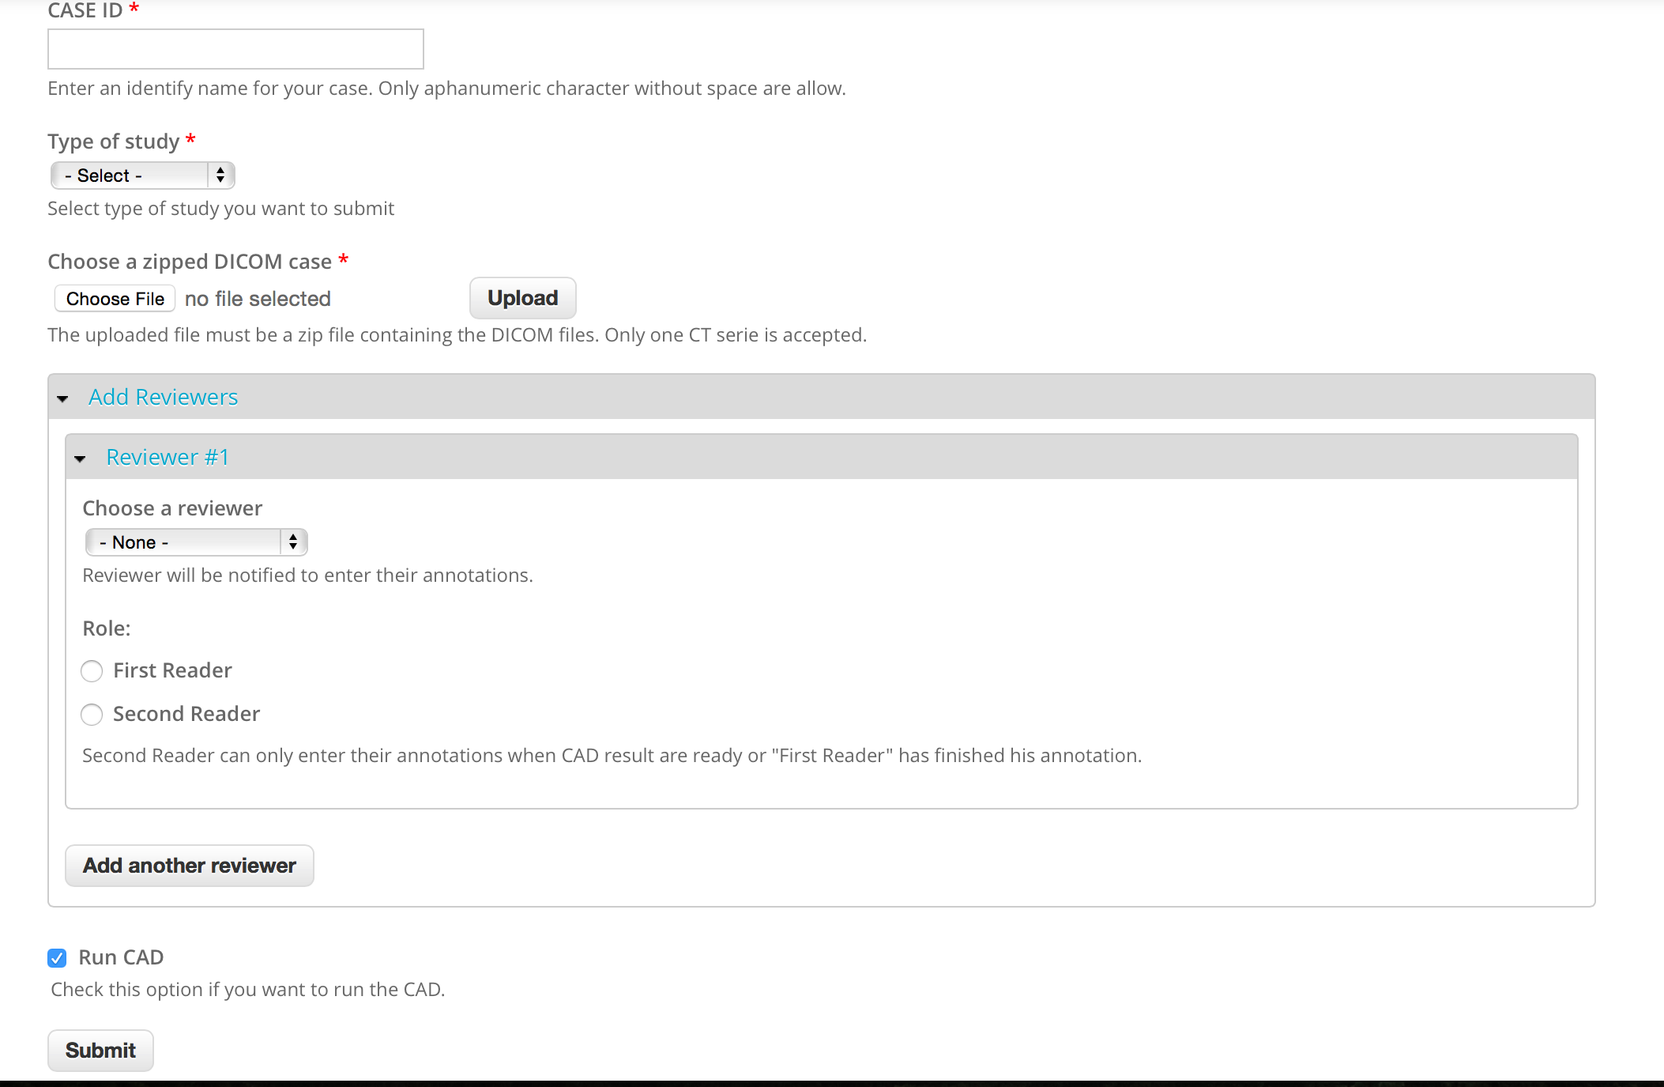
M5L: the web front-end – submission screenshot
m5l.to.infn.it

Slide 10
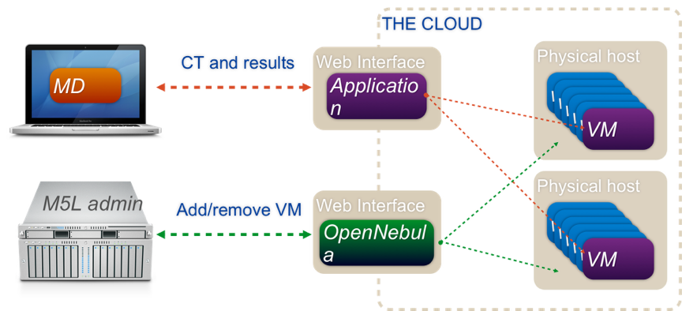
M5L: the cloud back-end
After the case submission, something is happening at INFN cloud computing centre…
The major advantage of having a cloud infrastructure is the possibility to add / combine multiple CADs to the exiting ones with limited effort, leading to an increase of the performances
Infrastructure As A Service: infrastcture are created according to user requests
SW as a Service: CAD algorithms computed by virtual machines
Open source dedicated tools (Open Nebula + Elastiq) to monitor jobs quueing
We are able to manage and compute up to 20 scans at the same time.
Mean processing time: 20”

Slide 11
M5L: CAD results
After CAD computations are completed, the user is notified with a mail with the link to CAD results…

Slide 12
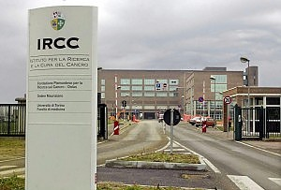
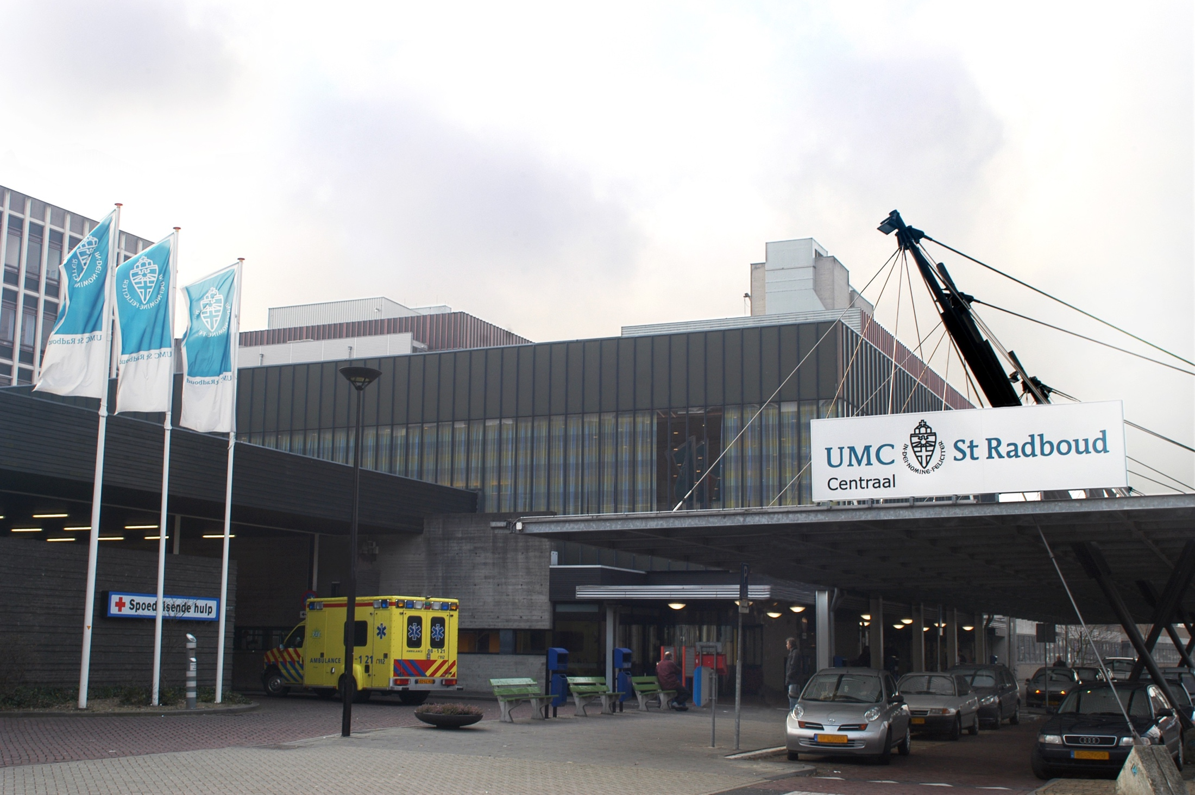
M5L: clinical validation and future developments
Investigate the impact of CAD as ‘second reader’ to the sensitivity of the radiologists with CT scans acquired during normal hospital routine
Investigate the impact of CAD as ‘cuncurrent reader’ to the sensitivity of the radiologists
Improve nodule segmentations
Improve algorithms for the computation of the volume of the nodules
Develop algorithms to investigate the temporal evolution of the nodule volume and relate it to its malignancy

Slide 13
Conclusion and references
Computer Aided Detection is becoming an essential tool to support the radiologist in lung cancer detection
Most of developed CADs are difficult to be widespread to the users because dedicated SW installation or new HW is required
The M5L project has proposed a new approach for CAD based on the WEB and cloud Computing
The on-going clinical validation will provide a quantification of the system and CAD inside clinical routine
We will be interesting in upgrading our network of users to perform observer studies
American Cancer Society, Cancer Facts and figures 2015
The NLST Research Team, Reduced lung-cancer mortality with low dose CT screening
Torres EL and oth, Large scale validation of the M5L lung CAD on heterogeneous CT datasets, MEDPHYSICS
Fantacci ME and oth, A Web Based Computer Aided Detection System for Automated Search of Lung Nodules in Thoracic CT Scans, BIOINFORMATICS 2015

