Slide 1
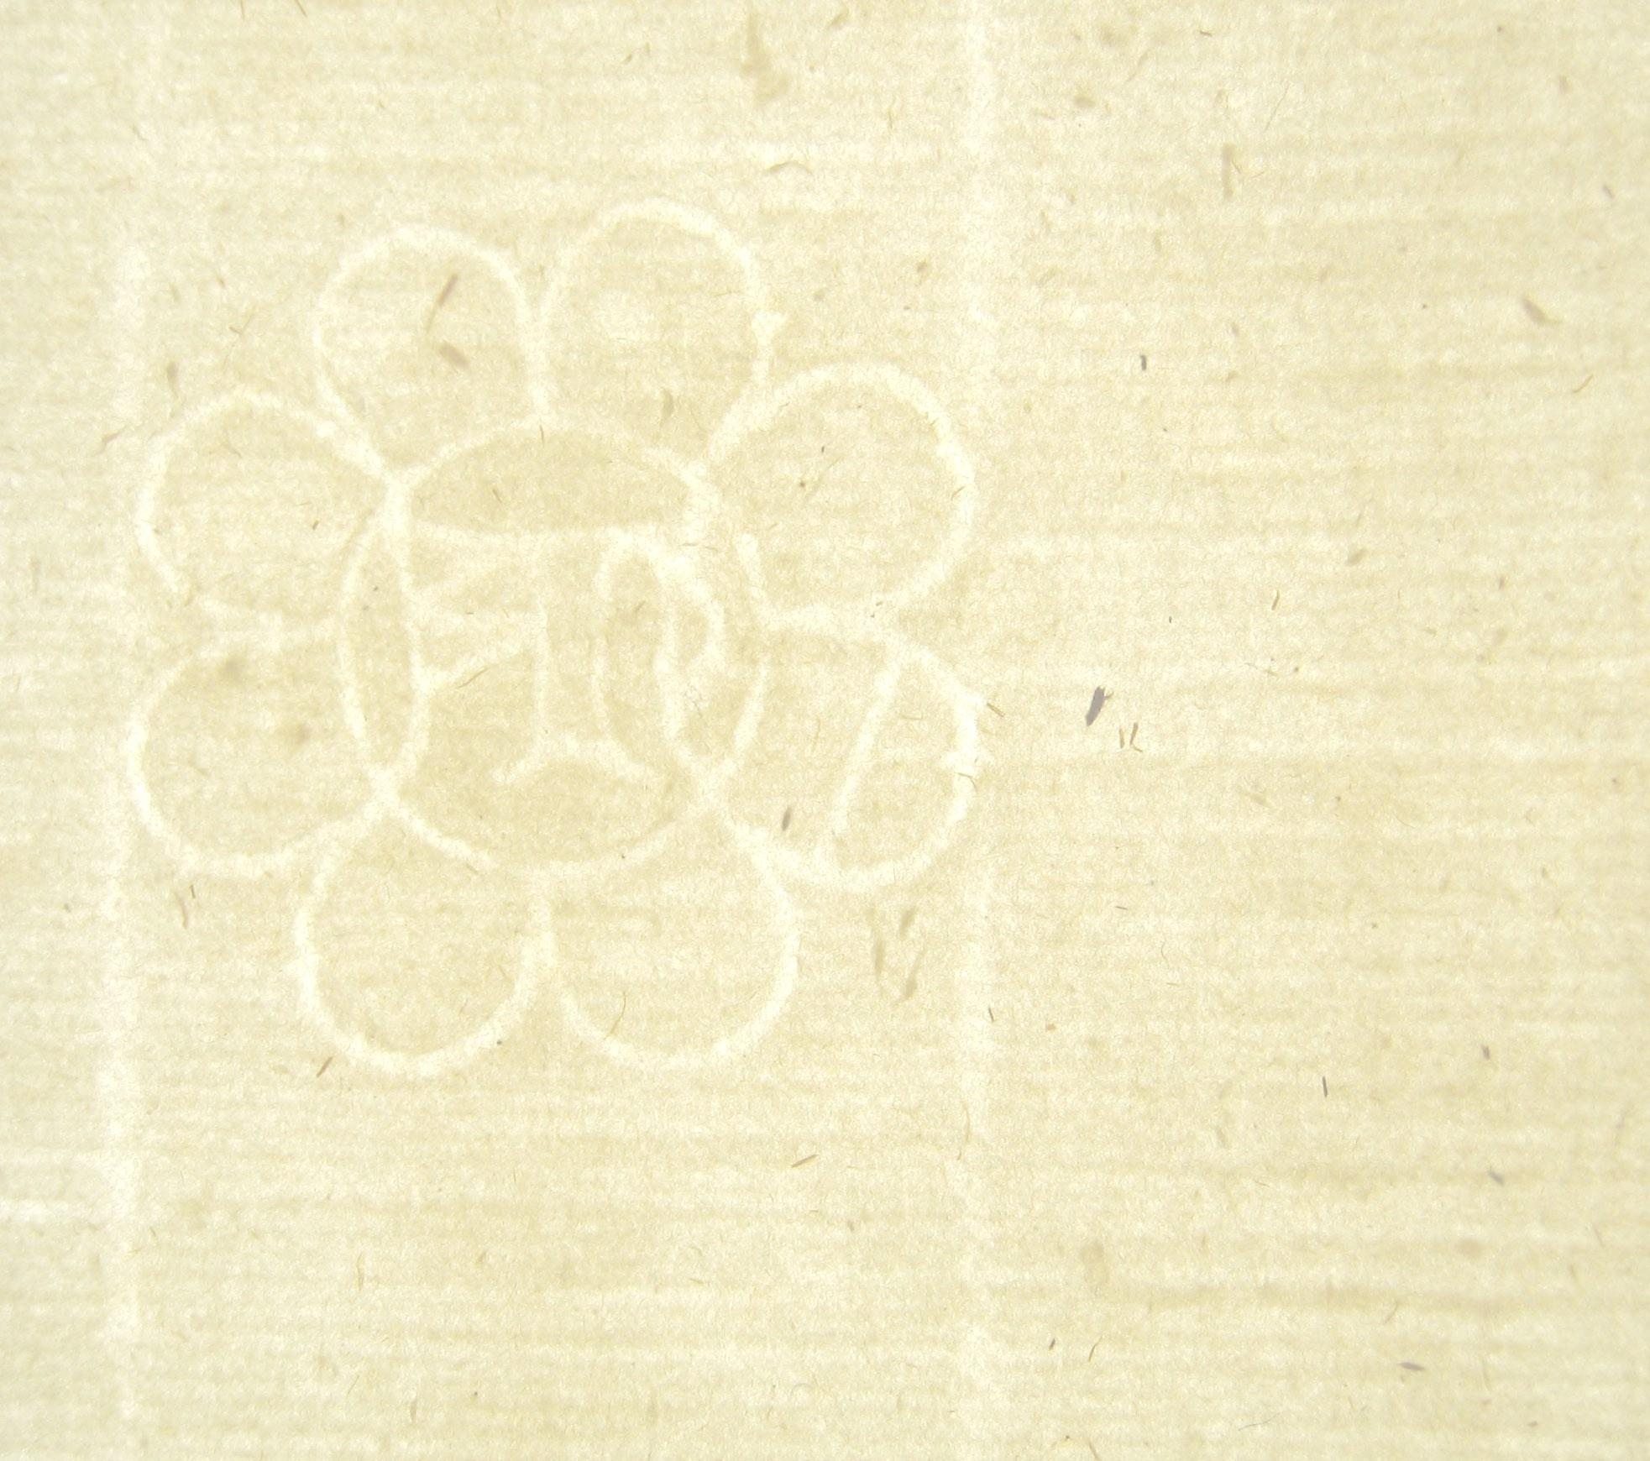
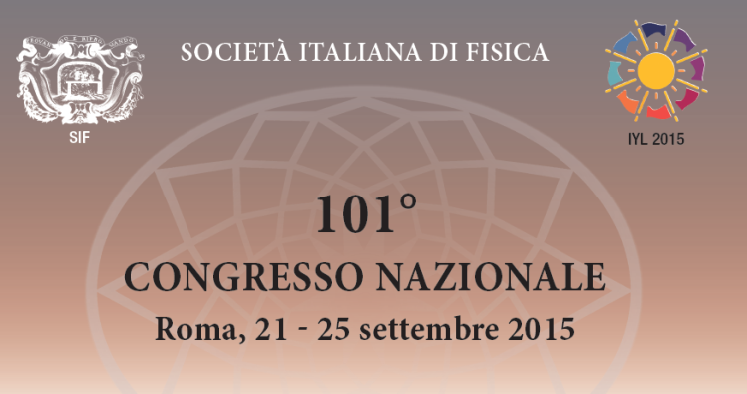
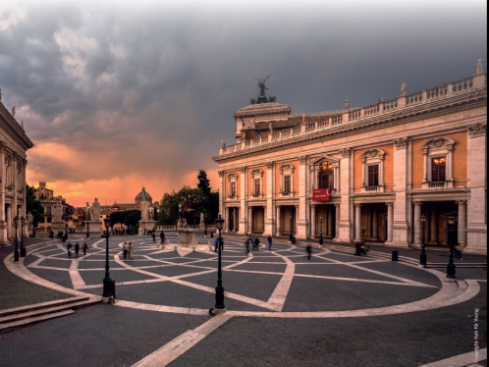

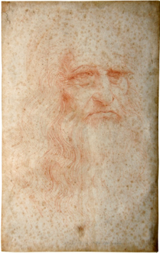
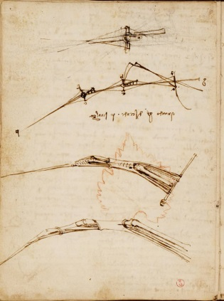
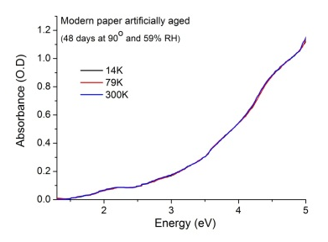

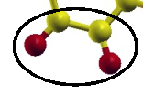





Optical properties of ancient paper are governed
by structural disorder of cellulose
Braidotti M. C., Mosca Conte A., Violante C., Conti C., Fastampa R.,
Pulci O., Lojewska J., Missori M.
Notes:
Thanks you to the chairman and to the organizing comitee for giving me the opportunity to present and good morning to everybody.
In this presentation I will show how by using an approach based on experimental and theoretical spectroscopy it is possible to evaluate the concentration of different kinds of oxidized groups induced by aging in paper acting as chromophores and causing ancient paper discoloration.

Slide 2
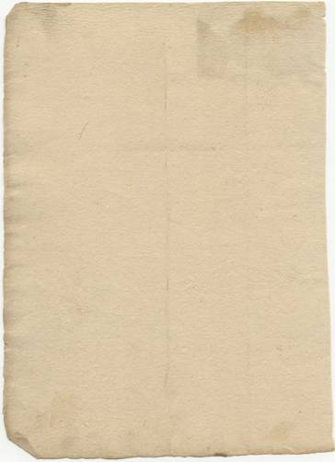
Yellowing of ancient paper
Notes:
2
2
1) l'ingiallimento dei substrati cartacei: problema di degradazione di immediata visione e generale per la carta. Cosa indica questo fenomeno e quali informazioni si possono ricavare ? (Articoli con Joanna) “Yellowing of ancient paper” “What is the cause of this phenomenon and what information can be found?”

Slide 3
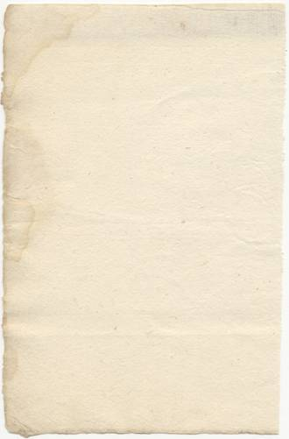
Yellowing of ancient paper

Slide 4
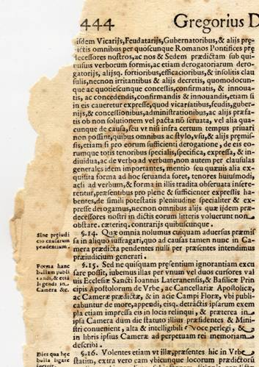
Yellowing of ancient paper

Slide 5
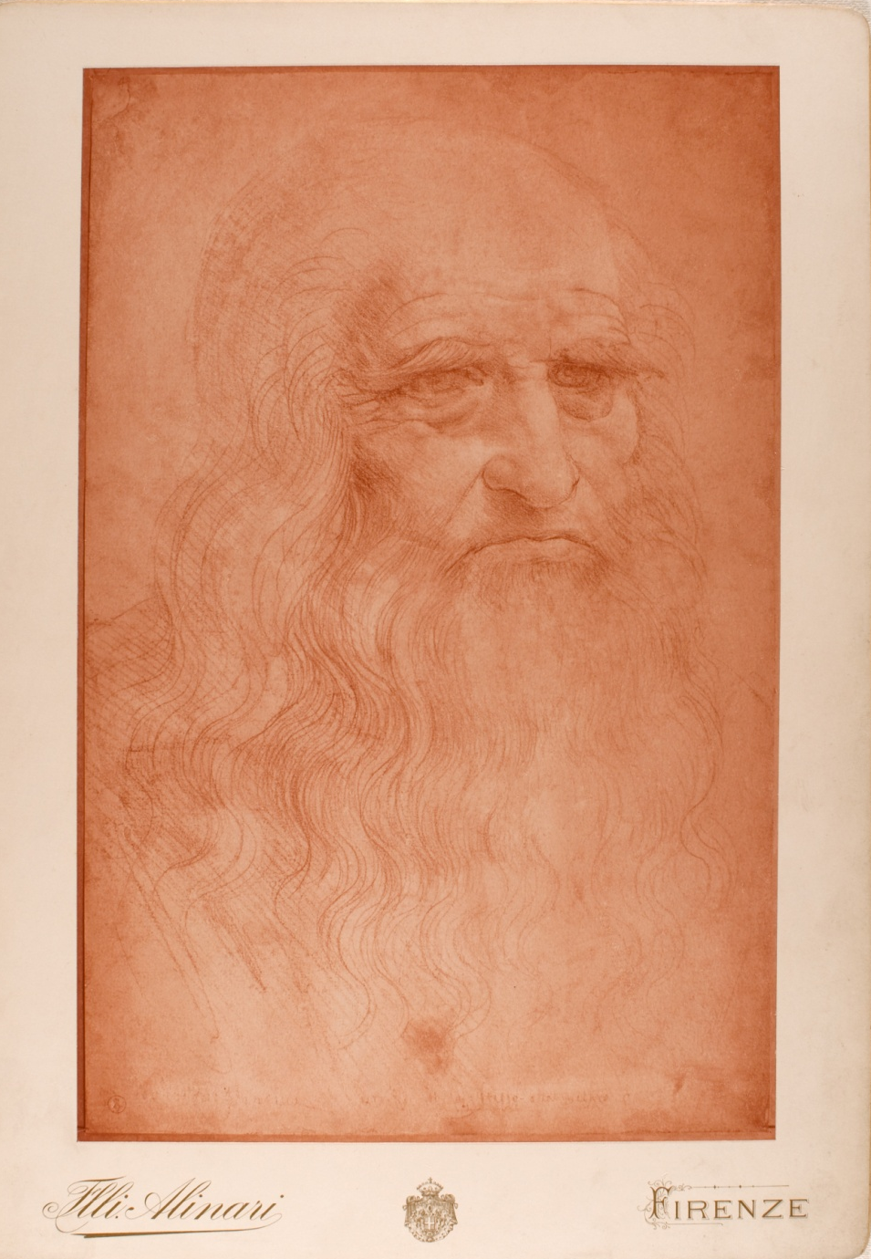
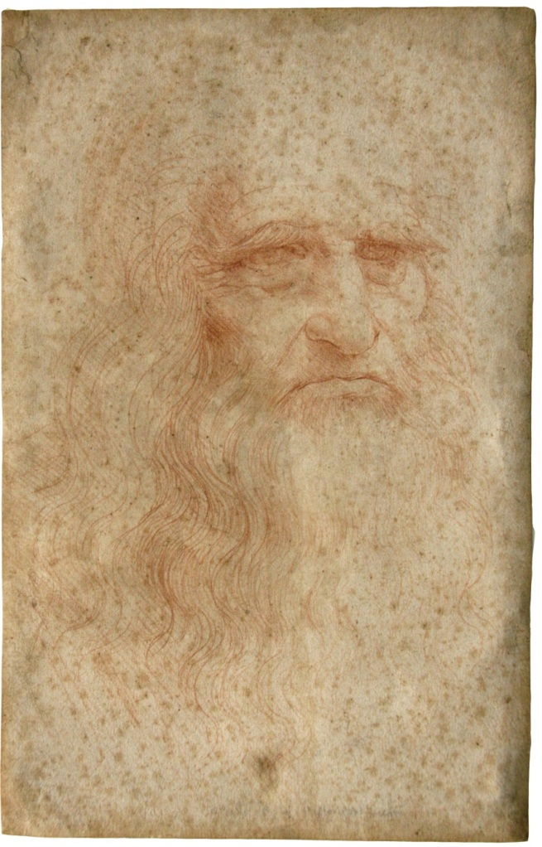
1898 2012

Slide 6
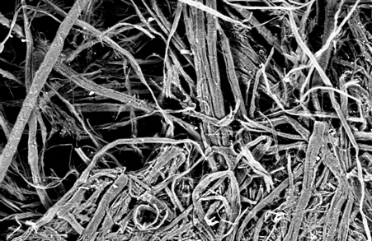
Paper: morphology and chemistry
100 μm

Slide 7
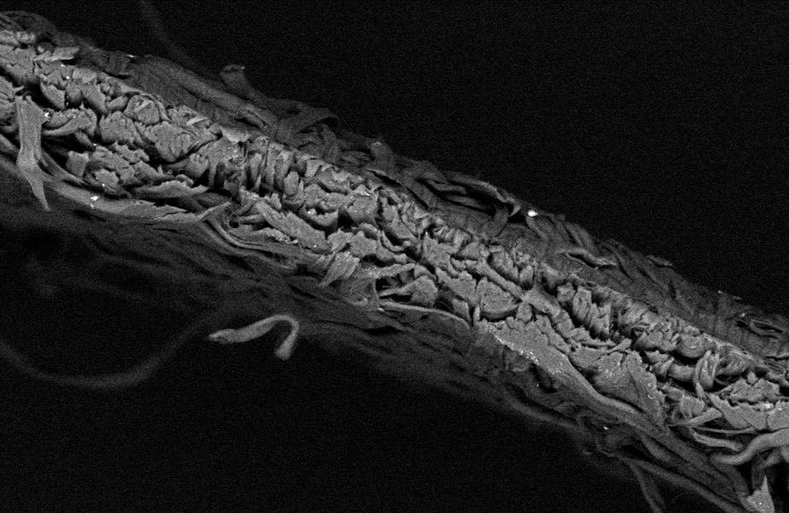
Paper: morphology and chemistry
100 μm
100 μm
Notes:
In order to give an answer to this interesting question we have to look in more detait to the physical and chemical properties of paper. Paper sheets mainly consists in a network of cellulose fibres. Here you can see scanning electron microscope images…this is a top view … and this is a cross-section of a paper sheet.
7

Slide 8
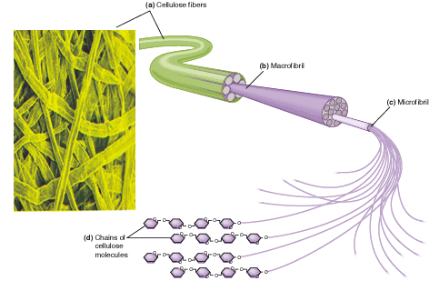
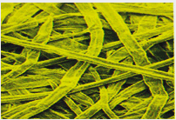
Paper: morphology and chemistry
100 μm
100 μm
cellulose fibres
macrofibrils
microfibrils
chains of
cellulose
molecules
Notes:
Fibers, with a typical diameter of 10 microns, are formed by the aggregation of fibrils. Microfibrils, the basic element of the supermolecular structure of cellulose are composed of chains of cellulose molecules made up of repeating units of glucopyranose arranged in assemblies of crystalline domains and amorphous regions.
8

Slide 9
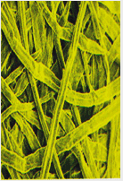
Paper: morphology and chemistry
100 μm
100 μm
cellulose fibres
macrofibrils
O
H
microfibrils
C
chains of
cellulose
molecules
cellulose polymer
high temporal stability
M. Missori, et al., Phys. Rev. Lett. 97, 238001 (2006).
Notes:
Isolated cellulose possesses a stable thermodynamical configuration, which allows an excellent durability over time.
9

Slide 10
Degradation at the molecular scale
thermal energy
O
H
radiative energy
humidity
C
micro-organisms
M. Bicchieri, et al., J. of Raman Spectr. 37, 1186 (2006).
T. Lojewski, et al., Carbohydrate Polymers 82, 370 (2010).
Notes:
10
Experimental studies have demonstrated that ageing of paper is mainly due to the degradation of cellulose caused by external agents, such as humidity, radiation, pollutants, or microorganisms, often acting all in synergic way.
At the nanoscale degradation results in two interconnected chemical reactions: hydrolysis of cellulose polymeric chains causes weakening of
the mechanical properties of the sheets. Oxidation causes the subsequent development of several products. Among these products, those responsible for yellowing are called chromophores.
In order to understand why the self-portrait appears to be in poor conditions we have to precisely quantify the cromophores responsible for its optical degradation. However, this is a very difficult task, since the fragility and uniqueness of the Leonardo drawings requires the elaboration of suitable, non-destructive investigation methods, able to provide quantitative information on chemical changes induced by ageing. Degradation byproducts can also increase the rate of paper degradation.
10

Slide 11
Degradation at the molecular scale
thermal energy
O
H
radiative energy
humidity
C
micro-organisms
hydrolysis
O
H
C
Variations of mechanical and morphological properties
M. Bicchieri, et al., J. of Raman Spectr. 37, 1186 (2006).
T. Lojewski, et al., Carbohydrate Polymers 82, 370 (2010).

Slide 12
Degradation at the molecular scale
thermal energy
O
H
radiative energy
humidity
C
micro-organisms
hydrolysis
oxidation
O
H
O
H
C
C
Development of acidic byproducts (pH)
UV-Vis active oxidized groups (chromophores)
Variations of mechanical and morphological properties
Variation of optical properties (yellowing)
M. Bicchieri, et al., J. of Raman Spectr. 37, 1186 (2006).
T. Lojewski, et al., Carbohydrate Polymers 82, 370 (2010).

Slide 13
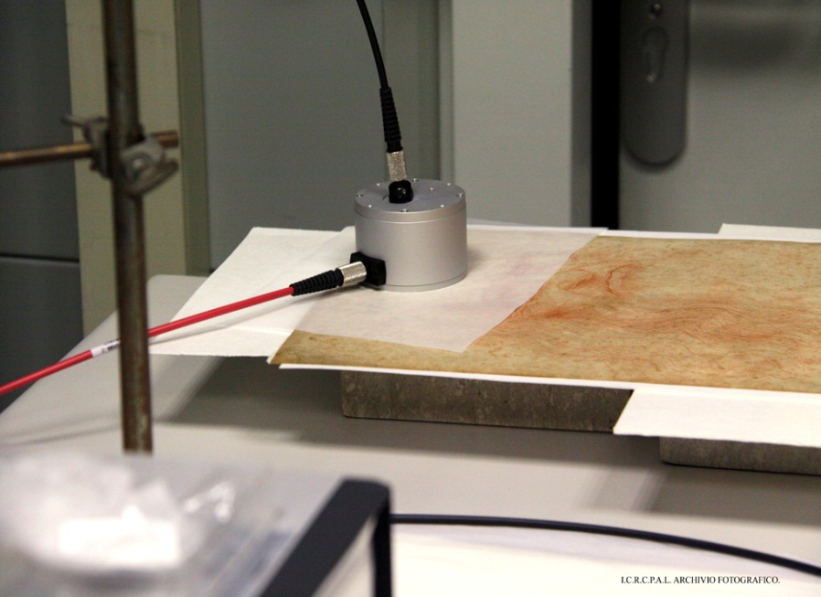
UV-Vis spectroscopy of ancient paper
Notes:
And the integrating sphere during the measurements on the self-portrait.

Slide 14
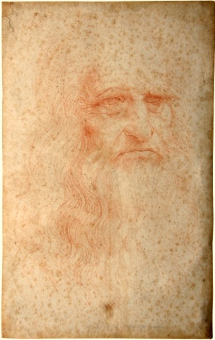
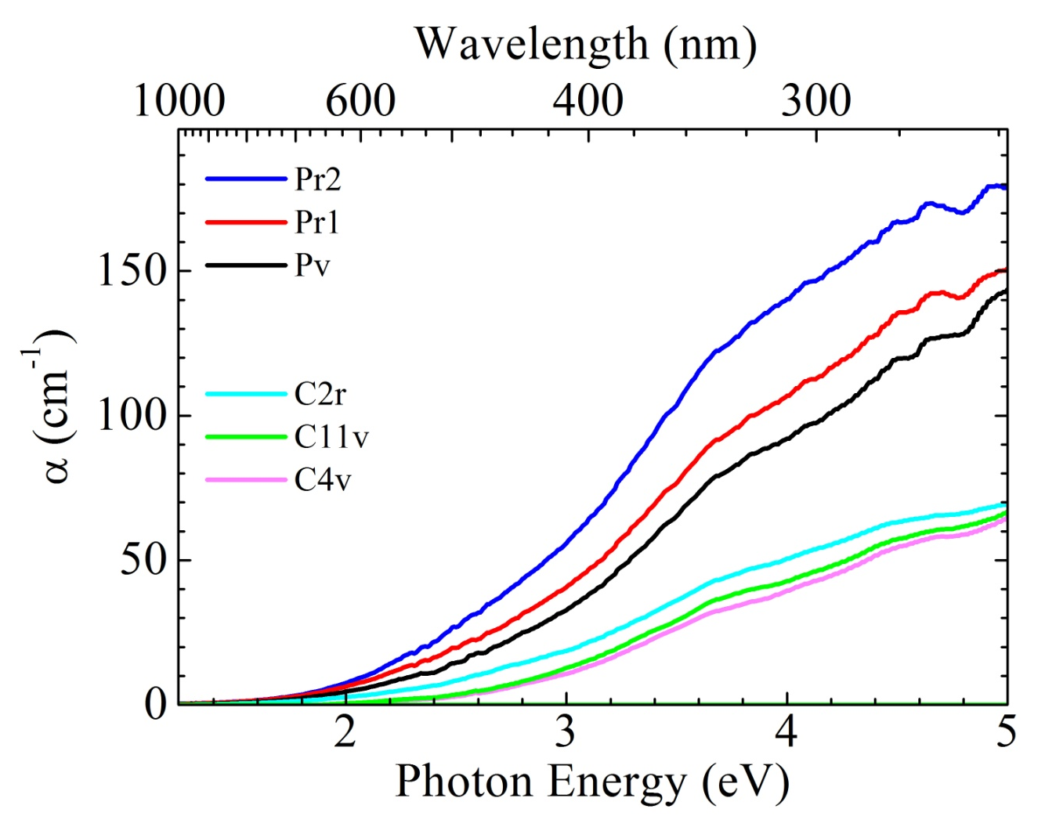
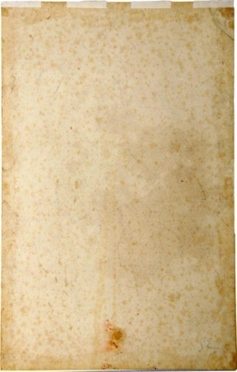
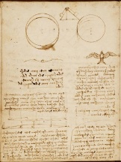
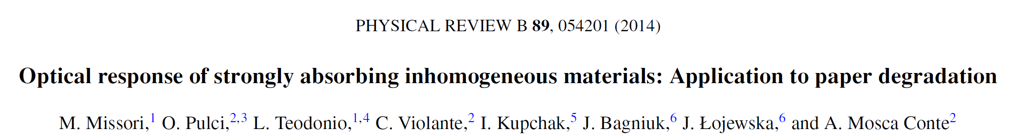
UV-Vis spectroscopy of ancient paper

Slide 15


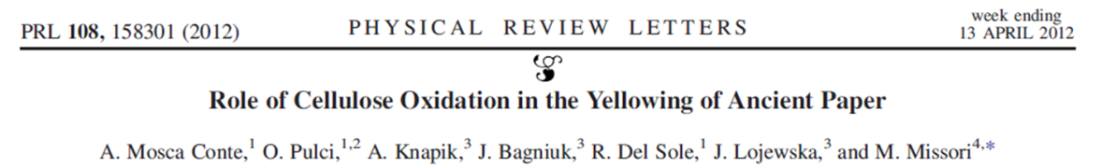
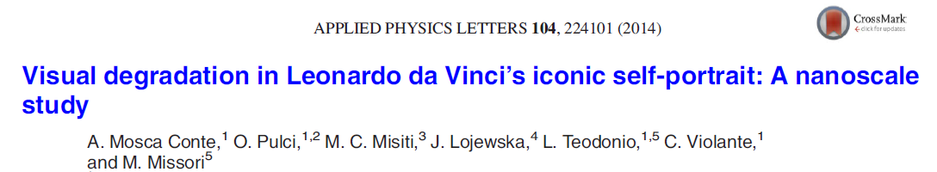
Theoretical simulations of cellulose UV-Vis absorption
Density
Functional
Theory (DFT)
Time-Dependent
DFT
http://www.quantum-espresso.org/
http://dp-code.org
Notes:
15
The absoption spectra of these oxidized groups were calculated by ab-initio simulation calculations. As a structural model for the simulation of optical properties we have chosen an infinite crystal of cellulose
as an approximation of cellulose crystalline domains. Cell parameters of the cellulose crystal were taken from X-ray diffraction data.
The atomic coordinates inside the cell, were theoretically calculated by the QUANTUM ESPRESSO
plane-wave DFT code.
The macroscopic dielectric function of cellulose were calculated by using the Casida algorithm
within a TDDFT framework.

Slide 16
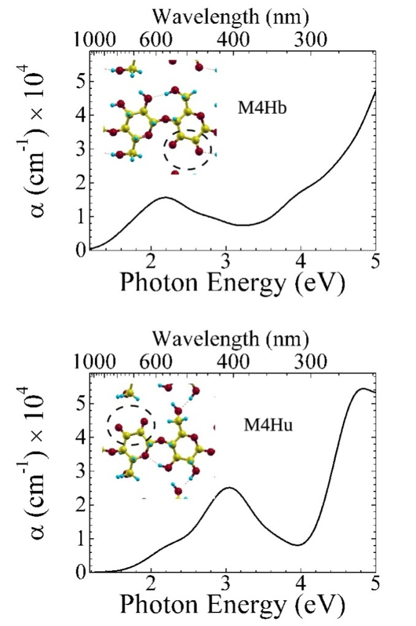
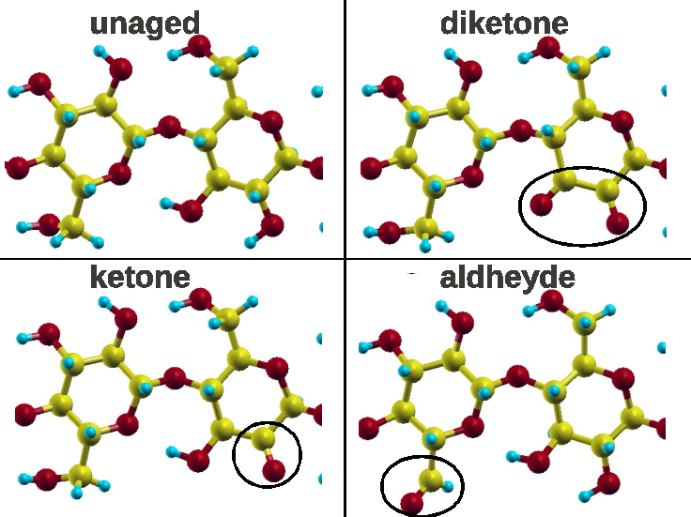
Theoretical simulations of cellulose UV-Vis absorption
Density
Functional
Theory (DFT)
Time-Dependent
DFT
http://www.quantum-espresso.org/
http://dp-code.org
diketones

Slide 17
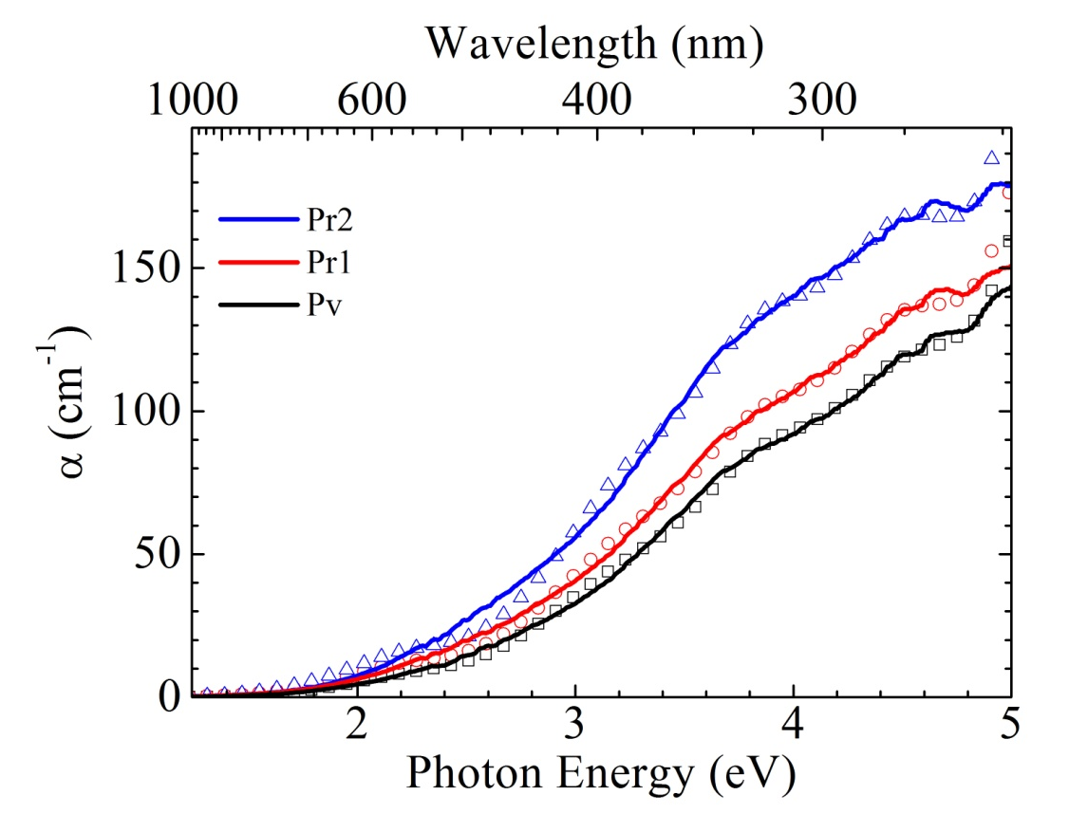
Theoretical simulations of cellulose UV-Vis absorption
Density
Functional
Theory (DFT)
Time-Dependent
DFT
http://www.quantum-espresso.org/
http://dp-code.org
T=0K+smearing
Room Temperature
diketones
6 mmol/100g of cellulose

Slide 18
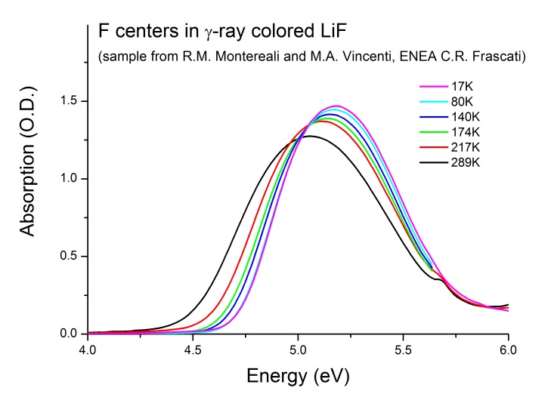
Temperature effect on spectral line shapes
of chromophores in solid
FWHM

Slide 19
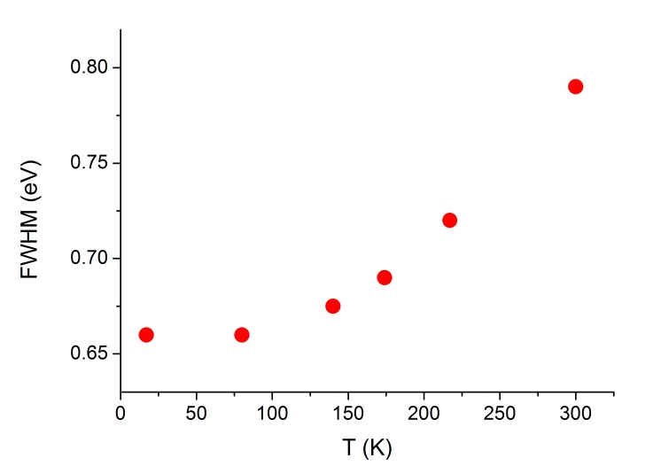
Temperature effect on spectral line shapes
of chromophores in solid
Thermal
broadening
FWHM

Slide 20
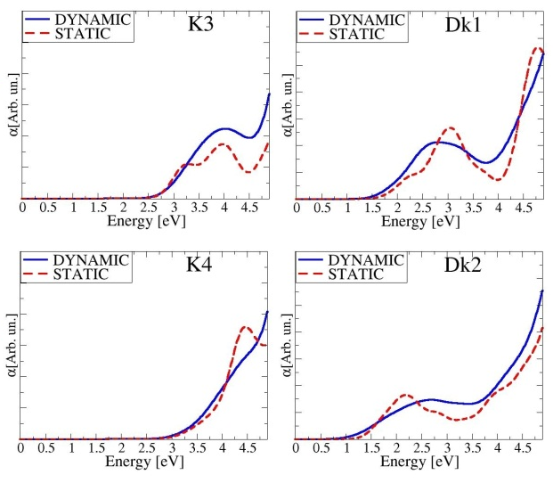
Temperature effect on spectral line shapes
of chromophores in solid
Thermal
broadening
FWHM
Molecular dynamics simulations
300K
14K

Slide 21
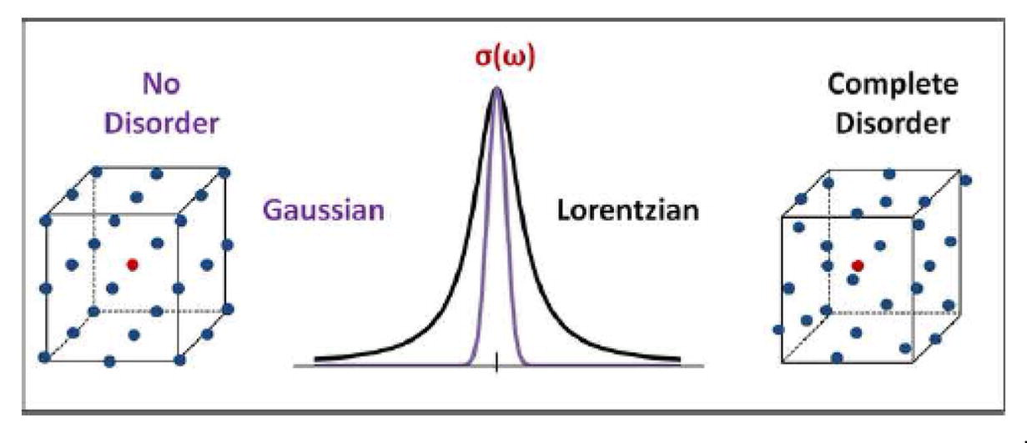
Temperature effect on spectral line shapes
of chromophores in solid
Thermal
broadening
FWHM
Molecular dynamics simulations
300K
14K
Disorder-induced broadening of the absorption line shape of a chromophore in a solid matrix
Prathamesh M Shenai et al., Disorder and spectral line shapes in two-level systems, Chem. Phys. Lett. 582, 66-70 (2013)

Slide 22
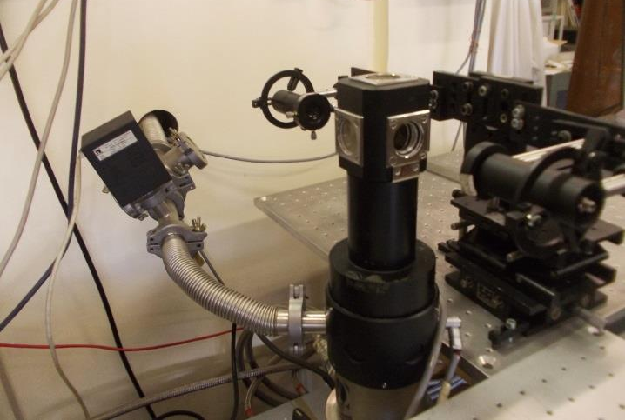
Experimental set-up for low-temperature UV-Vis spectroscopy of paper

Slide 23

Experimental set-up for low-temperature UV-Vis spectroscopy of paper
Light source
I_{o} (λ)
I_{t} (λ)
Detector
t

Slide 24
Experimental set-up for low-temperature UV-Vis spectroscopy of paper
I_{s} (λ)
Light source
I_{o} (λ)
I_{t} (λ)
Detector
t

Slide 25
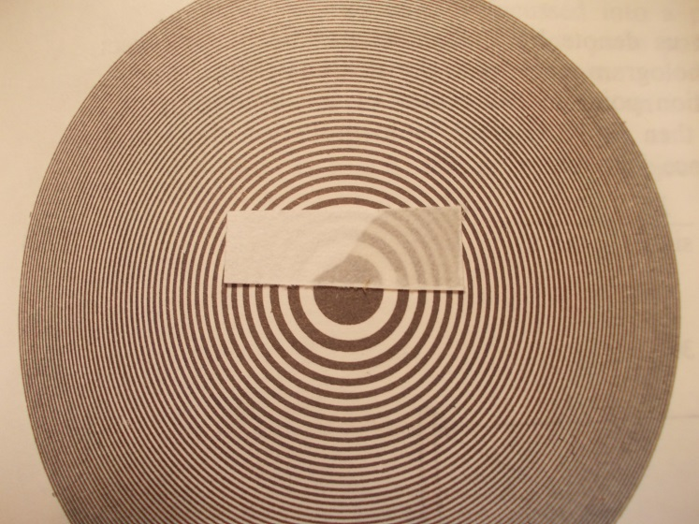
Decreasing the scattering of paper
Refractive index matching: refractive index of cellulose n_{c}⋍1.5
cryogenic, UV transparent, low viscosity → enamel of acrylate polymers (n_{c}⋍1.46)

Slide 26
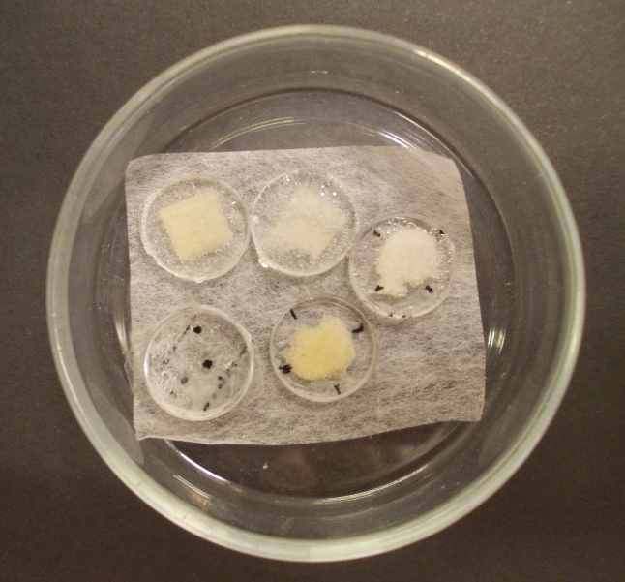
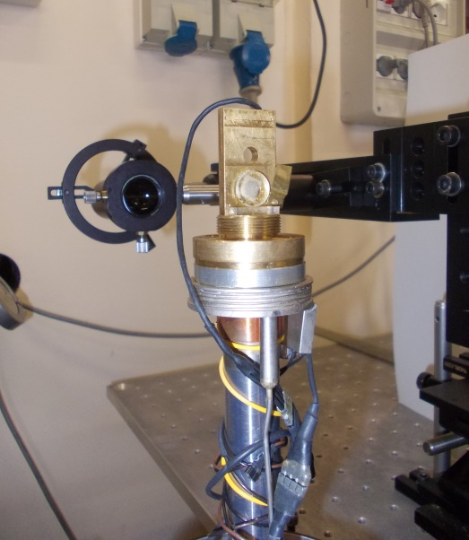
Decreasing the scattering of paper
Refractive index matching: refractive index of cellulose n_{c}⋍1.5
cryogenic, UV transparent, low viscosity → enamel of acrylate polymers (n_{c}⋍1.46)

Slide 27
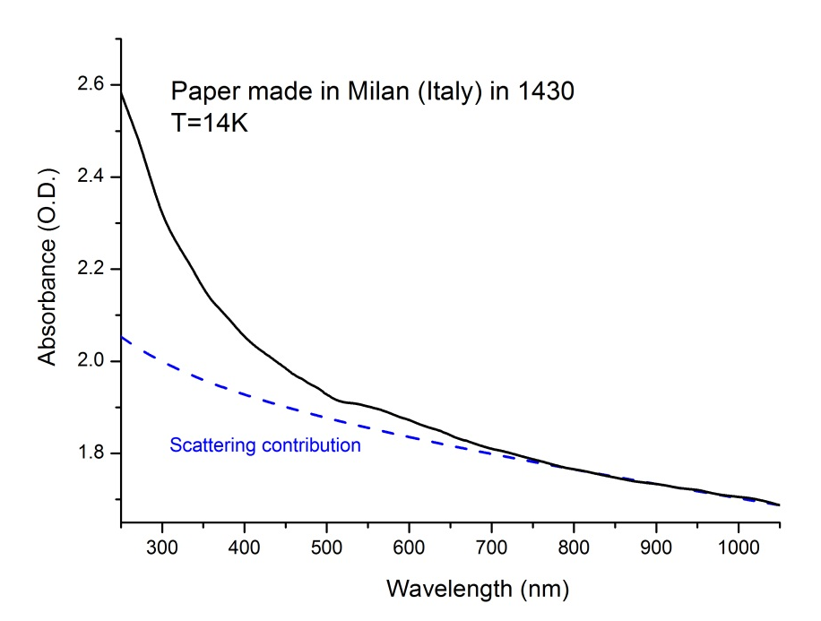
Experimental results

Slide 28
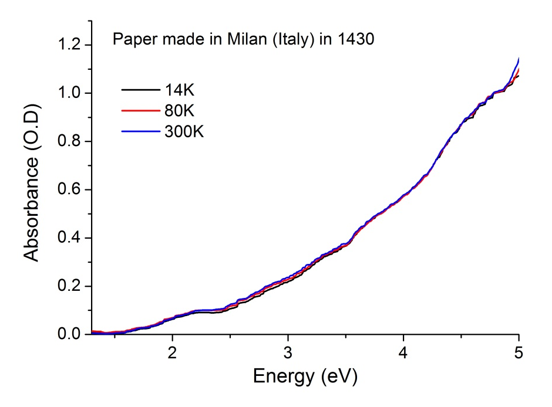
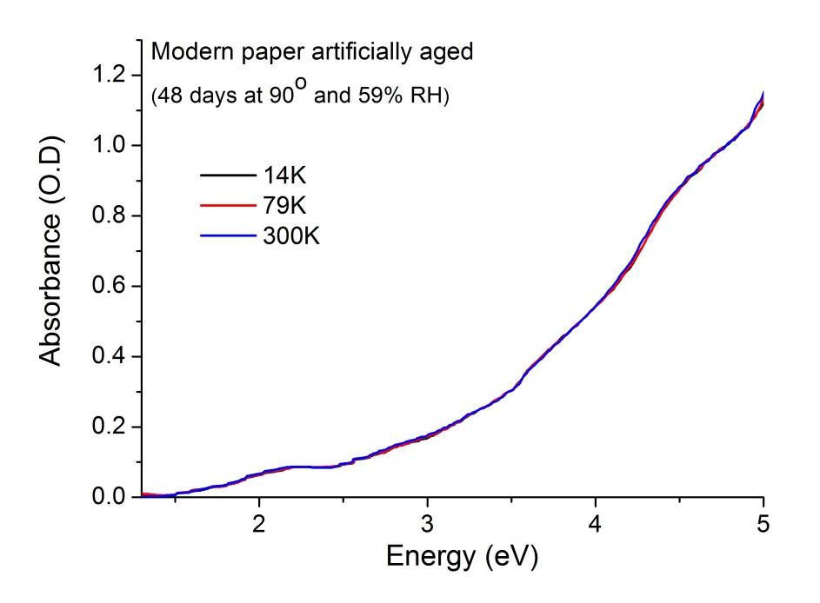
Experimental results
Tiny differences vs temperature

Slide 29
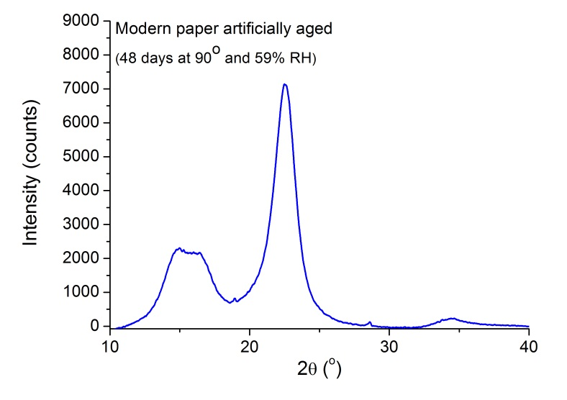
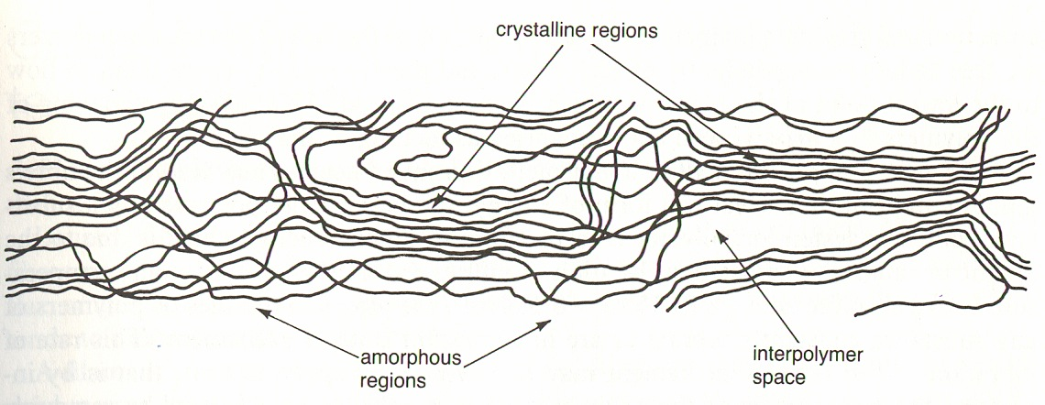
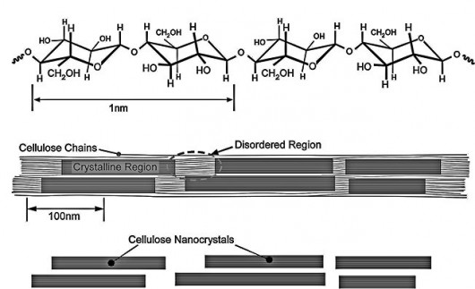
Chromophores localized in the disordered regions
of cellulose fibers
Cellulose fibers are composed of ordered and disordered regions
X-ray diffraction

Slide 30
Chromophores localized in the disordered regions
of cellulose fibers
Cellulose fibers are composed of ordered and disordered regions
X-ray diffraction
sites of oxidation
Crystalline regions are unaffected by oxidative degradation

Slide 31
Conclusions and suggestions...
The absorption spectra of paper show negligible modification as function of temperature (14-300K).
These results are interpreted as due to relevant disorder in cellulose fibers.
Our results provide insights in elucidating the nature of immediate microscopic environment of chromophores produced during cellulose degradation and responsible of paper yellowing.
We acknowledge CPU time granted by CINECA, funding from the EC’s FP7 grants no. 211956 (ETSF user project 211), CISSCA, ICRCPAL–MIBACT.

Slide 32
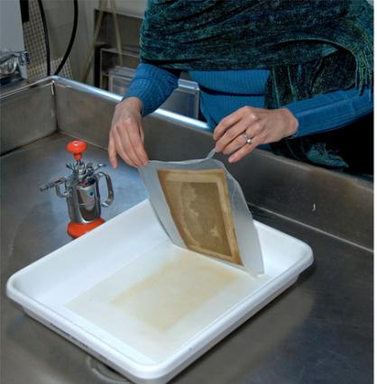
Conclusions and suggestions...
The absorption spectra of paper show negligible modification as function of temperature (14-300K).
These results are interpreted as due to relevant disorder in cellulose fibers.
Our results provide insights in elucidating the nature of immediate microscopic environment of chromophores produced during cellulose degradation and responsible of paper yellowing.
We acknowledge CPU time granted by CINECA, funding from the EC’s FP7 grants no. 211956 (ETSF user project 211), CISSCA, ICRCPAL–MIBACT.
Different chemical used for wet treatment of ancient paper materials
Since disordered regions have great accessibility to external agents → bleaching treatments could be improved by using less invasive dry methods based on nanoparticles or gases.

Slide 33
Thanks for
your attention

