Slide 1

Exploring the Universe with the Square Kilometer Array
Andrea Ferrara
Scuola Normale Superiore, Pisa, Italy
&
SKA Italian Science Coordination Board, Chair

Slide 2
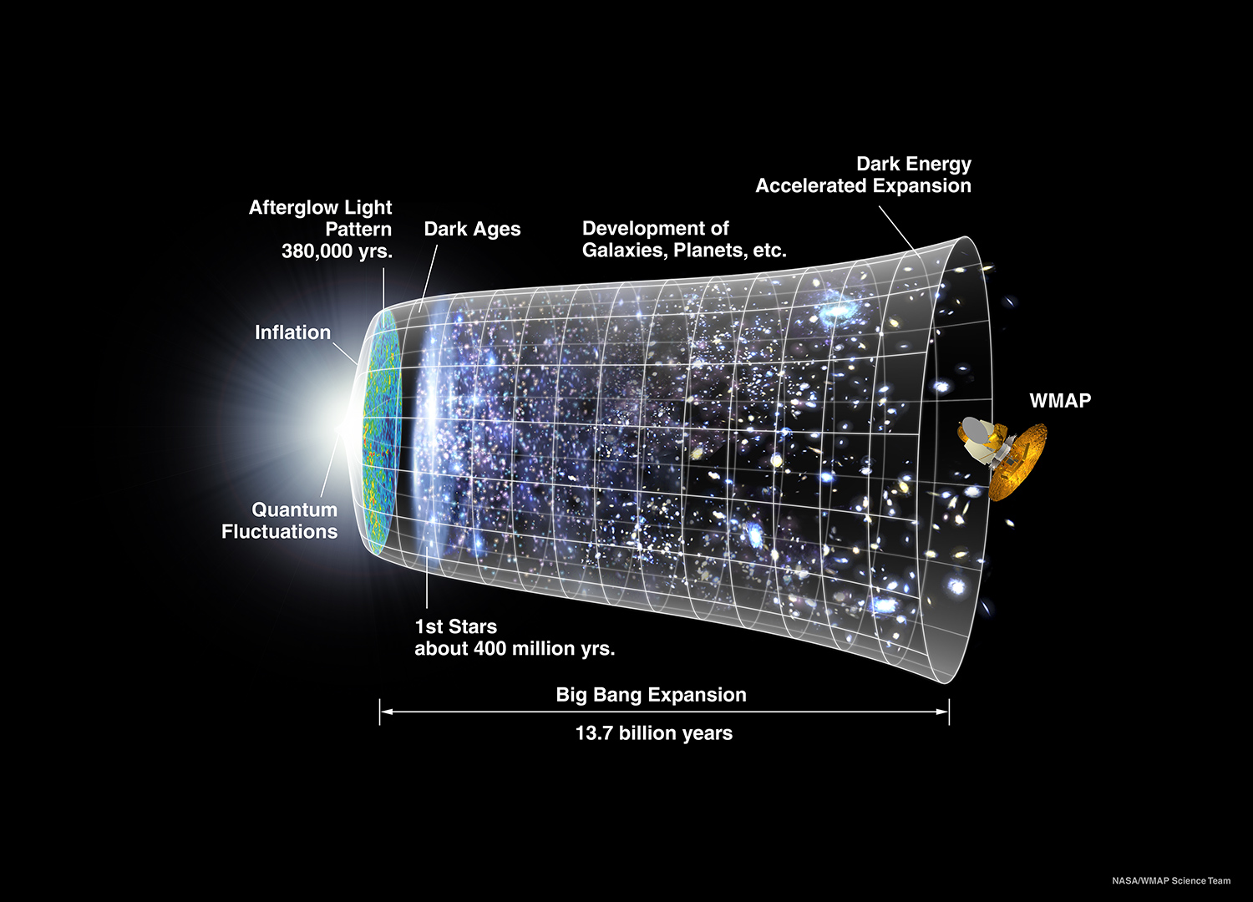
First Gyr

Slide 3
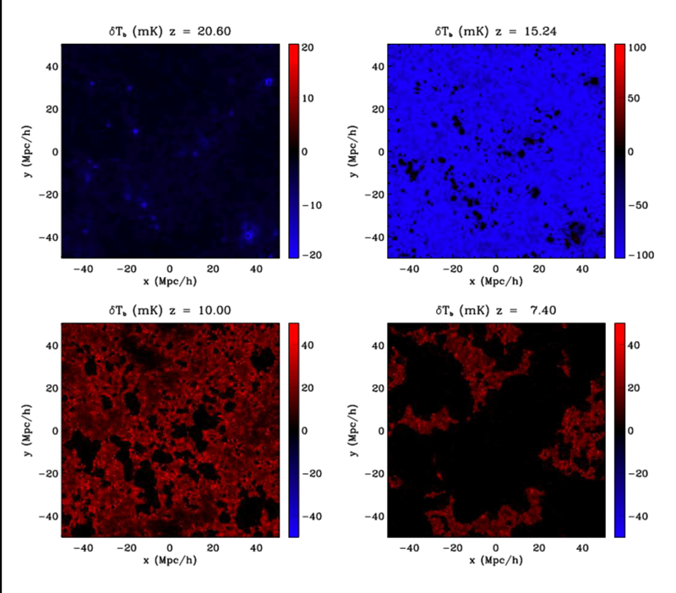
The Universe before the galaxies
266 million years after the Big Bang
Hydrogen disappears
478 million years
716 million years
Notes:
http://ccapp.osu.edu/images/jpritchard_image.gif

Slide 4

The dismissal of neutral hydrogen
Electron
Proton
First stars
Annihilating Dark Matter
Hydrogen is ionized and 21 cm emission quenched

Slide 5
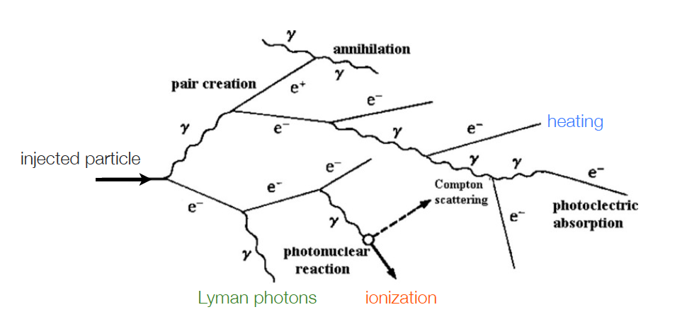
IGM THERMAL HISTORY
Valdes & AF 09; Mapelli+10; Evoli+12
DARK MATTER HEATING

Slide 6
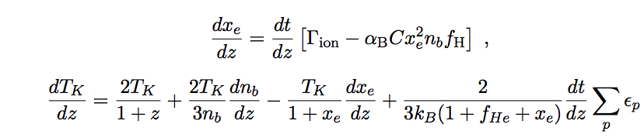
IGM THERMAL HISTORY
Evoli, Mesinger & AF+14
IONIZATION AND HEATING
IONIZATION EQUATION
ENERGY EQUATION
Compton heating
Astrophysical X-ray sources
Dark matter annihilations

Slide 7

Cosmic Reionization
In a 30 million light years comoving volume
Notes:
http://www.cita.utoronto.ca/~malvarez/reionization.mov

Slide 8
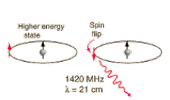

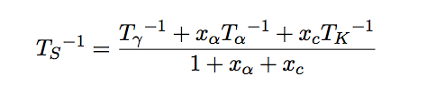
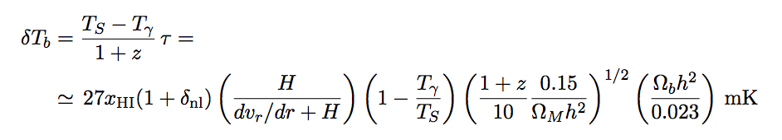
HI 21 CM LINE
BASIC PHYSICS
Notes:
T* = 0.068 K

Slide 9
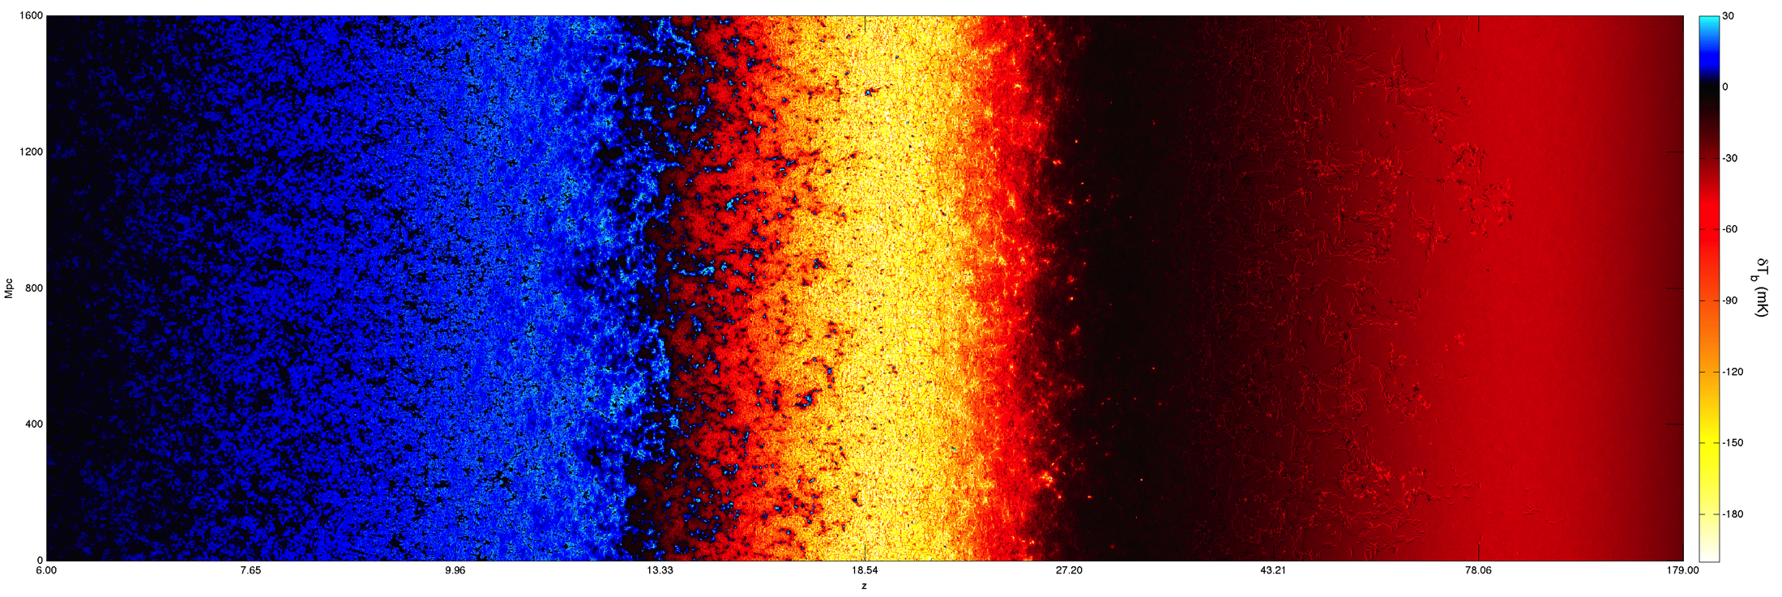
COSMic REIONIZATION
Mesinger, AF & Spiegel 2013; Pacucci+14
HI 21CM LINE View
Brightness Temperature Evolution
strong
absorption
emission
absorption
27
redshift
6
15
Epoch of Reionization
Cosmic Dawn
Dark Ages
IGM warmer than CMB
Strong T_{s} – T_{k} coupling
IGM colder than CMB
Lya coupling (WF effect)
X-ray preheating
IGM colder than CMB
Weak T_{s} – T_{k} coupling

Slide 10
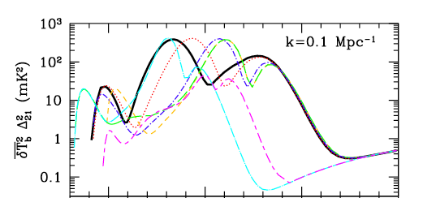
COSMic REIONIZATION
Mesinger, AF & Spiegel 2013
21CM POWER SPECTRUM
PAPER-64 RESULT
135 days/64 elements
2-sigma
Ali+2015
No cold reionization
HERA
SKA 1000h
10
20
30
40
redshift

Slide 11
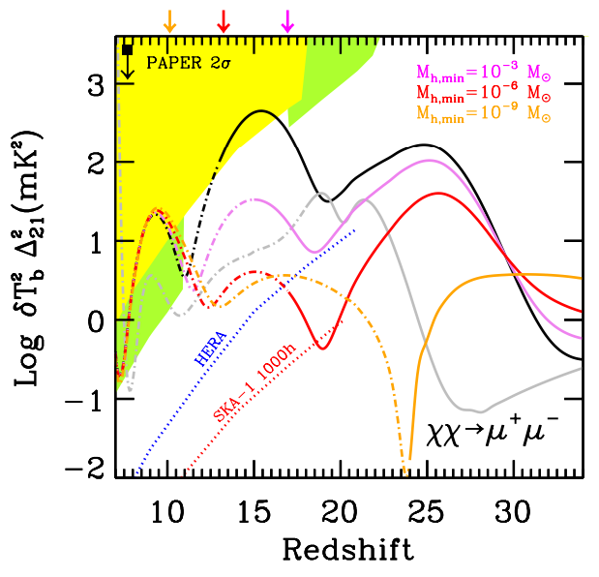
RESULTS
Evoli, Mesinger & AF+14
POWER SPECTRUM
LOFAR
MWA

Slide 12


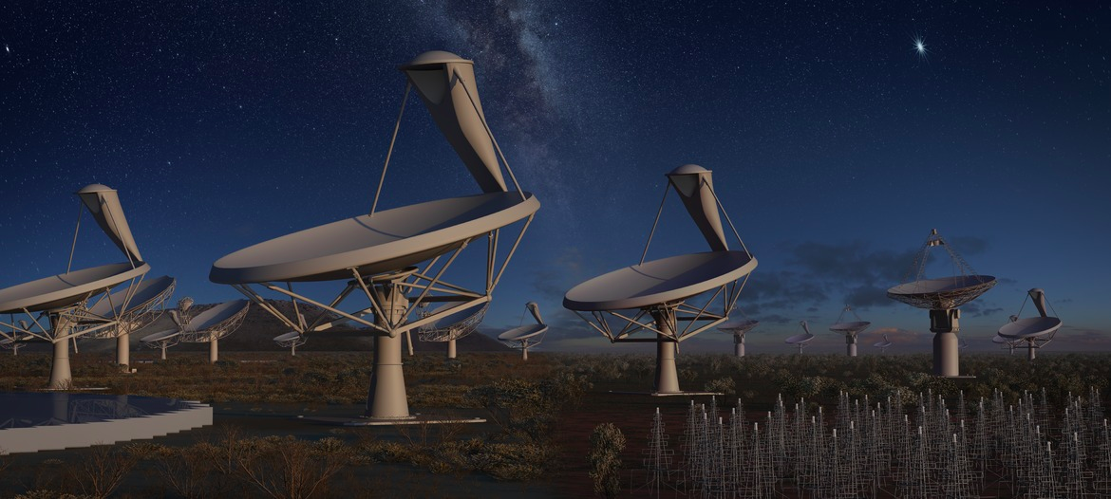
Diving in a hydrogen sea
The world’s largest radiotelescope

Slide 13

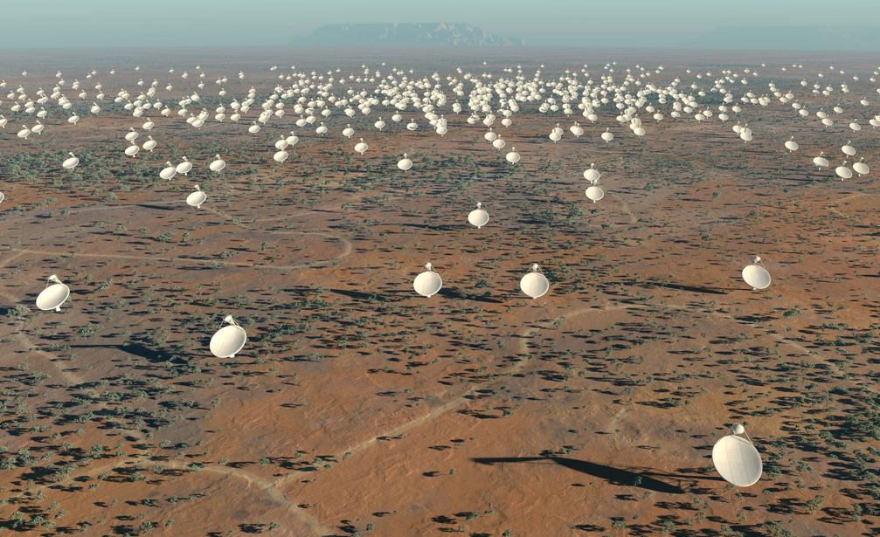
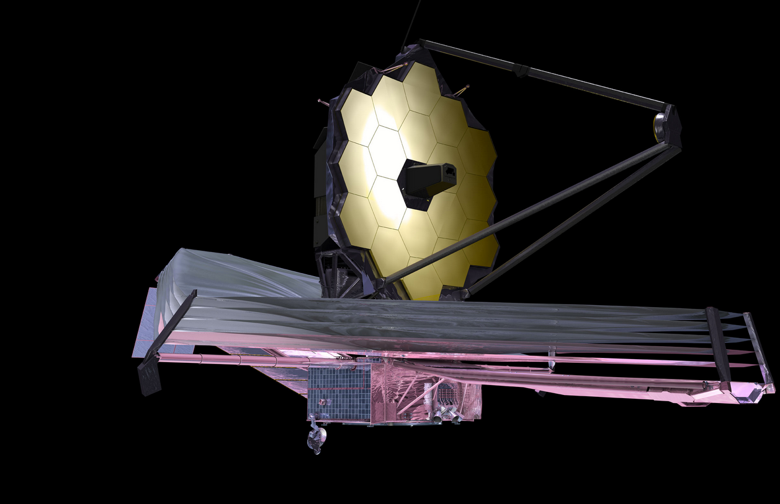
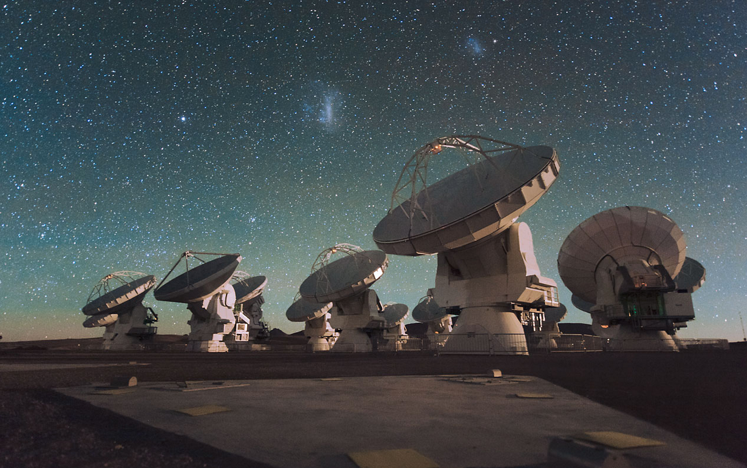
Great Observatories for the coming decades
E-ELT/TMT/GMT: optical/IR
Square Kilometre Array: cm/m
James Webb Space Telescope: NIR
Atacama Large Millimetre Array (ALMA): mm/submm

Slide 14
SKA Science
SKA: will be one of the great physics machines of 21st Century and, when complete, one of the world’s engineering marvels.
Science goals:
  Fundamental physics: Gravity, Dark Energy, Cosmic Magnetism
  Astrophysics: Cosmic Dawn, First galaxies, galaxy assembly and evolution; proto-planetary discs, biomolecules, SETI + much more
  The unknown: transients; +…????

Slide 15

SKA Science Book:
Science Director’s Report, BD-12-17

Slide 16
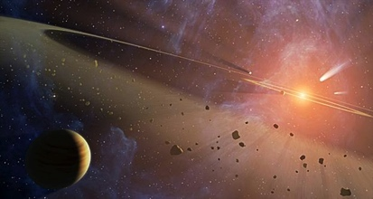
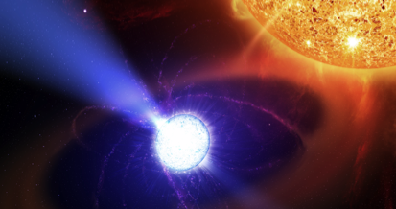
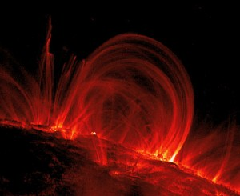
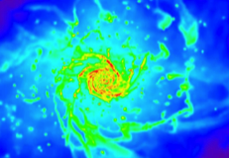
Headline Science with SKA1 and SKA2

Slide 17
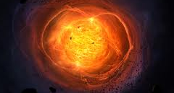
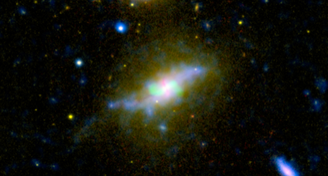
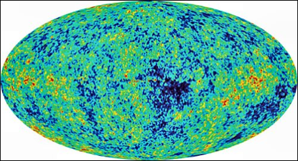

Headline Science with SKA1 and SKA2

Slide 18
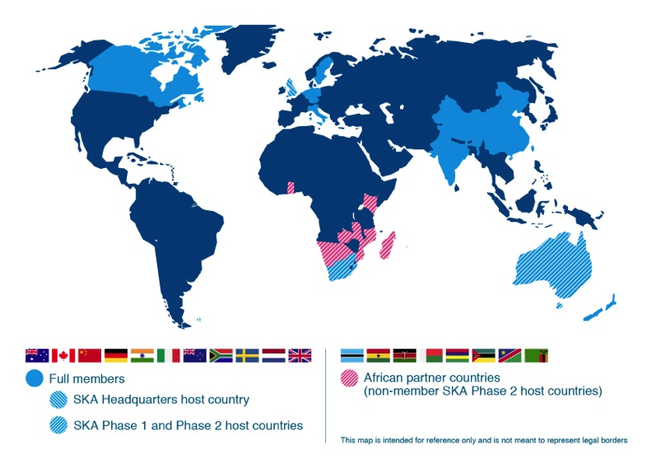
SKA Organisation: 10 countries, more to join
Observers:
France
Germany
Japan
Malta
Portugal
Spain
USA
Contacts:
Brazil
Ireland
Korea
Russia
Switzerland
Australia (DoI&S)
Canada (NRC-HIA)
China (MOST)
India (DAE)
Italy (INAF)
Netherlands (NWO)
New Zealand (MED)
South Africa (DST)
Sweden (Chalmers)
UK (STFC)

Slide 19
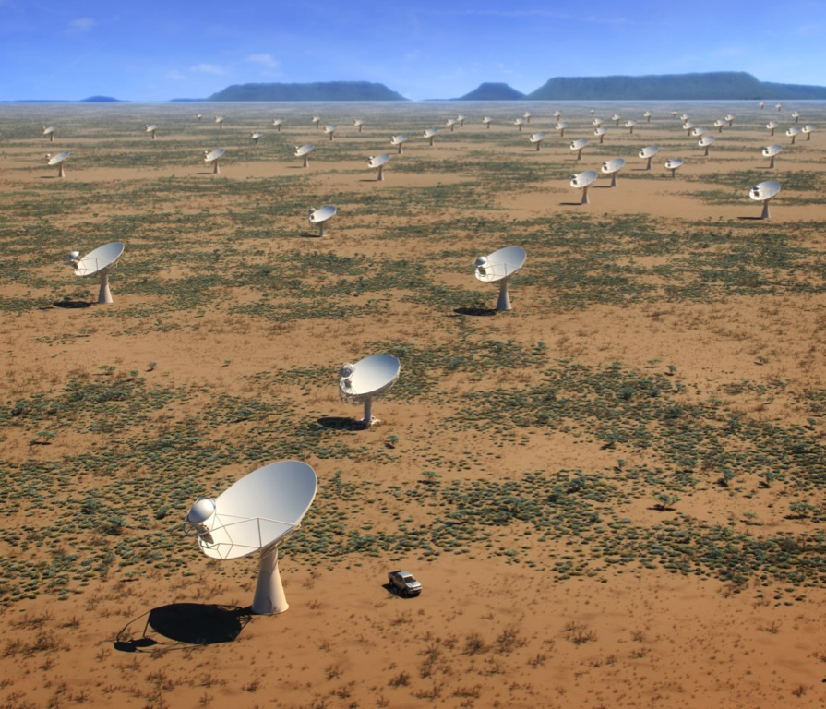
SKA-MID, Karoo, South Africa:
Phase 1: 200 dishes spread over 150km (2018 – 2023)
Phase 2: 2500 dishes spread over 3500km (2025 – 2033)
The Karoo
800km north of Cape Town
Radio quiet protected by
Astronomy Advantage Act
Building on MeerKAT

Slide 20
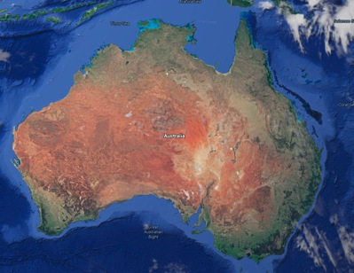
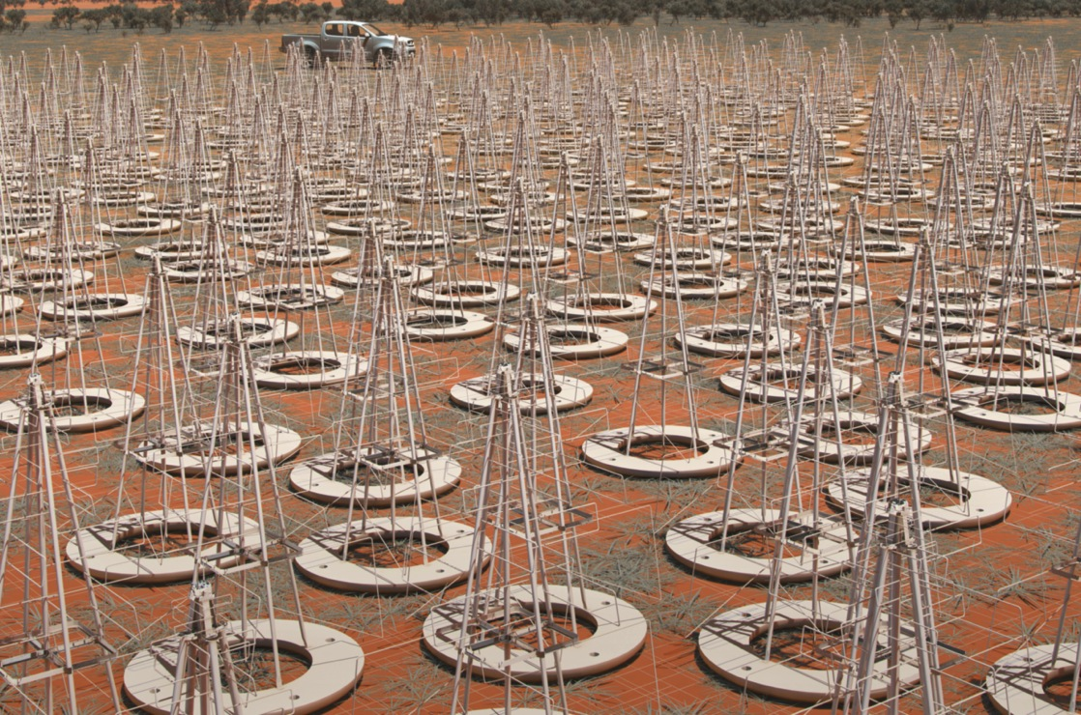
SKA-LOW, Murchison, Australia:
Phase 1: 130,000 dipole antennas over 80km (2018 – 2023)
Phase 2: 500,000 dipoles over 250km (2025 – 2033)
Murchison Desert
800km north of Perth
Very low popn density
Radio quiet zone protected
by ACMA
ASKAP and MWA precursors

Slide 21
Survey Speed Comparison

Slide 22
Key Science Projects:
Notional package of Key Science Projects in Q1 2015 based on the highest priority science objectives that have been recommended by our science community that will be:
  Consistent with capabilities of the SKA1 design
  Consistent with a realistic observing schedule filled at approximately 50% for the first 5 years of scientific operations
Adopt KSP policy
  Only scientists from SKA member countries may lead a KSP
  KSP Leadership is guaranteed to be distributed amongst SKA members in proportion to their financial contribution
  KSP participation (at the non-Leader level) is guaranteed to be distributed amongst SKA members in proportion to their financial contribution
  KSP participation (at the non-Leader level) of SKA non-members is capped at the value defined in the Access Policy

Slide 23
A Package of Notional SKA1 Key Science Projects
Outcome of well-documented SKA1 science prioritisation process
  All objectives originate with the science community
  Review and strong endorsement by advisory bodies (SRP, SEAC)
Should be viewed as representative package of high-impact science deliverables for the first five years of science operations

