Slide 1
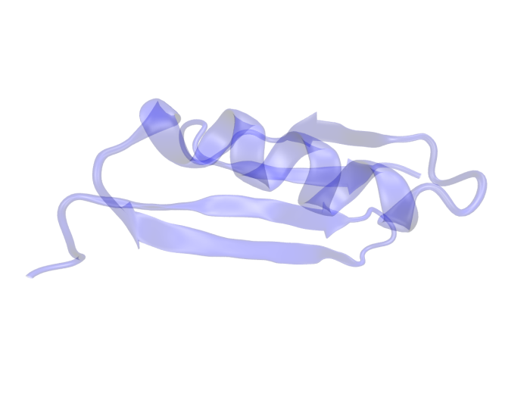
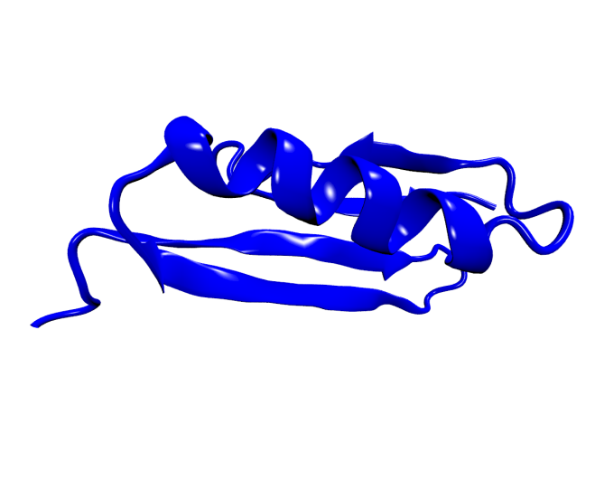


Designing highly specific probes with tunable affinity
GSHT...TCPKC
?
?
FOLDING
GSHT...TCPKC
DESIGN
Find a specific, stable, 3D structure given a fixed amino acid sequence
Find the sequence of amino acids which will fold in a given target structure
Francesca Nerattini
Computational Physics Group, University of Vienna

Slide 2
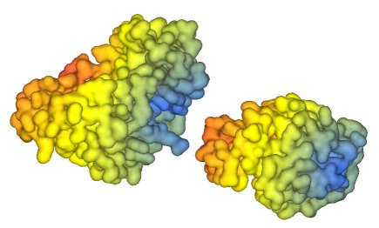
Protein-ligand binding
Goal:
Design protein-ligand systems characterized by high specificity and tunable affinity
Notes:
perche importante, interesse farmacologico!!!

Slide 3
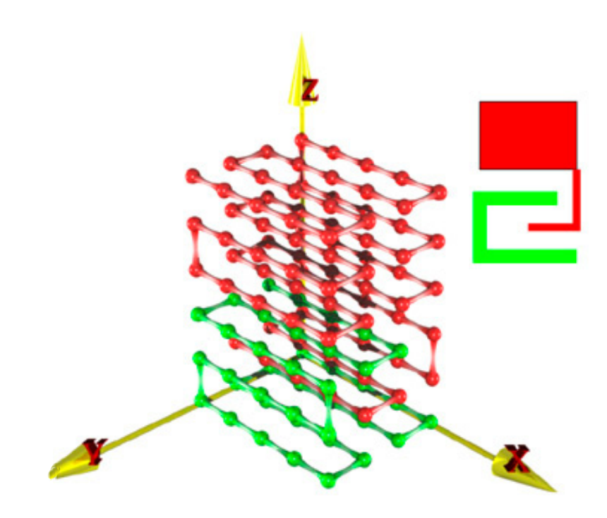
Protein-ligand binding ON LATTICE
Design (MC,CATERPILLAR) sequences of both protein and substrate
Introduce different percentages of “randomness”
Evaluate the Binding Affinity (folding,MC,CATERPILLAR) Δf ≡ −k_{B}T ln(Q_{b}/Q_{f})
[1] I. Coluzza and D. Frenkel. "Monte Carlo study of substrate-induced folding and refolding of lattice proteins." Biophysical journal 92.4 (2007): 1150-1156.

Slide 4
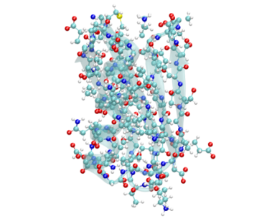
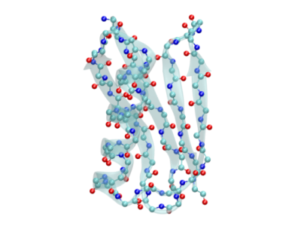
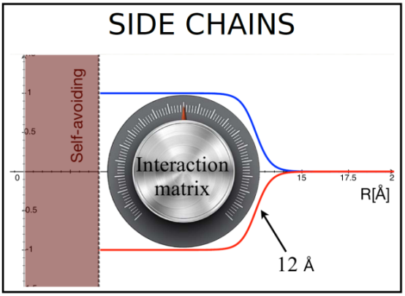
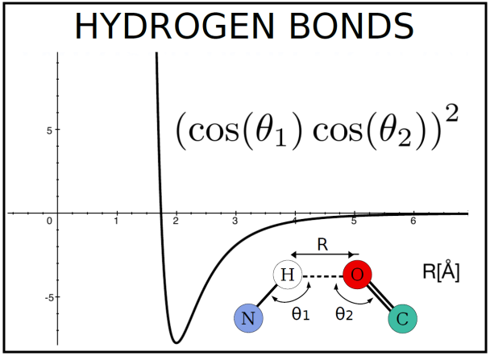
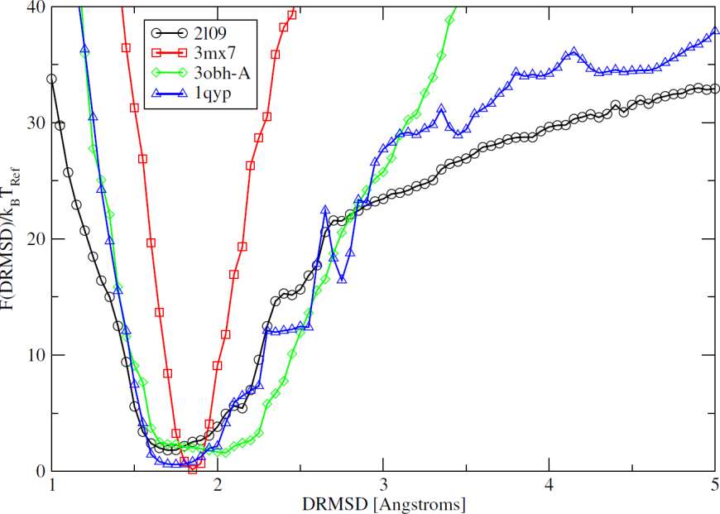
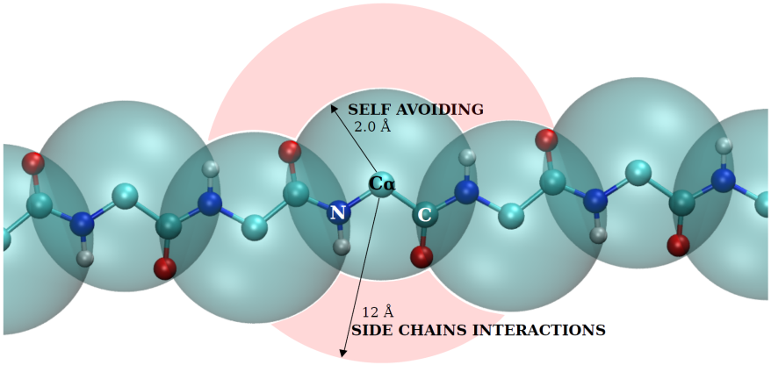
The CATERPILLAR model
ATOMISTIC
REPRESENTATION
COARSE GRAINED:
CATERPILLAR^{[1-2]}
COARSE GRAINED:
CATERPILLAR^{[1]}
ATOMISTIC
REPRESENTATION
[1] Coluzza, Ivan. "A coarse-grained approach to protein design: learning from design to understand folding." PloS one, 6, e20853 (2011)
[2] Coluzza, Ivan. "Transferable coarse-grained potential for de novo protein folding and design." PloS one, 9, e112852 (2014)
Notes:
caterpillar: is a coarse grained model in which we maintain all the mechanical structure of the bb and the constraints on the dihedral angles, while coarse graining all pairwise interacrtions which are centered on the Calpha. In particular we keep a self avoiding interaction of 2A radius and a pairwise interaction which depends on the identity of the aa of the pair with a cut off at 12 A. In order to reproduce protein structures and allow for folding and design we explicitly consider the directional hydrogen bonds interactions within the bb. In the current model solvent interactions are treated implicitly by assigning a degree of hydrophobicity to each aa type and computng the exposure of the aa along the bb. The effectiveness of the model can be proved by reconstructing the free energy landscape of sequences designed to fold into a target structure. As you can see from the figure in which we consider 4 sequences folding into different target structures, the model is very effective since all the curves have a funneled shape and the minima are at about 2 A drmsd from the target structure.

Slide 5
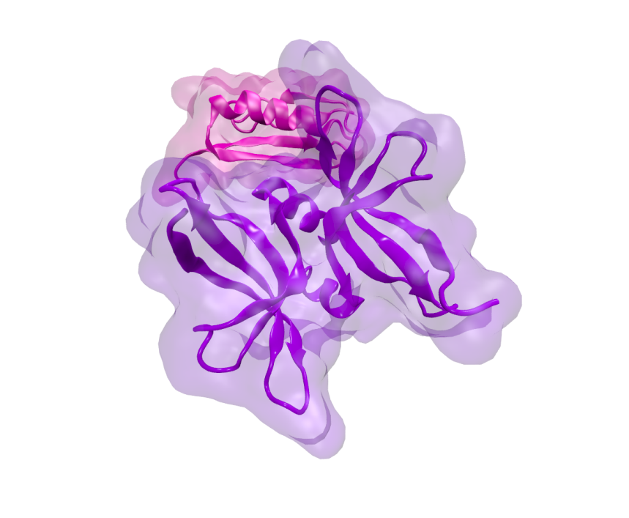
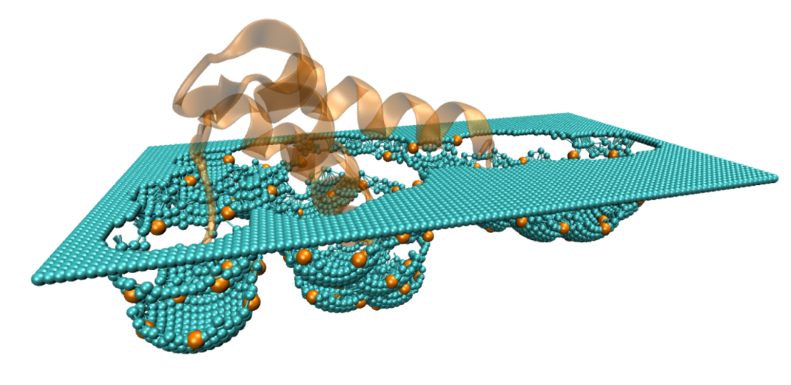

Protein-ligand binding OFF LATTICE
REAL SYSTEM:
protein docking
TEST SYSTEM:
protein-like surface
Notes:
qui ricorda di dire IDENTIFICATION OF TH POCKET per real e test system

Slide 6
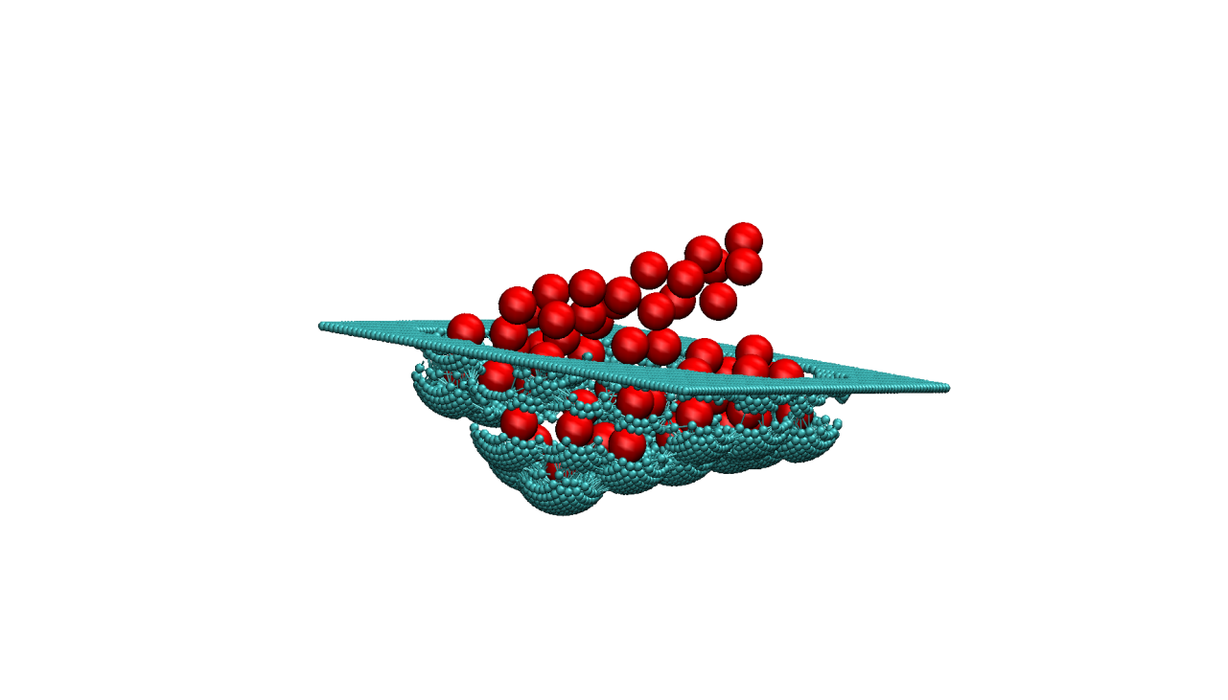
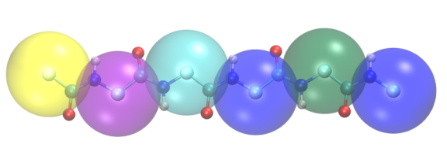
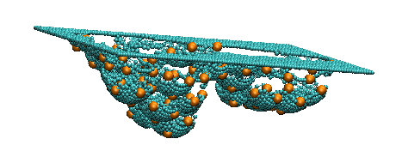
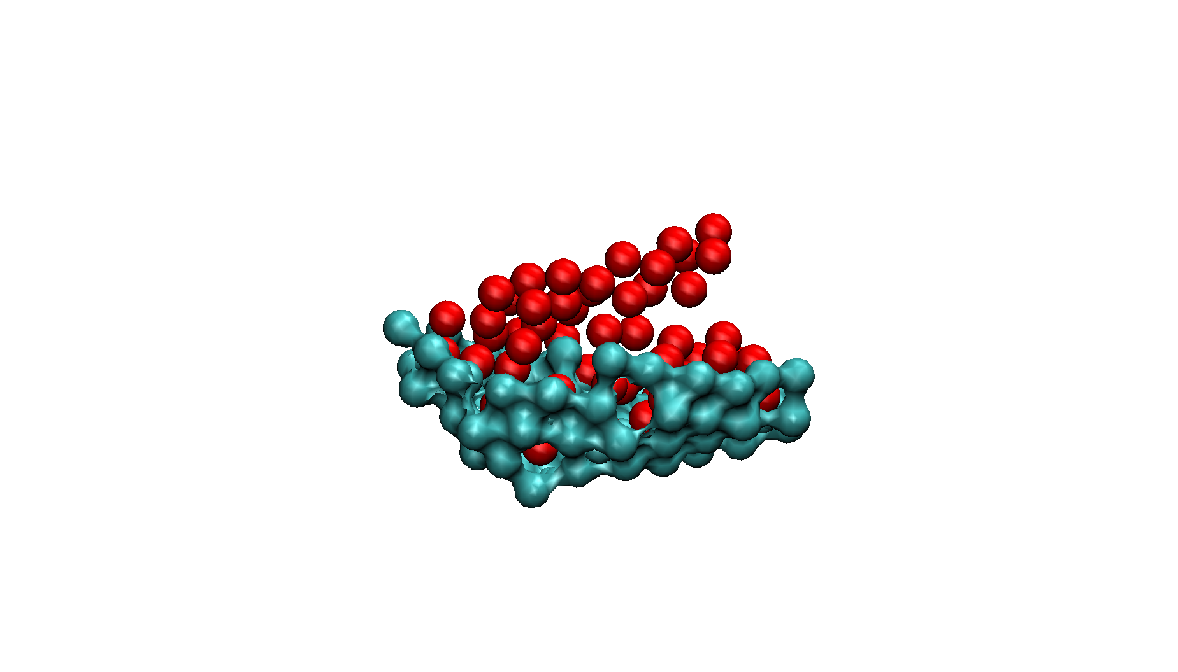
Protein-ligand binding OFF LATTICE
Surface modeling
Stretched protein
Dummy atoms
Cα carbons

Slide 7

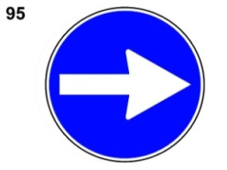
Protein-ligand binding OFF LATTICE
WORK IN PROGRESS
Design of protein-ligand sequences
Evaluation of the binding affinity
FUTURE DIRECTION
Protein-protein docking

Slide 8


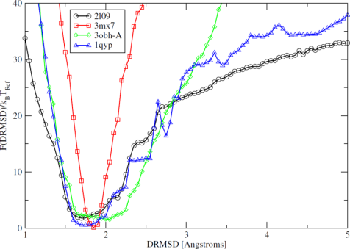
Test designed sequences stability
Replace the native sequence with the designed one
Side chain rotamer analysis (SCWRL4)
Set up simulation box
System equilibration
eventuale:
ricorda nel set up di parlare di problemi nomi amber ff
COARSE GRAINED:
CATERPILLAR
ATOMISTIC REPRESENTATION
GROMACS
amber99sb
TIP3P water
T = 298 K ; P = 1 atm
Notes:
mettere in ottica di improvement. modello è figo , ma per applicazioni farmaceutiche e proprietà chimiche è importante poter tornare da una descrizione cg ad una full-atom. inltre questo ci permette di confrontare il nostro modello con predizioni da MD con ff e full atom e se necessario migliorare i potenziali caterpillar. per fare questo ho messo su un protocollo che permette di ricostruire la struttura full atom partendo da seq caterpillar. le side chain sono aggiunte con programma … con analisi dei rotameri (leggi e spiega). Qui spiega come sono messe su le simulazioni

Slide 9
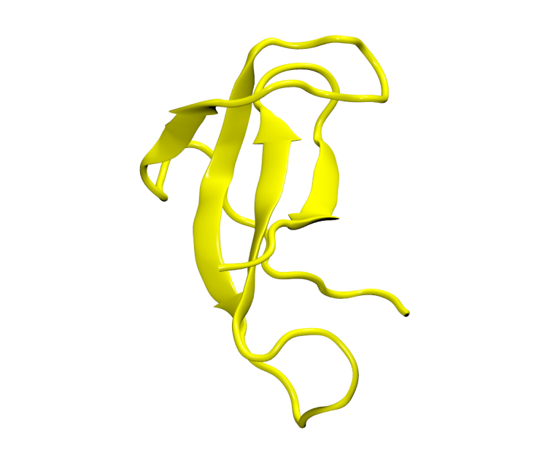

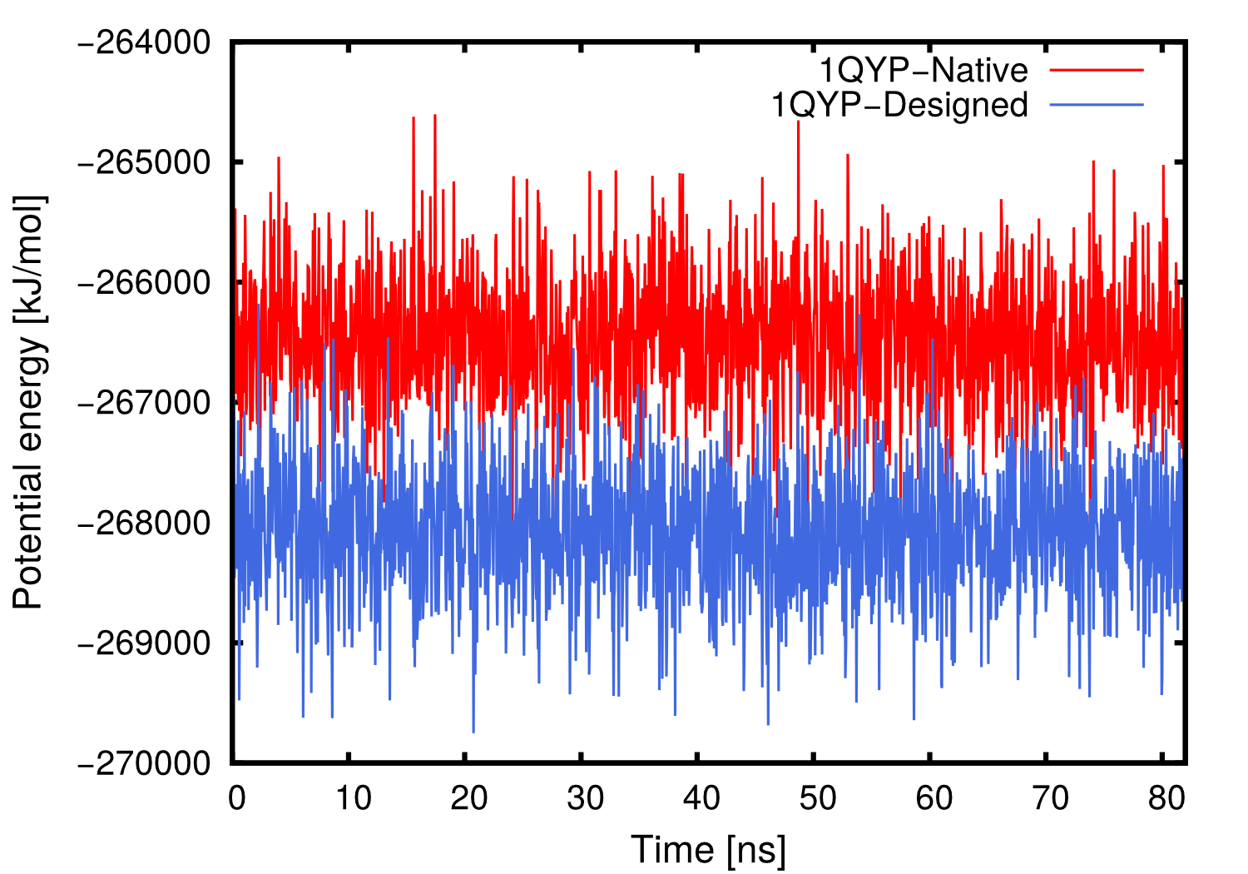
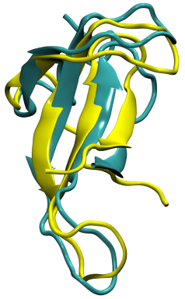
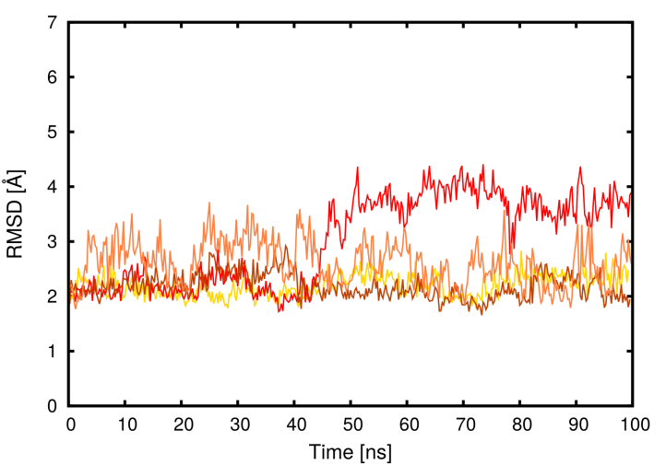
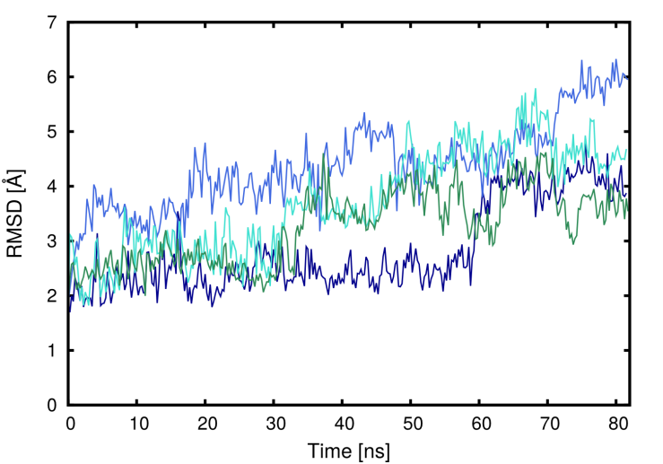
Full atomistic 1QYP
amber99sb
TIP3P water
T = 298 K ; P = 1 atm
GROMACS
Reference Structure
for RMSD from RCSB
Native seq.
Potential energy [kJ/mol]
Designed seq.
Native
Designed
RMSD [Å]
RMSD [Å]

Slide 10
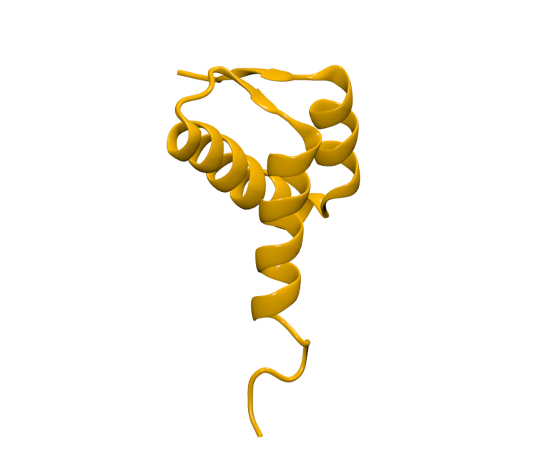
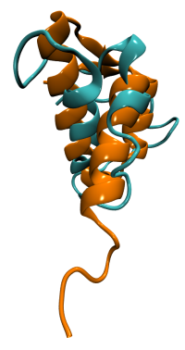
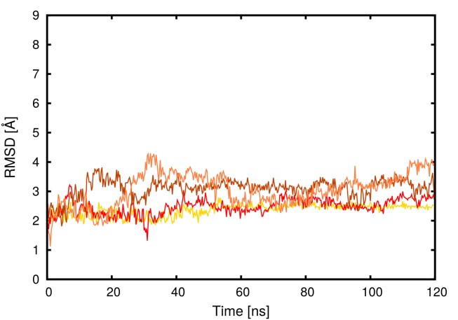
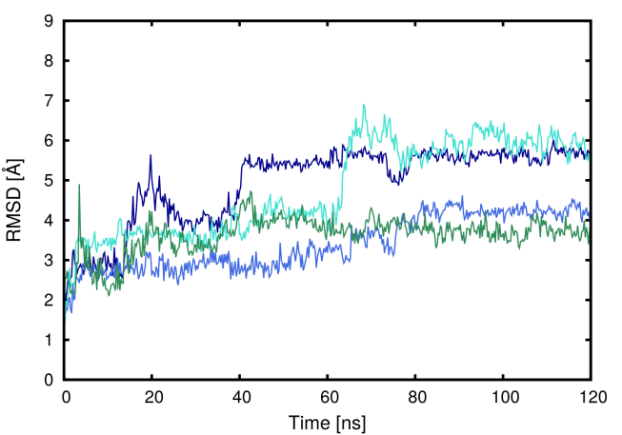
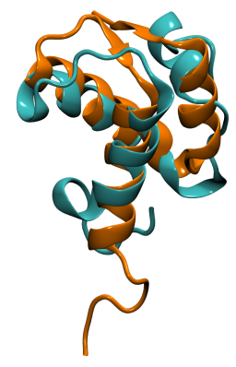
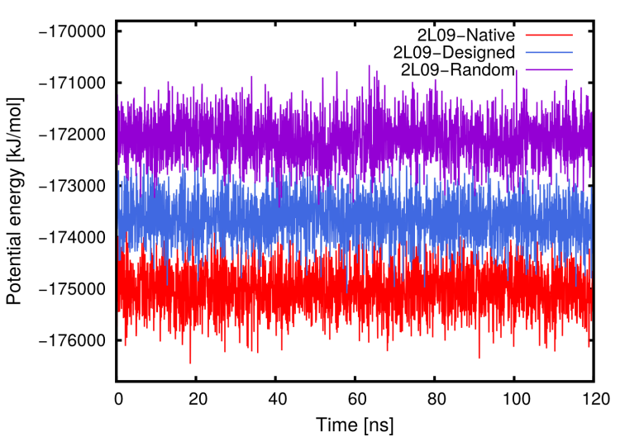
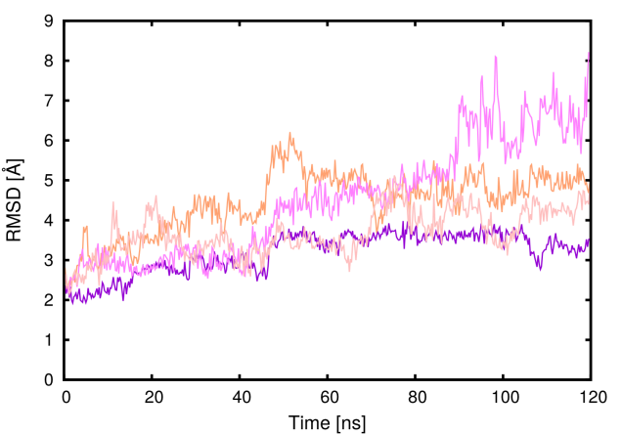
Full atomistic 2L09
amber99sb
TIP3P water
T = 298 K ; P = 1 atm
GROMACS
Reference Structure
for RMSD from RCSB
Native
Designed
RMSD [Å]
RMSD [Å]
Random
Random seq.
RMSD [Å]
Potential energy [kJ/mol]
Designed seq.
Native seq.

Slide 11


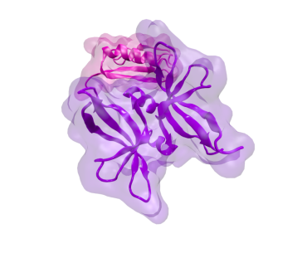
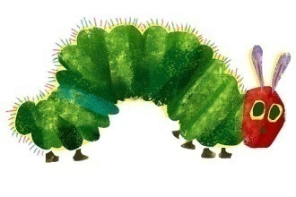
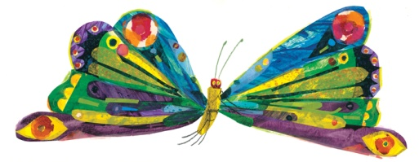

From here…
Protein-ligand binding:
Evaluate binding free energy and affinity of the test system.
Protein-protein docking.
Test of designed sequences:
Take advantage of MD feedback in order to improve the CATERPILLAR MODEL.
Set up BIAS-EXCHANGE METADYNAMICS with PLUMED.
per feedback importante: - interazione con solv
nuova matrice con Cbeta
usare MD traj corte per matrice
Notes:
Bias-exchange metadynamics (see Ref. [1]) is an approach specifically designed for accelerating rare events/computing the free energy in very complex cases, in which the variables that are relevant for the process are more than 2-3. In these cases, normal approaches such as metadynamics or umbrella sampling are very inefficient.
The method works as follows:
One first lists all the collective variables that are expected to be relevant for the process under investigation. There is no limitation on the number of variables.
One runs in parallel several molecular dynamics simulations, each biased with a metadynamics potential acting on one of the collective variables of the list.
At fixed time intervals, swaps of the configurations between pairs of replicas are attempted. The swap is accepted according to the Metropolis criterion.
Thus, the dynamics of each replica is biased in a direction that changes stochastically with time. This allows the system exploring a complex (multidimensional) free energy landscape with great efficiency, even if the bias at each time is only one-dimensional.

Slide 12







Acknowledgements
Prof. Christoph Dellago and Dr. Ivan Coluzza
Automated Bio Marker (ABM) - In silico automated tumor targeting
Dr. Luca Tubiana
Theory and simulations of designable modular bionic proteins
Dr. Valentino Bianco
M.Sc. Chiara Cardelli

Slide 13






Thank you for your attention

Slide 14
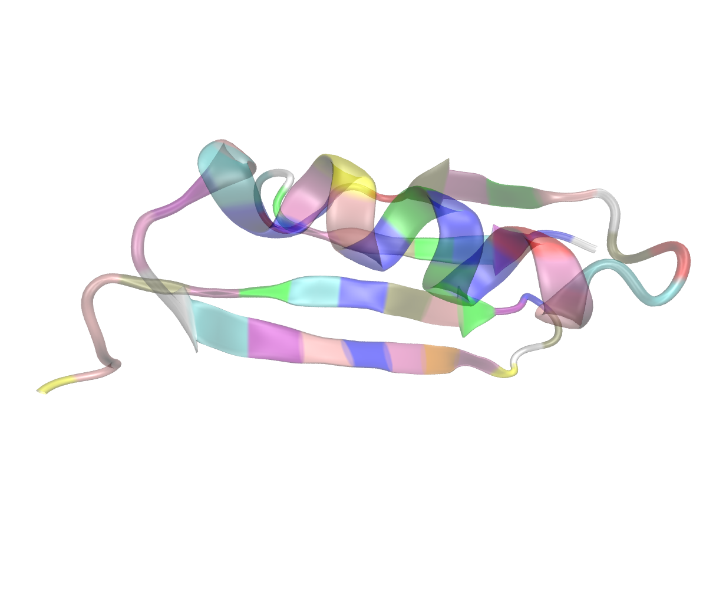
Designing highly specific probes with tunable affinity
Francesca Nerattini
Computational Physics Group, University of Vienna

Slide 15
Working with proteins..
Protein folding and design are major biophysical problems, the solution of which would lead to important applications
FOLDING
DESIGN
Find a specific, stable, 3D structure given a fixed amino acid sequence
Find the sequence of amino acids which will fold in a given target structure
GSHT...TCPKC
?
?
GSHT...TCPKC
Notes:
leggi

Slide 16

Protein-ligand binding OFF LATTICE
Identification of the pocket
  Active site
  Rotational analysis
Notes:
Natural sequences fold to a thermodynamically stable structures
Constraints are key to understand proteins. Constrains reduce the phase space and allow to reach a stable ground state (low frustration energy landscape)

Slide 17
Protein-ligand binding OFF LATTICE
Identification of the pocket
Surface modeling
  define parameters
  construct a 2D grid
  move grid point until the
  minimum distance from protein
  smooth the surface
  reduce the number of points

Slide 18
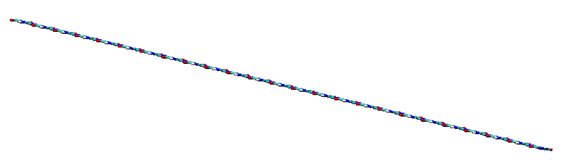

Protein-ligand binding OFF LATTICE
DESIGN
FOLDING
Stretched protein
Dummy atoms
Cα carbons
Notes:
end up with these structures.

Slide 19
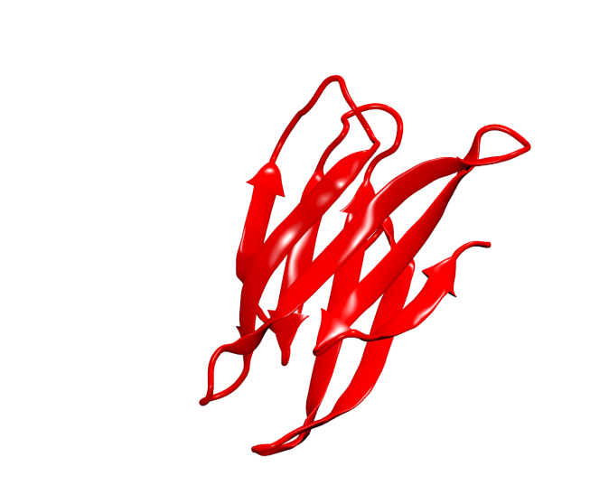
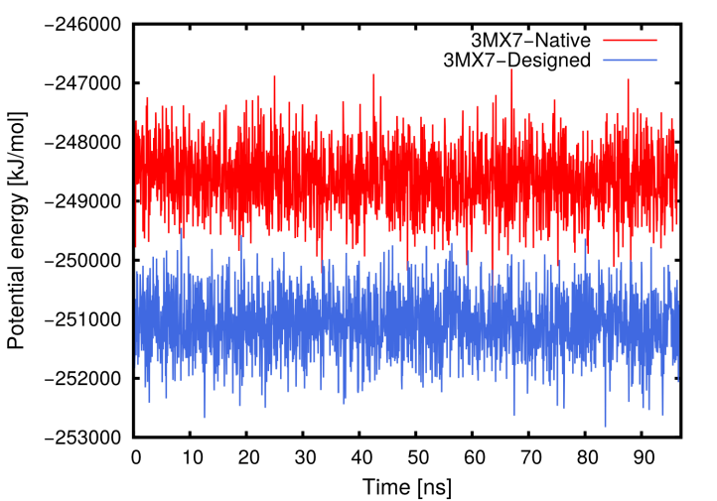
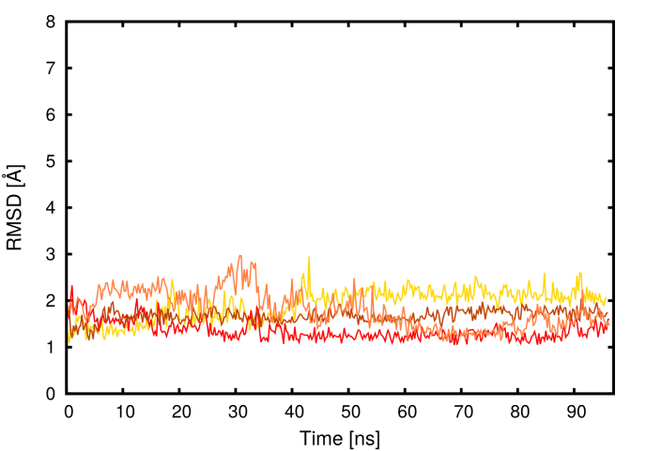
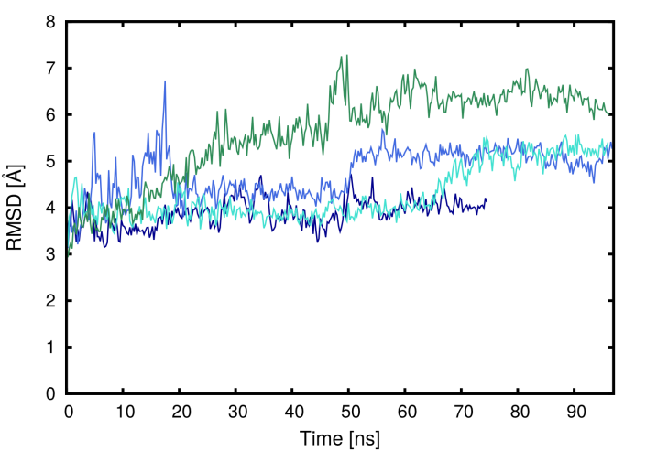
Full atomistic 3MX7
amber99sb
TIP3P water
T = 298 K ; P = 1 atm
GROMACS
Reference Structure
for RMSD from RCSB
Native
Designed
Notes:
OMINO LAVORI IN CORSO x tutte. partendo da strutture pdb per nativa e bb pdb per dsegnata con side chains aggiunte con rotamer analysis abiamo fatto 100 ns di dinamica e analizzato l’RMSD per nat e dis e la differenza di energia potenziale del sistema totale. grande differenza di energia tra le due e disegnata è piu bassa. mentre RMSD non è soddifacente.

Slide 20
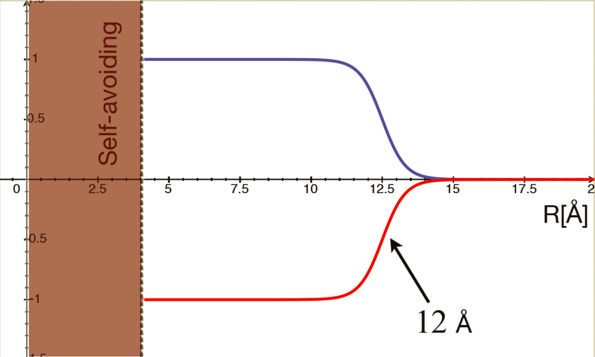
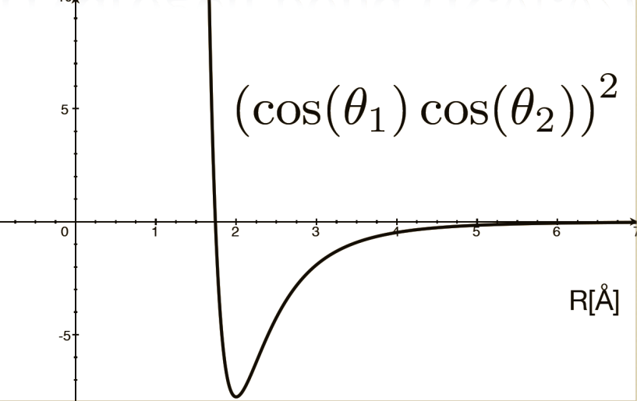
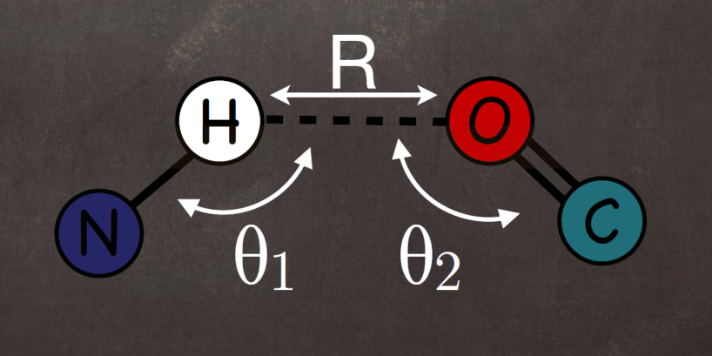
Model
Side chains interactions (R)
Hydrogen bonds (R,θ₁,θ₂)
The depth dependends on the interaction matrix, i.e. on the different nature of the amino acids
Notes:
Change the interaction matrix to match designed and natural sequences (maximum entropy principle, 120 protein from PDB and 100.000 designed seq for each natural seq)

Slide 21
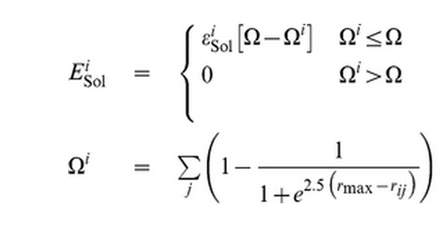
Model
Implicit solvent model
Ω = threshold for the number of contacts above which the amino acid is considered fully buried
ε^{i}_{Sol} = (rescaled) Dolittle hydrophobicity index
> 0 hydrophobic aa
< 0 hydrophilic aa
Notes:
ESOL penalizes the surface exposure of hydrophobic aa. threshold for the number of contacts in the native structure above which the amino acid is considered to be fully buried and epsilon is the Dolittle hydrophobicity index, rescaled by to make this term match the contributions from the other energy terms.

Slide 22
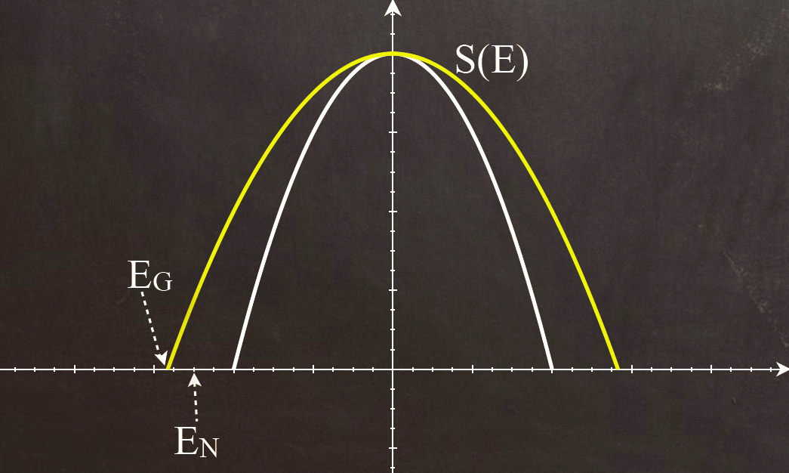
Model
Mean field theory Random Energy Model

Slide 23
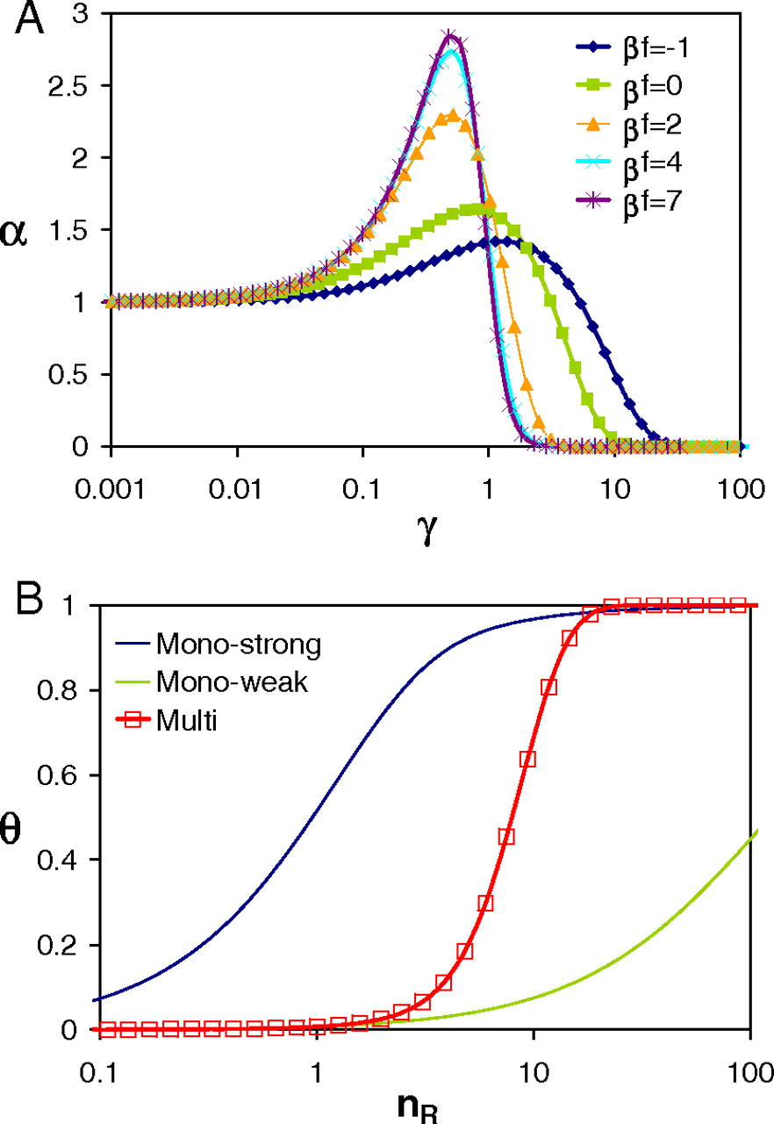
Bio Velcro
Automated Bio Marker (ABM) - In silico automated tumor targeting
Selective tumor cell targeting using low-affinity, multivalent interactions
CD47-signal regulatory protein alpha
F. J. Martinez-Veracoechea, and D. Frenkel PNAS 2011;108:10963-10968
Notes:
Design of protein ligands – receptors intractions consist in the search for aminoacid sequences whose lowest free energy state coincides with a given target conformation

Slide 24
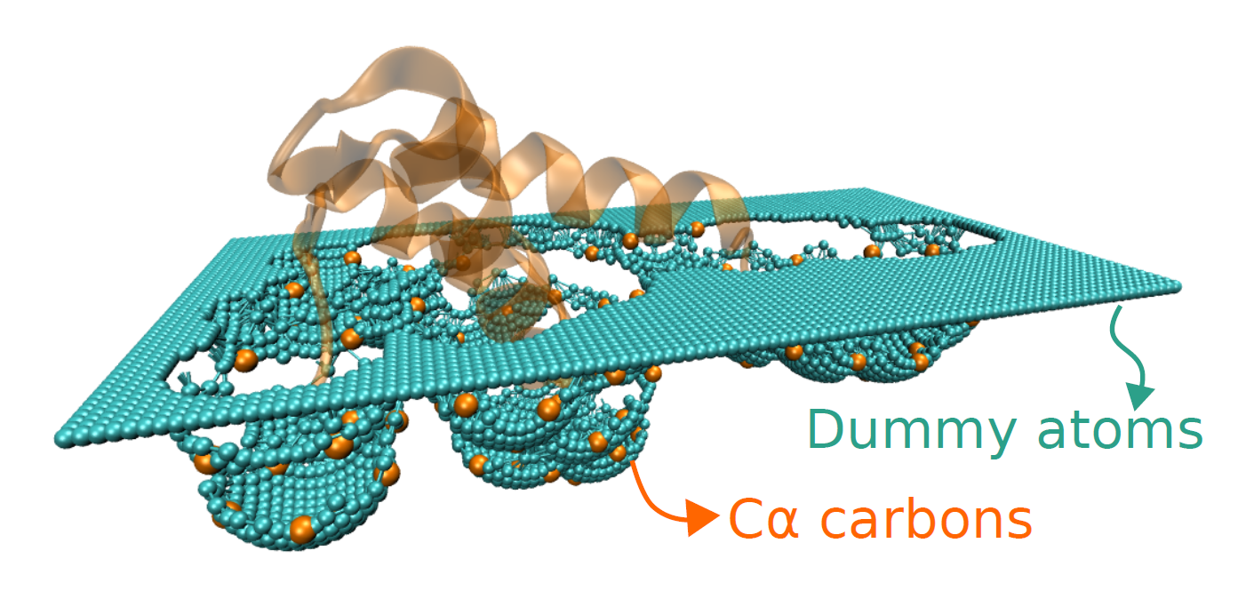

Slide 25
Full atomistic 2L09
amber99sb
TIP3P water
T = 298 K ; P = 1 atm
GROMACS
Native
Designed
Designed
Repeat
Random

Slide 26
Full atomistic 2L09
amber99sb
TIP3P water
T = 358 K ; P = 1 atm
GROMACS

Slide 27
Full atomistic 2L09
amber99sb
TIP3P water
T = 358 K ; P = 1 atm
GROMACS
SB
BBI
BB

Slide 28
Full atomistic 2L09

Slide 29
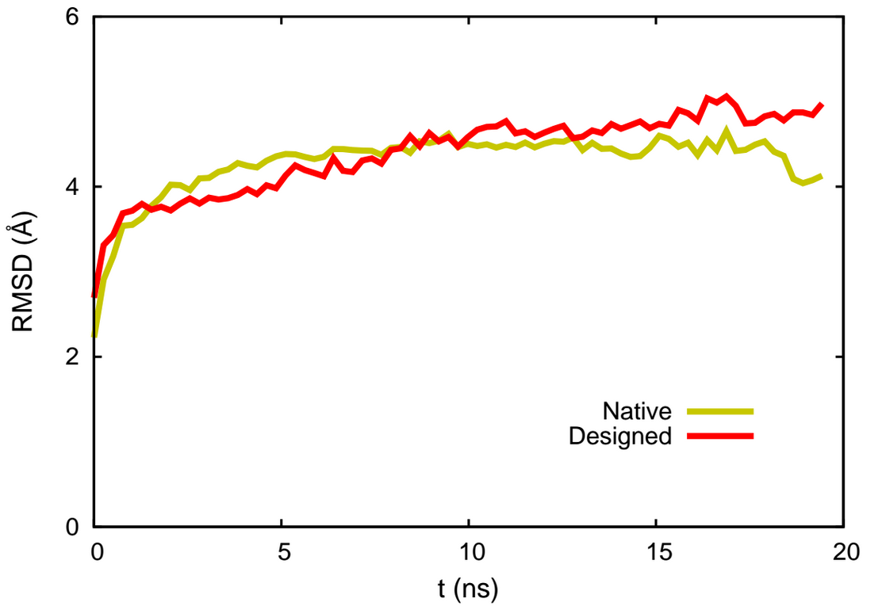
Full atomistic 2L09
amber99sb
TIP3P water
T = 298 K ; P = 1 atm
ORAC
Reference Structure: SOLUTION NMR from RCSB

Slide 30
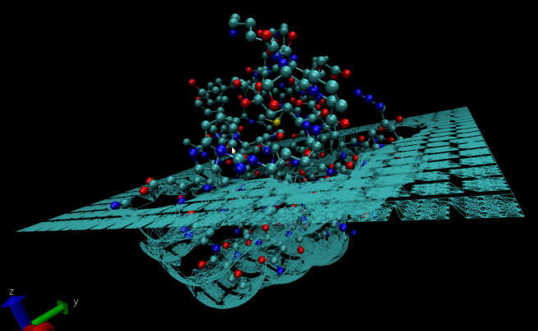
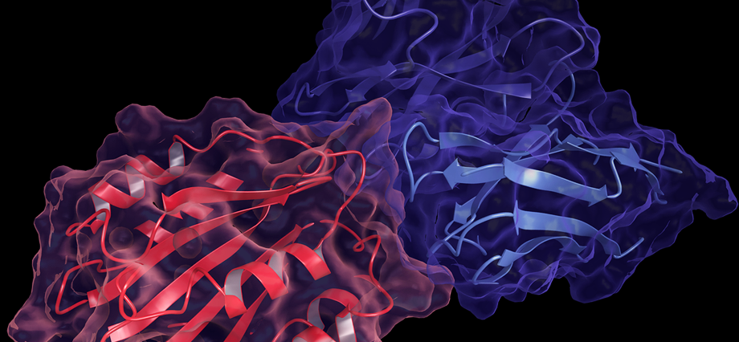
Protein-ligand binding OFF LATTICE
REAL SYSTEM:
protein docking
TEST SYSTEM:
protein-like surface

Slide 31


The CATERPILLAR model
Constraints are the key to understand proteins
COARSE GRAINED:
CATERPILLAR^{[1]}
ATOMISTIC
REPRESENTATION
ATOMISTIC REPRESENTATION
COARSE GRAINED:
CATERPILLAR^{[1-2]}
[1] Coluzza, Ivan. "A coarse-grained approach to protein design: learning from design to understand folding." PloS one, 6, e20853 (2011)
[2] Coluzza, Ivan. "Transferable coarse-grained potential for de novo protein folding and design." PloS one, 9, e112852 (2014)
Notes:
Natural sequences fold to a thermodynamically stable structures
Constraints are the key to understand proteins. Constraints reduce the phase space and allow to reach a stable ground state (low frustration energy landscape)

Slide 32
The CATERPILLAR model
COARSE GRAINED:
CATERPILLAR^{[1]}
COARSE GRAINED:
CATERPILLAR^{[1-2]}
ATOMISTIC
REPRESENTATION
[1] Coluzza, Ivan. "A coarse-grained approach to protein design: learning from design to understand folding." PloS one, 6, e20853 (2011)
[2] Coluzza, Ivan. "Transferable coarse-grained potential for de novo protein folding and design." PloS one, 9, e112852 (2014)
Notes:
caterpillar: is a coarse grained model in which we maintain all the mechanical structure of the bb and the constraints on the dihedral angles, while coarse graining all pairwise interacrtions which are centered on the Calpha. In particular we keep a self avoiding interaction of 2A radius and a pairwise interaction which depends on the identity of the aa of the pair with a cut off at 12 A. In order to reproduce protein structures and allow for folding and design we explicitly consider the directional hydrogen bonds interactions within the bb. In the current model solvent interactions are treated implicitly by assigning a degree of hydrophobicity to each aa type and computng the exposure of the aa along the bb. The effectiveness of the model can be proved by reconstructing the free energy landscape of sequences designed to fold into a target structure. As you can see from the figure in which we consider 4 sequences folding into different target structures, the model is very effective since all the curves have a funneled shape and the minima are at about 2 A drmsd from the target structure.

