Slide 1
Label-free NIR reflectance microscopy as a complimentary tool for two-photon fluorescence brain imaging
Emilia Margoni
European Laboratory for Non-linear Spectroscopy

Slide 2
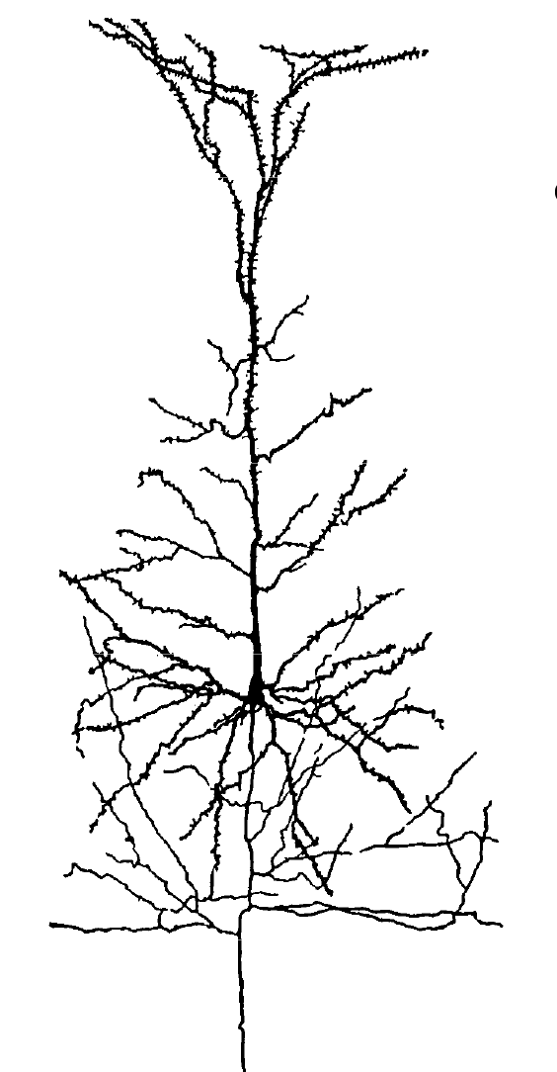
Optical techniques to explore the brain
The investigation of the brain requires several challenges in imaging technology, since brain activity spans many orders of magnitude both spatially (from nanometers to centimeters) and temporally (from milliseconds to months).
Thanks to their flexibility in terms of spatial and temporal resolution optical methodologies have become very useful in neuroscience research.
Synapses
μm scale
Neuron
mm scale
Whole mouse brain
cm scale
Notes:
2
2

Slide 3
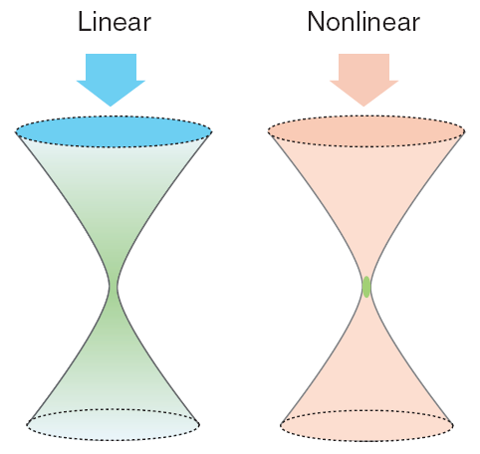
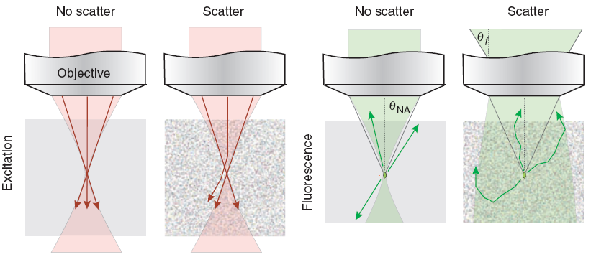
Two-photon Fluorescence (TPF) microscopy
Two-photon excitation advantages:
The fluorescence signal depends nonlinearly on the density of photon providing an absorption volume spatially confined to the focal region.
For commonly used fluorescence probes two-photon absorption occurs in the near-infrared wavelength range (700-1000 nm).
Signal generation and fluorescence collection in clear and in scattering tissues
TPF = Micron-scale resolution in deep tissue
Notes:
3
3

Slide 4
In vivo brain imaging
Imaging into brain cortex of a P90 GFP-M transgenic mouse.
The movie shows a partial neurite network made of the GFP labeled neurons.

Slide 5
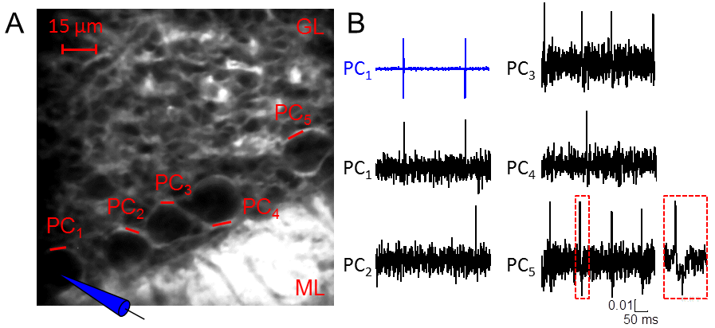
Optical recording of neuronal activity
We found that we are able to detect action potential in real time with a signal to noise around 7 in five neurons simultaneously. Simultaneous optical and electrical recording from cell one shows the high fidelity of the optical measurement. This data shows how this technique can be used to investigate neuronal synchronization opening promising perspective in understanding the computational rule of the brain.
P. Yan, C. Acker, WL. Zhou, P. Lee, C. Bollensdorff, A. Negrean, J. Lotti, L. Sacconi, S. D. Antic, P. Kohl, H. D. Mansvelder, F. S. Pavone, and L. M. Loew, Palette of fluorinated voltage sensitive hemicyanine dyes, Proc Natl Acad Sci U S A, (2102).

Slide 6
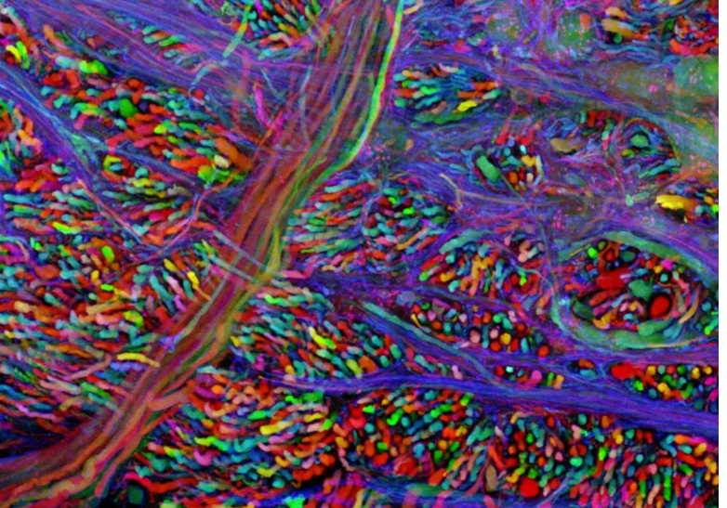
Advantage of a label free technique
The fluorescence emission from a variety of indicators has been widely used to get both structural and functional information, but:
The use of genetically encoded fluorescent indicators is nevertheless limited to few animal models, and surely cannot be applied to humans
The combination of fluorescent transgenic mice with animal model of pathologies requires complex genetic engeneering proceedures, so that the study of many deseases with fluorescent microscopy is limited
In this scenary, the possibilities offered by a non invasive label free technique are:
To get information on a sample without introducing any exogenous target
Less cost in terms of preparation of the samples
To make a human application achievable

Slide 7
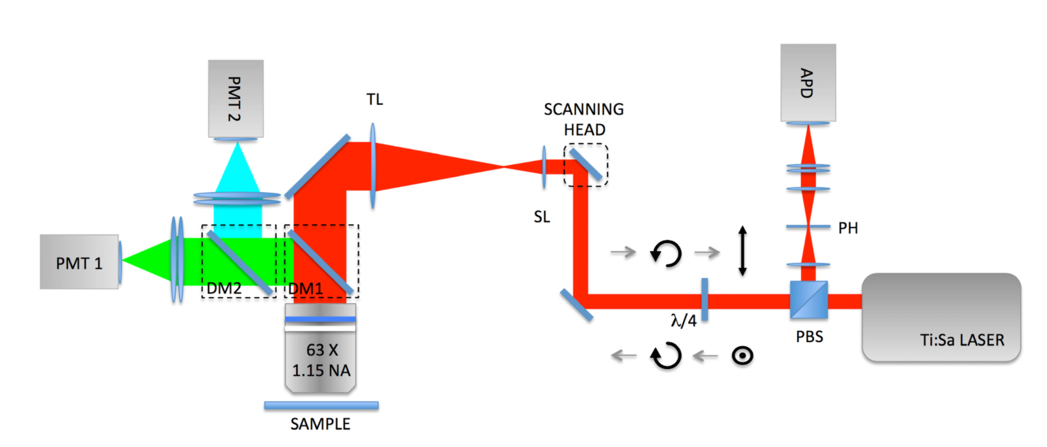
Custom-made NIR confocal reflectance combined with two-photon fluorescence apparatus
A polarization beamsplitter (PBS) along with a quarter waveplate is used to direct the descanned reflectance confocal signals to an avalanche photodiode (APD) module with a point spread function size pinhole (PH) in front. The black arrows highlight the status of polarization light in forward and backward direction.

Slide 8
PSF characterization
Axis | FWHM (μm) | SE (um)
X | 0.4082 | 0.0031
Y | 0.4398 | 0.0089
Z | 3.961 | 0.030
Axis | FWHM (μm) | SE (μm)
X | 0.4082 | 0.0069
Y | 0.4398 | 0.014
Z | 3.961 | 0.055

Slide 9
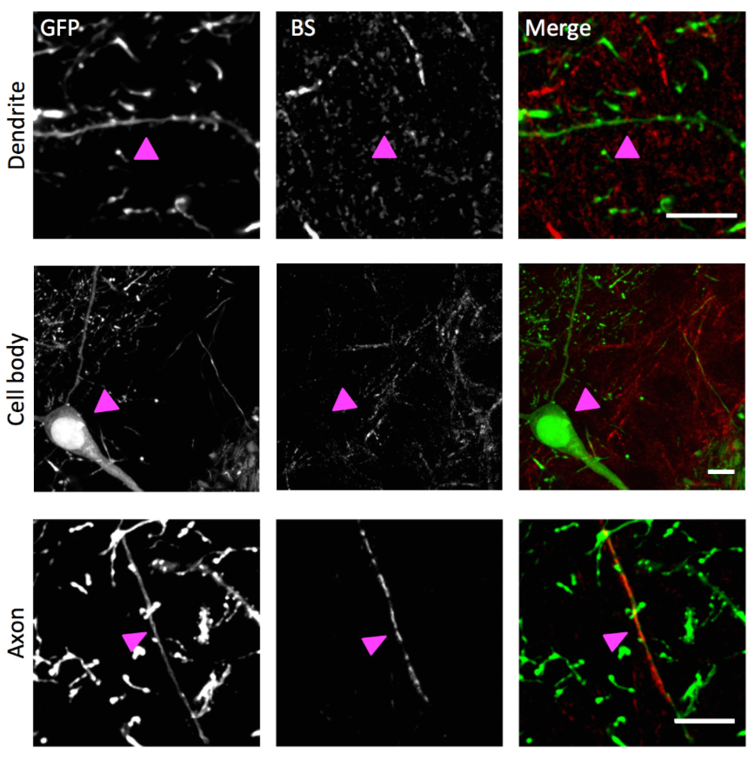
Ex vivo BS NIR and two-photon fluorescence imaging
In the upper panel there is a not reflective GFP-labeled dendrite (arrowhead). Cell bodies (in the middle panel) are also not reflective. Myelinated axons (lower panel) can be both fluorescent and reflective. From right to left: GFP fluorescence, myelin reflectance, merge with GFP in green and reflectance in red. Scale bar, 10 μm.

Slide 10
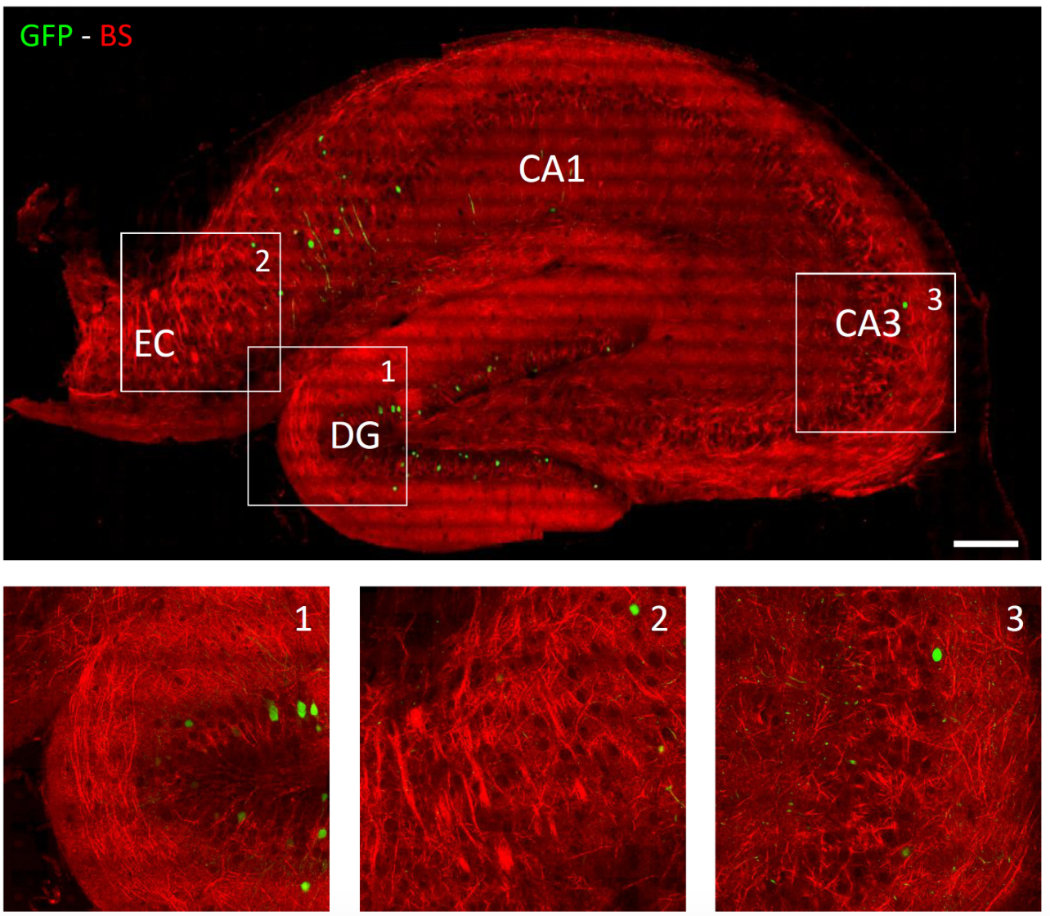
Thy1-GFPM mouse hippocampus imaging

Slide 11
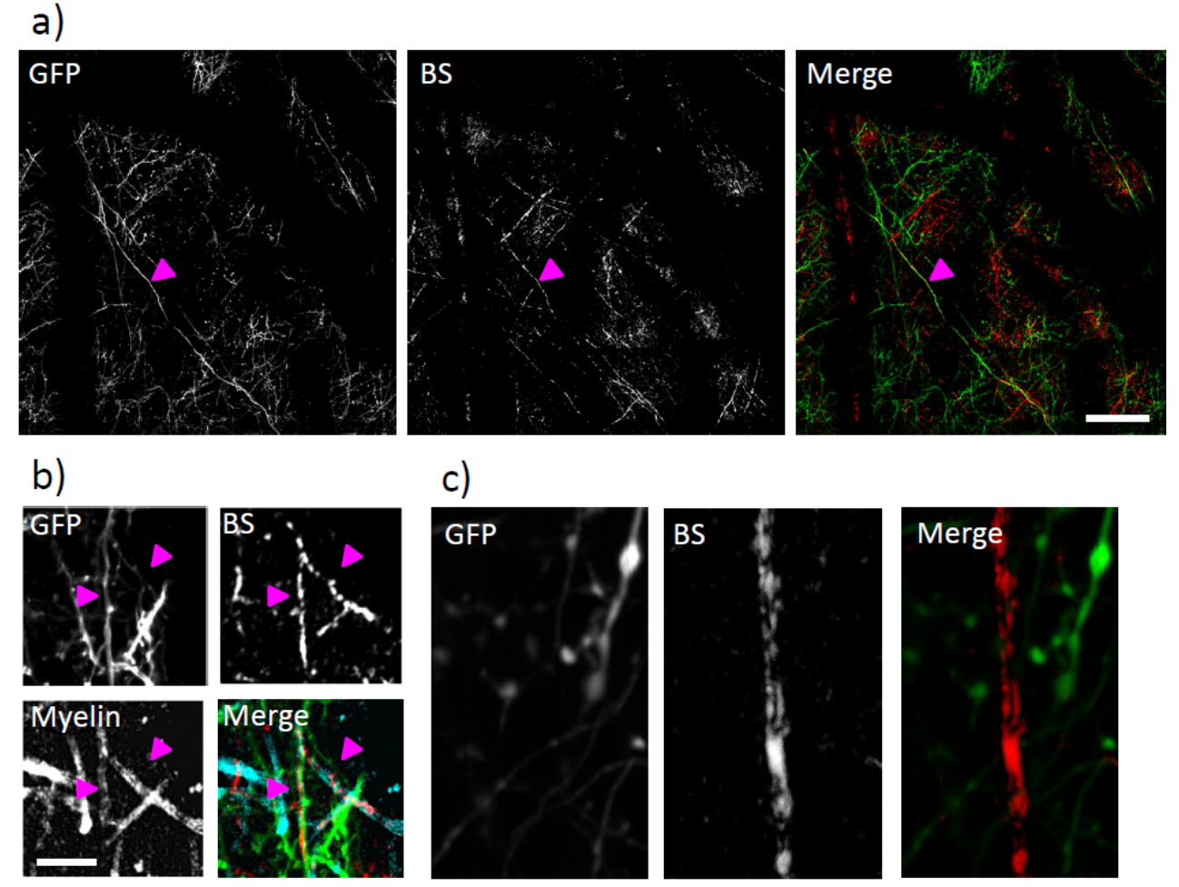
In vivo NIR reflectance and two-photon fluorescence imaging
a) Mosaic of 4×4 maximum intensity projections from 60 μm deep stacks. Colocalization of a myelinated axon in the fluorescence and BS channel, as pointed out by the magenta arrowhead. Scale bar, 50 μm.
b) Colocalization of NIR reflectance signal (BS) with GFP fluorescence and with Fluoromyelin labeling on the same axons (highlighted by magenta arrowheads). Scale bar, 10 μm

Slide 12
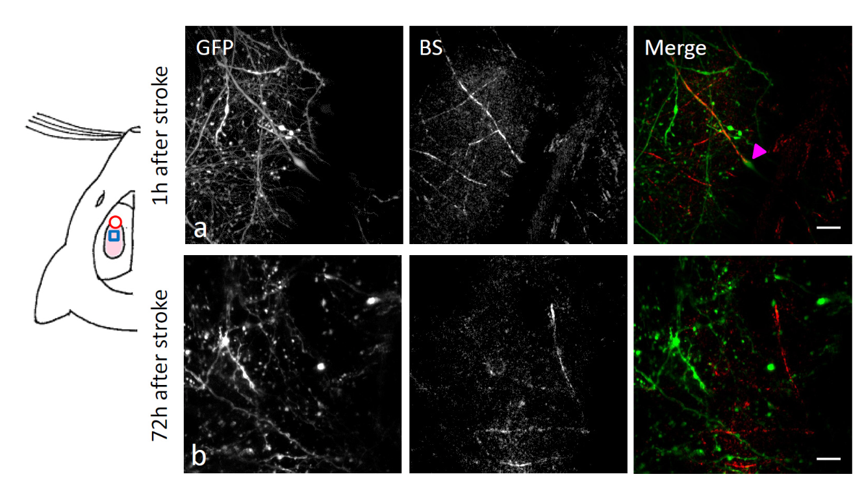
In vivo imaging of NIR reflectance after stroke
On the left, a cartoon of a mouse head illustrate the relative position of the craniotomy (light pink area), the stroke core (red circle) and the imaging region (blu square). Images show the retention of the BS signal in a myelinated axon partially degenerated one hour and 72 hours after stroke. Scale bar, 10 μm.

Slide 13
Conclusions
Here, we describe a complimentary and versatile approach that, by collecting the reflected NIR light, provides structural details on the myelinated axons and blood vessels in the brain, both in fixed samples and in live animals under a cranial window.
By combining NIR reflectance and two-photon imaging of a slice of hippocampus from a Thy1-GFPm mouse, we show the presence of randomly oriented axons intermingled with sparsely fluorescent neuronal processes. The back-scattered photons guide the contextualization of the fluorescence structure within brain atlas thanks to the recognition of characteristic hippocampal structures.
Interestingly, myelin formations allowed the label-free detection of axonal elongations over the layer 2/3 of mouse cortex under a cranial window in vivo.

Slide 14
Acknowledgements
Anna Letizia Mascaro
Irene costantini
Leonardo Sacconi
Francesco S. Pavone
Founded by:
Settimio Mobilio

