Slide 1
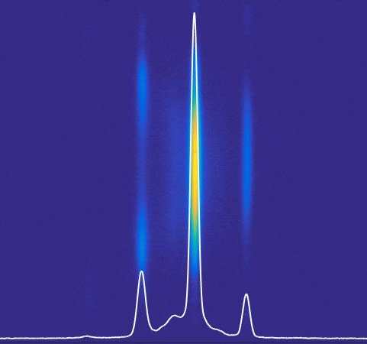
Multi-color High Gain FEL driven by seeded micro-bunching instability
Giuseppe Penco, E. Roussel,
E. Ferrari, E. Allaria, S. Di Mitri,
M. Veronese, M. Danailov,
D. Gauthier, L. Giannessi

Slide 2
Outline
Seeded Free electron Laser
Microbunching instability: How fix it…
…. how use it
Experiment at FERMI FEL in Trieste
(submitted to Phys Rev. Lett.)

Slide 3
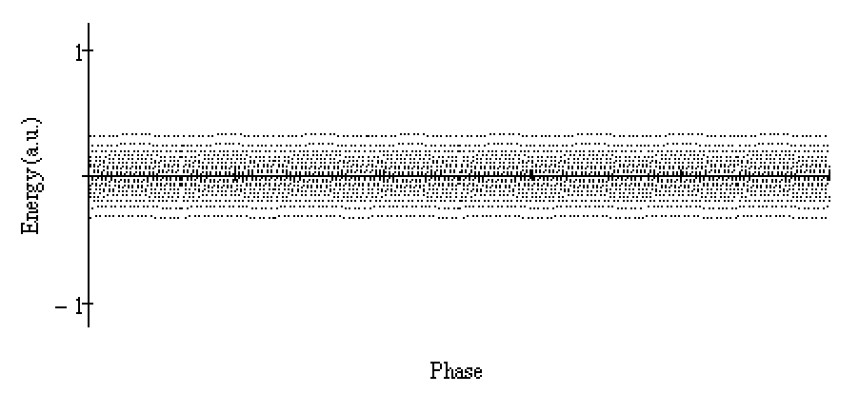
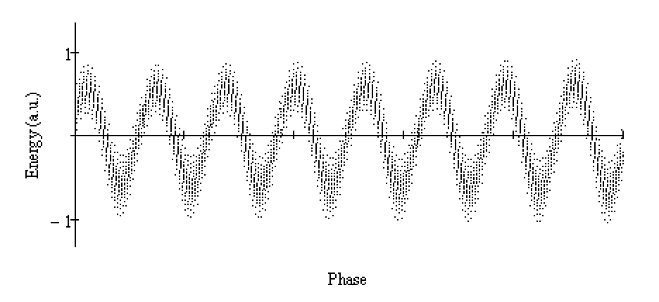
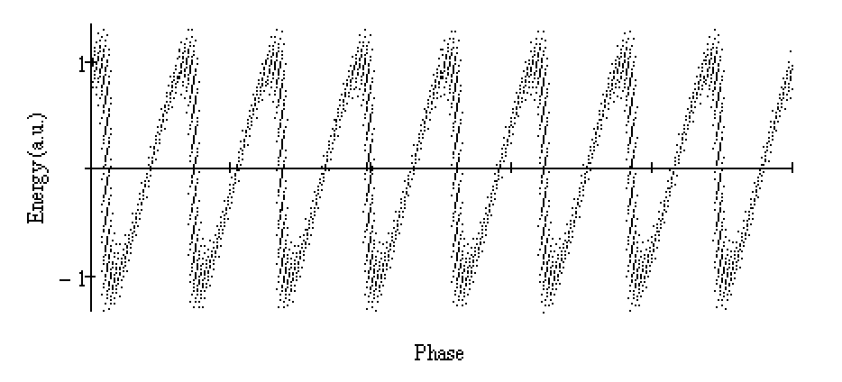
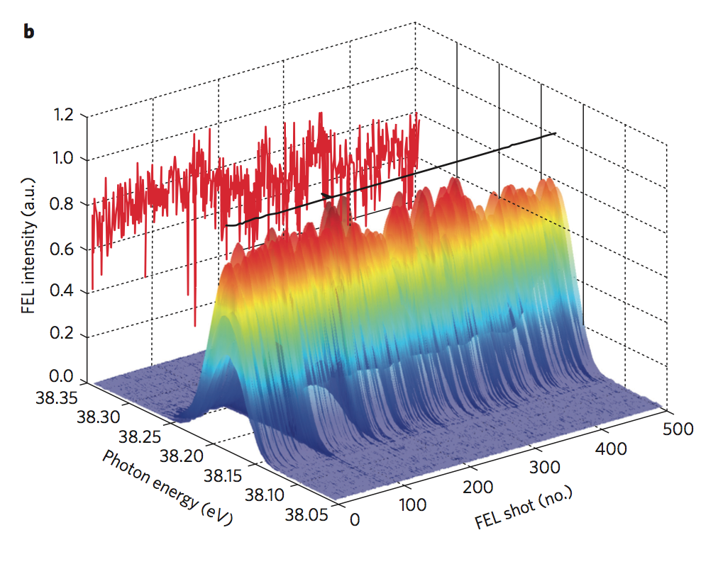
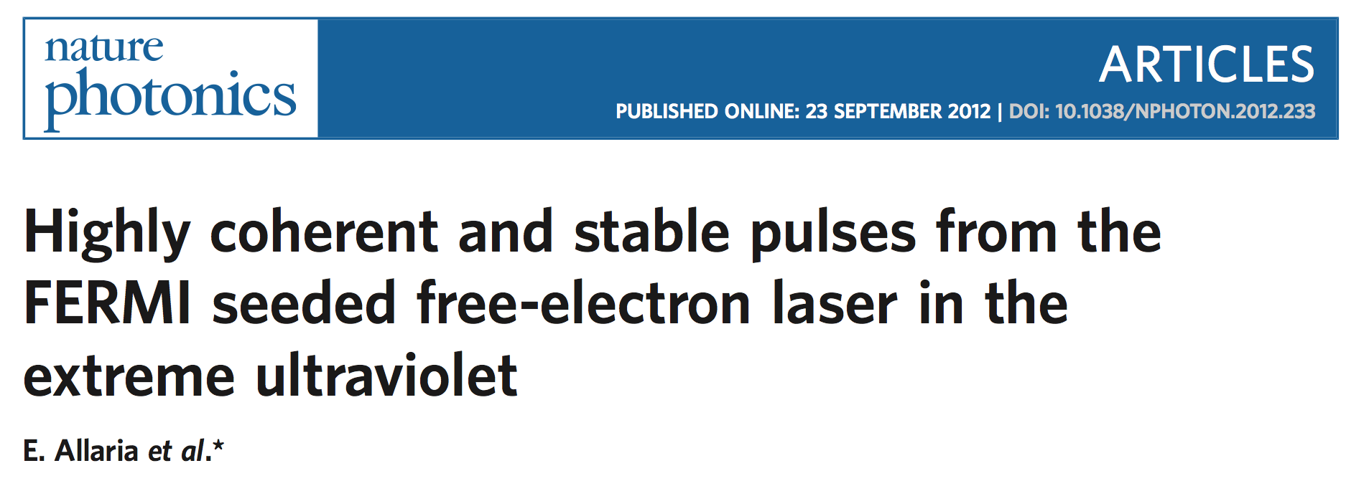
Seeded FEL (High Gain Harmonic Generation)
modulator
High gain radiator tuned at n^{th} harmonic
Seed
THG or
tuneable OPA
dispersion
n^{th} harmonic
radiation
Seed
e-beam
modulated e-beam
Central wavelength stability <10⁻⁴ (RMS)
Bandwidth ~10⁻³
Modulated beam
See L.Giannessi’s talk on Friday
Bunched beam
Fresh beam
Notes:
…il fascio cosi’ bunchato ha uno spettro contenente la lungh d’onda del seed e le sue armoniche, per cui quando viene mandato in una successiva catena di ondulatori risonanti ad un armonica del seed emette coerentemente

Slide 4
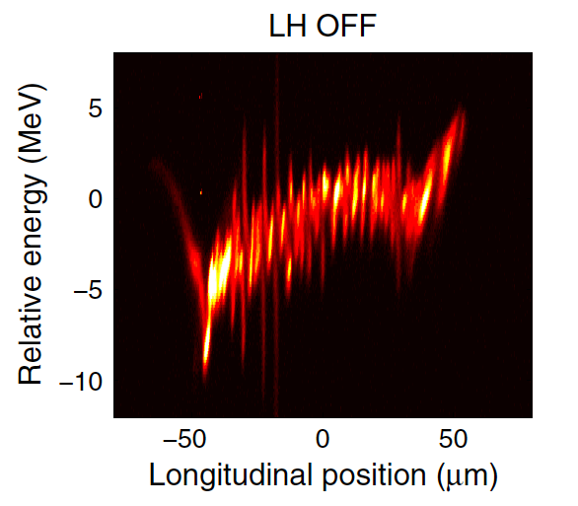
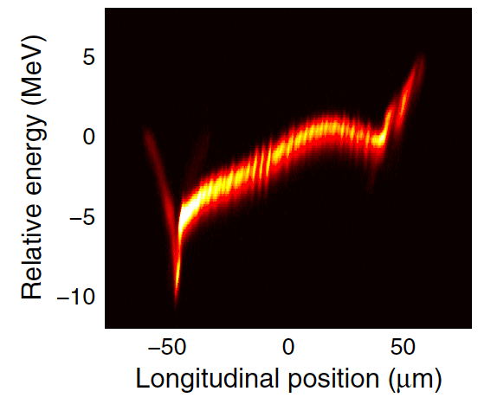

Micro-bunching instability
PROBLEM:
Since the uncorr. energy spread (σ_{E}) from the gun is very small, μ-bunching instabilities (MBI) driven by Longitudinal Space Charge and Coherent Synchrotron Radiation in the magnetic bunch compressor may grow and enhance σ_{E}, degrading the quality of FEL.
SOLUTION:
“Resonant laser-electron interaction in a short undulator induces rapid energy modulation at the optical frequency, which can be used as an effective energy spread for beam ‘heating’….”
Z. Huang et al. PRST-AB 7 074401 (2004).
Measured at LCLS
D. Ratner et al., Phys. Rev. ST-AB 18, 030704 (2015)
LH
Laser heater setup
,3,4
The chicane “washes out” the optical frequency modulation
Induce a controllable increase of σ_{E} to Landau damp the MBI: A modulation to suppress a modulation

Slide 5

Why don’t use Laser Heater to control the microbunching ?
LH shaping at FERMI
A stretched laser pulse interacts with a delayed copy.
The laser heater pulse is modulated using the chirped pulse beating technique [1].
The envelope of the laser pulse is modulated at a frequency proportional to the delay.
28.2ps
Time [ps]
[1] A. S. Weling and D. H. Auston, J. Opt. Soc. Am. B 13, 2783–2791 (1996)

Slide 6
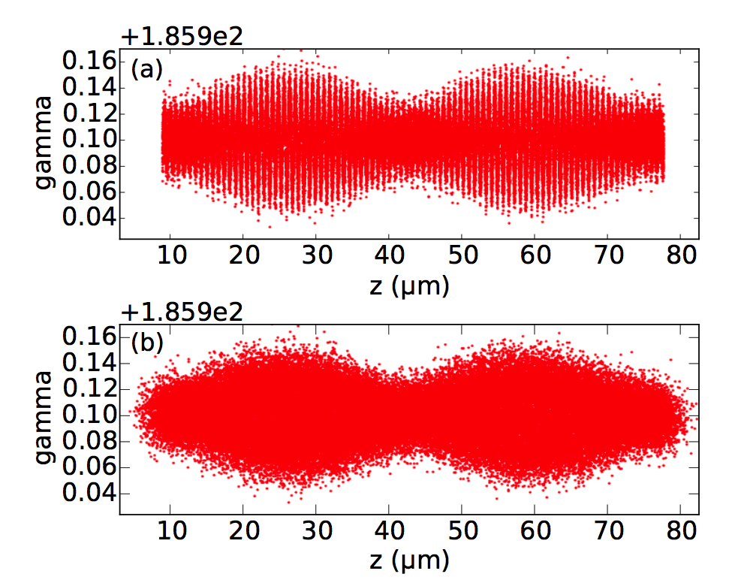
Modulation after Laser Heater chicane
For FERMI LH parameters, λ_{modulation}< 4 μm are smeared out after the chicane, so: λ_{LH} = 780 nm is Smeared Out; λ_{Beating} = 32.6 μm Survives!
In the chicane
32.6 μm
Optical modulation is smeared out.
780 nm
After the chicane
Beating modulation is still present.
32.6 μm
The beating can propagate downstream the LH chicane

Slide 7

Experimental observation of the modulated electron beam
e-beam energy spectrum
100MeV
300MeV
1.4GeV
Main LH pulse
(i.e. standard LH operation)
Submitted to Phys Rev. Lett.

Slide 8
Experimental observation of the modulated electron beam
e-beam energy spectrum
100MeV
300MeV
1.4GeV
Beating area of LH pulse
A modulation is clearly visible in the energy spectrum of the beam
Linear energy chirp (h = -20.2 m⁻¹), i.e., longitudinal position mapped to energy.
0.18 MeV
0.18 MeV => 32.4 μm modulation wavelength (nice agreement)
Submitted to Phys Rev. Lett.

Slide 9
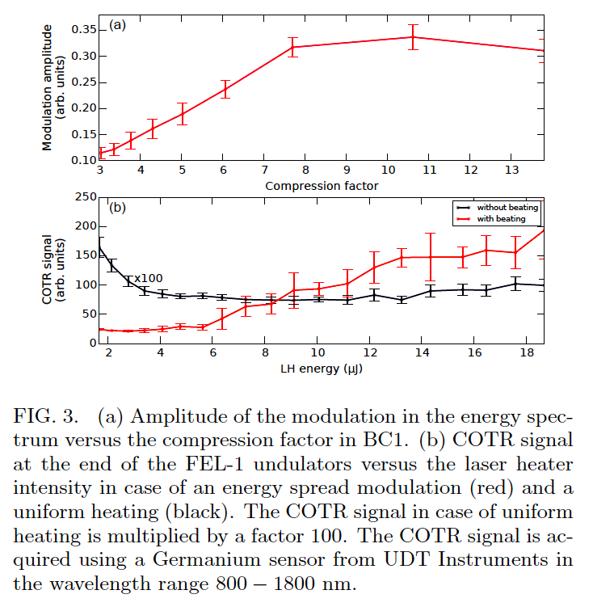
Microbunching Gain
At the LH exit, the modulation is mainly an energy spread modulation (at the beating wavelength).
It can be amplified by the MBI gain and converted into energy and/or density modulation at the bunch compressor (at the beating wavelength scaled by compression).
Increasing the compression (by increasing the angle of the chicane while keeping constant the energy chirp) leads to a growth of the modulation amplitude measured in the beam energy spectrum.
Measurements of the coherent OTR (COTR) in the infrared (in Undulator Hall):
  the modulation survives along the linac and in the undulators;
  COTR signal is amplified by the beating, and this indicates the presence of a few-μm-wavelength density modulation.
After BC1
At the end of FEL undulator
Submitted to Phys Rev. Lett.
Notes:
NB: non e’ un effetto di rotazione del R56 perche’ questo eventualmente avverrebbe in densita’ ma non in energia.
Arrivo alla chicane con una modulazione di energia, che si converte in densita’ in BC1 (molto debole). Aumentando l’R56, aumento il guadagno di u-bunching dovuto alla LSC tra BC1 e lo schermo che aumenta la modualzione in energia visibile nello spettrometro.

Slide 10
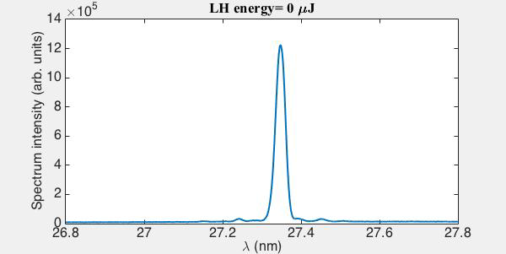
What happens when this pre-modulated beam is driven in the FEL undulators?
The pre-modulated beam interacts with the seed laser and leads to the emission of multi-color FEL pulses
After the dispersive section, the e-beam has density modulation at wavenumber k=2π/λ:
9 k_{s}
9 k_{s} + Ck_{b}
9 k_{s} - Ck_{b}
n,m integers
C: compression factor
k_{B}: beating wavenumber
k_{S}: seed laser wavenumber
By properly choosing the radiator resonance, i.e. the und. parameter K, one can select the freq. components to be amplified or, in other words, the harmonic of the seed laser and/or its sidebands
K=eB_{u}λ_{u}/2πm_{e}c
Submitted to Phys Rev. Lett.

Slide 11
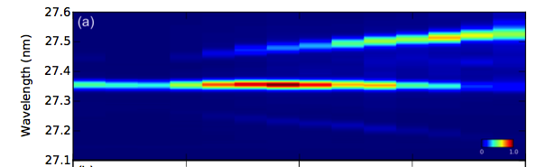
FEL spectrum tunability by changing the compression factor
C ~ 2
Compression factor
C >10
Submitted to Phys Rev. Lett.

Slide 12
Conclusion
We have demonstrated the possibility to seed the electron beam before compression, with a long wavelength modulation induced by the Laser Heater
The modulation is sustained and amplified by the MBI gain and can be propagated to the undulators
The seeded FEL spectrum can be controlled by this modulation, offering the possibility to generate multi-color FEL pulses, with spectral properties (as bandwidth and central wavelength stability) preserved.
This multi-color FEL is tunable by choosing the radiator resonance, the compression factor and by changing the beating frequency (acting on the laser heater pulses temporal separation).
Microbunching instability conversion:
From an issue to a possibility to control the FEL spectrum.

Slide 13
Thank You

