Slide 1

FERMI – The First X-UV externally seeded FEL facility
Luca Giannessi,
Elettra-Sincrotrone Trieste & ENEA.C.R. Frascati
Presented on behalf of the FERMI Machine Physics Team

Slide 2
High Gain Single pass FELs
N
S
N
S
N
S
N
S
e⁻ beam
S
N
S
N
S
N
S
N
Tunable in wavelength - mirrorless configuration: minimize interaction with matter ➔ VUV- X-Rays
Coherence (Transverse, single TEM 00 mode, FERMI also temporally coherent)
Narrow spectral bandwidth (10⁻³ – 10⁻⁴ relative bandwidth)
Ultra-short pulses (100 fs – 1 fs)
High Peak power (Multi GW to TW)
Ultra-fast coherent diffractive imaging and time-resolved scattering processes in chemical and biological systems, non-linear processes in ultra-intense X-ray radiation fields, matter in extreme states, phase transitions, population inversion & X-ray atomic lasers, low density systems, i.e. unperturbed atoms, molecules, and clusters.

Slide 3
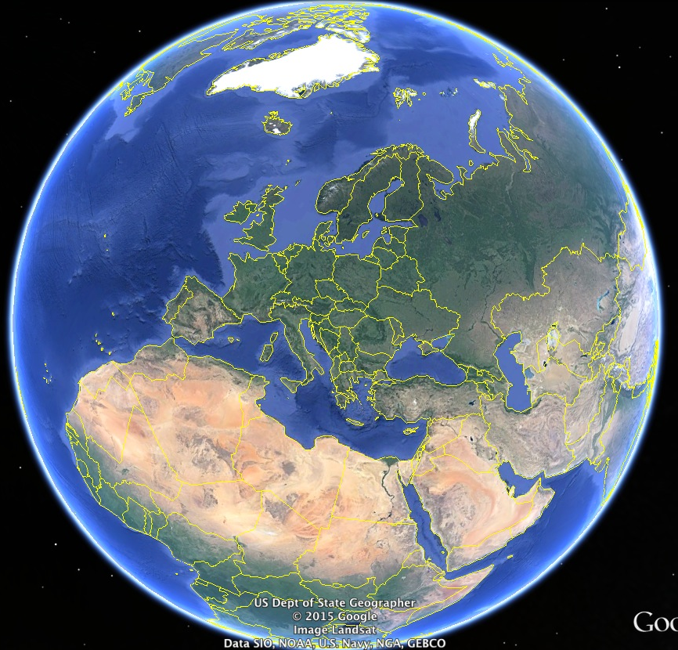

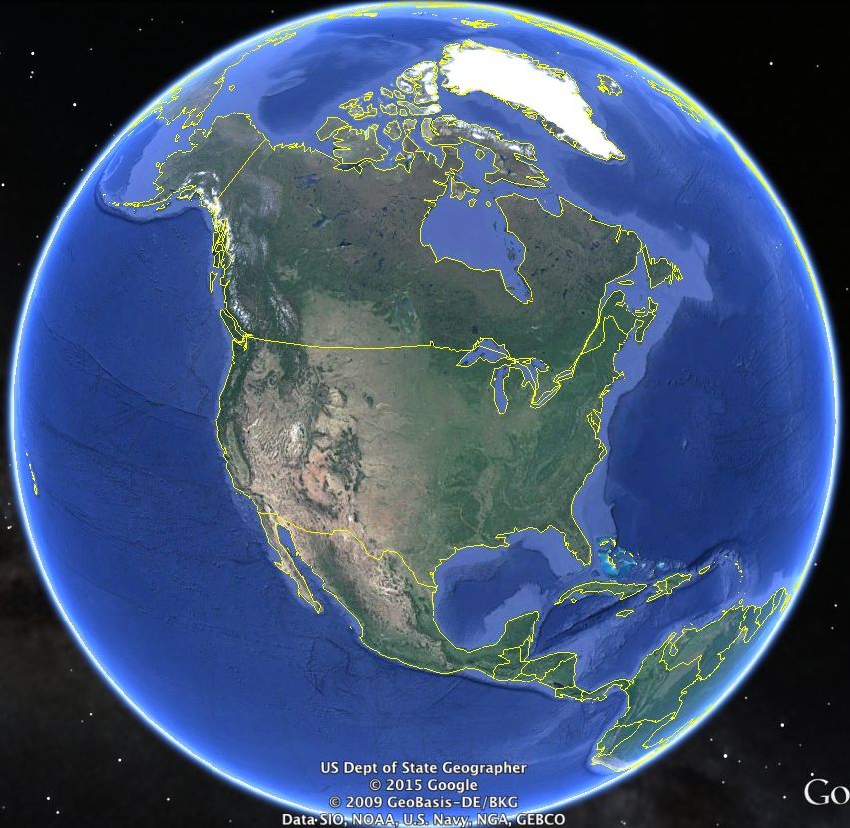

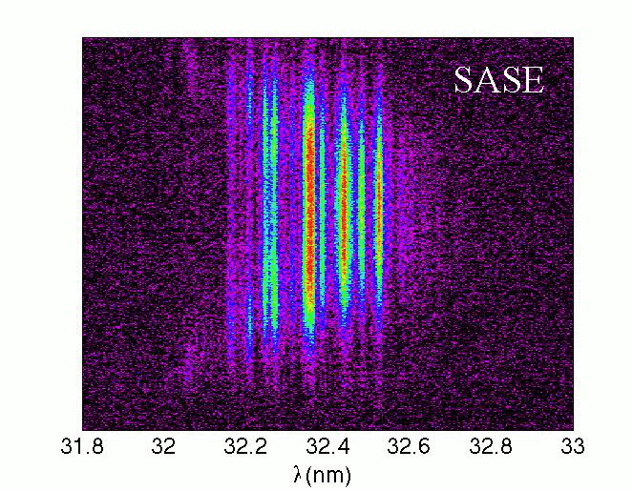
FEL user facilities in the world
Existing
FEL user
facilities
… in construction
2016-2017
FLASH
X-FEL
PSI
FERMI
DALIAN
SACLA
LCLS
SDUV FEL
PAL
LCLS II

Slide 4
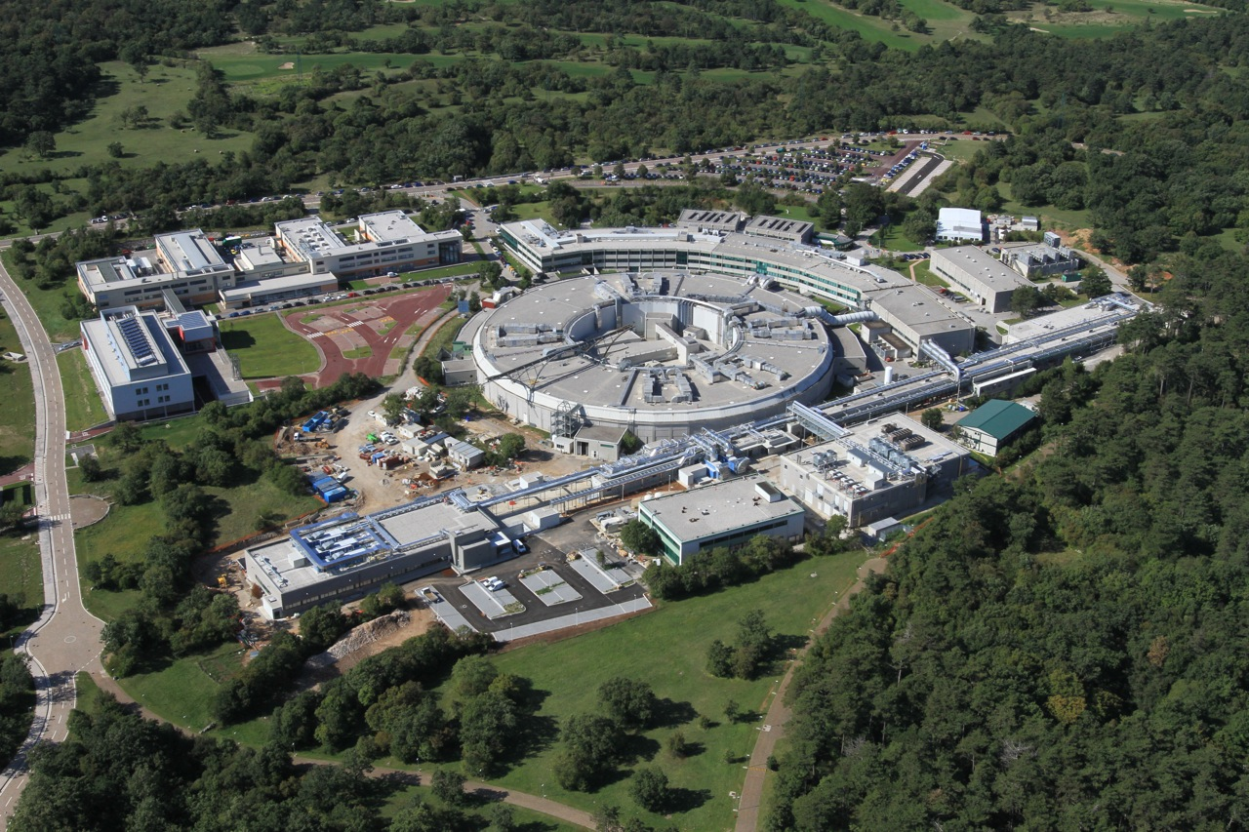
FERMI and Elettra
ELETTRA Synchrotron Light Source:
up to 2.4 GeV, top-up mode,
~800 proposals from 40 countries every year
FERMI FEL-1 & FEL-2 :
100 nm to 4 nm
High Gain Harmonic Generation FELs ≈190 proposals from first four calls for experiments in 2012-2016
∼ 200 m
Linac Tunnel +
Injector Extension
∼ 100 m
Undulator Hall
Sponsored by
Italian Minister of University and Research (MIUR)
Regione Auton. Friuli Venezia Giulia
European Investment Bank (EIB)
European Research Council (ERC)
European Commission (EC)
∼ 50 m
Experim. Hall

Slide 5
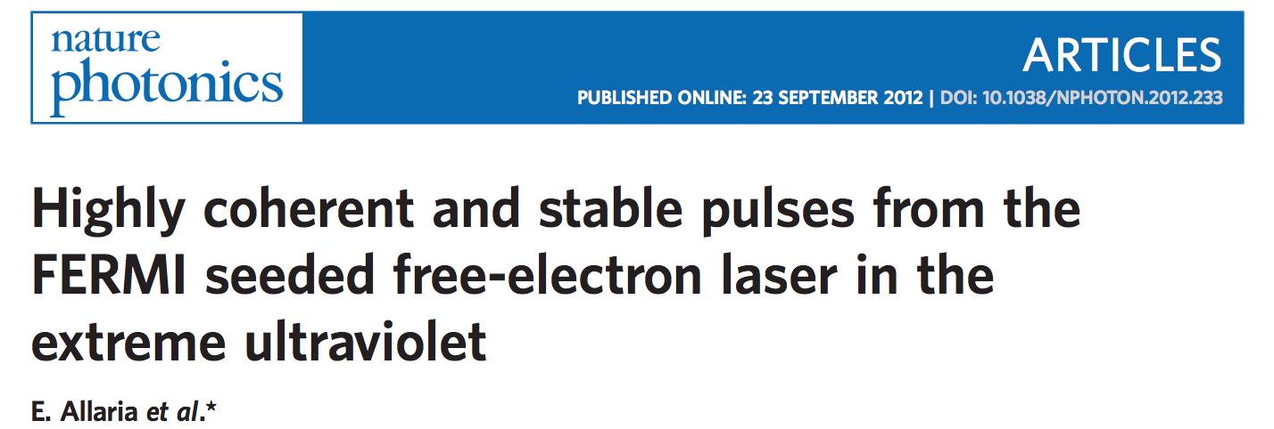
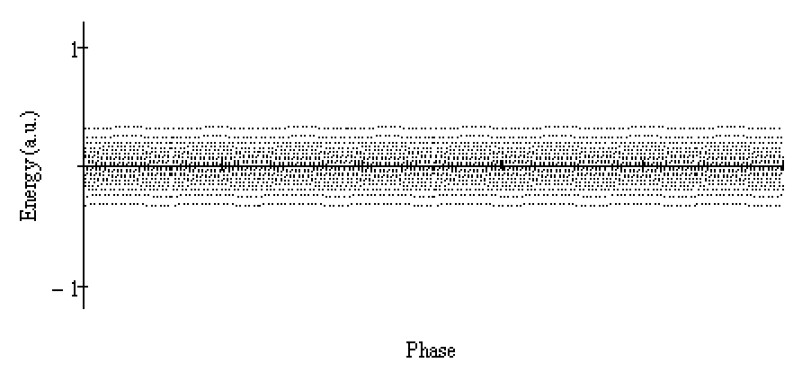
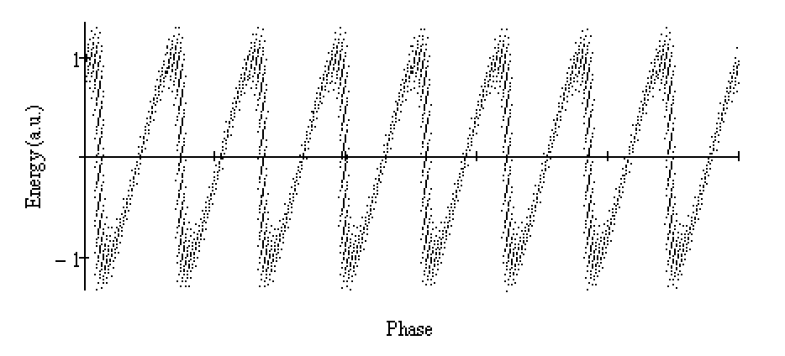
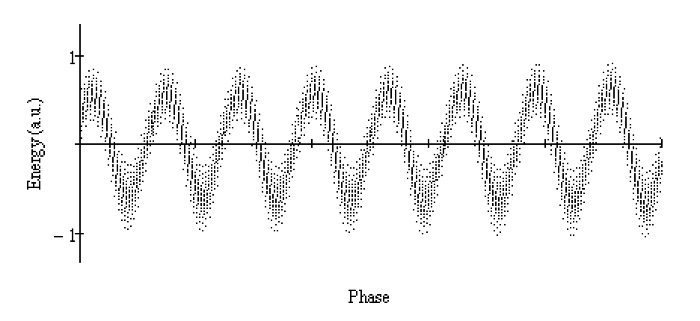
FEL-1:
High-Gain
Harmonic Generation
modulator
High gain radiator tuned at n^{th} harmonic
Seed
THG or
tuneable OPA
dispersion
Seed
n^{th} harmonic
radiation
e-beam
modulated e-beam
Modulated beam
Bunched beam
Fresh beam

Slide 6
FEL-1 & FEL-2 HGHG FEL
modulator
High gain radiator tuned at n^{th} harmonic
Seed
THG or
tuneable OPA
dispersion
FEL-1: Single stage HGHG configuration, nominal range 100-20 nm - Typical energy per pulse in the range 20-100 uJ. Seed: third harmonic of the Ti:Sa (up to 80-90 uJ, very limited (1%) tunability. Effective tunability: frequency upconverted OPA seed laser system. Most used OPA configuration (230-260 nm)
Other OPA processes (296-360nm). This requires a change of all the seed transport optics (>10 mirrors)
1st mod.
1st rad.
2nd mod.
DS1
DL
DS2
2nd rad.
FEL-2: Double stage HGHG configuration, nominal range 20-4 nm
Typical energy per pulse in the range 10 -100 uJ, depending on wavelength.
FEL performances tested in the range 14.4 – 4 nm – Upgrades: additional radiator in first stage/Higher e-beam energy – Improved seed laser system
Open for external users in 4th call. About 1/3 of the proposals are for FEL-2 and will receive beam-time in 2016.
4
14.4
20

Slide 7
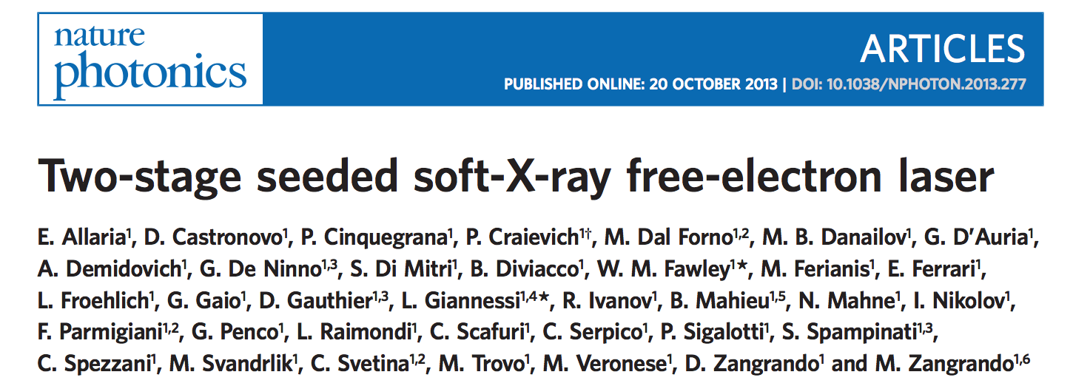
FEL-2:
The Fresh
Bunch Injection Technique*
Position:
1st mod.
1st rad.
2nd mod.
2nd rad.
DS1
DL
DS2
The seed @260nm
is on the tail of the e-beam
Seed
e-beam
n^{th} harmonic
(e.g. 32.5 nm)
The first stage converts the seed
to the n^{th} harmonic
(8th harmonic @32.5nm)
n^{th} x m^{th} harmonic
(e.g. 10.8 nm)
The delay line shifts the first stage output
to a fresh portion of the e-beam
The second stage converts the first stage
to the n^{th} x m^{th} harmonic of the seed
*L. H. Yu, I. Ben-Zvi, Nim 1993

Slide 8
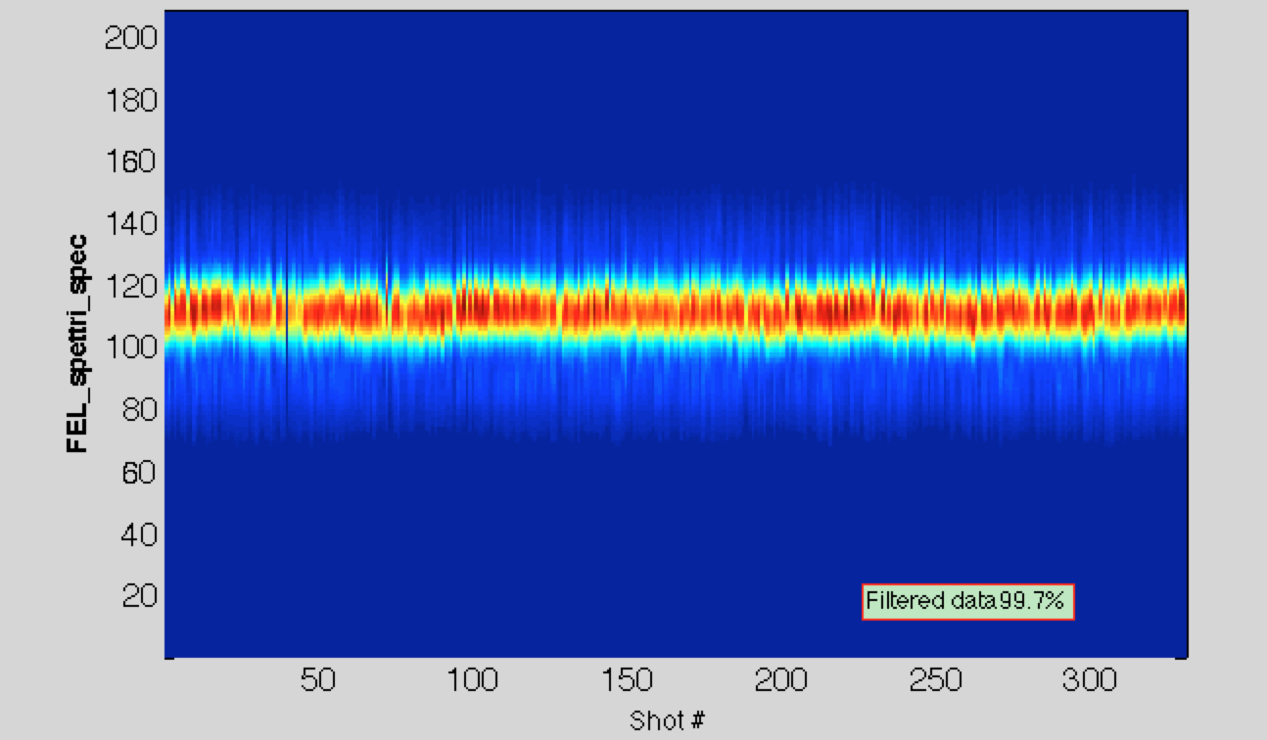
FEL-1 Spectral properties
The spectral properties can be preserved up to h11-h13 (h6 and h11 are shown in the pictures)
These sequences were acquired with the THG seed laser setup
With
With the OPA laser system similar spectral quality can be obtained, with limitations mainly depending on the optical properties of the mirrors transporting the seed to the undulator
Seeded by the OPA laser at 245nm, the h14 delivers more than 10 uJ with good spectral properties.

Slide 9
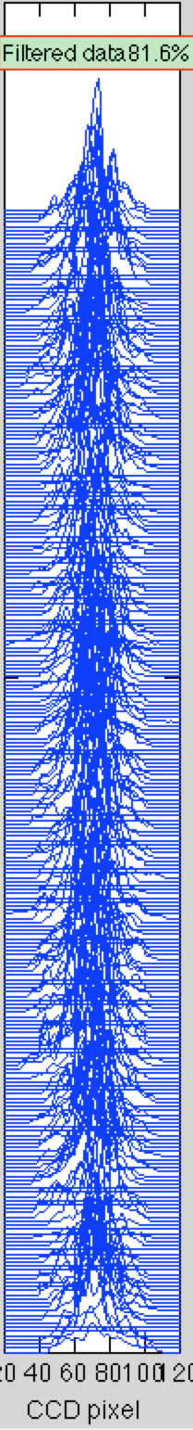
FEL-2
Spectral Properties
Single shot spectra measured down to 4 nm and show narrow linewidth with an energy per pulse at shorter wavelengths larger than 10 μJ.
5.4 nm
4.4 nm
Sequence of spectra @4nm. 20% of data discarded
With upgrades 2016:
1) Reduce the required input seed power between 6 and 4 nm to operate with OPA (tunable)
2) Higher e-beam energy -> higher gain – improved stability
Improve spectral quality & pulse energy at 4-4.5 nm
4.0 nm

Slide 10
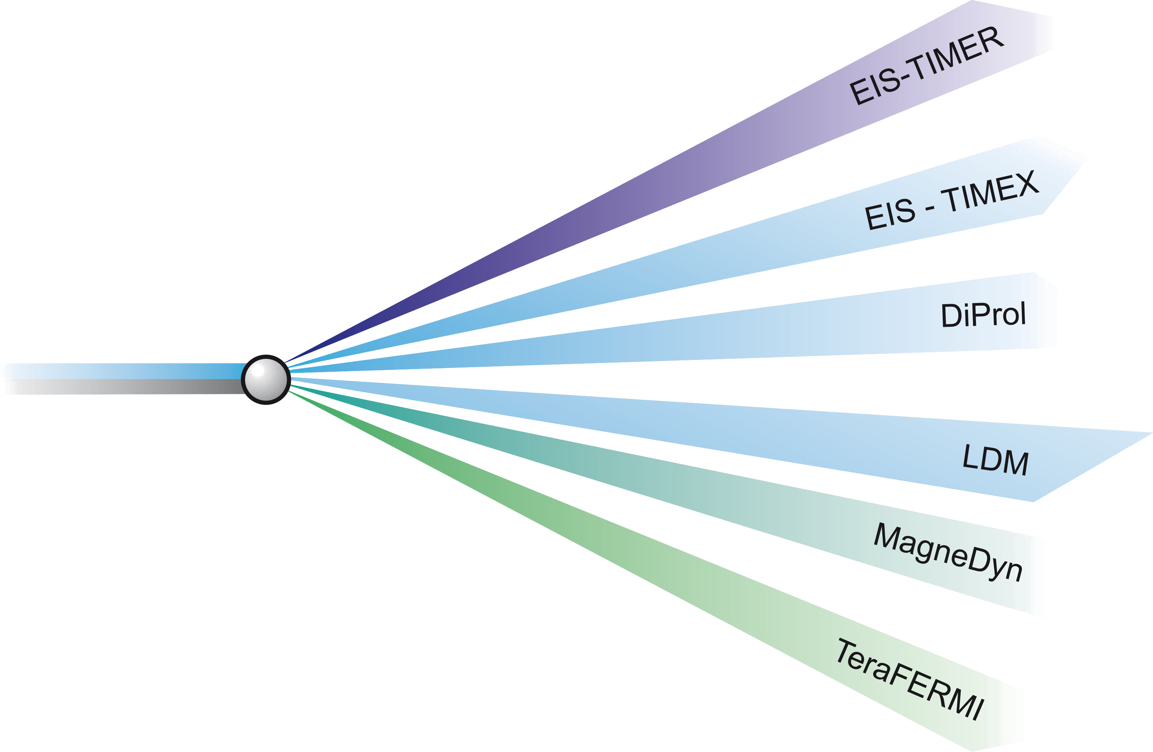
The six Beamlines
The EIS (coord. C. Masciovecchio) beamline consists of two separate end-stations (EIS-TIMEX E. Principi and EIS-TIMER F. Bencivenga), to exploit the time structure of the FEL source for performing time-resolved experiments through the pump-probe approach. Each end-station will exploit different key properties of the FERMI source EIS-TIMER end-station is a FEL-based Four-Wave-Mixing instrument that will exploit the time structure, harmonic content and coherence properties of the FERMI source.
DIPROI (coord. M.Kiskinova, beamline responsible Flavio
Capotondi) The shot-to-shot temporal and energy
stability of the seeded-FEL pulses at FERMI
has opened extraordinary opportunities for lensless Coherent
Diffraction Imaging (CDI) and in particular for Resonant Coherent
Diffraction Imaging (R-CDI), overcoming some of the limitations imposed
by the partial longitudinal coherence of the SASE-FELs. In addition, the multiple (linear and circular) polarization of Fermi-FEL pulses is an added value to explore specific contrast mechanisms, relevant to the spin and orbital sensitive electronic transitions.

Slide 11
The six Beamlines
LDM (coord. C. Callegari) endstation is designed to investigate atoms, molecules, and their aggregates (clusters) in an unperturbed environment (a supersonic jet in vacuum). It is based on a modular design which includes interchangeable sources for high- and low-temperature jets, helium nanodroplets, rare-gas and water clusters, metal clusters, and radical species. Simultaneous two-dimensional detection of electrons, ions, and photons allows a complete
characterization of thetarget species, under the intense
electromagnetic field produced by FERMI
Magnedyn (coord. F. Parmigiani) endstation is
designed to investigate ultra fast magnetization
dynamics. The studies of ultrafast magnetic dynamics in
nanoscopic magnetic bodies have become one of the most exciting
topics in contemporary magnetism. They break new ground scientifically
and explore length and times scales for tomorrows magnetic technologies. The natural time scales of the physical processes in such systems span an enormous range of about fifteen orders of magnitude, depending on the atomic, electronic, and spin structure and parameters such as temperature.

Slide 12
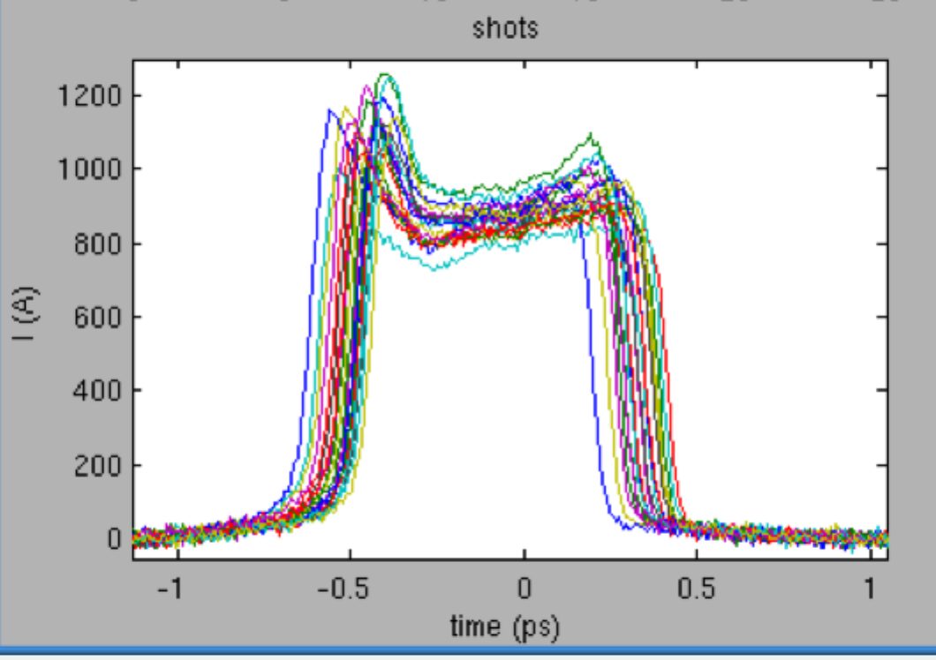
FEL-1 - Multiple pulse configurations
Multiple pulses can be generated by double pulse seeding in different ways, depending on the requirements on the output radiation. Temporal separation between 250-300 and 700-800 fs. Shorter separations are accessible via FEL pulse splitting*. Larger separations require the split & delay line.
Spectral separation 0.4-0.7%
Allaria et al., Nat. Comm., 2013
time
gain
bandwidth
spectrum
RAD2 gain
bandwidth
Spectral separation 2-3%
or much larger if the two radiators are tuned at different harmonics
Ferrari et al., Nat. Comm, 2015, submitted
spectrum
MOD gain
bandwidth
time
RAD1 gain
bandwidth
spectrum
Two (almost) temporally superimposed pulses at harmonic wavelengths of the seed. The two pulses are correlated in phase and the phase can be controlled with the phase shifter
(3.1 as rms resolution) Prince et al., Nat. Phot., submitted
MOD gain
bandwidth
time
spectrum
* See e.g. Mahieu et al. Optics Express 21, 22728 (2013)

Slide 13
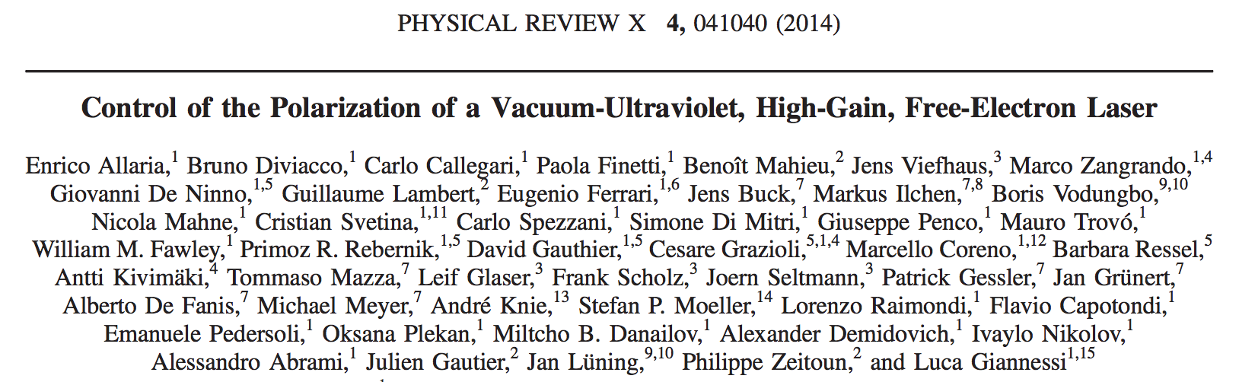

Highlights: Polarization
APPLE II undulators
allow the control
of the
light polarization
properties
Crossed polarized
undulators
allow polarization
switching

Slide 14
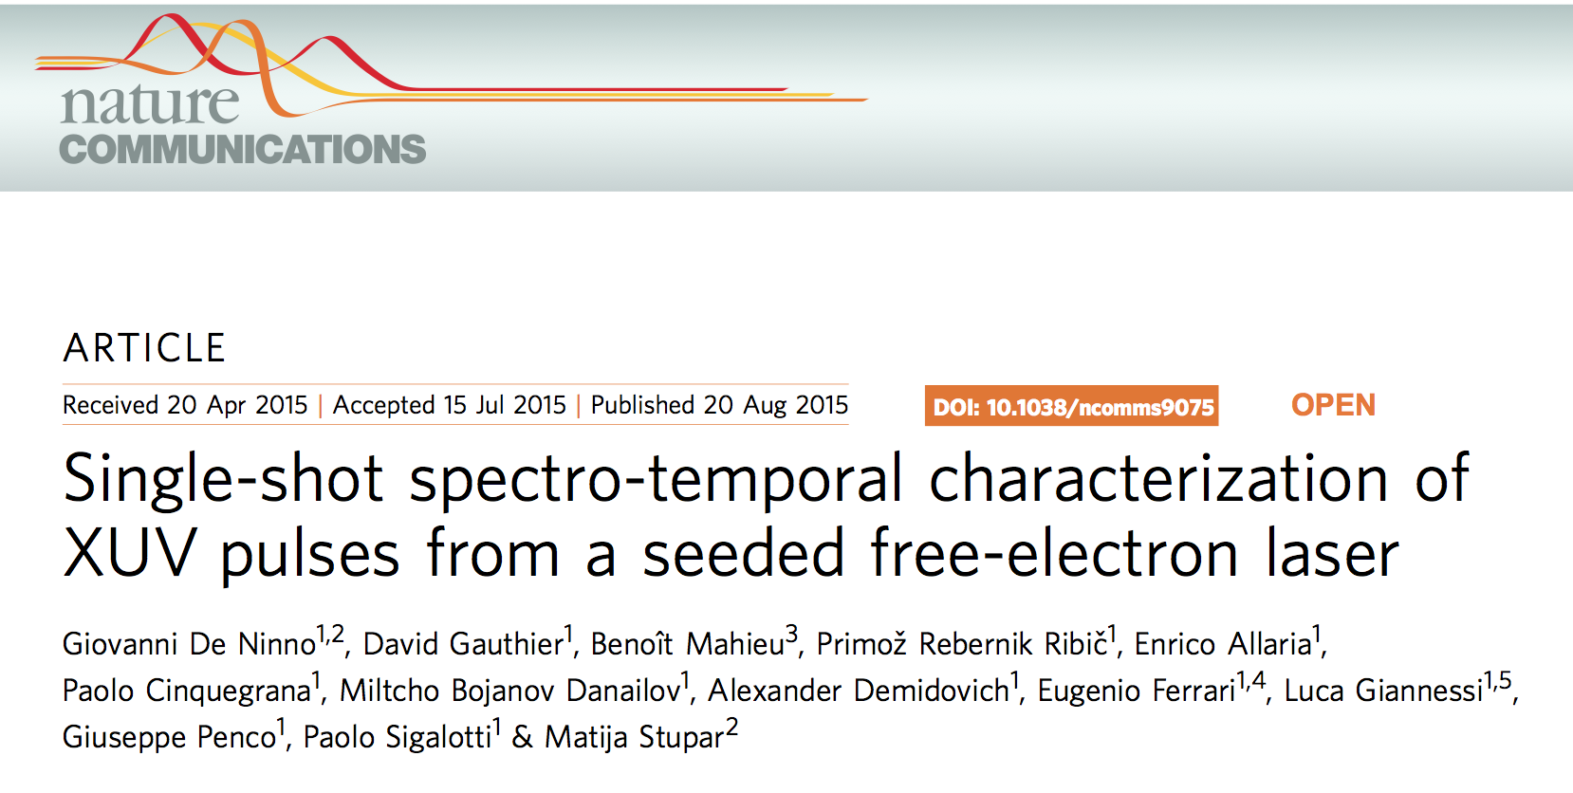
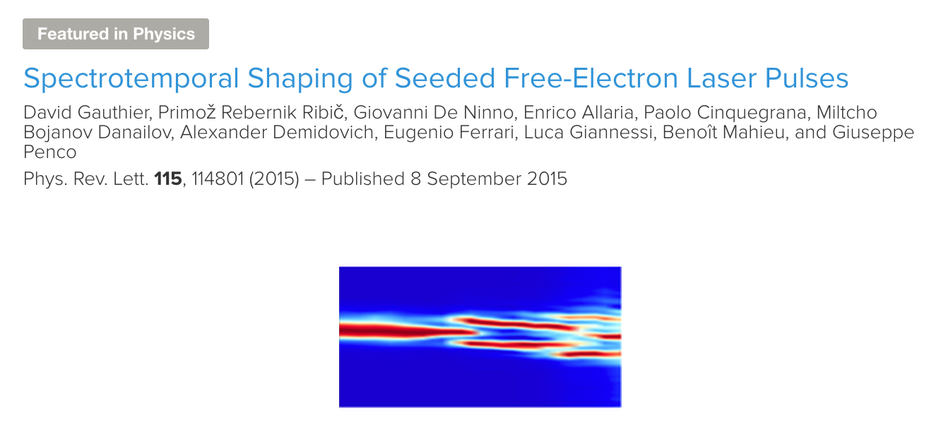
Highlights: Temporal Coherence
Complete
characterization
of the EM Fields in an
FEL pulse with the
SPIDER technique
Control of the
pulse properties,
Amplitude and phase
& generation of
Fourier Transform
Limited pulses

Slide 15
Summary
FERMI FEL-1 and now also FERMI FEL-2, are open to user experiments providing unprecedented performances in terms of longitudinal coherence, wavelength stability and spectral purity.
FEL-1 has benefited of the progresses done in the commissioning of FEL-2. The results are an higher energy per pulse, improved stability and extended spectral range (experiments on the Si edge with uJ energy per pulse).
With the improved control on the machine we are demonstrating the feasibility of new classes of experiments where coherence plays a major role, and that were so far accessible only to optical lasers.
More in general, seeded FELs are extremely flexible tools opening new perspectives in the use of short wavelength free electron lasers.
.

Slide 16
Bibliography
2012
E Allaria et al. Tunability experiments at the FERMI@Elettra free-electron laser. New Journal of Physics 11/2012; 14(14):113009.
E. Allaria et al. Highly coherent and stable pulses from the FERMI seeded free-electron laser in the extreme ultraviolet. Nature Photonics 09/2012; 6:699–704.
S. Di Mitri et al. Transverse emittance preservation during bunch compression in the Fermi free electron laser. Physical Review Special Topics - Accelerators and Beams 02/2012; 15(2):020701.
* S. Di Mitri, Design and Simulation Challenges of a Linac-based Free Electron Laser in the presence of Collective Effects, in Free Electron Lasers, edited by Sandor Varro, published by In Tech, 51000 Rijeka, Croatia, ISBN 978-953-51-0279-3 (March 2012).
* S. Di Mitri, M. Cornacchia, C. Scafuri and M. Sjostrom, Electron beam optics and trajectory control in the FERMI free electron laser delivery system, Phys. Rev. Special Topics -- Accel. and Beams, 15, 012802 (2012).
A.J. Corso, P. Zuppella, D. Windt, M. Zangrando, M.G. Pelizzo, Extreme ultraviolet multilayer for the FERMI@Elettra free electron laser beam transport system, Optics Express 20, 8006 (2012)
2013
E. Allaria et al. Two-stage seeded soft-X-ray free-electron laser. Nature Photonics 10/2013; 7(11):913-918.
B. Mahieu et al. Two-colour generation in a chirped seeded free-electron laser: a close look. Optics Express 09/2013; 21(19):022728.
G. De Ninno et al. Chirped seeded free-electron lasers: self-standing light sources for two-color pump-probe experiments.. Physical Review Letters 02/2013; 110(6):064801.
S. Di Mitri et al., Cancellation of coherent synchrotron radiation kicks with optics balance, Physical Review Letters 01/2013; 110(1):014801.
S. Di Mitri et al. Electron slicing for the generation of tunable femtosecond soft x-ray pulses from a free electron laser and slice diagnostics, Physical Review Special Topics - Accelerators and Beams 16/2013; 042801
P. Craievich et al. Modeling and experimental study to identify arrival-time jitter sources in the presence of a magnetic chicane, Physical Review Special Topics - Accelerators and Beams, 09/2013;
S. Di Mitri, Maximum brightness of linac-driven electron beams in the presence of collective effects, Physical Review Special Topics - Accelerators and Beams 05/2013; 16(050701).
S. Di Mitri et al., Electron slicing for the generation of tunable femtosecond soft x-ray pulses from a free electron laser and slice diagnostics, Physical Review Special Topics - Accelerators and Beams 04/2013; 16(4).
A. Perucchi, S. Di Mitri, G. Penco, E. Allaria, and S. Lupi, The TeraFERMI Terahertz spurce at the seeded FERMI Free-Electron-Laser facility, Rev. Sci. Instrum., 84, 022702 (2013).
G. Penco et al., " Optimization of a high brightness photoinjector for a seeded FEL facility", Journal of instrumentation 8, P05015 (2013)
E Allaria et al., Two-colour pump-probe experiments with a twin-pulse-seed extreme ultraviolet free-electron laser.. Nature Communications 09/2013; 4:2476.
F. Capotondi et al. Coherent imaging using seeded free-electron laser pulses with variable polarization: First results and research opportunities, Rev. Sci. Instrum. 84, 051301 (2013).
L. Raimondi et al. Microfocusing of the FERMI@Elettra FEL beam with a K-B active optics system: spot size predictions by application of the WISE code, Nucl. Instrum. and Meth A 710, 131-138 (2013).
D. Spiga, L. Raimondi, C. Svetina, M. Zangrando, X-ray beam-shaping via deformable mirrors: analytical computation of the required mirror profile, Nucl. Instrum. and Meth A 710, 125-130 (2013).
F. Bencivenga et al. Nanoscale dynamics by short-wavelength four wave mixing experiments, New J. of Physics 15, 123023 (2013).

Slide 17
Bibliography (cont.)
2014
E. Allaria et al., Control of the Polarization of a Vacuum-Ultraviolet, High-Gain, Free-Electron Laser. Physical Review X 12/2014; 4(041040).
E Ferrari et al. Impact of Non-Gaussian Electron Energy Heating upon the Performance of a Seeded Free-Electron Laser.. Physical Review Letters 03/2014; 112(11):114802.
G. Penco et al. Experimental Demonstration of Electron Longitudinal-Phase-Space Linearization by Shaping the Photoinjector Laser Pulse. Physical Review Letters 01/2014; 112(4):044801.
M. Danailov et al. Towards jitter-free pump-probe measurements at seeded free electron laser facilities, Optics Express, Vol. 22, Issue 11, pp. 12869-12879 (2014)
S. Di Mitri, M. Cornacchia, Electron beam brightness in linac drivers for free-electron-lasers, Physics Reports 06/2014;
S. Di Mitri, S Spampinati, Microbunching Instability Suppression via Electron-Magnetic-Phase Mixing, Physical Review Letters 04/2014; 112(13):134802.
E. Allaria et al., Energy slicing analysis for time-resolved measurement of electron-beam properties, Physical Review Special Topics - Accelerators and Beams 01/2014; 17:010704.
S. Spampinati et all. Laser heater commissioning at an externally seeded free-electron laser. Physical Review Special Topics - Accelerators and Beams 12/2014; 17:129795.
S. Di Mitri, Intrabeam scattering in high brightness electron linacs, Physical Review Special Topics - Accelerators and Beams 01/2014; 17(074401).
S. Di Mitri, Noninvasive emittance and energy spread monitor using optical synchrotron radiation, Physical Review Special Topics - Accelerators and Beams 01/2014; 17(122803).
P. Cinquegrana et al. Optical beam transport to a remote location for low jitter pump-probe experiments with a free electron laser, Physical Review Special Topics - Accelerators and Beams 04/2014; 17(4):040702.
S. Di Mitri. M. Cornacchia, Merit functions for the linac optics design for colliders and light sources, Nucl. Instr. and Methods in Phys. Res. A 735 (2014) 60--65.
S. Di Mitri and S. Spampinati, Estimate of free electron laser gain length in the presence of electron beam collective effects, Phys. Rev. Special Topics -- Accel. and Beams, 17, 110702 (2014).
T. Mazza et al., Determining the polarization state of an extreme ultraviolet free-electron laser beam using atomic circular dichroism, Nat Commun. 04/2014; 5.
A. V. Martin et al., X-ray holography with a customizable reference, Nature Communications 5, 4661 (2014).
C. Von Korff Schmising et al., Imaging Ultrafast Demagnetization Dynamics after a Spatially Localized Optical Excitation, Physical Review Letters 112, 217203 (2014).
C. Spezzani et al., Magnetization and microstructure dynamics in Fe/MnAs/GaAs(001): Fe magnetization reversal by a femtosecond laser pulse, Physical Review Letters, 113, 247202 (2014).
C. H. Yoon et al. Conformation sequence recovery of a non-periodic object from a diffraction-before-destruction experiment, Optics Express 22, 8085-8093 (2014).
2015
G. Penco et al. Experimental Demonstration of Enhanced Self-Amplified Spontaneous Emission by an Optical Klystron. Physical Review Letters 01/2015; 114:013901.
P. Craievich et al., Implementation of Radio-Frequency Deflecting Devices for Comprehensive High-Energy Electron Beam Diagnosis, IEEE Transactions on Nuclear Science, 62, 1 (2015)
E. Allaria et al., The FERMI Free Electron Lasers, J. of Synch. Rad. 22, 485 (2015)
….

Slide 18
Notes:
Last Slide 1: Thanks to the audience

Slide 19
Notes:
Last Slide 2: Aerial Photo of Elettra

