Slide 1
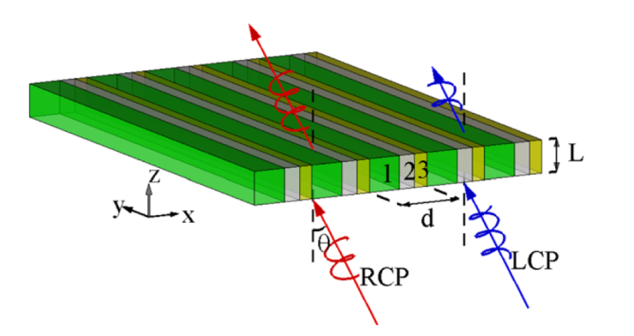
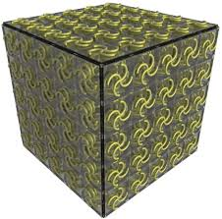
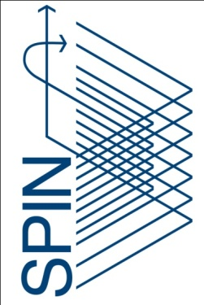
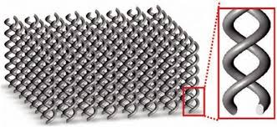
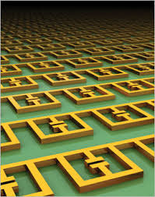
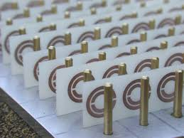
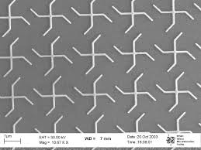
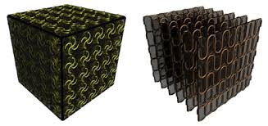
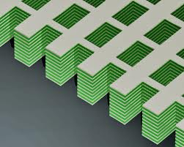
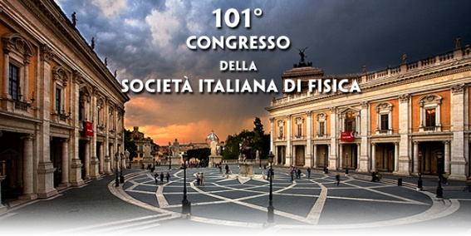
Electromagnetic spatial dispersion in periodic metamaterials
Carlo Rizza^{1,2}, Alessandro Ciattoni²
¹Department of Science and High Technology, University of Insubria, Via Valleggio 11, 22100 Como, Italy
²CNR-SPIN, via Vetoio 10, 67100 L’Aquila, Italy
Email:carlo.rizza@aquila.infn.it
Website: https://site.google.com/site/rizzacarlo81

Slide 2
Outline
Brief introduction on Periodic Metamaterials
Spatial dispersion:
artificial chirality/bi-anisotropy
&
Artificial magnetism
Homogenization theory: multi-scale approach
1D chiral metamaterials

Slide 3
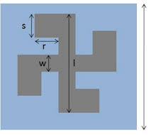
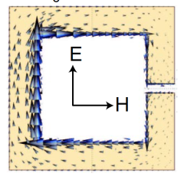
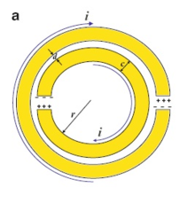
Metamaterials
Metamaterials are an arrangement of artificial structural elements, designed to achieve advantageous and/or unusual (electromagnetic) properties
d

Slide 4
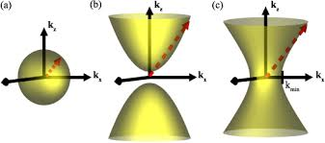
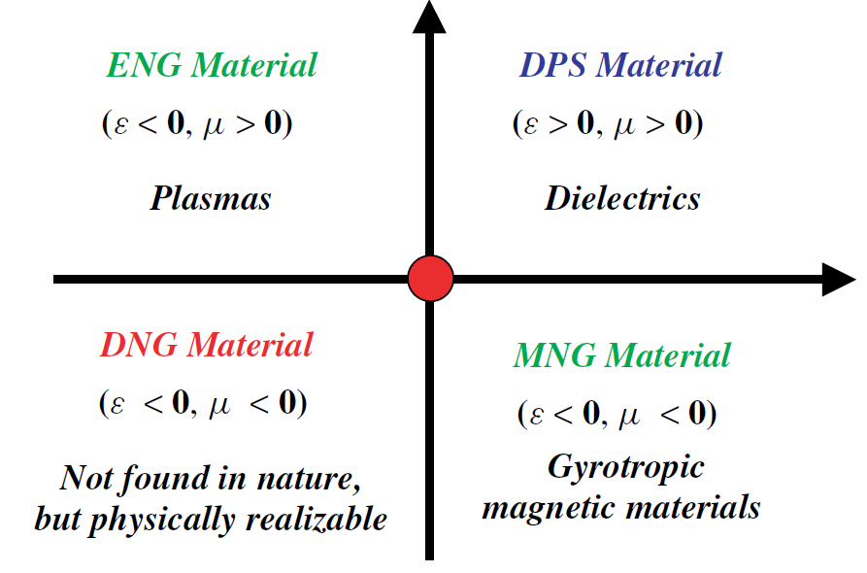
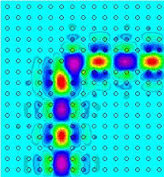
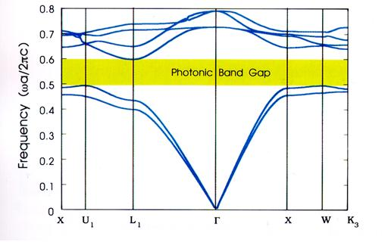
Periodic Metamaterials
Band Gap materials
(photonic crystals)
Effectively continuous
metamaterials
Hyperbolic media
Bragg scattering
Artificial Bianisotropy
Artificial magnetism
Structure organitation of conventional media
Spatial dispersion- optical nonlocality

Slide 5
Spatial dispersion
Spatial dispersion- optical nonlocality
Second-order spatial dispersion
Photonic crystals
Weak Dispersive
media
Effectively continuous media
Maxwell’s equations are invariant with respect to transformation:
First-order spatial dispersion
Bi-anisotropic response
Chiral tensor

Slide 6
Homogenization theory
A suitable homogenization theory is the key ingredient to develop metamaterials allowing to mold the flow of electromagnetic waves in unprecedented ways.
Fast
Slow
“Microscopic” equations
“Macroscopic” equations
New!!!
A. Ciattoni, C. Rizza, PHYSICAL REVIEW B 91, 184207 (2015)

Slide 7
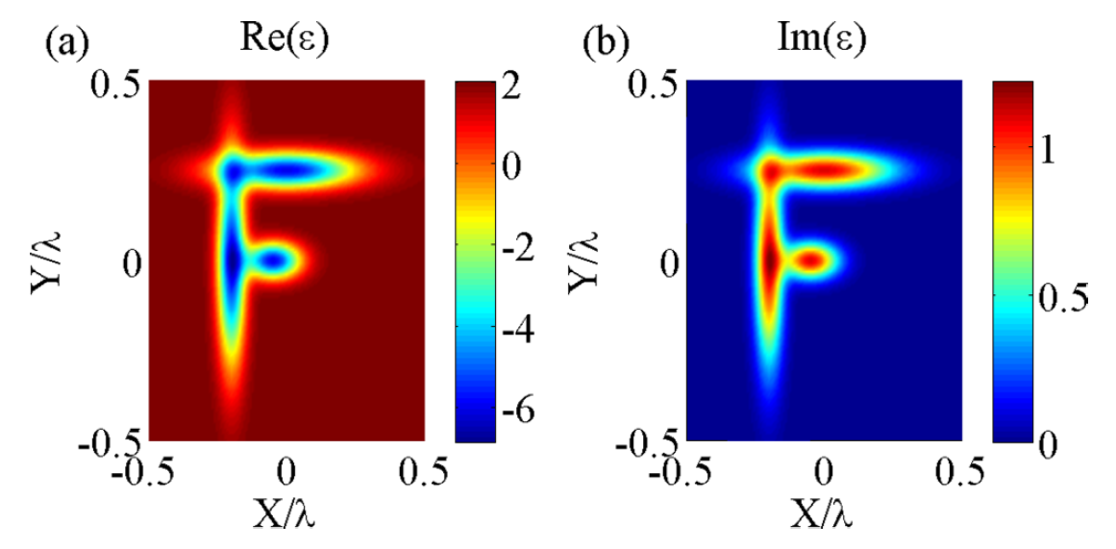
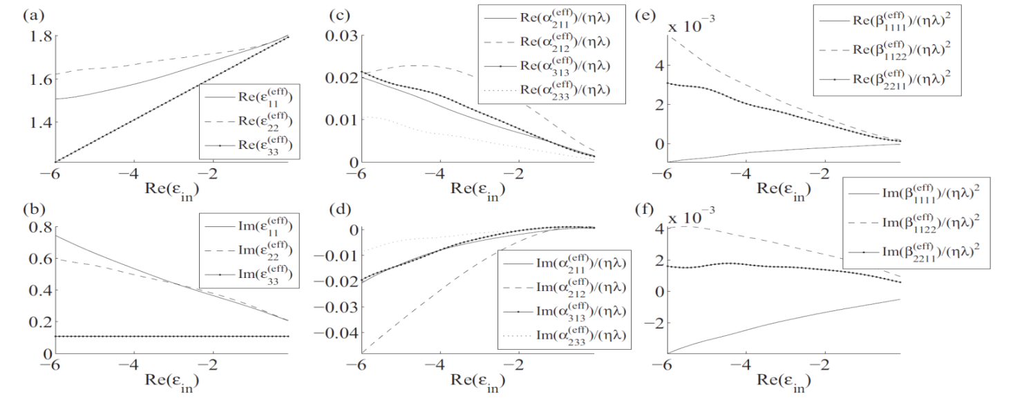
2D chiral metamaterials
A. Ciattoni, C. Rizza, PHYSICAL REVIEW B 91, 184207 (2015)

Slide 8
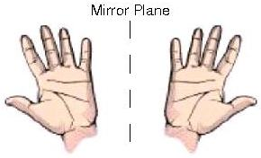
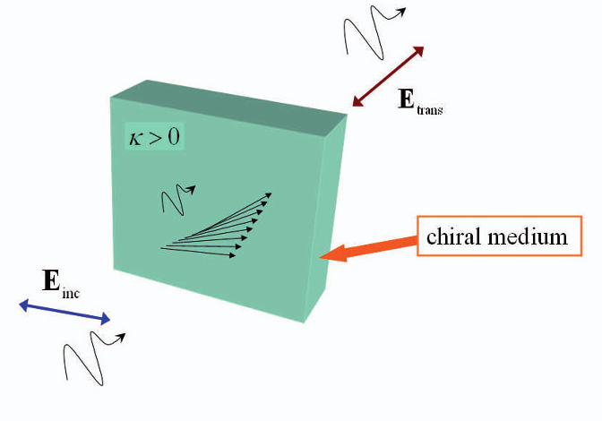
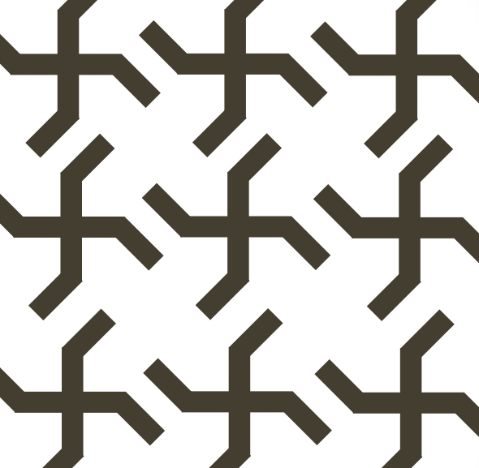
3D-2D chiral metamaterials
3D chirality: A left and right hand are mirror images of one another. Unlike a ball and its mirror image, a hand and its mirror image are not identical.
Optical activity/
electromagnetic chirality
Planar object is said to be 2D chiral if it cannot be brought into congruence with its mirror image unless it is lifted from the plane.2D chirality produces bi-anisotropic effects
A. Papakostas et al., “Optical Manifestations of Planar Chirality” PRL 90, 107404 (2003)

Slide 9
1D chiral metamaterials
translation
translation
The reflected and shifted structure corresponds to the original structure
The structure does not correspond to the original one whichever translation is applied !!!

Slide 10
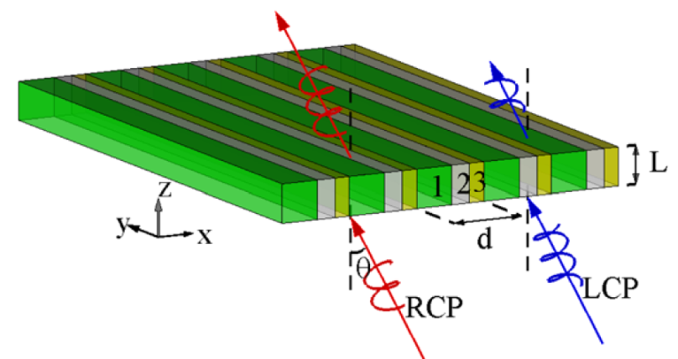
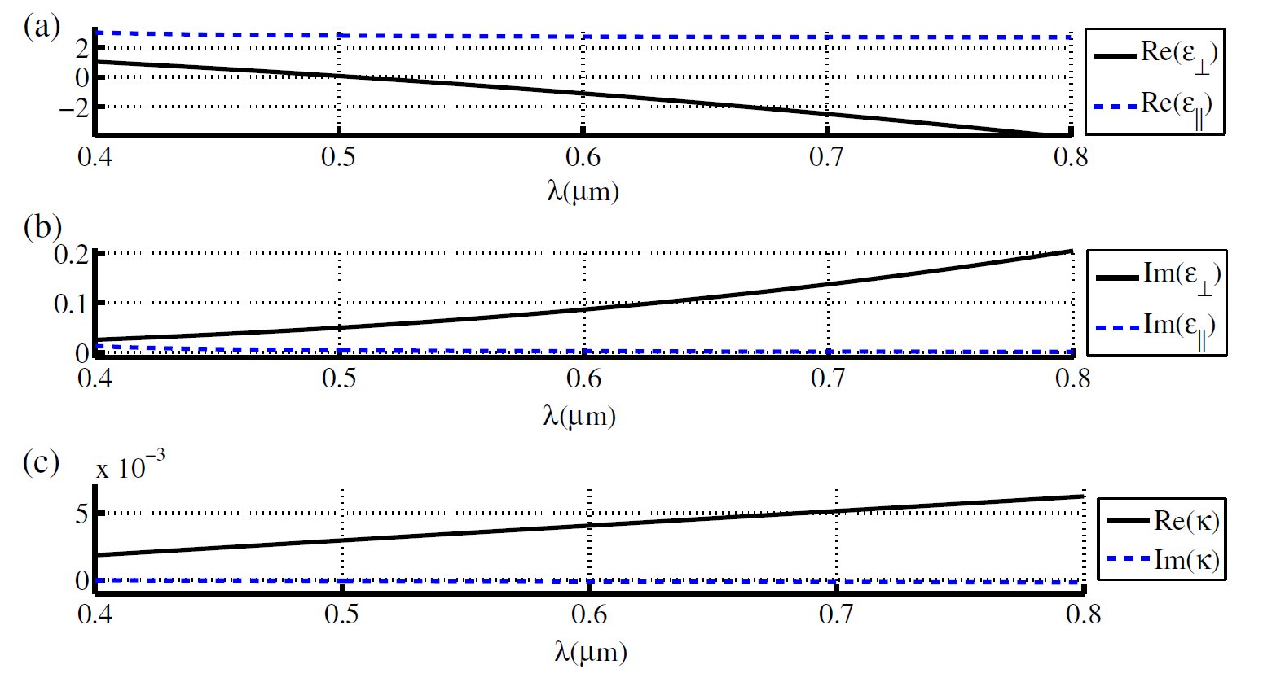
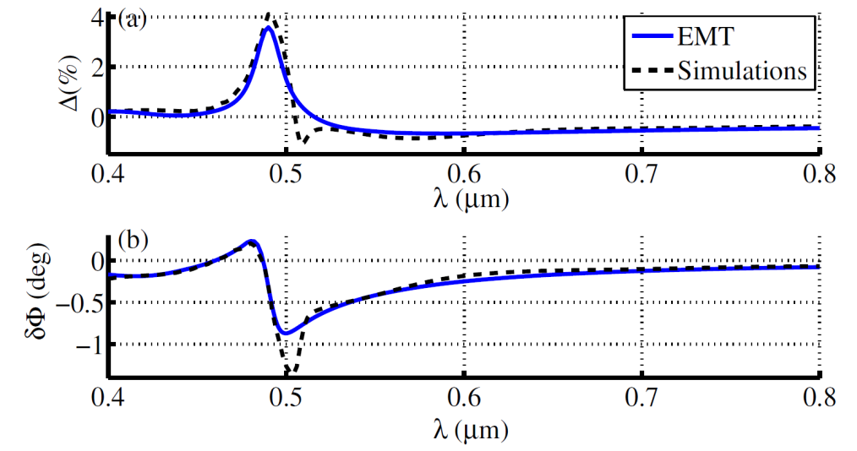
1D chiral Metamaterials
Omega-type response
Epsilon-near-zero
Enhancement !!!
C. Rizza et al. PRL 115, 057401 (2015)

Slide 11
Conclusions
Nonlocal homogenization theory in metamaterials
1D chirality & 1D chiral metamaterials
THz reconfigurable all-optical metamaterials (in collaboration with THz group, University of Bari)
Metasurfaces, high dielectric contrast,effects of second-order dispersion

Slide 12
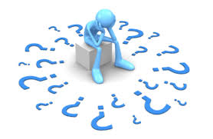
Thanks for your attention
Questions?

