Slide 1



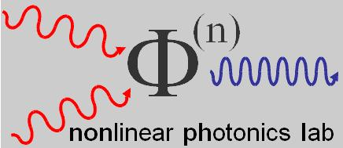
Artificial circular dichroism of self-assembled metallic nanostructures revealed by optical second-harmonic generation.
Alessandro Belardini, Marco Centini, Grigore Leahu, Eugenio Fazio, Concita Sibilia
Dipartimento di Scienze di Base e Applicate per l’Ingegneria
Sapienza Università di Roma
Roma, Italy
Joseph W. Haus, Andrew Sarangan
Department of Electrical and Computer Engineering
University of Dayton
Dayton,Ohio,USA
Concita.sibilia@uniroma1.it
Alessandro.belardini@uniroma1.it
http://www.sbai.uniroma1.it/laboratori/nonlinear_photonics_lab/

Slide 2
Summary
Optical nonlinearity (SHG) as a detector of symmetry breaking (chirality)
Chirality in plasmonic meta-surfaces
Symmetry breaking in self assembled metallic structures
Nonlinear response of tilted gold nanowires

Slide 3
Summary
Optical nonlinearity (SHG) as a detector of symmetry breaking (chirality)
Chirality in plasmonic meta-surfaces
Symmetry breaking in self assembled metallic structures
Nonlinear response of tilted gold nanowires

Slide 4
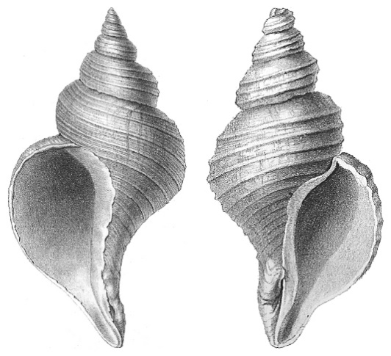
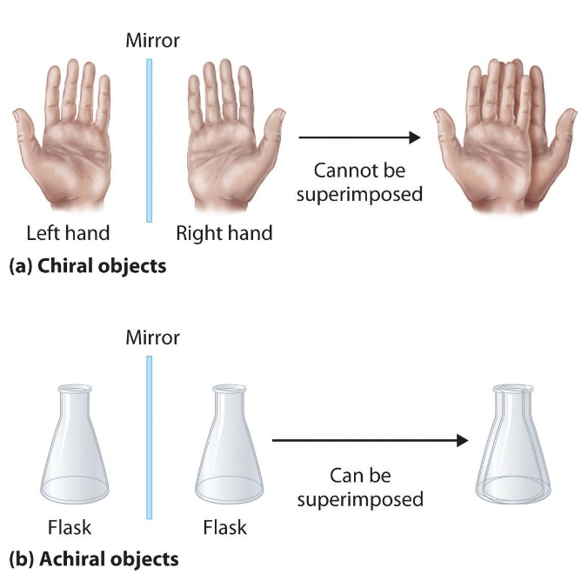
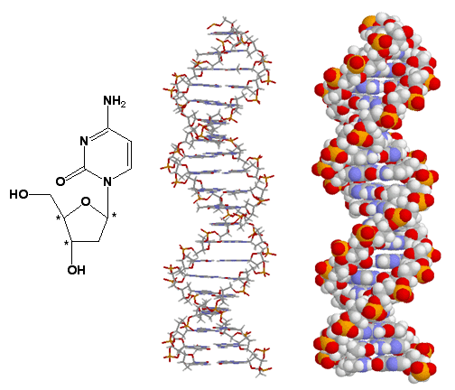
Chirality - generalities
Chirality (or handedness) is the lack of mirror symmetry
so
an object is chiral if it cannot be superimposed on its mirror images
In nature a huge number of objects are chiral, from shells to biomolecules such as DNA, sugar , proteins

Slide 5
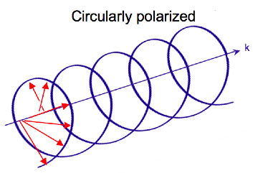
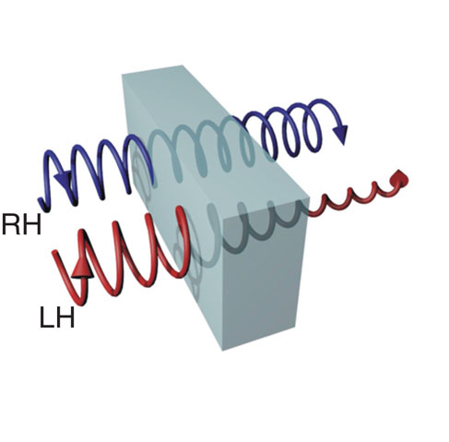
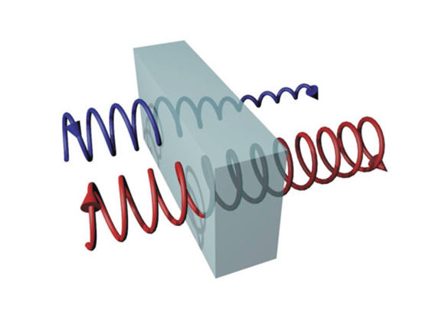
Also light presents chirality…
Circular dichroism: a particular interaction between chiral light with chiral molecules
Linear polarisation apart, there is also the circular polarisation state of the light:
The circular polarisation is chiral: can be left handed or right handed
Circular polarised light (chiral light) can be used in the investigation of chiral materials:
An example is the circular dichroism, where chiral materials absorb in different amount the right handed and left handed circular polarised light
LH
RH
Chiral material
Chiral material

Slide 6
SHG as sensor for symmetry breaking
χ⁽²⁾ terms (responsible for SHG) are identically zero in centro-symmetric media
So SHG is a clear sign for symmetry breaking in a structure under investigation
Metals usually present inversion symmetry → SHG from electric dipole term is zero
But still are present surface electric quadrupolar term (and magnetic dipolar term)
Adler PR (1964)
Jhe PR (1965)
Lee PR (1968)
Rudnick & Stern PRB (1971)
Sipe & Stegeman PRB (1980)
Kauranen PRL (2007)
In these cases SHG is very sensitive to the symmetry breaking in the geometrical arrangement of metallic nanoparticles
6

Slide 7
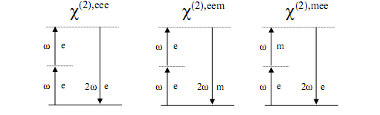
Second harmonic generation (SHG) as chiral detector:
SHG is sensitive to symmetry breaking
Nonlinear susceptibility expansion
Electric dipole source
Magnetic dipole source
,mee
, eme
Nonlinear magnetization

Slide 8

The optical response: just a matter of symmetry
Second harmonic generation is very sensitive to symmetry breaking
Verbiest, Taylor & Francis (2009)
V. K. Valev , J.J. Baumberg , C. Sibilia , and T. Verbiest, Adv. Mat. 18, 2517 (2013).
SHG-CD can be measured in transmission or in reflection

Slide 9
Summary
Optical nonlinearity (SHG) as a detector of symmetry breaking (chirality)
Chirality in plasmonic meta-surfaces
Symmetry breaking in self assembled metallic structures
Nonlinear response of tilted gold nanowires

Slide 10

3D and 2D Chirality
chirality is very important in nature and scientists try to replicate it artificially at the nanoscale
The most evident symmtetry breaking is the lack of myrror symmetry - chirality -
In the last years a lot of effort was devoted to the study on chiral plasmonic metamaterials
Both 3D- and 2D-chiral metamaterials were studied
3D chiral metamaterial
2D chiral metamaterial
Gansel et al., Science 325, 1513-1515 (2009)
Valev, V. K., et al., Adv. Mater., 26: 4074–4081 (2014)
10

Slide 11
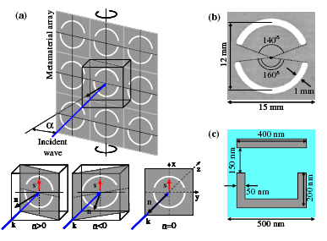
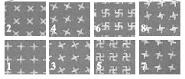
Pseudo Chirality (or Extrinsic Chirality)
E. Plum, PRL 102,113902 (2009)
Pseudo chirality:
A non-chiral element breaks the symmetry when is tilted with respect the incidence light.
The element thus assumes a chiral behavior
no-chirality
L
R
S.N. Volkov, PRA 79, 043819 (2009)
Pagina 11

Slide 12
Summary
Optical nonlinearity (SHG) as a detector of symmetry breaking (chirality)
Chirality in plasmonic meta-surfaces
Symmetry breaking in self assembled metallic structures
Nonlinear response of tilted gold nanowires

Slide 13
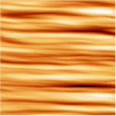
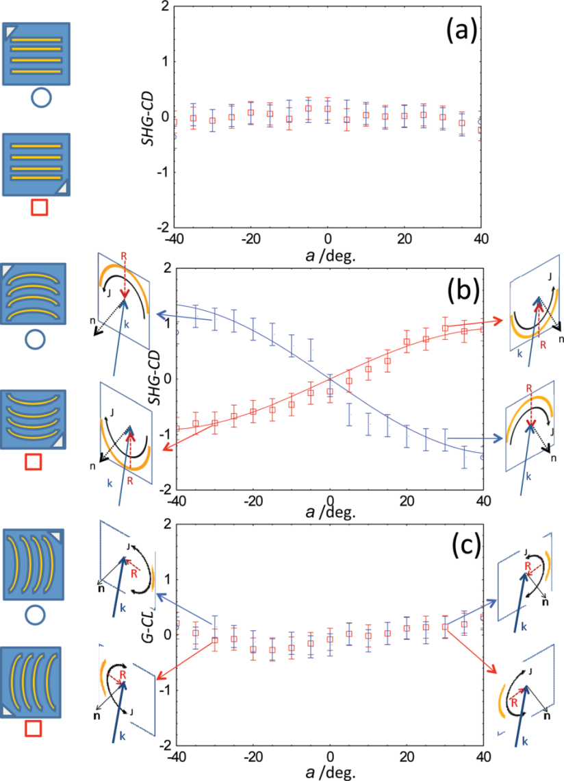
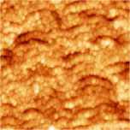
Self assembled straight and curved nanowires
A. Belardini et al., Phys. Rev. Lett. 107, 257401 (2011).
In collaboration with:
F. Buatier de Mongeot, D. Comoretto
University of Genova, Italy

Slide 14
Summary
Optical nonlinearity (SHG) as a detector of symmetry breaking (chirality)
Chirality in plasmonic meta-surfaces
Symmetry breaking in self assembled metallic structures
Nonlinear response of tilted gold nanowires

Slide 15
What appens with self assembled tilted nanowires?
In collaboration with
Joseph W. Haus, Andrew Sarangan
Univ. Oahio, USA
100 K
300 K
Si
Si

Slide 16
Morphological characterisation - 1
100 K sample
NWs homogeneously distributed on 2 cm x 2 cm surface

Slide 17
Morphological characterisation - 2
100 K sample
60° tilted image
NWs cluster dimension 100nm
NWs single fiber section 20nm
60° tilted image
NWs lenght 400nm

Slide 18
Morphological characterisation - 3
300 K sample
NWs homogeneously distributed on 2cm x 2cm surface
NWs length about 380nm
Section about 40nm

Slide 22
100k

Slide 23
Conclusions
We show how SHG measurements can be sensitive on symmetries of metallic nanopatterned surfaces
we show these effects on self –assembled structures produced by low cost and large area procedure
SHG signal through the nonlinear circular dichroism is sensitive also to extrinsic chirality signature
(good candidates as substrate for nonlinear molecular spectroscopy ?)
Acknowledgements
This work was partially supported by the MARINE project of the Italian Ministry of the Defence

Slide 24


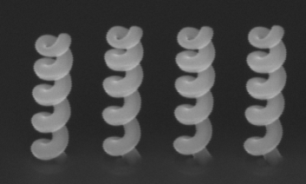

Chirality: from tradition to innovation
Thank you for your attention !

Slide 27
Reflectance spectra - 1

