Slide 1

Coupled nano-antennas as coherent and highly directional
infrared thermal emitters.
M. Centini, A. Benedetti, M.C. Larciprete, A. Belardini, R. Li Voti, M. Bertolotti
Dipartimento di Scienze di Base ed Applicate per l’Ingegneria. Sapienza Università di Roma, Via A. Scarpa 16, 00161 Roma, Italy.
* marco.centini@uniroma1.it
101° Congresso Nazionale della Società Italiana di Fisica
Roma, 21-25 settembre 2015

Slide 2
Summary
Introduction to thermal emission properties of nanoantennas and nanostructured devices;
Numerical Model;
Results;
Conclusions

Slide 3
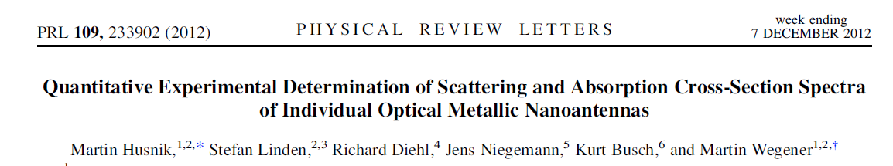
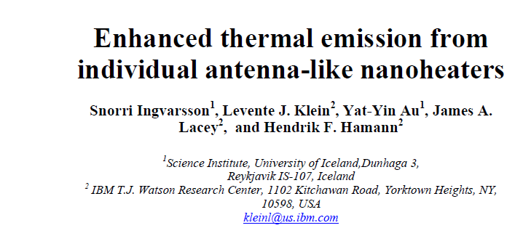
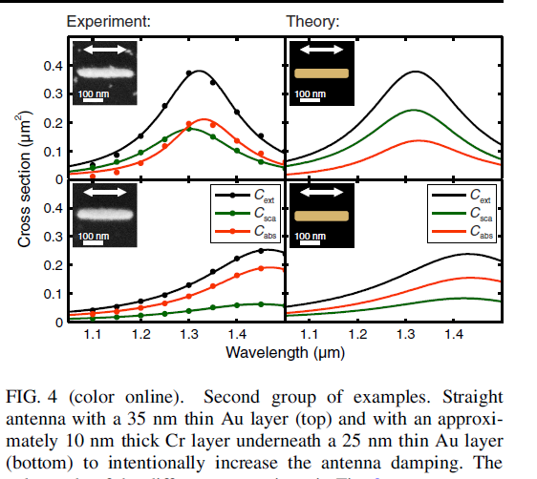
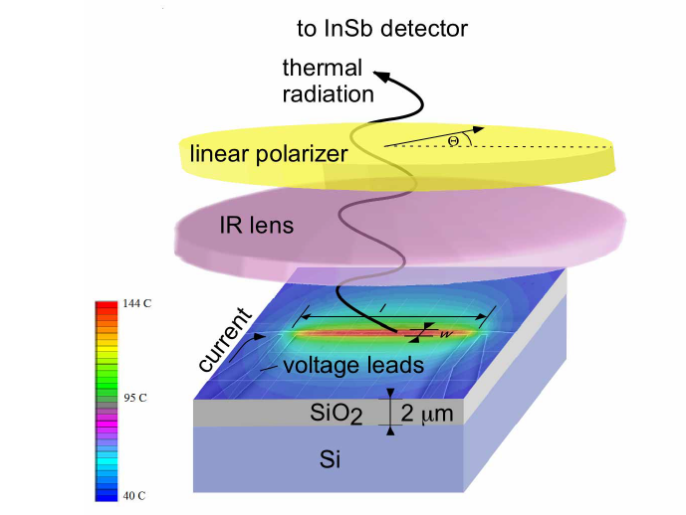
Introduction

Slide 4
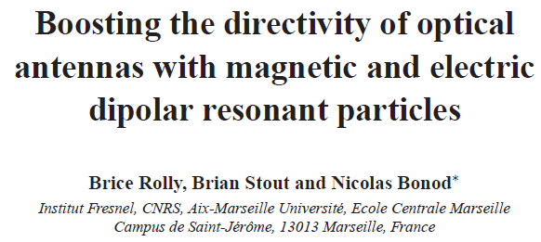
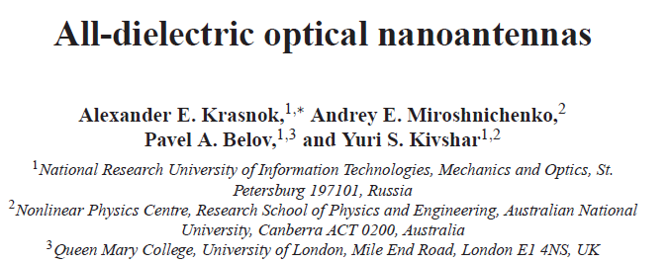
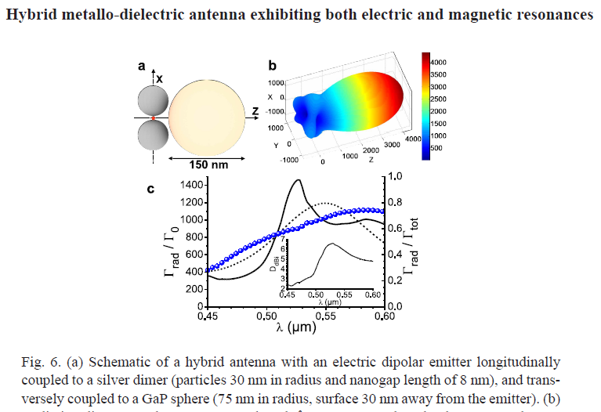
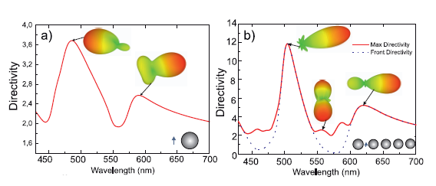
Introduction

Slide 5
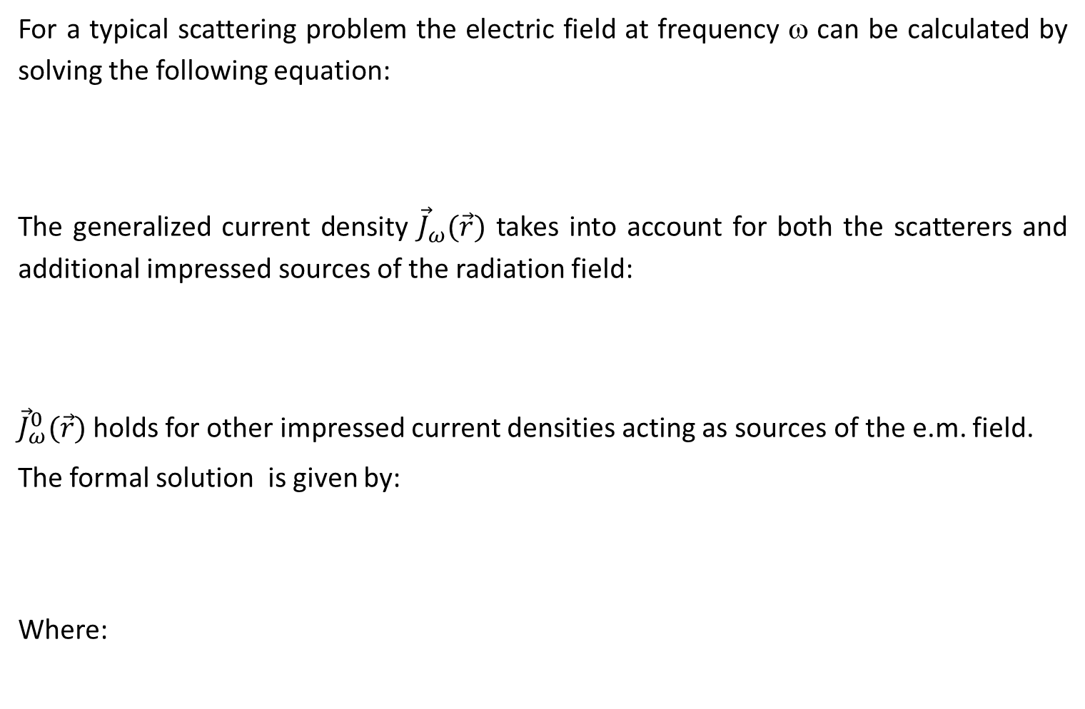
Numerical Model
For a typical scattering problem the electric field at frequency ω can be calculated by solving the following equation:
The generalized current density ${\vec{J}}_{ω}(\vec{r})$ takes into account for both the scatterers and additional impressed sources of the radiation field:
${\vec{J}}_{ω}^{0}(\vec{r})$ holds for other impressed current densities acting as sources of the e.m. field.
The formal solution is given by:
Where:

Slide 6
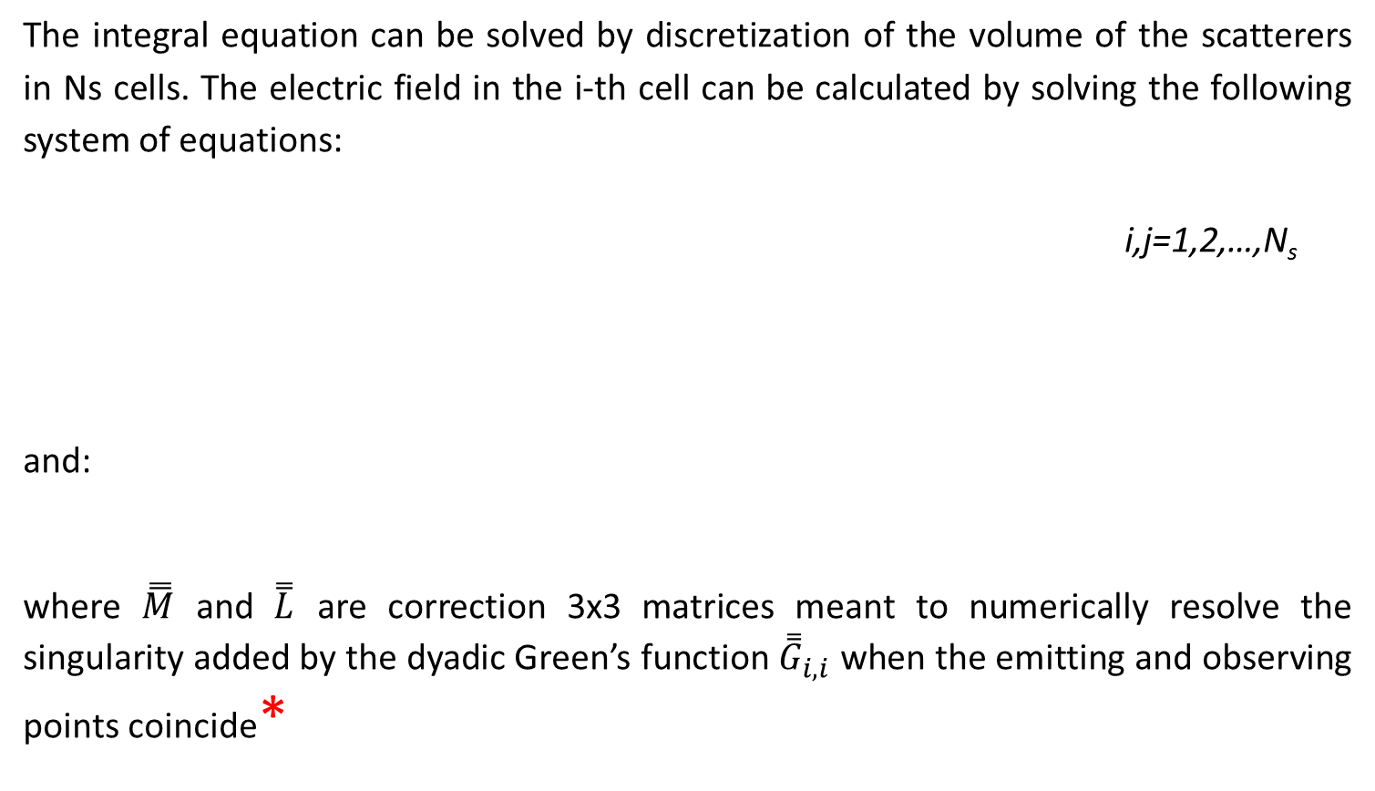
Numerical Model
The integral equation can be solved by discretization of the volume of the scatterers in Ns cells. The electric field in the i-th cell can be calculated by solving the following system of equations:
i,j=1,2,…,N_{s}
and:
where $\overset{̿}{M}$ and $\overset{̿}{L}$ are correction 3x3 matrices meant to numerically resolve the singularity added by the dyadic Green’s function ${\overset{̿}{G}}_{i,i}$ when the emitting and observing points coincide*
*A. D. Yaghjian, Proc. of the IEEE, Vol. 68, No.2 248-63 (1980).
O.J.F. Martin and N.B. Piller, Phys. Rev. E, Vol 58, 3 (1998)

Slide 7
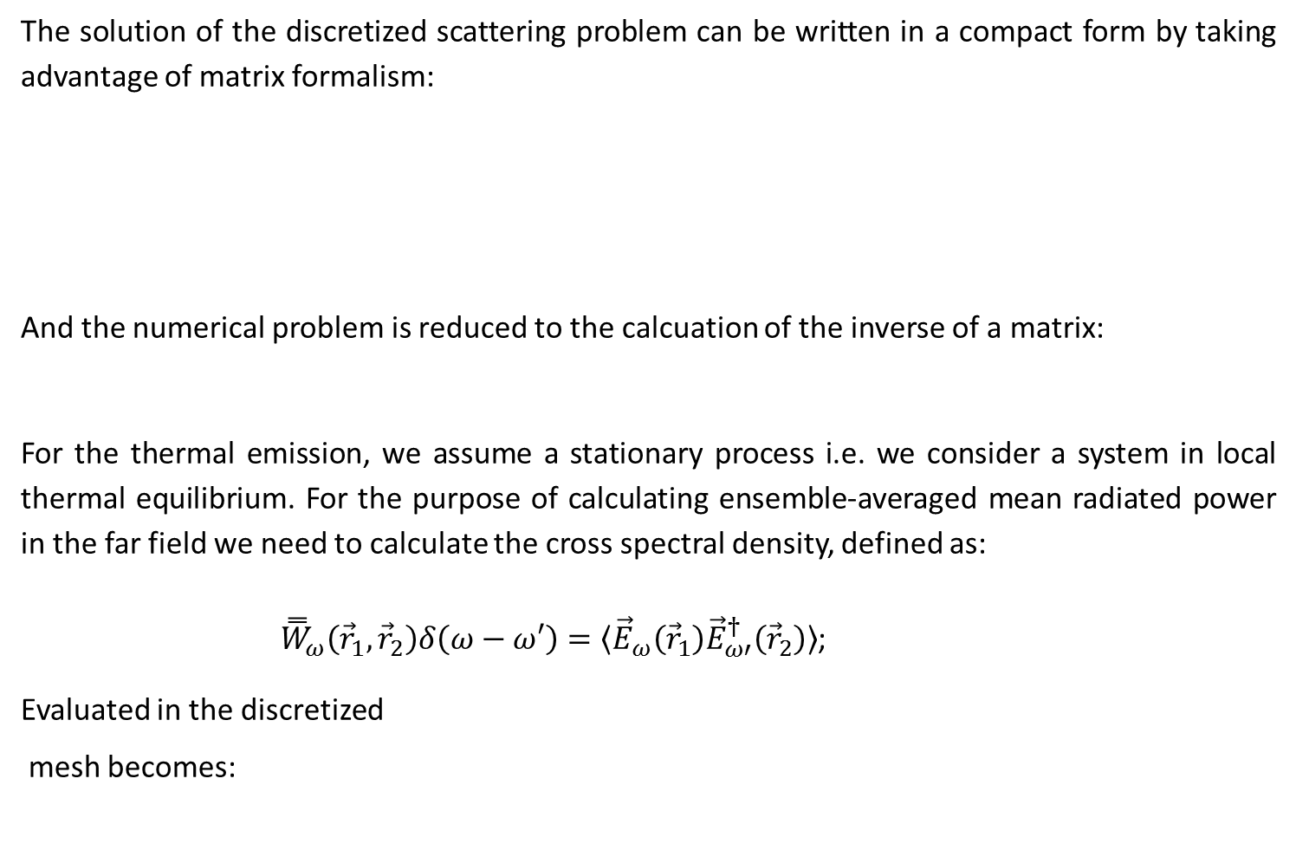
Numerical Model
The solution of the discretized scattering problem can be written in a compact form by taking advantage of matrix formalism:
And the numerical problem is reduced to the calcuation of the inverse of a matrix:
For the thermal emission, we assume a stationary process i.e. we consider a system in local thermal equilibrium. For the purpose of calculating ensemble-averaged mean radiated power in the far field we need to calculate the cross spectral density, defined as:
${\overset{̿}{W}}_{ω}\left({\vec{r}}_{1},{\vec{r}}_{2}\right)δ\left(ω−ω′\right)=〈{\vec{E}}_{ω}\left({\vec{r}}_{1}\right){\vec{E}}_{ω′}^{†}\left({\vec{r}}_{2}\right)〉$;
Evaluated in the discretized
mesh becomes:

Slide 8

Numerical Model
The radiated power is expressed through the product of the solution of a deterministic scattering problem (the K matrix) and the spectral cross correlation of the fluctuating sources. From the fluctuation–dissipation theorem:
Where $Θ$ is:
Then we can evaluate
Which in the discretized mesh gives the matrix:

Slide 9
Results
Relative emissivity as a function of wavelength calculated for a Au dipole nanoantenna 655 nm long, with a (83 nm x 33 nm) rectangular section.

Slide 10
Results
Three Au dipole antennas, of the same size of the previous one, placed at a distance of 85-nm from each other, along the y- direction.
(a)
(b)

Slide 11
Results

Slide 12
Results
three Au rods: two rods are of the same size (410nm x 73nm x 40 nm) while the rod on the left is (410nm x 73nm x 65 nm)

Slide 13
Conclusions
We developed a numerical method to study the thermal emission by nanoantennas and coupled oligomers.
Multipolar contributions are responsible for frequency selective and high directionality emission patterns.
Increasing the size of the system, the super-Planckian emission is reduced. Nevertheless it is possible to find a trade off between control of emission pattern and enhanced relative emissivity.
Optimized structures can be designed to increase asymmetry of the thermal emission. The model can be easily extended for non isothermal geometries.

Slide 14
Thank you

