Slide 1


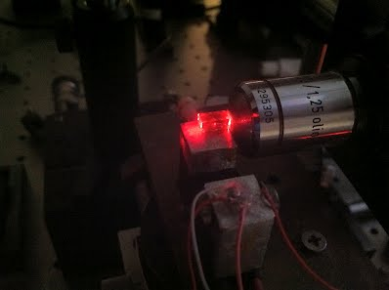
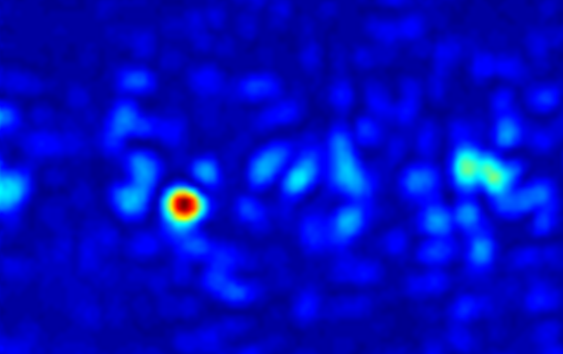



Spatial Rogue Waves in Photorefractive Ferroelectrics
Davide Pierangeli
Physics Department, Unversity of Rome “La Sapienza”, Rome, Italy
Fabrizio Di Mei, Claudio Conti, Aharon J. Agranat, Eugenio DelRe
Physics Department, Unversity of Rome “La Sapienza”, Italy
Center for Life Nano Science@Sapienza, Istituto Italiano di Tecnologia
ISC-CNR, Università di Roma “La Sapienza”, Italy
Applied Physics Department, Hebrew University of Jerusalem, Israel
Nonlinear Photonics in Disordered Media Group
101° CONGRESSO NAZIONALE DELLA SOCIETA ITALIANA DI FISICA
Roma, 21-25 settembre 2015
YIL15

Slide 2
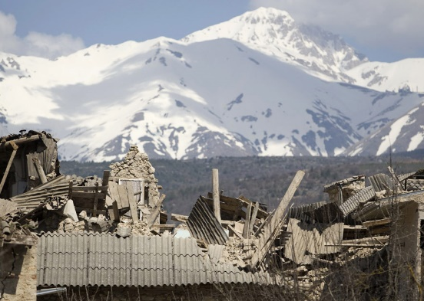
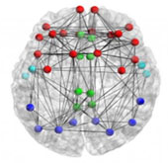
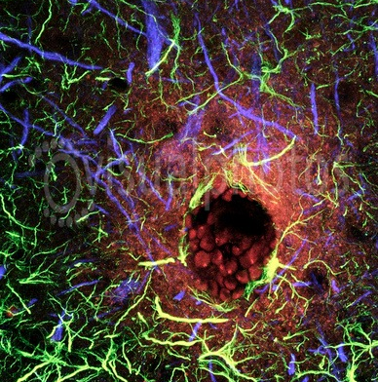
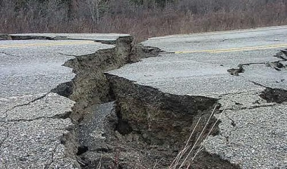

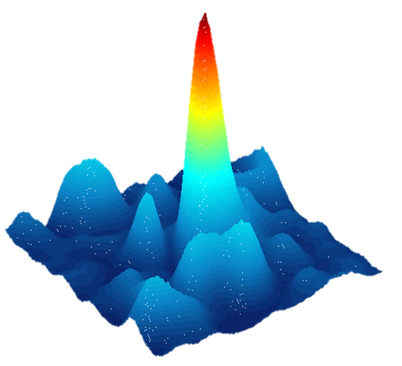
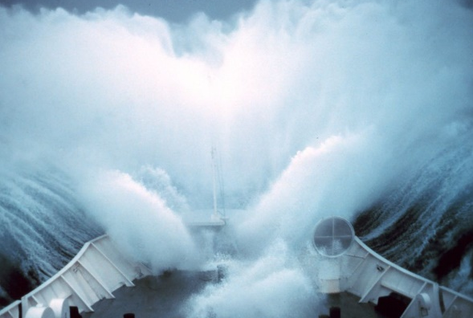
Extreme Events
breakdowns in networks
earthquakes
Rogue Waves
ocean and optical dynamics
M.Onorato et al., Phys. Reports 528, (2013)
financial crashes
PDF
intensity-amplitude
long-tail statistics

Slide 3
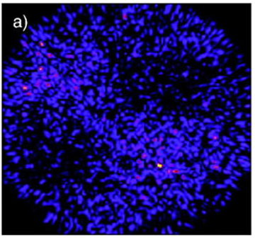
Optical Rogue Waves
Spatio-temporal events with extremely elevated amplitude
temporal domain:
light pulse propagation
in optical fiber
D.R.Solli et al, Nature 450, (2007)
J.M.Dudley et al., Nat. Photon. 8, (2014)
P.Walczak et al., Phys. Rev. Lett. 114, (2015)
chaotic laser resonators
Rogue Waves
C.Lecaplain et al., Phys. Rev. Lett. 108, (2012)
C.Bonatto et al., Phys. Rev. Lett. 107, (2011)
theoretical framework:
Generalized Nonlinear Schrödinger Equation (GNLSE)
Chaos and Complexity
spatial domain:
spatially-extended (2D-3D)
optical systems
PDF
y
x
A.Montina et al., Phys. Rev. Lett. 103, 173901 (2009)

Slide 4
Spatial Rogue Waves
nonlinear cavities
optical filamentation
S.Birkholz et al., PRL 111, (2013)
A.Montina et al., PRL 103, (2009)
key components:
N.Marsal et al., OL 39, (2014)
E.Louvergneaux et al., PRA 87, (2011)
turbulence
instabilities
out-of equilibrium
linear multimodal systems
disorder
?
beam propagation
in optical crystals
F.T.Arecchi et al., PRL 106, (2011)
C.Liu et al., Nat. Phys. (2015)
a key study
M.Leonetti et al., APL 106, (2015)
GNLSE
random waves
role of nonlinearity

Slide 5
Spatial Rogue Waves
in Photorefractive Ferroelectrics
Optical Rogue Waves
Nanodisordered ferroelectrics
Observation of spatial rogue waves
Nonlinear Shrodinger model
Rogue Solitons

Slide 6
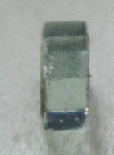
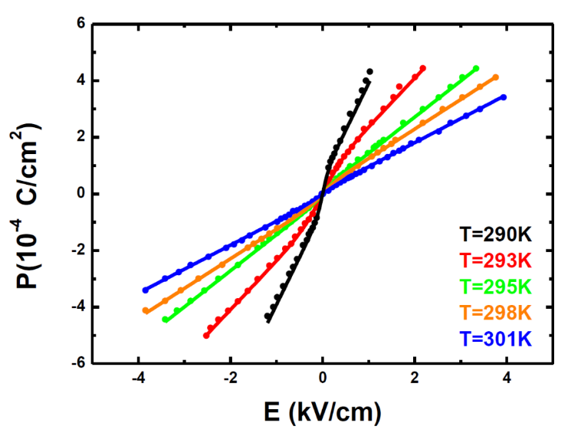
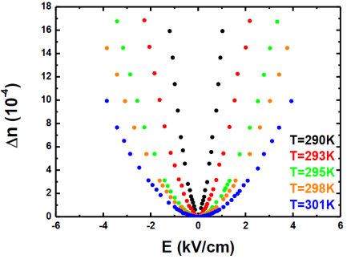
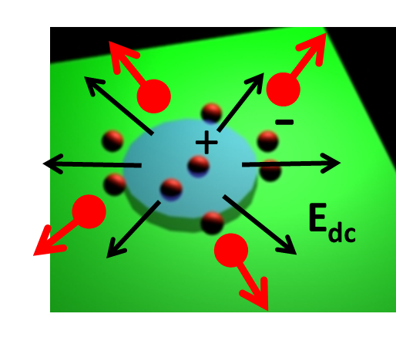
Nanodisordered ferroelectrics
KLTN
compositional disorder in perovskite structures
potassium-lithium-tantalate-niobate
K_{1-α}Li_{α}Ta_{1-β}Nb_{β}O₃
room-temperature ferroelectric phase transition
complex relaxation properties
out-of equilibrium responses
giant electro-optic effect
dielectric susceptibility
ferroelectric
paraelectric
(dipolar glass)
KNTN
T_{C}
χ∼10⁵
giant photorefractive nonlinearity
E.DelRe et al., Nat. Photon. 5, (2011)
photoinduced
space-charge field
D.Pierangeli et al., Opt. Mater. Express. 4, (2014)
D.Pierangeli et al., Opt. Lett. 39, (2014)

Slide 7
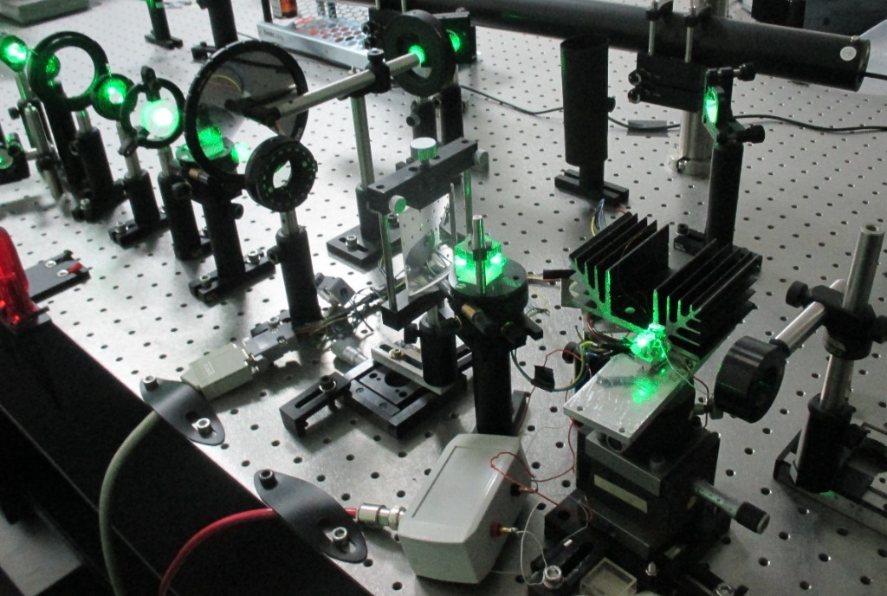
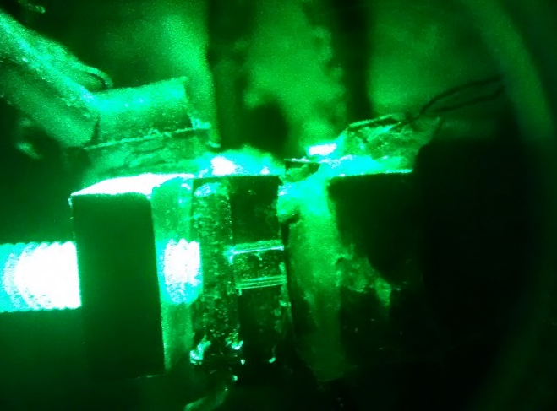
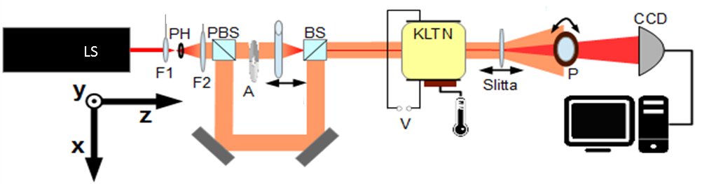
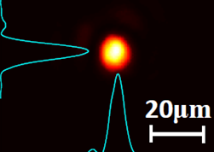
Nonlinear waves in critical ferroelectrics
experimental setup
A
z
CL
KLTN
2.4 mm
mW
micrometric beams
local-temperature control
high-voltage control
time-resolved detection
tuning light self-interaction

Slide 8
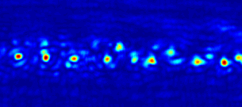
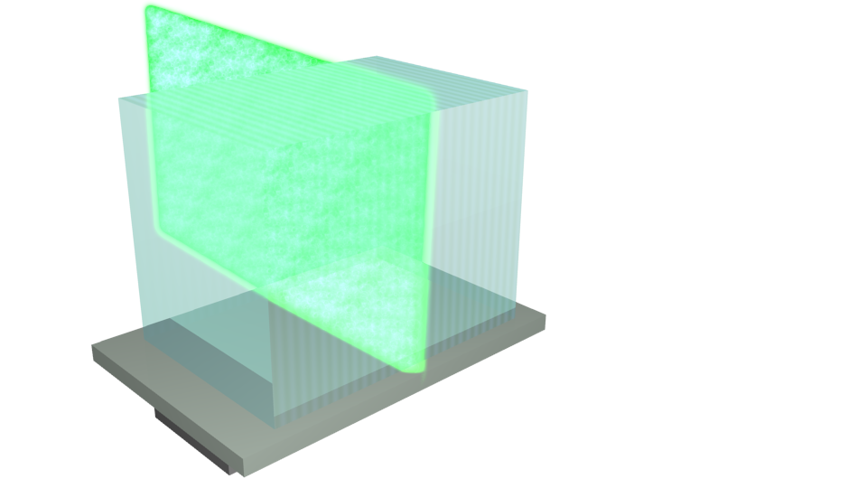
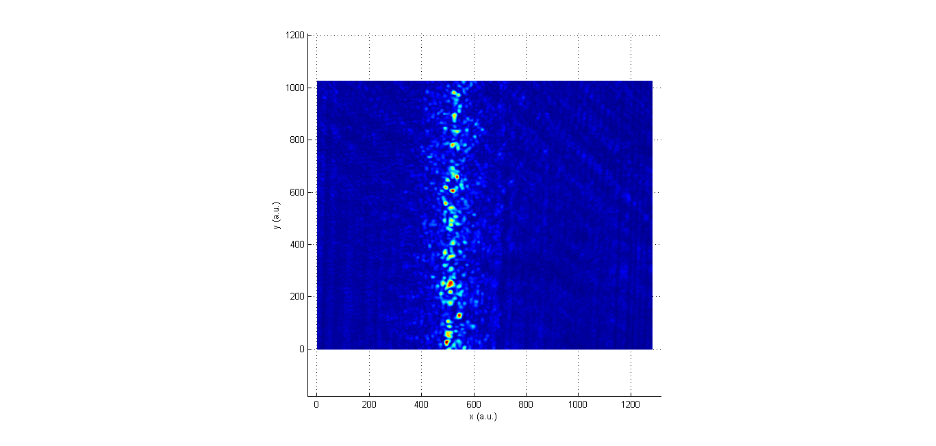
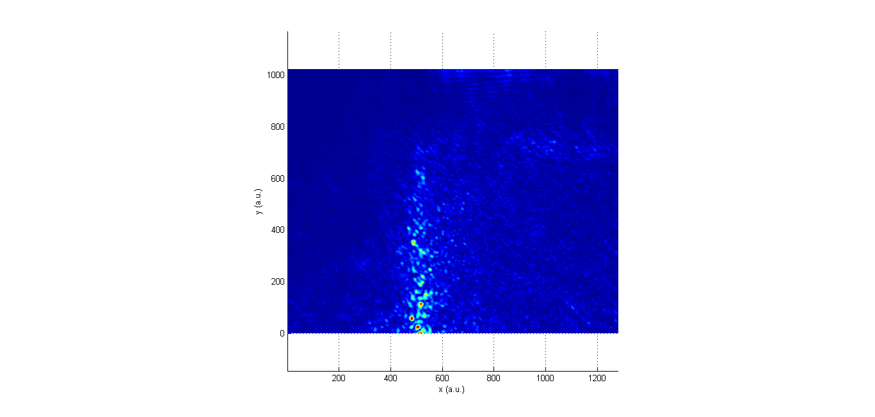

Nonlinear waves in critical ferroelectrics
using temperature gradients to explore different nonlinear propagation regimes
Applying E ≈ 2kV/cm
Modulation Instability
x
20μm
$∇$T
y
y
Speckle-like
x
z
T ≈ T_{C} + 1K
large-scale fluctuations
E-field
z
Critical Opalescence
x
y
bright localized peaks
local-temperature control
T_{C}
high-voltage control
highly nonlinear regime
time-resolved detection

Slide 9
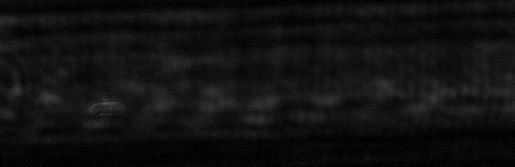
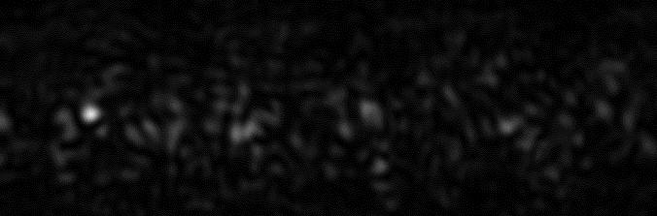
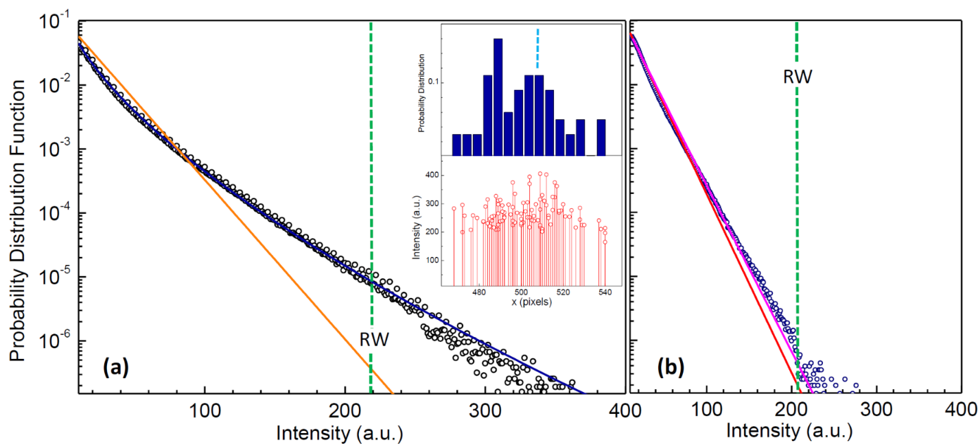
Rogue waves observation
weakly nonlinear
small
fluctuations
x
20μm
y
Output intensity distributions
highly nonlinear
extreme
fluctuations
I_{RW} ≈ 20 <I>
rogue event
highly nonlinear
weakly nonlinear
STATISTICS

Slide 10
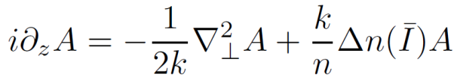
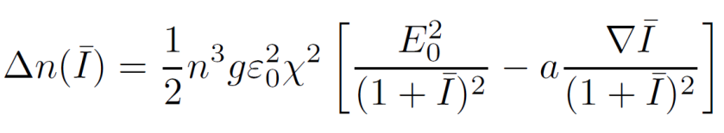
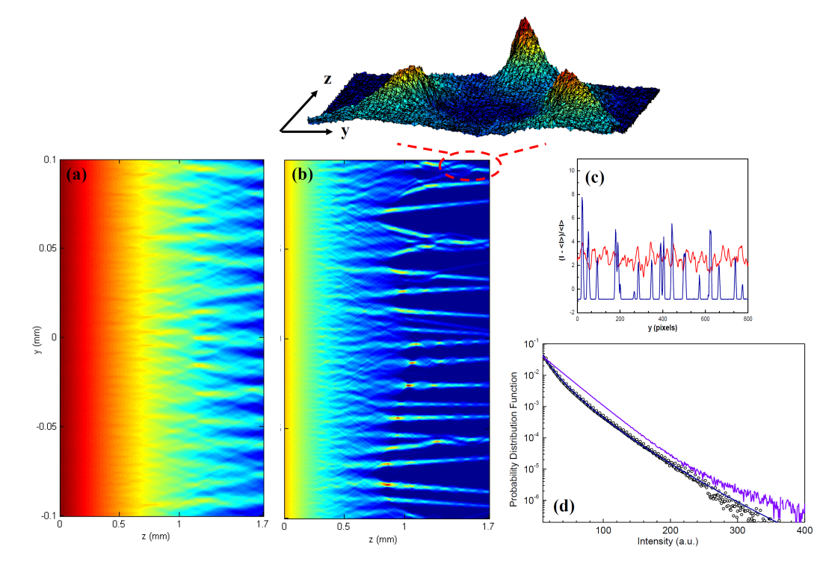
Generalized nonlinear Schrödinger model
diffraction + nonlinearity:
photorefractive (Kerr-like)
nonlinearity:
numerical results
input disorder
weakly nonlinear
good agreement with
experimental findings
key points:
Nonlinear origin
Soliton mergers
A.Armaroli et al., Optica 2, (2015)
highly nonlinear

Slide 11
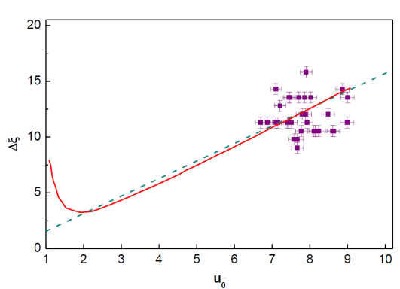

Solitonic interpretation
analyzing each rogue waves in terms of soliton existence coditions
existence curve
normalized amplitude and waist
experimental
dynamics
highly-saturated region
rogue
event
higly-saturated region:
self-similarity
time
soliton
train
localized waves with
arbitrary intensity can form
scale-invariance
soliton mergers

Slide 12
Outline
Observation of rogue waves for beam propagation in crystals
Rogue waves from a generalized nonlinear Shrodinger model
Higly-nonlinear photorefractive response
Media instabilities and turbulence at the ferroelectric phase transition
Rogue waves control through nonlinearity strength
Nonlinear origin
Spatial soliton mergers and waveform scale-invariance
Thanks for your attention!
References
D. Pierangeli, F. Di Mei, C. Conti, A.J. Agranat and E. DelRe,
Phys. Rev. Lett. 115, 093901 (2015).
davide.pierangeli@roma1.infn.it

