Slide 1

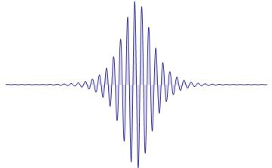


Light propagation in topological two-level structures
Istituto dei Sistemi Complessi
Laura Pilozzi - Claudio Conti
Istituto dei Sistemi Complessi – CNR
Via dei Taurini 19, Roma
www.isc.cnr.it
101° Congresso Nazionale SIF - Roma, 21 - 25 Settembre 2015

Slide 2
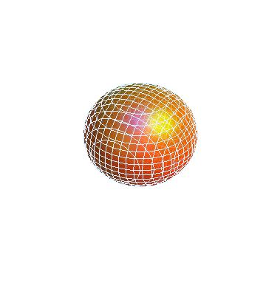
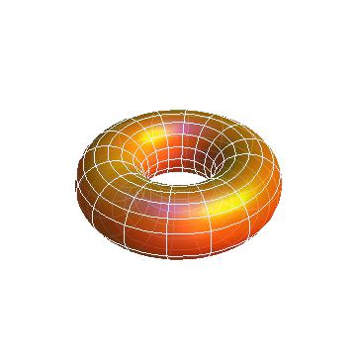
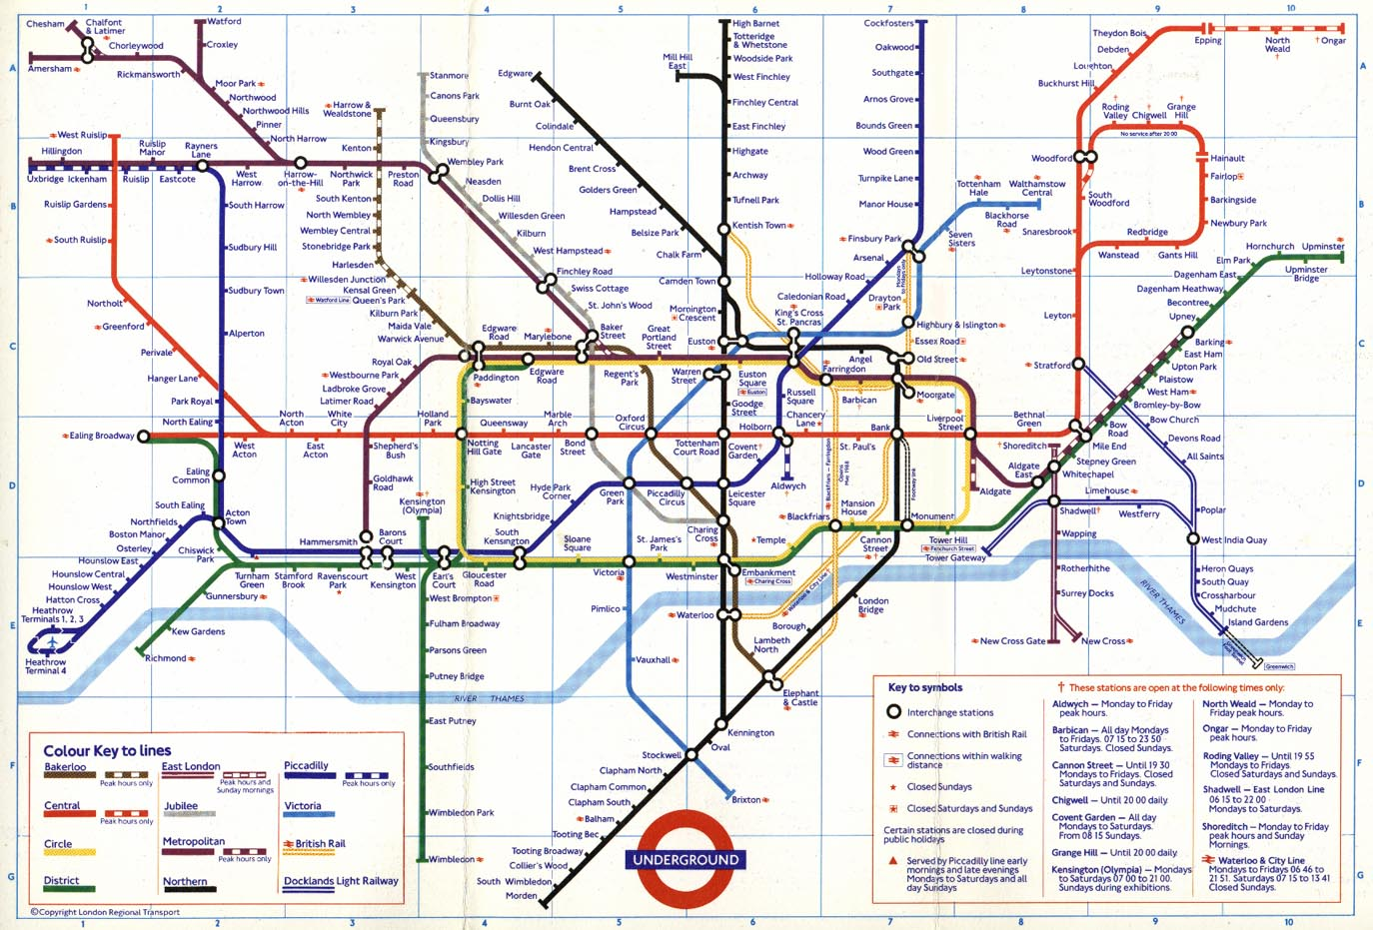
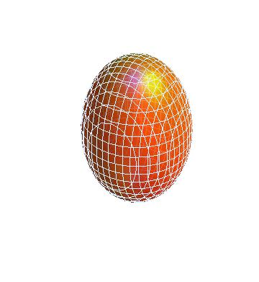

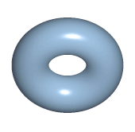
Topological properties
torus
sphere
ellipsoid
coffecup
donut
Euler characteristic
Gaussian curvature
101° Congresso Nazionale SIF - Roma, 21 - 25 Settembre 2015

Slide 3
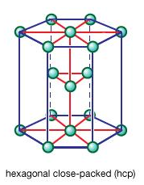
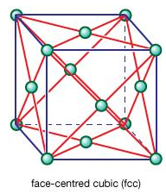
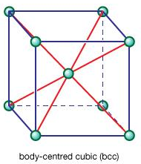
Topological physics
Quantum Hall effect
edge
B
edge
In the presence of a magnetic field B charged particles execute closed orbits inside the bulk but skip along the edge.
Landau symmetry-breaking theory
Topological classification
Topological insulator
101° Congresso Nazionale SIF - Roma, 21 - 25 Settembre 2015

Slide 4
Topological physics
Topological indexes
Euler characteristic
Chern number
Gaussian curvature
Berry curvature
Berry connection
Electron Bloch function
interface
3
3’
edge state
edge state
2
2’
1
1’
101° Congresso Nazionale SIF - Roma, 21 - 25 Settembre 2015

Slide 5
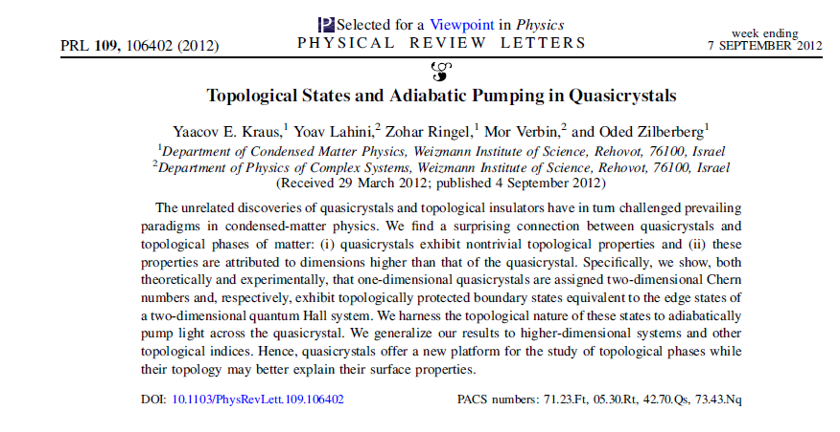
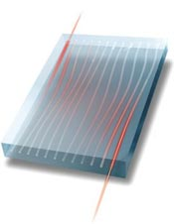
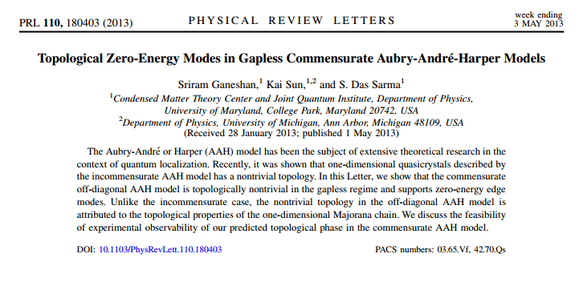
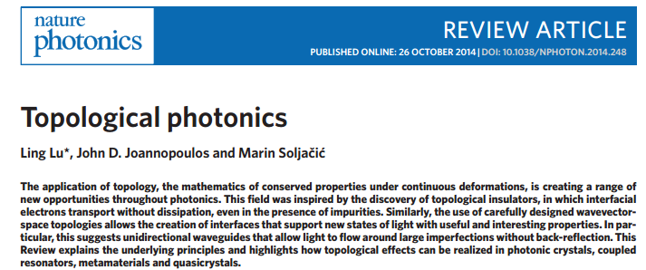

Topological physics……with light
one-dimensional quasicrystals
topological insulators
1D crystals with compound unit cell
101° Congresso Nazionale SIF - Roma, 21 - 25 Settembre 2015

Slide 6
Radiative topological states in resonant photonic crystals.
A. V. Poshakinskiy, A. N. Poddubny, L. Pilozzi, and E. L. Ivchenko Phys. Rev. Lett. 112, 107403 (2014)
Photonic topological insulator
1D Harper model
1D chains of resonant two-level layers (blue) in an homogeneus bulk (pink) of frequency-independent dielectric function
elementary cell
Uniform structure - US
Bragg structure - BS
z
Structure with three resonant layers A in the unit cell.
period of the primary lattice
modulation strenght
A
B
Harper modulation
resonant layer
barrier
101° Congresso Nazionale SIF - Roma, 21 - 25 Settembre 2015

Slide 7


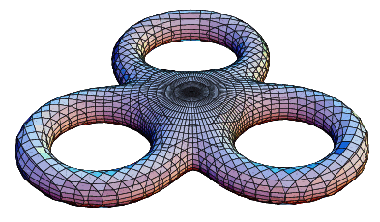
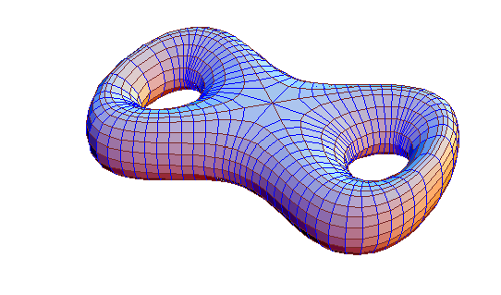
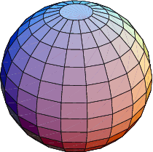
1D
2D
Topological physics……with light
Topological indexes
1D AAH model
Chern numbers
2D ancestor model
x
genus
3
2
0
101° Congresso Nazionale SIF - Roma, 21 - 25 Settembre 2015

Slide 8
Eigenfrequencies symmetries
Time inversion symmetry
Even eigenfrequencies in k
phase shift
the structure corresponding to a particular value of
is spatially inverted under the reversal
elementary cell
1/2
symmetric
1/3
1/4
non symmetric
1/5
lack of inversion centre
asymmetric cell
101° Congresso Nazionale SIF - Roma, 21 - 25 Settembre 2015

Slide 9
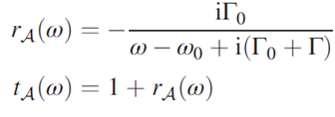
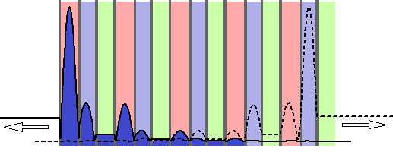

Band dispersion
Single layer transfer matrix
reflectivity
A
left edge mode
right edge mode
B
101° Congresso Nazionale SIF - Roma, 21 - 25 Settembre 2015

Slide 10

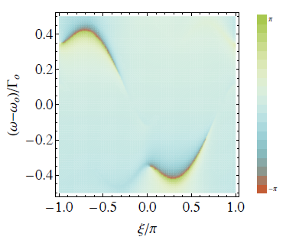
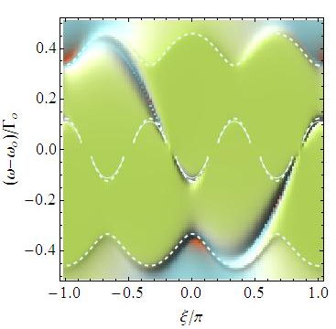
Uniform structure
phase
Reflectivity
Chern number = -1
winding number = 1
intensity
Chern number = 2
winding number = - 1
edge modes
gap
Chern number = -1
gap
immaginary
real
101° Congresso Nazionale SIF - Roma, 21 - 25 Settembre 2015

Slide 11
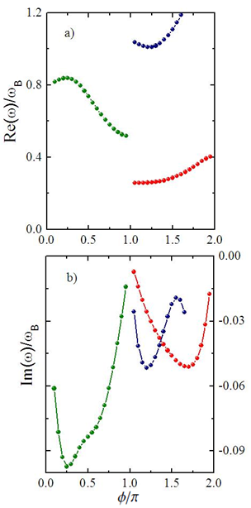
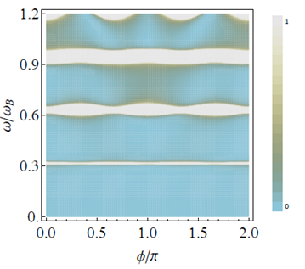
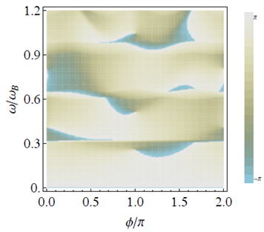
Modulated structure
Reflectivity
intensity
edge modes
gap
phase
gap
Chern number = -1
winding number = 0
gap
Chern number = -1
winding number = 1
Chern number = 2
winding number = - 1
Chern number = -1
101° Congresso Nazionale SIF - Roma, 21 - 25 Settembre 2015

Slide 12
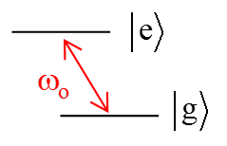
Modes detection
Finite Difference Time Domain simulations
Maxwell-Bloch equations
We follow the evolution of a pulse that moves in the structured region with an initial profile:
polarization relaxation rate
Rabi frequency
population relaxation rate
inversion population
initial inversion population
101° Congresso Nazionale SIF - Roma, 21 - 25 Settembre 2015

Slide 13
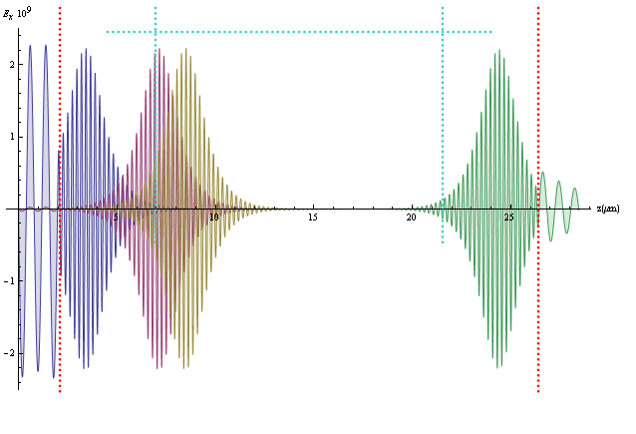

Self-Induced Transparency (SIT) pulse
Finite Difference Time Domain simulations
pulse duration
structured region
2π pulse
pulse amplitude
input layer
output layer
101° Congresso Nazionale SIF - Roma, 21 - 25 Settembre 2015

Slide 14
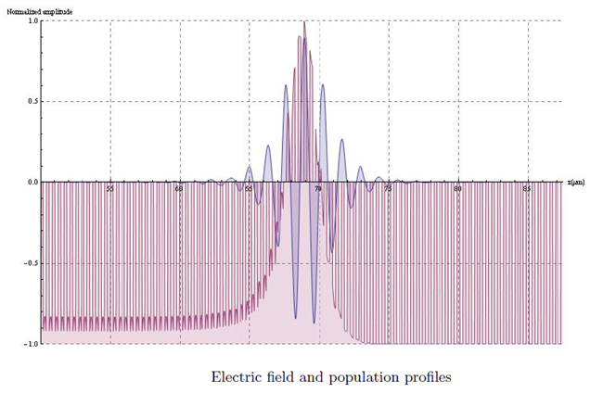
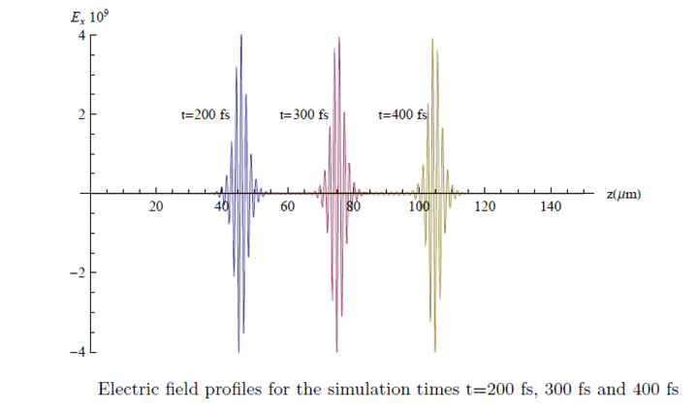
Self-Induced Transparency (SIT) pulse
Finite Difference Time Domain simulations
101° Congresso Nazionale SIF - Roma, 21 - 25 Settembre 2015

Slide 15
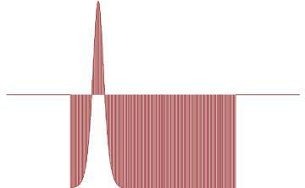
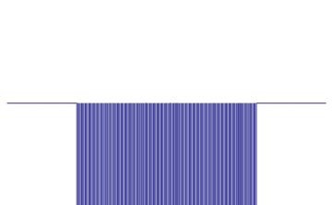
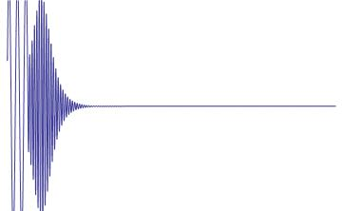
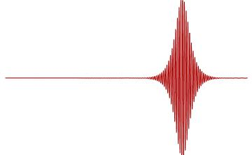

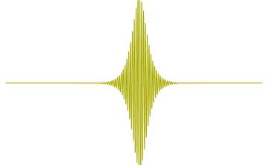
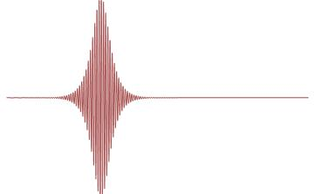
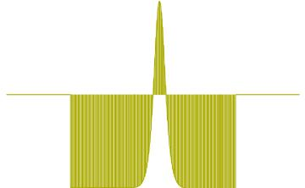

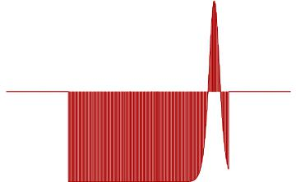
Self-Induced Transparency (SIT) pulse
Finite Difference Time Domain simulations
Population inversion profiles at different simulation times.
1
5
10
15
20
25
30
x (μm)
1
2
-1
x (μm)
1
1
5
10
15
20
25
30
-1
x (μm)
5
10
15
20
25
30
x (μm)
-1
5
10
15
20
25
30
1
-2
-1
1
5
10
15
20
25
30
x (μm)
Electric field profiles at different simulation times.
-1
5
10
15
20
25
30
x (μm)
-1
101° Congresso Nazionale SIF - Roma, 21 - 25 Settembre 2015

Slide 16
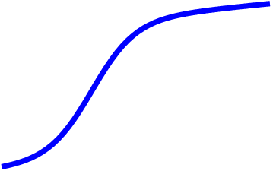
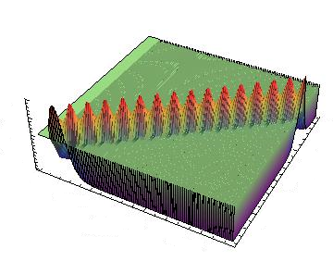
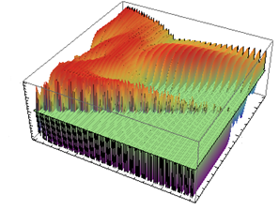
Edge modes detection
Finite Difference Time Domain simulations
t
topological
periodic
x
101° Congresso Nazionale SIF - Roma, 21 - 25 Settembre 2015

Slide 17
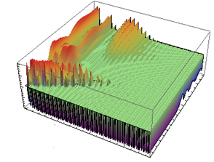
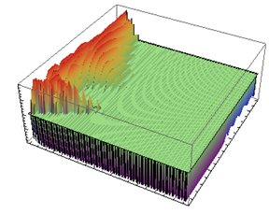
Edge modes detection
Finite Difference Time Domain simulations
101° Congresso Nazionale SIF - Roma, 21 - 25 Settembre 2015

Slide 18
Light propagation in topological two-level structures
Conclusions
We have demonstrated the presence of radiative topologically protected edge states in 1D resonant photonic crystals with a compound non centrosymmetric unit cell that survive despite the long-range light-induced coupling of the resonances and finite lifetime of their radiative decay.
The states are manifested in the stationary reflection spectra of the structure with finite nonradiative losses as well as in the time-dependent response to short optical pulses.
Trough FDTD solutions of Maxwell-Bloch equations we have shown that a direct observation of topological protected edge states can be achieved following the time evolution of the TLS population inversion.
Under SIT conditions localization manifests with a transition from a travelling population inversion to a standing one in the input face layers of the structure.
The realization of such RTI can be achieved considering as the active TLS rare-earth ions or quantum wells embedded in a semiconductor structure as effective two-level systems for low densities excitons with resonance close to the operating frequency.
101° Congresso Nazionale SIF - Roma, 21 - 25 Settembre 2015

