Slide 1
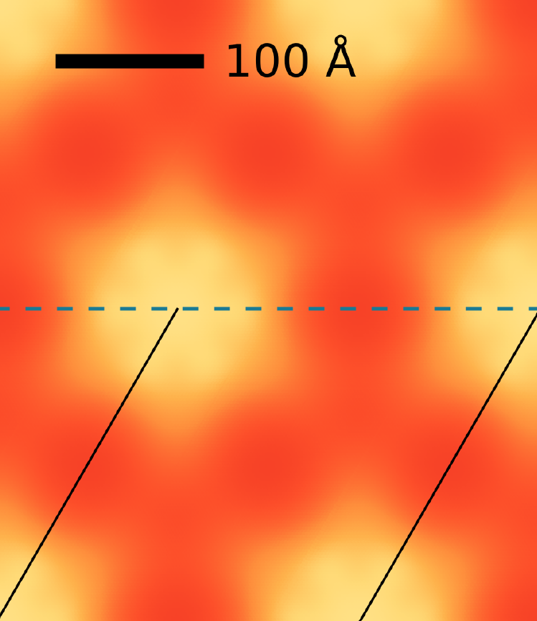
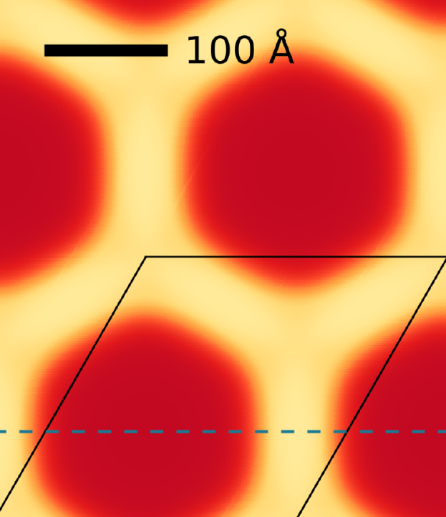
Moire’ patterns in graphene
Annalisa Fasolino
Institute for Molecules and Materials
Radboud University Nijmegen, The Netherlands

Slide 2
Moire’ patterns in graphene
Annalisa Fasolino
Institute for Molecules and Materials
Radboud University, Nijmegen, The Netherlands
graphene and van der Waals heterostructures
rotations and lattice mismatch → moire` patterns
rotations: graphene on graphene
mismatch: graphene on h-BN
effects on electronic structure
With thanks to
Merel van Wijk, Annelot Schuring
Guus Slotman, Shenjun Yuan, Misha Katsnelson

Slide 3
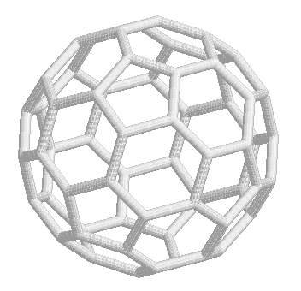
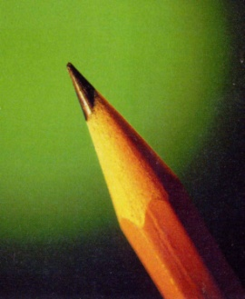
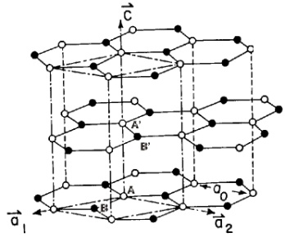
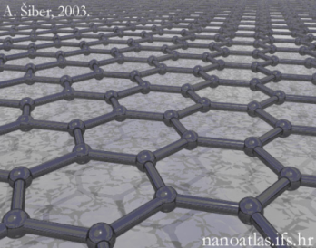
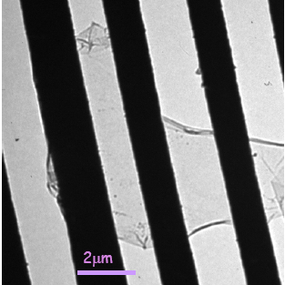
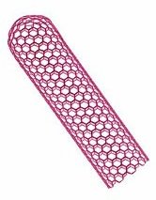
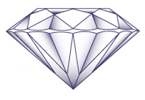
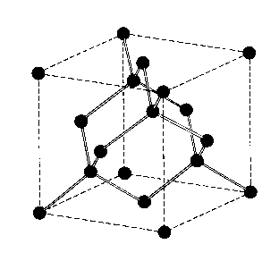
graphene: till 2004 the missing structure
3D
2D
0D
Fullerenes
Curl, Kroto, Smalley 1985
Nobel prize 1996
Graphite
1D
Carbon
Nanotubes
Graphene
Diamond
Novoselov et al., 2004
Nobel prize 2010
Multi-wall 1991
Single-wall 1993

Slide 4
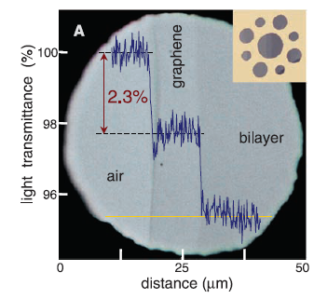
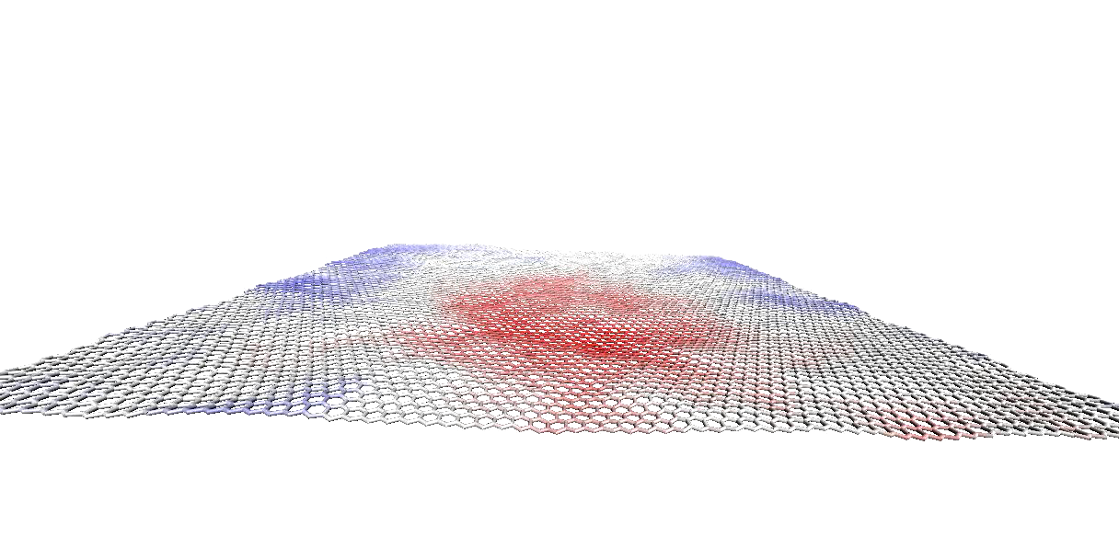
graphene: why so special
Science, 2008
Many superlatives
transparent and light conductor
- large out of plane fluctuations:
stable at finite temperature
due to anharmonic effects,
thermal ripples
scaling behaviour of elastic properties

Slide 5
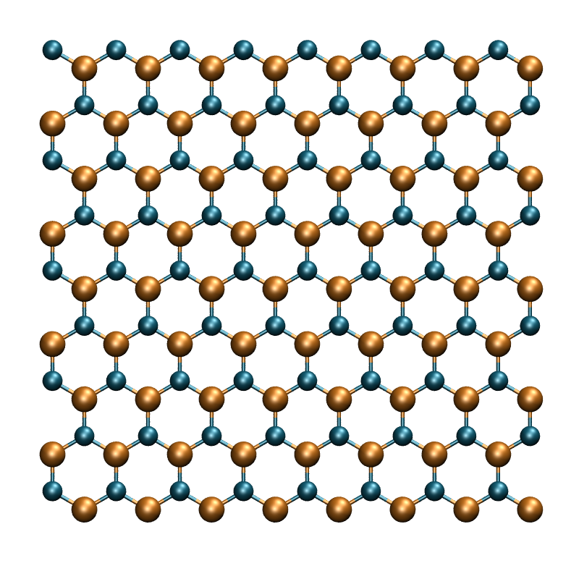
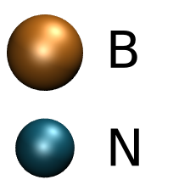
graphene on h-BN
- ripples are a source of scattering
- hexagonal Boron Nitride (h-BN) keeps graphene flat
and improves mobility
- insulator, small lattice mismatch (1.8 %)

Slide 6
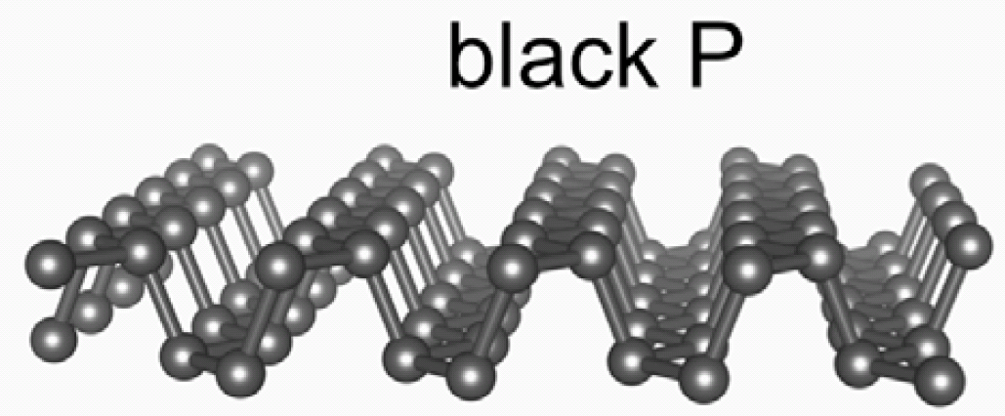
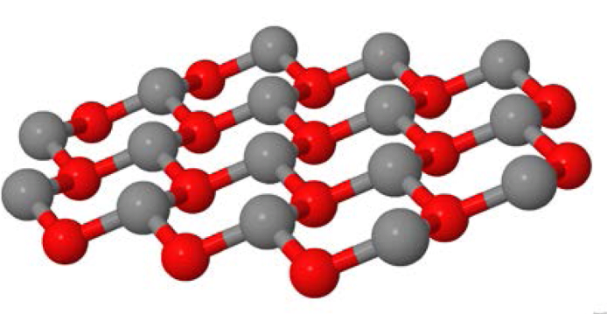
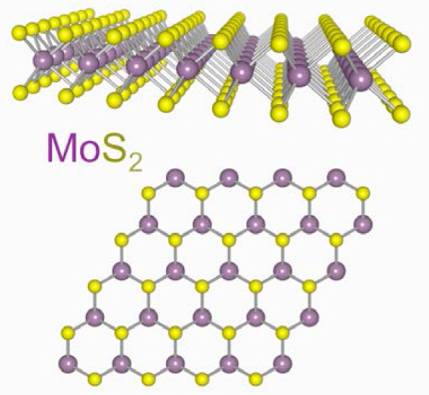

and many more 2D crystals
Silicene
….. and many more
up to now mostly produced by exfoliation, more reactive, semiconductors, very active field of research

Slide 7
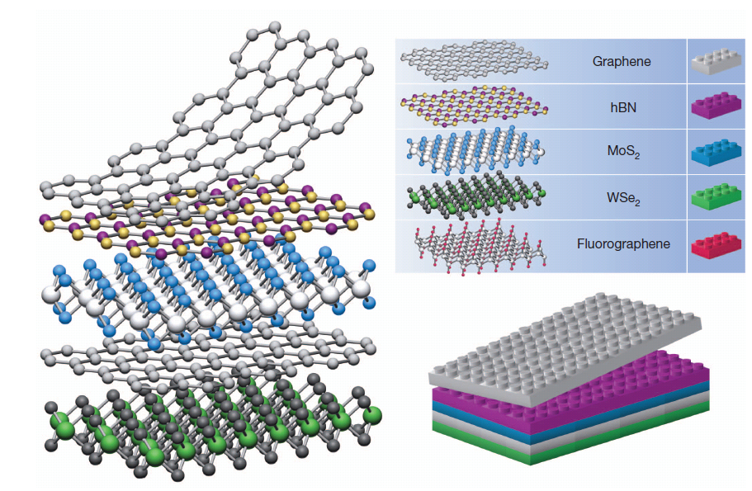
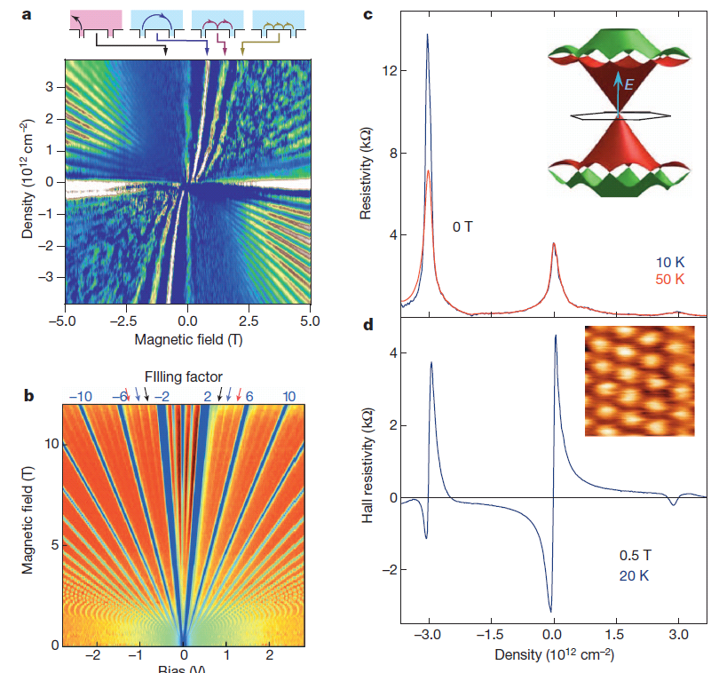
van der Waals heterostructures
A. K. Geim,I. V. Grigorieva, Nature 4 9 9 , 4 1 9 (2013)
new structures
lots of new effects
weak (van der Waals) interlayer interactions create tunable periodic modulation
modulation: (in)commensurability on demand

Slide 8
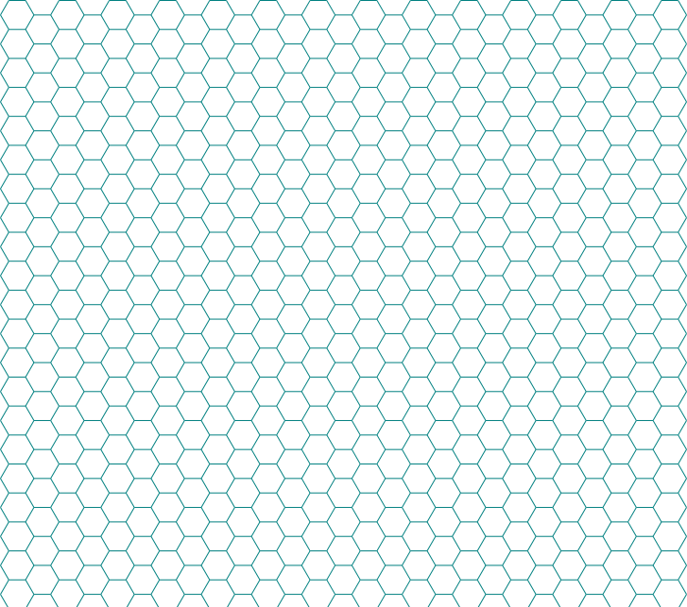
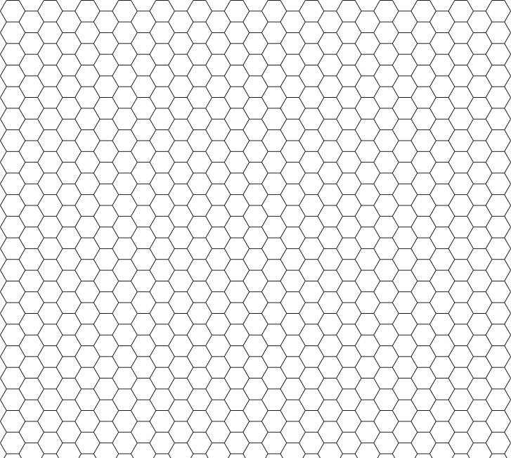
moire’ patterns
graphene on substrates with different orientation or lattice constant
leads to beautiful moiré patterns with large periodicity
many STM observations
30 nm

Slide 9

moire` silk
silk, used in traditional clothes
in the Netherlands
as status symbol

Slide 10
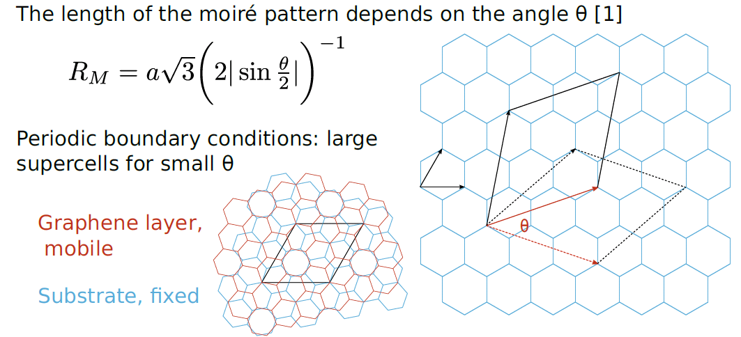
moire’ patterns: geometric constructions
30 nm

Slide 11

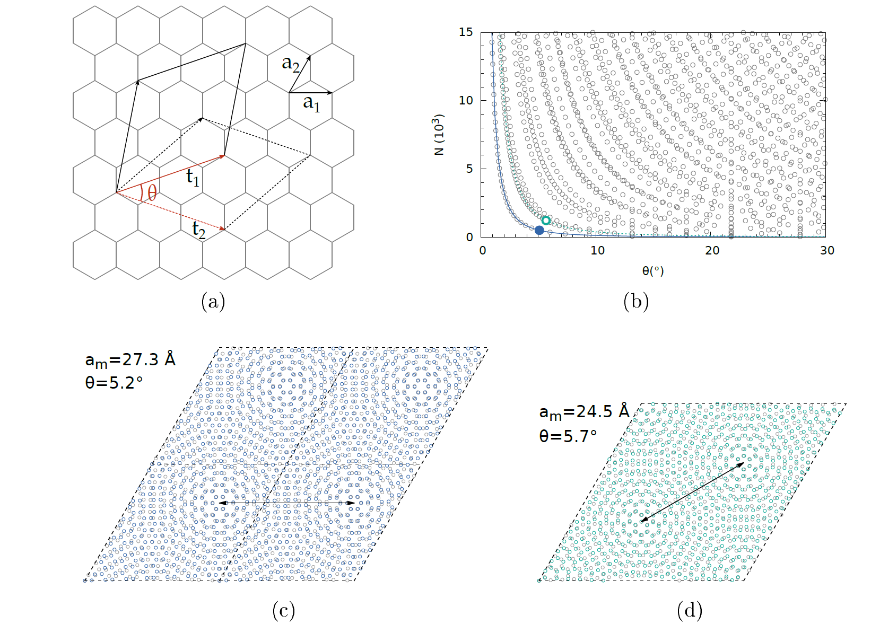
moire’ patterns: graphene on graphite
Size determined by relative angle
two different
moirons in one cell
apparent periodicity
≠
true one:
difficult determination
of angle from exp.
M.M. van Wijk et al., 2D Mater. 2, 034010 (2015) (arxiv:150.02540)

Slide 12
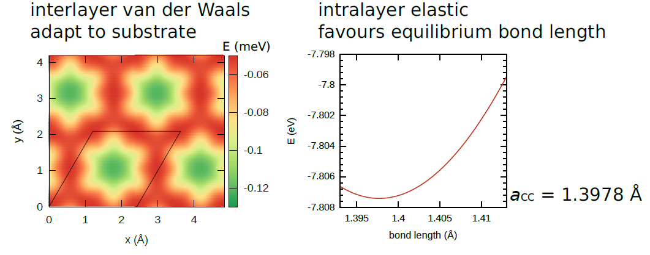
lattice relaxations minimize energy
competing interactions
Kolmogorov-Crespi
Brenner
numerical energy minimization by accurate potentials for carbon (Lammps)

Slide 13
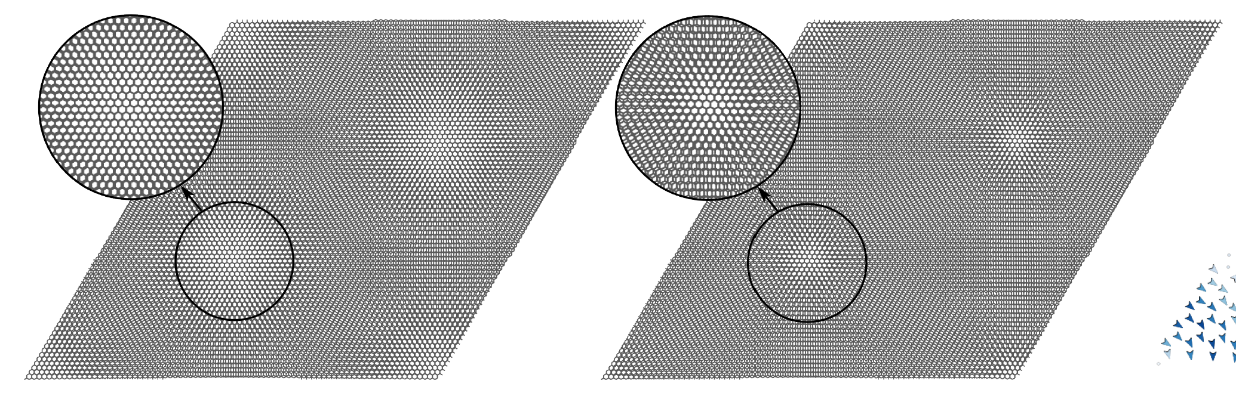


lattice relaxation: graphene on graphite substrate
displacements reduce area with unfavourable AA stacking

Slide 14
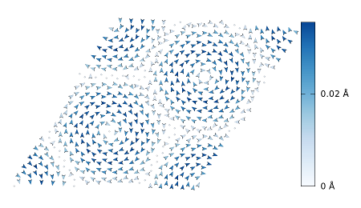
moire’ patterns: graphene on graphite
Size determined by relative angle
Structure due to atomic displacements
to minimize energy

Slide 15
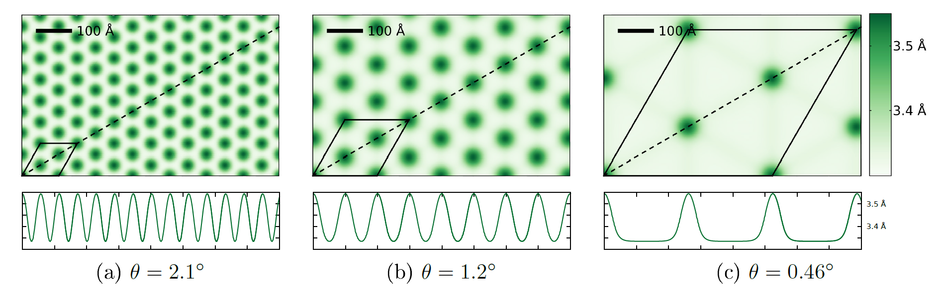
out of plane displacements z
colour
gives z
y
x
modulation sinusoidal → localized between flat domains

Slide 16
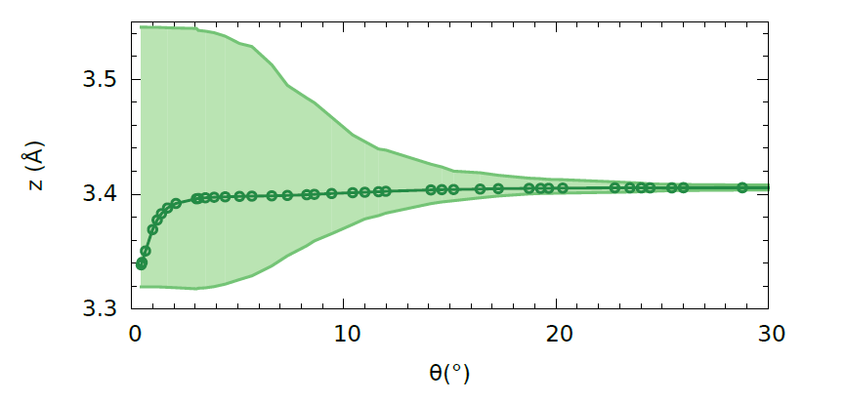
out of plane displacements z
colour
gives z
y
x
modulation sinusoidal → localized between flat domains
zav
zmax
zmin
M.M. van Wijk et al., 2D Mater. 2, 034010 (2015) (arxiv:150.02540)

Slide 17
out of plane displacements z
colour
gives z
y
x
modulation sinusoidal → localized between flat domains
zav
zmax
extrapolation to θ=0 fails
zmin
M.M. van Wijk et al., 2D Mater. 2, 034010 (2015) (arxiv:150.02540)

Slide 18
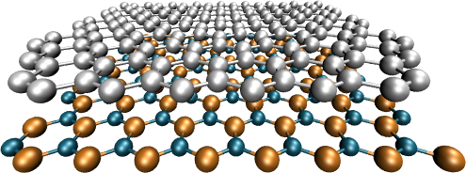
graphene on hexagonal Boron Nitride (h-BN)
graphene
h-BN
- insulator,
- 1.8 % larger lattice
parameter
C-BN interactions unknown
moire` patterns may reveal interlayer interactions
(weak van der Waals interactions difficult to measure and to calculate)

Slide 19
experiment: graphene on h-BN

Slide 20
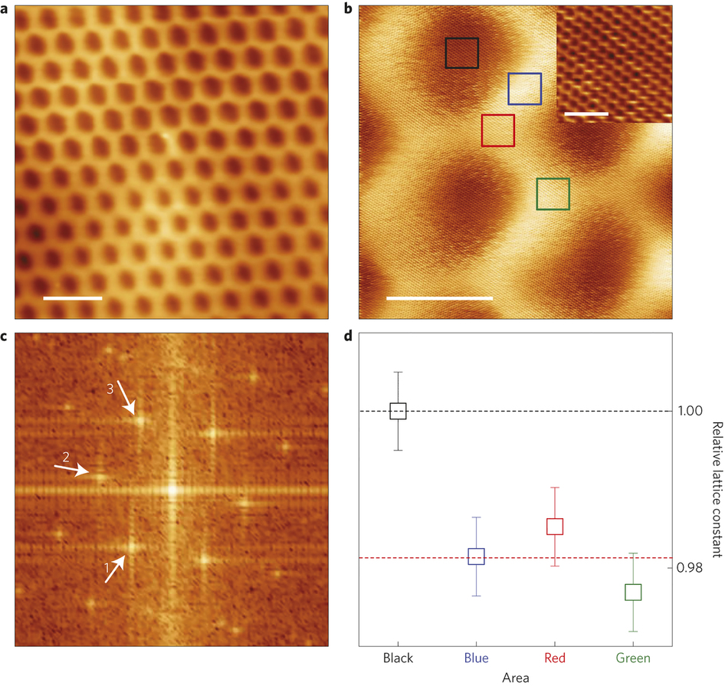
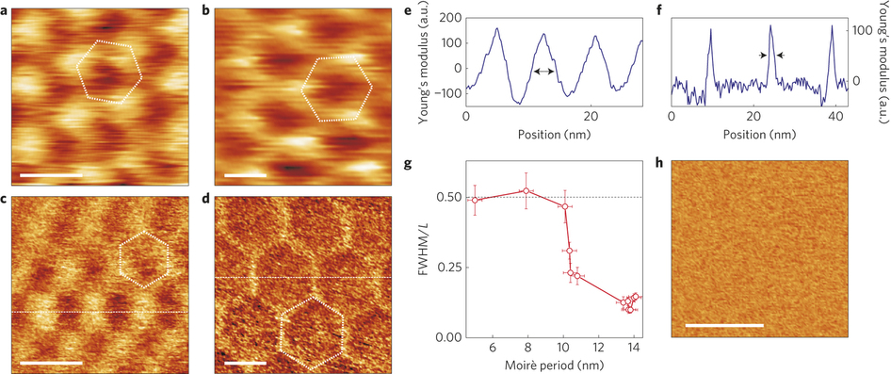
exp: graphene on h-BN, comm-incomm transition
~1.5°/ 8 nm
~0°/ 14 nm
center
stretched
1.0
0.98
Woods et al., Commensurate incommensurate transition in graphene on hexagonal boron nitride, Nature Physics 10, 451 (2014)
Notes:
Relative bond lengths. Competing energy terms.

Slide 21
constructing a graphene-hBN supercell
lattice mismatch 56 x 56 on 55 x 55 →1.8 %
0°: 13322 atoms
38°: 86254 atoms
+ angle
mobile graphene
rigid substrate
interaction potential is unknown:
begin by modeling model h-BN as stretched graphene

Slide 22
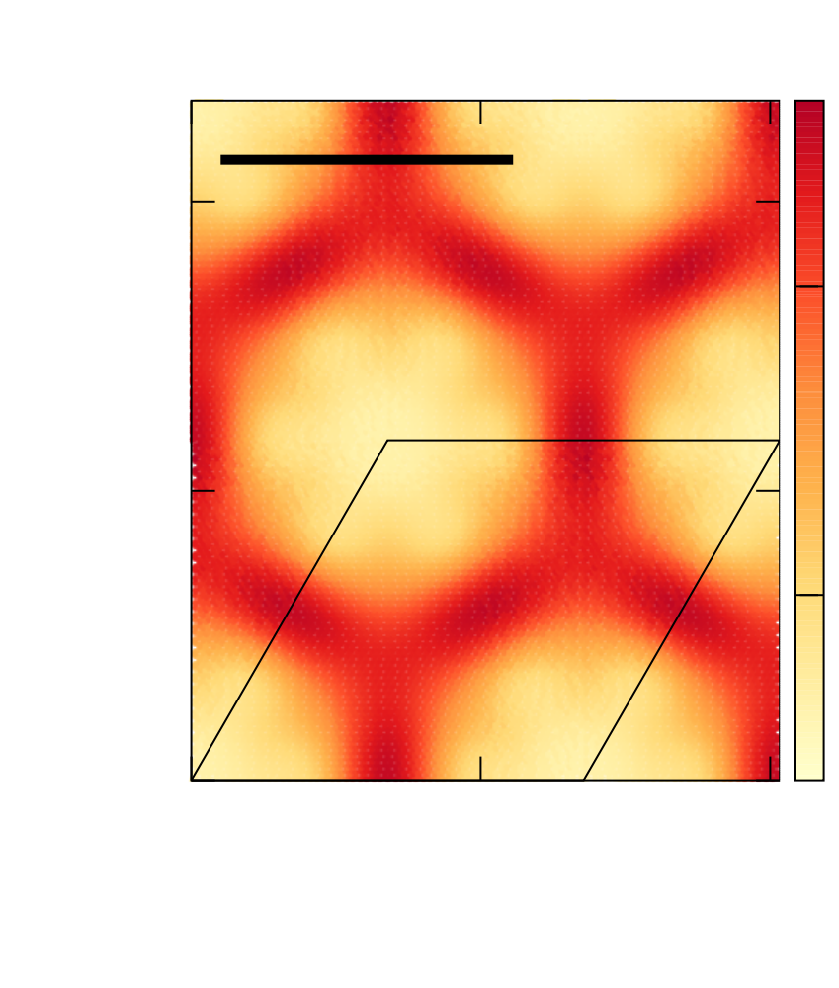
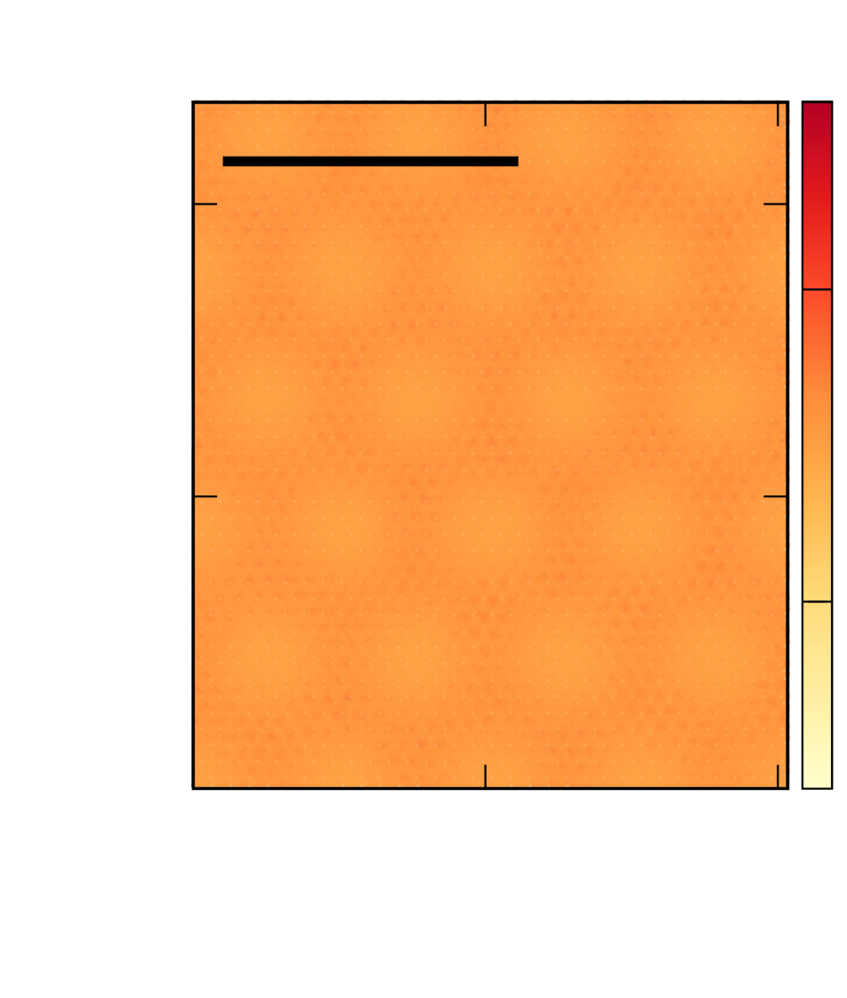
different displacement distributions
0°
38°
100 Å
100 Å
1.4 Å
1.4 Å
eq.
(exp 1.42 Å)
1.395 Å
1.395 Å
Small angle / large moiré pattern
Large angle / small moiré pattern

Slide 23
not quite as in experiment
0°
center
stretched
100 Å
1.4 Å
eq.
(exp 1.42 Å)
1.395 Å
1.0
center
compressed
0.98
Small angle / large moiré pattern

Slide 24
C-B interaction from =CN interaction to zero
Θ=0º
C-B interactions < ½ C-N interactions needed for experimental results

Slide 25

moire` as magnifying glass

Slide 26
moire magnifies interlayer interactions
C-B interaction from =CN interaction to zero
M. M. van Wijk, A. Schuring, M. I. Katsnelson, and A. Fasolino Phys. Rev. Lett. 113, 135504 (2014)

Slide 27
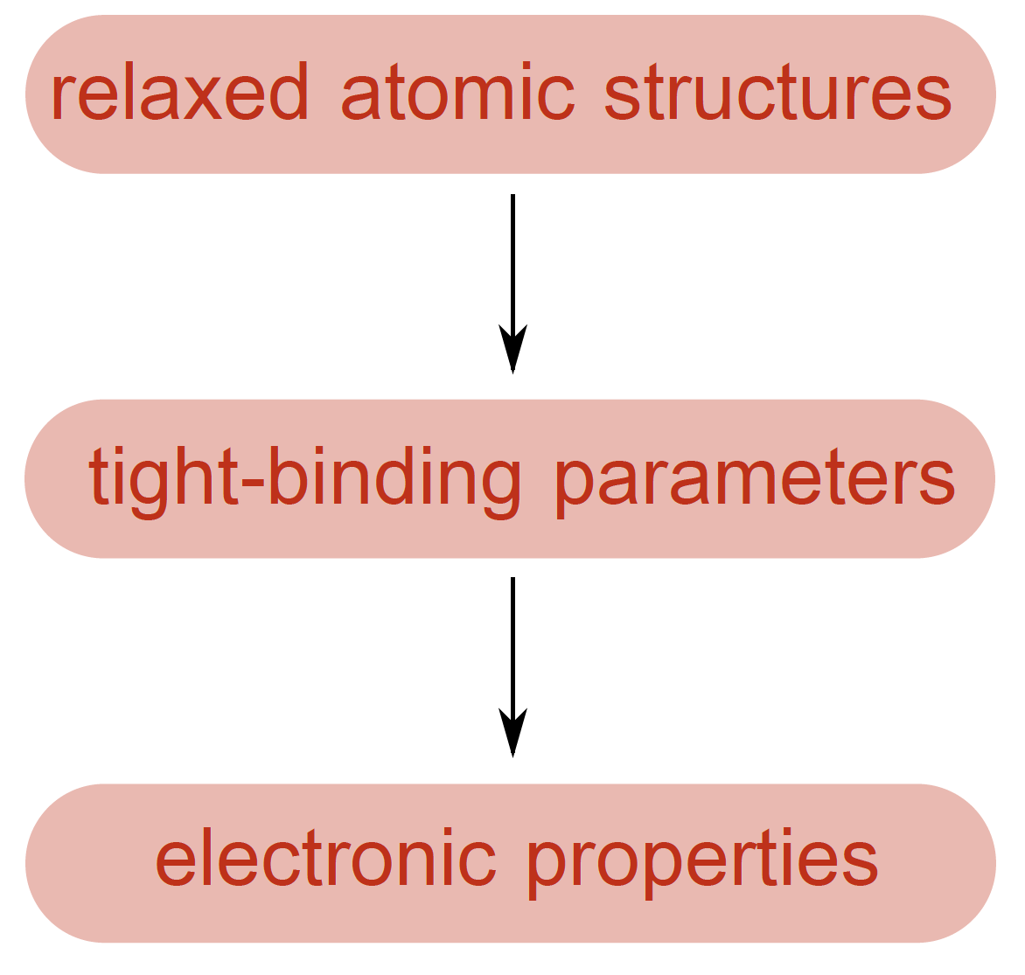
effect of moire` patterns on electronic structure
lattice mismatch → large supercells
relax structures with atomistic
simulations using empirical potentials
obtain tight-binding parameters
using the relaxed structure
perform calculations of electronic
properties using the tight-binding
propagation method
S. Yuan et al. Phys. Rev. B, 82, 115448 (2010)

Slide 28
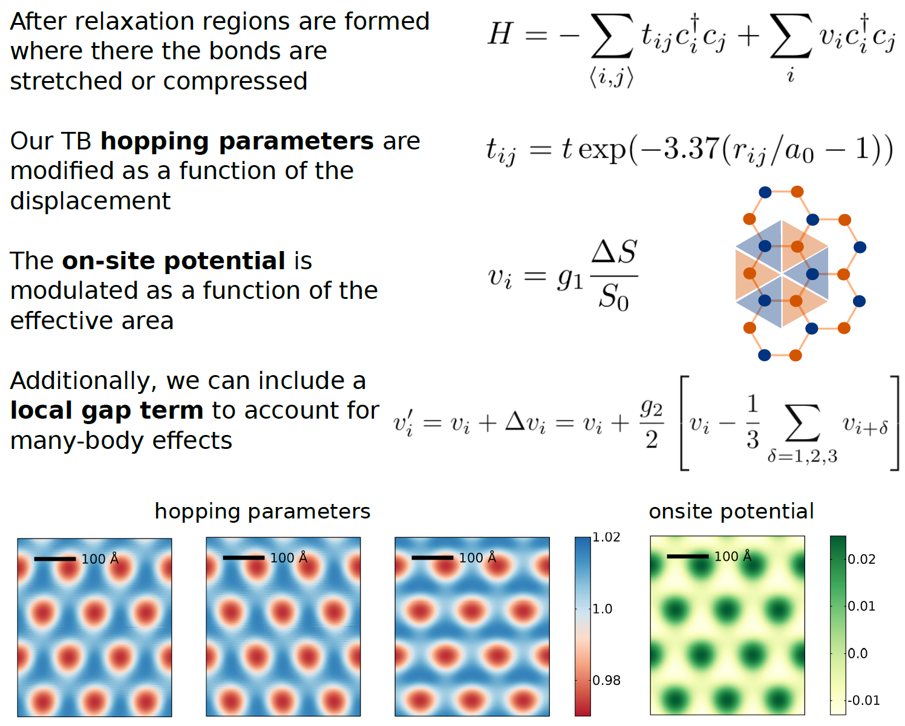
tight binding parameters

Slide 29
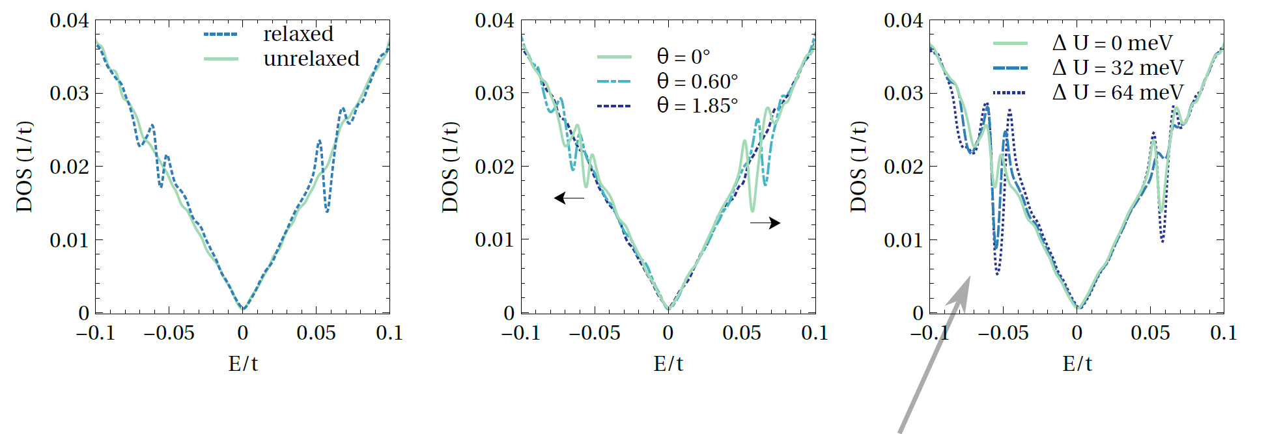
density of states (DOS)
relaxation lead to additional Dirac points, depending of the rotation angle Θ
depth of minima can be tuned
by including the local gap term ΔU = <|Δvi|>,
which changes the on-site potential drastically
G. Slotman et al. arXiv:1507.03146 (2015).

Slide 30
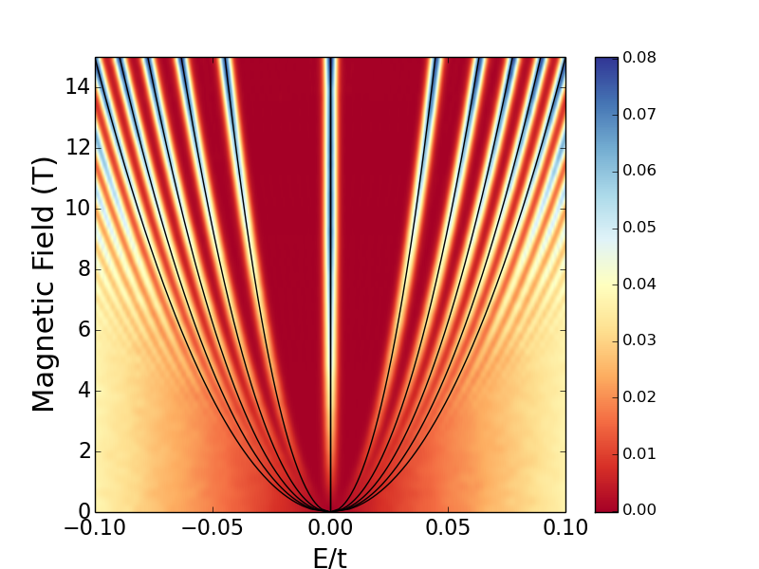
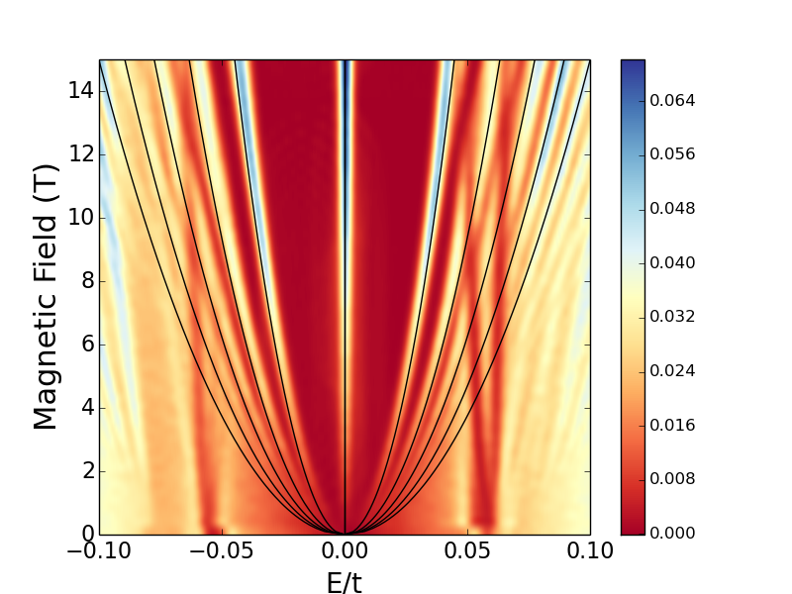
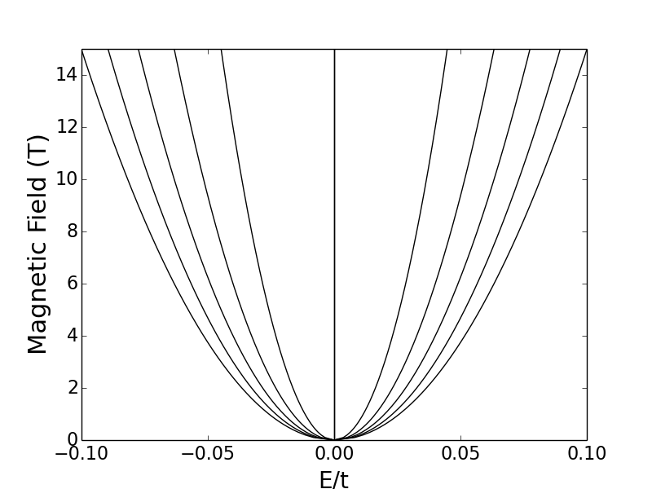
magnetic field: Landau levels
due to moire’
2D Landau levels
pristine graphene
2D Landau levels
graphene-hBN
G. Slotman et al. arXiv:1507.03146 (2015).

Slide 31
Moire’ patterns in graphene
Annalisa Fasolino
Institute for Molecules and Materials
Radboud University Nijmegen, The Netherlands
graphene and van der Waals heterostructures
rotations and lattice mismatch → moire’ pattern
rotations: graphene on graphene
mismatch: graphene on h-BN
effects on electronic structure
With thanks to
Merel van Wijk, Annelot Schuring
Guus Slotman, Shenjun Yuan, Misha Katsnelson

Slide 32

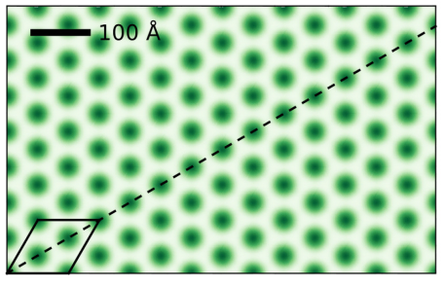
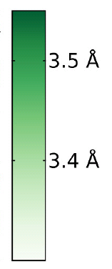



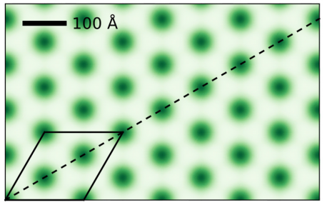

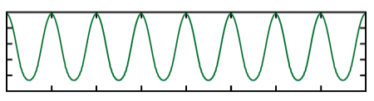


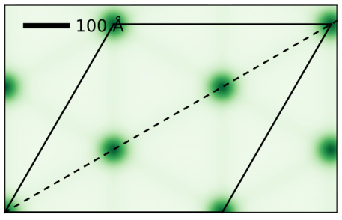



out of plane displacements z
z-displacement along diagonal
sinusoidal
localized between
flat domains

Slide 33
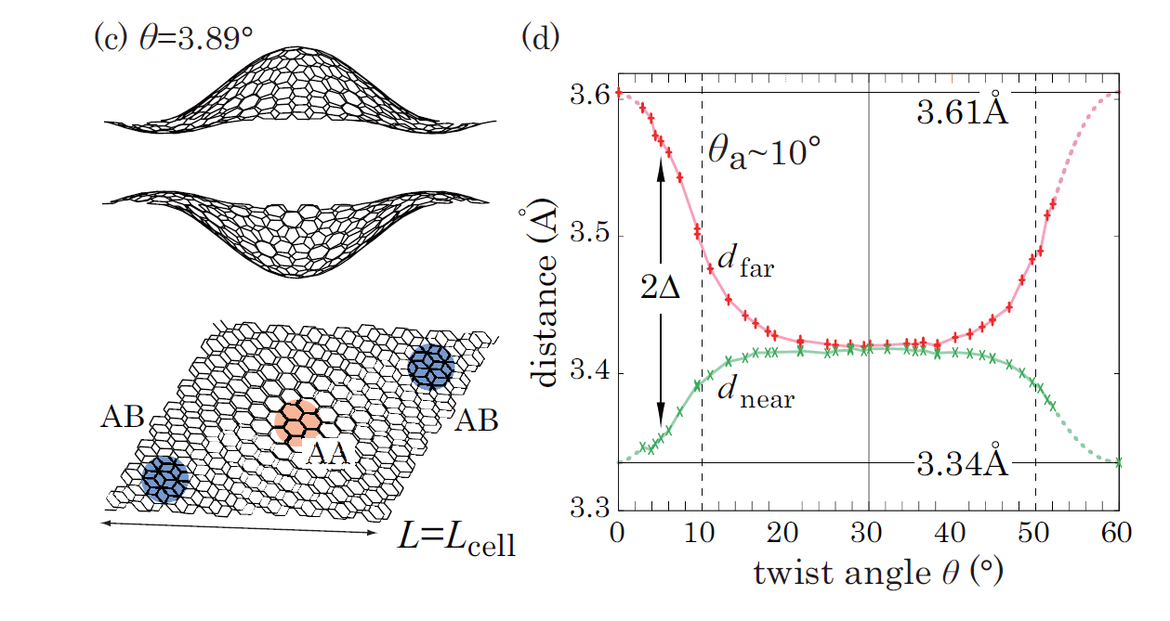
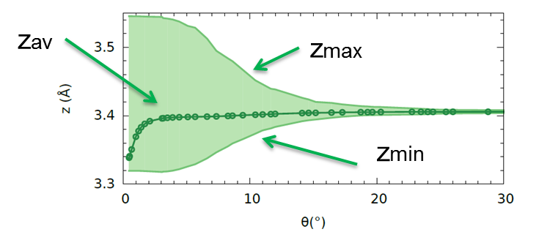

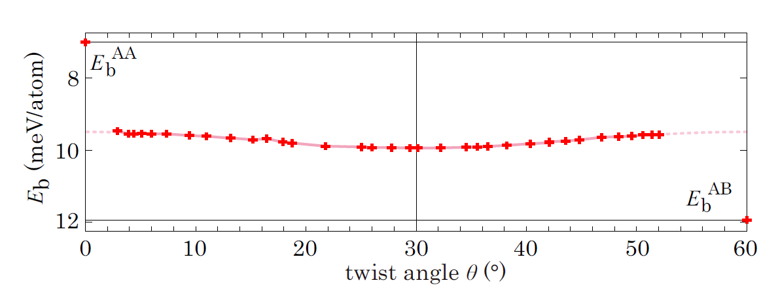
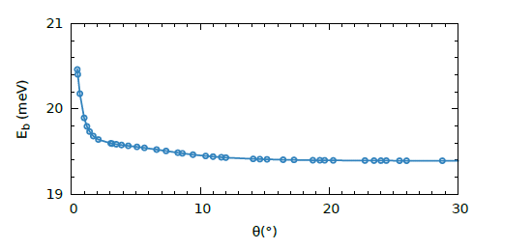
Atomistic vs DFT
AB stacking
AA stacking
K. Uchida et al. PRB 90, 155451 (2014)
M.M. van Wijk et al., 2D Mater. 2, 034010 (2015) (arxiv:150.02540)

Slide 34
graphene is extremely stiff
Graphene piece, micron long attached on one side does not collapse nor scroll

Slide 35
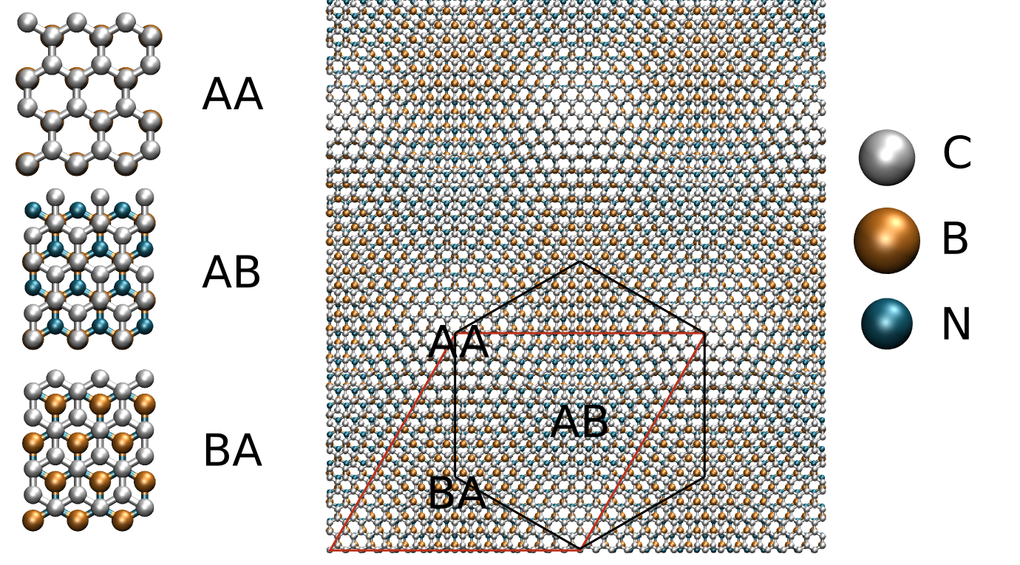
stacking energy
regions of most favourable stacking adapt to h-BN lattice parameter

Slide 36
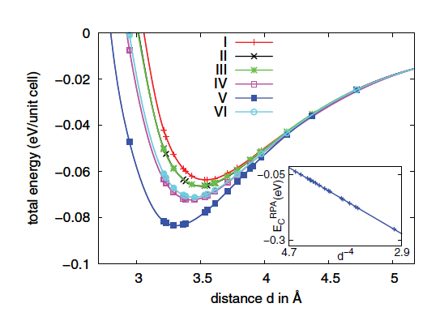

scale down CB interactions
Sachs et al, PRB 84, 195414 (2011)

Slide 37
magnetic field: Landau levels
2D Landau level

Slide 38
magnetic field: Landau levels
2D Landau levels
pristine graphene

