Slide 1
Transport signatures of strong Rashba spin-orbit coupling
Valentina Brosco
ISC-CNR & Dipartimento di Fisica, Università di Roma “La Sapienza”
In collaboration with:
Lara Benfatto, Claudio Grimaldi and Emmanuele Cappelluti
Valuable discussions with:
Marco Grilli, Sergio Caprara, Claudio Castellani, Roberto Raimondi
arxiv: 1506.01944

Slide 2
Purpose of the talk
clarify whether and how spin-orbit coupling affects DC charge transport
Outline
Motivations
Model and regimes
Results
Single-particle properties
Conductivity and mobility
Perspectives
Simple analytical expressions !

Slide 3
Spin-orbit (SO) coupling in solids
- weak anti-localization
anomalous Hall effect
spin Hall effect, spin relaxation
- topological phases
Majorana fermions
...
“understand and control the transport of spin-polarized currents and to eventually apply this knowledge in information technologies”
SPINTRONICS = spin transport electronics
D. Awshalom, Physics (2009)
Intense efforts to engineer structures and materials with strong spin-orbit coupling
Rashba ⇐ structural inversion asymmetry or
external gates
Intrinsic
Types of spin-orbit coupling
Dresselhaus ⇐ bulk inversion asymmetry
Extrinsic
Due e.g to scattering with impurities...
In this talk: Rashba spin-orbit coupling in charge transport

Slide 4
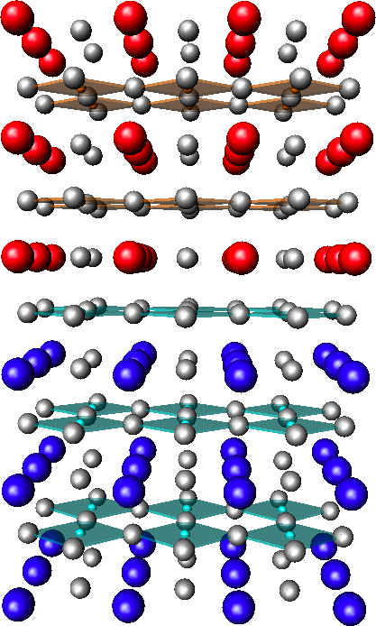
Emerging new materials …
Spin-orbit coupling estimates range from 5 to 20 meV;
Spin-orbit coupling up to 200 meV
Spin-orbit coupling up to 100 meV
Surface alloys
Oxides heterostructures
Adatoms: Bi, Pb
LaAlO3
A. Ohtomo & . Huang, Nature (2004); A. Caviglia et al., Nature (2008); …
2DEG
Crystal:
Ag, Au but also Si,Ge
SrTiO3
Gate tunable
C. Ast et al., Phys. Rev. Lett. (2007); K. Yaji et al., Nature Comms. (2009);
Tunability by changing stoichiometry
Surfaces of BiTeX, X=Cl,I,..
Other systems:
HgTe quantum wells
Organometal compunds
- Ferroelectric oxides
…
…with strong (tunable) Rashba coupling
After Sakano et al. Phys. Rev. Lett. (2013); Eremeev et al.ibid. (2012); A. Crepaldi ibid. (2012);…
Notes:
Recently new materials have been fabricated with strong Rashba coupling,
Here I just present some examples that look more representative: namely, surface alloys, Bismuth Telluro Halides
and oxide interfaces.
In the first two cases, So coupling of the order of 100 meV observed in the second case the reported SO coupling one order of magnitude smaller, but strong tunability…

Slide 5
Common features are:
2-dimensional
strong spin-orbit coupling, E0
tunable carrier density, small EF
Very different from traditional III-V semicondutors where SO coupling is a small perturbation!
Need for a theoretical description of transport
non-perturbative in E0/EF
Notes:
After first sentence, So coupling not a small perturbation as in III-V semiconductors but it can be the dominant energy scale.

Slide 6
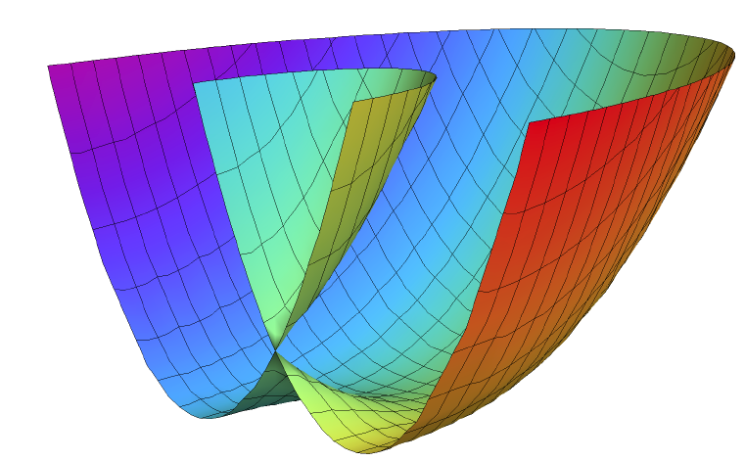
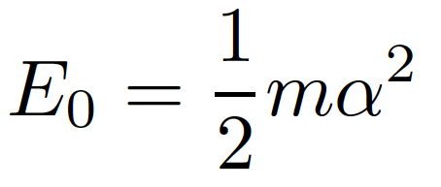
Hamiltonian
Rashba model
+
Disorder
E⁺(p)
Gaussian random disorder with
“white noise” correlations
E0
E⁻(p)
Inelastic scattering (phonons, e-e) negligible
Two chiral sub-bands with opposite helicities
Disorder characterized by
elastic scattering at zero of spin-orbit
Spin-orbit coupling strength
Helicity operator:
E.I. Rashba, Sov. Phys. Usp. (1965)
Notes:
Simplest model to describe the crucial features of these systems: 2DEG with disorder and Rashba coupling.
In the clean limit spectrum of Rashba model consists of 2 shifted parabolae, the shift proportional to R. coupling constant and effective electron mass.
E0 measures the intensity of the SO coupling.

Slide 7
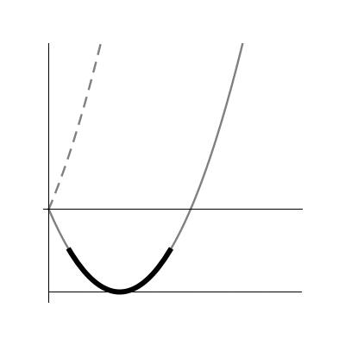
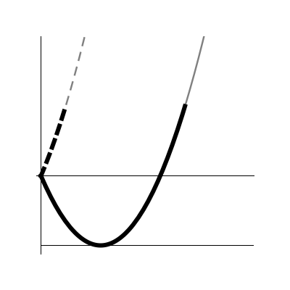
Three regimes
Relevant energy scales:
Diluted impurities
(i) Weak SO regime :
Chiral bands heavily broadened by disorder
(Dyakonv-Perel’ regime)
(ii) Strong SO regime :
(iii) Ultrastrong SO regime:
E
E
μ
μ
FS = two circles
with equal helicities
Fermi surface (FS) = two circles with opposite helicities

Slide 8
Single-particle properties

Slide 9
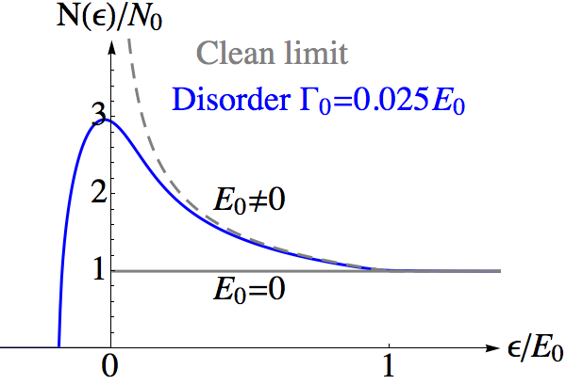
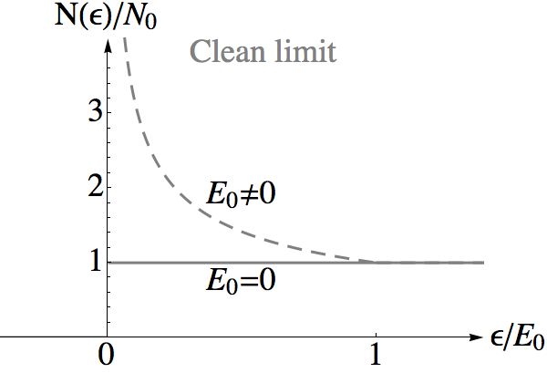
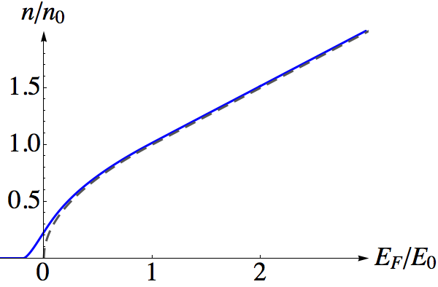
Density of states (DOS)
Van Hove singularity due to Rashba coupling
Disorder induced smearing
Band edge
Charge density
Critical density
Analytical formulae in clean limit !

Slide 10
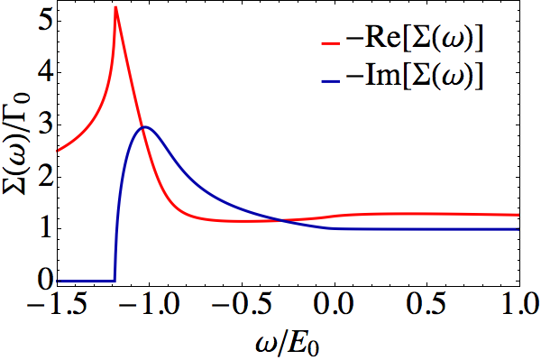
Green’s function
Diagrammatic perturbation theory in Matsubara frequencies
Diagonal matrix in the helicity basis
Self-consistent Born approximation
(SCBA)
Impurity average
Σ(iωn) =
Spin-independent self-energy!
G(iωn)
Lowest order in
DOS and elastic scattering rate:
Notes:
Let me just very briefly give you some technical details.
To calculate we use diagrammatic perturbation theory in Matsubara frequencies and then we do the analytical cont.
We do SCBA which corresponds to this diagram and gives the lowest order in gamma0/EF. It’s a conserving theory.
In this approx. diagonal green’s function and spin-independent self-energy.
Self-energy of course determined by solving sc equation, both real and imaginary part are calc.
Let’s focus on imaginary part this gives both Dos at EF and gamma.

Slide 11
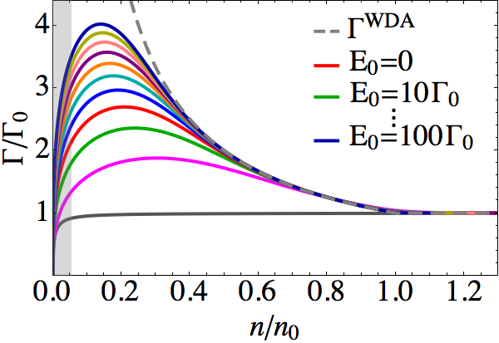
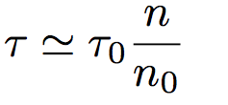
Elastic scattering rate within self-consistent Born approximation
Shaded region : corrections to SCBA
important
Weak-disorder approximation (WDA)
Neglect broadening of spectral functions
Quasi-particle approx.
Elastic scattering rate and time
in the WDA
Notes:
Structure of Gamma is strongly influenced by van Hove singularity, as the dos.
Good analytical estimate of by WDA, WDA fails when I start to feel the band edge

Slide 12
Transport properties

Slide 13
Longitudinal DC conductivity within Born approximation
Matsubara frequencies diagrams
+
+
+…
=
Bare current
“Dressed”
current
Same vertex also leads to vanishing spin-Hall effect !!!
A or R = advanced or retarded argument
Spin-Hall bubble
=
=
Bare spin-current
Disorder only affects the “anomalous” part of the current
Anomalous terms
Momentum and current (velocity) NOT parallel
[J,H]≠0
Notes:
This slide is just to tell you what we calculated: we calculated the conductivity within LRT, within Born approximation this corresponds to sum all ladder diagrams and it can be related to bare current- renormalized current correlation function.
The current and the Green function have a matricial structure, both bare and dressed currents have an anomalous term.

Slide 14
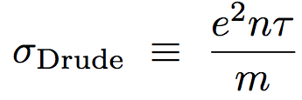
Conductivity
In the absence of spin-orbit coupling
within our assumptions:

Slide 15
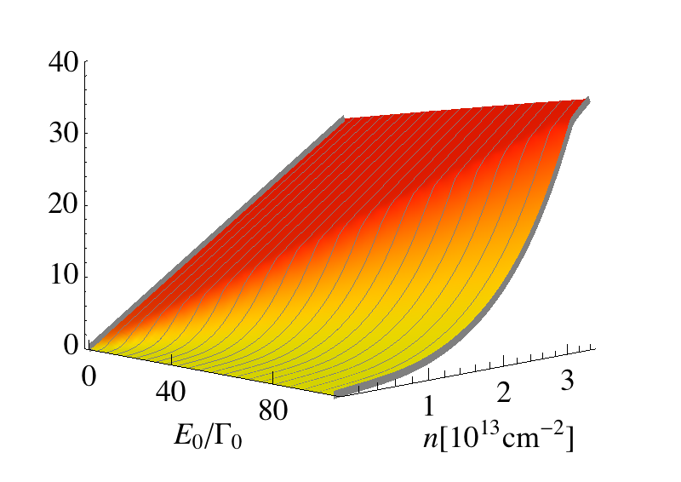
Conductivity as a function of density and Rashba coupling
If E₀ > Γ₀ at low-doping conductivity becomes sublinear and deviates from Drude law
By appropriate rescaling universal behavior obtained

Slide 16
Two charge-transport regimes
Analytical results within WDA
Remarkably simple formula!
Decrease of the conductivity due to BOTH
Increase of the scattering rate
Non-zero anomalous vertex

Slide 17
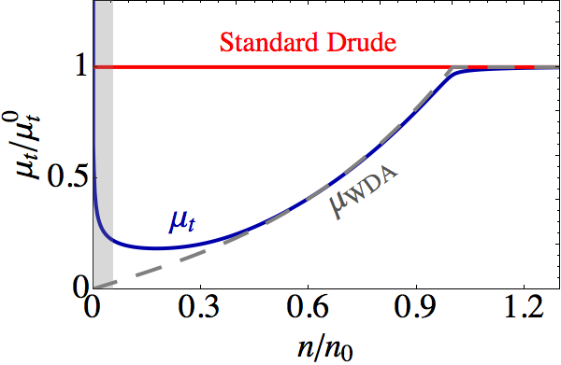
Mobility, μ_{t}
μ_{t} =vdrift/E
Drift velocity per unit electric field
Related to the conductivity, via
Drude limit
High accuracy of WDA !

Slide 18
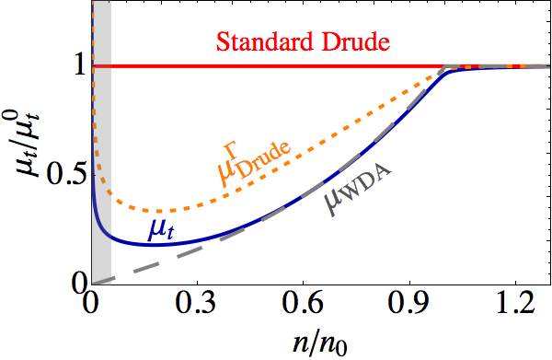
Two-fold origin mobility modulation
Strong dependence of the mobility on doping due to BOTH
Increase of the scattering rate
Non-zero anomalous vertex

Slide 19
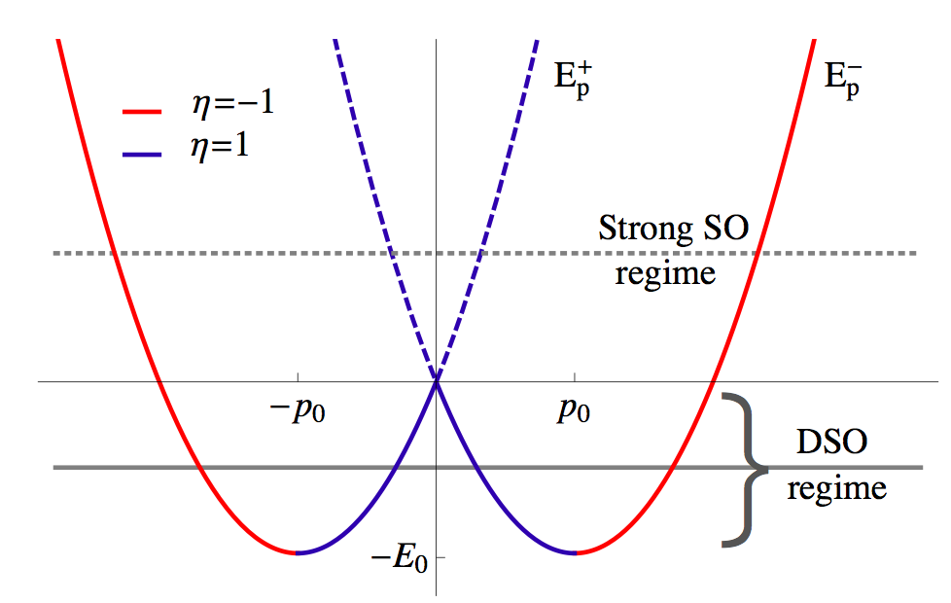
Different classification of the states
in the strong and dominant SO coupling regimes
Average velocity of helicity state s
In both regimes we have:

Slide 20
Boltzmann approach and relaxation time approximation
recover Kubo results
within WDA
k₊
k₋
Back-scattering
within the same band is suppressed

Slide 21
Conclusions
Two regimes of charge transport in the presence of Rahsba coupling
In the dominant SO-coupling regime:
Enhancement of transport scattering
Non-zero anomalous vertex
Reduction of the mobility and of the longitudinal conductivity
Analytical universal formulae to describe the conductivity which could be readily used to fit experiments
New physics in ultrastrong spin-orbit regime
Measure E₀ in a plain DC transport experiment!
Perspectives
arxiv: 1506.01944

Slide 22
Some numbers

Slide 24
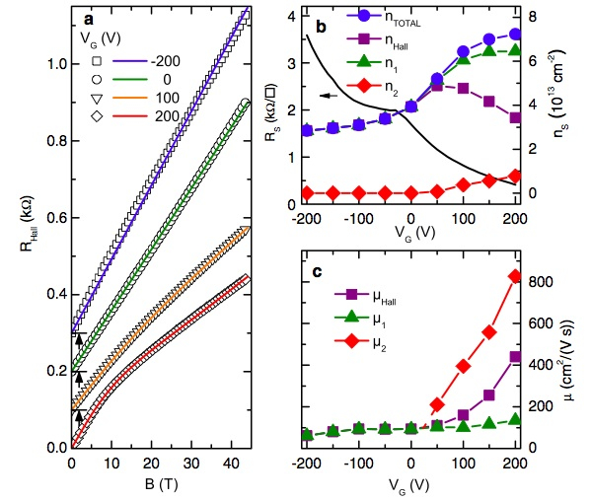
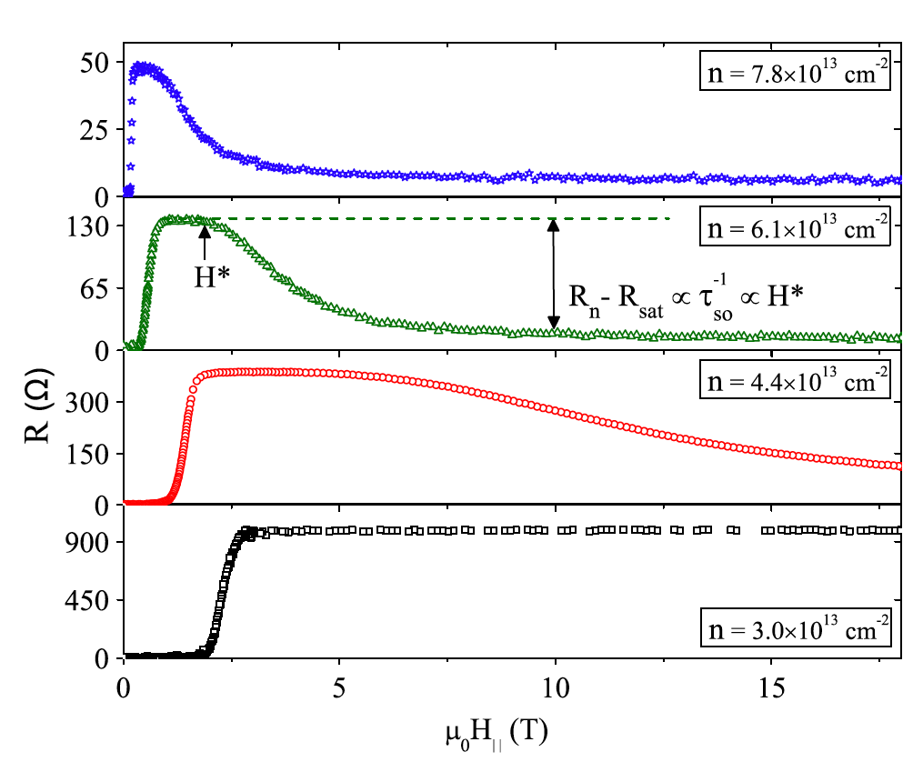
Anomalies in transport
In-plane magnetic field
After J. Biscaras et al. PRL (2012)
After M. Ben Shalom et al. PRL 2010
Density dependent mobility due to different species of carriers, different subbands ?

Slide 25
Decomposition of the current
Transverse and longitudinal components
Diagonal in the chiral basis
Proportional to ασy
Always negligible contribution due to negligible overlap of spectral functions
At strong spin-orbit only intraband contributions to the conductivity

Slide 26
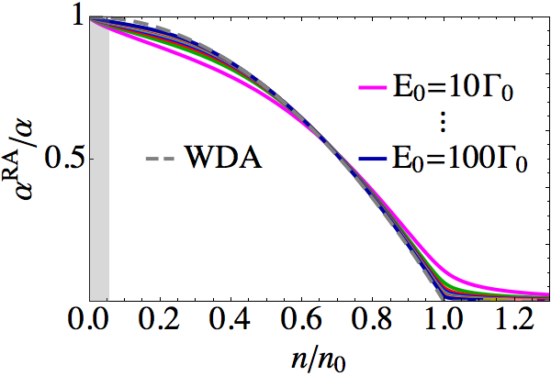
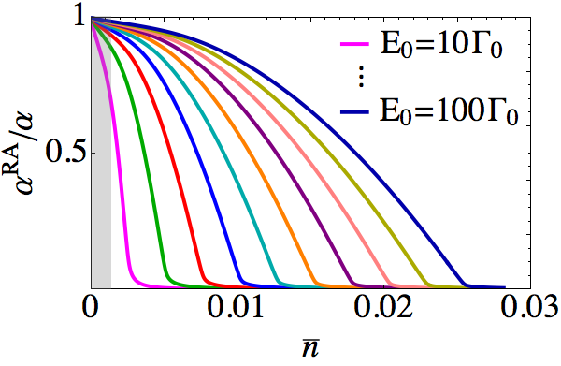
Dressed anomalous vertex
Universal analytical results within WDA
Vertex corrections are relevant in both regimes!

