Slide 1
SC of KM3
Vidyo meeting of Thursday, February 18
The km3-IT sea bed infrastructure
The new CTD & IL cables
The optical pod in the JB
Deployed tower & JB status

Slide 2
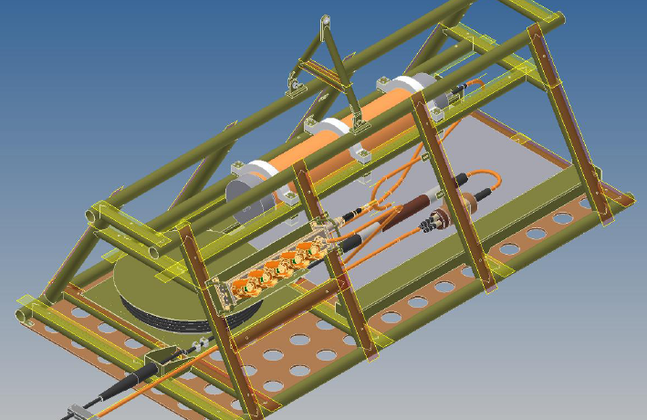
The NEW cable termination Frame
As in December
Dec. 17: meeting in Billund to try to anticipate time schedule
Present delivery time: end JUNE
ODI items delivery time: 1st week of April
New CTF delivery time : try to anticipate to the end of April
As in February
ODI items: test on Mach 3.
DC/DC converter (MVC): test on March 6
Assembly: Mid March
Acceptance Test of the CTF: last week of March
New CTF present delivery time: first week of April
→

Slide 3
Special interlink cables (9AWG) from CTF to JBs
Mail from Euroceanique to Riccardo on January
Delivery date :
20th of March2015
P/N 1090516 (interlink type 1 – 390m) qty : 1
P/N 1090517 (interlink type 1 – 310m) qty : 1
P/N 1090515 (interlink type 1 – 590m) qty : 1 –
P/N 1090518 (interlink type 1 – 130m) qty : 1

Slide 4
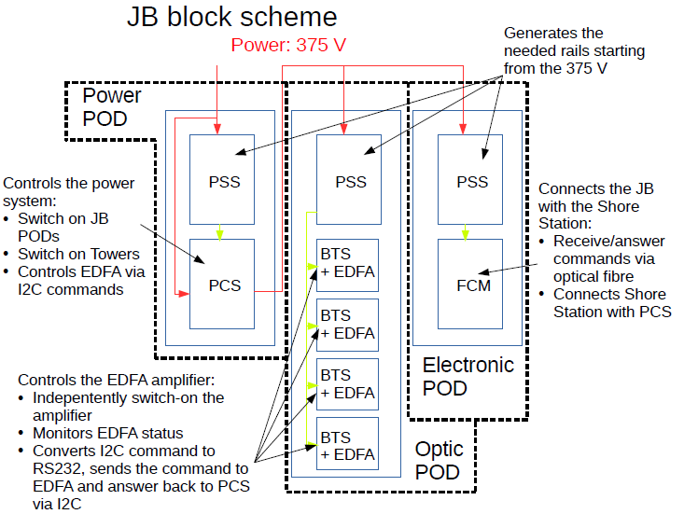

Slide 5
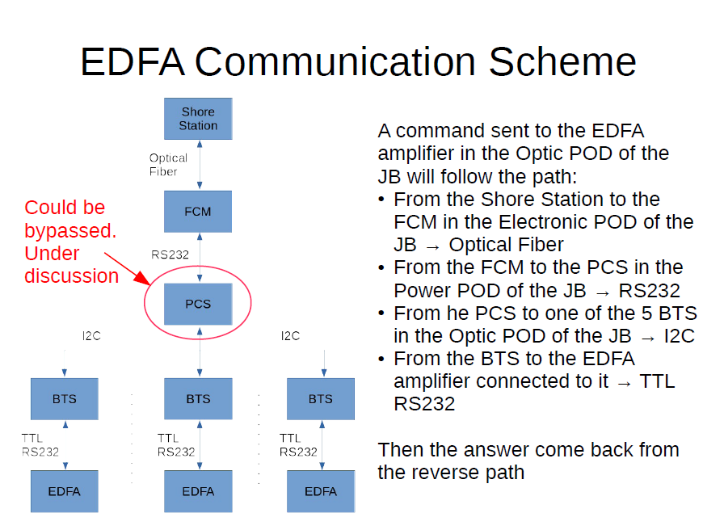

Slide 6
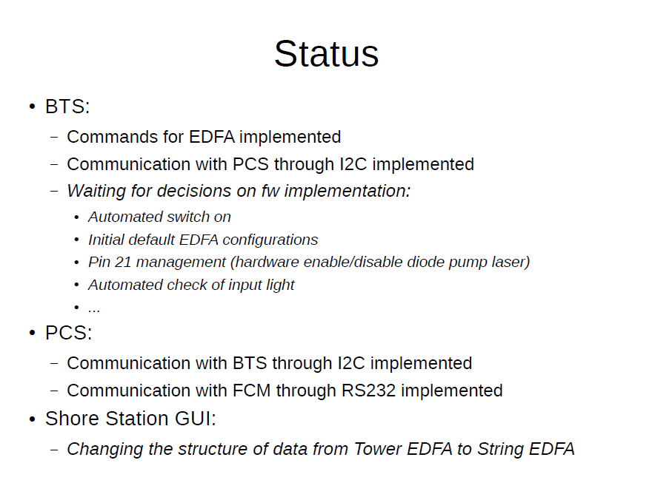

Slide 7
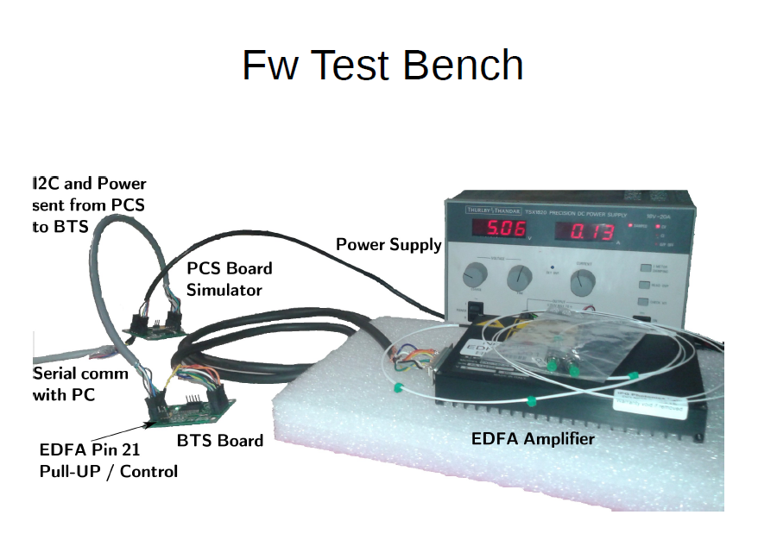

Slide 8
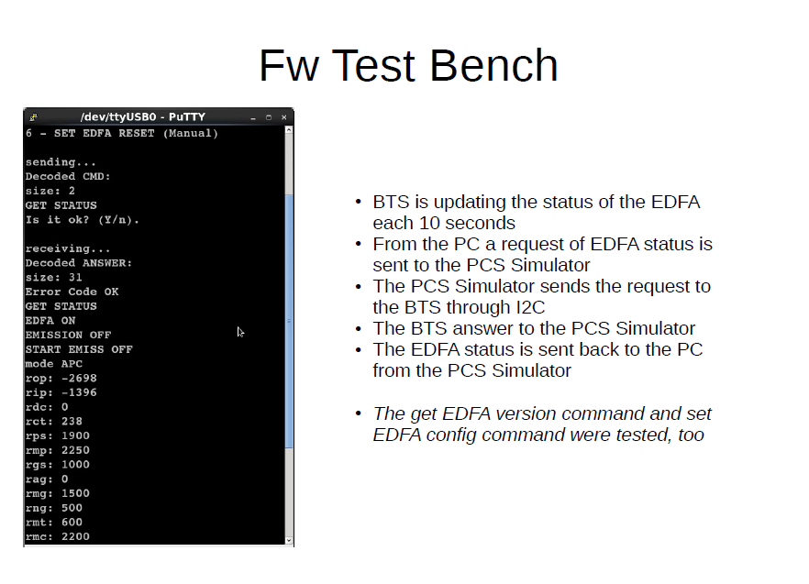

Slide 9
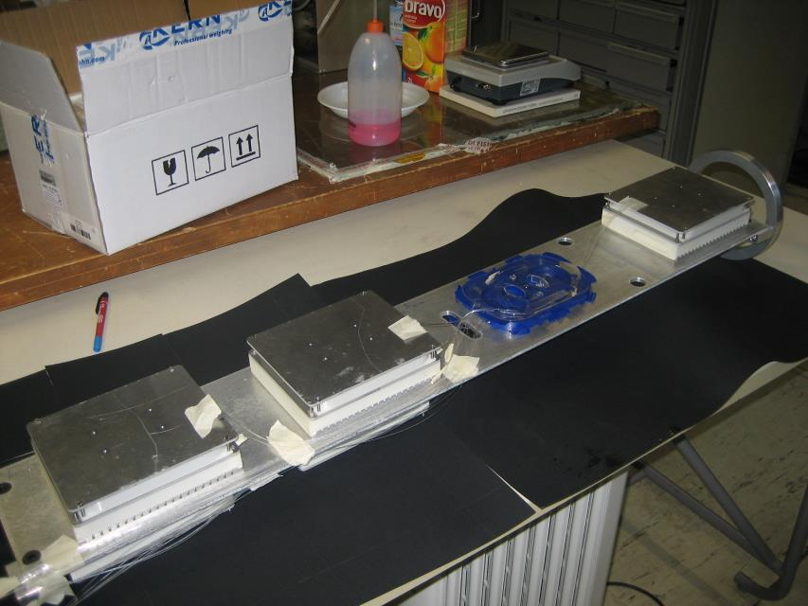
Assembling test of the optic pod

Slide 10
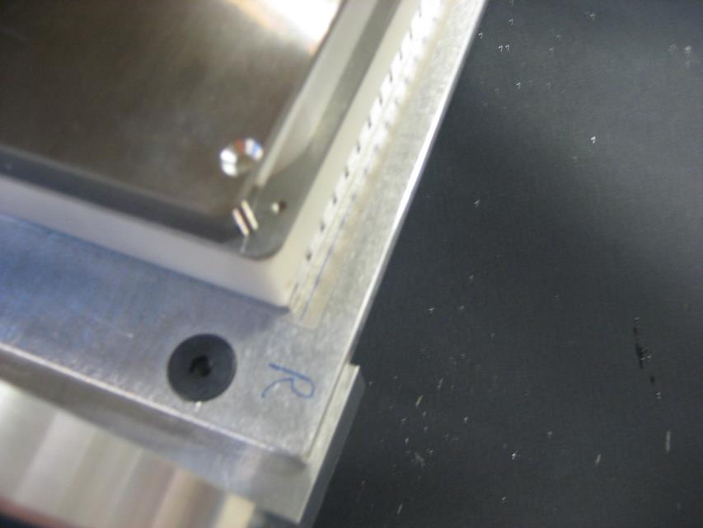
Insulating EDFA fom the backplane
Thin (0.2 mm)
insulating MICA sheet

Slide 11
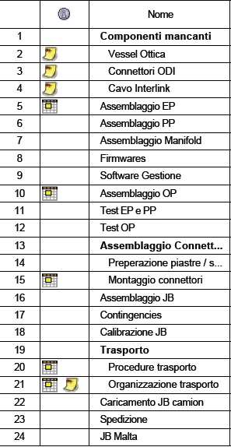
Gannt

Slide 12
Status of the JB and of the Tower already deployed
Deployed and immediately operational on November, 17th
Initial status: nominal conditions; 2 out of 84 OMs with zero signal (but PMTs base active→ no water inlet on the spheres)
On November 25 we observe an increase of the current on the 375V line to floor #6 : from 20mA nominal to the upper acceptable limit of 80 mA. In these condition the PCS electrically disconnect the floor. No evidence of anomalous behavior on the current, (low) voltage, temperature, humidity on the floor control module before this increase.
Similar behavihour observed in the other floors during the following weeks. (more than one half of the floors)
No evidence of recovery when switch OFF/ON sequence is applied

Slide 13
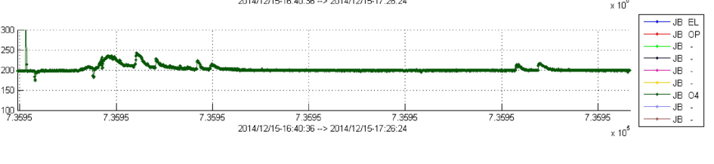
Current intensity@375V on floor #12 measured in the base of the tower
?
Current intensity@375V measured in the JB
~ 40’ time interval

Slide 14
Detailed investigation of possible reasons of the fault are underway
Test in pressure water tank of the backbone
Test of the full power configuration from tower base to one floor
The second full integrated tower will be switched on
Recovery of the full tower planned during next sea operation, March 16

Slide 15
JB status
till early February: 1 output on (tower) , 7 outputs off.
February 5th: 7 output from OFF→ ON to check possible curren leaks. Vout=375V, Iout=0 mA
February 9th: set current upper limit on Power Control Board to 50mA on all 375V lines
This limit is too low for the power supply of the 4 EDFAs in the OPTIC pod
↓
no more communication with JB was possible
↓
system is no more under control
↓
decide to switch off the MVC

Slide 16
This is a severe error PARTIALLY due to lack of man power and pressure on deployment date
However, the JB did not suffer any damage. Can be cured during next sea operation with JB on board to allow reconfiguration
Unconfortable situation but:
Recovery and redeploy of JB scheduled on March, 16 (should be easy)
Recovery of the tower scheduled in the same sea operation (more difficult)
Power shorts @375: should be easy to identify
Power cut will allow to complete power cabinet installation at the shore station

