Slide 1
Which kind of companies
During the Mid Term Review we got suggestions from Octavian Buiu, our reviewer, about companies that could be interested to our developments and we plan to contact them as soon as WP5 will have some results
We have to find stakeholders!

Slide 2
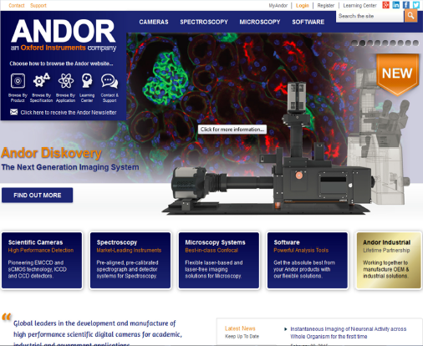
http://www.andor.com/
Andor technology, based in Belfast, part of Oxford Instruments as 2014, “Global leaders in the development and manufacture of high performance scientific digital cameras for academic, industrial and government applications

Slide 3
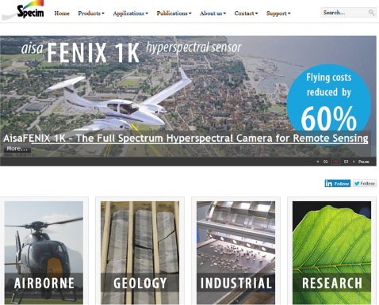
http://www.specim.fi/
Hyperspectral Imaging Cameras and Systems – SPECIM
To this day, in order to reach the high-ends of precision, durability and functionality, SPECIM has been in the forefront with new technological solutions applied to hyperspectral imaging
World class research, business, and defense organizations are relying on Specim quality when performance and
reliability matters

Slide 4
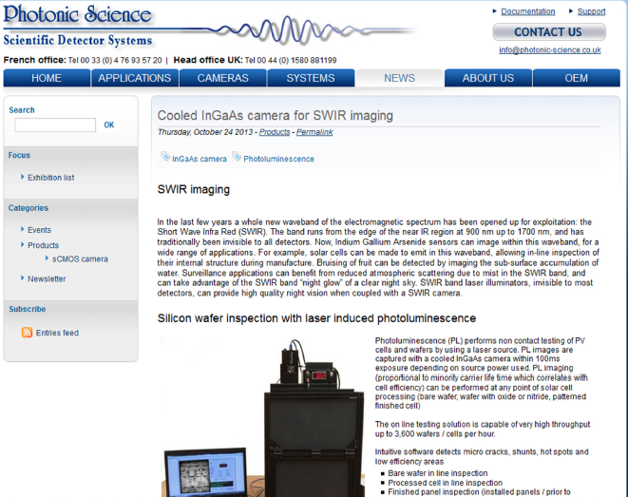
http://www.photonic-science.co.uk/news/index.php?post/2013/05/06/new-cooled-ingaas-camera-quantitative-SWIR
Photonic Science – Scientific Detector Systems - SWIR imaging - In the last few years a whole new waveband of the electromagnetic spectrum has been opened up for exploitation: the Short Wave Infra Red (SWIR). The band runs from the edge of the near IR region at 900 nm up to 1700 nm, and has traditionally been invisible to all detectors. Now, Indium Gallium Arsenide sensors can image within this waveband, for a wide range of applications.
For example, solar cells can be made to emit in this waveband, allowing in-line inspection of their internal structure during manufacture. Bruising of fruit can be detected by imaging the sub-surface accumulation of water. Surveillance applications can benefit from reduced atmospheric scattering due to mist in the SWIR band, and can take advantage
of the SWIR band “night glow” of a clear night sky. SWIR band laser illuminators, invisible to most detectors, can provide high quality night vision when coupled with a SWIR camera

Slide 5
http://www.arm.com/ The Architecture for the digital world

Slide 6
However ….
Also in Tuscany ….
Alkeria srl Polo scientifico e Tecnologico Via Giuntini 25 int. 36 - 56023 Navacchio (PI) - Italy Tel. +39 050 77 80 60 Fax +39 050 76 91 12

Slide 7
http://www.n-zero.it
N Zero Srls
Via S.Martino, 302/A 55049 Viareggio (LU)
WEBKan by N Zero

