Slide 1
FTK IAPP Workshop: 11/03/2015
WP5: A new approach to
Image Processing
Calliope-Louisa Sotiropoulou

Slide 2
A New Approach to Image Processing
WP5: Image Processing
Impact of IAPP outside HEP community

Slide 3
A New Approach to Image Processing
The FTK Processor is a very fast, powerful and efficient pattern matching machine →
So if we remove the physics analysis that comes after tracking and the geometry of the detector that comes before, then….
The particle tracking problem is in fact an image processing problem

Slide 4
A New Approach to Image Processing
The concept (of WP5) is to…
Use existing resources and ideas (e.g. the AMchip, AMboards) for image processing and pattern matching for different application fields
A great number of interdisciplinary applications – not limited to image processing - is available: biomedical imaging (e.g. MRI), cognitive imaging (Del Viva’s algorithm¹), security (real time face recognition, personnel tracking), DNA analysis, smart cameras, data mining (e.g. data servers, search engines) etc.
¹M. Del Viva, G. Punzi, and D. Benedetti. Information and Perception of Meaningful Patterns. PloSone 8.7 (2013): e69154.

Slide 5
FTK for Image Filtering
Image Filtering → Finding Contours is the way human brain operates: New approach for image processing hardware
Major difference between HEP and Human Brain:
  For HEP we are aware a-priori of the relevant patterns
  The Human Brain is trained in real time
  (we are not aware of the patterns beforehand and we always adjust to new environments)
Target:
Design and prototype a pattern matching machine that executes both training and filtering in real time using high performance embedded systems (FPGAs, ASICs and combination of the two - SiP / System In Package)

Slide 6
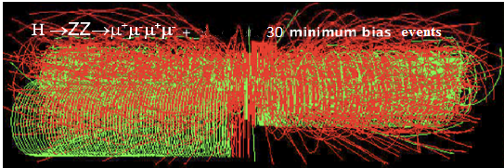
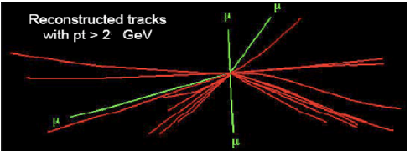
FTK for Image Filtering
HEP
Filtering of Natural Images

Slide 7


FTK for Image Filtering
Build small arrays of pixels (3x3 for static images or 3x3x3 for movies – 3rd dimension for time) that are AM patterns (M. Del. Viva, G. Punzi)
B/W 2⁹=512 patterns: 101-010-100, ……. , 111-011-001
4 gray level 2¹⁸= 256 Kpatterns: 00,00,01-00,01,00-11,00,10 …..
B/W + time 2²⁷= 128 Mpatterns: 111,000,000 - 000,111,000 - 000,000,000
Training: Calculate the frequency of each pattern in the sample images/frames
Compute Probability Density Histograms (PDHs) for different training image sets
Select the relevant patterns to be put in the AM bank

Slide 8
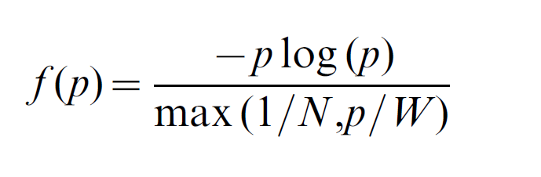
FTK for Image Filtering
Choice of relative patterns: Choose the pattern set that maximizes entropy H under real constraints
Unbounded entropy
Entropy yield per unit cost and for each pattern:
Where p is the probability that a given portion of the input data matches a specific pattern, N is the maximum number of storable patterns and W is the maximum allowed total rate of pattern acceptance.

Slide 9
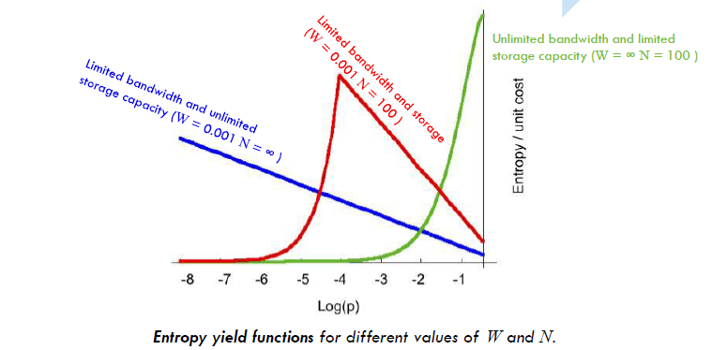
FTK for Image Filtering

Slide 10
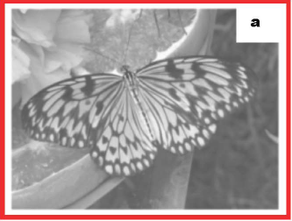
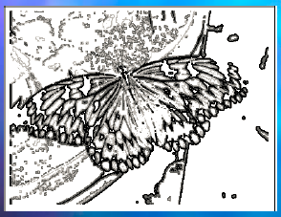
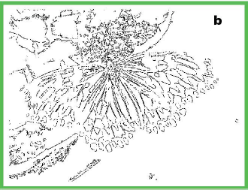
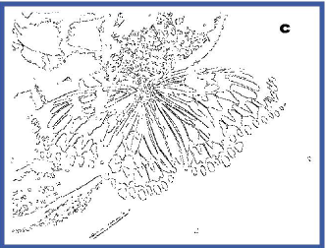
FTK for Image Filtering
4 grey level:
2¹⁸ patterns
Stored N=2000
= 1/64 of 1 chip
= 50 mW
Accepting only
these 50 patterns
Accepting only
these 16 patterns
9.8%
5.5%

Slide 11
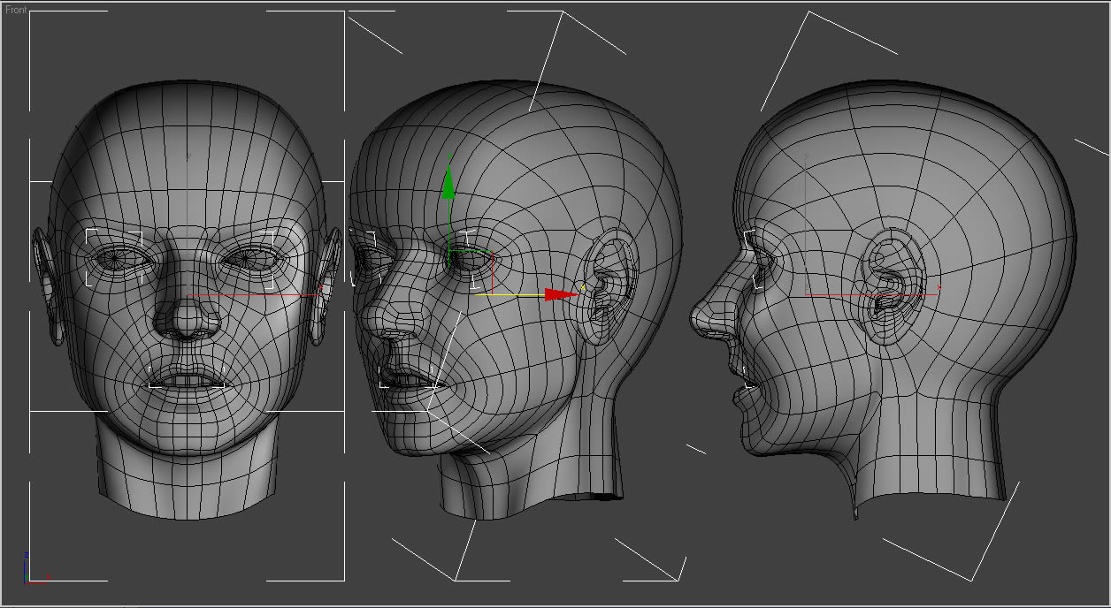
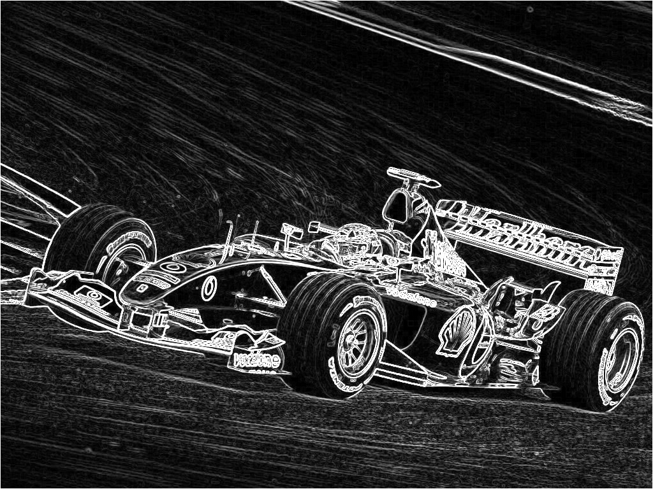
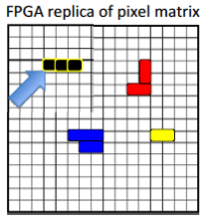
FTK for Image Filtering
After contour identification a variety of post-processing implementations can be used
  2D Pixel Clustering
  Image/video reproduction with contours visible
  Shape recognition

Slide 12
Current Plans 1:
Use of AMchip 05 Test system
A Virtex-6 LX240T Development board with a system implemented to test the AMchip
Functions that exist:
  Pattern loading
  Pattern comparison
  Ethernet connection
  IPbus controls
  GTX transceivers etc.

Slide 13
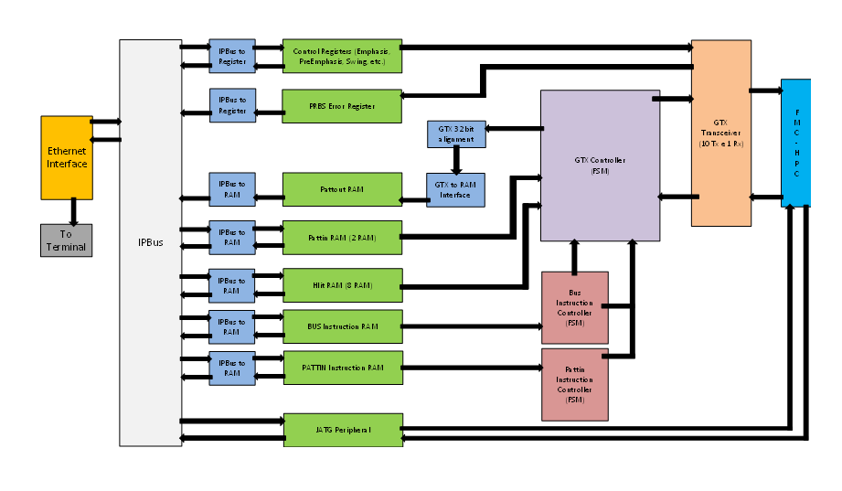
Current Plans 1:
Use of AMchip 05 Test system

Slide 14
Current Plans 1:
Use of AMchip 05 Test system
Adapt the existing system to load images and execute the training phase
  Identify all existing patterns, generate Probability Density Histograms
  Identify useful patterns
Adapt the existing system to execute pattern matching
  Load the useful patterns to the AMchip
  Execute pattern matching for various input images
  Extract contours or/and execute a post processing step (e.g. clustering)

Slide 15
Current Plans 1:
Training Phase – Calculate the frequency of each possible pattern
4 Gray levels 2¹⁸= 256 Kpatterns (B/W movement: 2²⁷= 128 Mpatterns)
i. e. pattern = 11,11,11-11,11,11, 01,11,11
Each pattern = its own address
32 b × 256 k
= 500 kB
Pattern = ADDRESS
FREQUENCY = FREQ(pattern)
(movement
32 b ×128 M
= 500MB)
Ext Memory
2 GB
16 bits
18 (or27) bits
Each Location contains the updated frequency of a pattern. When a pattern is identified the specific pattern address is read, contents are increased by one (+1), and written back in the same location - ACCUMULATION

Slide 16
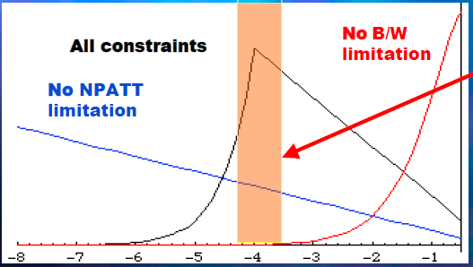
Current Plans 1:
Training Phase – Updating Frequencies
Patterns that are efficient carriers of information
given the bandwidth (W) & memory limits (N)
Log(p)
W/N>p
W/N<p
f(p) = -pNlog (p)
f(p) = -Wlog (p)
FREQ(pattern)
-pNlog (p)
RAM
16 bits
Compare
To THR
Y/N
FREQ(pattern)
-Wlog (p)
Count patterns that pass
THR and compare to N
Write them in the AM
RAM
16 bits

Slide 17
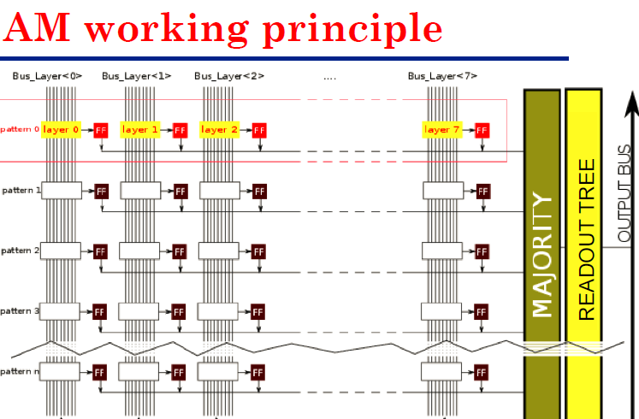
Current Plans 1:
Running Phase – Filtering Patterns
4 gray levels $→256 kpatterns→\sim 1\% good kpatterns=2 kpatterns$
GOOD for AM05 used with threshold 1 – same pattern written 8 times in the 8 columns
Each comparison we (1) compare 8 patterns (2) read for each match the bitmap (3) give INIT
………
Patt0 Patt1 Patt2 Patt7
Running Phase
Bus_layer0 Bus_layer1 Bus_layer2 …….. Bus_layer7
layer0
layer1
layer2
pattern0
layer7
layer0
layer1
layer2
pattern1
layer7
pattern2
pattern3

Slide 18
Future Plans 2:
Use of ATCA AMchip Mezzanine
One mezzanine with 8 Amchips-05
Parallel input and also parallel output
8x more patterns available for comparison
More suitable for video input

Slide 19
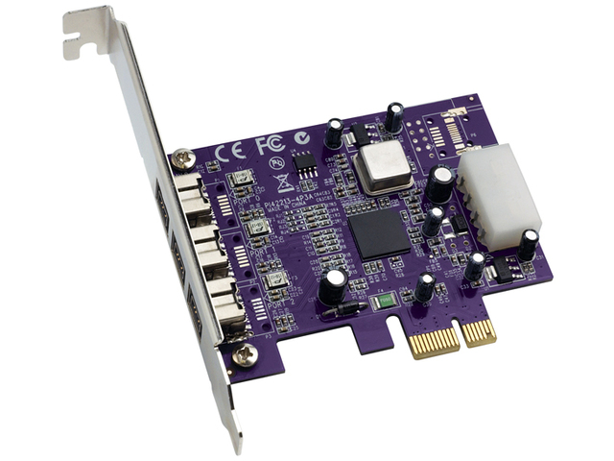
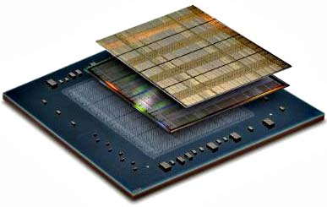
Future Plans 3:
Use of an Ultrascale evaluation board and System on Chip (SiP) systems
More resources available on the FPGA device → New technology, new design approaches, greater challenges (Ultrascale)
Merge the devices on a single chip (SiP)
Targeting the development of a portable and flexible hardware accelerator (possibly with a PCI type interface) to be easily interconnected with a PC

Slide 20
Thank you…

