Slide 1
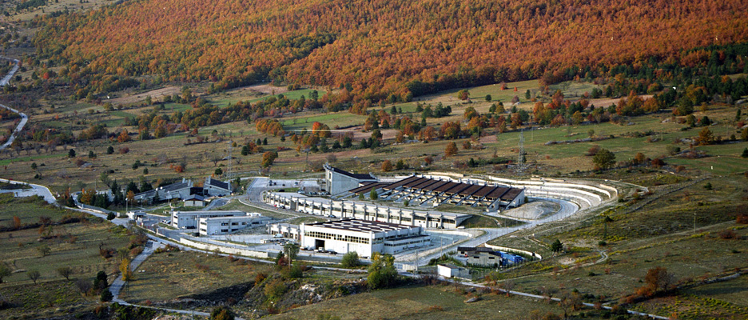
Laboratori Nazionali del Gran Sasso

Slide 2
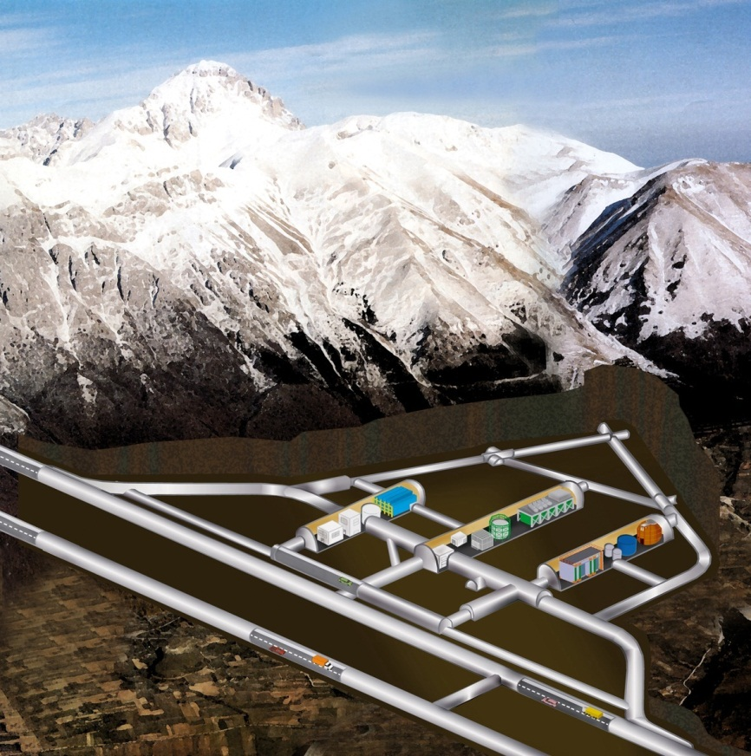
Laboratori Nazionali del Gran Sasso
Muon flux: 3.0 10⁻⁴ m⁻²s⁻¹
Neutron flux:
2.92 10⁻⁶ cm⁻²s⁻¹ (0-1 keV)
0.86 10⁻⁶ cm⁻²s⁻¹ (> 1 keV)
Rn in air: 20-80 Bq m⁻³
Surface: 17 800 m²
Volume: 180 000 m³
Ventilation: 1 vol / 3.5 hours
3400 m.w.e.
1.1 μ / (m² h)
Mechanical Design and Workshop
Electronics Lab & Service
Chemistry Lab & Service
ULB Lab & Service
> 900 users from 29 countries
~ 100 Staff
225 avg. daily presence in 2014
~ 8000 visitors/y
Virtual tour via Street View

Slide 3
LNGS

Slide 4
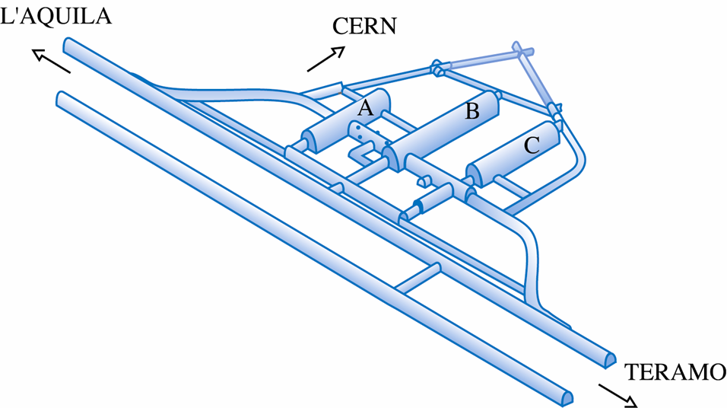
LNGS Activities
CRESST
XENON 1T
ERMES
GERDA - II
LVD
XENON
GINGER
ERMES-W
LUNA
CUORE
DARK SIDE 50
BOREXINO
VIP
LUNA-MV
COBRA
LOW ACTIVITY LAB
DAMA/LIBRA

Slide 5
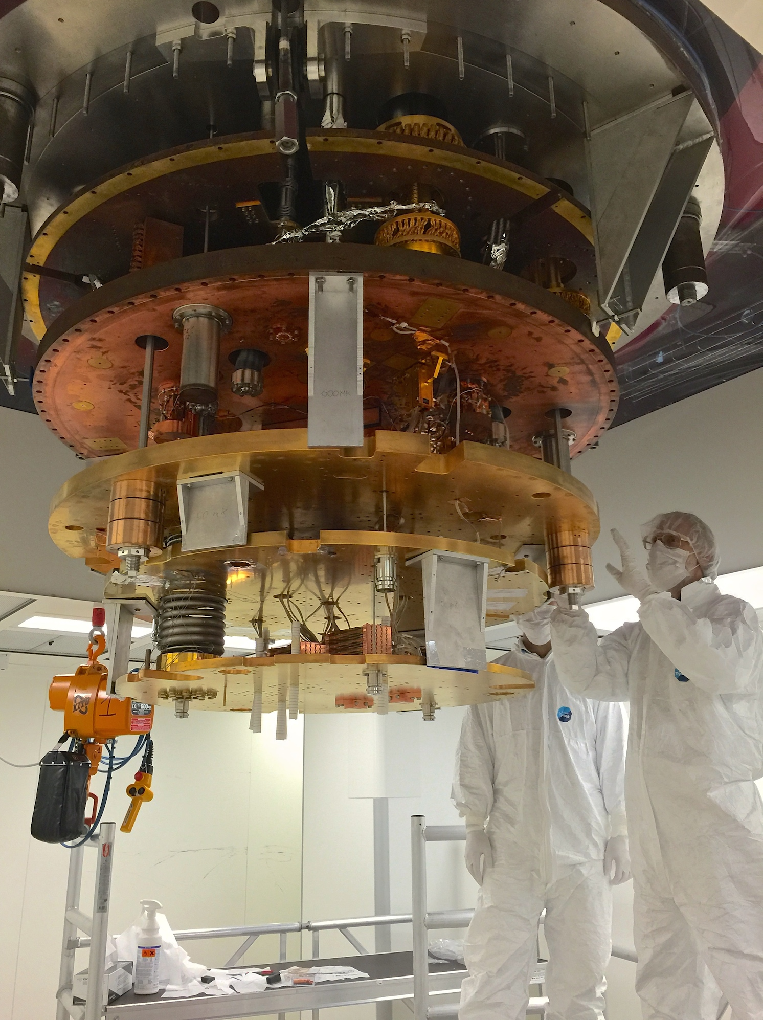
LNGS Neutrino
SN neutrino:
  LVD 1 kton liquid scint. Waiting for SN since 1992
Solar Neutrino:
  Borexino: real-time measurement of pp neutrino, …, Geo-neutrinos
Double Beta Decay
  Gerda / Gerda-II: ⁷⁶Ge
  CUORE – the coldest m³ in the world : ¹³⁰Te
  Cobra: ¹¹⁶Cd
  LUCIFER: R&D phase on crystals
Sterile Neutrino
  Borexino-SOX (CeSOX first)

Slide 6
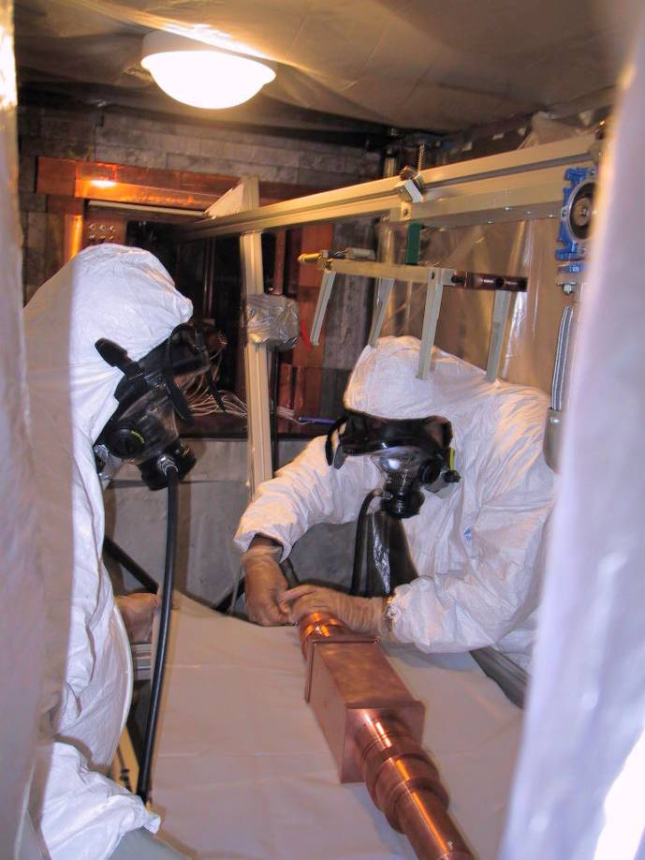
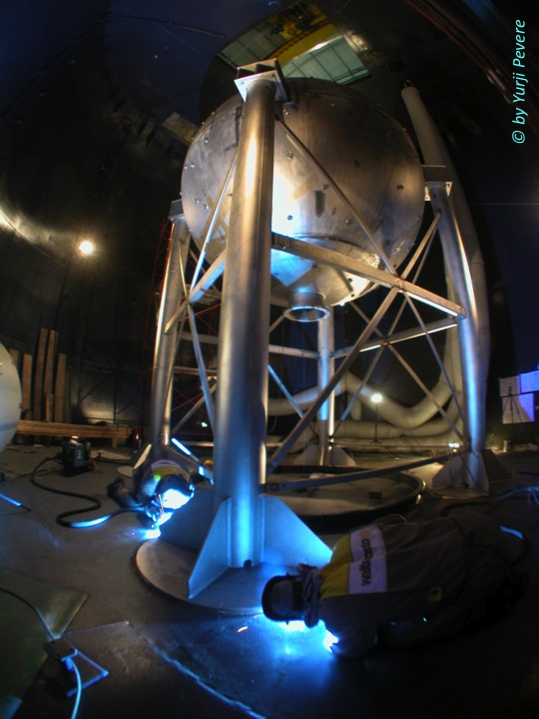
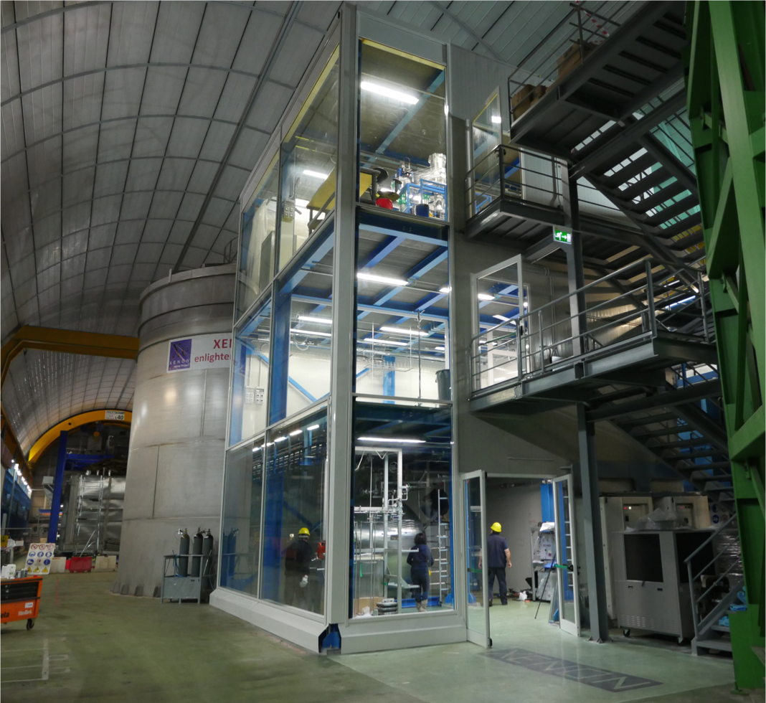
LNGS Dark Matter
DAMA/Libra: NaI
  Reports annual modulation
NaI
  INFN-LNGS is going to support independent test of DAMA result
CRESST
  CaWO₄ scint with bolometric r/o
XENON family
  Double phase liquid Xe TPC
DarkSide
  Liquid Ar TPC double phase

Slide 7
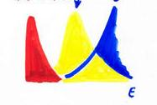
LNGS Nuclear Astrophysics
Maxwell
Boltzmann
Gamow Peak
σ
LUNA-400 – LUNA-MV
  Measurement of small x-section relevant to Nucleosynthesis
  LUNA-MV upgraded with intense C-beam
Solar neutrinos:
  ³He(³He,2p)⁴He, ³He(⁴He,γ)⁷Be, ¹⁴N(p,γ)¹⁵O
Age of globular cluster:
  ¹⁴N(p,γ)¹⁵O
Light nuclei nucleosynthesis
  ¹⁵N(p,γ)¹⁶O, ¹⁷N(p,γ)¹⁸O, ²⁵Mg(p,γ)²⁶Al
Big Bang Nucleosynthesis:
  ²H(α,γ)⁶Li, ³He(⁴He,γ)⁷Be, ²H(p,γ)³He
Next:
Light nuclei nucleosynthesis:
  ¹⁷O(p,α)¹⁴N, ²²Ne(p,γ)²³Na, ²³Na(p,γ)²⁴Mg, ¹⁸O(p,γ)¹⁹F, ¹⁸O(p,α)¹⁵N
He burning and stellar evolution:
  ¹²C(α,γ)¹⁶O
s process nucleosynthesis:
  ¹³C(α,n)¹⁶O, ²²Ne(α,n)²⁵Mg

Slide 8
LNGS General, Multidisciplinary
GINGER
  Ring-laser to probe Lense-Thirring effect
Cosmic Silence
  Study effect of very low radiation doses on cells, fleas, …
  Test Linear No Threshold model
ERMES-W
  Primary resources, global geodynamic…
VIP
  Test Pauli Exclusion Principle

Slide 9
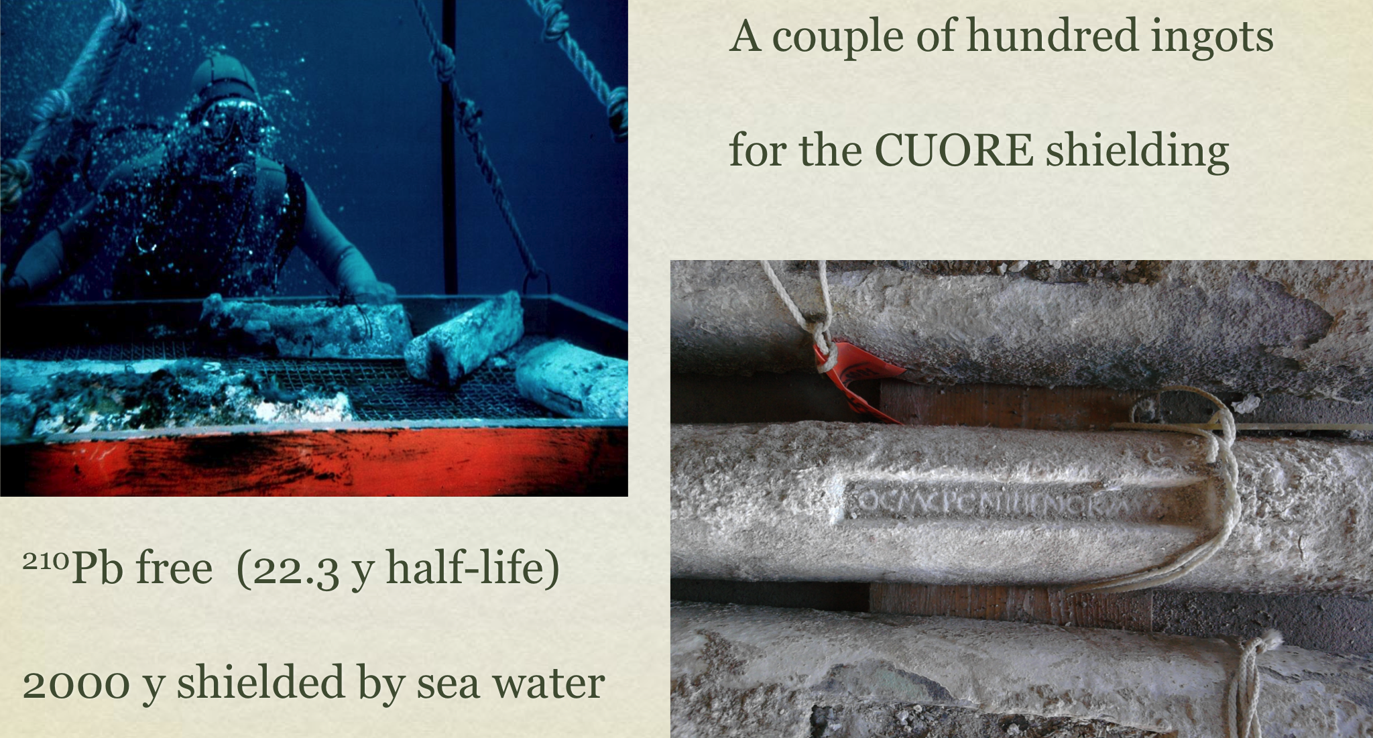
2000 Years Old LRT

