Slide 1
The SPARC_LAB Thomson source
C. Vaccarezza
on behalf of the SPARC_LAB team

Slide 2
Outline
General layout
Thomson Source design parameters
Laser & electron beam parameters
Source optimization & reference WP
Experimental results
What’s next

Slide 3
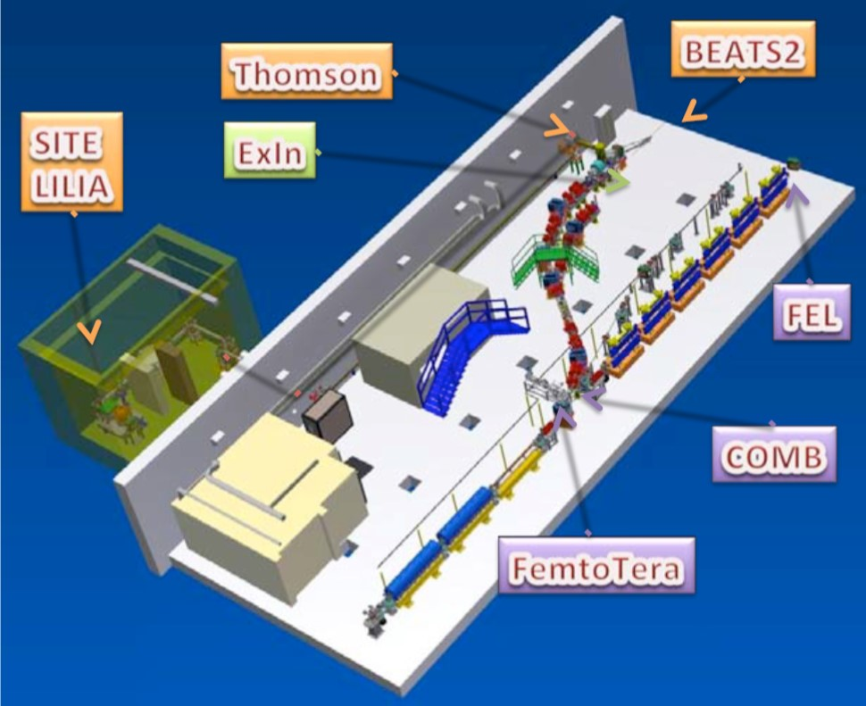
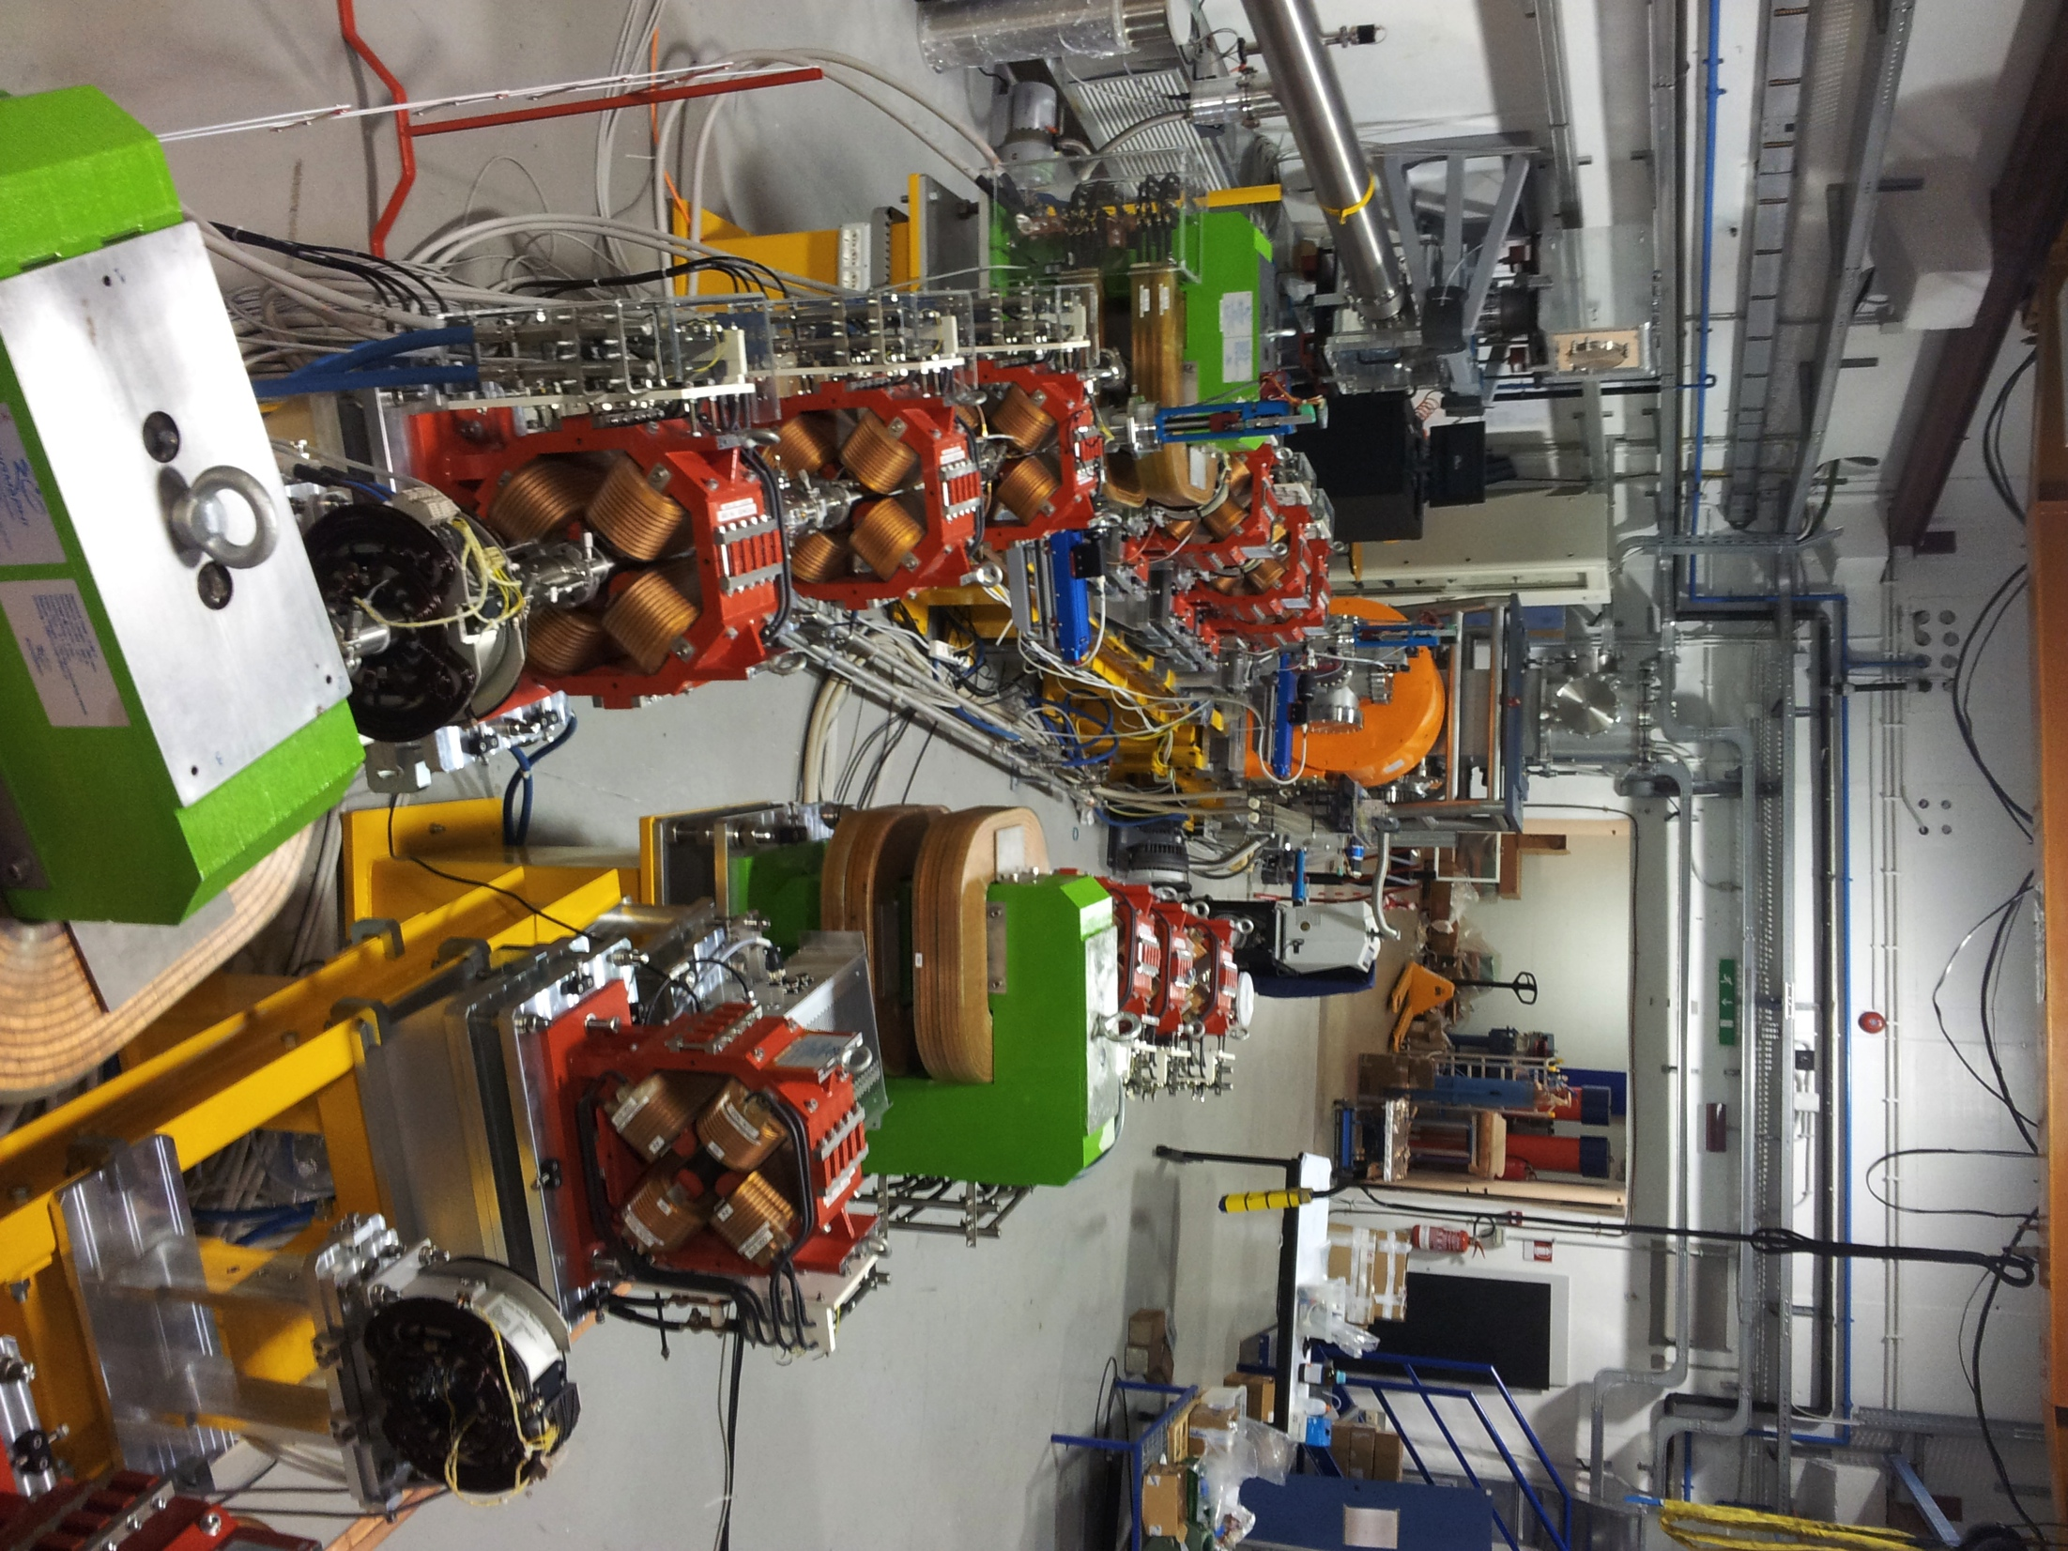
SPARCLAB

Slide 4
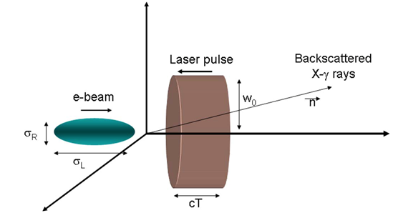
Thomson source design parameters
X-ray beam characteristics
Photon Energy (keV) | 20÷500
Photon number per shot | 10⁹
Source rms radius (μm) | 10
Bandwidth (%) | 10

Slide 5
APPLICATIONS @ 20-500 keV
Mammography
Identification of fissile materials
Cristallography
Microdensitometry 3D for cultural her.
Single Shot Imaging at psec time scale
(not accessible to FELs for hν > 20 keV
precluded to Sync. Light Sources, CW)

Slide 6
Thomson Source Parameter List
FLAME Laser
SPARC Electron Beam
Wavelength 800 nm
Compressed pulse energy 1-5 J
Pulse duration/bandwidth 6 ps
Rep.Rate 10 Hz
Beam quality M2 <1.5
Energy stability 10%
Pointing stability < 2 µm
Synchronization with SPARC photoinjector clock < 1 ps
Bunch charge 100-800 pC
Energy 30-150 MeV
Length 15-20 ps
ε_{n x,y} 1-3 µ rad
Energy spread <0.1 %
Spot size at IP 5-20 µm
Rep.Rate 10 Hz

Slide 7
A TS source driven by high-quality electron beams can work in different operating modes, e.g.:
High-flux-moderate-monochromaticity mode(HFM2) suitable for medical imaging when high-flux sources are needed
Moderate-flux- monochromatic-mode (MFM) suitable to improve the detection/dose performance
Short-and-monochromatic-mode (SM) useful for pump-and- probe experiments e.g. in physical-chemistry when tens of femtosecond long monochromatic pulses are needed.

Slide 8
From theory
*-P. Tomassini et al Appl. Phys. B 80, 419-36 , 2005
-P. Tomassini et al. IEEE Trans. on Plasma Sci. 36,n.4, 2008

Slide 9
HFM2 operating mode
For the first experiments the source has been optimized for applications in medical imaging, mammography in particular.
Highest X-ray flux at about 20 keV, with a relative radiation energy spread < 20% and keeping as low as possible the high harmonics contribution.

Slide 10
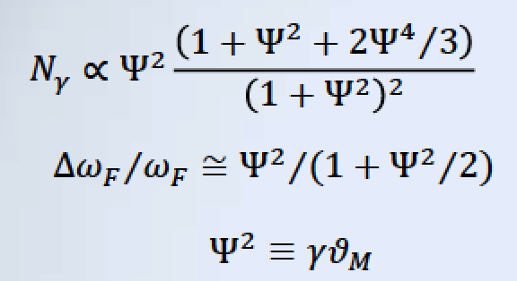
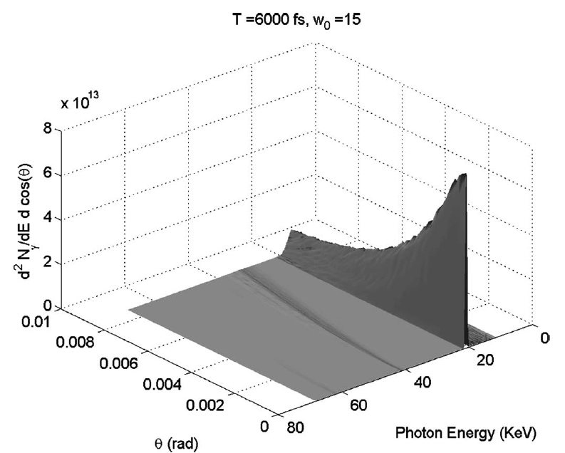
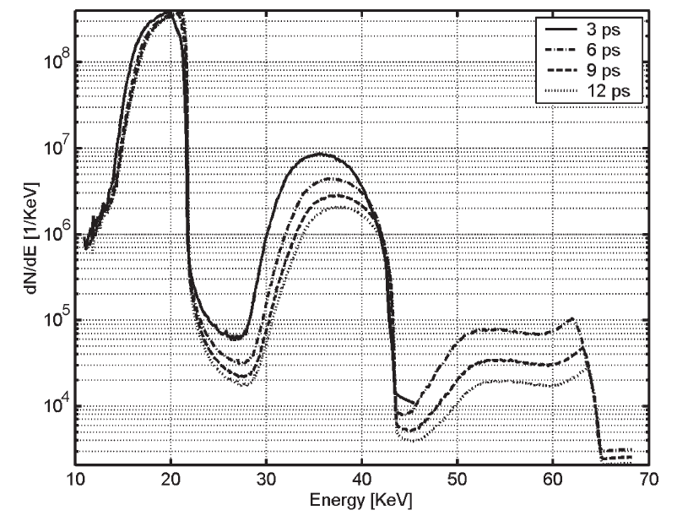
The Thomson Interaction laser
for
Spectral–angular (integrated in the azimuthal angle φ) distribution of the collected radiation for the optimized parameters w = 15 μm and duration T = 6 ps, where ϑ_{M} = 8 mrad
Spectra of the collected radiation for pulses of duration 3, 6, 9, and 12 ps.

Slide 11
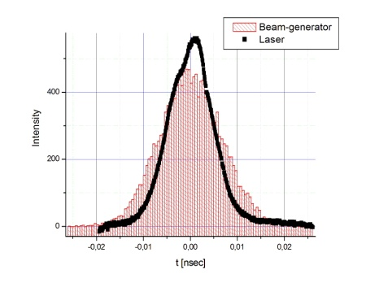
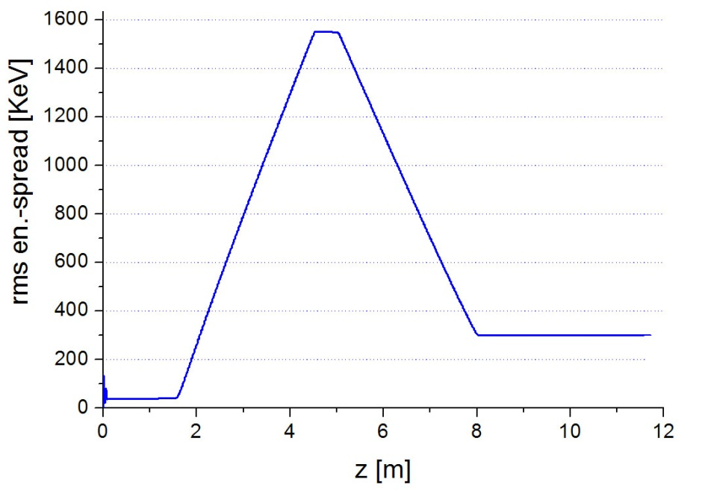
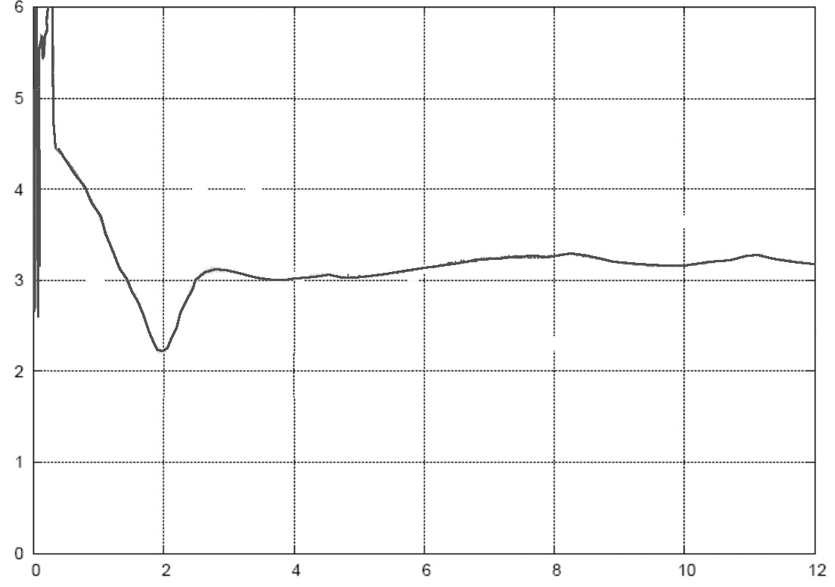
The nominal case injector : 30MeV, 840pC
2007 measured beams
ε_{x,y}= 2.7 mm-mrad (at first TW Cavity entrance)
sol. embedded
sol. embedded
Off
11.0 MV/m
2.0 MV/m
120 MV/m
ϕ(S1)=0°
ϕ(S2)=90°
Measured Laser-profile
A.Bacci
Int.
ε_{th}=1.2 mm-mrad (norm. σ_{x}= 1 mm)
σ_{t} = 6.5 psec
Q_{bunch} = 840 pC
σ_{x,y} = 0.57 mm
Energy Spread Correction
t [ps]
6
emittance
3 mm-rad
ε_{x} [mm-mrad]
0
12
z [m]

Slide 12
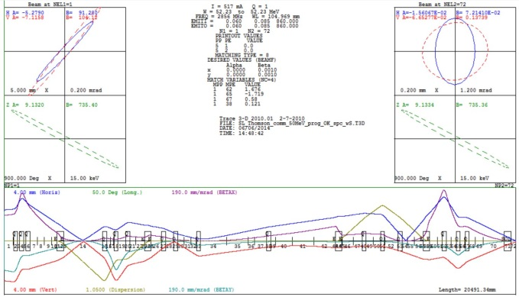
e⁻beam envelope evolution down to IP
Twiss parameters and envelope evolution from the linac exit to the Thomson IP obtained with the TRACE3D code

Slide 13
Source spectra simulations
Spettro
θ=6 mrad
V.Petrillo
E_{e}=30 MeV
N_{tot}=1,69 10⁹
Δω/ω (FWHM)=10.5 %
Δω/ω rms=5.2 %
div (FWHM)= 22 mrad
div rms= 5.3 mrad
θ=1 mrad

Slide 14
BEATS 2 experiment
I phase: Experimental verification of possible applications to breast diagnostic of the X Thomson beam produced in the laboratories of Frascati LI2FE
Scattering chamber setup – X-ray beam line setup (collimators, beam monitors, photon flux measurement) Electron beam and laser beam alignment. Collision parameter optimization for 20keV energy: stability ( flux, jitters) and spectral distribution. Imaging line installation. Topographic characterization of 20 keV X beam. Characterization of focal spot (effective area of collision). Preliminary tests of absorption and phase contrast radiography.
II phase: Monochromatic absorption radiography experiments w human tissue equivalent samples and dosimetry at 20 keV. Contrast phase radiography experiments w human tissue equivalent samples and dosimetry at 20 keV. Collision parameter optimization for 40 keV energy. Topographic characterization of 40 keV X beam. Contrast phase radiography experiments at 40 keV. Radiography experiments at the two energies and dosimetry. Collision parameter optimization at the iodine k-edge (33 keV) Differential radiography experiments at k-edge and dosimetry

Slide 15
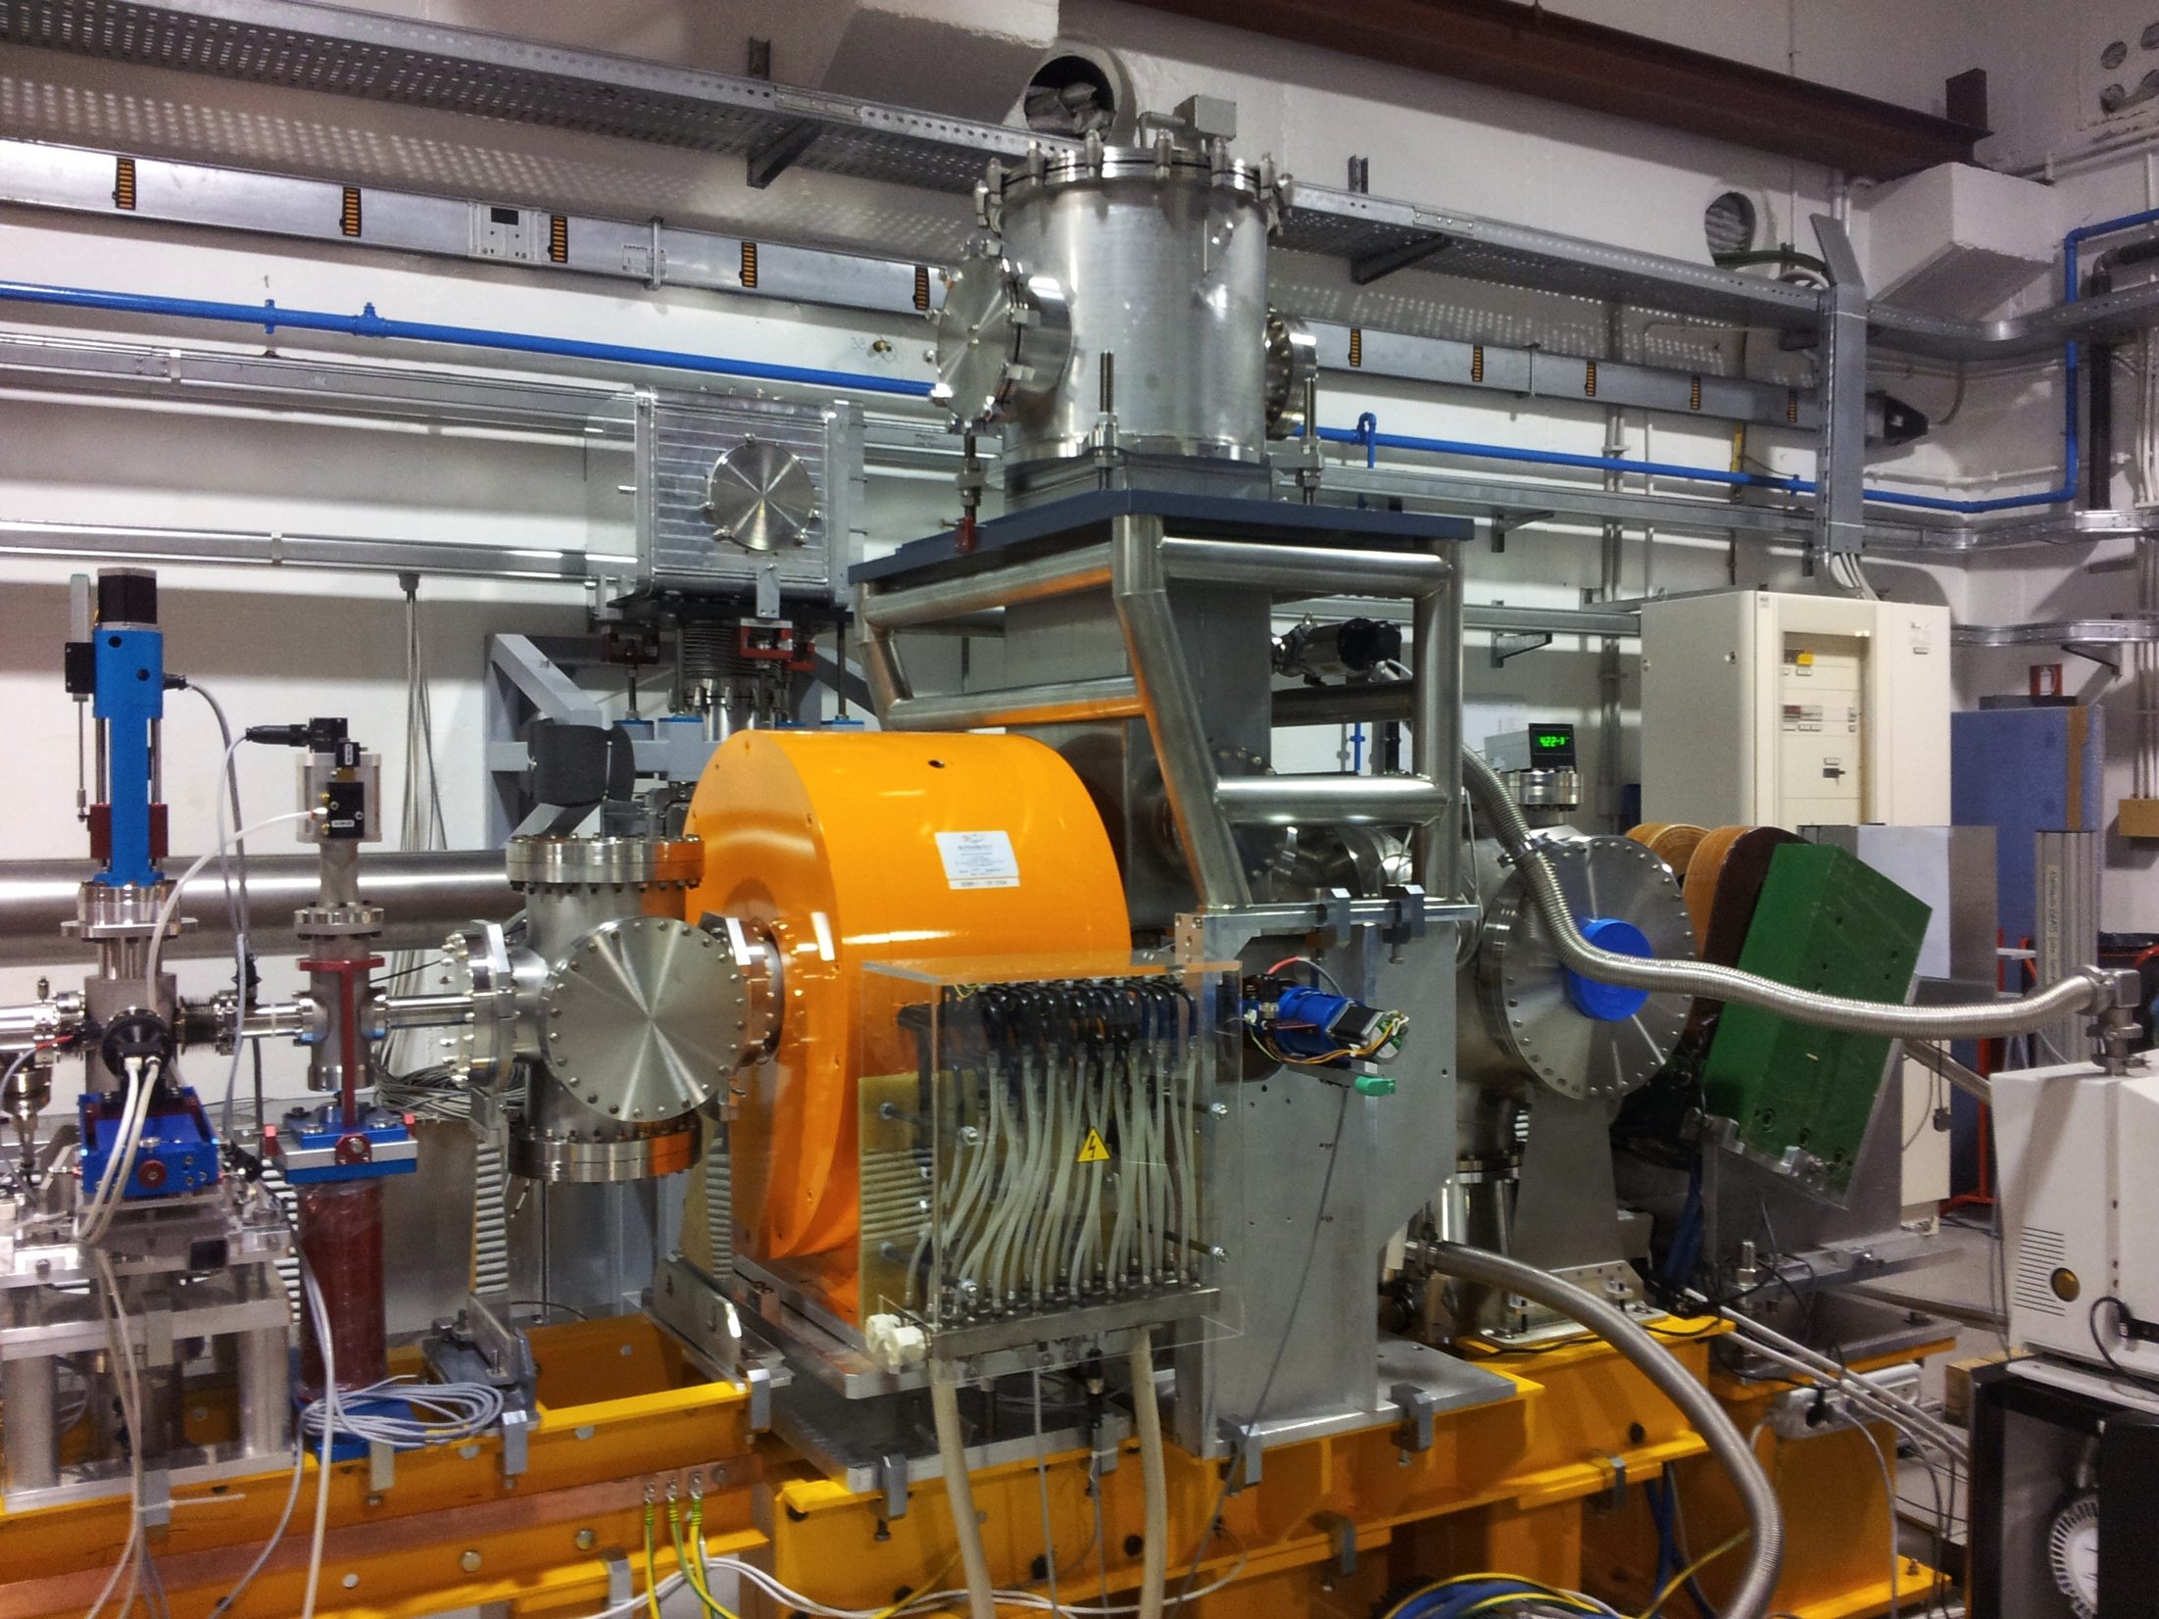
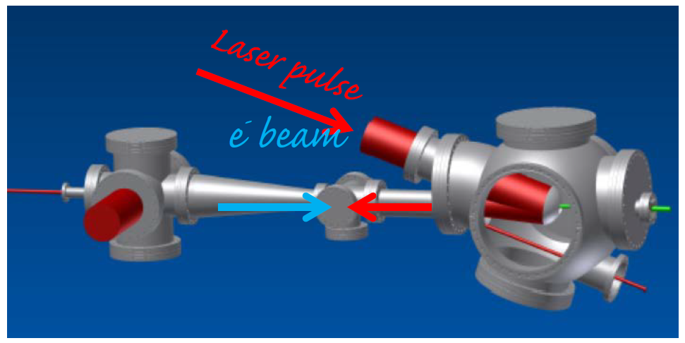
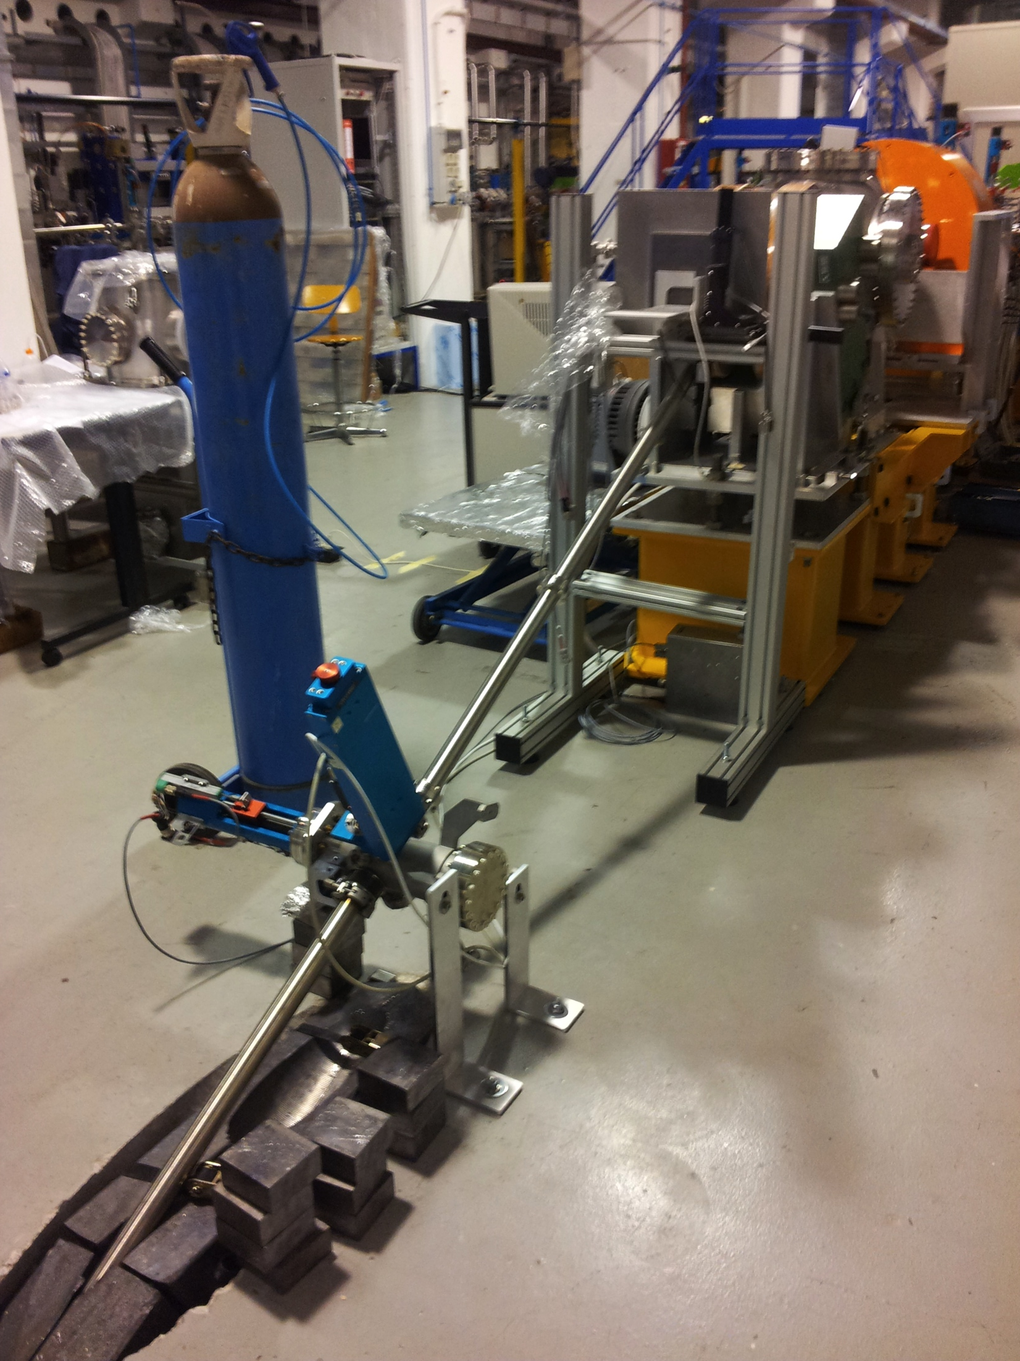
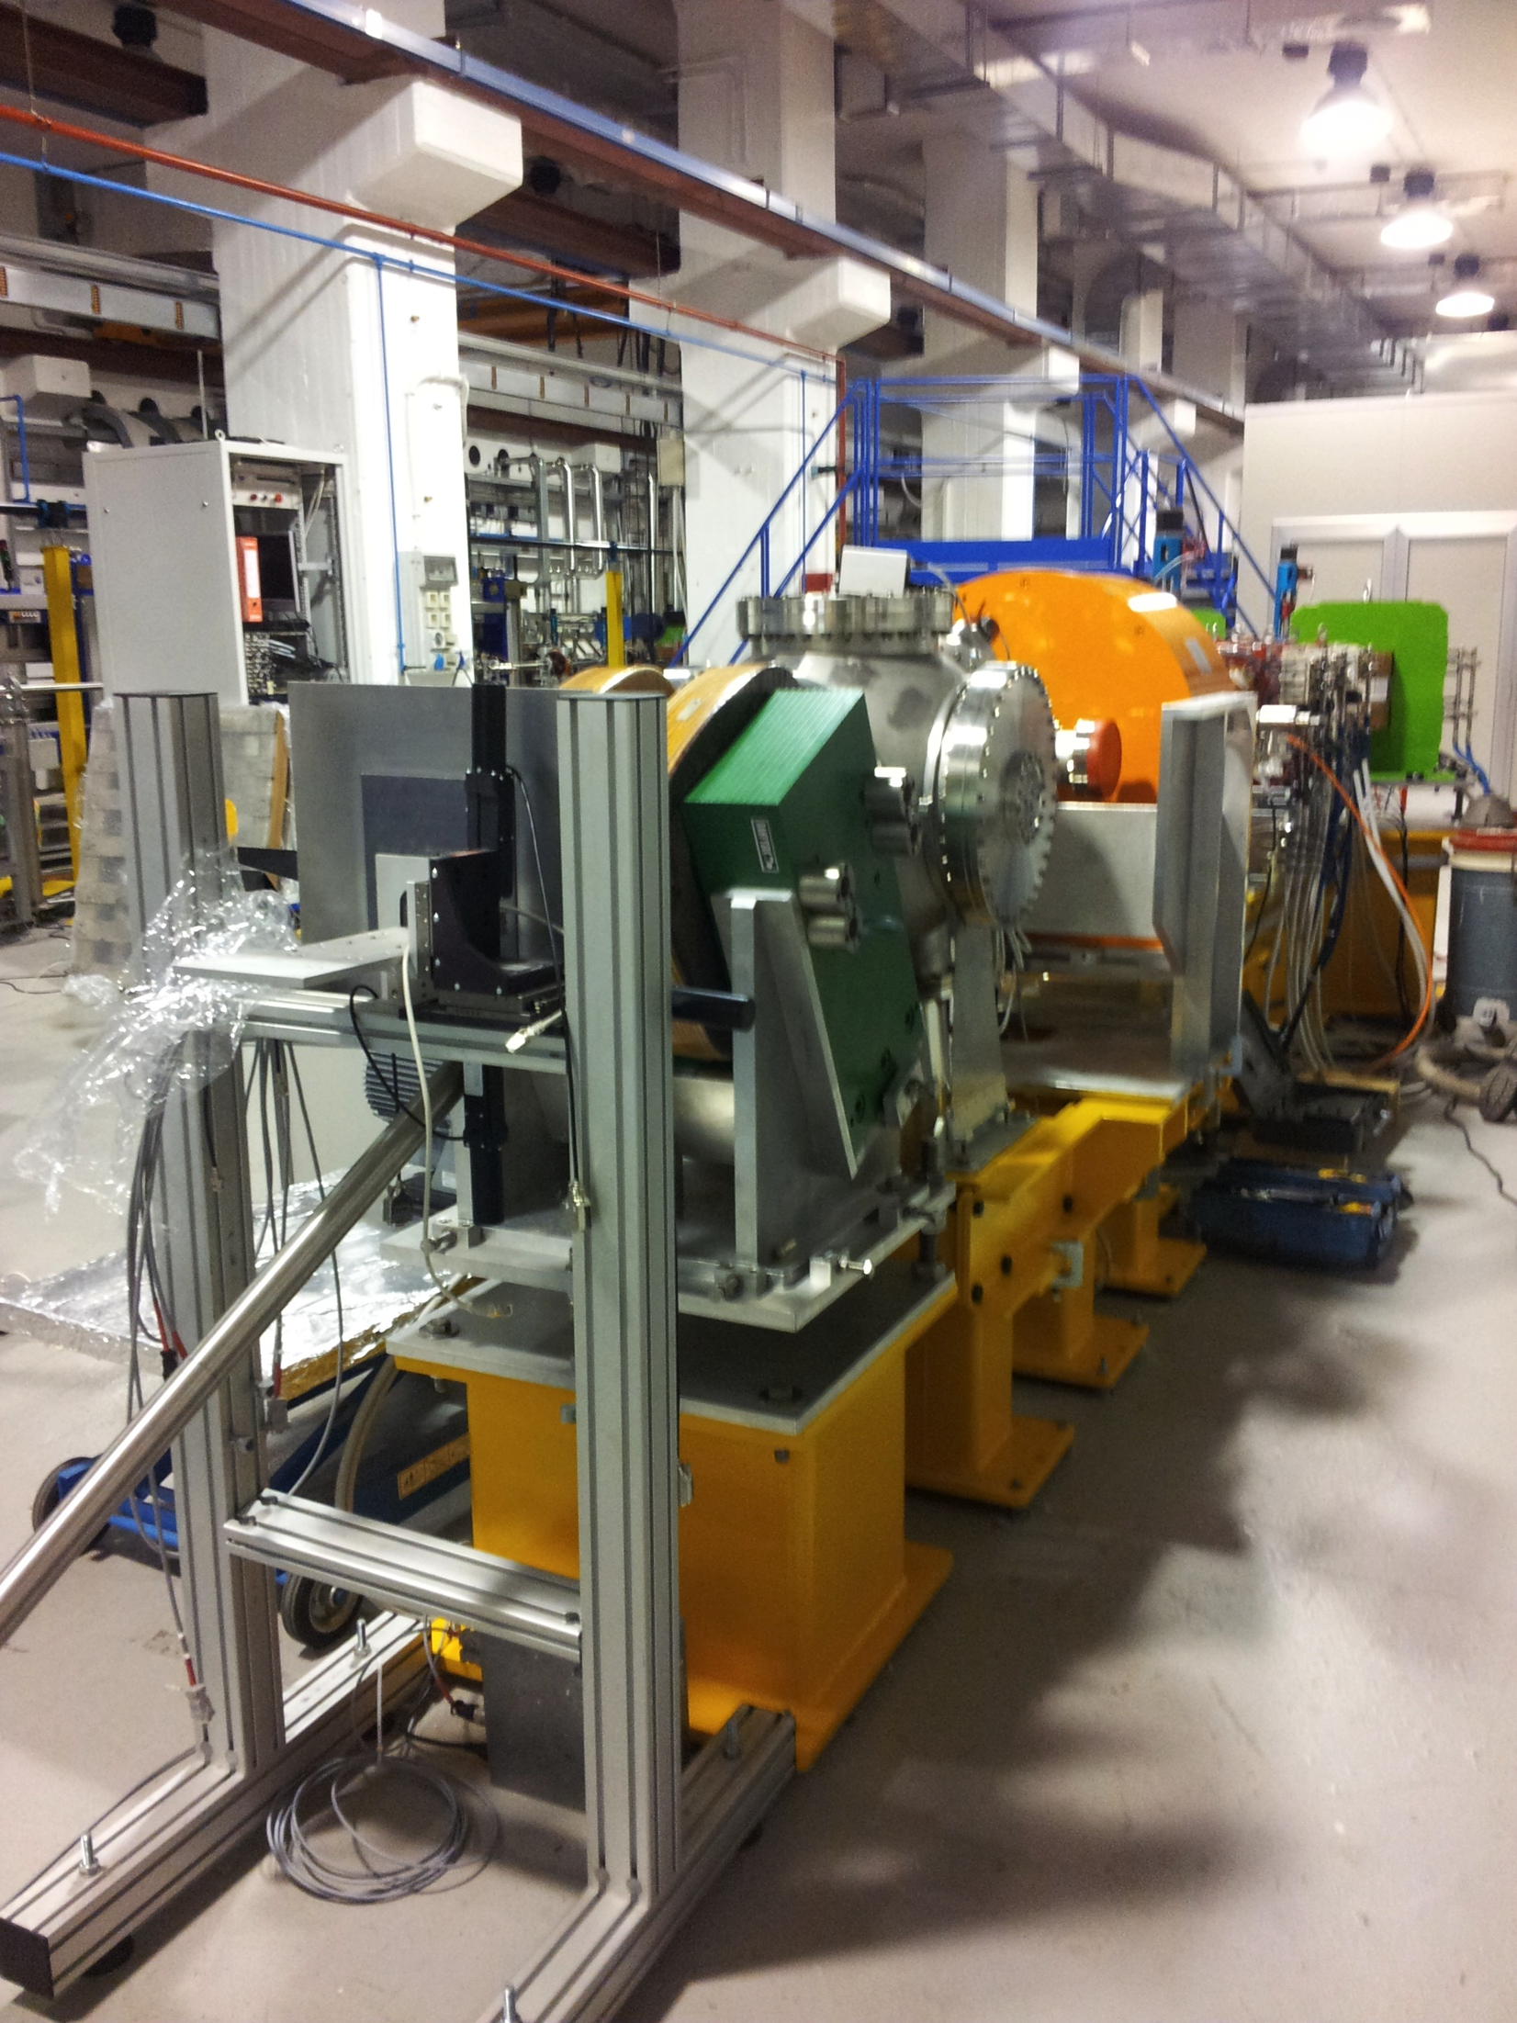
1st commissioning phase configuration

Slide 16
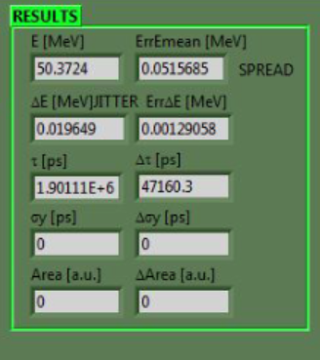
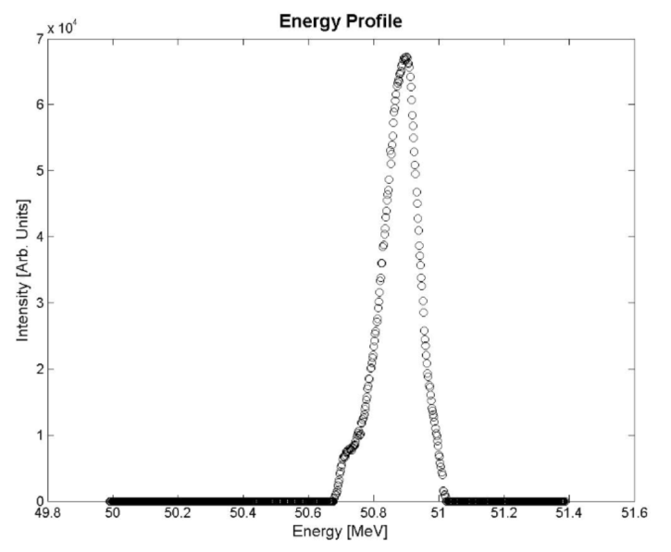
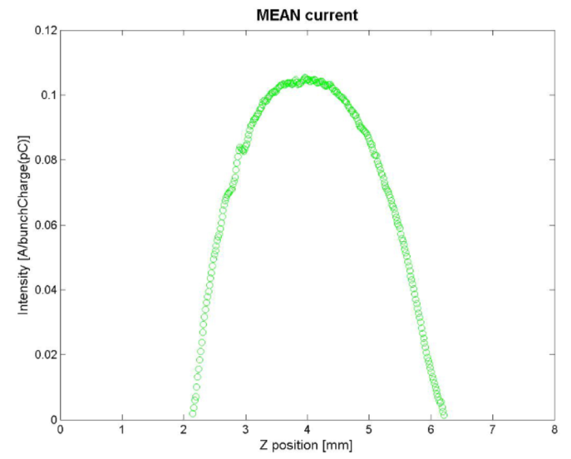
50 MeV Working point 1
Charge (daily avrg):Qav= 200 ± 20 pC
Energy (daily avrg):Eav= 50.6 ± 0.2 MeV
Launch phase: Φ= + 30°
Laser pulse length = 8.3 ps
S1 phase: Φ= - 20°
S2 phase: Φ= + 65°
S3 phase: Φ= - 90°
Bunch length rms = 3.1 ps

Slide 17
50 MeV WP Emittance (best) 2
Linac meas:
Emittance90% emitny=1.53736 mm mrad std_emitny=0.0917644 mm mrad betay_in=35.3509 m std_betay=2.16708 m alphay_in=-2.52296 std_alphay=0.184184 sigmaX @ PTL=0 mm sigmaY @ PTL=0.74157 mm
Emittance90% emitnx=1.20039 mm mrad std_emitnx=0.0527792 mm mrad betax_in=21.4779 m std_betax=1.10179 m alphax_in=-2.53342 std_alphax=0.171565
PLX meas:
Emittance90% emitny=2.39145 mm mrad std_emitny=0.118678 mm mrad betay_in=59.046 m std_betay=3.60262 m alphay_in=40.1767 std_alphay=2.4532 sigmaX @ PTL=0.540578 mm sigmaY @ PTL=1.19534 mm
Emittance90% emitnx=1.50711 mm mrad std_emitnx=0.0688194 mm mrad betax_in=17.8999 m std_betax=0.883045 m alphax_in=-0.982182 std_alphax=0.11063

Slide 18
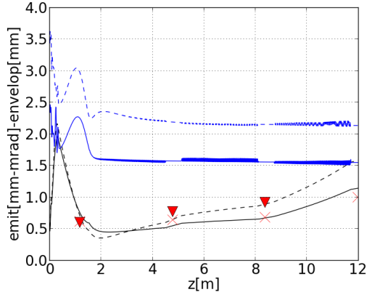
e⁻beam envelope evolution in the linac
Electron beam emittance (blue curves) and envelope evolution (black curves) from the photocathode to the linac exit calculated with the Astra code.
The dots represent the beam spot measurements taken in this configuration at screen locations along the linac.

Slide 19
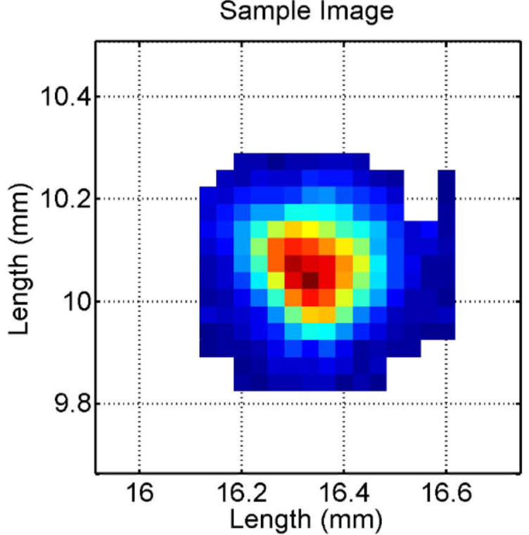
50 MeV WP Emittance 3
Thomson meas:
Emittance90% emitnx=4.82406 mm mrad std_emitnx=7.12887 mm mrad betax_in=3.41413 m std_betax=1.37934 m alphax_in=1.82552 std_alphax=2.21207
IP beam size w solenoid:
X Sigma (mm) 8.913322E-2 (2.688746E-3)
Y Sigma (mm) 8.826175E-2 (3.250392E-3)
X centroid (mm) 1.634655E+1 (5.039738E-2)
Y centroid (mm) 1.007501E+1 (2.500132E-2))

Slide 20
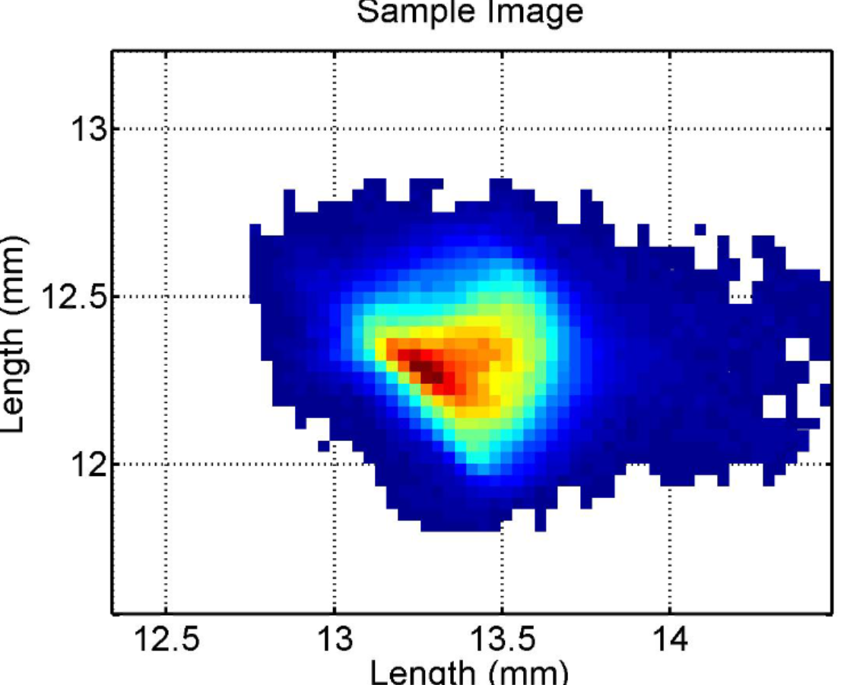
Beam size at IP w photon signature
X Sigma (mm) 2.374734E-1 (8.227418E-3)
Y Sigma (mm) 1.597200E-1 (1.249213E-2)
X centroid (mm) 1.341996E+1 (6.399130E-3)
Y centroid (mm) 1.236400E+1 (8.072908E-2)

Slide 21
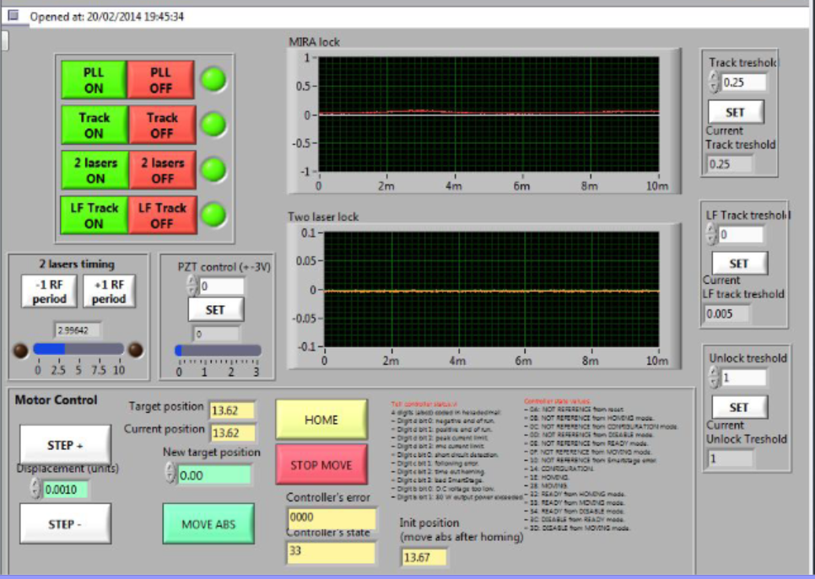
The synchronization system

Slide 22
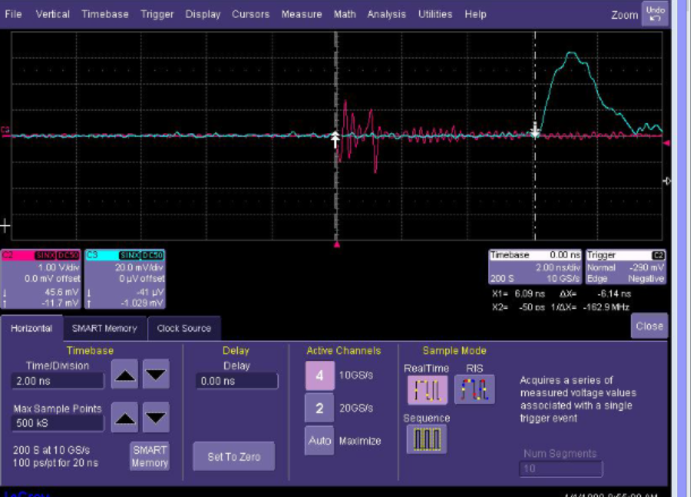
The synchronization system

Slide 23
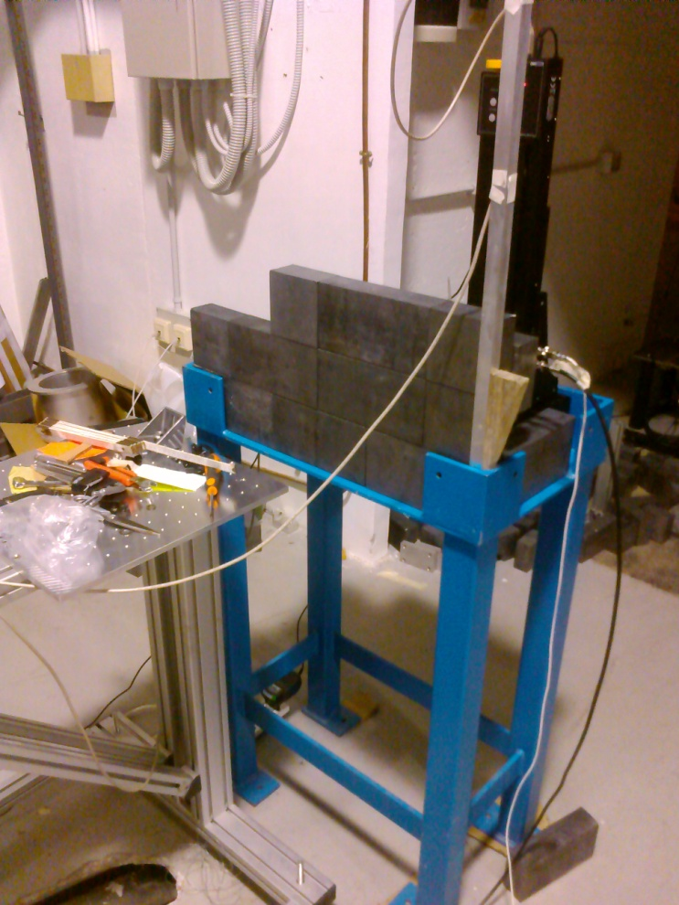
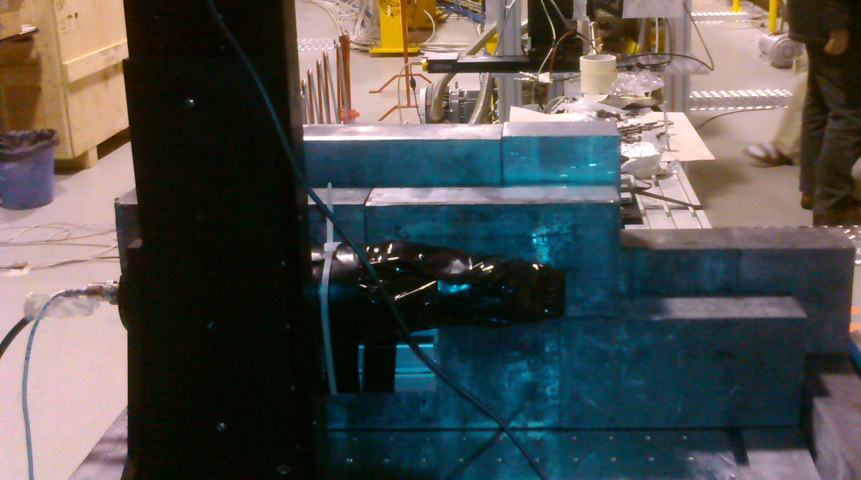
Detector: PMT+CsI scintillator
Rear view (PMT)
Front view (shielding)

Slide 24
We also checked that the signal is absent if only FLAME is on (no e- beams)

Slide 25
The signal is (almost) completely attenuated by 0.5 mm of Pb.
This is in agreement with the attenuation characteristics of the expected X-rays

Slide 26
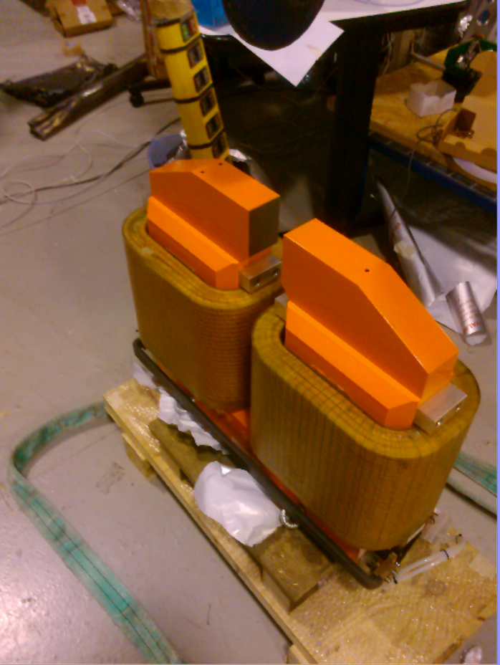
Since July 2014:
To recover the most critical issues: background and beam-beam overlap:
Dumping dipole installation (delivered Jan 2014) w tapered pipe to the flag.
Parabolic mirror Chamber & Interaction cross alignment
Solenoid cooling system decoupling from RF system

Slide 27
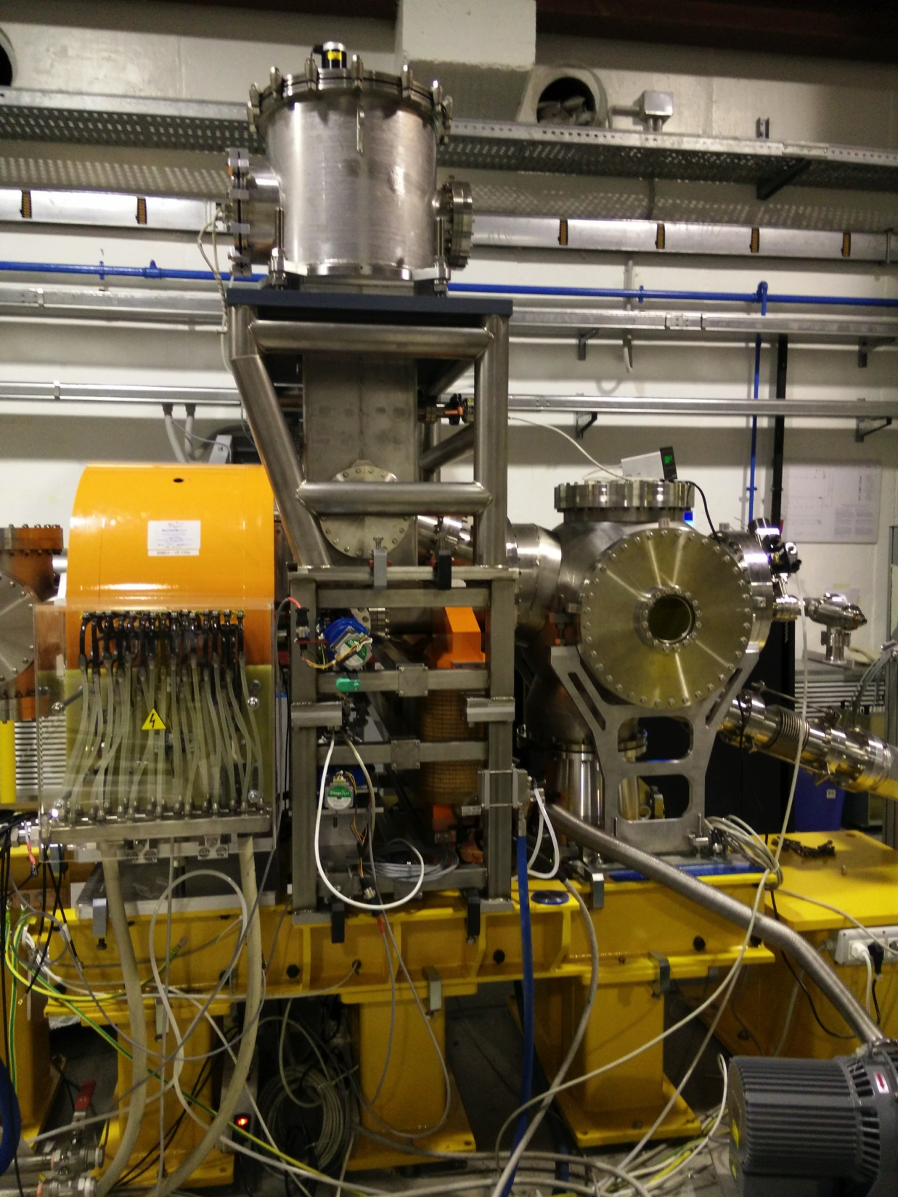
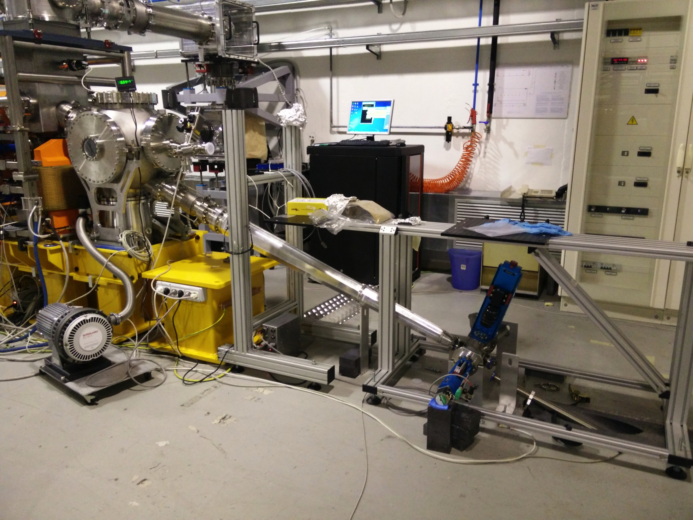
New IP configuration:

Slide 28
2015 Activity
Thomson Source low-high energy characterization
Beats2 experiment completion
Electron energy distribution after interaction study

