Slide 1
The INFN COSA project
Daniele Cesini – INFN-CNAF
(On behalf of the COSA collaboration)

Slide 2
INFN-CSN5 COSA project
COSA: Computing On SOC Architecture
Duration: 2 years from January 2015
Departments: 7 INFN
CNAF, PI, PD, ROMA1, FE, PR, LNL
BUDGET :51.5 kEuro Year I

Slide 3
Objectives
Acquire know-how
Porting e benchmarking of low power System on Chip
Operations of Linux system on SoCs
Benchmarking hybrid architectures
Unification of INFN HW testing activities
Continuation of the COKA project
Porting on traditional accelerator (GPU/MIC)
Continuation of the HEPMARK projects
X86 benchmarking
Study of dedicated low latency interconnection with ARM+FPGA devices
Prepare H2020 proposal on LowPower computing calls

Slide 4
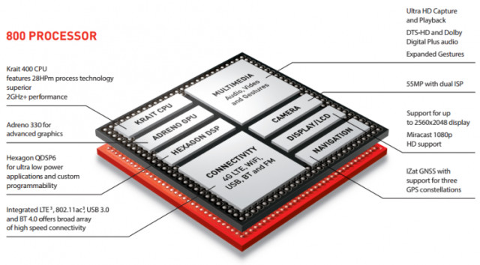
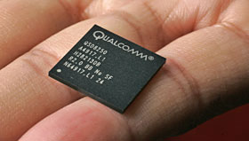
Low-Power System on Chip (SoCs)

Slide 5
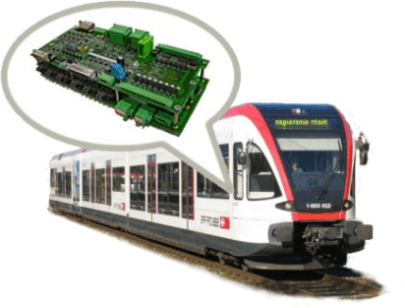
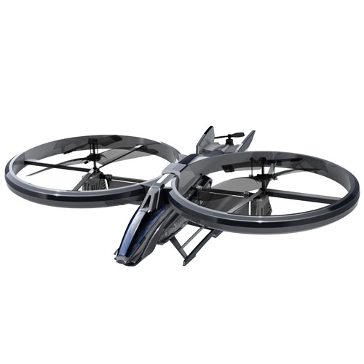
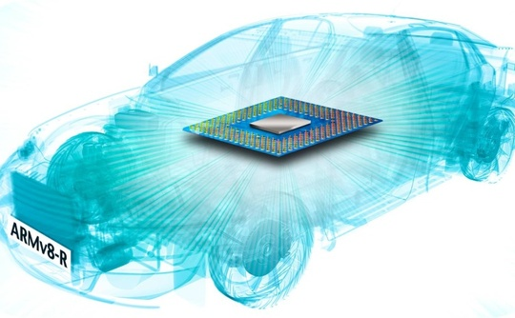
Where do I find a SoC?
Mobile
Embedded

Slide 6
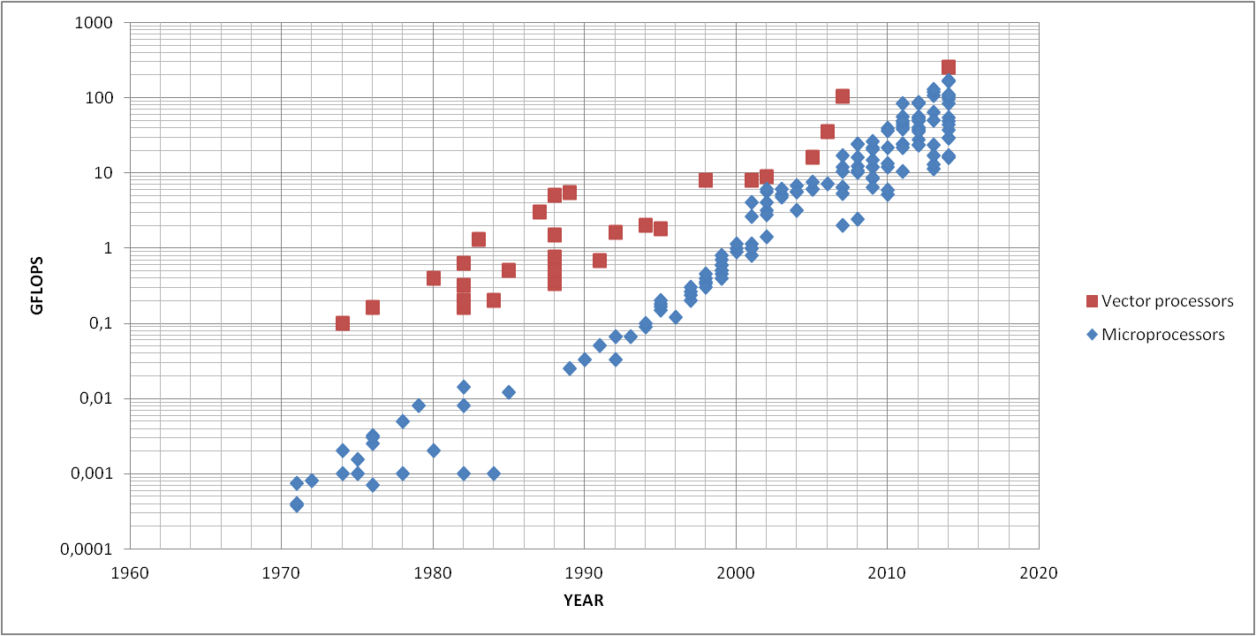
Vector vs Micro computing power
NEC SX-ACE
NEC SX-5
HITACHI S820/60
CRAY-1
INTEL i7
Pentium Pro
INTEL8086
MOS 6510
Why did microprocessors take over?
They have never been more powerful…
….but they were cheaper, highly available and less power demanding

Slide 7
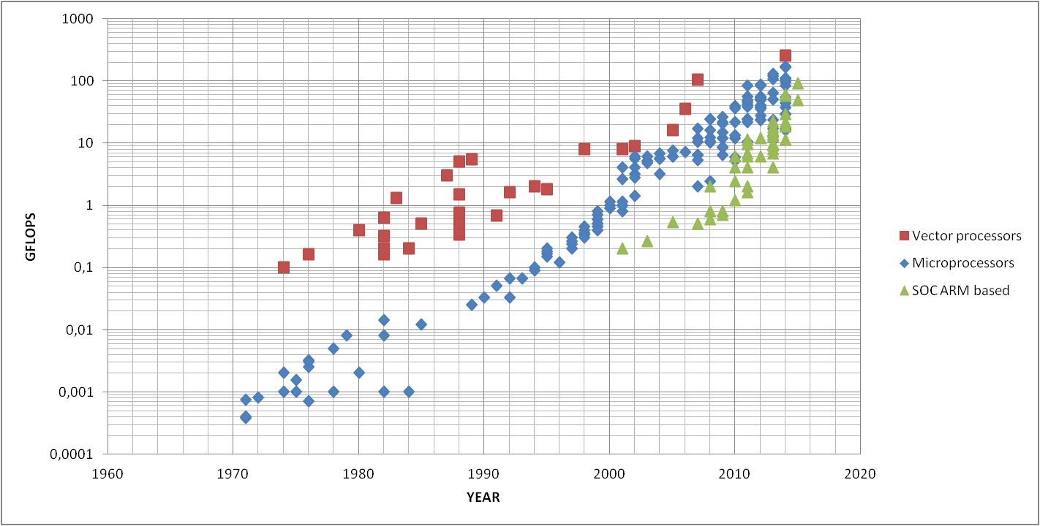
Vector vs Micro vs ARM based
Is history repeating?

Slide 8
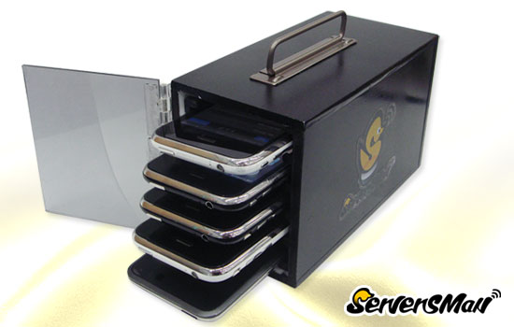
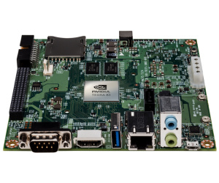
Ok, but then....an iPhone cluster?
NO, we are not thinking to build an iPhone cluster
We want to use these processors in a standard computing center configuration
Rack mounted
Linux powered
Running scientific application mostly in a batch environment
..... Use development board...

Slide 9
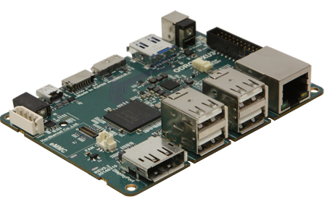
ODROID-XU3
Powered by ARM® big.LITTLE™ technology, with a Heterogeneous Multi-Processing (HMP) solution
4 core ARM A15 + 4 cores ARM A7
Exynos 5422 by Samsung
~ 20 GFLOPS peak (32bit) single precision
Mali- T628 MP6 GPU
~ 110 GFLOPS peak single precision
2 GB RAM
2xUSB3.0, 2xUSB2.0, 1x107100 eth
Ubuntu 14.4
HDMI 1.4 port
64 GB flash storage
Power consumption max ~ 15 W
Costs 150 euro!

Slide 10
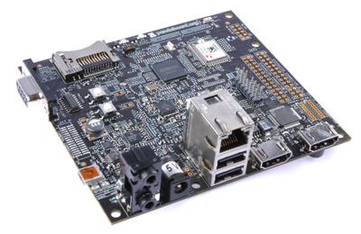
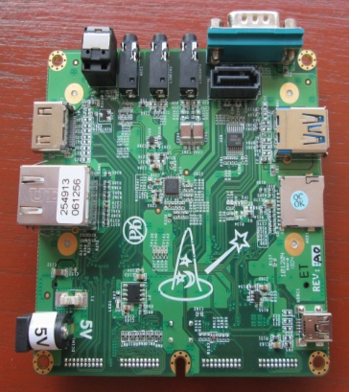
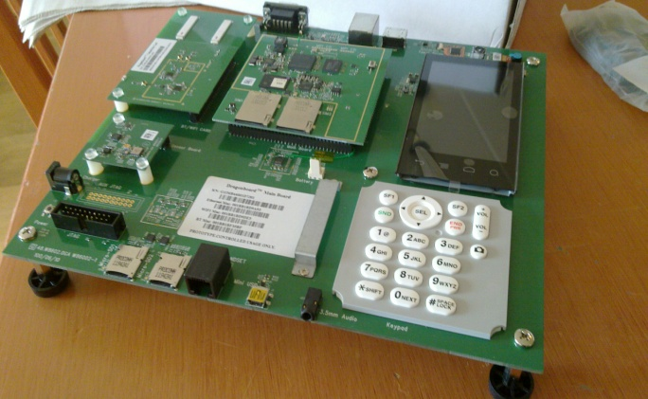
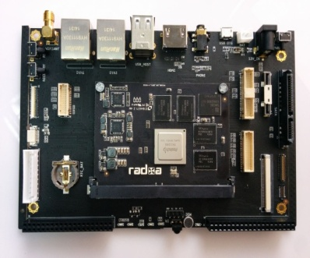
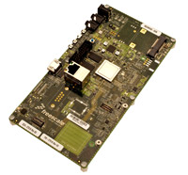
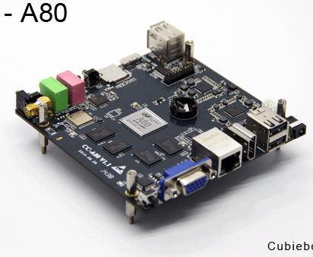
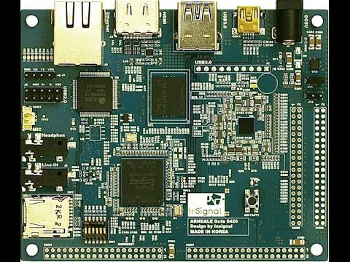
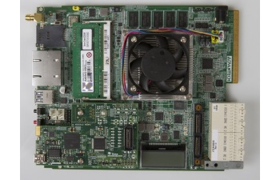
Other nice boards
PandaBoard
WandBoard
Rock2Board
DragonBoard
SabreBoard
CubieBoard
Arndale OCTA Board
Texas Instruments EVMK2H
http://elinux.org/Development_Platforms
...and counting...

Slide 11
Some specs
BOARD | SOC |  |  |  | GFLOPS (CPU+GPU) | Eth
 | Model | ARM IP | GPU IP | DSP IP
FREESCALE (Embedded SoC) SABRE Board | Freescale i.MX6Q | ARM A9(4) | Vivante GC2100 (19.2GFlops) |  | 25 | 1Gb
ARNDALE (Mobile SoC) Octa Board | Samsung Exynos 5420 | ARM A15(4) A7(4) | ARM Mali-T628 MP6 (110Gflops) |  | 115 | 10/100
HARDKERNEL (Mobile SoC) Odroid-XU-E | Samsung Exynos 5410 | ARM A15(4) A7(4) | Imagination Technologies PowerVR SGX544MP3 (51.1 Gflops) |  | 65 | 10/100
HARDKERNEL (Mobile SoC) Odroid-XU3 | Samsung Exynos 5422 | ARM A15(4) A7(4) (HMP) | ARM Mali-T628 MP6 (110 Gflops) |  | 130 | 10/100
INTRINSIC (Mobile SoC) DragonBoard | Qualcomm Snapdragon 800 | Qualcomm Krait(4) | Qualcomm Adreno 330 (130Gflops) |  | 145 | 1Gb
TI (Embedded SoC) EVMK2H | TI Keystone 66AK2H14 | ARM A15(2) |  | TI MS320C66x (189Gflops) | 210 | 1Gb (10Gb)
TDP between 5W and 15W
(EVMK2H > 15W)

Slide 12
NVIDIA JETSON TK1
First ARM+CUDA programmable SoC based Linux development board
4 cores ARM A15 CPU
192 cores NVIDIA GPU ➔ 300 GFLOPS (peak sp)
~ 21 GFLOPS/W (sp
... for less than 200 Euros
32bit
64bit version announced
Notes:
Ci sarebbe anche una versione a 64 che nessuno ha mai visto

Slide 13
How do you program them? (in a Linux environment)
GCC+OpenMP+MPI available for ARM architectures
OpenCL for the GPU
If you are lucky enough to find working drivers
CUDA available only on the Jetson K1
Computing capability 3.2 (vs 3.5)
Cross compilation
GCC5+OpenMP4 tests ongoing…

Slide 14
Limitations of the tested boards
Commodity SoCs and development boards have a number of limitations:
32 bit
Small caches
Small RAM size in the boards (O(2GB))
However modern SoCs can address 40bit
No ECC memory
Frequent failures and system crashes
Slow connections (10/100Mb eth) in many cases
Ethernet via USB in same boards
HW bugs

Slide 15
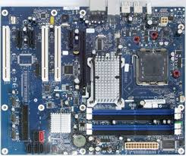
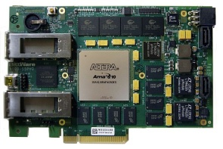
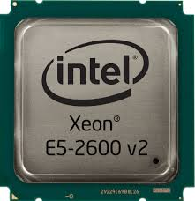
COSA Clusters
CNAF
ROMA1
~25 board SoC Based
(GFLOPS nominali di 2 server
tradizionali con GPU)
Anno I
4 board ARM+FPGA based
+ 1 server
16 board ARM+FPGA based
+ 4 server
Anno I
+ ~10 nuove board
Anno II
ex cluster COKA (2 server)
+ nuove acquisizioni (1 server)
+ nuove acquisizioni (1 server)
(server = cpu + acceleratori)
Anno II
Anno I
Anno II
PD
Ex cluster HEPMARK
+ nuove acquisizioni (~ 3 server)
+ nuove acquisizione (~ 3 server)
Anno I
Anno II

Slide 16
Activities & WPs
WP1: Management
WP2: Technology Tracking and Benchmarking
WP3: Implementation of the CNAF prototype
WP4: Development of dedicated network connections
WP5: Application Porting
WP6: Technology Transfer and Dissemination

Slide 17
Project Timeline
Jan 2015
Benchmarking
Tests of new boards
Cluster implementation
Cluster setup at CNAF (25 boards)
Application Porting
Tests under real life condition
Clusters upgrade (+10boards @CNAF, +12 boards @ ROME)
Benchmarks with real life applications and synthetic tests
Tests of first FPGAs for dedicated low latency network
Selection of the final architecture for the clusters
Cluster Setup in ROME (4 FPGA bords)
Application Porting
Dissemination and H2020 Preparation
Sept 2015
Jan 2016
Dec 2016

Slide 18
CNAF COSA cluster network
ssh
DHCP, TFT, NFS, LDAP, NAT, etc
CNAF
eth1
MASTER
(lowpower x86-64)
eth0
172.16.11.0/23
10.0.0.0/24
ARM
ARM
ARM
ARM
ARM
……

Slide 19
COSA power network
Card
Card
Card
Card
Card
……
LabVIEW DC probe
12V
230V AC
Power probe
LabVIEW DC probe
5V

Slide 20
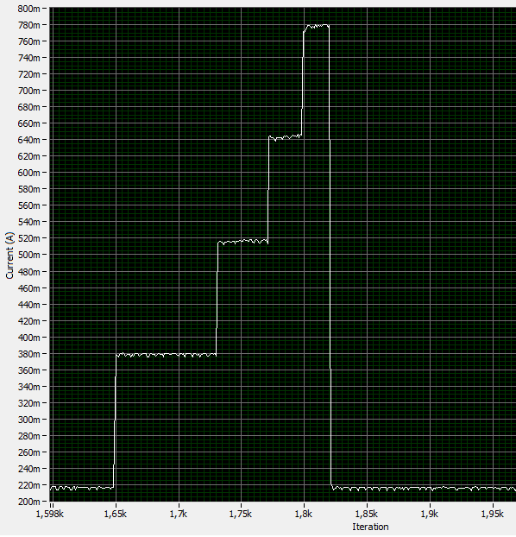
OPENMP π computation on Jetson
4
3
# | TIME (s) | POWER (W) | ENERGY (J)
1 | 26,1 | 4,6 | 120,1
2 | 13,1 | 6,2 | 81,2
3 | 8,7 | 8,7 | 75,7
4 | 6,5 | 6,5 | 42,2
2
CURRENT (A)
1
TIME

Slide 21
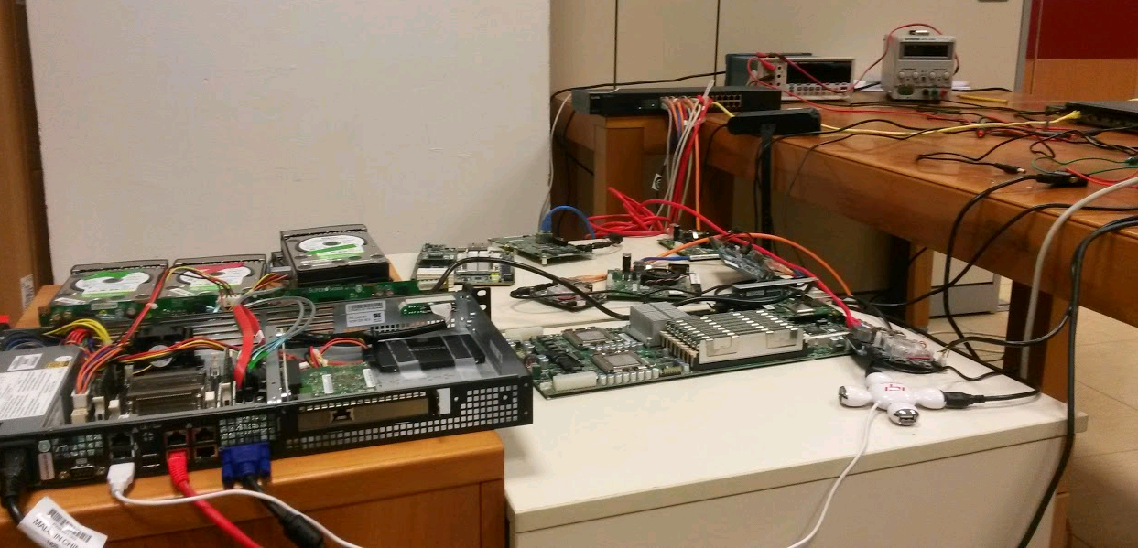
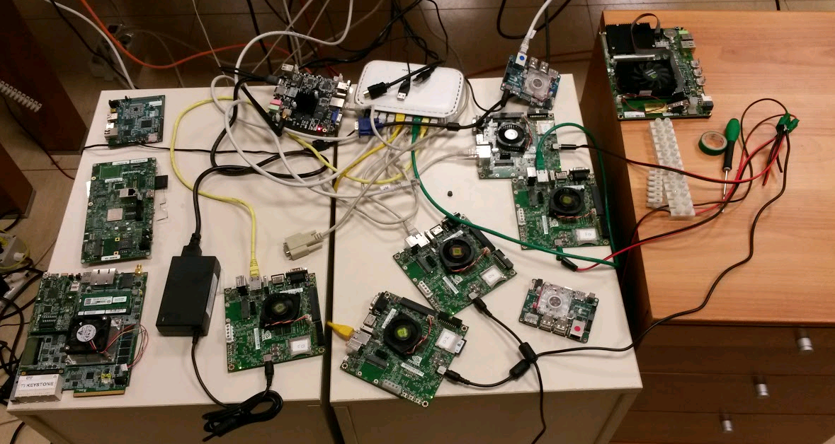

Slide 22
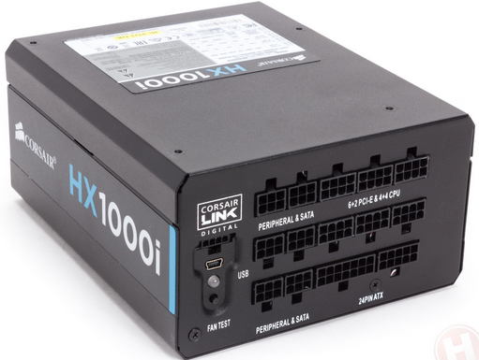
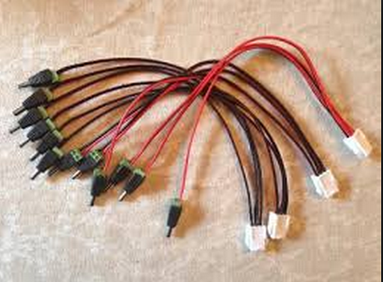
PSU&Cables
PSU HX1000i
12 linee 12V (Jetson)
6 linee 5V
Cavi GRIDSEED
Da 1 MOLEX a 3 BARREL

Slide 23
Applications
Theoretical Physics (PR, FE)
Parallel applications usually run in HPC environments
Lattice Boltzmann fluid dynamics
Monte Carlo simulations of Spin-Glass systems
Lattice Quantum ChromoDynamics simulations
Experimental Physics (PI, PD, CNAF)
HEP experiments High Level Trigger applications
Montecarlo and analysis of LHC experiments
Applications needing portable systems
Computer tomography
Neural Networks (RM1)
DPSNN-STDP code

Slide 24
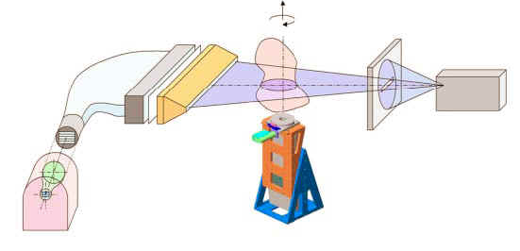
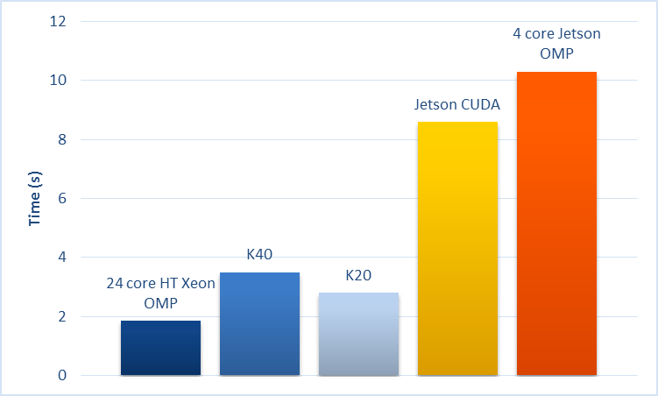
Filtered Backprojection (1/2)
Lower is better
CPU &GPU
(*) in collaboration with the physics department of the Bologna University and CHNET
1024 x 1024 pixel
Master thesis of Elena Corni:
Implementazione dell’algoritmo Filtered Back-Projection (FBP)
per architetture Low-Power di tipo Systems-On-Chip

Slide 25
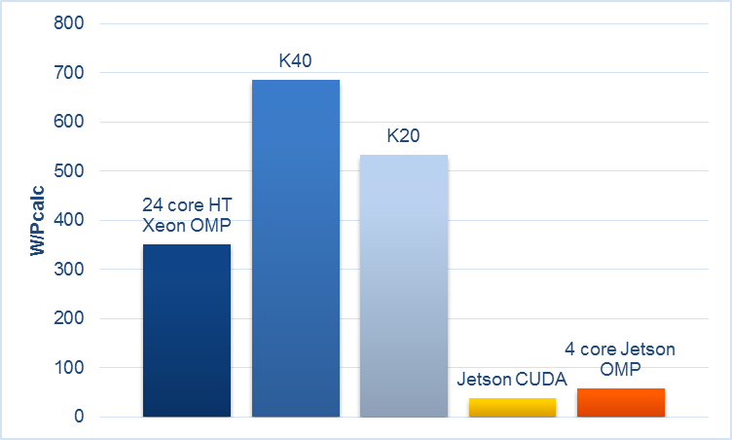
Filtered Backprojection (2/2)
On (2xE5-2620+K20): 3241 slices in 1 h: 350 Wh
On 5 x Jetson-K1: 3840 slices in 1 h: 41 Wh
Lower is better
1024 x 1024 pixel

Slide 26
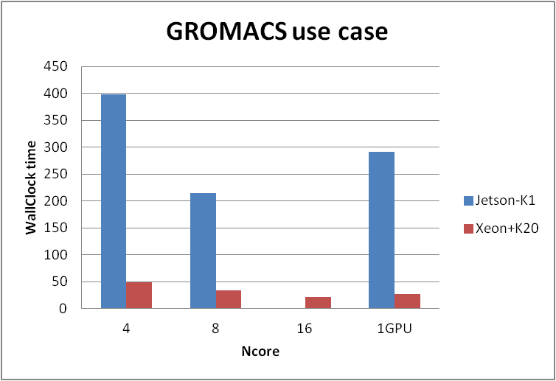
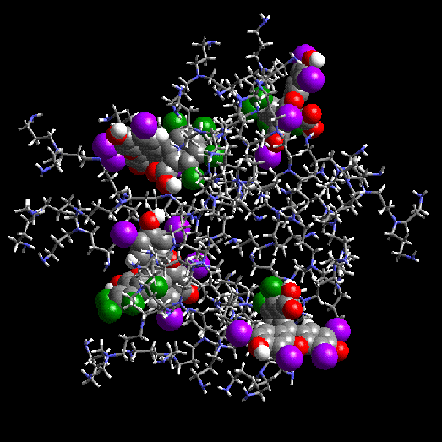
Molecular Dynamics on Jetson-K1
Parallel application for CPU and GPU: real life use case with GROMACS
CPU&GPU
1 jetson MPI
Lower is better
1 jetson CUDA
2 jetson MPI
Jetson-K1 about 10X slower using the same number of CPU cores
Jetson-K1 about 10X slower using the GPU (vs. an NVIDIA Tesla K20)
Jetson-K1 13.5W
Xeon+K20 ~320W

Slide 27
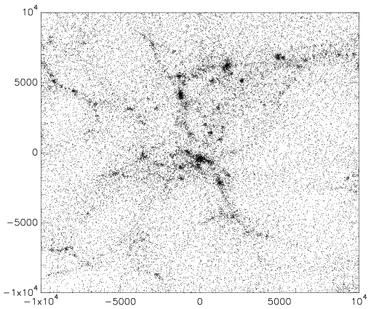
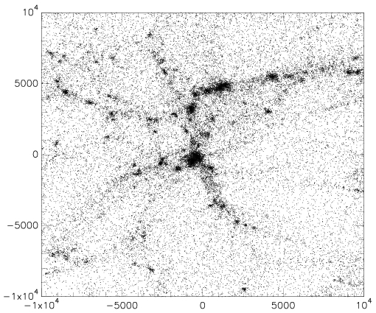
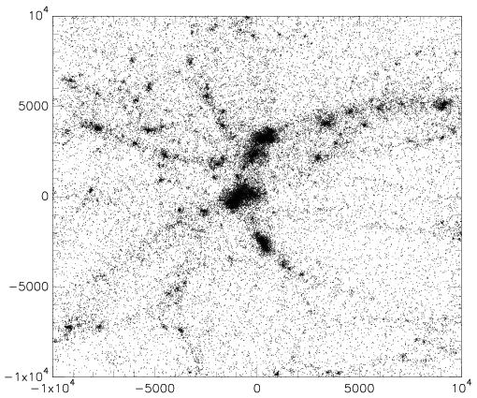
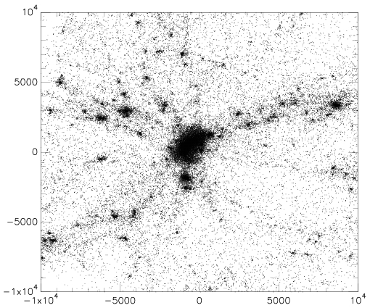
Formation of a galaxy cluster with Gadget2
MULTI BOARD
CPU ONLY
276498 particles, formation of a cluster
of galaxies in an expanding Universe

Slide 28
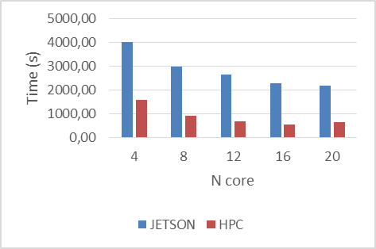
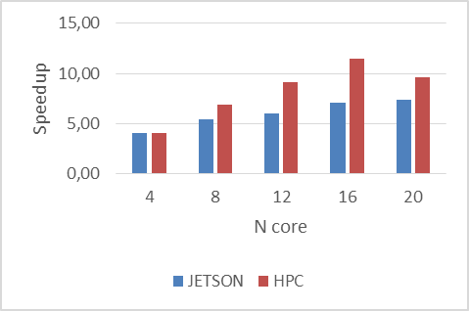
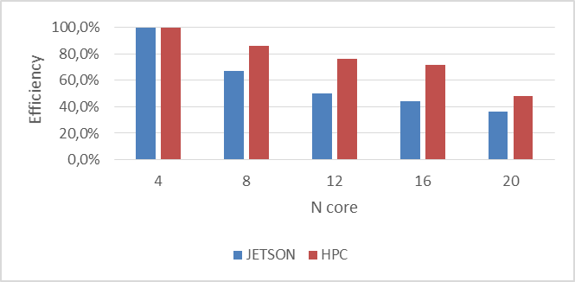
Formation of a galaxy cluster

Slide 29
Neural Networks: DPSNN-STDP

Slide 30
See Enrico Calore talk

Slide 31
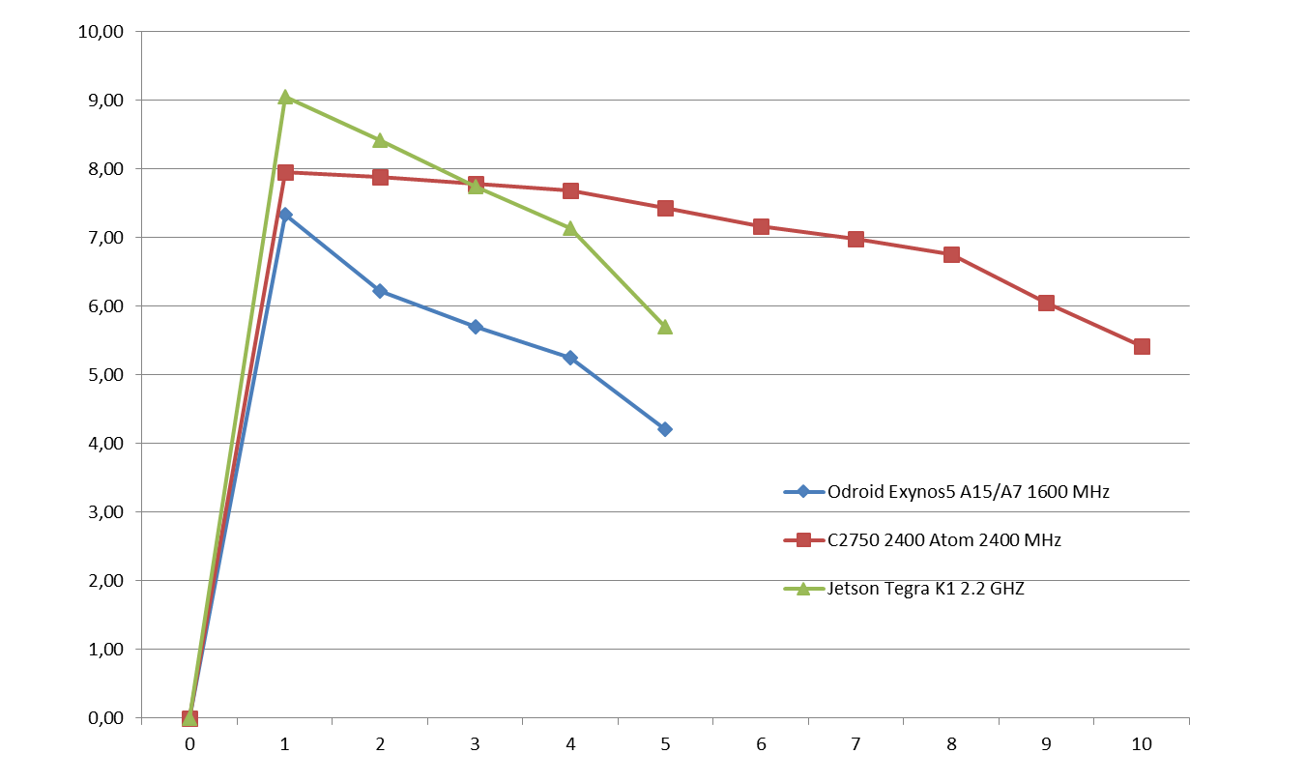
HS06
HS06 on Exynos5, TegraK1 and Atom C2750 –
Per core loaded
(data from M.Michelotto@HEPIX 2014 https://indico.cern.ch/event/320819/session/3/contribution/30/material/slides/0.pptx )

Slide 32
Tests from CMS
More on Pantaleo talk…

Slide 33
Low latency connection through FPGAs
FPGA SoCs are hybrid components that integrate a programmable hw component and a multicore low power ARM CPU
Two main reasons to test them in COSA
Acceleration of computational task executed by microP embedded in the FPGA taking advantage of the RDMA capabilities of the APEnet architecture
APEnet v5, NaNet, PICOLO systems
Computational tasks executed on the ARM CPU taking advantage of the integrated low latency connection capabilities in the
Study of new architectures, i.e ExaNeSt
More on Lonardo
talk…

Slide 35
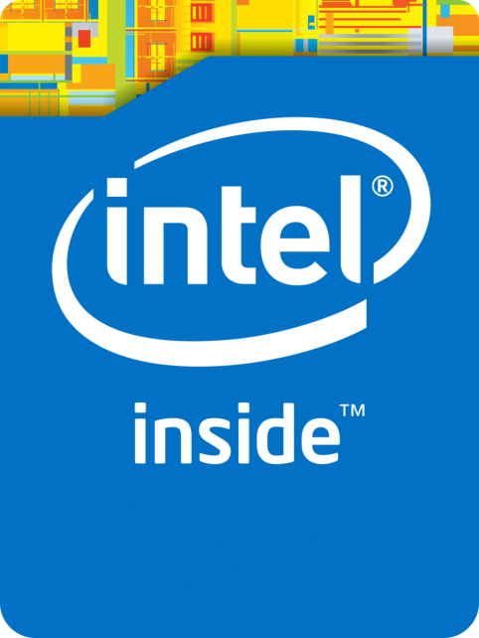
Only ARM based SoCs? And Intel?
INTEL produce SoCs
Some of them are low power
Already 64bit
Integrated GPU
CILK++ programmable
OpenCL programmable

Slide 36
Some low power from Intel
ATOM - BayTrail
i7 Mobile
XEON D
CORE M
AVOTON

Slide 37
2 cores + GPU
Intel HD Graphics
OpenCL 2.0 Support
4.5 Watt (TDP)
(*) http://www.notebookcheck.net/Intel-Core-M-5Y70-Broadwell-Review.130930.0.html
(**) http://www.intel.com/content/www/us/en/processors/core/core-m-processor-family-spec-update.html

Slide 38
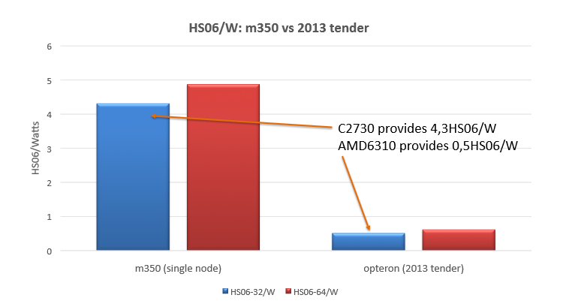
AVOTON on HP Moonshot - HS06
(data from A.Chierici@HEPIX https://indico.cern.ch/event/305362/session/2/contribution/22/material/slides/0.pdf )

Slide 39
Conclusion
COSA is showing that mobile and embedded low power System-on-Chip are becoming attractive for scientific computing
In particular if you manage to extract power from the GPU
But hey still have many limitations for a production environment
We are continuing to acquire know-how on hybrid architectures (both low power and traditional systems)
Operations
Performance Measurement
Application porting
Programming models
It was decided to wait for the next generation 64bit SoCs before expanding the low power clusters
COSA participated in the creation of the H2020 proposal for PICOLO
LEIT-ICT4 2014 call

Slide 40
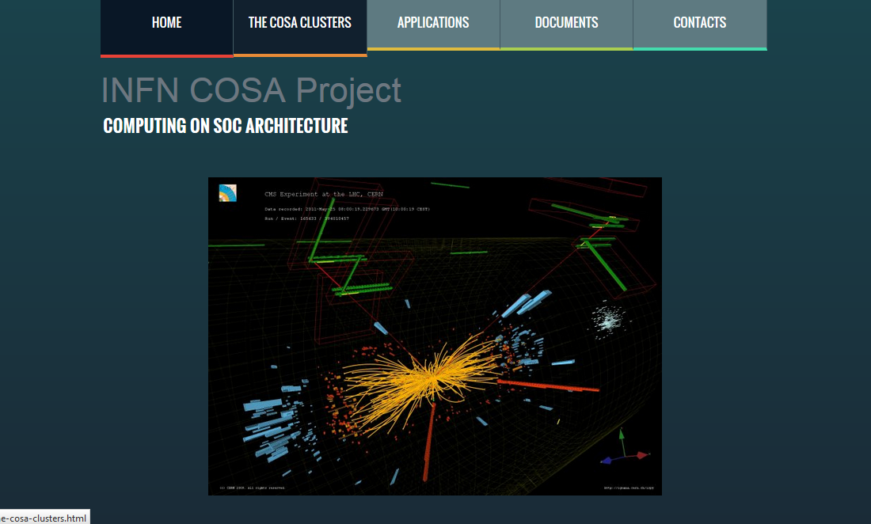
Links and contacts
http://www.cosa-project.it
COSA@HEPIX Talk (https://indico.cern.ch/event/346931/session/5/contribution/57/material/slides/0.pdf )
COSA@GDB talk (https://indico.cern.ch/event/319744/contribution/1/material/slides/0.pdf)
COSA Indico (https://agenda.infn.it/categoryDisplay.py?categId=779 )
COSA mailing list: cosa-project__at__lists.infn.it

Slide 41
Backup

Slide 42
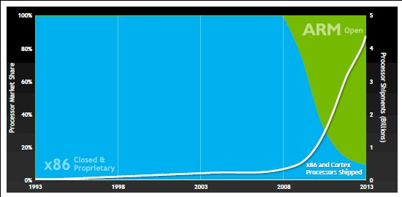
ARM based processor shipment
ARM based processors are shipped in billions of units
ARM licences the Intellectual Properties to manufactures
…many manufactures ….
Samsung (Korea), MediaTek (China), Allwinner (China), Qualcomm (USA), NVIDIA (USA), RockChip (China), Freescale (USA), Texas Instruments (USA), HiSilicon(China), Xilinx (USA), Broadcom(USA), Apple(USA), Altera(USA), ST(EU) , WanderMedia(Taiwan), Marvel(USA), AMD(USA)etc..

Slide 43
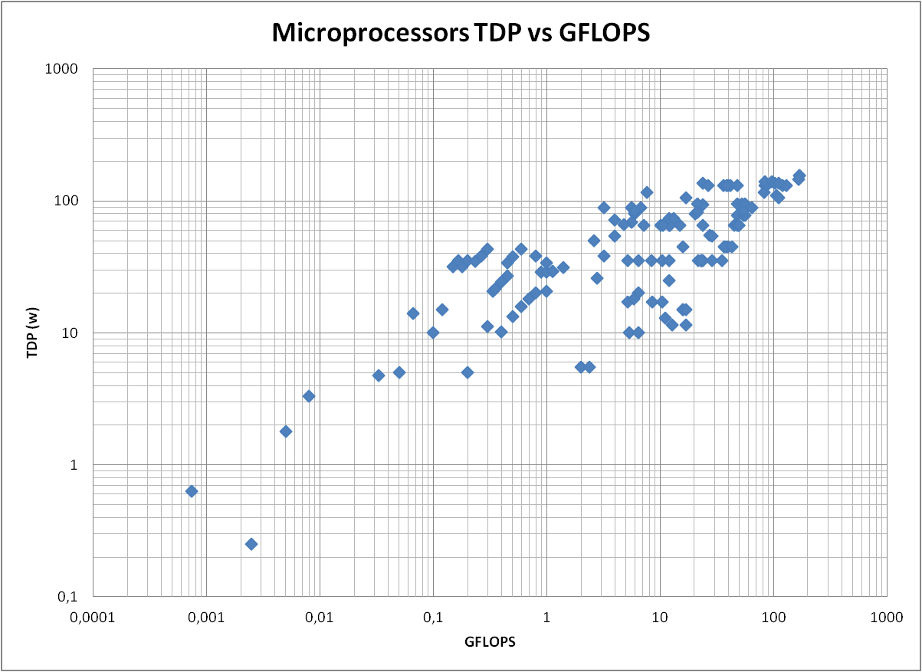
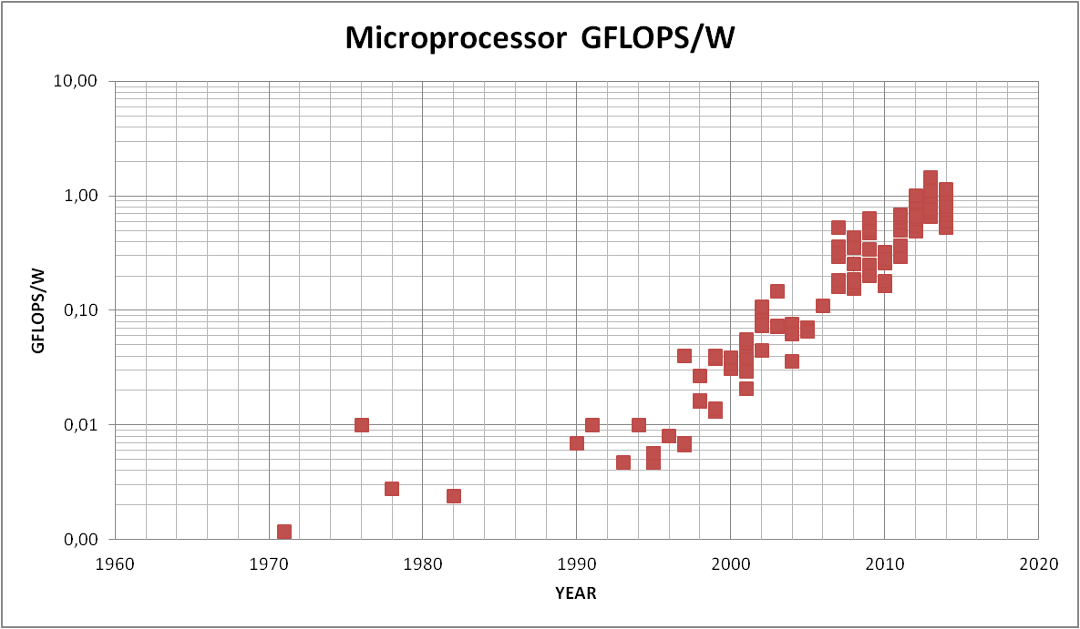
CPU GFLOPS/Watt

Slide 44
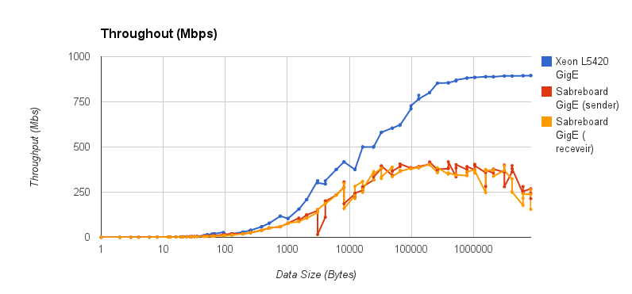
Gbit Ethernet
While latency was comparable to a server class 1Gb ethernet card (50/75 us)

Slide 45
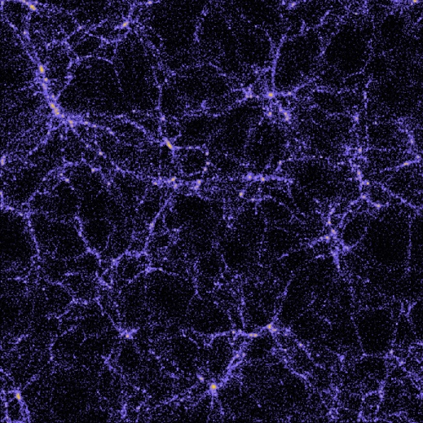
Real use-case: evolving the Universe
MULTI BOARD
CPU ONLY
128³ particles in a cube of 250 Mpc side, 13.6 Gyr
Jetson-K1 about 2.6X slower than Xeon using 4 CPU cores, and about 4.4X slower using 8 CPU cores
Jetson-K1 12.1 W
Xeon ~220 W

Slide 46
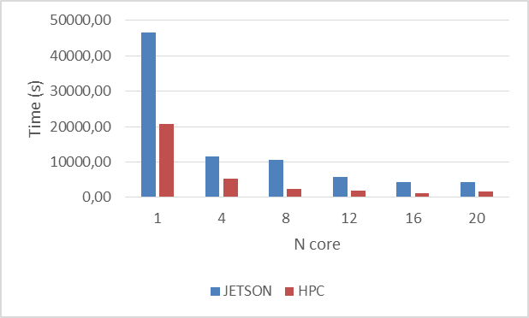
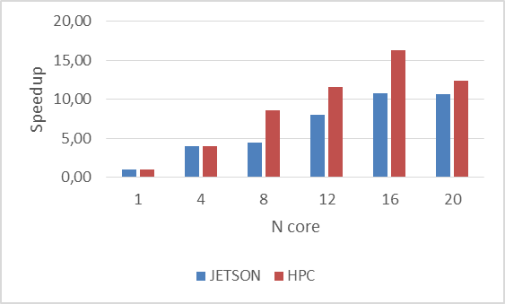
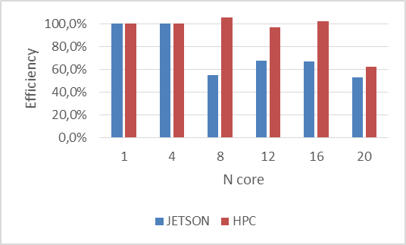
Real use-case: evolving the Universe

Slide 47
Test on Intel AVOTON
Eth interconnect
in both machines
N.B. – Comparison with an old Penryn Xeon CPU

Slide 48
GPU acceleration in K1
4 core ARM A15 ~ 18 GFLOPS
Kepler SMX1 192 core ~ 300 GFLOPS (sp)
~ 15 W
~ 21 GFLOPS/W (sp)
2 x (E5-2673v2 (IvyBridge) 8 core)
~ 200 GFLOPS (dp)
220 W
NVIDIA TESLA K40 2880 core
~ 1400 GFLOPS (dp) ~ 4300 GFLOPS (sp)
235 W
CPU+GPU ~ 3 GFLOPS/W (dp)
~ 9 GFLOPS/W (sp)
Notes:
NB: single precision 32 bit architecture

