Slide 1
TMDs in experiments

Slide 2
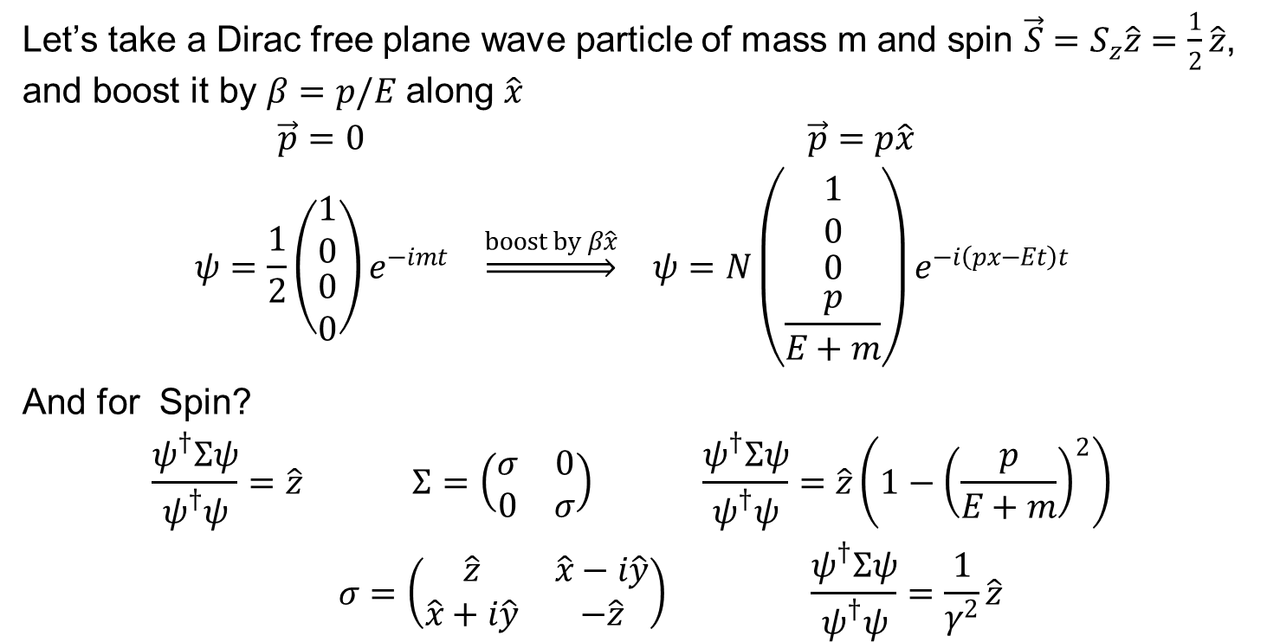
Boosting transverse Spin
Let’s take a Dirac free plane wave particle of mass m and spin $\vec{S}=S_{z}\hat{z}=\frac{1}{2}\hat{z}$, and boost it by $β=p/E$ along $\hat{x}$
$$\begin{matrix}\vec{p}=0 & & \vec{p}=p\hat{x} \\ ψ=\frac{1}{2}\left(\begin{matrix}1 \\ 0 \\ \begin{aligned}0 \\ 0\end{aligned}\end{matrix}\right)e^{−imt} & \underset{⇒}{boost by β\hat{x}} & ψ=N\left(\begin{matrix}1 \\ 0 \\ \begin{aligned}0 \\ \frac{p}{E+m}\end{aligned}\end{matrix}\right)e^{−i\left(px−Et\right)t}\end{matrix}$$
And for Spin?
$$\begin{matrix}\frac{ψ^{†}Σψ}{ψ^{†}ψ}=\hat{z} & Σ=\left(\begin{matrix}σ & 0 \\ 0 & σ\end{matrix}\right) & \frac{ψ^{†}Σψ}{ψ^{†}ψ}=\hat{z}\left(1−{\left(\frac{p}{E+m}\right)}^{2}\right) \\ & σ=\left(\begin{matrix}\hat{z} & \hat{x}−i\hat{y} \\ \hat{x}+i\hat{y} & −\hat{z}\end{matrix}\right) & \frac{ψ^{†}Σψ}{ψ^{†}ψ}=\frac{1}{γ^{2}}\hat{z}\end{matrix}$$

Slide 3
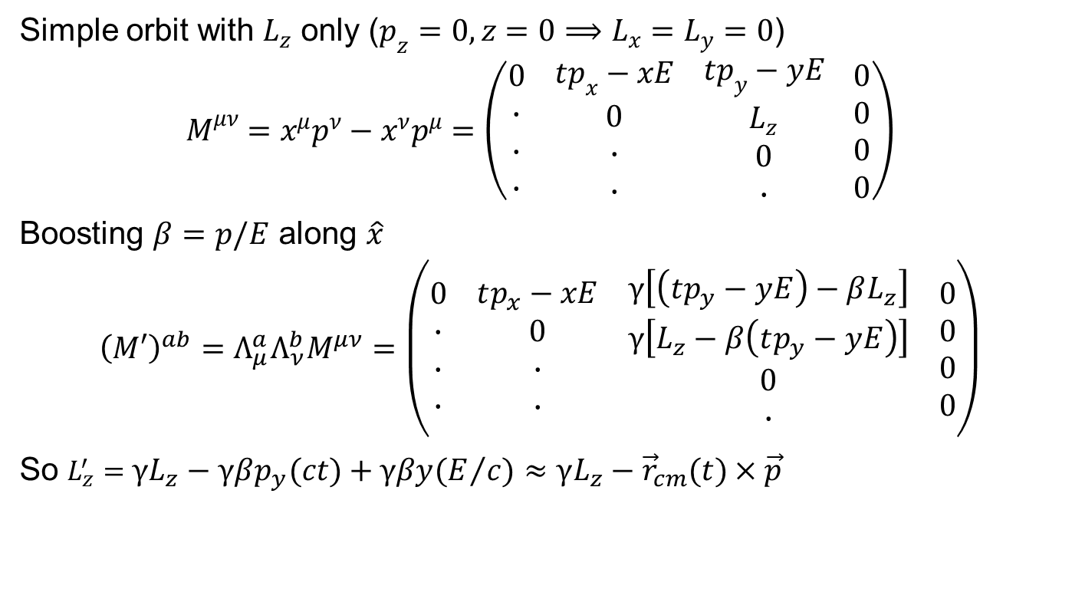
Boosting orbital angular momenta
Simple orbit with $L_{z}$ only ($p_{z}=0, z=0⟹L_{x}=L_{y}=0$)
$$M^{μν}=x^{μ}p^{ν}−x^{ν}p^{μ}=\left(\begin{aligned}0 \\ ∙ \\ ∙ \\ ∙\end{aligned}\begin{aligned} \\ \\ \\ \end{aligned}\begin{aligned}tp_{x}−xE \\ 0 \\ ∙ \\ ∙\end{aligned}\begin{aligned} \\ \\ \\ \end{aligned}\begin{aligned}tp_{y}−yE \\ L_{z} \\ 0 \\ ∙\end{aligned}\begin{aligned} \\ \\ \\ \end{aligned}\begin{aligned}0 \\ 0 \\ 0 \\ 0\end{aligned}\right)$$
Boosting $β=p/E$ along $\hat{x}$
$${\left(M′\right)}^{ab}=Λ_{μ}^{a}Λ_{ν}^{b}M^{μν}=\left(\begin{aligned}0 \\ ∙ \\ ∙ \\ ∙\end{aligned}\begin{aligned} \\ \\ \\ \end{aligned}\begin{aligned}tp_{x}−xE \\ 0 \\ ∙ \\ ∙\end{aligned}\begin{aligned} \\ \\ \\ \end{aligned}\begin{aligned}γ\left[\left(tp_{y}−yE\right)−βL_{z}\right] \\ γ\left[L_{z}−β\left(tp_{y}−yE\right)\right] \\ 0 \\ ∙\end{aligned}\begin{aligned} \\ \\ \\ \end{aligned}\begin{aligned}0 \\ 0 \\ 0 \\ 0\end{aligned}\right)$$
So $L_{z}^{′}=γL_{z}−γβp_{y}\left(ct\right)+γβy\left(E/c\right)≈γL_{z}−{\vec{r}}_{cm}\left(t\right)×\vec{p}$

Slide 4
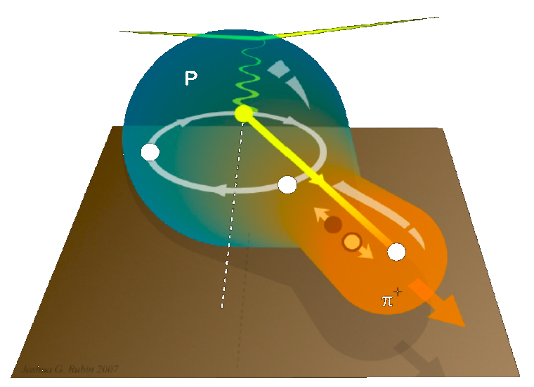
TMD and Single Spin Asymmetries

Slide 5
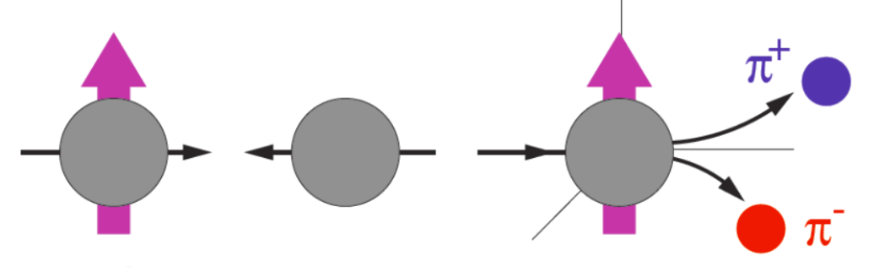

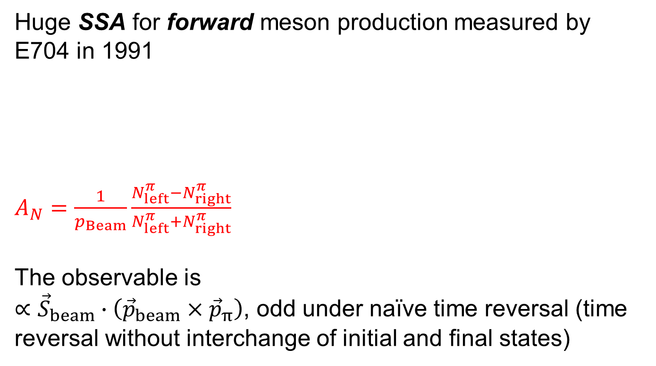
The (re)start: SSA in $p^{↑}p⟶πX$
Huge SSA for forward meson production measured by E704 in 1991
$A_{N}=\frac{1}{p_{Beam}}\frac{N_{left}^{π}−N_{right}^{π}}{N_{left}^{π}+N_{right}^{π}}$
The observable is
$∝{\vec{S}}_{beam}∙\left({\vec{p}}_{beam}×{\vec{p}}_{π}\right)$, odd under naïve time reversal (time reversal without interchange of initial and final states)

Slide 6
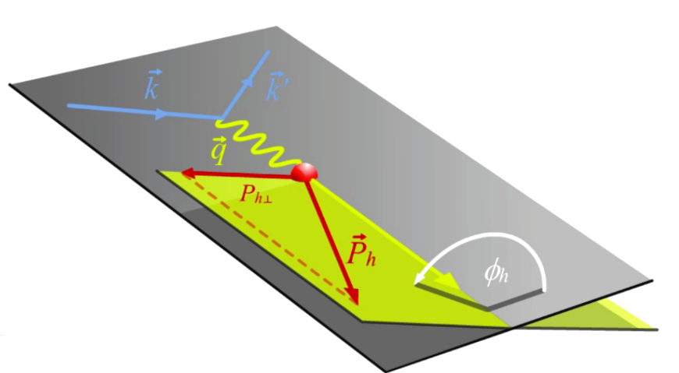
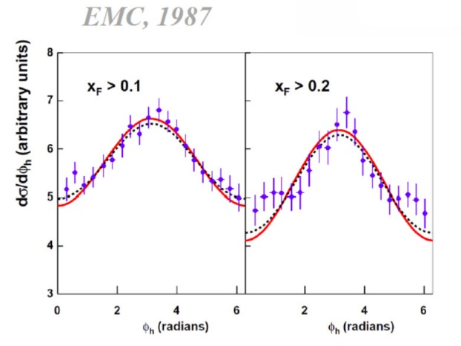
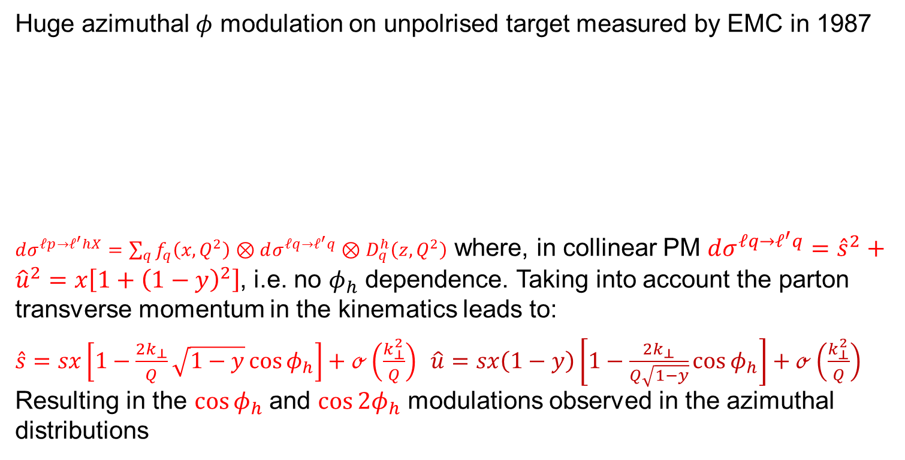
(Re)start: another TM effect
Huge azimuthal $φ$ modulation on unpolrised target measured by EMC in 1987
$dσ^{ℓp→ℓ^{′}hX}=\sum_{q}{f_{q}\left(x,Q^{2}\right)}⊗dσ^{ℓq→ℓ^{′}q}⊗D_{q}^{h}\left(z,Q^{2}\right)$ where, in collinear PM $dσ^{ℓq→ℓ^{′}q}={\hat{s}}^{2}+{\hat{u}}^{2}=x\left[1+{\left(1−y\right)}^{2}\right]$, i.e. no $φ_{h}$ dependence. Taking into account the parton transverse momentum in the kinematics leads to:
$\hat{s}=sx\left[1−\frac{2k_{⊥}}{Q}\sqrt{1−y}\cos{φ_{h}}\right]+ℴ\left(\frac{k_{⊥}^{2}}{Q}\right) \hat{u}=sx\left(1−y\right)\left[1−\frac{2k_{⊥}}{Q\sqrt{1−y}}\cos{φ_{h}}\right]+ℴ\left(\frac{k_{⊥}^{2}}{Q}\right)$ Resulting in the $\cos{φ_{h}}$and $\cos{2φ_{h}}$ modulations observed in the azimuthal distributions

Slide 7
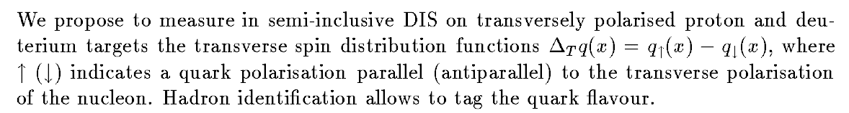
Few facts:
Transverse Spin and Momentum effects were put under scrutiny by the COMPASS Proposal in 1996, starting with transversity via the Collins mechanism
The measurement of the Sivers PDF was added to the program soon after … the other TMD with the developments over the years
Measurements started in 2002 by HERMES (p) and COMPASS (d)
This field has grown considerably in the last years and comes one of high priority measurements for the JLab12 program

Slide 8
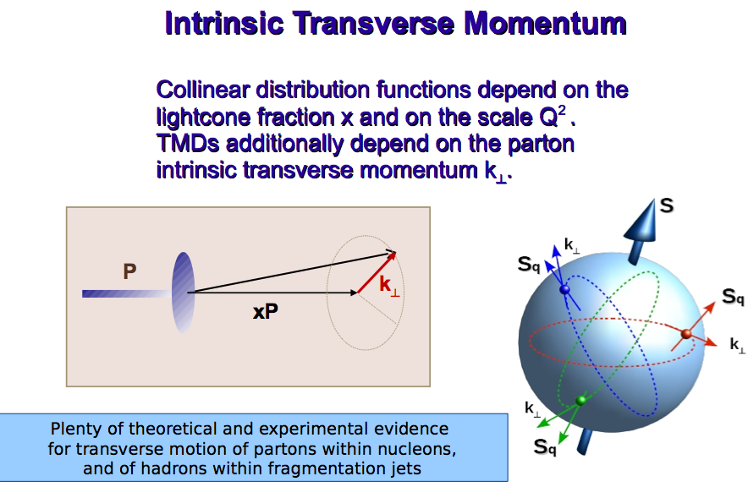
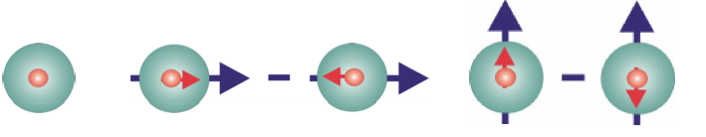
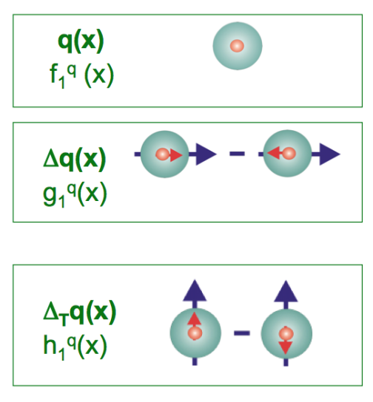
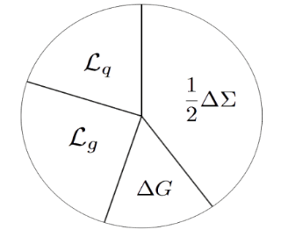


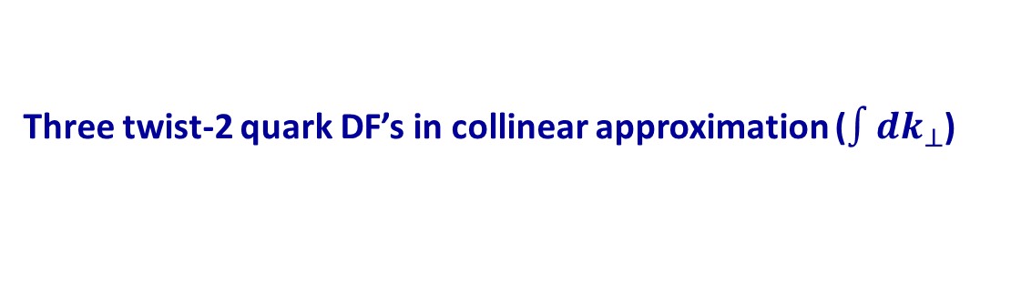
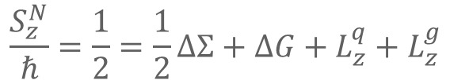
The spin of the proton
Three twist-2 quark DF’s in collinear approximation ($\int{dk_{⊥}}$)
$$Φ_{Coll}^{Tw−2}\left(x\right)=\frac{1}{2}\left\{q\left(x\right)+S_{L}γ_{5}g_{1}\left(x\right)+S_{T}γ_{5}γ^{1}h_{1}\left(x\right)\right\}n^{+}$$
helicity
transversity
$$\frac{S_{z}^{N}}{ℏ}=\frac{1}{2}=\frac{1}{2}ΔΣ+ΔG+L_{z}^{q}+L_{z}^{g}$$
NR limit
[boost, rotat.]=0
J_{q}
➡
$$h_{1}\left(x,Q^{2}\right)=g_{1}\left(x,Q^{2}\right)$$
≈30% : Spin puzzle
When $k_{⊥}$ is taken into account …
J_{g}

Slide 9
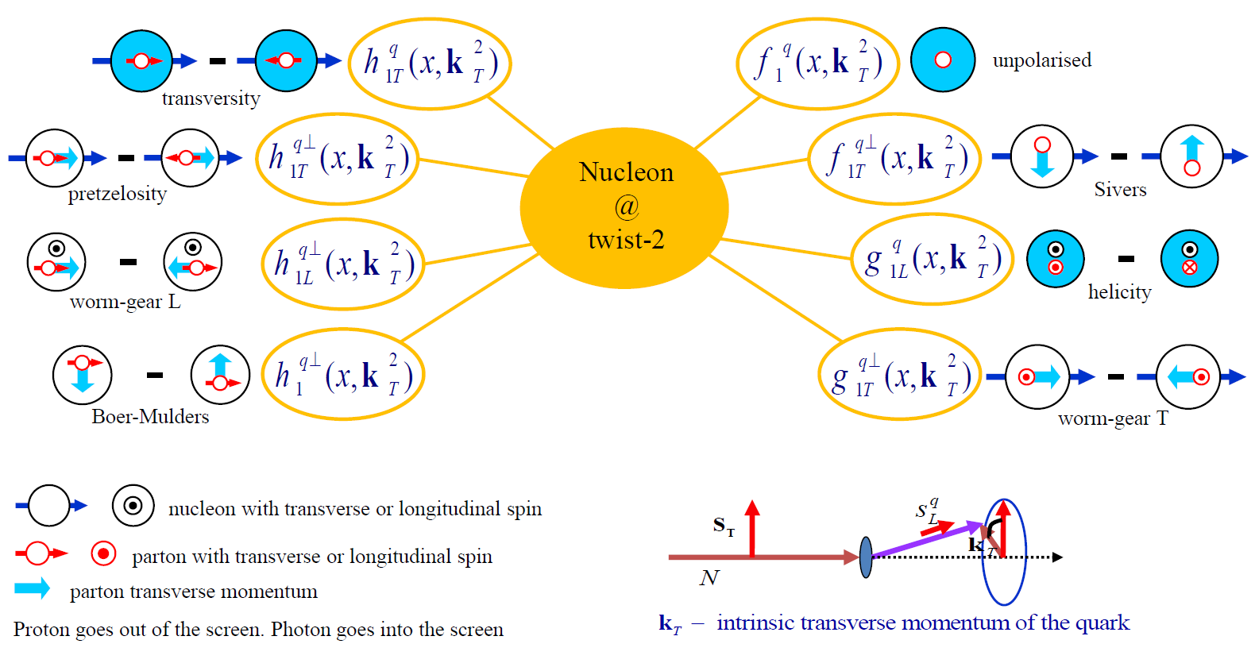
TMD Distribution Functions

Slide 10
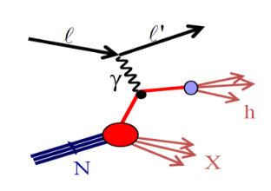
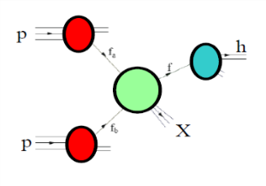
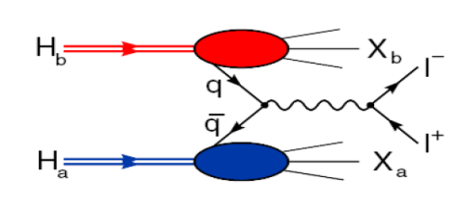


Accessing TMD PDFs and FFs
SIDIS off polarized p, d, n targets
hard polarised pp scattering
polarised Drell-Yan
$e^{+}e^{−}→h_{1}h_{2}$
HERMES
COMPASS
JLab
future: eN colliders?
$$σ^{ℓp→ℓ^{′}hX}\sim q\left(x\right)⊗{\hat{σ}}^{γq→q}⊗D_{q}^{h}\left(z\right)$$
RHIC
COMPASS
RHIC
FNAL
future: FAIR, JPark, NICA
$$σ^{hp→μμ}\sim {\overline{q}}_{h}\left(x_{1}\right)⊗q_{p}\left(x_{2}\right)⊗{\hat{σ}}^{\overline{q}q→μμ}\left(\hat{s}\right)$$
BaBar
Belle
Bes III
$$σ^{e^{+}e^{−}→h_{1}h_{2}}\sim {\hat{σ}}^{ℓℓ→\overline{q}q}\left(\hat{s}\right)⊗D_{q}^{h_{1}}\left(z_{1}\right)⊗D_{q}^{h_{2}}\left(z_{2}\right)$$

Slide 11
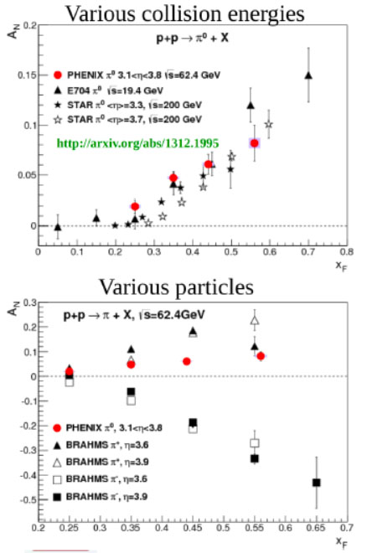




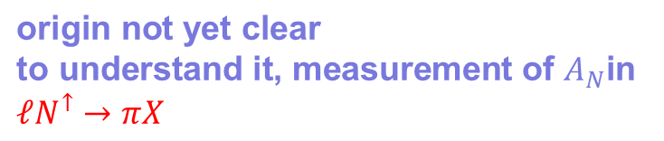
SSA in $p^{↑}p⟶πX$
$$\text{origin} \text{not} \text{yet} \text{clear}$$
$$\text{to} \text{understand} \text{it}\text{, }\text{measurement} \text{of} A_{N}\text{in}$$
$$ℓN^{↑}→πX$$

Slide 12
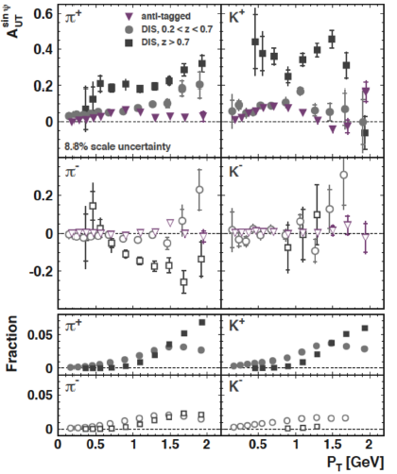
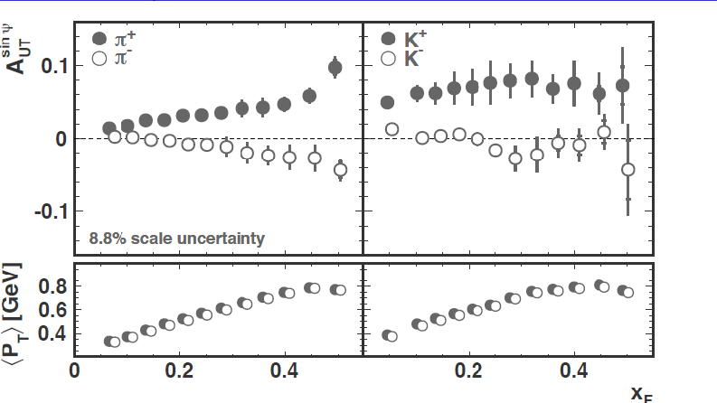
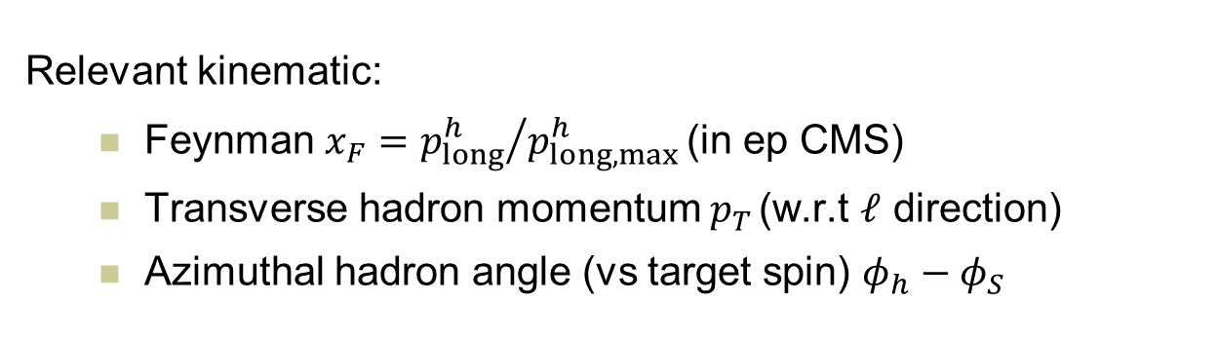
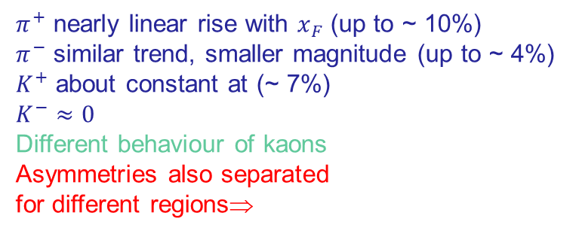

HERMES inclusive SSAs
Relevant kinematic:
  Feynman $x_{F}={p_{long}^{h}}/{p_{long,max}^{h}}$ (in ep CMS)
  Transverse hadron momentum $p_{T}$(w.r.t $ℓ$ direction)
  Azimuthal hadron angle (vs target spin) $φ_{h}−φ_{S}$
$$ℓp^{↑}⟶hX$$
$π^{+}$ nearly linear rise with $x_{F}$ (up to ~ 10%)
$π^{−}$ similar trend, smaller magnitude (up to ~ 4%)
$K^{+}$ about constant at (~ 7%)
$K^{−}≈0$
Different behaviour of kaons
Asymmetries also separated
for different regions⇒

Slide 13
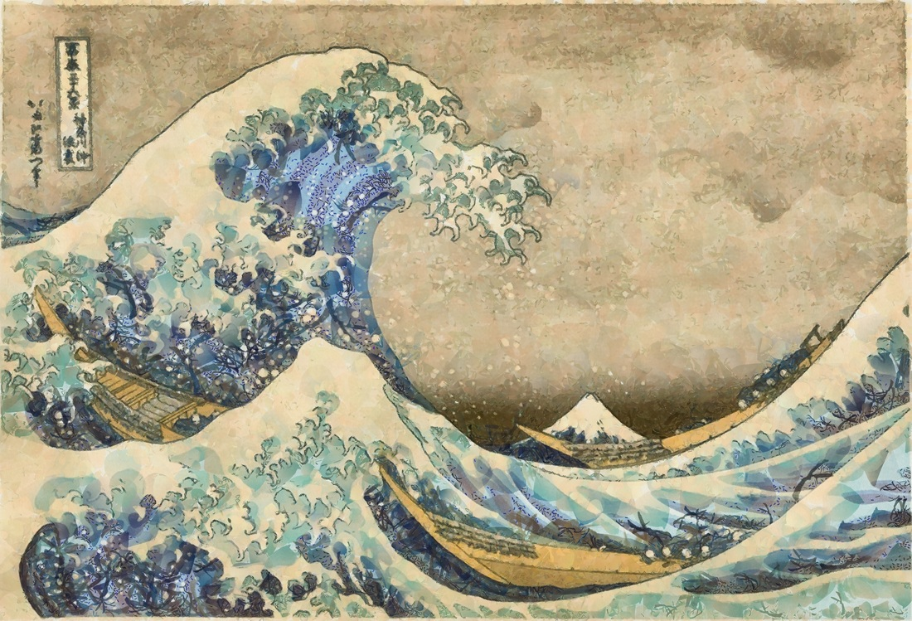
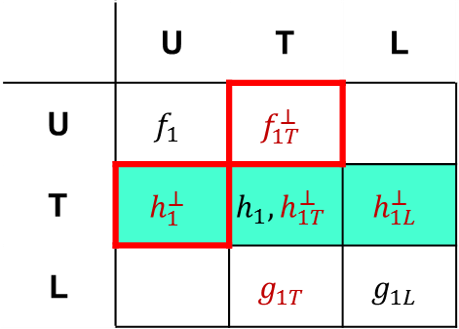
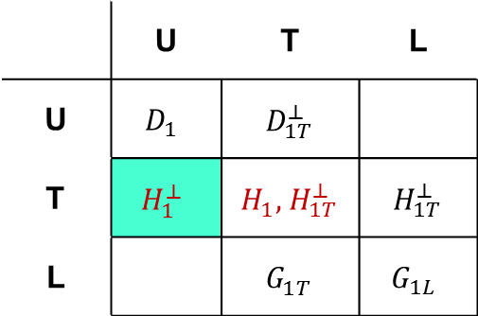
SIDIS access to TMDs
TMDs
FFs
Nucleon polarization
Hadron polarization
 | U | T | L
U | $$f_{1}$$ | $$f_{1T}^{⊥}$$
T | $$h_{1}^{⊥}$$ | $$h_{1}, h_{1T}^{⊥}$$ | $$h_{1L}^{⊥}$$
L |  | $$g_{1T}$$ | $$g_{1L}$$
 | U | T | L
U | $$D_{1}$$ | $${ D}_{1T}^{⊥}$$
T | $$H_{1}^{⊥}$$ | $H_{1}^{}, { H}_{1T}^{⊥}$ | $${ H}_{1T}^{⊥}$$
L |  | $${ G}_{1T}^{}$$ | $$G_{1L}$$
Parton polarization
Parton polarization
T odd
chiral odd
Factorisation (Collins & Soper, Ji, Ma, Yuan,
Qiu & Vogelsang, Collins & Metz...)

Slide 14
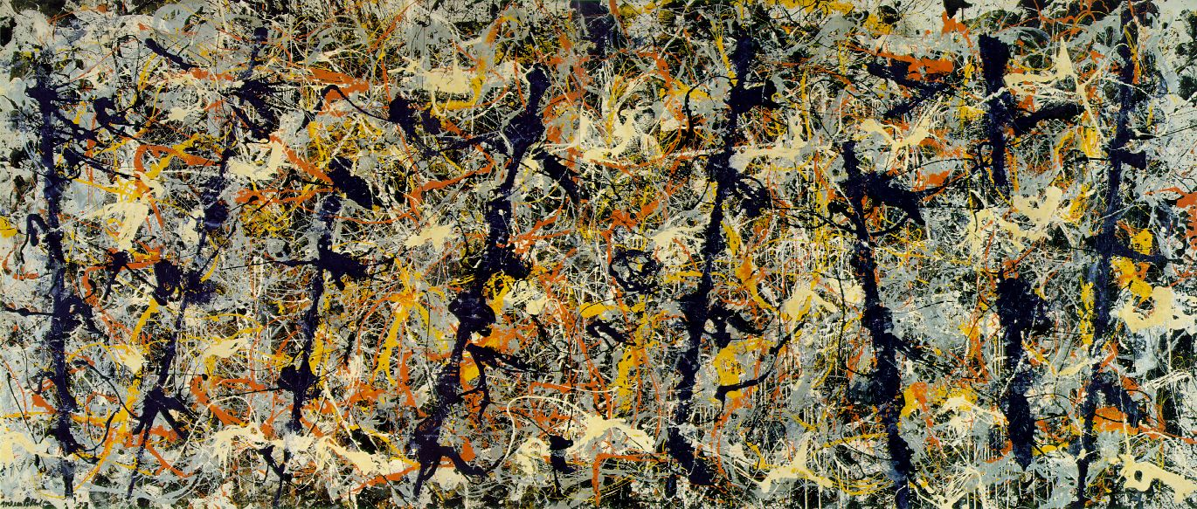
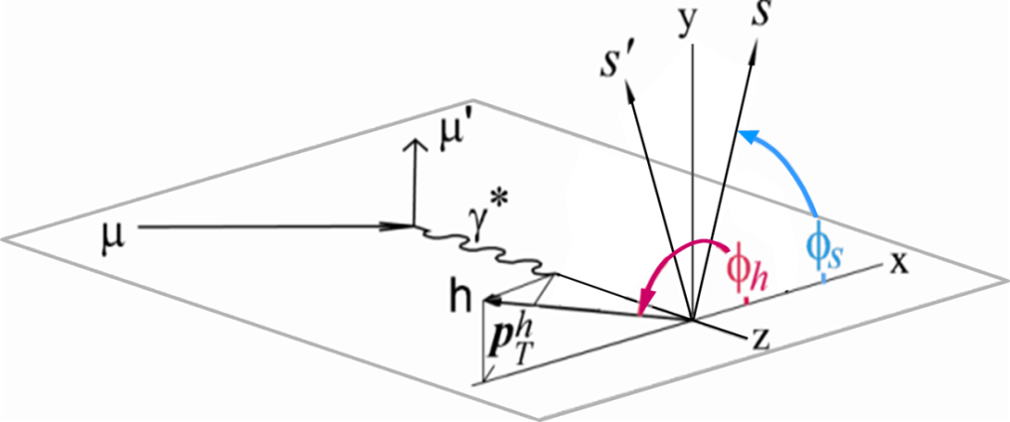
SIDIS 1h x-section

Slide 15
LO content
SIDIS
DY

Slide 16
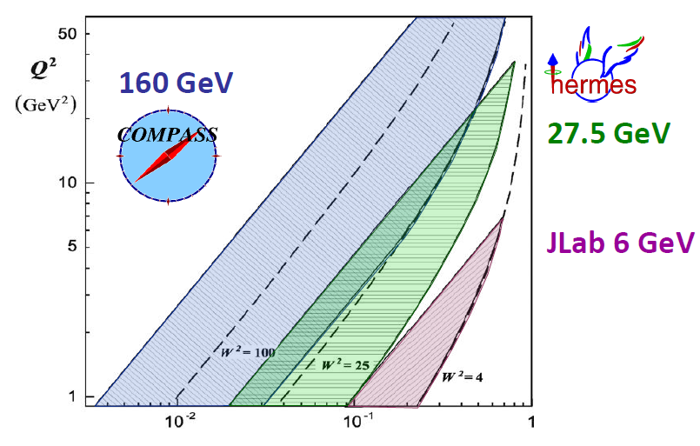
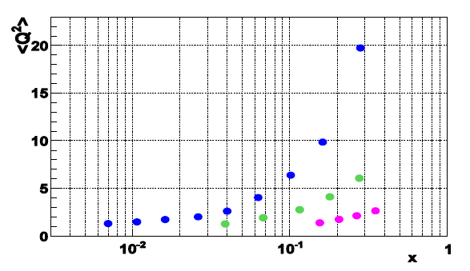
Phase space of different SIDIS -experiments
0.004 < x < 0.3, 25<W²<200GeV²
0.023 < x < 0.4, 10<W²< 50GeV²
0.14 < x < 0.5, 4<W²< 10GeV²

Slide 17


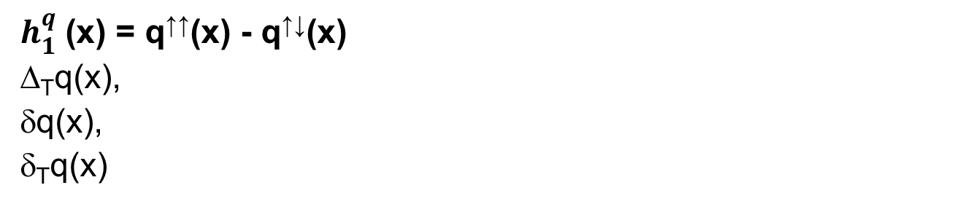
Transversity PDF
$h_{1}^{q}$ (x) = q↑↑(x) - q↑↓(x)
Δ_{T}q(x),
δq(x),
δ_{T}q(x)
q=u_{v}, d_{v}, q_{sea}
quark with spin parallel to the nucleon spin in a transversely polarised nucleon
probes the relativistic nature of quark dynamics
no contribution from the gluons  simple Q² evolution
Positivity: Soffer bound……………..
first moments: tensor charge……….
sum rule for transverse spin in PM…
it is related to GPD’s
is chiral-odd: decouples from inclusive DIS
Soffer, PRL 74 (1995)
Bakker, Leader, Trueman, PRD 70 (04)

Slide 18
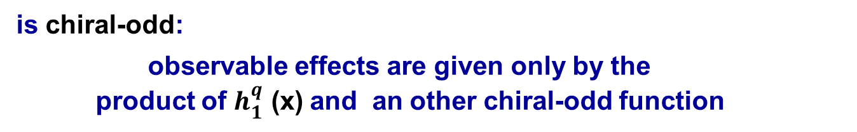
Transversity
is chiral-odd:
observable effects are given only by the
product of $h_{1}^{q}$ (x) and an other chiral-odd function
can be measured in SIDIS on a transversely polarised target
via “quark polarimetry”
“Collins” asymmetry “Collins” Fragmentation Function
“two-hadron” asymmetry “Interference” Fragmentation Function
Λ polarisation Fragmentation Function of q↑Λ

Slide 19
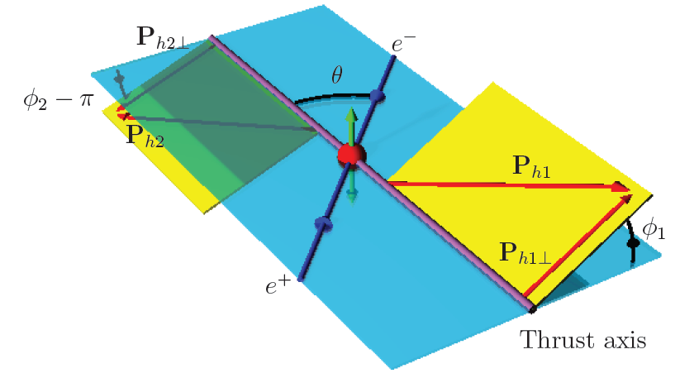
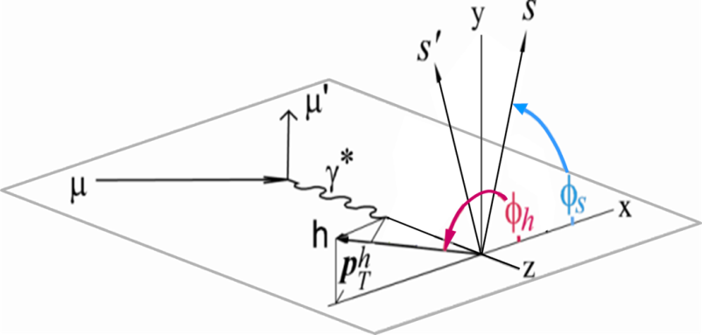
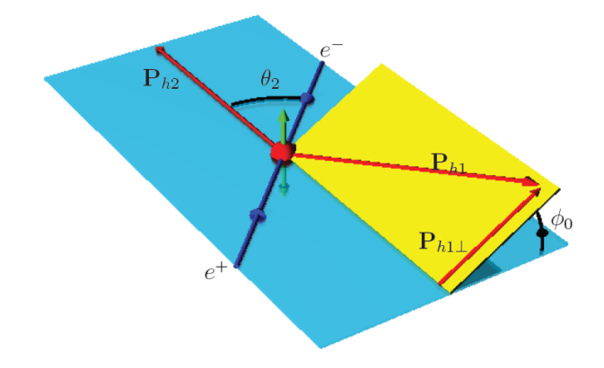
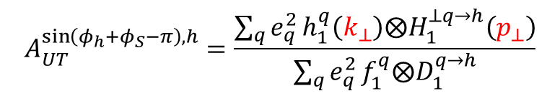
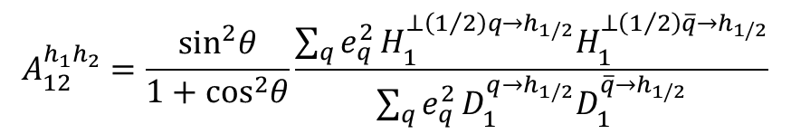
Transversity from Collins SSA and Collins FF
$$A_{UT}^{\sin\left(φ_{h}+φ_{S}−π\right), h}=\frac{\sum_{q}{e_{q}^{2}}h_{1}^{q}\left(k_{⊥}\right)⨂H_{1}^{⊥q→h}\left(p_{⊥}\right)}{\sum_{q}{e_{q}^{2}}f_{1}^{q}⨂D_{1}^{q→h}}$$
$$A_{12}^{h_{1}h_{2}}=\frac{\sin^{2}θ}{1+\cos^{2}θ}\frac{\sum_{q}{e_{q}^{2}}H_{1}^{⊥\left(1/2\right)q→h_{1/2}}H_{1}^{⊥\left(1/2\right)\overline{q}→h_{1/2}}}{\sum_{q}{e_{q}^{2}}D_{1}^{q→h_{1/2}}D_{1}^{\overline{q}→h_{1/2}}}$$
Collins effect:
a quark with an upward (downward) polarization, perpendicular to the motion, prefers to emit the leading meson to the left (right) side with respect to the quark direction

Slide 20
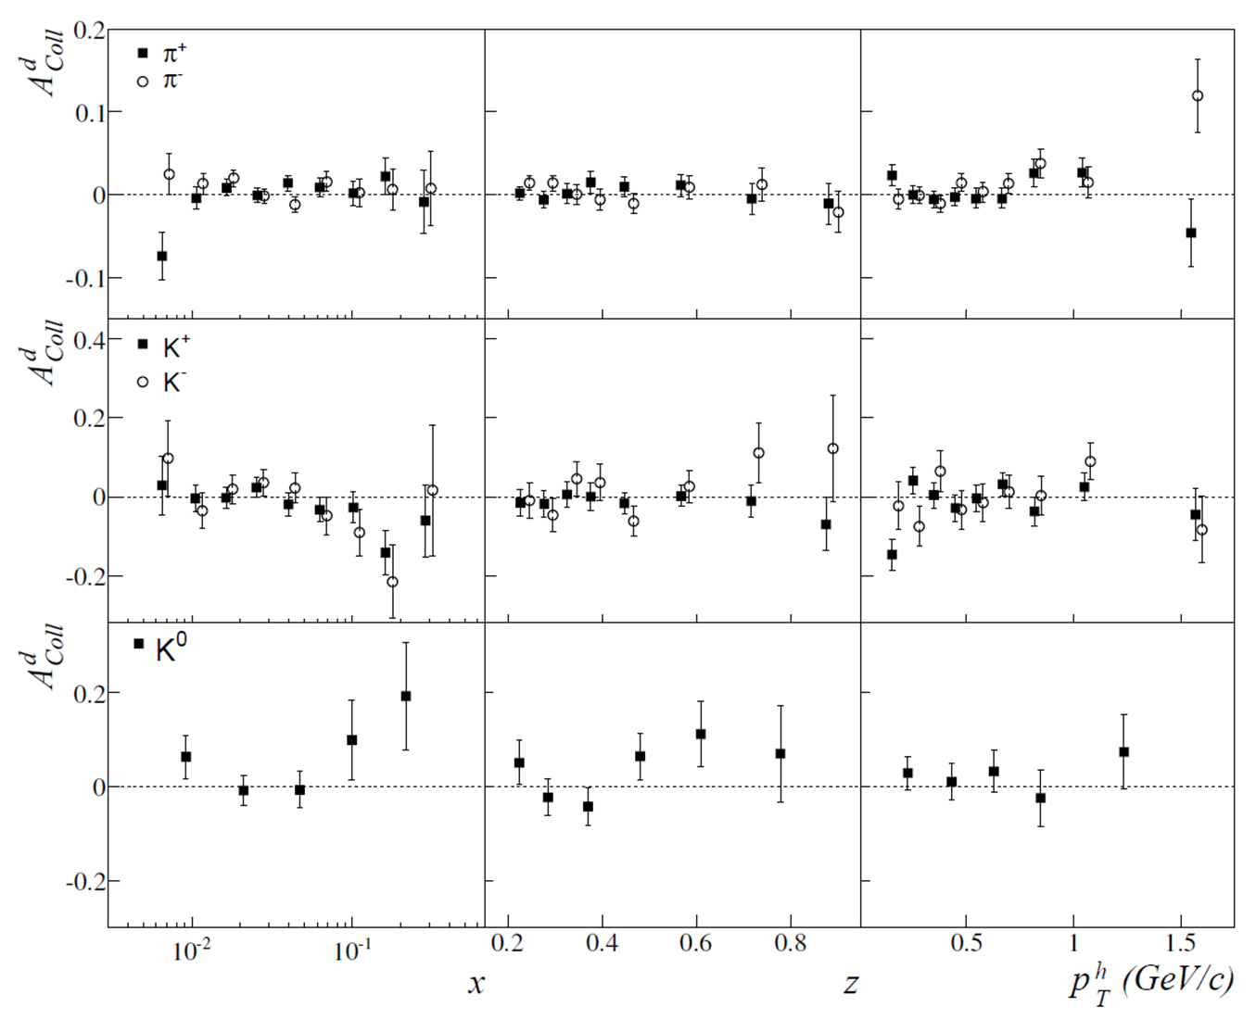

Collins asymmetry on deuteron

Slide 21
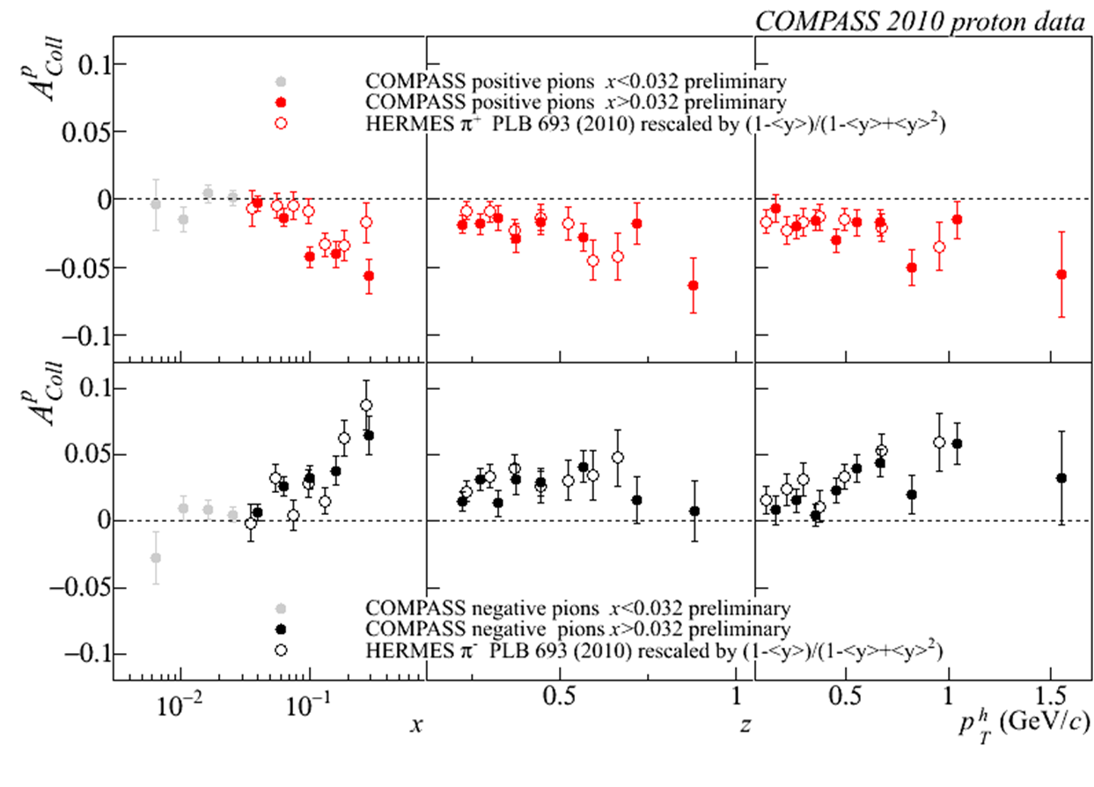
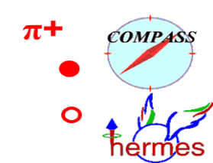
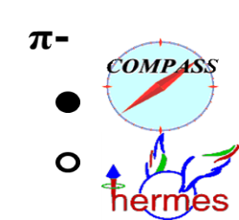
Collins asymmetry on proton
x > 0.032 region
charged pions
COMPASS and HERMES results
Notes:
21

Slide 22
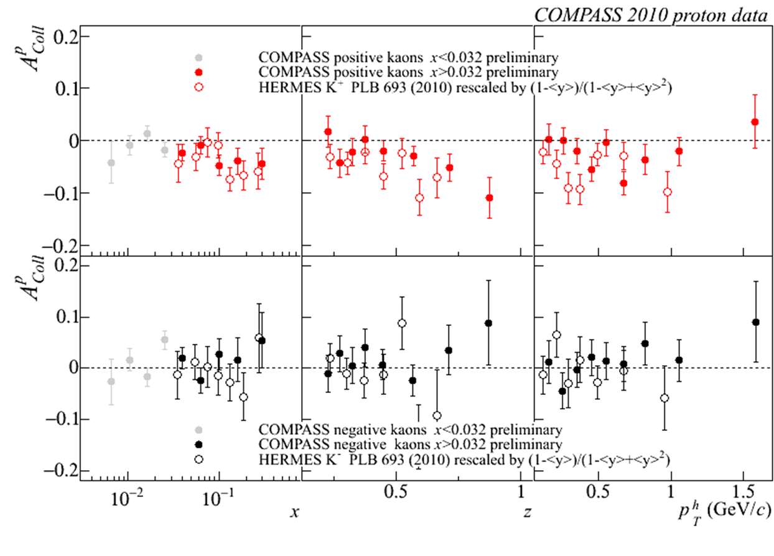


Collins asymmetry on proton
x > 0.032 region
charged kaons
COMPASS and HERMES results
K+
K-
Notes:
22

Slide 23
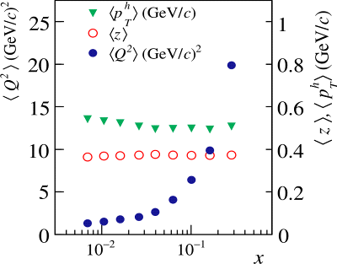


Collins asymmetry on proton
x > 0.032 region
same strength:
a very important, not obvious result!
~12
~ 4
no strong Q² dependence
Notes:
23
\

Slide 24
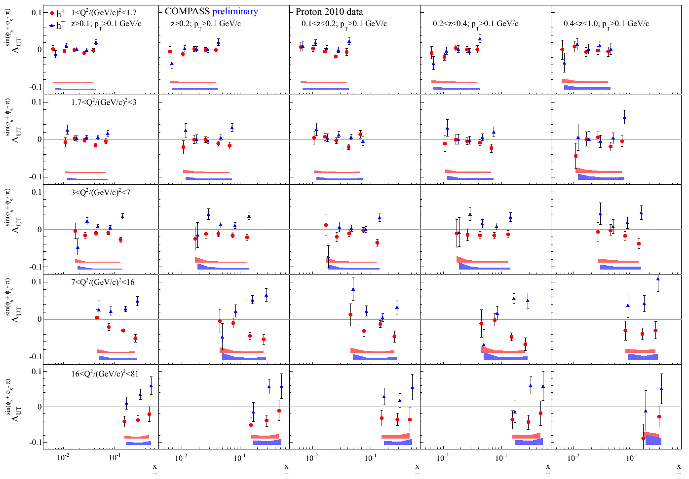
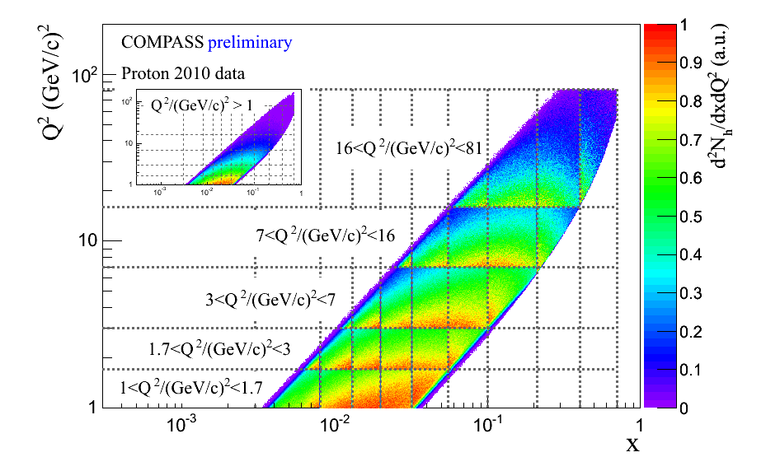
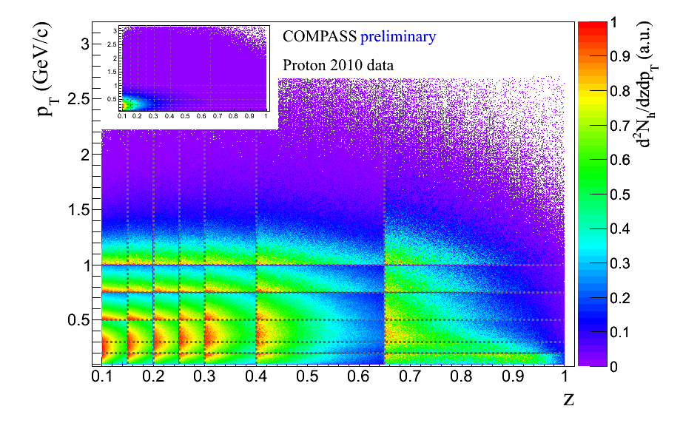
Collins asymmetry on proton. Multidimensional
First extraction of TSAs within a Multi-D $\left(x:Q^{2}:z:p_{T}\right)$ approach
π-
One dense plot out of many
Notes:
24

Slide 25
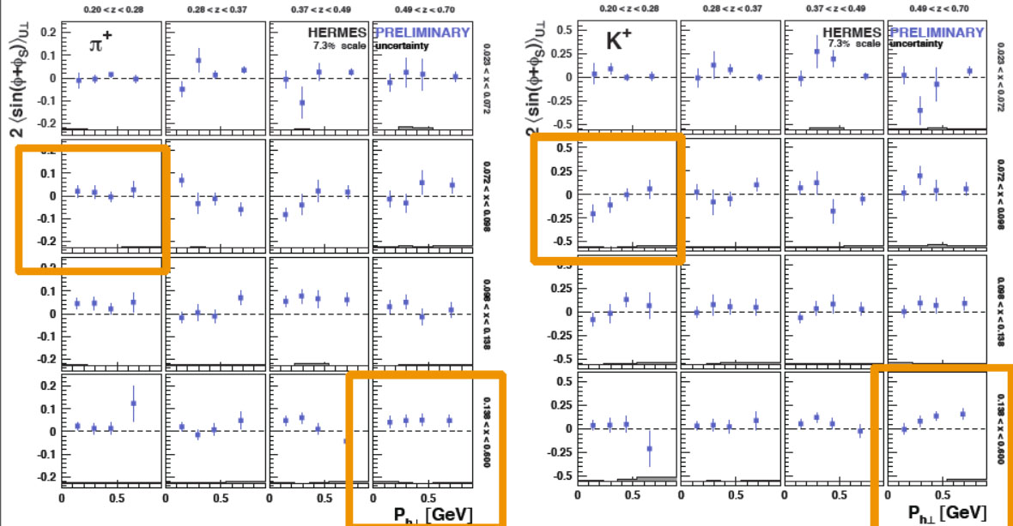
Collins asymmetry on proton. Multidimensional
Extraction of TSAs within a Multi-D $\left(x:z:p_{T}\right)$ approach
Notes:
25

Slide 26


Collins asymmetry on neutron
PRL 107 072003 (2011)
JLab Hall A

Slide 27







Collins asymmetry on $e^{+}e^{−}$

Slide 28






Collins asymmetry on $e^{+}e^{−}$
𝜋𝜋 => non-zero asymmetries, increase with z₁, z₂
𝜋K => asymmetries compatible, with zero
KK => non-zero asymmetries, increase with z₁,z₂

Slide 29



Collins asymmetry fits
M. Anselmino et al., arXiv:1303.3822
fit to HERMES p, COMPASS p and d, Belle $e^{+}e^{−}$ data
2010 p data
d data
Notes:
29

Slide 30


Transversity from Collins
Combined analyses of HERMES, COMPASS and BELLE fragm.fct. data
Anselmino et al. arXiv: 1303.3822

Slide 31



statistical correlations
Collins (Sivers, …) asymmetries measured vs x, z, p_{T}^{h}
correlation coefficients
correlation coefficients
x
x
z
p_{T}^{h}
correlation coefficients
charged pions
also available for
charged hadrons
charged kaons
have to be taken into account
z
p_{T}^{h}

Slide 32

The other way to
YTISREVSNART

Slide 33


2h asymmetries on d
$$A_{UT}^{\sin\left(φ_{R}+φ_{S}−π\right)}=\frac{\sum_{q}{e_{q}^{2}h_{1}^{q}\left(x\right)H_{q→h_{1}h_{2}}^{∡}\left(z, ℳ_{h_{1}h_{2}}^{2}\right)}}{\sum_{q}{e_{q}^{2}q\left(x\right)D_{q}^{h_{1}h_{2}}\left(z, ℳ_{h_{1}h_{2}}^{2}\right)}}$$

Slide 34


2h asymmetries on p
$$A_{UT}^{\sin\left(φ_{R}+φ_{S}−π\right)}=\frac{\sum_{q}{e_{q}^{2}h_{1}^{q}\left(x\right)H_{q→h_{1}h_{2}}^{∡}\left(z, ℳ_{h_{1}h_{2}}^{2}\right)}}{\sum_{q}{e_{q}^{2}q\left(x\right)D_{q}^{h_{1}h_{2}}\left(z, ℳ_{h_{1}h_{2}}^{2}\right)}}$$

Slide 35


2h asymmetries in $p^{↑}p⟶ππX$
$$dσ_{UT}∝\sin{φ_{RS}}f_{1}⊗h_{1}⊗{\hat{σ}}^{qq→qq}⊗H_{1,q}^{∡}\left(z,M\right)$$

Slide 36



IFF asymmetry on $e^{+}e^{−}$

Slide 37



Transversity from 2h p and d results
use the same coefficients evaluated by A. Bacchetta et al. from Belle data [JHEP1303 (2013)119]

Slide 38




Hadron correlations
Interplay between Collins and IFF asymmetries
common hadron sample for Collins and 2h analysis

Slide 39


Asymmetries for $x>0.032$ vs $∆φ=φ_{h^{+}}−φ_{h^{−}}$
$$a=\frac{σ_{1C}^{h^{+}h^{−}}\left(Δφ\right)}{σ_{U}\left(Δφ\right)}=−\frac{σ_{2C}^{h^{+}h^{−}}\left(Δφ\right)}{σ_{U}\left(Δφ\right)}$$
ratio of the integrals compatible with $4/π$

Slide 40


Sivers Asymmetry
Sivers: correlates nucleon spin & quark transverse momentum k_{T} /T-ODD
at LO:
$$μp^{↑}→μXh^{±}$$
The Sivers PDF
1992 | Sivers proposes $f_{1T}^{⊥}$
1993 | J. Collins proofs $f_{1T}^{⊥}=0$ for T invariance
2002 | S. Brodsky, Hwang and Schmidt demonstrate that $f_{1Tq}^{⊥}$ may be $≠0$ due to FSI
2002 | J. Collins shows that${\left(f_{1T}^{⊥}\right)}_{DY}=−{\left(f_{1T}^{⊥}\right)}_{SIDIS}$
2004 | HERMES on p: $A_{Siv}^{π^{+}}≠0$ and $A_{Siv}^{π^{−}}=0$
2004 | COMPASS on d: $A_{Siv}^{π^{+}}=0$ and $A_{Siv}^{π^{−}}=0$
2008 | COMPASS on p: $A_{Siv}^{π^{+}}≠0$ and $A_{Siv}^{π^{−}}=0$

Slide 41



Sivers asymmetry on deuteron
PLB 673 (2009) 127
understood as
u – d cancellation
$$f_{1T,u}^{⊥}≈−f_{1T,d}^{⊥}$$

Slide 42



Sivers asymmetry on deuteron and proton for Gluons

Slide 43



Sivers asymmetry on p
charged pions (and kaons), HERMES and COMPASS
smaller values measured by COMPASS with respect to HERMES;
same indication for K+

Slide 44

Sivers asymmetry on proton
charged hadrons, 2010 data - Q² evolution
comparison with
S. M. Aybat, A. Prokudin and T. C. Rogers calculations PRL 108 (2012) 242003
No TMD
evolution
with TMD
evolution
Notes:
44

Slide 45




Chromodynamic lensing
Use SIDIS Sivers asymmetry data to constrain shape
Use anomalous magnetic moments to constrain integral
$$f_{1T}^{⊥\left(0\right)q}\left(x,Q_{L}^{2}\right)=−L\left(x\right)E^{q}\left(x,0,0,Q_{L}^{2}\right)$$
$L\left(x\right)−$ Lensing function (from Burkart)
$E^{q}−$ GPD related to quark OAM
$n$-th moment of a TMD with respect to $k_{⊥}$
$$f_{1T}^{⊥\left(n\right)q}\left(x,Q^{2} \right)=\int{d^{2}k_{⊥}{\left(\frac{k_{⊥}^{2}}{2M^{2}}\right)}^{n}f_{1T}^{⊥\left(0\right)q}\left(x,k_{⊥}^{2},Q_{L}^{2}\right)}$$

Slide 46
Sivers asymmetry on neutron
JLab Hall A

Slide 47


Test of universality
T-odd character of the Boer-Mulders and Sivers functions
In order not vanish by time-reversal invariance T-odd SSA require an interaction phase generated by a rescattering of the struck parton in the field of the hadron remnant
Time reversal
SIDIS
these functions are process dependent, they change sign to provide the gauge invariance
Boer-Mulders
Sivers

Slide 48

Sivers asymmetry on proton. Multidimensional
First ever extraction of TSAs within such a Multi-D $\left(x:Q^{2}:z:p_{T}\right)$ approach
π-
DY RUN STARTING!!!
Notes:
48

Slide 49

Importance of unpolarized SIDIS for TMDs
The cross-section dependence from $p_{T}^{h}$ results from:
  intrinsic $k_{⊥}$ of the quarks
  $p_{⊥}$ generated in the quark fragmentation
  A Gaussian ansatz for $k_{⊥}$ and $p_{⊥}$ leads to
  $\left\langle p_{T,h}^{2}\right\rangle =z^{2}\left\langle k_{⊥}^{2}\right\rangle +\left\langle p_{⊥}^{2}\right\rangle$
The azimuthal modulations in the unpolarized cross-sections comes from:
  Intrinsic $k_{⊥}$ of the quarks
  The Boer-Mulders PDF
These are difficult measurements were one has to correct for the apparatus acceptance

Slide 50




X-section dep. from $p_{T}^{h}$

Slide 51

New results

Slide 52
Boer-Mulders and Cahn effects, a reminder

Slide 53
Boer-Mulders and Cahn effects

Slide 54
Conclusions (?)
A lot of data on the shelf being used;
New PP results from RHIC
SIDIS results will continue to come in the future both from COMPASS and from JLAB12;
In the near future COMPASS will provide first polarized DY
  Whats NEXT?

Slide 55
Theory side, a suggestion
The amount of data is rapidly increasing;
The phenomenological analysis of Collins/Sivers/Unpolarised Asyms…is helping to get insight on the mechanisms
We have strong groups of IT theorists leading the field
Maybe (?) it is the right time for them to setup a Collaborations, aiming to a global analysis of all this data sets.
And for experiments …

Slide 56
Nucleon Structure Outlook
This is a defining period for the future, which can be bright
Next decade gets important input from HL-LHC, COMPASS, JLab-12 GeV
LHeC (and FCC-he) utilizes an envisioned 60-GeV ERL off the LHC (or its upgrade). They will be the ultimate tools to study high-energy DIS, and allow unprecedented measurements of
  parton distributions of gluons in nucleons and nuclei, down to the region of the highest-density matter
  precision Higgs characterization
  resolving proton (and LQ) structure down to a few times 10⁻⁵ fm
EIC science requires polarization & luminosity & detection capability. EIC allows a unique opportunity to make a (textbook) breakthrough in nucleon structure and QCD dynamics
  explore and image the 3D (spin) structure of the nucleon
  discover the role of gluons in structure and dynamics
  understand the emergence of hadrons from color charge
Rolf Ent: Workshop on the Long Term Strategy of INFN CSN1
Elba, May 22 – May 24, 2014
Lepton scattering has proven its science value over the last 5 decades!
These projects deserve the strongest support – they can be on your horizon!

Slide 57
Electron Ion Colliders
Past
Possible Future
Europe
US
China
Europe
EIC
CEIC
 | HERA@DESY | LHeC@CERN | eRHIC@BNL | MEIC@JLab | HIAF@CAS | ENC@GSI
E_{CM} (GeV) | 320 | 800-1300 | 70-150 | 12-70 → 140 | 12 → 65 | 14
proton x_{min} | 1 x 10⁻⁵ | 5 x 10⁻⁷ | 4 x 10⁻⁵ | 5 x 10⁻⁵ | 7 x10⁻³ →3x10⁻⁴ | 5 x 10⁻³
ion | p | p to Pb | p to U | p to Pb | p to U | p to ~⁴⁰Ca
polarization | - | - | p, ³He | p, d, ³He (⁶Li) | p, d, ³He | p,d
L [cm⁻² s⁻¹] | 2 x 10³¹ | 10³³⁻³⁴ | 10³³ → 10³⁴ | 10³⁴⁻³⁵ | 10³²⁻³³ → 10³⁵ | 10³²
IP | 2 | 1 | 2+ | 2+ | 1 | 1
Year | 1992-2007 | 2025 | 2025 | Post-12 GeV | 2019 → 2030 | upgrade to FAIR
Followed by FCC-he?
Figure-8
Figure-8
Dormant
High-Energy Physics
Hadron Physics
Note: x_{min} ~ x @ Q² = 1 GeV²

Slide 58
EIC: the MACHINE to image quarks and gluons
All of us dream of

Slide 59


Thank You

Slide 60


Other SSAs - Deuteron data
two twist-2 asymmetries can be interpreted in QCD parton
“pretzelosity” ⊗ Collins FF
In some models $h_{1T}^{⊥}=g_{1}−h_{1}$
on deuteron asymmetries compatible with zero: again cancellation between proton and neutron?

Slide 61

Other SSAs - proton data
“pretzelosity” ⊗ Collins FF

Slide 62

Other SSAs - proton data
“pretzelosity” ⊗ Collins FF

Slide 63

Other SSAs - neutron data
“pretzelosity” ⊗ Collins FF

Slide 64

Other Transverse Target spin asymmetries on d

Slide 65

Other Transverse Target spin asymmetries on p

Slide 66

Other Transverse Target spin asymmetries on p

Slide 67

Other Transverse Target spin asymmetries on n

Slide 68

Collins Asymmetry on p - π, K id.
Correlation between outgoing hadron & quark transverse spin
→ $h_{1}^{u} \& h_{1}^{d}$
π-
combined 2007 – 2010 results
π+
preliminary
Agreement HERMES/COMPASS → no Q² dependence seen Now also produced in bins of z and y

Slide 69

Importance of unpolarized
SIDIS for TMDs
The cross-section dependence from $p_{T}^{h}$ results from:
  intrinsic k_{T} of the quarks
  $p_{⊥}$ generated in the quark fragmentation
The azimuthal modulations in the unpolarized cross-sections comes from:
  Intrinsic k_{T} of the quarks
  The Boer-Mulders PDF
These are difficult measurements requiring to take into account apparatus acceptance
COMPASS and HERMES have
  results on ${}_{}^{6}{LiD} \left(\sim d\right)$ and $d$ from
  No measurements on $p$ since on $NH_{3} \left(\sim p\right)$ nuclear effects may be important
$⇒$COMPASS-II, measurements on LH₂ in parallel with DVCS

Slide 70


Collins asymmetry on proton
charged pions and kaons
combined 2007 – 2010 results
π-
~ h+ / h-
π+
preliminary
K-
compatible
with π+ / π-
K+
preliminary
Notes:
70

Slide 71

SIDIS 1h x-section

Slide 72









Players on SIDIS playground
Hall B
Beam: ≤6 GeV e⁻; 85% polarization
Target: polarized targets ³He, ⁶LiD, NH₃
Large acceptance spect. electron/photon beams
Hall C
Hall A
Beam: 160 GeV μ; 75% polarization
Target: ⁶LiD; 50% polarization
NH_{3;} 90%
Beam: 27.5 GeV e±; <50>% polarization
Target: polarized p gas targets; $\left\langle 85\%\right\rangle$ polarization
7 GeV spectrometer,
1.8 GeV spectrometer,
large installation experiments
Two high-resolution
4 GeV spectrometers

Slide 73


Players on FF playground

Slide 74

Spin, L and the free Dirac H
$H=α∙\vec{p}+βm$
$\begin{matrix}\vec{L}=1 \vec{x}×\vec{p} \\ =1 i\vec{x}×\vec{∇}\end{matrix}$ ⇒ $\begin{matrix}L \text{position} \text{dependent}\text{, }\text{doesn}\text{’}\text{t} \text{commute} \text{with} ∂_{i} \text{in} H \\ \left[H,\vec{L}\right]=−α∙\vec{∇}\end{matrix}$
$\vec{L}$ not conserved
$\vec{Σ}=\left(\begin{matrix}\vec{σ} & 0 \\ 0 & \vec{σ}\end{matrix}\right)$ ⇒ $\begin{matrix}\text{Pauli} \text{matrices} \text{in}\vec{Σ} \text{a}\text{nd} H \text{d}\text{o} \text{not} \text{commute} \\ \left[H,\vec{Σ}\right]=2α∙\vec{∇}\end{matrix}$
spin not conserved
$\left[H,\vec{L}+\frac{1}{2}\vec{Σ}\right]=\left[H,\vec{J}\right]=0$ J conserved

