Slide 1
New 3D Layout
Gian-Franco Dalla Betta
University of Trento and TIFPA INFN, Trento, Italy
Description of a problem with CMS sensors
  The problem
  Possible solution ?

Slide 2
New (small) pixels to be compatible with existing ROCs
The sizes of interest of new pixels (50x50, 25x100) do not match
those of existing ROCs:
  ATLAS FEI3: 50x400
  ATLAS FEI4: 50x250
  CMS PSI46: 150x100
Bump bonding new small pixels to these ROCs does not allow to
connect all pixels … what to do with other regions ?
  Alternate small pixels to very big pixels ?
  Big pixels have too large capacitances, they may prevent from
  proper threshold tuning (also in small pixels)
  Leave big pixels floating ?
  → Boundary conditions not properly defined
  Ground large pixels with metal grid → Best solution

Slide 3
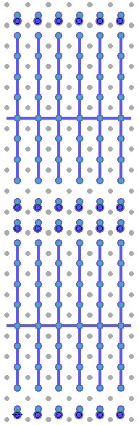
Example: FEI4 compatible test pixels 50 x 50
4x50 + grid
The grid common to all large pixels can be grounded at the sensor periphery exploiting the extra-pads present on the FEI4 ROC.
Similar extra pads are present on the FEI3 ROCs
They were initially intended for the guard ring to be grounded in planar sensors
450 μm
50 μm
Extra pads
in FEI4 IBL
design
450 μm

Slide 4
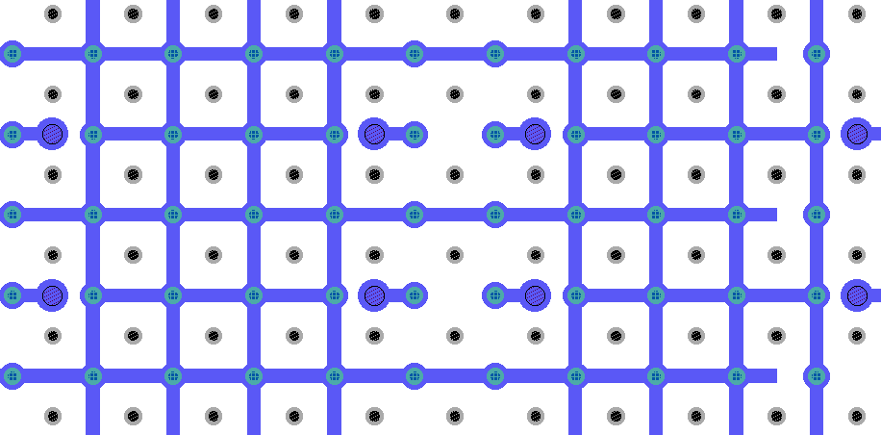
Example: PSI46 compatible test pixels 50 x 50
Single cells 50x50 + grid

Slide 5
Problem with PSI46
The problem to use the grid with the PSI46 ROC is that no extra-pads are available.
How can be grid be grounded ? At this time I see only one solution:
the grid could be extended on one side of the sensor, beyond the edge of the ROC after flip-chip, and a wire bonding could be made there.
Wire bonding
pads on ROC
SENSOR
ROC
Wire bonding
pad for grid
on sensor

