Slide 1
Gaspard-Hyde-Trace workshop 2015
Mechanics for test of Gaspard trapezoidal telescope
Orsay Tandem June 2015

Slide 2
Trapezoidal Telescope
design (brief reminder)

Slide 3
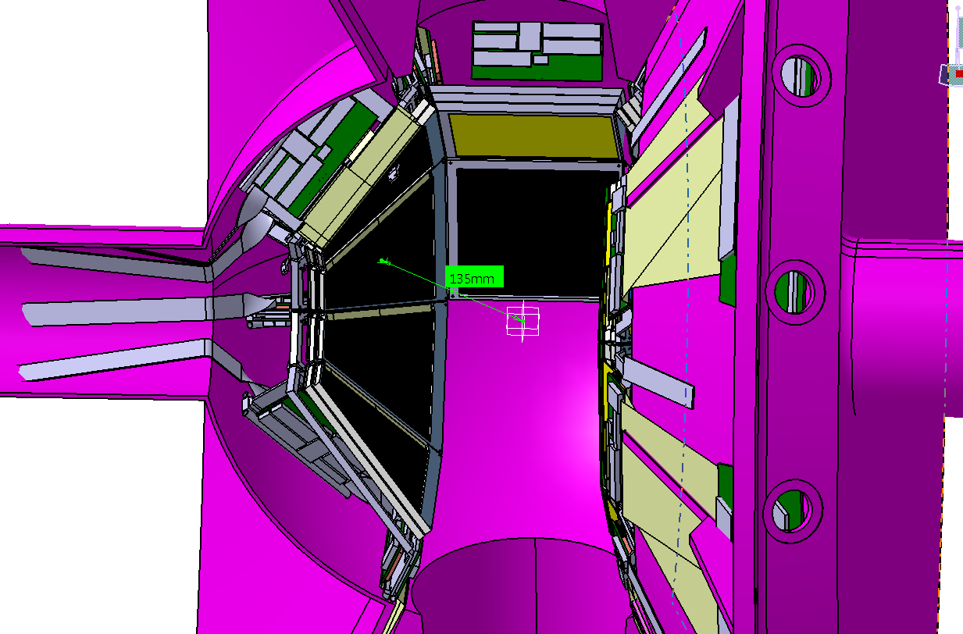
Trapezoidal silicon in the spherical chamber ( Gaspard )
8 trapezoidal silicon with 3 layers for forward side
8 trapezoidal silicon with 2 layers for backward side
7 rectangular central silicon with 2 layers
Radius spherical chamber : 225 mm

Slide 4
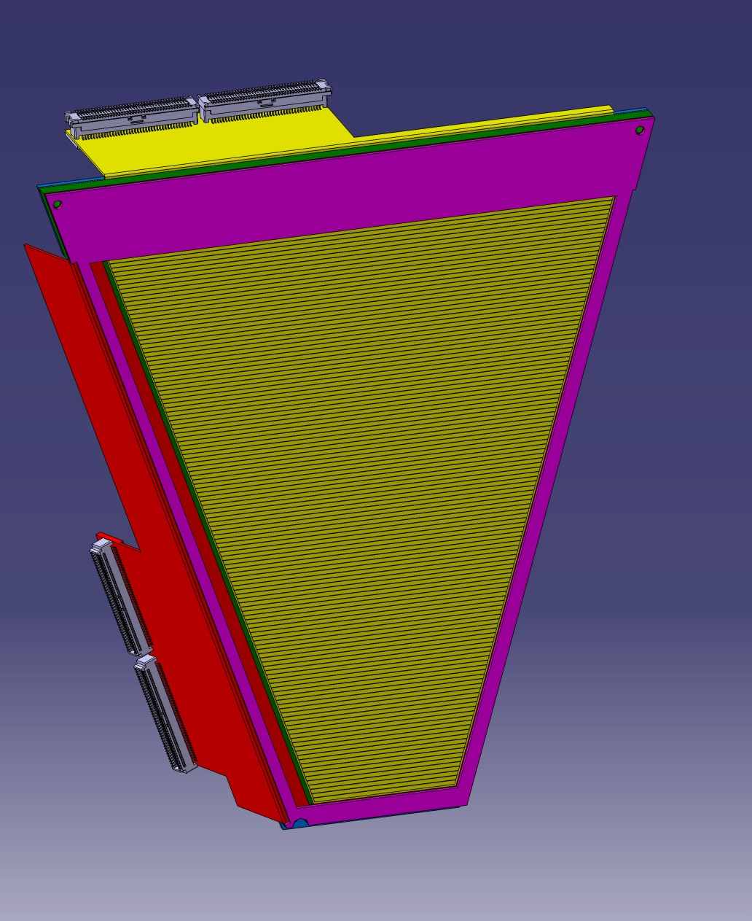
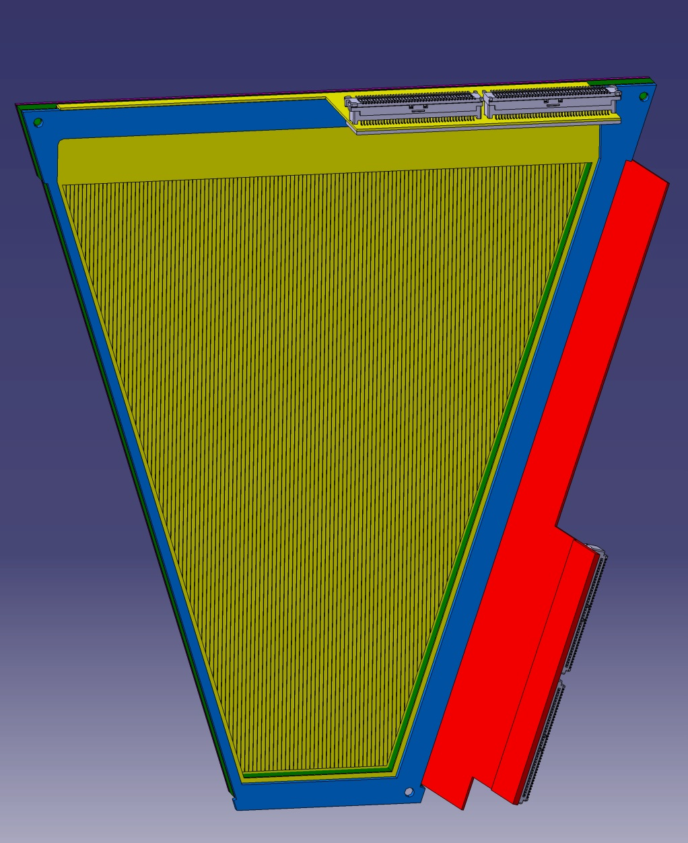
Trapezoidal silicon 1st layer : thickness = 500 µ
small flex
91,5 mm
104,4 mm
25,3 mm
Large flex
Front face = 128 strips X , pitch = 0,816mm
Backward face = 128 strips Y ,pitch=0,71mm

Slide 5
Trapezoidal silicon mechanical Kapton design for Gaspard
small flex bended at 90°
Large flex bended at 90°

Slide 6
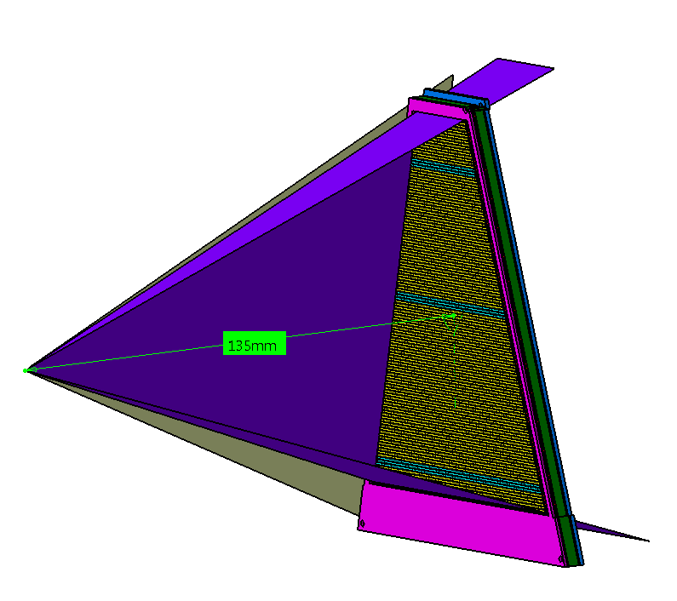
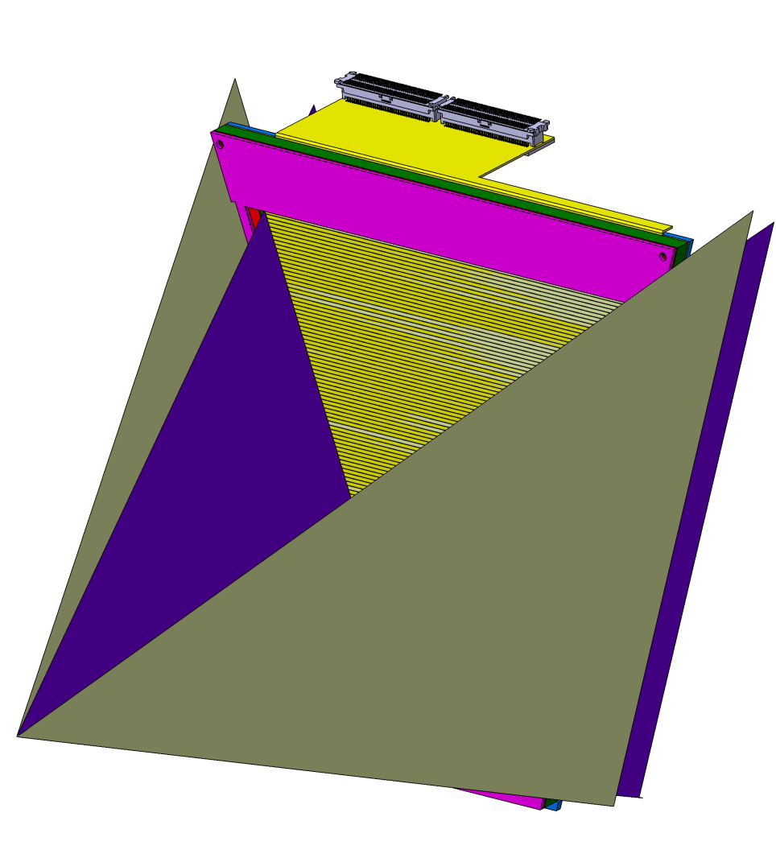
Design of the trapezoidal silicon
Angle between 2 external yellow plans = 45° (360° / 8 trapezoidal silicium) Keeping volume
Detail: purple plan tangent to the edge of the strips
Angle between 2 internal purple plans = 42,33° (acceptance in each direction)

Slide 7
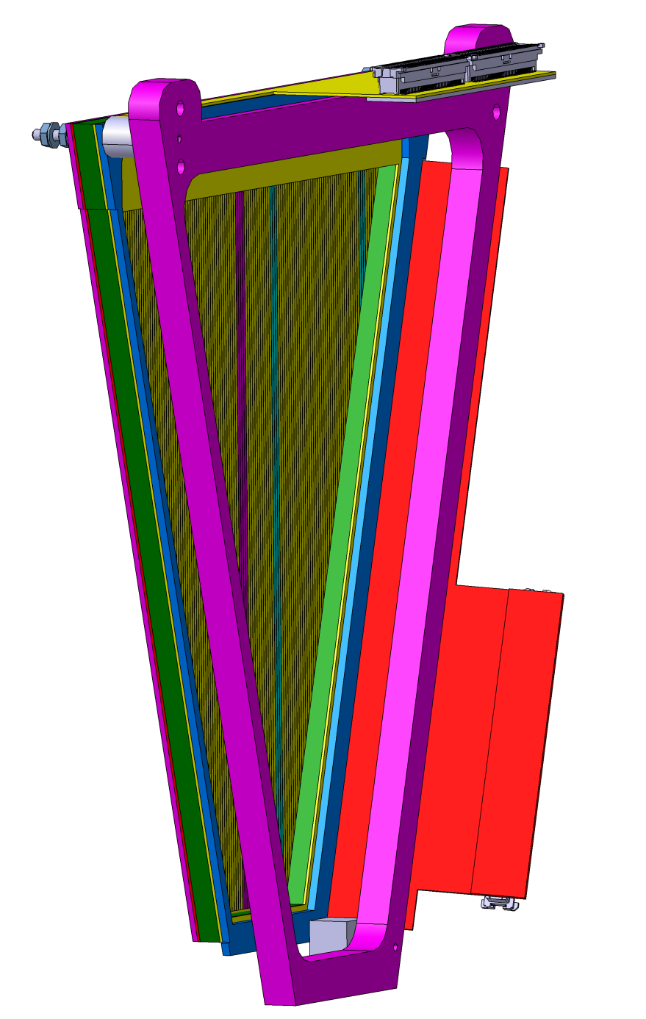
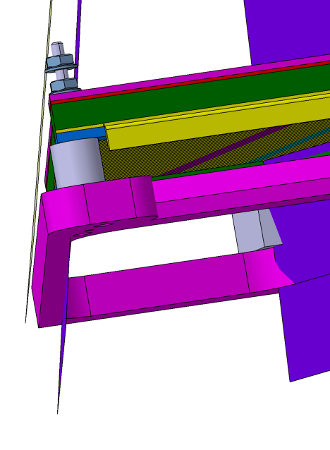
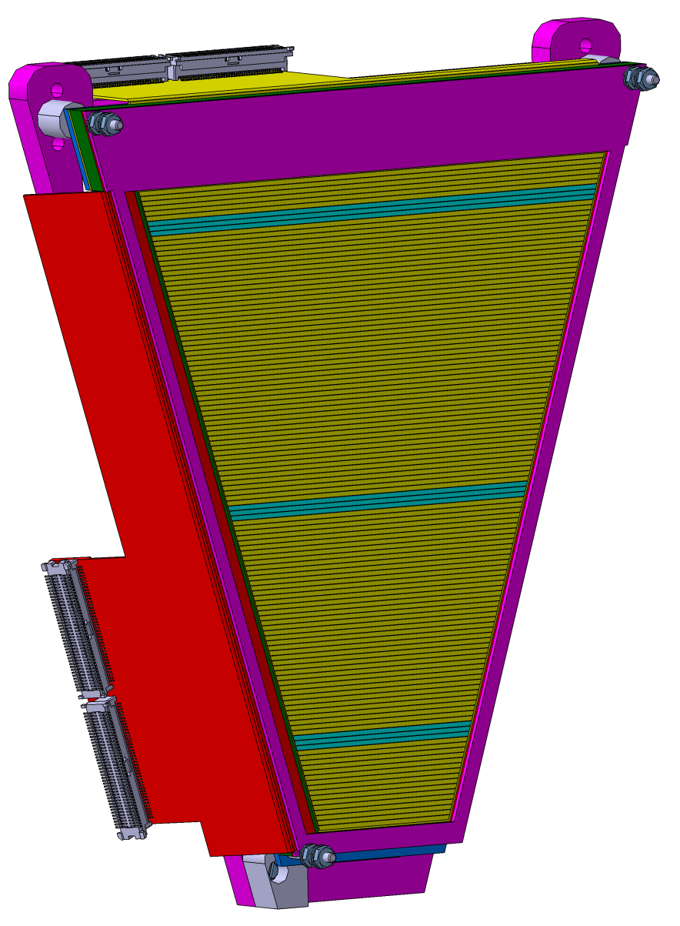
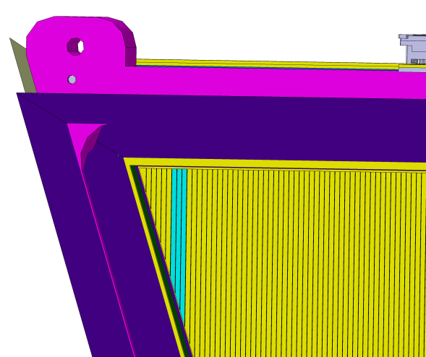
Design of the frame support silicium
Aluminum frame
Frame in the dead zone
3 spacers instead the layer 2

Slide 8
General mounting
in Orsay Tandem
for june experiment

Slide 9
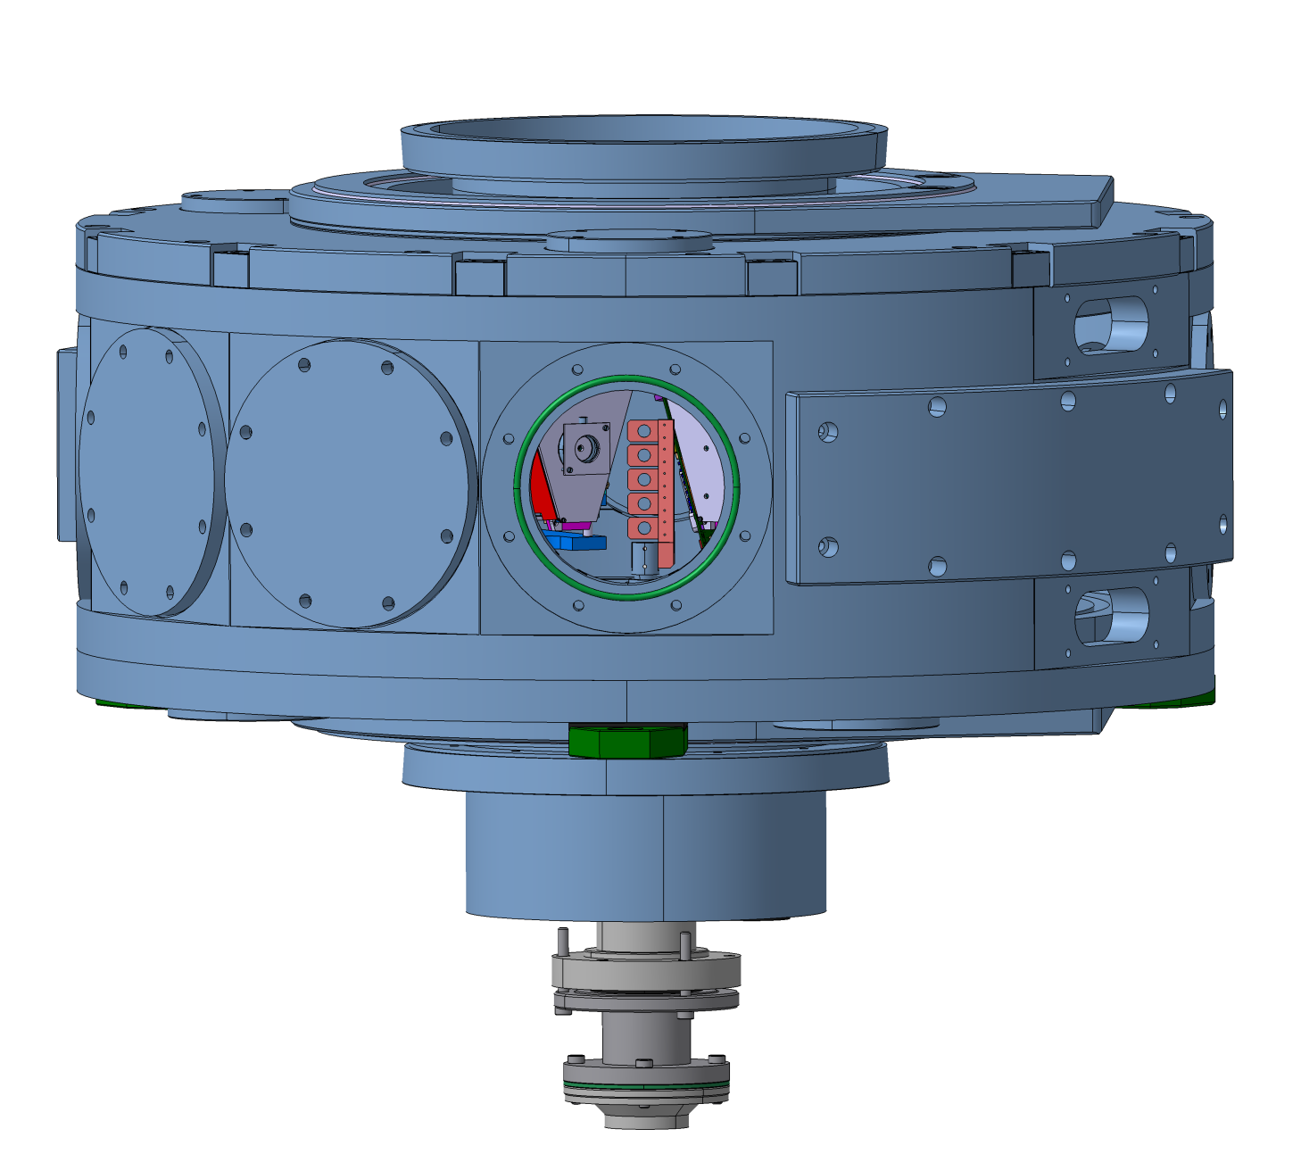
Empereur Vacuum chamber CAD
H = 366 mm
Ø 890 mm

Slide 10
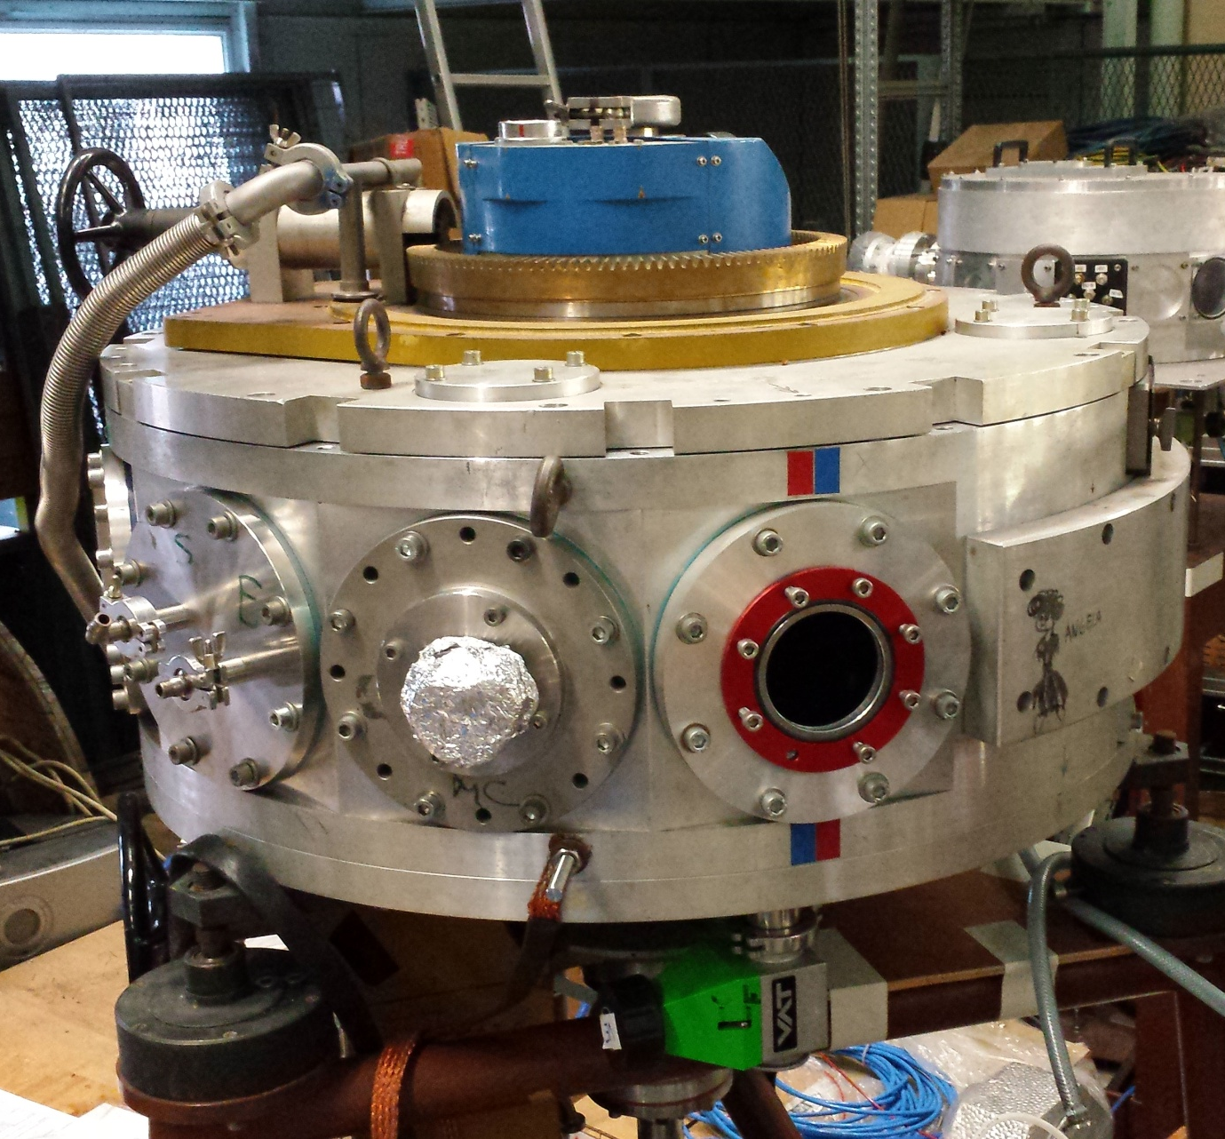
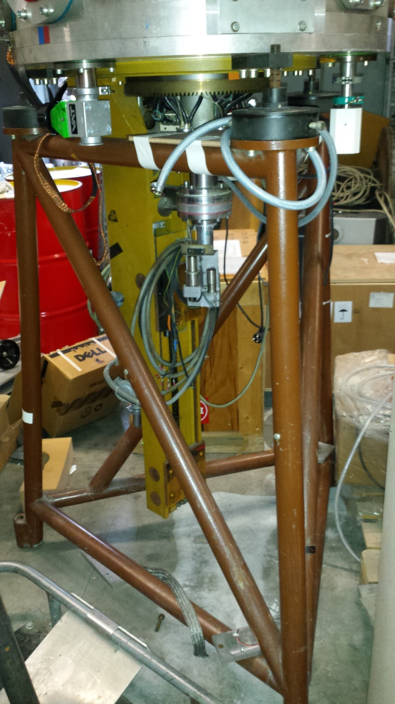
Empereur Vacuum chamber in Orsay Tandem

Slide 11
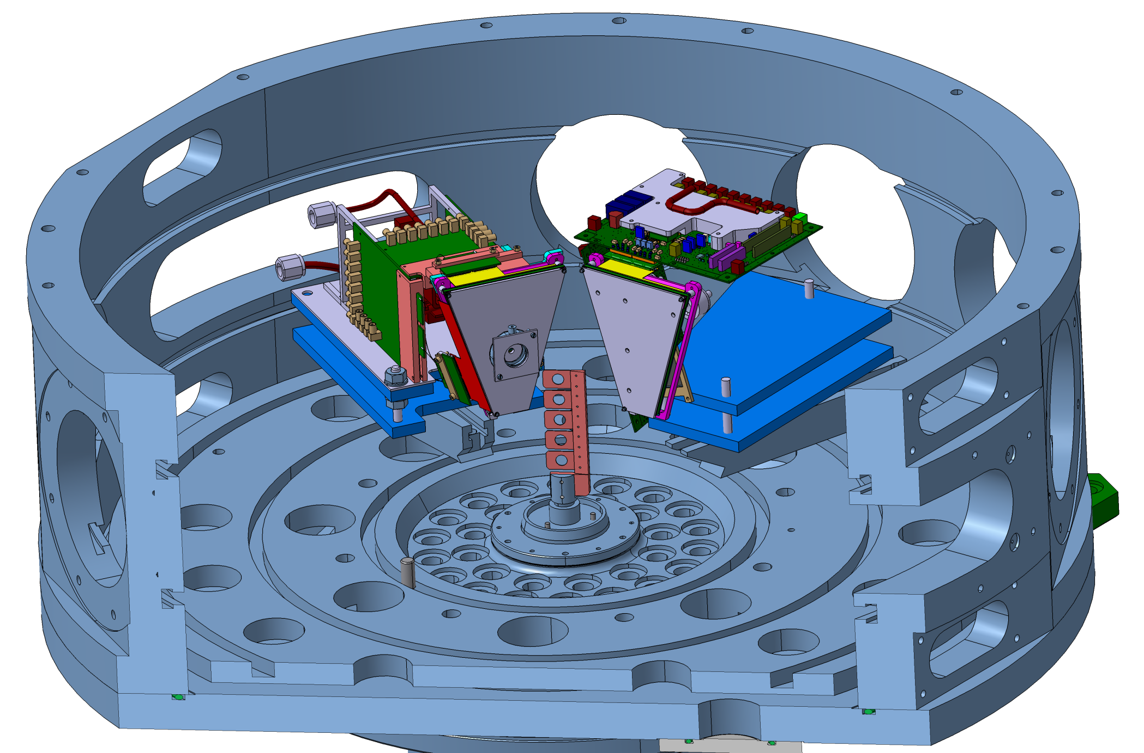
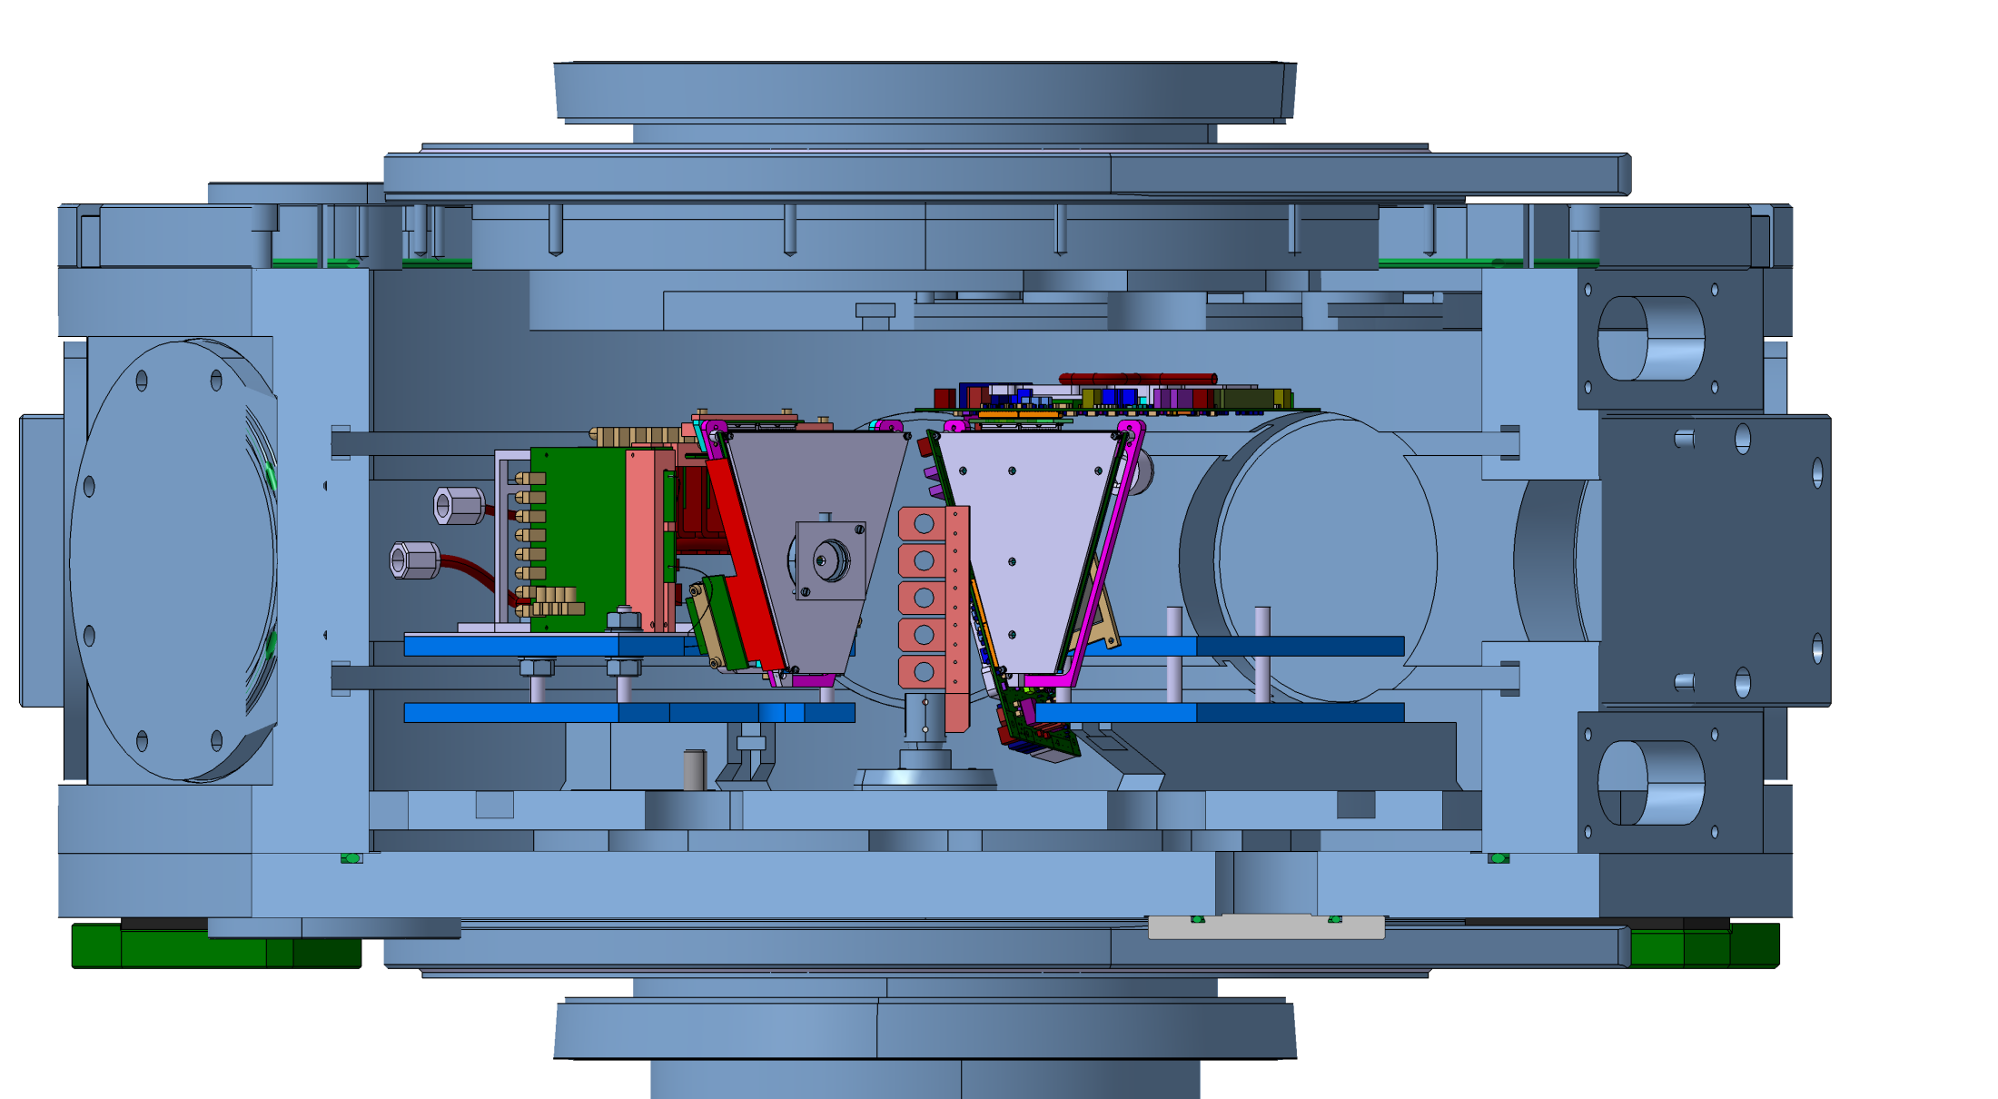
General view in Empereur Vacuum chamber
BB13 mounting
IPACI mounting
Beam

Slide 12
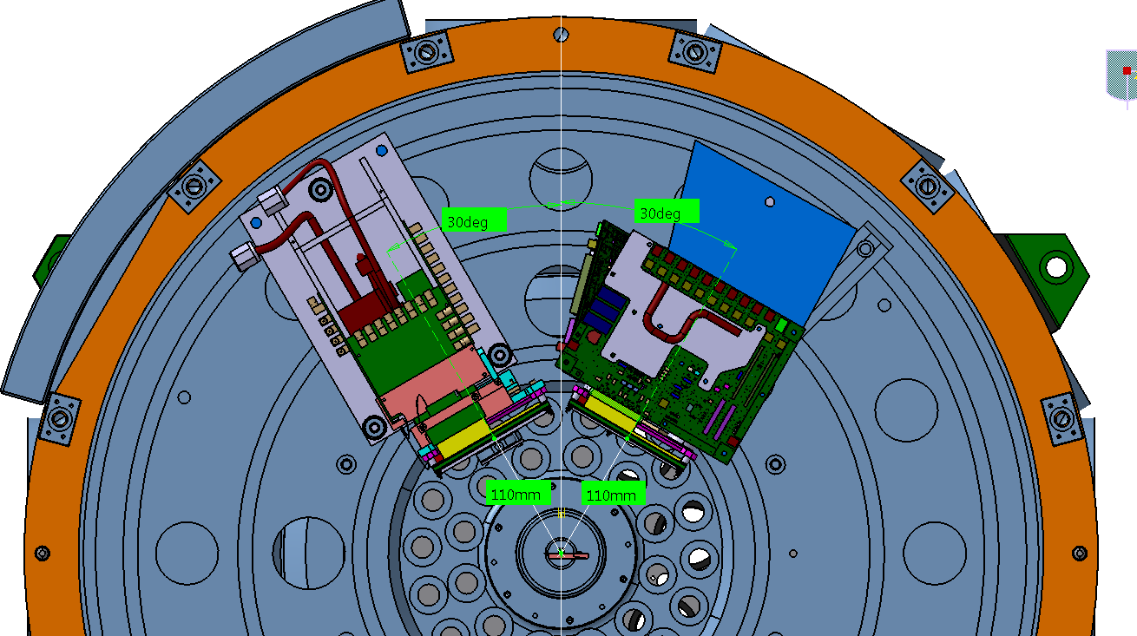
General view in Empereur Vacuum chamber
Edge of the chamber
BB13
IPACI
Beam

Slide 13
BB13 mounting

Slide 14
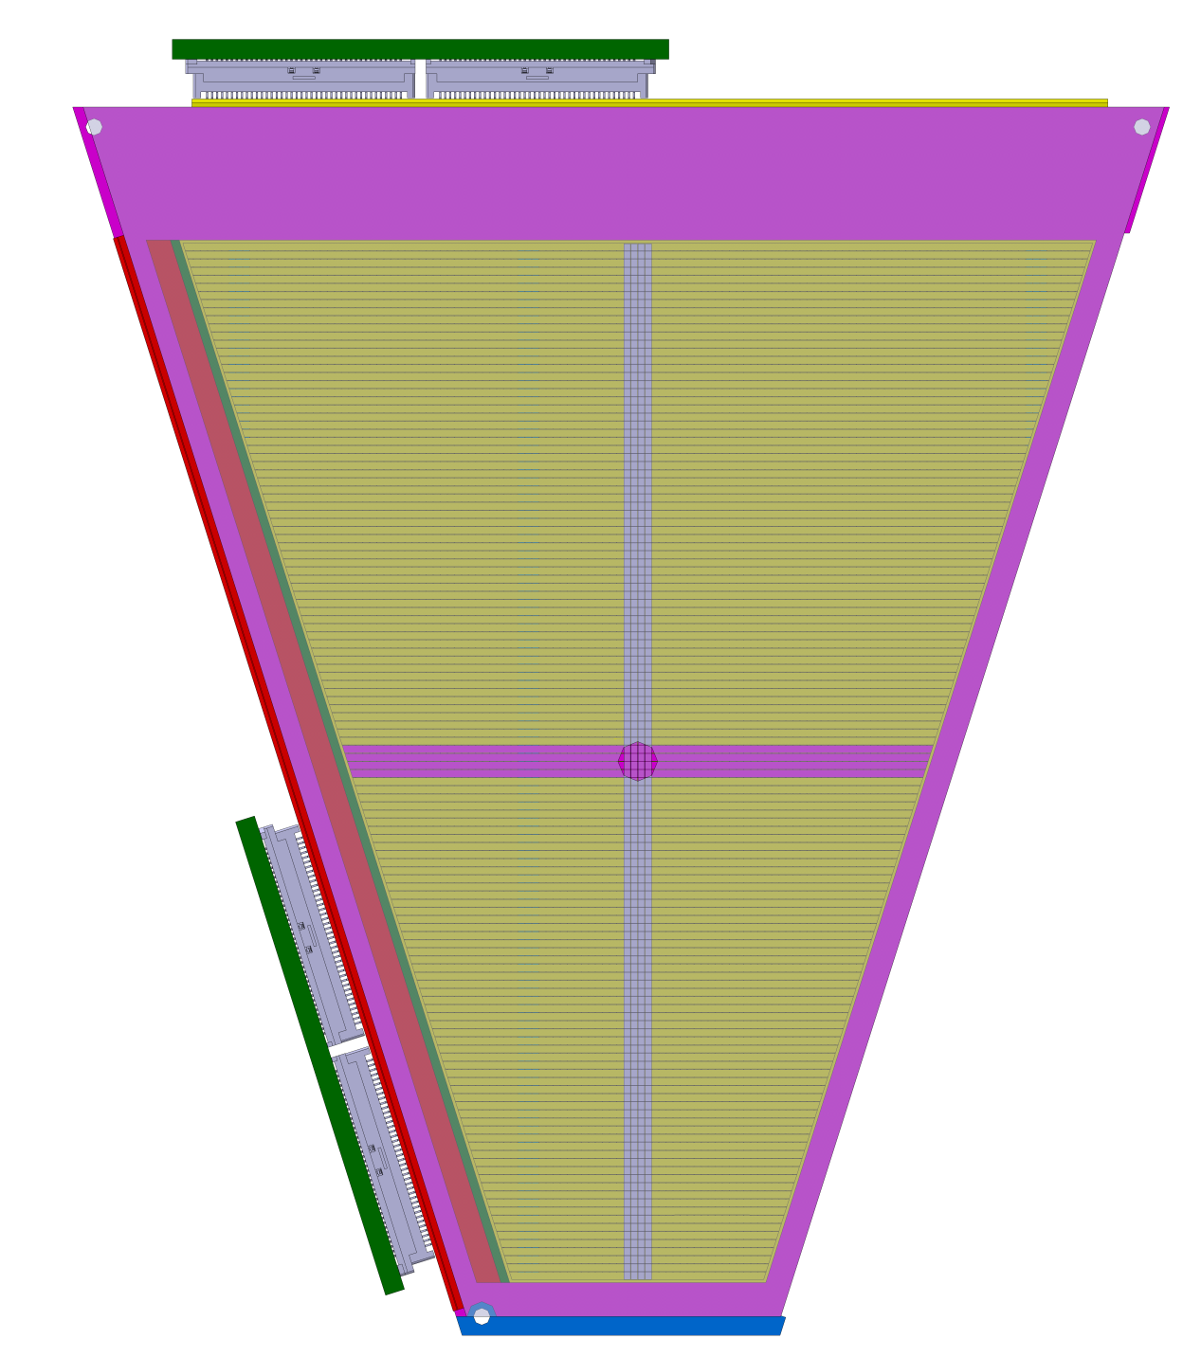
Strips read on silicium for BB13 mounting
Strips 63,64,65,66
Strip 128
Strip 1
Strip 1
Mask: aluminum plate thickness 3mm with 1 hole
d = 4,2mm at the intersection of the strips
Strips 63,64,65,66
Strip 128

Slide 15
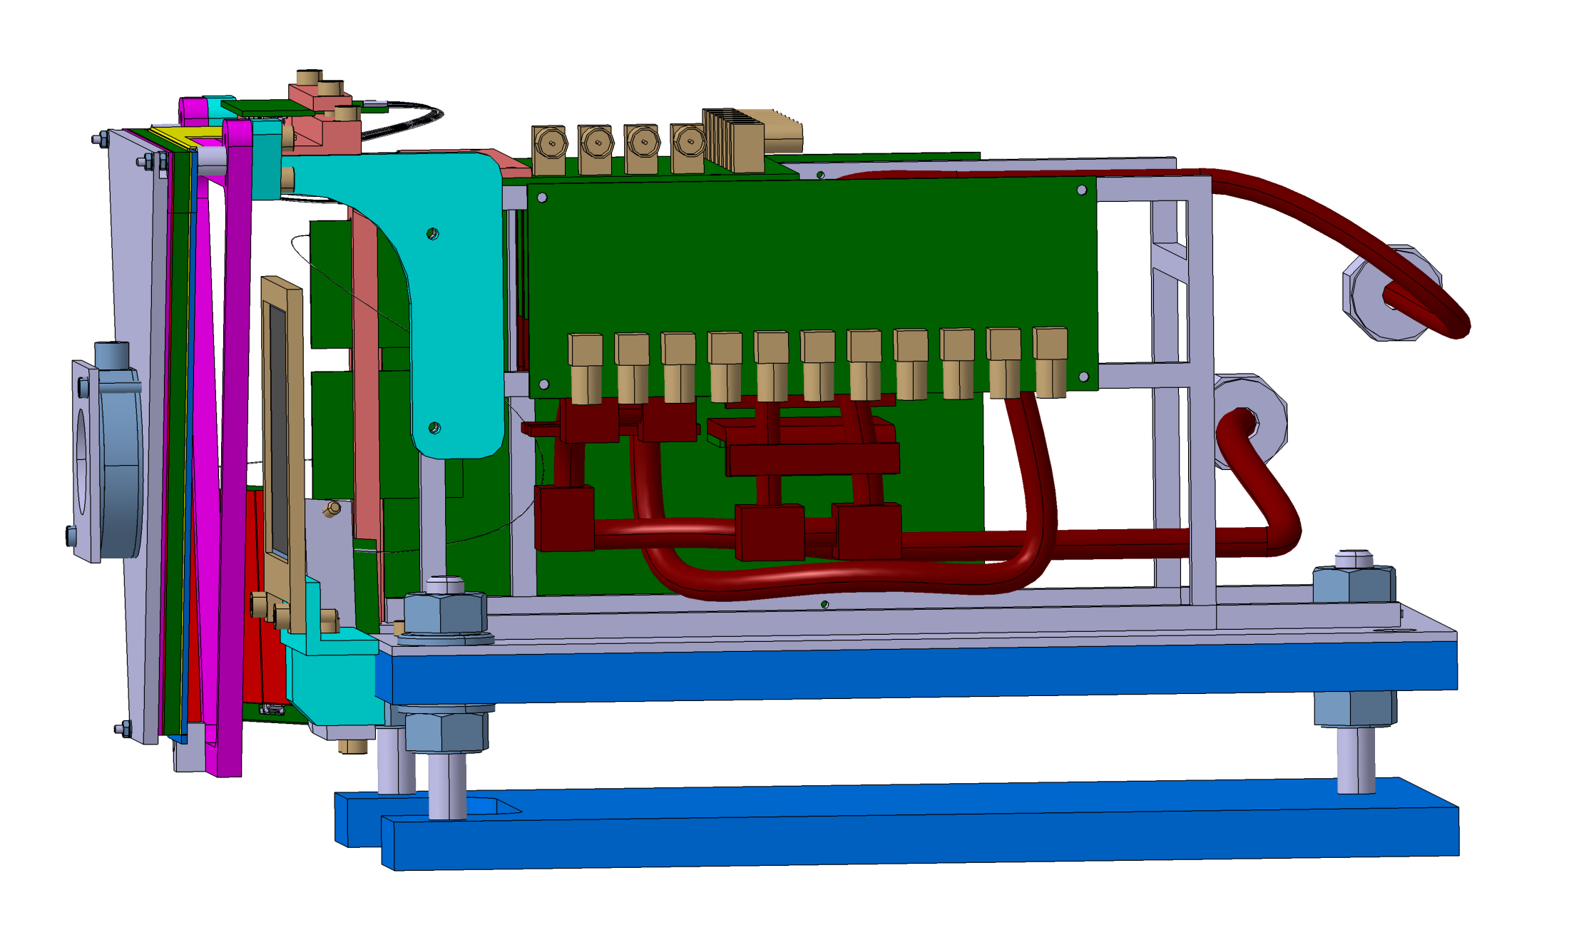
Strips read on silicon for BB13 mounting
silicon 1 pad d= 30 mm ,thickness =40µ)
BB13 pcb cards and its cooling system (existing)
silicon 1 pad
(50 x 50 mm x 500µ)
Part supporting silicon frame
Mask

Slide 16
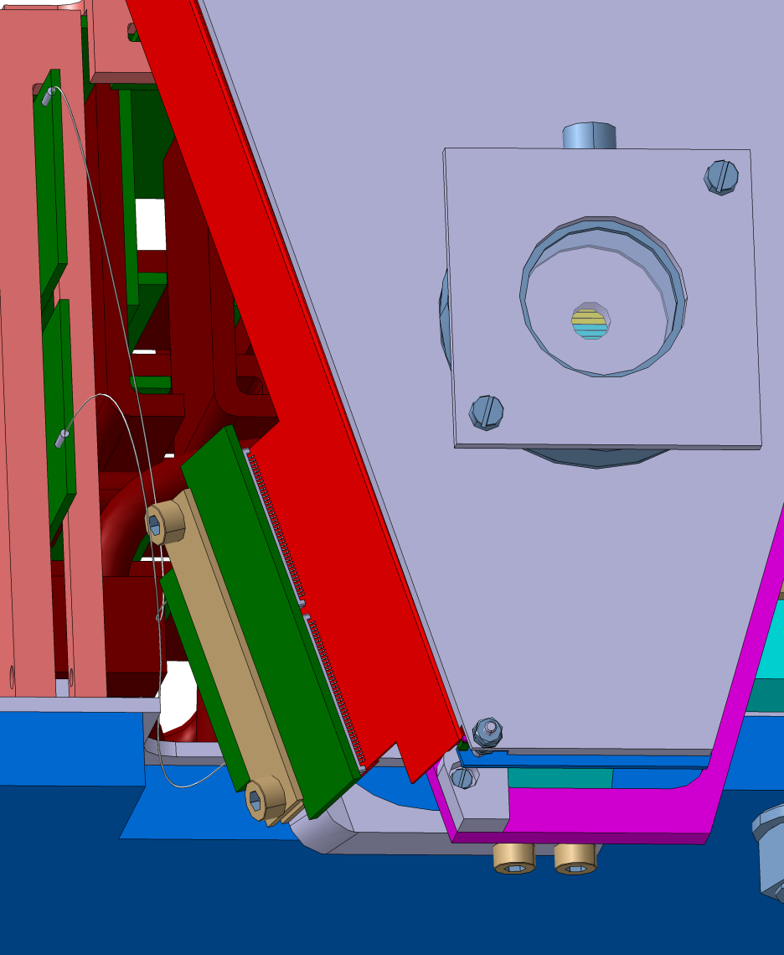
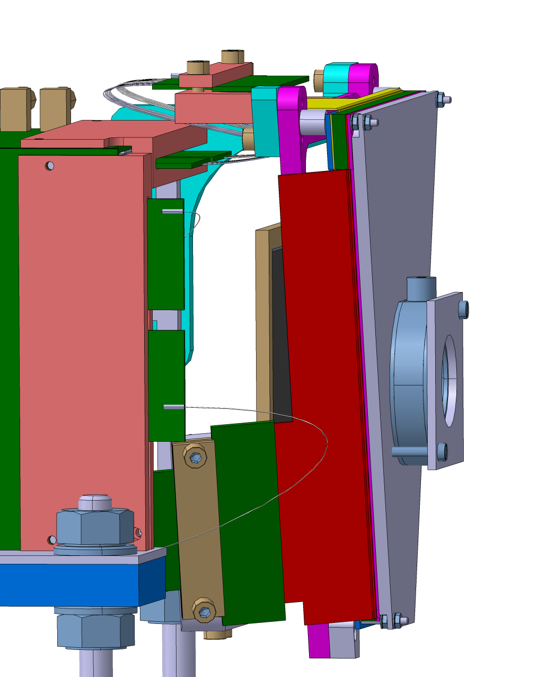
Wire and flex connection on silicon for BB13 mounting
Saver BB13 for small flex + wires
Saver BB13 for large flex + wires

Slide 17
IPACI mounting

Slide 18
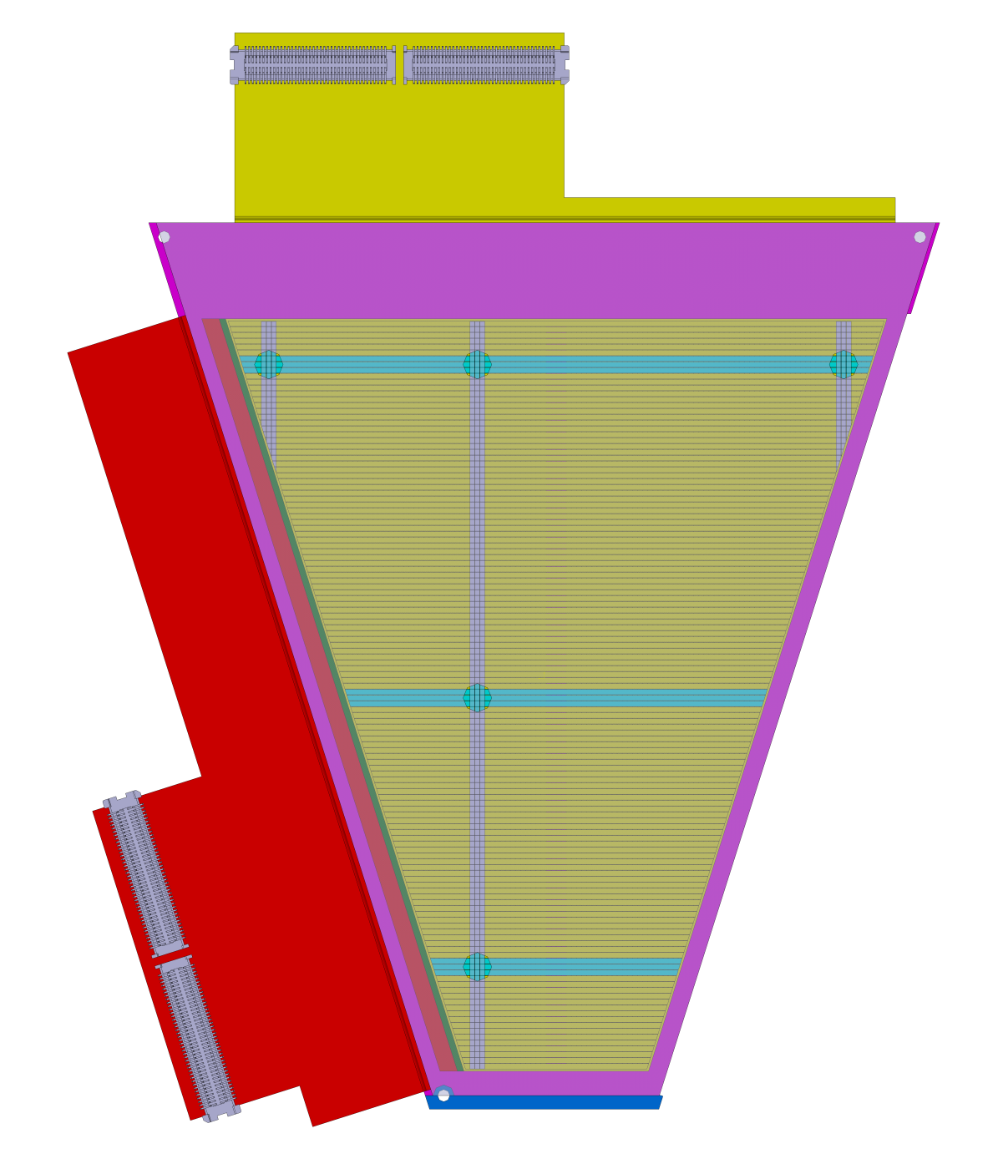
Strips read for silicon IPACI mounting
Strips 7,8,9
Strips 48,49,50
Strips 120,121,122
Strip 1
Strips 7,8,9
Mask: 5 holes
d = 4,2mm in Aluminum plate 3mm
Strips 64,65,66
Strips 110,111,112

Slide 19
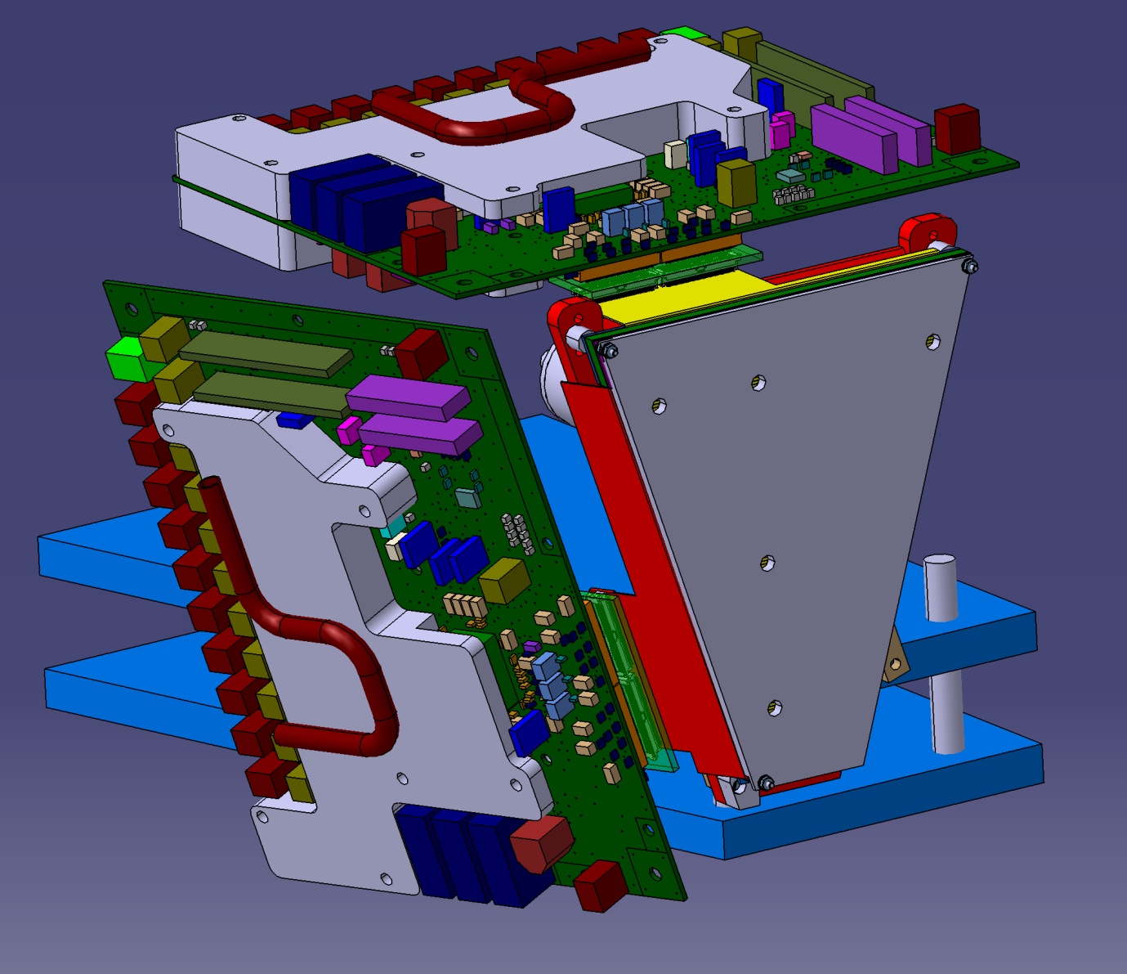
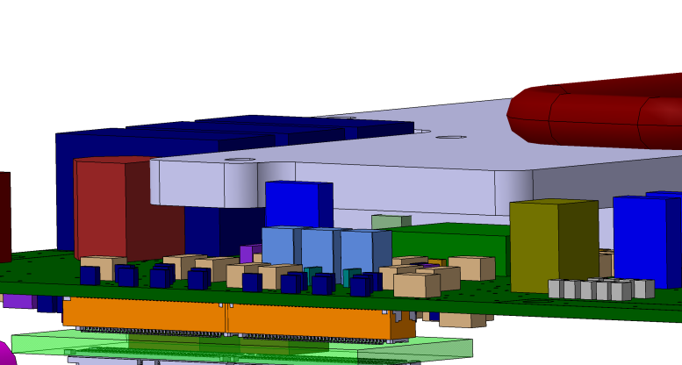
IPACI mounting
Aluminum box with tube for cooling system
IPACI pcb cards
Mask

Slide 20
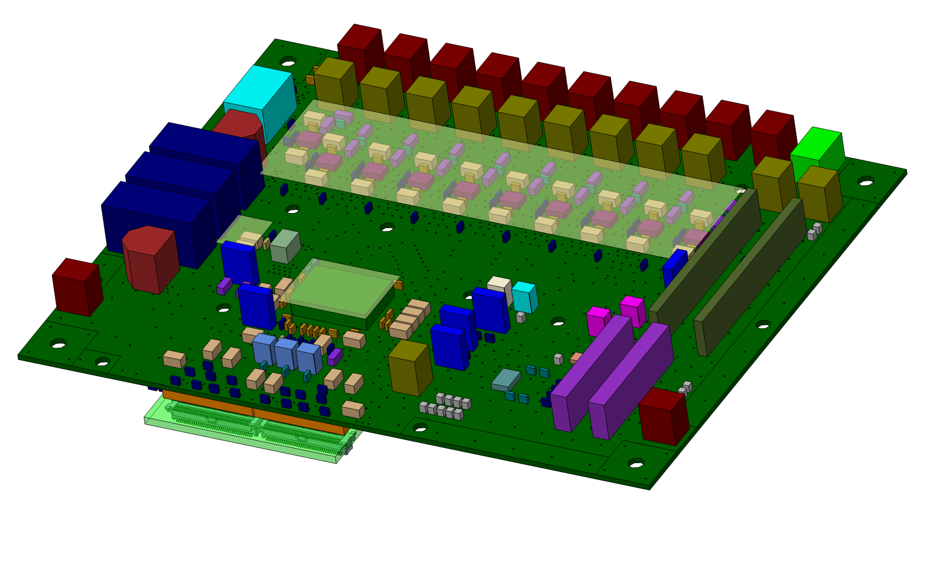
IPACI PCB ( cooling)
3 Hot area have to be cool on each side
Gap pad between aluminum box and hot components for heat conduction

Slide 21
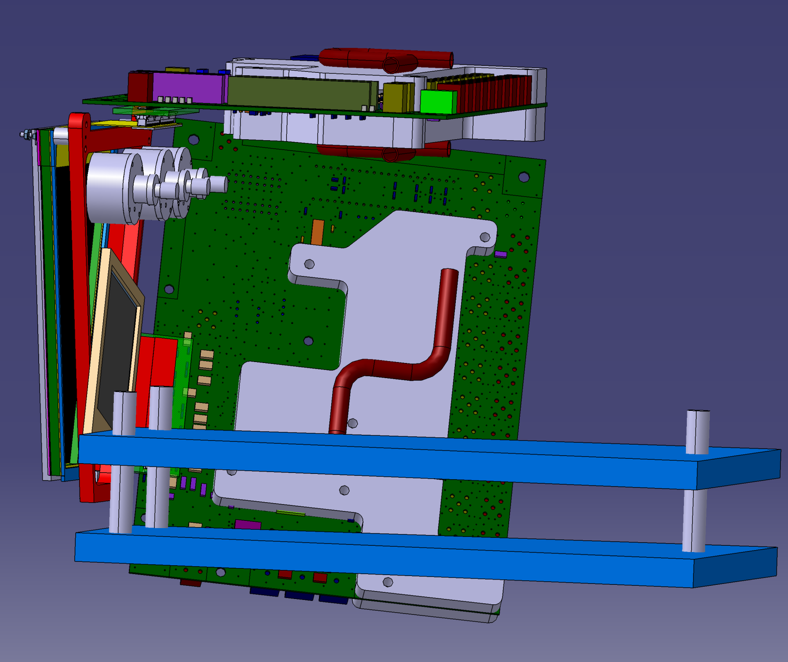
1) IPACI mounting
3 silicons 1 pad
ø 12 x 3mm
1 silicon 1 pad 50 x 50 x 500µ

Slide 22
Shedule
- End of April : BB13 mecanics ready for a test with a source in Davy chamber
- Beginning of June : IPACI mecanics and Empereur device ready
- Mid June : Tandem experiment ready

